Slide 1
Diamond Target Simulation
Emanuele Leonardi
PADME General Meeting - LNF 1-2 March 2016

Slide 2
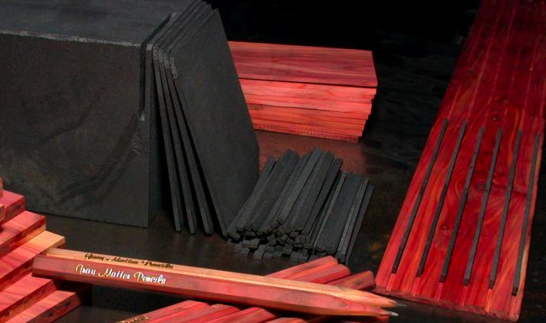
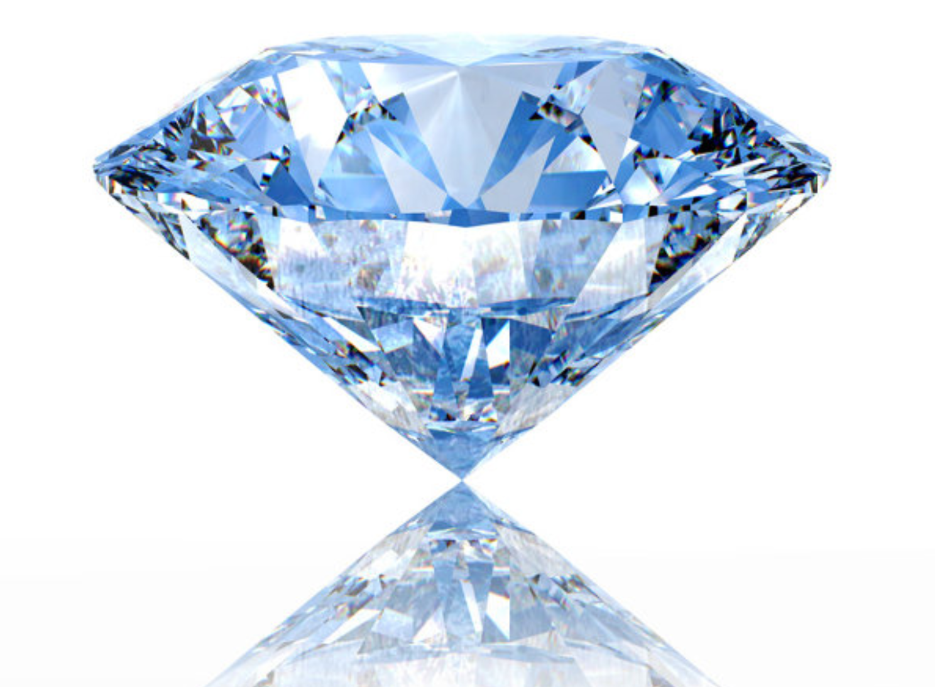
Materials
Diamond = Carbon at a density of 3.515 g/cm³
// Create Diamond material to be used for Target
G4Material* Diamond = new G4Material("Diamond",3.515*g/cm3,1);
Diamond->AddElement(G4Element::GetElement("C"),100.*perCent);
Material: Diamond density: 3.515 g/cm3 RadL: 12.147 cm Nucl.Int.Length: 22.817 cm
Imean: 81.000 eV
---> Element: C (C) Z = 6.0 N = 12.0 A = 12.01 g/mole
---> Isotope: C12 Z = 6 N = 12 A = 12.00 g/mole abundance: 98.93 %
---> Isotope: C13 Z = 6 N = 13 A = 13.00 g/mole abundance: 1.07 %
ElmMassFraction: 100.00 % ElmAbundance 100.00 %

Slide 3
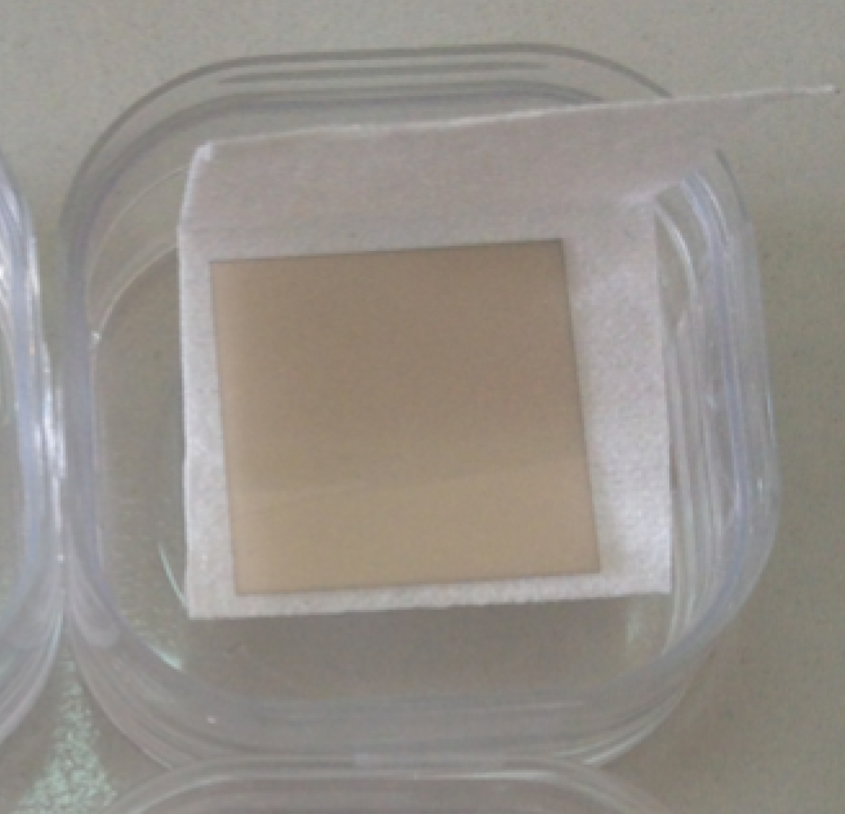
Diamond Target
Size: 2 cm × 2 cm × 100 µm
Position: (0 cm, 0 cm, -20 cm) w.r.t. front face of magnet yoke
// Create Target plaque (a box)
G4double targetX = geo->GetTargetSizeX();
G4double targetY = geo->GetTargetSizeY();
G4double targetZ = geo->GetTargetSizeZ();
G4Box* solidTarget = new G4Box("Target",targetX*0.5,targetY*0.5,targetZ*0.5);
// Create Target logical volume using Diamond material
fTargetVolume = new G4LogicalVolume(solidTarget,
G4Material::GetMaterial("Diamond"),"Target",0,0,0);
// Position Target logical volume inside World
G4ThreeVector positionTarget = G4ThreeVector(geo->GetTargetPosX(),
geo->GetTargetPosY(),
geo->GetTargetPosZ());
new G4PVPlacement(0,positionTarget,fTargetVolume,"Target",fMotherVolume,false,0,false);

Slide 4
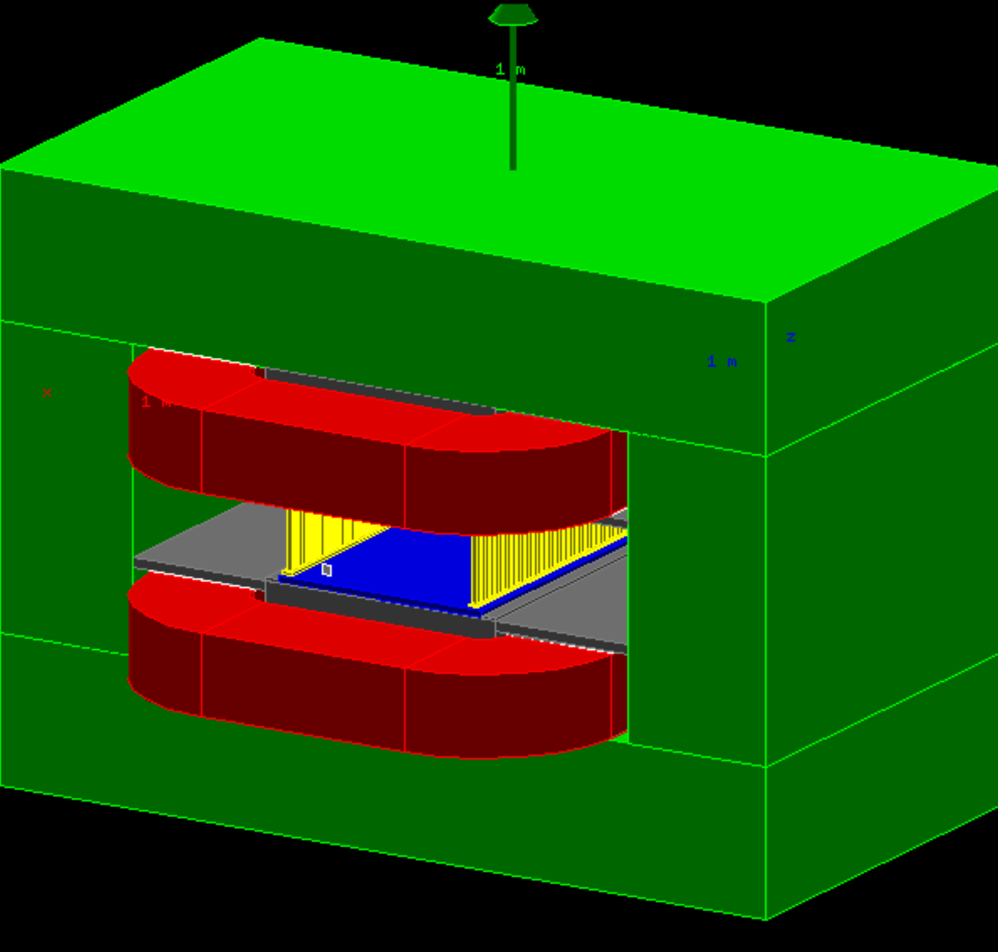
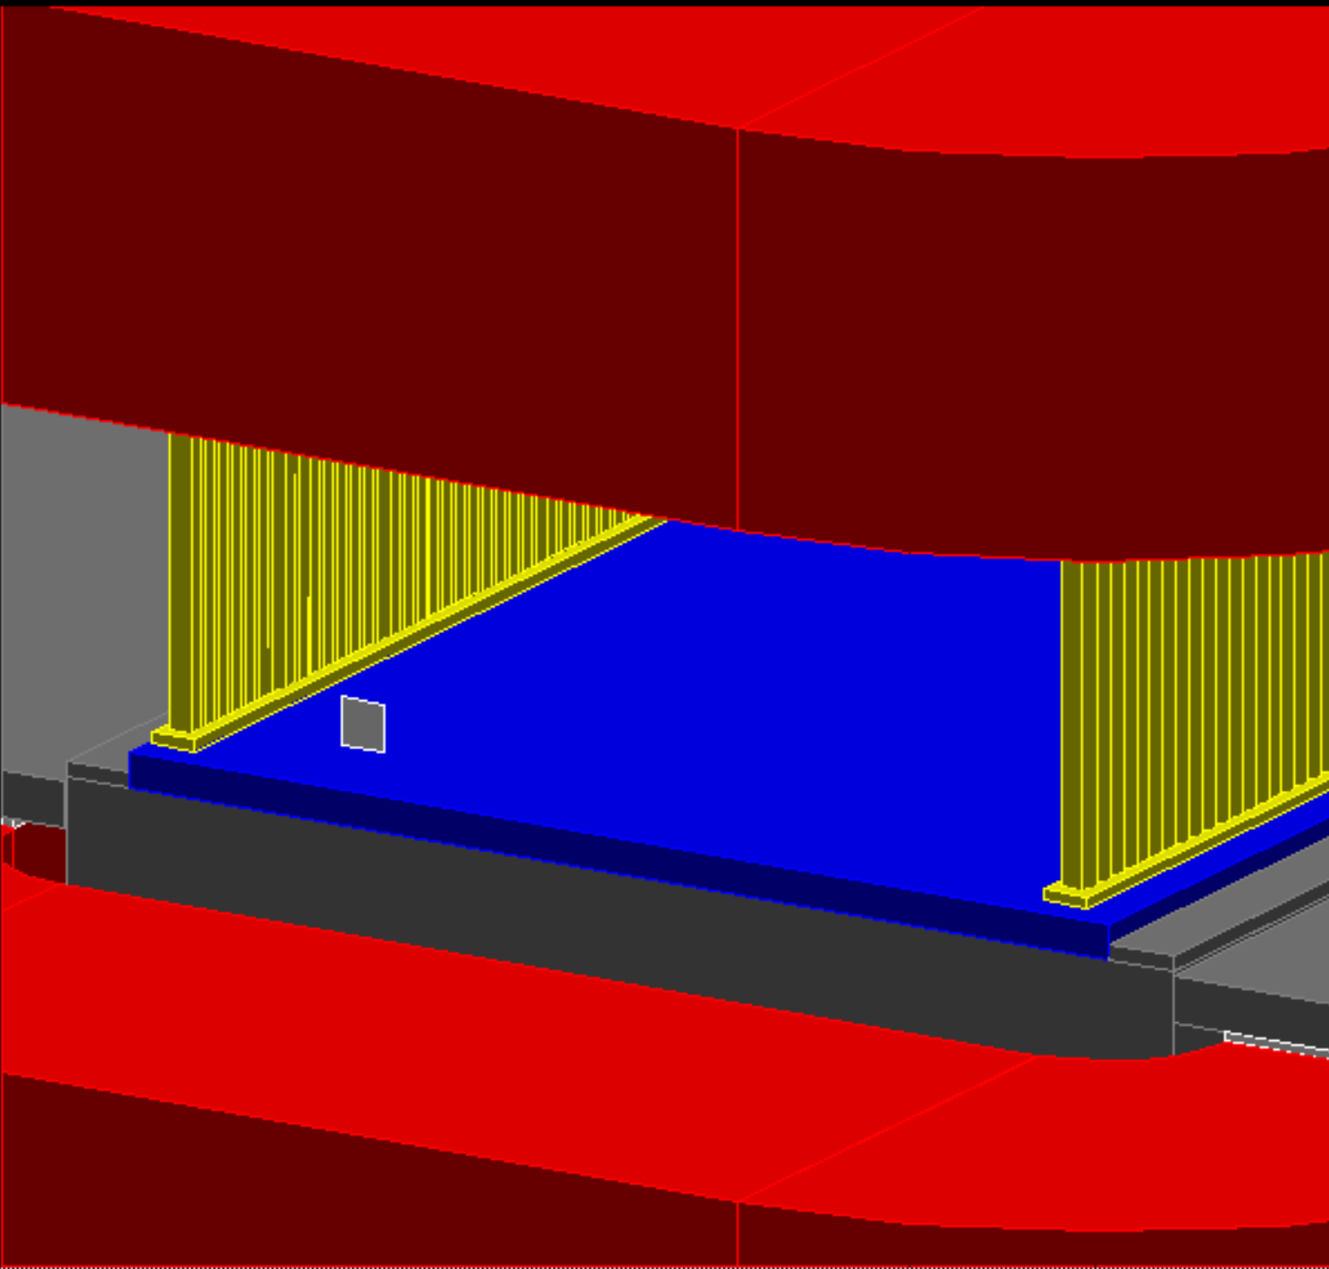

Slide 5
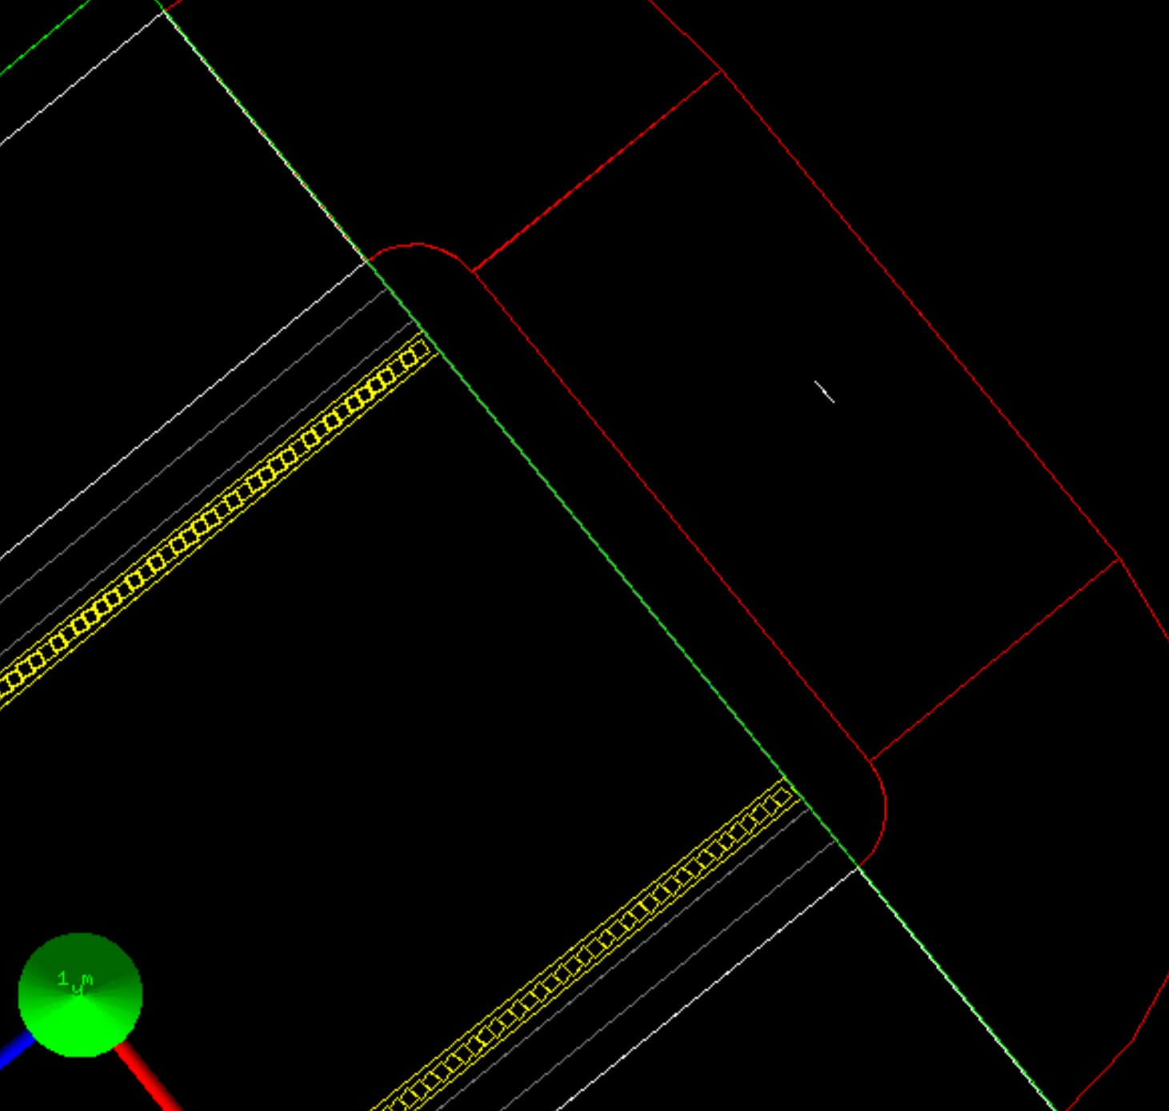
Datacards
Size and position of the Target can be
changed at run time using GEANT4 datacards.
N.B. position must be given in the PADME coordinate system, centered at the center of the magnet yoke.
/Detector/Target/FrontFaceZ -70.
/Detector/Target/Size 2.
/Detector/Target/Thickness 100.
2 cm
2 cm
100 µm

Slide 6
Particle tracking
When a particle crosses the Target, GEANT4:
simulates all physical interactions with the material
ionization, bremsstrahlung, annihilation, …
computes the energy released.
*********************************************************************************************************
* G4Track Information: Particle = e+, Track ID = 1, Parent ID = 0
*********************************************************************************************************
Step# X Y Z KineE dEStep StepLeng TrakLeng Volume Process
0 0 fm 0 fm -70 cm 549 MeV 0 eV 0 fm 0 fm World initStep
1 0 fm 0 fm -70 cm 549 MeV 4.22e-23 eV 1e+03 nm 1e+03 nm World Transportation
2 0 fm 0 fm -70 cm 549 MeV 35.3 keV 100 um 101 um Target Transportation
3 3.03 mm 7.89 mm 6 m 549 MeV 2.83e-16 eV 6.7 m 6.7 m World OutOfWorld
Translation: a 549 MeV almost horizontal primary e⁺ crossed the Target
at its center releasing a total energy of 35.3 keV via the ionization process.

Slide 7
Signal generation
Each energy deposit (hit) must be mapped to the charge collected by the nearest read-out strips with a transport function which depends on the energy, time, and position of the hit.
All charges collected by a strip are accumulated together to generate the final signal.
N.B. given the thickness of the Target and the width of the strips, we expect that most of the charge released by a single particle will be collected by a single strip.
Target
$$Q_{0}$$
$$Q_{1}$$
$$Q_{2}$$
$$\text{(}{\vec{x}}_{0}\text{,}E_{0},t_{0}\text{)}$$
$$Q_{3}$$
$$Q_{4}$$
$$\text{(}{\vec{x}}_{1}\text{,}E_{1},t_{1}\text{)}$$
$$Q_{5}$$
$$Q_{6}$$
$$Q_{7}$$
$$Q_{8}$$
$$Q_{9}$$
Action item: define the transport functions
$$Q_{j}(t)=\sum_{i}{q_{j}\text{(}\text{t},{\vec{x}}_{i}\text{,}E_{i},t_{i}\text{)}}$$

Slide 8
Persistency
In principle, the result of the signal generation is a set of charge vs time histograms, one per read-out strip, which mimics the signal seen by the FADC.
Computing and storing these histograms is both:
time consuming
requires a huge amount of storage
Can we apply some approximated method to:
Define a higher (and more compact) level of output?
Avoid the creation of the histograms?
Action item: define the final output data

Slide 9
ToDo List
Finalize Target geometry adding the support structure and the readout hardware
Will be done as soon as the technical design is available
Define the transport functions to generate the signal on the read-out strips
Define the final data to be stored in the MC output files
A PADME common persistency framework, based on ROOT, is under development

