Slide 1
PADME gamma rejection study
Mauro Raggi
PADME Ecal meeting Frascati, 1 March 2015

Slide 2
Outline
Definition of ECAL and SAC geometry
Angular coverage of photon veto system in PADME
2g and 3g final state toy MC study
3g background and Ecal and SAC inefficiency
Physiscs lists
Consideration about inefficiency and timing performance
Proposal for a lead Glass based SAC (NA62 ex OPAL SF57)

Slide 3
Toy MC studies of gamma BG
Define the layout of the photon veto system of the PADME experiment on the basis of rejection factors for γγ and γγγ BG
Uses 100K e⁺e⁻ ->γγ(γ) generated using CalcHep program
Uses 1M e⁺e⁻ ->γγ(γ) generated using CalcHep program
Provides kinematics distribution of the 3 final state gamma
Still to be implemented angular correlation with primary positron in MC and beam spot size

Slide 4
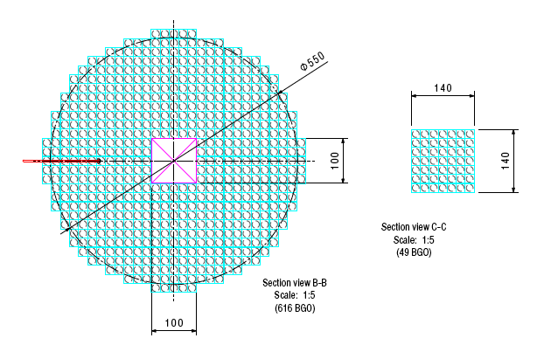
The PADME photon veto system
ECal
SAC
(small angle calorimeter)

Slide 5
ECAL and the 2γ and 3γ BG
Geometrical defintion
6 cm θ=20 mrad
28.5 cm θ=93 mrad
Fiducial cuts
9 cm θ = 30 mrad
25 cm θ = 83 mrad
Good recoil gamma definition:
10 MeV < E < 500 MeV
30 mrad < θ < 80 mrad

Slide 6
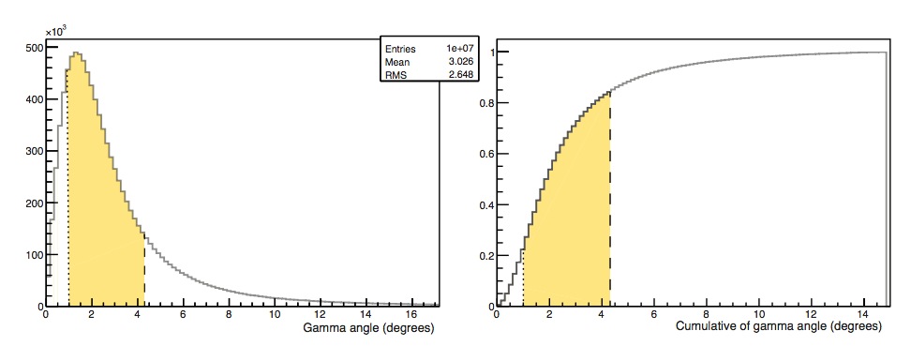
DA
Geometrical acceptance with present angular coverage almost saturated
Inner hole 1.15 degree 20 mrad
Max angle 4.3 degree 75 mrad

Slide 7
BG studies definitions
Detector acceptance
Lost
LAV
Target
Ecal
SAC
Detector | Angle | Name
Small angle Calo | 0-20 mrad | NSAC
Electromagnetic Calo | 20-75 mrad | NCal
Large angle Veto | 75-110 mrad | NLAV
Lost | >110 mrad | Nlost
NseeSAC= NSAC+Ncal
NSeeLAV= NLAV+Ncal
NSeeALL= NLAV+NCal+NSAC

Slide 8
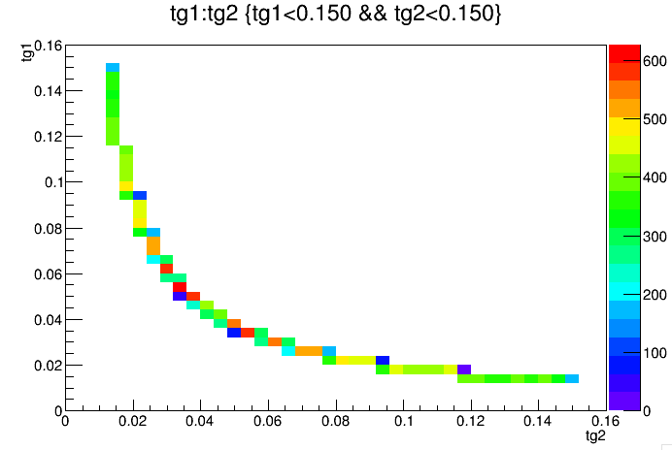
The 2γ background kinematic
Ecal acc
Ecal good γ
Ecal good γ
Ecal acc

Slide 9
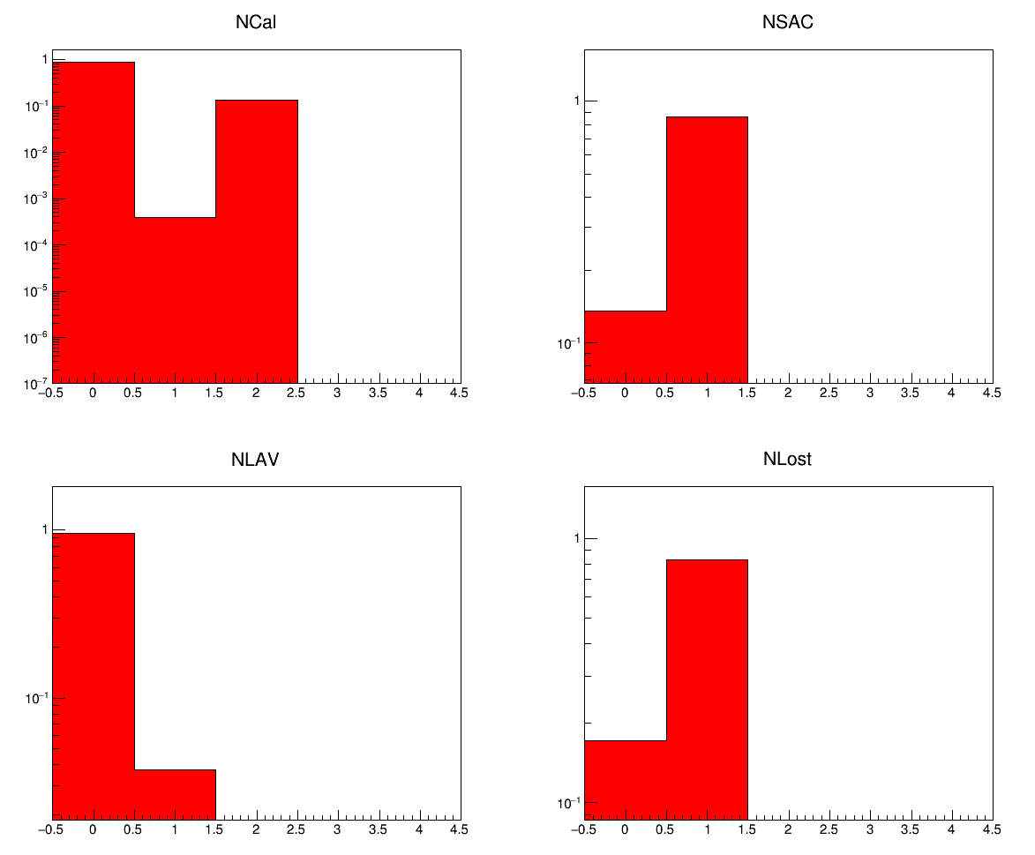
2γ distribution no cuts
Most probable case: 1SAC + 1LOST
Very rare 1 in ECaL <10⁻³

Slide 10
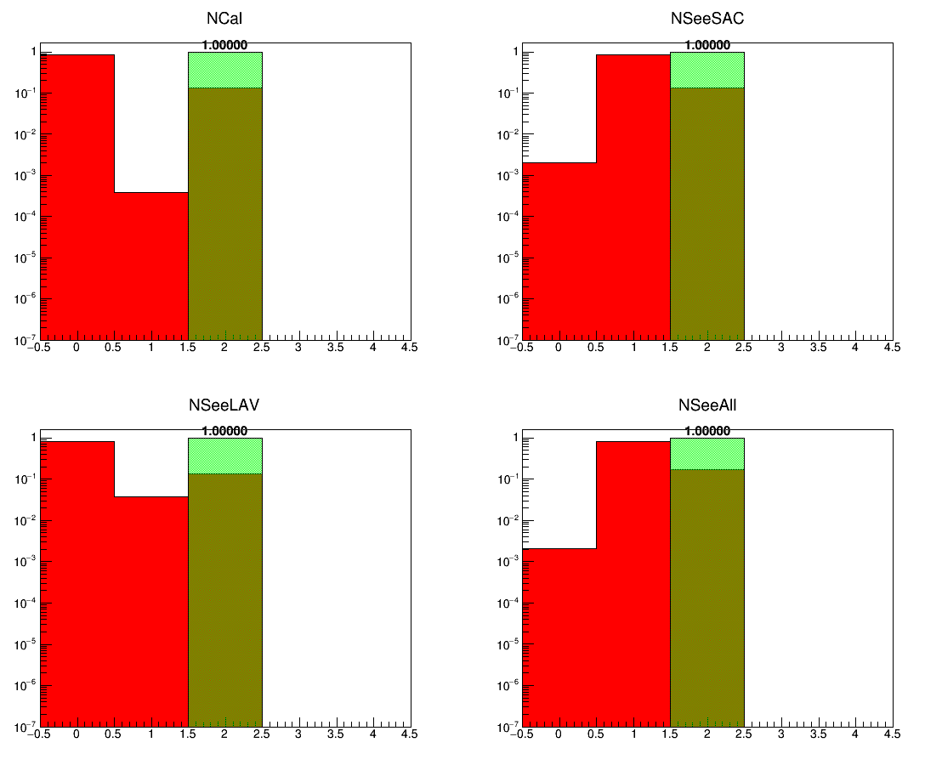
After applying the 1γ cut

Slide 11
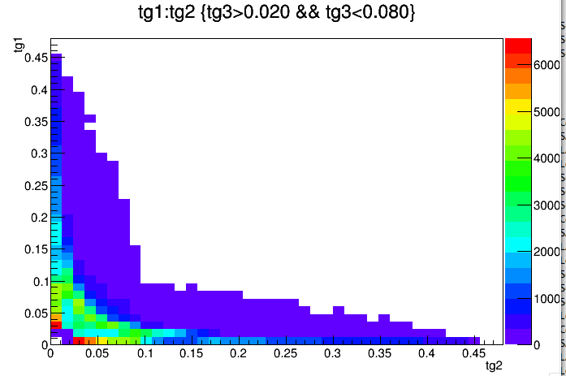
3g background kinematics

Slide 12
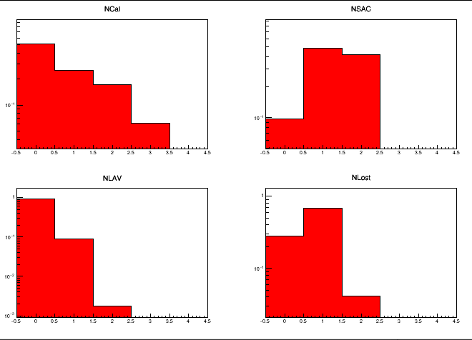
3γ geometrical distribution
SAC has 1γ in ~90% of events
Few event at Large angle
Two lost are very rare

Slide 13
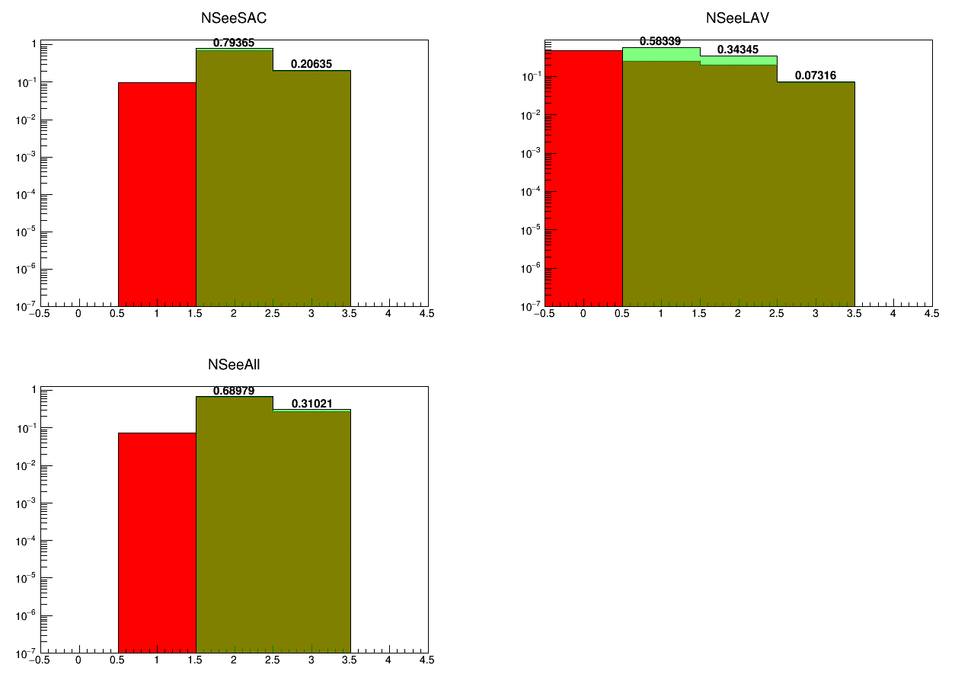
With standard 1γ definition
Just summing the detectors multiplicity
Asking for a good gamma in Ecal as defined.
Ecal + SAC always contain at least 2 gammas if Ecal has a good one Ecal +LAV has a 58% inefficiency! LAV does’nt help that much.

Slide 14
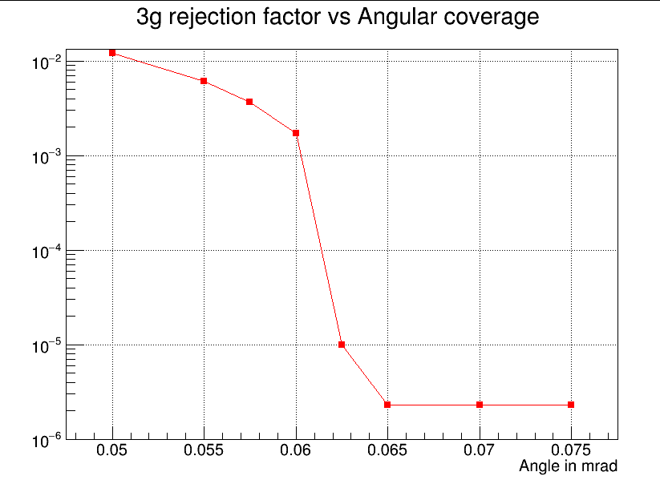
Changing gamma acceptance

Slide 15
Conclusion from TOYMC analysis
Two gamma BG can be reduced to 0 just by using the Ecal if Ecal acceptance is properly defined
At least 2 of the 3 gamma background can be detected with a full angular coverage of θ<65 mrad (ECal+SAC)
Minimum energy in the SAC is not that relevant in the SAC inefficiency

Slide 16
Three gamma analysis on MC
The same sample of 3γ events has been processed in the MC
Full simulation of the showers in the Ecal is performed
No additional positrons are included just 1 3γ event
Ecal inefficiency fully simulated including punch through and reconstruction of the cluster energy.
Still missing proper treatment of photonuclear interaction
Events in the SAC are killed just after entering the volume and the energy, time and position of the particle is recorded.
No SAC inefficiency except geometrical one.
Exact energy of the cluster (No reconstruction)

Slide 17
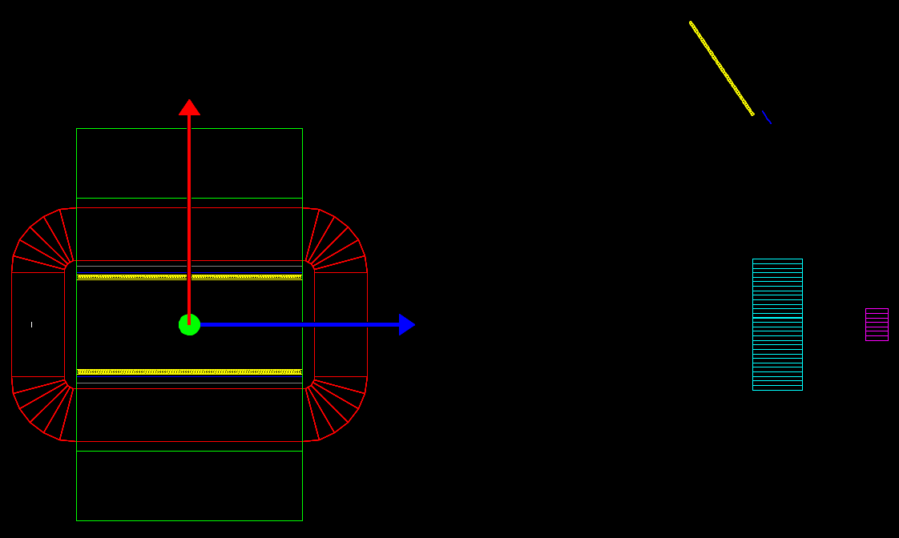
MC layout used
Ecal to target distance 3000 mm Ecal radius 280 mm ECal inner hole radius 60 mm
Magnet gap 200 mm

Slide 18
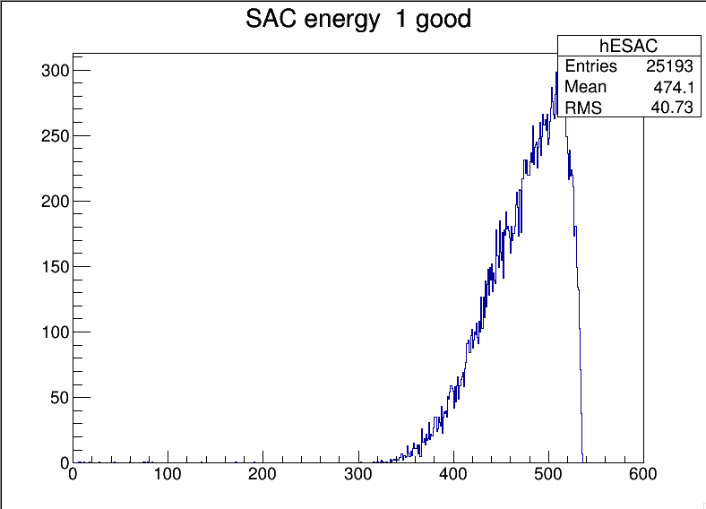
SAC energy due to 3γ events
Energy distribution in the sac under the condition:
(GisGood==1. && NClusters==1. && NSAC<2)

Slide 19
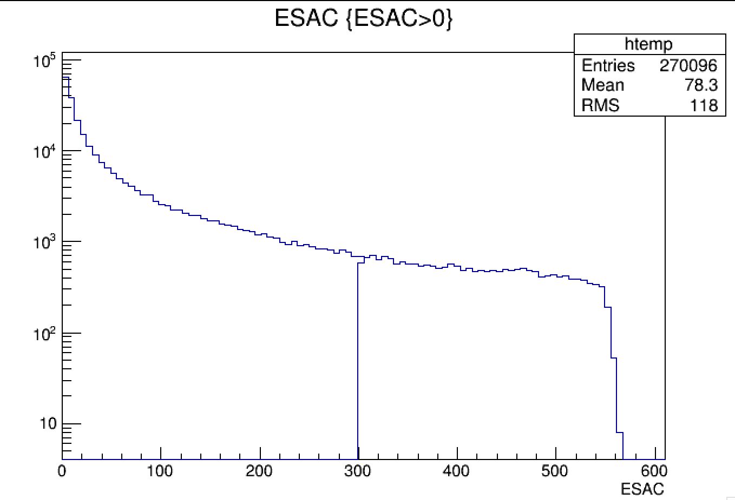
Energy distribution of γ from IB G4
270096
20749
Only about 7.7% of the IB photon with E>300MeV
Order 1 or 2 in 40 ns. Need a detector blind to photons below 100 MeV

Slide 20
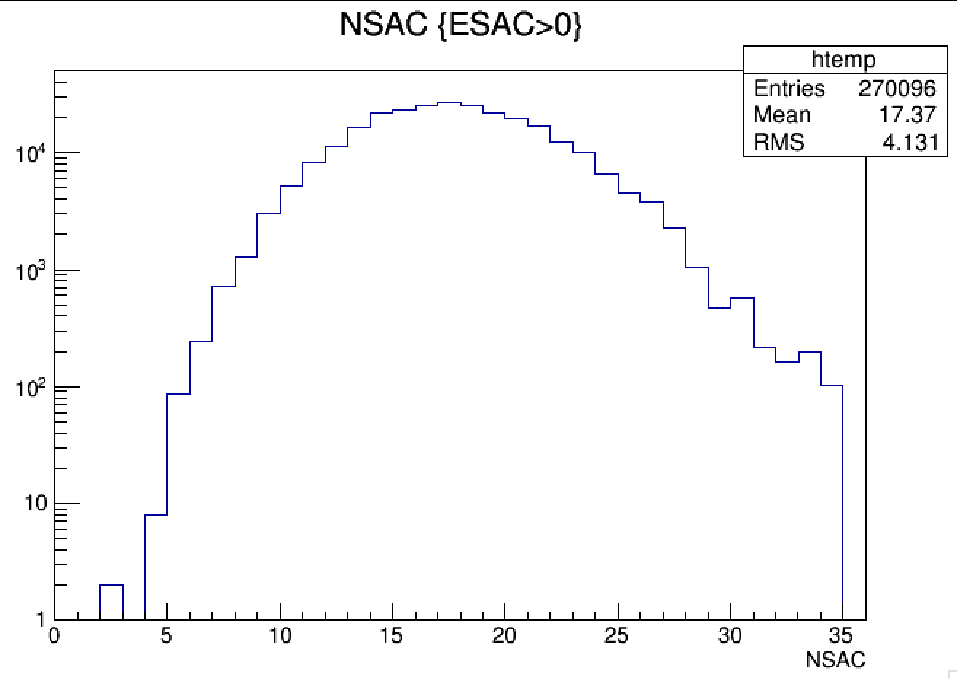
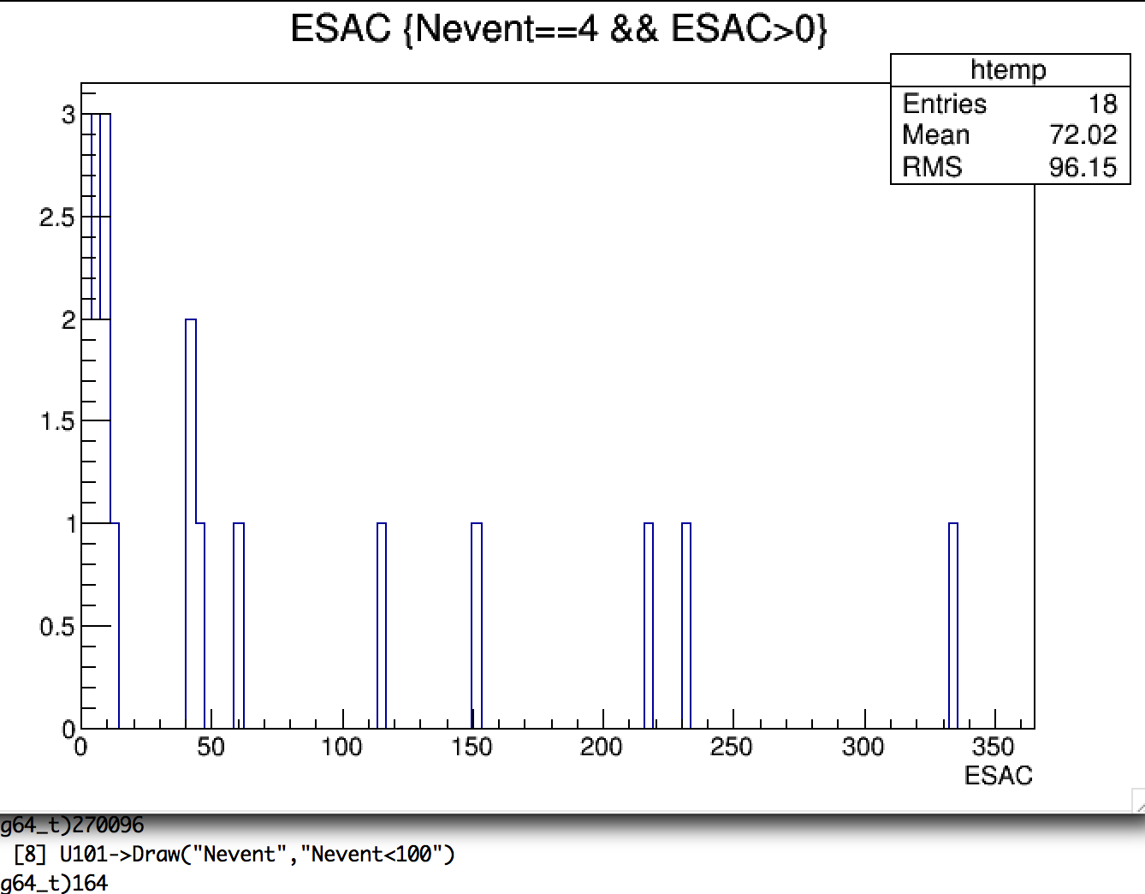
NSAC distribution

Slide 21
Study of veto efficiency due to timing
Assuming the system has a timing resolution in the difference Ecal-SAC of the order of 500ps with small dependence from the energy
Ecal <700 ps per crystal
SAC <300 ps per crystal
We can estimate the effect of missing gamma due to timing by hit and miss technique once a inefficiency is established
Obtain BG estimates for the full 1e13 run.
The inefficiency is related to the timing window of the veto.
We can estimate random veto probability per single photon

Slide 22
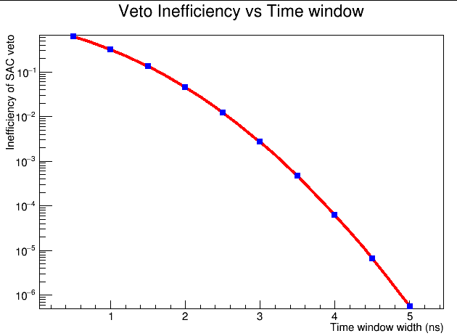
Veto Ineff vs time window

Slide 23
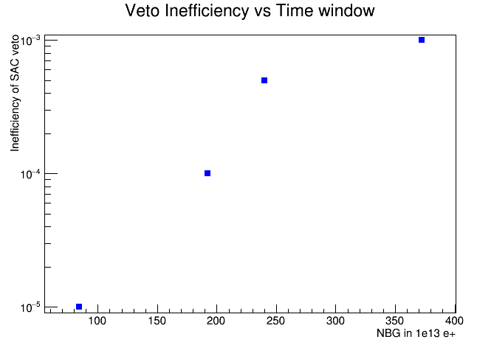
NBG with random inefficiency
3.3 ns window
3.5 ns window
3.8 ns window
4.4 ns window
Due to the high number of bremsstrahlung photon the optimal solution has to identified balancing acceptance loss due to over veto and BG due to inefficiency of the SAC.

Slide 24
Summary table
Ineff SAC | BG acc | NBG 1e13 | T_{wind} in ns | Veto prob 1γ
1e-3 | 6.2e-5 | 372 | 3.3 | 8.2% in 40ns
5e-4 | 4.0e-5 | 240 | 3.5 | 8.75% in 40ns
1e-4 | 3.2e-5 | 192 | 3.8 | 9.5% in 40ns
1e-5 | 1.4e-5 | 84 | 4.4 | 11% in 40ns
Being the veto probability on the last column of the table per 1γ in the SAC we need to minimize the number of γ candidate
We can use the following algorithm:
For each track in the positron veto search a matching γ in the SAC using time and energy. If found remove the cluster from candidate list
On the remaining ones remove that with energy below a certain thr.

Slide 25
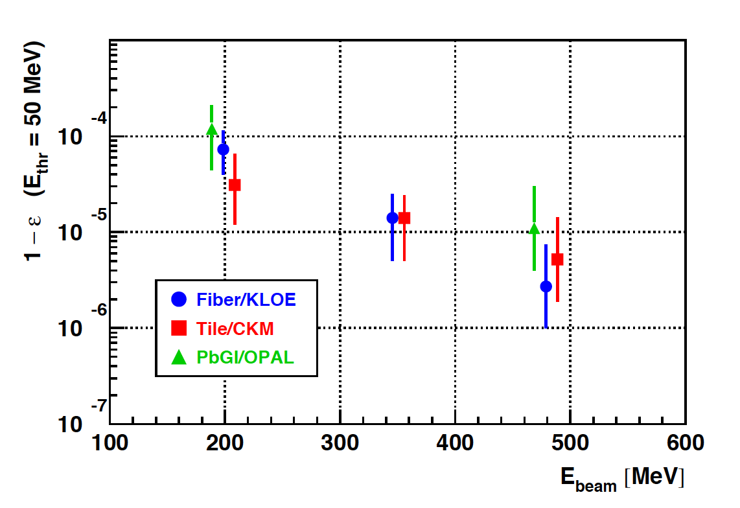
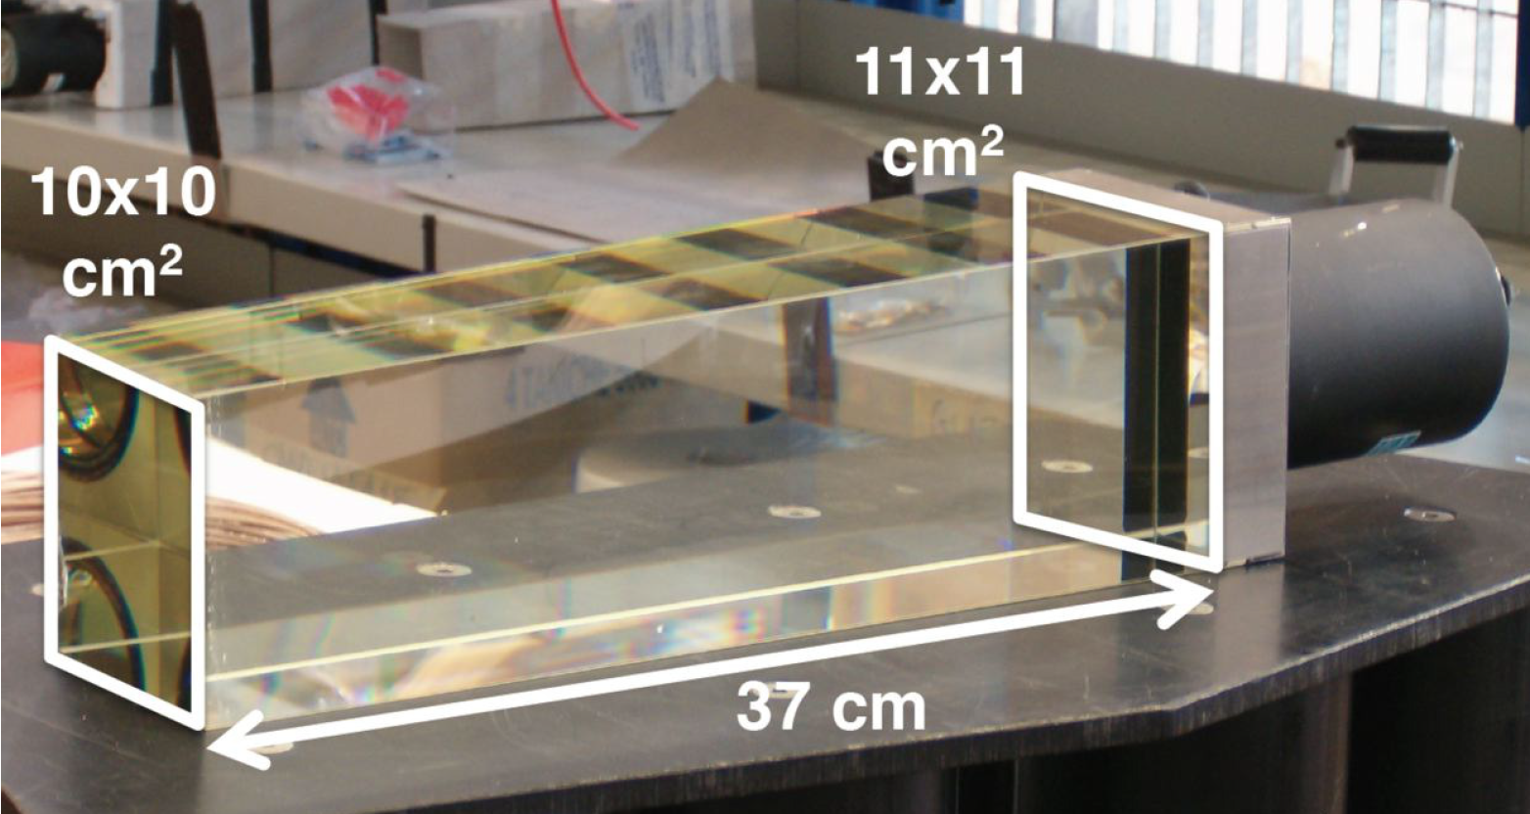
Possible SF57 NA62 based SAC
Very fast signal to cope with very high rate
Rate up to 5-10 cluster in 40 ns expected
Minimum E_{γ} to detect > 50 MeV
No need for very high LY
Good time resolution (<300ps)
Why don’t we us a Cherenkov radiator??
NA62 reused ex OPAL SF57 block
Inefficiency for electrons at BTF

Slide 26
PADME SAC form OPAL blocks
By cutting a OPAL block we can obtain 49 20x20x180mm³ crystals
Original OPAL LY ~0.3 p.e. MeV with 32% PMT coverage
Can reach near to 50% with 19mm PMTs on 20x20mm² crystals
Much better light collection due to much smaller crystals
Can we reach the 1p.e. MeV level? G4 simulation needed

Slide 27
Conclusions
ee->γγ background can be rejected just using Ecal
ee->γγ(γ) background needs an angular coverage up to 65 mrad
Calorimeter position and geometry almost finalized
Sensitivity comparison required by INFN as milestone
Acceptance for recoil photon up to 80 mrad can be achieved
Energy of relevant photon in the SAC seem to be high >300 MeV
No need for a very efficient SAC at low energy
Timing is a crucial aspect of the Veto system
The efficiency could be limited by the random veto probability more than from the detector performance.
OPAL lead glass SF57 is a possible candidate for SAC
LY to be estimated by G4 simulation.
Is a test in July possible?

