Slide 1
PADME Ecal status
Mauro Raggi
PADME Ecal meeting
Frascati, March 1st 2016

Slide 2
PADME Ecal remainder
PADME Ecal is the heart of the PADME invisible experiment
Calorimeter performance reflects on the M²_{Miss} resolution which is a crucial ingredient of the invisible decay sensitivity
Ecal is supposed to measure E, position and time of the cluster
  Δx,Δy ~ 2-3 mm
  σ(E)/E ~ 1-2%/sqrt(E) for energy as low as 50-100MeV
  ΔT < 500 ps on single cell
Need a very dense, high light yield, good timing crystal and a segmentation at few cm² level in the readout

Slide 3
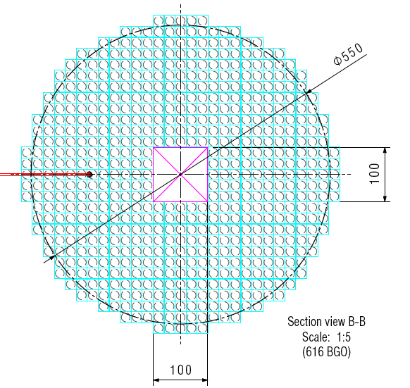
The calorimeter geometry
30 cm
New baseline solution cylindrical shape: radius 285 mm, depth 220 mm
  Square shaped inner hole 100 mm side
  Active volume 54208 cm³ total of 616 crystals 20x20x220 mm³ (-40 crystal wrt old baseline) readout by 15mm diameter active area PMT
Expected performance for PADME ECAL:
  σ(E)/E ≈ 2%/√E after first test at BTF
  σ(θ)₃₀₀ = 6 mm/3 m ~1.75 mrad
  Angular acceptance 20-83 mrad
  Time resolution per single crystal < 700 ps

Slide 4
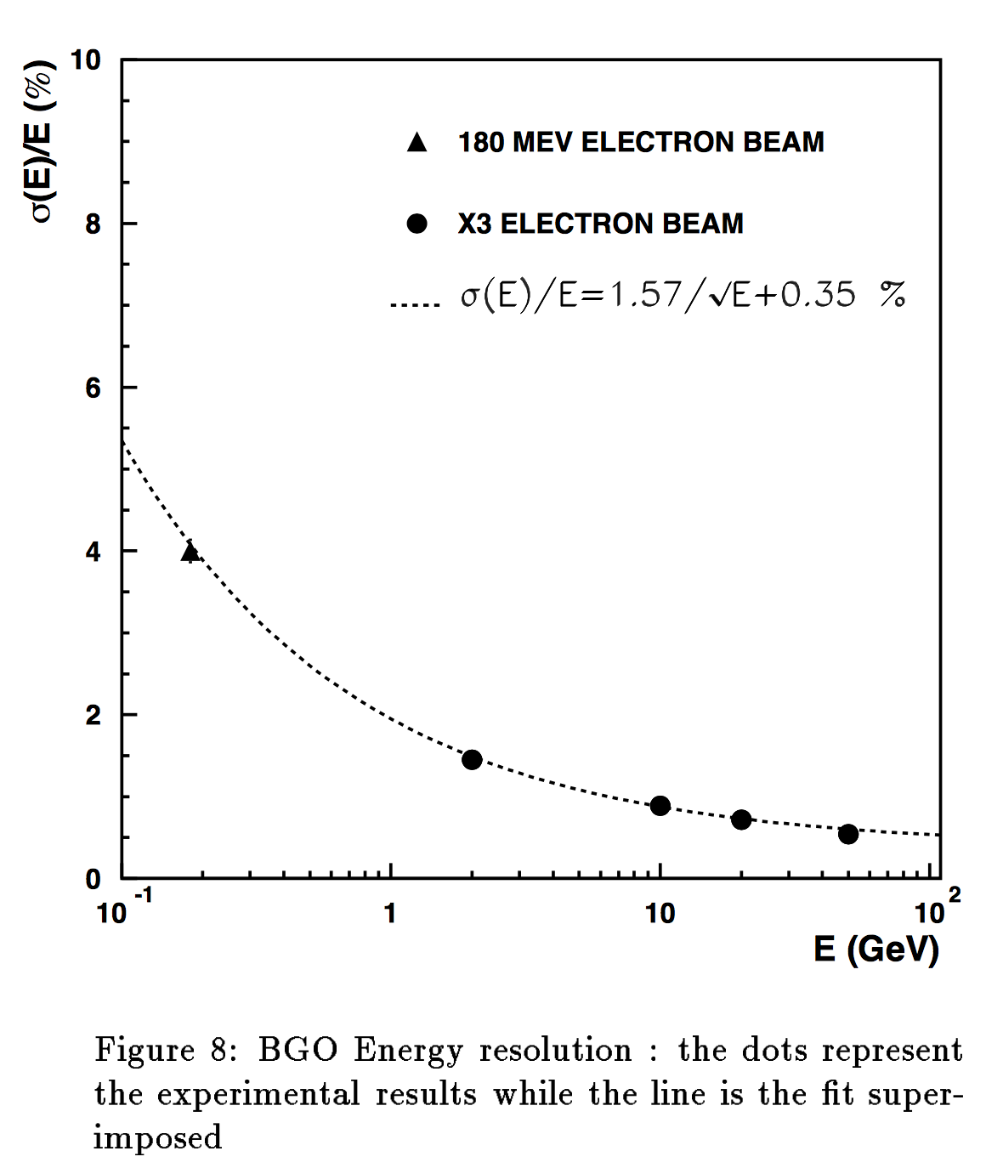
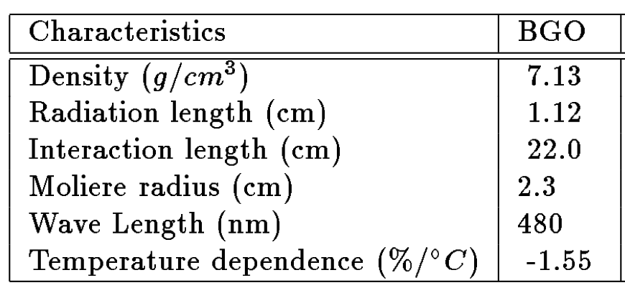
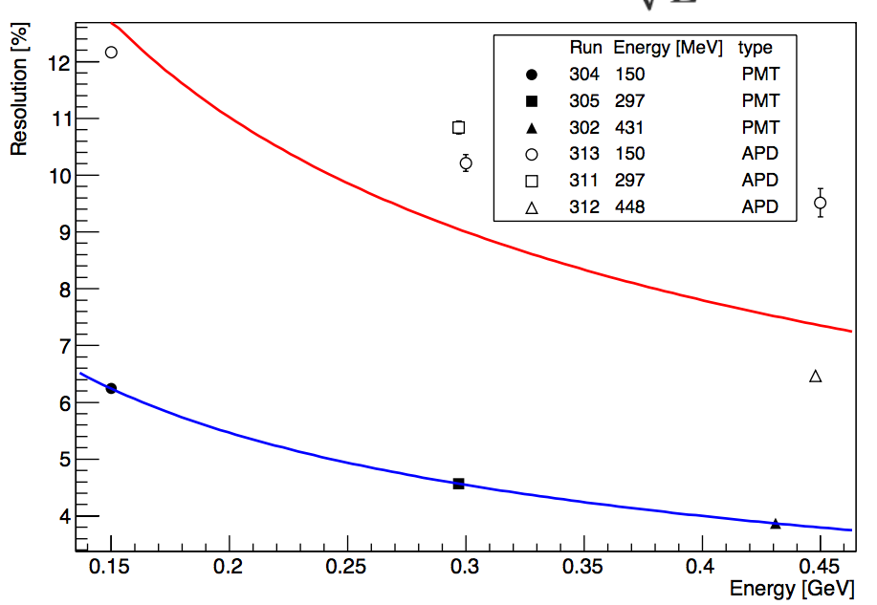
L3 BGO and PADME test beam
L3 collaboration
PADME

Slide 5
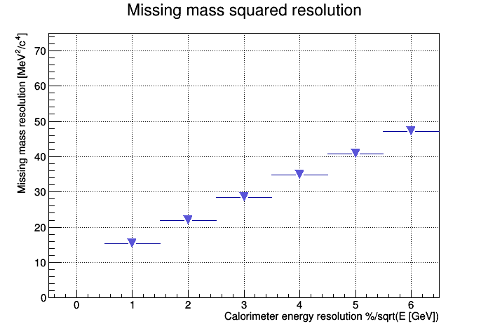
Missing mass and Ecal resolution
PADME test beam
L3 BGO
Are we able to get the same figure of merit with PADME Ecal?

Slide 6
BGO crystal procurement
At present we have collected ~150 crystals of different shapes at LNF
Informal agreement to get ~550 crystal from dismounted L3 Ecal
Agreement obtained for testing and characterizing crystals at CERN:
  Remove original photodiodes
  Remove painting
  Heat the crystal at 300 degree for annealing 15 crystals day
  Label each crystal
  Measure the transmittance using the old L3 machine up to 25 crystal/day
Still waiting to understand if we can actually get the crystals and where. URGENT!

Slide 7
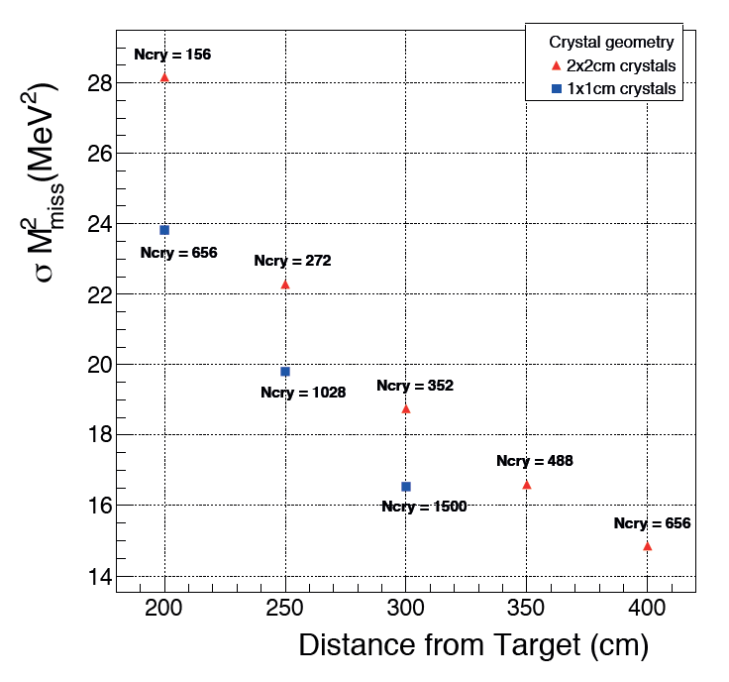
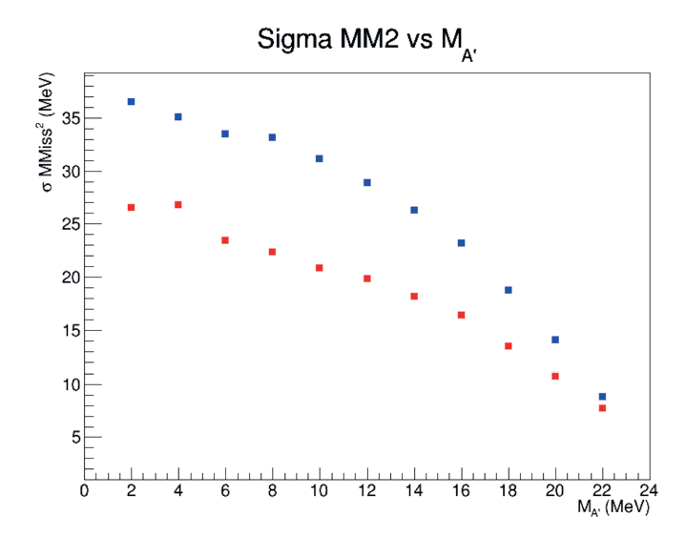
Expected performance comparison
From MC side we still need to compare senstivity vs distance Ecal target and start comparing with test beam results.

Slide 8
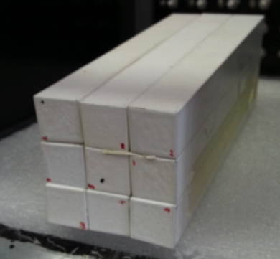
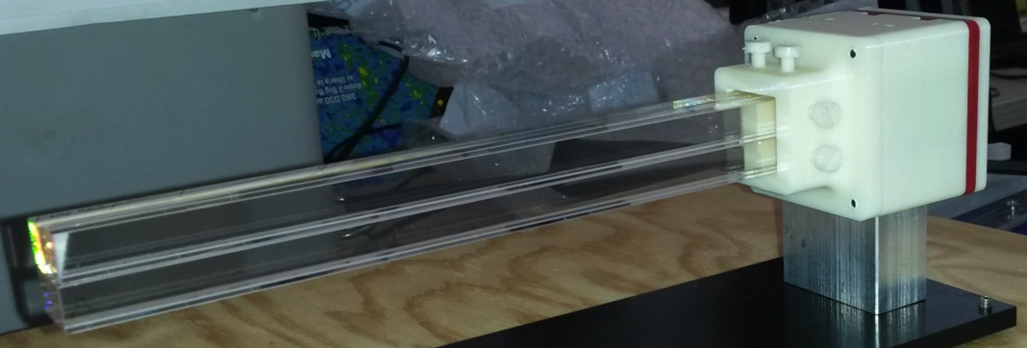
Cutting the L3 BGO crystals
We already have 3 crystals cut by Silo firm into 10x10mm² samples:
  8 crystals 10x10x220 mm optically polished (1 broken)
  4 crystals 10x10x220 mm raw surfaces
  Cutting + polishing cost is 200+VAT € per original L3 crystals (4 PADME crystals) ~40K€
27 crystals already cut by Silo in 20x20x220 mm³
  Cutting cost is in this case 94.8€ VAT included
  In this case we need 656 crystals ~63K€
Still need to identify final wrapping and painting

Slide 9
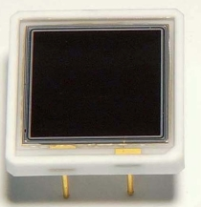
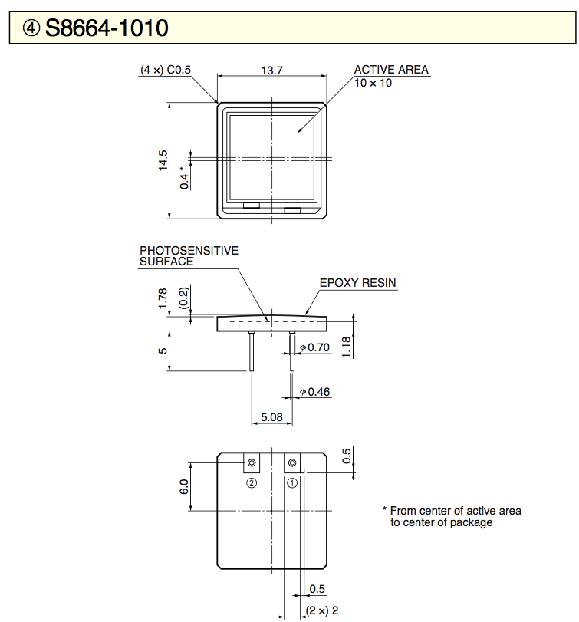
Calorimeter photosensors APD
Hamamatsu APD S8664-55 not suitable for 20x20mm² crystal
20x20mm² crystals with Hamamatsu APD S8664-1010
  Quoted price 315 euro/pcs (total cost 700 pcs 220K€)
  After the test beam we know they are not ideal solution
    Gain too small ~200 + G=300 on FE give a lot of noise 6x10⁴
We now have other 6pcs ordered from Hamamatsu in November
  Total of 16 pcs can equip a 4x4 matrix
  Need to be tested and calibrated

Slide 10
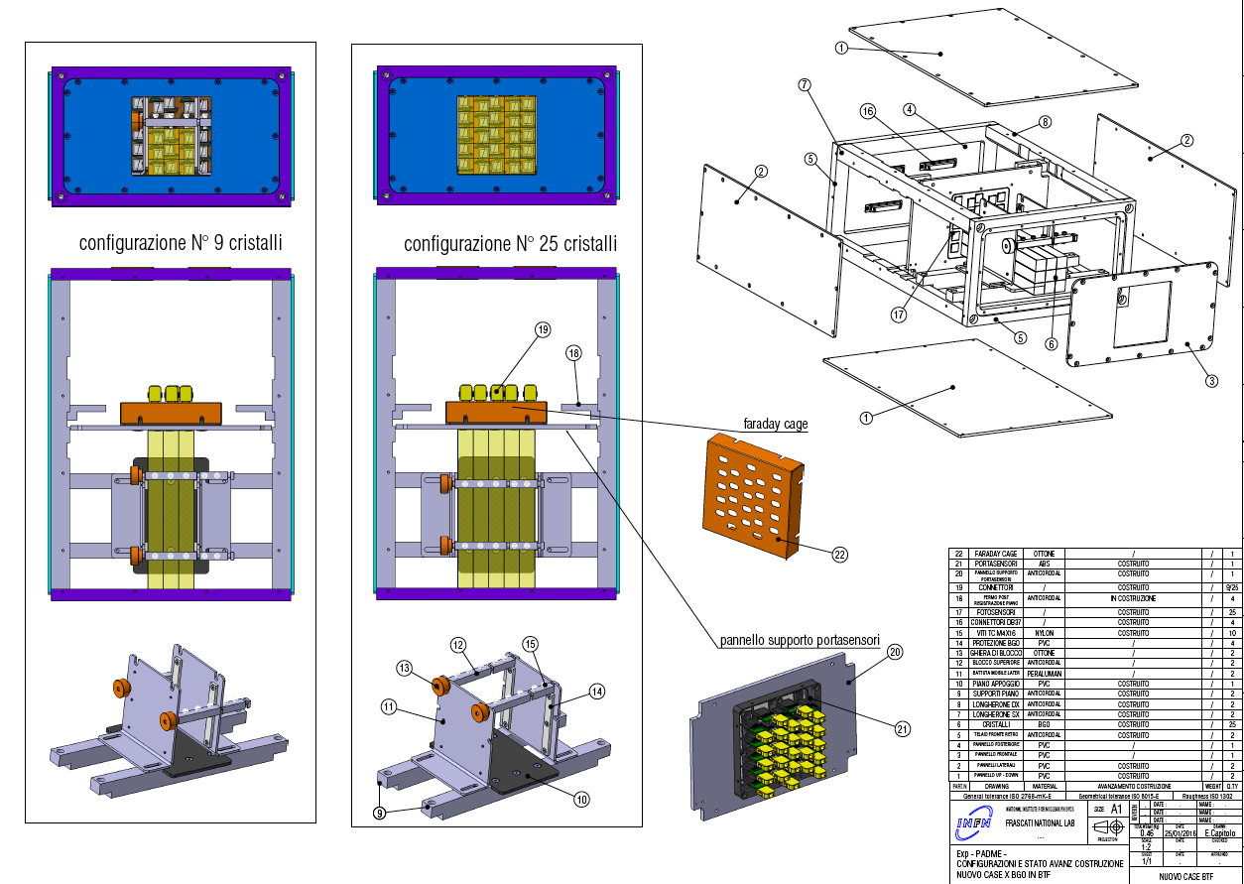
Test beam ECAL mechanics APD

Slide 11
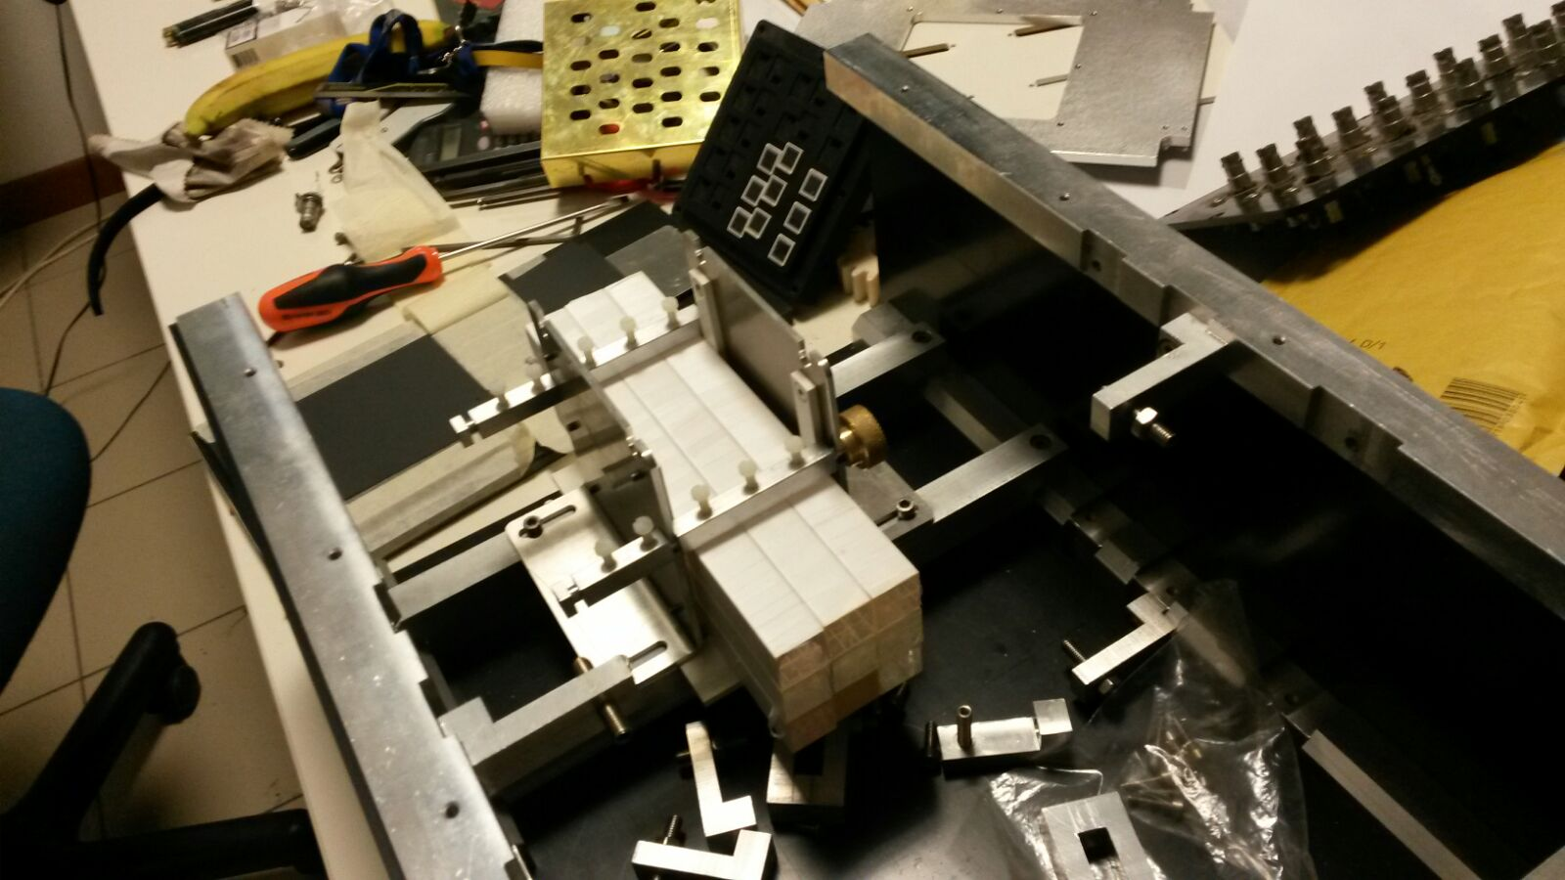
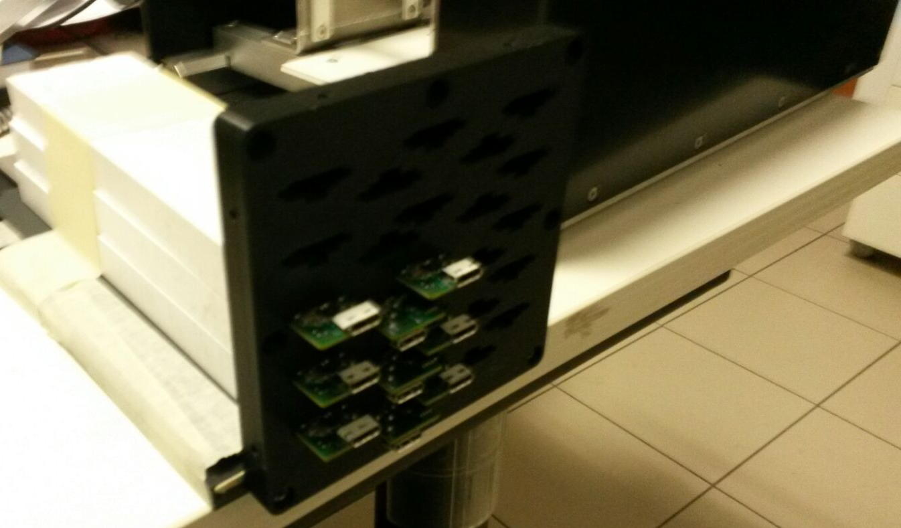
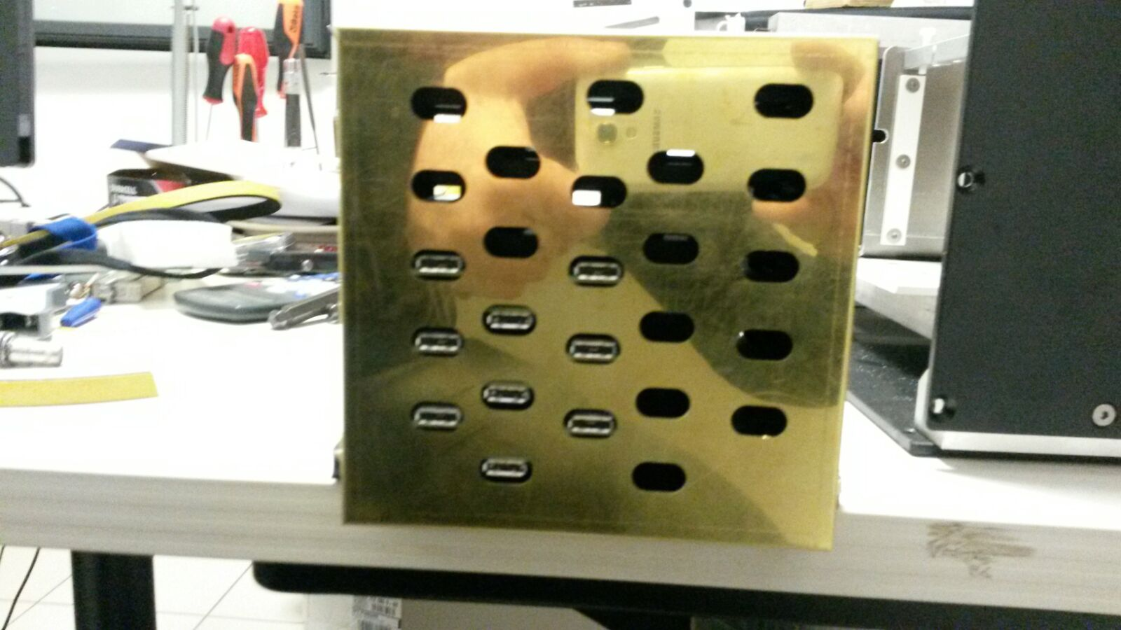
Ecal mechanics assembly

Slide 12
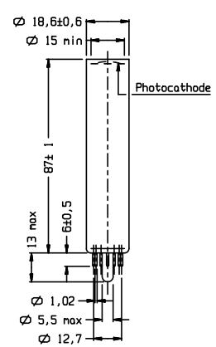
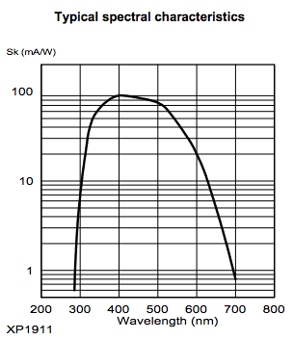
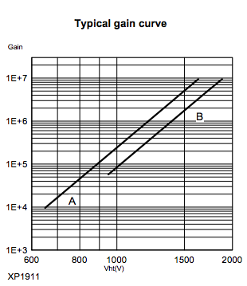

PMT readout XP1911
15mm diameter active area 44% coverage of 20x20mm² crystal
HZC Photonics XP1911-XP1912 are on paper identical to orginal Photonis
  Quoted price very cheap at the level of the APD
  Several interaction but still difficult to place and order
The XP1911 could be the baseline solution for Ecal but:
  Quality of the PMT to be verified
  Interaction with the firm rather difficult so far. Do we know any Chinese?

Slide 13
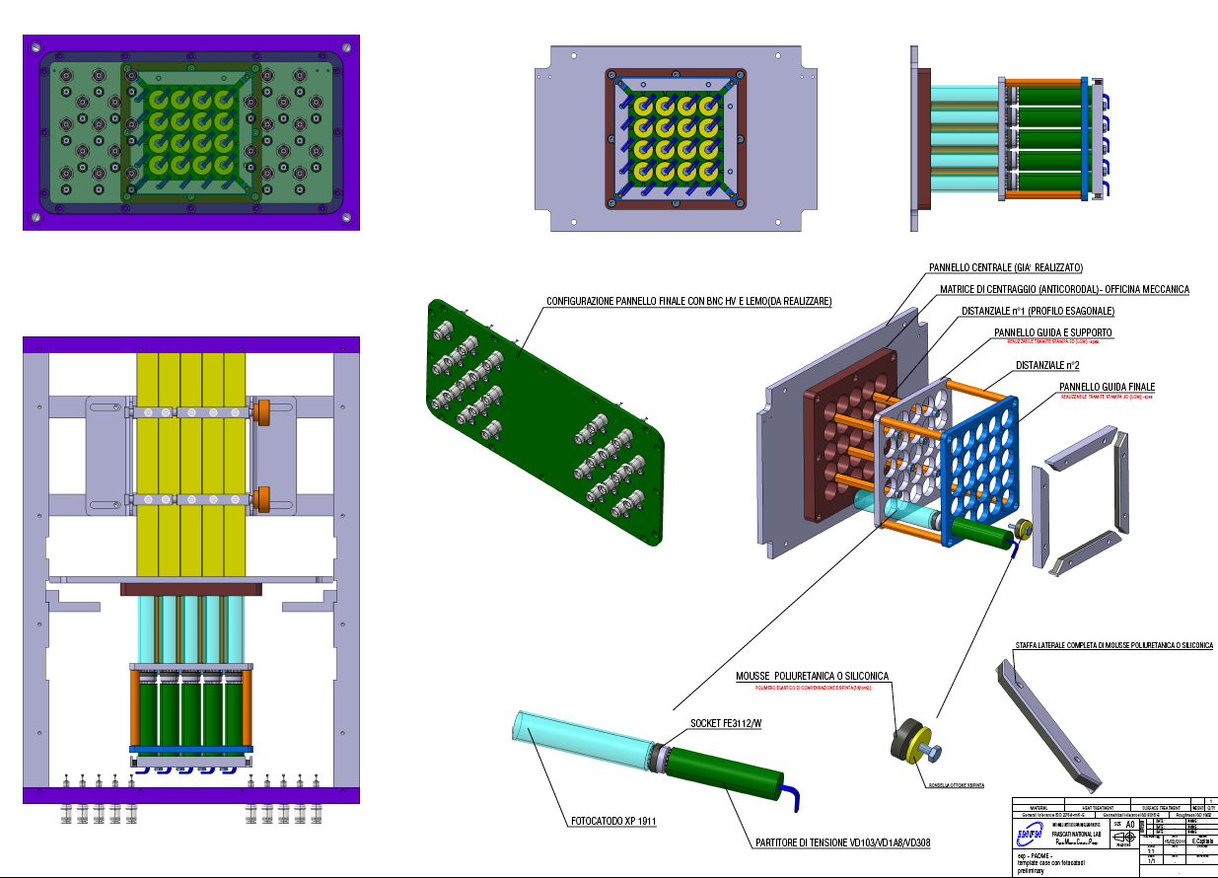
Test beam Ecal mechanics PMT

Slide 14
Ecal test beam preparation status
We plan to equip a 25 20x20 mm² crystal matrix for the next test beam with PMT and APD readout:
  All the crystal are already available
  Read out: 10 APD S8664-1010 on loan from Belle II (thanks to Giuseppe and Riccardo hope to get 6 more from Hamamatsu in time)
  40 channels of FE electronics + power supply APD available.
  64 FADC channels + readout software already in use at Frascati
  Mechanical support refurbishing almost terminated
Missing parts:
  25 PMT XP1911 will be ordered with 2015 money from China ASAP
  HV system for the 25 PMT
  Find a final solution for the wrapping at present teflon
  Calibration of the crystals needed with cosmic rays or radioactive source

Slide 15
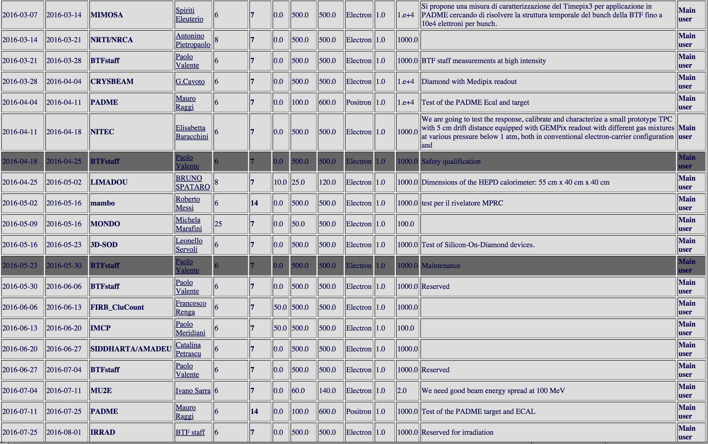
Test beam in 2016

Slide 16
Test beam April 2016
The test beam during the first week of April:
Too early for a final study of full PMT and APD readout.
  Difficult to obtain better results without new APDs and PMTs
  Can profit of better mechanics for the APD test
Can we use it to study the timing performance of the system with respect to an external timing?
  Timing can be studied if time-pix3 timing performance are good enough.
  Need to integrate readout of Ecal and Timepix-3
  It timepix3 works can study position resolution as well
Study of the pedestral with random generated gates
  Get 1 pedestal each 50 events out of spill to study pedestal behavior.
  Try to understand low energy tails and BG in the beam

Slide 17
July test beam
Need to have both Ecal readout (APD PMT) fully operational
  25 PMTs and 16 APD with proper readout electronics.
  Need calibrated PMT APD and crystal (radioactive source)
Need an external tracking system to select single electron
  Study spatial resolution wrt to independent measurement
Need external precise timing to measure time resolution of Ecal
  Positron veto bars?
  Measure both single crystal and cluster time resolution
Trigger = (beam & Pveto) OR random
Ecal prototype
Positron beam
Tpix3?
Pveto

Slide 18
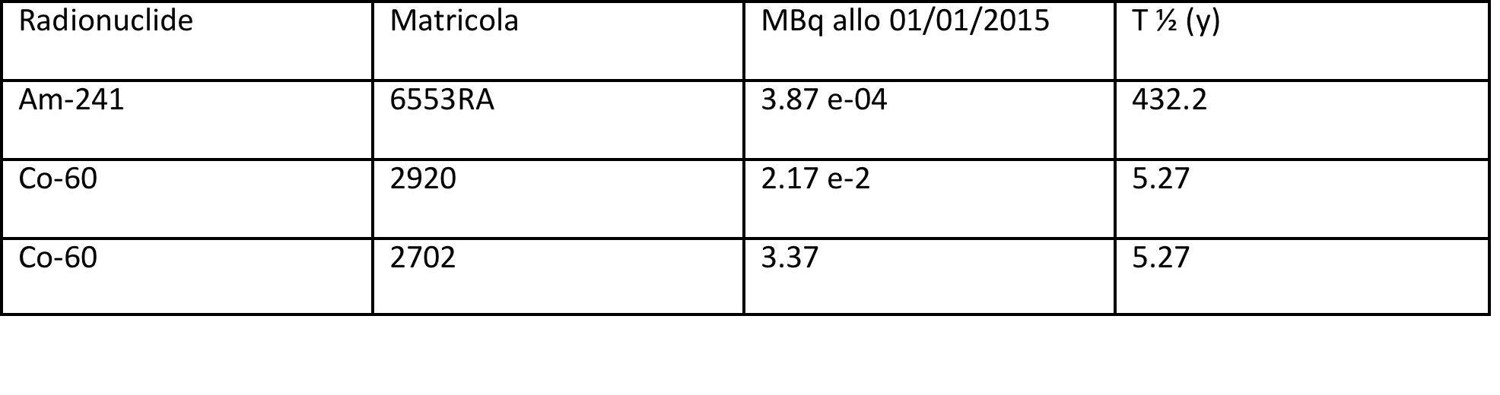
Crystal characterization
We need to start calibrating crystals with radioactive sources to measure light yield and minimum energy threshold.
At LNF there is a dedicated area where radioactive sources are accessible. I already discussed with the head of HEP division the possibility of installing long term area with PADME test stand.
We have to book a period and start working soon with cobalt.
Need to optimize wrapping, optical polishing of lateral surface, optical coupling to PMT/APD.
Co⁶⁰
V1742 Analog In
Trigger crystal
CO
Crystal to test
γ₁
γ₂
V1742 Analog In
FO
Discr
V1742 Trig In

Slide 19
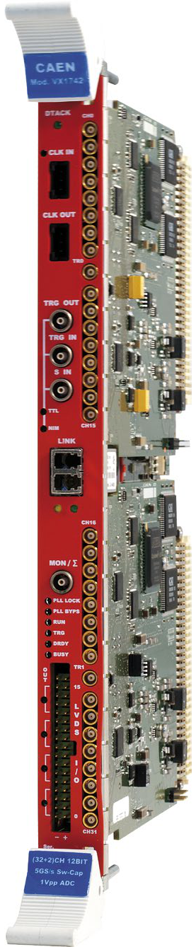
Calorimeter readout V1742
V1742
PCI Express CONET2 Controller
12-bit @ 5 GS/s, 1024 samples per event
5, 2.4,1 GS/s selectable sampling frequencies
1024 samples means (max 1us integration time)
VME64/VME64X (32 ch.)
Special trigger analog inputs 2 ch.
1 Vpp input dynamic range with programmable DC offset adj.
16 programmable LVDS I/Os
Daisy chain capability
Customization for PADME discussed in a meeting in Viareggio:
Modification of sampling rate down to 700MHz
5, 2.4,1 GS/s +750 MS/s selectable sampling frequencies
1024 samples at 750 MHz means (max 1.36 us integration time)
1.5 Vpp input dynamic range (+50% dynamic range)
Prototype board with such a modifications expected soon for tests
Threshold (mV)
Minimum effective threshold < 12 mV
Small dispersion (RMS = 1.3 mV)
High and Low threshold channels can be swapped reducing the minimum threshold

Slide 20
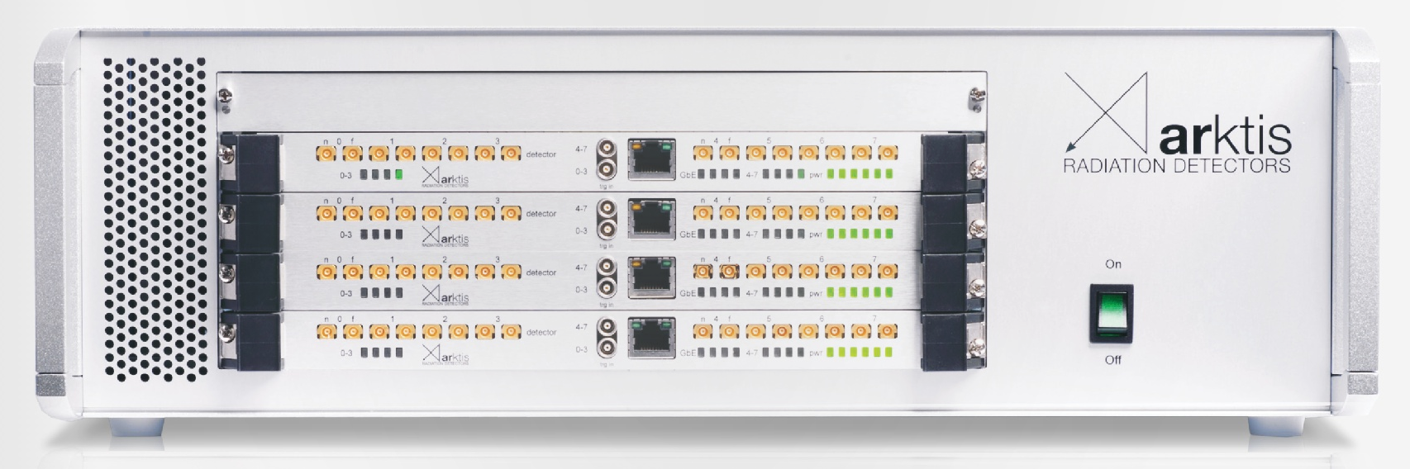
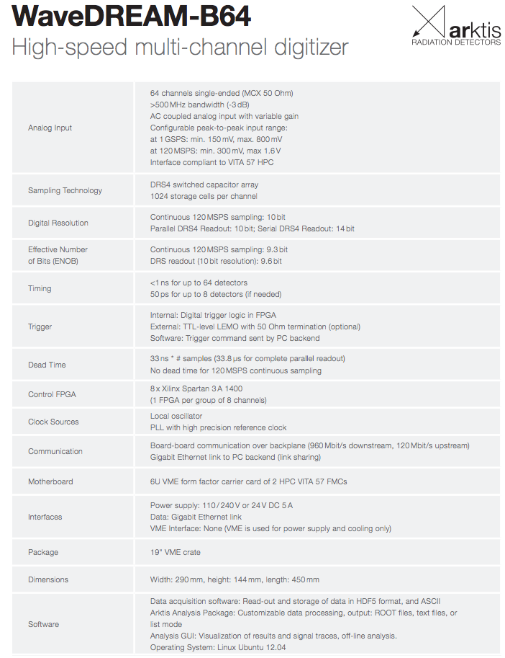
Alternative solution for the readout
Alternate solution WaveDream 64 ch by Arktis?
  Milestone for August 2016 still open
  Many issue to be clarified (trigger, timing, delivery time)
Is the ECAL readout cost very for the two solutions?
Is WD64 customizable for the PADME requirements?
Is the timing good enough?
Direct contact with the firm with on site visit is necessary. Note for the referee needed. Volunteers?

Slide 21
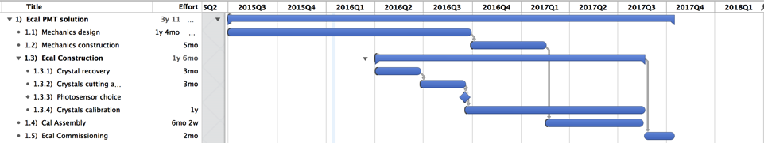
Ecal Schedule
Delay foreseen in the crystal recovery procedure
  We still don’t have the crystals in our hands
Milestone in autumn of 2016 for the photosensor choice need successful July test beam!

Slide 22
Conclusions
Prototype test in November 2015 successful 2.3%/√E resolution
  Still improvement needed to obtain <2% with PMT
  Need better data for APD readout
Crystal procurement stacked risk for impact in the schedule
Missing readout for the April test beam
  Can study position resolution and timing?
Need to start preparing test stand for crystal calibration with radioactive source.

