Slide 1
The Proton Computed Tomography Apparatus developed by INFN (RDH-WP3)
M. Bruzzi^{1,2}, D. Bonanno³, M. Brianzi², M. Carpinelli^{4,9}, G.A.P. Cirrone⁵, C. Civinini², G. Cuttone⁵, D. Lo Presti^{3,8},G. Maccioni⁴, S. Pallotta^{2,7,8}, N. Randazzo³, M. Scaringella², F. Romano⁵, V. Sipala^{4,9}, C. Talamonti^{2,7,8}, E. Vanzi¹⁰
^{Prima – RDH Collaboration}
¹Physics and Astronomy Department, University of Florence, Florence, Italy
²INFN - Florence Division, Florence, Italy
³INFN - Catania Division, Catania, Italy
⁴INFN Cagliari Division, Cagliari, Italy
⁵INFN - Laboratori Nazionali del Sud, Catania, Italy
⁶Physics and Astronomy Department, University of Catania, Catania, Italy
⁷Department of Biomedical, Experimental and Clinical Sciences, University of Florence, Florence, Italy
⁸SOD Fisica Medica, Azienda Ospedaliero-Universitaria Careggi, Firenze, Italy
⁹Chemistry and Pharmacy Department, University of Sassari, Sassari, Italy
¹⁰ Fisica Sanitaria, Azienda Ospedaliero-Universitaria Senese, Siena, Italy
RDH Meeting
Roma 01/02/2016

Slide 2
Introduction
Two pCT systems: 5x5cm²; 5x20cm²
Analysis results from the small area system
  Algebraic Reconstruction Technique
  Uppsala June-2015 test → High energy Tomography
Large area apparatus status
  Tracker
  Calorimeter
200 MeV tests
Plans for 2016

Slide 3
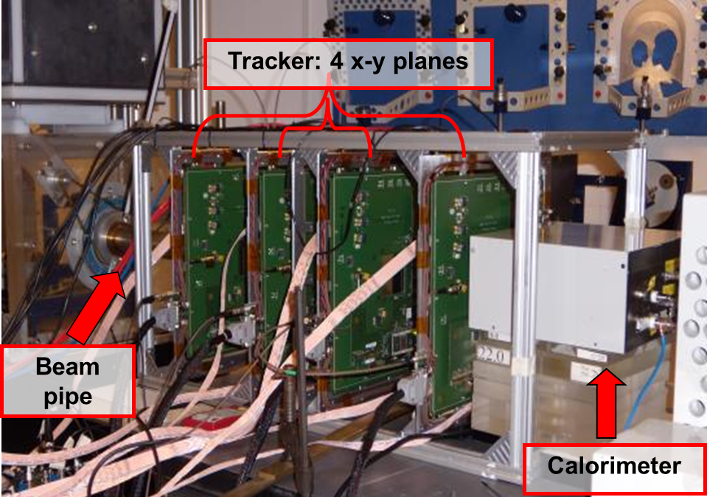
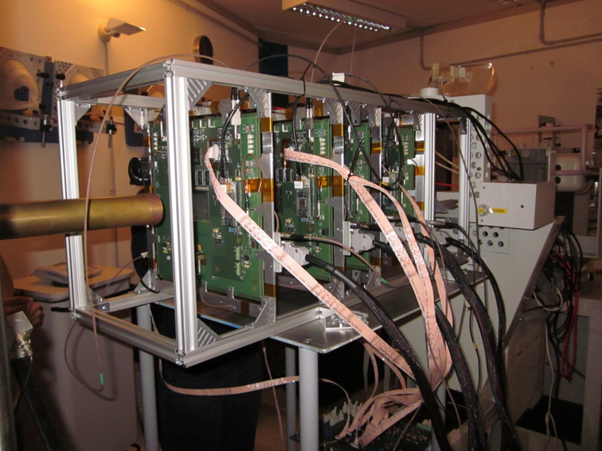
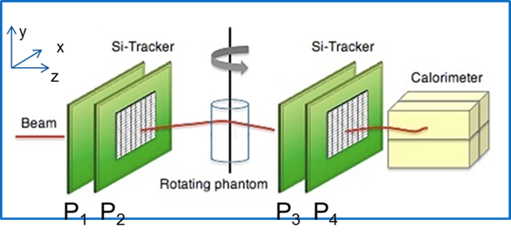
PRIMA collaboration: small area pCT apparatus
First test at INFN-LNS:
May 2011
High energy test at
TSL-Uppsala:
June 2015
Four x-y silicon microstrip based tracking planes
Yag:Ce calorimeter
Proton entry and exit positions and directions
Proton residual energy

Slide 4
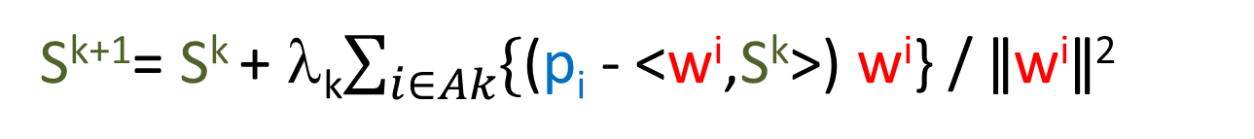
Algebraic Reconstruction Techniques
The system could be solved using an iterative formula:
S^{k+1}= S^{k} + λ_{k}$\sum_{i∈Ak}{\{}$(p_{i} - <w^{i},S^{k}>) w^{i}} / ǁw^{i}ǁ²
Gordon, R; Bender, R; Herman, GT J. Theor. Biol. (1970) 29 (3): 471–81.
S^{k} image vector at iteration k (stopping power)
w^{i} i^{th} track length in each pixel (vector) → Tracker
p_{i} stopping power integral (number) → Calorimeter
λ_{k} relaxing factor (constant value or →0 as ~k⁻¹)
S⁰ initial image: {0} or approx (i.e., from FBP reconstruction).
Three algorithm variants (depends on the events in A_{k} set):
  A_{k} = {1-event}: ART → too much ‘salt-pepper’ noise
  A_{k} = {full data set}: SART (simultaneous ART) → better noise
  A_{k} = {1/n of the full data set}: BI-SART (n-Block iterative SART) → good noise performance with faster convergence

Slide 5
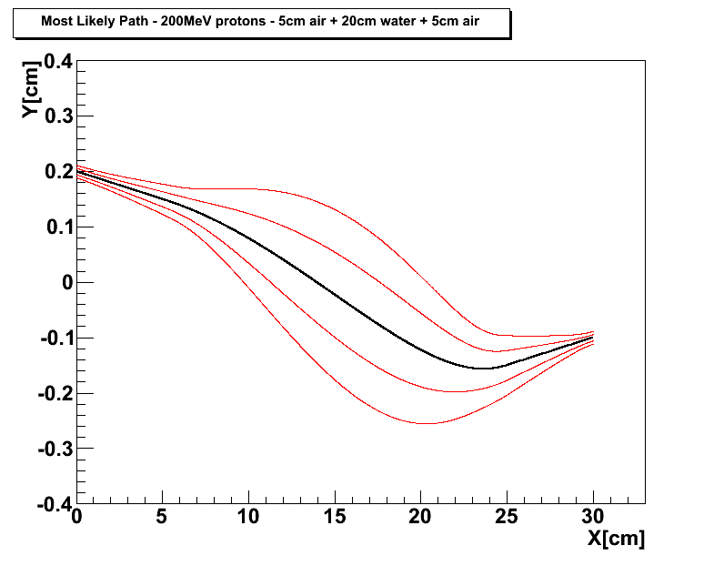
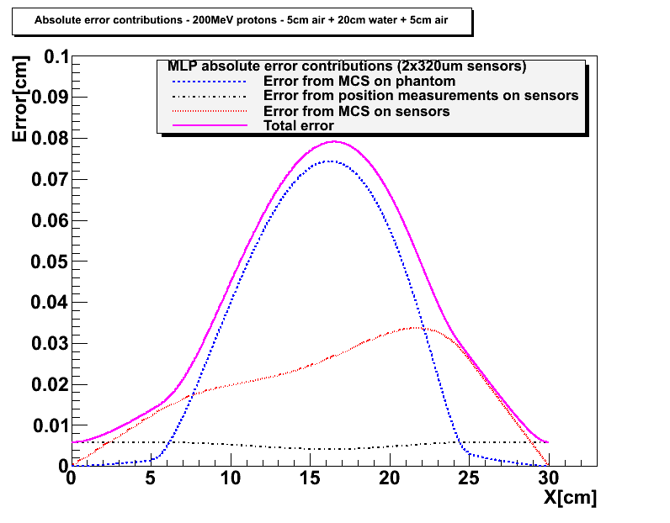
Most Likely Path in a pCT geometry
Starting from D.C. Williams Phys. Med. Biol. 49 (2004) and R.W. Shulte at al. Med. Phys. 35 (11) (2008)
5 cm of air have been inserted in front and behind the 20cm H₂O phantom
MLP example with 200MeV
kinetic energy protons in
20cm of water:
Entry: Y(0) = 0.2cm
Y’(0) = -10mrad
Exit: Y(20) = -0.1cm
Y’(20) = +10mrad
Silicon microstrip detectors:
320μm thick
200μm strip pitch
MLP error envelope plus contributions from detector position measurement error (~ pitch/√12) and MCS inside the silicon sensors →
The sensor thickness contribution affects only the MLP error at the edge of the phantom
σ ~ 150-250μm
200MeV in
90MeV out
Notes:
Errore sulla posizione del mlp errore fino a 800um nel centro a bordo fantoccio e’ dell’ordine di 200-300um

Slide 6
Uppsala 2015 Test Beam
Performed at ‘The Svedberg Laboratory’ (TSL-Uppsala)
24 hours beam time (550 €/hour) + beam setup (2200€)
Beam energy at pCT detector (phantom): 172.5±0.9 MeV
Instantaneous beam intensity: 10kHz
Cyclotron duty cycle: 10%
Mean DAQ frequency: 1 kHz
Data sets:
  Calorimeter calibration: 10⁶ events at 78, 121, 160 MeV (no phantom)
  Tracker alignment: 3*10⁶ events at 173 MeV (no phantom)
  40 angles (0º-351°): 1.5*10⁶ events per angle
  Radiography: 1.5*10⁶ events

Slide 7
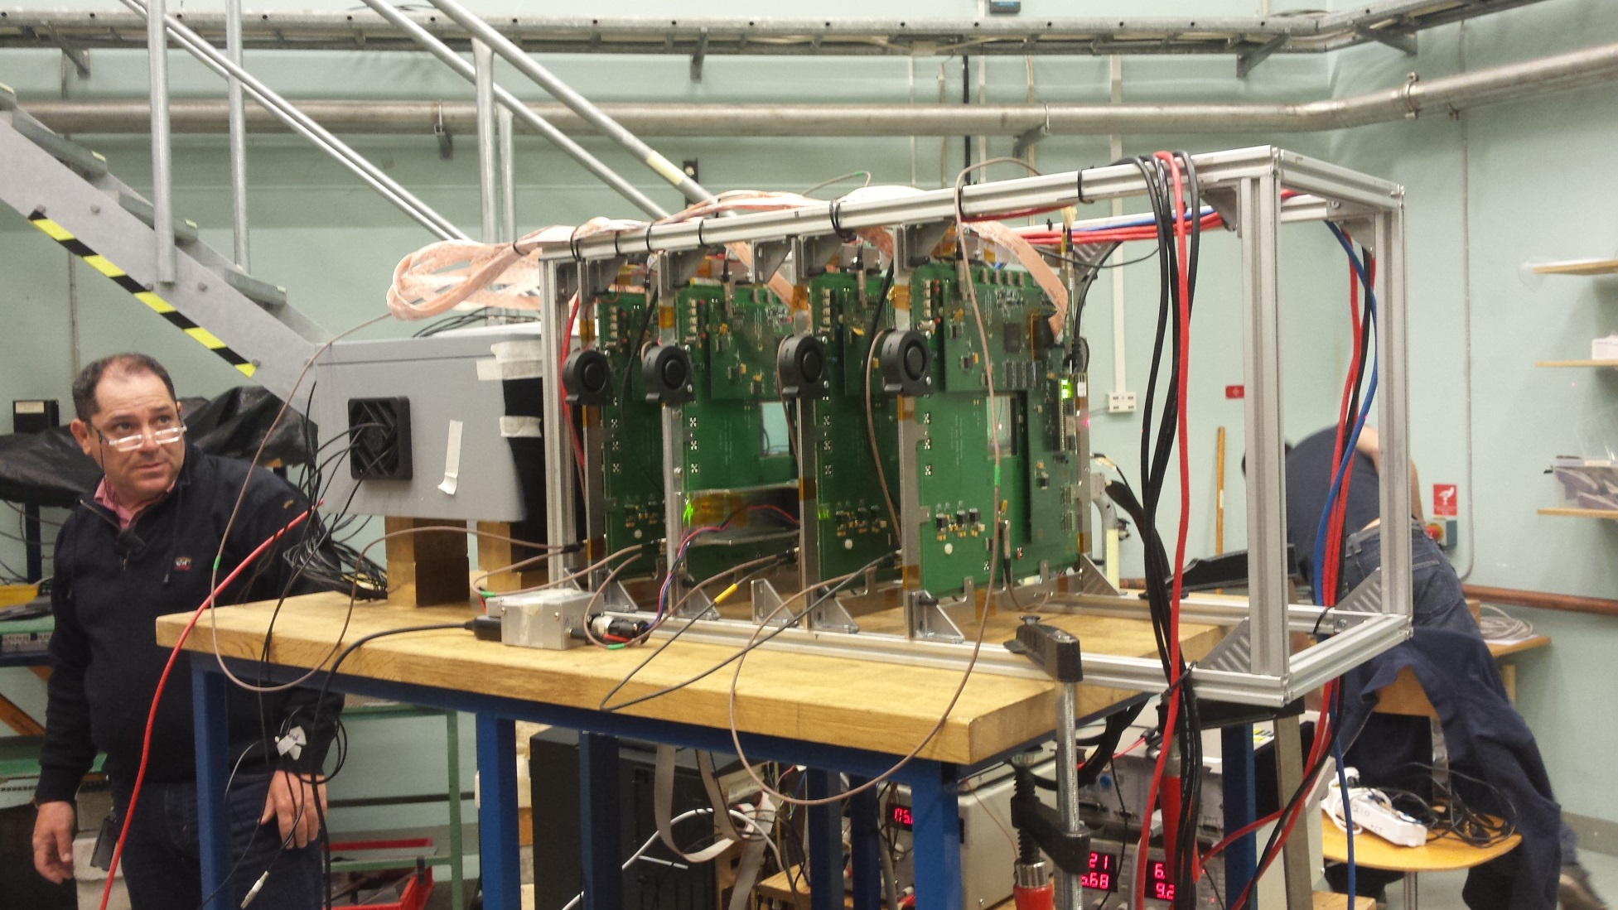
Uppsala set-up

Slide 8
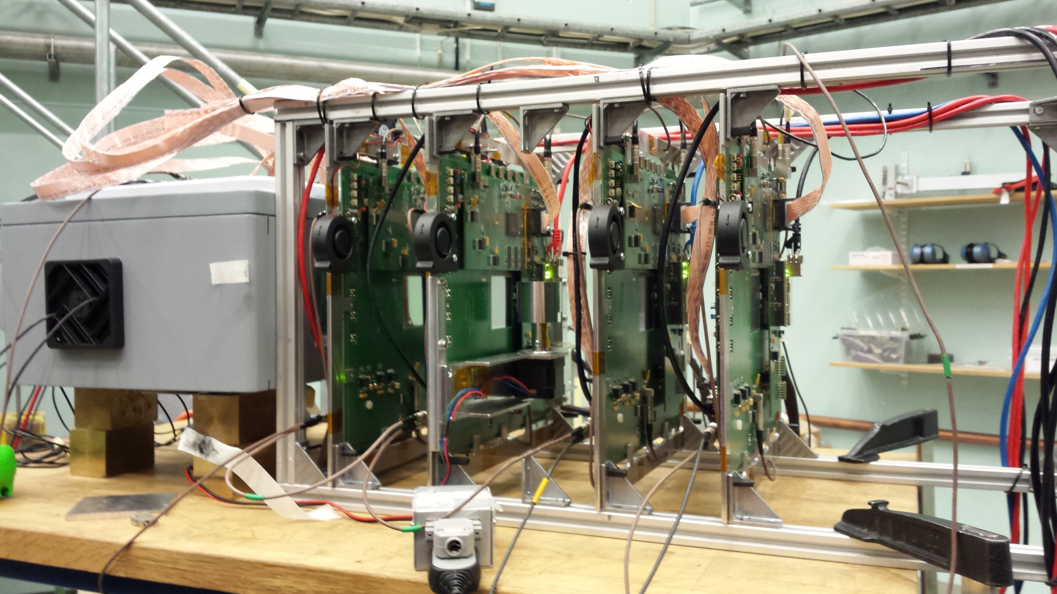
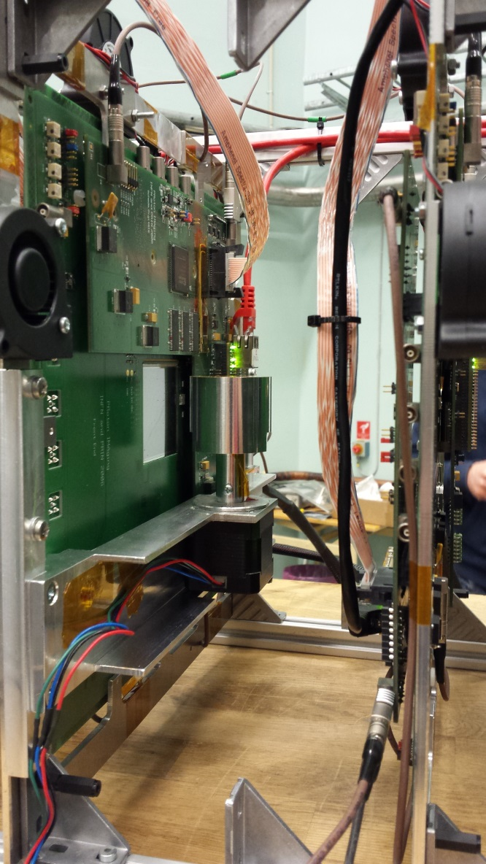
Phantom mounted on pCT system

Slide 9
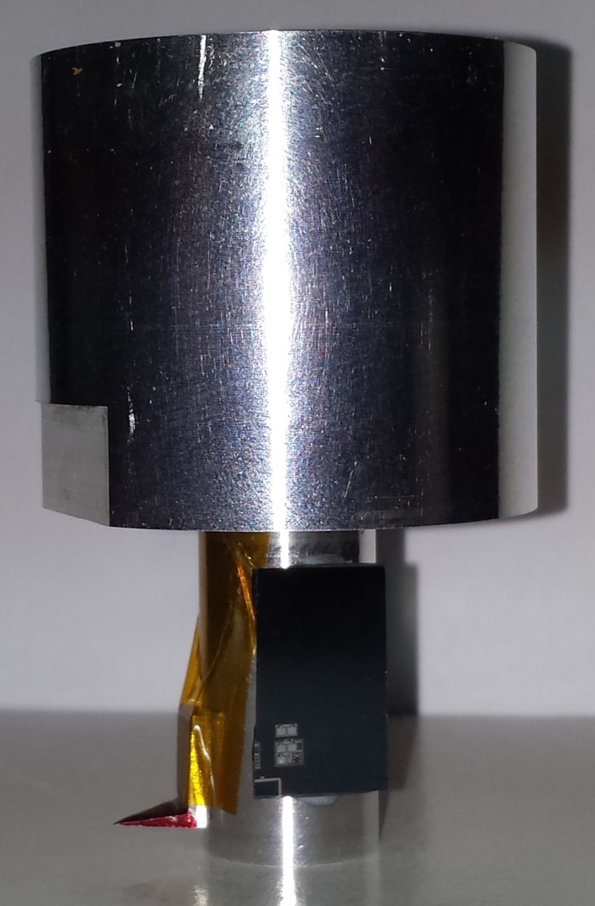
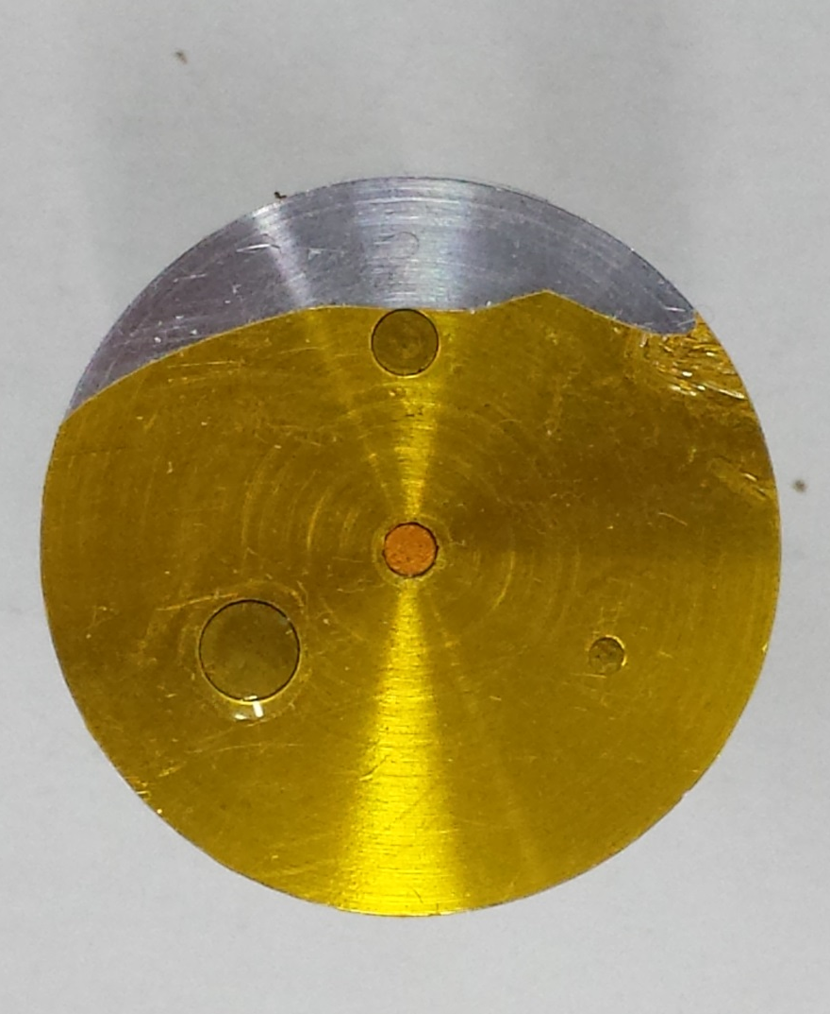
Uppsala test: phantom
Phantom dimensions limited by the system field of view (5cm)
To have a reasonable energy measurement error the phantom material could not be plastic-like: ΔE_{PMMA}(5cm)~22MeV (to be compared with the calorimeter resolution at 200MeV σE_{calo}~4-5MeV)
We decide to use Aluminium for the phantom body with Iron and Copper insert to simulate high constrast material (e.g., muscle-bone structure)
An empty hole and a uniform section have been made to evaluate space resolution for different constrast and density r.m.s. measurement
During data taking the phantom is rotated by 9° using a remotely controlled micro-step motor (step angle = 1.8°)
φ=4mm
φ=3mm
φ=2mm
φ=6mm
45mm

Slide 10
Algebraic algorithm implementation
Iterative algebraic algorithms have a rather high computing cost
Using a sequential CPU, and moving a lot of computing from the algorithm itself to the preprocessing phase, a 50-iterations image takes about 3+3 hours to complete with little space for improvement
Parallel computing on GPUs is a way to decrease the computation time at the expense of a learning phase
Hardware: NVIDIA GeForce GTX TITAN X (not so expensive: ~1000 Euro, 12GB memory, 3072 Cuda cores, 24 Multi-processors, 786432 parallel threads)
Software: Cuda on Visual Studio (Community edition, free)

Slide 11
GPU parallelism
All data (tracker coordinates and calorimeter energy) is copied from disk to GPU memory once at the beginning of job (~2GB)
The Most Likely Path is recalculated at each iteration (GPU ‘general rule’: faster to recompute than store on disk and recall)
Most of the algorithm operations are pixel-by-pixel: use one thread per pixel (up to a maximum of 512x512 pixels)
Some calculations are independent: use the ‘stream’ on GPU to further parallelize them (e.g., the MLP calculation is done on the shadow of the BI-SART algorithm, so no computing cost for it)
Move the reconstructed images only from GPU to CPU to store them on disk at the end of each iteration
The preprocessing phase takes about 1’-2’ for the whole dataset
One iteration on GPU now costs 1’ 15" for a 512x512 pixels image with 2x10⁶ events (128x128 pixels image is iterated in less than 10")

Slide 12
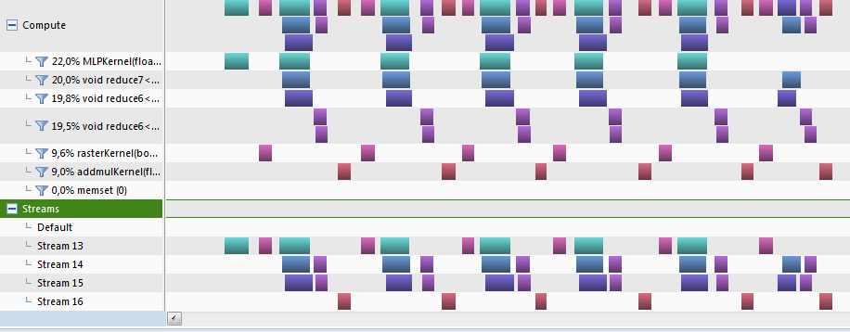
CUDA timeline
Kernel: some code executed on different threads (e.g., 1 thread per pixel)
time
Different kernels are executed in parallel on different streams
Group of 16 events

Slide 13
BI-SART reconstructed tomographies
Images shown here are obtained using a 4-blocks BI-SART algorithm, with relaxation parameter (λ_{k}) chosen to have the density r.m.s. minimum around iteration 10
No a-priori knowledge of the phantom boundary is requested (only an external larger container is known to the algorithm)
The proton tracks are calculated using the Most Likely Path formulas (MLP operators, ~300MB, stored in GPU memory)
The phantom is divided into 5 slices, each vertically uniform
  Slice thickness: 4-6mm
At the moment only a 2D reconstrution version is available → vertically project a slice onto a plane
The color palette indicates the Stopping Power (at 175 MeV) as it is calculated by the algorithm

Slide 14
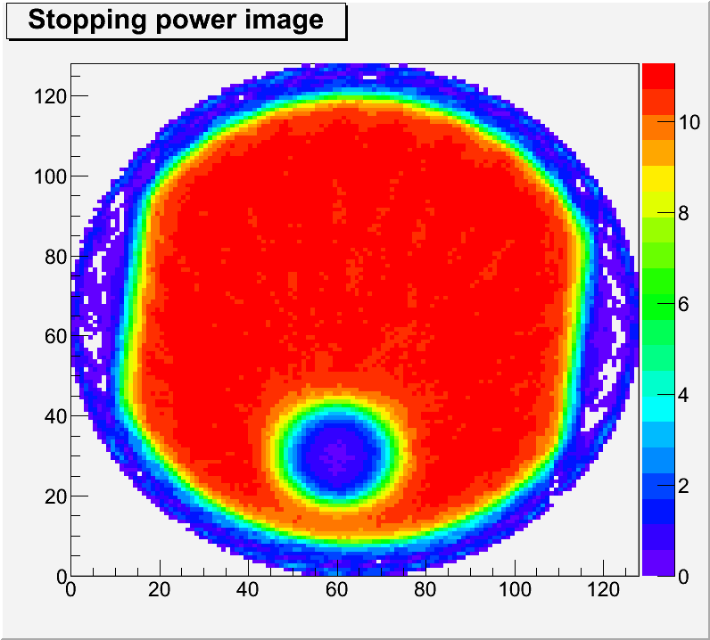
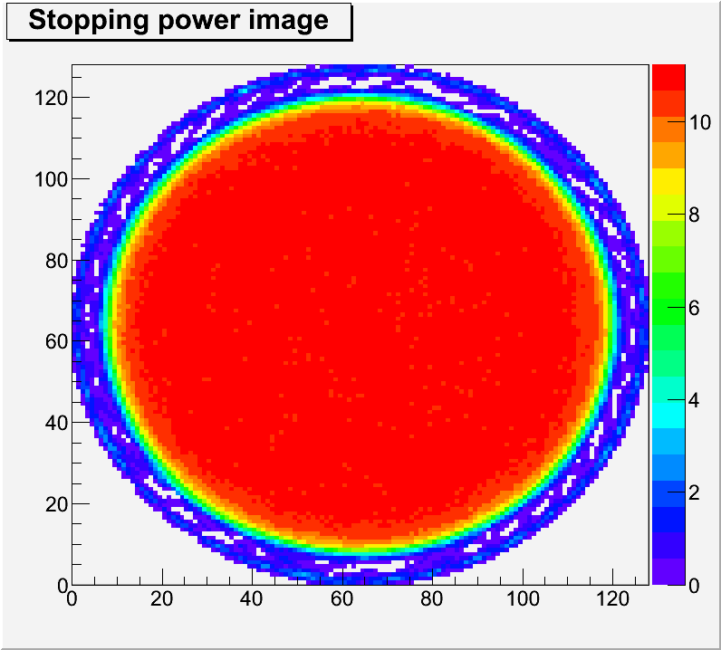
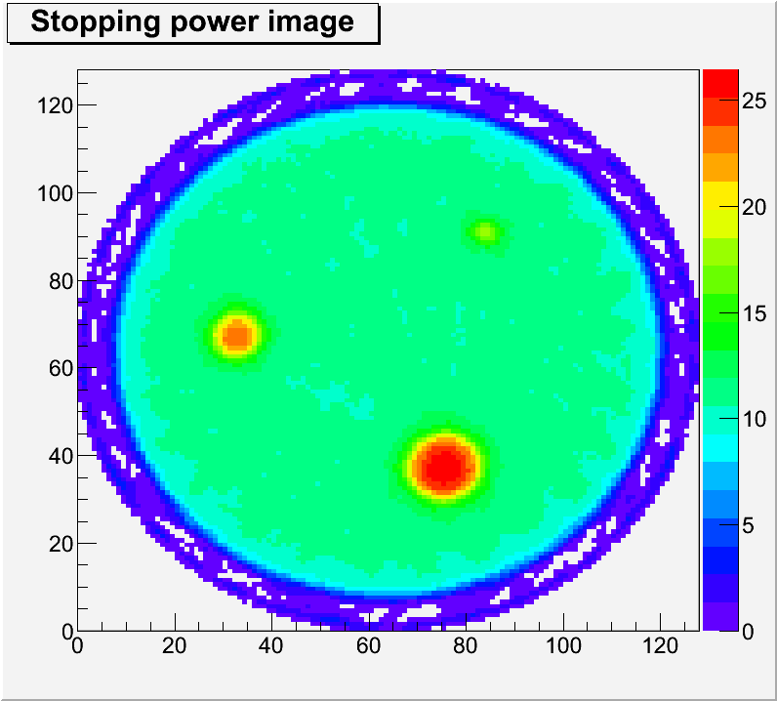
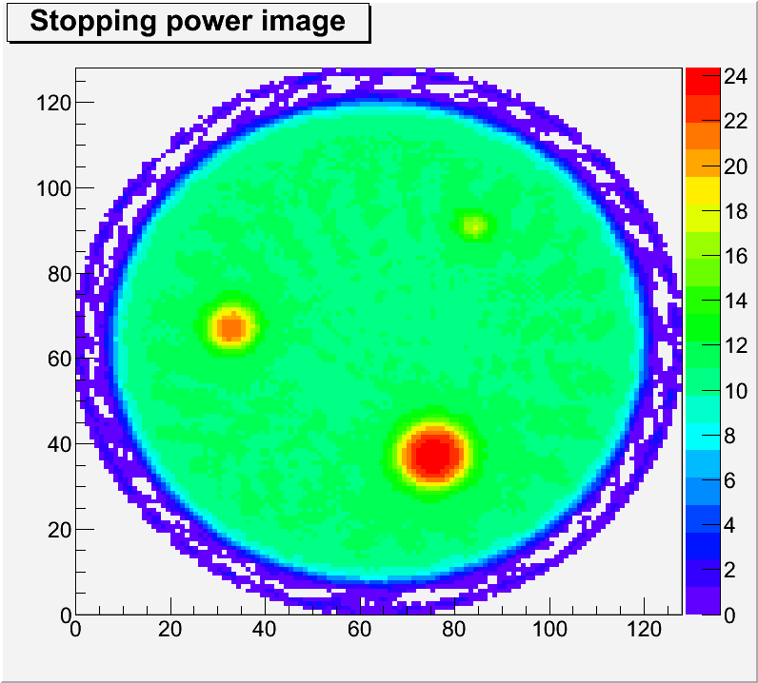

BI-SART starting for empty picture
Iteration 11

Slide 15
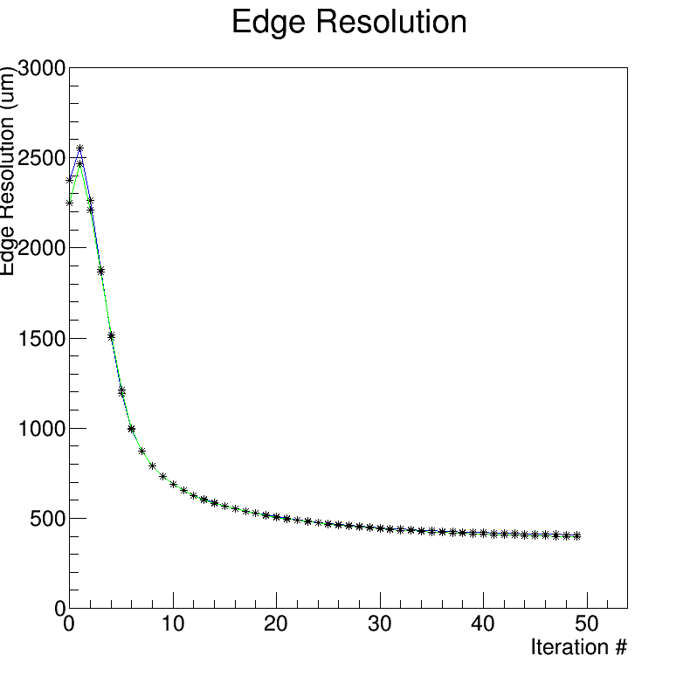
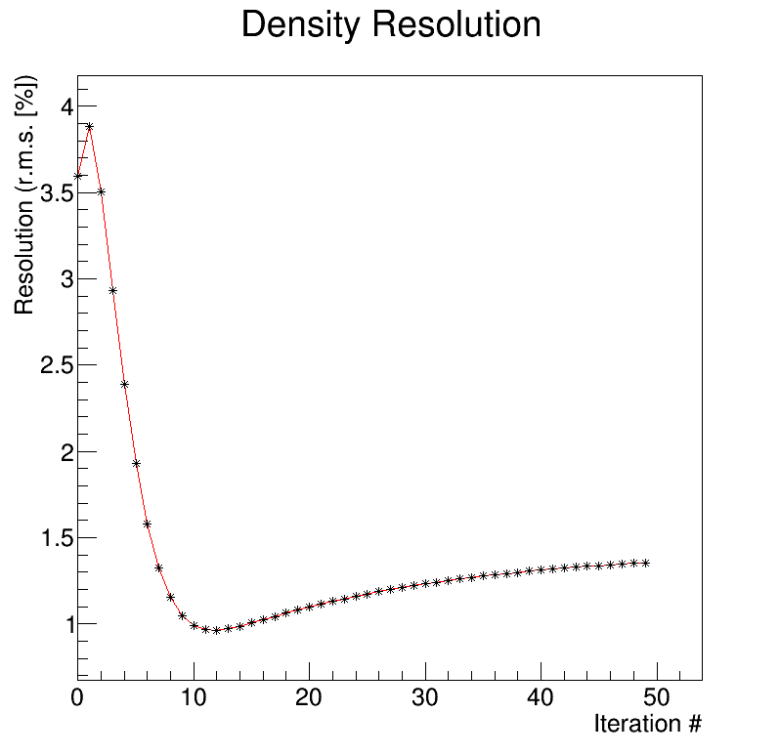
Resolutions
BI-SART (from {0}
BI-SART (from {0}
650μm at iteration 11
0.96% at iteration 11
The edge resolution has been obtained fitting the edge of the tomography with an error function and quoting the sigma
The density resolution is the r.m.s. of the pixel stopping power distribution taken in a uniform fiducial region of the phantom

Slide 16
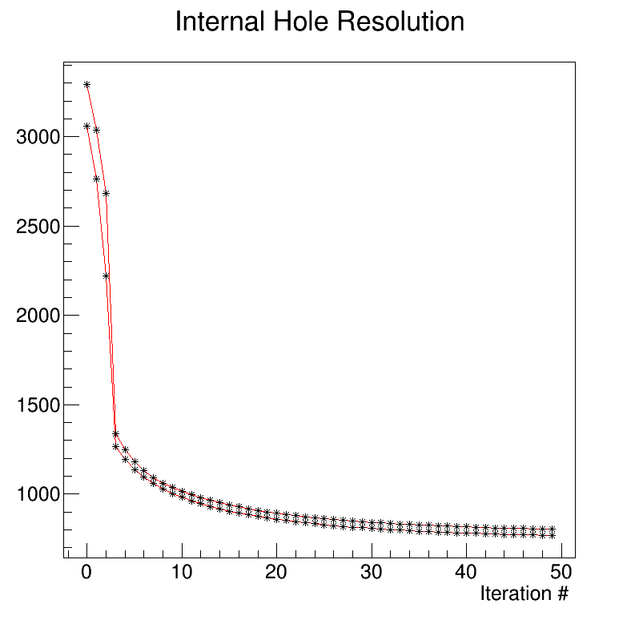
Insert resolution
BI-SART (from {0}
The Stopping Power values at iteration 50 are the following:
Aluminium: 10.9 MeV/cm
(expect. 10.4 MeV/cm)
Iron: 26.45 MeV/cm
(expect. 27.03 MeV/cm)
Copper: 28.7 MeV/cm
(expect. 29.53 MeV/cm)
  Comments: probably the insert tolerance w.r.t. the hole decreases the measured SP, as a matter of fact for Fe and Cu a 2÷3% underestimation is observed);
  The +5% overestimation observed for the Aluminium could be ascribed to the material used which is not pure Al but anticorodal.
960μm at iteration 11
The internal insert resolution has been obtained fitting the edge of the 6mm diameter inserts with an error function and quoting the sigma

Slide 17
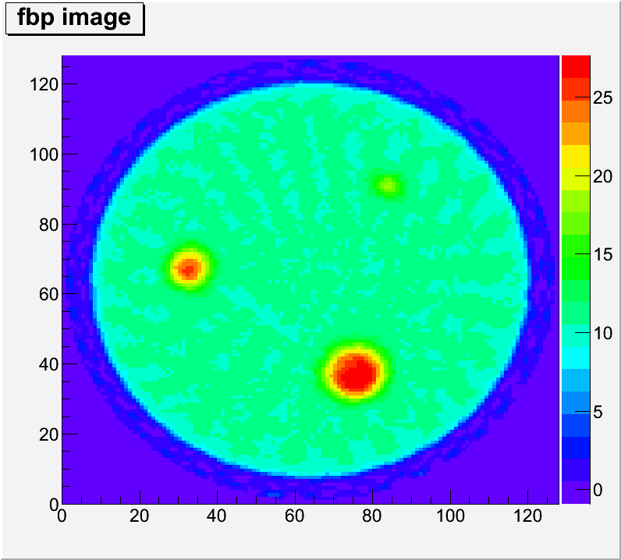
Filtered Back Projection reconstructed tomographies
The Filter Back Projection algorithm assume a parallel beam with straigth tracks
This is not true for protons because of multiple scattering
Nonetheless we apply the FBP algorithm to reconstruct a pCT image
This image could be eventually used as a starting point (seed) for the iterative algorithm
FBP edge resolution: 600μm
FBP density resultion: 1.8%
FBP internal insert resolution: 900μm
Same spatial resolutions of BI-SART with a factor two worser density resolution
400 μm pixel size, SP normalized to BI-SIRT image
FBP – hard filter

Slide 18
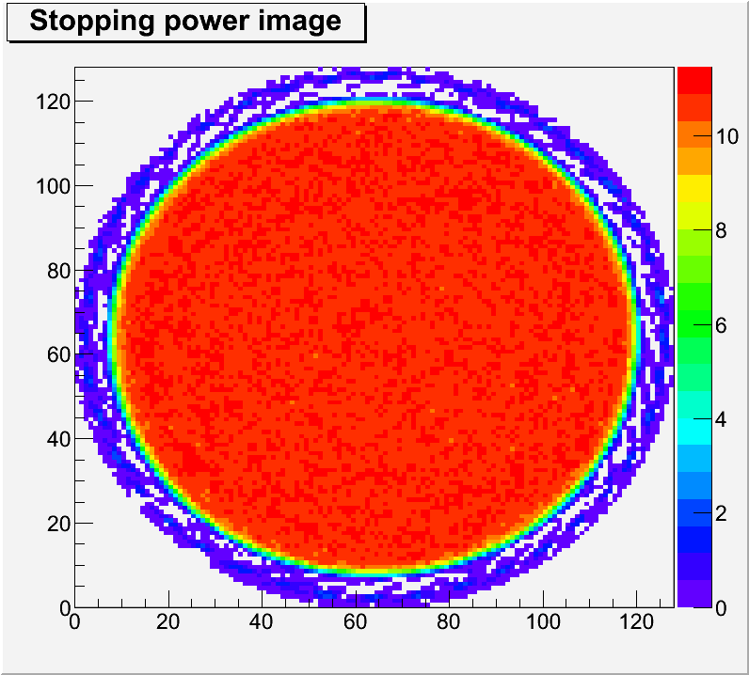
BI-SART starting from FBP
Starting from {0}
Starting from FBP
Much more uniform
Better spatial resolution

Slide 19
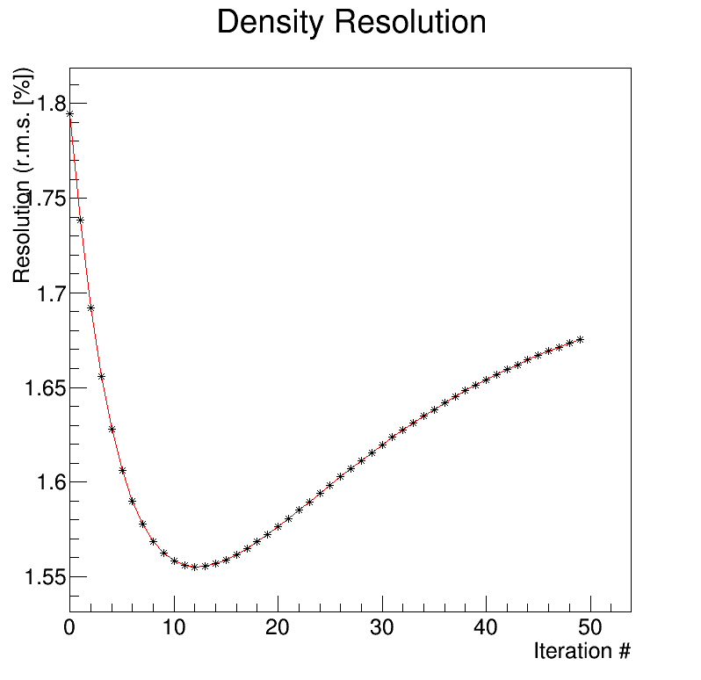
BI-SART starting from FBP
Starting from {0}
Starting from FBP
0.96%
1.55%
Better uniformity

Slide 20
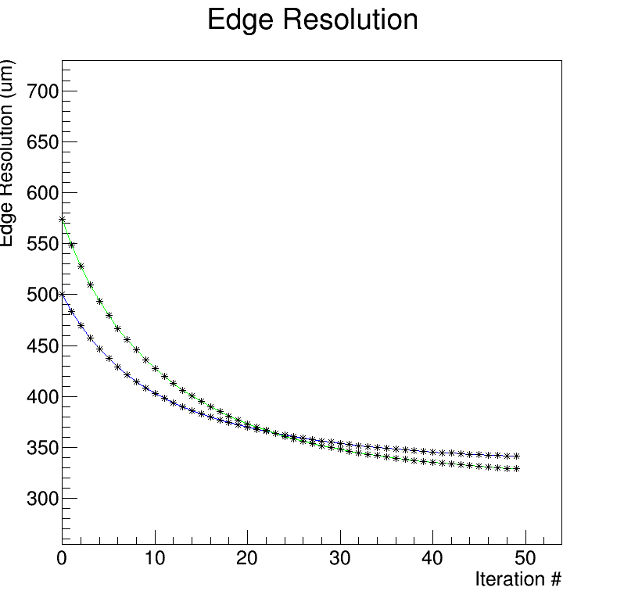
BI-SART starting from FBP
Starting from {0}
Starting from FBP
400μm at 11
650μm at 11
340μm at 50
400μm at 50
Better spatial resolution

Slide 21
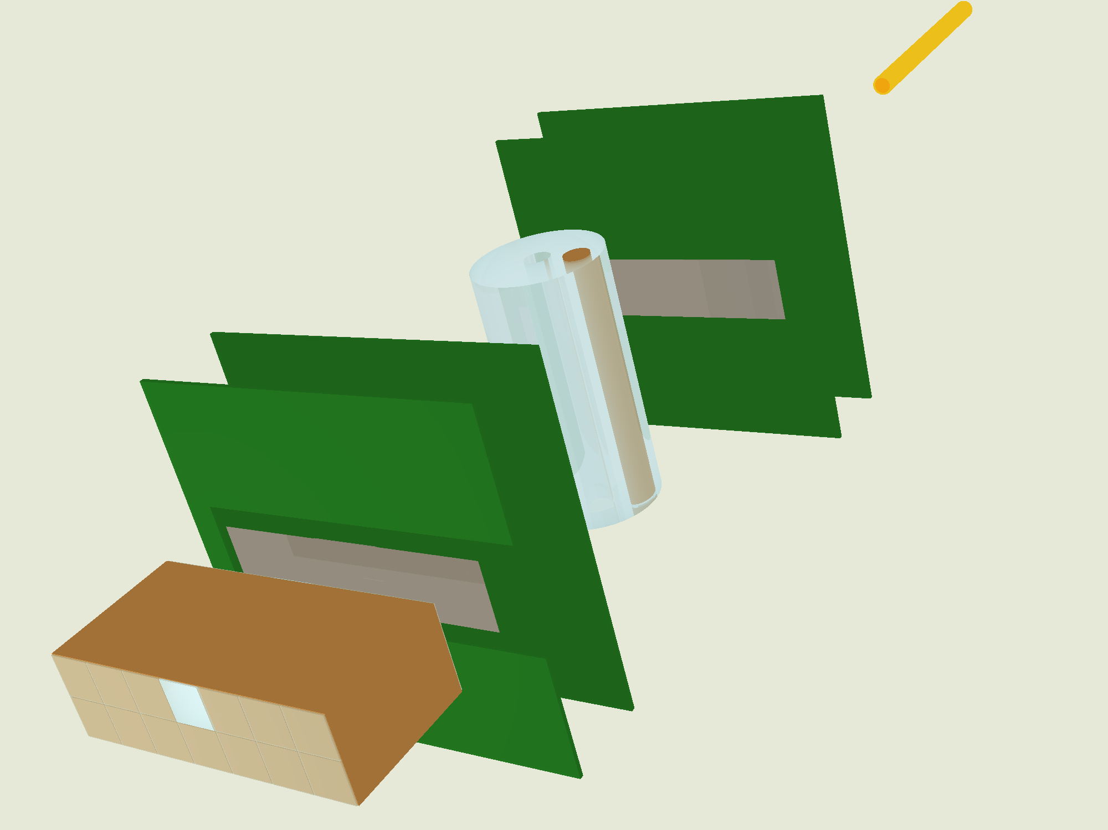
pCT upgrade (5x20cm²)
A system similar to the one already tested
  Microstrip tracker
  YAG:Ce calorimeter
But with a 50 x 200 mm² field of view
On-line data aquisition
1 MHz capability
Rectangular aspect ratio to perform tomographies in slices
Phantom
Beam pipe
Tracker planes
Silicon sensors
Calorimeter

Slide 22
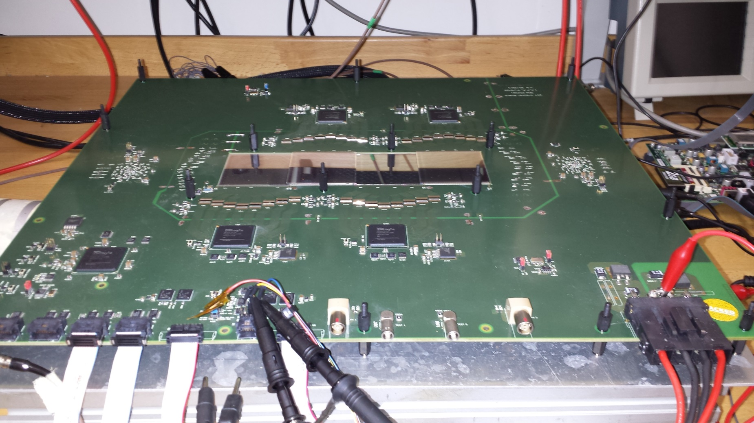
Fully assembled Tracker plane
Chip front-end
Silicon μstrip
Master FPGA
Virtex6
Slave FPGAs

Slide 23
New tracker plane
New tracker front end chip
  Better I2C functionality
  Less threshold dispersion
New version of the printed board
  FPGA programmability issues solved
  New buffer chips
The new front-end chips have been delivered last november
The new printed board, delivered in november too, had mounting problems (we should received it from last iteration this week)
In the meanwhile problems to the INFN-Florence bonding machine (discontinued by Delvotech, repaired by our technician)
This week: test of the new front-end chip on the new tracker board

Slide 24
2016 High energy runs (200 MeV)
Need O(100kHz-1MHz) instantaneous intensity beam
  Calorimeter/scintillator (preliminary)
Test of the extended view pCT system (Spring 2016)
  One/two Tracker bords + Calorimeter integration
  Noise performance
  Rate capability
Data acquisition for tomography (second half of 2016)
  Full pCT system with different phantoms

Slide 25
2016 pCT plan
Analysis
  3D reconstruction, algebraic algorithm evolution, reconstruction parameters optimization
Extended view pCT system
  Validate the tracker plane, calorimeter and DAQ integration
    Test at LNS, April 2016
  Production and assembly of the 4/5 final tracker planes (PCB and front-end chips) by June 2016
  Data taking with the full system during second half of 2016 (at least two runs)

Slide 26
Algebraic Reconstruction Techniques
Iterative algorithm to reconstruct tomographic images (proton stopping power maps) from ‘projections’ (for pCT set of single proton events)
Starting point (S(x,y,E) stopping power):
Introducing the mass stopping power S/ρ:
E₀ = a fixed energy (200 MeV or ... 60 MeV in our case)

Slide 27
Algebraic Reconstruction Techniques
Dividing by S/ρ at energy E:
The left hand side doesn’t depend too much on the material composition (~2-4*10⁻³) and could be replaced by the one measured for liquid water (NIST pstar tables - http://physics.nist.gov/PhysRefData/Star/Text/PSTAR.html):

Slide 28
Algebraic Reconstruction Techniques
Integrating along the proton path:
E_{in} is given by the accelerator, E_{out} by the calorimeter and the ‘path’ by the tracker (Most Likely Path)
Subdividing the object into a set of pixels, for the i^{th} proton:
Where w_{ij} is the path length of proton i inside the pixel j
Wang, Med.Phys. 37(8), 2010: 4138

Slide 29
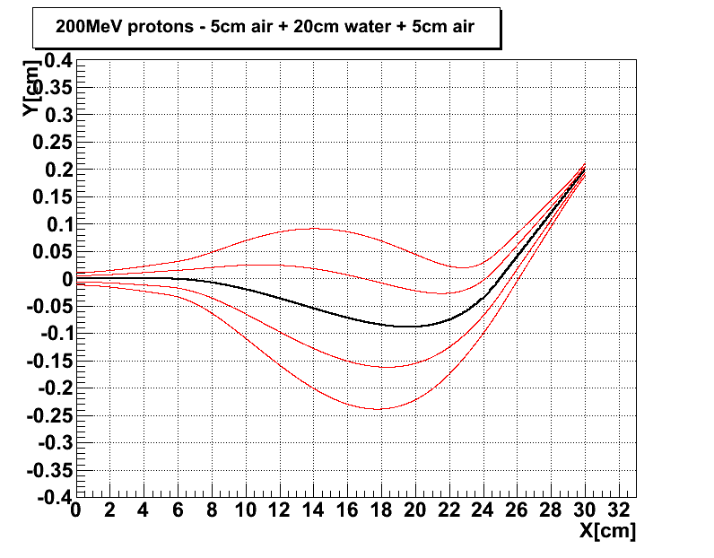
Pixel 1
Pixel j
Phantom: 20 cm of water
p out 90 MeV
Computational challenge: find the simplest (fastest) way to build the w_{ij} matrix (could have billions of elements, most of them equal to zero)
p in
200
MeV
w_{ij}
Pixel N

Slide 30
Algebraic Reconstruction Techniques
The problem is then to solve, for S_{j}, the following set of equations:
N = number of pixels; M number of protons
In our case:
  N = (250x250)=62500 pixels
  M ~ 36(angles)*10⁶ events

Slide 31
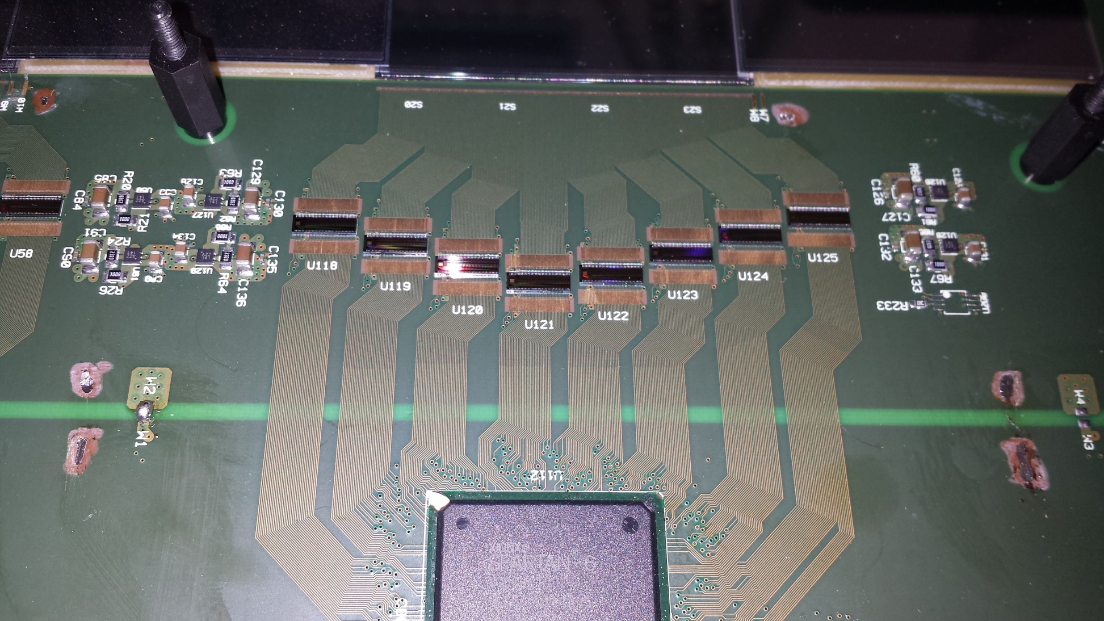
Read-out group
Silicon microstrip detectors
Front-end chips
Power regulators
FPGA slave

Slide 32
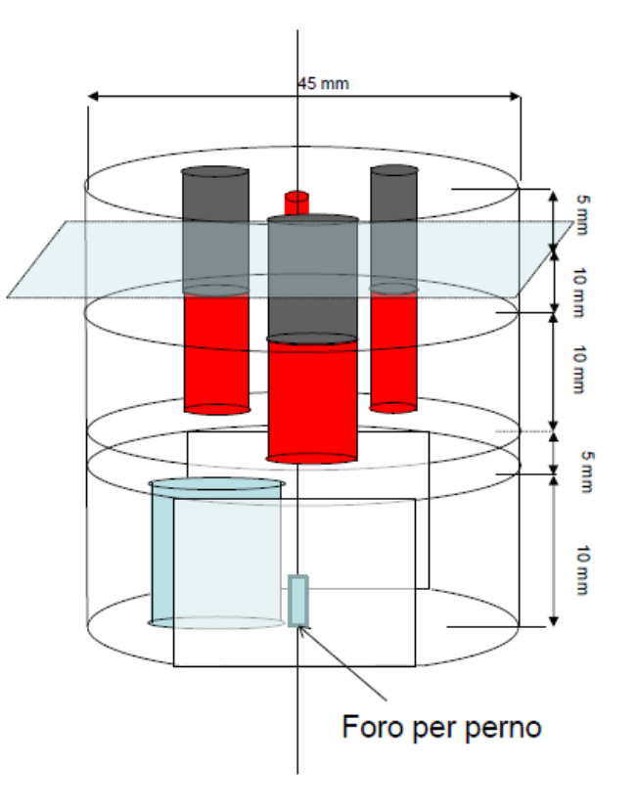

Slide 33
Calorimeter calibration and Tracker alignment
Using four energy points in the range 78-172 MeV, the calorimeter has been point-by-point calibrated (400 cells, 3x3mm² each).
The tracker has been aligned using 2x10⁶ events taken without phantom:
  Plane no. 3 has been fixed (absolute reference frame)
  Furthermore, for each of the other planes: out of 6 degrees of freedom 3 have been fixed (Δz, Δα, Δβ) and three free to vary (Δx, Δy, Δγ);
  Global minimization of the residuals has been done
  Δx~(300÷500)±(40÷70)μm (horizontal position has no mechanical constraint → screw tolerance)
  Δy ~(30÷90)±(40÷70)μm (vertical position easier to be mechanically constrained)
  Δγ ~(1÷3)±(0.3÷0.7)mrad

Slide 34
Data preprocessing
The ~6x10⁷ tomography events have been preprocessed in order to remove three main source of background
  Multiple protons
  Nuclear interactions in the calorimeter
  Elastic nuclear interactions in the phantom/silicon sensors
Events of categories 1) and 2) are cut using an energy compatibility criterion (-9+8MeV from the expected energy), while events of category 3) are removed using the proton scattering angle (more than 3 sigma away from expected MCS)

Slide 35
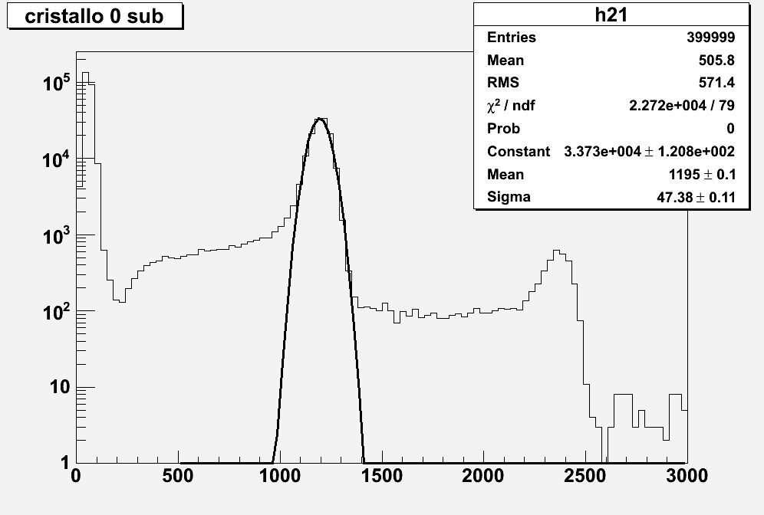
New YAG:Ce calorimeter data
60 MeV
σ=3.9%
Double protons=120 MeV
Noise = 10 MeV
ADC counts

Slide 36
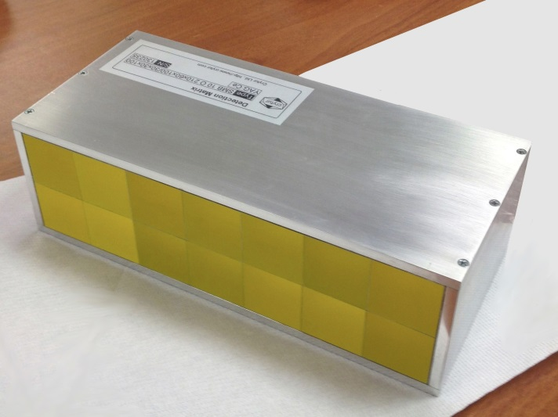
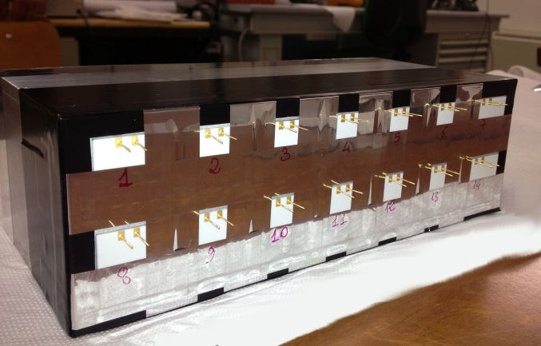
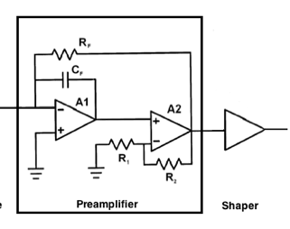
YAG:Ce calorimeter
Data Acquisition System
2x7 YAG:Ce Crystals Array
Size: 3x3x10cm³
FlexRIO
NI PXIe-7962R
CHASSIS NI PXIe-1071
Ad.Mod.
NI-5751
14 Analog Channels
Parallel read-out
Sampling: 5MS/s
24 Samples x event
RT Controller
NI PXI-8102
7Dig I/O GEN
Dig. Trigger
Disable Trigger
Silicon Photodiodes 1.8x1.8cm²
Tracker
x14
Fast Charge Amplifier + Shaper

