Slide 1
WP 7 (INFN-RDH) Detector for high intensity beam M 6 (INFN-IRPT) New TERA chip development
Camere Monitor per fasci di alta intensità
R. Cirio, F. Fausti, L. Fanola Guarachi, S. Giordanengo, F. Marchetto, G. Mazza, V. Monaco, R. Sacchi, A. Vignati
INFN e Università di Torino
Notes:
I will describe the progress of the work project 7 and 6 that involves

Slide 2
Fasci di elevata intensità
Acceleratori di nuova generazione a fasci pulsati
Sincrociclotroni, Accel. lineari, Cyclinacs, FFAGs, ...
Acceleratori Laser Driven
Nuove modalità di trattamento ipofrazionato
Typical Characteristics for high flux pulsed charged particle beams
Pulse frequency (kHz) | 0.2 – 1
Pulse Length (μs) | 5 – 20
Number of particles per pulse (prot/pulse) | 10⁷ -10⁸
Instantaneous Intensity (prot/s) | 10¹² -10¹⁴ (~µA)
Notes:
Nowadays new compact accelerators for charged particles beam therapy have been proposed where high beam intensities occur in short pulses. The typical characteristics of high flux beam are:

Slide 3
Fasci di elevata intensità
Intensità di corrente raccolta nella camera vs. E_{beam}
~ 2-3 ordini di grandezza
altà densità di ionizzazione → inefficienza di raccolta
saturazione dell'elettronica di FE
Notes:
Nowadays new compact accelerators for charged particles beam therapy have been proposed where high beam intensities occur in short pulses. The typical characteristics of high flux beam are:

Slide 4
Efficienza di raccolta
Ricombinazione iniziale e colonnare
ricombinazione tra cariche generate lungo la traccia
non dipende dal dose rate
corretta attraverso calibrazione dosimetrica delle camere
teoria di Jaffe
Ricombinazione di volume
ricombinazione tra cariche generate da tracce vicine
dipende dal dose rate, quantità che si vuole misurare !
diverse parametrizzazioni in letteratura, (Boag, Wilson, Townsend…)
In generale
cresce all’aumentare della densità di ionizzazione nel gas
diminusce al crescere del rapporto E/d=V/d²

Slide 5
Rivelatore a doppio gap
d₂=2d₁
Con V e d fissati il rapporto tra le correnti misurate nelle due camere depende solo da n₀
Intensità di corrente raccolta agli elettrodi
L’efficienza di raccolta depende da:
tensione V tra gli elettrodi
distanza d tra gli elettrodi
densità di ionizzazione n₀
saturazione
Intensità di corrente del fascio
Notes:
For High Flux Beams the recombination phenomenon increases and therefore the total charge collection is inefficient unless a very high voltage between the electrodes is applied. The solution is a detector with different gaps….

Slide 6
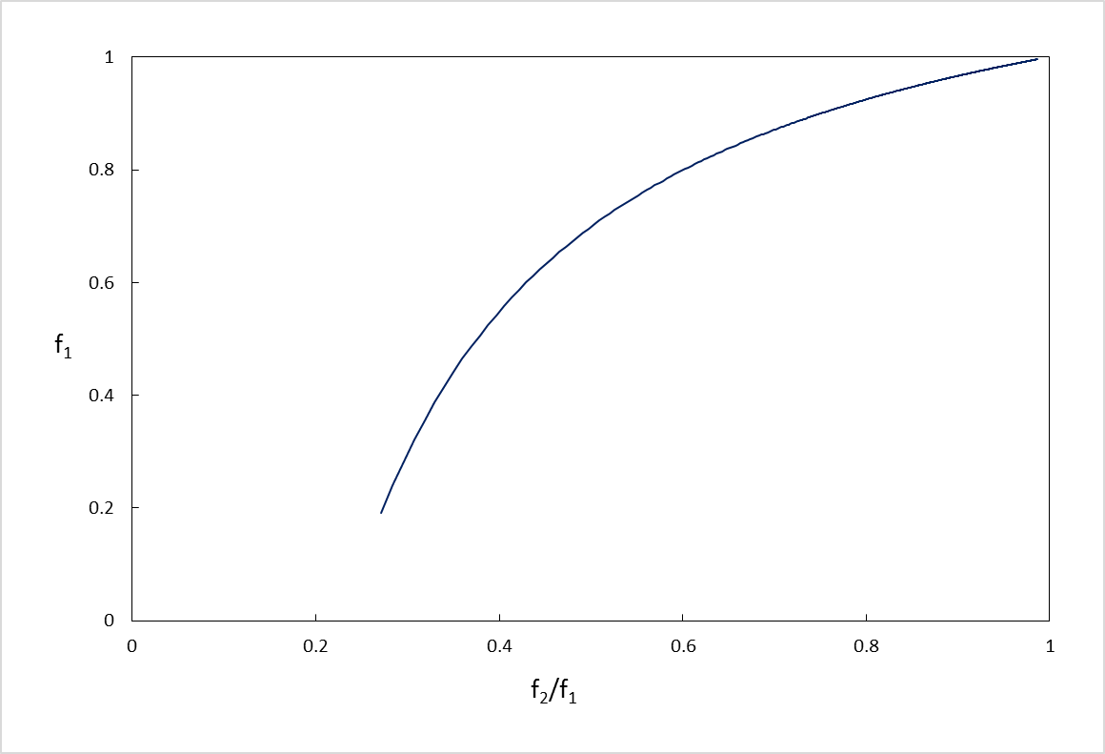
Rivelatore a doppio gap
→ relazione univoca tra efficienza f₁ e rapporto f₂/f₁
→ determinabile sperimentalmente
Si determina l’efficienza della camera 1
f1 = Efficiienza di raccolta della camera 1
f2/f1 = Rapporto tra le efficienze
E’ dato dal rapporto (normalizzato per le distanze) tra le correnti delle 2 camere

Slide 7
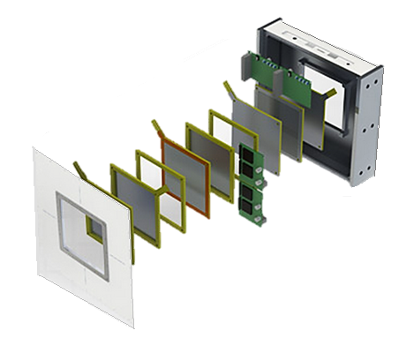
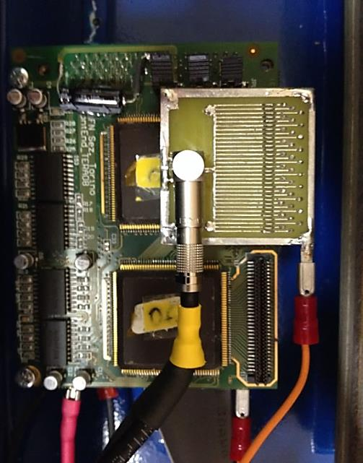
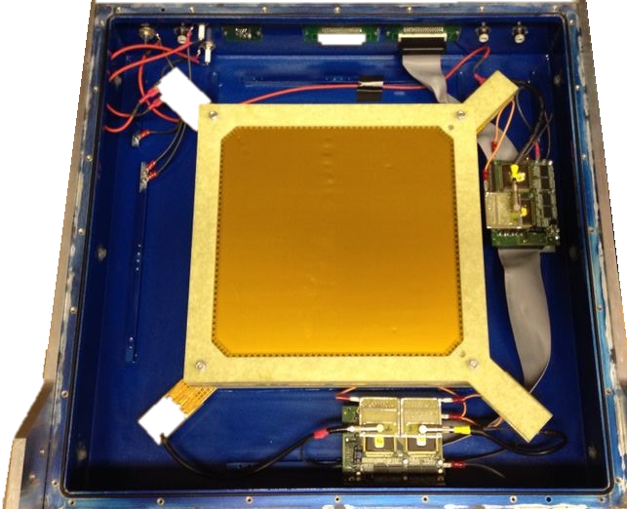
Rivelatore Multi-Gap
3 IC con anodi e catodi indipendenti, gap da 0,5 - 1 - 1,5 cm
Elettronica di lettura basata su front-end TERA08 modificato

Slide 8
Caratterizzazione del rivelatore
Carbon Ion Beam 120 MeV/u @ CNAO
Proton Beam at Bern University Hospital (Cyclotron of 15MeV)
Fascio pulsato @ CATANA (62 MeV)
Nota:
Efficienza determinata variando la tensione e fittando i dati con modelli di ricombinazione

Slide 9
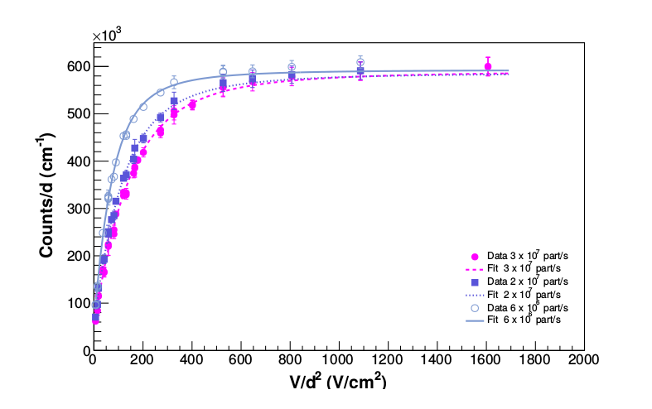
Misure a CNAO
Fit globali delle tre camere con modello di Boag-Wilson, a tre flussi differenti

Slide 10
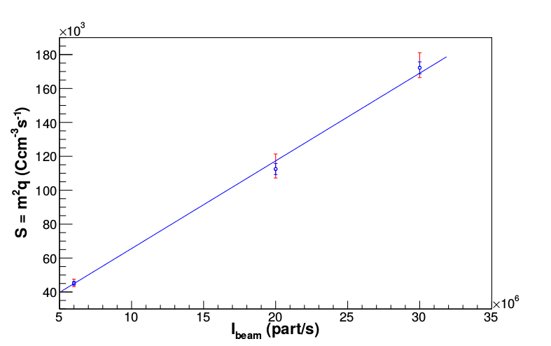
Misure a CNAO
Densità di ionizzazione vs flusso del fascio

Slide 11
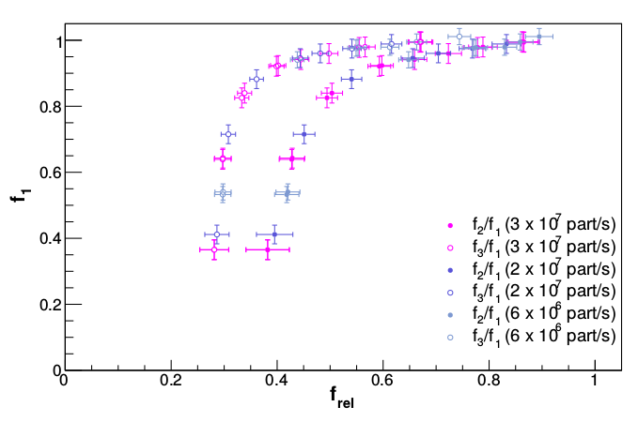
Misure a CNAO
caratteristica del rivelatore
f₃/f₁
f₂/f₁

Slide 12
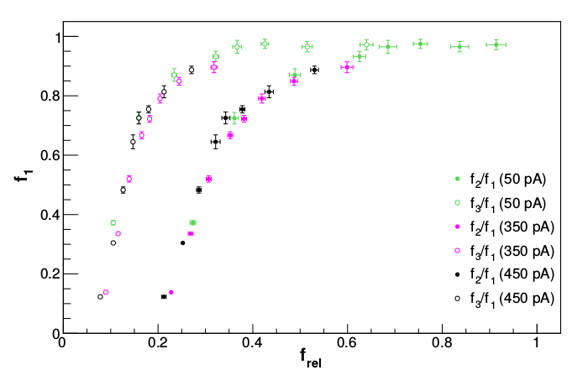
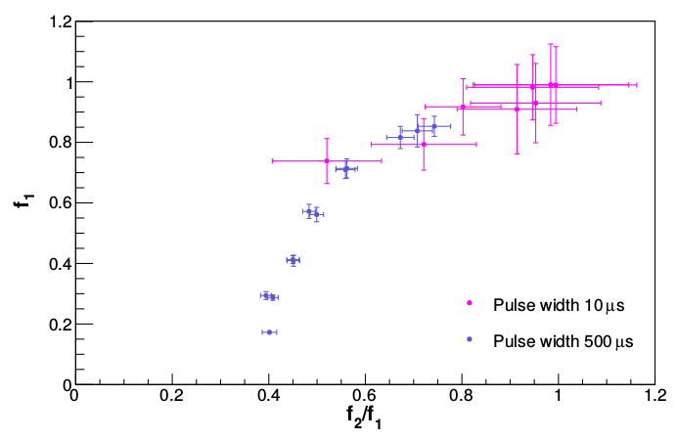
Caratteristica del rivelatore
Bern Cyclotron (protons 15 MeV)
LNS
(pulsed protons 62 MeV)
Conclusioni
verificato la validità del metodo proposto
caratteristica indipendente dall'intensità/pulse width
caratteristica dipende dalla qualità del fascio

Slide 13
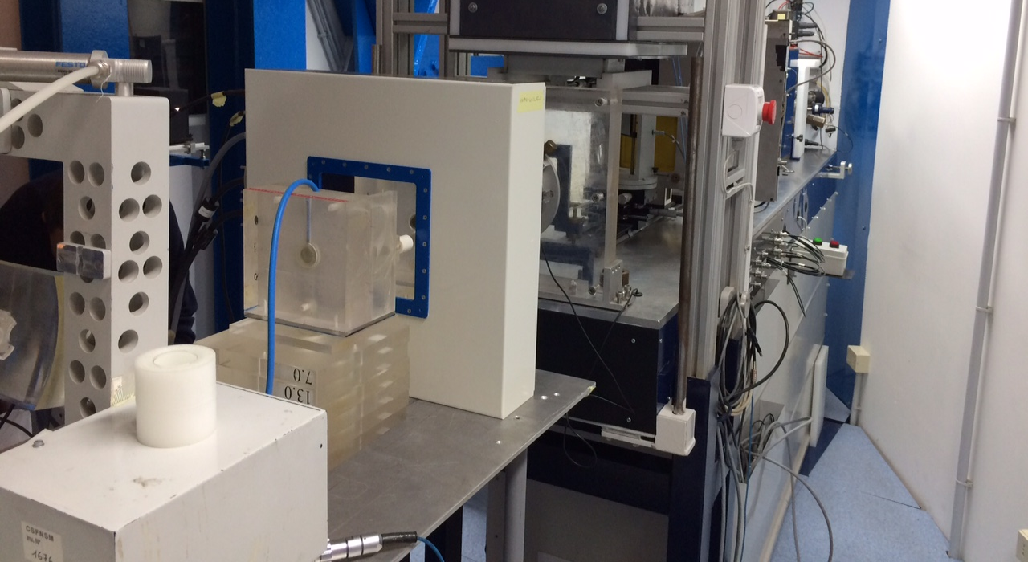
Risultati
Tesi di Dottorato di L. Fanola Guarachi
NIM A 798 (2015) 107- 110 (caratterizzazione del readout) + articolo in preparazione per risultati si fascio
Camera doppio gap realizzata da De.Tec.Tor per ELIMED

Slide 14
TERA09 Design
Basato sull'architettura di TERA08:
Same process technology AMS CMOS 0.35 μm
Increase clock from 100 to ~ 300 MHz
Max count frequency ~ 80 MHz (20 MHz in TERA08)
Counters sums are integrated in the chip
Cooperation agreement signed with De.Tec.Tor S.r.l for the development of the new chip → PhD Federico Fausti;
A joint patent INFN/UniTo/De.Tec.Tor has been submitted;
Premio Marconi della SIF 2015 a Federico Fausti (De.Tec.Tor) e Simona Giordanengo (INFN)

Slide 15
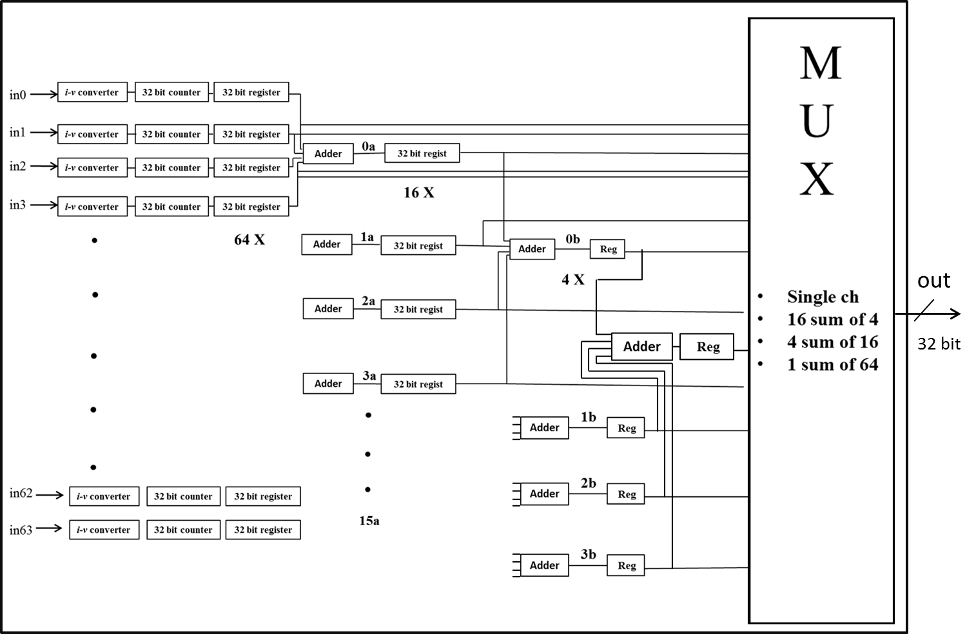
Block diagram of TERA09
38 bit
sums triggered by load signal
half-full register warning signal provided

Slide 16
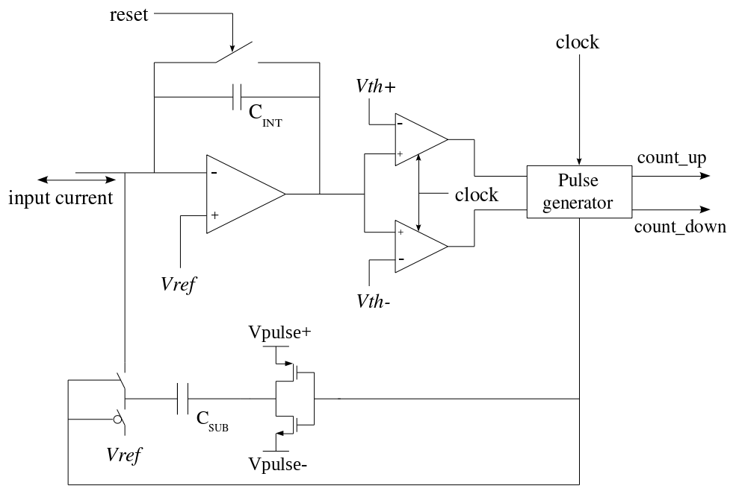
The current to frequency converter
feedback capacitor C_{int} 600fF → 1,2 pF
OTA bias current 200 μA → 800 μA
clock cycle saved in the FSM, single 200 fF C_{sub}
post-layout simulations 100 MHz → 320 MHz clock

Slide 17
Project status and plans
as presented at RDH meeting
(Rome, Dec. 17st 2014)
ASIC submission : July - Sep. 2015
Test board design: Oct.-Nov. 2015
Chips from foundry: Dec. 2015
ASIC characterization: beginning 2016
Test radiation tolerance: 2016
Integration with detector and beam test: 2016

Slide 18
Project status and plans:
Current state
Submission date to Europractice: Sep. 14th 2015
Submission date to AMS: Sep. 21st 2015
Samples out from AMS: Nov. 6th 2015
Packaged samples from Europractice: Nov. 23rd 2015
Test board PCB design: Oct. 2015
Test board PCB manufacturing: Nov. 2015
DAQ system with LabVIEW FPGA: Nov.-Dec. 2015
ASIC characterization: Dec.-March 2016
Integration with detectors and beam tests

Slide 19
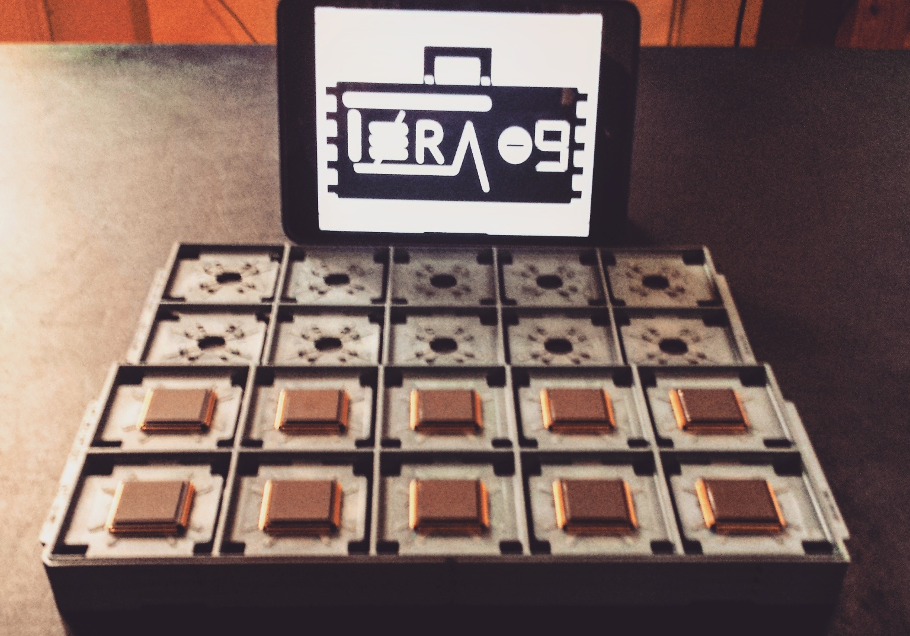
TERA09 (23/11/2015)

Slide 20
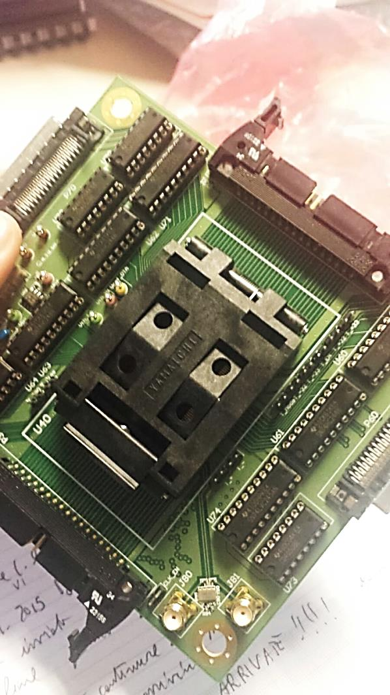
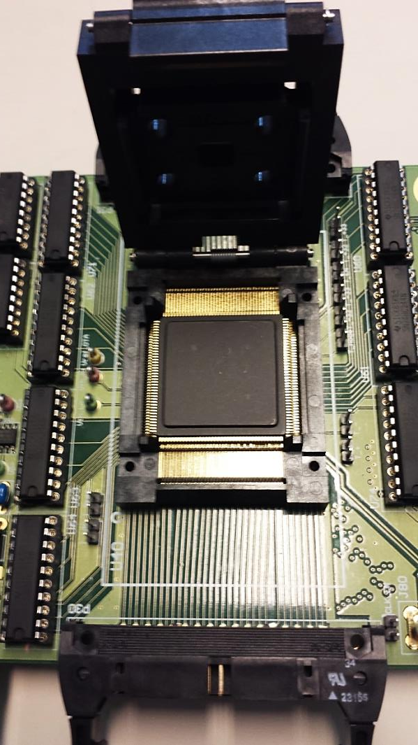
TERA09 Test board

Slide 21
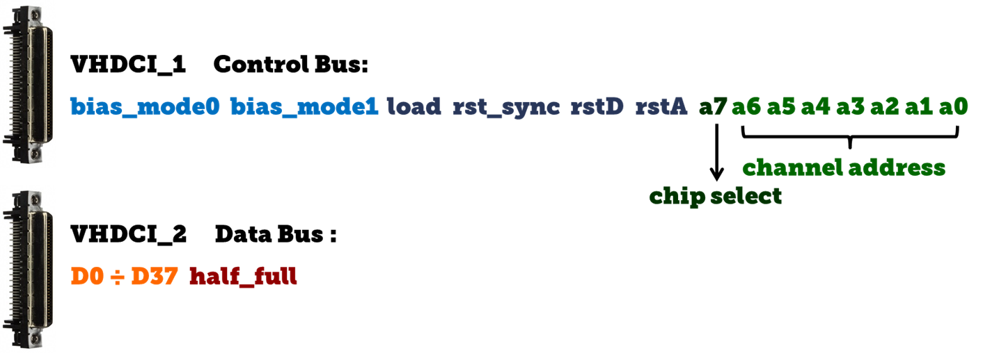
DAQ based in NI FPGA

Slide 22
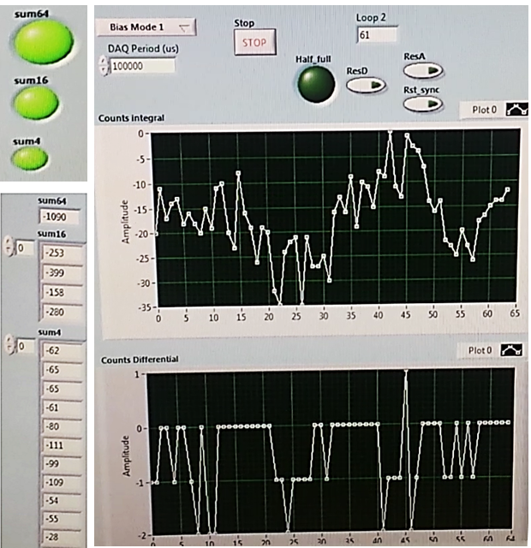
Screenshots: pedestals
=
+

Slide 23
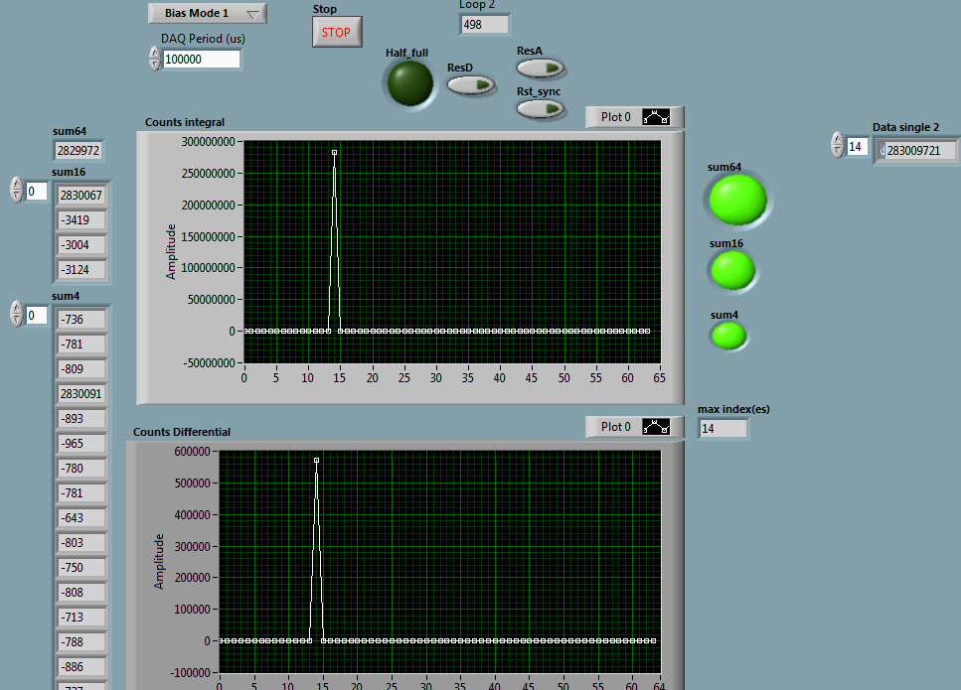
Screenshots: 1 ch signal
=
+
i=1μA, clk=250Mhz

Slide 24
Results 100 MHz clk
channel saturation in TERA08
deviation from linearity ± 0,5 %

Slide 25
Results 200 MHz clk

Slide 26
Results 265 MHz clk
deviation from linearity at large positive currents ~ 4% under investigation
strange features above 270 MHz frequency

Slide 27
Conclusioni
Parte digitale testata fino a 265 MHz
Caraterizzazione della parte analogia in progress
Alcune cose da capire/testare, in particolare ad alte frequenze
Da fare:
Disegnare front-end board (Riunione con De.Tec.Tor a breve)
Test di danneggiamento da radiazione
necessari ?
Convenzione con De.Tec.Tor per sfruttamento commerciale TERA09
pensare al prossimo chip
27

Slide 28
Thanks for your attention

Slide 29
64 channels
registers
Sum of 4 channels
Sum of 16 channels
Sum of 64 channels
Digital part of the chip finalized

Slide 30
TERA09 Design
Several attempts to modify the analog part to increase the frequency of the recycling integrator.
Two examples of OTA design:
Mirrored Configuration
$$I_{in}=8μA, 80 MHz \left(tck=320MHz\right)$$
Folded Cascode
$$I_{in}=8μA, 50 MHz (tck=200MHz)$$
Submission of the first TERA09 prototype scheduled for July 27th

Slide 31
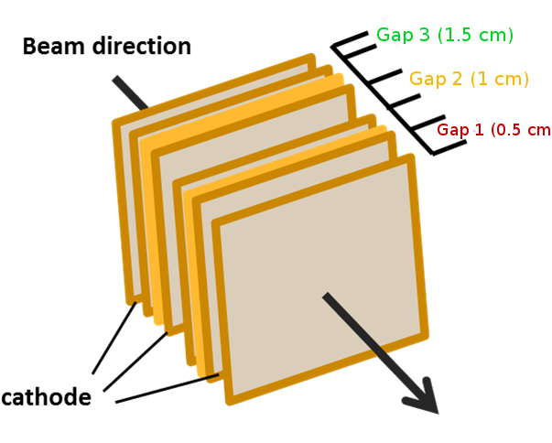
Camera Multi-Gap
Material | Thickness (mm)
Mylar | 12,00 E-3 | Cathode
Aluminum
Nitrogen/Air | Gap | Frame
Aluminum | 17,00 E-3 | Anode
Kapton | 25,00 E-3
Notes:
The beam passes through 3 parallel ionization chambers with independent anodes and cathodes separated by a different gaps with the characteristics described in the table…

Slide 32
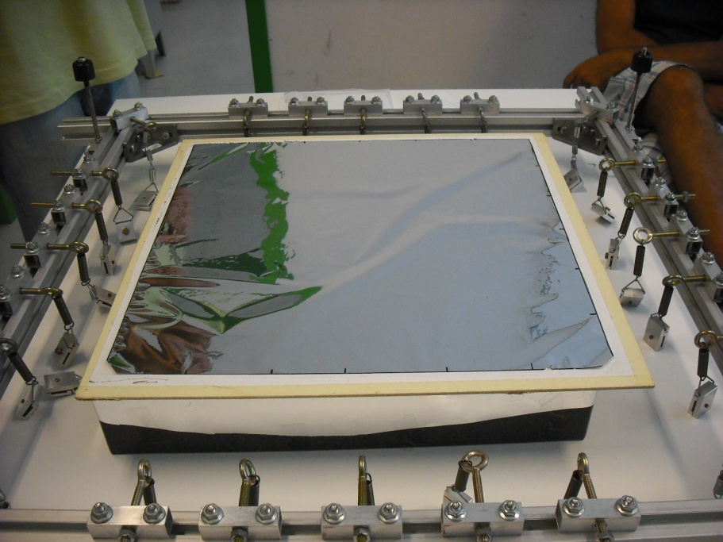
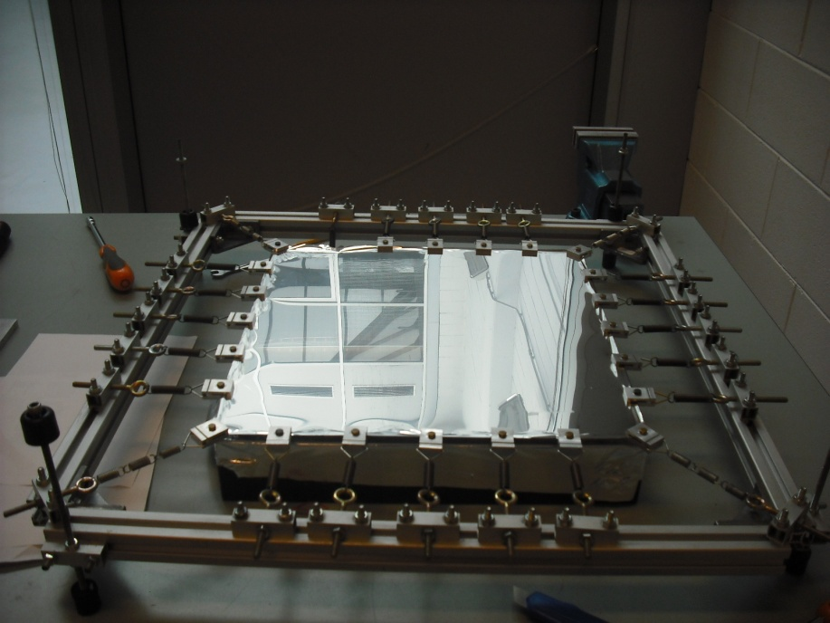
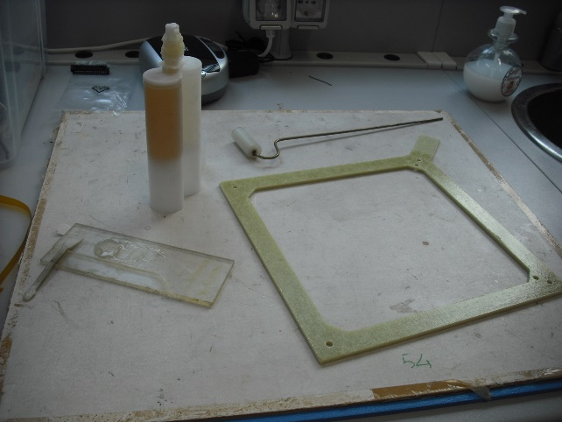
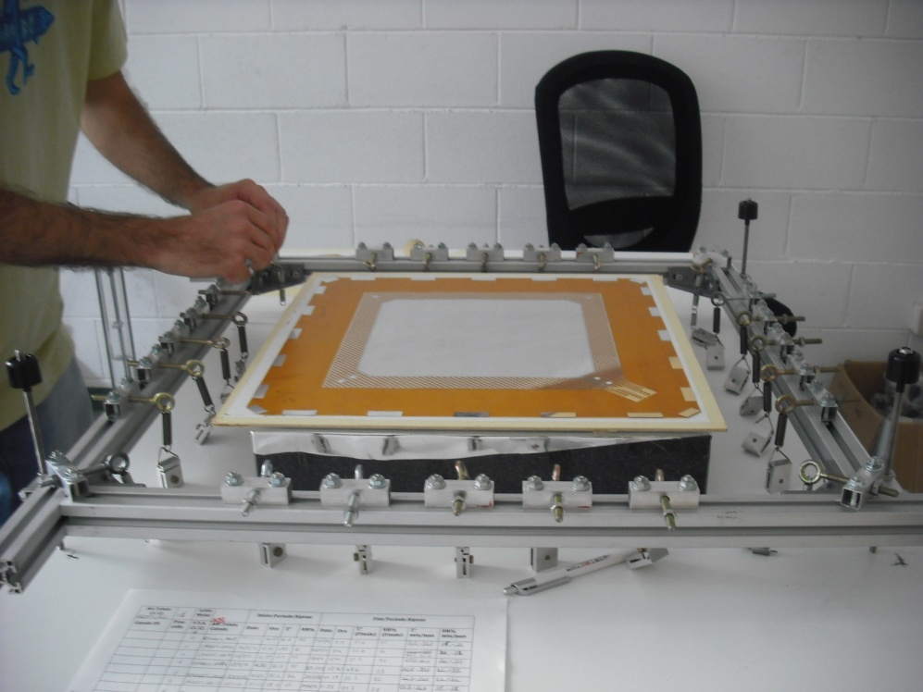
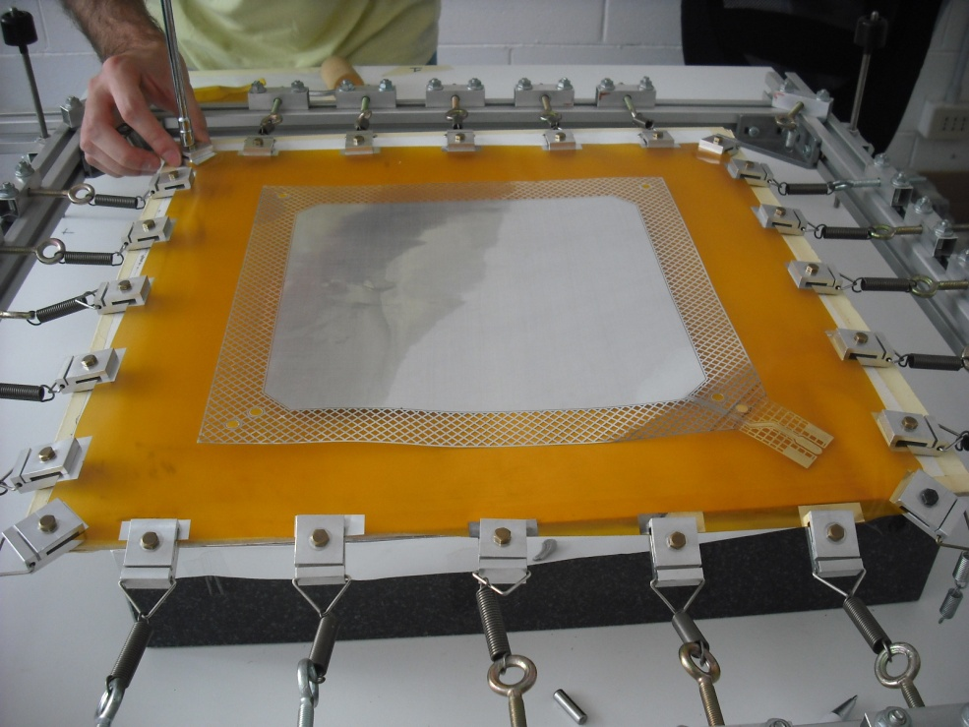
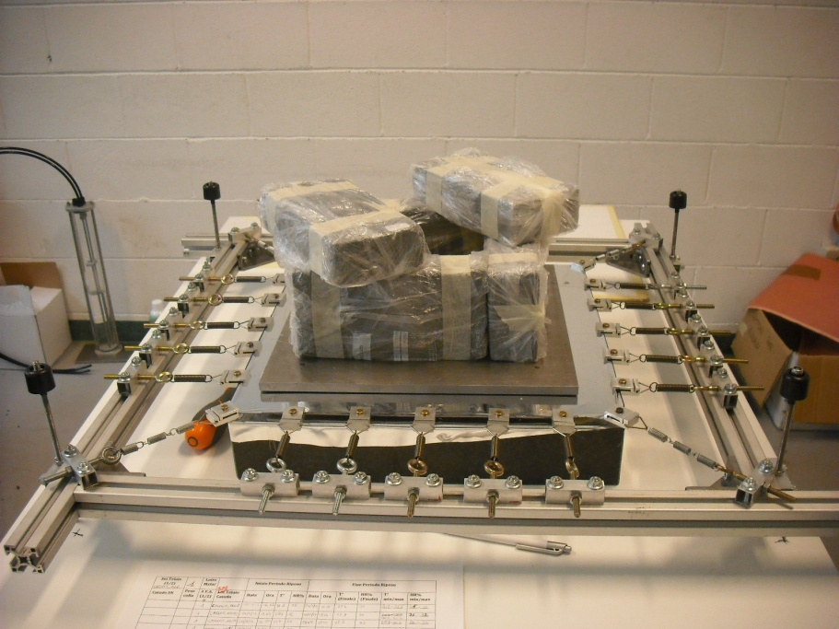
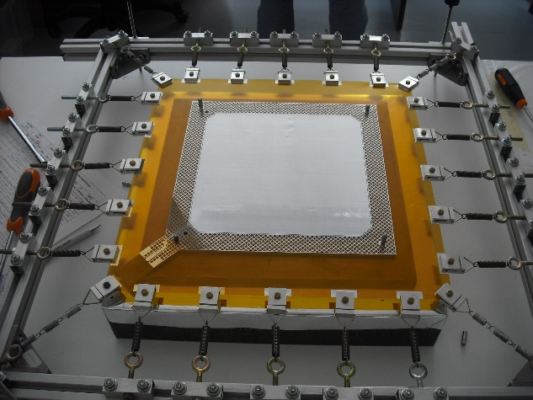
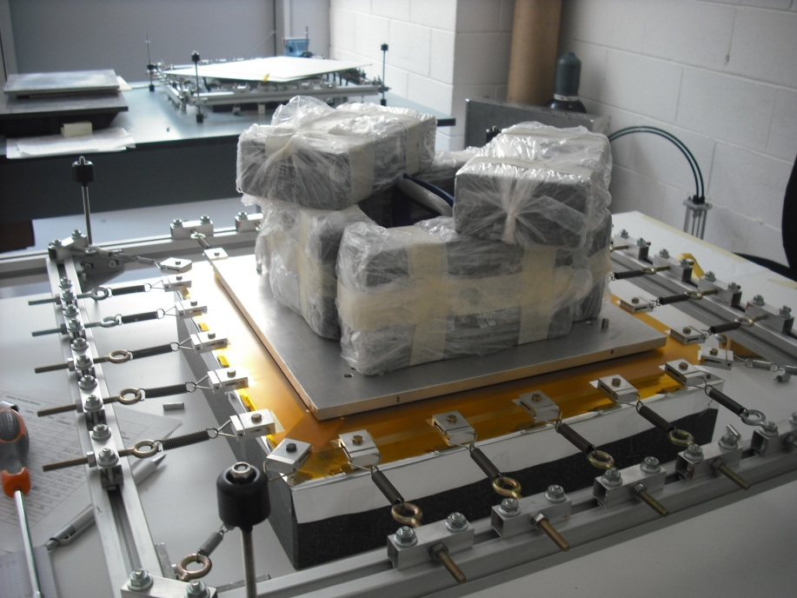
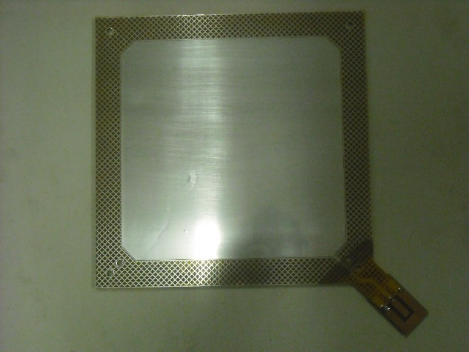
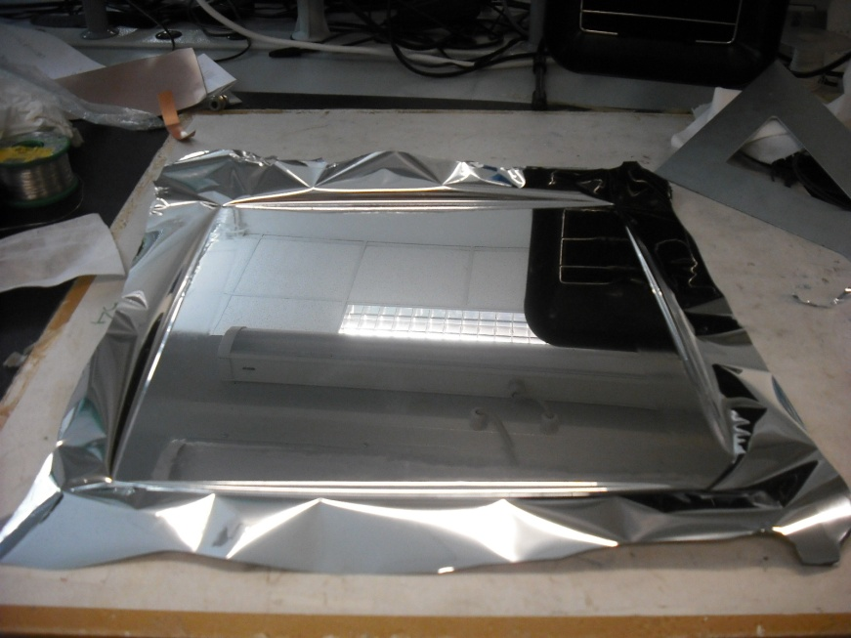
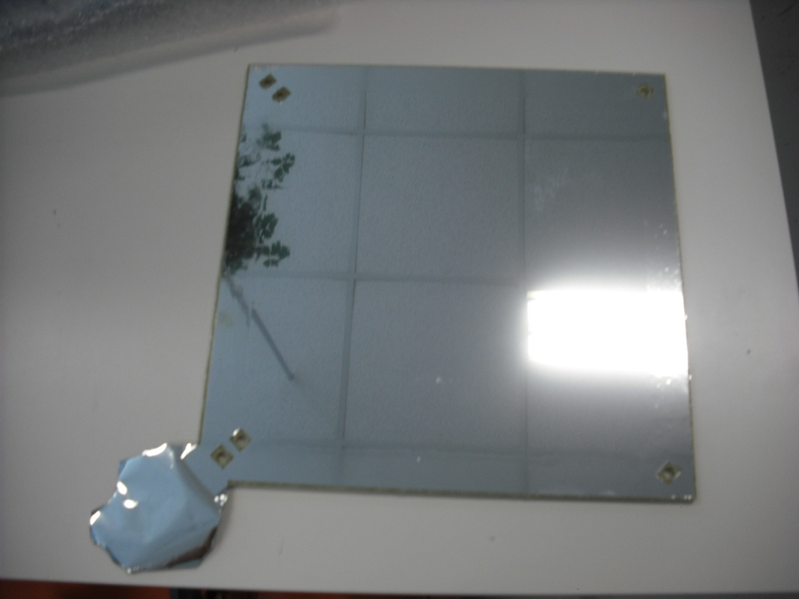
Detector Assembly
Notes:
Every anode or cathode is glued onto a fiberglass frame to assure rigidity and flatness uniformity, this is done in a series of steps. First special stretching procedure using small clamps and springs . Afterwards the anode or cathodes are glued onto the frame and finally after one day the clamps are removed.

Slide 33
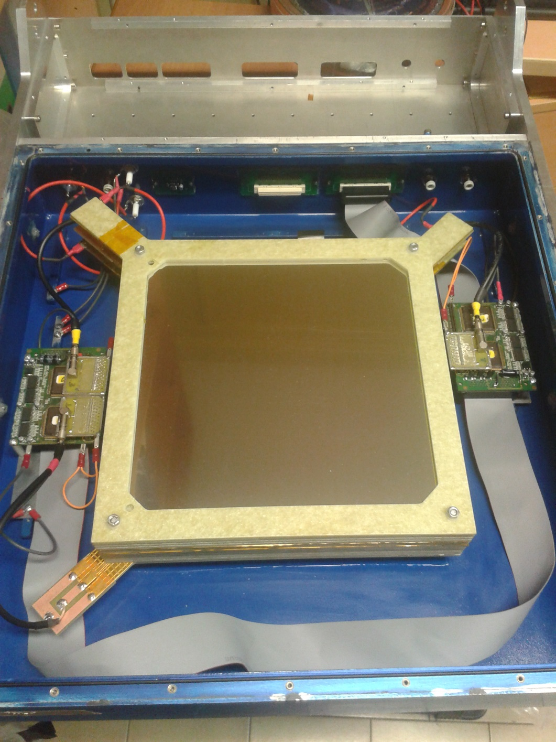
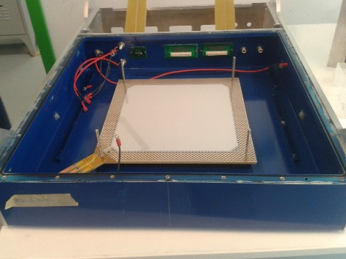
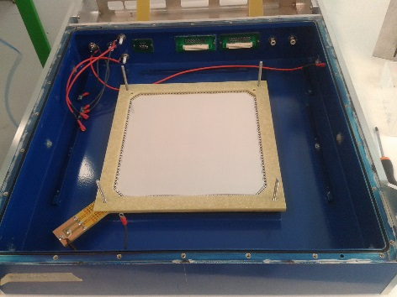
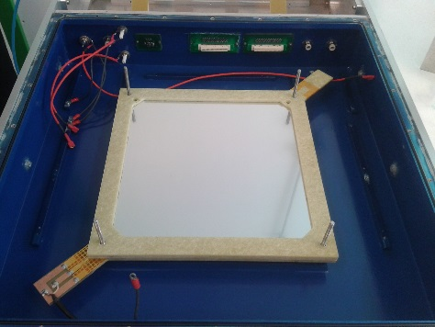
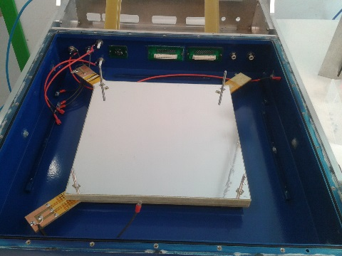
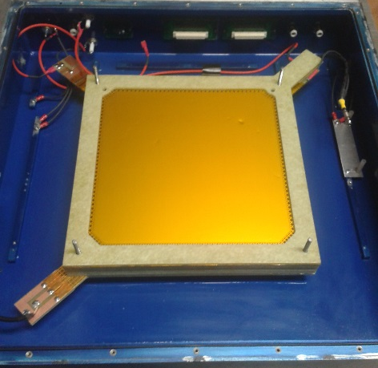
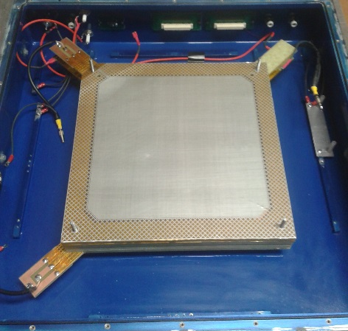
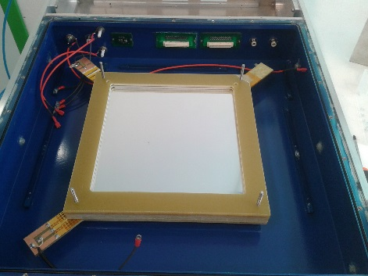
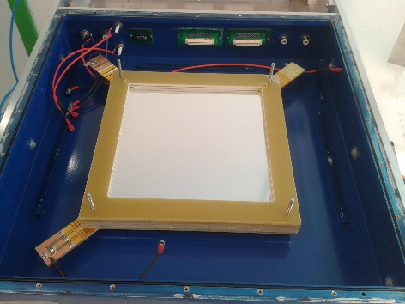
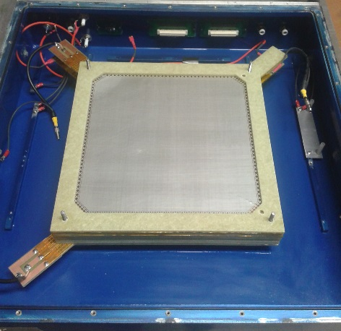
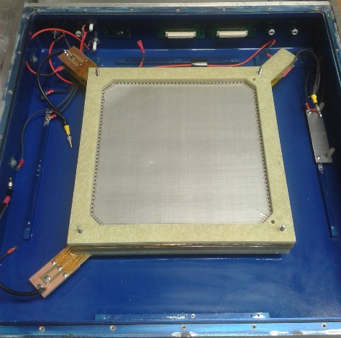
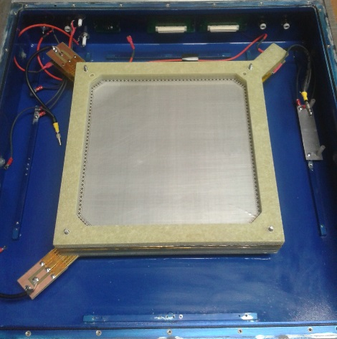
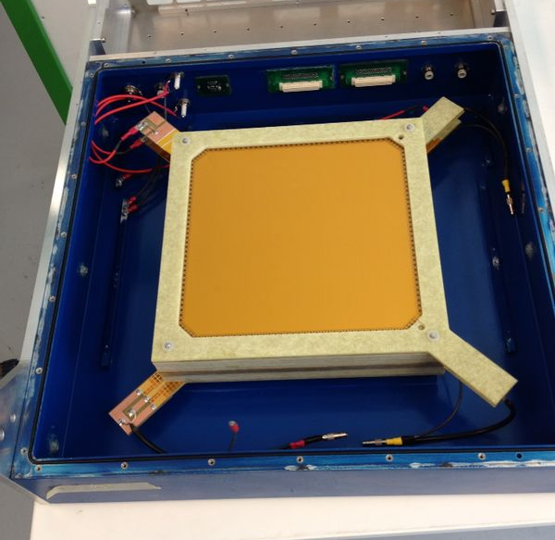
BEAM
Detector Assembly
anode
1
frame
2
cathode
3
cathode
4
frame
5
frame
6
anode
7
anode
8
frame
9
frame
10
frame
11
cathode
12
Notes:
Each frame containing an anode or cathode is placed into the box taking into account its position along the beam line. And when the package is completely assembled the readout electronics is placed.

Slide 34
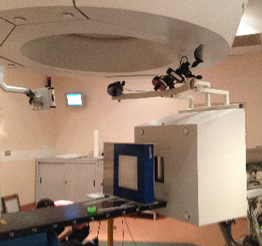
Test with Carbon Ions at CNAO
Synchrotron
Beam lateral FWHM: 4 mm
Beam Flux:
≈ 3×10⁷ (part/s)
≈ 2×10⁷ (part/s)
≈ 6×10⁶ (part/s)
Beam Energy (120MeV/u)
Voltage between electrodes: 13-400 V
10⁸ particles
Notes:
For each voltage and each flux the monitor was irradiated with 10 to the 8 particles

Slide 35
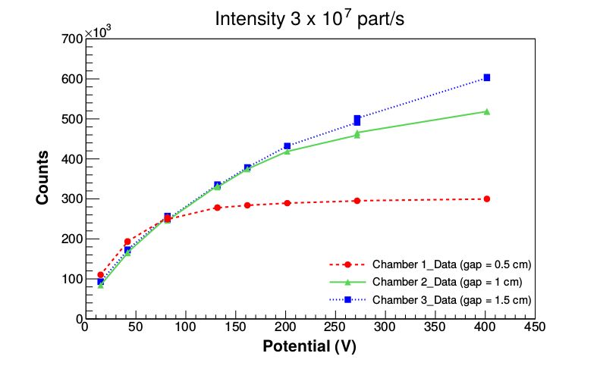
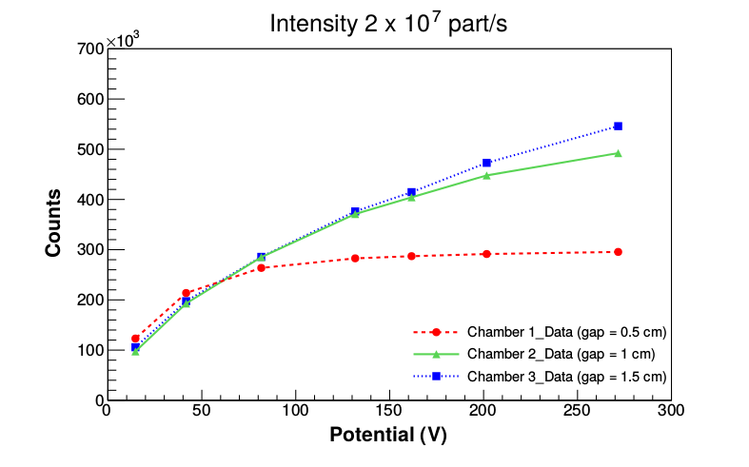
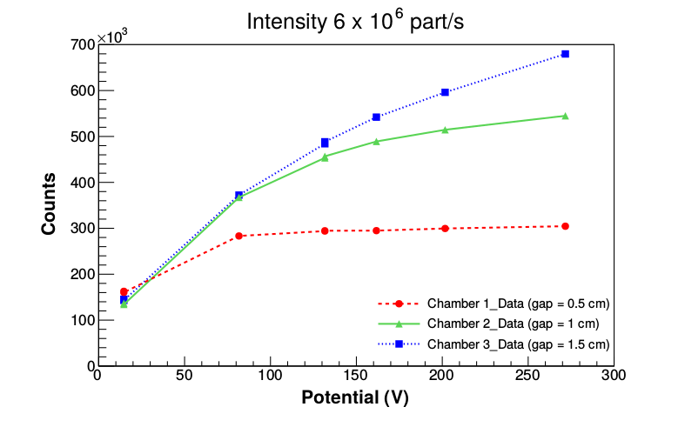
Continous beam of carbon ion at CNAO - Synchrotron, 120 MeV/u
Notes:
The number of counts, corresponding to the delivery of 10 to the 8 carbon ions, as a function of the voltage applied between the electrodes for the different beam fluxes is shown.
for all the uxes, the saturation
curves at lower potential of the three ionization chambers are overlapped.
Such behavior is due to the fact that, each ionization chamber has dierent gap and thus different collection effciencies, giving rise a different slopes for
the three saturation curves.

Slide 36
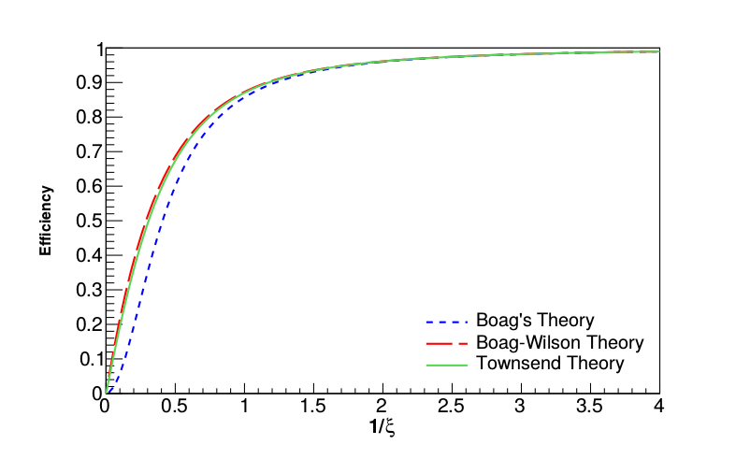
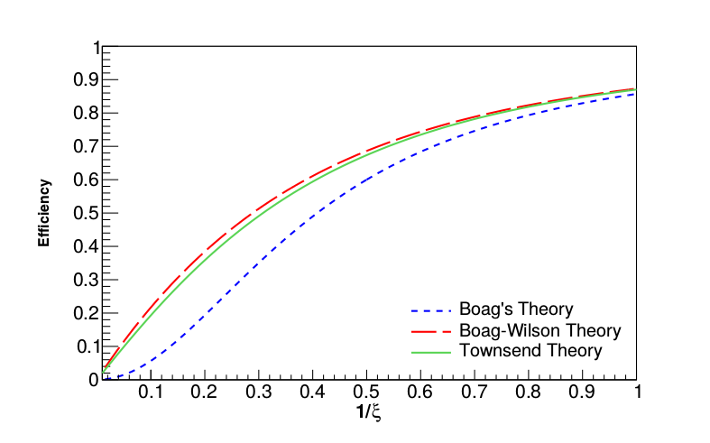
Boag’s Theory
$$ξ→\frac{1}{V}$$
$$f=\frac{1}{1+\frac{1}{6}ξ^{2}}$$
Boag – Wilson Theory
$$f=\frac{2}{1+\sqrt{1+\frac{2}{3}ξ^{2}}}$$
Townsend Theory
$\sqrt{\frac{4}{f^{2}ξ^{2}}−1}tan\left[\frac{fξ^{2}}{4}\sqrt{\frac{4}{f^{2}ξ^{2}}−1}\right]=$1

Slide 37
Boag-Wilson Theory
m
$$f=\frac{2}{1+\sqrt{1+\frac{2}{3}ξ^{2}}}$$
where
By the minimization of χ² it is possible to find C_{sat}, and the n_{O} and K:
$$X^{2}=\sum{{\left(C_{i}−(fC_{∞}+K)\right)}^{2}}$$
$$X^{2}=\sum{{\left(C_{i}−\left(\frac{2C_{∞}}{1++\sqrt{1+\frac{2}{3}S\frac{d^{4}}{V_{i}^{2}}}}+K\right)\right)}^{2}}$$
$$f=\frac{C_{i}−K}{C_{sat}−K}$$
$$S=m^{2}n_{0}$$
$$C_{sat}=C_{∞}+K$$

Slide 38
Global Fit
Normalizing the data to chamber 2:
$$X^{2}=\sum{{\left(\frac{C_{i}}{d}−(fC_{∞}+K)\right)}^{2}}$$
$$X^{2}=\sum{{\left(\frac{C_{i}}{d}−\left(\frac{2C_{∞Ch2}}{1+\sqrt{1+\frac{2}{3}S\frac{d^{4}}{V_{i}^{2}}}}+K\right)\right)}^{2}}$$
$$C_{satCh2}=C_{∞Ch2}+K$$
$$f=\frac{C_{i}−Kd}{\left(C_{sat}−K\right)d}$$
$$S=m^{2}n_{0}$$
$$C_{satCh1}=C_{satCh2}\frac{d_{Ch1}}{d_{Ch2}}$$
$$C_{satCh3}=C_{satCh2}\frac{d_{Ch3}}{d_{ch2}}$$

Slide 39
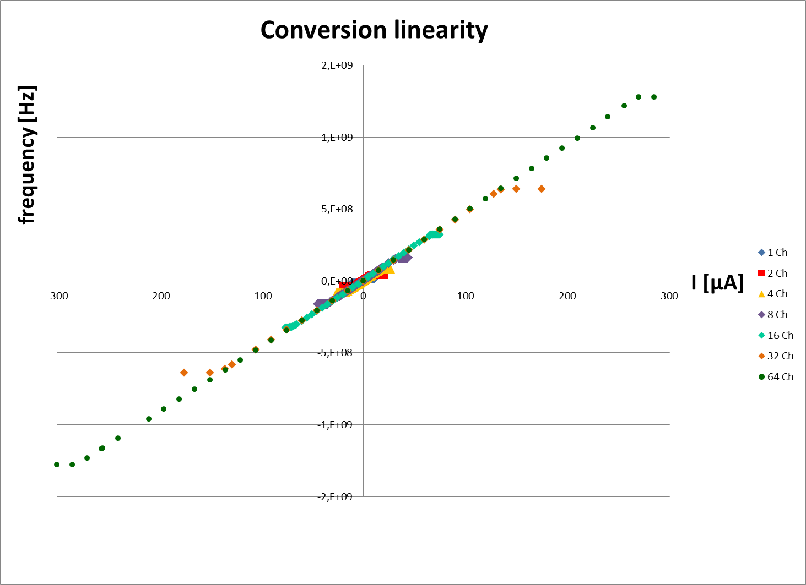
Nuovo chip TERA09
Per le applicazioni previste è necesario aumentare il range dinamico > 100X rispetto al chip TERA08
64 canali in parallelo: saturazione a ∼ 270 μA
Soluzione studiata e testata su TERA08;
modifiche alla parte analogica e digitale del chip
finanziamento tramite premiale IRPT
∼ 120 k€ + AdR biennale
sottomissione primo prototipo a fine luglio
secondo prototipo nel 2016
1 canale: saturazione a ∼ 4 μA
Trasferimento Tecnologico
co-finanziamento della ditta De.Tec.Tor , interessata allo sfruttamento commerciale, Cooperation Agreement con INFN
Sottomessa domanda di brevetto INFN-Unito-De.Tec.Tor

Slide 40
To do 2015 - 2016
Testare la camera con fasci pulsati con le caratteristiche descritte
Integrare il nuovo chip TERA09 nella camera

Slide 41
schematic
3D representation
gerber
The PCB design

Slide 42
The PCB functional blocks diagram

Slide 43
First linearity study: the CAD prediction
measurements
Using a Q_{c} of 200fC
(most used in therapy)
TERA08
The single channel saturation point is moved from 4μA to 16 μA
A. La Rosa et Al., Nucl. Instr. and Meth. A 583 (2007) 461-468.
post layout simulations
The digital architecture (with an integrated channels parallel connection) permits to extend the current input range up to 1mA (and over, with a Q_{c} that can reach 660fC)
TERA09

Slide 44
Addressing scheme (followed also for the digital logic tests)
Channel address via 7 bit bus
0b₅b₄b₃b₂b₁b₀: select register channel b₅b₄b₃b₂b₁b₀
1b₅b₄b₃b₂x0 : select 1st level sum registers
1b₅b₄xx01 : select 2nd level sum registers
1xxxx11 : select 3rd level sum register
44

Slide 45
Digital logic tests
On-line control of the sums
Reset interaction and correct settings (rstA, rstD, rst_sync)
Half_full warning
These functionalities have been tested with a
LVDS clock up to 265MHz → 66.25 MHz of converter frequency
→ $\sim$ 13 μA of input current
(single channel current injection)
Clock generator Agilent 8113A

Slide 46
TERA09 Characterization

Slide 47
Conversion linearity
&
Quantum charge fluctuations
Changing the clock frequency
SMA for external clk source
On board 350MHz vco

Slide 49
100 MHz clk

Slide 50
265 MHz clk

