Slide 1
Experimental Cave at Trento CPT: status update
Francesco Tommasino
RDH/IRPT Meeting – Roma, 1 Feb 2016

Slide 2
TIFPA and Proton Therapy - APSS
Official Agreement for scientific collaboration
Goal: to setup one of the most advanced laboratories for radiation biophysics research in Proton Therapy
Target experiments:
Radiation Biophysics & Radiobiology
Space shielding
Detector development and testing

Slide 3
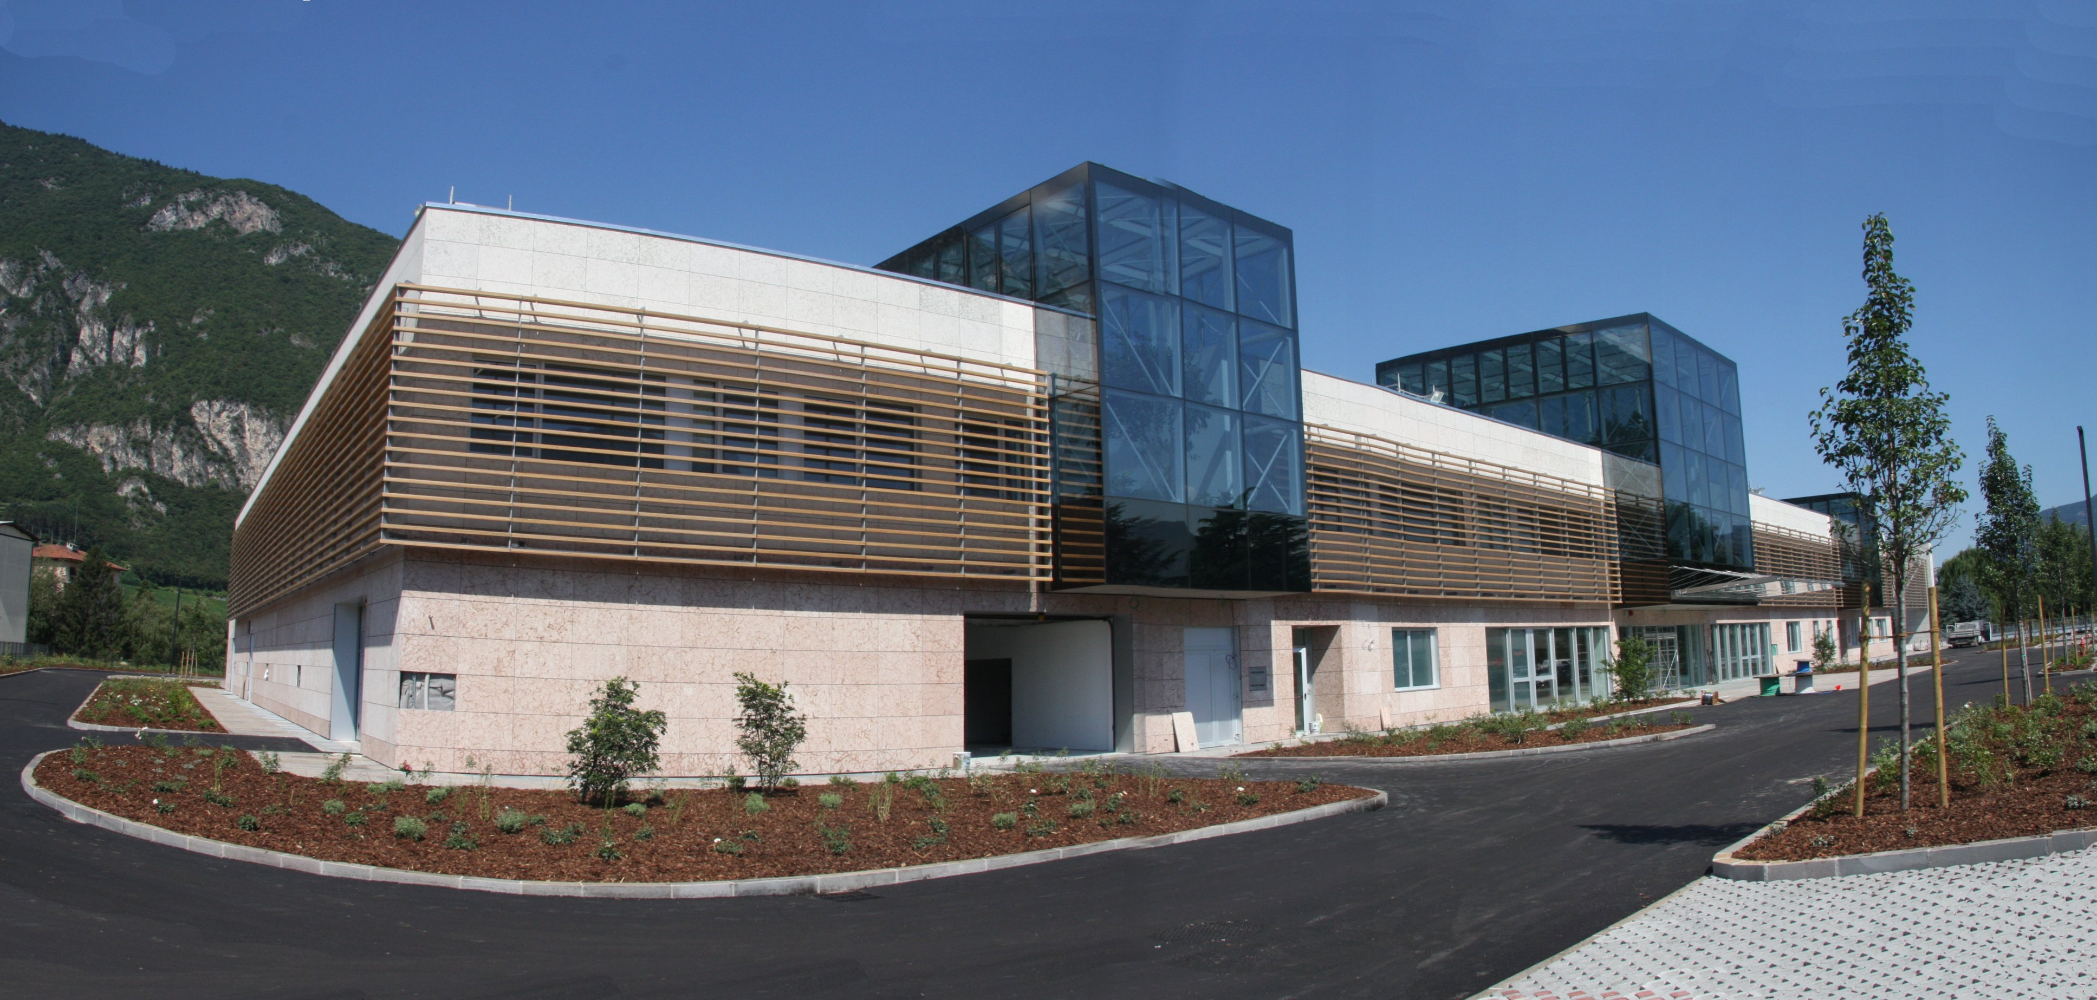
Trento Proton Therapy Center
Patients treated at 22/1/2016:
72 Adults (≈50% brain and H/N)
10 Pediatric (2 cranio-spinal irradiation)
Courtesy dr. F. Dionisi

Slide 4
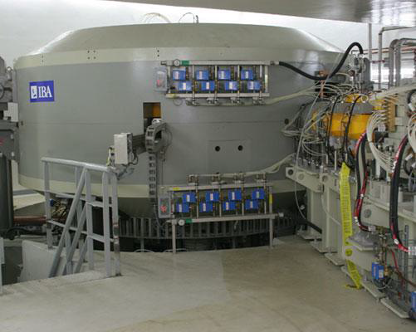
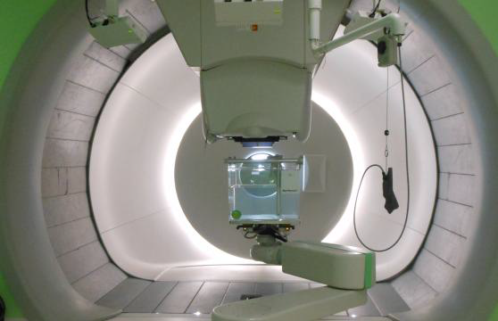
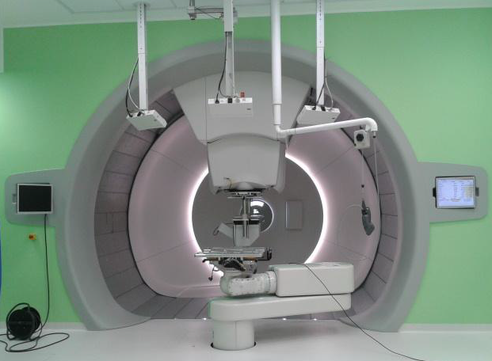
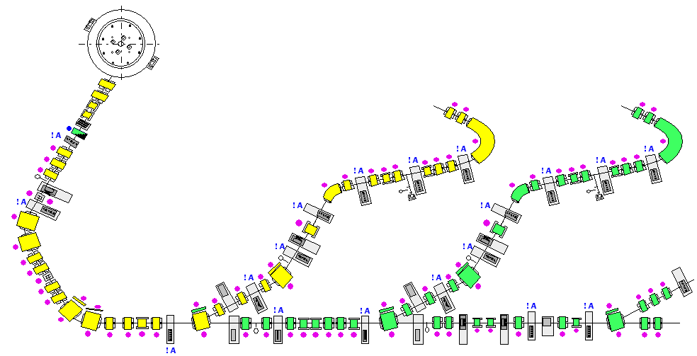
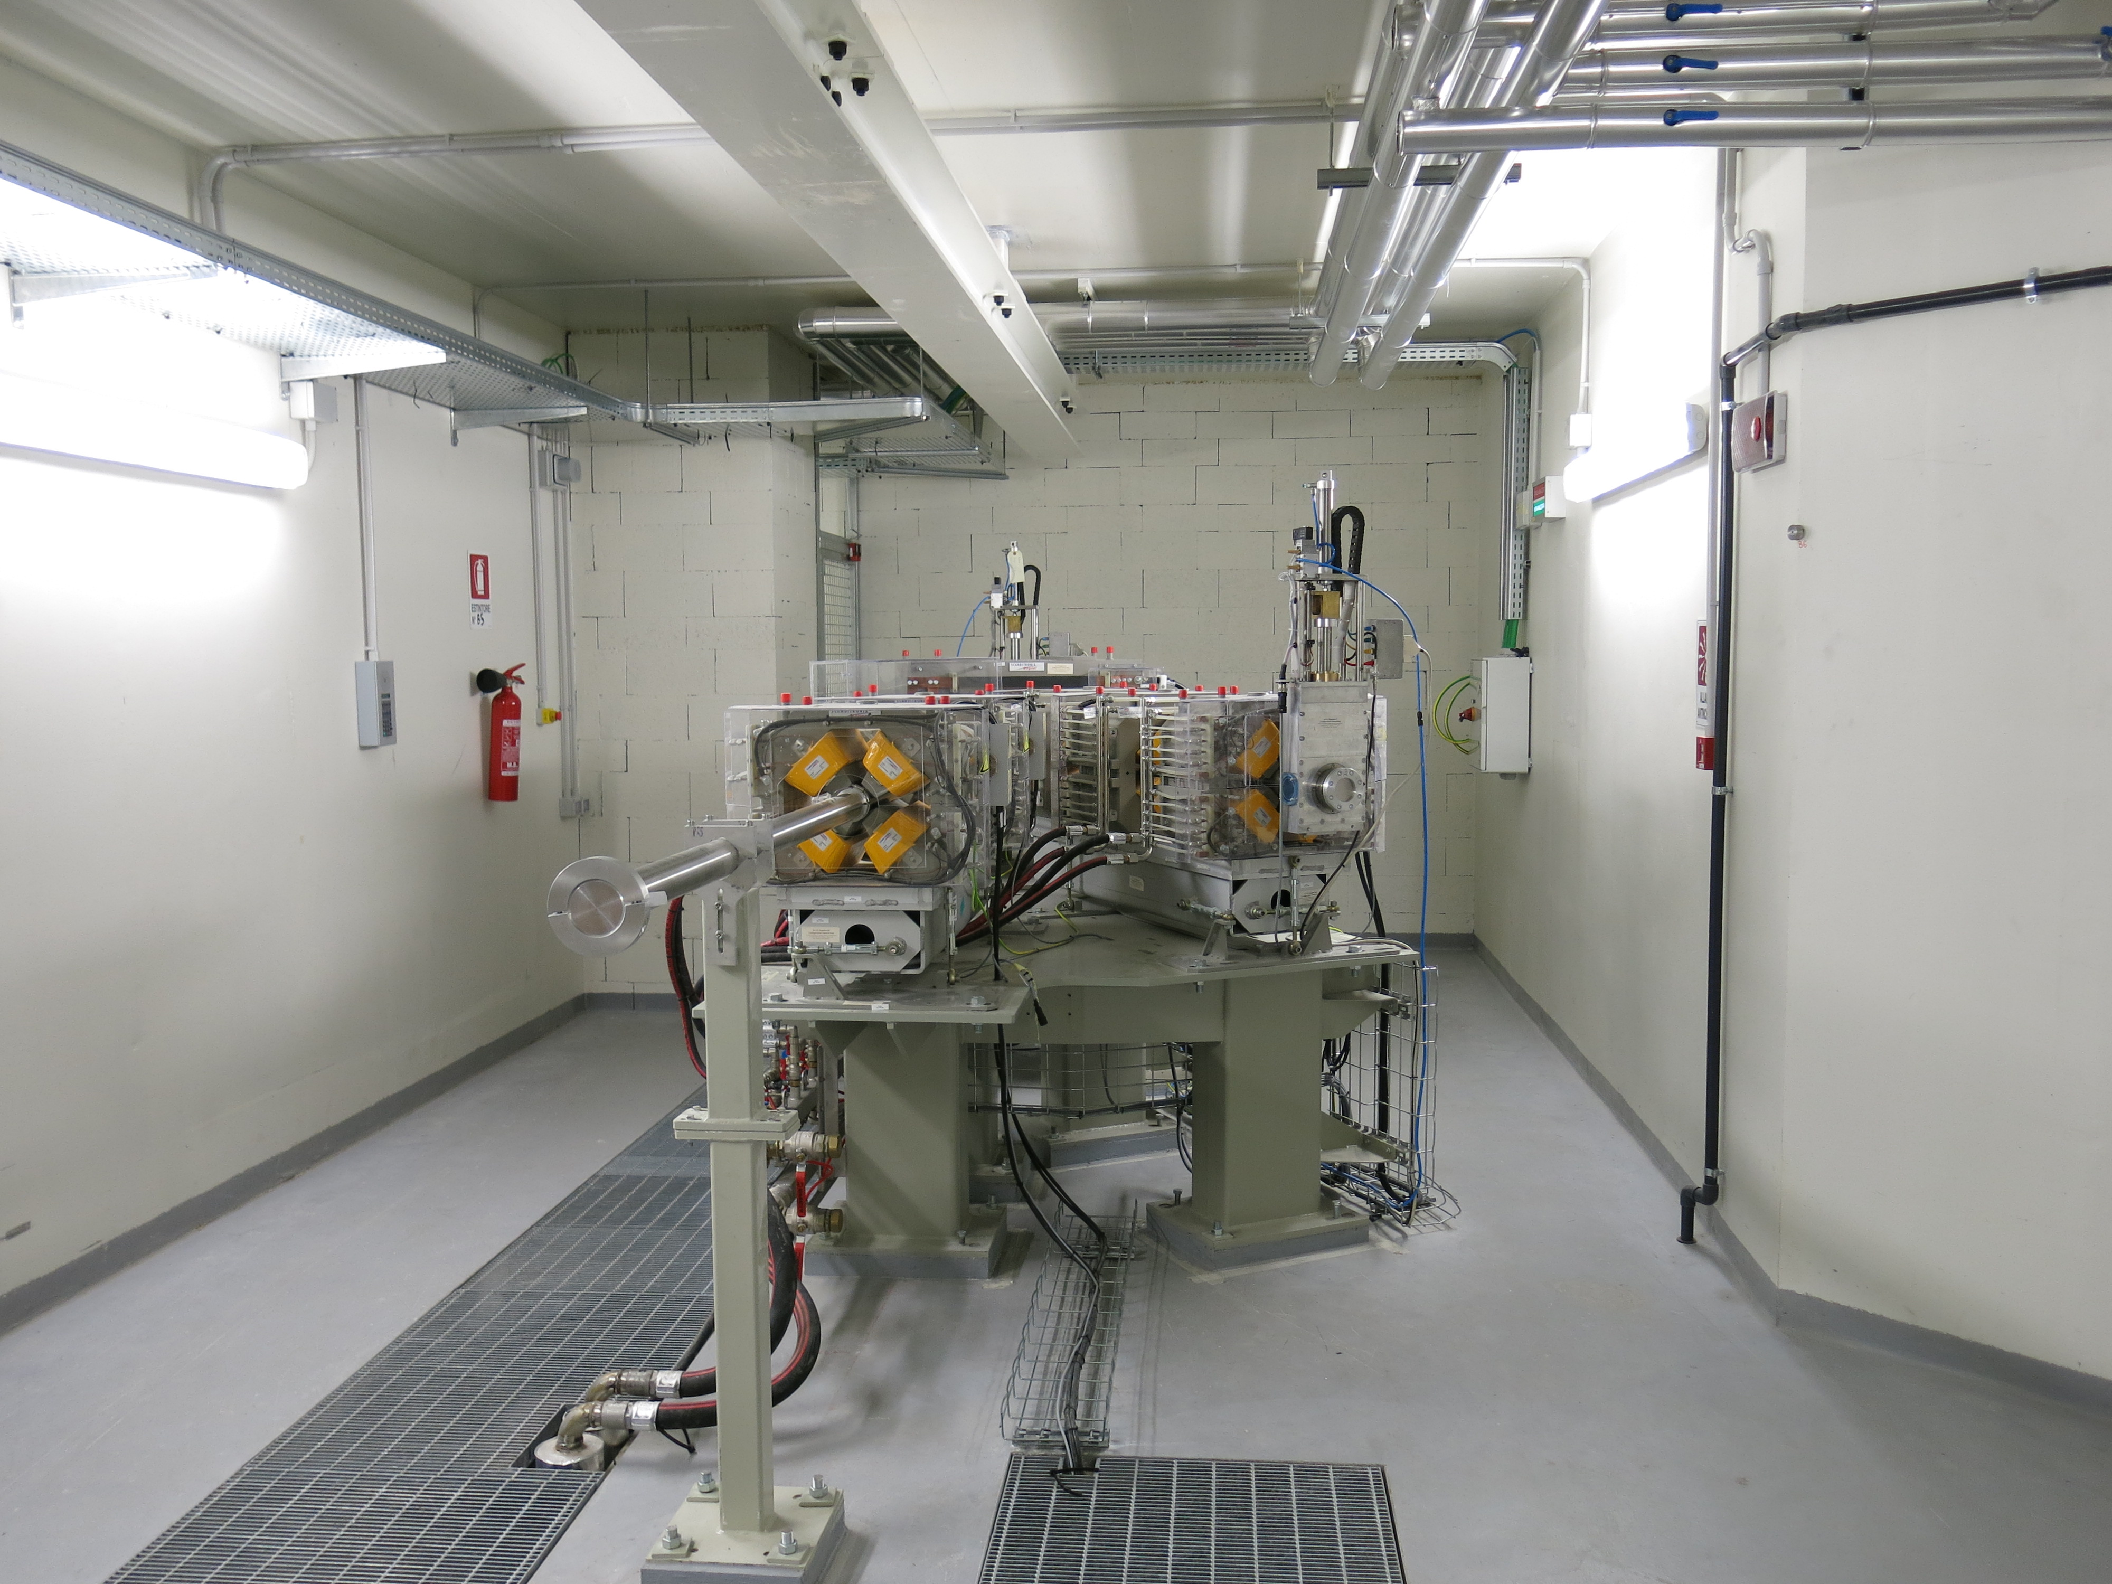
Notes:
- IBA Proteus PLUS

Slide 5
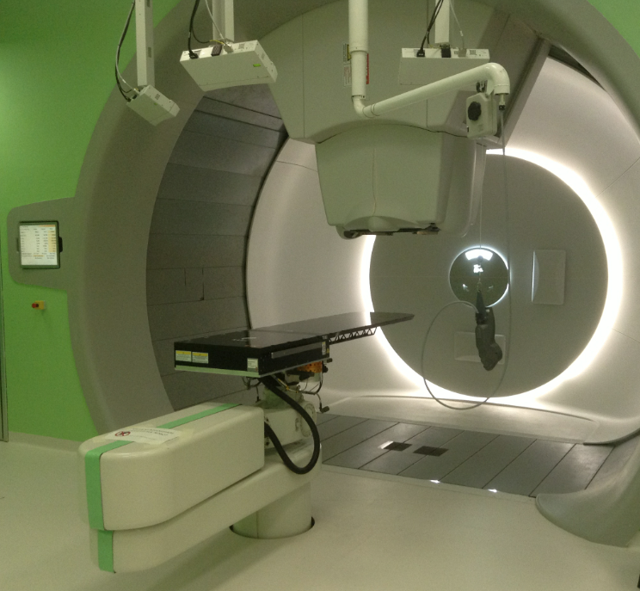
Full active pencil
beam scanning

Slide 6
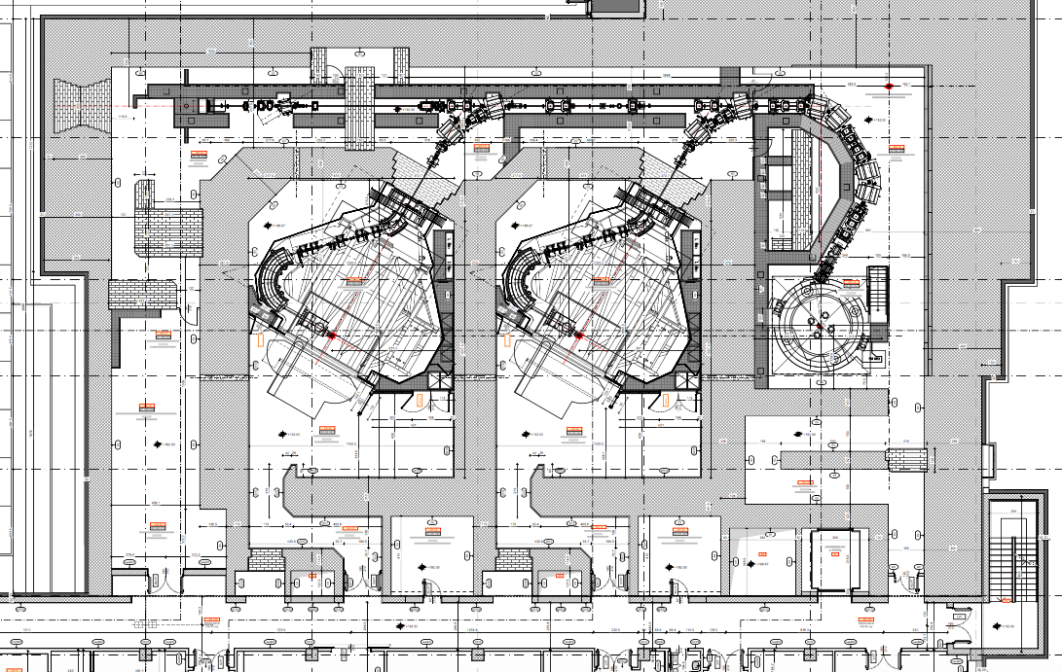
Experimental Cave
Multi-functional laboratory
IBA facility

Slide 7
Cave construction Plan
Phase I: plan design and basic equipment for beam characterization (patch panels, lasers, cameras)
Phase II: installation of equipment for physics and biology experiments (phase I + 6 months)
Phase III: completion of installation experimental equipment, generation of quasi-monoenergetic fast neutrons (unique facility in Europe!) – phase II + 6 months
ready in ≈1 year

Slide 8
Experimental cave, Proton Therapy Center - Trento
Beam Production:
Isochronous Cyclotron
Energy Range: 70-225 MeV
Beam Current: 320 nA
Typical Efficiency: ≈55%
Min Time for Energy Change: 2 s
Notes:
32 signal cables Lapp coaxial RG58
12 HV cables Lapp coaxial RG213
Ethernet
D-sub9 e D-sub25

Slide 9
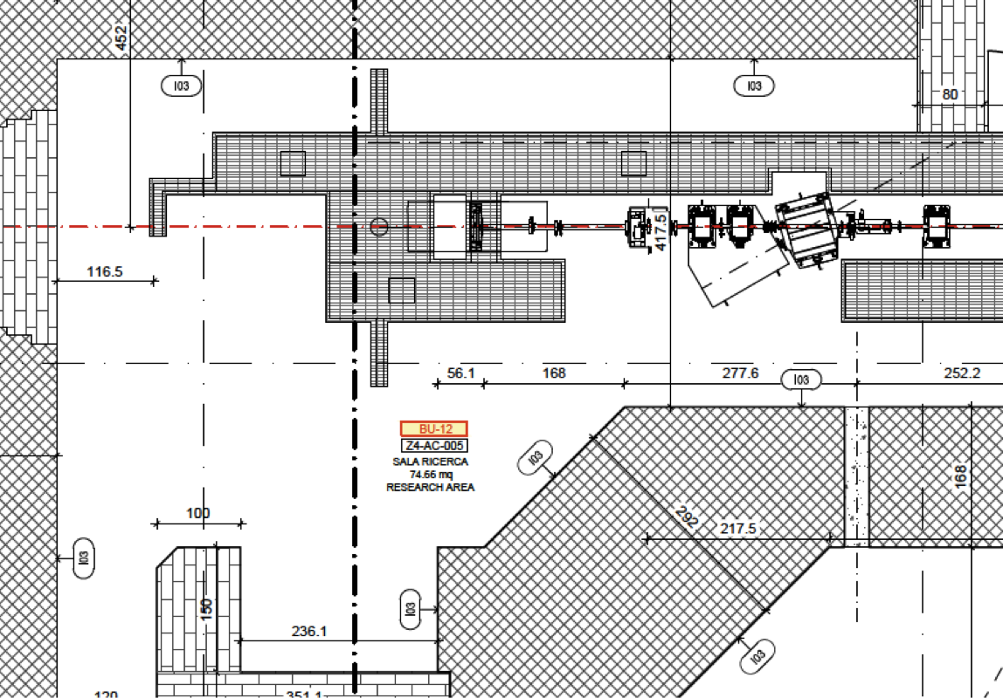
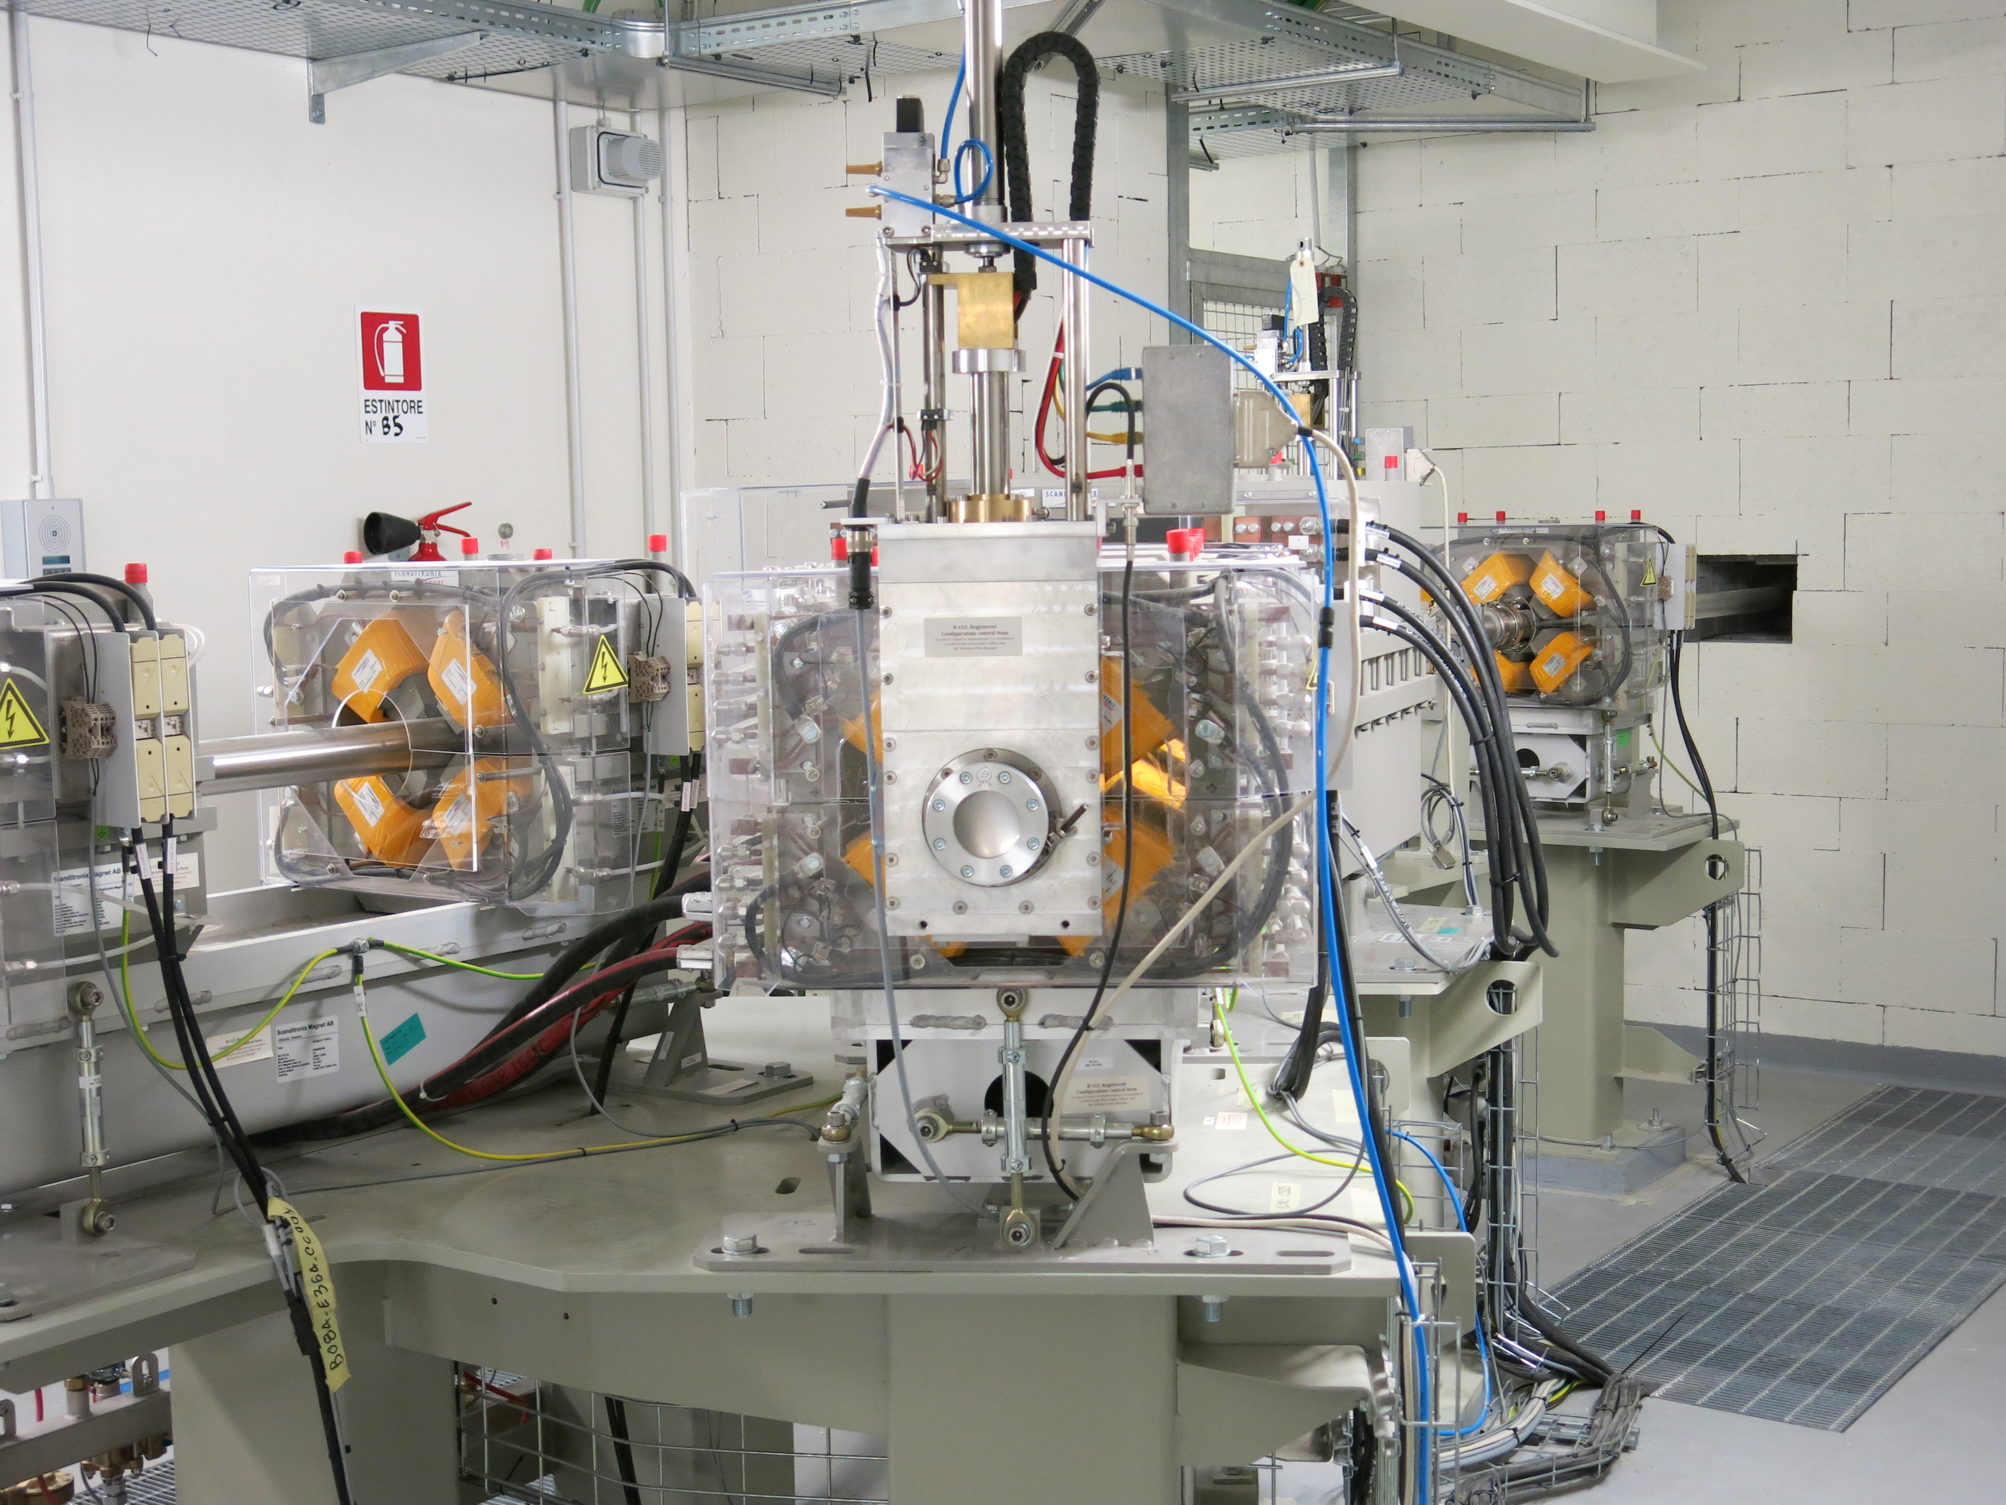
“Biology” Line at 0°
“Physics” Line at 30°

Slide 10
Experimental cave, Proton Therapy Center - Trento
Next Steps:
Beam tuning with IBA (suggestions for specifications?)
Beam characterization in a clinical-like context (range, beam profile, spot size, divergence)
Build-up of library of beam characteristics (ref. for users)
Setup of both lines with adjustable tables + target station for biology
Start first experiments (2016!!)
Feb – March
2016
March – June
2016
SOH hours available on request (TIFPA/APSS):
Mon/Fri 19:00-22:30
Sat 6:00 – 14:30
Notes:
Bragg peak ionization chambers from PTW, large diameter 2.5 cm water proof
Lynx for beam size and beam profile (scintillation layer coupled with CCD camera) thus replacing GaF chromic

Slide 11
TIFPA: what else...

Slide 12
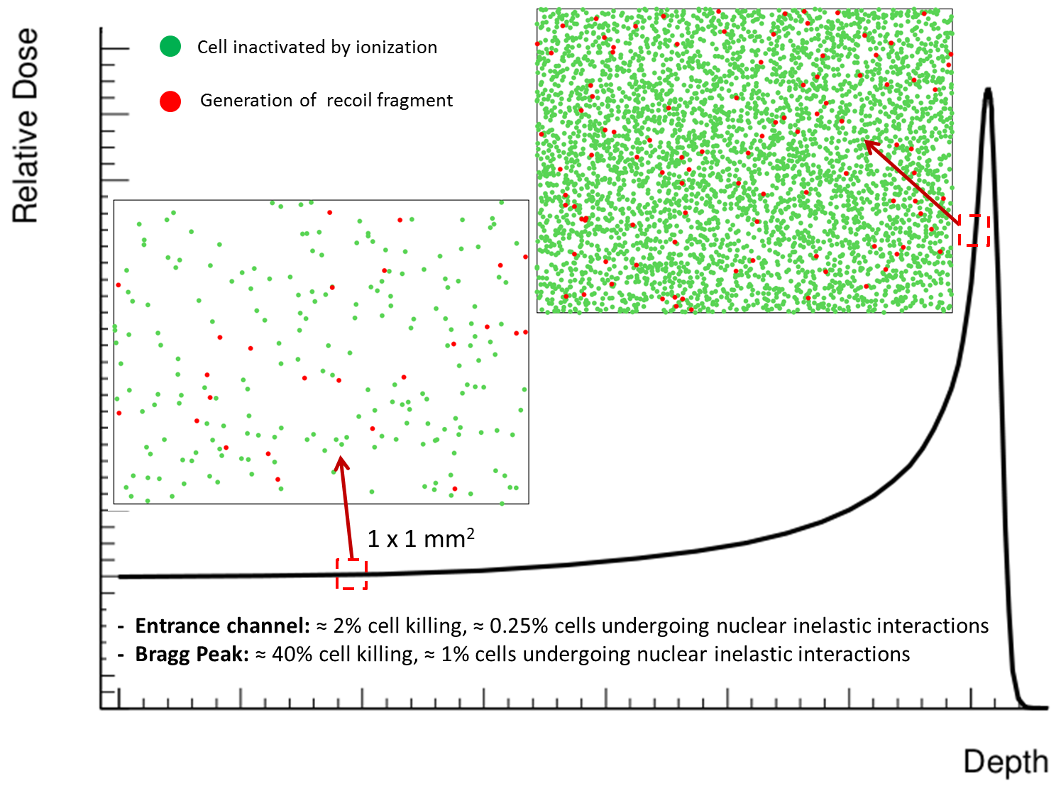
Target fragmentation in proton therapy
About 10% of biological effect in the entrance channel due to secondary fragments…first order approximation!
Largest contributions of recoil fragments expected from
He, C, Be, O, N
See also dedicated MC studies:
- Paganetti 2002 PMB
- Grassberger 2011 PMB
Cross Sections needed!!!
Tommasino & Durante Cancers 2015
Notes:
Entrance channel 0.5 KeV/mum and 0.2 Gy -> about 3% cell killing
Bragg peak 2.5 keV/mum and 2 Gy -> about 60% cell killing
Expectations in terms of fragment contributions coming from prostate patient (Grassberger)

Slide 13
Impact of target fragmentation in clinical practice
Improved description would be needed for:
Better definition of peak-to-entrance ratio
Side effects in the entrance channel (NTCP)
and dose to target (TCP)
Prediction of secondary cancer risks
Implications for space radiation research
→ FOOT experiment (submission to INFN CSN 3)
PRIN 2015 Proton On Patient
Notes:
Possible preliminary test with INSIDE dose profiler (SiPM + Absorber + Calo): test of general idea, indications for detector optimization
Separate secondaries by charge/mass (particle ID), measure energy spectra
Lack of information about production of heavy fragments, missing total reaction cross sections p on X in therapeutic energy range
Heavy fragments, low energy -> very low residual range (microns) difficult to detect; 10 microns target? Energy Dep in target, systematic difficult to disentangle
Inverse Kinematics? Shoot 0.6 Beta C,N,O on H target (patient-on-proton), measure proj fragments, inverse velocity transformation
In this case fragments would be essentially forward directed and have residual range of several cm, target can have mm thickness

Slide 14
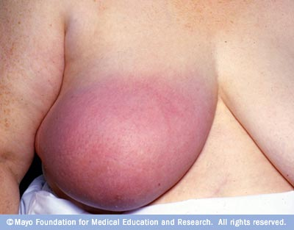
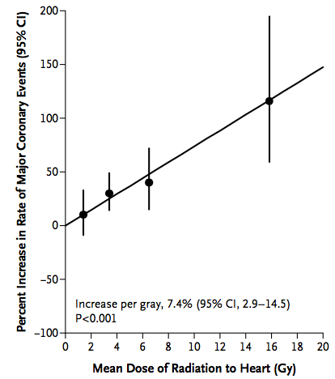
Protons for breast cancer
About 200,000 new cases per year in U.S
Most affected at the most productive part of life
Most patients survive (> 2 millions survivors)
Majority receives radiation
“Horror” stories from side effects of radiation leads many women to choose mastectomy over X-rays
Darby et al 2012
New Eng J Med
Ares et al 20120 Int J Rad Oncol Biol Phys
Notes:
- Jolie: mutated BRCA1 -> 87% prob breast cancer
BC most common cancer in women worldwide
Darby et al: risk major cardiac complications 7.4% Gy^-1
Average heart dose about 5 Gy

Slide 15
Exposure to cosmic rays is a strong limit to space exploration (mission to Mars ≈1 Sv)
Evidence of increased radioresistance in hybernators (e.g. squirrels)
Recent accidents to humans brought back new interest!
NASA investigating deep-space hibernation technology
October 17, 2014 - www.phys.org
Open questions:
Possible to extend hybernation to non-hybernators?
Radioprotective effects also for particle irradiation?
Mechanisms of increased radioresistance?
PRIN 2015 (INFN – UniBo – UniTn):
Hibernation-induced heavy ions radioprotection for deep space exploration

Slide 16
Thank you!

Slide 17
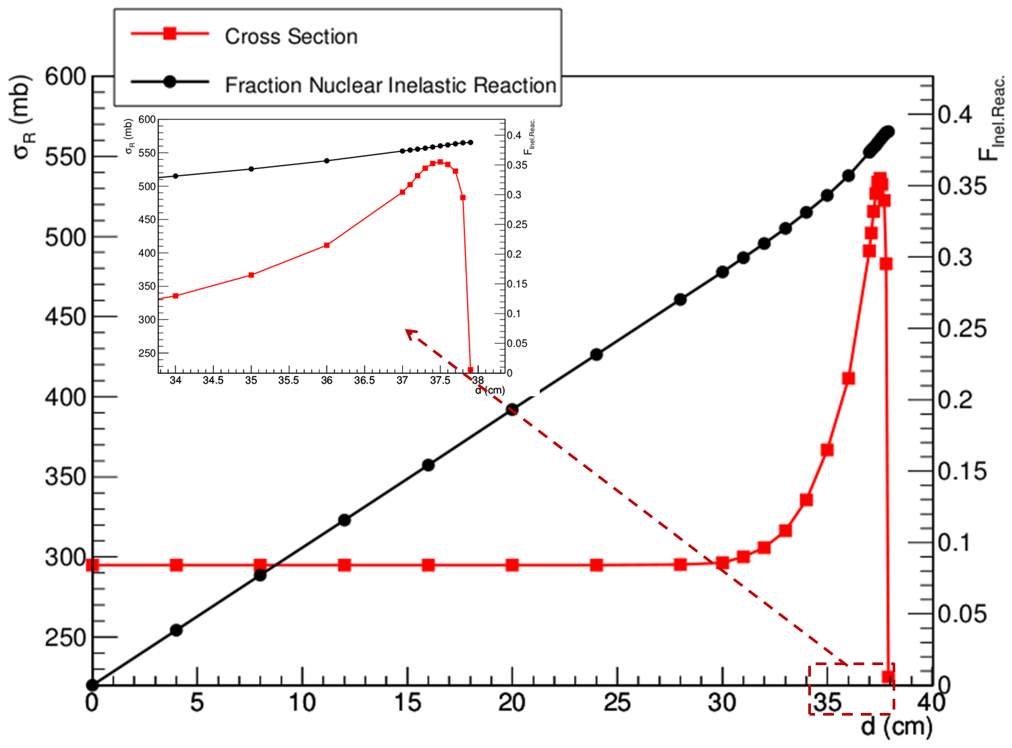
Target fragmentation in proton therapy
In water, about 1% cm⁻¹ of protons undergo inelastic nuclear interactions: production of low energy heavy recoils!
Example: 250 MeV proton beam in water
Bradt-Peters formula (Sihver 2009 Radiat Meas):
depending on E_{p} and Z_{t} range
What about biological effects?
Tommasino & Durante Cancers 2015

Slide 18
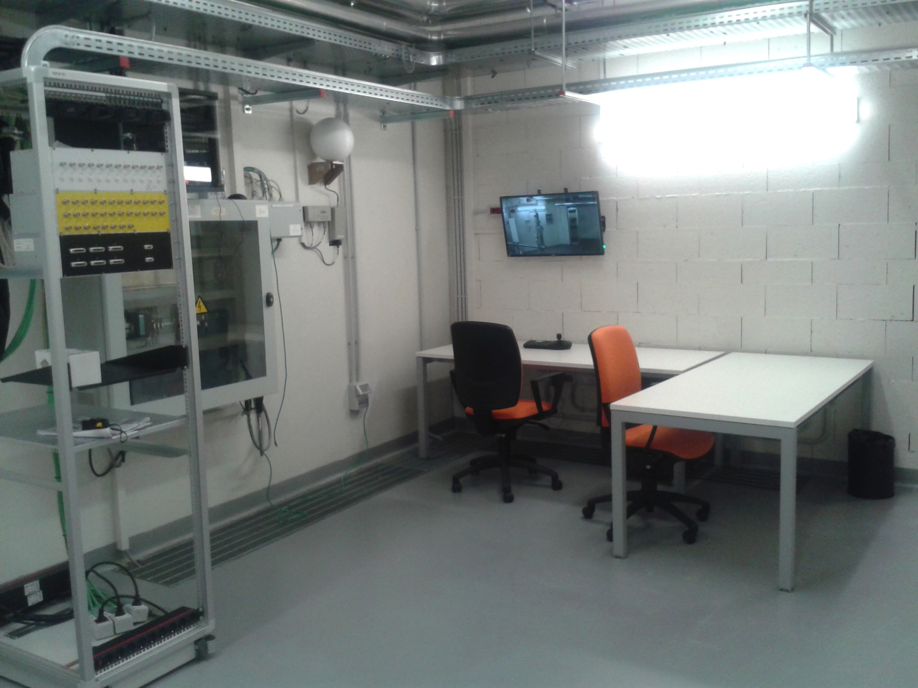
Experimental cave, Proton Therapy Center - Trento
Dedicated control room:
Patch panel to the Cave (signal cables, HV cables, D-SUB, Ethernet)
Laser and Cameras control system
Large space available for material storage and preparation
Possibility to move to TIFPA offices for long-lasting data acquisition

Slide 19
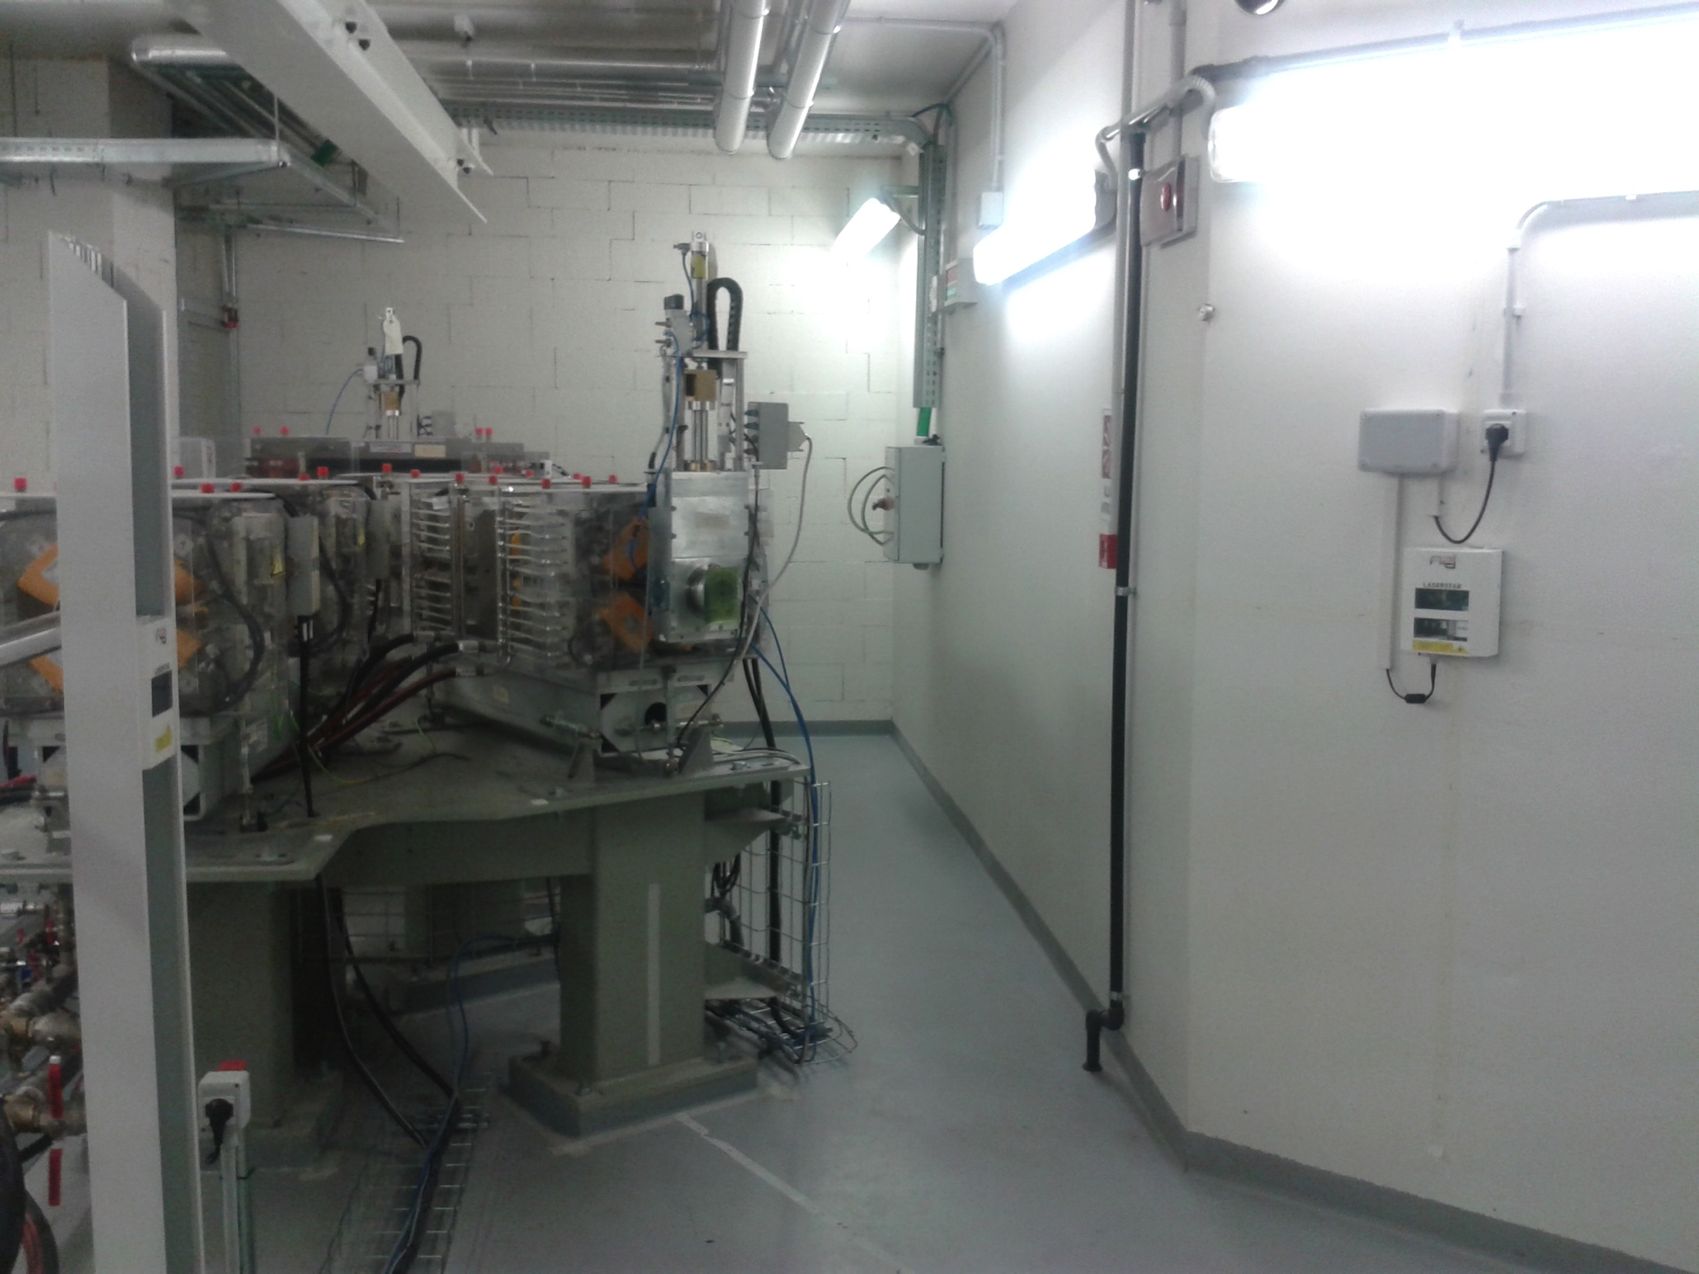
Experimental cave, Proton Therapy Center - Trento
“Biology” line at 0°
“Physics” line at 30°
Isocenter at 1.5 m from exit window
Target station needed for generation of large fieds (passive modulation)
Isocenter at 1.2 m from exit window

