Slide 1
A new analysis technique to measure fusion excitation functions with large beam energy dispersions
P.Figuera
INFN-Laboratori Nazionali del Sud

Slide 2
Outline:
Physical motivations behind our study
Origin of large beam energy dispersion and related problems
Discussion on proposed solutions
Examples and results for the ^{6,7}Li+^{120,119}Sn study

Slide 3
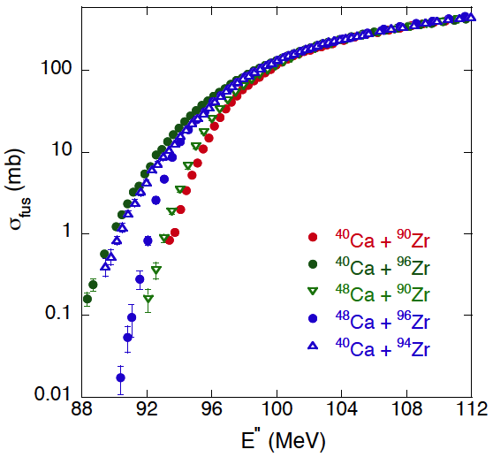
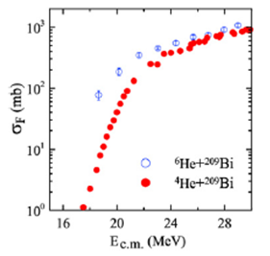
Physical motivations behind our study
Still many interesting open questions under study concerning reaction dynamics below the barrier. Examples: Effects on fusion of: n transfer channels with different Q values; n-halo/skin structure; coupling to continuum with weakly bound projectiles.
Transfer channels Q>0
Examples
A.M. Stefanini et al., PRC76, 014610(2007)
L.F.Canto et al NPA 821, 51, (2009)
In general a better understanding of structure effects on the reaction dynamics
can help improving the calculations in the astrophysical regime. Possible Examples:
C.Spitaleri, C. Bertulani et al. : Phys. Lett. B 755, 275, (2016)
C.J.Horowiz et al.: Phys. Rev. C 77,045807,(2008)
V.I. Zagrebaev et al.: Phys. Rev. C 75, 035809, (2007)

Slide 4
Possible sources of ‘large’ beam energy dispersions
.
Problems : low cross sections+ low beam intensity if RIBs are used → thick targets
Large beam energy distribution inside the targets due to combined effect of:
energy loss, straggling, target non uniformity, beam quality .
In addition stacked target technique often used → amplification of above effects
STEP 1
Single or multiple target
activation
target
catcher
STEP 2
Off-line measurement of the produced activity
(X or α or γ)
BEAM

Slide 5
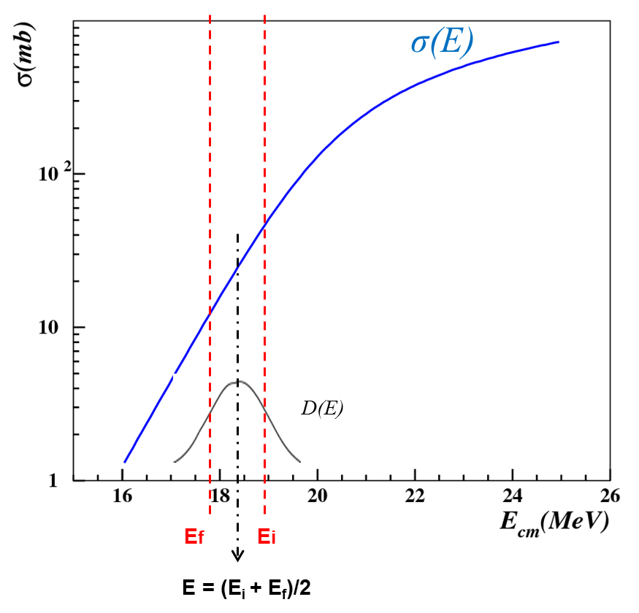
Effects of large beam energy dispersion
When is measured with large energy distributions in the target, the measurement will not represent the excitation function but it will carry information on it. The possibility to pin-down the correct excitation function will depend upon various factors.
To which energy E do we have to associate the measured σ_{mean} ?
a) E_{mean}=(E_{i}+E_{f})/2
b)
We measure:

Slide 6
To which energy do we have to associate the measured σ_{mean} ?
E_{mean}=( E_{i}+E_{f} )/2
We define E_{r} such that σ_{mean}= σ(E_{r}) with σ(E) true excitation function.
σ(E)
σ_{mean}(E)
E_{r}

Slide 7
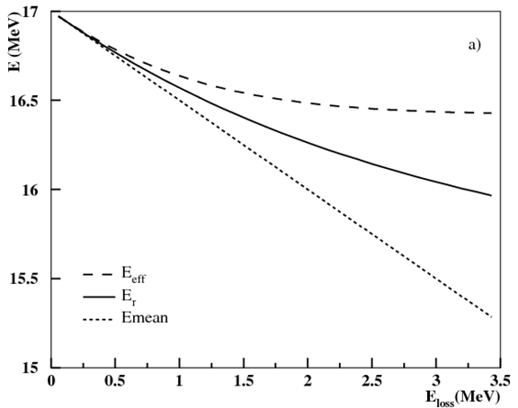
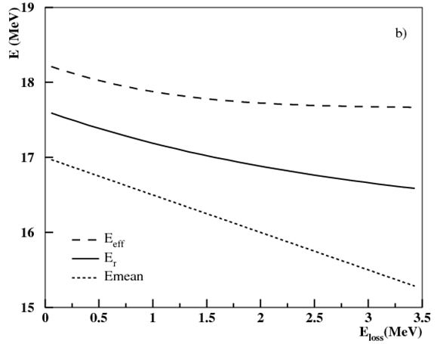
Are E_{mean} or E_{eff} good approximations of E_{r} ?
Analytical answer possible only by simplifying the problem. We assumed: 1) 17 MeV beam entering a foil
2) We limit ourselves to the exponential region → σ(E)=σ₀exp(-α(E₀-E))
3) Constant beam energy FWHM within the target of 0 or 2 MeV
4) Energy decreasing linearly inside the target E=E₀-βt
δ beam energy distribution entering target
Gaussian beam energy distribution FWHM=2 MeV
E_{loss} (MeV)
E_{loss} (MeV)
In general none of the two approaches gives the correct E_{r}

Slide 8
A possible deconvolution procedure to extract σ(E)
For each energy point i we measure
We look for a function gu(E,μ) (with μ parameters to be determined) which best reproduces the real σ(E). We calculate:
We find the best parameter set by minimizing:
Possible ‘Wong like’ guess function gu(E,μ) with parameters A,B,C
M. Fisichella et al. Phys. Rev. C 92, 064611 (2015) ; Application also in M.Fisichella et al: . Phys. Rev. C 95, 034617 (2017)

Slide 9
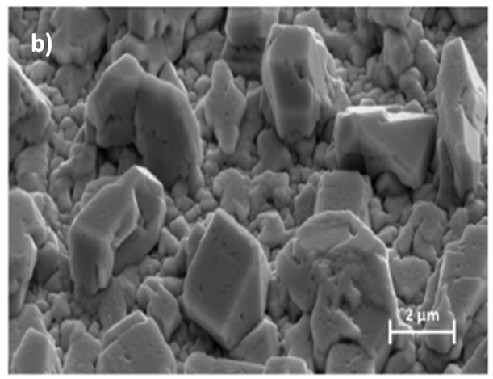
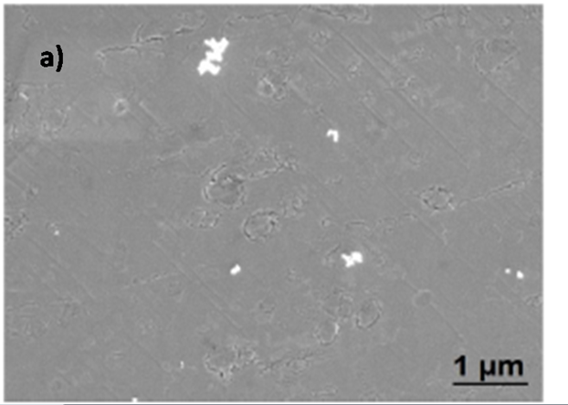
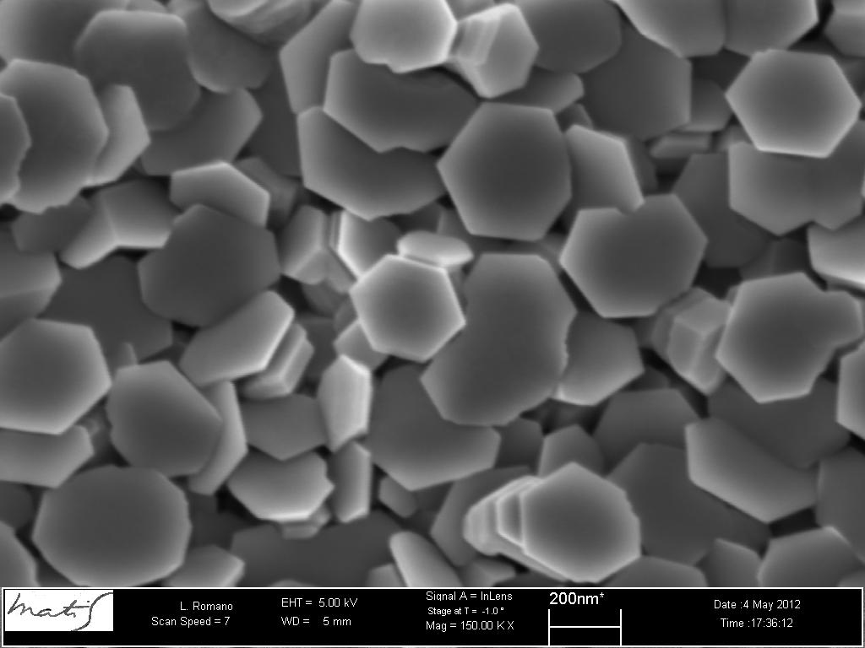
Have targets uniform thickness?
¹²⁰Sn target ∼ 0.7 μm (0.5 mg/cm²),
evaporated onto ⁹³Nb 2mg/cm²
size of grains up to 2 μm on Sn side
no structures on the Nb side
⁶⁴Zn target ∼ 0.4 μm (0.250 mg/cm2),
hexagonal grains 0.2 μm

Slide 10
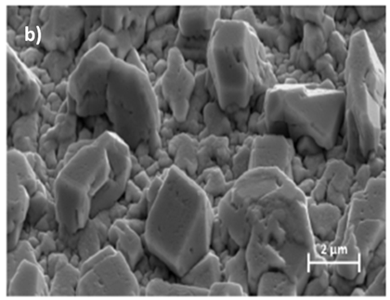
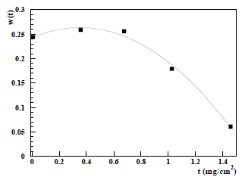
A method to extract target thickness probability distributions
Residual energy after target
D₅
D₄
D₃
D₂
D₁
EXP
SIM
α
(5.48 MeV)
D_{T} = ∑ D_{i} w_{i}
Thickness probability distribution w(t) for our Sn targets

Slide 11
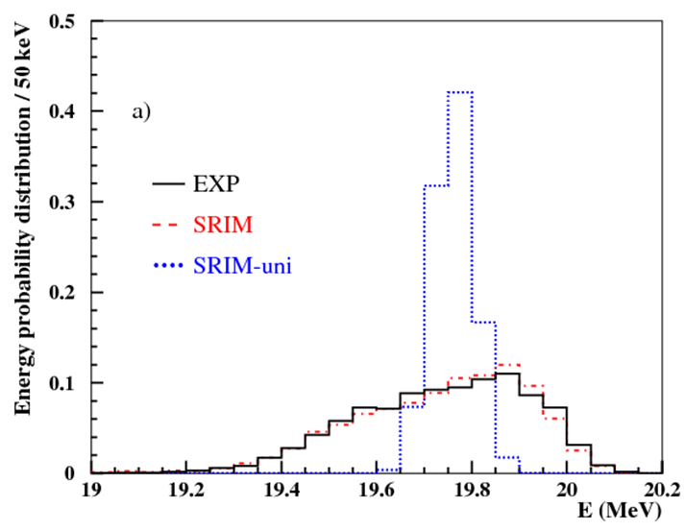
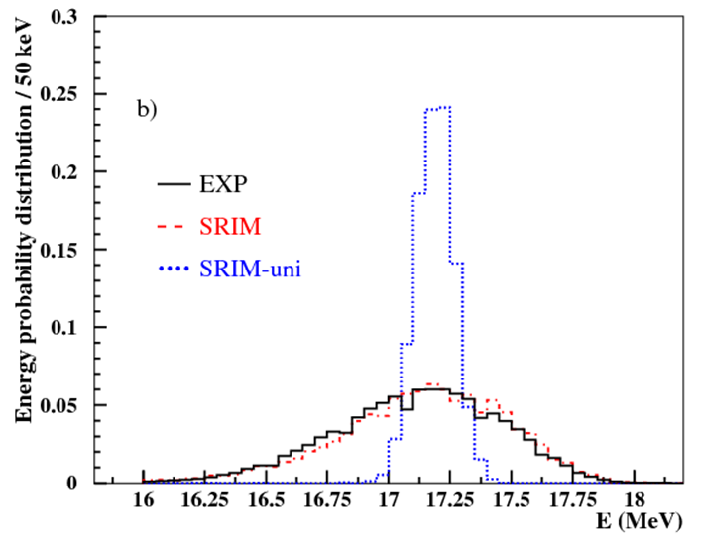
Validation of the method used to extract
the target thickness distributions
Comparison between experimental and calculated (using extracted w(t) )
residual energy spectra of 21 MeV ⁶Li crossing 1 and 3 ¹²⁰Sn+⁹³Nb foils
1 foil
3 foils

Slide 12
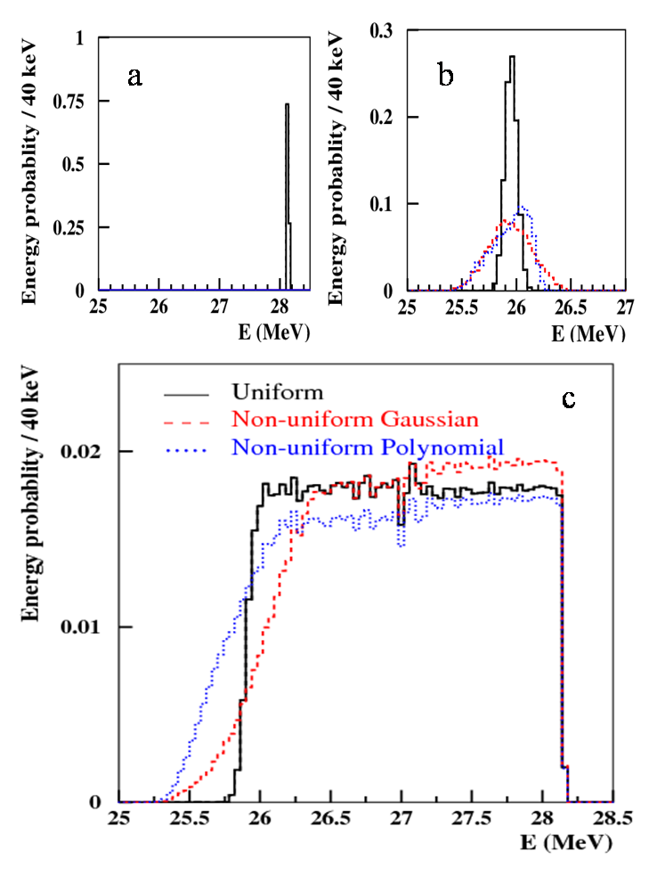
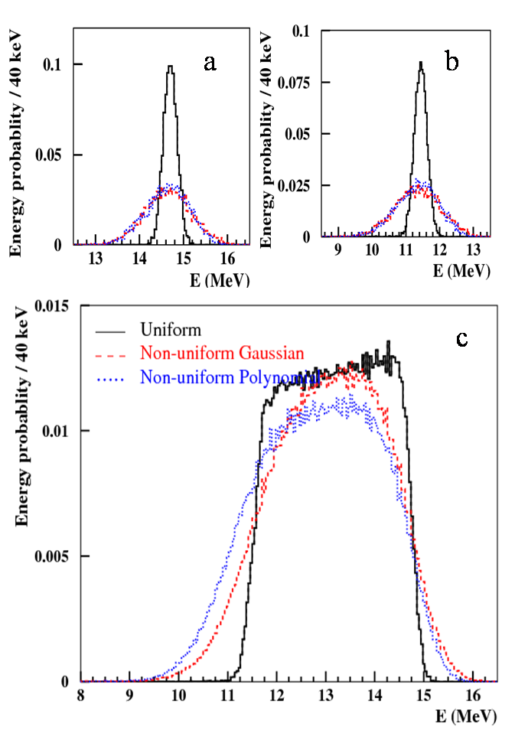
Simulation study for ⁹Li+¹²⁰Sn
We assume:
⁹Li beam of 28 MeV impinging on a stack of 5 ¹²⁰Sn targets 5 mg/cm²
each followed by a ⁹³Nb catcher/degrader 1.5 mg/cm² thick.
We consider 3 different cases:
1)Uniform Sn and Ni foils
2)Gaussian thickness distribution for ¹²⁰Sn (FWHM = 20%) and for ⁹³Nb (FWHM=15%)
3) ‘polinomial’ thickness distribution for ¹²⁰Sn and Gaussian for ⁹³Nb (FWHM=15%)
First target Last target

Slide 13
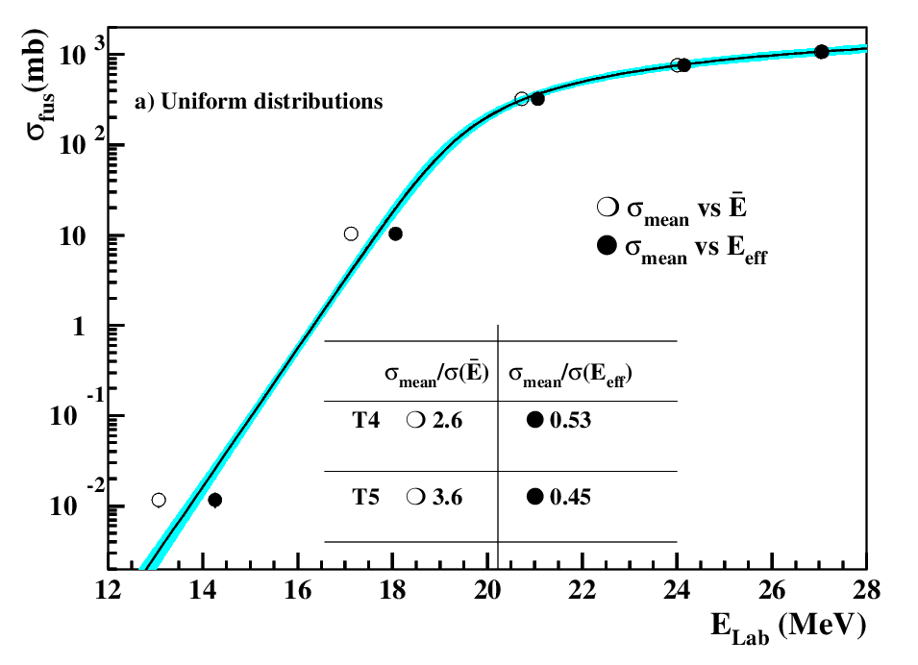
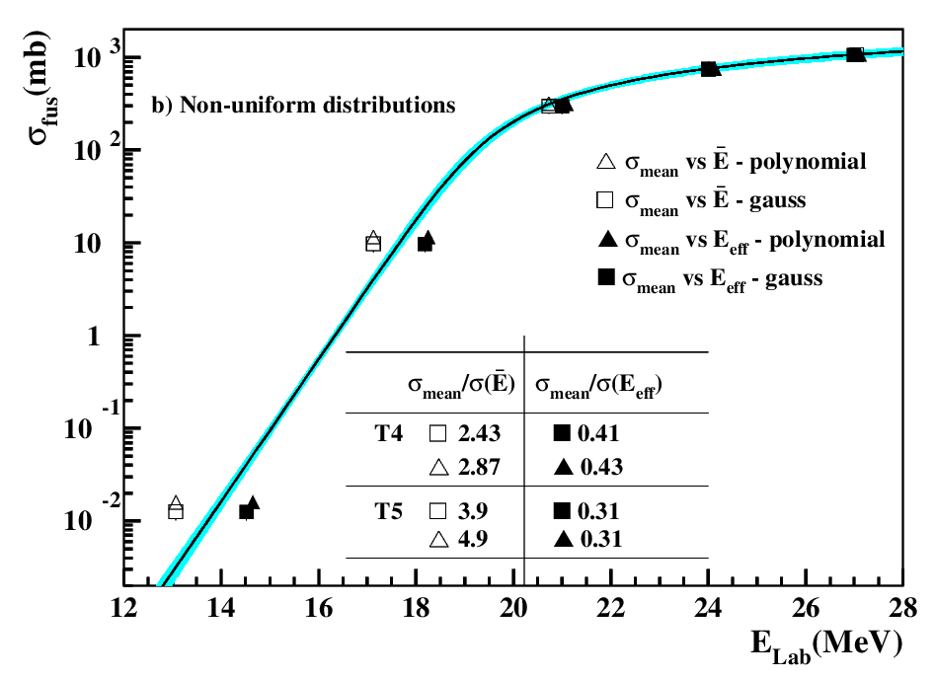
⁹Li+¹²⁰Sn Simulation results
E_{mean}=(E_{i}+E_{f})/2
Unfolding procedure

Slide 14
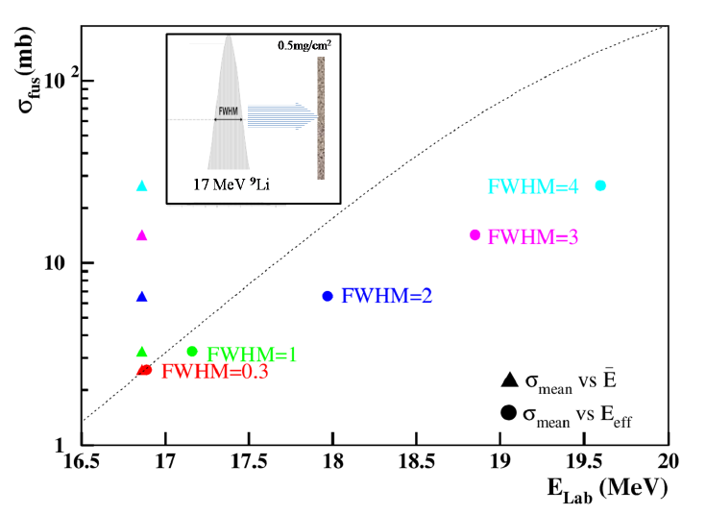
⁹Li+¹²⁰Sn Simulation results
⁹Li at 17 MeV average energy with different FWHM impinging on target
E_{mean}=(E_{i}+E_{f})/2

Slide 15
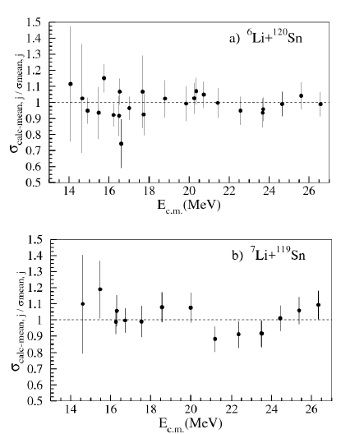
Application to the ^{6,7}Li+^{120,119}Sn data
Goals
n transfer effects on fusion for
^{6,7,8,9}Li+^{120,119,118,117}Sn
CF supression above barrier
Unfolding
Even if energy spread in target is small unfolded curve deviates fro σ vs E_{mean} and σ vs E_{eff} at the lowest energies
Consistency check
Ratio of
and measured mean cross-section (σ_{meas}) vs E_{c.m}. In the whole energy range calculated and measured mean cross-section are approximately the same.
M.Fisichella et al: . Phys. Rev. C 95, 034617 (2017)

Slide 16
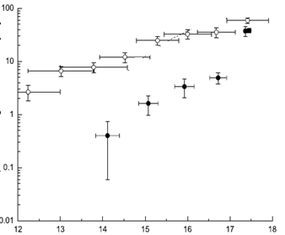
Effects of beam energy spread from published data: two examples
σ vs E_{mean}
Authors estimate factor 100 effect on data due to large energy dispersion. Data are not unfolded.
⁶He+²⁰⁶Pb
σ vs E_{eff}
Effective energy approach applied, authors state:
‘if energy averaging procedure is disregarded σ overestimated by factor 3’ . However also this approach is incorrect.
Y. Peniozhkevich et al. PRL 96,162701, (2006) R. Wolski et al. EPJ A47, 111, (2011)

Slide 17
Summary
An effort as to be made to properly consider the sources of beam energy dispersion inside the targets
Energy loss, energy straggling, target non uniformity, beam quality
and their effects on the measured cross sections.
When dealing with non a negligible variation of the cross section within the beam energy dispersion either the representation vs E_{mean} or vs E_{eff} do not provide the correct fusion excitation function.
We propose an unfolding procedure that allows to extract the proper excitation function provided that the targets are fully characterised and the correct D(E) calculated.
A procedure to characterise the targets is also proposed based of TRIM simulations and residual energy spectra measured with an α-source.

Slide 18
Collaboration
A.DiPietro, P.Figuera, M.Fisichella, M.Lattuada, A.C.Shotter, C.Ruiz, M.Zadro
RBI Zagreb

Slide 20
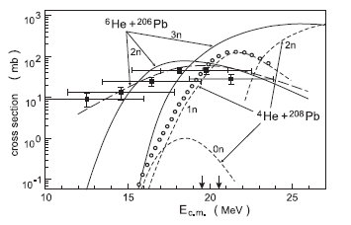
Considerations on some published fusion studies with RIBs (1)
⁶He+²⁰⁶Pb Y. Peniozhkevich et al PRL 96,162701, (2006)
6 ²⁰⁶Pb targets alternated with Al degraders.
6 MeV FWHM energy dispersion after the stack.
Authors estimate 2 orders of magnitude effect on data due to large energy dispersion but do not unfold data.
⁶He+²⁰⁶Pb R. Wolski et al. EPJ A47, 111, (2011)
8 ²⁰⁶Pb targets alternated with Ti degraders.
1.3 MeV FWHM energy dispersion after the stack.
Measured sigma factor 10 lower than Peniozhkevich one
Effective energy approach applied, authors state:
‘if energy averaging procedure is disregarded σ overestimated by factor 3’ .
Problems in the used E_{eff} approach.
σ_{F}
E_{c.m}.

Slide 21
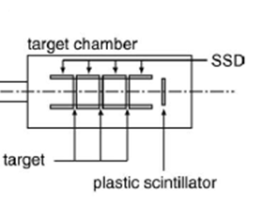
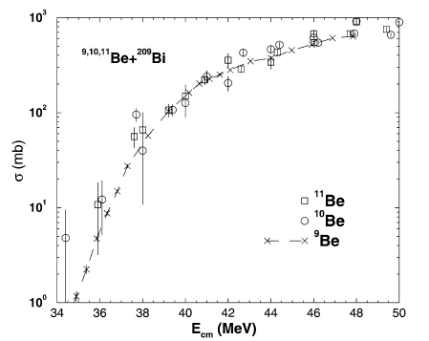
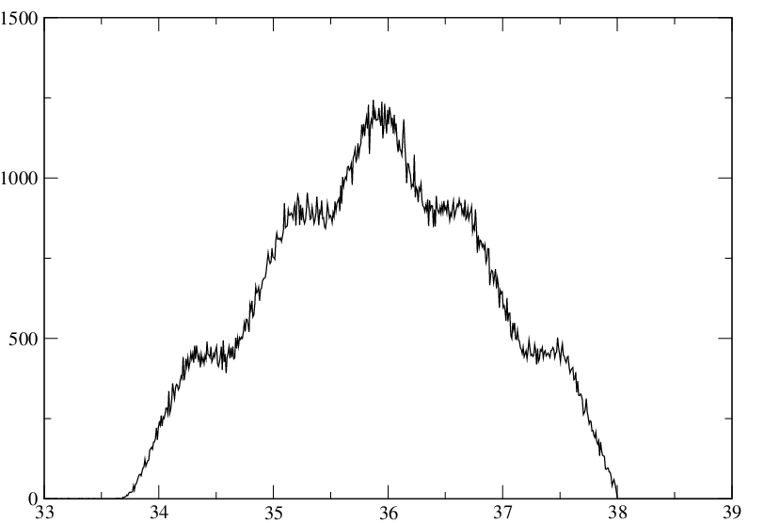
Considerations on some published fusion studies with RIBs (2)
¹¹Be+²⁰⁹Bi C.Signorini et al. NPA 735, 329, (2004)
2 MeV incoming beam energy distribution.
3 targets irradiated.
From the given information only rough estimate of D(E) possible. Using this D(E) estimate, our unfolding procedure predicts a small overestimation of σ(E) which is within the reported error bars for ¹¹Be.
Energy Probability
E(MeV)

Slide 22
Considerations on some published fusion studies with RIBs (3)
⁶He+¹⁹⁷Au
Y.Penionzhkevich et al. EPJ A31, 185, (2007)
Different stacks irradiated
Beam energy distribution ∼ ± 2.5 MeV reported for the lowest energy points.
With reported beam energy spread, assuming the σ(E) slope is the real one, the σ(E) is expected to be overestimated by a factor 2-3 at the lowest energies.
⁶He+¹⁹⁷Au
⁸He+¹⁹⁷Au
‘The measured FWHM for each target was used to define the energy spread for each σ(E) point’.

Slide 23
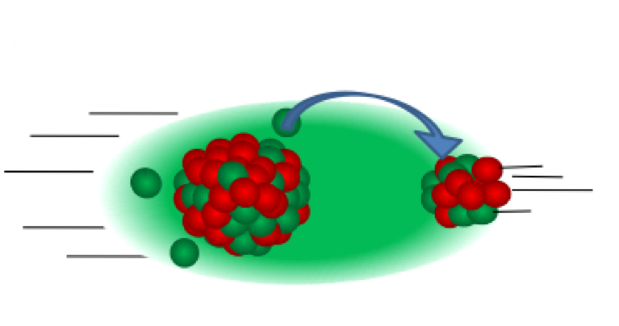
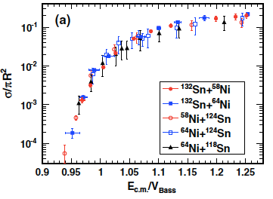
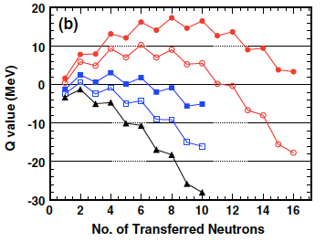
Coupling of relative motion with Transfer channels with Q>0
Transfer channels Q>0
A.M. Stefanini et al., PRC76, 014610(2007)
No all study agree about the role of Q_{value} on enhancing fusion. Using radioactive beams (weakly bound systems) reaction with very high positive Q_{value} can be accessed.
Z. Kohley et al. PRL 107, 202701 (2011)

Slide 24
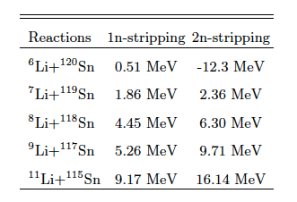
Investigation can be undertaken using ⁶Li, ⁷Li, ⁸Li, ⁹Li,¹¹Li Beams
Possible to undertake a survey e.g. :
^{x}Li + ^{y}Sn → fusion, x+ y → constant ; Sn has 10 stable isotopes
⁶Li + ¹²⁰Sn
⁷Li + ¹¹⁹Sn
⁸Li + ¹¹⁸Sn
⁹Li + ¹¹⁷Sn
¹¹Li + ¹¹⁵Sn
In ⁶Li and ⁷Li induced reactions large Q_{value} for d and t transfer respectively
*Same compound system (¹²⁶I)
*Sn entrance channel conditions similar
* Q(n) values differ
Total Fusion at
and below barrier
(more than 95% fusion cross section → Production of ^{123,124}I )
Determine fusion cross section by measuring residual ^{123,124}I activity

Slide 25
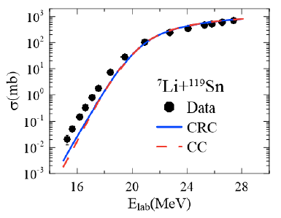
Effects of Q_{value} > 0 on sub-barrier fusion?
CRC calculations include coupling to transfer channel. Negligible difference with CC calculation. Transfer coupling effect negligible.
M.Fisichella et al. Phys. Rev. C accepted for pub.

Slide 26
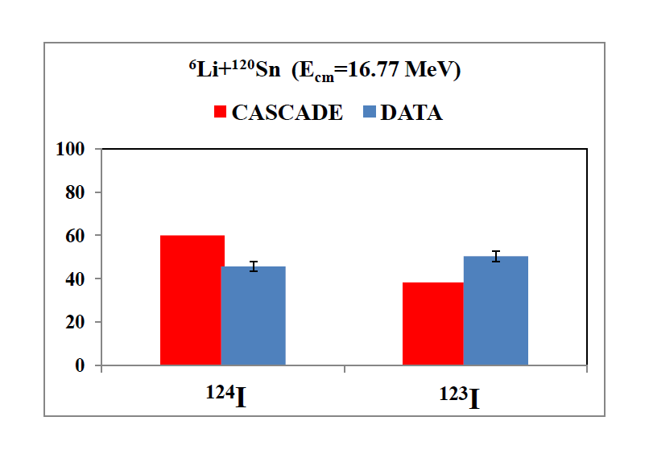
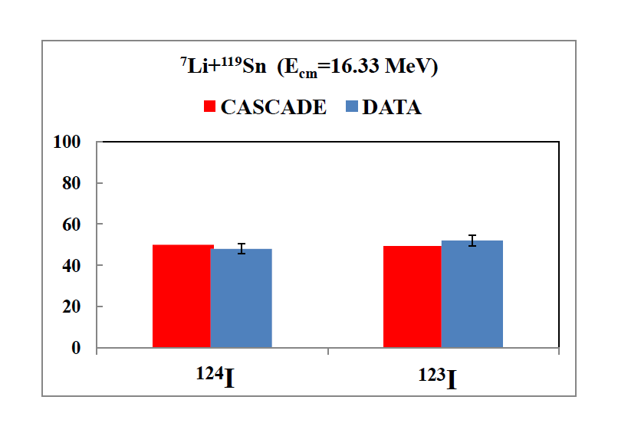
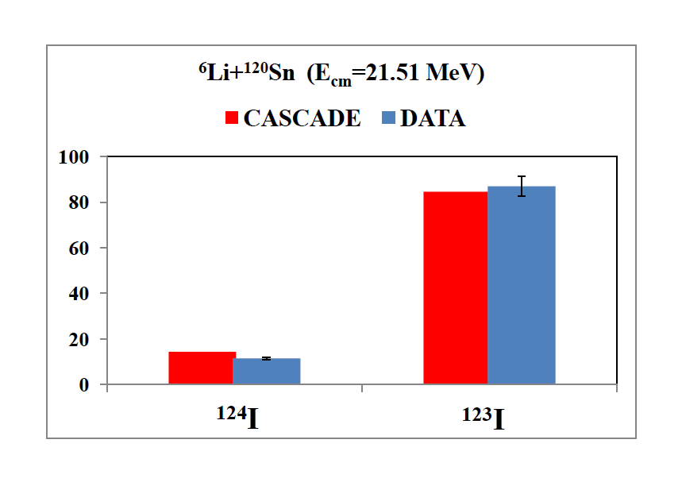
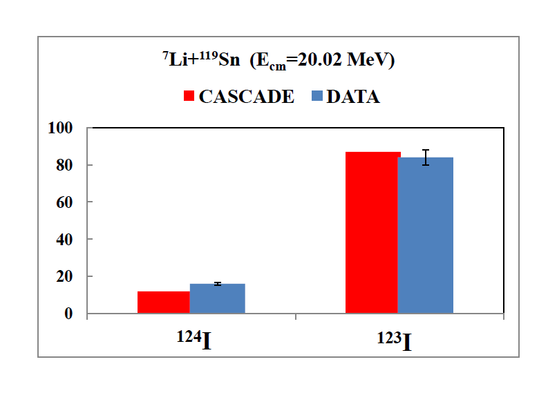
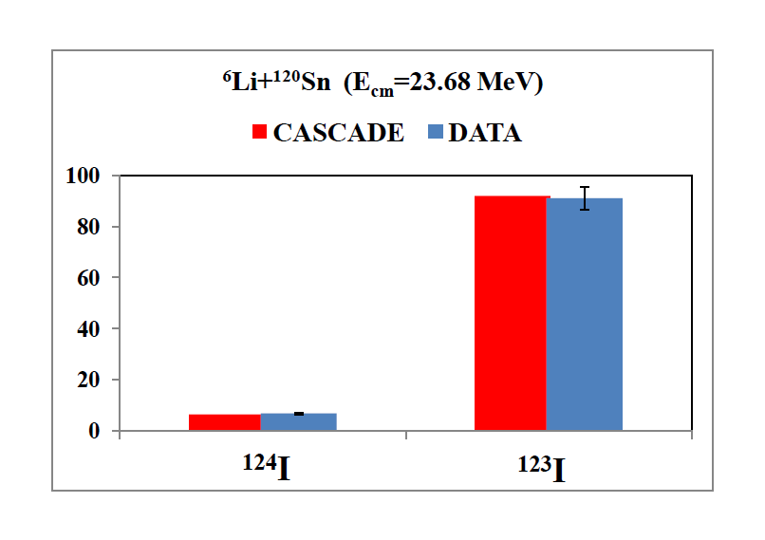
RESE RELATIVE DEI RESIDUI DI EVAPORAZIONE
Determinati:
⁶Li+¹²⁰Sn
⁷Li+¹¹⁹Sn
A_{0exp}
ε_{Si(Li)}
k_{α}
numero
particelle
incidenti
spessore
bersaglio
σ_{ER}/σ_{CF}(%)
σ_{ER}/σ_{CF}(%)
E_{cm} = 16.77 MeV
E_{cm} = 16.33 MeV
E_{cm} = 21.51 MeV
E_{cm} = 20.02 MeV
E_{cm} = 23.68 MeV
E_{cm} = 23.53 MeV
Sezioni d’ urto
di produzione
dei E.R.
Ottimo accordo tra i dati e le previsoni di modello statistico

Slide 27
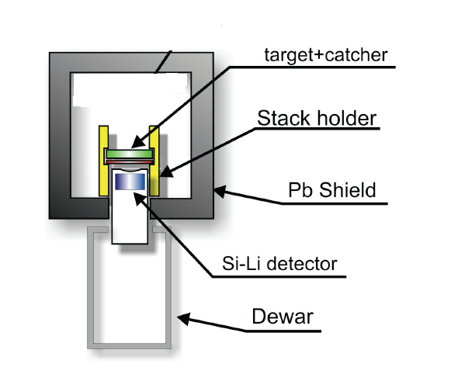
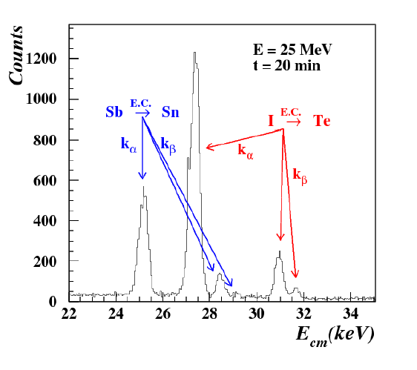
MISURE “OFF-LINE” DEI RAGGI X CARATTERISTICI
⁶Li +¹²⁰Sn
Fusione completa:
Fusione incompleta:
⁶Li +¹²⁰Sn
¹²⁶I*
⁷Li +¹¹⁹Sn
⁶Li
d
α
t
⁷Li
α
Dall’ analisi dei raggi X è possibile identificare
solo gli elementi ma non i differenti isotopi prodotti
d +¹²⁰Sn
¹²²Sb*
t +¹¹⁹Sn

Slide 28
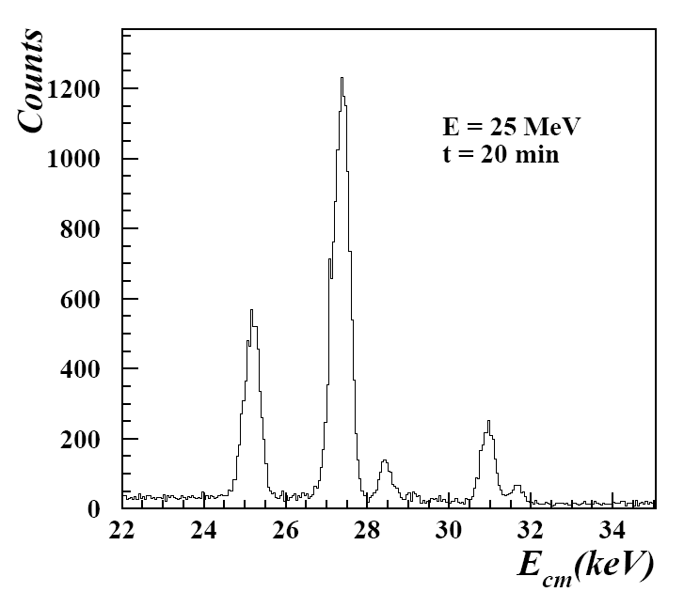
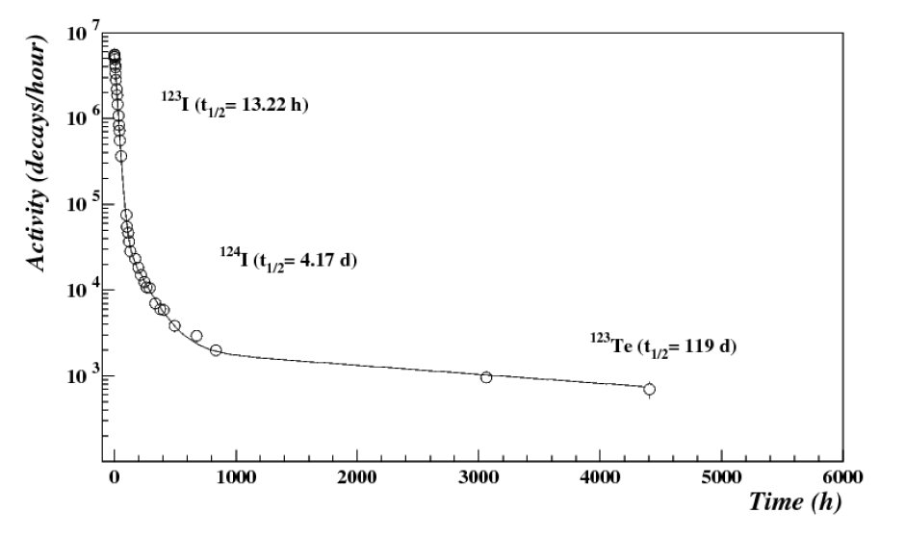
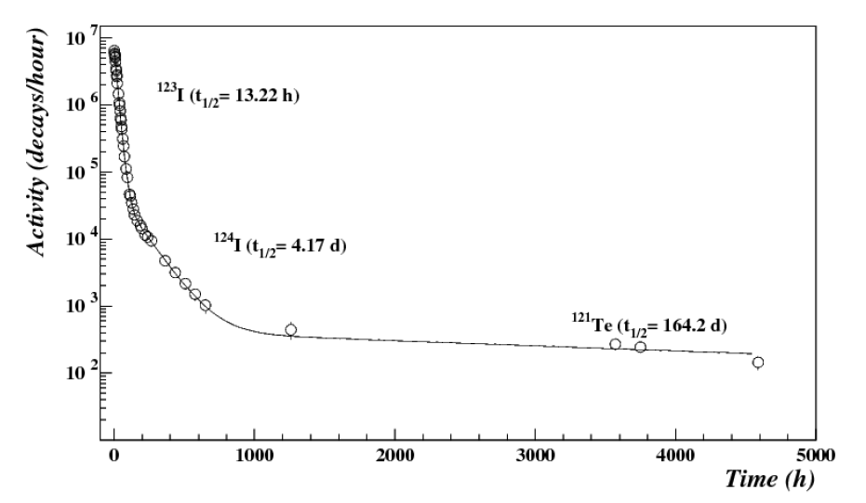
CURVE DI ATTIVITA’
E’ possibile discriminare gli isotopi misurando
l’attività di ciascun elemento nel tempo
⁶Li +¹²⁰Sn
3n
¹²³I
¹²⁶I*
⁷Li +¹¹⁹Sn
2n
¹²⁴I
L
K
L
K
¹²³I (t_{1/2}=13.22h)
⁶ Li @ 25 MeV
k_{α} X-ray
E.C.
A
A
₅₃I
₅₂Te
¹²⁴I (t_{1/2}=4.17d)
¹²³Te (t_{1/2}=119d)
Fusione incompleta:
α +¹²⁰Sn
¹²⁴Te*
^{123m}Te + n
⁷ Li @ 25 MeV
α +¹¹⁹Sn
¹²³Te*
¹²²Te
(stabile) + n
¹²³I (t_{1/2}=13.22h)
^{121m}Te + 2n
¹²⁴I (t_{1/2}=4.17d)
¹²¹Te (t_{1/2}=164d)
L
K
internal conversion
γ
k_{α} X-ray
A
Dai fit delle curve di attività è possibile ottenere A_{0exp}
₅₂Te

Slide 29
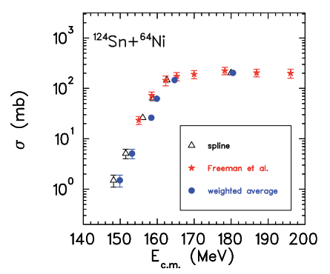
Effects of beam energy spread from published data: some examples
Authors estimate factor 100 effect on data due to large energy dispersion. Data are not unfolded.
⁶He+²⁰⁶Pb
σ vs E_{mean}
σ vs E_{eff}
Effective energy approach applied, authors state:
‘if energy averaging procedure is disregarded σ overestimated by factor 3’ . However also this approach is incorrect.
Y. Peniozhkevich et al. PRL 96,162701, (2006)
R. Wolski et al. EPJ A47, 111, (2011)
Approximate approach that accounts for energy spread in target applied in ^{124,132}Sn+⁶⁴Ni. Difference with E_{eff} found.
J.F.Liang et al. PhysRevC.75.054607

Slide 30
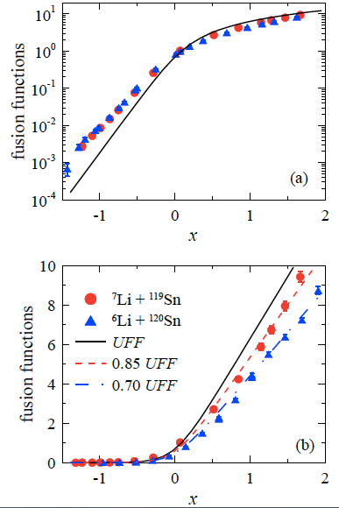
^{6,7}Li+^{120,119}Sn results
Data reduction procedure to eliminate
static and coupling to bound
state effects.
L.F. Canto et al :NPA 821,51,(2009)
Fusion cross-section enhanced below the barrier and suppressed above.
No sub-barrier differences between ⁶Li and ⁷Li.
Suppression factors above barrier slighter smaller then for heavier targets.

