Slide 1
TGC upgrade for SLHC (ATL-P-MN-0028)
Fra le parti più colpite dall’aumento di rate previsto a SLHC ci sono le Small Wheels
Le TGC con catodo a bassa resistività (OPAL) sopportano rate superiori a 100 kHz/cm**2
Il progetto si propone di sostituire l’attuale SW (incluse le CSC) con una struttura TGC’s ad alta rate, di 2 multilayer a 4 volumi di gas ciascuno;
TGC’s fatte da: precision radial strips (3x1200 mm**2) con lettura digitale e analogica per trigger e tracking; radial pads (50x300 mm**2) usate solo nel trigger; azimuthal wires 2 mm pitch.
Nella fase I è previsto solo l’upgrade della parte CSC

Slide 2
ISTITUTI PARTECIPANTI
Israele (Technion, Tel Aviv, Weizmann);
Giappone (KEK, Kobe, Nagoya, Tokyo);
Argentina (La Plata e Buenos Aires);
Chile (Pontificia Univ. De Chile e Univ. Federico Santa Maria);
Roma1, partecipazione ancora da definire.

Slide 3
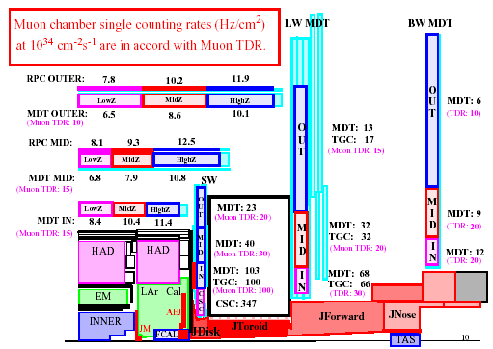
Muon background counting rate @L=10³⁴

Slide 4
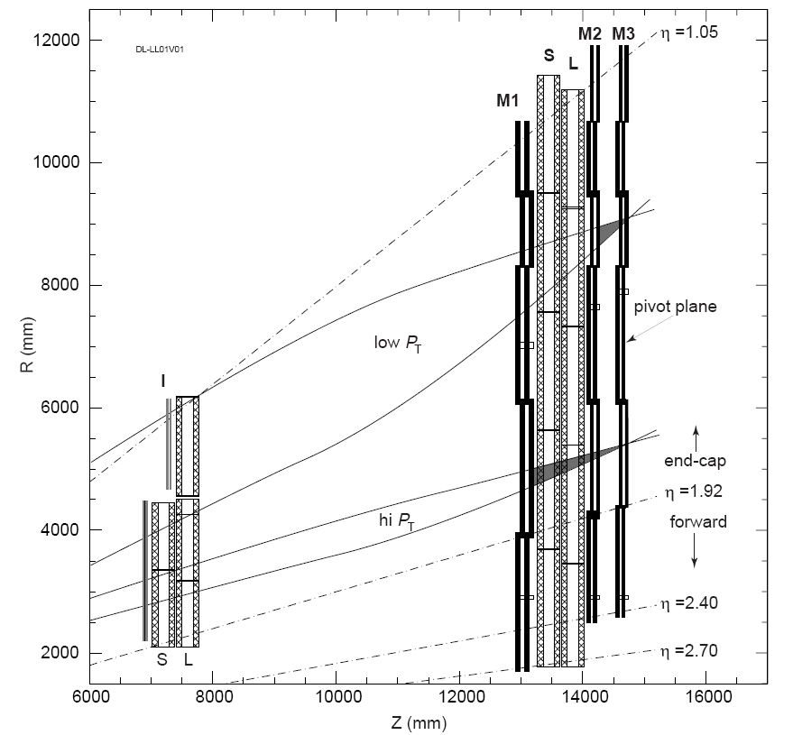
Most worrisome problem is neutrons
TGC
Shield
Try to increase neutron shielding in SW, by combining Tracking and trigger
While installing neutron shielding behind SW
One has to construct 3m long detectors that contain 8 tracking layers and fit in ~30cm

Slide 5
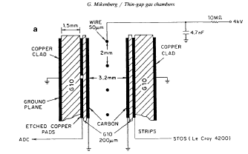

Slide 6
Proposed arrangement for SW
Transition between two
Gas volumes occurs at 4
Places in each multilayer
To allow relative alignment
With tracks
Each multilayer is precise
To ~microns by construction
12cm
3m
Notice different
Scales
: Intended arrangement for the replacement for the detectors in the Smal Wheel. Notice the different scales in the radial dimensions (3m in radius) and in the thickness (120mm total thickness). Each module consists of 2 multilayers, each layer (50mm thickness) containing 4 gas gaps (each gas gap made of 2 chambers in the radial direction, but staggered with respect to its neighbor, for relative alignment). Each gap provide 3 coordinates (radial strips, radial pads and azimuthal wires).

Slide 7
Prototype under construction

Slide 8
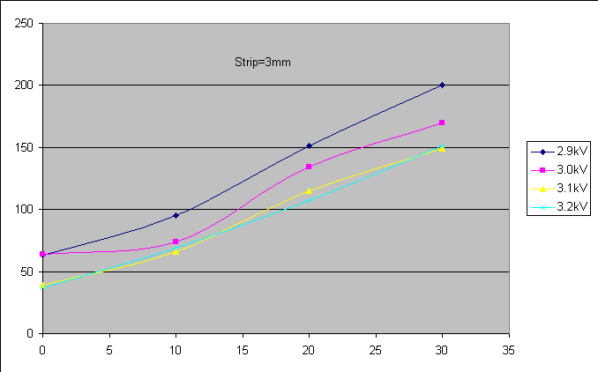
Results obtained in previous test beam (T9)
Resolution in
microns
Angle of incidence in DEG
With 3mm strips, a position resolution of <150 microns has been achieved for Angles<20DEG

Slide 9
Conclusions
Not all previous technologies are necessarily bad.
For the very forward region one should seriously think about combining trigger and tracking in a single type of detector to be able to have the maximal number of layers.
This is particularly important for the SW region, where one must have high efficiency (>98%) to be able to perform any MUON measurement.
TGC’s with small resistivity cathodes have been irradiated to a total charge of 6Coulomb/cm, showing no performance deterioration.
A full size prototype that has all the characteristics needed for the SW at the SLHC is being completed and will be tested in may 2009.

Slide 10
TileMuon Trigger
Scopo: ridurre la rate di noise da background ad alta luminosità in caso di L1 Muon Barrel rate troppo elevata;
Viene utilizzato il layer esterno del tile;
Si richiede la coincidenza tra il tile ed il L1 Muon Barrel;
L’hardware per l’input del tail nel L1 Muon Barrel è già stato previsto nel trigger attuale, attraverso 32 bit di ingresso a ciascuna delle 64 schede Sector Logic (via una scheda sussidiaria adiacente);
Il punto più rilevante da affrontare è la diversa segmentazione in eta e phi dei due subdetectors;
Gruppi impegnati: Roma1, Roma2, Rio de Janeiro.

