Slide 1

LHC status and prospects for Run II and beyond
M. Giovannozzi
CERN – Beams Department
On behalf of the LHC commissioning teams
Acknowledgements: A. Apollonio, G. Arduini, H. Bartosik, F. Bordry, R. Bruce, R. De Maria, W. Höfle, G. Iadarola, M. Lamont, A. Langner, K. Li, E. Métral, G. Papotti, S. Redaelli, G. Rumolo, R. Tomás, J. Uythoven, J. Wenninger, EiCs, Operators, and commissioning teams
Aperitivo scientifico – University of Bologna, Dep. of Physics and Astronomy

Slide 2
Outline
Introduction: Run 1, LS1, and hardware commissioning
Run 2: highlights from commissioning and 2015 run
Run 2: perspectives for 2016
…and beyond
Summary and outlook

Slide 3
Setting the scene
LS2 starting in 2018 (July) => 18 months + 3 months BC
LS3 LHC: starting in 2023 => 30 months + 3 months BC
Injectors: in 2024 => 13 months + 3 months BC
Physics
Shutdown
Beam commissioning
Technical stop
(Extended) Year End Technical Stop: (E)YETS
30 fb⁻¹
YETS
EYETS
YETS
LS 2
YETS
Run 2
Run 3
Run 2
LS 2
Run 3
PHASE 1
YETS
LS 3
Run 4
YETS
LS 3
Run 4
300 fb⁻¹
PHASE 2
LS 4
Run 5
LS 5
LS 4
Run 5
LS 5
Goal of 3’000 fb-1 by mid 2030ies

Slide 4
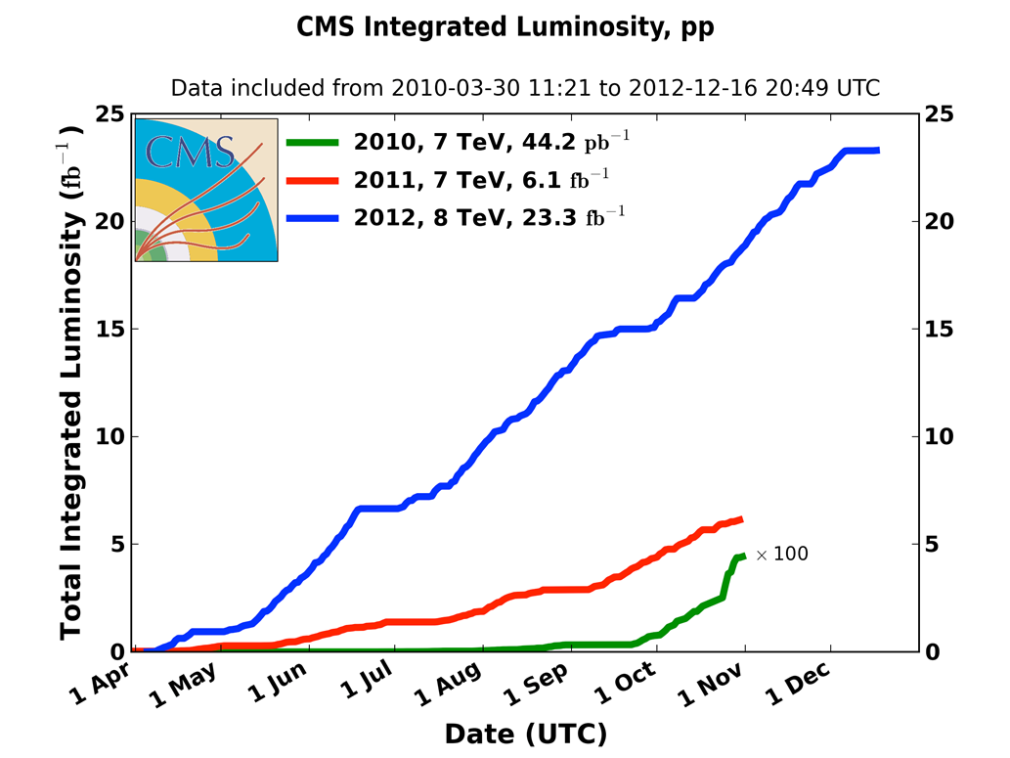

Run 1 luminosity
18 June: end running period ~6.7 fb⁻¹ for summer conferences

Slide 5
Run 1 performance
 | 2010 | 2011 | 2012 | Nominal
Beam energy [GeV] | 3500 | 3500 | 4000 | 7000
Bunch spacing [ns] | 150 | 50 | 50 | 25
No. of bunches | 368 | 1380 | 1380 | 2808
β* [m] ATLAS and CMS | 3.5 | 1.0 | 0.6 | 0.55
Bunch intensity [protons/bunch] | 1.2 x 10¹¹ | 1.45 x 10¹¹ | 1.7 x 10¹¹ | 1.15 x 10¹¹
Norm. emittance [mm.mrad] | ~2.0 | ~2.4 | ~2.5 | 3.75
Peak luminosity [cm⁻²s⁻¹] | 0.02 x 10³⁴ | 0.37 x 10³⁴ | 0.77 x 10³⁴ | 1 x 10³⁴

Slide 6
LS1 activities and goals
Main motivation for LS1:
Consolidation of the Large Hadron Collider to enable the operation at the design energy of 7 TeV.
  This goal had to be achieved through (amongst others...):
  - Consolidation of superconducting splices (10170 splices, 27000 shunts!);
  - Installation of 5000 new electrical insulation systems;
  - 612 new relief valves installed.
Timeline: Feb. 2013 - Dec. 2014, followed by hardware commissioning.
Other important activities took place in the 2 year stop!

Slide 7
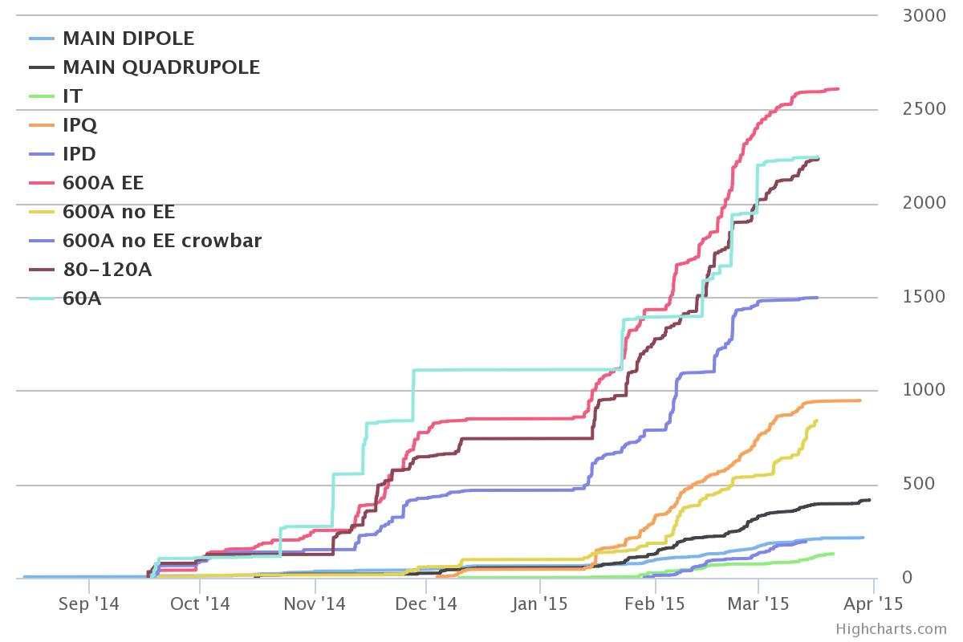
Hardware commissioning
Activities started on
September 15th, 2014.
Powering tests were completed at 8 am on Friday April 3rd
Scope of 2014-15 hardware commissioning (HWC): circuit powering and protection.
Prepare the LHC for operation at 6.5 TeV
1566 SC circuits
commissioned through
execution and analysis
of more than 10000
test steps (~13800
steps with re-execution)
Number of commissioning steps versus time
Powering system defined the duration of the HWC.
In parallel, commissioning takes place for all the other accelerator systems

Slide 8
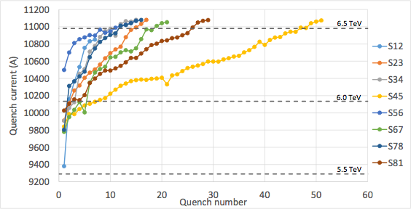
Dipole training
Target energy for 2015: 6.5 TeV.
Choice confirmed by HWC!
Sector | # Training quench | Flattop quenches
S12 | 7 | 0
S23 | 17 | 0
S34 | 15 | 1
S45 | 51 | 0
S56 | 18 | 3
S67 | 22 | 1
S78 | 19 | 3
S81 | 29 | 0
Total | 171 | 8
All LHC dipoles were trained above nominal current before installation.
Training stopped after the 2008 incident: safe operation < 4TeV.
After removing HW limitations, training started for all sectors.

Slide 9
Outline
Introduction: Run 1, LS1, and hardware commissioning
Run 2: highlights from commissioning and 2015 run
Run 2: perspectives for 2016
…and beyond
Summary and outlook

Slide 10
Priorities for 2015
The main goal of 2015 was to prepare 2016 as a physics “production run” at 25 ns. Aim at an integrated luminosity of 10 fb⁻¹.
Preparation for 2016:
1. Establish proton-proton collisions at 13TeV with 25 ns
bunch spacing.
2. Establish the operation at low β* → Start with β* = 80 cm
(conservative). Estimated ultimate reach in Run 2: ~ 40 cm 3. Determine optimum running conditions for 2016
Heavy ions: 1 month of Pb-Pb physics at the end of 2015.
2015 optics configuration is different with respect to Run 1
IR4 (B1/2): increased β-functions at key instruments and transverse damper
IR8 (B2): changed phase advance to compensate for IR4 change
IR8 (B1/2): change of crossing scheme for 25 ns bunch spacing

Slide 11
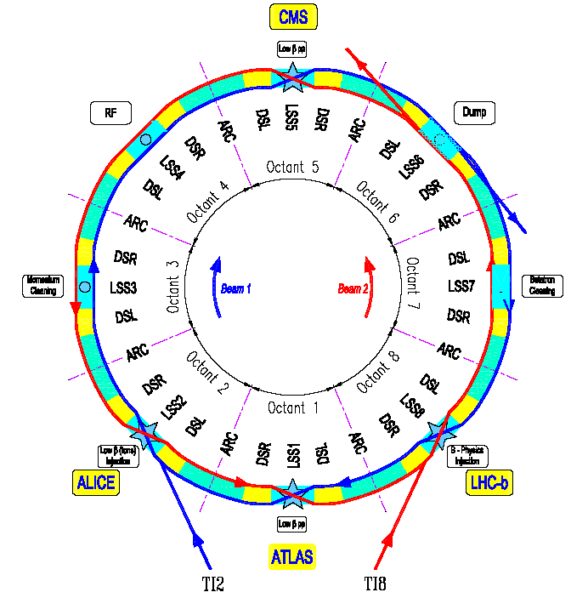
The LHC in a nutshell
The LHC machine has an height-fold symmetry.
Eight arcs (arc is the curved periodic part of the machine).
Sixteen dispersion suppressors to match the arc with the straight sections (geometry and optics).
Eight long straight sections (also called insertion regions).

Slide 12
Commissioning strategy
Low intensity commissioning of full cycle – 8 weeks
First stable beams – low number of bunches
Scrubbing for 50 ns
Intensity ramp-up with 50 ns
  Re-establish high intensity operation;
  Characterize vacuum, heat load, electron cloud, losses, instabilities, UFOs, impedance.
Scrubbing for 25 ns
Intensity ramp-up for 25 ns operation with relaxed β*
The physics programme is much richer than the high luminosity part!
  Van der Meer scans
  High-beta operation
  LHCf runs

Slide 13
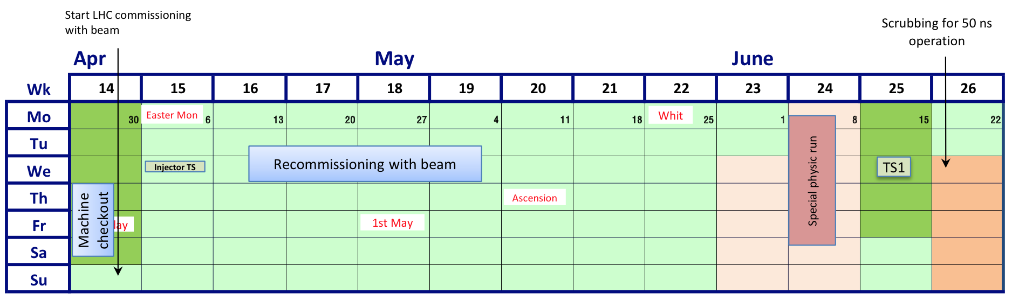
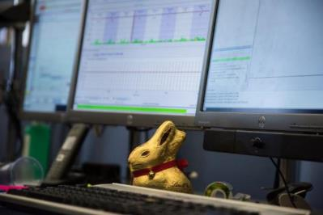
2015 schedule: Q2
LHCf PHYSICS
FIRST BEAMS 5th April
FIRST STABLE BEAMS
3rd June
PILOT PHYSICS
Pilot physics – up to ~40 bunches per beam
5 days special physics at β* = 19 m for LHCf, (VdM, TOTEM, and ALFA postponed)
Integrated luminosity for LHCf: more than 16 nb⁻¹ (requested 10 nb⁻¹)

Slide 14
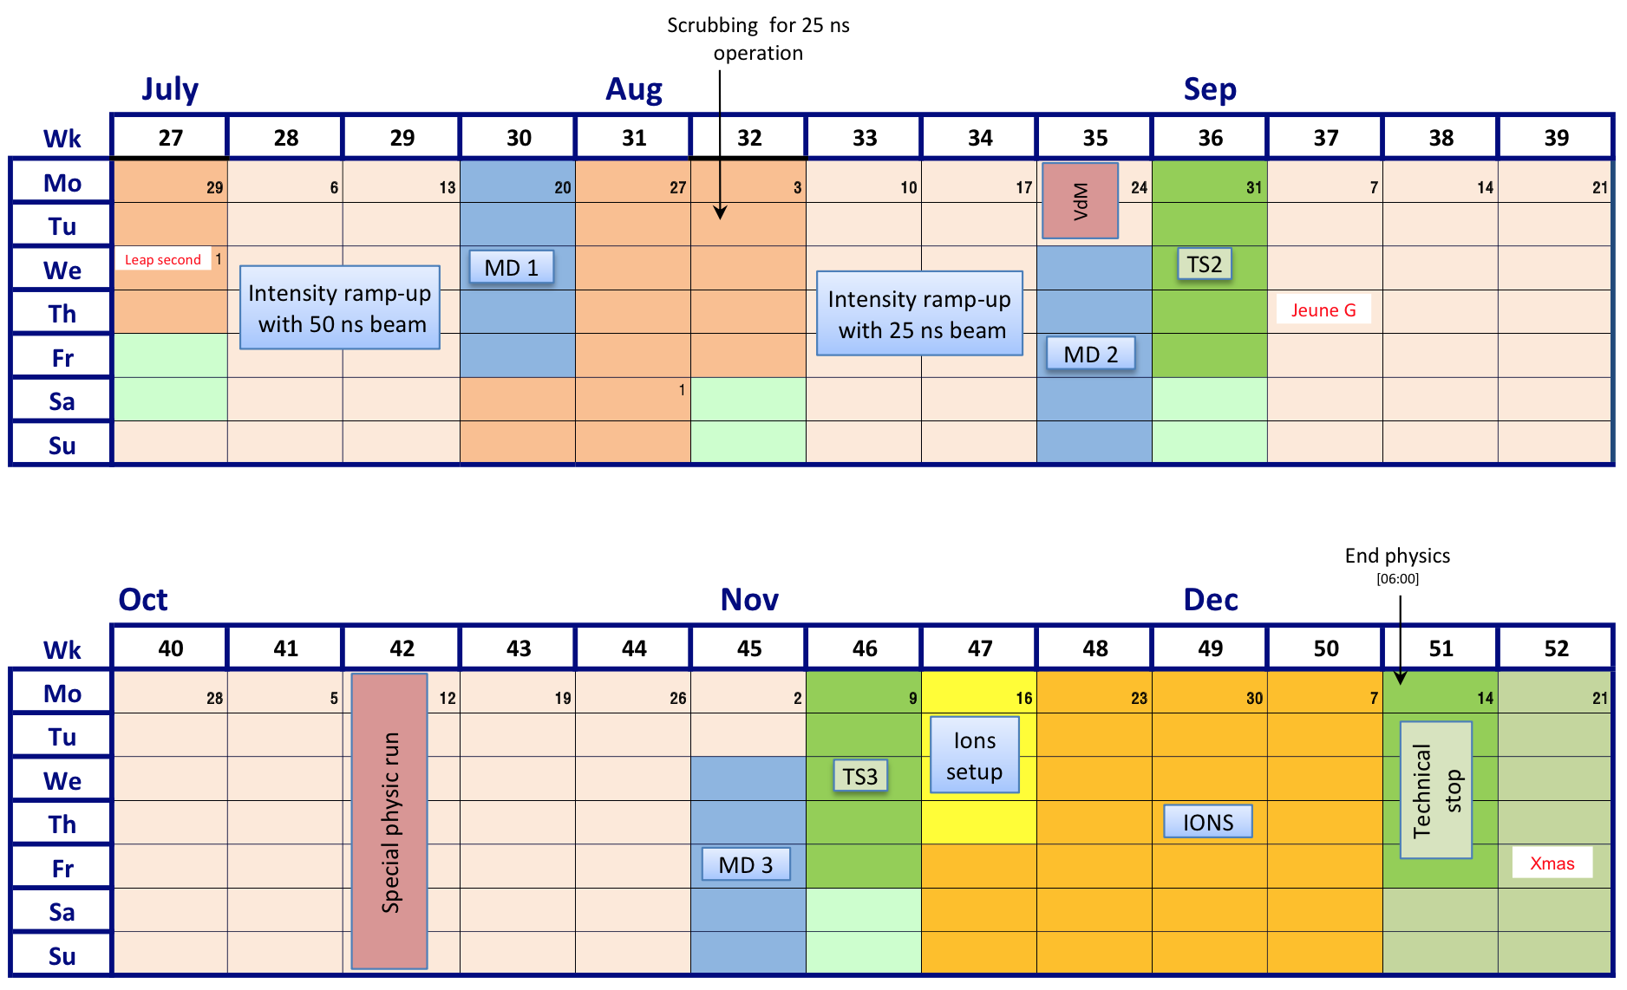
2015 schedule: Q3/Q4

Slide 15
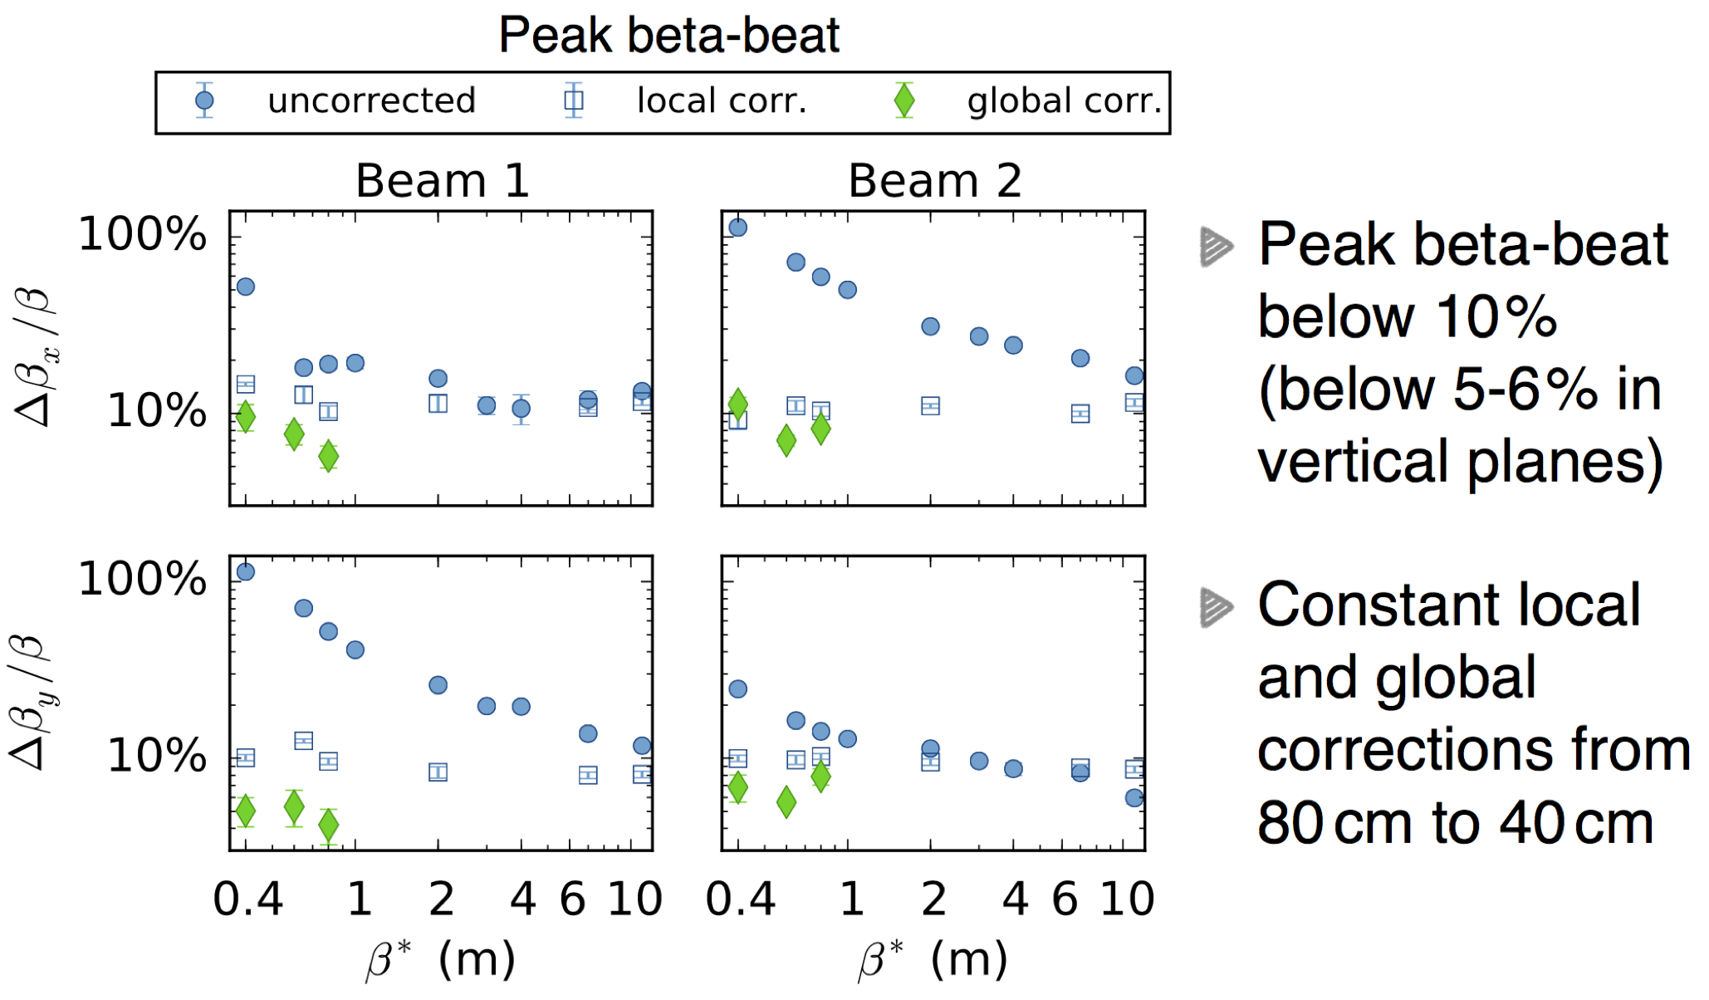
Highlights from 2015: Optics
Courtesy A. Langner

Slide 16
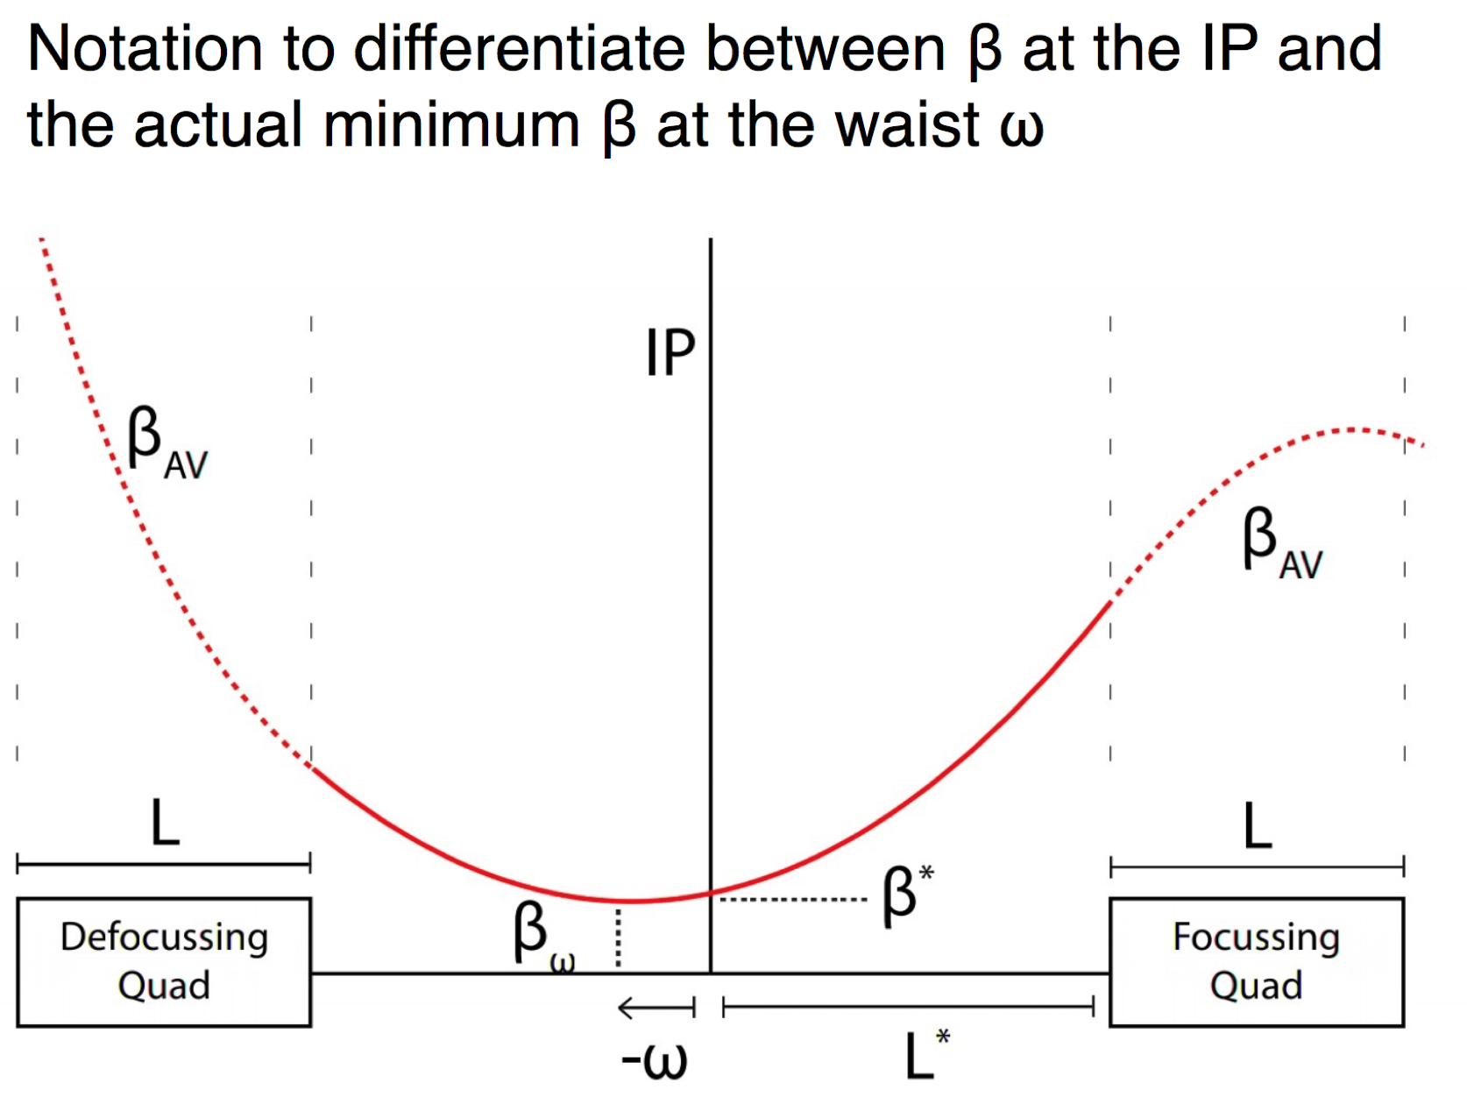
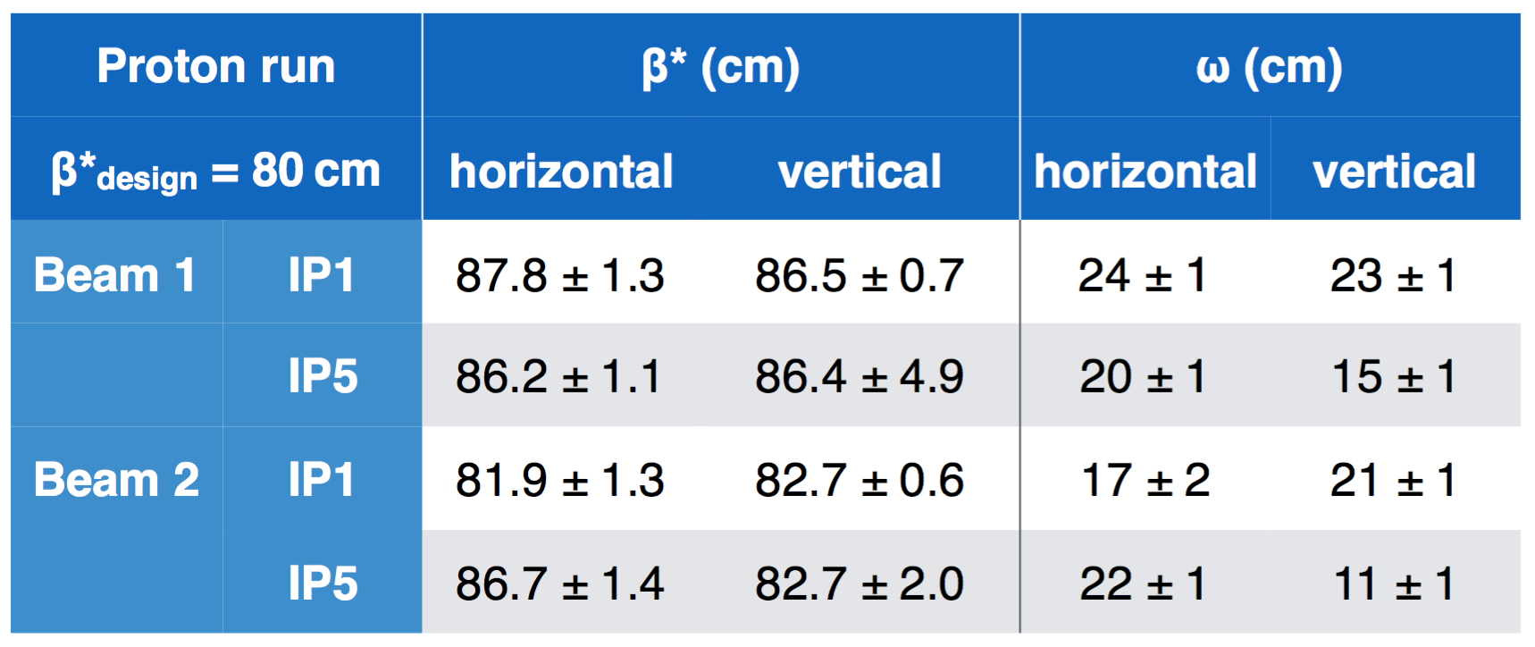
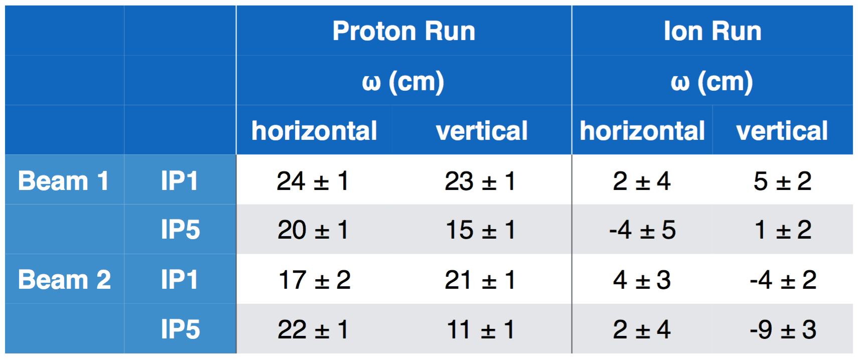
Highlights from 2015: Optics
Optics control is becoming more and more demanding.
Courtesy A. Langner
Waist position can be successfully adjusted.
The impact on luminosity can be up to 3-5%.

Slide 17
Highlights from 2015:
Electron-cloud
Schematic of electron-cloud build up in the LHC beam pipe during multiple bunch passages, via photo-emission (due to synchrotron radiation) and secondary emission.
Courtesy F. Ruggiero

Slide 18
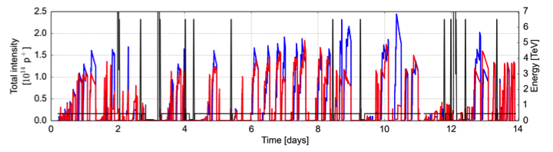
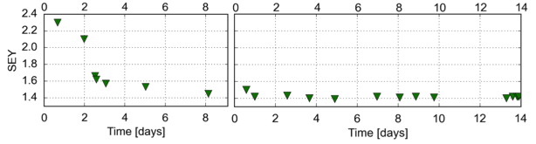
Electron cloud (25 ns)
Courtesy G. Iadarola
Scrubbing Run provided sufficient mitigation against beam degradation at 450 GeV but full suppression of the e-cloud was not achieved
    During the physics intensity ramp-up the machine was in the presence of the e-cloud
Beam stability at 450 GeV problematic: need for high chromaticity strong octupoles and full transverse damper performance

Slide 19
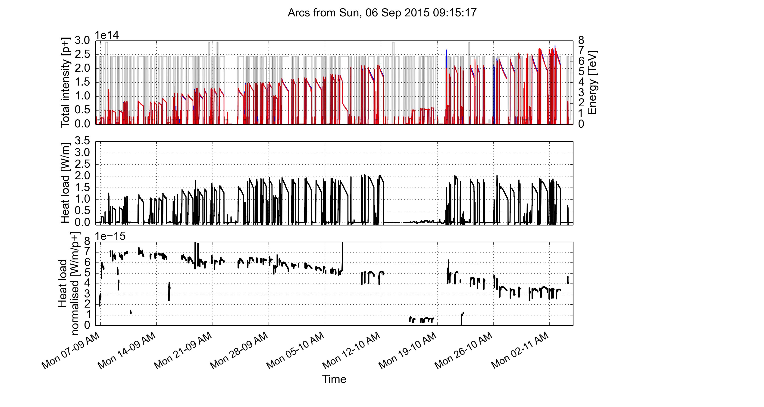
Scrubbing accumulated during the physics run
High β*
Filling pattern
72 bpi
144 bpi
72g72
72g72
(4x36) bpi
100 ns
Target b. length
1.25 ns
1.3 ns
1.35 ns
1.35 ns
Courtesy G. Iadarola

Slide 20
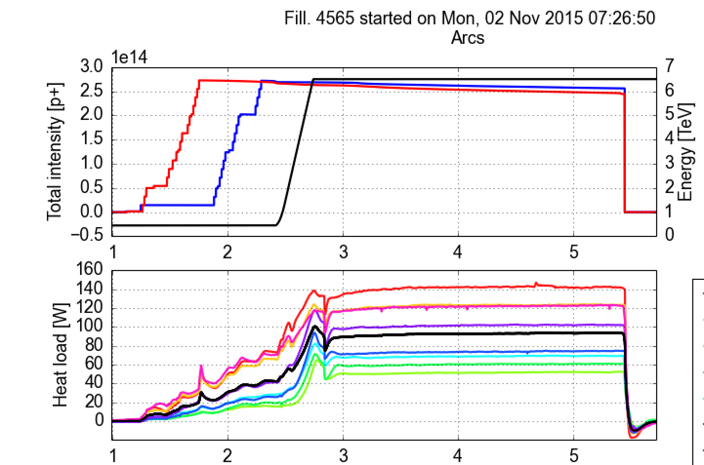
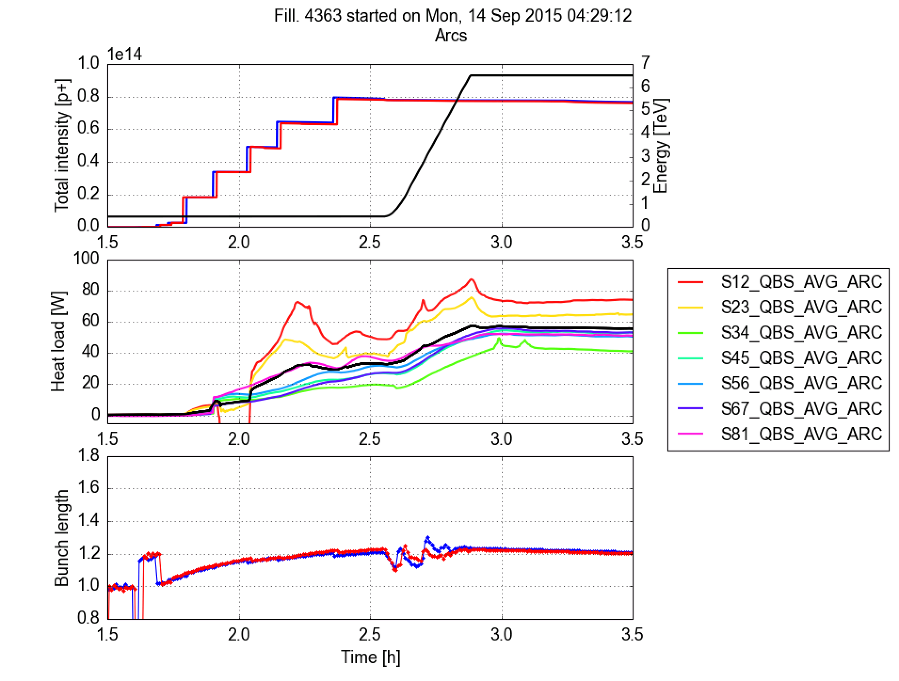
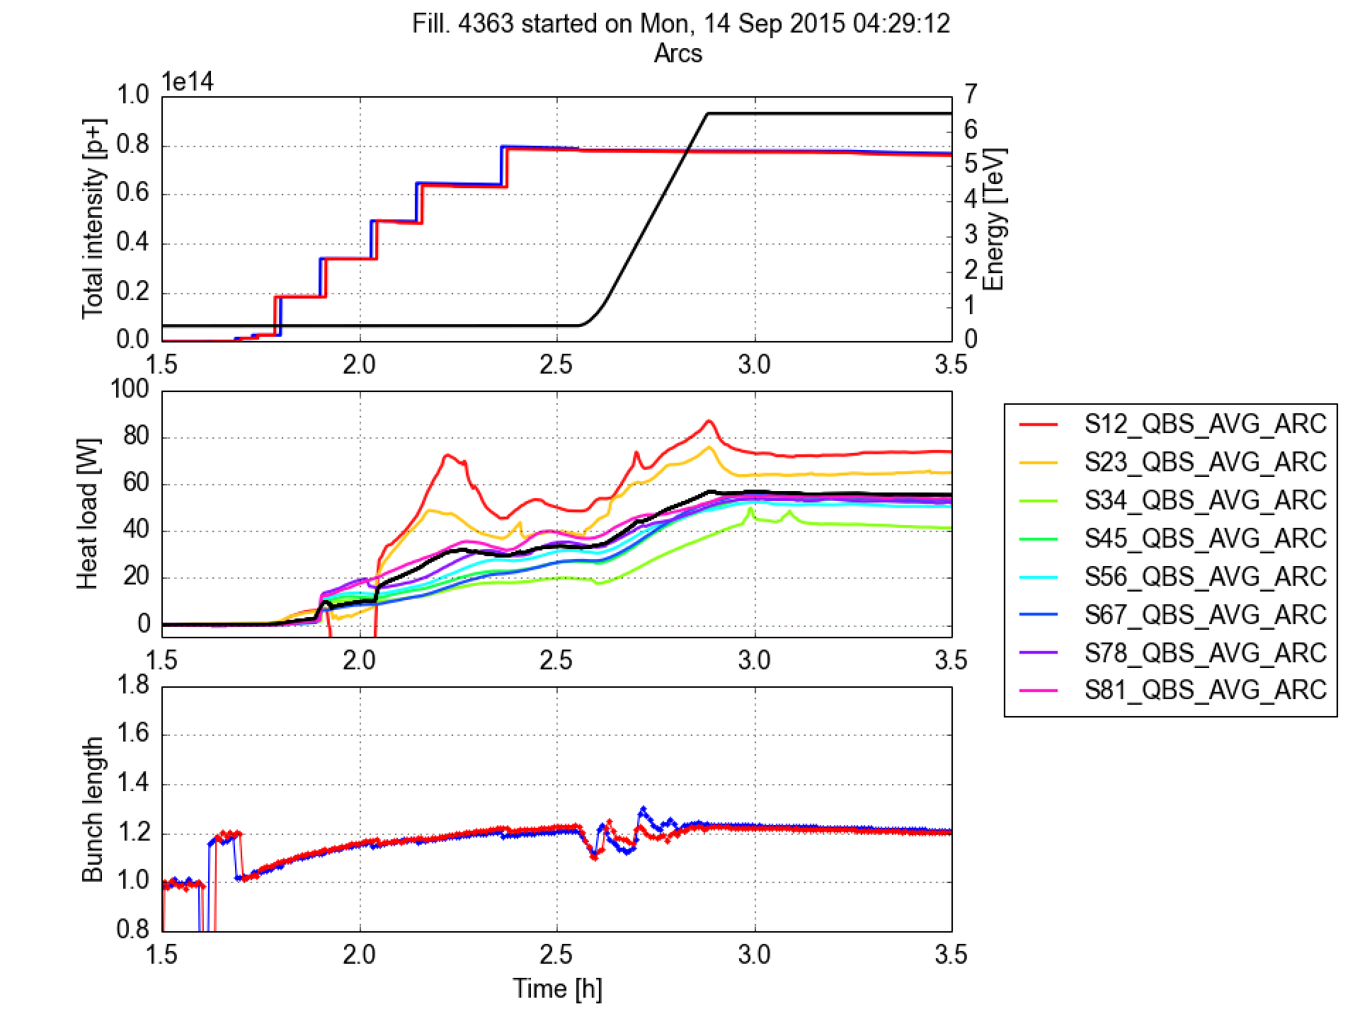
Situation at the end of the p-p run
Achieved in 2015: 2244b. in trains of 36b.
2244b.
Factor 3 spread among heat loads in different sectors
Sectors 81, 12 and 23 close to the limit with this filling scheme
Sectors 34, 45, 56, 67 (and cold magnets in IRs) have already enough margin to accommodate the nominal beam
Avg. per half cell
Average
Impedance+synch. rad
Courtesy G. Iadarola

Slide 21
Collective effects
Collective effects had been in action throughout the whole 2015 driven by:
  Electron cloud
  Beam-beam
  Impedance
They required to run the LHC with
  High chromaticity
  Strong octupoles
  High damper gain
We managed, but we are pushing beam dynamics to the limits…

Slide 22
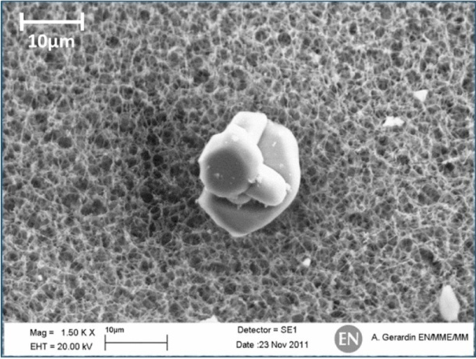
Highlights from 2015: Unidentified Falling Objects
A possible explanation for UFO:
  A macroparticle falls from the top of the beam screen. The mechanism for the release of the particle is not well understood.
  The macroparticle is ionized by the primary the protons in the beam.
  At the same time, inelastic collisions result in particle showers that heat the SC coils and are registered in the BLMs.
  The positively ionized macroparticle is subsequently repelled from the beam due to the beam electric field.
R~10 µm
Courtesy B. Auchmann

Slide 23
Highlights from 2015: UFOs
Rates of registered UFOs in Arcs and DSs at 6.5 TeV.
Scrubbing
Scrubbing
End of pp
50 ns
25 ns
normalized to intensity
TS1
MD1
MD2/TS2
special physics
1/2
Courtesy B. Auchmann
Is a ratio of 10 UFOs/hr already the asymptote?

Slide 24
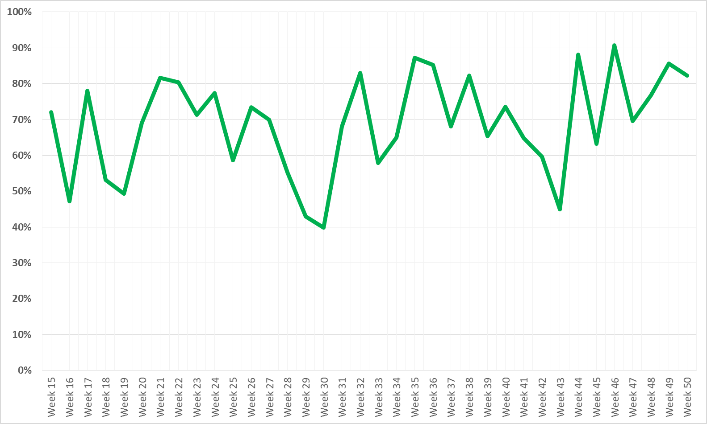
LHC availability
Courtesy A. Apollonio
69 %
Cryo CV + SPS magnet replacement
Linac2 HV Cable
Earth fault + cryo valve replacement + LBDS self trigger + ADT
Earth fault RCS.A78B2 + QPS mBS SEUs
Availability = (Total Time – Downtime) / Total Time
Beam Commissioning
Sp. Ph.
TS
Scrub.
RU
50
MD
Scrub.
RU
25
MD
TS
25 ns Run
MD
TS
IS
Ion Run

Slide 25
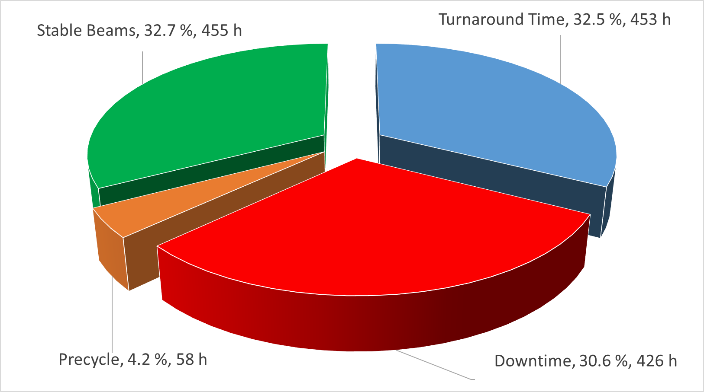
Availability for physics – 25 ns
Courtesy A. Apollonio
70 fills
22 End Of Fill, 48 dumped due to faults
Fraction of premature dumps: 48/70 = 68.6 %
Average turnaround (per SB) = 453/70 = 6.5 h
Average Fault time (per SB) = 426/70 = 6 h

Slide 26
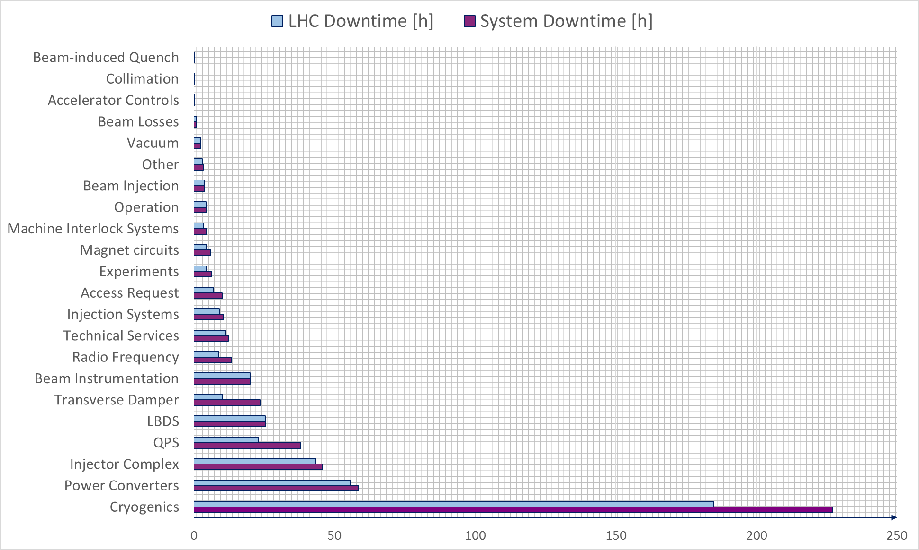
Operational efficiency
Courtesy A. Apollonio
LHC downtime: filtering faults occurred in the shadow of others
System downtime: NOT filtering faults occurred in the shadow of others

Slide 27
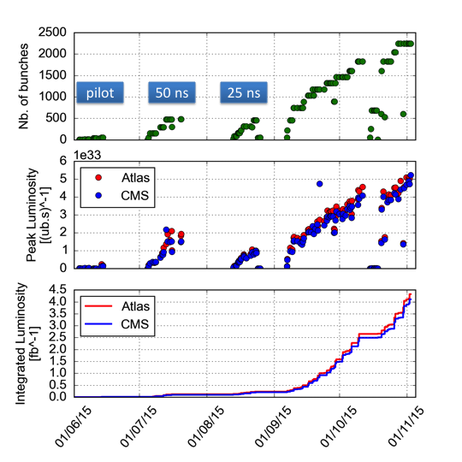
Final performance achieved
Maximum number of bunches limited by
  machine protection
  e-cloud

Slide 28
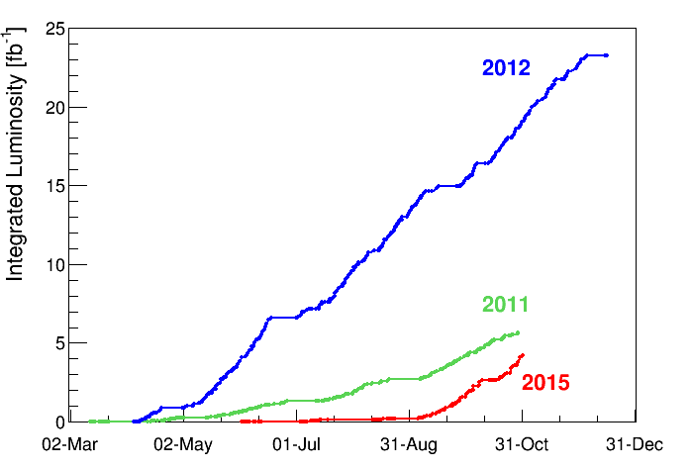
Final performance achieved
The initial projections of integrated luminosity for 2015 were ~ 8-10 fb⁻¹. Achieved ~ 4.3 fb⁻¹.
Slope at the end of the run close to 2012 slope (last week of operation > 1 fb⁻¹)
The main reasons for the lower value:
Start-up delays (~ 4 weeks),
- Availability issues:
radiation failures on the quench protection tunnel electronics; solved after TS2
- Electron clouds mitigation

Slide 29
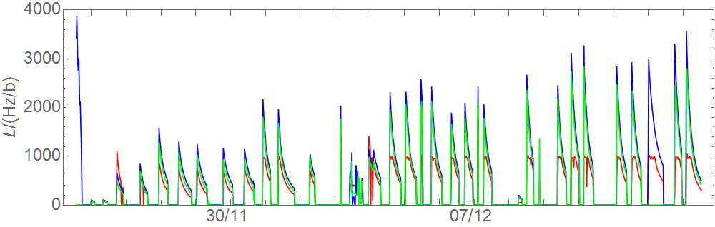
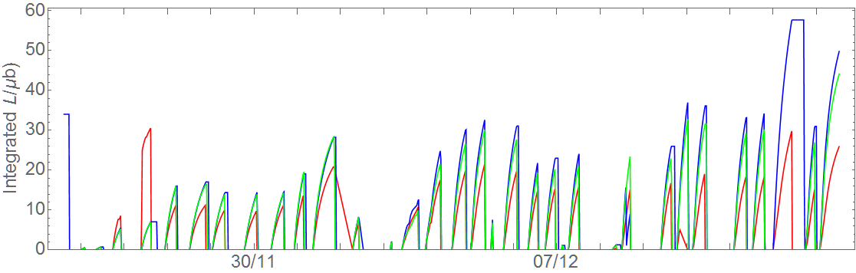
Heavy ions in the end…
k_{b}=474
Start of HL-LHC HI
Van der Meer scans
k_{b}=518
k_{b}=426
Source refill
ALICE polarity reversal
k_{b}=250
Design luminosity
`Crystal
coll. MD
k_{b}=10-50
Collimation quench test
25/11
BFPP quench test&recovery
LHCb should have about 2% of ATLAS
18 days
ATLAS
ALICE
CMS
Integrated luminosity in each fill
25/11
Courtesy J. Jowett

Slide 30
Outline
Introduction: Run 1, LS1, and hardware commissioning
Run 2: highlights from commissioning and 2015 run
Run 2: perspectives for 2016
…and beyond
Summary and outlook

Slide 31
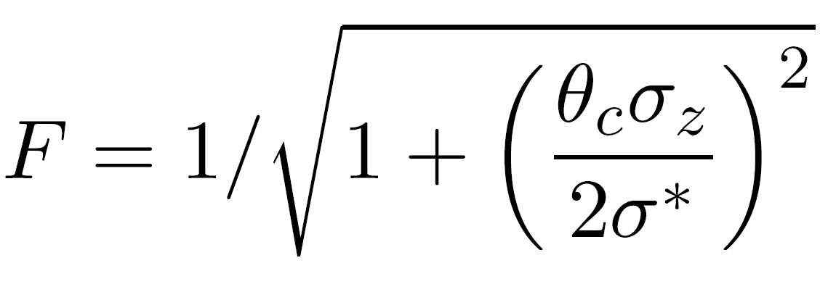
Possible parameters for 2016 run
Different strategies to improve LHC:
  Reduce β*
    Implies available beam aperture (larger beam size in the triplets, larger crossing angle for beam-beam separation)
    Implies good control of the optics (linear and nonlinear)
    Implies good control of orbit stability for collimator system
  Increase beam intensity
    Number of bunches -> control of e-cloud and collective effects (instabilities and beam-beam)
    Intensity/bunch -> control of collective effects and beam losses
  Increase beam brightness
    better performance at the level of the LHC injectors, but special beams have been already developed and are available.
    good control of emittance over the LHC cycle

Slide 32
Performance expectations
Figures absolutely unofficial!!!
Courtesy M. Lamont
Energy | 6.5 TeV
Bunch spacing | 25 ns
Bunch population | ~1.25e11
Max bunches/injection | 288
Max. number bunches | 2748
Nc GPDs | 2736
Emittance exit SPS | 2.7 mm.mrad
Emittance into SB | 3.4 mm.mrad
Beta* GPDs | 40 or 50
Crossing angle GPDs | 185 or 165
Peak luminosity (10³⁴ cm⁻²s⁻¹) | 1.1 or 1.0
Integrated per 150 days (fb⁻¹) | 33.2 or 30.7

Slide 33
Outline
Introduction: Run 1, LS1, and hardware commissioning
Run 2: highlights from commissioning and 2015 run
Run 2: perspectives for 2016
Perspectives for the rest of Run 2
…and beyond
Summary and outlook

Slide 34
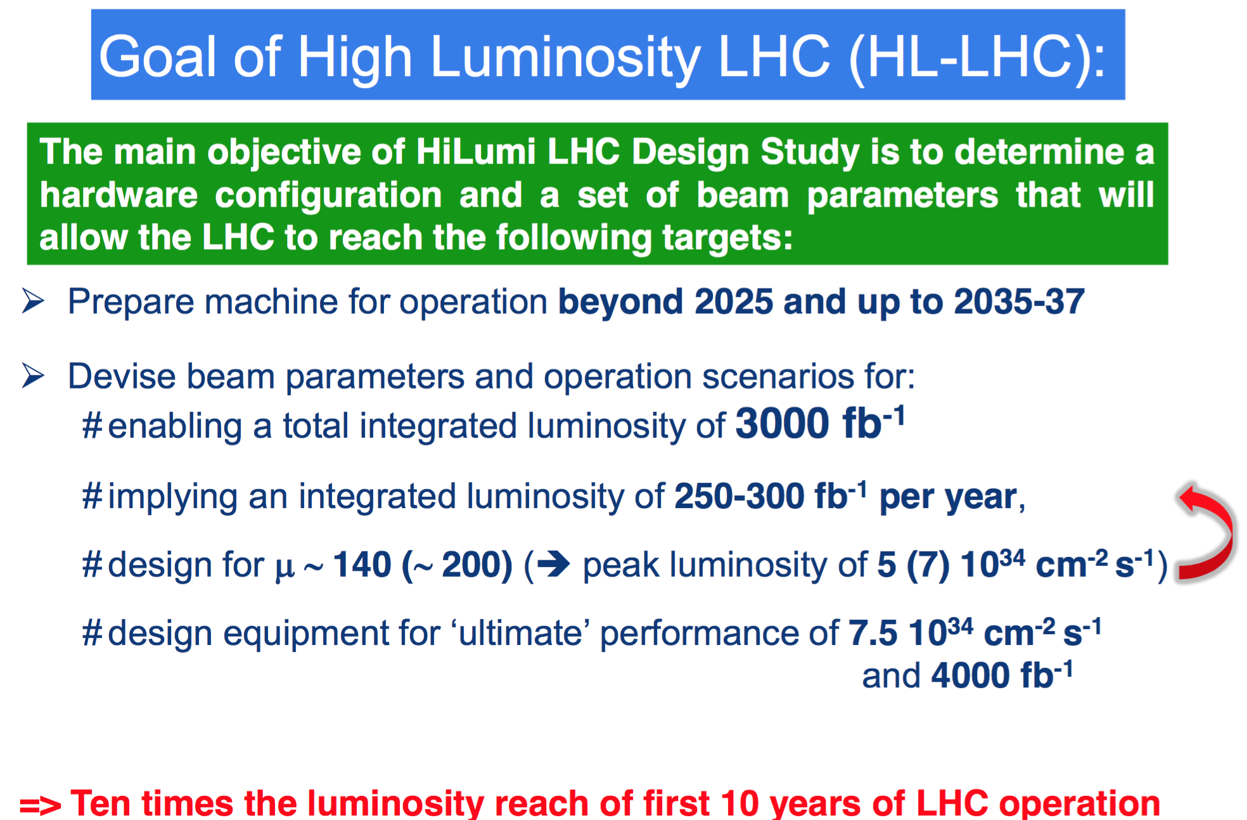
The future of LHC: HL-LHC
Courtesy F. Bordry

Slide 35
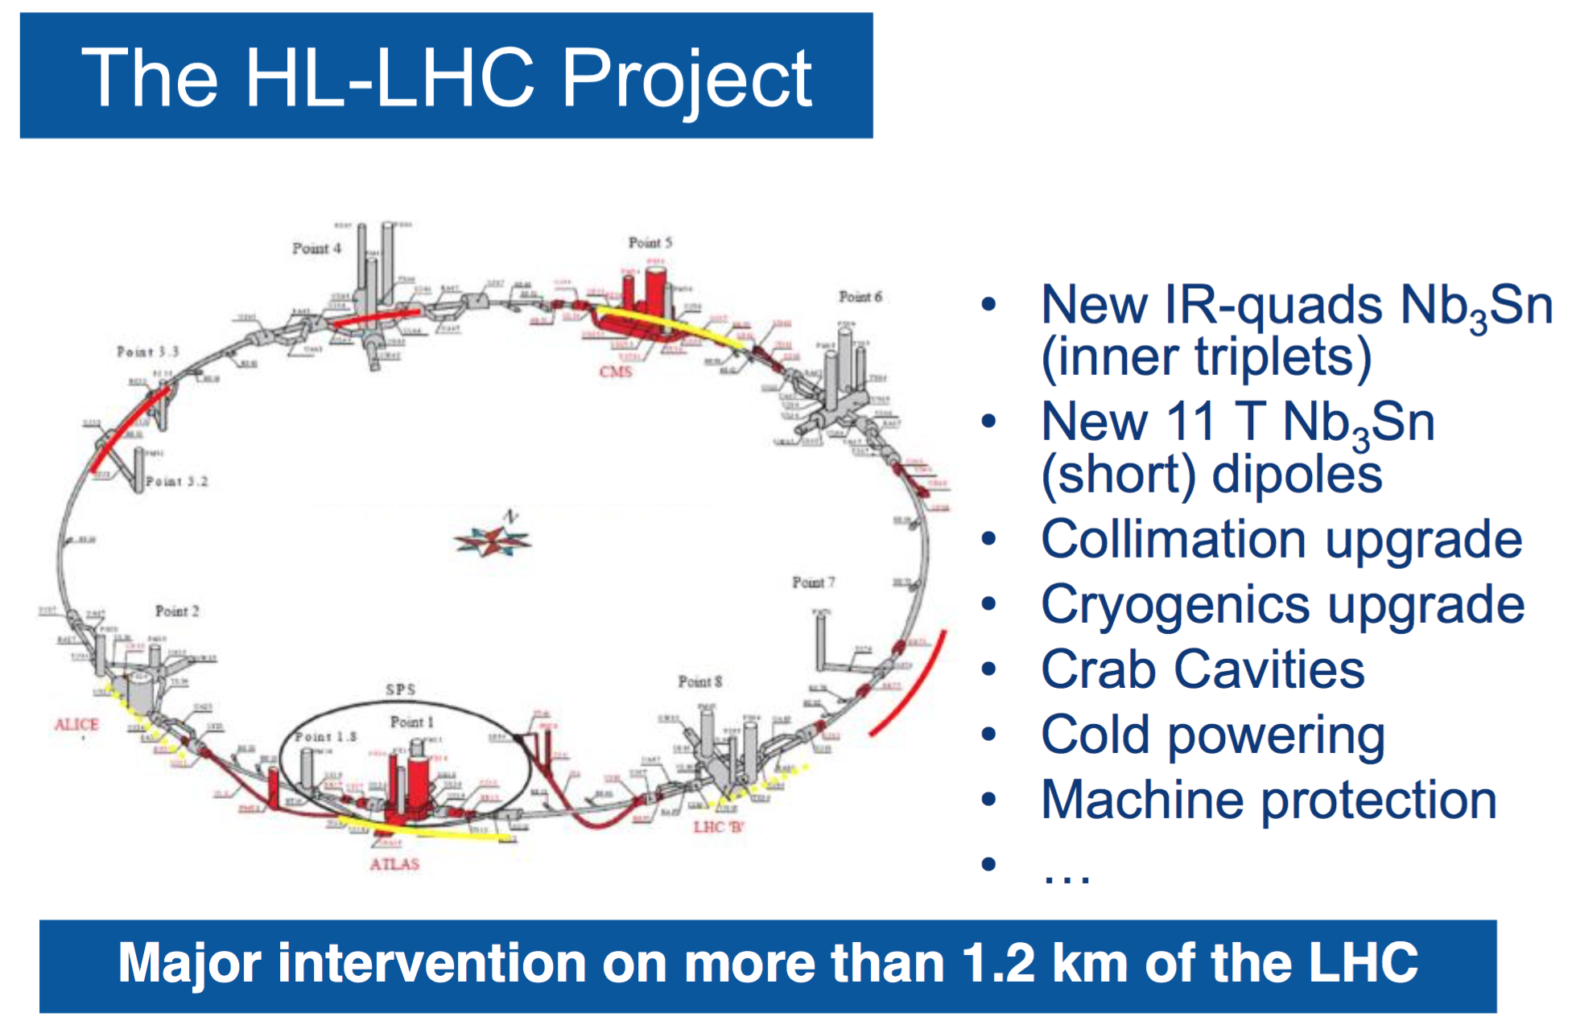
The future of LHC: HL-LHC
Courtesy F. Bordry

Slide 36
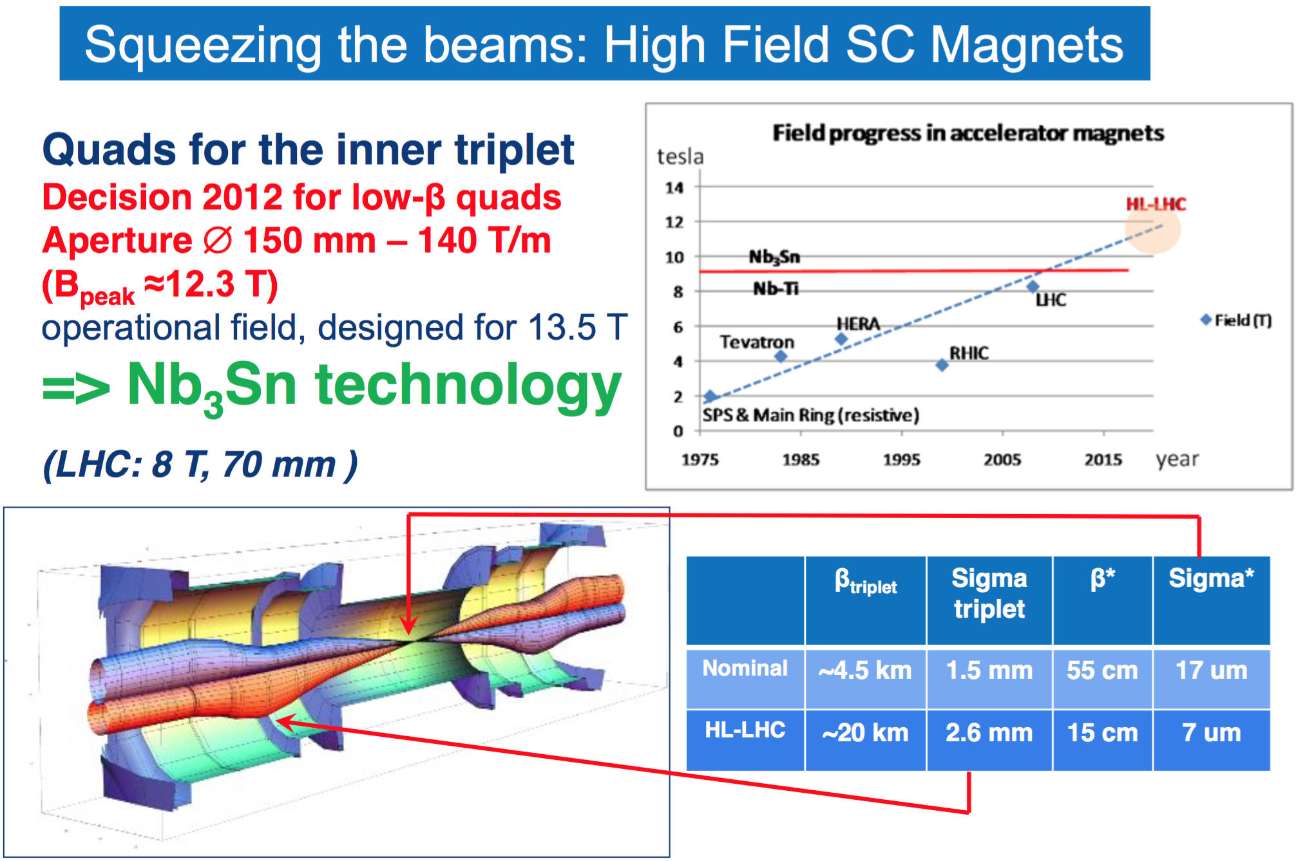
The future of LHC: HL-LHC
Courtesy F. Bordry

Slide 37
The future of LHC: HL-LHC
HL-LHC will be not only a challenge in terms of technology, but also in terms of beam dynamics:
  Unprecedented small beta* (implying huge betas in triplets): excellent control of optics needed.
  Strong beam-beam effects: need to find mitigation measures (e.g., wires to compensate for beam-beam interaction)
  Need to mitigate very large crossing angles restoring good overlap between colliding bunches using innovative techniques (crab cavities)
  Control of collective effects and instabilities
  Ensure halo control using novel techniques (e.g., electron lenses)
  …

Slide 38
Outline
Introduction: Run 1, LS1, and hardware commissioning
Run 2: highlights from commissioning and 2015 run
Run 2: perspectives for 2016
Perspectives for the rest of Run 2
…and beyond
Summary and outlook

Slide 39
Summary and outlook
The LHC has been brought out of the long shutdown and successfully commissioned. Physics programme with 25 ns has been also accomplished.
Challenges ahead of us:
  Electron cloud: Scrubbing run successful, but heat load is still high (in particular in some sectors). We will have to live with electron-cloud…
  Instabilities and beam-beam effects: made LHC operation in 2012 challenging. In 2015 they already showed signs of presence…
  UFOs: Conditioning effect observed, not a problem in 2015…
  Beam induced heating and radiation to electronics: mitigation measures implemented during LS1 and proved their effectiveness in 2015.
  Machine availability: very good in 2015. It will be a key for the production in 2016

Slide 40
Summary and outlook
Successful, high-performance particle accelerators require
  Mastering state-of-art technology
  Ensure excellent availability and high average performance
These are certainly necessary conditions
But…
  Understanding and mastering beam physics is a key to a successful exploitation of these marvellous tools!

Slide 41
Thank you for your attention

Slide 42
Reserve slides

Slide 43
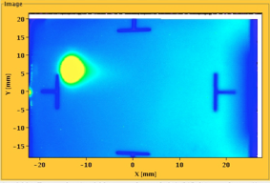
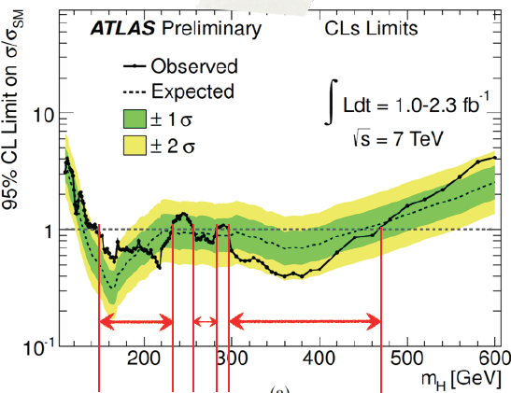
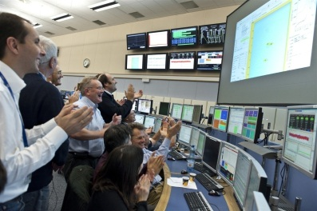


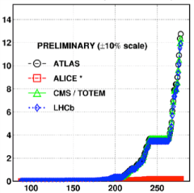
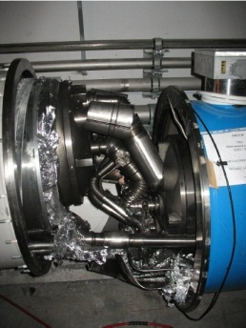
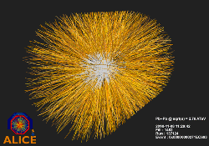
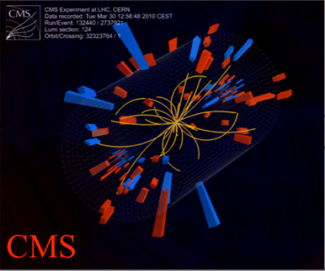
Run 1 overview
August 2008
First injection test
November 29, 2009
Beam back
August, 2011
2.3e33, 2.6 fb⁻¹
1380 bunches
June 28 2011
1380 bunches
September 10, 2008
First beams around
4 July, 2012
October 14 2010
1e32
248 bunches
1380
6 June, 2012
6.8e33
December 2012
23.3 fb⁻¹ delivered
2008
2009
2010
2011
2012
March 30, 2010
First collisions at 3.5 TeV
November 2010
Ions
18 June, 2012
6.6 fb⁻¹
to ATLAS & CMS
September 19, 2008: Disaster
Accidental release of 600 MJ stored in one sector of LHC dipole magnets
February, 2013
p-PB run, then start of 1st long shutdown (LS1)

Slide 44
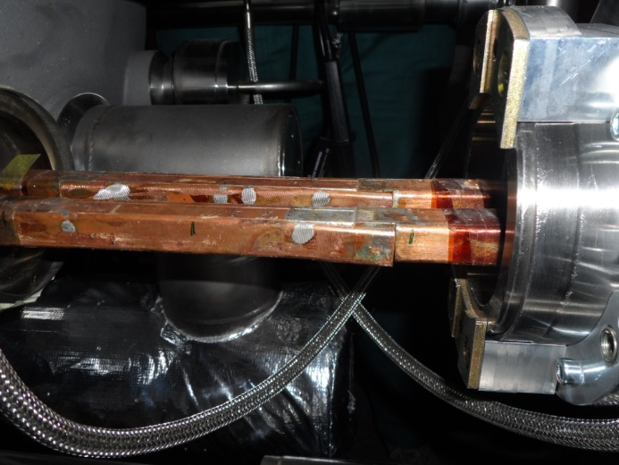
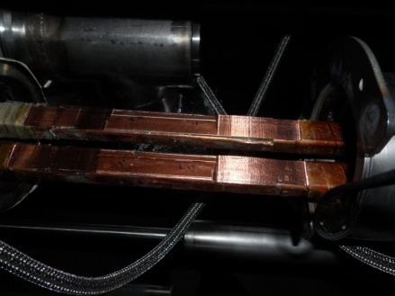
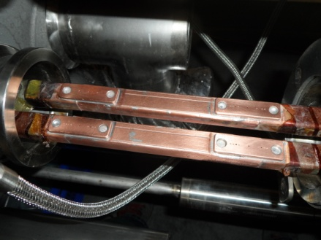
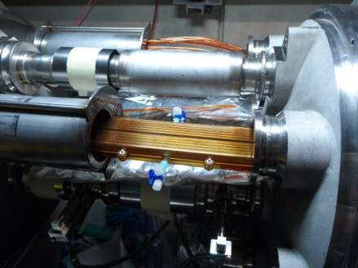
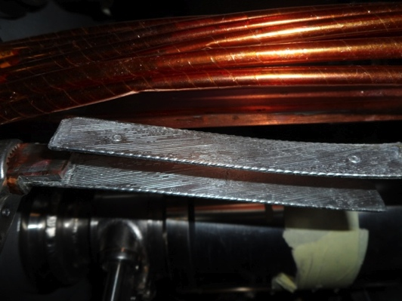
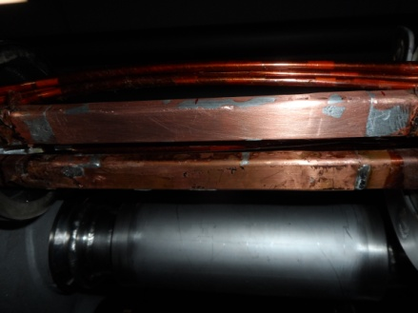
Splice consolidation process
Old splices
10170 splices
Machined splices
Consolidated splices including shunts
> 27000 shunts
30% of the splices (initially estimated at 15%)
~ 3000
Unsoldering of splice and superconducting cables
Reconstruction and soldering of splice and super-conducting cables
Consolidated and
insulated splices
Total interconnects: 1695 (10170 high current splices). Number of splices redone: ~3000

Slide 45
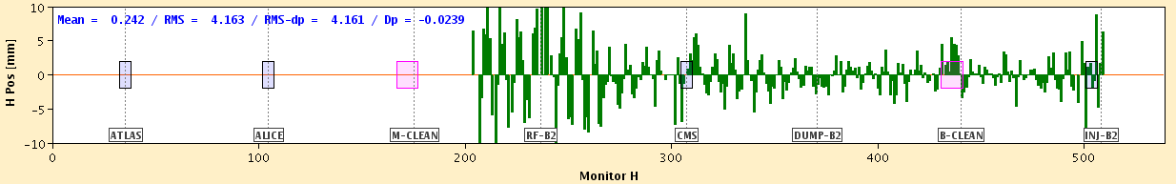
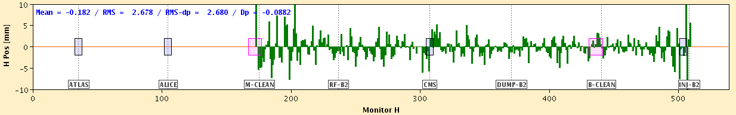
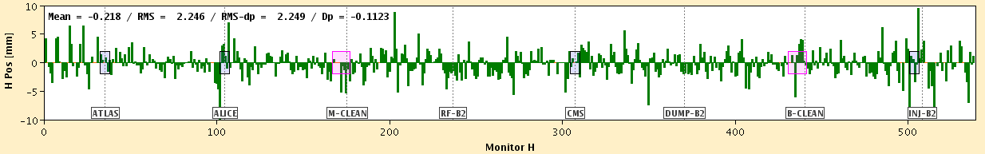
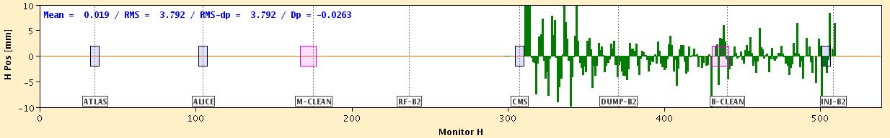
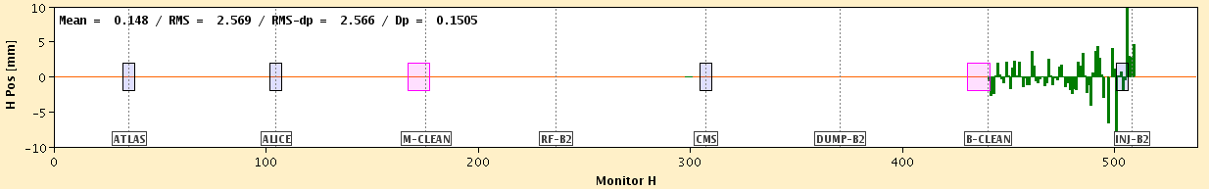
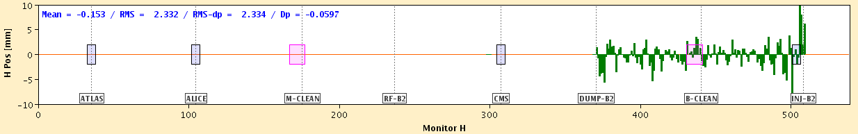
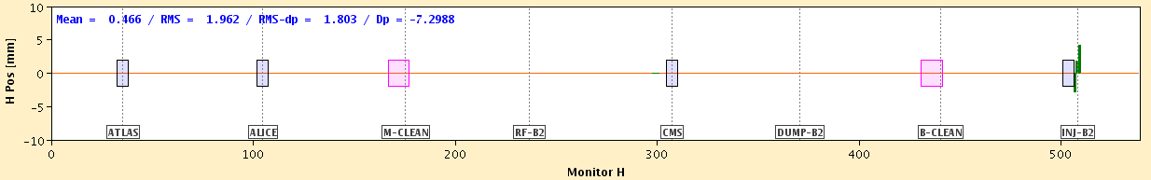
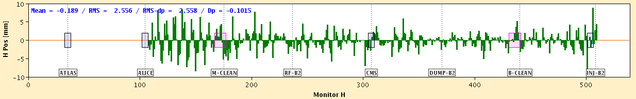










Easter beam threading
After completion of the HWC of the two sectors kept on hold, beam commissioning started on the Easter Sunday, April 5th.
Threading of B2 started at 10:12, ended 10:41.
Followed by 1 hour of work to establish a closed orbit and circulate more than 25 turns.
Threading of B1 started at 11:54, ended 12:26.
Almost immediately obtained a closed orbit and more than 25 turns.
Horizontal
Vertical
Courtesy J. Wenninger

Slide 46



The first hurdle
A short to ground developed in sector 34 on March 21st, during current decay following a training quench.
Fault location identified on March 24th: R < 0.2 Ω at the anode diode lead of a main dipole: suspect a metallic debris.
After tests in the lab, it was decided to try and
vaporize/displace the debris through a capacitive
discharge through the short.
The short was successfully removed on
March 30th, later confirmed by
re-qualification.
Courtesy A. Siemko

Slide 47



The second hurdle
Various dump of B2 triggered after ~10-15 min at flat top by BLMBI.15R8.B0T20_MBA-MBB. Suspected multiple UFO events.
Initially, aperture scans did not identified any apparent reduction.
After the local warm up of the beam screen a reduction of aperture has been observed corresponding to an obstacle lying on the beam screen (ULO).
40 μs int. time
4-corrector bump in V plane
3-corrector bump in H plane
Q15
B15=1.14*Q15
Q15
B15=0.86*Q15
Q14
Q16

Slide 48


Aperture measurements in 15R8.B2
Cut applied with IR7-TCPs: 4σ_{y} and 3σ_{x}
Step of 2-3mm for H bumps, 1mm for V bumps (~1.4σ_{y} at MB15R8)
Safe aperture (last step before losses on MB15R8)
Physics aperture at MB.15R8
Aperture in units of σ
~-8.4mm
~12σ_{y}
Courtesy D. Mirarchi
Measurements performed at injection
The aperture restriction seems to get worse between injection and top energy (and sometimes even at injection)! Current strategy: continue beam commissioning, monitor the behaviour of the ULO, and check with higher intensity beams.

Slide 49

The LHC in a nutshell
H
beam
waist
V
silver
mid-cell
silver
silver
mid-cell
silver
Six dipoles are located in each cell. Each dipole comprises correctors:
  Sextupoles
  Octupoles and decapoles
Two quadrupoles are located in each cell. Each quadrupole is e quipped with:
  Beam Position Monitor
  Dipole corrector (for closed orbit)
  Sextupoles (for chromaticity)

Slide 50

Highlights from 2015: UFOs
2011: Decrease from ≈10 UFOs/hour to ≈2 UFOs/hour.
2012: Initially, about 2.5 times higher UFO rate than in October 2011.
UFO rate then decreased. Up to 10 times more UFO rate with 25ns.
  Extrapolation to 7 TeV: 91 UFO related beam dumps (based on 2011: 112 dumps)!!!
Courtesy T. Baer

