Slide 1
INSIDE in-beam PET system assembly and test at INFN Torino
R. Wheadon , F. Pennazio
Torino INSIDE Group
INSIDE meeting, Pisa, January 20th 2016

Slide 2
PET detectors construction at INFN Torino
Lost over two months due to problems ordering components
Detector boxes completed and tested with cooling last week before Christmas 2015 thanks to unprecedented (and unrepeatable) contribution from the entire INFN Torino electronics laboratory personnel
Support mechanics delivered 13th January 2016
First acquisition with all boards 15th January 2016
INSIDE meeting, Pisa, January 20th 2016
R. Wheadon, F. Pennazio

Slide 3
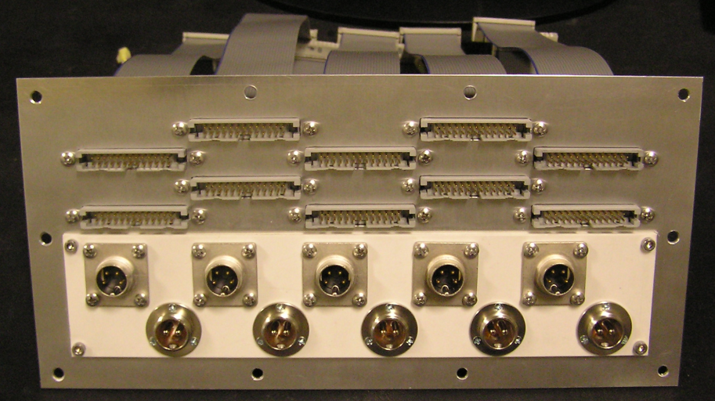
FE boards on cooling support
Connector panel
INSIDE meeting, Pisa, January 20th 2016
R. Wheadon, F. Pennazio

Slide 4
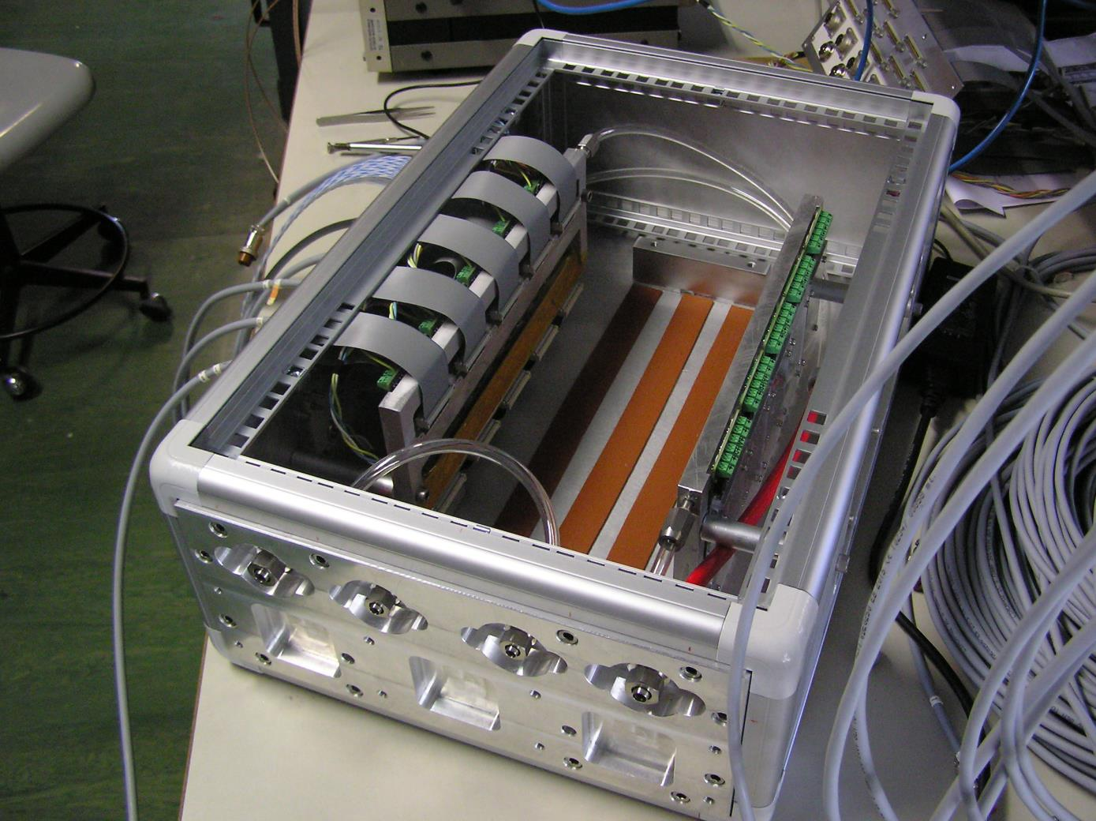
FE boards mounted and cabled in PET box
INSIDE meeting, Pisa, January 20th 2016
R. Wheadon, F. Pennazio

Slide 5
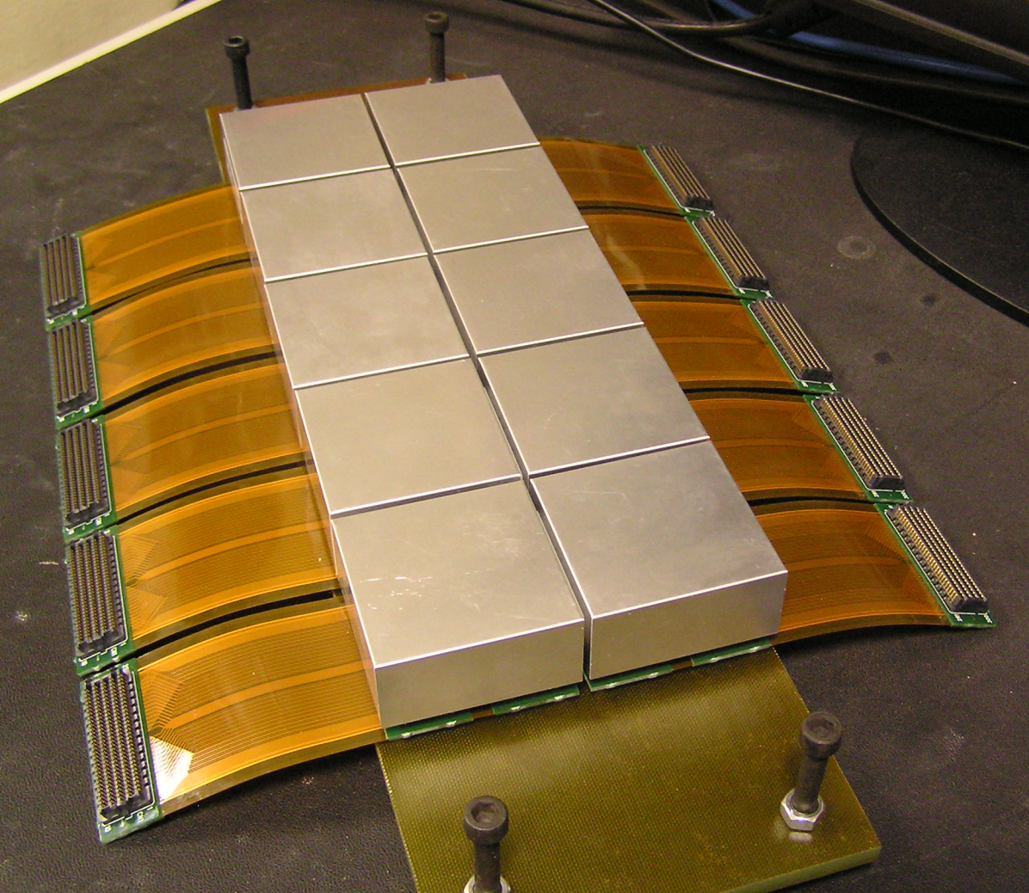
Detector blocks on glass-fibre support
INSIDE meeting, Pisa, January 20th 2016
R. Wheadon, F. Pennazio

Slide 6
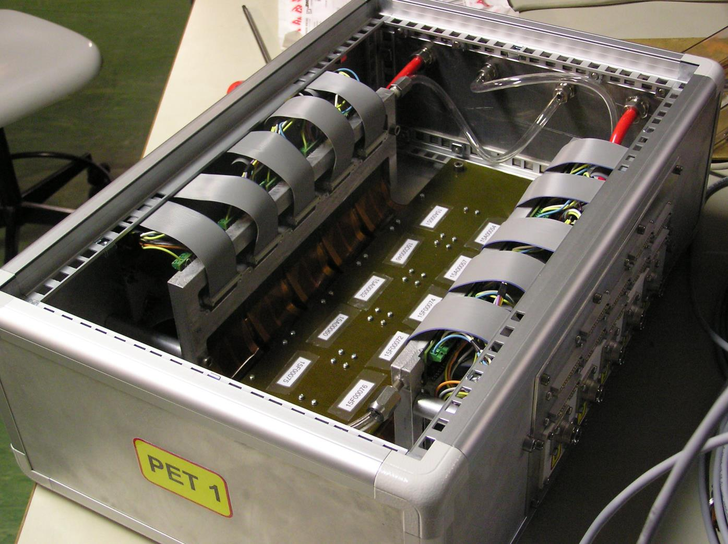
Completed box
INSIDE meeting, Pisa, January 20th 2016
R. Wheadon, F. Pennazio

Slide 7
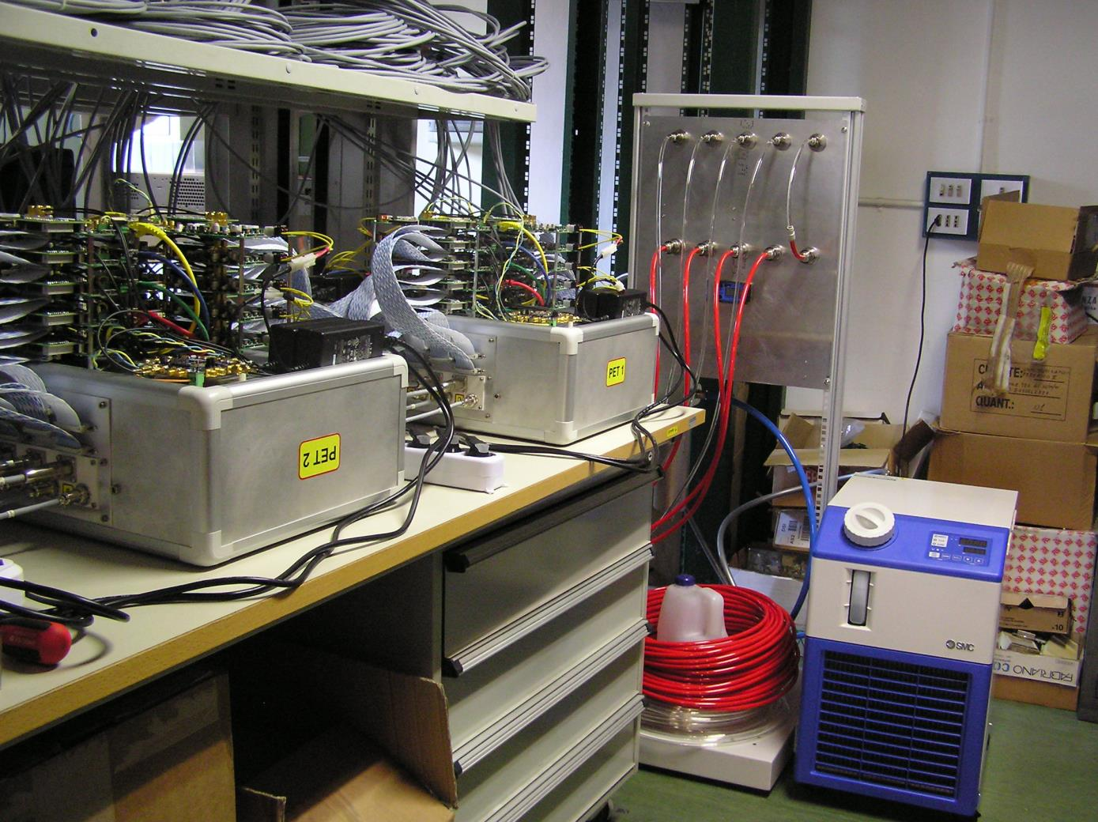
Ready for test with Tx boards and chiller connected
INSIDE meeting, Pisa, January 20th 2016
R. Wheadon, F. Pennazio

Slide 8
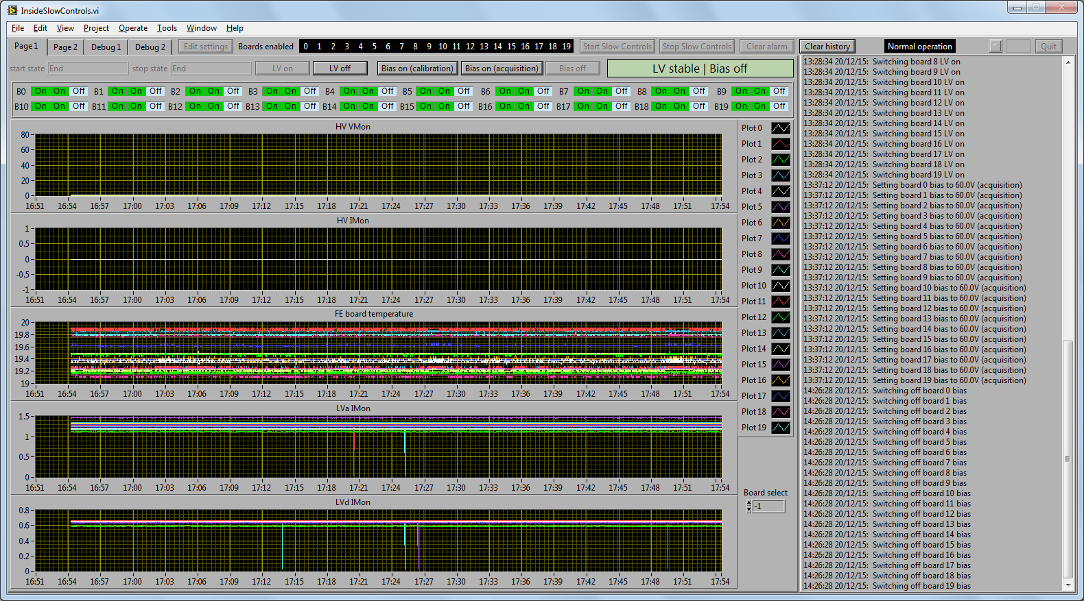
Excellent temperature stability (glitches in LV current are CAEN software glitches)
INSIDE meeting, Pisa, January 20th 2016
R. Wheadon, F. Pennazio

Slide 9
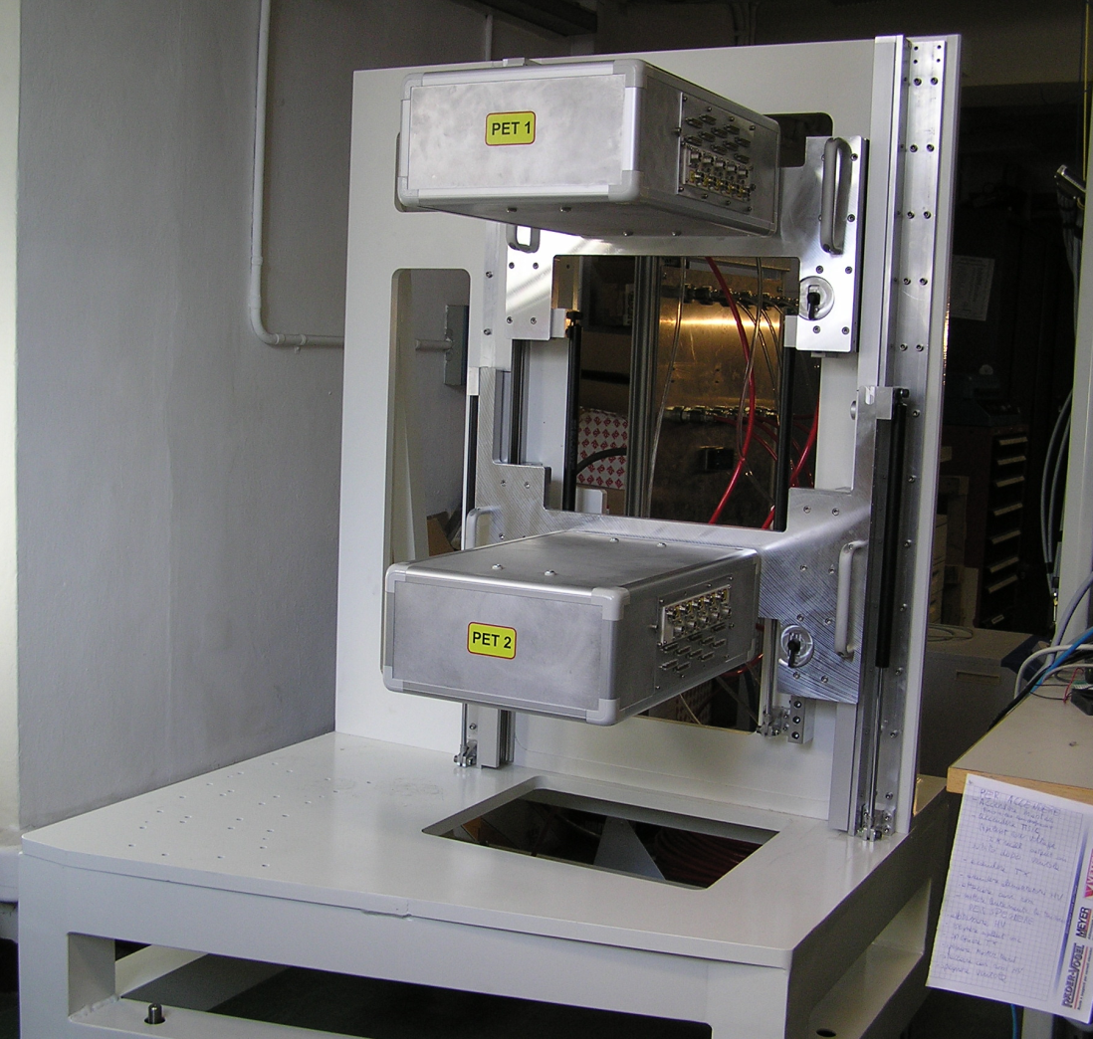
Completed mechanics
INSIDE meeting, Pisa, January 20th 2016
R. Wheadon, F. Pennazio

Slide 10
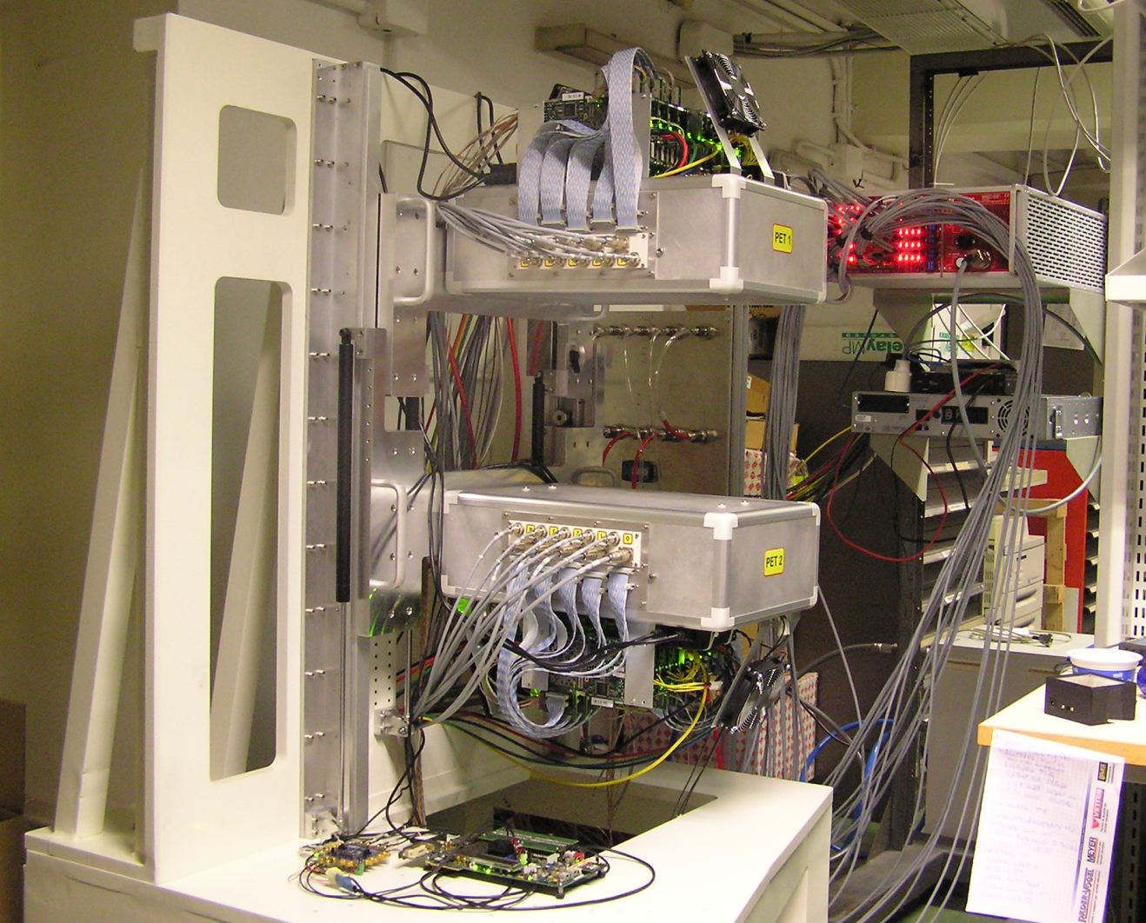
Completed PET detector (running)
INSIDE meeting, Pisa, January 20th 2016
R. Wheadon, F. Pennazio

Slide 11
System configuration, Data Acquisition and monitoring set up
TREATMENT ROOM
CONTROL ROOM
Crate
INSIDE in-beam PET system
Switch
LabView SW
(….)
Master
board
DAQ SW
GUI
TX
(….)
TX
Switch: 24-port Gigabit + 8 port Gigabit
Control PC (desktop)
DAQ Server: 32 cores HT, 128 GB ram
Monitoring PC: 4 cores, 6 Gb RAM (desktop)
INSIDE meeting, Pisa, January 20th 2016
F. Pennazio, R. Wheadon

Slide 12
Background single events
Firmware-decoded events
Lutetium background spectrum
Good background rate uniformity
INSIDE meeting, Pisa, January 20th 2016
F. Pennazio, R. Wheadon

Slide 13
TOFPET Tfine distribution
Raw data format acquisition
Lutetium background spectrum
Tfine with ideal calibration should be [0,1]
INSIDE meeting, Pisa, January 20th 2016
F. Pennazio, R. Wheadon

Slide 14
TOFPET EoC-SoC new calibration
Raw data format acquisition
Lutetium background spectrum
New Gui feature: EoC-SoC calibration and TOFPET calibration files update
-> corrected Tfine interval -> better firmware decodification
INSIDE meeting, Pisa, January 20th 2016
F. Pennazio, R. Wheadon

Slide 15
Firmware-decoded Tfine distribution
Decoded data format acquisition
Lutetium background spectrum
Good Tfine uniformity
INSIDE meeting, Pisa, January 20th 2016
F. Pennazio, R. Wheadon

Slide 16
TOFPET parameters check
Firmware-decoded TOT
Lutetium background spectrum
Good TOT uniformity
INSIDE meeting, Pisa, January 20th 2016
F. Pennazio, R. Wheadon

Slide 17
TOFPET parameters check
Firmware-decoded TOT
Lutetium background spectrum
TOT in coincidence
INSIDE meeting, Pisa, January 20th 2016
F. Pennazio, R. Wheadon

Slide 18
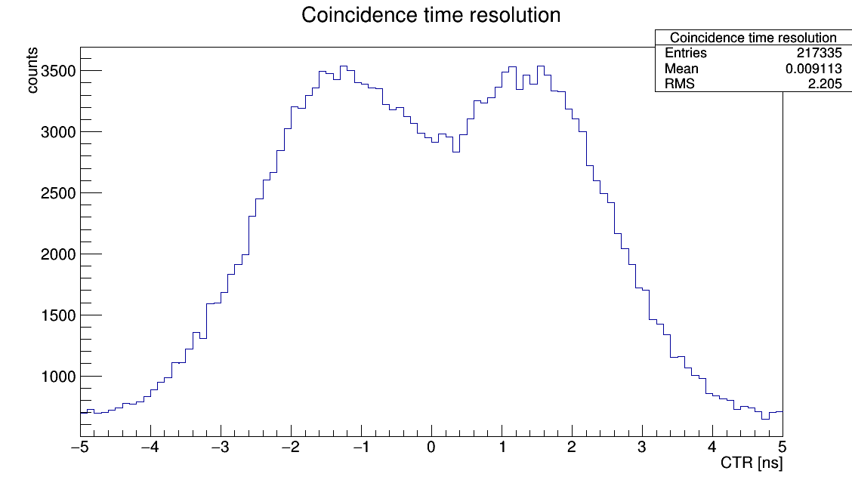
…and what about the CTR?
30 cm head distance
2 ns separation between peaks
Firmware-decoded TOT
Lutetium background spectrum
CTR with 5 ns window
-> calibration software (already tested for 2 boards) works, source needed to perform actual calibration
INSIDE meeting, Pisa, January 20th 2016
F. Pennazio, R. Wheadon

Slide 19
Conclusions
Full PET heads assembled, mounted on support mechanics and tested
Uniform temperature
First acquisition performed with all boards with background Lu radiation
Raw data and firmware-decoded data tested
Part of TOFPET calibration performed with DAQ Gui
What can be done with background data is as expected
Validation with sources scheduled for January, 22 and 29
Of course, hardware (FPGA placement), firmware and software development will continue…
INSIDE meeting, Pisa, January 20th 2016
F. Pennazio, R. Wheadon

Slide 20
INSIDE meeting, Pisa, January 20th 2016
F. Pennazio, R. Wheadon

