Slide 1
Detection of inhomogeneities with charged particles
G. Battistoni for the analysis group of HIT test
(with A. Baratto, E. De Lucia, M. Marafini,
I. Mattei, S. Muraro, V. Patera, A. Rucinski,
A. Sarti, M. Toppi, G. Traini et al.)

Slide 2
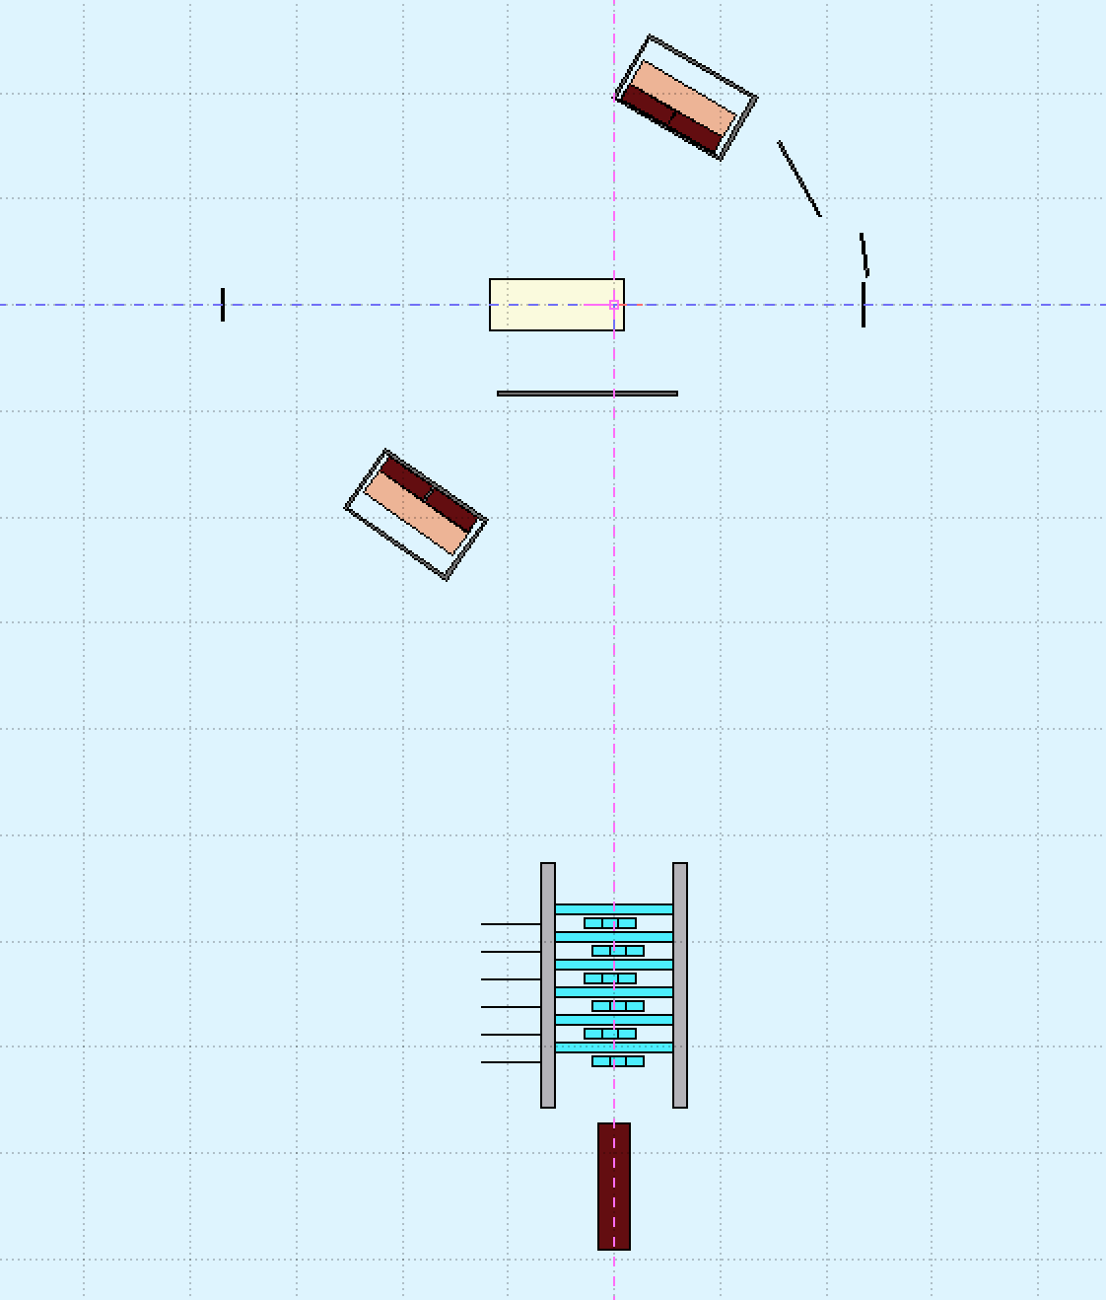
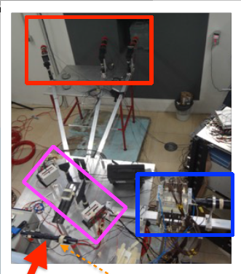
New recent analysis of charged particle data taken at Heidelberg with He, C and O beams
Beam
PMMA Target
Plastic Scintillator for
TOF measurement
p
Drift Chamber
LYSO Crystal

Slide 3
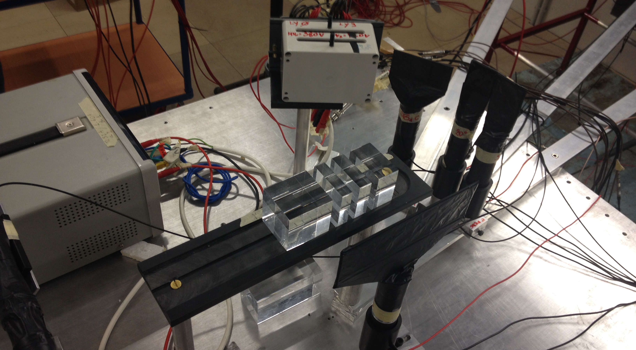
The case of segmented target geometry
The only case tested in this configuration was
¹⁶O at 260 MeV/u, measuring at 90º

Slide 4
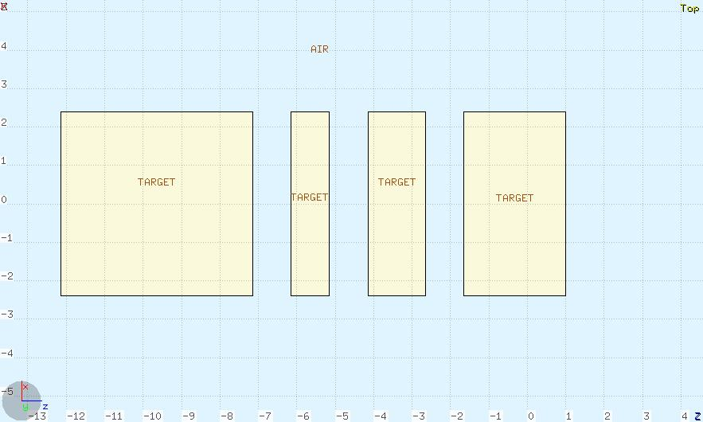
Segmented geometry
5 cm
1 cm
1.5 cm
2.65 cm
1 cm
1 cm
1 cm
12.15 cm

Slide 5
Reference exp. data for the homgeneous target (single PMMA piece 10 cm long)
Normal geometry

Slide 6
Exp. data + MC
(normalized to the same area for the moment)
Exp. Data
MC
10 cm
B.P. position

Slide 7
Exp. data with segmented geometry
Integral = 3988 tracks
Corresponding to about 7.7 10⁸ primaries
Thickness = 2.5 cm PMMA (~3cm H₂O)

Slide 8
Exp. data + MC
Exp. Data
MC
Simulation:
1995 tracks/3.8 10⁸ primaries
= 5.25 10⁻⁶ tracks/primary
Data:
3988 tracks/7.7 10⁸ primaries
= 5.19 10⁻⁶ tracks/primary
5 cm
1 cm
1.5 cm
2.65 cm

Slide 9
The data plot shown here corresponds to a detector acceptance much saller than that of Dose Profiler
We can approximately scale (at the same distance from target) to the acceptance of Dose Profiler considering a factor ~17, (conservative!!!) that no. of reconstructed tracks would correspond to ~4.5E+07 primaries
From MC we learn that for O at 260 MeV/u in order to deliver a 1 Gy on a 3x25x25 mm³ slice around the Bragg Peak one needs 2.4 10⁷ O primaries, that number corresponds to a physical dose of ~1.9 Gy.
We also know from MC how to scale for more reasonable thicknesses. That no. of reconstructed tracks would correspond in the Dose Profiler to:
~2.71E+08 prim: ~11 Gy @ 7 cm PMMA ~(8.4 cm H₂0)
~6.66E+08 prim: ~28 Gy @10 cm PMMA ~(12.0 cm H₂0)

Slide 10
Structures can be spotted with lower statistics
50%
~ 0.95 Gy @2.5 cm_{PMMA}
~5.72 Gy @7 cm_{PMMA}
~14.1 Gy @10 cm_{PMMA}
20%
~ 0.4 Gy @2.5 cm_{PMMA}
~2.3 Gy @7 cm_{PMMA}
~5.62 Gy @10 cm_{PMMA}
The presence of structures remains
distinguishable also for lower doses
The occurrence of a range larger than expextation at the given energy can in any case be detected at low dose
10%
~ 0.2 Gy @2.5 cm_{PMMA}
~1.1 Gy @7 cm_{PMMA}
~2.8 Gy @10 cm_{PMMA}

Slide 11
Conclusions
We are in principle able to detected range variation and even spot inhomogeneities in target using charged particles (resolution on structures might also depend on the angle…)
Considering that O is a candidate for large dose treatments (hypoxical tumors…) the monitoring with a limited portion of treatment seems feasible
Statistical significance and achievable accuracy have to be studied in detail yet
Notice: data and MC are close, also in absolute value
This allow us to study the behaviour in more complex situations (angle different from 90º, smaller structures, etc.)
Take all this as preliminary!!

