Slide 1
Calo meeting
P. Valente

Slide 2
HZC Photonics
Chinese company, transferred entire Photonis production (equipment, patents, etc.) from France (Brive) to Hainan
http://hzcphotonics.com/en_index.html
Relevant PMT models:
XP1911, XP1912, XP2812
First preliminary (and confidential) offer for 600 pieces:
--- € XP1911, --- € XP1912
+ voltage divider --€
+ VAT
= --- € (XP1911), --- € (XP1912)

Slide 3
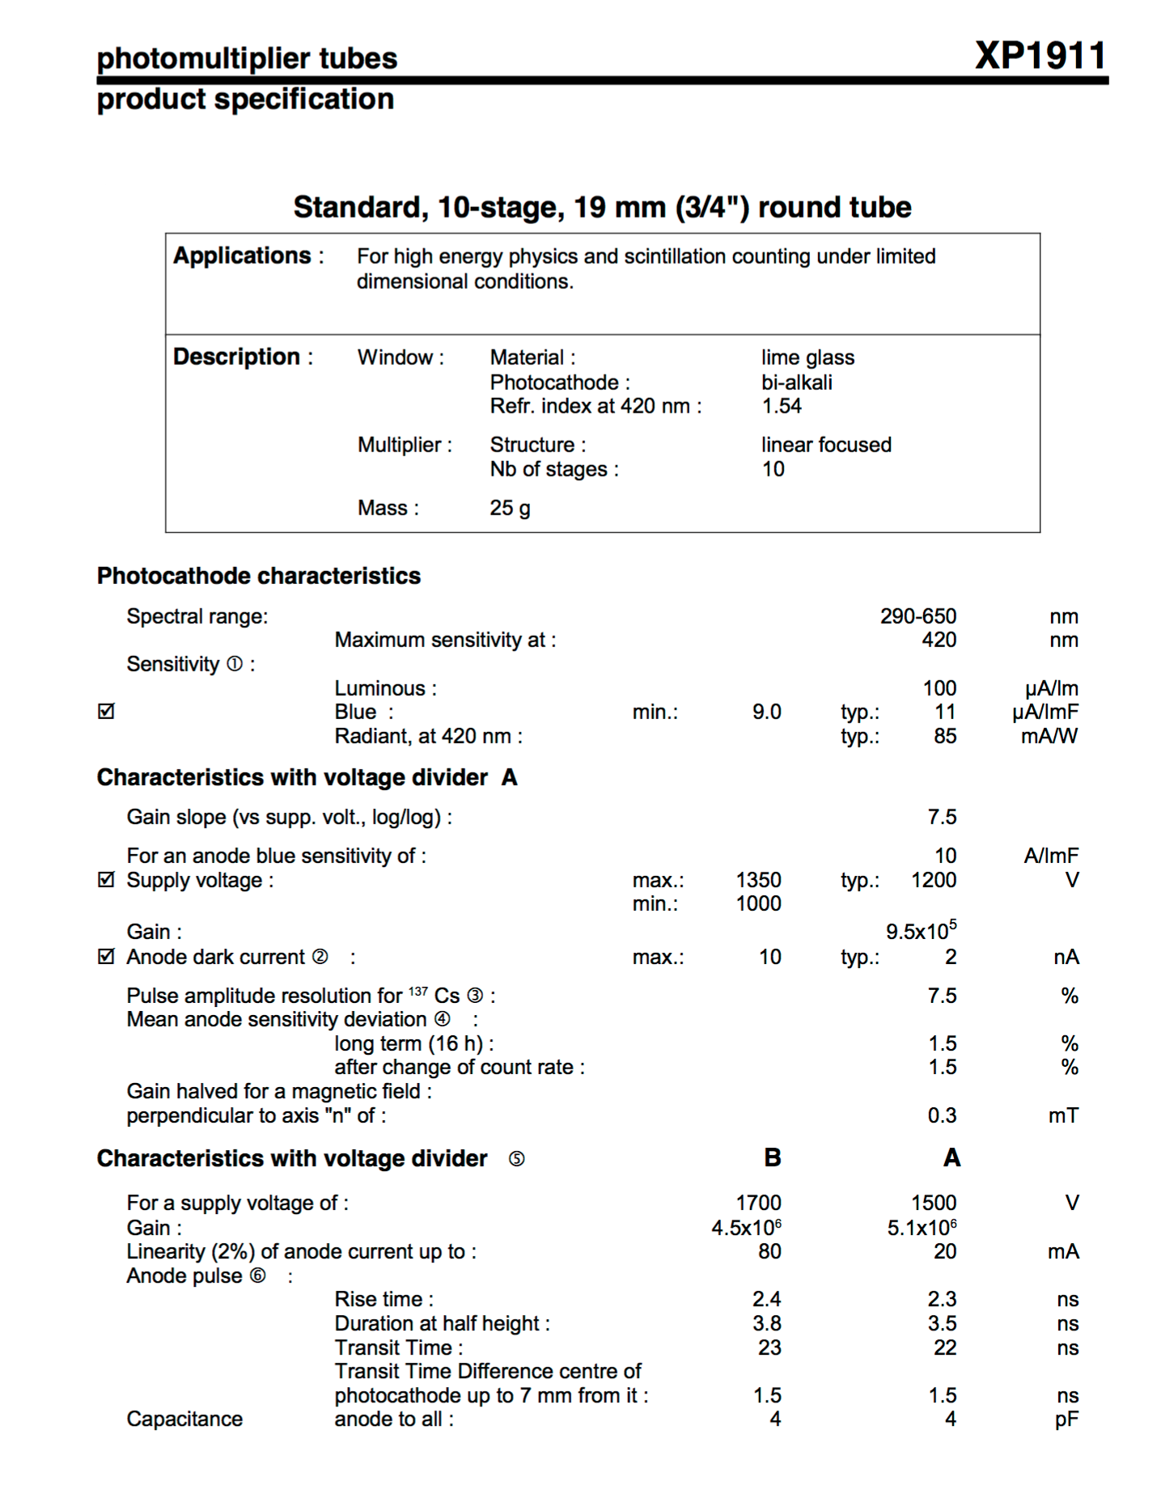

Slide 4
My conclusion is that:
¾’’ Photomultipliers should be considered very seriously:
Unbeatable high gain and linearity range
Very simple (if any…) front-end electronics
The additional cost of HV supply can be compensated and also minimized:
E.g. do we really need the monitoring of individual currents? Fewer HV channels and a simple distributor would reduce the price (linearly with the grouping factor)

Slide 5
DRS4
Wavedream2 under development for MEG2 by S. Ritt at PSI.
Not ready before end of 2016. Commercialization not foreseen by now.
Wavedream (the previous version) sold by Arktis.
33 ns*n of samples dead time
Continuous sampling possible at 120 MSPS at 10 bit
Adjustment of range (up to 0.8 V at 1 GSPS, 1.6 V at 120 MSPS) possible
S. Ritt: going to 700 MSPS (or even 500 MSPS) depends on the chip, not on the board
S. Ritt confirms that external trigger is not a precision one, all PLL have to be synchronized by means of an external reference clock
CAEN can also provide customization to the 1742 board (see Mauro’s talk): 1.5 V dynamic range, 700 MSPS
Dead time can also be improved

Slide 6
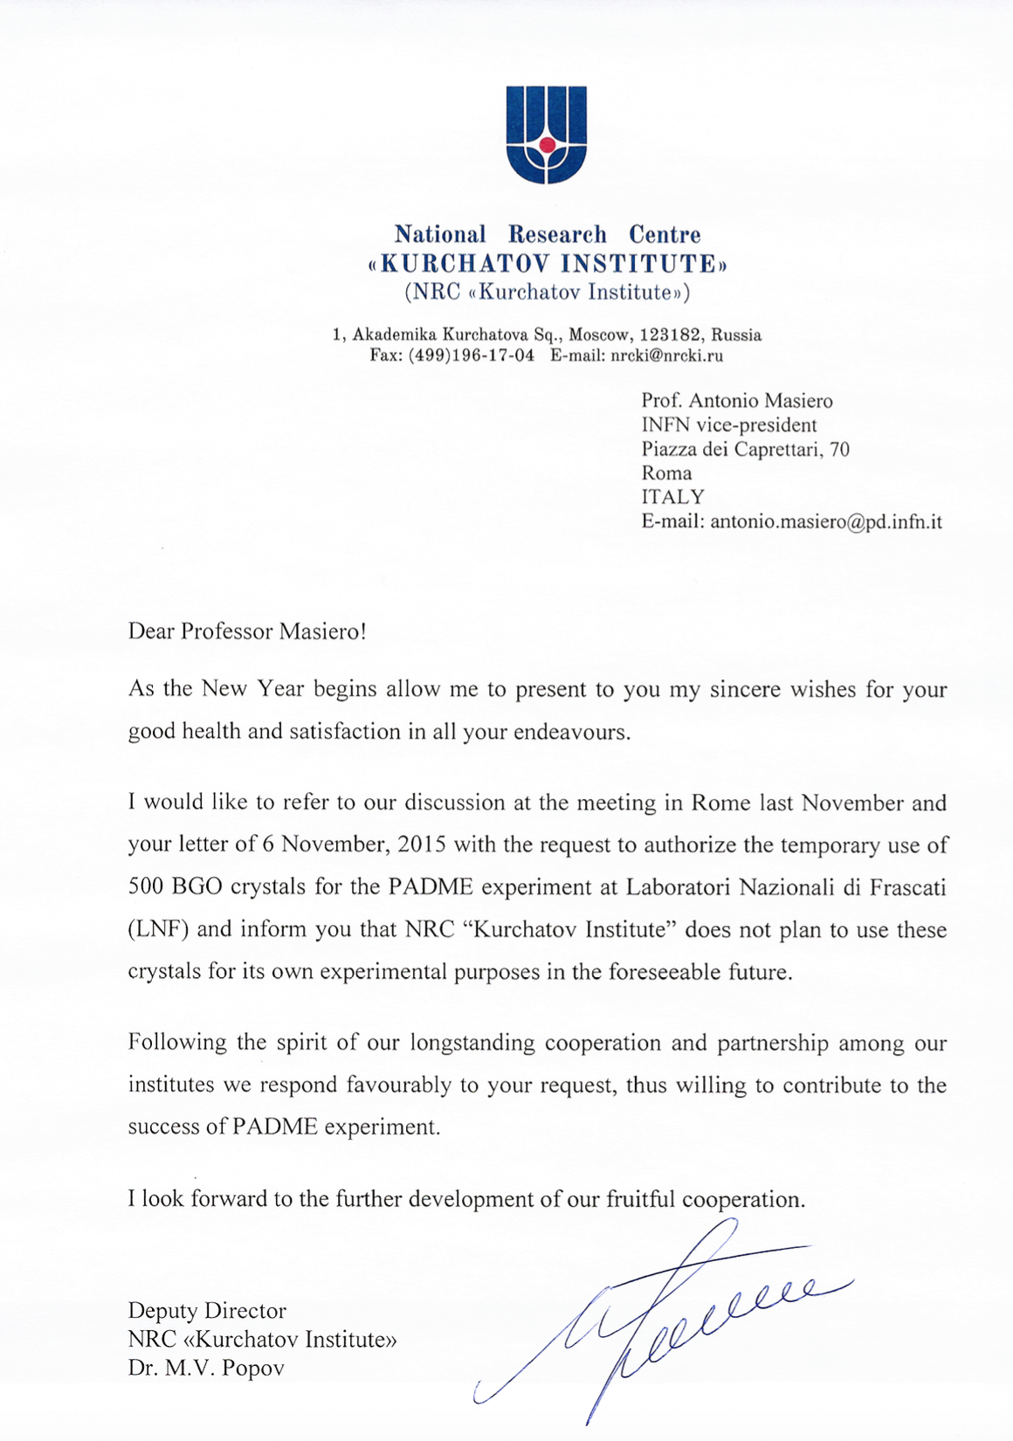
Crystals
Letter from Kurchatov arrived!
Now final letter to S. Ting will be sent
To do soon:
Arrange crystal checking and selection at CERN
Transport to Scandicci for cutting and wrapping or (more probably) painting
We have in the meanwhile, i.e. NOW:
Decision on non-readout sides for polishing
Decision on wrapping or painting
Design of the mechanics
As soon as possible, if we want to buy sensors and electronics in 2016:
Decision on photosensors + front-end electronics

Slide 7
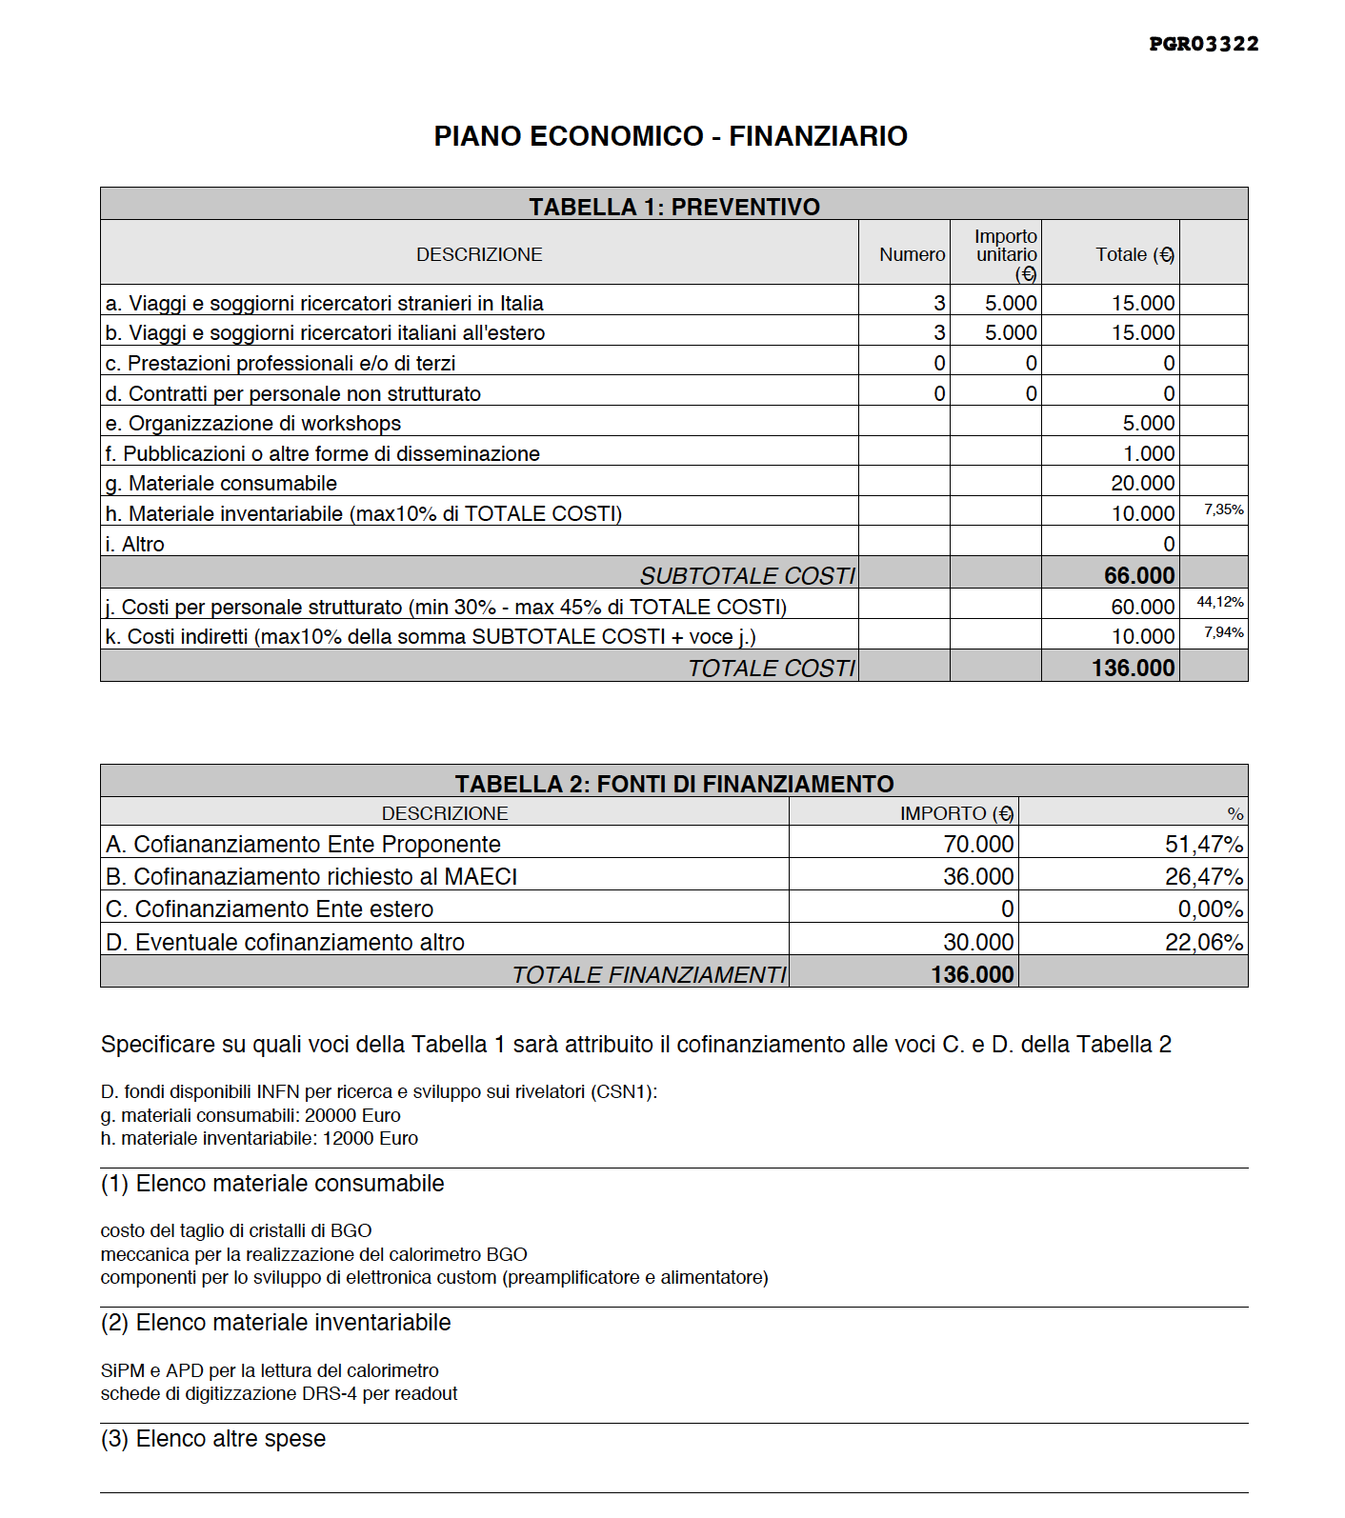
Last minute news

