Slide 1
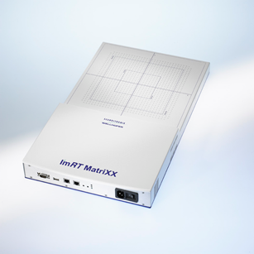
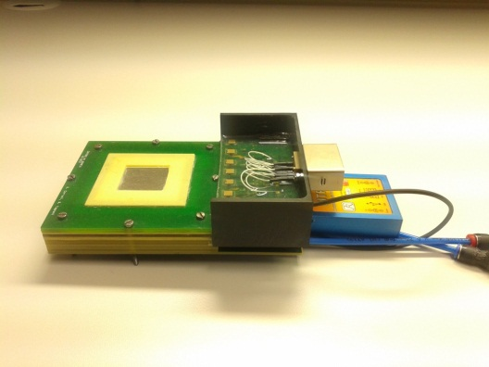
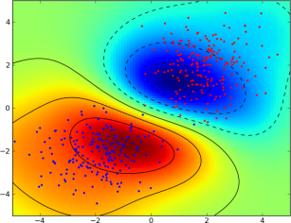
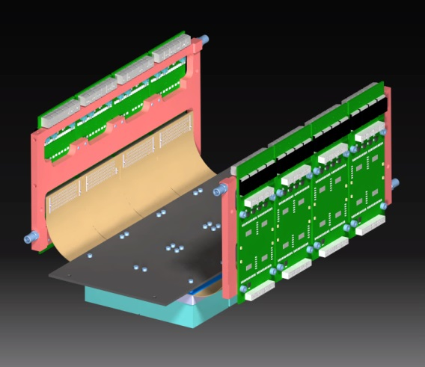
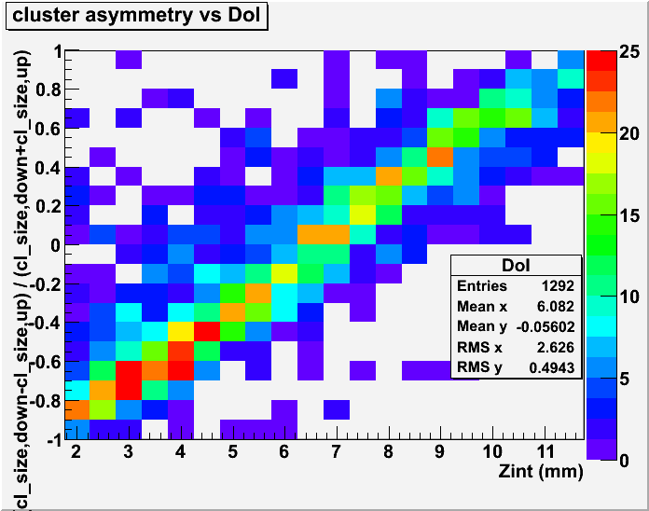
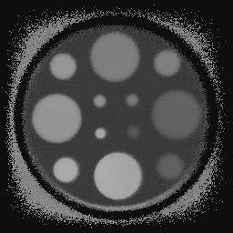
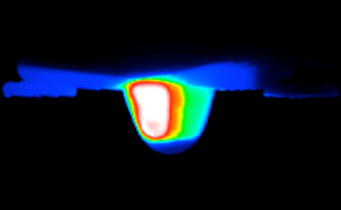
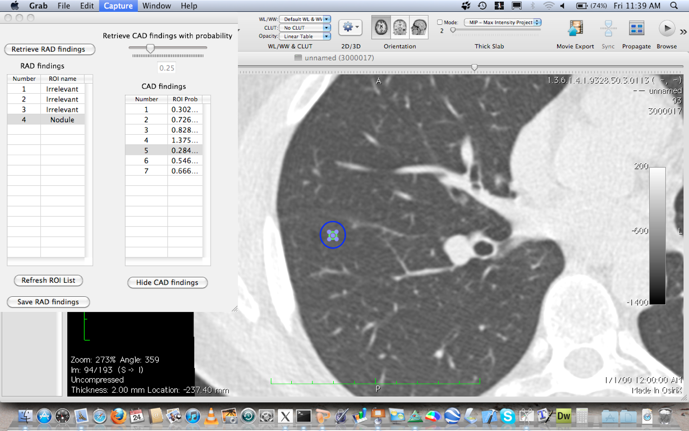
Computing in Medical Applications
Piergiorgio Cerello
INFN – Sezione di Torino
cerello@to.infn.it

Slide 2
the Matrix
 | App | Diagnosis Detector simulation | Therapy Treatment planning | Therapy Quality Assurance | Diagnosis Image Processing | Biological Modelling
Tech
Web |  |  |  |  | M5L, MIND, etc.
Cloud |  | everyone (FLUKA, Geant4/5) | I-SEE | INSIDE | M5L, MIND, etc. | WaveScalES
GPU |  | Geant5 | RIDOS
High-perf. DAQ |  |  |  | PROMPT
Data Access, Preservation |  |  |  |  |  | ?

Slide 3


Simulazione
Interazione radiazione-materia
“simulation of the passage of particles through matter”
due preziosissimi strumenti sviluppati inizialmente per la fisica delle particelle

Slide 4
The WaveScalES project
See talk by E. Pastorelli
Large scale simulations of the cortical activity investigating slow waves, plasticity, sleep and memory consolidation
Brain research:
→ Computational Neuroscience: novel experimental methodologies and massive parallel simulations for multi-scale theoretical models
The WaveScalES project:
  Experimental (perturbative) investigation, modelling and simulation of multi-scale Slow Wave Activity and transition to awakeness
  Part of the Human Brain Project (HBP)

Slide 5
Cortical simulations
The simulation of the cortical field activity can be accelerated using parallel/distributed computers. However, there are several challenges, including:
  Neural networks heavily interconnected at multiple distances, local activity rapidly produces effects at all distances → Prototype of non-trivial parallelization problem
  Each neural spike originates a cascade of synaptic events at multiple times: t + Δt_{s} → Complex data structures
  Multiple time-scales (neural, synaptic, spikes, long and short term plasticity models) → Non-trivial synchronization at all scales: mixed time-driven (delivery of spiking messages) and event-driven (synaptic activity and neural dynamic)
  Gigantic synaptic data-base. A key issue for large scale simulations → Clever parallel resource management required

Slide 6
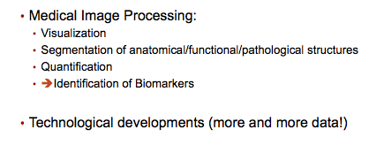
Image processing
See talk by A. Retico
Central vs. distributed processing

Slide 7

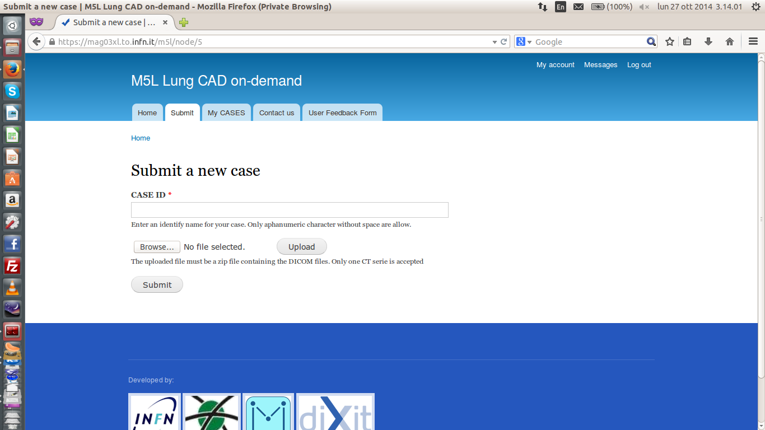
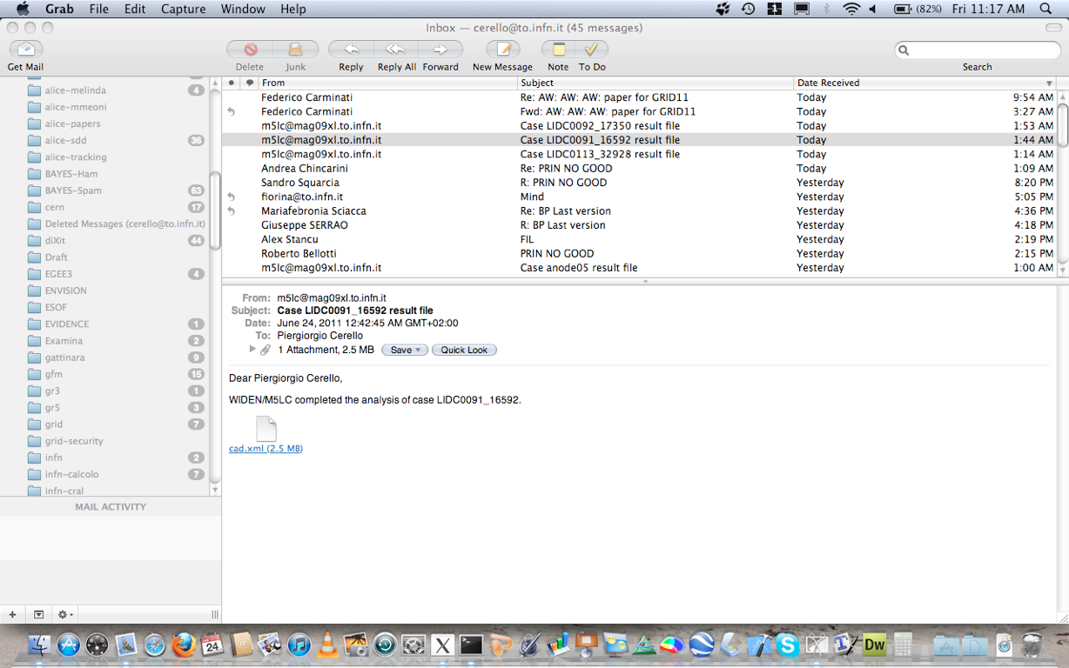
Diagnostica WEB / Cloud + Image Processing
Ricerca automatica di noduli in CT polmonari
Sensibilità ~ 80% a 6 FP/scan,
Validazione Clinica in corso
130 noduli, S ~ 90%,
+10% noduli in seconda lettura
Validazione su 949 CT
http://m5l.to.infn.it

Slide 8
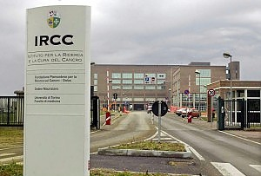
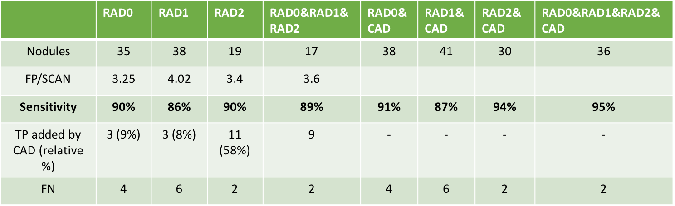
Clinical Validation / preliminary
Collaboration with the Radiology Department of IRCCS Candiolo (Italy)
every day CT scans of oncological patients under-going staging or re-staging are submitted to M5L
three radiologists independently annotate the CTs (first-reader mode)
CAD results are made available to radiologists for review (second-reader mode) only after the first-reading annotation was completed
Goal: dataset of about 1000 scans

Slide 9
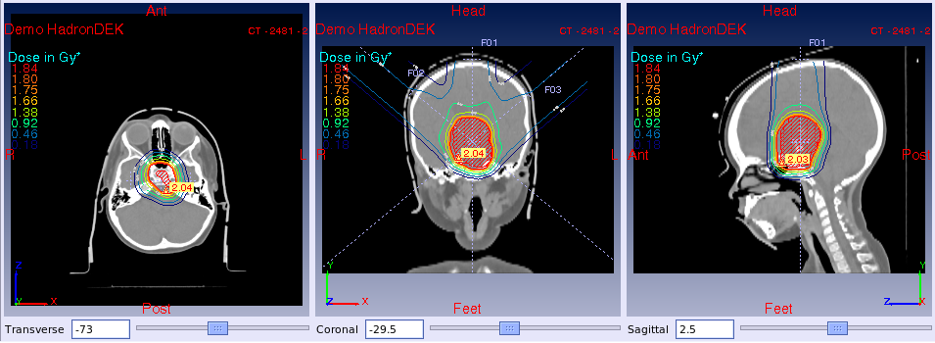
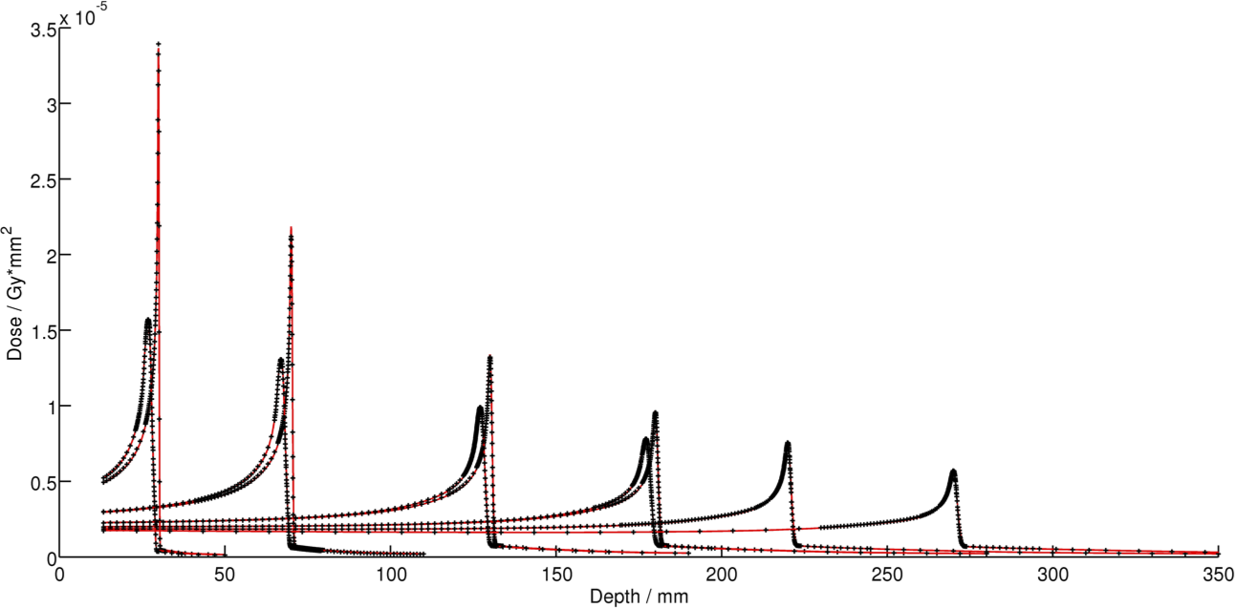
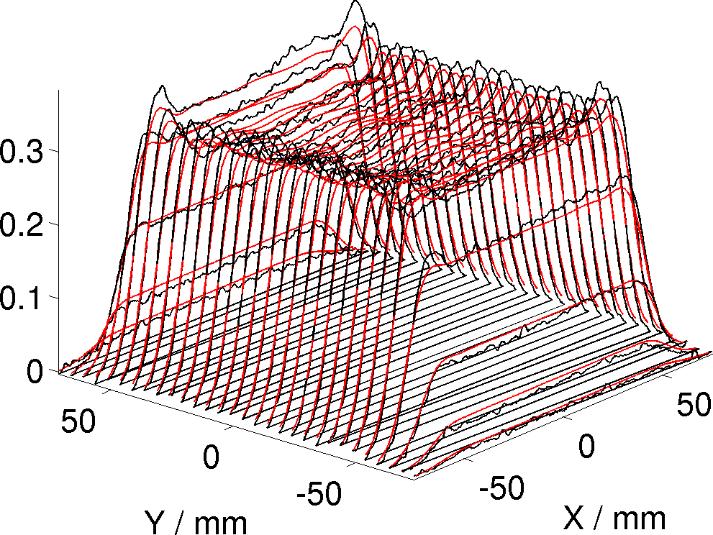
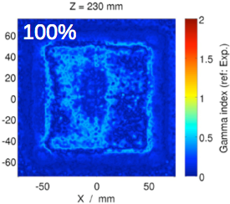
Terapia: piani di trattamento
“PlanKIT”: kernel per Terapia con fasci di ioni
Collaborazione INFN/IBA
Validazione Clinica a CNAO (Pavia)
Aspetti innovativi
  Multi-Ione (protoni, carbonio et al.)
  Modelli Radiobiologici
  Valutazione simultanea di: dose, RBE, LET, dose effettiva, sopravvivenza cellulare, etc…
  Simulazione veloce della dose con GPU
Patent pending
(SOBP 13-23.5 cm,
10x10x10 cm^3)

Slide 10

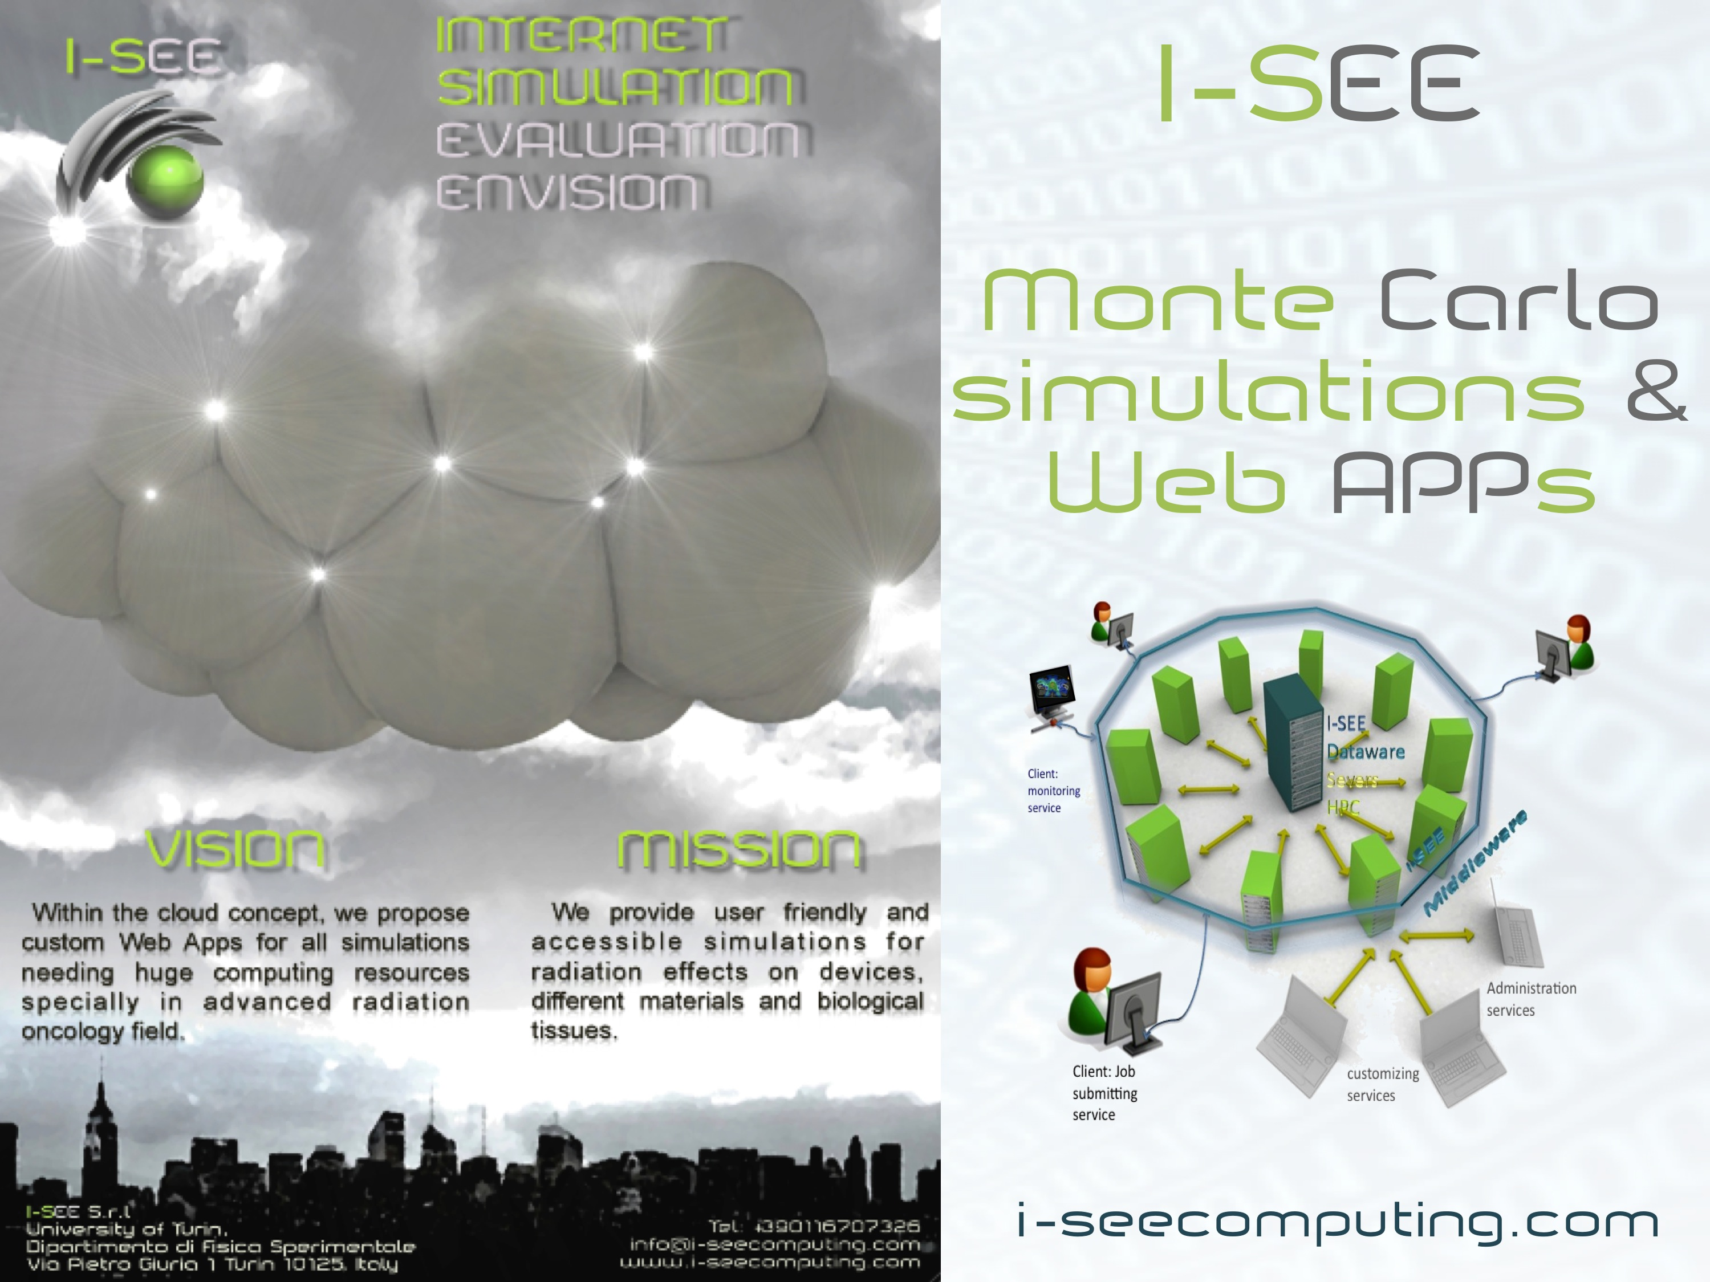
Spin-off:

Slide 11
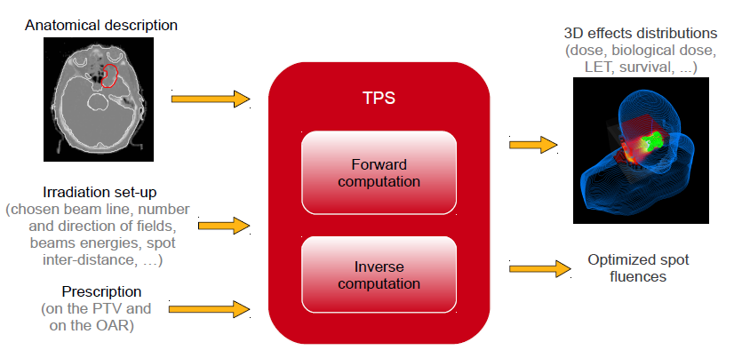
Treatment Planning in PT
See talk by S. Giordanengo
Notes:
Che cos’è un TPS

Slide 12
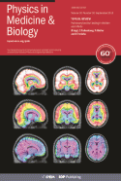
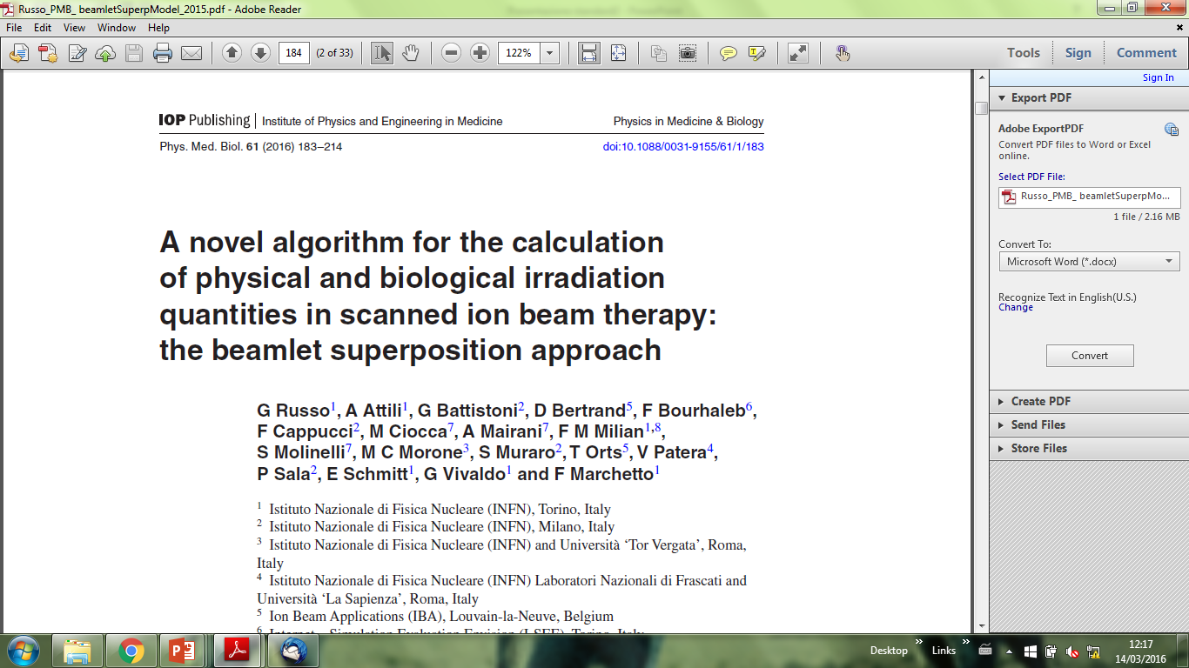
CUDA porting of INFN-IBA TPS
Phys. Med. Biol. 61 (2016) 183–214
Overview of the INFN TPS algorithms: → CPU and GPU implementation results
Notes:
Che cos’è un TPS

Slide 13
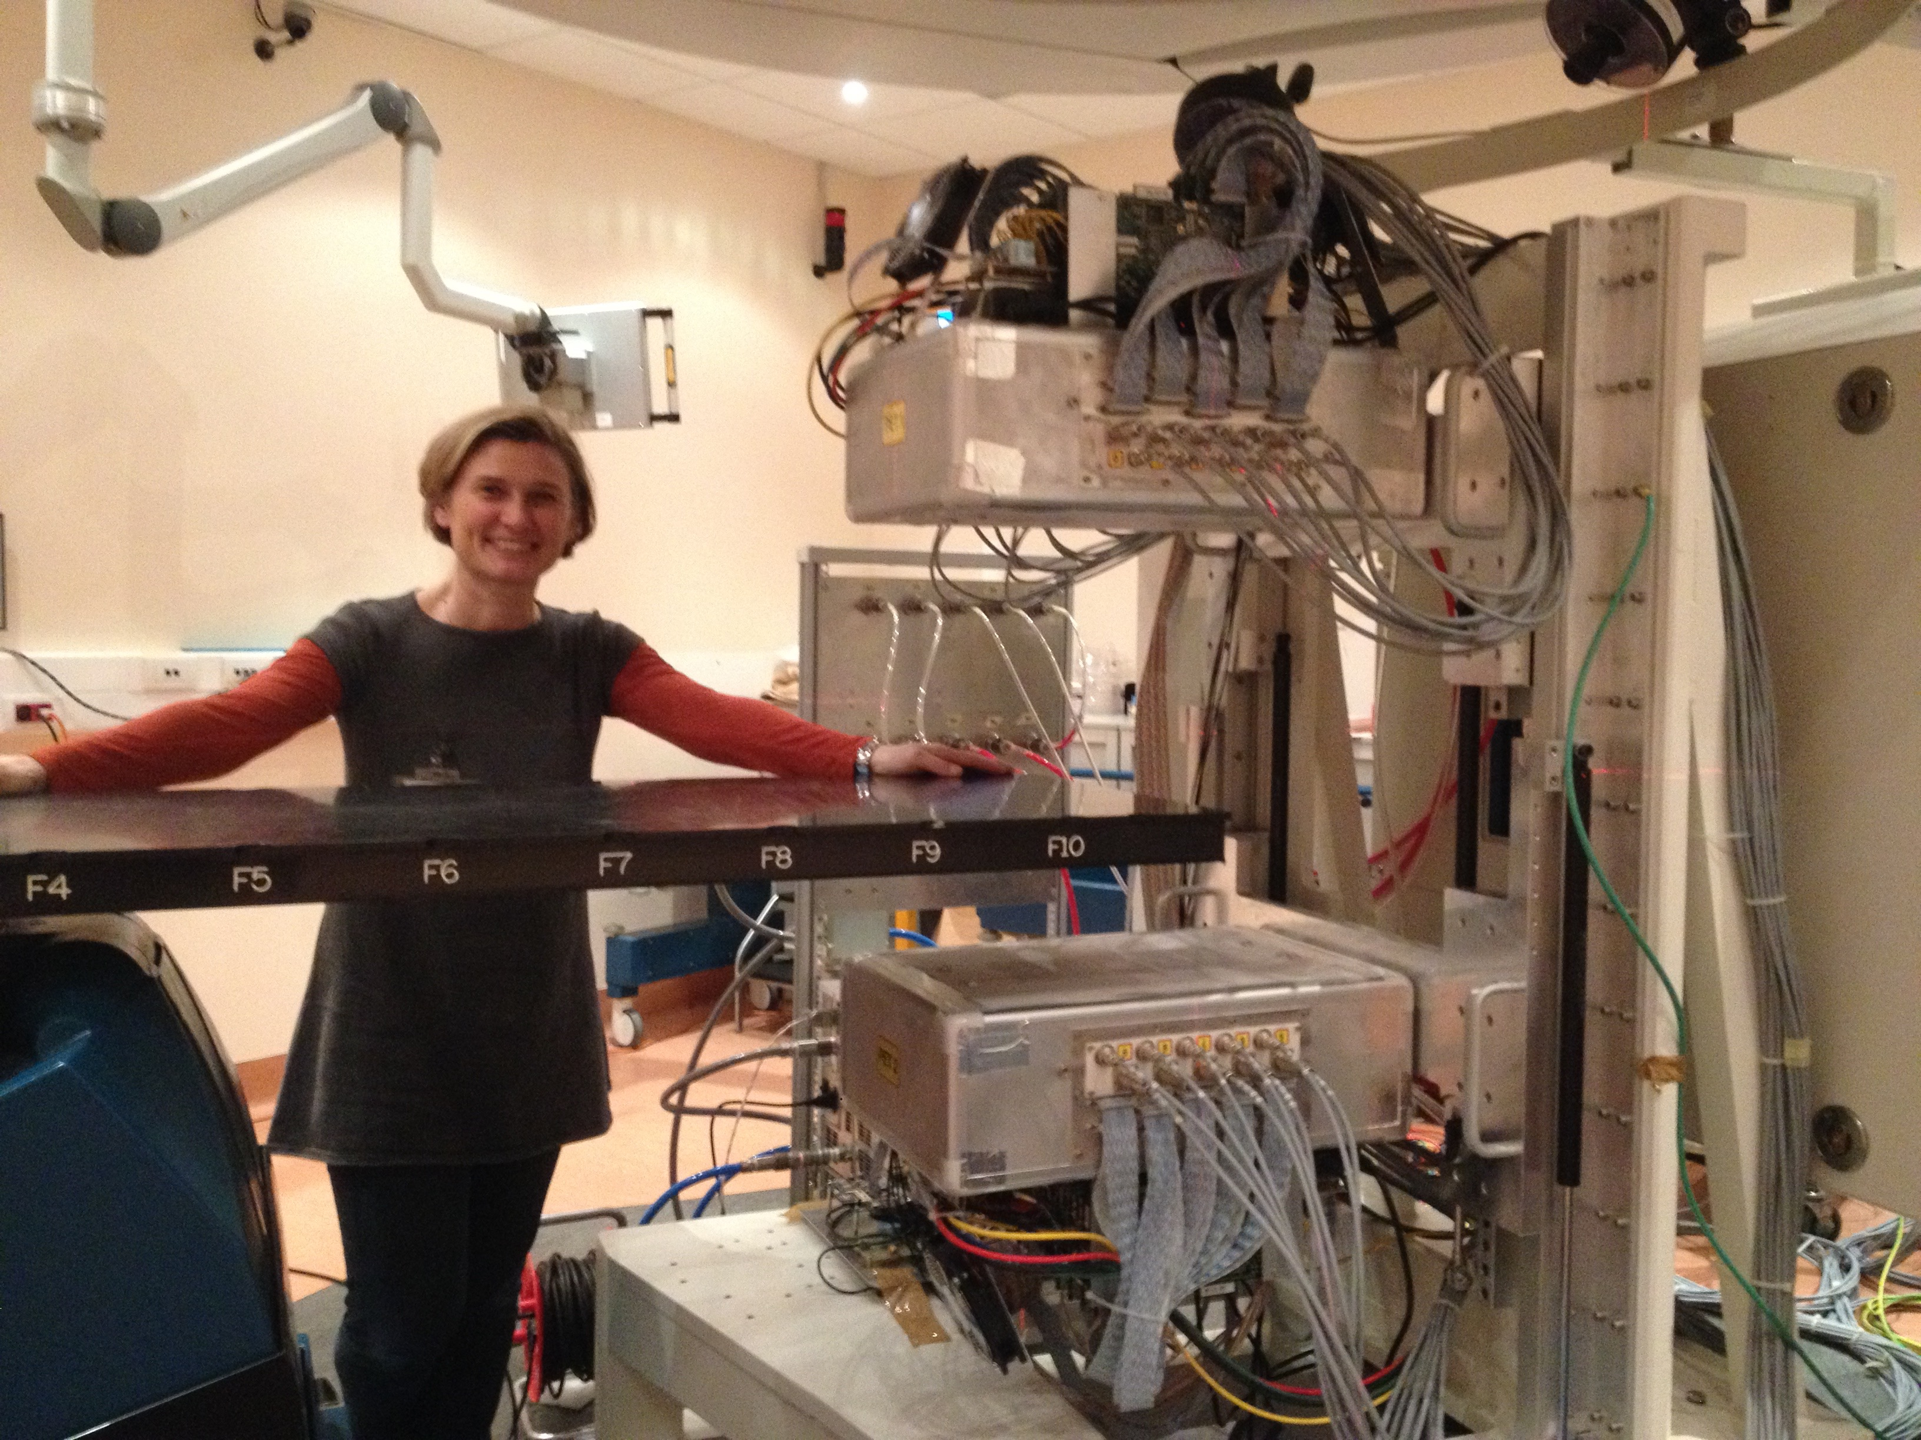
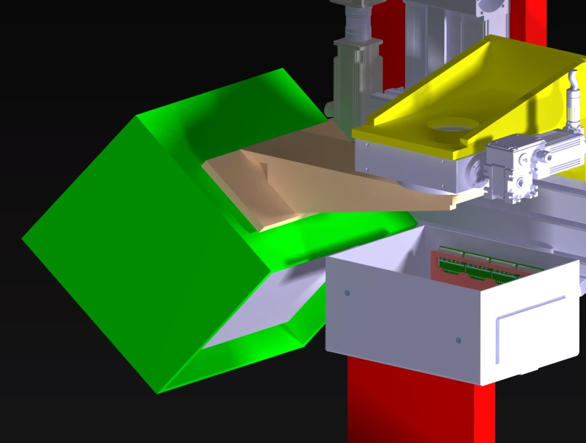

Terapia: monitor di dose 3D
See talk by F. Pennazio
INSIDE: dov’e’ (< 1mm) il picco di Bragg?
In-beam PET
Tracciatore
Primo test PET @ CNAO 7/2/2016

Slide 14
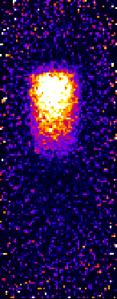
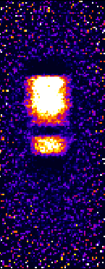
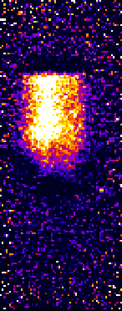
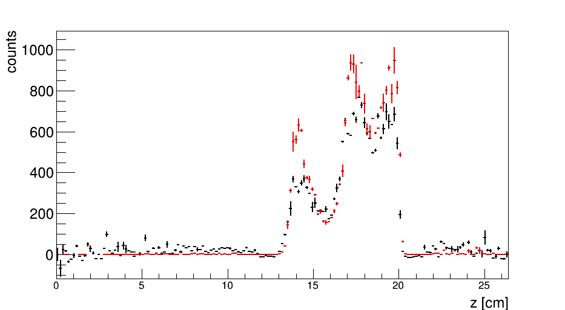
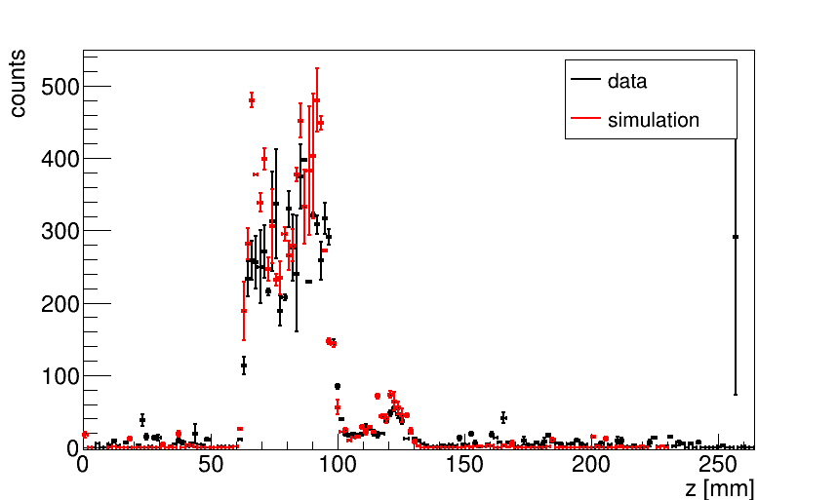
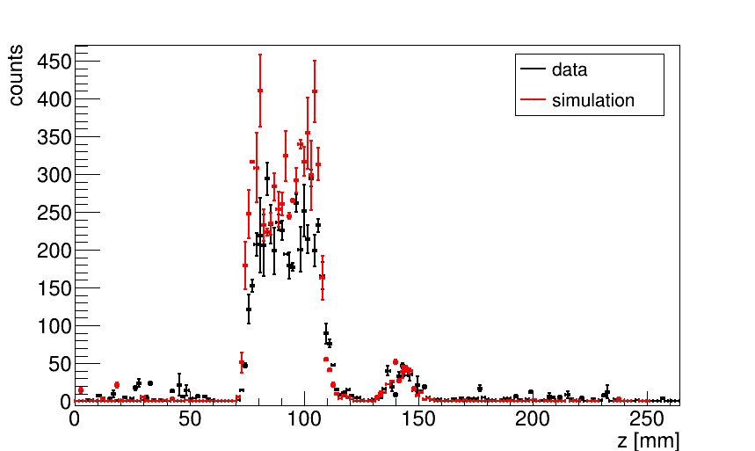
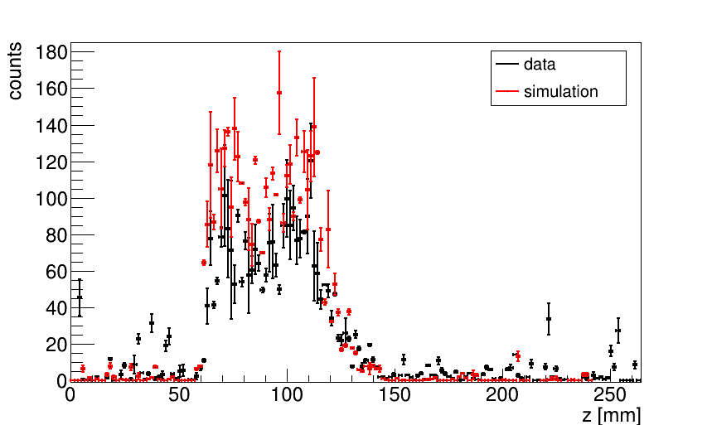
Image and profile reconstruction
Preliminary – 25/02/2016 NO AFTER TREATMENT
A
B
D
Data
Simulation
beam
PMMA phantom
2 slices 2.7x2.7 cm² (E₁ = 77 MeV, E₂= 105 MeV)
Acquisition time = 254 s
PMMA phantom with hole
2 slices 2.7x2.7 cm² (E₁ = 77 MeV, E₂= 105 MeV)
Acquisition time = 155 s
PMMA phantom
Real treatment plan (E_{min}= 76.6 MeV, E_{max}= 124.5 MeV)
Acquisition time= 133 s
Notes:
DEVO ANCORA CAMBIARE LE IMMAGINI E METTERE QUELLE INTERSPILL

Slide 15
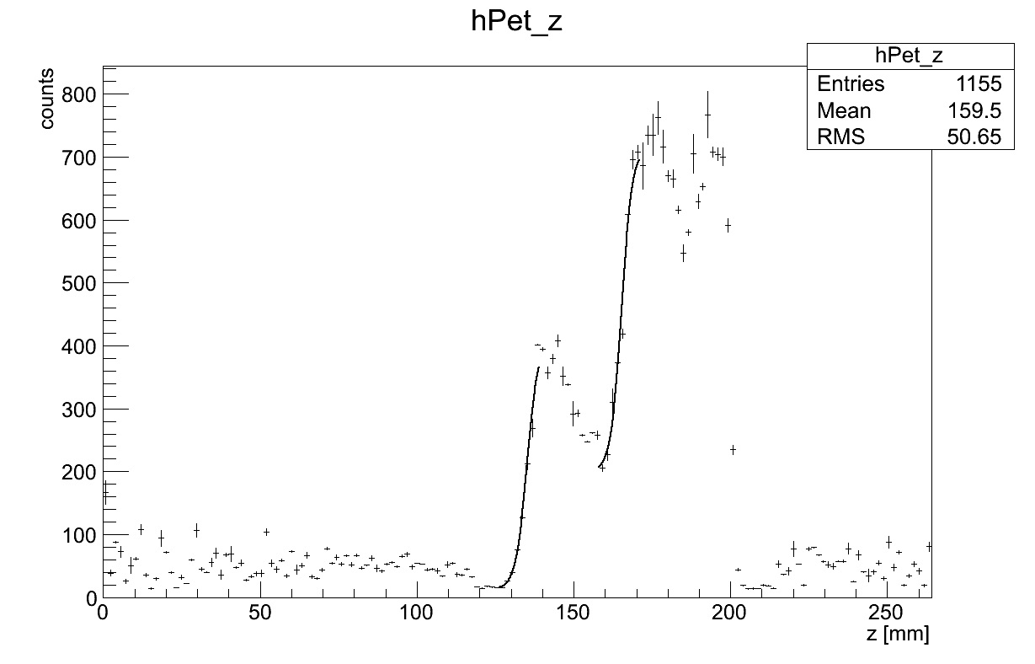
Preliminary results
Bragg peak
77 MeV
beam in
Bragg peak
105 MeV
10¹⁰p
Expected difference
31.2 mm
Measured difference
(30.2 +/- 0.3) mm

Slide 16
DAQ developments and upgrades
in-spill DAQ and Image reconstruction
    required for use at cyclotrons
use for pre-validation
hypofractionation
larger acceptance, higher speed (ASIC)
multiple lesion treatment
Notes:
Il firmware ha un tempo di sviluppo più lungo, quindi è stato sviluppato in // al sw, ma molte funzionalità sono state testate e raffinate in sw prima e codificate in fw dopo. Nuove funzionalità possibili combinando la nuova generazione di FPGA e eventualmente Soc, che essendo programmabili danno capacità di calcolo a basso costo in parallelo (se ne metterebbero una per board). Conseguenze: più quantità monitorabili, possibilità di applicare calibrazioni più fini (cioè calibrare il TDC per ogni TAC per esempio…) e monitorare più quantità

Slide 17
in sintesi…
…molte applicazioni mediche sono rilevanti dal punto di vista del calcolo scientifico…

