Slide 1
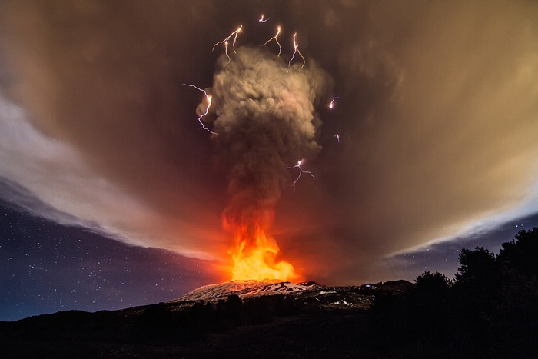
The Guardian newspaper
(curtesy :Remi’ bougault)
eruption at Mount Etna
WELCOME at HIB@lns – one day workshop-LNS CATANIA
The workshop is promoted by INFN-LNS and INFN-Sezione di Catania. It is supported by LNS User’s Committee and by the European Collaboration on High Intensity Stable Beams (ECOS).
The organisers are grateful to all the speakers, conveners and participants for the effort they made to support the initiative.

Slide 2
WHY
nuclear matrix element measurements in double exchange direct reactions and nexus with neutrino physics
the production of medium - mass exotic beams by in-flight method and connections with (multi-) fragmentation reactions, transfer reactions, and clustering phenomena.
possible overlaps with physics of heavy and super heavy elements are also expected (with stable and RIBs beams)

Slide 3
HOW
Upgrade the Superconducting Cyclotron (SC) by increasing the beam intensity of two orders of magnitude with respect to the existing SC facility in Catania
(underground idea): to progress in the field of Heavy Ion reactions at Fermi energy with both stable and exotic beams and related applications.
(Hoping that:) different topics will benefit of this upgrade.

Slide 4
The evolutionary character of the main reaction mechanism in HI above Coulomb energy (E/A > 10MeV/nucleon)
Time
FERMI ENERGY
J.Wilczyinski, PL Vol 47B, n.6(1973)
Time scale of nuclear detection systems

Slide 5
GOAL
A first report to be submitted to INFN
Call for proposals and letters of intent for PAC committee
The role of Users of LNS is crucial.

Slide 6
Message from Mauro Taiuti (president of INFN nuclear Physics committee )
Dear Angelo,
my greetings to all participants in the HIB @ lns workshops.
I think that your proposal for HIB upgrade is of strategic importance for the future of LNS !, so 'as I did for the SPES project, I will follow' with much interest your programs and the follow-up of the activity.
full success for the Workshop.

Slide 7
Message from Eugenio Nappi (INFN Executive board):
Dear Angelo, pls transmit
my greetings to all participants in the HIB @ lns workshops.
It is the intention of the President Fernando Ferroni and the INFN Executive Board to support the initiative related to the enhancement of the beam Intensity of the cyclotron. As told us, recently, by Giacomo (Director of LNS) it is receiving significant positive feedback and great interest from the international scientific community, and leading scientists in the field of nuclear physics. I wish you all full success for the Workshop.

