Slide 1

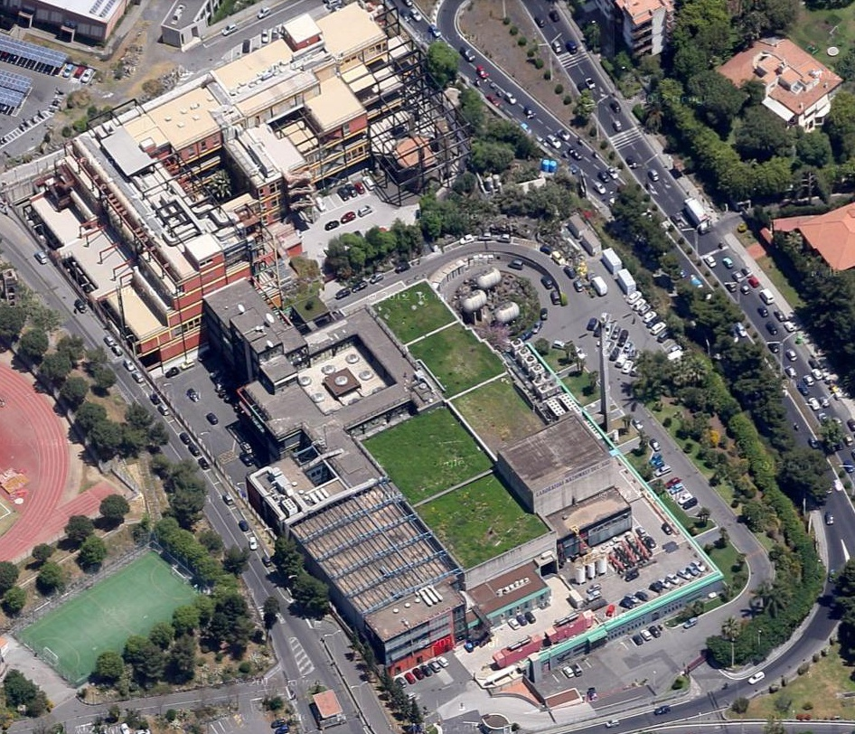
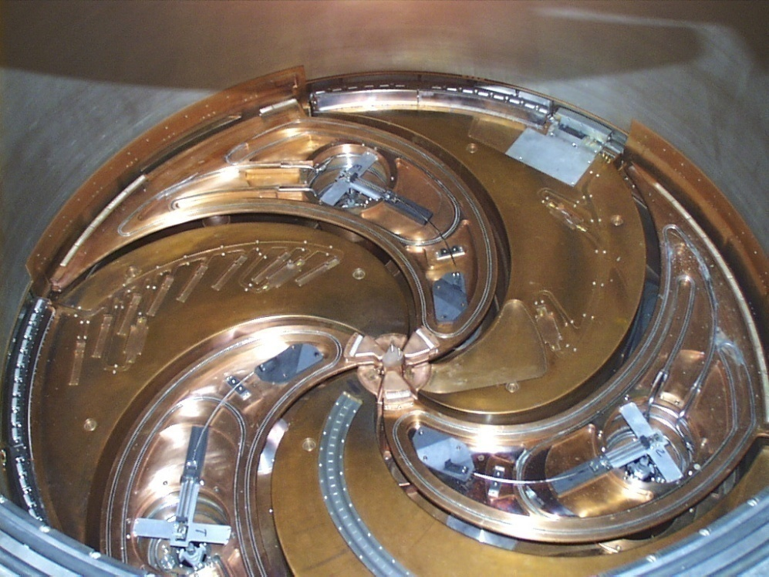
The Research Division activity at LNS
Stefano Romano
INFN – Laboratori Nazionali del Sud, Catania, Italy

Slide 2
Plan …
Summary on scientific activities
Overview on experimental facilities
The structure of the Reseach Division
Support to the users

Slide 3




Scientific activities

Slide 4
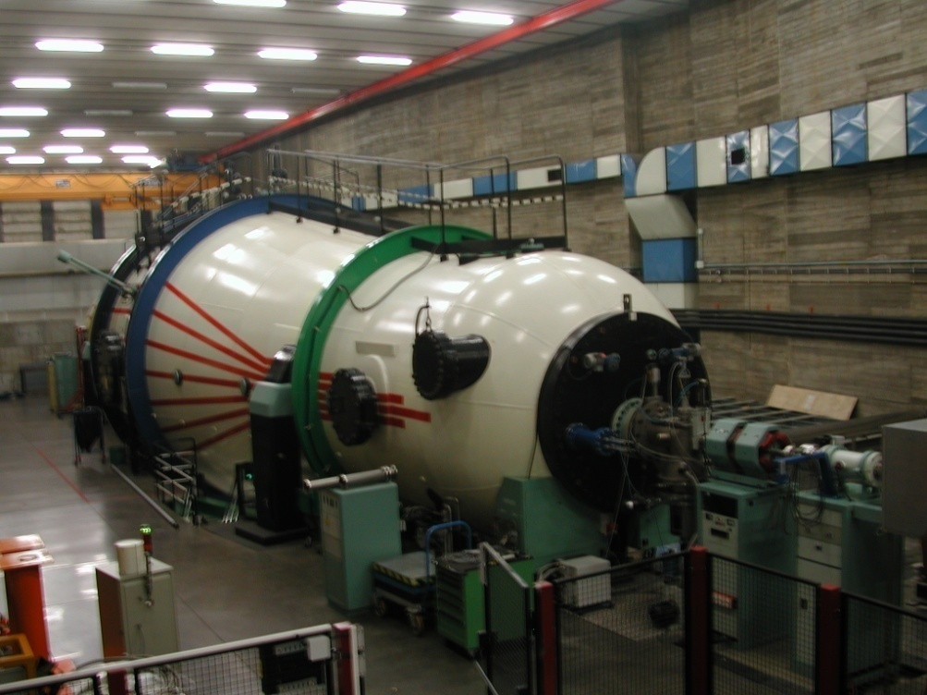
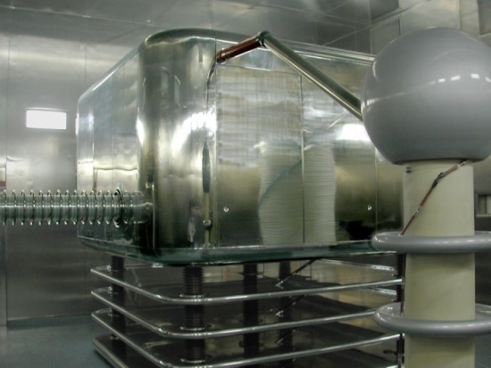
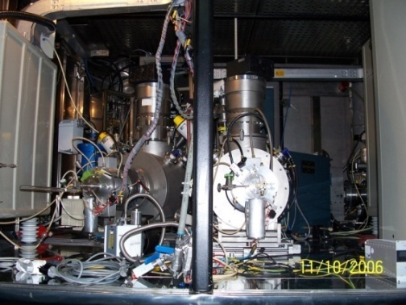
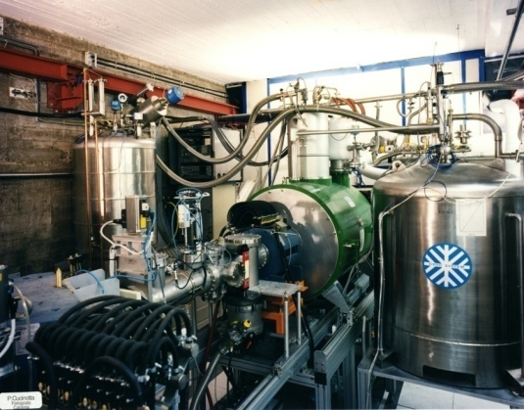
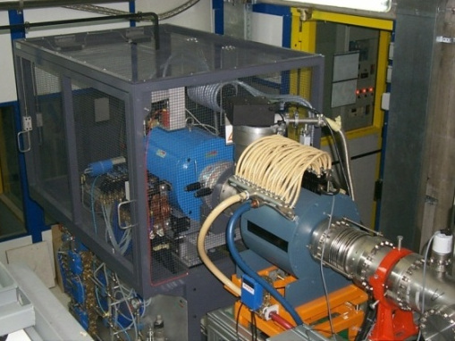
Accelerator equipment for ion beam production
Come studiare i primi istanti di vita dell’Universo?
450 KV injector
2 sputtering sources
Normal conducting ECR source CAESAR
Superconducting ECR source SERSE

Slide 5
Superconducting Cyclotron developed beams
^{A}X E (AMeV)
H₂⁺ 62,80
H₃⁺ 30,35,45
²D⁺ 35,62,80
⁴He 25,62,80
He-H 10, 21
⁹Be 45
¹¹B 55
¹²C 23,62,80
¹³C 45,55
¹⁴N 62,80
¹⁶O 21,25,55,62,80
¹⁸O 15,55
¹⁹F 35,40,50
²⁰Ne 20,40,45,62
²⁴Mg 50
²⁷Al 40
³⁶Ar 16,38
⁴⁰Ar 15,20,40
⁴⁰Ca 10,25,40,45
^{42,48}Ca 10,45
⁵⁸Ni 16,23,25,30,35,40,45
^{62,64}Ni 25,35
^{68,70}Zn 40
⁷⁴Ge 40
^{78,86}Kr 10
⁸⁴Kr 10,15,20,25
⁹³Nb 15,17,23,30,38
¹⁰⁷Ag 40
¹¹²Sn 15.5,35,43.5
¹¹⁶Sn 23,30,38
¹²⁴Sn 15,25,30,35
¹²⁹Xe 20,21,23,35
¹⁹⁷Au 10,15,20,21,23
²⁰⁸Pb 10
⁴He 80 AMeV
¹¹²Sn 43.5 AMeV
In red beams with intensity 10¹² pps

Slide 6
Availability of the Superconducting Cyclotron and Tandem beams
In case of full operation of the accelerators the annual availability of the beam time is
Superconducting Cyclotron
400 BTU = 3200 h
Tandem
350 BTU = 2800 h
All the activities performed with the accelerators are approved by the
LNS Program Advisor Committee

Slide 7
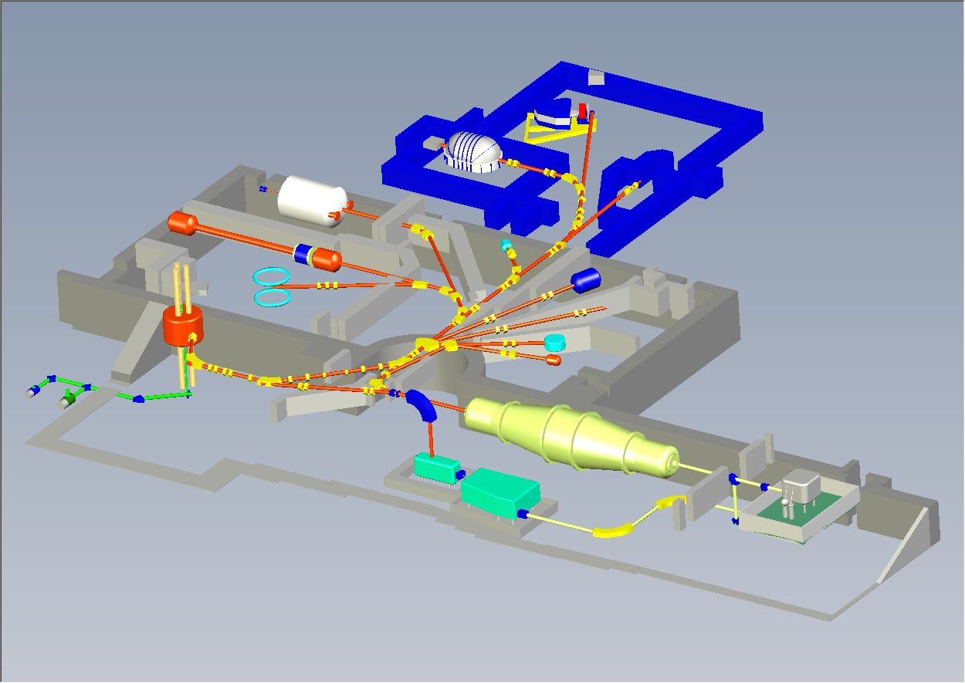
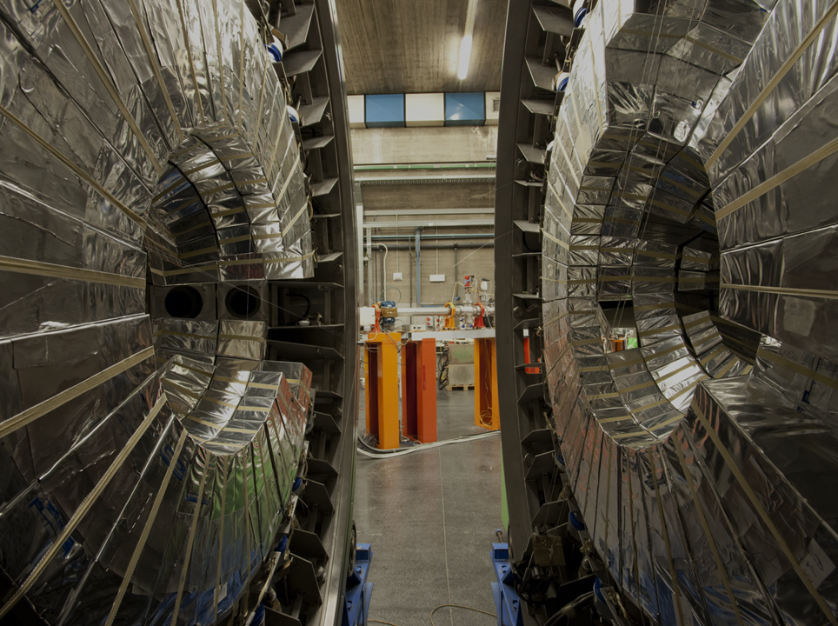
LNS lay-out: accelerators and experimental halls
I Laboratori Nazionali del Sud
Chimera
Magnex
Ciclope
Catana
Medea
0°
20°
MEDEA:
Multi
Element
DEtector
Array
40°
60°-80°
FRIBS@LNS
Superconducting
Cyclotron
Tandem
EXCYT

Slide 8
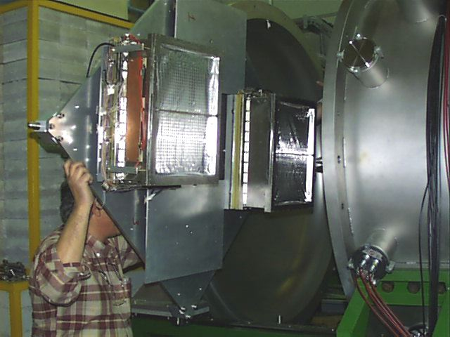
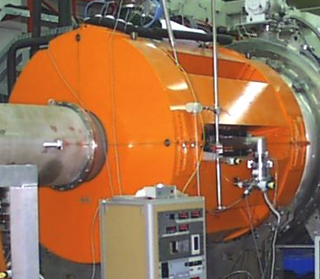
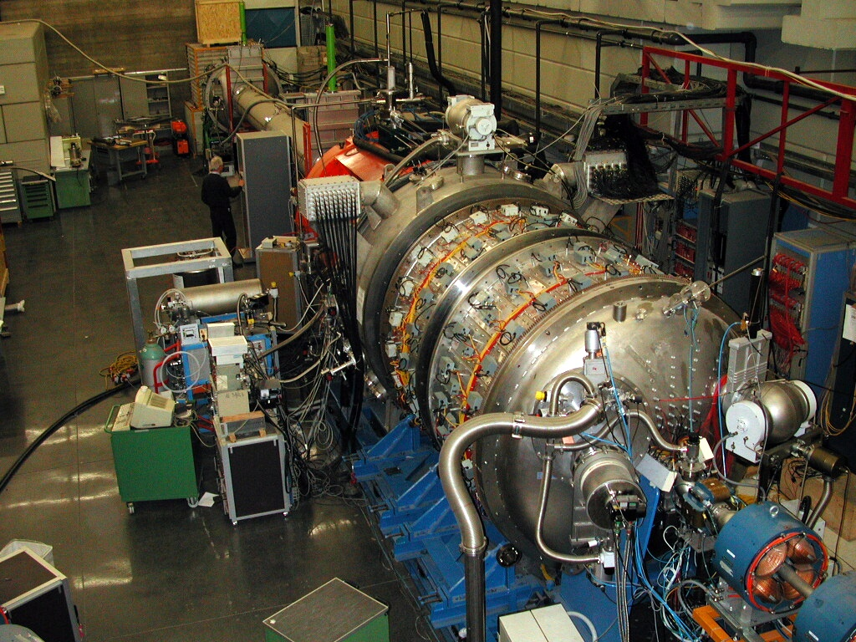
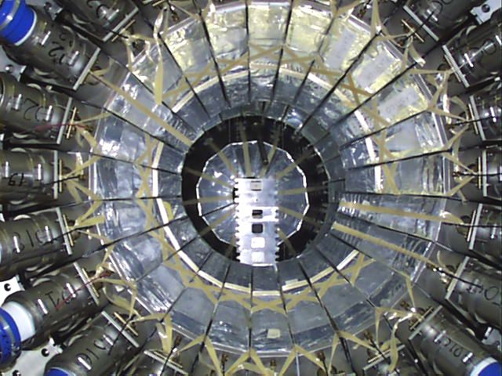
MEDEA - SOLE - MACISTE
MACISTE
8 gas -plastic position
sensitive detectors
θ ≤ 6⁰
SOLE
Superconducting Solenoid
0⁰ ≤θ ≤ 6⁰
MEDEA
180 BaF₂ detectors
30⁰ ≤θ ≤ 180⁰

Slide 9
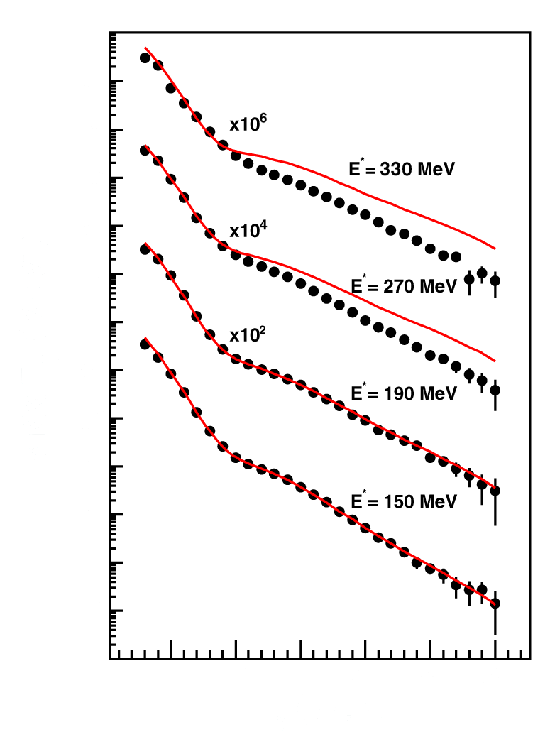
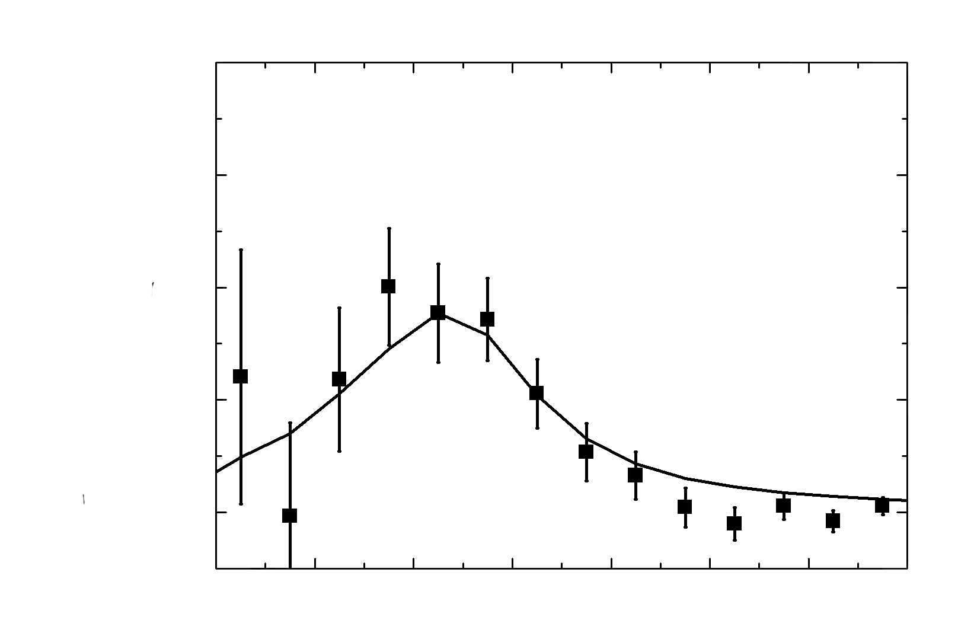
GDR in A = 110 ÷ 132 nuclei
Dynamic Dipole in A=192 nuclei
Reactions: ¹¹⁶Sn + ¹²C @ 17 and 23 MeV/A
¹¹⁶Sn + ²⁴Mg @ 17 and 23 MeV/A
Reactions: ⁴⁰Ca + ¹⁵²Sm @ 10A MeV
⁴⁸Ca + ¹⁴⁴Sm @ 11.1A MeV
Incomplete fusion reactions
Incomplete fusion reactions
γ and light charged particles in coincidence with evaporation pruducts
γ and light charged particles in coincidence with evaporation pruducts
ToF measurements
ToF measurements
Exp. Data
Cascade
E_{γ} (MeV)
E_{GDR} = 13 MeV
E_{dd} = 11 MeV Γ_{dd} = 3.5 MeV
M_{γ} (θ_{γ}) = (1.0 ± 0.1) 10⁻⁴ γ/sr
E_{DD} < E_{GDR}
High deformed system
Quenching of GDR at E*/A ≈ 2.0 MeV/A
Sudy of the density behaviour of the symmetry term in EOS
D. Santonocito et al. – PRC 90 (2014) 054603

Slide 10
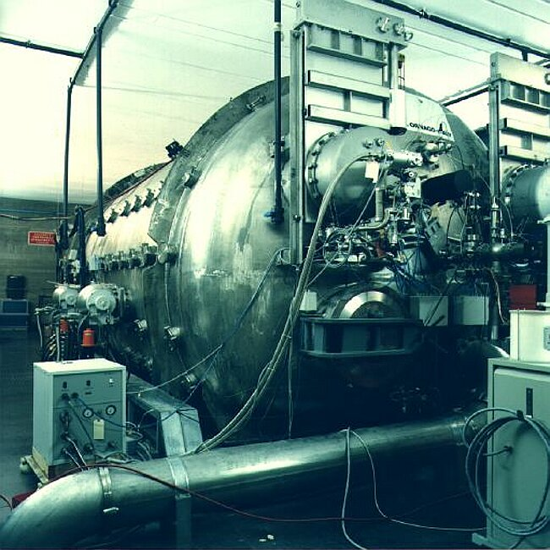
LNS lay-out: accelerators and experimental halls
I Laboratori Nazionali del Sud
Chimera
Magnex
Ciclope
Catana
Medea
0°
20°
40°
60°-80°
FRIBS@LNS
Superconducting
Cyclotron
Tandem
EXCYT

Slide 11
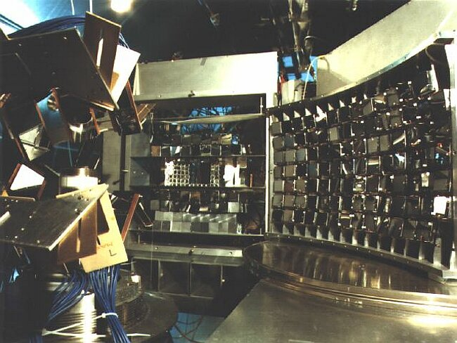
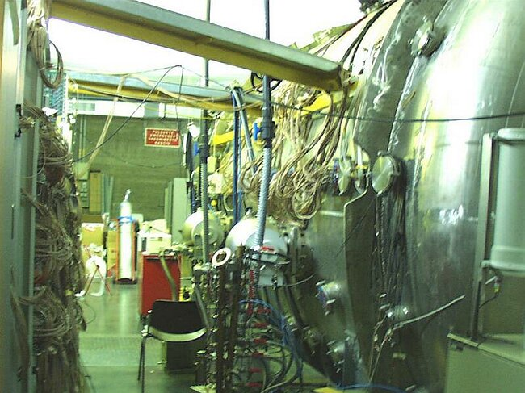
The Ciclope scattering chamber
(general purpose vacuum chamber, 4m length, 2m diameter)
Nuclear Physics
Tests for large Experimental setup tests
applications

Slide 12
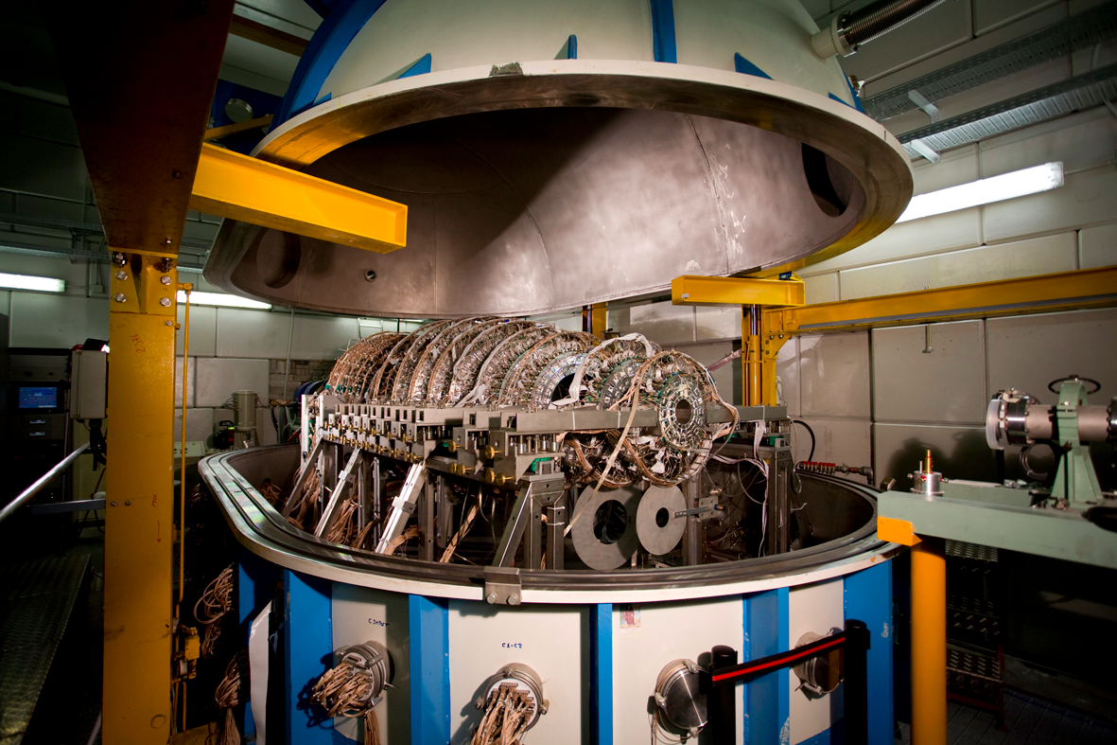
LNS lay-out: accelerators and experimental halls
I Laboratori Nazionali del Sud
Chimera
Magnex
Ciclope
Catana
Medea
0°
20°
40°
60°-80°
FRIBS@LNS
Superconducting
Cyclotron
Tandem
EXCYT

Slide 13
CHIMERA (CHarged Ion Mass and Energy Resolving Array)
is a 4pi detector for charged particles devoted to the study of nuclear reaction at intermediate energies and operating at Laboratori Nazionali del Sud in Catania
Equation of State of Asymmetric nuclear matter
isospin dependence of the symmetry energy
Time scale of particles and cluster emission
Isospin dependence of compound nucleus formation and decay (ISODEC)
Use of the FRIBS beam lines: coupling CHIMERA with the FARCOS prototype (CLIR [¹⁶C] and PIGMY [⁶⁸Ni] experiments (2015)
CHIMERA

Slide 14
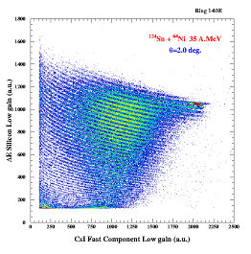
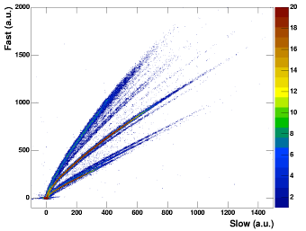
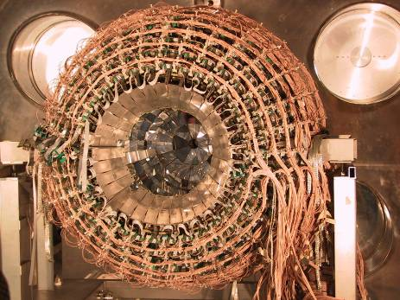
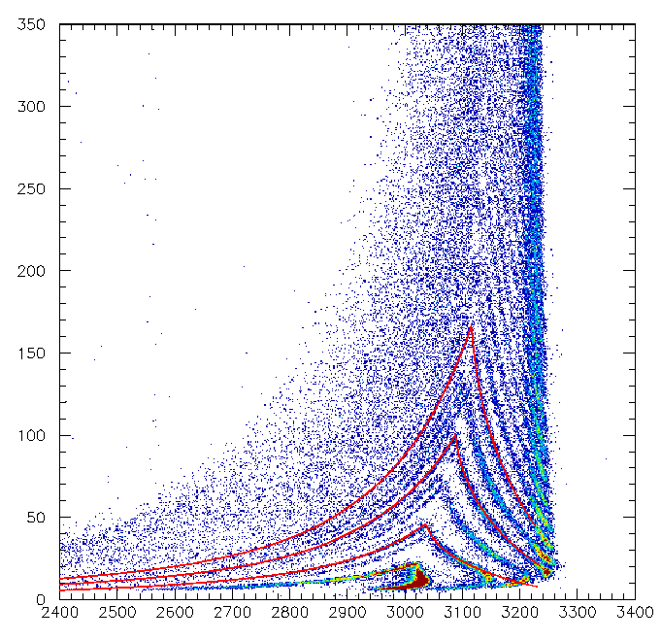
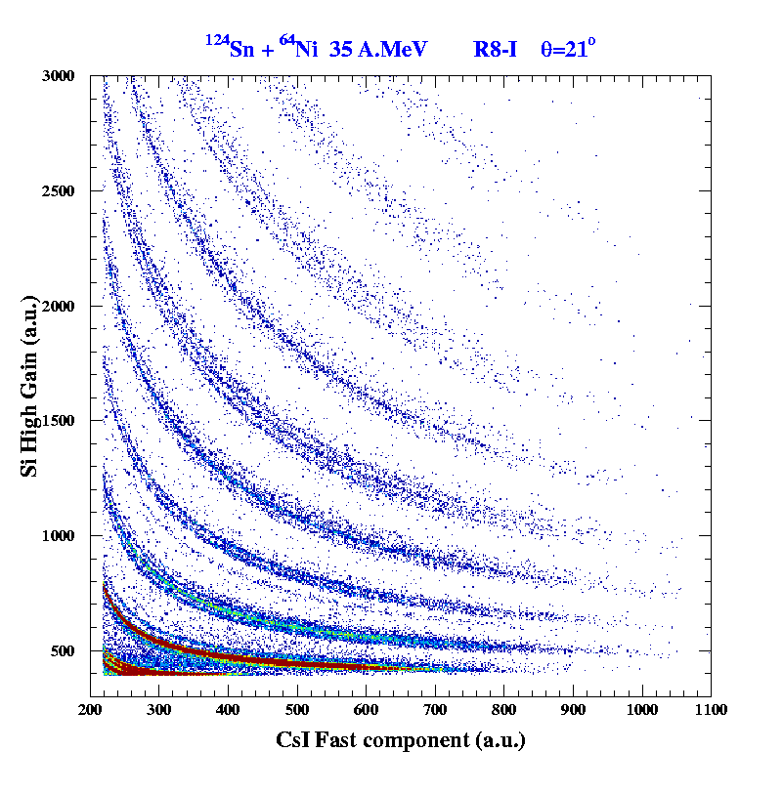
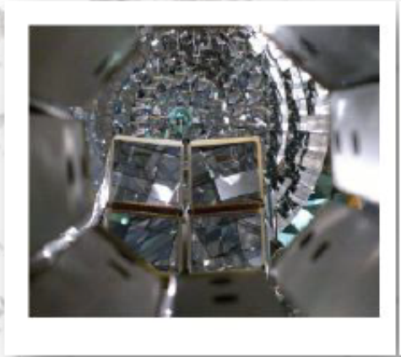
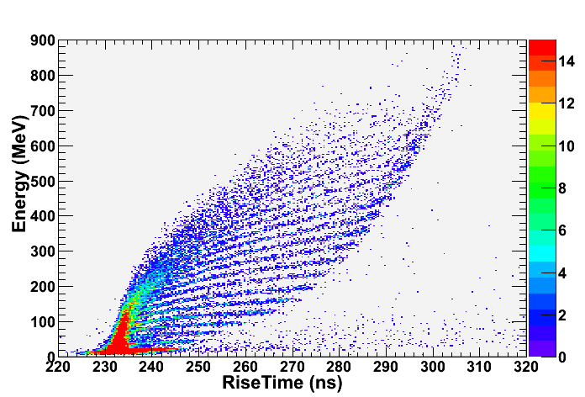
CHIMERA Detector: Identification methods
CsI(Tl)
PSD – CsI
Light particles
ΔE-E Si-Csi
charge for all particles punching through silicon
1192
Be
Li
Si
a
Z=50
HI
³He
α
t
d
p
ΔE-ToF
mass measurements for particles stopped in silicon
ΔE-E
isotopic identification
Z=6
PSD – Si
charge identification for particles stopped in silicon
Z=16
Z=10
Recently improved by an array of triple telescopes DSSSD-CsI FARCOS
Z=6

Slide 15
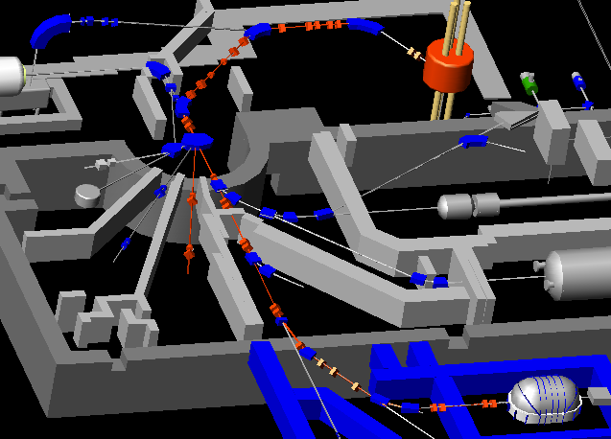
FRIBS@LNS: in Flight Radioactive Ion Beams
Production Target:
0.5, 1.5, 2.5 mm Be
FRIBs
station
20° beam line - HODO
≈ 90% vs. FRIBs station
CHIMERA beam line
≈ 50% vs. FRIBs station

Slide 16
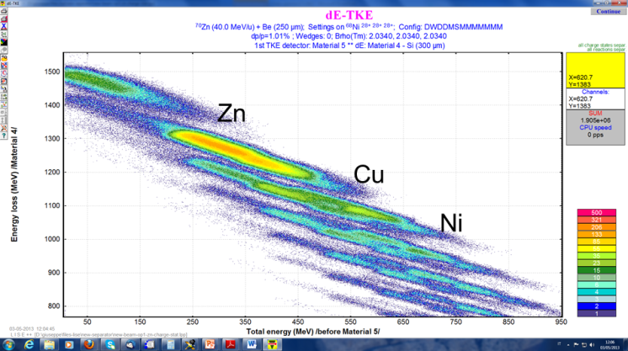
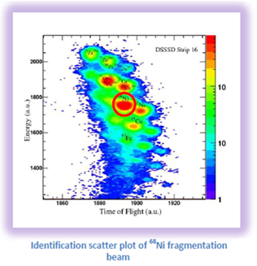

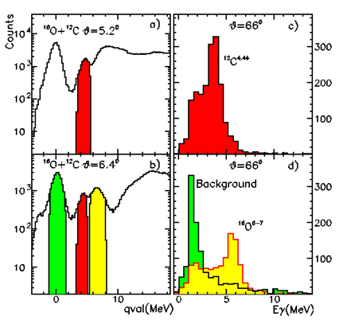
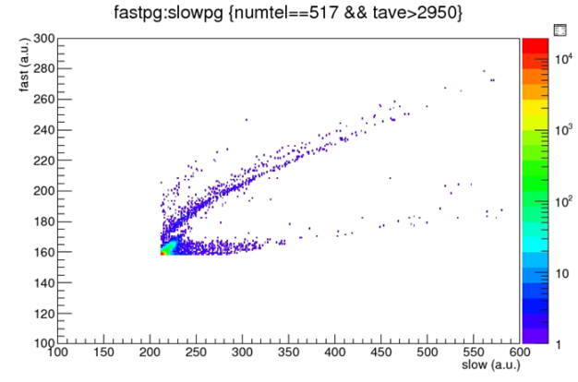
The most recent experiment with 68Ni Fribs beam (december 2015): the Pygmy resonance measurement
Expected ⁶⁸Ni identification in FARCOS silicon detectors
⁶⁸Ni*
n
SPHERE
RING 1-9
γ-rays on the CsI(Tl) of the sphere
CHIMERA
Neutrons on the CsI(Tl) of CHIMERA rings covered by FARCOS
G.Cardella NN2015 and HIB talk

Slide 17
Beams developed at FRIBS@LNS
primary beam | beam | intensity (kHz/100W)
18O 55 AMeV | 16C | 120
setting 11Be | 17C | 12
 | 13B | 80
 | 11Be | 20
 | 10Be | 60
 | 8Li | 20
18O 55 AMeV | 14B | 3
setting 12Be | 12Be | 5
 | 9Li | 6
 | 6He | 12
13C 55 AMeV | 11Be | 50
setting 11Be | 12B | 100
36Ar 42 AMeV | 37K | 100
setting 34Ar | 35Ar | 70
 | 36Ar | 100
 | 37Ar | 25
 | 33Cl | 10
 | 34Cl | 50
 | 35Cl | 50
20Ne 35 AMeV | 18Ne | 50
setting ne18 | 17F | 20
 | 21Na | 100
70Zn 40 AMeV
setting 68Ni | 68Ni | 20
Beams to be delivered in 2014-2015 to approved experiments
¹⁶C (CHIMERA)
⁶⁸Ni (CHIMERA)
⁸He (CHIMERA) new
¹⁴Be (test experiment) new
³⁸S (MAGNEX) new
Unique facility in Europe

Slide 18
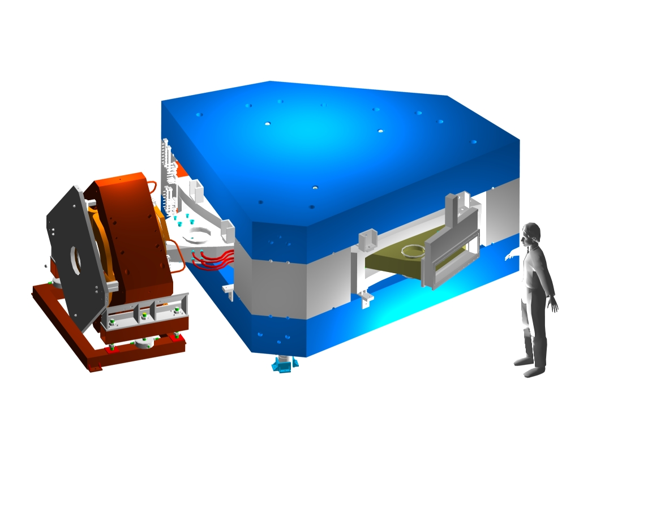
LNS lay-out: accelerators and experimental halls
I Laboratori Nazionali del Sud
Chimera
Magnex
Ciclope
Catana
Medea
0°
20°
40°
60°-80°
FRIBS@LNS
Superconducting
Cyclotron
Tandem
EXCYT

Slide 19
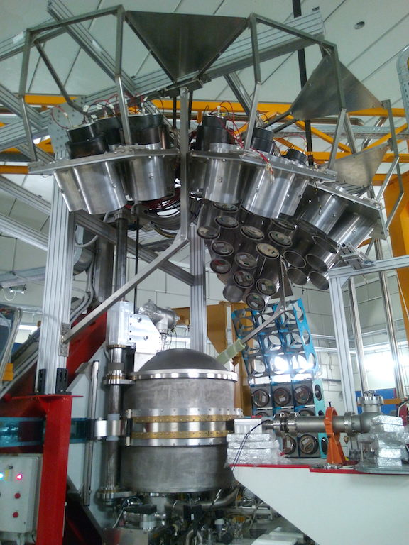
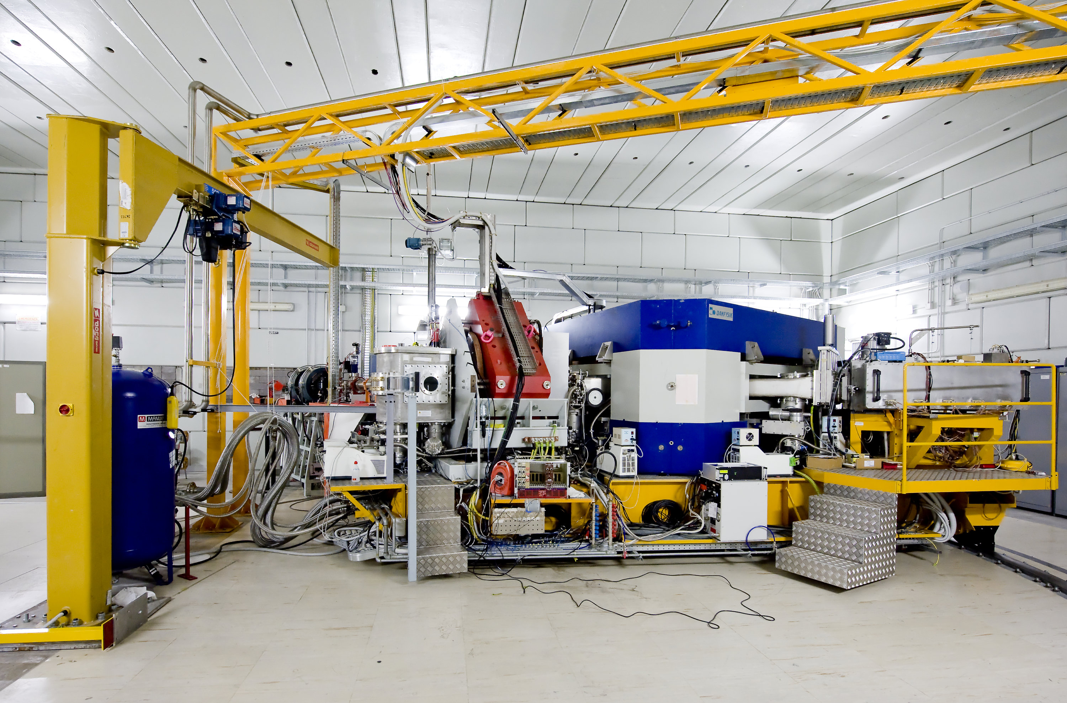
MAGNEX*EDEN
Light nuclei structure
Nuclear astrophysics
Spectroscopy
Structure effects on reaction mechanism
Exotic nuclei
Isgm
DCE

Slide 20
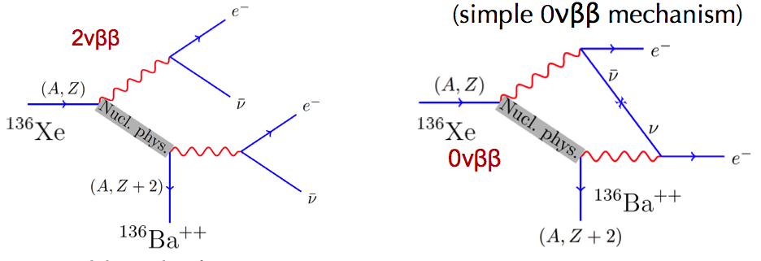
Physics case demanding high intensity: double β decay
F. Cappuzzello talk
A lot of new physics inside
but one should know Nuclear Matrix Element (NME)

Slide 21
LNS lay-out: accelerators and experimental halls
I Laboratori Nazionali del Sud
Chimera
Magnex
Ciclope
Catana
Medea
0°
20°
40°
60°-80°
FRIBS@LNS
Superconducting
Cyclotron
Tandem
EXCYT

Slide 22
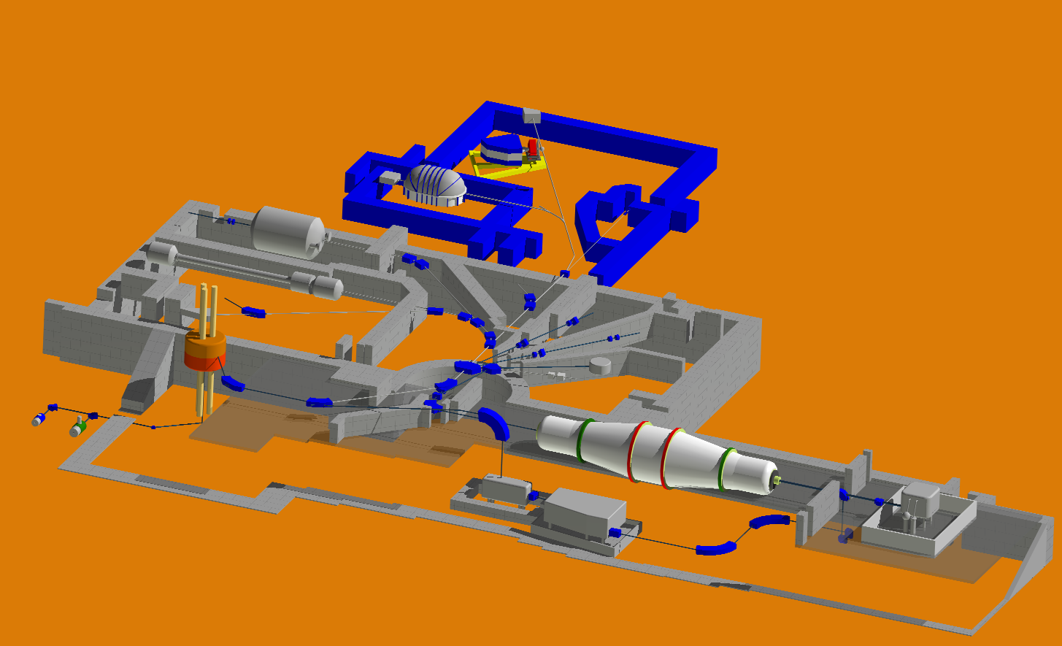

Multidisciplinary beam lines at INFN-LNS
Two rooms are available at LNS for multidisciplinary activities irradiations:
  CATANA beam line (clinical proton beams at 62 MeV)
  0° beam line (protons and light ions up to 80 AMeV)
both equipped with detectors for beam diagnostics and dose monitoring.
Beam lines and experimental rooms at LNS
MAGNEX
CHIMERA
MEDEA
CATANA
Superconducting Cyclotron (CS)
0°
20° room
40° room
TANDEM

Slide 23
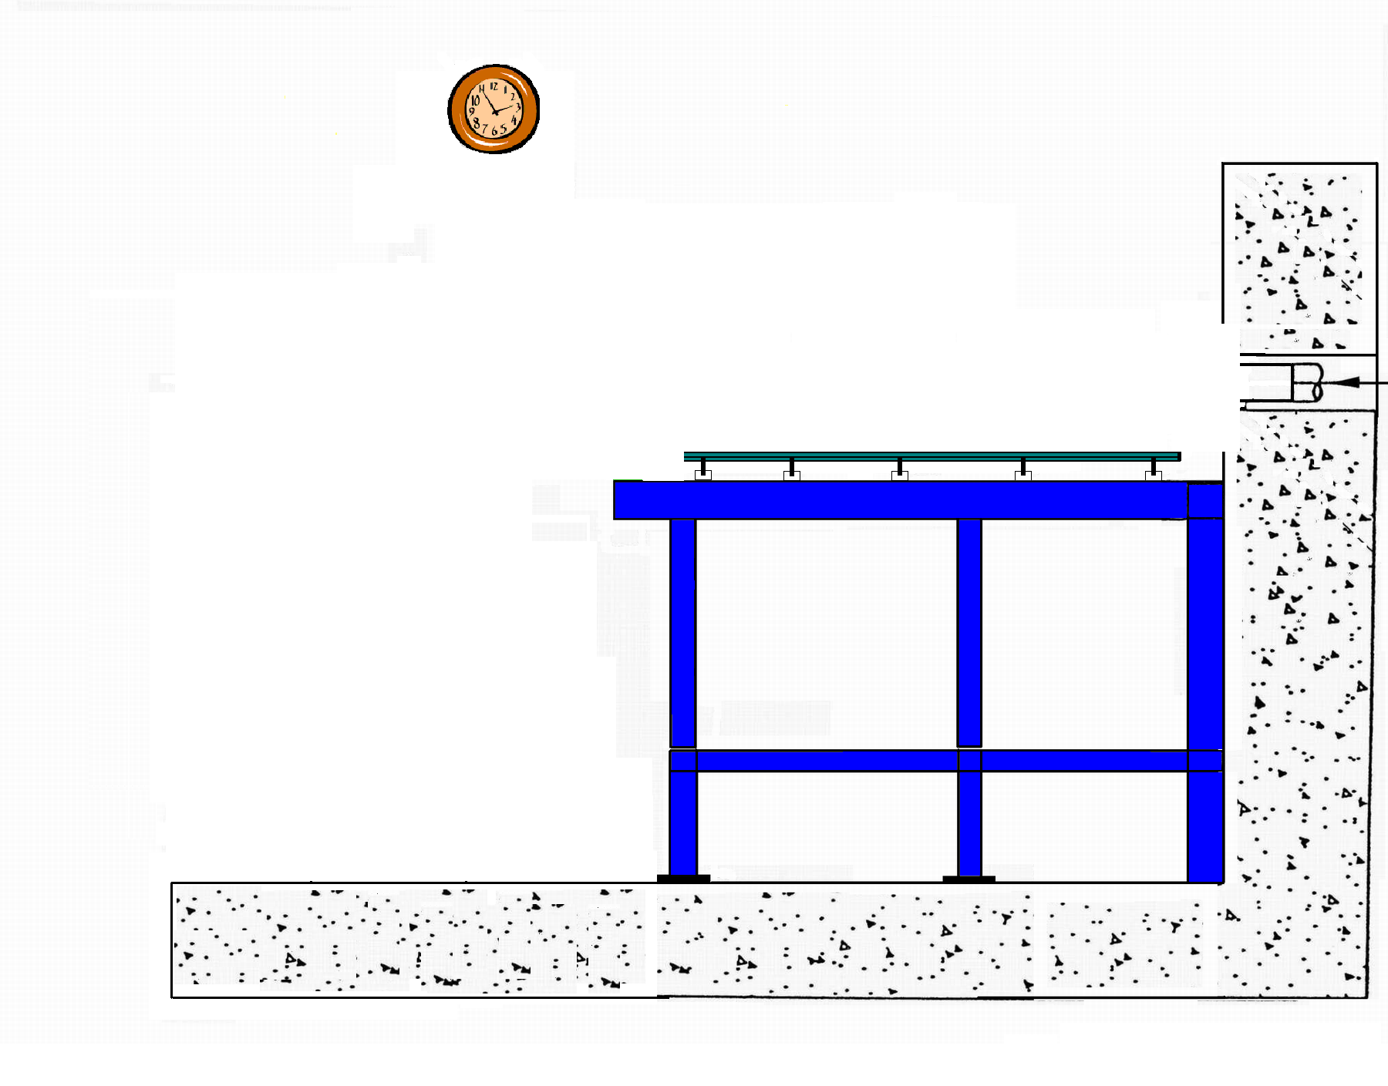
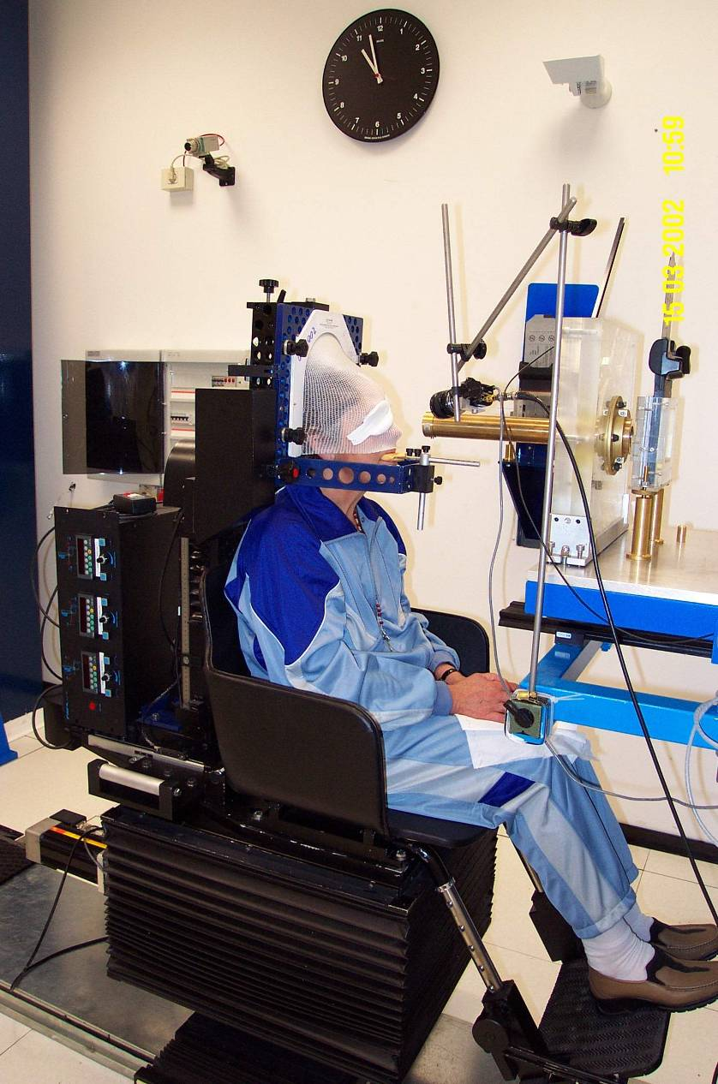
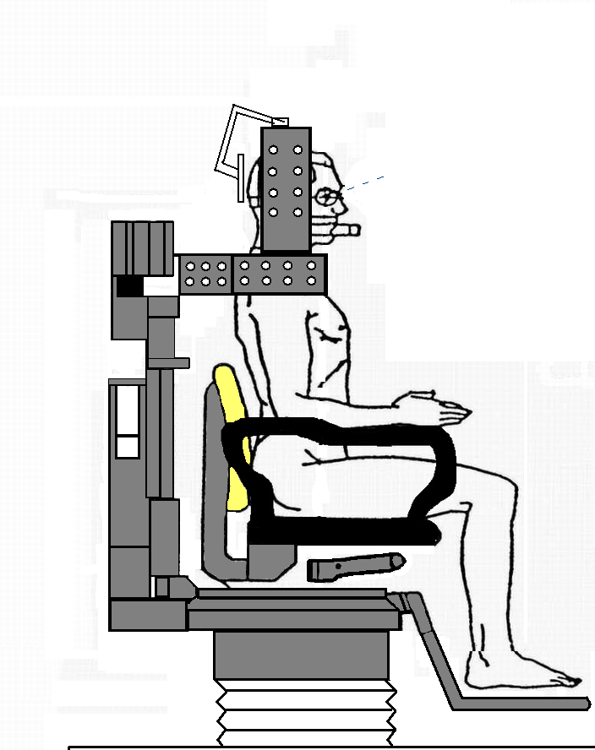
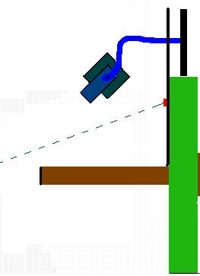

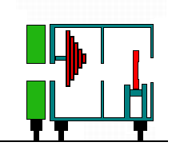
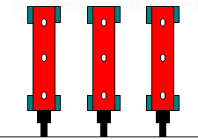
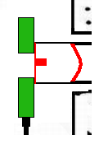

CATANA proton therapy beam line
Ligth field
Modulator & Range shifter
Monitor chambers
Scattering system
Laser

Slide 24
Total Number of patients | > 300
Deaths | 6
 | Metastatis | 5
 | Other | 1
Eye retention rate | 95 %
Surviving | 98 %
LOCAL CONTROL | 95 %

Slide 25
LNS lay-out: accelerators and experimental halls
I Laboratori Nazionali del Sud
Chimera
Magnex
Ciclope
Catana
Medea
0°
20°
40°
60°-80°
FRIBS@LNS
Superconducting
Cyclotron
Tandem
EXCYT

Slide 26
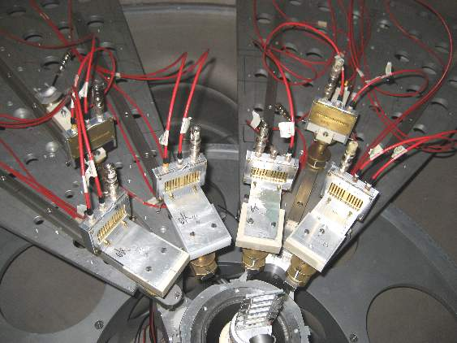
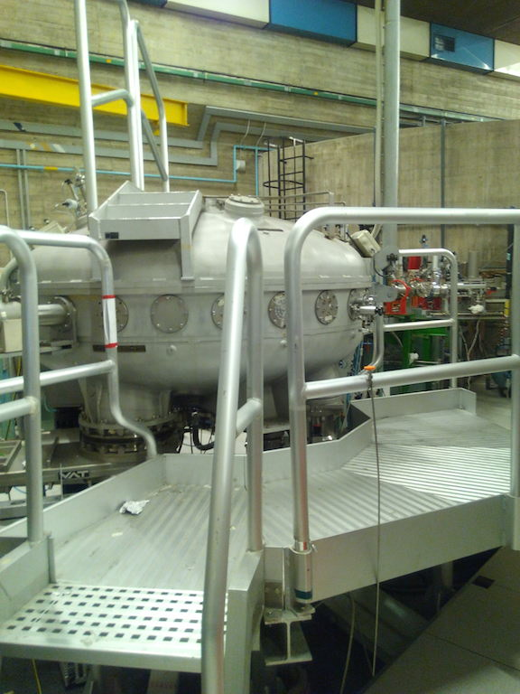
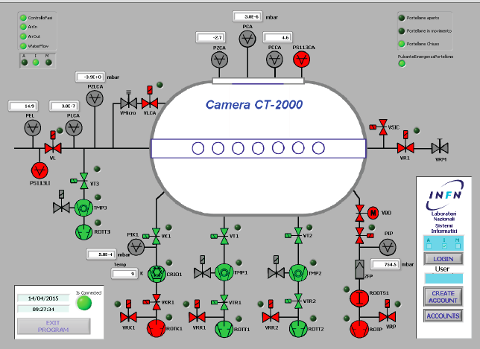
The scattering chamber 2000
(2 m diameter)
Nuclear Physics
Nuclear Astrophysics
Applications
NEW!

Slide 27
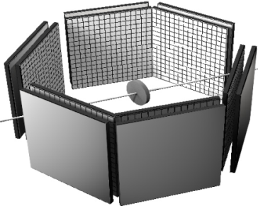
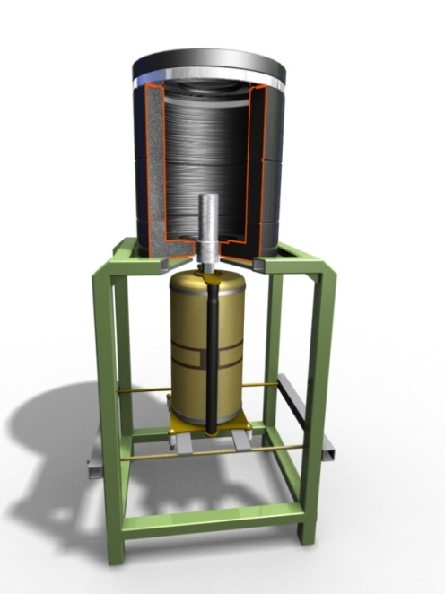
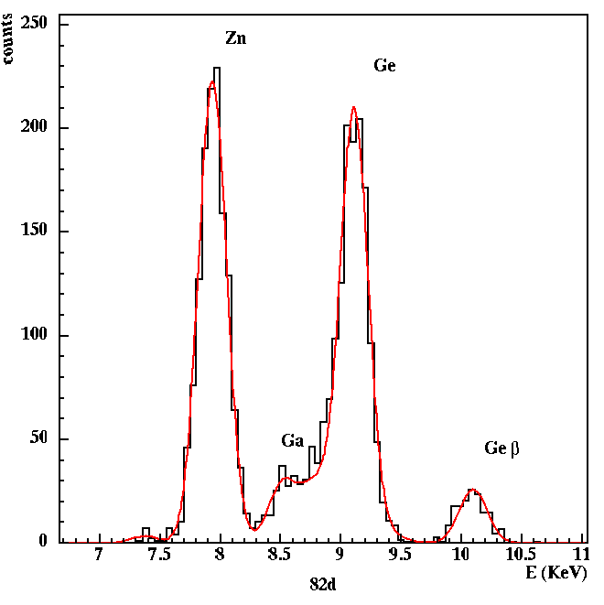
Reaction and nuclear structure studies at the CT 2000 Chamber
Elastic and direct processes studied with Si telescopes systems like e.g. CLAD.
Elastic excitation functions measured with the TTIK technique filling the chamber with gas
CLAD 6 highly segmented
Si telescopes
⁴He
Fusion excitation functions with the activation technique have been measured. Decay
of the activated foils followed off line in a dedicated lab with lead shielded detectors
E.R.
target
catcher
BEAM

Slide 28

Basic idea:
it is possible to extract the cross section of the a + b → c + d
two-body reaction from the
THM
Progetto Premiale Astrofisica Nucleare
quasi-free contribution of an appropriate three-body reaction
a + x → c + d + s
b ⊕ s clusters
 only b interacts with a
s is considered to be spectator
to the reaction
break-up
x
s
b
d
Today, the THM is believed to be the unique technique which allows one to investigate nuclear effects in nuclear and astrophysical scenarios.
a
c
virtual two body reaction
a + b → c + d
G.Baur: Phys. Lett.B178,(1986),135
(pole approximation)
C. Spitaleri et al., PRC 64(2001)068801
C. Spitaleri et al., PRC 69(2004)055806

Slide 29
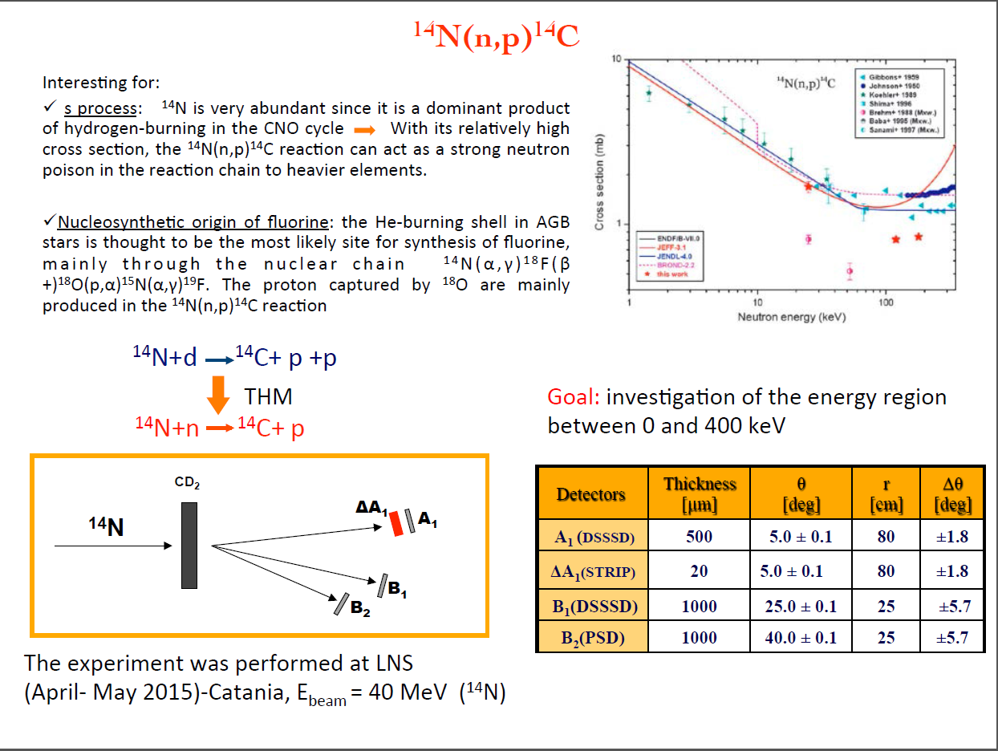

Slide 30
R. D. towards users …
Research Division
User Service
Computing Service
Scientific Information Service
Marine Infrastructures Service

Slide 31







AISHA
AREA
Personnel: 9
KM3NET
AREA
Technical support for
experimental facilities
electronics and detectors
target preparation
maintenance
….
Data handling
Magnex + Chimera

Slide 32

Computing Service
Personnel: 3
Support for
acquisition systems
data storage
wifi connections
email account
….
New computing system - 2015

Slide 33





Scientific Information Service
Personnel: 2
Scientific publications
Events
Visit at LNS
Access to the Guest-House
…
LNS PAC meeting

Slide 34

Marine Infrastructures Service
Personnel: 11

Slide 35
“European Nuclear Science
and Applications Research”
The Transnational Access to LNL and LNS - Ensar2
Consortium Agreement signed!
Starting date January 1st 2016 … ?
To be eligible to benefit from access to the infrastructure under the grant agreement, a user group must satisfy the following two conditions:
a) the user group leader and the majority of the users must work in a institution established in a Member State or Associated State;
b) the user group leader and the majority of the users must work in a country other than the country(ies) where the legal entity(ies) operating the infrastructure is(are) established.

Slide 36



TNA03 – Deliverables
NSDBF → Nuclear Structure and Dynamics Based Facilities
AIPF → Applied and Interdisciplinary Physics Facilities
Min. quantity of access to be provided
4424 h / 4y
204 users / 4y
52 projects / 4y
Notes:
36

Slide 37
LNS towards users
Research Division
Accelerator Division
Technical Division
Radioprotection and Safety Services
Administration Service

