Slide 1
LNS User Meeting 15/12/2014
Members of the user commettee (2015-2016):
Enrico De Filippo – INFN sez. Catania (coordinator of the user group)
Silvio Cherubini - INFN - LNS and Catania University
Marco Circella – INFN sez. Bari
Chiara Nociforo - GSI Darmstadt
Gabriele Pasquali – INFN sez. Firenze
Last User committee election was on december 2014
Next Renewal : december 2016
From regulations:
The Users Committee of the Laboratori Nazionali del Sud discusses the development proposal of the Laboratory and the technical-administrative and logistical problems of the users.
This year the User Committee has supported the organization of the HIB workshop on high intensity cyclotron beams

Slide 2
Suggestions and information from the users comes from:
1) Direct contacts of users with committee members or the coordinator
2) End of run forms
Generally they are reported to direction (through the LNS «consiglio di laboratorio») or to the heads of involved divisions or to the users support service (currently D. Santonocito). Often, not complex problems can be resolved easily in this way.
The end-of-run form is the best way to maintain the database of users (at least for users of the accelerators) line and improve the LNS “efficiency”
Generally we receive a good number of «end of run» forms from users of the accelerators but only if the compilation and sending of the form is kindly «pushed» by e-mail (i generally do this periodically for cyclotron users)

Slide 3
Activity at the Cyclotron November 2014-December 2015 (after Helium liquefier stop)
In red: end of run form available
Nuclear physics
Fazia test (2014) Ciclope
CLIR CHIMERA
RAINBOW MAGNEX
O16-Magnex MAGNEX
DRIP_LINES MAGNEX
ISOFAZIA Ciclope
Fazia test Ciclope
SIKO CHIMERA
PIGMY CHIMERA
FAZIA-Sym Ciclope
Interdisciplinary physics
MAPRAD 0°
RADIOSTEM 0°
HADMAC 0°
DNA-BRAGG Catana
PRIMA Catana
MIMOBRAGG 0°
IONMAPS 0°
REDOLIB 0°
PIRAMIDE 0°
WP1-BIO 0°
IRSIDIA 0°
DIAPIX 0°
MITRA 0°
DOPET Catana
ELIMED 40°
ARDENT Catana
PREDATE Catana
TERASPARC Ciclope
List from Danilo Rifuggiato (PAC2015)

Slide 4
2015 report
Schedule | Time preparation | Electronic LNS pool | Requested module available | Acq LNS used | Beam on target | Reason for beam lost | Time to dismount | Need LNS service | Support satisfaction | Guest house
yes | yes | no |  | no | 100% |  | yes | yes | yes | Nice, noisy
yes | yes | yes | yes | no | 70% | Experiment | yes | yes | yes | Longer stay required
yes | yes | no |  | Partial | 90% | Beam tests |  | yes | yes | fine
yes | yes | no |  | no | 60% | Experiment | yes | no
yes | yes | yes | yes | no | 90% | Beam unstable | yes | yes | yes | clean
yes | yes | no |  | no | 60% | Experiment tasks | yes | yes | yes | perfect
yes | no | yes | yes | no | 70% | Beam unstable | yes | yes | yes | Good. No laundry
yes | yes | no |  | no | 80% | Source problems and exp. | Yes | yes | yes | fine

Slide 5
Schedule | Time preparation | Electronic LNS pool | Requested module available | Acq LNS used | Beam on target | Reason for beam lost | Time to dismount | Need LNS service | Support satisfaction | Guest house
yes | yes | yes | yes | Yes | 80% | Sources | yes | yes | yes | good
yes | yes | yes | yes | Yes | 90% | Source intensity |  | yes | yes | good
General considerations on comments and problems:
On beams: effort must be done for the improvement of the sources intensity, in particular for FRIBS beams
On acquisitions rooms: O° not confortable and noisy for long experiments
Magnex room small and very crowded when there are a lot of participants
Lack of chairs in Ciclope daq. room (resolved ?) and
furniture (resolved) in Ciclope chamber.
Problem of rain inside the daq rooms and 2nd
distribution [heavy rain] (resolved ?)
Problems for preparation, starting vacuum and tests in Chimera when Magnex is working
On guest house: Generally very nice. Some difficulty to pay (resolved?). Few lack of services.

Slide 6
PROGRAM
14:30 - 14:50 G. Cuttone Communications and news from LNS director
14:50 - 15:00 E. De Filippo News from user committee
15:00 – 15:20 D. Rifuggiato Status of the accelerators and news for the users
15:20 – 15:40 S. Romano The Research Division activity at LNS
15:40 – 16:00 A. Pagano Summary and report on HIB workshop
Coffee break 16:00 - 16:20
16:20- 16:40 P.P. Figuera Low energy reactions mechanism studies with
weakly bound nuclei al LNS
16:40 – 17:00 F. Romano News on irradiations beam line and new projects in
in-vivo experiments
17:00 – 17:20 P. Migliozzi (INFN-Napoli) Activities and news in 2015 for
Km3Net project
17:20 – 17:40 M. La Cognata Activities and news from ASFIN group
17:40 - 18:xx : Open Discussion and brief contributions from users (5 minutes, 3,4 slides): problems to be raised for the User Committee and LNS direction, new projects, ideas, communications, etc.,
Talks : 15 min + 5 discussion

Slide 8
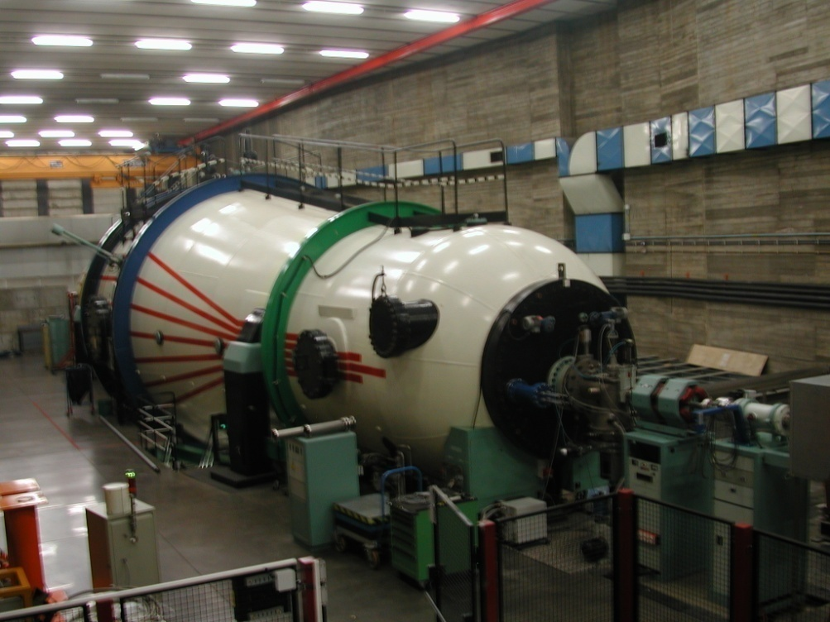
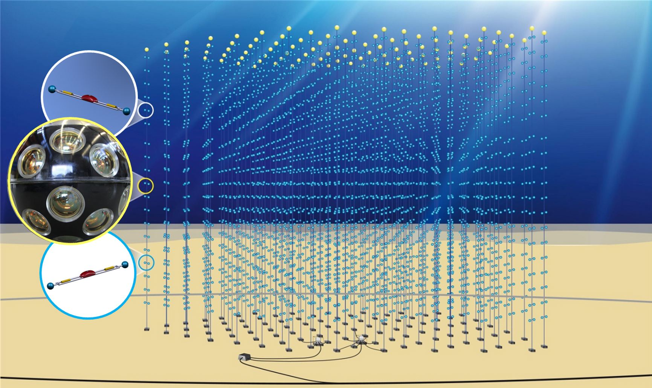
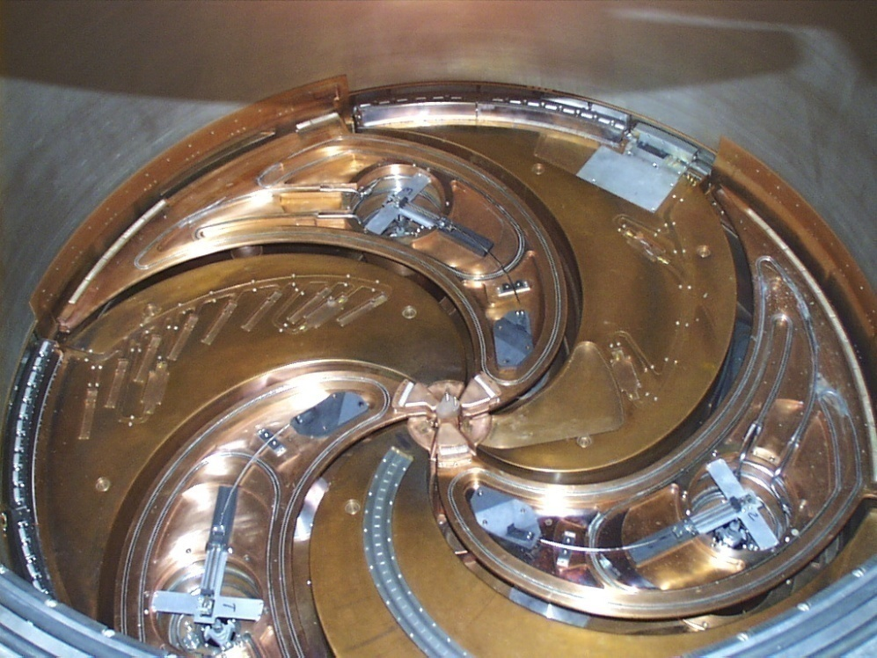
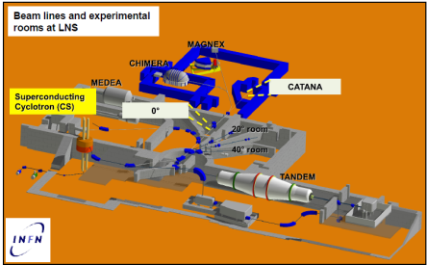
The User Committee has supported the organization of the HIB workshop on high intensity cyclotron beams
The Users Committee of the Laboratori Nazionali del Sud discusses the development proposal of the Laboratory and the technical-administrative and logistical problems of the users that belong to different communities following the research directions of LNS:
Nuclear physics with cyclotron in 2015 (interdisciplinary not included)
CLIR (FRIBS) CHIMERA
RAINBOW MAGNEX
O16-Magnex MAGNEX
DRIP_LINES MAGNEX
ISOFAZIA Ciclope
Fazia test Ciclope
SIKO CHIMERA
PIGMY (FRIBS) CHIMERA
FAZIA-Sym Ciclope
Km3Net, neutrino physics, INFN group II physics
Physics with accelerators:
Nuclear physics
Interdisciplinary physics
Catana beam line
0° beam line, irradiation

Slide 9
Possibility to enlarge the cyclotron users community (new detectors, coupling of existing detectors) ?
Consequences in infrastructures: improvements on ECR sources, beam lines, detectors? New man-power ?
Concequences on research: cyclotron stopping
year | 2013 | 2014 |  | 2015 | 2016 | 2017 |  | 2018 | 2019 |  | 2020
Phase1
Phase2
Phase3
Phase4
See Alessandra Calanna talk

