Slide 1
Cosmic Microwave Background Polarization
B-modes polarization of the CMB:
produced by dark matter structures (lensing) crossed by CMB photons
Produced by the inflation process in the very early universe (E=10¹⁶ GeV ??) and its tensor fluctuations.
Measurement method:
Accurate maps of the Stokes parameters of the CMB
Exquisite control of systematic effects in polarimeters
Wide frequency range for accurate monitoring of locally produced polarization
Current limits:
Ratio tensor/scalar fluctuations : r < 0.1 @ 95% C.L. (Planck, Keck, BICEP)
For single-field, slow-roll inflation:
Not only r, but also n_{s}, n_{T}, and possibly the full inflaton potential V.

Slide 2
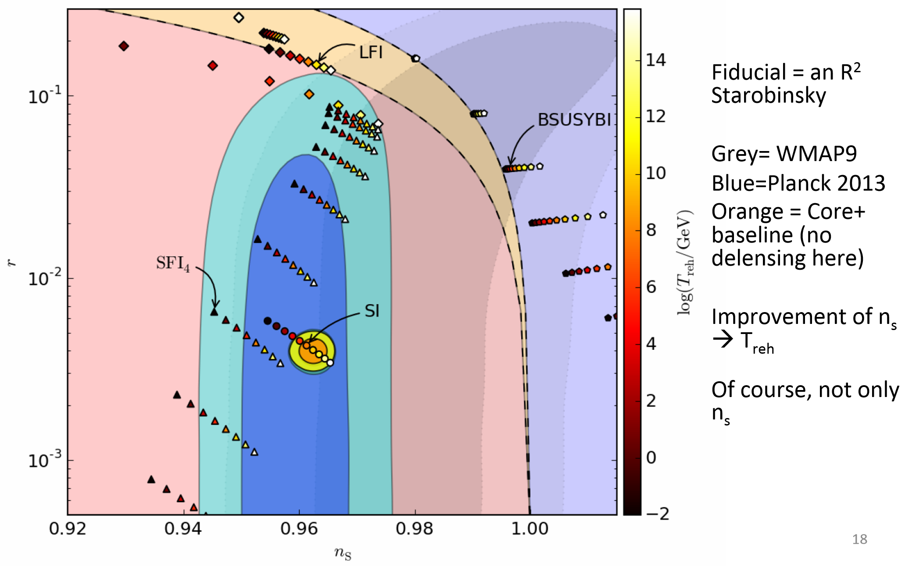
Inflation model testing

Slide 3
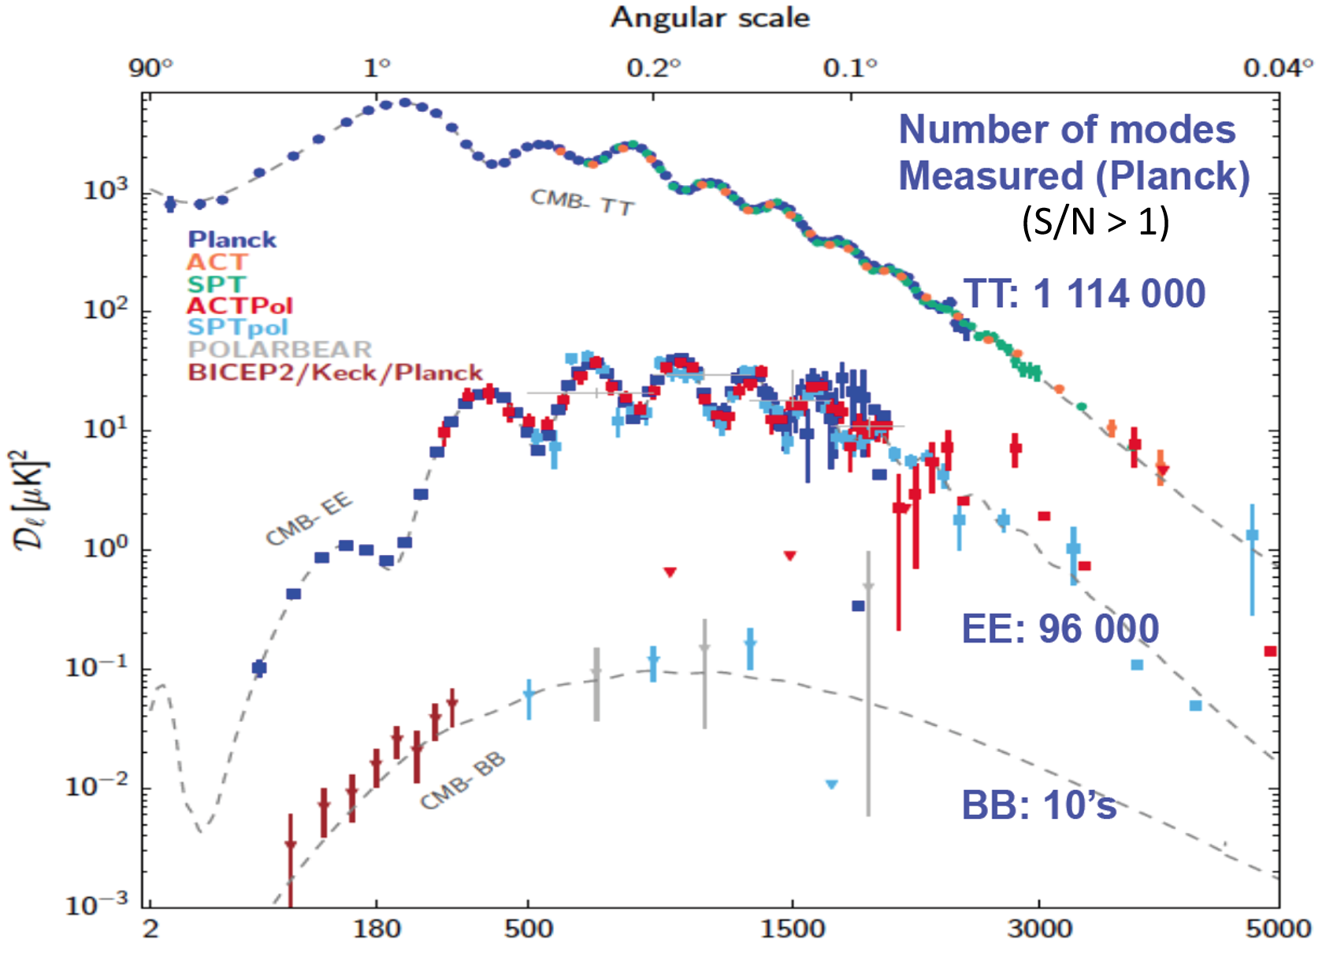

Slide 4
Forthcoming B-modes experiments
Planck flown, preliminary results published, legacy analysis by 2016. Best limits in synergy with Keck & BICEP
EBEX balloon flown
SPIDER balloon flown 1/2 (95 & 145 GHz)
Keck array, BICEP2 published (95 & 140 GHz, south pole)
ABS done (145 GHz, Atacama)
CLASS in preparation (38, 93, 148, 217 GHz, Atacama)
ACTpol (90 & 146 GHz, Atacama) taking data
PolarBEAR publishing and taking data (95 & 150 GHz, Atacama)
SPTpol publishing and taking data
B-side balloon with KIDs under discussion in France
LSPE being prepared (140, 220, 240 GHz, arctic balloon flight)
QUBIC being prepared (140 & 220 GHz, Dome-C Antarctica)
Stage 4 at the horizon
LiteBIRD satellite in phase A
M5 – ESA call for medium mission coming in spring 2016 (COrE++)
Many !
Many !

Slide 5
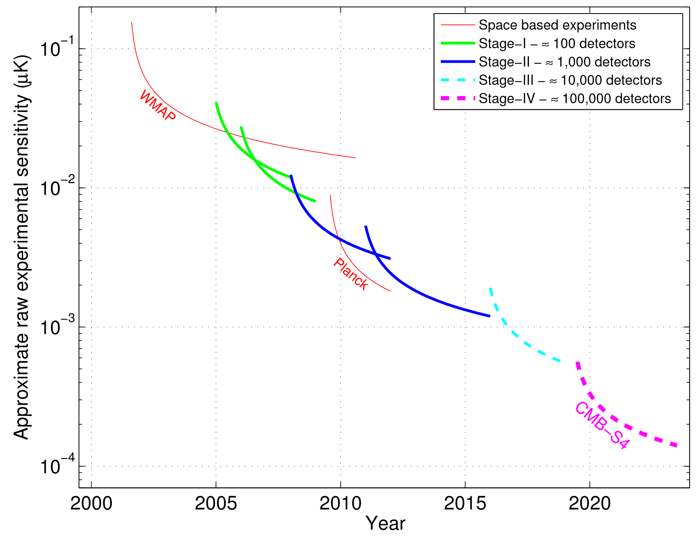

Slide 6
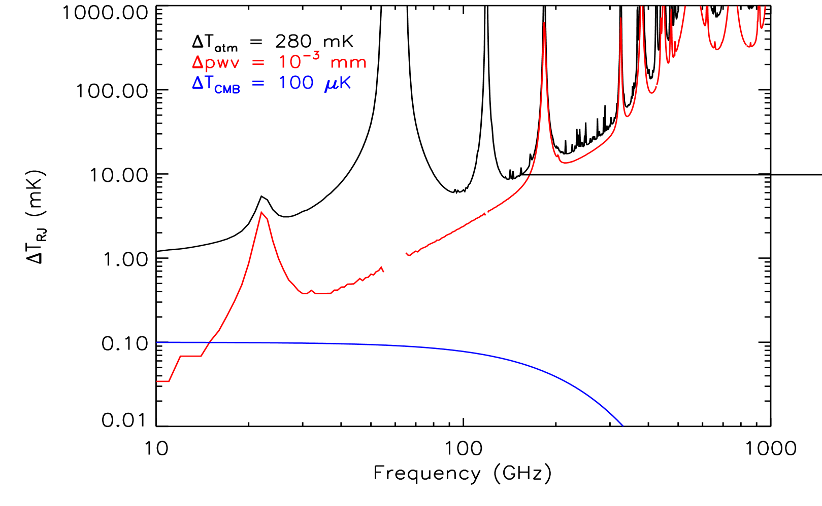
10mK
10⁵
0.1μK

Slide 7
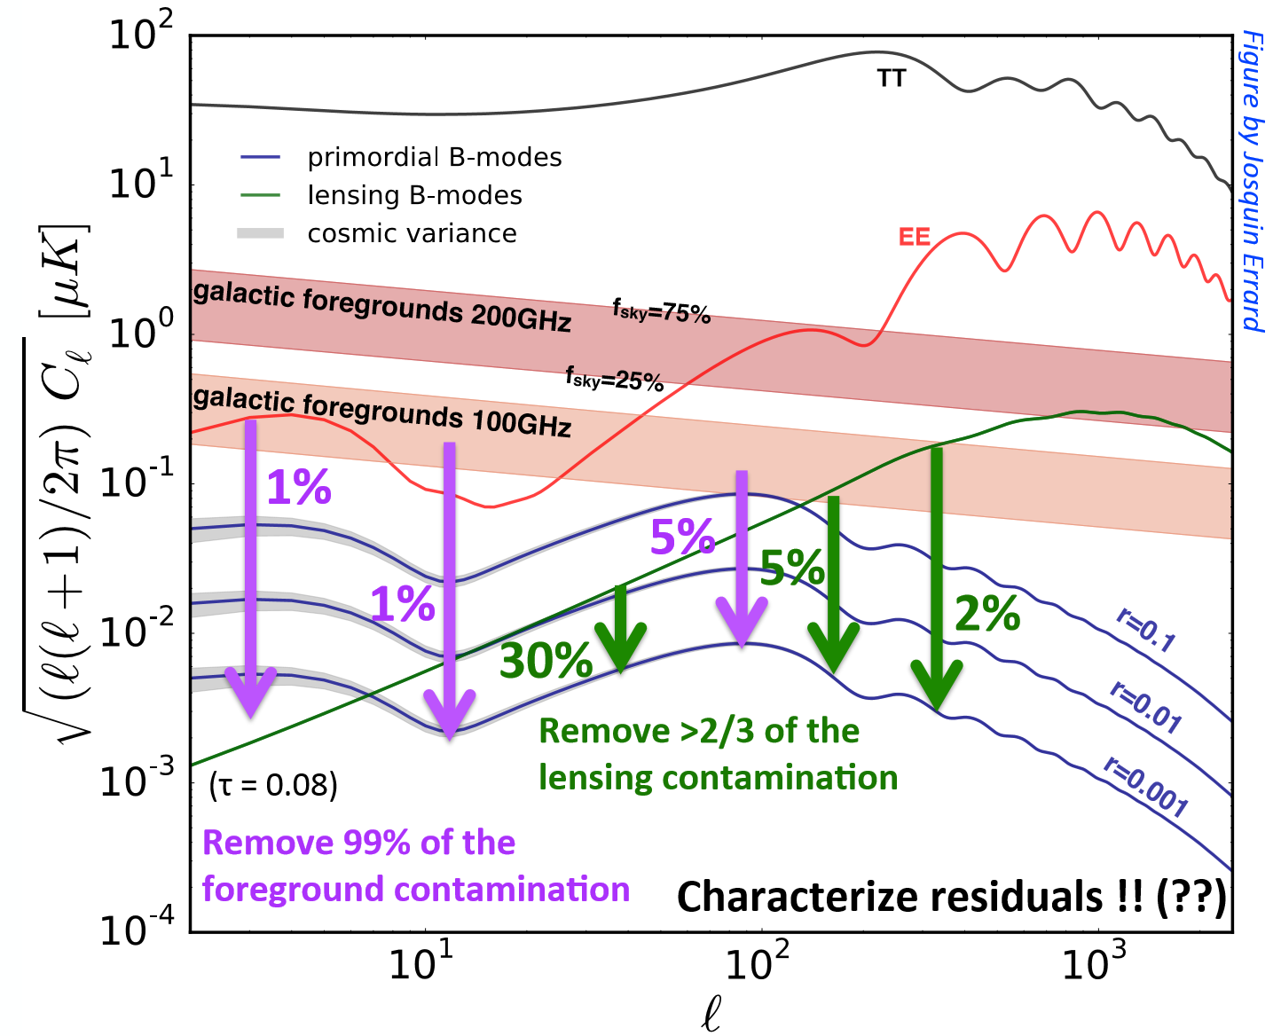

Slide 8
COrE++
Current
Experiments
LSPE, QUBIC
in Europe
M5
MO
LiteBIRD
2025-2030
S4
balloons
r=10⁻⁴
2025-2030

Slide 9
LSPE in a nutshell
The Large-Scale Polarization Explorer is :
an instrument to measure the polarization of the Cosmic Microwave Background at large angular scales
using a spinning stratospheric balloon payload to avoid atmospheric noise
flying long-duration, in the polar night
using a polarization modulator to achieve high stability
Frequency coverage: 40 – 250 GHz (5 channels, 2 instruments: STRIP & SWIPE)
Angular resolution: 1.3º FWHM
Sky coverage: 20-25% of the sky per flight
Combined sensitivity: 10 μK arcmin per flight
Current collaboration: Sapienza, UNIMI, UNIMIB, IASFBO-INAF, IFAC-CNR, Uni.Cardiff, Uni.Manchester. INFN-GE, INFN-PI, INFN-RM1, INFN-RM2, INFN-FE
See planck.roma1.infn.it/lspe

Slide 10
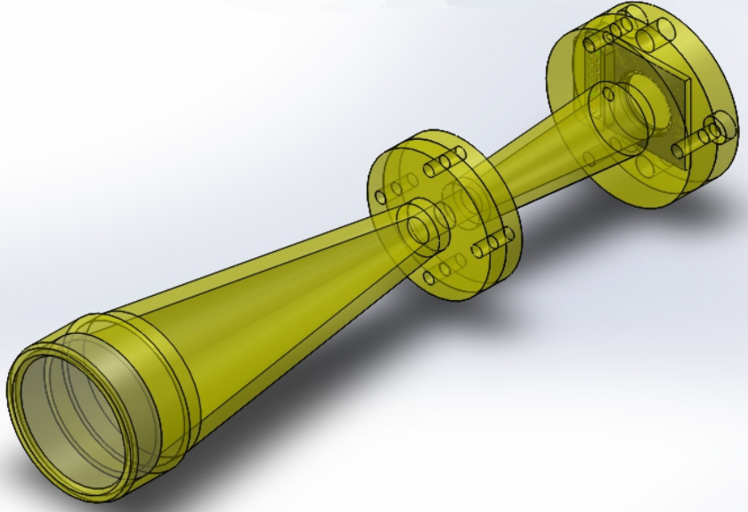
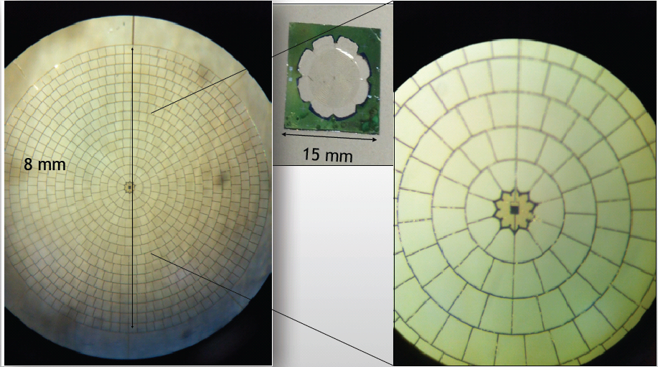
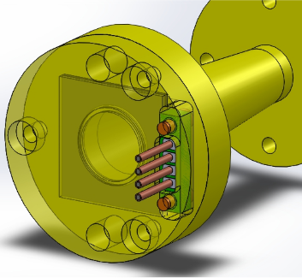
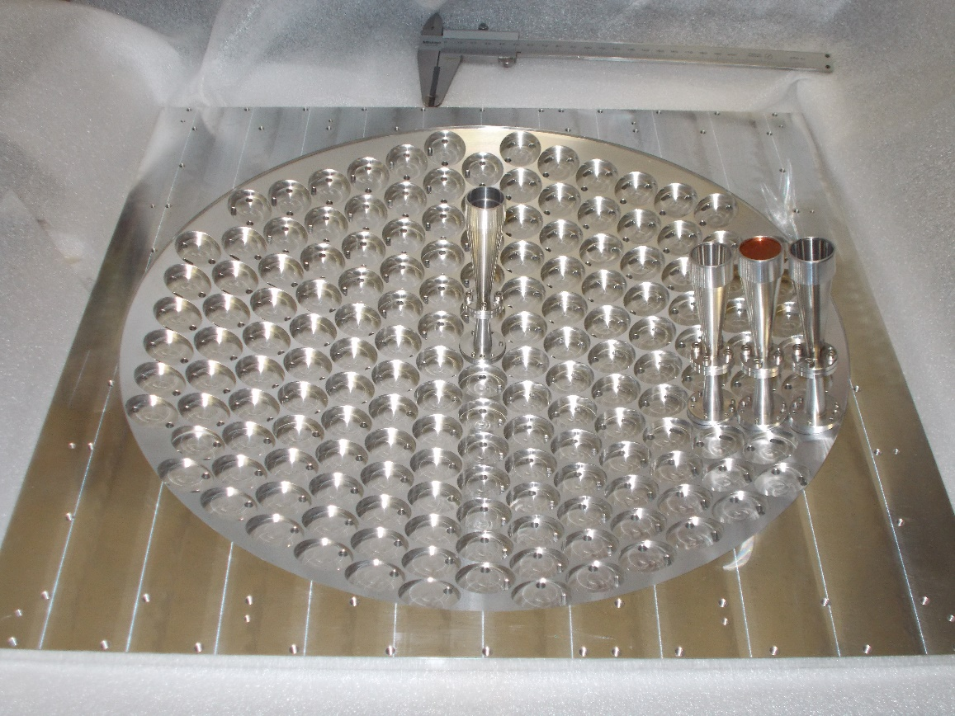
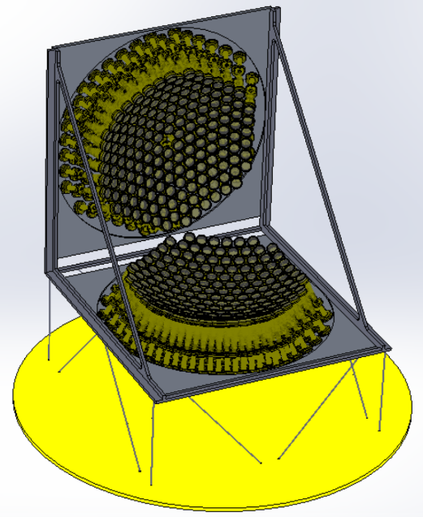
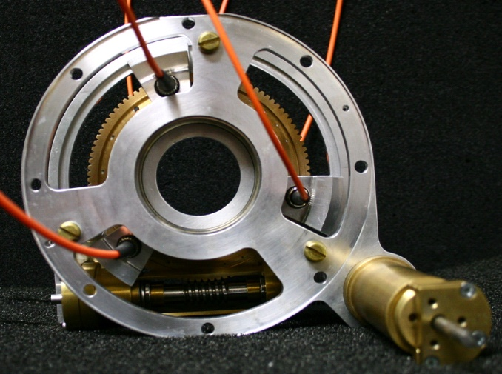
LSPE: enabling technologies
Multi-mode
TES detectors
Large focal plane arrays
Rotating HWP

Slide 11
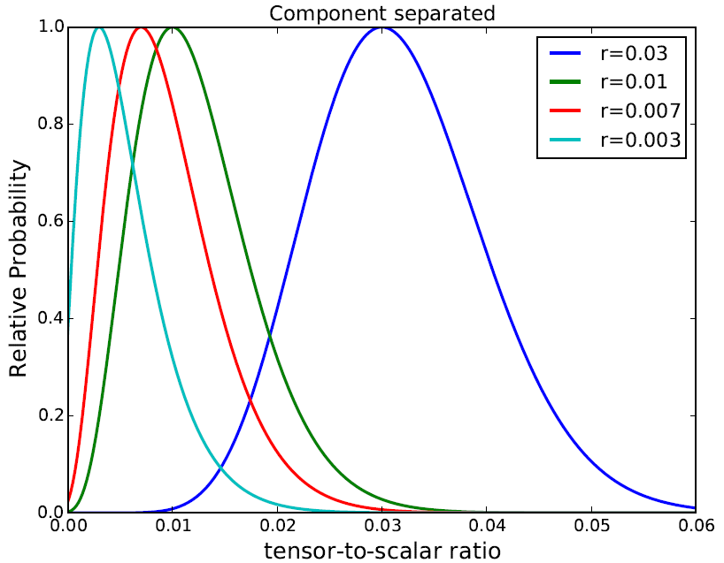
SWIPE Performance Forecast (1st flight)
L. Pagano, F. Piacentini

Slide 12
COrE++
Current
Experiments
LSPE, QUBIC
in Europe
M5
MO
LiteBIRD
2025-2030
S4
balloons
r=10⁻⁴
2025-2030

Slide 13
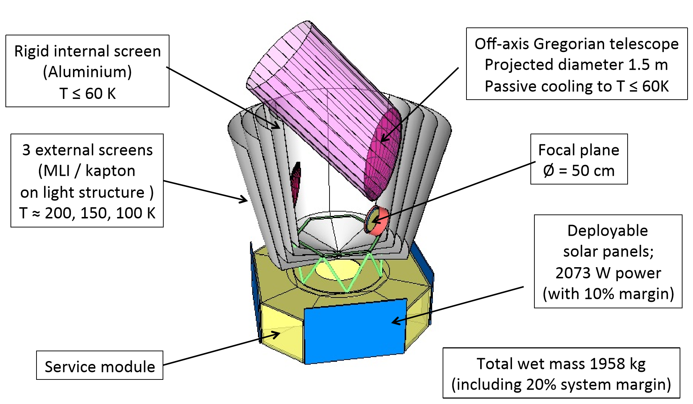
COrE -> COrE+ -> COrE++

Slide 14
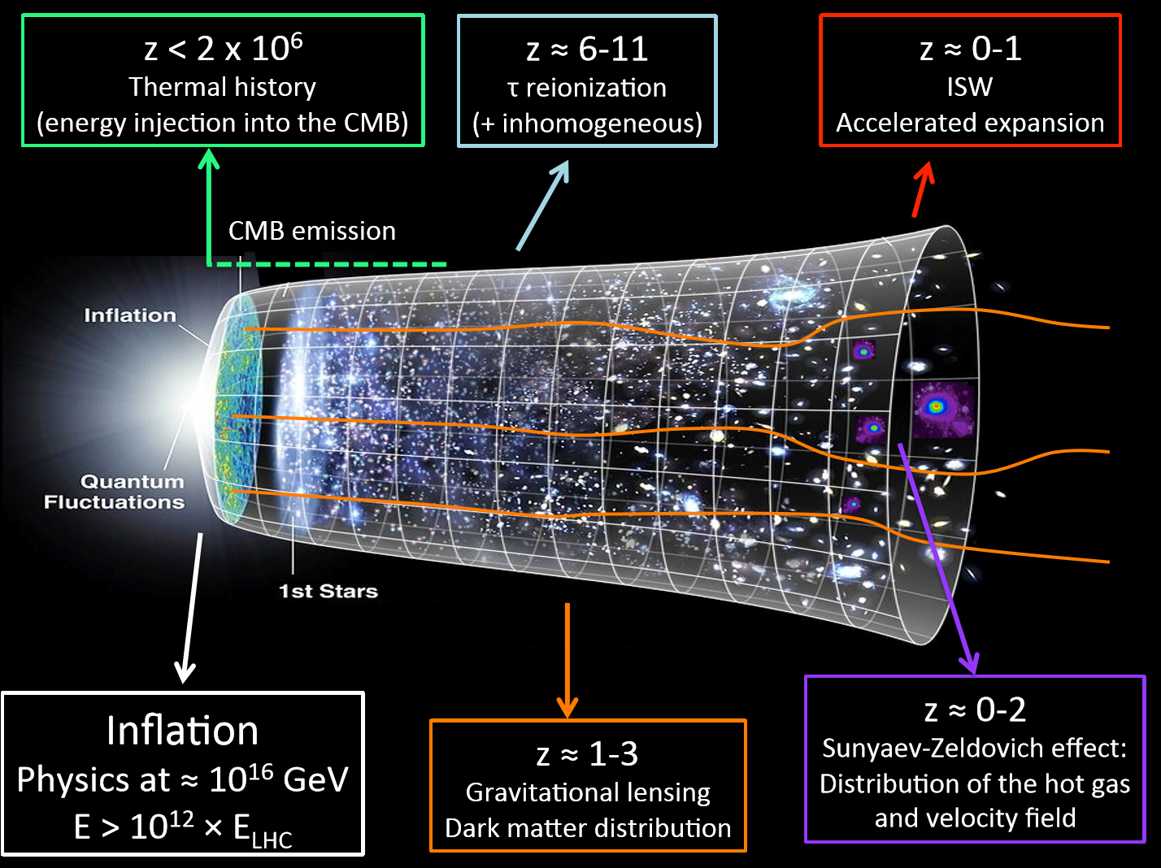

Slide 15
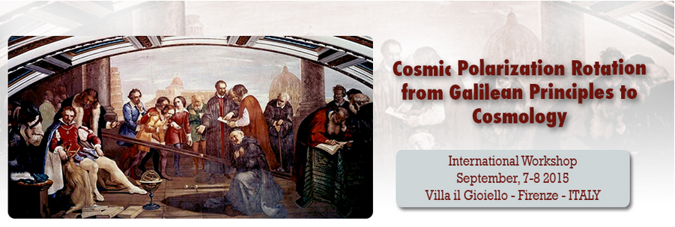
Not just inflationary B-modes
A very active community is interested to Cosmic Polarization Rotation
The orientation of polarization appears to be the most stable property of photons.
However, changes in the polarization angle of photons traveling over cosmological distances are foreseen, for example, if fundamental physical principles, such as the Einstein Equivalence Principle, are violated, or if there is a Faraday rotation.
A very difficult measurement. Usually based on non-zero <TB> &<EB>
See presentations/papers at http://www.arcetri.astro.it/cpr/

Slide 16
… and the spectrum of the CMB !
COBE-FIRAS demonstrated that the spectrum of the CMB is a high accuracy blackbody.
However, several processes lead to inevitable distortions ! New trend (PIXIE et al.): ultra-high precision measurements of the spectrum
Comptonization & free-free distortion associated with reionization / structure formation & hot galaxy clusters
Dissipation of acoustic modes at small scales:
complementary probe of inflation over additional ~10 e-folds!
signal for standard power spectrum
Hydrogen and Helium recombination lines from z ≃ 1000
HI Balmer & Paschen-α lines
additional anisotropic signals
Resonant scattering signals of “metals” during the dark ages

