Slide 1
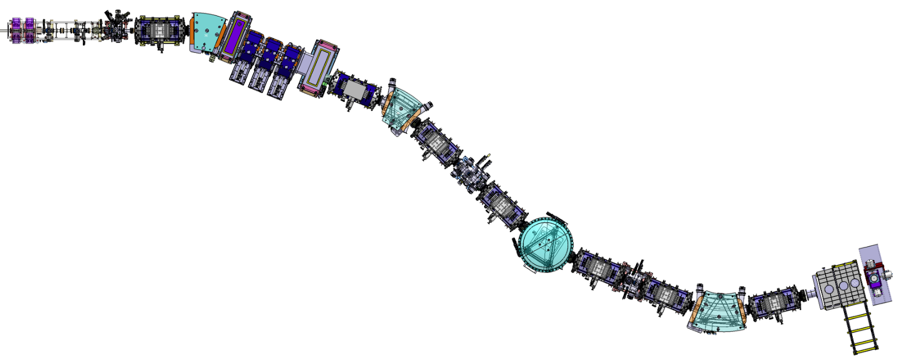
Super Separator Spectrometer
Facility @ SPIRAL2
Join LIA COLL-AGAIN COPIGAL POLITA WORKSHOP – April 2016, LNS Catania
H. Savajols (GANIL)
http://pro.ganil-spiral2.eu/spiral2/instrumentation/s3

Slide 2
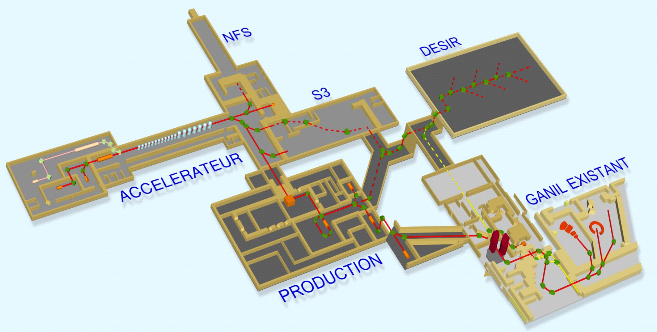
SPIRAL2 Phase1 (2017-)
Increase the intensity of stable beams
High intense neutron source
(HI≤ 10¹⁵ pps, p-Ni)
DESIR Phase1+ (2020-)
Low energy facility
⁴⁸Ca @ 2,5 pµA
A/Q=7
LINAG
33 MeV p, 40 MeV d (5mA)
A/q=3 - 14.5 A.MeV HI (1mA)
High Intensity Injector Phase1++ (2021?)
High Intensity
(HI≤ 10¹⁵ pps, p-U)
Sofar @ RFQ:
5,5 mAe proton beam
1,7 mAe of 4He2+ beam
Soon 36Ar12+
⁴⁸Ca @ 15 pµA
http://pro.ganil-spiral2.eu/spiral2/instrumentation/s3

Slide 3
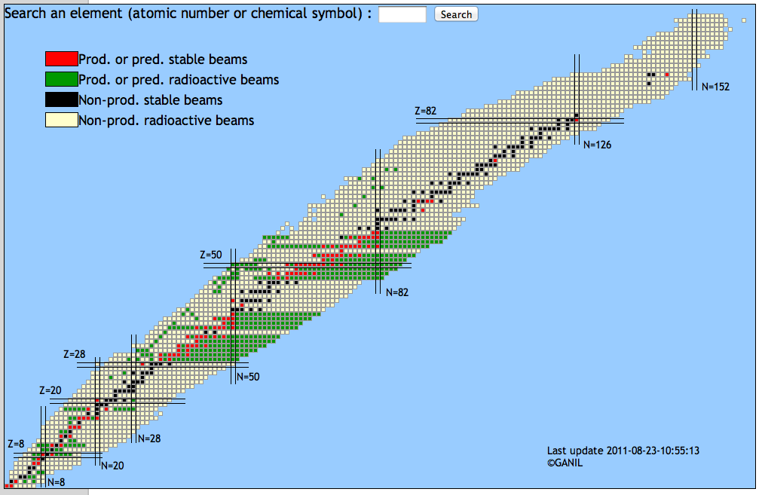
High Intensity Stable beams @ SPIRAL2
Reference project ≤ 10¹⁵ pps, p-Ni, 0.75 MeV/n – 14.5 MeV/n
Phase 1++ ≤ 10¹⁵ pps, p-U, 0.75 MeV/n – 8.5 MeV/n
LINAC SPIRAL2 A/Q=7 (Phase 1 ++)
Phoenix V3
hypothesis
Ions | Intensity (pµA) [A/Q=3] | High Intensity [A/Q=7]
¹⁸O | 216 | 375
¹⁹F | 57 | 50
³⁶Ar | 35 | 40
⁴⁰Ar | 5.8 | 30
³⁶S | 9.2 | 30
⁴⁰Ca | 6 | 20
⁴⁸Ca | 2.5 | 15
⁵⁸Ni | 2.2 | 10
⁸⁴Kr | 0 | 20
¹²⁴Sn | 0 | 10
¹³⁹Xe | 0 | 10
²³⁸U | 0 | 2.5
LINAC SPIRAL2 A/Q=3
The competitiveness is at 10 pμA
✕5-10
Strengthen the phase 1+ scientific program
Open new perspectives (Pb,U heavy beams)
✕10^{x}
Notes:
RIB available GANIL will cover the following regions.
Very promising RIB will be available in the next future at GANIL, and if you want to get more precise beam intensity as well as the energy, please
Use the new interactive web interface has been put online
where any users can estimated the currently available and future beams at the GANIL/SPIRAL1/SPIRAL2 facility.
Regions produced with light beams (ISOL), HI beams ISOL and in-flight completed by nuclei produced with high intensity RIB of ff.

Slide 4
Physics goals
Study of rare events in nuclear and atomic physics
⁵⁸Ni+⁴⁶Ti→¹⁰⁰Sn +4n
(I=10pµA) ➔ 3evt/s @ σ_{th}=5nb
Nuclei produced by
Fusion-Evaporation
Proton Dripline & N=Z nuclei
Shell correction effects
Study the role of π-ν correlations
Deformation – shape coxistence
Exotic decay
Astrophysics rp-process
Fundamental interaction
⁴⁸Ca+²³⁸U→⁻²⁸³112+3,4n
(I=10pµA) ➔20evt/week/pb
Heavy and Superheavy
Elements
Limit of the nuclear existence
Shell correction effects
Reaction mechanism
Atomic properties
Nuclei produced by
nucleon transfer reaction
Ion-Ion interactions
Neutron-rich Nuclei
Evolution of shell closure
(Tensor, 3-body forces …)
Atomic physics
FISIC project
➔ test nuclear and atomic models and guide new theoretical development
Notes:
The aim of S3 is to use the unique combination of the high intensity heavy ion beams with a high resolution high transmission separator to study rare events in nuclear and atomic physics.
The main reaction mechanism at that energy is fusion evaportaion and the first physics cases we have in mind is the study… not only synthesis of new element which of course will benefit
of the high intensity but also detailed spectroscopy studies and gs properties …
Th other region of interets is the neutron deficeint nuclei and N=Z nuclei, with yied order of magntitude higher than fragmentation facility
Those nuclei are bencmark for shell model calculation where you can study in paticular proton-neutron correlations. You may also get information
that are important in oher domains like : astrophysics …
The other reaction mechanism you can try is deep inelastic rection with this very high intensity HI beams where you can produce light neutron rich nuclei
And finally we plan to use the high intensity beam to mlake ion ion collosion to probe atomic processes.
eactionat coulomb barrier energy delivered
By the LINAC and a new high resolution and high Transmission versatile in)flight separator spectromter

Slide 5
Technical challenges
High Beam intensity (10pµA = 6.10¹³p/s or more)
High power loss density in target and beam dump
Rejection of the beam : >10¹³
Reactions at Low Energy (fusion-evaporation residues)
Large solid angle : +/- 80 mrad X and +/- 80 mrad Y
Charge state acceptance of +/- 10% (q=20⁺)
Momentum acceptance for each charge state Bρ: +/- 10%
Many reaction channels (evaporation channels)
M/q selection : 1/350 (FWHM) resolution
Identification in Z when possible
Versatility (transfer reactions & ion-ion collisions)
➔ High range in energy [Bρ_{max} = 1.8Tm]
➔ Secondary reactions
Notes:
In order to address this very ambitious physics program, We have to face a number of technical challenges

Slide 6
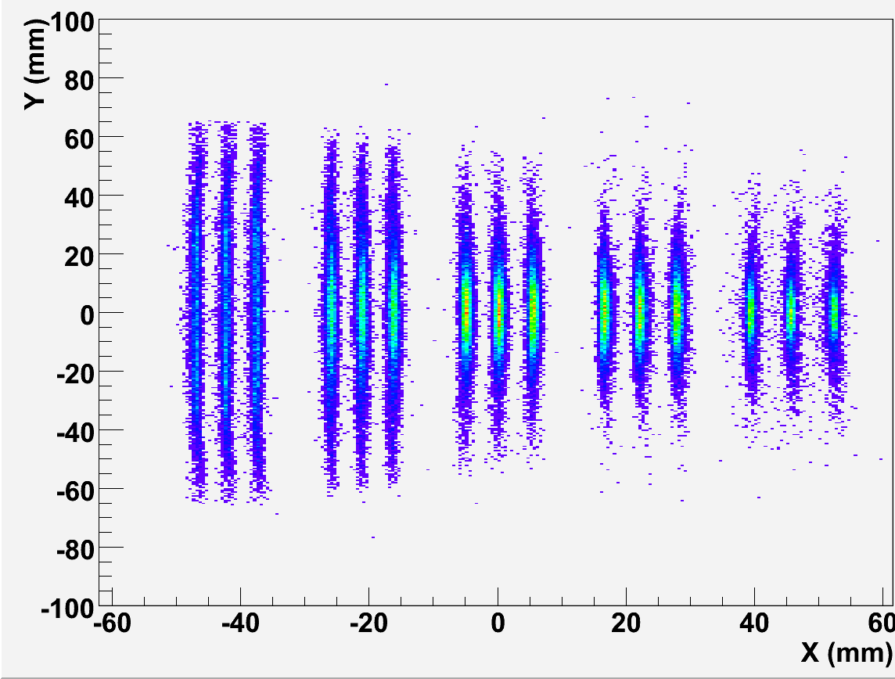
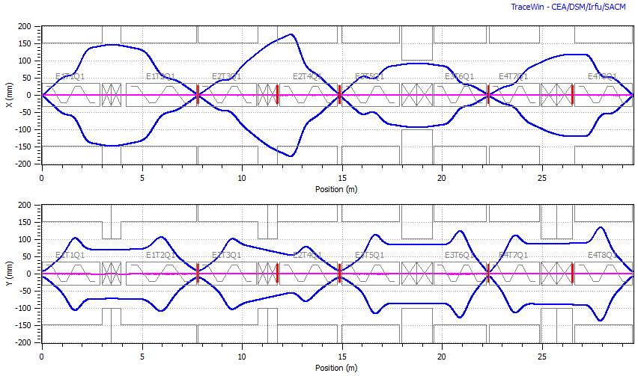
Optics
Image 2
Achromat selection
Extended drift to place detector arrays
Multistep separation
Large acceptance
Variable modes
Mass resolution (ΔM/M=460)
Image 1
Highly selective
beam rejection
Image 3
TKE selection
Image 4 : Mass selection
A=101,100,99
Image 4
Δ(M/Q) ≈ 460
Horizontal
300
mm
22+
23+
24+
25+
26+
Momentum Achromat
Mass spectrometer
Tracewin simulation code:
Full raytracing in the multipole 3D
field maps
Automatic optimisation of 80 fields
300
mm
Vertical
Notes:
The design we propose is a two-stage selection (Bρ & m/q) for very good rejection of both the beam and adjacent mass channels of reaction products
The optical design of such complex spectrometer is only possible with full raytracing sophisticated software and modern computer capabilities

Slide 7
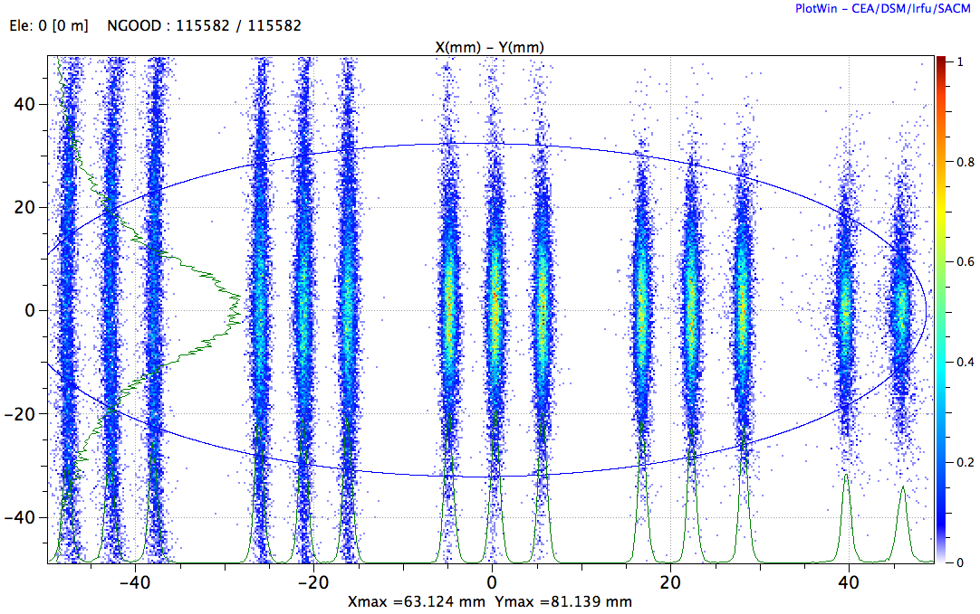
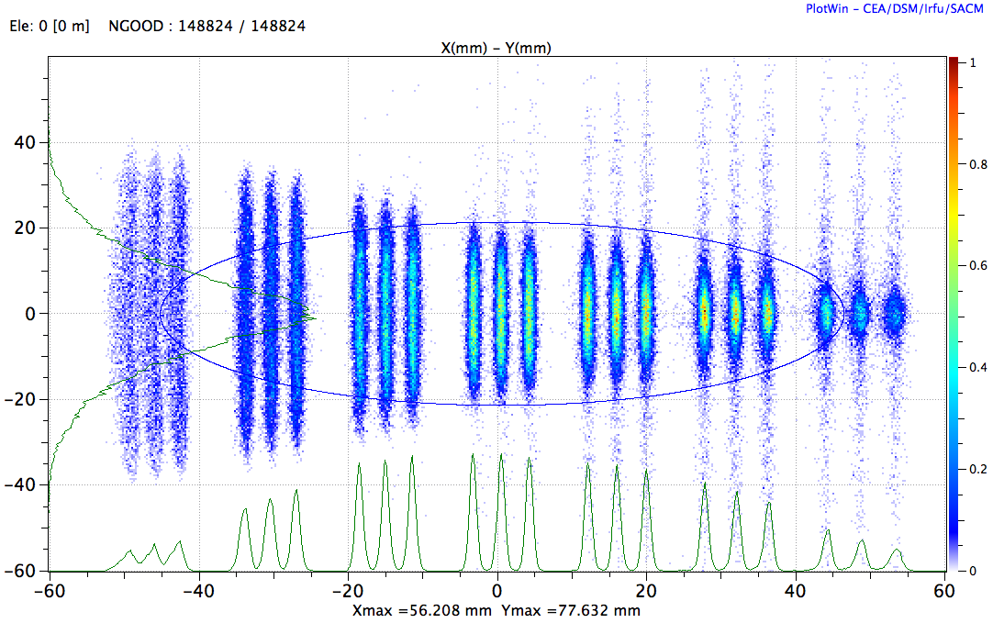
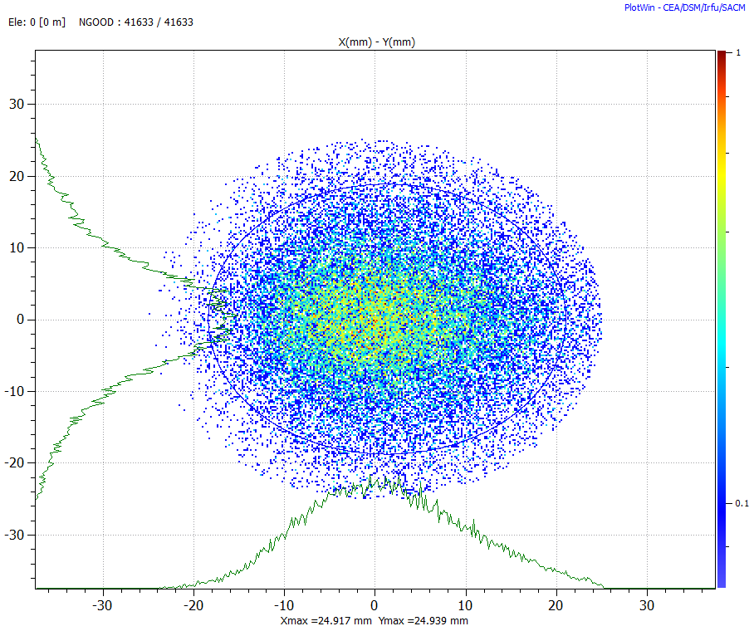
Operational modes & performances
High Resolution mode
Designed for maximum selection
Weighted mass resolution: ΔM/M = 460
Folded transmission: 50% for ⁵⁸Ni + ⁴⁶Ti → ¹⁰⁰Sn²⁴⁺ + 4n
High Transmission mode
Designed for very asymmetric reactions
Weighted mass resolution: ΔM/M = 260
Folded transmission: 15-20% for ²²Ne + ²³⁸U ➔ ²⁵⁵No + 5n
Converging mode
Designed for gas cell – Laser spectroscopy
Folded transmission: 68% for ⁵⁸Ni + ⁴⁰Ca ➔ ⁹⁴Ag + p3n
1) High resolution
2) High transmission
3) Converging
φ=5cm
Notes:
The versatility of the S³ design allows the spectrometer to operate in different modes, depending on the priorities of the experiments.
In the high resolution mode, the spectrometer is tuned to maximize the mass resolution on 5 charge states of the reaction products (Q_{average}=20+) at the final focal plane (10x10cm²).
While …
In the high transmission mode, the transmission of the reaction products is maximized and the target is brought the closest as possible to the first magnet.
In the converging mode, the mass dispersion at the end is strongly suppressed in order to focus all the reaction products on a small (5 cm diameter) surface (Figure 6). This mode is specifically useful with the low energy branch and focuses the nuclei in the gas catcher window.

Slide 8
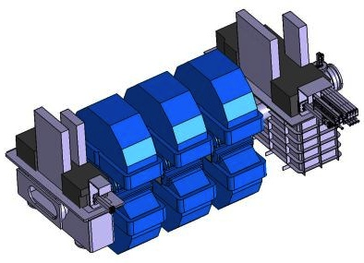
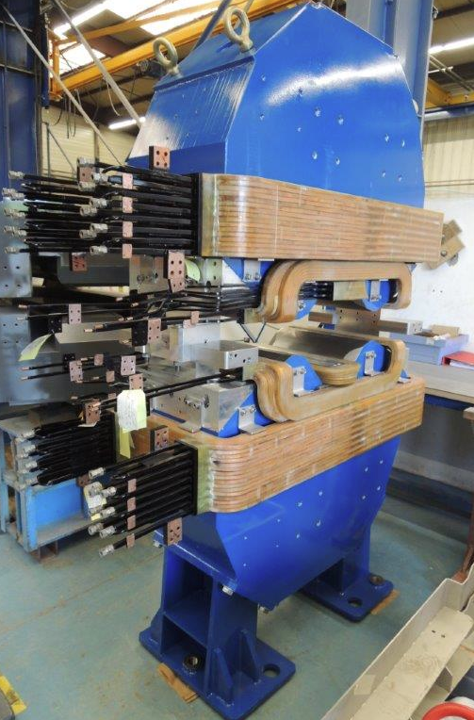
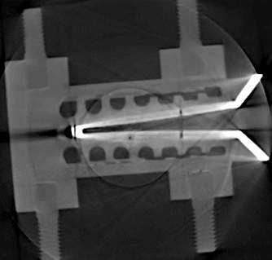
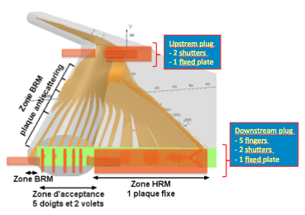
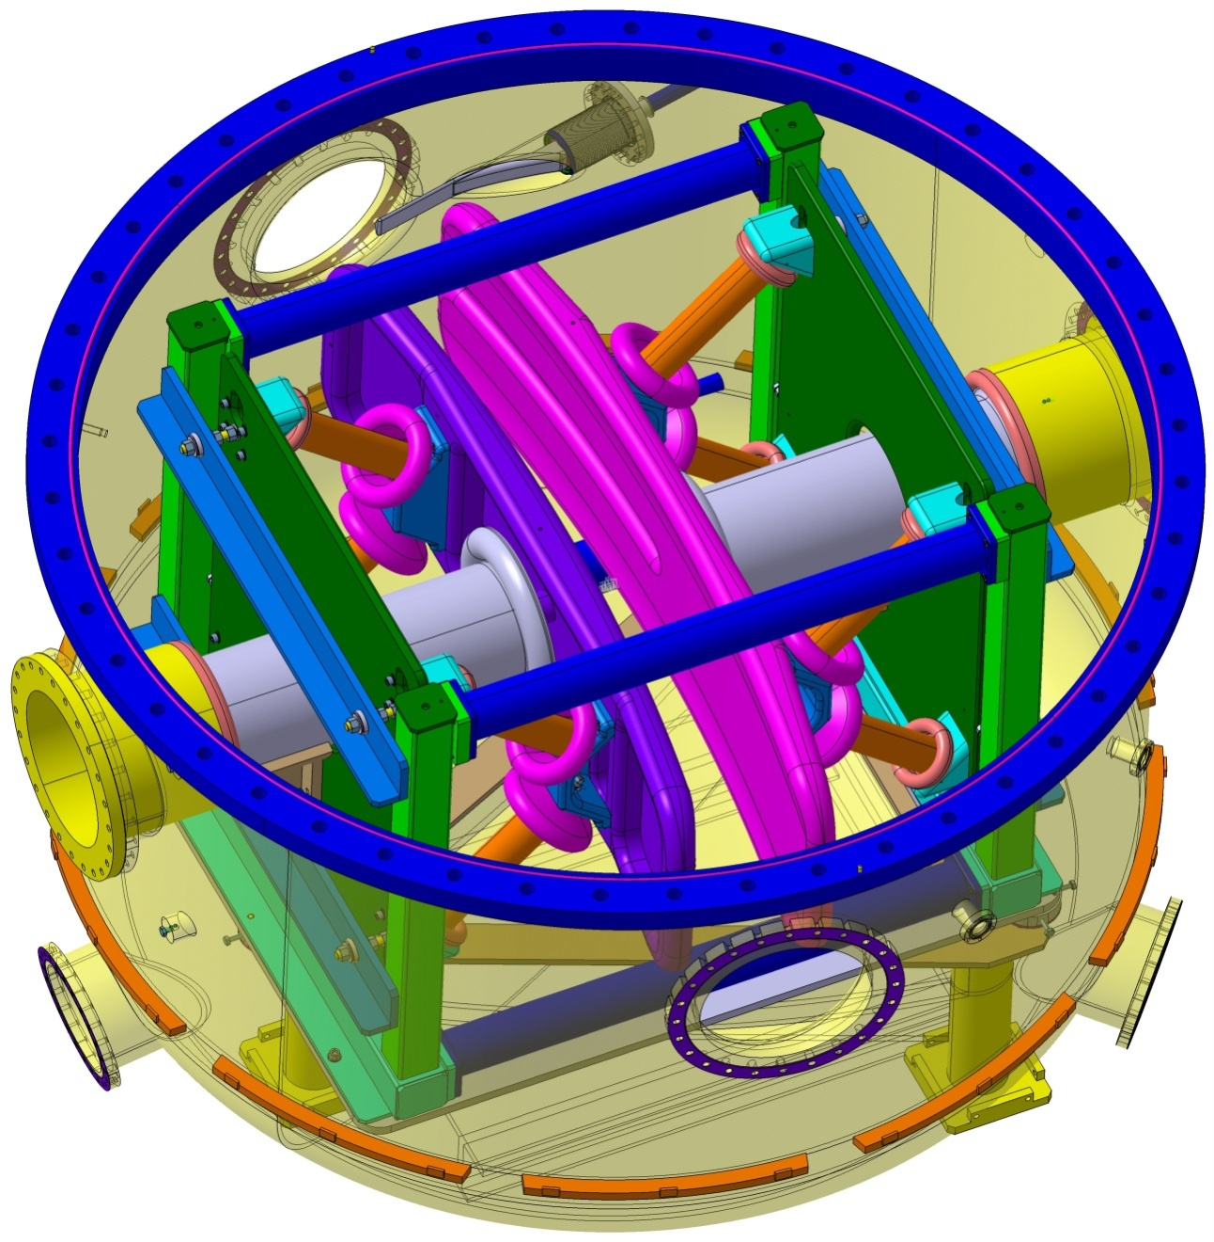
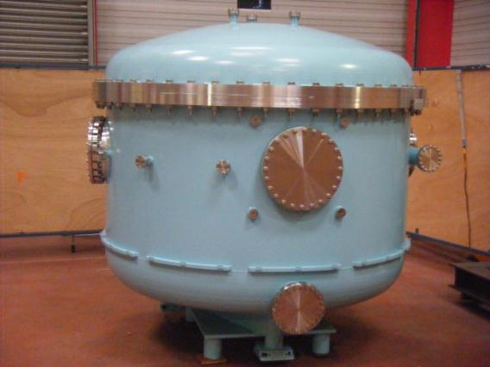
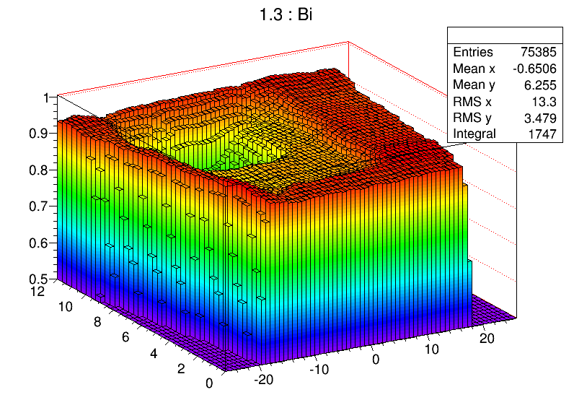
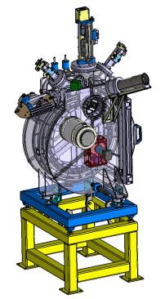
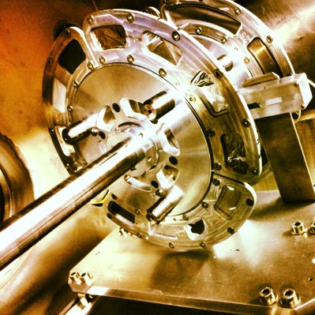
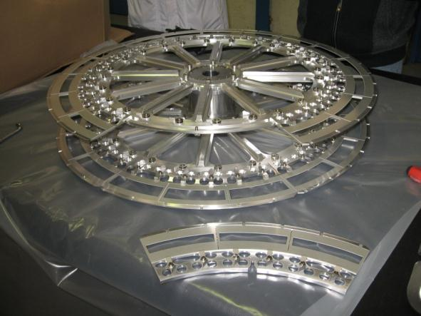
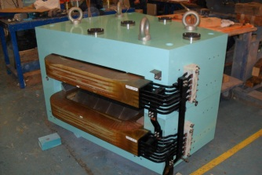
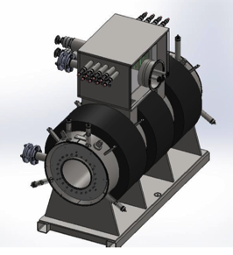
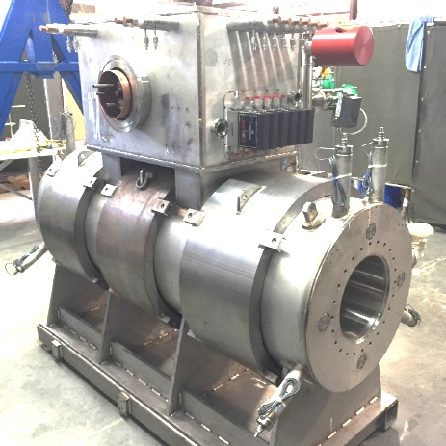
Technical highlight
(T4 2017)
(beam dump & Movable fingers)
Beam spot :
σ_{X}=0.5mm, σ_{Y}[0.5-2.5mm]
Energy precision ≈5.10⁻³
Dispersive zone
tested
for 5kW/cm²
E-Dipole
20 cm gap & +/- 350 kV
Eρmax : 12-14 MeV
Open slit in the anode
Target system
3 × M-dipoles
High power rotating targets
(3000-5000 rpm)
Stable & Actinide systems
Large H & V gaps
SC Multipoles
Q+S+O fields
Notes:
The S3 device includes
A highly durable target,
Magnetics dipoles with large gap for the momentum dispersions
“primary selection line” of S³, which in located at the middle of the momentum achromat. Its function is to ensure the rejection of the majority of the primary beam that passed through the target without nuclear interaction. These ions, with different charge state can be blocked in different parts of the primary rejection line. Each beam dump must be able to sustain the very high power of the incoming beam (up to 40kW). When the beam is within the momentum acceptance of the spectrometer, specific, thin beam dump (“fingers”) have been designed to block the very high power density of the beam (up to 5kW/cm²) while letting most of the nuclei of interest pass through. When the beam is outside the acceptance, the quadrupole magnets with embedded sextupole corrections have a horizontal aperture to bring the beam in a lateral dump. Due to the very high intensities, the resulting radio-activation of the material is also very important. All beam dumps are enclosed in a lead shielding, ensuring a minimal radioactivity to the environment and to the staff.
An electric dipole that is combined to the last magnetic dipole, that selects the different reaction products and measure their mass with high resolution
The backbone of S³ is composed of 7 triplets of superconducting aircore multipoles,

Slide 9
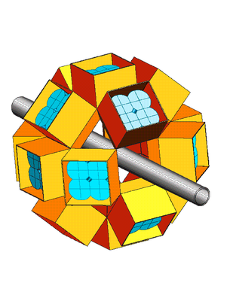
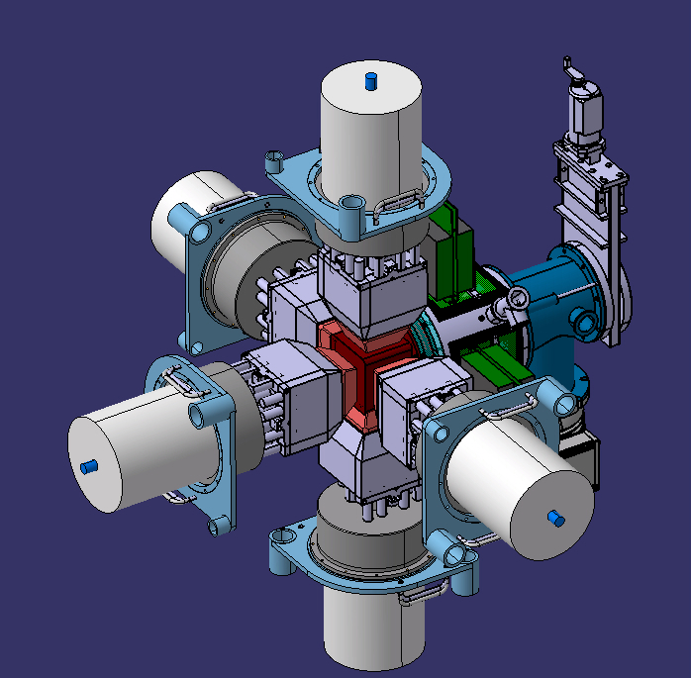
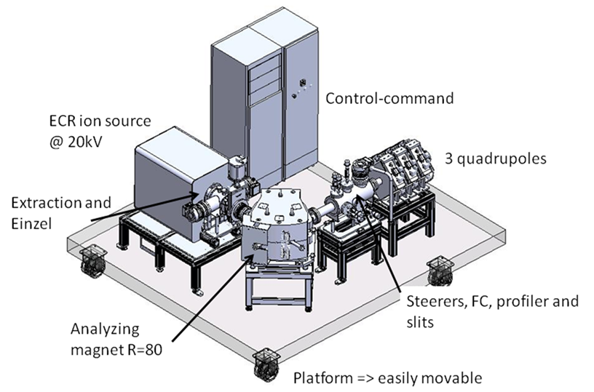
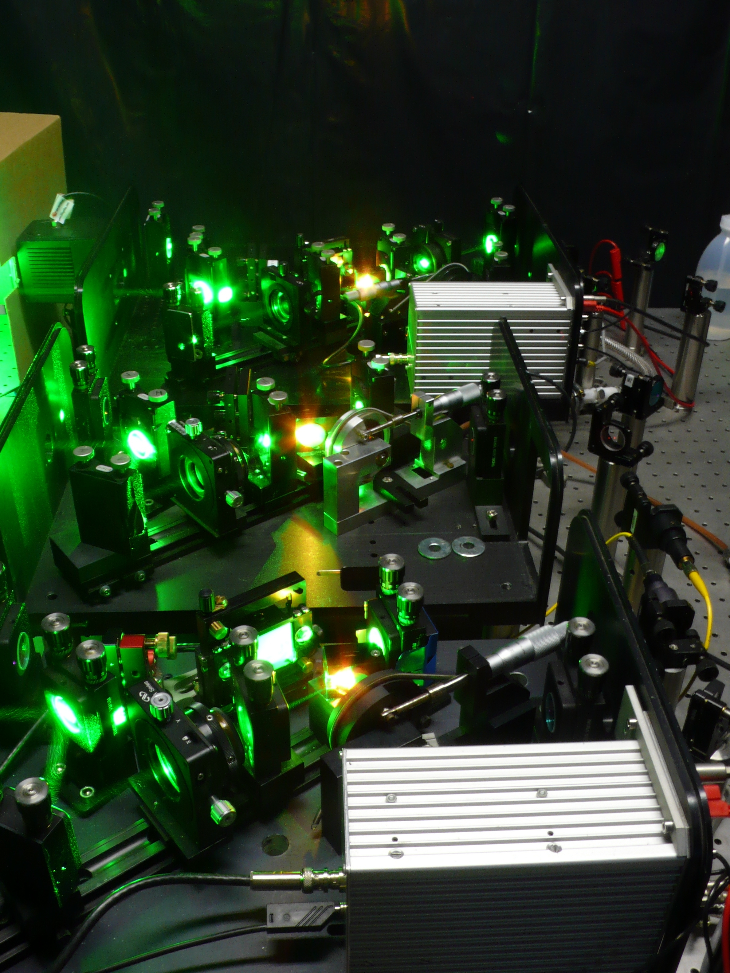
Experimental Techniques
In-beam spectroscopy
Two step reactions
EXOGAM2/AGATA
PARIS
MUST2/GASPARD
Eur. Phys. J. A (2015) 51: 66
Delayed spectroscopy
SIRIUS setup
Implantation-decay
station at the mass
dispersive plan
Atomic physics
FISIC setup
Fast Ion Slow
Ion Collisions
Electron exchange
Ground state properties
(mass, size, moments, spins)
REGLIS³ setup
Low Energy
Branch
DESIR
Notes:
Various experimental techniques are planned to be used to address the various scientific cases. First at the focal plane

Slide 10
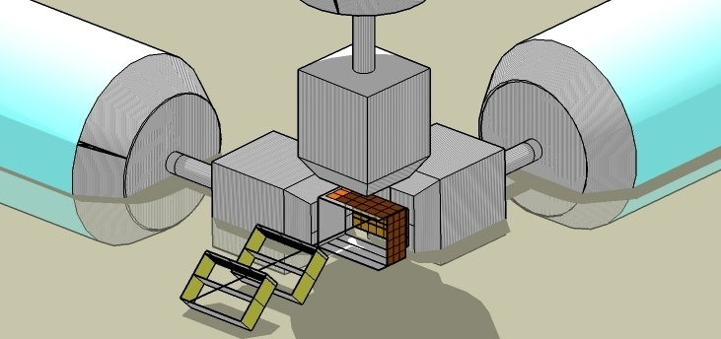
SIRIUS
(T4 2017)
IPHC, CSNSM, Irfu, GANIL
SIRIUS (Spectroscopy & Intendification of Rare Ions Using S³)
Germanium detector
e.x. Exogam2, CLODETTE
Time of flight + tracking detector
Implantation detector
(HI, α and e⁻ decay)
Large size (200x150 mm²)
Time Resolution < 1ns
Position resolution = 1mm
Very low thickness
Tunnel detector for escaped e⁻ and α
Large detector size 10x10cm²
High resolution FWHM
Ability to detect large> 50MeV pulse
Followed (≈ 10µs)
by a weak (<15MeV) pulse.
No Dead time
Conversion electrons FWHM <5 keV
Escaped alpha FWHM 15 keV
Recoil-decay tagging
Short decay times
High Resolution High efficiency
Mass separation
Notes:
Let me detailed the two setups that will be installed at the final focal plane.
The SIRIUS setup for spectroscopy and identification of rare ions

Slide 11
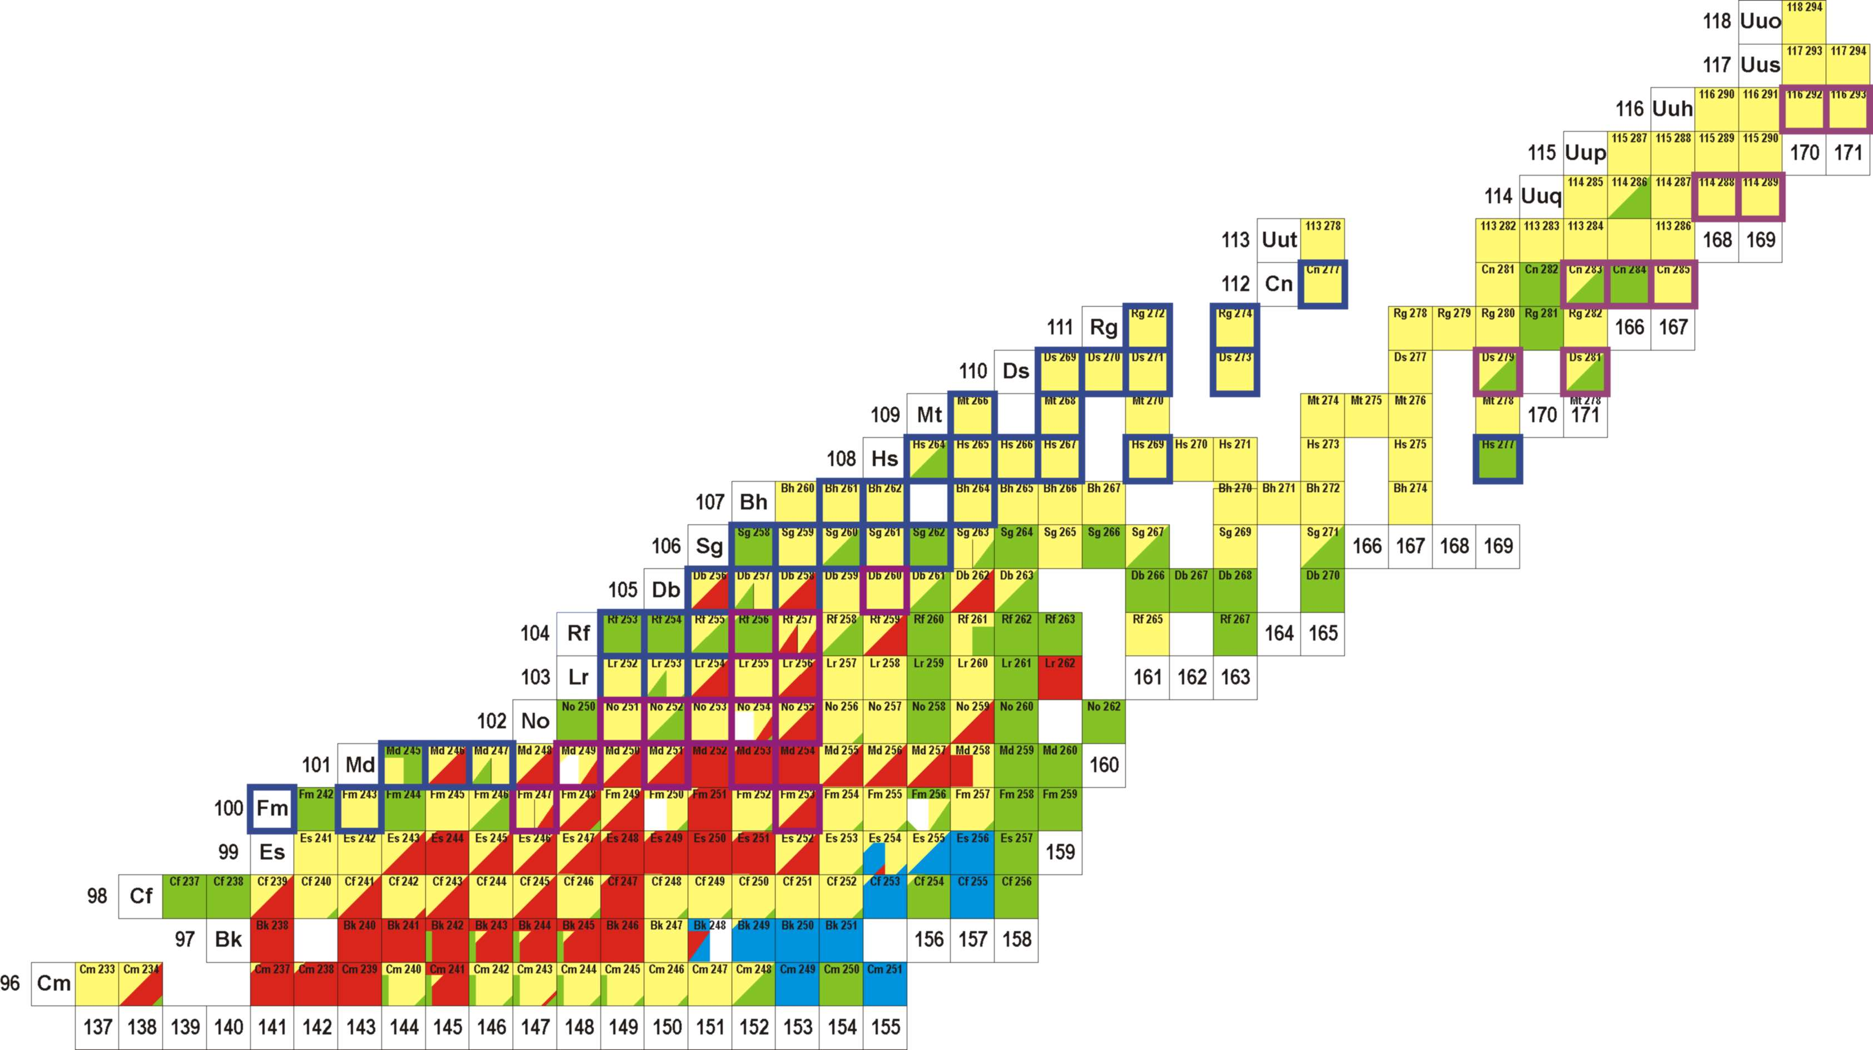
VHE/SHE day 1 Science opportunities
Nuclear structure
Quasi-particle excitations ➔ deformation/K-isomers
nuclide | feature | X-section [nb] | rate [h⁻¹] | 21UT integral
 |  |  |  | day 1 | phase 1++
²⁵⁴No | ER | 2000 | 60.000 | 6×10⁷ | 1×10⁷
²⁵⁶Rf | ER | 17 | 550 | 90.000 | 5.4×10⁵
²⁶⁶Hs | ER | 15 (²⁷⁰Ds) | 0.34 | 57 | 285
^{266m}Hs | K-isomer | 15 (²⁷⁰Ds) | 0.01 | 2.5 | 12.5
²⁷⁰Ds | ER | 15 | 0.45 | 76 | 380
^{270m}Ds | K-isomer | 15 (²⁷⁰Ds) | 0.22 | 38 | 190
²⁶²Sg | α-decay | 15 (²⁷⁰Ds) | 0.02 | 5 | 25
²⁷⁶Cn | ER | 0.5 (²⁷⁷Cn) | 0.01 | 2.5 | 12.5
²⁸⁸115 | ER | 10 | 0.3 | 50 | 300
²⁸⁸115 | L X-rays | 10 | 1,8 | 300 | 1800
Reaction studies
Isospin dependent investigation
SHE Synthesis
I=10pµA
➔ 1evt/month@σ~10fb
Decay & Synthesis
Rate summary vs GSI UNILAC
2-4 [A/Q=3]
15-20 [A/Q=7]
Gap Hot & cold fusion
Deformed
transfermium
Z > 112 ➔ Actinide targets
Notes:
The physicists’ collaboration has established a list of priority measurements to be performed with this setup.
In the SHE region,
The high production rates will permit detailed spectroscopy studies of nuclei that are today produced only with few rates
like in the region of deformed transfermium for nuclear structure studies.
The use of variious stable isotopes of Si, S, Ar and Ca beams on U target will also make possible to bridge the gap between the hot and cold fusion chains and to learn about
The mechanism of fusion and fission and the isospin dependance
Finally the use of actinide target with high intense beam open a way for the synthesis of the heaviest element with the aim to go down to 10fb sensitivity
either through decay spectroscopy (alpha, proton, electron, gamma…)
(In depth spectroscopy of deformed transfermium, bridging the gap between hot and cold fusion chains, SHE synthesis in future, ¹¹²Ba-¹⁰⁸Xe -¹⁰⁴Te super-allowed α decay, …

Slide 12
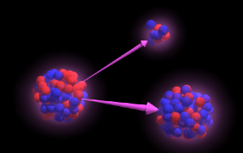
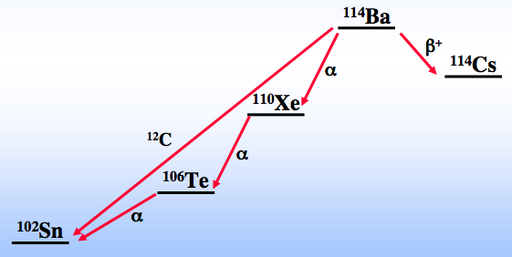
¹⁰⁰Sn region experimental status
Day1 experiments: N=Z
¹¹²Ba-¹⁰⁸Xe -¹⁰⁴Te super-allowed α decay and search for cluster radioactivity
¹¹²Ba
¹¹⁴Ba
¹¹⁵Ba
¹¹⁶Ba
CN
¹¹²Cs
¹¹³Cs
¹⁰⁸Xe
¹⁰⁹Xe
¹¹⁰Xe
¹¹¹Xe
¹¹²Xe
CN
N=50
¹⁰⁸I
¹⁰⁹I
α decay
¹⁰⁵Te
¹⁰⁶Te
¹⁰⁷Te
¹⁰⁸Te
proton decay
¹⁰⁴Te
CN
β-delayed protons
with sizeable branch
Observed/expected
¹⁰³Sb
¹⁰⁴Sb
¹⁰⁵Sb
Z=50
⁹⁸Sn
⁹⁹Sn
¹⁰⁰Sn
¹⁰¹Sn
¹⁰²Sn
¹⁰³Sn
¹⁰⁴Sn
CN
Excited states
Fusion-evaporation
⁹⁷In
⁹⁸In
⁹⁹In
¹⁰⁰In
¹⁰¹In
¹⁰²In
¹⁰³In
CN
⁹⁵Cd
⁹⁶Cd
⁹⁷Cd
⁹⁸Cd
⁹⁹Cd
¹⁰⁰Cd
¹⁰¹Cd
¹⁰⁰Cd
Decay properties
Fusion-evaporation
CN
⁹³Ag
⁹⁴Ag
⁹⁵Ag
⁹⁶Ag
⁹⁷Ag
⁹⁸Ag
⁹⁹Ag
¹⁰⁰Ag
¹⁰¹Ag
Decay properties
Existence
Fragmentation
⁹²Pd
⁹³Pd
⁹⁴Pd
⁹⁵Pd
⁹⁶Pd
⁹⁷Pd
⁹⁸Pd
⁹⁹Pd
¹⁰⁰Pd
CN
Exotic decays from the 21⁺ isomer in ⁹⁴Ag
Notes:
For the neutron deficient nuclei, as I early mentionned the region of 100sn is of particular interest. This slide somehow summarizes
What is known today … there is still room for decay properties measurements and more specifically we would like to search for alpha decay chains
As the superallowed and cluster radioactivity predicted in Ba isotopes.
And also exotic decays from the high spin isomer in 94Ag.

Slide 13
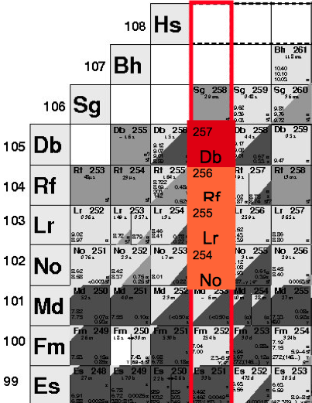
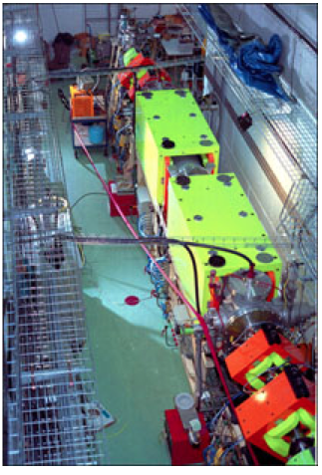
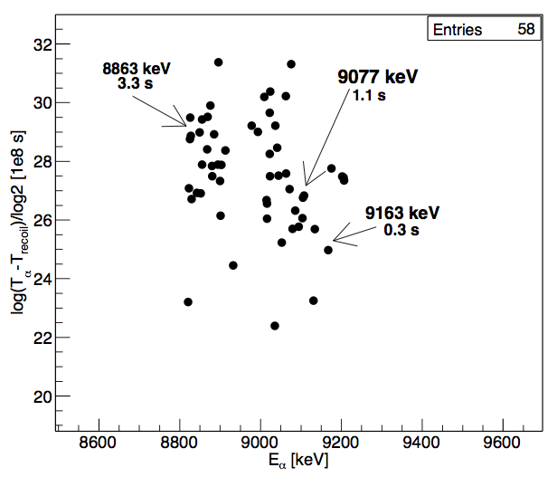
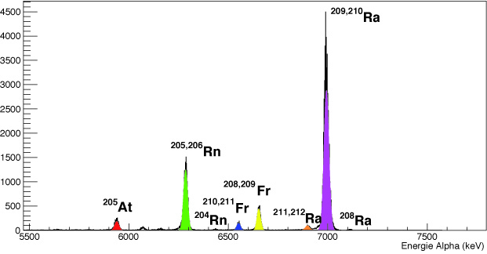
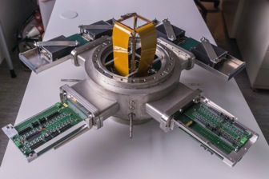
Synthesis of ²⁵⁷Db @ GANIL
E656 experiment : J. Piot & M. Vostinar (GANIL)
Measure new electromagnetic transitions in ²⁵⁷Db, ²⁵³Lr and ²⁴⁹Md
²⁰⁹Bi(⁵⁰Ti,2n)²⁵⁷Db σ=2.4 nb
events ²⁵⁷Db
First experiment using ⁵⁰Ti GANIL - up to 0.5 pμA
Separation by LISE velocity filter Rejection : 3.10¹⁰
Transmission : 15% (➔ Gain factor 15-20 with S³)
Set the course for the S³ VHE-SHE Physics program
Instrumentation ➔New SHIP FP detection

Slide 14
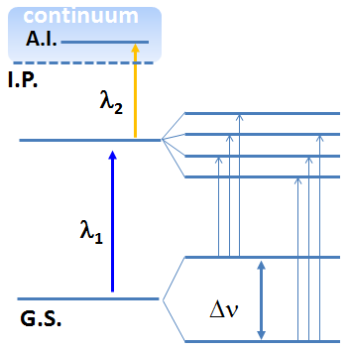
S3-LEB Science opportunities
REGLIS³ @ SPIRAL2
(Some experiments require higher purity, low energy ions in vacuum,…)
Making use of the high-intensity heavy-ion beams from SPIRAL-2 and the Super Separator Spectrometer and implementing the "In-Gas Laser Ionization Spectroscopy - IGLIS" technique to:
Produce pure RIB (including isomeric beams)
Perform medium resolution laser spectroscopy studies in neutron-deficient region of the nuclear chart (A>70)
Perform mass measurements with the MR-TOF and decay spectroscopy in new regions of the nuclear chart
Sensitivity
(1/20000)
Information
- charge radii
- spin
- magnetic dipole moment
- electric quadrupole moment
Nuclear-model independent way (provided the atomic physics is known or calibration standards are available)
R. Ferrer · LAP 2015, East Lansing, July 7-11, 2015
Notes:
The RIBs are pre-selected by the in-flight spectrometer S3
Reactions producted are stopped and neutralized in 500mbar Ar gas cell
The gas cell can be fast for fast evacuation
Unwanted ions are collected
Broad band in the gas cell Ionization to look for atomic transitions
Ionization in the low temperature, low pressure supersonic jet for high resolution spectroscopy (200MHz resolution, isomer purification)
Ion of interest transported through radiofrequency quadrupoles, S-shape
Differential pumping, QMF for first separation and then sent to the identification station or through the Multireflection time of flight mass separator for beam purification or for mass measurement.
In the future, We will produce high purity isotopic or isomeric RIBs for other users in the DESIR facility.

Slide 15
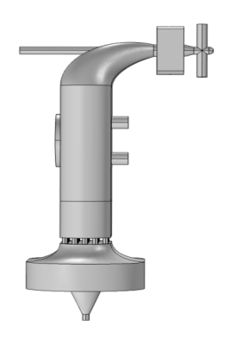
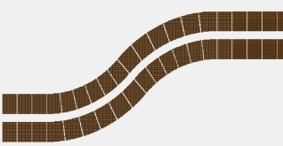
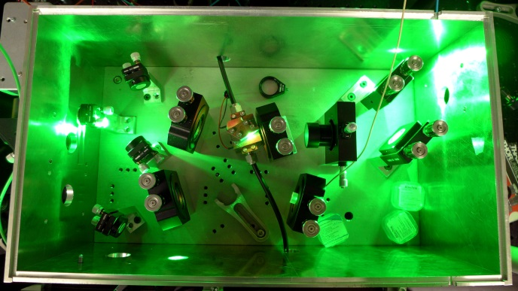
Low Energy Branch
MCP
(Gas cell, laser system)
(RFQs)
(mr-TOF-ms, laser system
infractructure, safety, RFQsdetectors)
(Gas cell)
(narrow band-width laser
pre-studies at MARA)
MR ToF MS
(m/Δm ~ 10⁵)
200 - 500 mbar Ar
R. Ferrer et al., NIM B 317 (2013) 570
Yu. Kudryavtsev et al., NIM B 297 (2013) 7
diff. pumping
RFQ
QMF
(m/Δm ~ 100)
bender
S-shape RFQ
buncher
gas cell
EVRs
Neutralized EVRs
towards Multi Purpose Room - Idenfification/detection
from
S³
Photoions
Two lasers systems: TiSa and dye
towards DESIR
λ_{1,2}
in-gas-cell
ionization
λ₂
in-gas-jet
ionization
λ₁
10⁻⁸ mbar
10⁻² mbar
10⁻³ - 2.10⁻⁵ mbar
Provide pure & low energy beams from S³
Perform medium resolution laser spectroscopy
Notes:
The RIBs are pre-selected by the in-flight spectrometer S3
Reactions producted are stopped and neutralized in 500mbar Ar gas cell
The gas cell can be fast for fast evacuation
Unwanted ions are collected
Broad band in the gas cell Ionization to look for atomic transitions
Ionization in the low temperature, low pressure supersonic jet for high resolution spectroscopy (200MHz resolution, isomer purification)
Ion of interest transported through radiofrequency quadrupoles, S-shape
Differential pumping, QMF for first separation and then sent to the identification station or through the Multireflection time of flight mass separator for beam purification or for mass measurement.
In the future, We will produce high purity isotopic or isomeric RIBs for other users in the DESIR facility.

Slide 16
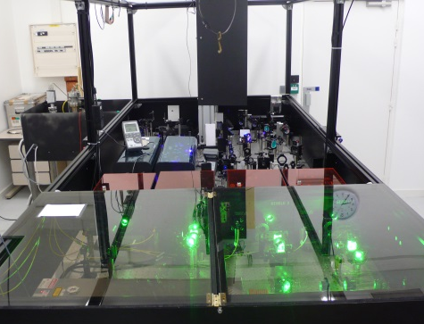
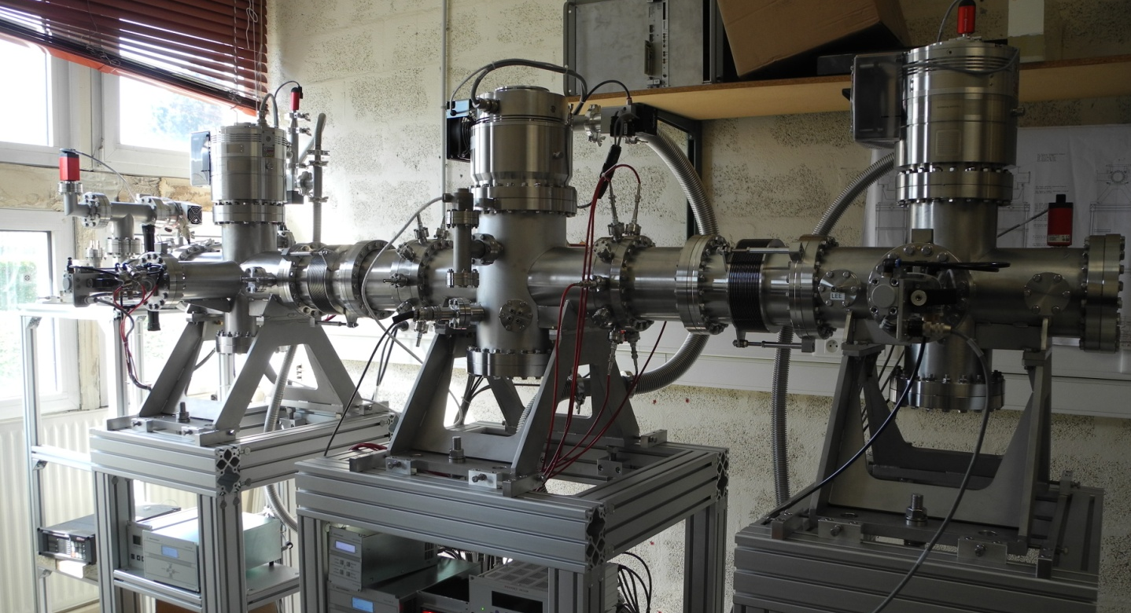
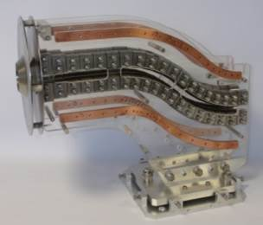
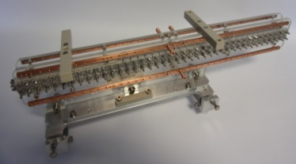
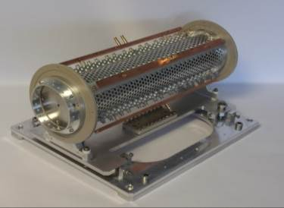
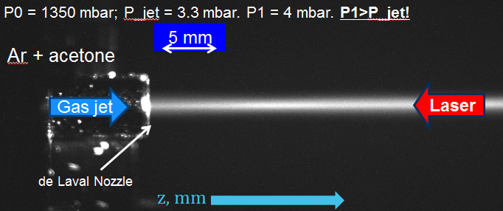
LEB Technical highlights
(T4 2017)
PILGRIM
MCP
TiSa Lasers
MR ToF MS
(m/Δm ~ 10⁵)
diff. pumping
RFQ
QMF
(m/Δm ~ 100)
bender
S-shape RFQ
buncher
gas cell
EVRs
Neutralized EVRs
towards Multi Purpose Room - Idenfification/detection
from
S³
Photoions
RFQ systems
In-Jet Laser spec system
Notes:
The RIBs are pre-selected by the in-flight spectrometer S3
Reactions producted are stopped and neutralized in 500mbar Ar gas cell
The gas cell can be fast for fast evacuation
Unwanted ions are collected
Broad band in the gas cell Ionization to look for atomic transitions
Ionization in the low temperature, low pressure supersonic jet for high resolution spectroscopy (200MHz resolution, isomer purification)
Ion of interest transported through radiofrequency quadrupoles, S-shape
Differential pumping, QMF for first separation and then sent to the identification station or through the Multireflection time of flight mass separator for beam purification or for mass measurement.
In the future, We will produce high purity isotopic or isomeric RIBs for other users in the DESIR facility.

Slide 17
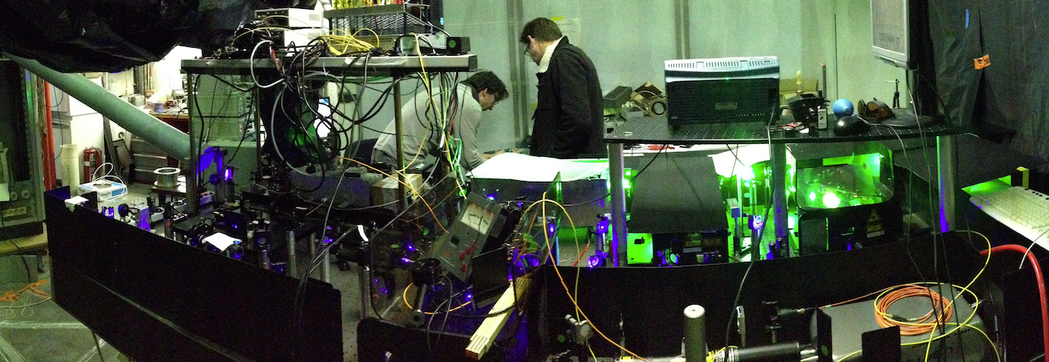
LEB preparatory experiments
In-gas jet In-gas cell
²¹⁵Ac (N=126)
5GHz
²¹⁵Ac
T _{½} = 0.17s
400 MHz
²¹⁴Ac
T _{½} = 8.2s
LEUVEN
MAINZ
Jyväskylä
GANIL
Notes:
This low energy branch at S3 will open unique oppoptunities
Unique opportunities for the creation of short-lived isotopes
by fusion-evaporation and deep-inelastic reactions
Provide access to species not available
by isolde techniques
The physicists’ collaboration has established a list of priority measurements to be performed with this setup.

Slide 18
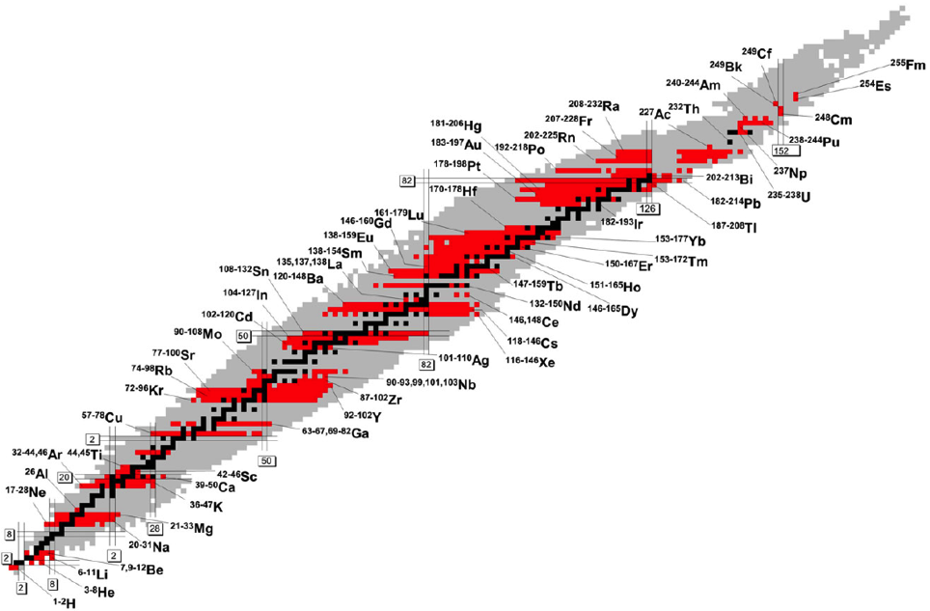
LEB day 1 Science opportunities
Close to the N=Z line (up to and beyond ¹⁰⁰Sn) - shell evolution, nuclosynthesis, symmetries
Heavy neutron-deficient refractory element region and trans lead region - shapes and shape coexistence, exotic decay modes
Heavy (and Super Heavy) element region - single-particle
versus deformation, atomic physics
LOI - first day experiments have been presented
ready to be worked into full proposals
Neutron-rich below ²⁰⁸Pb - nucleosynthesis
Blaum K., Dilling J., Nörtershäuser W. Phys. Scr. T152 (2013) 014017
Notes:
This low energy branch at S3 will open unique oppoptunities
Unique opportunities for the creation of short-lived isotopes
by fusion-evaporation and deep-inelastic reactions
Provide access to species not available
by isolde techniques
The physicists’ collaboration has established a list of priority measurements to be performed with this setup.

Slide 19
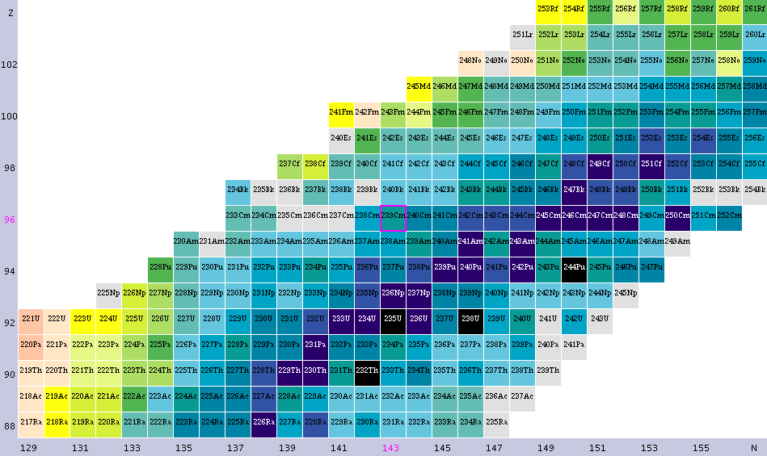
VHE and SHE region
To study the SHE region experimental data are needed in the heavy-mass region - e.g. laser spectroscopy: charge radii, magnetic moments, electrical quadrupole moments, spins → atomic physics input
New and more detailed atomic physics data will become available
₁₀₄Rf
₁₀₂No
₁₀₀Fm
₉₈Cf
₉₆Cm
₉₄Pu
₉₂U
₉₀Th
₈₈Ra

Slide 20
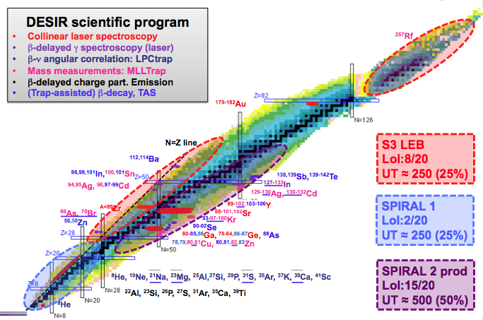
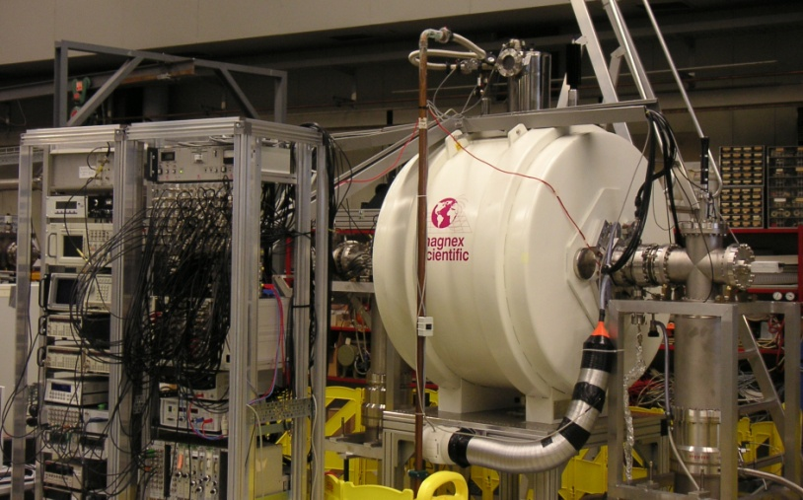
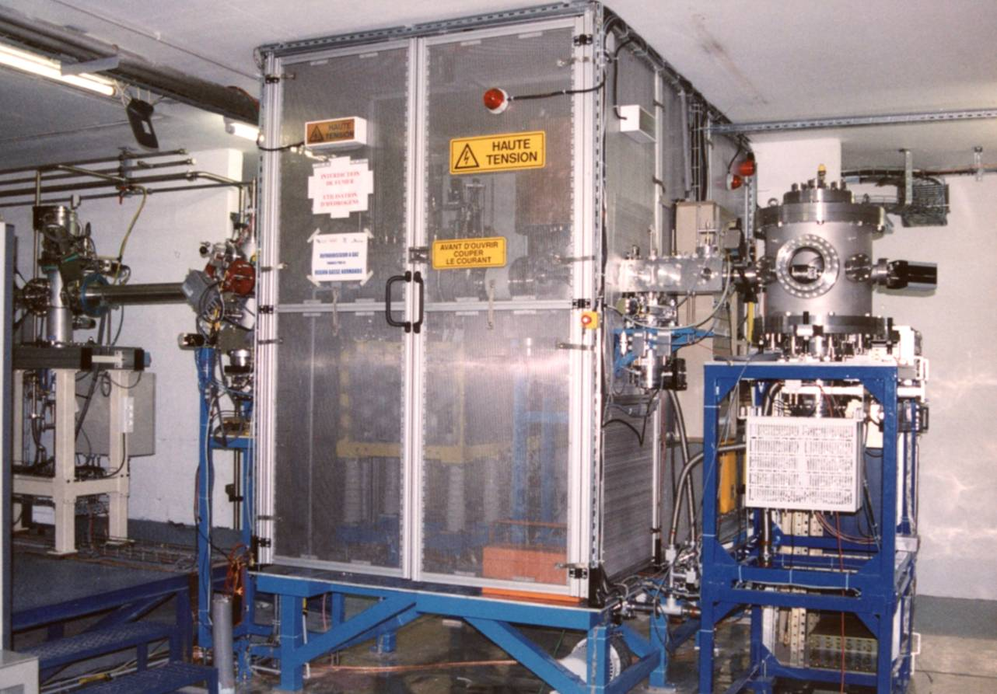
Funded (July 2015)
DESIR hall
S3-LEB
HRS
SPIRAL1
High quality 1+ RIB (10-60KV)
S³ LEB (REGLIS3):
laser ionization source + MR-ToF
refractory elements
n-deficient nuclei & very heavy nuclei
SPIRAL1:
beam + target fragmentation
ECR + FEBIAD + Surface ionization
light nuclei

Slide 21
Conclusions
Start the scientific program with SPIRAL2 in 2017
Commissioning and operation of SPIRAL2 Phase 1 in 2016
First experiment with NFS in 2017
S³ is a low energy in-flight separator for the Spiral2 stable beams
Fusion-evaporation, two-step reactions, rare channels, electron exchange…
Designed for the selection and identification of rare events
2 steps rejection and >350 Mass resolution
High transmission of evaporation residues
High versatility
Two basic detection set-ups
Implantation-decay spectroscopy station (SIRIUS)
In gas cell laser ionization & spec. + MR ToF (LEB)
➔ First beam delivered to S³ end 2017 and first experiment in 2018

Slide 22
Conclusions
S³ in first Spiral2 LoI (2006)
Primary
Target
Spectrometer
Separator

