Slide 1
Development of Optical Resonant Cavities for laser-Compton Scattering
Tohru Takahashi
Hiroshima University
for
Y.Hosaka, Y. Uesugi，Y. Honda, A. Kosuge，T. Omori，T. Takahashi，J. Urakawa，M. Washio
KEK-Waseda-Hiroshima University
September 29 2016
Channeling2016@Desenzano del Garda, Italy

Slide 2
Contents
Status and Issues of the Optical Resonant Cavity
An idea of the feedback-free cavity
Status of the R&D
  Continuous Wave -> Pulsed Oscillation

Slide 3
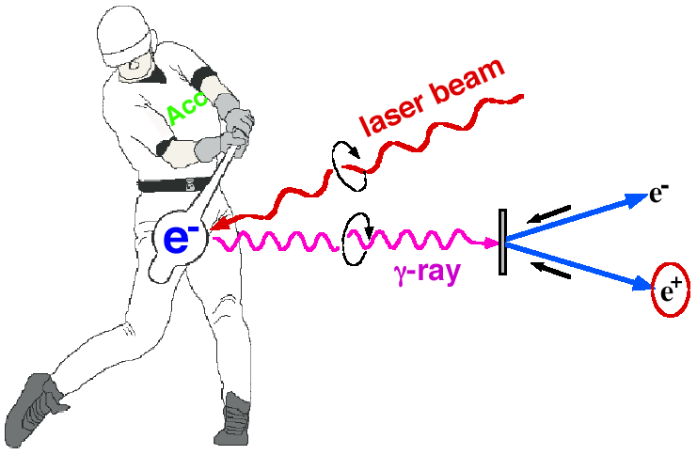
Introduction
Photons by Laser-Compton Scattering
  Lower electron energy
  Polarized photons
x ray
Polarized gamma ray:
M.Fukuda. et. al, Phys. Rev. Letts. 91, 164801 (2003)
Polarized e+ ;
T.Omori, et. al, Phys. Rev. Letts 96, 114801(2006)
Issue
Intensity of photons

Slide 4
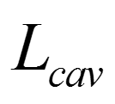

Enhancing laser pulse energy using an Optical Resonant Cavity
O(10pm) or less

Slide 5
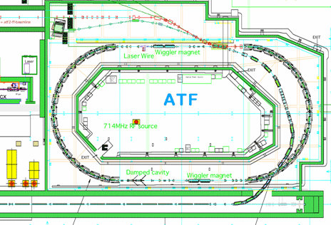
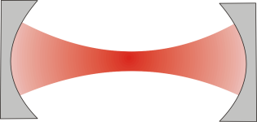
29th Mar 2013
Setup at the KEK-ATF
Laser cavity
detector
ATF parameter
1.3GeV
1×10¹⁰ electron/bunch
Up to 10 bunch/train
2.16×10⁶ turn/s

Slide 6
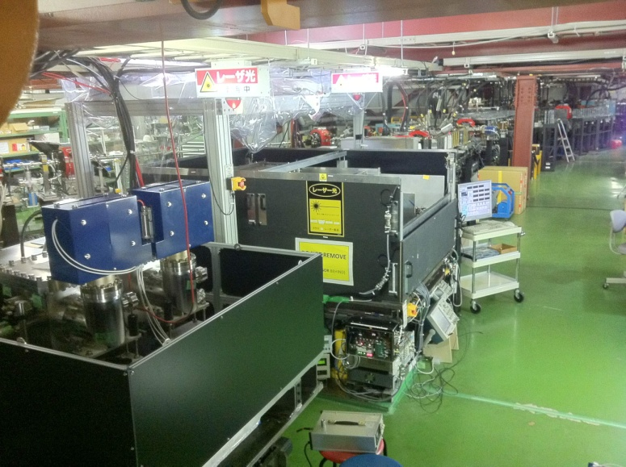
4 mirror cavities at the KEK-ATF
KEK-Hiroshima
installed 2011
LAL-Orsay
installed summer 2010
relatively simple control system
employs new feed back scheme
sophisticated control
digital PDH feedback

Slide 7
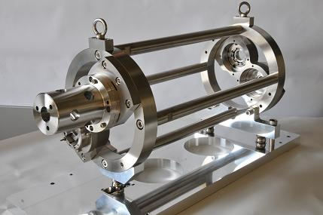
The KEK-Hiroshima Cavity
Plane Mirror
Plane Mirror
Concave Mirror
IP
Concave Mirror
Main Parameters
Circumference: L_{cav}=1.68m
Finesse: F=4040(Measured)
Power Enhansement: 1230

Slide 8
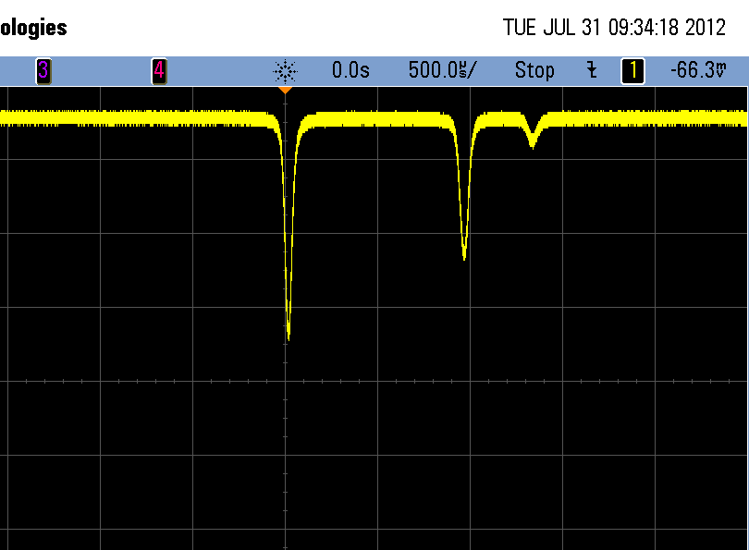
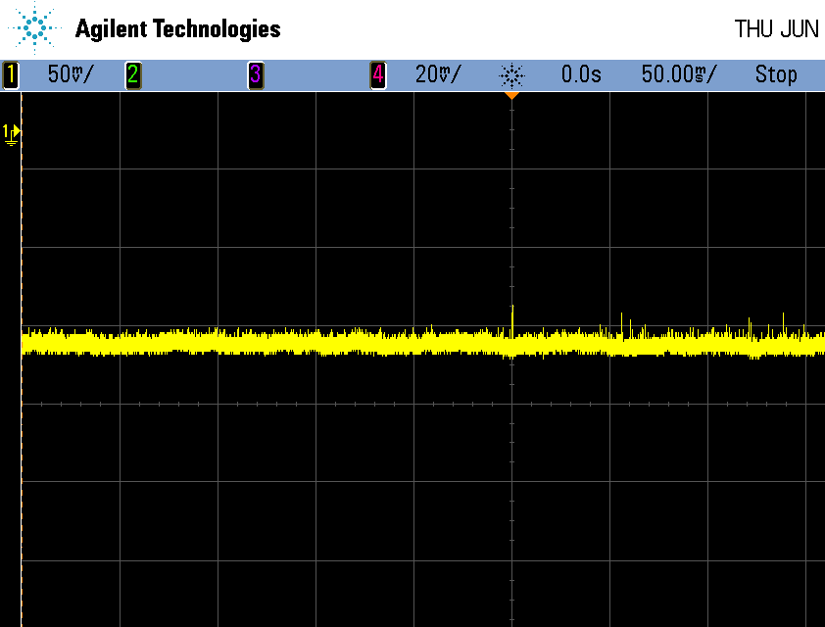
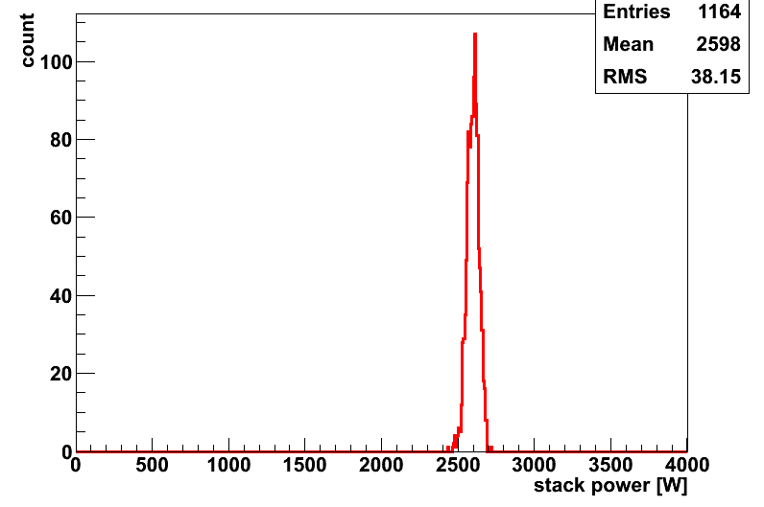
Stored Laser Power in the cavity
14th Sep 2012
Sotred power
Right pol
Left pol
Must be
Laser Power: 2.6kW
w/ 38W fluctuation
achieved
Stored Power [w]

Slide 9

Toward High Power Storage
High reflective mirrors
  99.999%
  very low power loss O(ppm) to prevent thermal effect
  sophisticated control system
  sophisticated mirror treatment and leaning
(currently ~16pm)
  A Feedback free cavity

Slide 10
Self- Resonating Mechanism
(KEK,Waseda,Hiroshima)
Laser medium
An Optical cavity is embedded in the laser oscillation
Start laser oscillating with a wavelength selected by the cavity (positive feedback)
If the cavity length changes, the system continue or resume to oscillation with a new wavelength selected by the cavity
Cavity

Slide 11
The optical setup
Fiber amp.
to SP
YDF
to SP
Coupler1
WDM
Coupler2
FI1
PD2
M2
M1
Pump LD
FP cavity
HWP
FC2
W2
W1
FC1
FI2
PBS2
L2
QWP3
QWP2
L1
PBS1
QWP1
Cavity
PD3
PD1
Reflectivity of the cavity mirror > 99.999%
Cavity has an intrinsic finesse of 640,000

Slide 12
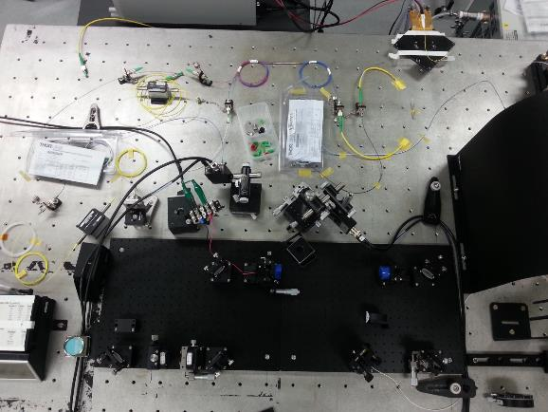
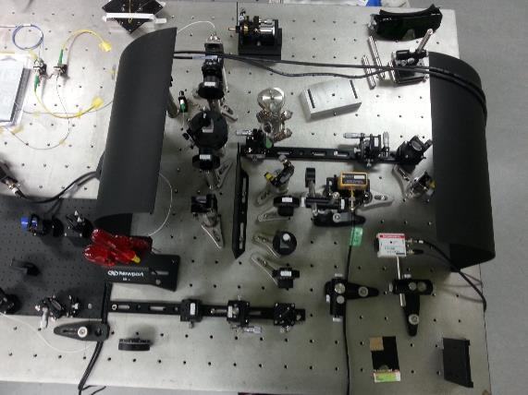
It looks,,,
WDM
YDF
Cavity
Pump LD

Slide 13
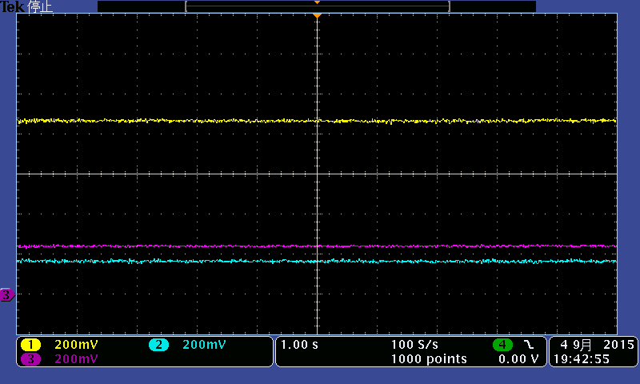
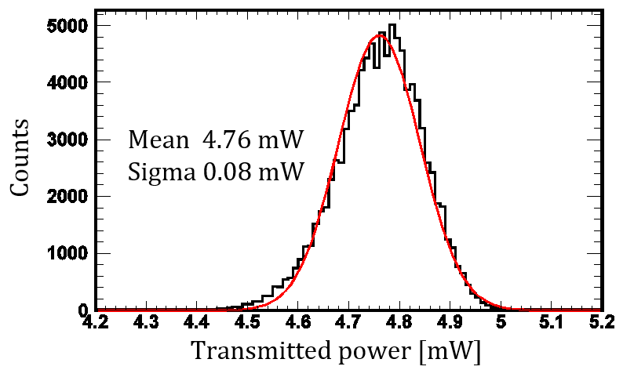
High Finesse Oscillation (CW)
Incident power 13.5 mW
Transmitted power 4.8m W
σ ~ 1.7 %
Reflected power 2.8 mW
  The Effective Finesse inc. stability of the system
  = 324,000
  Power enhancement 187,000
to SP
Amplifier
PD2
PD3
Cavity
PD1
APL Photonics 1, 026103 (2016);

Slide 14
Toward the mode locked pulse Oscillation
Seeding mode locked pulses with
Nonlinear Polarization Rotation (NPR) optics
NPR fiber optics

Slide 15
Pulse Oscillation
Mode locked pulsed oscillation requires overlap of laser pulses in the
inner loop (cavity ) and the outer loop
We chose,,,,,

Slide 16
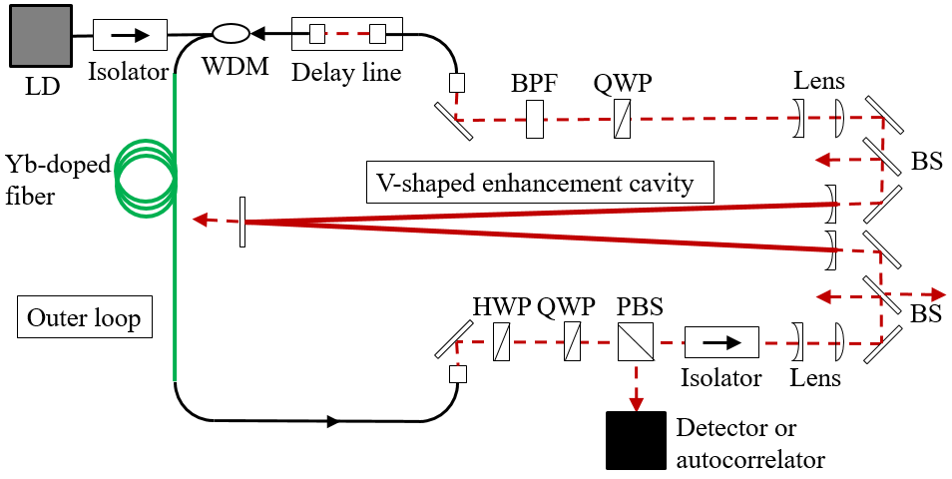
Demonstration of the pulse oscillation

Slide 17
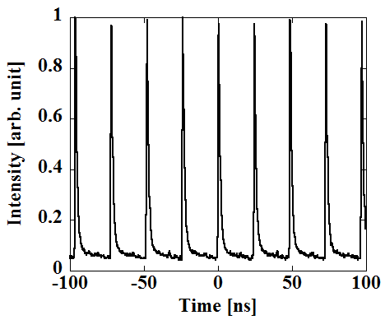
Model locked pulse oscillation
After adjustment of L_{loop}
by hand:
requirement for pulse overlap
automatic:
requirement for
Current issue
not stable enough
the oscillation lasts a few second
but resumes by itself !

Slide 18
Summary
R&D of optical cavities for laser-Compton light source is on going with a collaboration of KEK-Waseda-Hiroshima
Toward the High power storage in the cavity
  Precise cavity control by the feedback sysyem
  New idea to avoid precise control of high finesse is on going.
Feedback scheme
  Fineese of 4040 -> 40,000 is planed
Feeback free mechamism
  Successfully demonstrated
  High finesse oscillation with continuous wave
  mode locked pulse oscillation
  Stability and higher frequency is planned towared the Compton experiment

Slide 19
Performance of the cavity (alone)
Cavity
PD
Decay time constant
τ = 142.5±0.1 [us]
Laser
1047 nm
Transmitted power [a.u.]
Triger signal
Switch OFF
Time [us]
Finesse: F = 2πcτ / L (L: cavity length)
☆ Measured finesse:
F = 650,000 which corresponds to R = 99.99952 %
ΔL must be less than 1.6 pm to keep this cavity on resonance

Slide 20
Schematic
Yb fiber amp.
Pump LD
Output
Isolator
Input
Cavity

Slide 21
Power and enhancements
Power Inside the cavity 4.2W
Incident power 0.111W
Power Enhancement 38

Slide 22
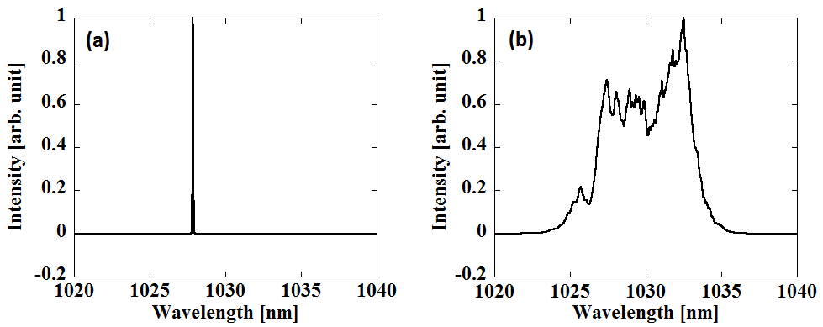
Model locked pulse oscillation
After adjustment of L_{loop}
CW
Mode-Locked
Pulse
Intensity [arb. unit]

Slide 23
Miyoshi PosiPol2010
L_{cav}
λ
dL∝λ/enhancement ~0.01nm
for enhancement ~1000

