Slide 1
Secondary positrons and electrons measured by PAMELA experiment
Vladimir Mikhailov (MEPhI)
For PAMELA collaboration

Slide 2
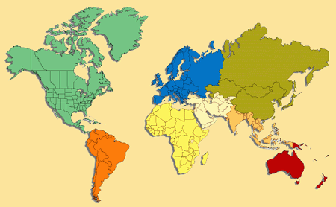
PAMELA Collaboration
Italy:
Bari
Florence
Frascati
Naples
Rome
Trieste
CNR, Florence
Russia:
Moscow
St. Petersburg
Germany:
Sweden:
Siegen
KTH, Stockholm

Slide 3
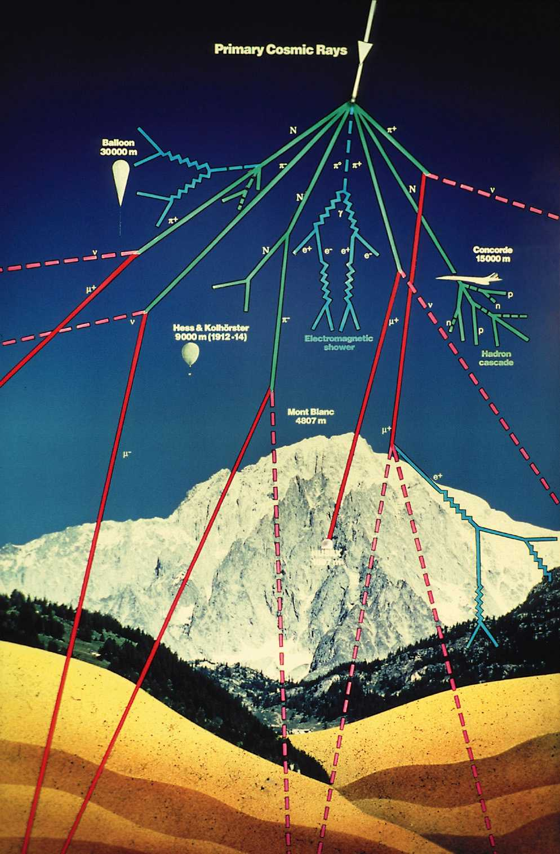
~500 km
Primary cosmic ray
~40 km
Atmospheric boundary
N. Grigorov Possibility of existence of a radiation belt around the earth consisting of electr.ons with energies of 100 MeV and above. Soviet Physics Doklady, Vol. 22, p.305, 1977
Production of charged pions in CR protons interaction with residual atmosphere
π±→μ±→е±
Trapping of secondary particles by the Earth magnetic field
livetime T(h)~ 1/ρ(h)
Intensity I_{e}(h) ~I_{cr}×ρ(h)×T(h)~ ρ·/ρ≈ I_{e}(h) ~ constant (h)
from ~100 to ~1000км
Basilova et al. 1978
Kurnosova et al.1979: first measurements
Galper et al 1983 : electron excess in SAA

Slide 4
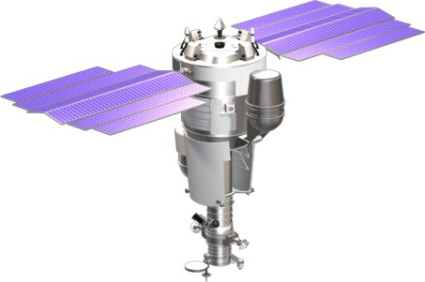
The PAMELA Experiment
Resurs DK satellite built by
the Space factory «TsSKB Progress»
in Samara (Russia)
PAMELA is here
Satellite was launched 15.06.2006 on elliptical polar orbit with inclination 70⁰,
altitude 350-610km. Circular orbit with altitude ~570km from September 2010
Mass: 6.7 tons
Height: 7.4 m
Solar array area: 36 m²
Trigger rate ~25Hz (outside radiation belts)
Event size (compressed mode) ~ 5kB
25 Hz x 5 kB/ev → ~ 10 GB/day
Since July 2006 till Junuary 2016:
~3200 days of data taking
~50 TByte of raw data downlinked
~9•10⁹ triggers recorded and analyzed

Slide 5
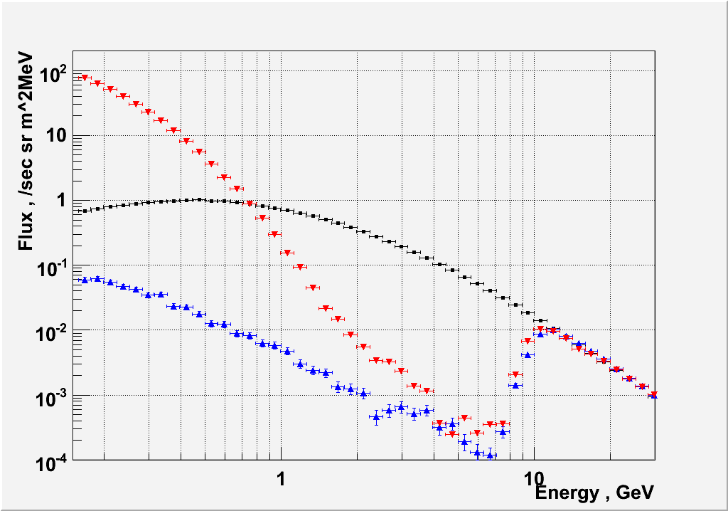
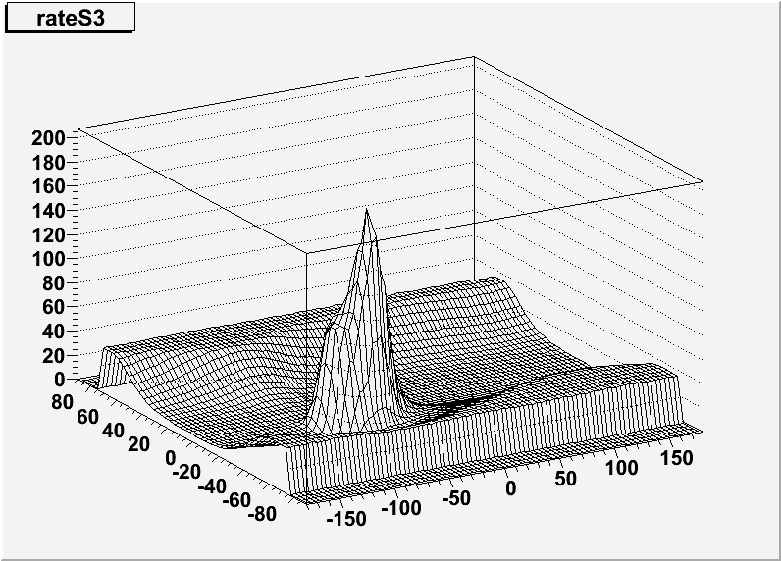
Spectra in different parts of magnetosphere
Analyzed data July 2006 – November 2009 (~1400 days)
Identified ~ 1× 10⁶ electrons and ~ 1× 10⁵ positrons between 50 MeV and 100 GeV
Trapped protons in SAA.
Magnetic polar cups
(→ galactic protons)
S3 count rate, au
Secondary re-entrant-albedo protons
Latutude, deg
Longitude, deg
Geomagnetic cutoff

Slide 6
Positron to electron ratio for secondary particles
AMS-01 experiment (1998)
Due to East-West effect
ratio e+/e- is about ~5
In near equatorial region
Result of AMS-01 confirmed by PAMELA
Adriani et al , JGR ,2009

Slide 7
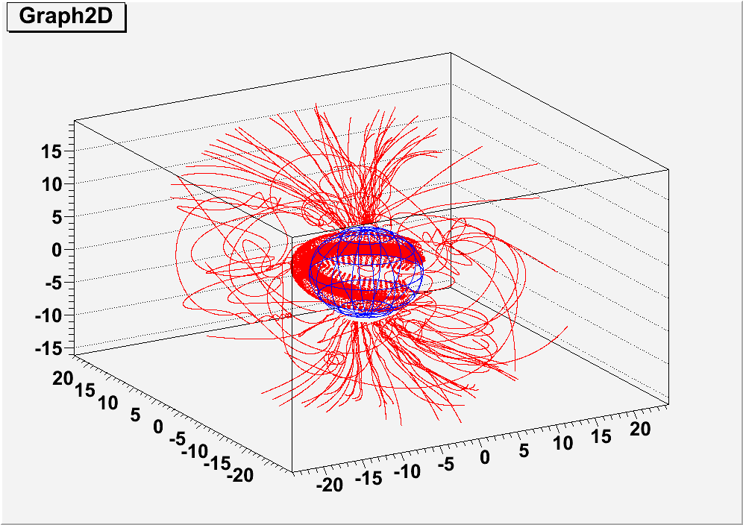
Data analysis
Trajectories of positrons and electrons were reconstructed in the Earth's magnetic field
IGRF field model was used (http:/nssdcftp.gsfc.nasa.gov)
Boundary :
Losses in atmosphere Hmin=30 km,
Escaping Hmax=20000 km
Time of tracing Tmax=35 second
(correspond to drift time around the Earth for particles with energy E~100 MeV)
The method of tracing was used previously in AMS-01 experiment
Z, 1000км
Y, 1000км
X, 1000км
Reconstructed trajectories of electrons and positrons detected by PAMELA during several orbits

Slide 8
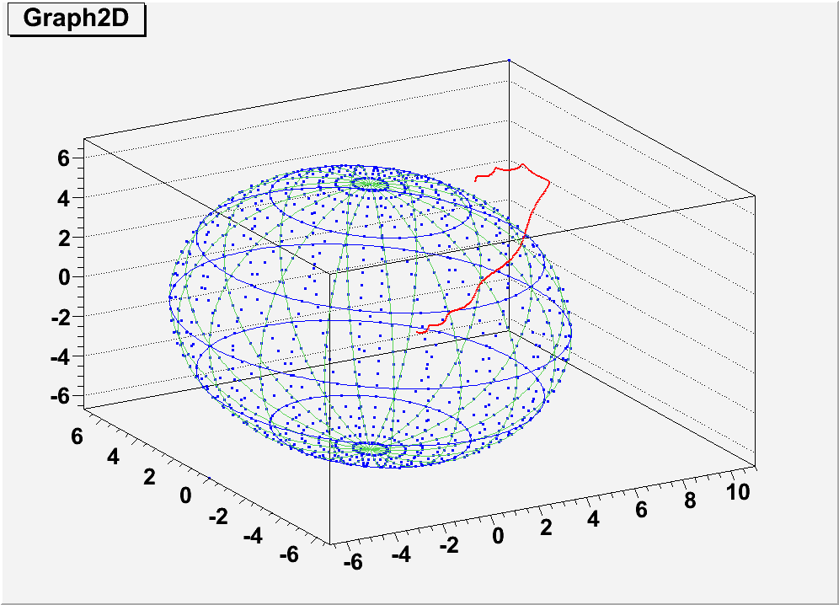
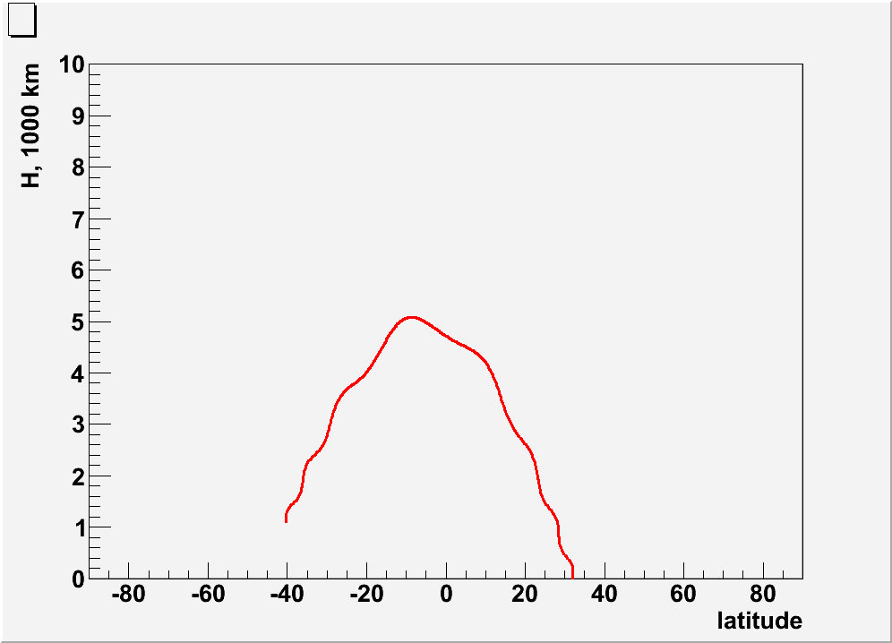
Samples of particles trajectories:
Simple reentrant albedo:
Altitude vs latitude
Z, 1000км
У, 1000км
Х, 1000км
Trajectory of re-entrant albedo positrons with rigidity R=1.24 GV
Time of flight ~0.1 s

Slide 9
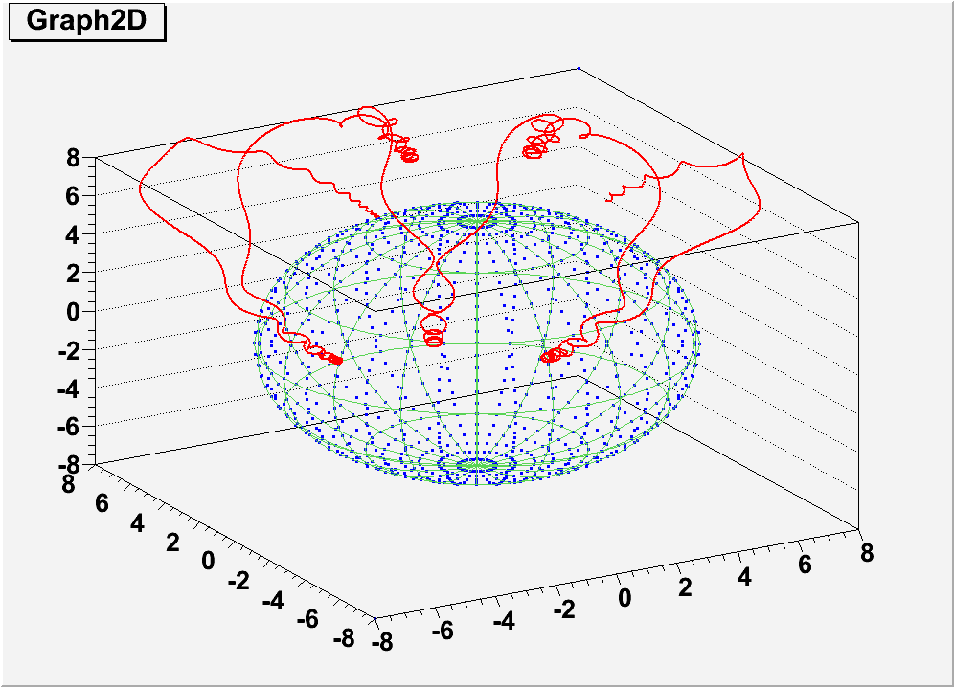
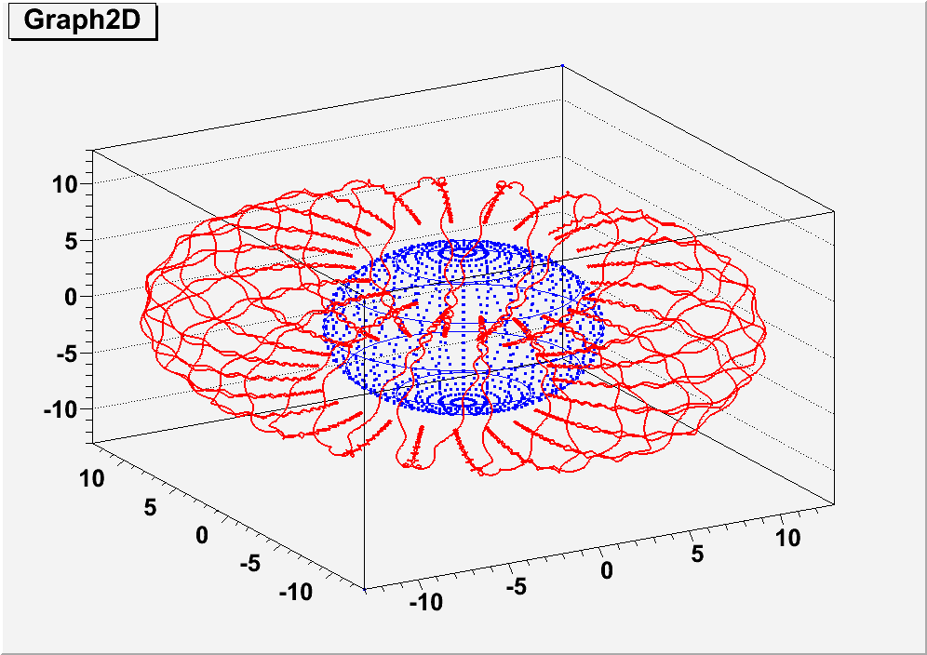
Quasi-trapped particles:
Z, 1000км
Y, 1000км
X, 1000км
Positron trajectory with rigidity R~1.2 GV,
Positron trajectory with rigidity R~0.5 GV
Time of flight >>0.1 s at R<1GV. The time is decreasing with R increasing

Slide 10
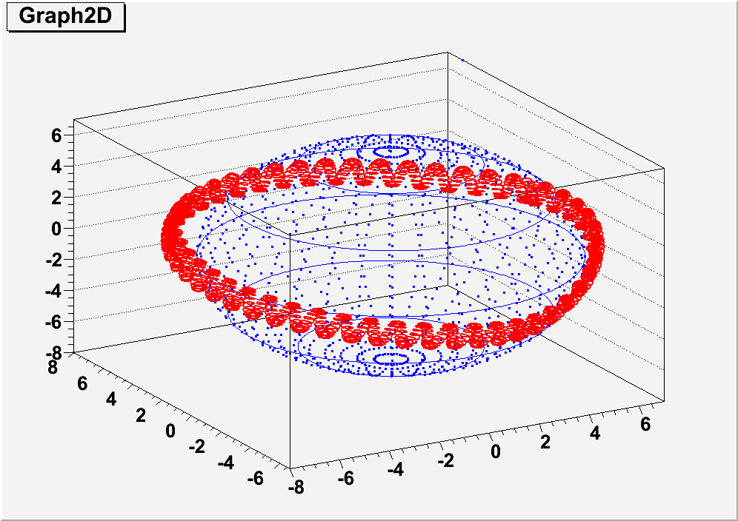
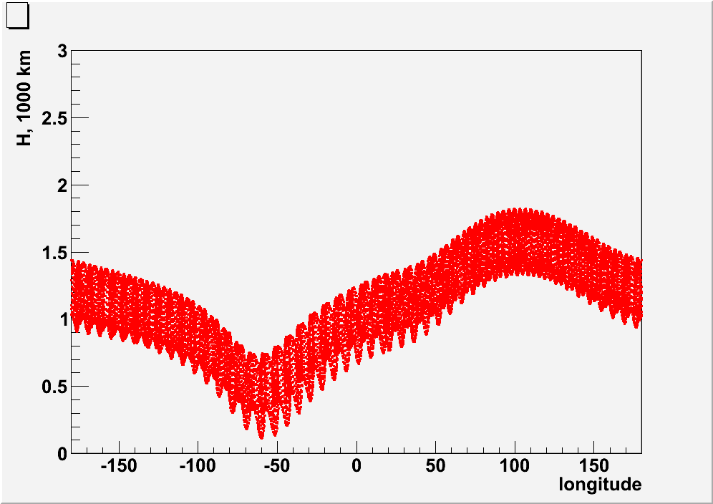
Trapped positron
Z, 1000км
У, 1000км
Х, 1000км
Altitude vs longitude. Minimal trajectory altitude is in South Atlantic Anomaly region.
Positron trajectory with rigidity R~1 GV, pitch-angle about 90 °.

Slide 11
Quasi-trapped particle near geomagnetic cut-off
Positron trajectory with rigidity R=2.24 GV, with small pitch-angle

Slide 12
Cosmic ray trajectory near geomagnetic cut-off
Chaotic trajectory of non-adiabatic type .

Slide 13
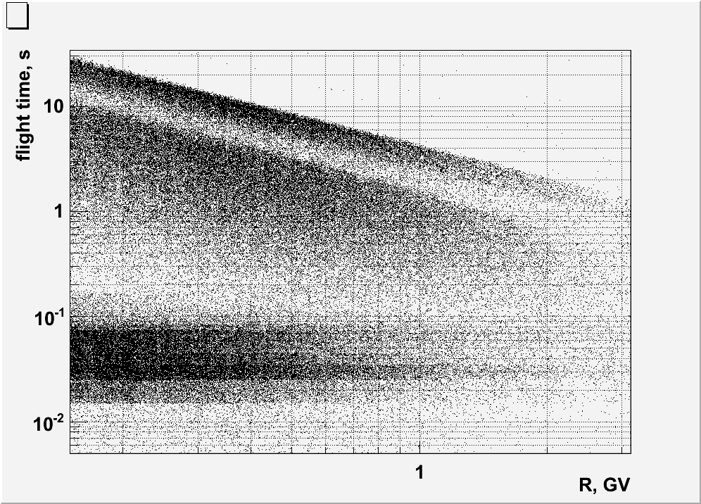
Electron and positron flight time in magnetosphere
Cosmic ray (CR) selected
by Hmax>20000 km
The flight time versus energy from the tracing of leptons.
Difference with AMS-01: More wide interval of altitudes (350-600 km), possibility to work in SAA. There is trapped component with very long flight time

Slide 14
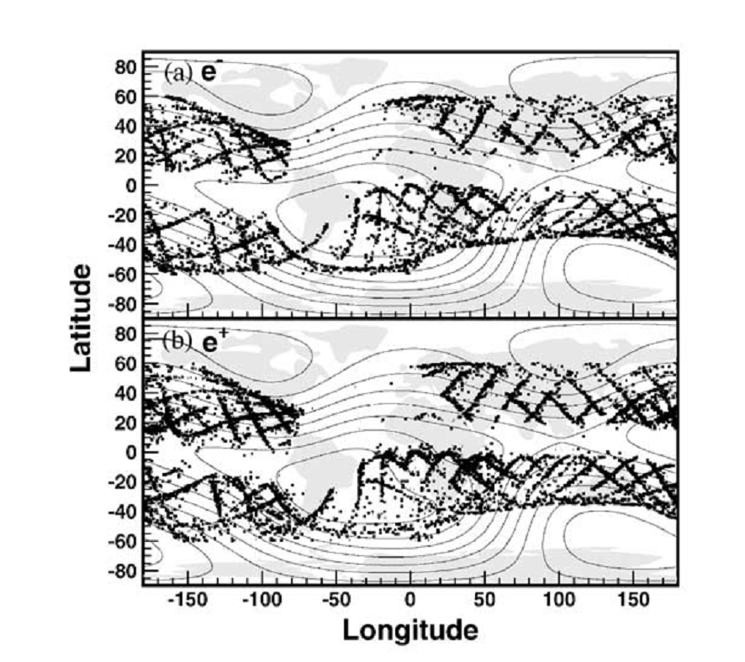
Re-entrant albedo: point of origin
PAMELA
AMS-01
electrons
positrons
M. Agular, et al. Physics Reports. 2002. V. 366. P. 331

Slide 15
Quasi-trapped albedo: points of detection
positrons
electrons

Slide 16
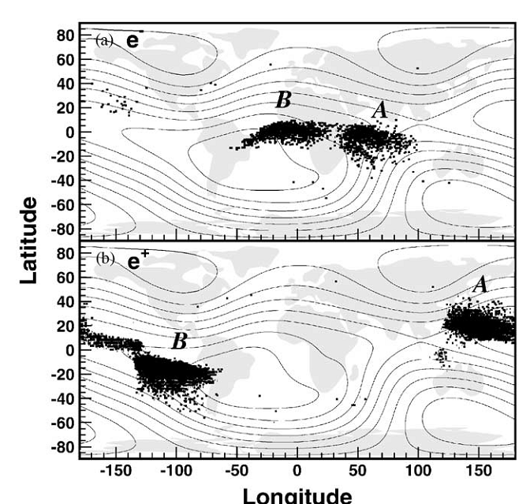
Quasi-trapped particles: points of origin
PAMELA
AMS-01
electrons
positrons

Slide 17
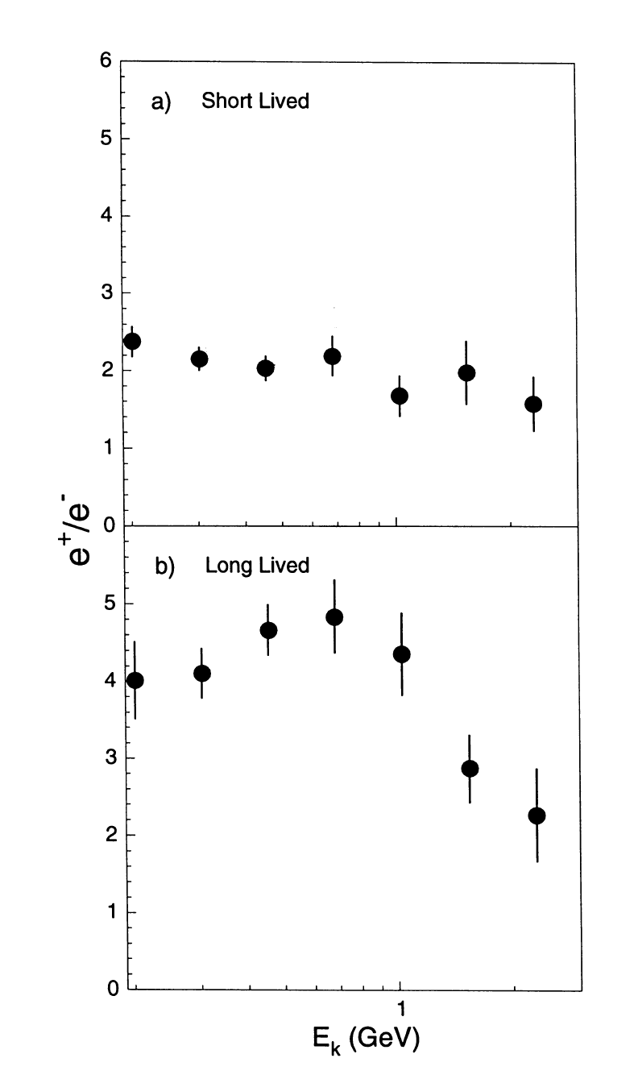
Positron to electron ratio vs energy
PAMELA
AMS-01
E_{k} (GeV)

Slide 18
Stably trapped particles: points of detection
positrons
electrons

Slide 19
Space distribution of trapped particles
positrons
electrons

Slide 20
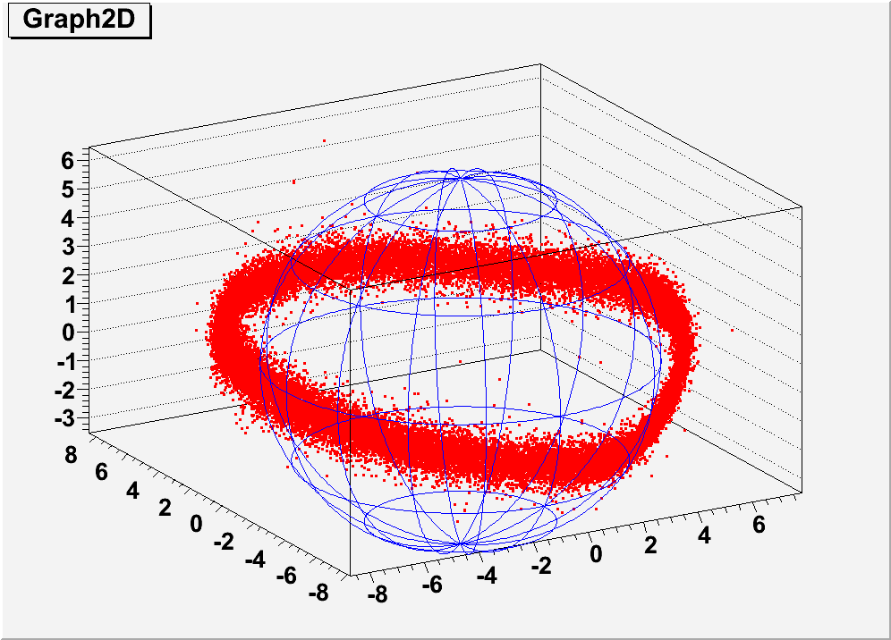
Space distribution of trapped particles

Slide 21
Geomagnetic coordinates L-B of detected trapped particles

Slide 22
Positron to electron ratio

Slide 23
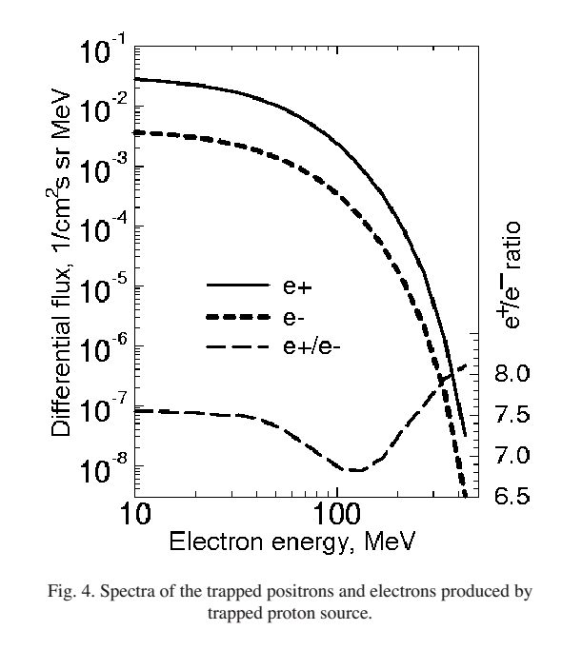
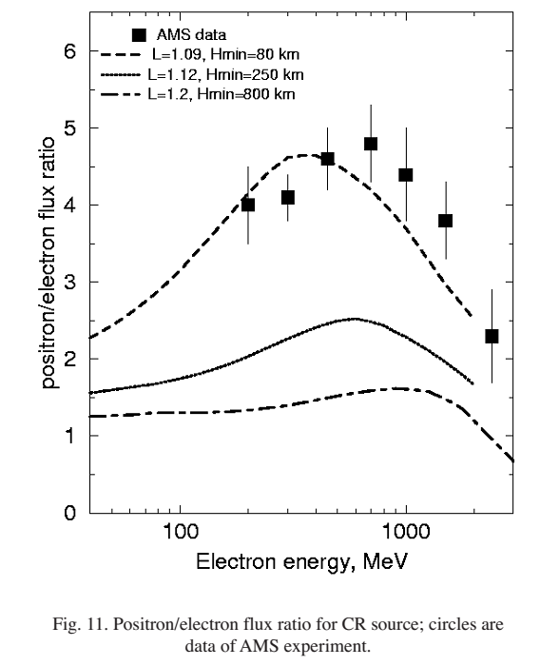
Sources of trapped electrons and positrons with E>10 MeV
Gusev et al, 2001, 2004 :TP source are limited in spatial distribution at around L=1.2± 0.1 with the energy spectrum showing a steep cutoff at energy of about ~ 300 MeV. The calculated e+/e- flux ratios in the belt due to this source are high and attain values of ≥7 in the energy range of 10 to 500 MeV. The simulated results for the CR source, at the center of the positron belt, are about 100 times lower than the positron fluxes of the TP origin at L=1.2.
Trapped proton (TR) interactions
CR interaction with residual atmosphere

Slide 24
Ratio of positrons to electrons vs L-shell for trapped particles

Slide 25
Ratio of positrons to electrons vs L-shell for trapped particles
CR source
CR source

Slide 26
ratio e+/e- in LB coordinates for trapped particles
Altitude increasing

Slide 27
ratio e+/e- in LB coordinates for trapped particles
Altitude increasing
0.18<B<0.2 G , 1.12<L<1.3

Slide 28
Energy distributions of trapped electrons and positrons 0.18<B<0.2 G , 1.12<L<1.3

Slide 29
Conclusion
1. Particle tracing in magnetosphere selects
- cosmic ray
- re-entrant albedo
- quasitrapped
- trapped
electron and positron
2. Charge composition of stably trapped particles in radiation belt differs from longlived quasitrapped component
3. PAMELA detects more electrons then positrons on boundary of radiation belt
at E <0.5 GeV

Slide 30
Thank you!

Slide 31
Spare slides

Slide 32
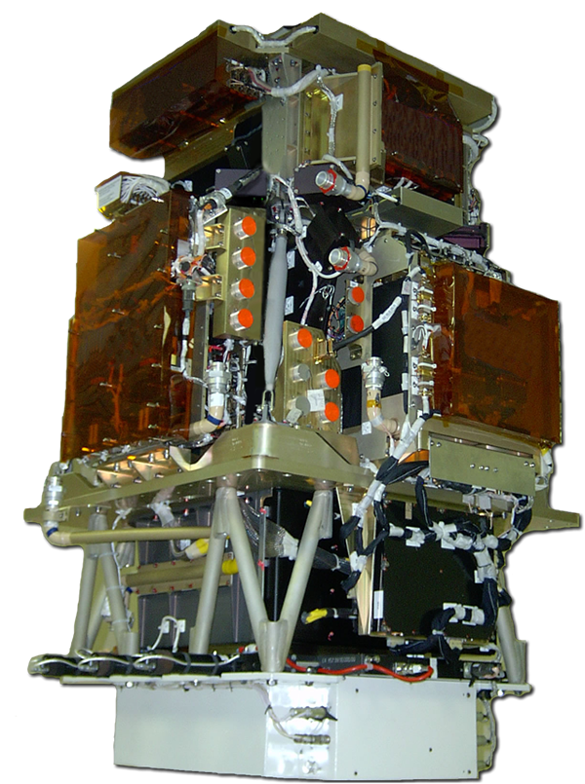
PAMELA detectors
Main requirements → high-sensitivity antiparticle identification and precise momentum measure
+ -
Time-Of-Flight
plastic scintillators + PMT:
Trigger
Albedo rejection;
Mass identification up to 1 GeV;
- Charge identification from dE/dX.
Electromagnetic calorimeter
W/Si sampling (16.3 X₀, 0.6 λI)
Discrimination e+ / p, anti-p / e⁻
(shower topology)
Direct E measurement for e⁻
Neutron detector
³He tubes + polyethylene moderator:
High-energy e/h discrimination
GF: 21.5 cm² sr Mass: 470 kg
Size: 130x70x70 cm³
Power Budget: 360W
Spectrometer
microstrip silicon tracking system + permanent magnet
It provides:
- Magnetic rigidity → R = pc/Ze
Charge sign
Charge value from dE/dx
Notes:
Overview of the apparatus

Slide 33
Electron and positron spectra in SAA

Slide 34
Отношение e+/e- для 0.18<B<0.2 , 1.18<L<1.13

