Slide 1
Experimental overview on Future Solar and Heliospheric research
Timo Laitinen
Jeremiah Horrocks Institute, UCLAN, UK
ECRS Torino, 4-9 September 2016

Slide 2
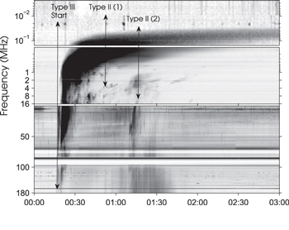
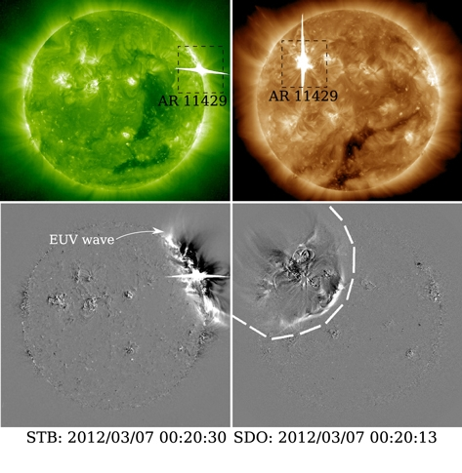
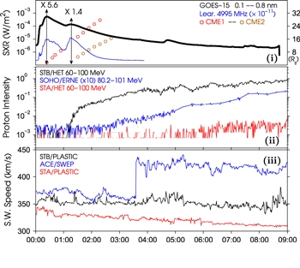
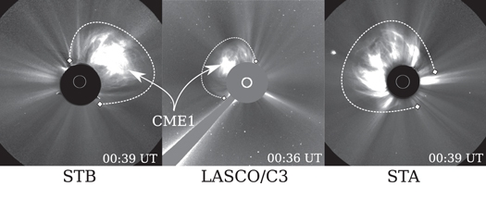
Heliospheric particles: What can we learn
Chance of identifying cosmic ray acceleration and transport processes
Able to observe the in situ plasma and fields
High-precision remote sensing observations
X/Gamma rays: signature of accelerated particles
Coronagraphs: a view of ejected mass
EUV: Coronal waves, loop dynamics, eruptions, source populations?
Radio waves: signature of accelerated electrons, shocks
Kouloumvakos+ 2016

Slide 3
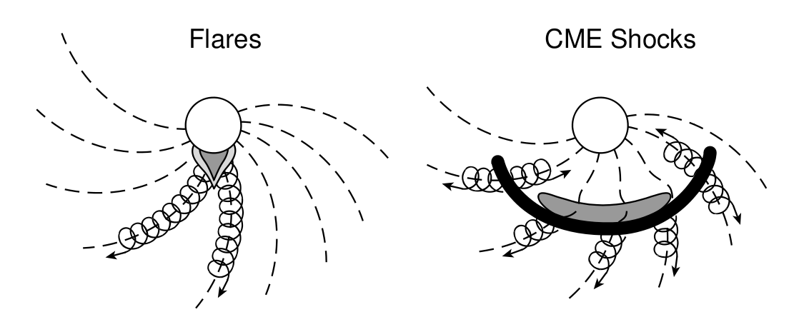
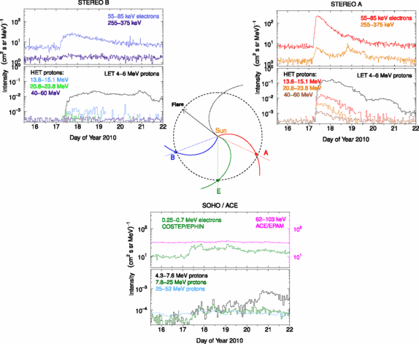
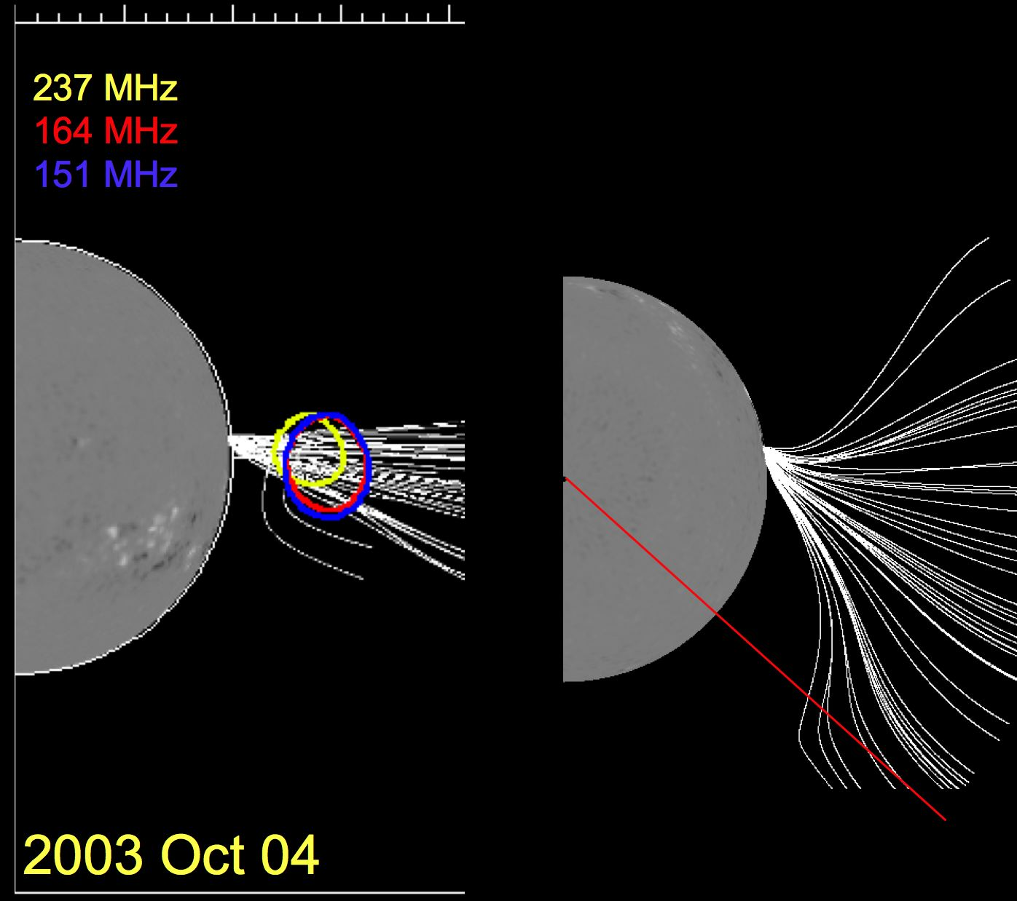
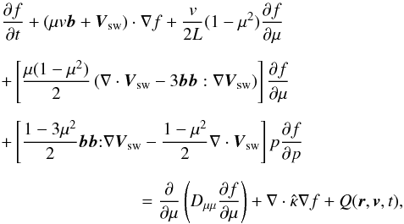
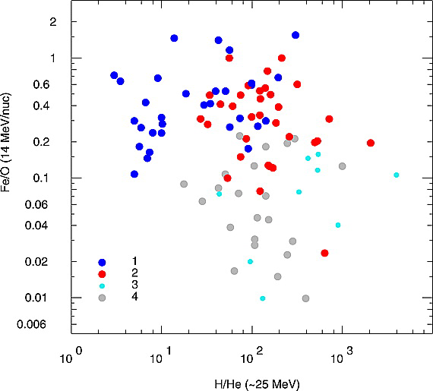
SEP sources?
SEP sources: 2-class paradigm, mixed classes or continuum?
Very wide events with multi-spacecraft observations (Dresing+ 2012, 2014; Richardson+2014;Lario 2014,2016,…)
Field line expansion?
Coronal wave?
Wide source?
Cross-field transport?
SEP transport and solar wind turbulence?
Proper transport and turbulence models?
Reames 1999
Dresing+ 2012
Cane+ 2010

Slide 4
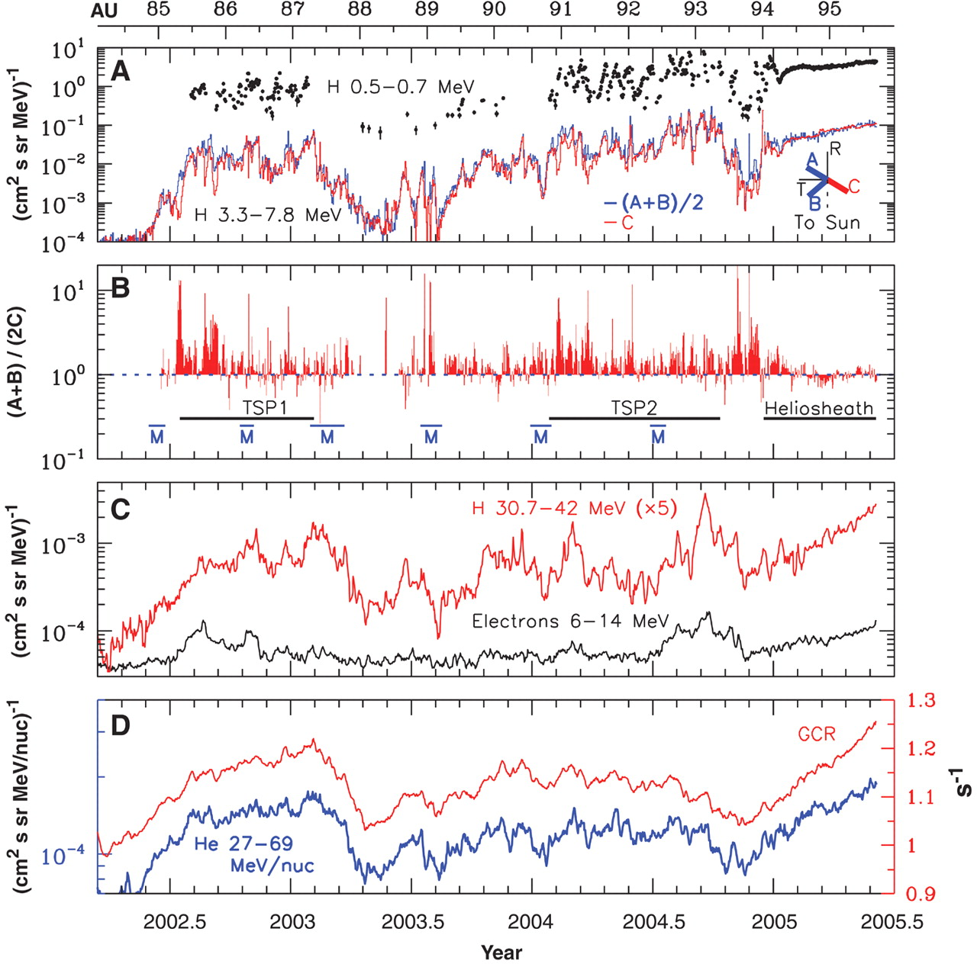
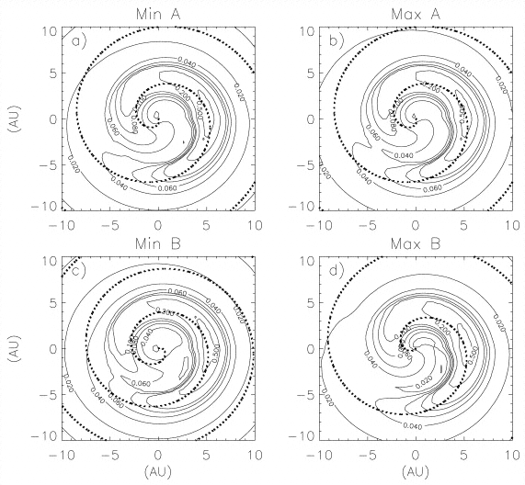
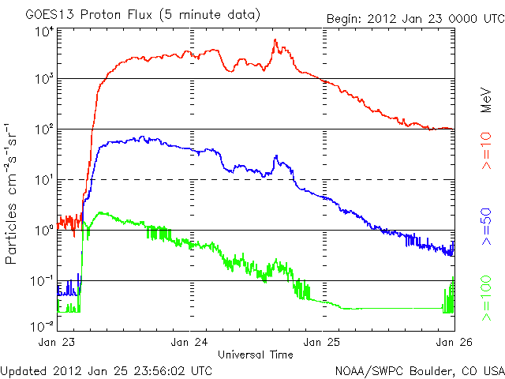
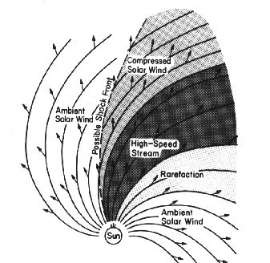
Other cosmic ray sources
Interplanetary transients: Accelerated particles in situ
Corotating interaction regions: Quasi-static shocks at ~ 2 AU
Jovian Electrons: Analysis of diffusion coefficients
Anomalous cosmic rays: Accelerated at termination shock?
Modulation of local interstellar spectrum: input and output!
Hundhausen, 1972
Stone+ 2005
Ferreira+ 2003

Slide 5
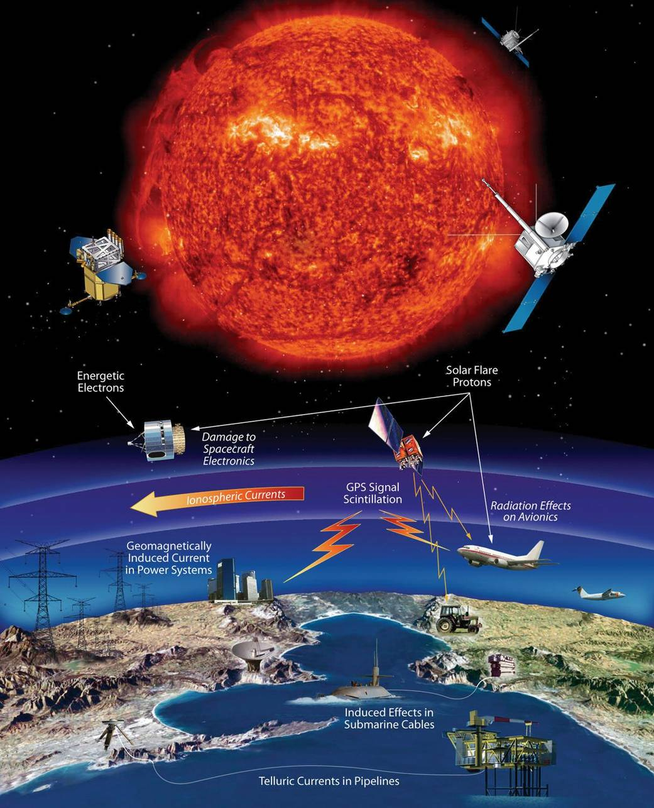
Space Weather
Space Weather in National and International Risk Classifications: taken seriously
Cosmic Ray aspect: hazard to spacecraft/astronauts, polar aviation, communication
Operative SW missions different have requirements:
Continuous monitoring
Real-time alerts
Not necessarily easily usable for science
NASA

Slide 6
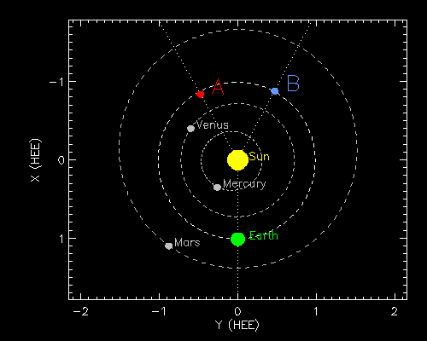
The Fleet
The Earth: Neutron monitor network
Earth-Orbiting
Pamela, 80 MeV/n-20 GeV/n
AMS 1 GV-2 TV
GOES, GOES-R: e >0.6- MeV integral, p, He 1-700 MeV/n, >1-100 MeV integral
L1
SOHO (1995-): ERNE, EPHIN
Ions: 1-120 MeV/n
Electrons: 0.25-10 MeV
ACE (1997-): CRIS, ULEIS, SWIMS, EPAM, SIS, SEPICA, SWEPAM, SWICS
Ions 0.1 kev- 500 MeV, electrons 0.03-0.31 MeV
WIND (1994-): 3DP
3 eV – 400 keV electrons
http://stereo-ssc.nascom.nasa.gov/cgi-bin/make_where_gif
STEREO A/B: HET, LET, SEPT, SIT
Electrons 30 keV-6 MeV, ions 60 keV-100 MeV/n
STEREO B lost and found but not working yet

Slide 7
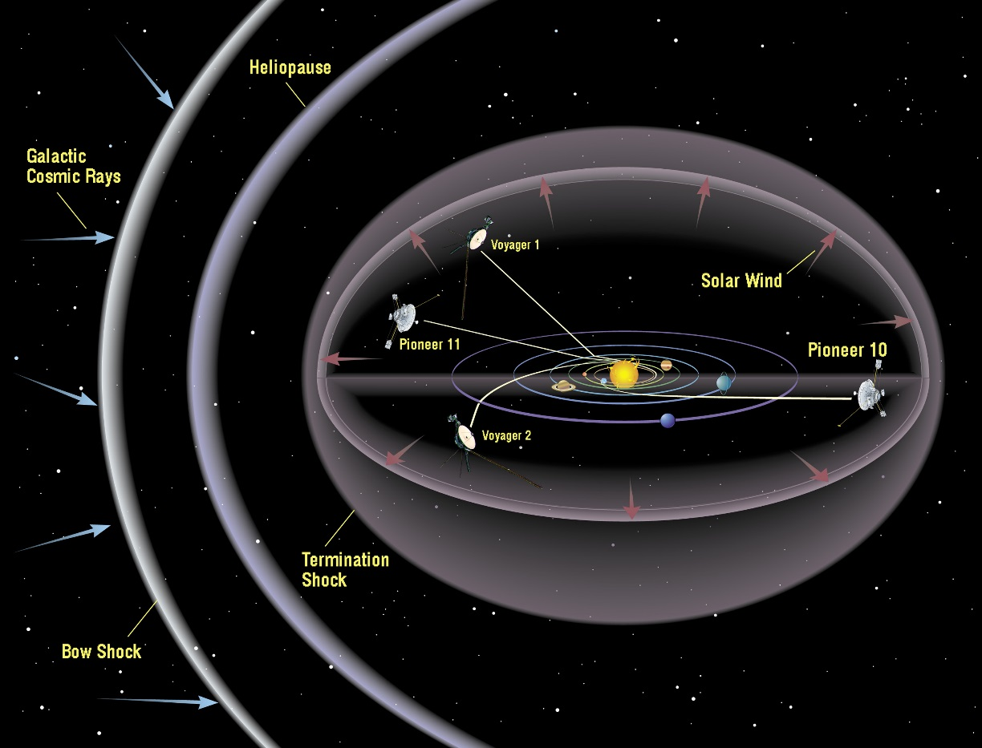
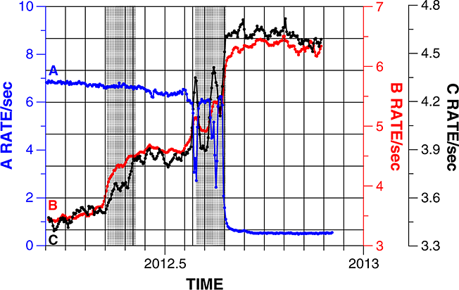
Outer heliosphere
Voyager 1
136 AU: In interplanetary space
10 keV-100 MeV e, 10 keV – 550 MeV/n ions
Voyager 2
112 AU: In the heliosheath
4 eV-100 MeV e, 10 eV – 550 MeV/n ions
NASA
Webber&McDonald 2013

Slide 8
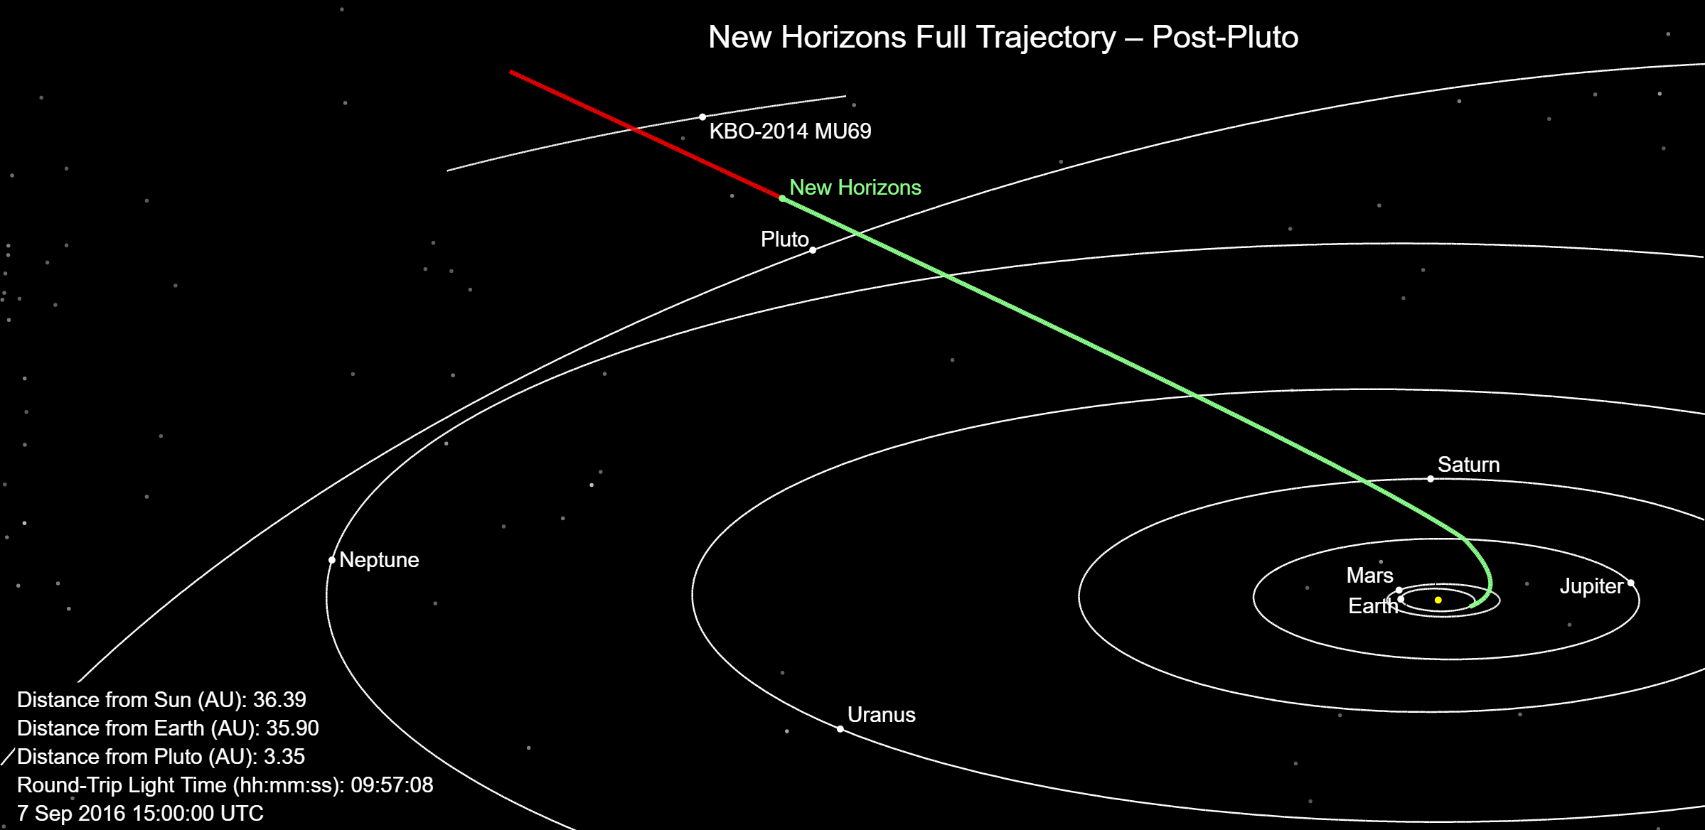
Particle instruments in planetary missions
Mercury
Messenger EPPS/EPS
Electrons 20-700 keV, ions 10 keV – 5 MeV
Future: Bepi Colombo SIXS
Mars
MAVEN SEP
Ions 25 keV-12 Mev,
Electrons 25 keV-1 MeV
MSL Curiosity’s RAD
Ions -100 MeV/n, e -10 MeV
Saturn:Cassini
LEMMS, 20 keV – 130 MeV
INCA, Ion and Neutral camera, 7 keV – 8 MeV
Jupiter:
Juno: JEDI
10 keV-1 MeV electrons, 10 keV-10 MeV ions
Upcoming: Juice PEP/JoEE
Pluto:
New Horizons: PEPSSI, SWAP
Ions 20 keV-1Mev, electrons 25-500 keV
12-degree sectors
On the way to Kuiper Belt next!
Often unclear if data is available, usable
… but many successfully used!

Slide 9
Looking good! Or is it? What about the Future?

Slide 10
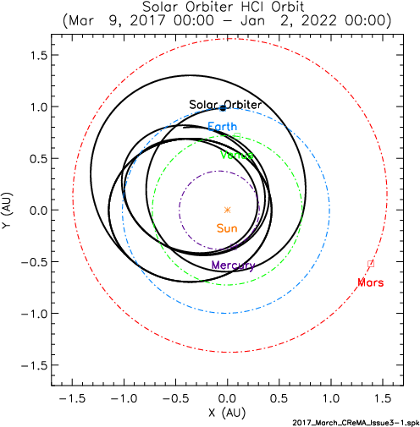
Solar Orbiter
Orbit: 0.285-0.91 AU
Inclination 25, increases to 34 degrees during extended mission 2027
Launch: October 2018
3.5-year Cruise Phase, 3.5-year nominal mission
Near-corotation with the Sun
No Realtime data, latency depends on orbital phase
Science Focus:
How does Sun create and control Heliosphere
What drives solar wind, coronal magnetic fields
How do solar eruptions produce SEPs
How does solar dynamo work
http://www.sorbete.srg.uah.es/

Slide 11
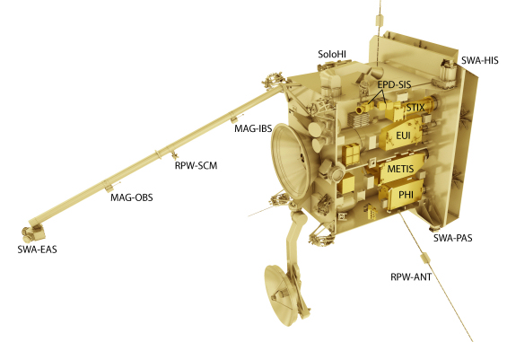
Solar Orbiter Instruments
In situ: Data continuous starting from Cruising phase
EPD, Energetic Particle Detector
MAG. Magnetometer
SWA: Solar Wind Plasma Analyser
RPW: Radio and Plasma waves
SWA: Solar Wind Analyser
Remote-sensing: Data not continuous
EUI: Extreme Ultraviolet
METIS: Coronagraph
PHI: Polarimetric and Helioseismic Imager
SOLO-HI: Solar Heliospheric Imager
SPICE: Spectral Imaging of the Coronal Environment
STIX: X-ray Spectrometer/Telescope

Slide 12
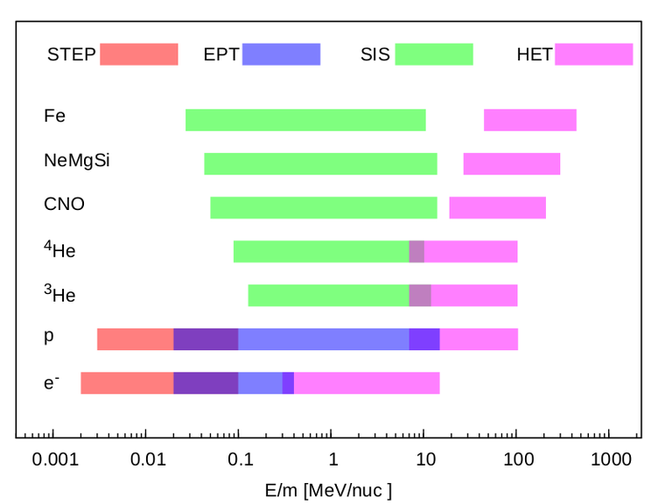
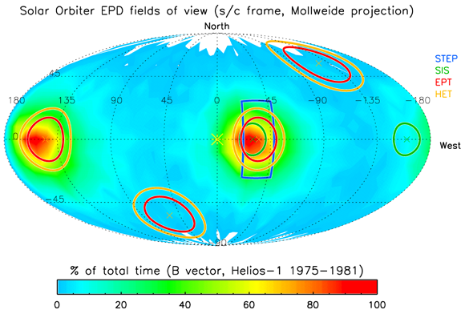
Solar Orbiter: Cosmic Rays
Wide range of energies and isotopes
Non-rotating spacecraft, but distributed sensor pointing directions to obtain anisotropies
STEP and SIS 2 apertures, EPT and HET 4, apertures, distributed
EPD suite ready for integration
http://www.physik.uni-kiel.de/de/institute/ieap/ag-wimmer/solo

Slide 13
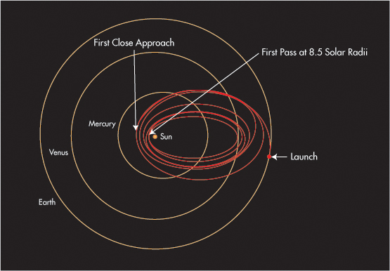
Solar Probe Plus
Launch: July 30 2018
7 Venus flybys, down to 8.5 solar radii
First flyby September 2018, data collection October 2018
Closest approaches 2024-
Science goals
Structure and dynamics of magnetic fields at solar wind sources
Trace energy that heats corona and accelerates solar wind
Determine mechanisms that accelerate and transport energetic particles
Explore influence of dusty plasma on solar wind and energetic particles
http://solarprobe.jhuapl.edu/

Slide 14
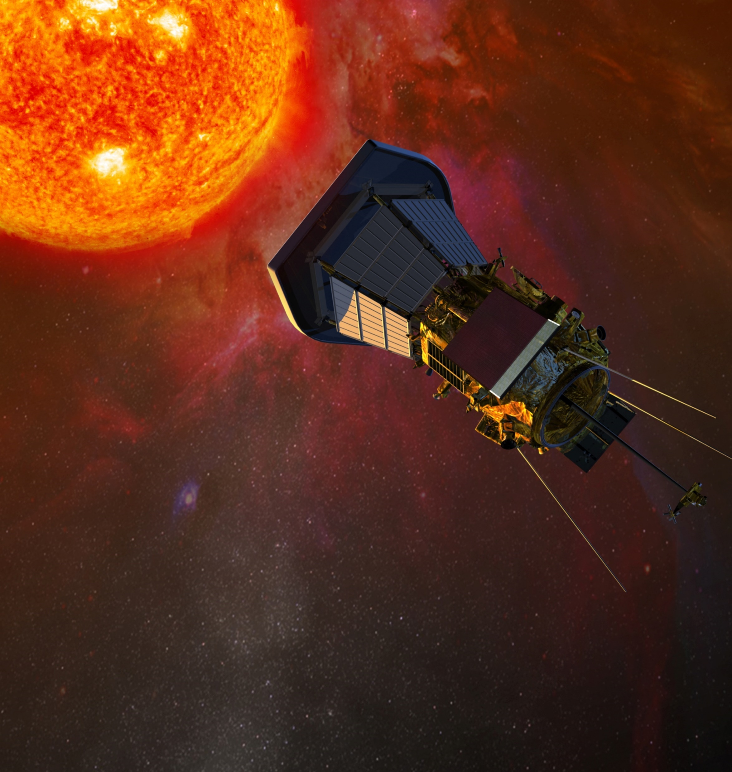
Solar Probe Plus Instruments
SWEAP: Suprathermals 10 eV-20 keV
ISIS EPI-Lo:
Electrons 20 keV – 1 MeV, angular resolution 45 degrees
Ions 40 keV – 15 MeV/n, up to iron, angular resolution 15-30 degrees
Cadence 1 s
EPI-Hi
Electrons 0.5-6 MeV, angular resolution 45 degrees
Ions 1-100 MeV/n, up to iron, angular resolution 30 degrees
Cadence 1 s, most products 1-5 min
FIELDS: Electromagnetic fields instrument
WISPR: Wide-field imager

Slide 15
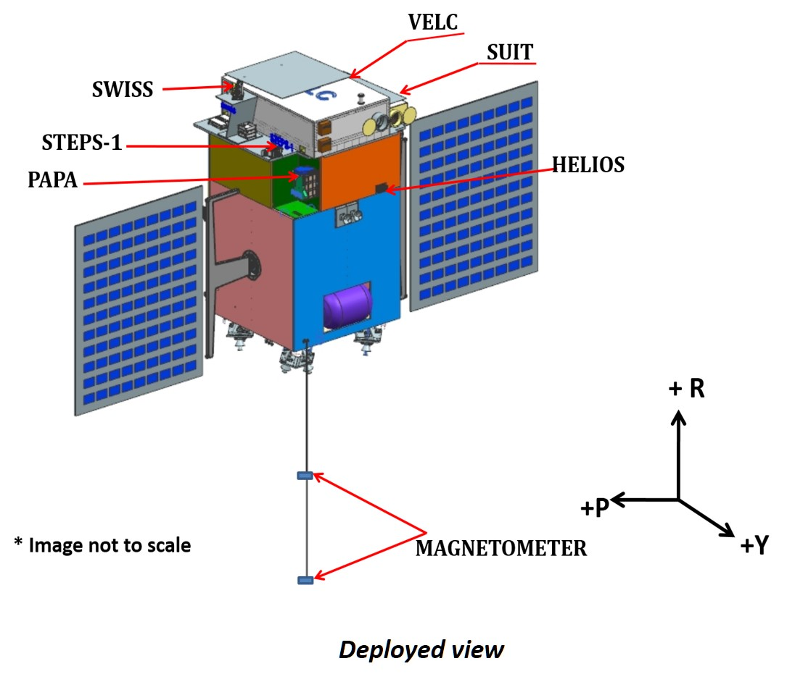
Aditya-L1
First indian solar mission
L1 mission
VELC: Coronagraph
SUIT: Ultraviolet imager
SolEXS, HEL1OS: X-ray spectrometres
Magnetometer
ASPEX: Energetic particle instrument:
0.1-20 keV electrons
0.02-5 MeV/n ions
Launch 2019-2020

Slide 16
L5 missions (none approved)
Interest for a permanent L5 observer for Space Weather
“Side-view” of CMEs
Advance warning of new solar active regions
Advance warning of corotating interaction regions
Akioka+ (2005): Wide field coronal imager, 42 degrees
EASCO (Gopalswamy+, 2011):
Full set of in situ and remote sensing instruments
INSTANT (ESA)/RESCO (China):
EUV, coronagraph, heliospheric imager, magnetometer, solar wind plasma
UK MET Office: Carrington L5
An operational Space Weather Mission: “only for Space Weather”
Not necessarily with cosmic ray instruments
Liu+, 2010

Slide 17
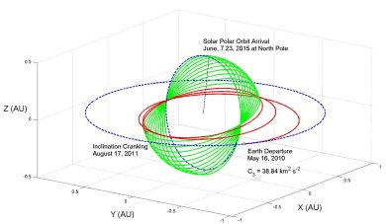
Roadmaps, White Papers…
NASA Roadmap:
Heliospheric Boundary Mission
Interstellar probe
Solar Polar Imager
L5 mission
Proposals for interstellar probe

Slide 18
Summary
In situ and remote sensing support for heliospheric cosmic ray research bring new challenges for understanding the cosmic ray acceleration and transport processes
Research currently supported with a large fleet of observing spacecraft
Many of the fleet are old, or designed for other than heliospheric research
3 spacecraft being built with cosmic ray instruments
Space Weather in the political map, but missions may be operationally driven

