Slide 1





Detection of extensive air showers with the NEVOD-EAS cluster type detector
25th European Cosmic Ray Symposium (ECRS-2016)
I.A. Shulzhenko¹, M.B. Amelchakov¹, N.S. Barbashina¹, A.G. Bogdanov¹,
Chiavassa^{2,3}, N.E. Fomin¹, N.N. Kamlev¹, S.S. Khokhlov¹, R.P. Kokoulin¹,
K.G. Kompaniets¹, V.Yu. Kutovoy¹, O.I. Likiy¹, G. Mannocchi⁴, V.V. Ovchinnikov¹,
A.A. Petrukhin¹, O. Saavedra², V.V. Shutenko¹, G. Trinchero⁴, I.I. Yashin¹
¹ National Research Nuclear University MEPhI, Scientific and Educational Center NEVOD, Moscow, Russia
² Dipartimento di Fisica dell’ Università degli Studi di Torino, Turin, Italy
³ Sezione di Torino dell’ Istituto Nazionale di Fisica Nucleare - INFN, Turin, Italy
⁴ Istituto di Fisica dello Spazio Interplanetario – INAF, Turin, Italy
Torino, Italy, September 4 - 9, 2016

Slide 2
NEVOD-EAS array

Slide 3
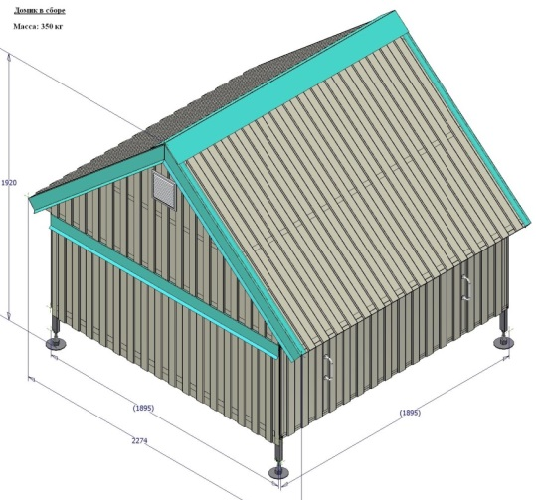
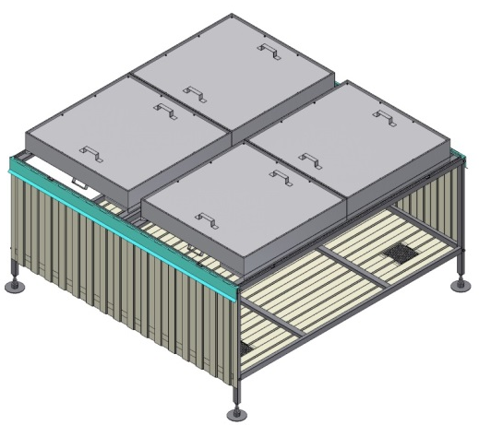
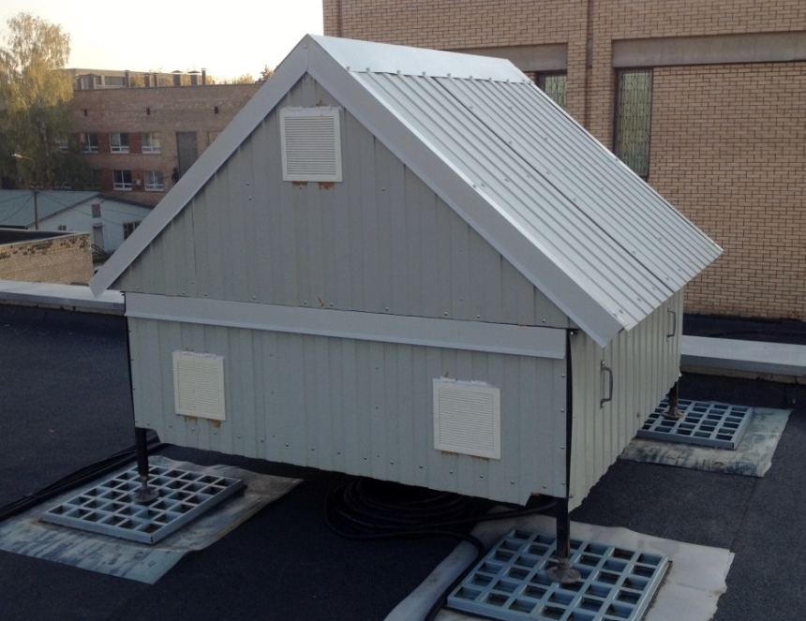
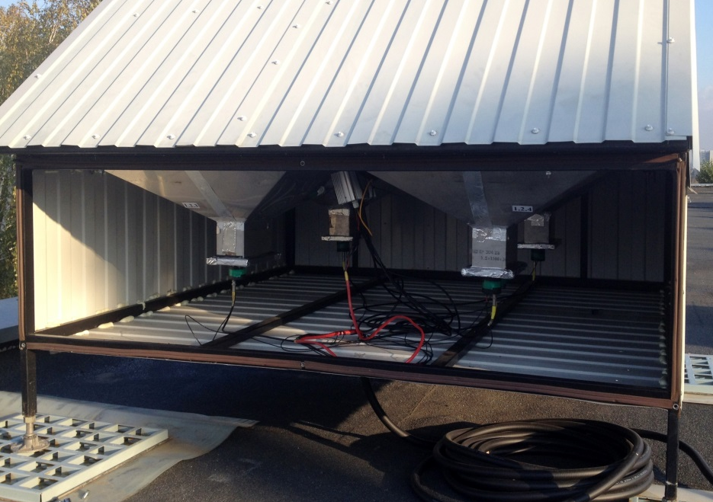
Counter and detector station (DS) of the NEVOD-EAS array

Slide 4
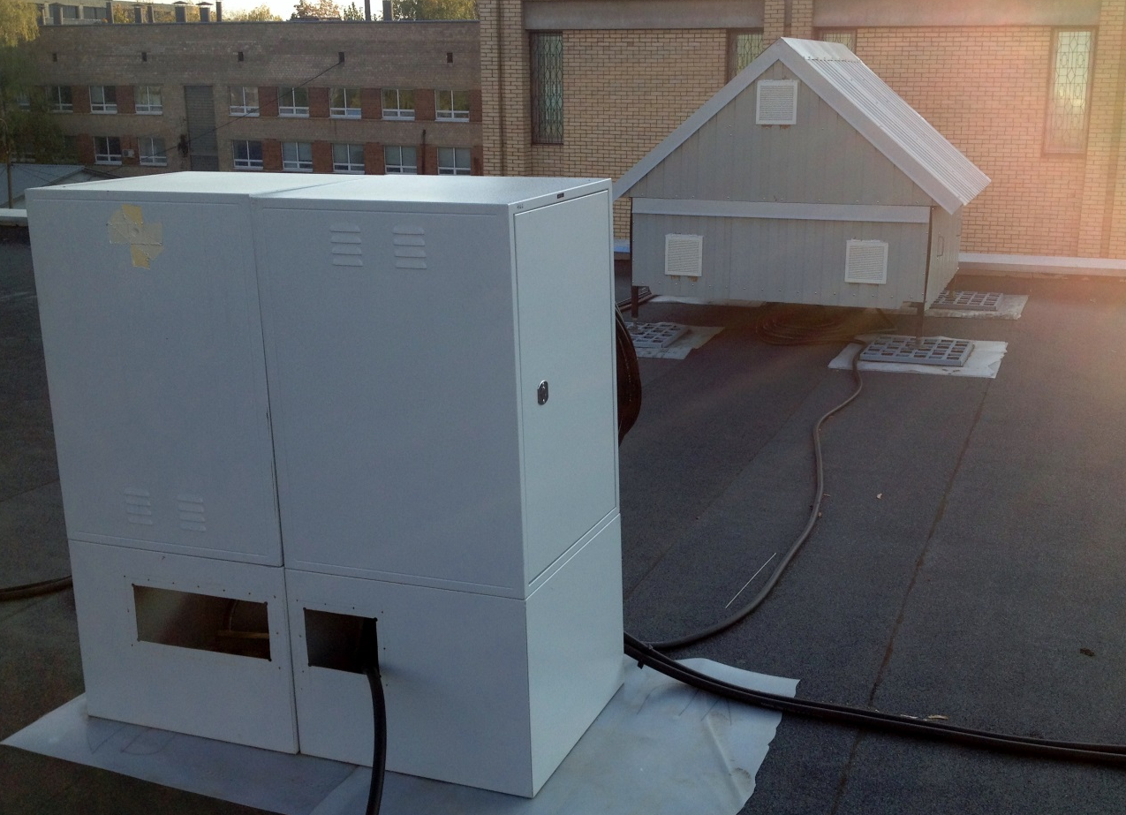
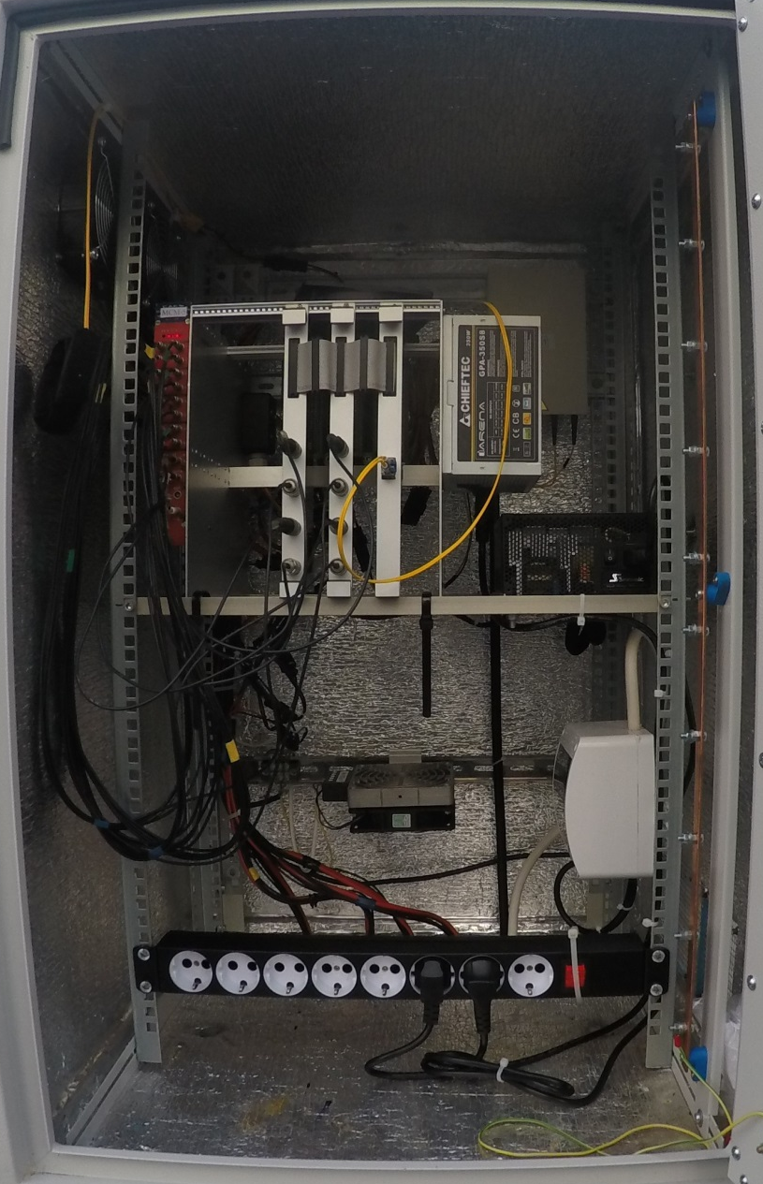
Local Post of the cluster
Local Post tasks:
- summation of standard PMTs signals;
- digitizing of PMTs signals;
- event selection according to triggering conditions;
- operation in exposition and monitoring modes;
- DS power supply;
- control of temperature inside DS and LP.

Slide 5
Central DAQ Post
Central DAQ Post tasks: - cluster synchronization;
- cluster control;
- reception and storage of experimental
and monitoring data.

Slide 6
Central DAQ Post

Slide 7
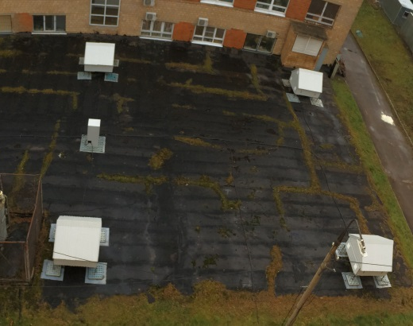
Central part of the NEVOD-EAS array
Clusters No. 1 & 2
13.3×12.4 m²
Cluster No. 4
15.0×15.0 m²
Cluster No. 3
25.1×18.9 m²

Slide 8
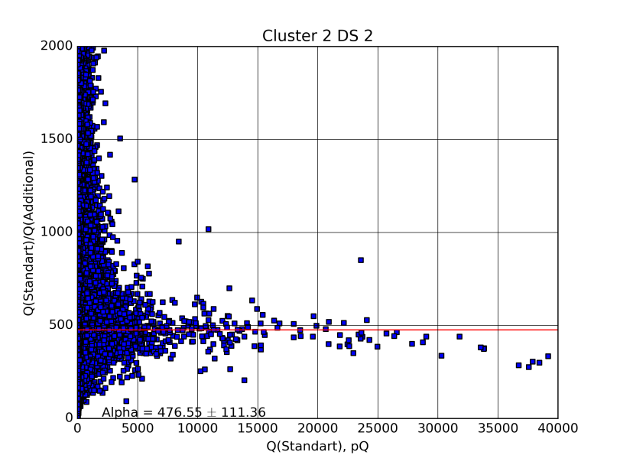
Response of the NEVOD EAS detector stations and counters
123
Cluster 2 DS 2
Ratio between response charges of
DS and additional PMT
Отношение заряда отклика ДС к заряду отклика доп. ФЭУ
Заряд отклика ДС
Charge of DS response, pQ
Distribution of DS on position of “muon” peaks
Distribution of additional PMTs on charge of response to 1 particle (VEM)
<Q_{add1µ}> = 0.14 pQ
σ_{Qadd1µ} = 0.03 pQ

Slide 9
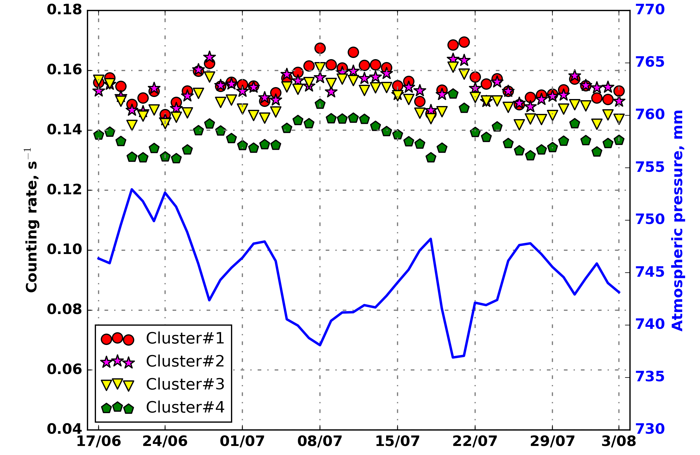
Counting rate of the NEVOD-EAS clusters
Barometric coefficient ~ -0.71 ÷ -0.81 %/mmHg

Slide 10
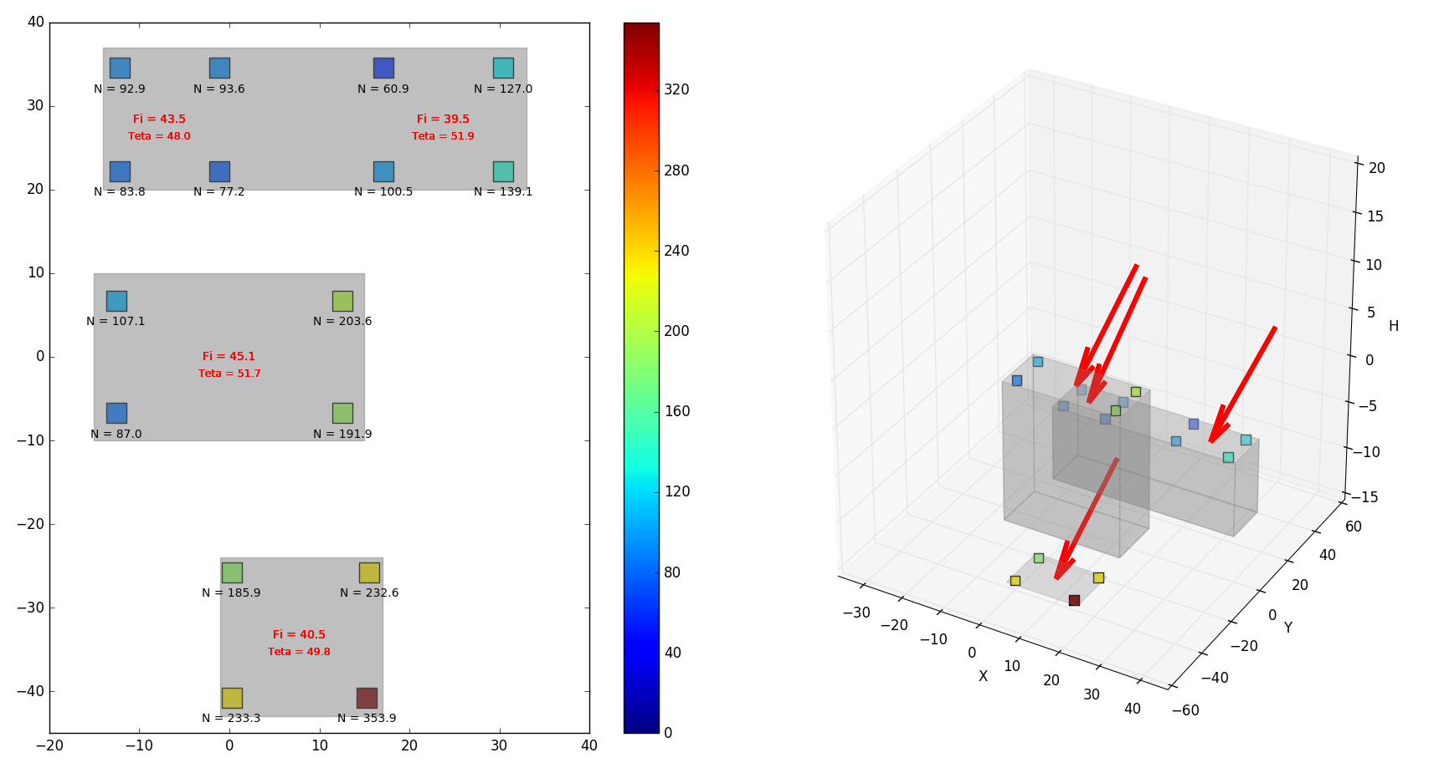
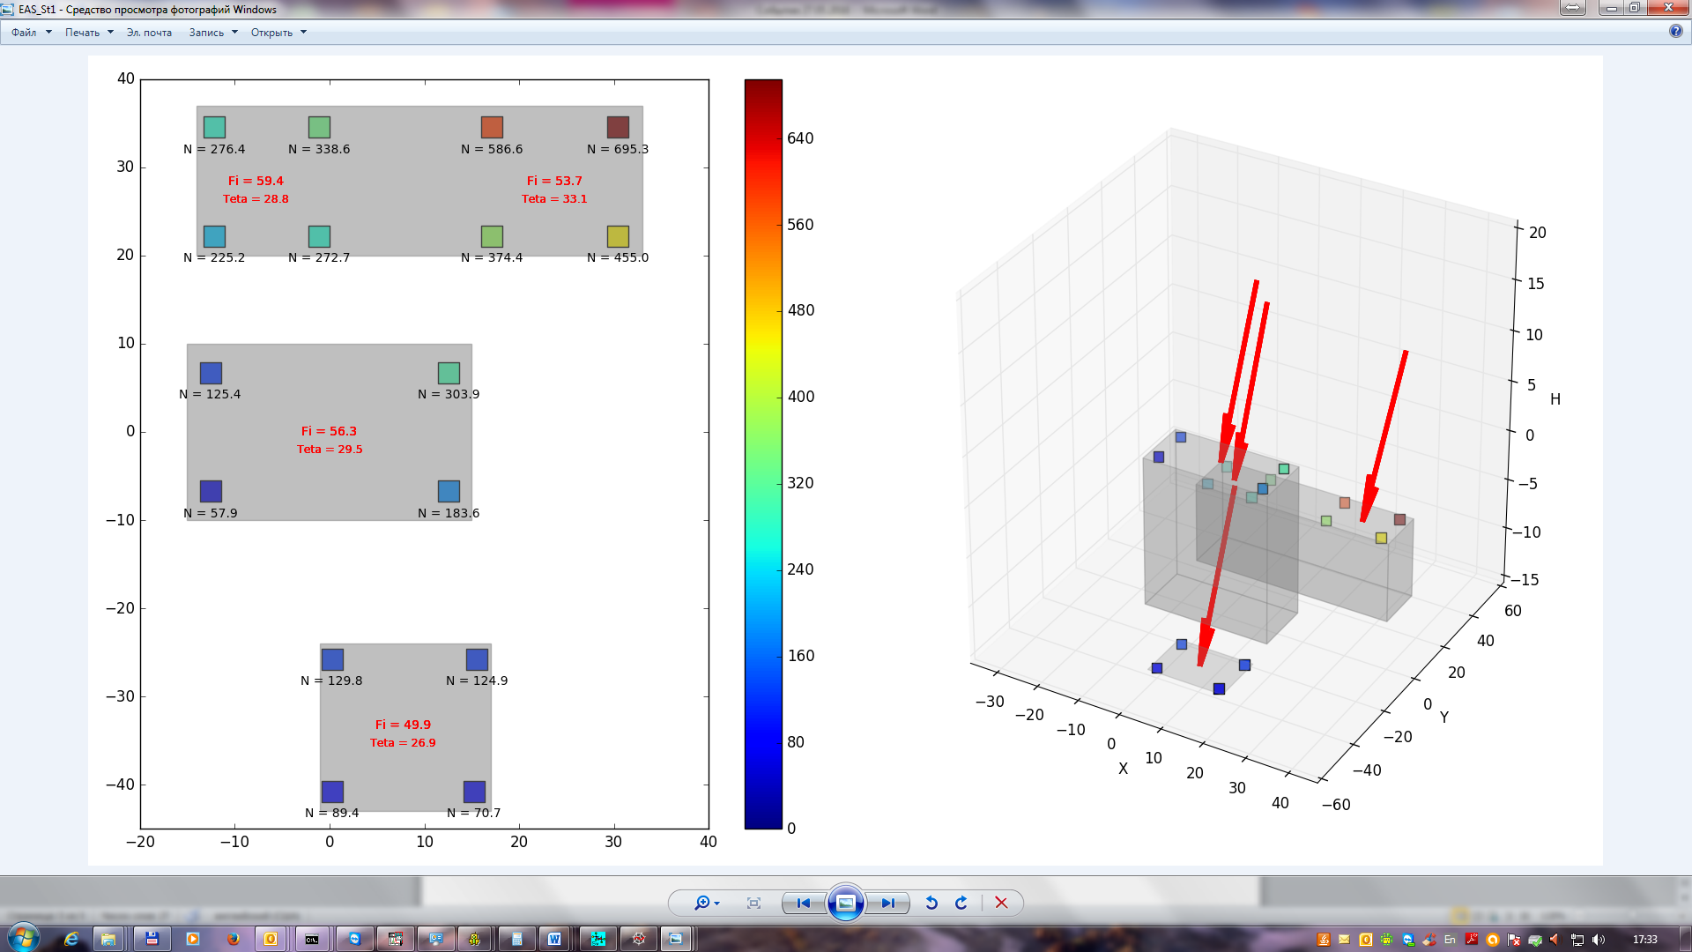
Registration of showers with the NEVOD-EAS array
θ = 48.0°
φ = 133.5°
θ = 51.9°
φ = 129.5°
Число ШАЛ: 712
θ = 51.7°
φ = 135.1°
Number of EAS: 712
<ψ> = 3.8°
σ_{ψ} = 2.6°
Number of registered EAS
θ = 49.8°
φ = 130.5°
Mean angular deviation of directions reconstituted by individual clusters from the average direction in the event, °

Slide 11
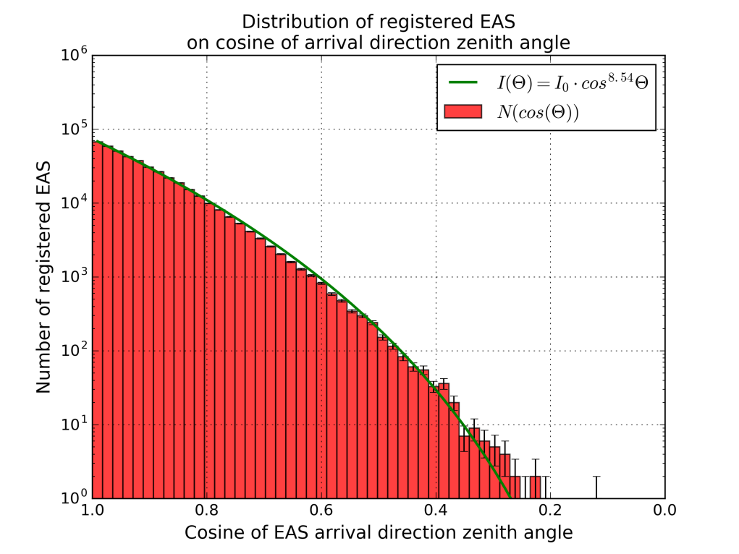
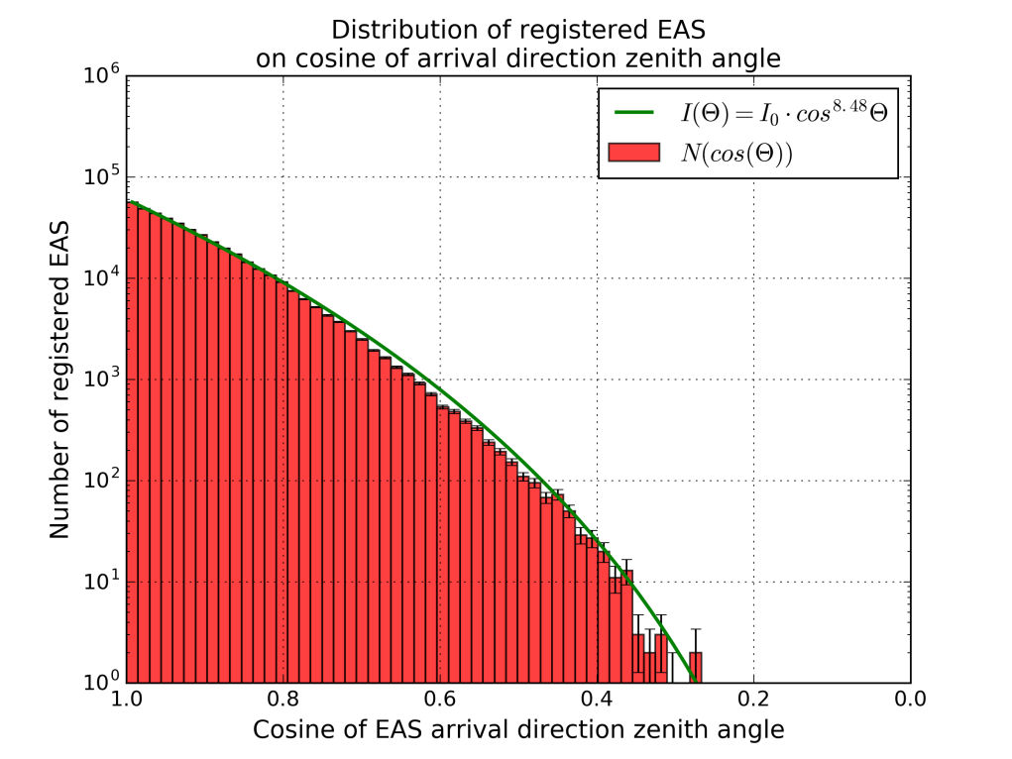
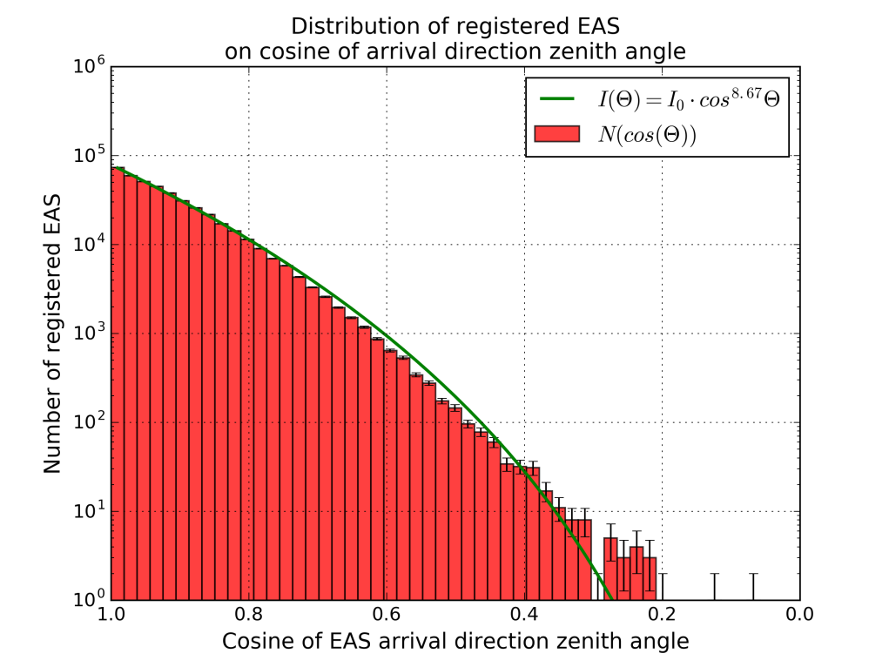
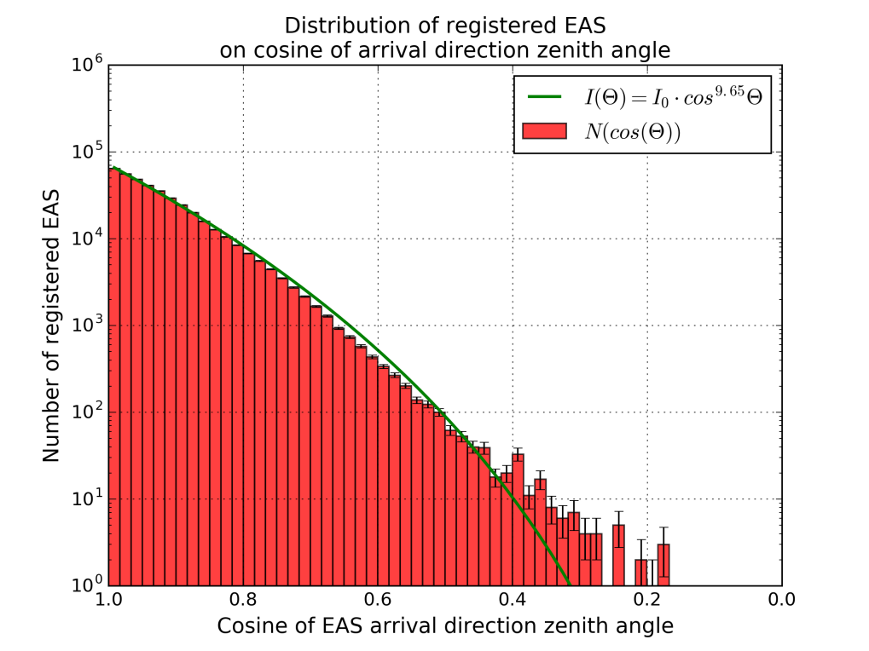
Reconstruction of EAS arrival direction
Cluster 1
α ~ 8.5
Cluster 2
α ~ 8.5
Cluster 3
α ~ 8.7
Cluster 4
α ~ 9.7

Slide 12
Example of joint event:
NEVOD-EAS (27.05.2016 3:09:26)
Cluster No.3 on the roof of the NEVOD-DECOR building
θ = 28.8°
φ = 149.4°
θ = 33.1°
φ = 143.7°
θ = 29.5°
φ = 146.5°
θ = 26.9°
φ = 139.9°

Slide 13
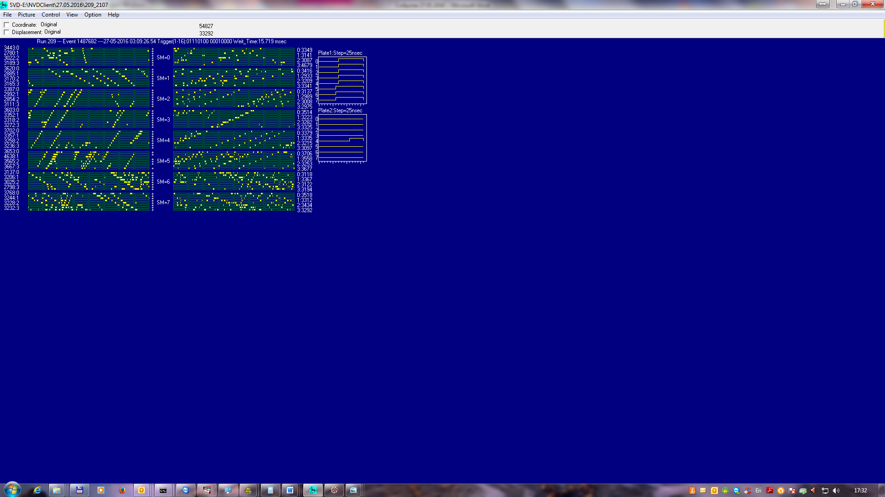
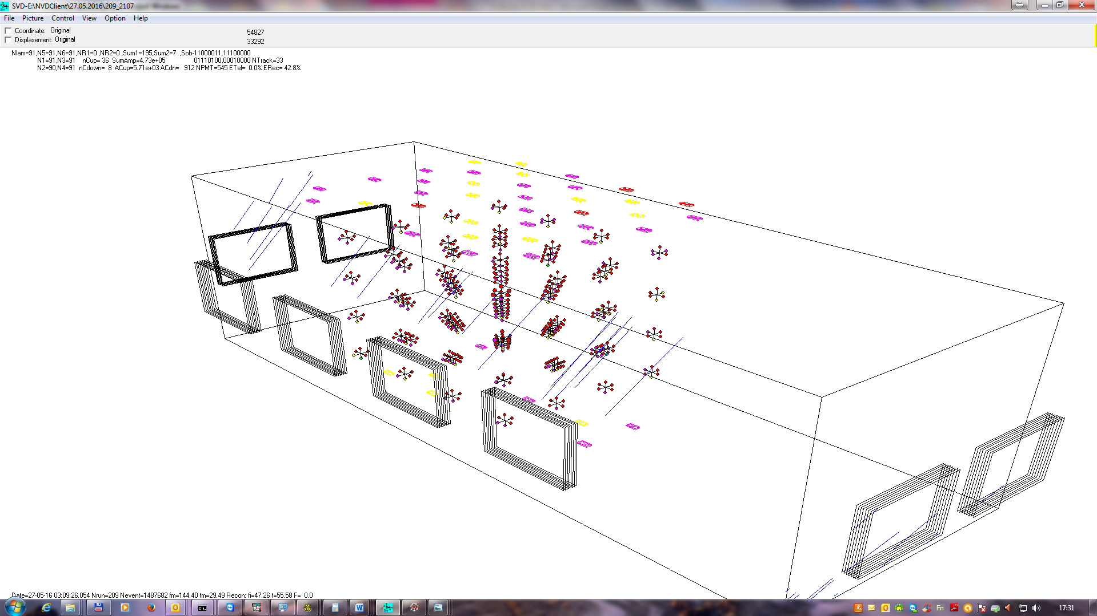
Example of joint event:
NEVOD-DECOR-CTS (27.05.2016 3:09:26)
NEVOD-DECOR-CTS
θ = 29.49°
φ = 144.40°
NEVOD-EAS
θ = 29.5°
φ = 146.5°

Slide 14
Conclusion
The central part of the NEVOD-EAS cluster type shower array which includes 4 clusters located at the area of about 10⁴ m² has been created and started.
A series of measurements with a duration of 49 days has shown:
1) characteristics of 4 clusters of the NEVOD-EAS central part are quite similar;
2) the possibility of using of cluster approach to the reconstruction of EAS parameters has been proved;
3) the accuracy of EAS arrival direction reconstruction is, at this stage, about 4° and will be improved with an increase of number of clusters.
Our plans:
2016
2017–2020
- start of operation of the 1st stage of the NEVOD-EAS peripheral part (+ 5 clusters, total area ~ 2×10⁴ m²)
- start of operation of the 2nd stage of the NEVOD-EAS peripheral part (total area ~ 0.2 × 10⁶ m²)

Slide 15
Thank you for attention!

