Slide 1
Neda: detecting neutrons in experiments with exotic nuclei at spes facility
B. DE CANDITIIS¹, E. VARDACI¹, J. VALIENTE², V. MODAMIO², G. JAWORSKI²
¹Dipartimento di Fisica “E. Pancini”, Università degli Studi di Napoli “Federico II” and INFN Sez. di Napoli, Napoli, Italy
²Laboratori Nazionali di Legnaro, Legnaro (PD), Italy

Slide 2
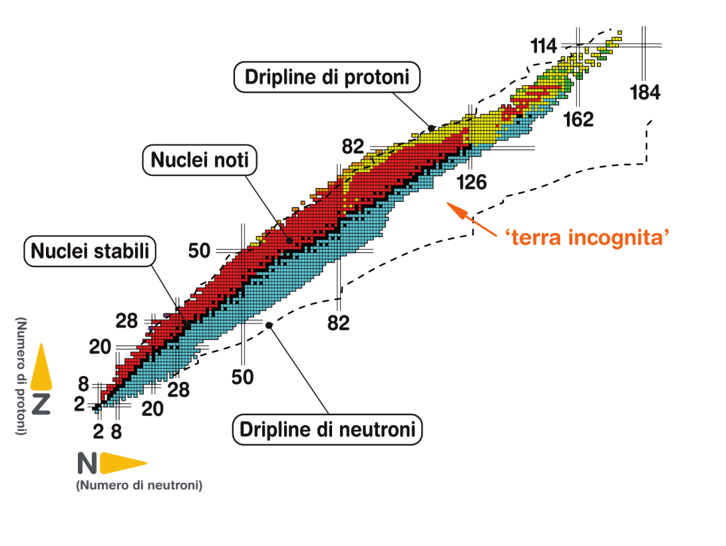
Selection of the neutron channel…
… for an improved gamma-to-background ratio
$$A+B→C^{∗}→C+n+γ+c.p.$$
AN EXCELLENT NEUTRON DETECTION EFFICIENCY IS MANDATORY FOR STUDIYNG PROTON RICH NUCLEI
Multi-neutron channel selection
Discrimination from different kind of radiation
Signal-background discrimination

Slide 3
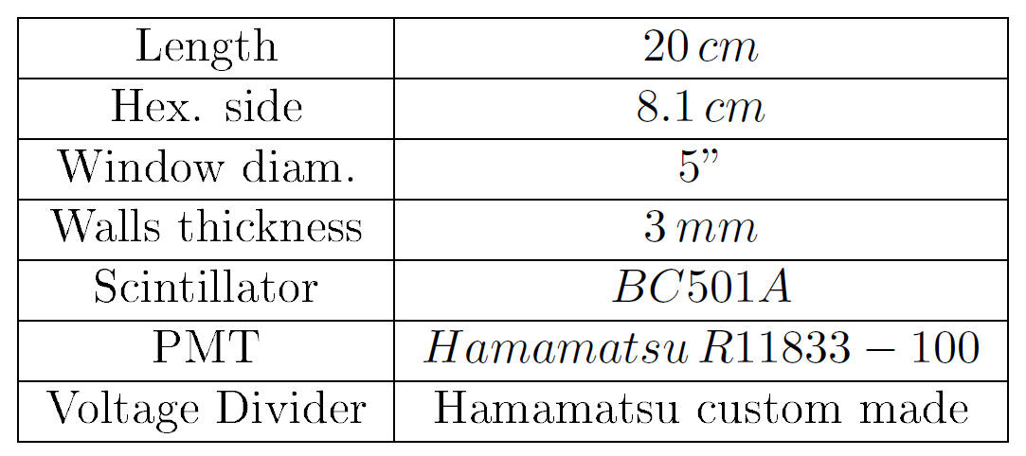
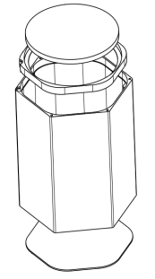
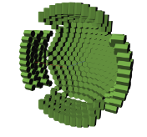
The neda array
CELL
PMT

Slide 4
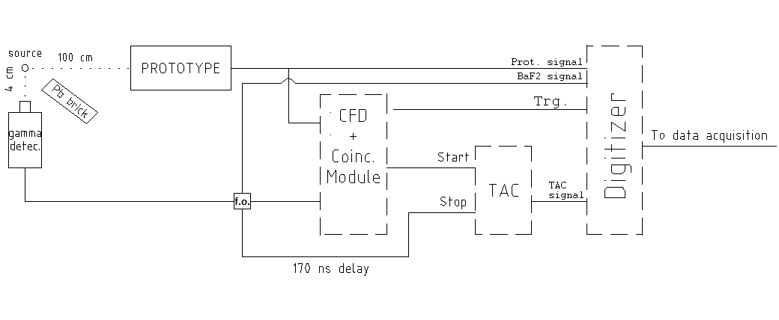
Setup and tests
252Cf
SOURCE
500Mhz, 12 bit
DIGITIZER
TRG: (n-γ),(γ-γ) COINCIDENCES
PHOTOELECTRON YELD
SIGNAL SHAPE ANALYSIS
DISCRIMINATION POWER EVALUATION WITH CHARGE COMPARISON AND INTEGRATED RISE TIME ALGORITHMS
TIME OF FLIGHT ANALYSIS(TOF) AS FURTHER DISCRIMINATION METHOD
COMPARISON OF THE RESULTS WITH A CILINDRICAL 5″×5″ CELL COUPLED TO THE SAME PMT

Slide 5
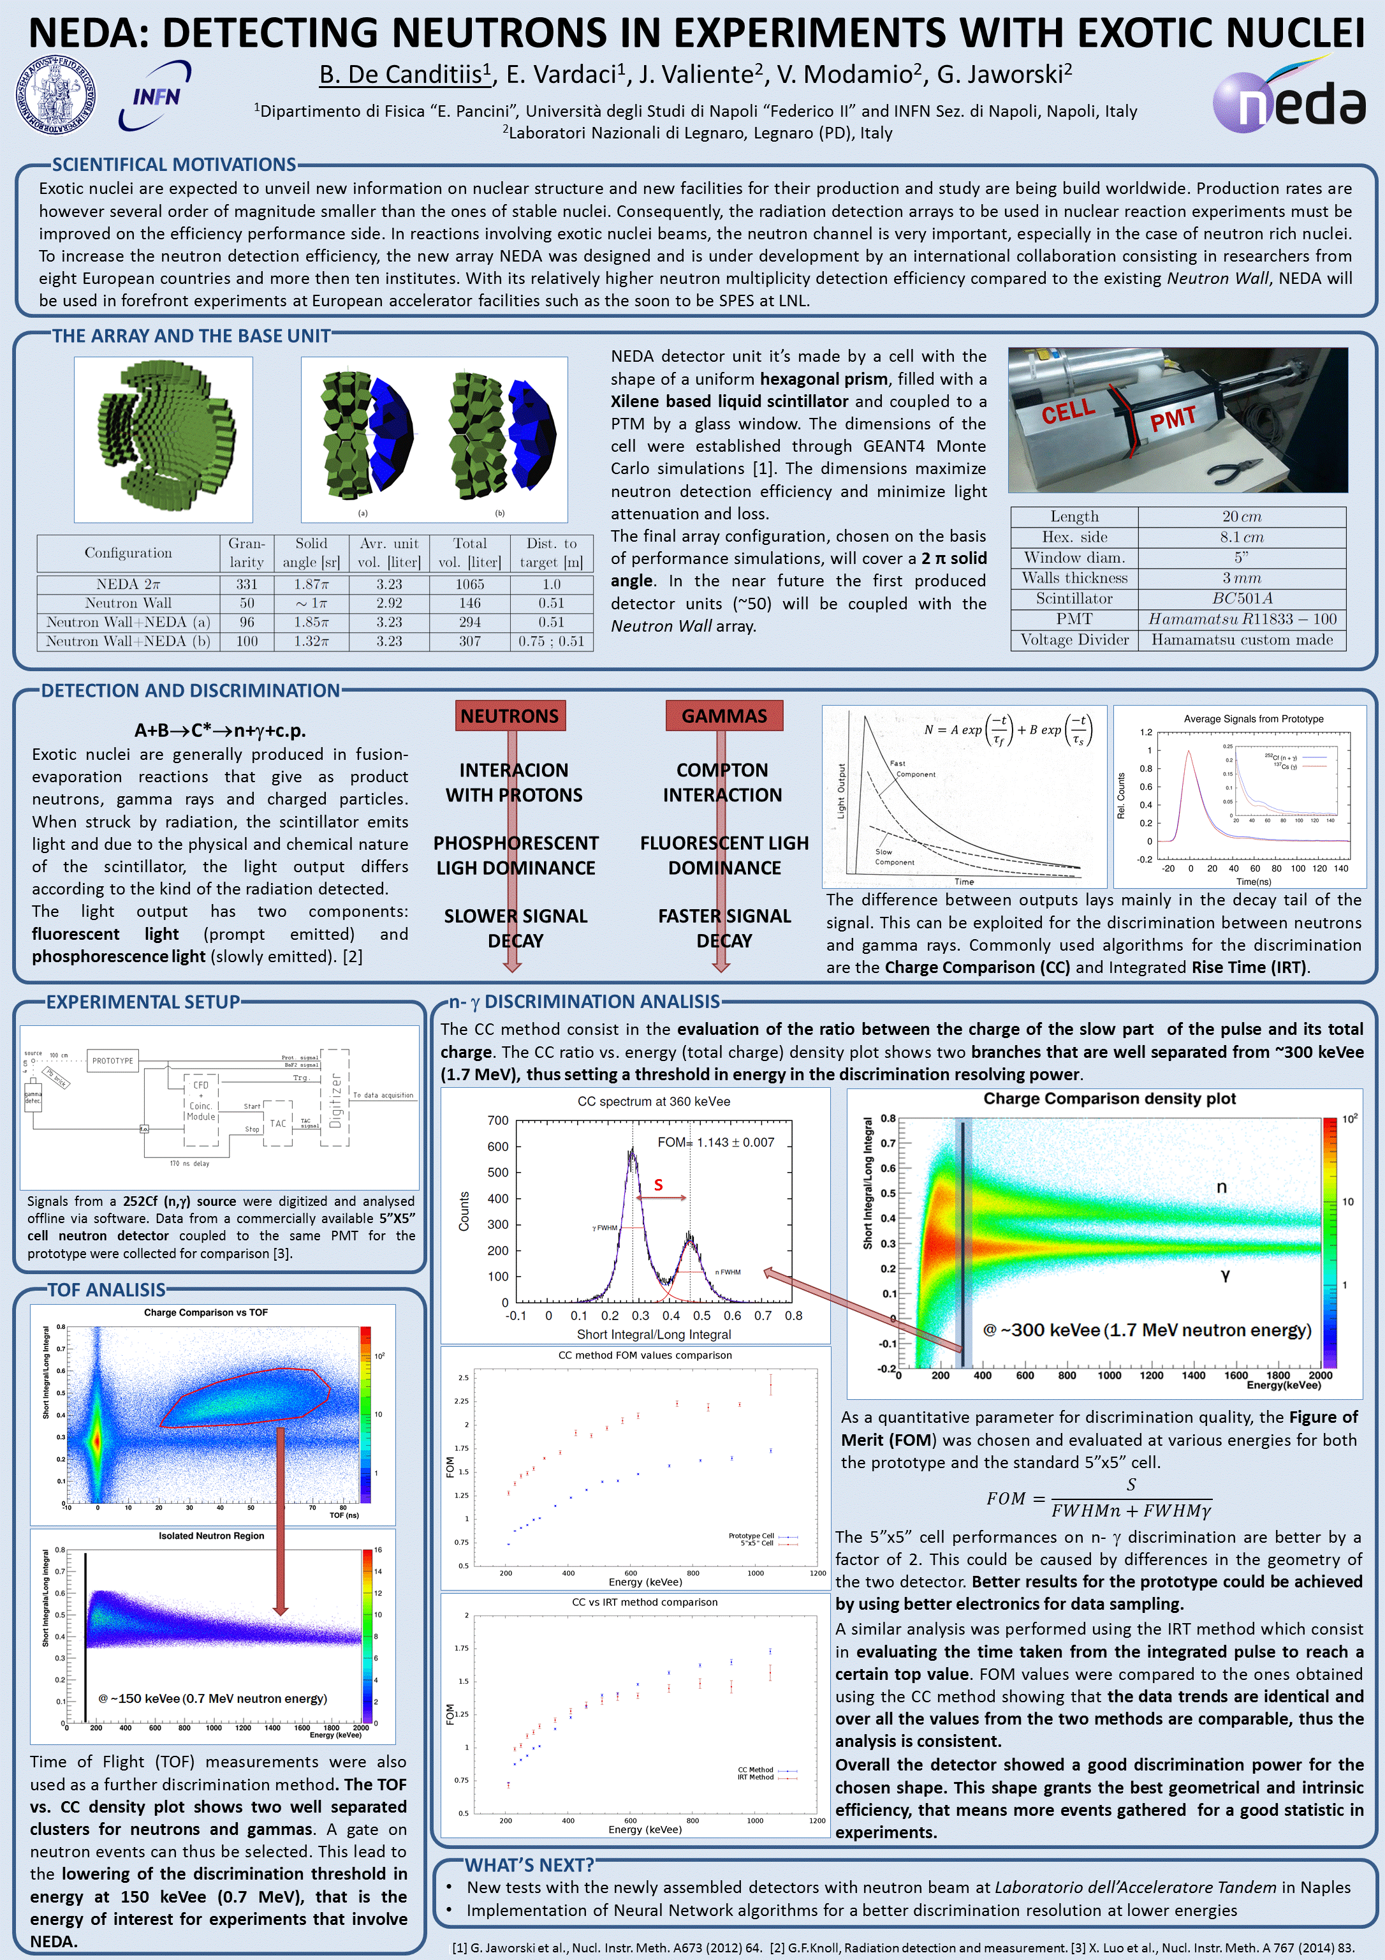
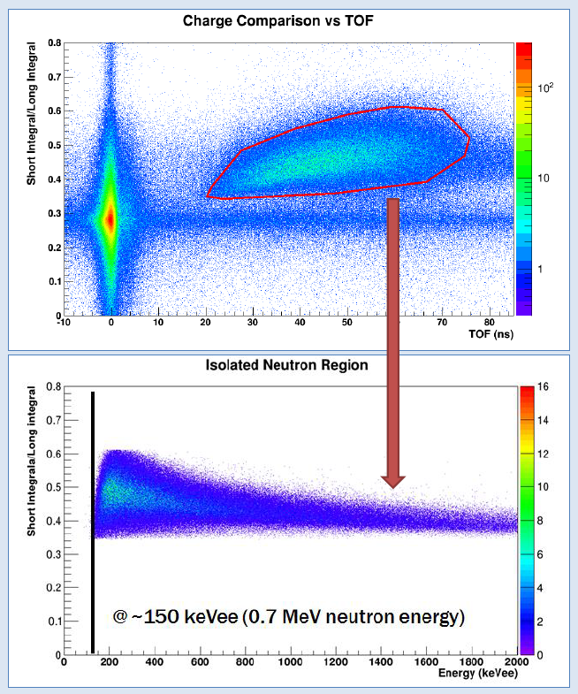
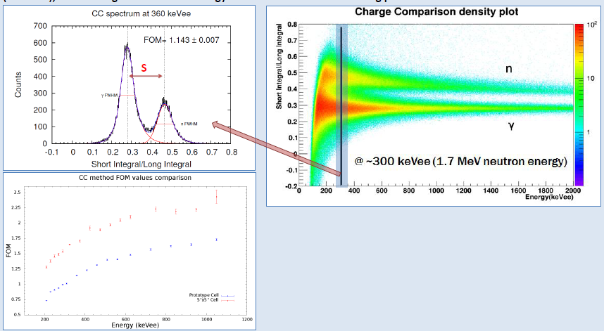
The poster

