Slide 1


A self-consistent multiphonon approach to spectroscopic properties of even and odd nuclei
G. De Gregorio
Università di Napoli Federico II
INFN
In Collaboration with
N. Lo Iudice, Univ. Federico II & INFN Napoli
F. Knapp Charles University (Prague)
P. Veselý NPI Řež ( Prague)
INFN 2016

Slide 2
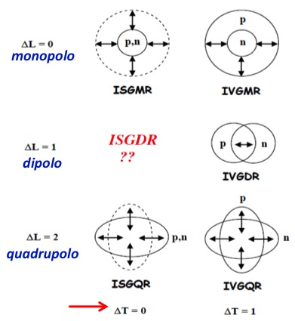
Collective Modes
ISGMR
IVGMR
ISGDR
IVGDR
ISGQR
IVGQR

Slide 3
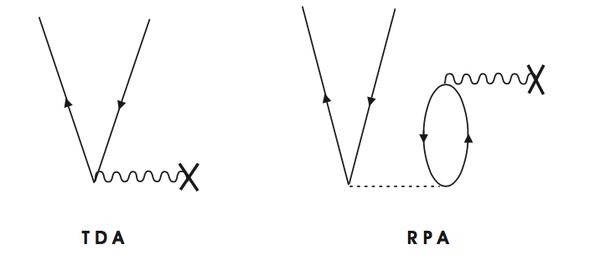
Theoretical description of collective motion
Semiclassical
Microscopic (Harmonic appriximation)
mapping
TDA
| λ >=O_{λ}† | HF >
O_{λ}† = Σ_{ph} c_{ph}(λ) a†_{p} a_{h}
RPA
| λ >=O_{λ}† | 0_{corr} >
O_{λ}† = Σ_{ph} [X_{ph}(λ) a†_{p} a_{h} – Y_{ph}(λ) a†_{h} a_{p}]

Slide 4
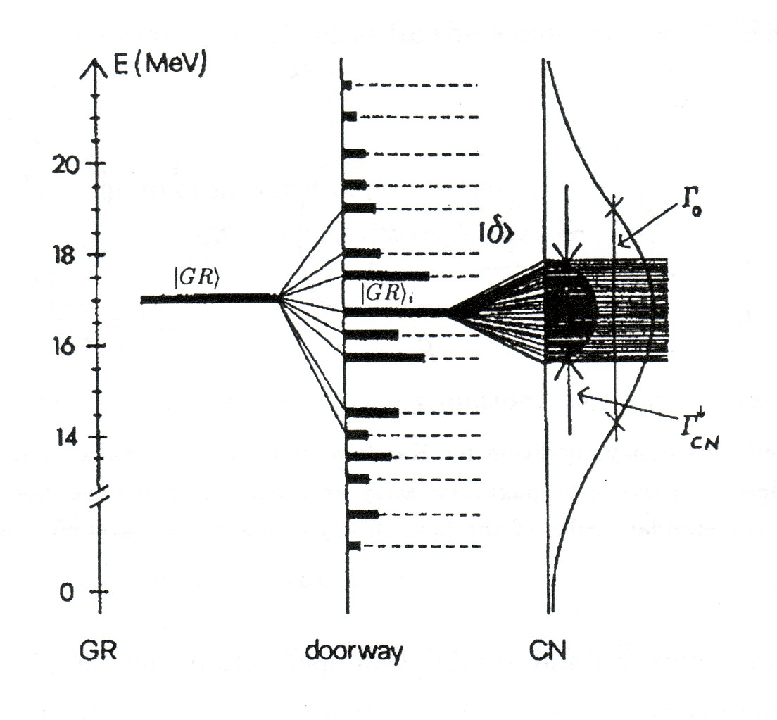
Collective modes: anharmonic features
Landau Damping
Collisional damping: Beyond RPA
TDA or RPA
From P.F. Bortignon, A. Bracco, R.A. Broglia,
Giant Resonances (hap, 1998)

Slide 5
Equation of Motion Phonon Method
Main Goal: Generating n-phonon basis (n=0,1,2,…)
O_{λ}† = Σ_{ph} c_{ph}(λ) a†_{p} a_{h}
TDA
How: EoM
TDA
EoM
Problem: |α_{n}> redundant
<α_{n’}|α_{n}> = δ_{nn’} δ_{αα’}
Solution: Cholesky
Full eigenvalue problem {|α_{n}>} (n=0,1,2,…)
<Ψ_{ν}| Ψ_{ν′} > = δ_{νν′}

Slide 6
Features:
Pauli principle fully accounted
Holds for an Hamiltonian of general form
No Approximations but allow for them naturally
Implementation:
Chiral Potential: NNLO_{opt}
Perform HF(B)
Generate (Q)TDA phonons (free of CM spurious admixtures)
Generate the (orthonormal) multiphonon basis {|α_{n}> }
Full diagonalization

Slide 7
Application : Dipole response in nuclei
PDR
GDR
1-5%
of EWSR
about 100%
of EWSR
Strength (a.u.)
5
10
15
Energy [MeV]

Slide 8
Dipole response in ¹³²Sn
δρ
PDR
GDR
δρ
ω
GDR
F. Knapp, et al., PRC 90, 014310 (2014)
P. Adrich et al., PRL 95 132501 (2005)
σ
PDR
ω

Slide 9
Dipole response in ²⁰⁸Pb
GDR
PDR
F. Knapp, et al PRC 92, 054315(2015)
GDR
PDR
Tamii et al., PRL 107 062502 (2011) , Crespi et al., PRL 113 012501 (2014)

Slide 10
Dipole response in ²⁰O
Quasi-particle formulation of the EMPM
GDR
PDR
G. De Gregorio, et al. Phys. Rev. C 044314 (2016)
E. Tryggestad, et al., Phys Rev. C 67, 064309 (2003).

Slide 11
Odd-even multiphonon basis
[H, O_{λ}† ] [H, a†_{p}]
EoM
< ν_{n} |[H, a†_{p}]|α_{n}>
n-phonon basis
|ν_{n}> = Σ_{pα} C^{ν}_{pα} a†_{p} |α >
<ν’|ν> = δ_{νν’}
Full Eigenvalue problem
Final wavefunction
|Ψ_{μ}> = Σ_{i} C^{μ}_{νi} | ν_{i} >

Slide 12
Dipole response in ¹⁷O and ¹⁷F
GDR
GDR
PDR
GDR
PDR

Slide 13
Concluding remarks
Even nuclei
Multiphonon configurations are needed for
describing the fine structure of the GDR
generating a rich low-energy 1⁻ spectrum
studying the detailed structure of the PDR
Odd nuclei
•One- and two-phonon states enhance greatly the density of levels at high-energy.
Three-phonon states play a crucial role, through their coupling to one-phonon states,
a) shift downwards their energies
b) increase the density of levels at low-energy
c) shift the peak of the cross section towards the experimental region
d) reproduce roughly the pygmy resonance

Slide 14
Thank you

Slide 15
Application: ¹⁷O spectra

Slide 16
Application: ¹⁷F spectra

Slide 17
Mean Values and transitions
Nucleus | Obs. | HF | EMPM | Exp¹
¹⁷O | μ (nm) | -1.9130 | -1.833 | -1.893
 | Q(barn) | 0 | -0.00841 | -0.025
 | B(E2; 5/2⁺₁ ->1/2⁺₁ ) (e²fm⁴) | 0 | 0.17 | 2.18
¹⁷F | μ (nm) | 4.79 | 4.62 | 4.72
 | Q(barn) | -9.94 | -7.60 | 5.8
 | B(E2; 5/2⁺₁ ->1/2⁺₁ ) (e²fm⁴) | 48.79 | 21.89 | 21.64
¹⁷F -> ¹⁷O + β⁺ | _{log(ft)} | 3.294 | 3.391 | 3.358
¹ Tilley D. R. et al., Nucl. Phys. A 564 (1993)

Slide 18
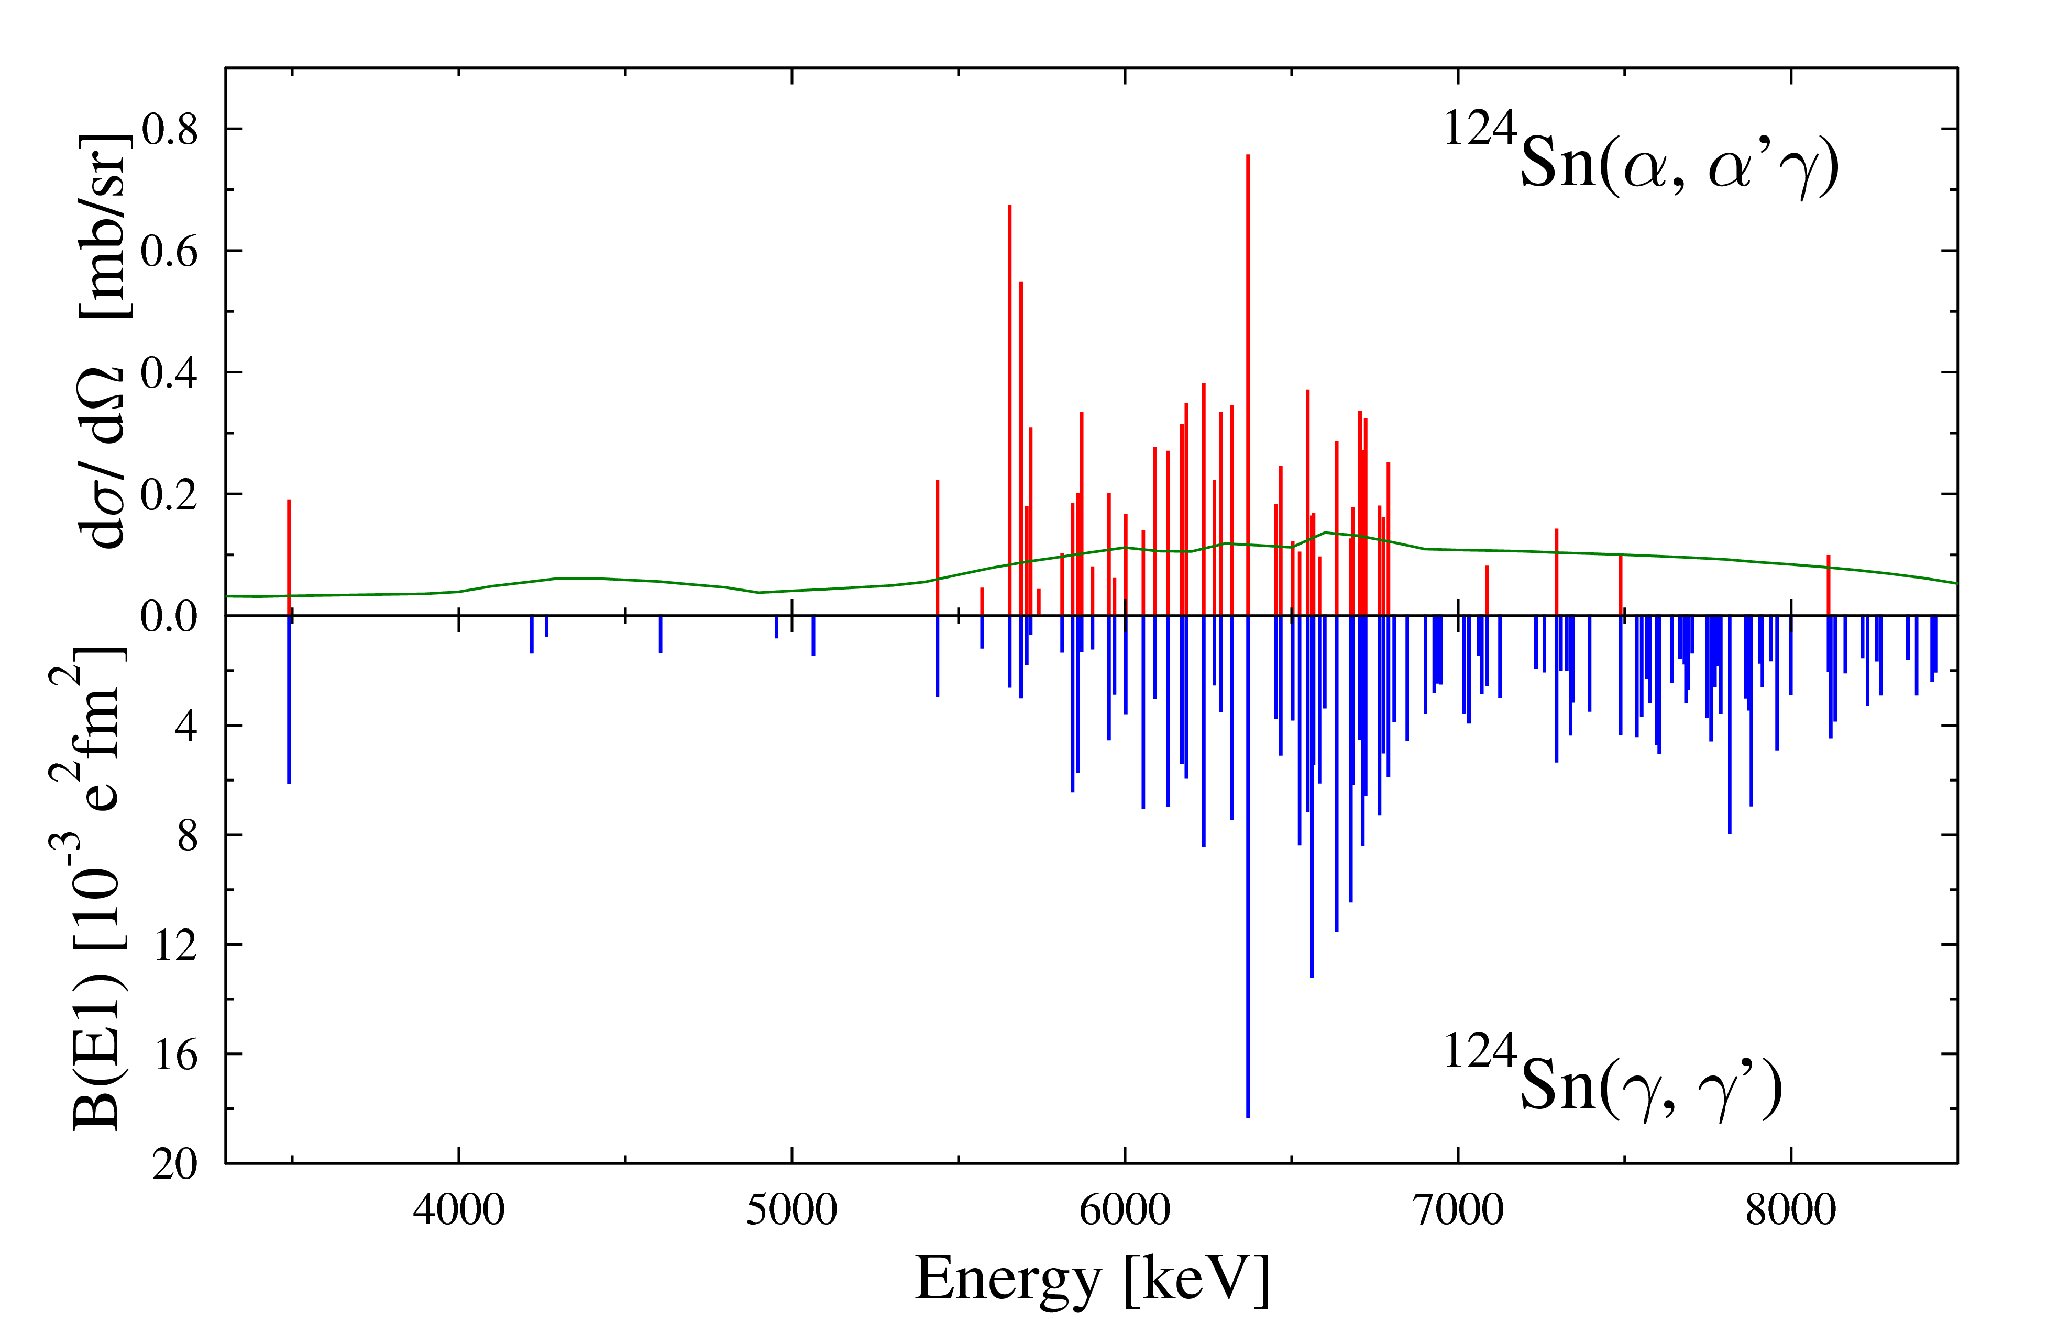
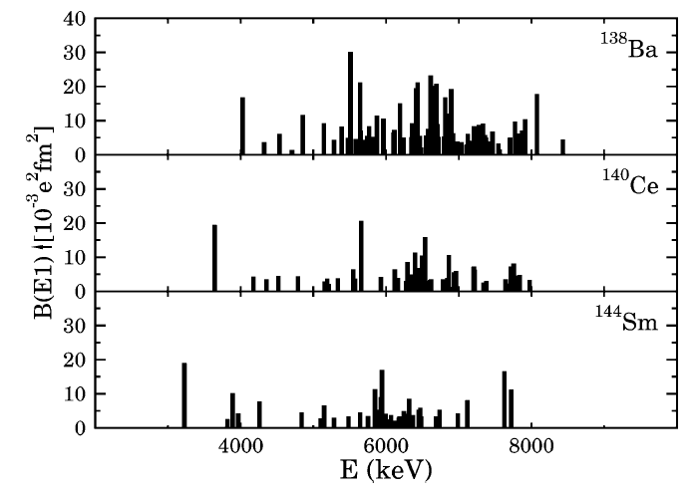
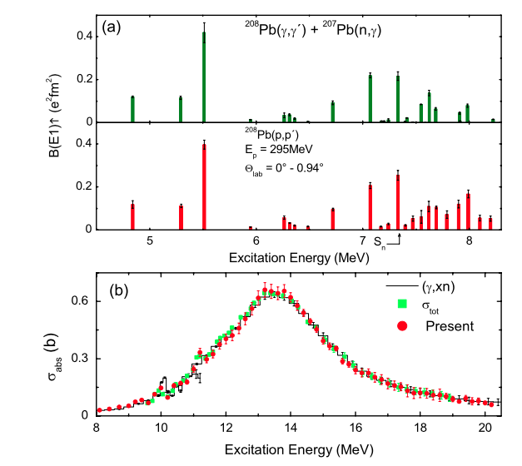
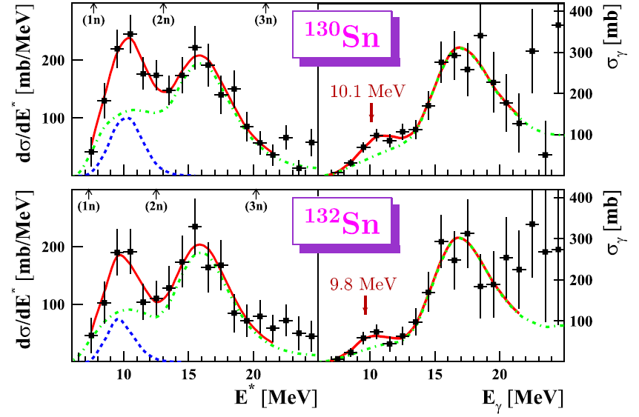
Dipole response in nuclei: Experiments
(γ,γ‘)
Radioactive Nuclei: Coulomb Exc.
Zilges et al. Phys. Lett. B 542 (2002) 43
Endres et al PRC 85 064331 (2012)
For a review
D. Savran, T. Aumann, A. Zilges
Progress in Particle and Nuclear Physics 70 (2013) 210
P. Adrich et al., PRL 95 (2005) 132501
Tamii et al., PRL 107 (2011) 062502

Slide 19
GDR
pygmy

