Slide 1









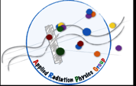

Radio-Guided-Surgery: status and perspectives
R. Faccini
University “La Sapienza” and INFN Rome
Incontro Nazionale Fisica Nucleare 16/11/2016
Chirone→ Chir2
http://arpg-serv.ing2.uniroma1.it/arpg-site/index.php

Slide 2
Overview
Radio-Guided Surgery(RGS): basic concepts
γ probes – briefly
β⁺ probes
Novel development: β⁻ RGS

Slide 3
Radioguided surgery

Slide 4
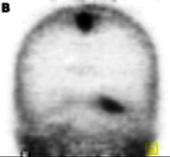
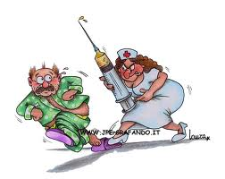
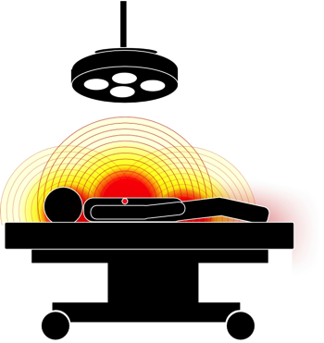
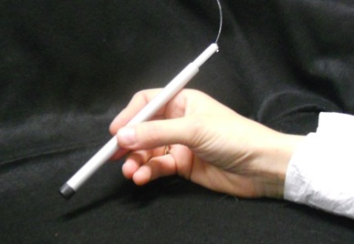
Radio Guided Surgery
PET/SPECT scan to estimate receptivity and background
Each tumor requires its own tracer
During surgery a probe is used to detect residuals/lymphnodes
Administration of radio-tracer
Probe adjustable to needs

Slide 5
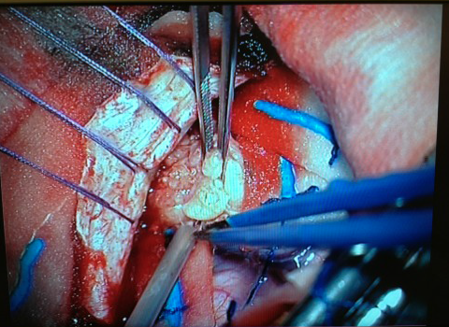
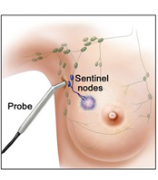
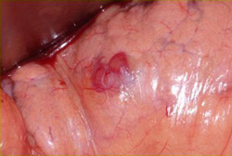
Intra-operative probes
Needed when
  Complete Tumor resection is mandatory
    example: brain, pediatric tumors
  Identification of lymph-node is needed
    Example: breast tumor, melanoma
  Tumor identification can reduce invasiveness
    Example: parathyroid adenoma, insulinoma,…
Notes:
PANCREAS

Slide 6
Critical Aspects
Identification of clinical applications
Choice of the radio-nuclide
Identification of tracer and its match with the radio-nuclide
Probe design
Tests

Slide 7
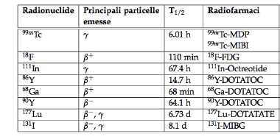
Possible radio-nuclides
Already tested nuclides include
SPECT
PET
Molecular RT

Slide 8
Radioguided surgery: γ probes

Slide 9
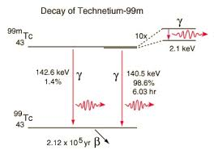
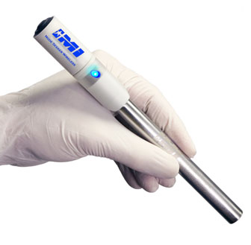
Existing: gamma probes
Choice of radio-nuclide: gamma emitting, in particular ^{99m}Tc
- well known detectors (camera or probes)
- used for SPECT: large number of known radio-tracers
Applications of interest:
  Search for tumor residuals (colon cancer, parathyroid adenoma, osteoid osteoma)
  Complete sentinel-node mapping (malignant melanoma and breast cancer)

Slide 10
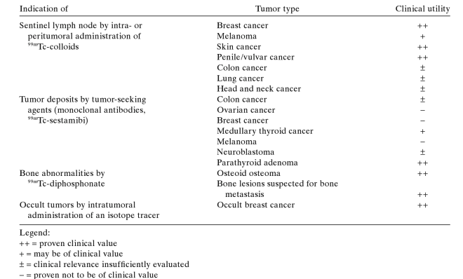
Gamma probes applications
TARGET
TUMOR
UTILITY
Local non-specific tracers
Systemic administration
Mariani, Giuliano, Strauss 2004

Slide 11
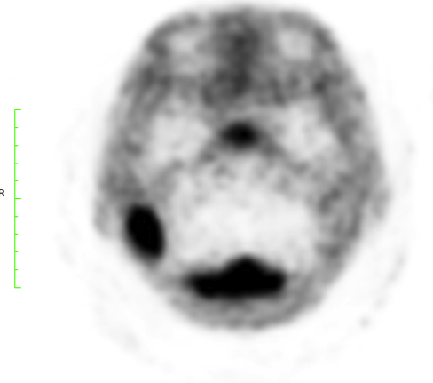
LIMITS OF γ-RGS
140 keV photons
➔ attenuation in body ~8cm
Long range of gamma’s involve:
  exposure of medical personnel
  Background from healthy organs
Difficult to apply in:
Brain tumors
Abdominal tumors
Pediatric tumors
probe

Slide 12
Radioguided surgery: β⁺ probes

Slide 13
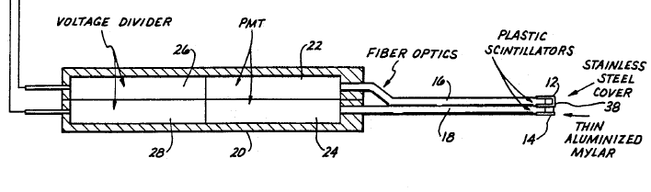
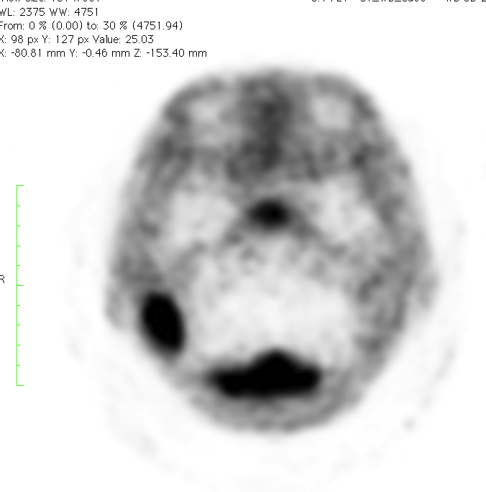
β⁺ RGS
Daghighial et al 1994
Raylman et al 2001
Use of β⁺ decaying isotopes (same as PET) ➔ detect positron (little penetration)
Dual detectors for gamma background subtraction
Two channels:
one sensitive to both positrons and gamma (14) (N1=P+G)
one sensitive only to gamma (12) (N2=G)
signal=N1-N2
γ
e+ (signal)
probe

Slide 14
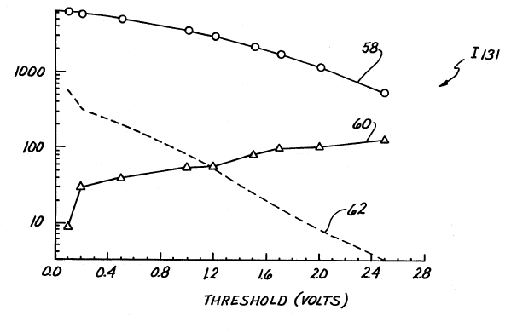
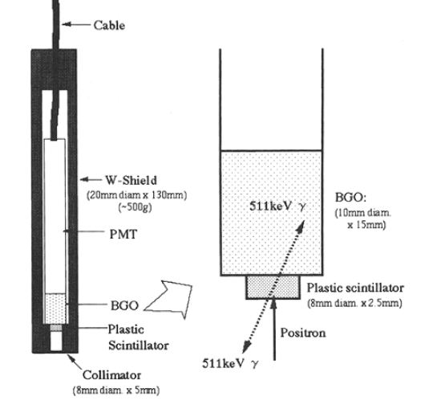
β⁺ RGS: developments
Tests with point-like source
1994 Daghighian: two different detectors for beta and γ
2001 Raylman: integrated dual-detector with semi-conductor devices
2005 Yamamoto: plastic+BGO phoswitch
No shielding
Shielded against β
ratio

Slide 15
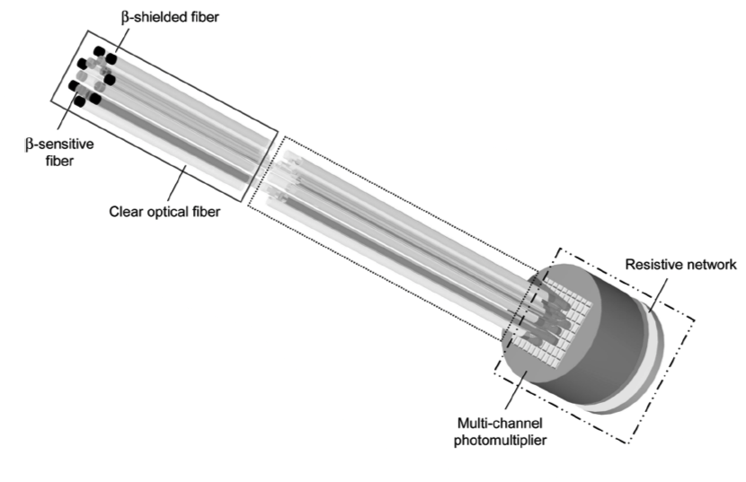
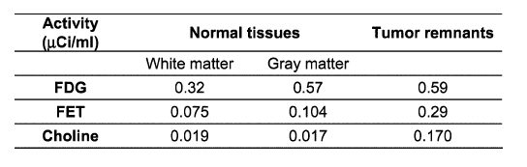
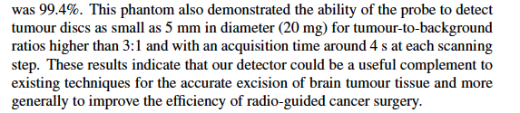
β⁺ RGS: clinical applications
Brain tumors: difficult use of pre-operative information
2007Bonzom et al :
  attach it to the surgical device
  Different tracers considered to carry ¹⁸F
2009 Bogalhas et al:
  Test on phantom
Conclusions

Slide 16
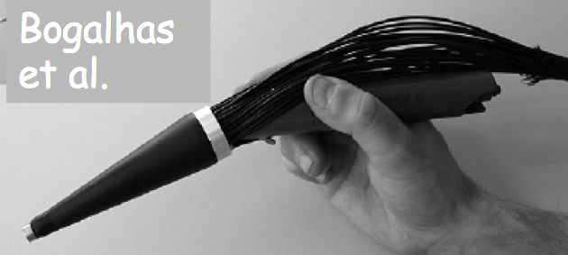
β⁺ RGS
Use of β+ tracers(positrons): pros
  Detect positron that travels ~100 times less
  PET tracers can be used
Use of β+ tracers: cons
  Large irradiation of medical personnel (~20 μSv/hr)
  Positrons annihilate and produce photons → background → need to subtract background
        Longer time to have a response
        More encumbrant detector

Slide 17
Radioguided surgery: β⁻ probes

Slide 18
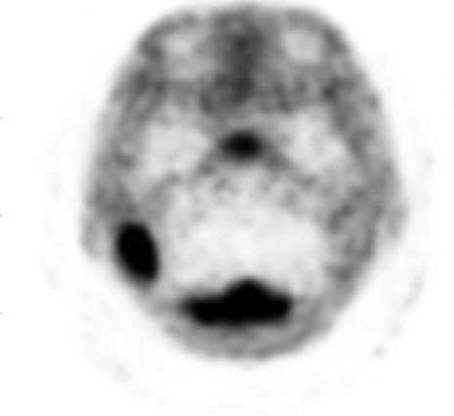

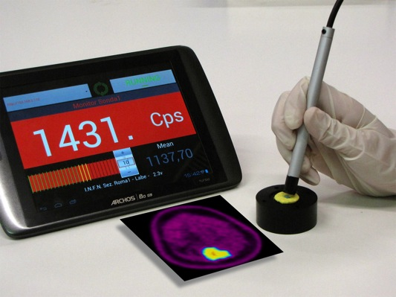
A CHANGE IN PARADIGM
Use of β⁻ tracers (electrons): pros
  Detect electrons that travel ~100 times less than γ
  Tracers with ⁹⁰Y can be used (already used for Molecular RT)
  No background from gamma
      Shorter time to have a response
        Smaller administered activity
      Smaller and more versatile detector
      Very reduced effect of nearby healthy tissues
      Reduced dose to medical staff
E. Solfaroli Camillocci et al, Sci. Repts. 4,4401 (2014)
e⁻ (signal)
probe
EXTEND RGS TO MORE CLINICAL CASES
Notes:
brevetto!?

Slide 19

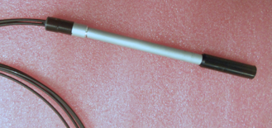
RESEARCH PATH
Probe Prototypes

Slide 20
Low energy e- detector
p-terphenyl as scintillator
  High signal:
    LY(pterf)=3LY(Anthracene)
  Low Z
    Low sensitivity to photons
  Small attenuation length
    λ=(4.73 ± 0.06) mm
scintillator
γ
e⁻
Light sensor
2mm
Usually unused because signal attenuates if detector too thick
→ Not for low energy electrons
Note: also in case of pure β- emitters gamma rejection is important because of brehmsstrahlung
R. Faccini et al, Properties of P-Terphenyl as detector for α, β, and γ radiation, IEEE Trans. on Nucl. Sci. 2014; 61: 1483-7

Slide 21
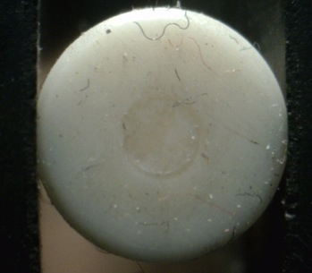
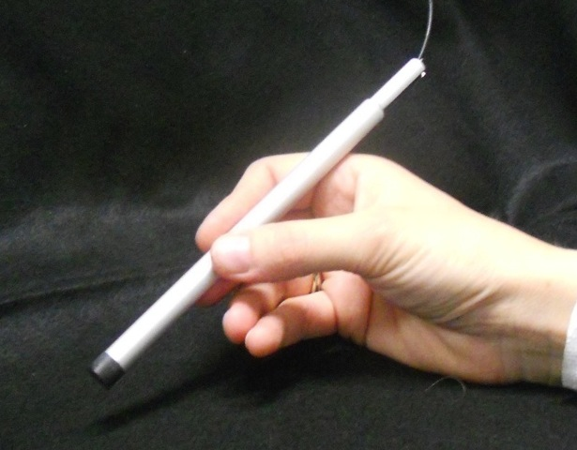
Prototypes
Core: cylindrical scintillator of p-terphenyl d=2.1mm, h=1.7mm
encapsulated into a PVC ring to shield it against radiation coming from the sides;
inserted as a tip inside an easy handling aluminum body.
A thin black PVC cap makes the enclosure light tight.
Two options for light collection:
  Scintillating fiber and PMT
  SiPM (SensL B/C-series)
CORE
2.1mm
7mm
PMT
PVC
14cm
Optical fiber
1cm
0.4mm thick PVC layer in front
Constraints on medical devices apply

Slide 22
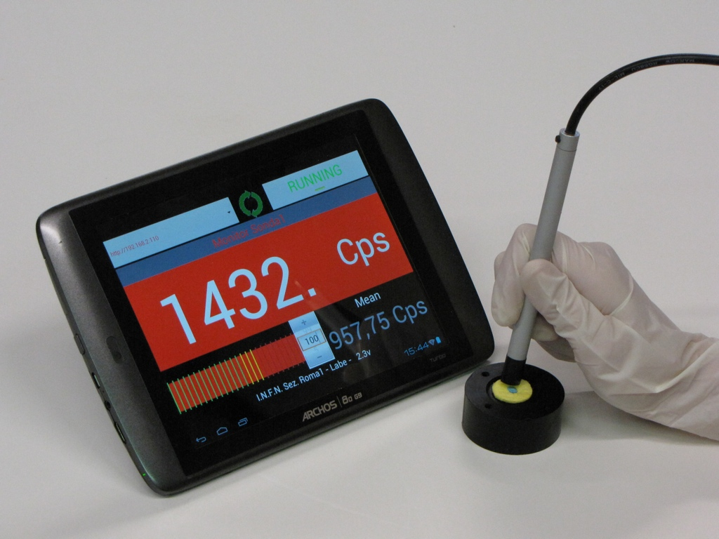

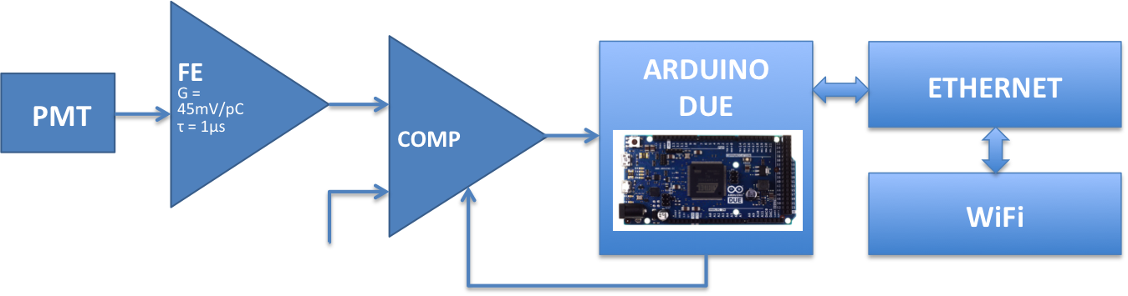
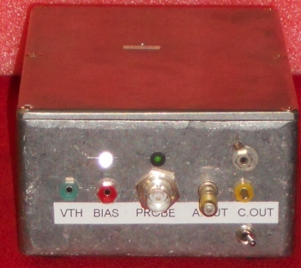

Electronics Read-out
ARDUSiPM
LABE-INFN RM1
Electronics read-out is portable and customized to match the surgeon needs
acoustic and visual alarm;
wireless data transfer;
no connection with electrical line (bacteries)
user interface available both for PC or tablet.
No Danger of electric discharge on patient

Slide 23
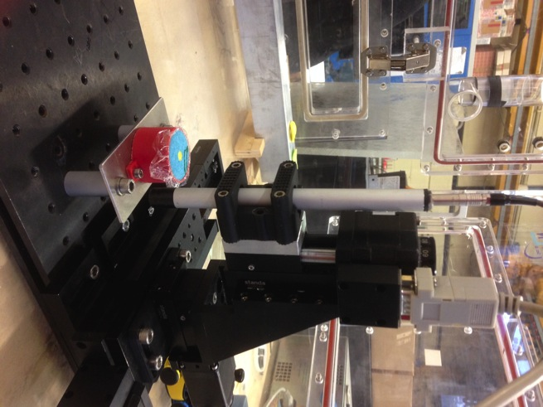
RESEARCH PATH
E. Solfaroli Camillocci et al, J. Phys.: Conf. Ser. 620 012009(2015)
Probe Prototypes
Lab tests (phantom factory)
Measure spatial sensitivity
Gamma rejection
Estimate performances on phantoms
Estimate dose on surgeon
Estimated dose on surgeon administering 3MBq/kg:
  1μSv/hr on surgeon’s hands
  0.13 μSv/hr on medical personnel
23

Slide 24
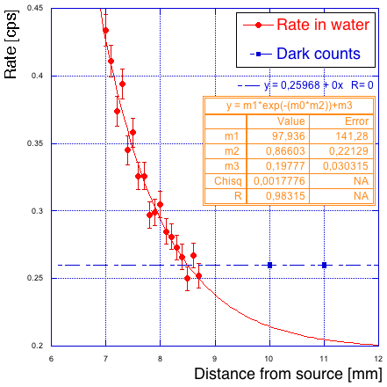
Sensitivity to Electrons
Scan with different thicknesses of water
Detection efficiency on ⁹⁰Sr point source
  Rate 3.8·10⁵ cps/MBq.
  εβ=40%
Scan in water
  Eβ>500keV.
  Detection efficiency εβ>80% in the β⁻ ⁹⁰Y energy range.

Slide 25
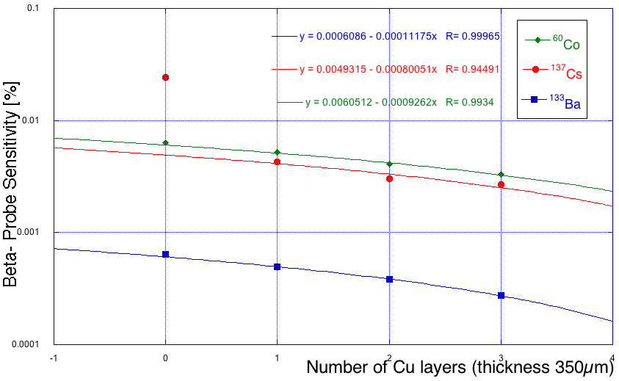
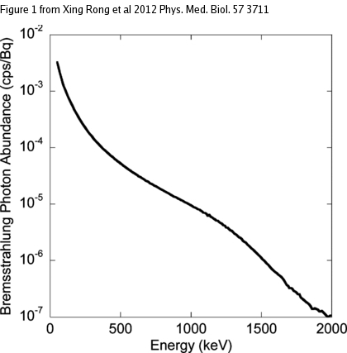
Background Rejection
Background is mainly due to photons coming from Bremsstrahlung.
Sensitivity to photons
Bremsstrahlung Eɣ spectrum
⁹⁰Y in water
⁶⁰Co Eɣ=1170, 1330KeV
¹³⁷Cs Eɣ=662KeV
¹³³Ba Eɣ=80-350KeV
ɛɣ<10⁻³
ɛɣ<10⁻²
Almost transparent to Bremsstrahlung photons.

Slide 26
“Ad-hoc” Phantoms
To simulate tumor remnant embedded in healthy tissue.
Motorized scans with S4-Probe
Tumor residual V=0.05ml
embedded in tissue with A/10
All the possible configurations of tumor residual embedded in healthy tissue.

Slide 27
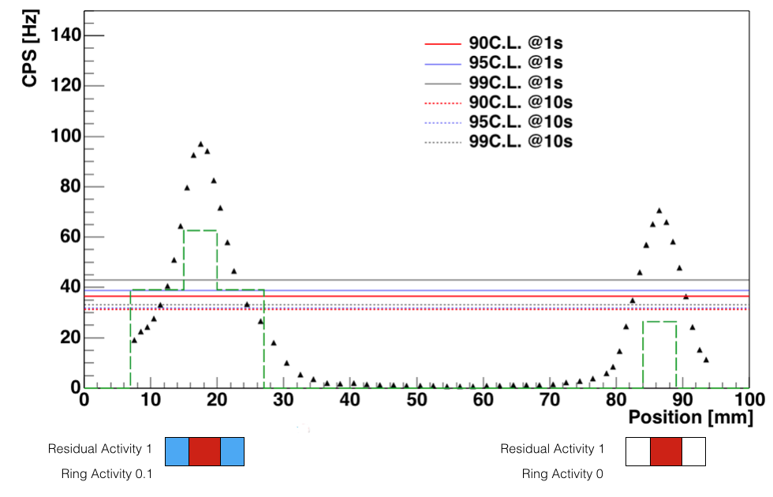
Active Spot Identification
False positive probability
TNR=10

Slide 28
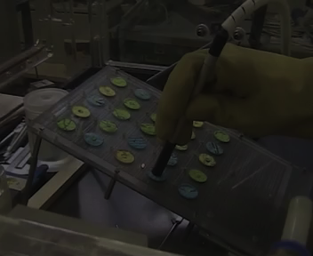
Human Factor
To include the human factor in the test colleagues were asked to simulate the surgeon:
Phantoms simulating tumor remnants embedded in healthy tissue with different TNRs
All “surgeons” required at least 4-5 seconds per position to take a decision.

Slide 29
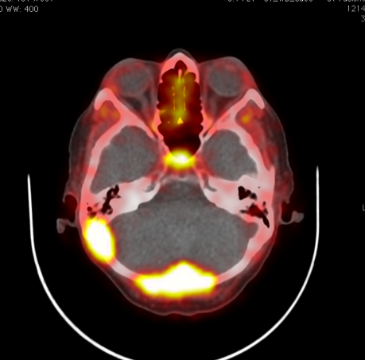
RESEARCH PATH
Start with existing radiotracers:
Somatostatine analogues marked ⁹⁰Y
Probe Prototypes
Lab tests (phantoms)
Identification of proof of principle
Meningioma is avid of ⁹⁰Y-DOTATOC
➔ Able to detect 0.1 ml residuals administering only 1MBq/kg
29

Slide 30
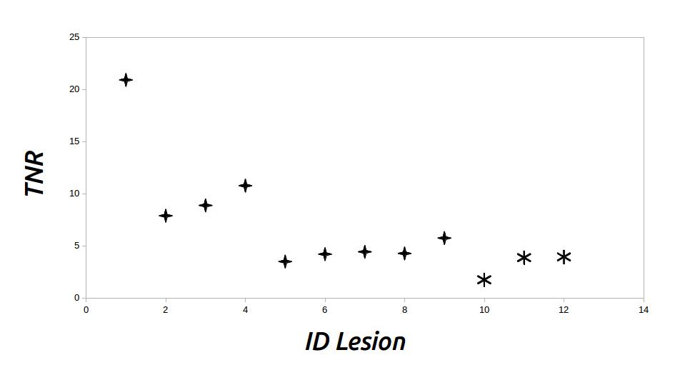
RESEARCH PATH
Start with existing radiotracers:
Somatostatine analogues marked ⁹⁰Y
Probe Prototypes
Lab tests (phantoms)
Identification of proof of principle
Estimate sensitivity from PET with ⁶⁸Ga
Identification of first clinical cases
First clinical cases:
Glioma (low and high grade)
GEP-NET (start from small bowel)
30

Slide 31
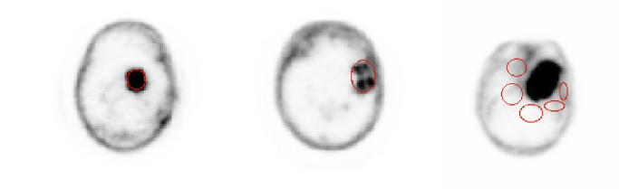
DOTATOC uptake in glioma
F. Collamati et al,. J Nucl Med 56 (2015) 3-8
DOTATOC is a somatostatin analog ➔ known receptivity from NET .. but glioma?
Even if TNR too low for therapy, can it be used for RGS?
Use 68Ga-DOTATOC PET scans to estimate signal and background
ROI definition
meningioma
HG glioma
Non-tumor

Slide 32
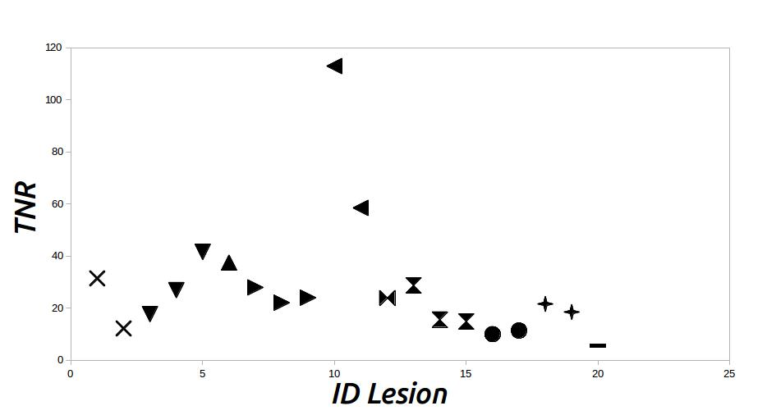
Glioma vs Meningioma
F. Collamati et al,. J Nucl Med 56 (2015) 3-8
meningioma
glioma
TNR
0 40 80 120
TNR
0 10 20
Meningioma has a definitely larger uptake, but is the glioma one acceptable?
Use FLUKA simulation to translate from activities to false positive (FP) and false negative (FN) rates
Consider a residual identified if FP<1% and FN<5%
TNR of glioma is acceptable if probe can take >~6s to give answer

Slide 33
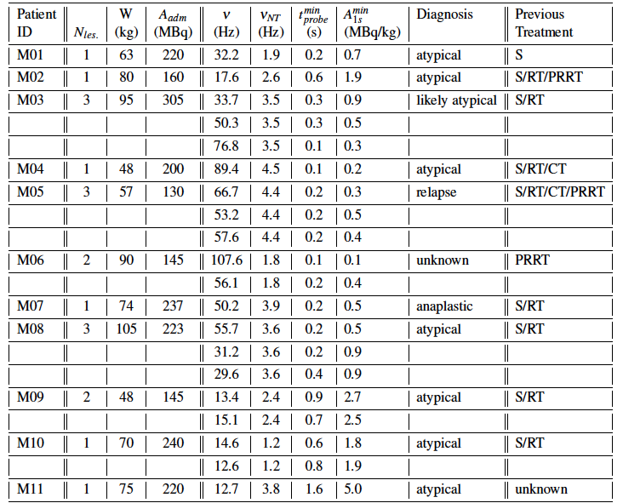
RGS for meningioma
*
**
Very large uptake
Can inject as low as 0.5 MBq/kg
* Time needed to detect 0.1 ml residual if 3MBq/kg are administered
** Activity that needs to be administered to achieve 1s response time

Slide 34
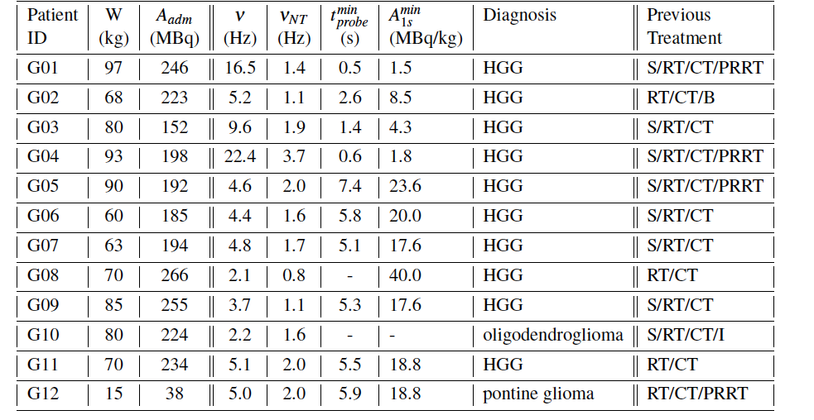
RGS for glioma
*
**
Needs to wait for ~6s, but it works
Margins to improve probe
* Time needed to detect 0.1 ml residual if 3MBq/kg are administered
** Activity that needs to be administered to achieve 1s response time

Slide 35
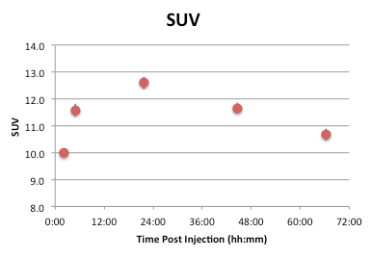
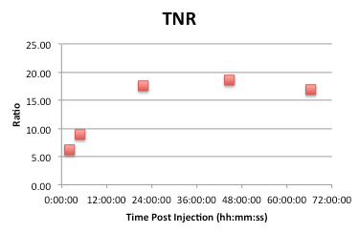
Time Evolution of uptake
F. Collamati et al,. J Nucl Med 56 (2015) 1501-6
Lab tests (phantoms)
Identification of proof of principle
TNR for liver NET vs time
Values estimated from dosimetric SPECTs with ¹⁷⁷Lu-DOTATOC
CONCLUSIONS:
GEP-NETs (small bowel, insulinoma, …) are a good candidate and similar among each-other
the best SUV and TNR are achieved if surgery is 24hrs after injection
35
Notes:
A similar clinical study was performed on SPECT images of patients with liver NET, allowing us to conclude that the TNR is good enough to perform B- RGS within 1 second per spot by injecting an activity that is one third of the one used for a PET.
In this study we also evaluated the variation in time post injection of the TNR of liver NET, finding it to reach a maximum at about 24h p.i., that thus represents in view of a possible protocol the best time lapse between the injection and the performing of RGS

Slide 36
RESEARCH PATH
Probe Prototypes
Lab tests (phantoms)
Identification of proof of principle
Identification of first clinical cases
We are here
Ex-Vivo tests on Meningioma
36

Slide 37
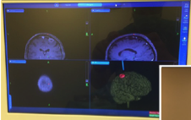
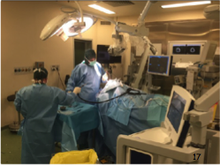
Ex-vivo test on meningioma
E. Solfaroli et al., submitted to JNM
PET with Ga68 on Sep 14th
  Tumor SUV ~2g/ml (relatively low, but enough)
  TNR ~ 14 (good)
8mCi Y90—DOTATOC on Oct 9th
Surgery on Oct 10th

Slide 38
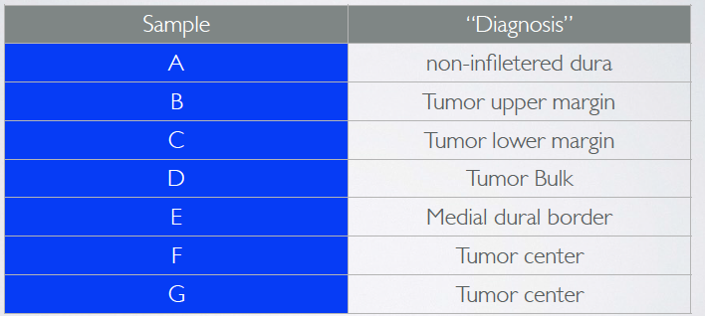
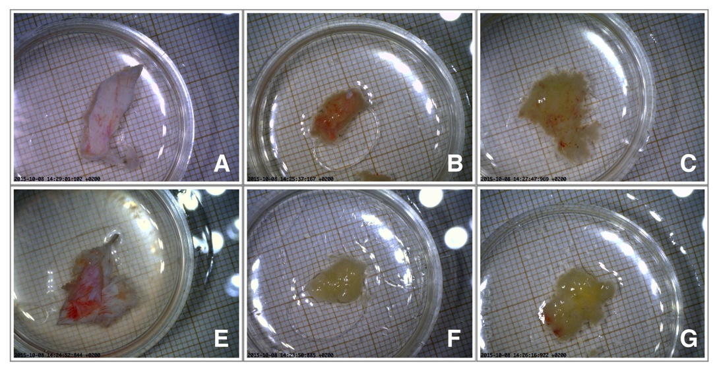
The
Samples
A
B
C
E
F
G

Slide 39
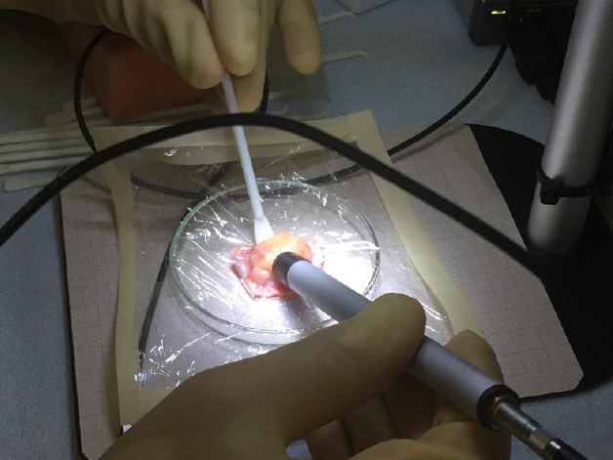
Evaluating the samples rate

Slide 40
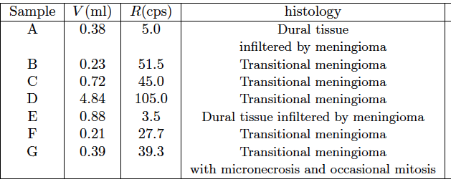
Results
E. Solfaroli et al, Physica Medica 32 (2016), pp. 1139-1144
Residuals as small as 0.2ml are visible
Predictions with simulation are reliable (115 cps predicted, 105 observed)
Healthy brain ~1cps (simulation) →also infiltrated dure can be identified
+ Confirmed very
low exposure of
medical personnell

Slide 41
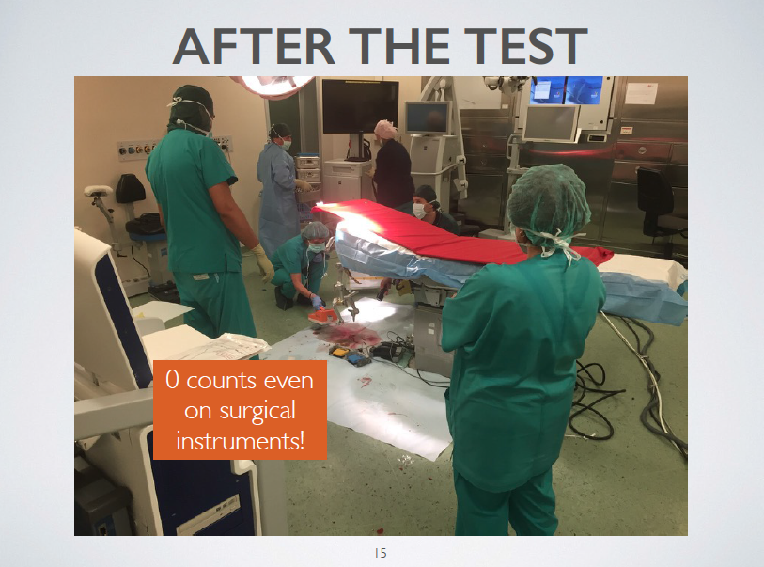
IRRADIATION MEASUREMENTS

Slide 42


Probe developments
CHIR2
Use CMOS technology to lower energy threshold (with INFN& Uni PG) → allow use of other isotopes
  Matrix design for basic “imaging”
Develop prototype for endoscopic (laparoscopy/Da Vinci …) use
  Multichannel design with p-terphenil

Slide 43
Radiotracers for
Radioguided surgery

Slide 44

γ-RGS: the Tc crysis
^{99m}Tc is produced from ⁹⁹Mo decays
Current production method
  Canada 50%, Netherland 40%
  + …
Need alternative methods
  ¹⁰⁰Mo(p,2n)^{99m}Tc [direct ^{99m}Tc production] → Canada
  ¹⁰⁰Mo(γ,n)⁹⁹Mo, ²³⁸U(γ,f)⁹⁹Mo →USA, Canada
  ⁹⁸Mo(n,γ)⁹⁹Mo → testing parent ⁹⁹Mo production
  ¹⁰⁰Mo(n,2n)⁹⁹Mo → testing (easier to implement)
Nuclear plants
being dismissed
Developments in accelerator physics required

Slide 45

β⁺ RGS: different isotopes
¹⁸F not the only tracer
Mean β⁺ energy critical parameter
Each tracer has different clinical applications
(87.9%)

Slide 46

β⁻ probe on β⁺ isotopes
Positron/γ separation with copper layers
Results scaled to 10kBq/ml
10 kBq/ml | ¹⁸F | ⁶⁸Ga
Counts no shield (e+γ) | 11.9±0.3 | 51.2±0.8
Counts with Cu shield (γ) | 3.0±0.1 | 1.7±0.1
Difference (e) | 8.9±0.3 | 49.5±0.8

Slide 47
β- RGS:
Other isotopes (I)
used in Nucl. Med.
Isotopes of those used in Nucl. Med.
Same chem family of those used in Nucl. Med.
C. Mancini-Terracciano et al., arXiv:1610.09246
Isotope | T_{1/2}(h) | E_{g}(keV) | I_{g}(%) | EP_{b}(keV) | I_{b}(%) | Use
¹⁸F | 1.8 | 511 | 200 | 633.5 | 97 | FDG, most tumors
²¹Si | 2.6 |  |  | 1491 | 100 | Same family as C (used in PET)
³²P | 343 |  |  | 1710 | 100 | Brain tumors [1]
⁶⁷Cu | 62 | 93/184 | 16/48 | 377/468/561 | 22/20/99 | Cu-64 in immuno-PET[3]
⁸³Br | 2.4 |  |  | 935 | 99 | Same family as F
⁹⁰Y | 64 |  |  | 2280 | 100 | NET & Brain tumors[1]
⁹⁷Zr | 17 | 743 | 93 | 759 | 88 | ⁸⁹Zr used in immuno-PET [2]
¹³¹I | 192 | 365/637 | 82/7 | 334/696 | 7/90 | Thyroid[1]
¹³³I | 20.8 | 530 | 87 | 1227 | 83.4 | Thyroid
¹⁵³Sm | 46 | 103 | 29 | 635/704/808 | 31/49/18 | Bone Cancer[1]
¹⁷⁷Lu | 160 | 112/208 | 6/10 | 500 | 79 | NET & Brain tumors[1]
¹⁸⁸Re | 17 | 155 | 15 | 1962/ 2118 | 25/72 | Bone & Liver [2] Cancer
[1] Review in Yeaong C.H. et al. J. Zhejiang Univ. SCIENCE B Vol.15 No.10 P.845-863 (2014)
[2] van de Watering F.C. et al. Biomed Res Int. 2014;2014:203601.
[3] Asabella A.N. et al. BioMed Res. Intl. 786463 (2014)

Slide 48
β- RGS:
Other isotopes (I)
* Time needed to detect a 0.1 ml residual with FN<5% FP<1% if 3MBq/kg are administered and SUV=4, TNR=8
Isotope | E_{g}(keV) | I_{g}(%) | EP_{b}(keV) | I_{b}(%) | T*_{min}(s)
¹⁸F | 511 | 200 | 633.5 | 97 | >25
²¹Si |  |  | 1491 | 100 | 0.4
³²P |  |  | 1710 | 100 | 0.3
⁶⁷Cu | 93/184 | 16/48 | 377/468/561 | 22/20/99 | >25
⁸³Br |  |  | 935 | 99 | 0.9
⁹⁰Y |  |  | 2280 | 100 | 0.5
⁹⁷Zr | 743 | 93 | 759 | 88 | 0.8
¹³¹I | 365/637 | 82/7 | 334/696 | 7/90 | >25
¹³³I | 530 | 87 | 1227 | 83.4 | 2.8
¹⁵³Sm | 103 | 29 | 635/704/808 | 31/49/18 | 3.1
¹⁷⁷Lu | 112/208 | 6/10 | 500 | 79 | >25
¹⁸⁸Re | 155 | 15 | 1962/ 2118 | 25/72 | 0.4
OK with current probe
High SUV and TNR required: improvements in γ rejection and energy threhold useful
Significant improvements in γ rejection and energy threhold required

Slide 49





β- RGS: alternative tracers with ⁹⁰Y
Synthesis of new radio-
tradiotracers (with ⁹⁰Y)
Monoclonal antibodies
(NIMOTUZUMAB) for EGFR receptors
MIBG
Development of nano-scale carriers composed of polymers, antibody and ittrium
Y
AB
Nucl . Medicine and Chemistry
Chemistry and CTF

Slide 50
Oncology
Radio-Chemistry
Nuclear Physics
Nuclear Medicine
Radio-Guided-Surgery
Radiation detection
Particle accelerators

Slide 51
BACKUP

Slide 52





FOOT in pills
Sections/Labs: Bologna, Frascati, Milano, Napoli, Perugia, (Pavia), Pisa, Roma1, Roma2, Torino, Trento
People: ~50 researcher, ~24 FTE
DATA taking foreseen @ CNAO, TIFPA, LNS, BTF
Experiment with translational approach: focus on nuclear physics, physics applied to medicine and radioprotection in space

Slide 53



Dosimetric imaging
BEAM
brain
Generation of calibration database for deconvolution of material absorption using FLUKA MC trained with experimental data.
Development of lookup table to connect the emission point distribution of the secondary charged particle with the BP, in different, non homogeneous material
True
emission
profile
Profiler
Reconstructed emission profile
After deconvolution

Slide 54



The INSIDE PET system
DAQ sustains annihilation and prompt photon rates during the beam irradiation
Two planar panels each 10 cm x 20 cm wide. Each panel will be made by 2 x 4 detection modules
Each module is composed of a pixelated LYSO scintillator matrix 16 x 16 pixels, 3x3 mm² crystals, 3.1 mm pitch, for a total sensitive area of 5x5 cm²
One SiPM array ( 16x16 pixels) is coupled to each LYSO matrix. 200 ps FWHM TOF capability
Notes:
Two planar panels each 10 cm x 20 cm wide. Each panel will be made by 2 x 4 detection modules.
Each module is composed of a pixelated LYSO scintillator matrix 16 x 16 pixels, 3 mm x 3 mm crystals, pitch 3,1mm, for a total sensitive area of 5 cmx 5 cm.
One array of SiPM ( 16x16 pixels) are coupled one-to-one to each LYSO matrix.

Slide 55

Current Efforts (II)
Setup the whole chain for radio-tracer development:
- cold synthesis
- hot synthesis
- in vitro tests
- animal tests
→ equip a facility for
animal tests with radioactivity
➔ Need imaging capable to measure biodistribution of β- emitting tracers ➔ SPECT with Brehmsstrahlung
Nucl . Medicine and Chemistry
Chemistry and CTF

