Slide 1

Nuove opportunita' per la Fisica Adronica negli USA
Patrizia Rossi
Jefferson Lab/LNF-INFN
Terzo Incontro Nazionale di Fisica Nucleare - INFN2016
14-16 November 2016, INFN-Laboratori Nazionali di Frascati (Italy)

Slide 2

Outline
Physics Motivation:
still many open questions in hadron/nuclear physics
The tool: an Electron Ion Collider
Who?
Where?
When?

Slide 3



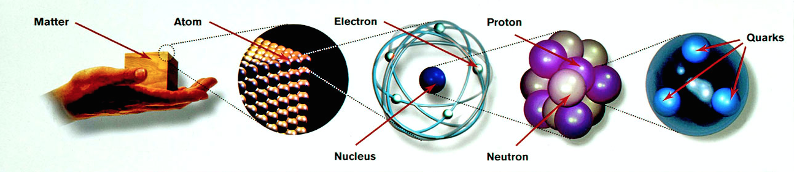


Physics Motivation: an asymmetric path
Still many open questions!
How do we reconcile the picture of quarks & gluons with nucleons & nuclei?
How can we recover the well know characteristic of the nucleon from the properties of its colored building blocks?

Slide 4
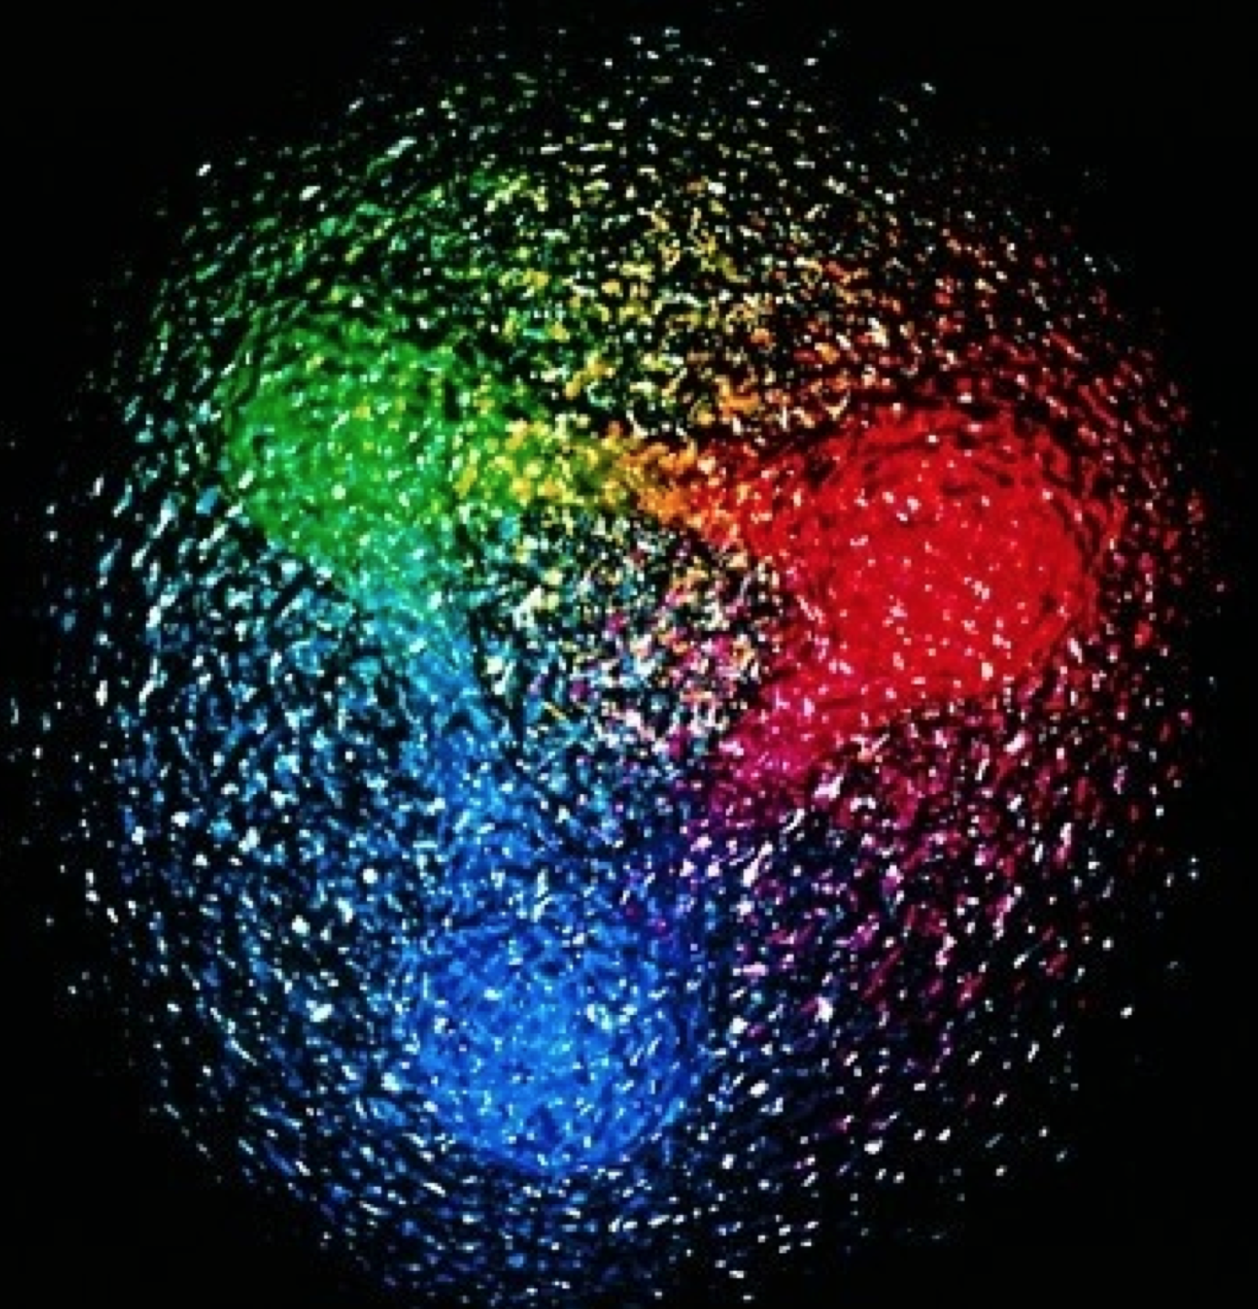
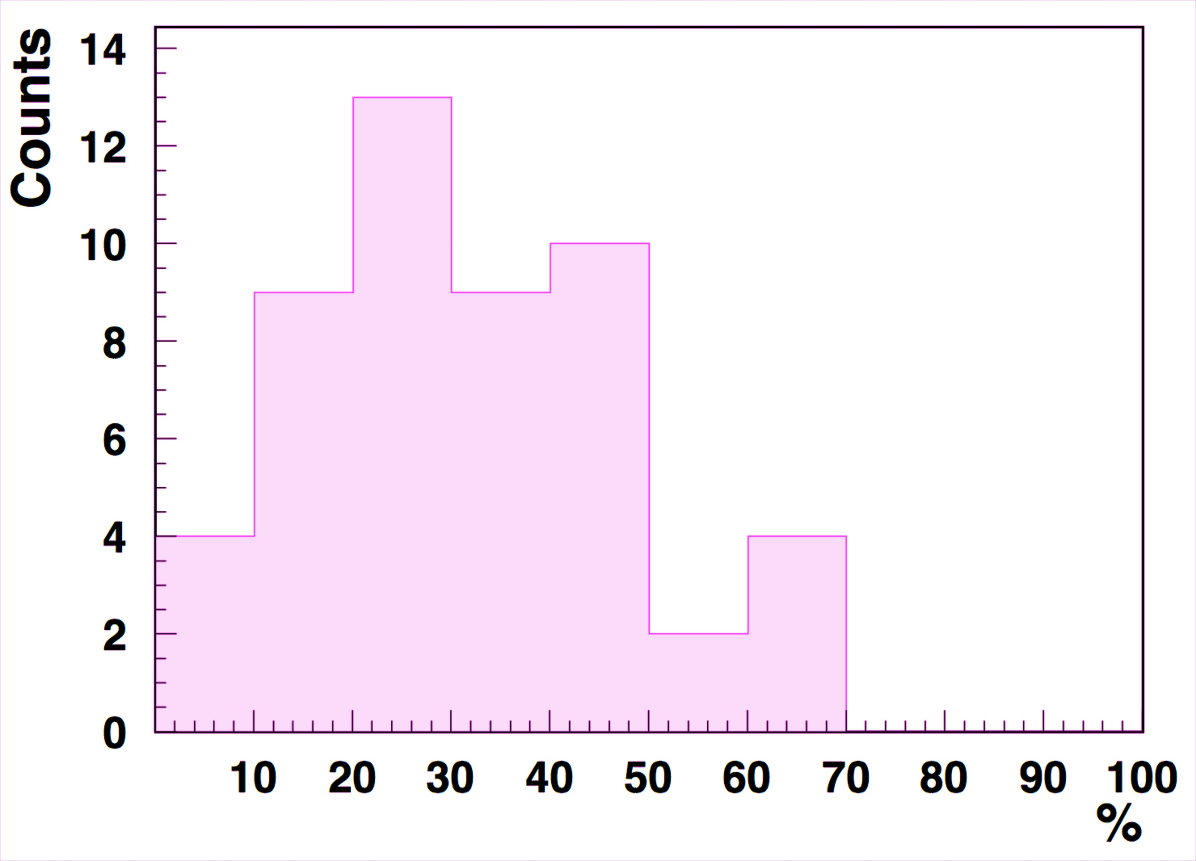
How much do we know about the structure of the nucleon?
P. Rossi’s poll
4

Slide 5
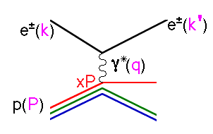
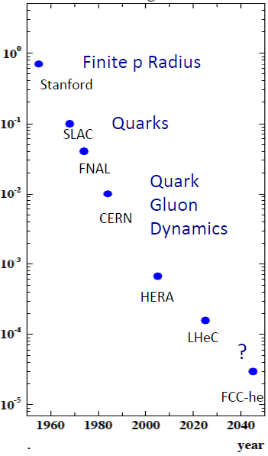

Resolving the Structure of the Proton
e⁺e⁻
distance
γ*(Q²)
e h
hh
2 independent variables: x, Q² (s=xyQ²)
Change of x ➔ projects out different configurations where different dynamics dominate
Change of Q² ➔ change of the resolution scale
Future
5

Slide 6
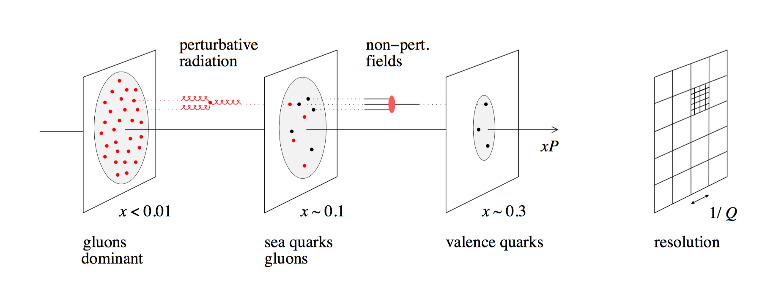
The answer: an Electron Ion Collider
L
X

Slide 7
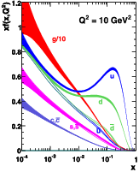
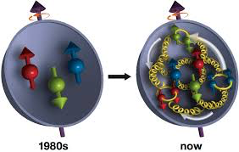
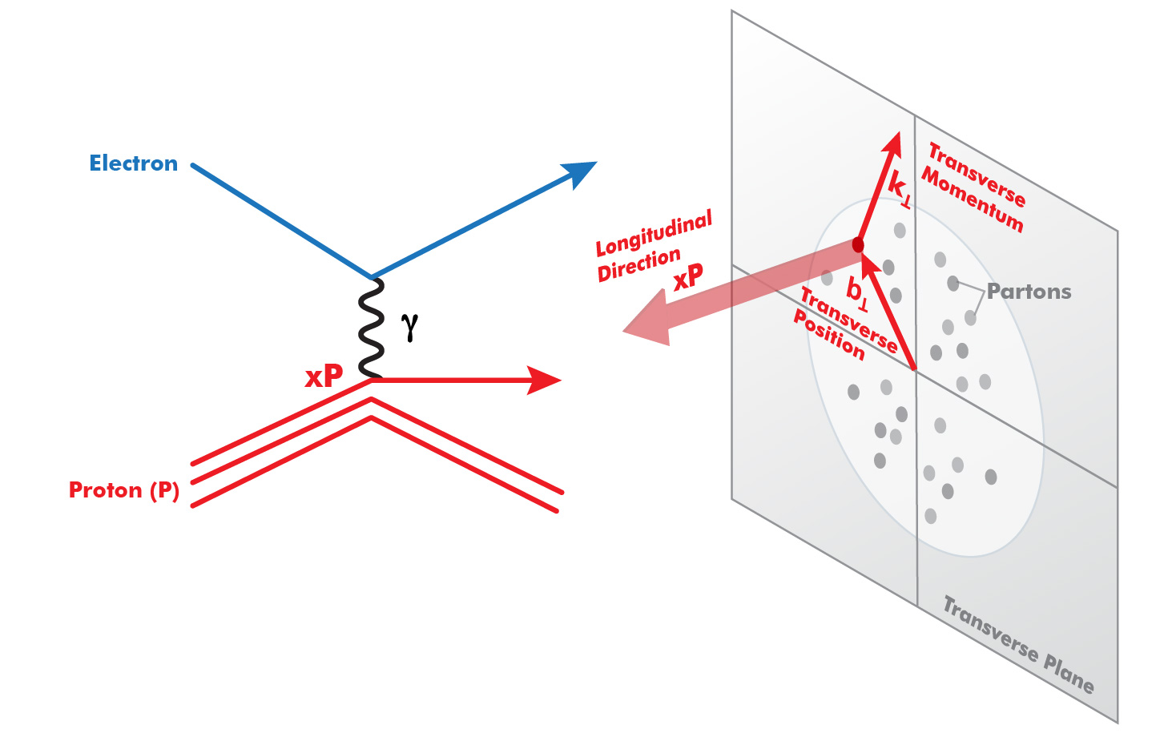
The answer: an Electron Ion Collider
L
Dramatic rise in gluon density
JLAB12
EIC
COMPASS
H1/ZEUS
EMC
HERMES
x
s_{p}≠ Σ s_{q}
EIC: resolve the gluon and sea quarks structure of nucleon and nuclei with high precision
7
3D Structure: TMD’s, GPD’s
7

Slide 8
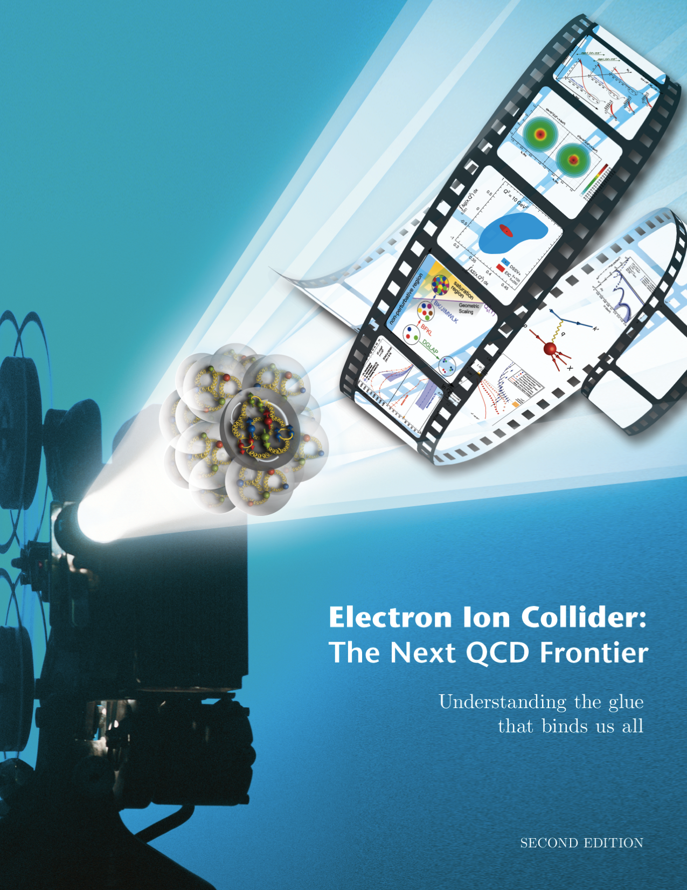

The Electron Ion Collider
1212.1701.v3
A. Accardi et al
arXiv: 1212.1701.v3
Key parameters:
Energy, Luminosity, Polarization
For e-N collisions:
Polarized beams: e, p, d/³He
E_{e} =5-10(20) GeV
Luminosity L_{ep} ~ 10³³⁻³⁴ cm⁻²sec⁻¹
20-100 (140) GeV Variable C.M.
For e-A collisions:
  Wide range in nuclei up to A above 200 (Au, Pb)
Luminosity per nucleon same as e-p
Variable center of mass energy
World’s first
Polarized e-N & e-A collider
8
8
Accardi et al., Eur. Phys. J. A (2016) 52: 268

Slide 9
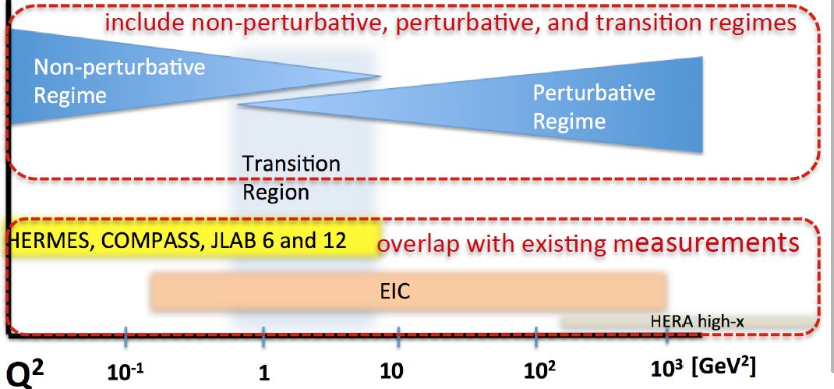
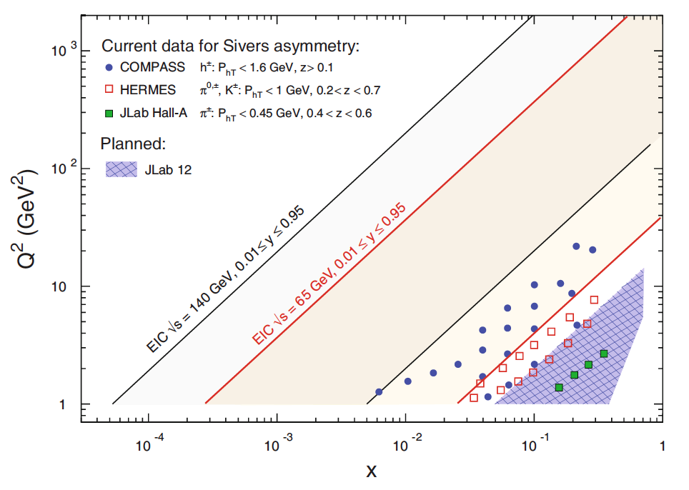
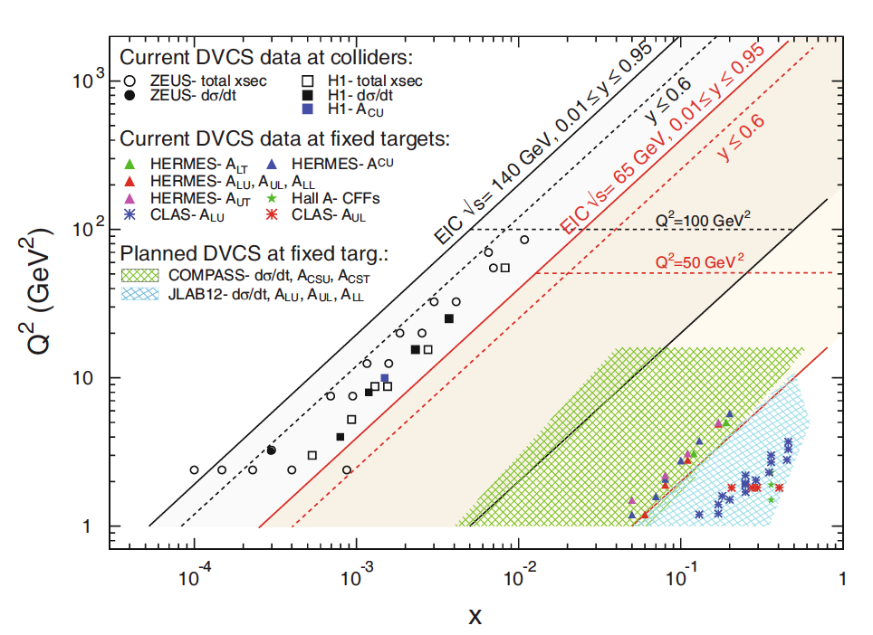
Kinematical Coverage for 3D-Imaging
SIDIS
DVCS

Slide 10
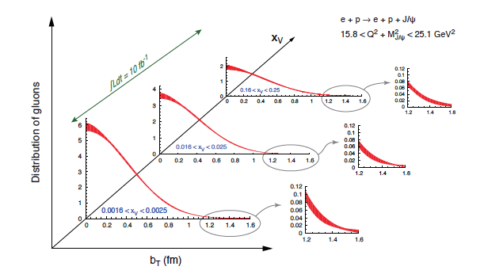
Spacial Imaging with EIC
e + p → e’+ p’+ γ
L: 10 fb⁻¹ for |t| < 1 GeV² & 100 fb⁻¹ for |t| > 1 GeV²
Sea
Pol. Sea
e + p → e’+ p’+ J/ψ

Slide 11
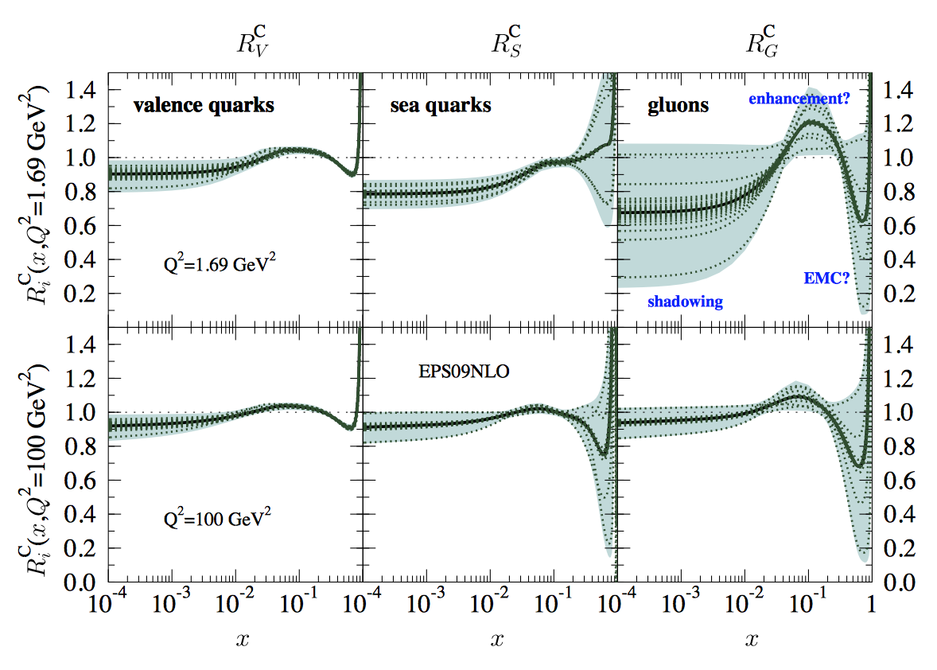
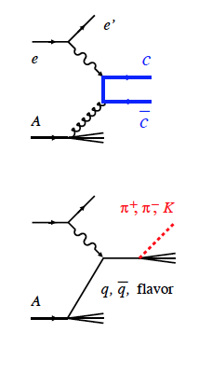
Nuclear gluons and sea quarks with EIC
Goal : study the nucleon-nucleon interaction
➔Modification of the nucleon quark-gluon structure in a nucleus
arXiv:1209.1546
Sea quarks
Gluons
Semi-inclusive DIS
Open-charm production
Q²=1.69 GeV²
Q²=100 GeV²
Sea quarks enhanced at x 0.1?
Flavor decomposition?
Gluons suppressed at x > 0.3?
Enhanced at x 0.1?
LHC ALICE: Strong gluon shadowing at x < 0.01

Slide 12
Hadronization in cold QCD matter with EIC
How do hadrons emerge from quarks and gluons?
What is nature telling us about confinement?
Energy loss by light vs. heavy quarks
  With EIC: Unprecedented precision and control on parton kinematics & control of length-in-medium by selecting appropriate nuclei.

Slide 13
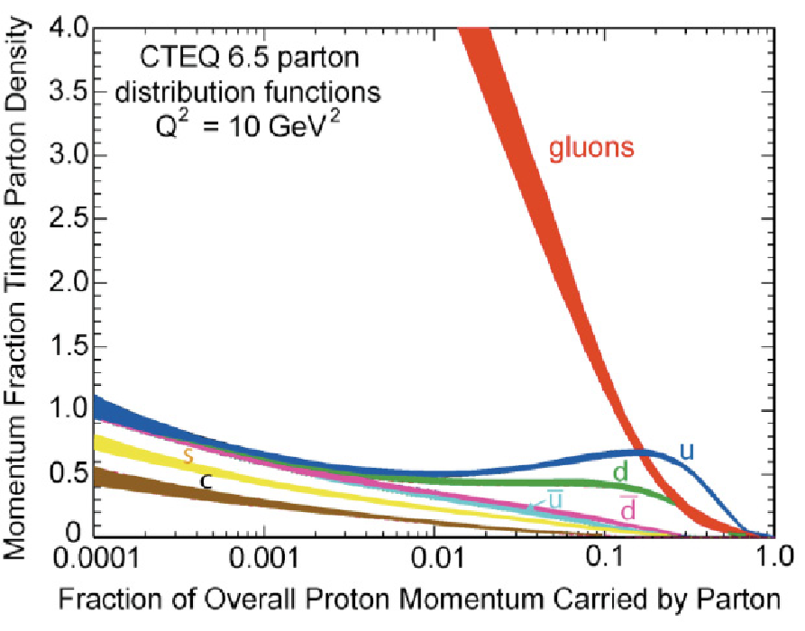
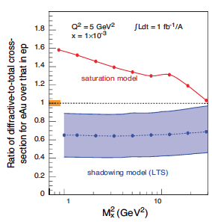
Gluon Saturation with EIC
Low x: dramatic rise of gluon density
Process quenched by gluon-gluon recombination
➔Saturation scale, Q_{s} (gluon splitting = gluon recombination) ➔Existence of a state of saturated, soft gluon matter:
Color Glass Condensate (CGC)
Q_{S}²(eA)∝Q_{S}²(ep)A^{1/3} ➔Enhancement of Q_{S} with A
➔Saturation regime reached at significantly lower
Kowalski, Teaney
PRD 68:114005
energy in nuclei
Notes:
New evolution eqn.s @ low x & moderate Q² BFKL eq.

Slide 14

The 2015 Long Range Plan for Nuclear Science
NSAC and APS DNP partnered to tap the full intellectual capital of the U.S. nuclear science community in identifying exciting, compelling, science opportunities
Recommendations:
The progress achieved under the guidance of the 2007 Long Range Plan has reinforced U.S. world leadership in nuclear science. The highest priority in this 2015 Plan is to capitalize on the investments made.
The observation of neutrinoless double beta decay in nuclei would…have profound implications.. We recommend the timely development and deployment of a U.S.-led ton-scale neutrinoless double beta decay experiment.
Gluons…generate nearly all of the visible mass in the universe. Despite their importance, fundamental questions remain…. These can only be answered with a powerful new electron ion collider (EIC). We recommend a high-energy high-luminosity polarized EIC as the highest priority for new facility construction following the completion of FRIB.
We recommend increasing investment in small-scale and mid-scale projects and initiatives that enable forefront research at universities and laboratories.
NP is implementing these recommendations which are supported in the President’s FY 2017 request

Slide 15
Report Card on DOE NP Stewardship
Talk at JLab User Group Meeting June 2016
Dr. Jehanne Gillo
Division Director, Facilities and Project Management
DOE/Office of Nuclear Physics
2007 LRP Recommendations:
We recommend completion of the 12 GeV CEBAF Upgrade at Jefferson Lab. The Upgrade will enable new insights into the structure of the nucleon, the transition between the hadronic and quark/gluon descriptions of nuclei, and the nature of confinement.
Over 96% complete; restart of science in FY2017
We recommend construction of the Facility for Rare Isotope Beams (FRIB), a world-leading facility for the study of nuclear structure, reactions, and astrophysics. Experiments with the new isotopes produced at FRIB will lead to a comprehensive description of nuclei, elucidate the origin of the elements in the cosmos, provide an understanding of matter in the crust of neutron stars, and establish the scientific foundation for innovative applications of nuclear science to society.
Construction ∼60% complete, 10.5 weeks ahead of schedule
We recommend a targeted program of experiments to investigate neutrino properties and fundamental symmetries. These experiments aim to discover the nature of the neutrino, yet-unseen violations of time-reversal symmetry, and other key ingredients of the New Standard Model of fundamental interactions. Construction of a Deep Underground Science and Engineering Laboratory is vital to U.S. leadership in core aspects of this initiative.
  Projects underway (KATRIN, CUORE, Majorana Demonstrator, FNPB, neutron EDM)
The experiments at the Relativistic Heavy Ion Collider have discovered a new state of matter at extreme temperature and density—a quark-gluon plasma that exhibits unexpected, almost perfect liquid dynamical behavior. We recommend implementation of the RHIC II luminosity upgrade, together with detector improvements, to determine the properties of this new state of matter.
Upgrade completed

Slide 16
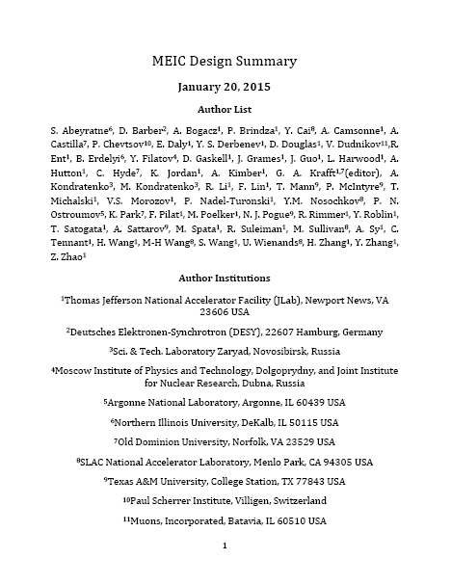

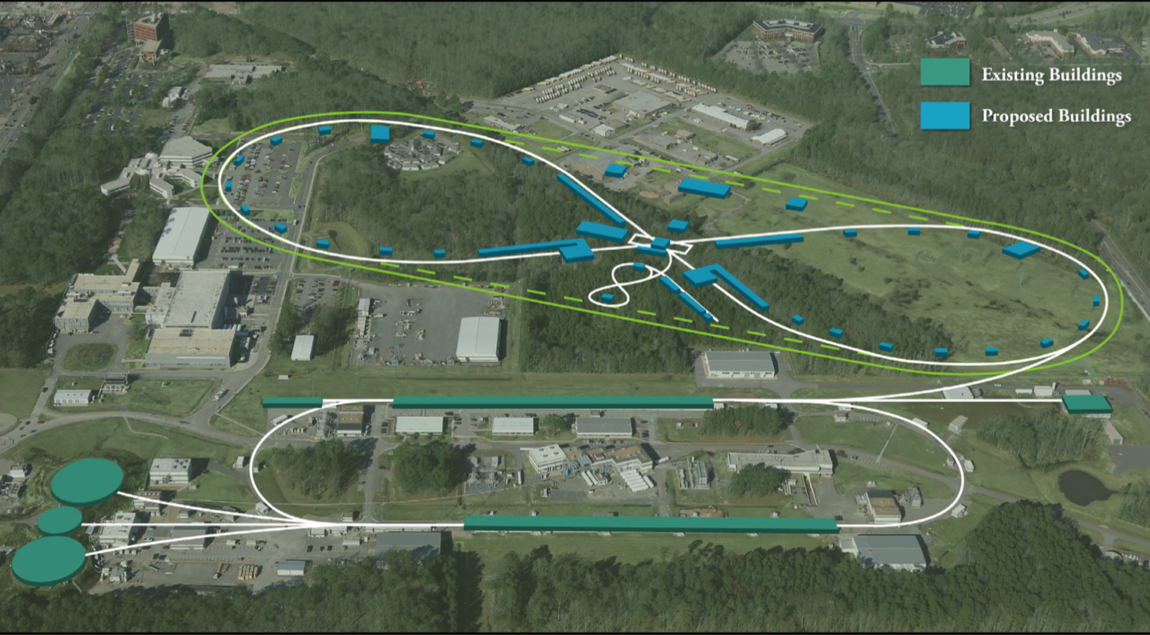
JLEIC (Jefferson Lab)
8-100 GeV
2015
3-10 GeV
8 GeV
arXiv:1504.07961
Energy range:
e-: 3-10 GeV
p : 20-100 GeV
Ring-Ring design
Electron complex
  CEBAF
  Electron collider ring
Ion complex
  Ion source
  SRF linac (285 MeV/u for protons)
  Booster
  Ion collider ring
Figure-8 ring to preserve polarization
Land is secured!
17 acres donated by the city of NN for the EIC
Notes:
Bow-Tie shaped ring to address the polarization preservation without Siberian snakes
The land is secured: the City and JLab have signed a Memorandum of Agreement, which promises the availability of the 17 acres for expansion of Jefferson Lab when the need arises.

Slide 17
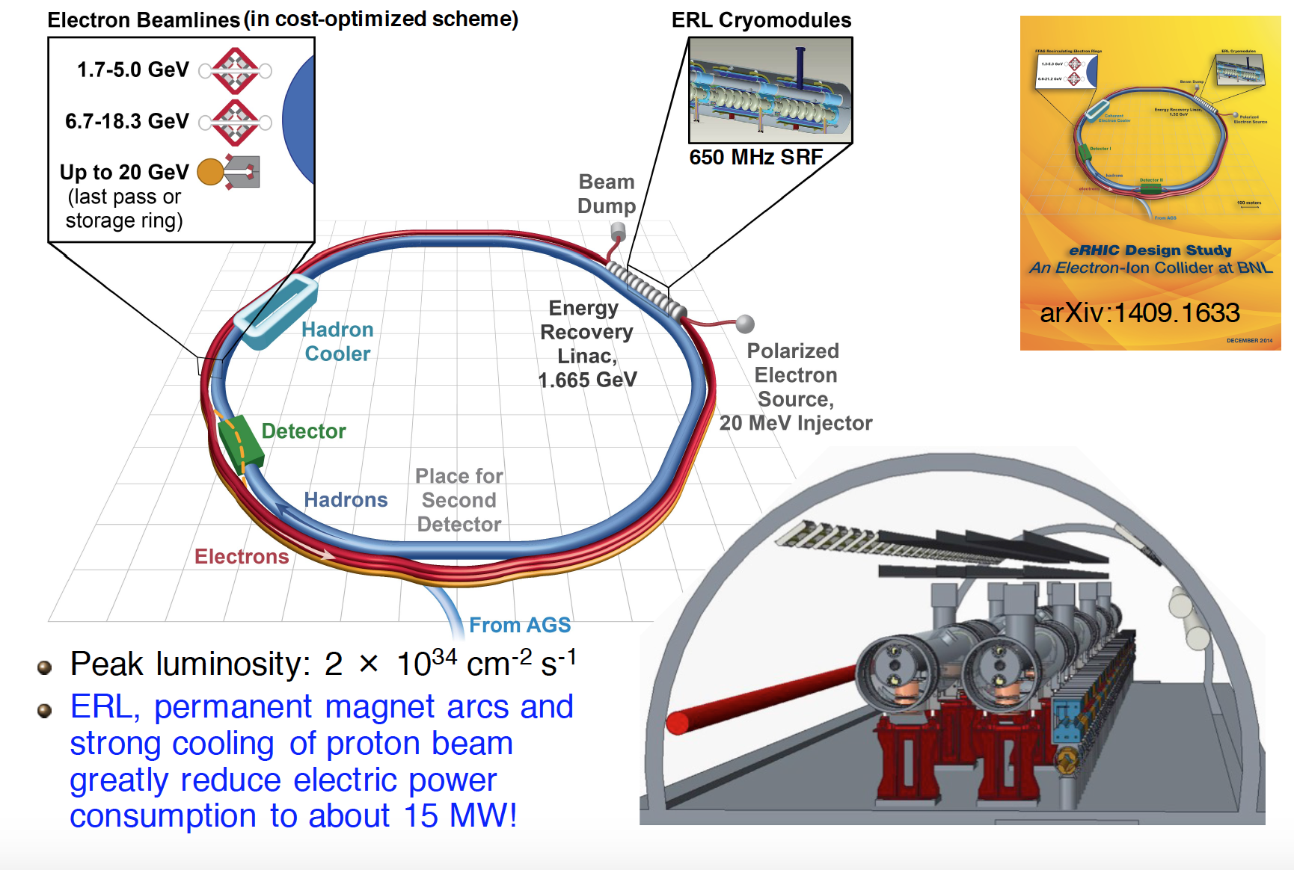
eRHIC (Brookhaven National Lab)
Linac-Ring design
  Also developing a Ring-Ring design
Uses existing Blue Ring from RHIC and a multi-pass 1.3 ERL

Slide 18
EIC Accelerator Developments
NSAC Cost review: January 2015
DOE-NP will increase EIC accelerator R&D in FY17 through ‘tax’ on JLab/BNL:
  In addition to the R&D FY17 funds NP will redirect and pool ~2.6% operations funds President request from JLAB and BNL
A Priority Review Committee will be convened on Nov 29- Dec 2 to prioritize areas and topics, report in early January 2017
A funding opportunity announcement (FOA) call for proposal will follow at a later date in 2017

Slide 19
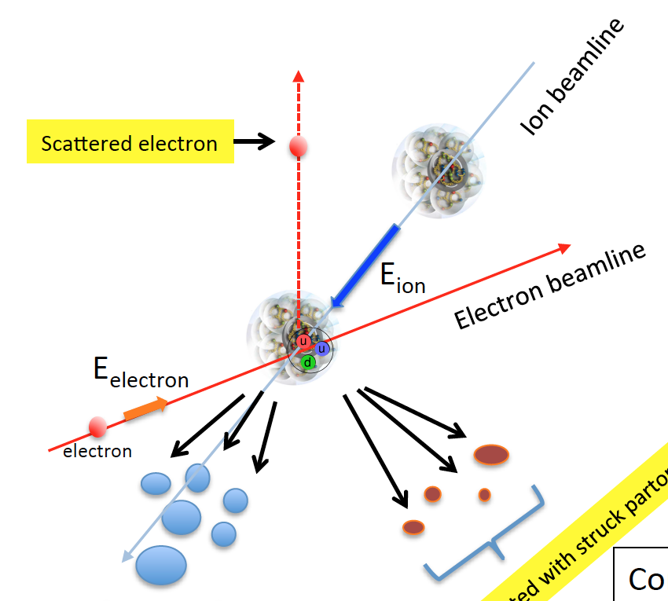
EIC Challenges
Aim of EIC is nucleon and nuclear structure beyond the longitudinal description ➔requirements for the machine and detector different from all previous colliders including HERA
Need of high beam energies to resolve partons in nucleons
  Q² up to ~1000 GeV²
Need to resolve quantities (k_{t}, b_{t}) of the order a few hundred MeV in the proton
➔ Limited proton beam energy and high luminosity needed
Need to detect all three types of particles:
  scattered electron
  particles associated with initial ion
  particles associated with struck parton
Scattered electron
Particles associated with struck parton
Partecle associated with initial ion
These become more forward boosted and harder to measure with increasing E_{ion} and E_{ion}/E_{electron}

Slide 20
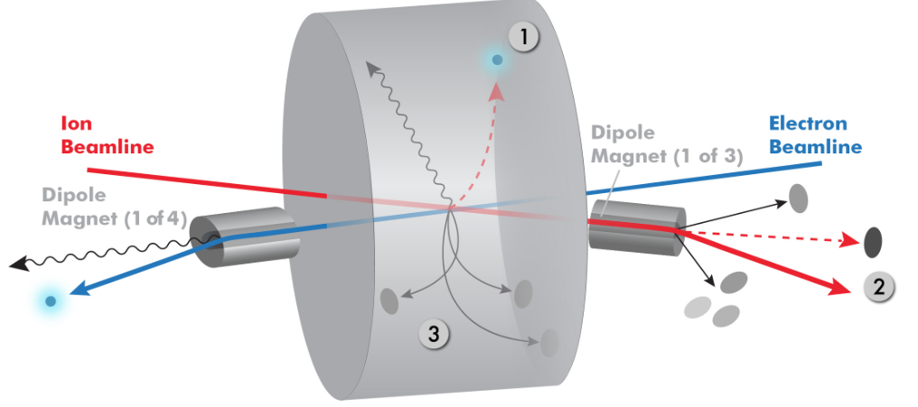



Interaction Region Concept @ JLEIC
The goal is to get ~100% acceptance for all final state particles, and measure them with good resolution.
Experimental challenges: a) beam elements limit forward acceptance, b) central Solenoid not effective for forward
Central Detector with Solenoid Magnet (to analyze scattered electron and particles associated with struck parton)
Beam crossing angle creates
room for forward dipoles
Dipoles analyze the forward particles and create space for detectors in the forward direction (Particles associated with Initial Ion)
Courtesy of R. Yoshida

Slide 21
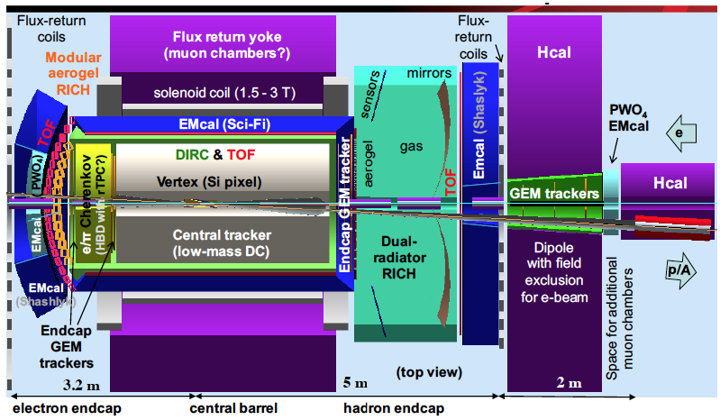
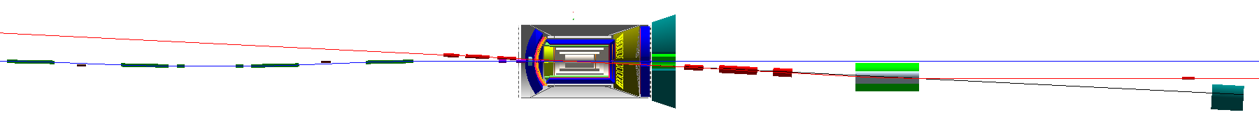
Detector and Interaction Region @ JLEIC
Integrated detector region design developed satisfying the requirements of
  Detection – Beam dynamics – Geometric match
GEANT4 detector model developed, simulations in progress
e⁻ crab cavities
ion crab cavities
IP
e⁻
Compton polarimetry
forward ion detection
ions
forward e⁻ detection
spectrometers
dispersion suppressor/
geometric match
p
(top view in GEANT4)
e
low-Q² electron detection
and Compton polarimeter
Forward hadron spectrometer
ZDC
Extended Detector (TOTAL Acceptance) : 80 m

Slide 22
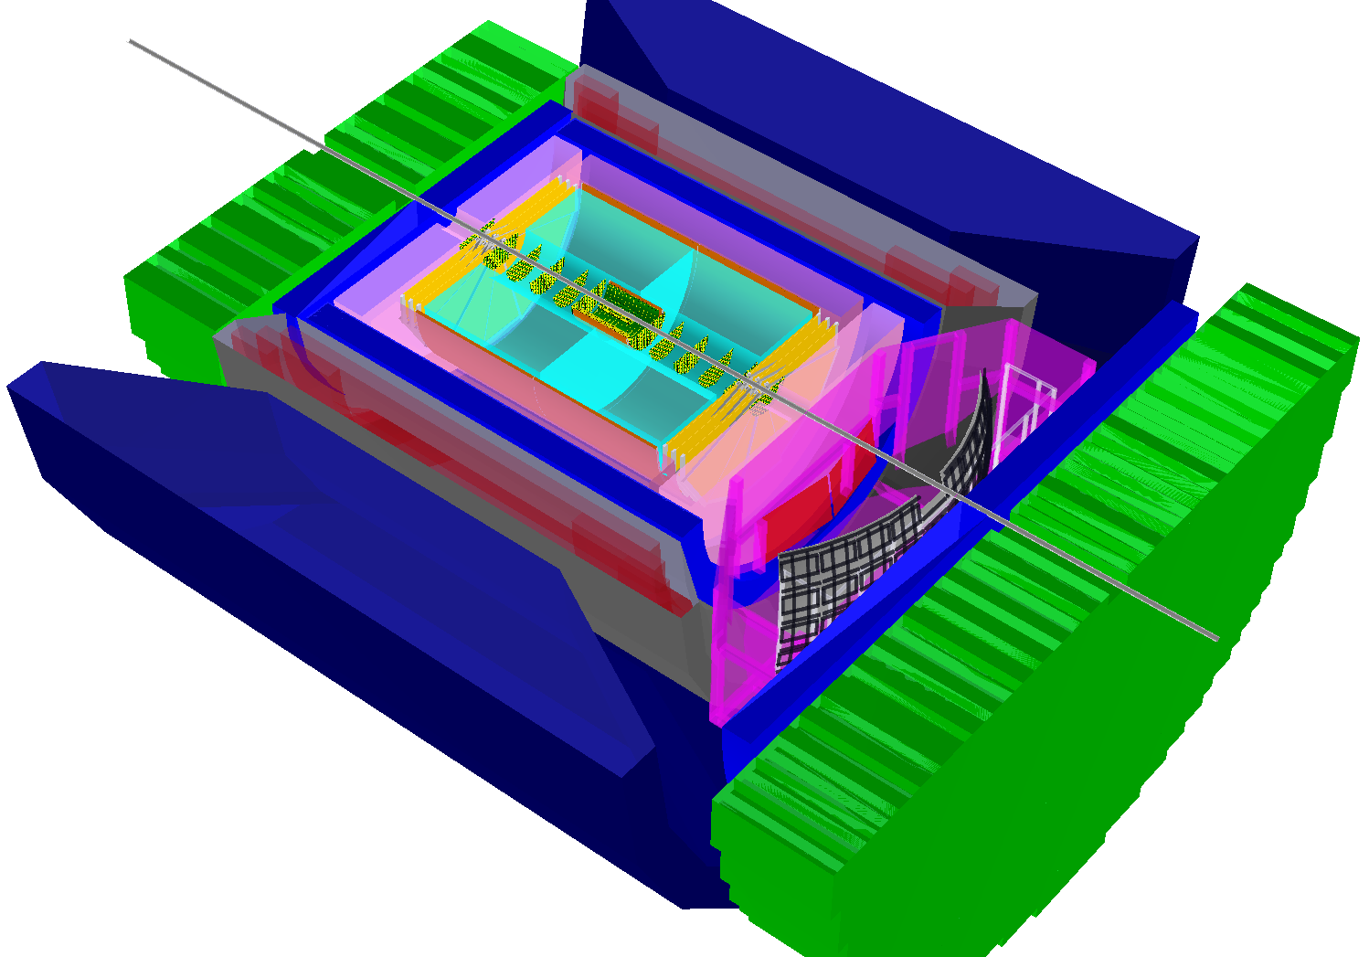
BeAST Detector @ eRHIC
(Brookhaven eA Solenoidal Tracker)
hadronic calorimeters
e/m calorimeters
RICH detectors
9.0m
hadrons
electrons
silicon trackers
TPC
GEM trackers
Micromegas barrels
3T solenoid cryostat
magnet yoke

Slide 23
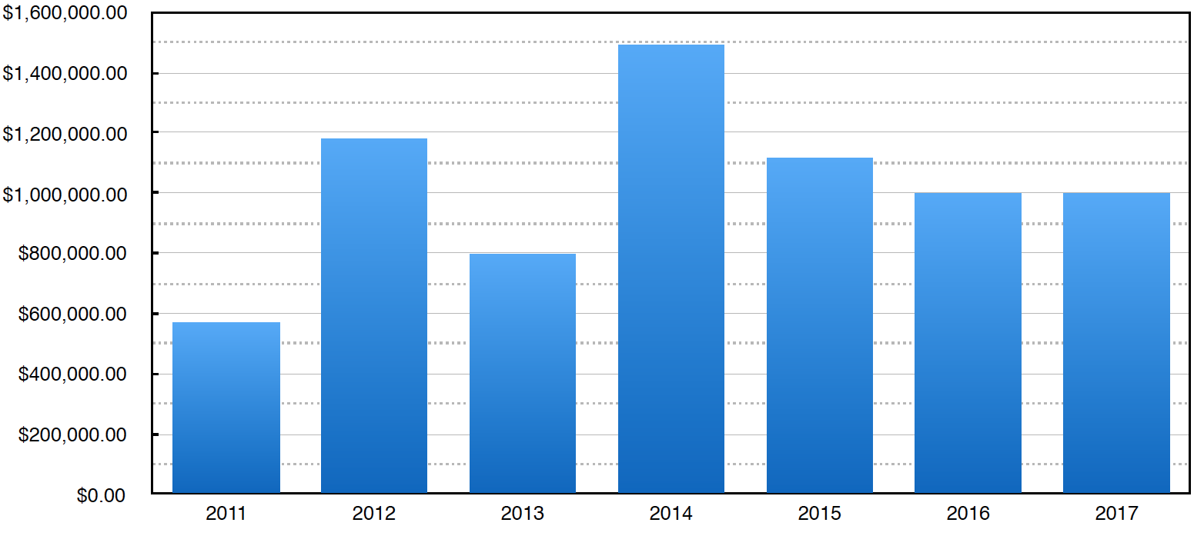
EIC Detector Requirements and R&D
Hermetic detector, low mass inner tracking, good PID (e and π/k/p), calorimetry
Moderate radiation hardness requirements, low pile-up, low multiplicity
➔ Specific requirements for an EIC demand R&D that it is not covered by main stream HEP, HENP R&D.
Available Project Funds
Total since 2011: $7,721,740
Program started in 2011 and funded by DOE : 1M$-1.5M$/year
Standing EIC Detector Advisory Committee which meets twice a year.
Committee strongly supports the formation of consortia.
Currently:
‣ Tracking consortium - 7 institutions
‣ Calorimeter consortium - 12 institutions
‣ PID consortium - 20 institutions
Potential future candidates:
‣ Si Vertex consortium
‣ Software and Computing consortium
Program explicitly open to international participation
Fiscal Year
Currently exploring possibility of increasing this number substantially
INFN Ferrara, Roma, and ISS
(An integrated program for particle identification (PID) )
INFN Trieste
(EIC Tracking R&D & Developing Analysis Tools and Techniques for the EIC )
https://wiki.bnl.gov/conferences/index.php/EIC_R%25D

Slide 24
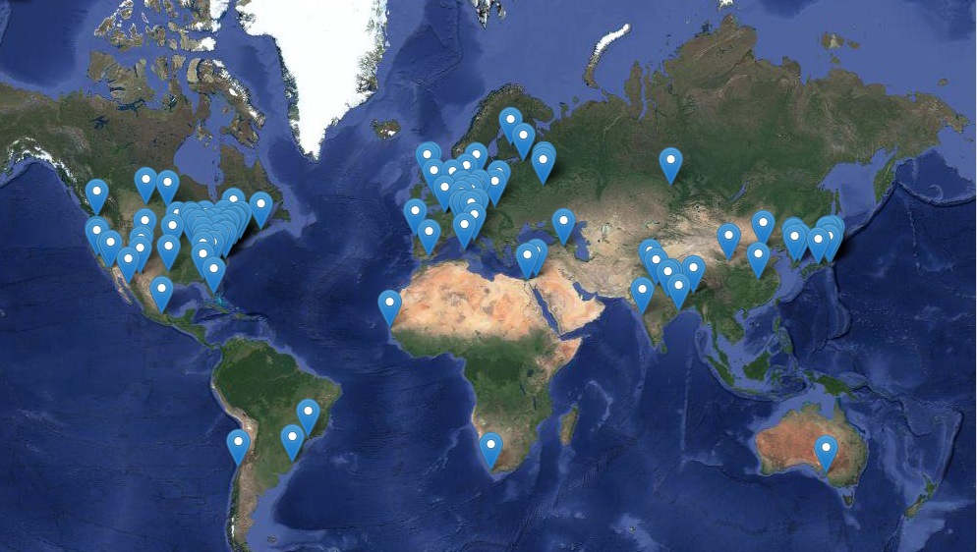
EIC User Group (EICUG)
Currently 663 Collaborators, 147 Institutions, 28 countries
(http://www.eicug.org
EIC Users Group Charter voted in June 2016
Chair of Istitution rapresentative board elected
Elections for the Steering Committee and its Chair coming soon

Slide 25
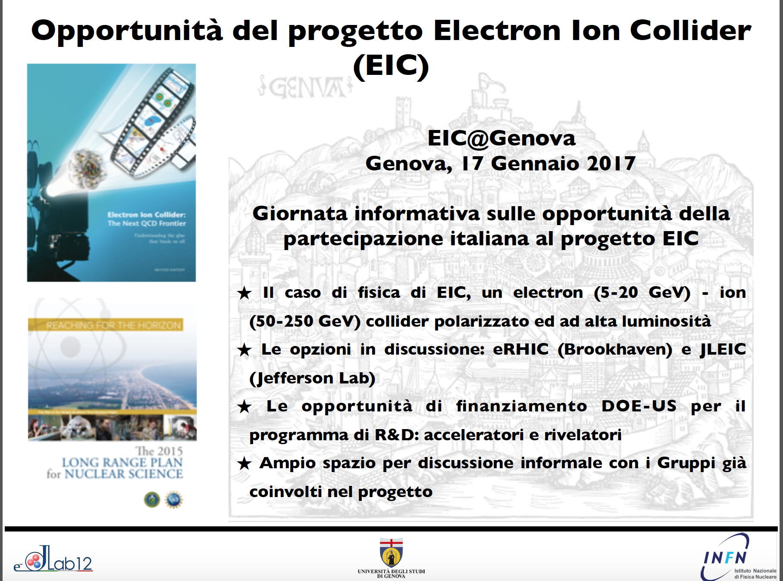

Slide 26
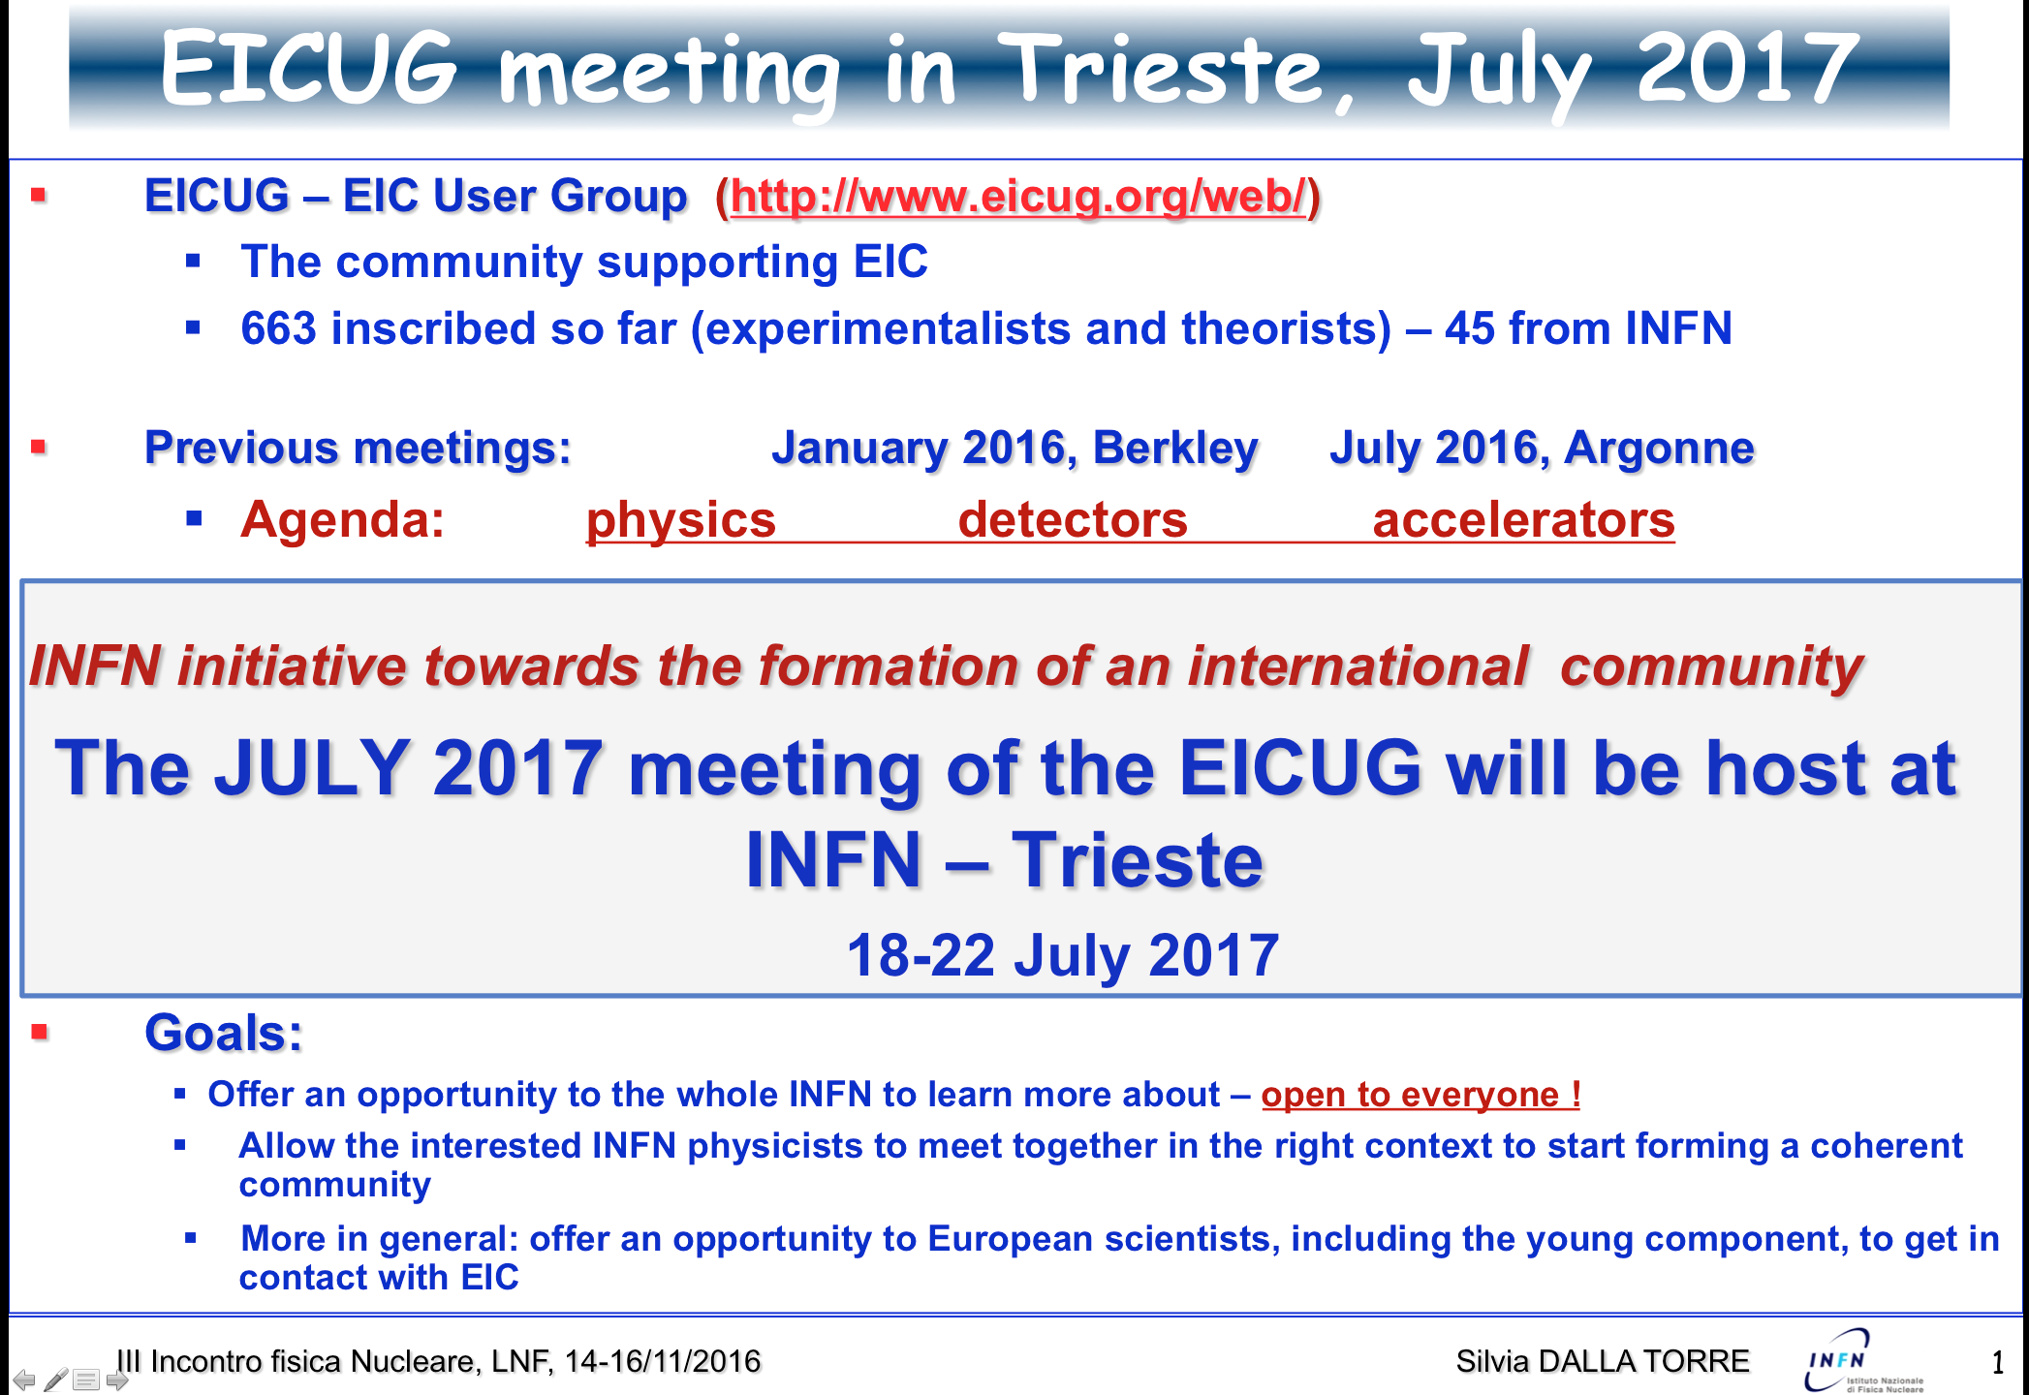

Slide 27
EIC Timeline
Activity Name | 2010 | 2011 | 2012 | 2013 | 2014 | 2015 | 2016 | 2017 | 2018 | 2019 | 2020 | 2021 | 2022 | 2023 | 2024 | 2025
12 GeV Operations
12 GeV Upgrade
FRIB
EIC Physics Case
NSAC LRP
NAS Study
CD0
EIC Design, R&D Pre-CDR, CDR
CD1(Down-select)
CD2/CD3
EIC Construction
We are here
pre-project
on-project
Pre-CDR
CDR
CD0 = DOE “Mission Need” statement; CD1 = design choice and site selection (VA/NY)
CD2/CD3 = establish project baseline cost and schedule

Slide 28
National Academy of Sciences
DOE charge to National Academy of Science (NSAC meeting - March 2016)
The committee will assess the scientific justification for a US domestic electron ion collider facility, taking in to account current international plans and existing domestic facility infrastructure. In preparing its report, the committee will address the role that such a facility could play in the future of nuclear physics, considering the field broadly, but placing emphasis on its potential scientific impact on quantum chromodynamics.
Committee being assembled (Chair confirmed: Gordon Baym, University of Illinois )
First organizational meeting in January 2017
Expect resolution in Fall/Winter 2017

Slide 29
Conclusions and Outlook
The US Nuclear Science Advisory Committee approved as one of the four recommendations in its 2015 Long Range Plan a high-energy Electro-Ion Collider
EIC goal is to revolutionize the understanding of nucleon and nuclear structure and associated dynamics, and to explore new states of QCD
The basic scientific requirements for such a facility are:
  Highly polarized ( 70%) electron, proton, and light ion (d,3He) beams
  Ion beams from deuteron to the heaviest nuclei (Uranium or Lead)
  Variable center of mass energies from 20 - 100 GeV (upgradable to 150 GeV)
  High collision luminosity ~10³⁴ cm⁻²s⁻¹
Two designs, well underway, have been proposed by scientists at RHIC and JLab both capable of delivering a frontier accelerator facility
There exists world wide interest in collaborating on the EIC:
  663 Collaborators, 147 Institutions, 28 countries
  More and more involved in the Detector R&D and in defining the EIC research program beyond the EIC White Paper.
  Next EICUG meeting hosted by Trieste INFN & University in July 2017
DOE has initiated the various processes necessary for the EIC’s realization
The US EIC is on track to become a reality in the near future

Slide 30
Backup

Slide 31
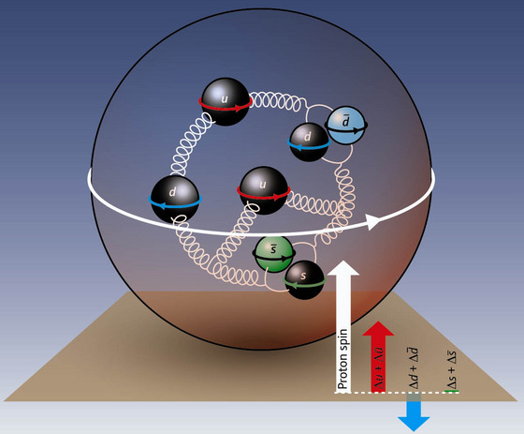
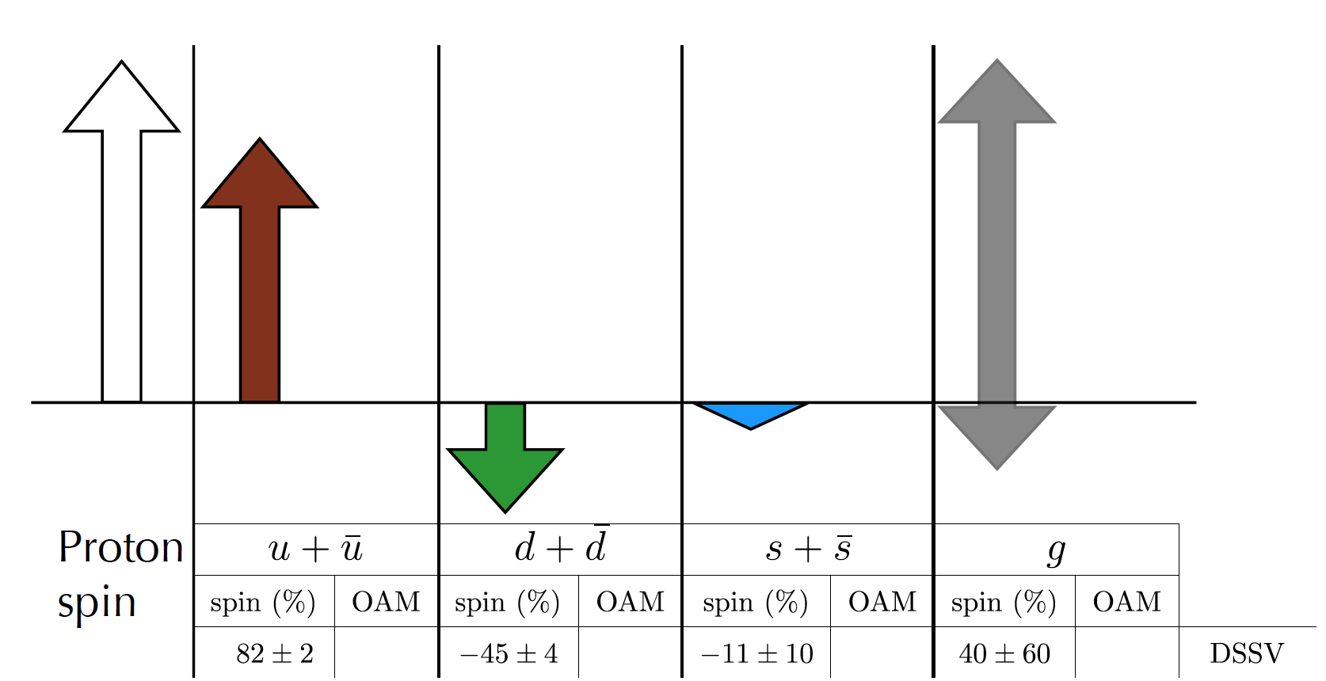
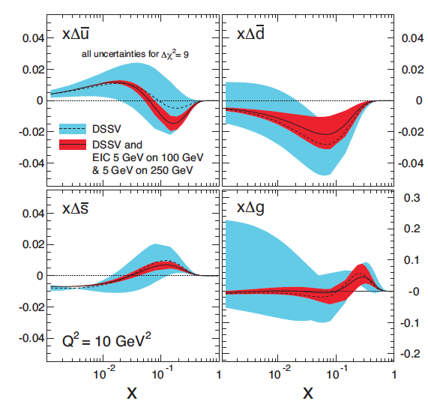
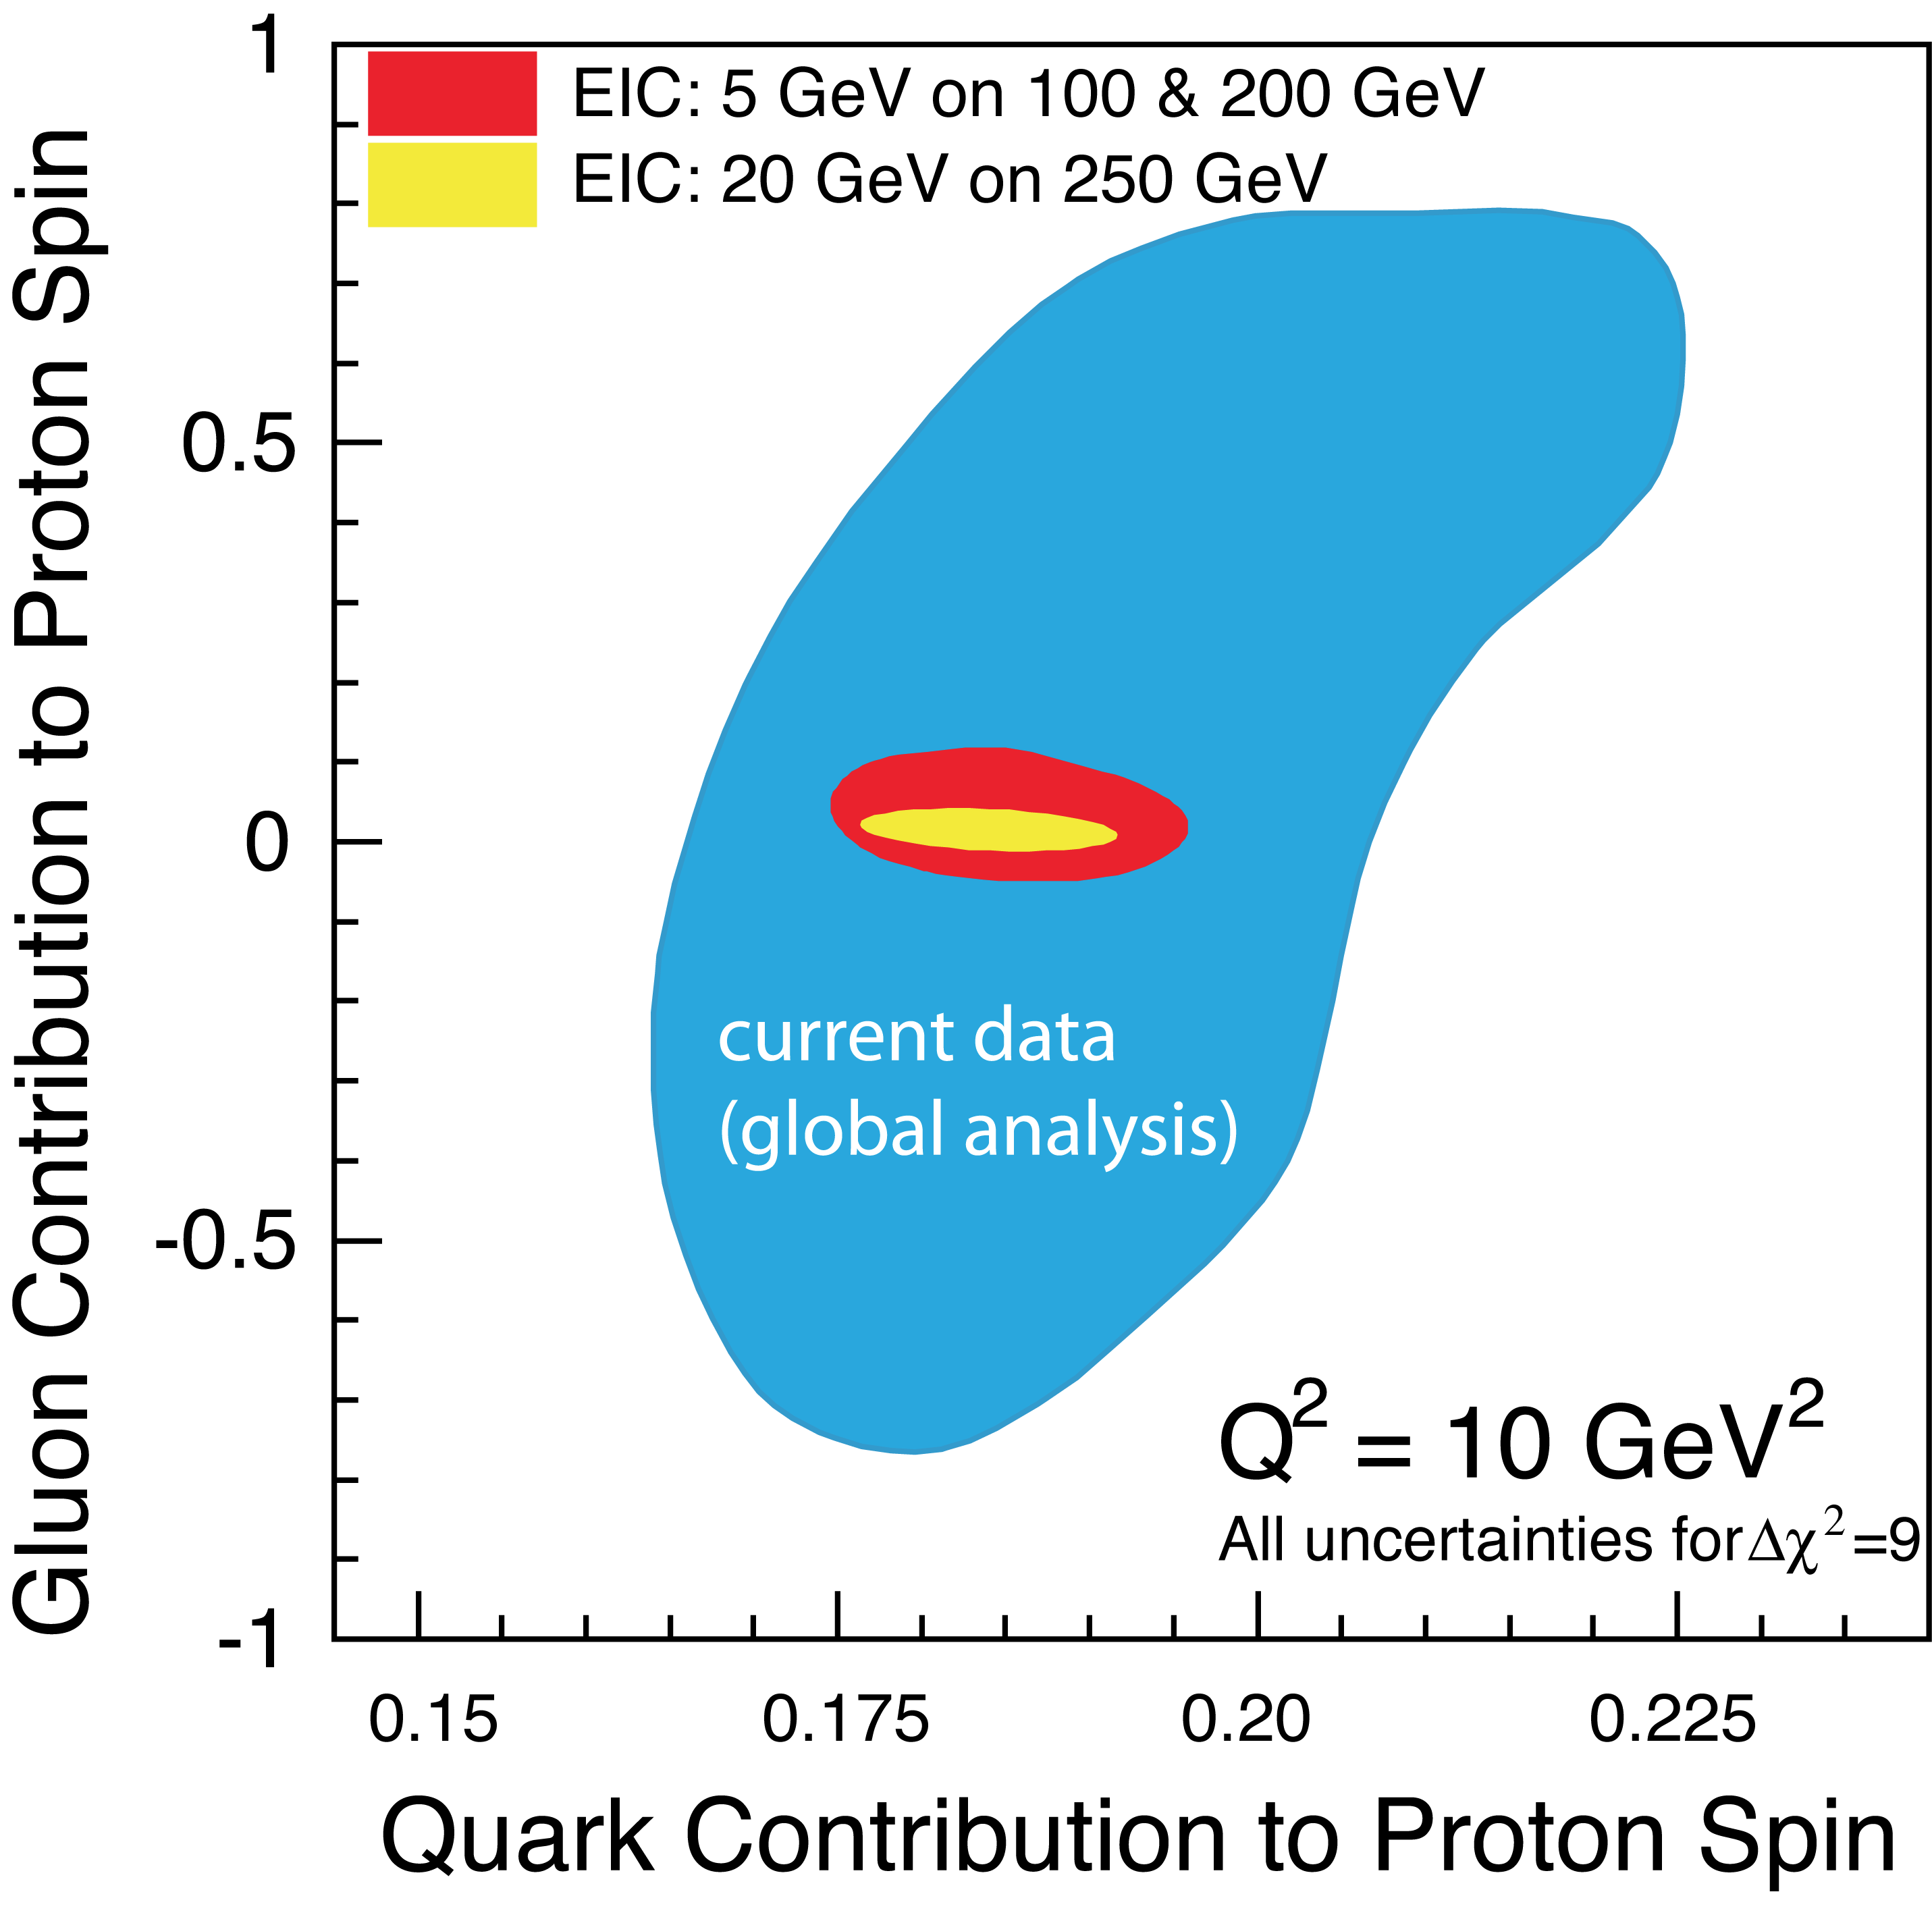
The Proton Spin
Spin Sum rule
Quark spin
Best known (~30%)
Gluon spin
Poorly known
OAM
Little known (DVCS)
With a Polarized EIC
Precision in ΔΣ and Δg ➔ stringent and independent constraints on L_{q}+L_{g}
Spin Flavor decomposition of the Light Quark Sea
Tremendous improvement on Δg
Improvement in ΔΣ
Notes:
Red Interior Page Design
Right: x=0.001 - 1

Slide 32
Charge to the EIC (2016)
The committee will assess the scientific justification for a U.S. domestic electron ion collider facility, taking into account current international plans and existing domestic facility infrastructure. In preparing its report, the committee will address the role that such a facility could play in the future of nuclear physics, considering the field broadly, but placing emphasis on its potential scientific impact on quantum chromodynamics.
In particular, the committee will address the following questions:
What is the merit and significance of the science that could be addressed by an electron ion collider facility and what is its importance in the overall context of research in nuclear physics and the physical sciences in general?
What are the capabilities of other facilities, existing and planned, domestic and abroad, to address the science opportunities afforded by an electron-ion collider? What unique scientific role could be played by a domestic electron ion collider facility that is complementary to existing and planned facilities at home and elsewhere?
What are the benefits to US leadership in nuclear physics if a domestic electron ion collider were constructed?
What are the benefits to other fields of science and to society of establishing such a facility in the United States?

Slide 33
Community Panel Evaluation on EIC R&D (DRAFT)
Rockville, Nov 30 – Dec 2 2016
Scope Defined for the Panel
Status of EIC R&D to date: Evaluate the current state of EIC-related accelerator R&D supported to date by NP competitive accelerator R&D funds and by individual laboratory NP funds.
EIC Design Concepts: Examine the current EIC design concepts under consideration in the U.S. and identify a risk level (High, Medium or Low) for the realization of each concept.
Technical Feasibility: For each EIC design concept, identify key areas of accelerator technologies that must be demonstrated or advanced significantly in order to realize the technical feasibility of the concept.
Priority List of R&D: Generate a list of R&D areas for each EIC design concept, prioritized (High, Medium, Low) in the context of associated risk and impact of activity to value engineering and technical feasibility. Identify R&D items that have relevance to multiple EIC design concepts.
Cost and Schedule Range: To the extent possible and within the time constraints of the meeting, provide an estimate of cost and schedule range for each item on the R&D list above.

Slide 34
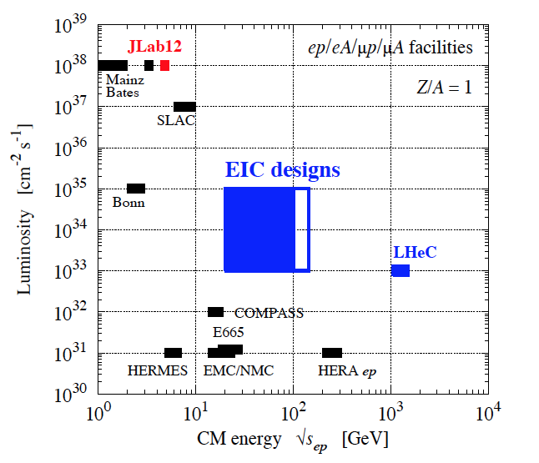
CM energies & Luminosity for e.m. scattering

Slide 35
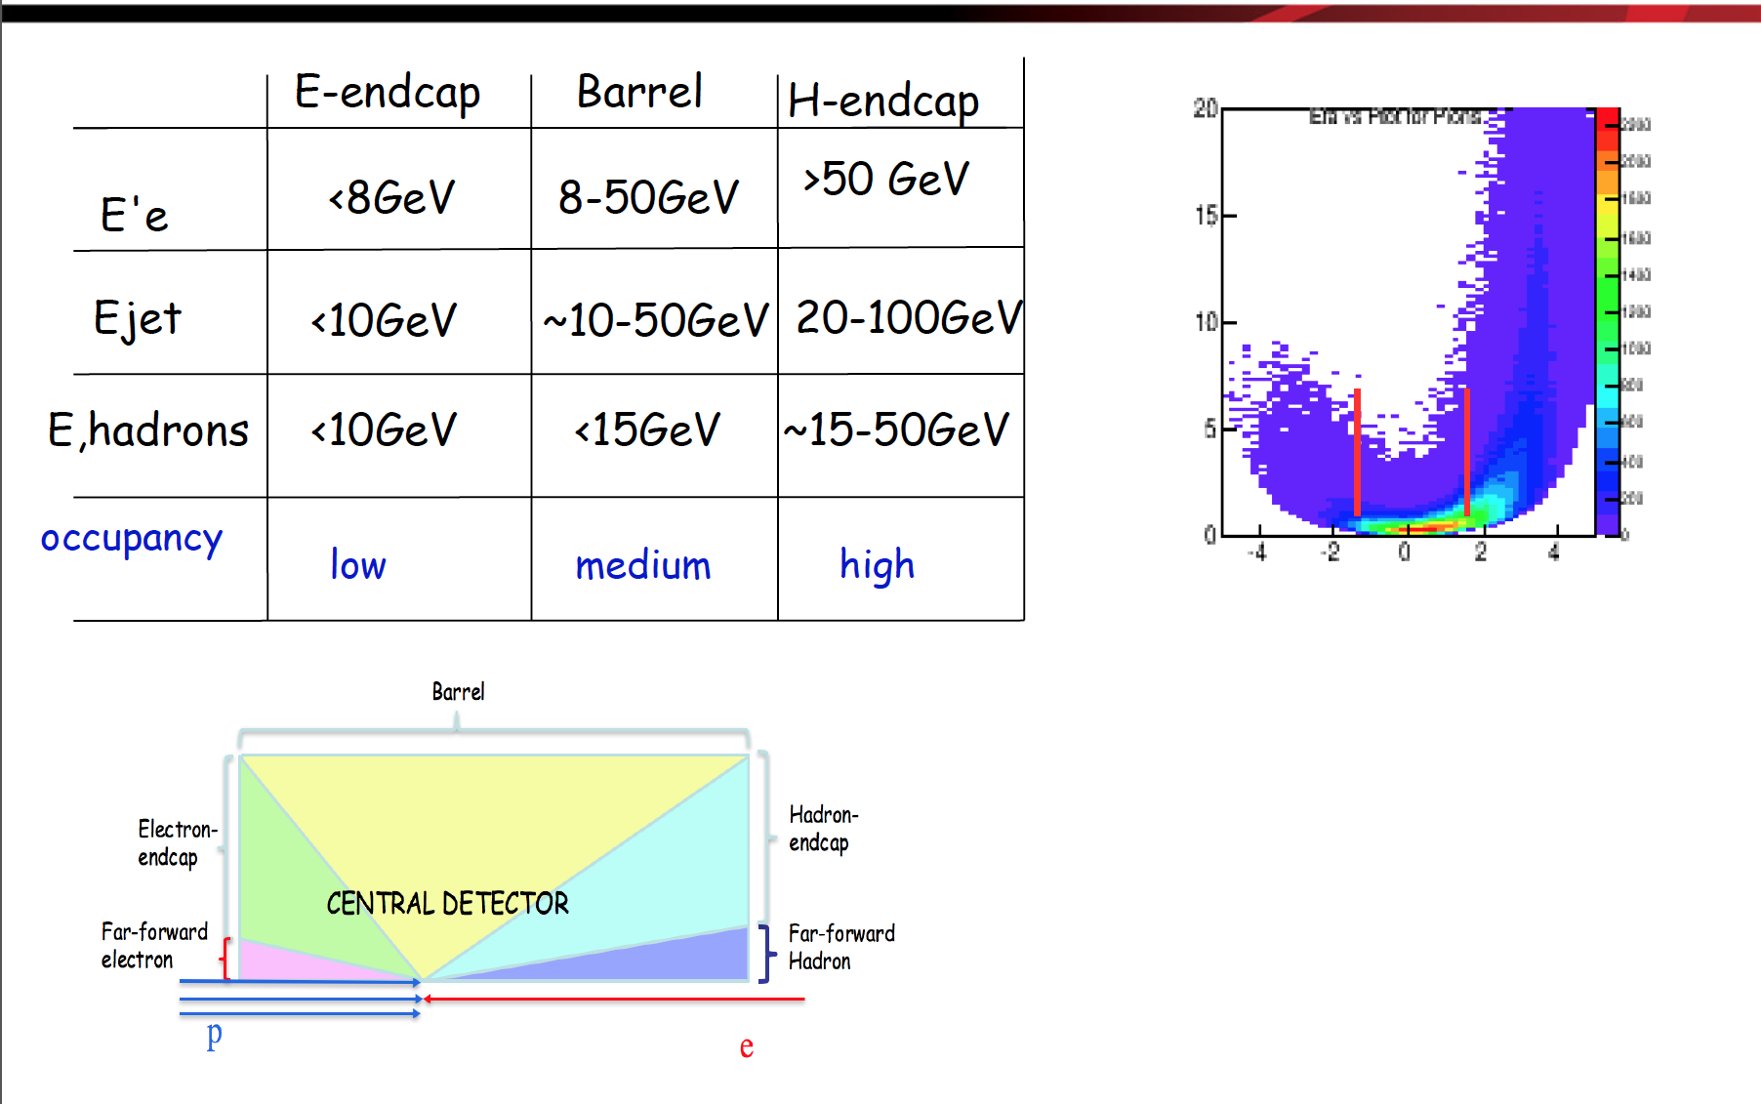
Particle Distribution

