Slide 1

Spin effects in QCD and
3D nucleon structure
Motivations
3D nucleon structure
TMDs (Transverse momentum dependent distributions)
Transverse single-spin asymmetries in various processes
GPDs (Generalized parton distributions)
Open issues

Slide 2
Disclaimer/apologies
Not covered in this talk:
Models of TMDs and GPDs
Lattice calculations
- Parton orbital angular momentum
- GPD phenomenology
- TMDs/GPDs in nuclei
- Double Parton Distribution Functions

Slide 3
Motivations (general statements)
Nucleon: still a mysterious object despite 50 years of studies
QCD and confinement: still to be understood
Spin: fundamental quantum degree of freedom
A tool to study the inner structure of composite systems

Slide 4


Transverse Spin effects:
$A_{N}$ in $p^{↑}p →$ π X… a long-standing puzzle
Collinear twist-2 QCD
$A_{N}$ $≤$ few %
Almost energy independent

Slide 5
1-D picture of the nucleon
inclusive DIS
DIS Structure Function
Collinear PDFs

Slide 6
(open) Physics issues
Orbital motion of quarks/gluons
Its correlation to proton spin
Intrinsic transverse momentum of quarks/gluons
Spatial distribution of quarks/gluons
3D structure
Non perturbative effects in high-energy processes
Origin of transverse/azimuthal spin asymmetries
Observables
Role of local color gauge invariance of QCD
Factorization, universality, resummation
QCD at work

Slide 8




TMDs: How can we access them?
Two-scale processes: $Q^{2}≪$ $k_{T}^{2}$ $≈Λ_{QCD}^{2}$
Drell-Yan $pp → l^{+} l^{− } X$
$$e^{+}e^{−}→ ππ X$$
SIDIS $lp→l^{′}h X$
TMD factorization proven

Slide 9


And possibly in processes like
$$pp →π X$$
$(pp → γ X$, $pp→jet X)$
Single scale processes
$$pp→ π jet X$$
And more

Slide 10



Where can we access TMDs?
EIC
SIDIS
Drell-Yan
$e^{+}e^{−}$ → π π X
$pp→ π X , pp→ π jet X$

Slide 11
Theory: factorization and evolution
Collinear approach
Factorization
Evolution → DGLAP eqs.
A cornerstone in pQCD
TMD approach…more involved

Slide 12
TMD Factorization and evolution
DY processes
Collins approach (2011)
pQCD
Non perturbative parts
Collinear PDF
In SCET analogous expression in $b$ space: Echevarria, Idilbi, Scimemi (2012)
Theor. equivalent but potentially different in phen.
Role of NON perturbative input

Slide 13
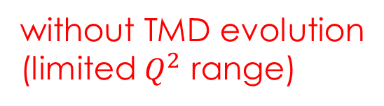
TMDs and unpolarized cross sections
SIDIS multiplicities
without TMD evolution
(limited $Q^{2}$ range)
Anselmino, Boglione, Gonzalez,
Melis, Prokudin (2014)
Signori, Bacchetta, Radici, Schnell (2013)

Slide 14
TMDs: flavour structure
Gaussian widths
Signori, Bacchetta, Radici, Schnell (2013)
up < down < sea ????
to be further explored

Slide 15

Fit to Drell-Yan and $Z^{0}$ production data
TMD evolution at NNLL (SCET)
UD, Echevarria, Melis, Scimemi (2014)
(223 data points)
Tevatron
Low energy

Slide 16



TMDs at LHC
Predictions from NNLL fit
$$pp→Z X$$
Pure pQCD
Ferrera (2014)
UD, Echevarria, Melis,
Scimemi (2014)
Uncertainty in
$$pp→H X$$
Inclusion of the
non perturbative
piece ($k_{T}$)

Slide 17
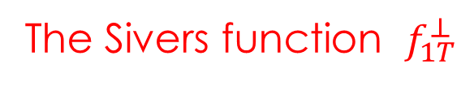
TMDs and spin
Beyond the unpol ($f_{1}$), helicity ($g_{1}$) and transversity ($h_{1}$) distributions,
surviving in the collinear limit, there are 5 TMDs more, in particular
The Sivers function $f_{1T}^{⊥}$
Sivers (1989)
Correlation between the spin of the proton and the parton transverse momentum

Slide 18
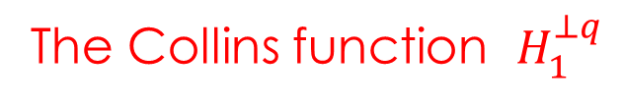
Analogously, one can define TMDs in the fragmentation process.
In particular, for its relevance
The Collins function $H_{1}^{⊥q}$
Collins (1992)
Correlation between the spin of the fragmenting quark and the hadron transverse momentum
Crucial for the first ever extraction of the transversity distribution

Slide 19
Sivers and Collins functions extensively studied
theoretically, experimentally and phenomenologically
SIDIS
CLEAR evidence from data
HERMES, COMPASS
Collins
Sivers
First phase: analysis with DGLAP evolution
Second phase (just started): TMD evolution

Slide 20

Extracted Sivers functions
TO-CA and PV groups
large-$x$ region: unconstrained [→JLab]
sea region: unconstrained [→EIC]
Effect of
TMD evolution
Aybat, Collins, Qiu, Rogers (2012)

Slide 21
Distortion in the transverse plane
Non zero Sivers effect related to parton orbital angular momentum

Slide 22
Modified universality of the Sivers function
Collins (2012)
Final state interactions in SIDIS
Initial state interactions in DY
A clear-cut test
If falsified:
- misunderstanding of final-state interacts. leading to T-odd effects
- missing points in QCD factorization (TMD and collinear) [most severe scenario]

Slide 23
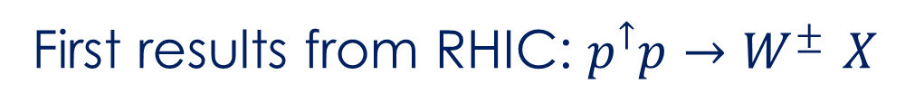
First results from RHIC: $p^{↑}p→W^{± }X$
STAR Collaboration (2016)
No TMD evolution
First hint at the sign change,
but large exp. errors and …
Kang et al (2016)

Slide 24
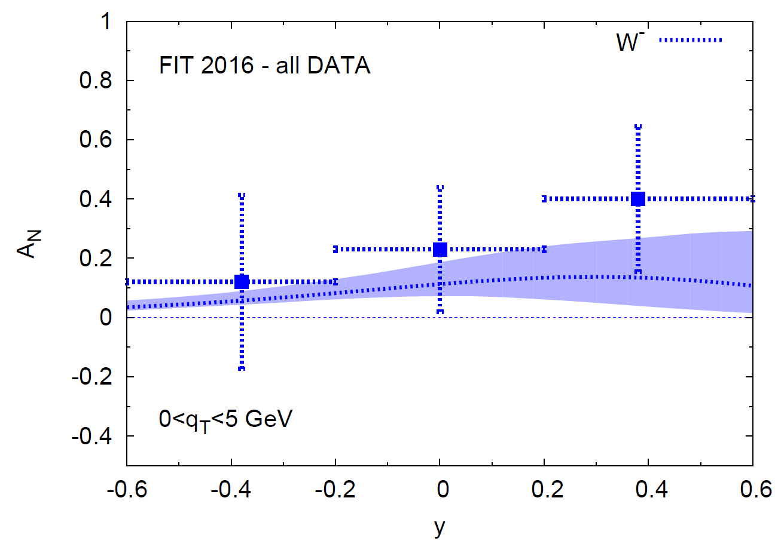
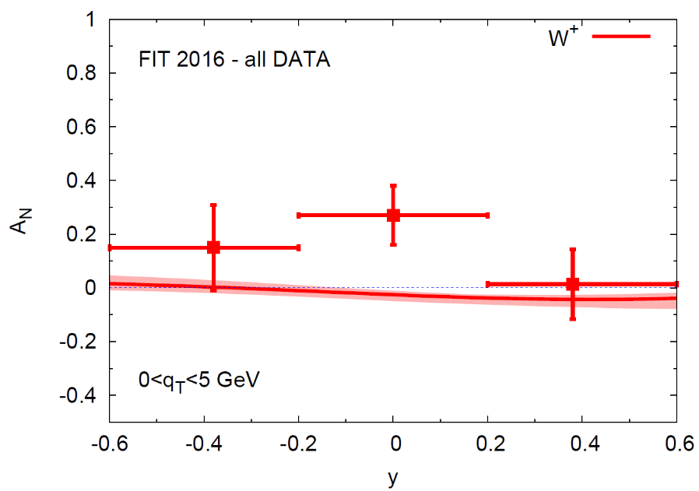

New analysis: (in progress) Anselmino, Boglione, UD, Murgia, Prokudin (2016)
Sign reversed
Underestimated at large $q_{T}$

Slide 25

Collins function & transversity
Combined analysis of
SIDIS
and $e^{+}$ $e^{−}$ $→ππ X$
Without TMD evolution
Anselmino, Boglione, UD, Melis, Murgia, Prokudin (2015)

Slide 26
Same analysis but with TMD evolution
Kang, Prokudin, Sun, Yuan (2015)
No compelling TMD evolution yet
Remember: SSAs are ratios….

Slide 27
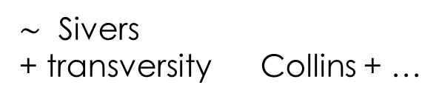
Back to $A_{N}$ : further evidences of Sivers and Collins effects
$\sim$ Sivers
+ transversity Collins + …
In a phenomenological TMD scheme
Non separable
From SIDIS extractions to RHIC $pp$ data (STAR (2008))
(Anselmino, Boglione,UD, Leader, Melis, Murgia, Prokudin (2012 & 2014))
Sivers effect alone
Collins effect alone

Slide 28

Higher-twist contributions to $A_{N}$
Collinear factorization: proven
Qiu, Sterman (1991)
Twist-three functions corresponding, and related, to the TMDs, like
Boer, Mulders, Piljman (2003)
Using these relations one is not able to describe $A_{N}$ (sign mismatch issue)
A completely new twist-3 fragm. function seems to be able to explain $A_{N}$
$A_{N}$ in $pp→γ X$ ideal to disentangle the two approaches ($A_{N}$ with different sign)

Slide 29

In the meantime ….
another successfully description within a TMD scheme
of a SSA for a single -inclusive process: $l p → π X$
Predictions from TMD fact. at LO + Weizsäcker-Williams approximation
HERMES data (2014)
UD, Flore, Murgia (2016)
[LO] Anselmino, Boglione, UD, Melis, Murgia, Prokudin (2010&2014)

Slide 30
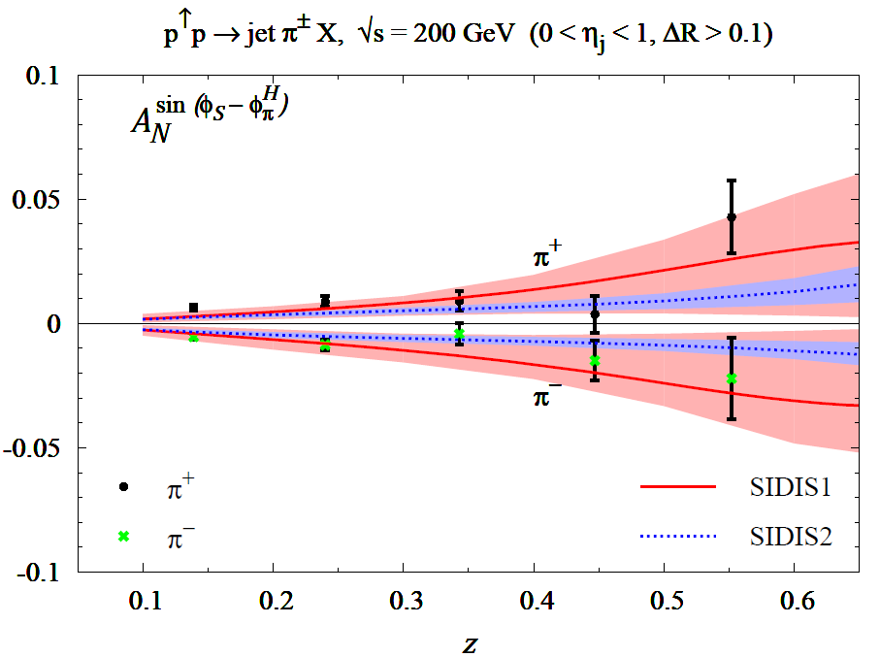
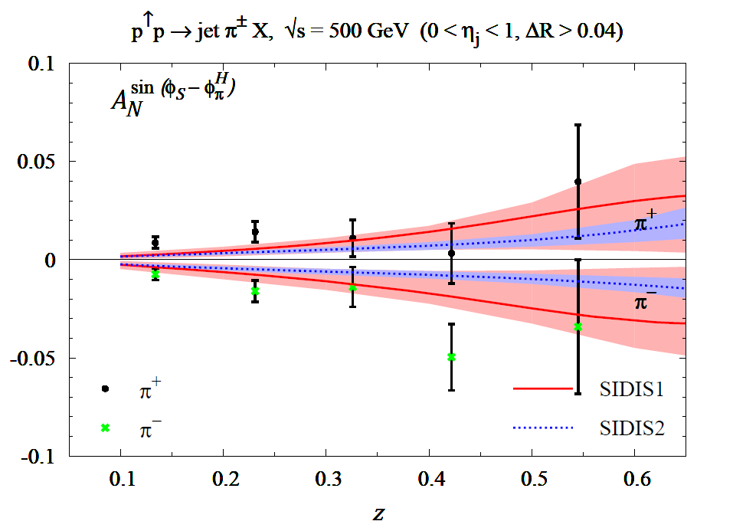


Collins function: from SIDIS to $pp→ π jet X$
$<p_{T}^{Jet}> =$ 13 GeV
$<p_{T}^{Jet}> =$ 31 GeV
200 GeV
500 GeV
Data from STAR Collaboration (2015)
UD, Murgia, Pisano (2011, 2016)
without TMD evolution
Universality of the Collins function and mild (or no) TMD evolution

Slide 31
Open issues in TMD phenomenology
TMD evolution and its relevance
An example
Kang (2015)
w/o TMD evolution
Role of non perturbative input choices
Transverse momentum dependence in SIDIS and its consistency with DY
TMD factorization breaking effects in $pp→ π X , pp→jet jet X$ (sizeable???)
Gluon TMDs at low x and parton saturation,
TMD factorization vs. Color Glass Condensate

Slide 32
Proton spin puzzle
Non trivial decomposition [Leader, Lorcé (2014)]

Slide 33
GPDs: few hints
Virtual Compton scattering
GPDs: Information on position and
quark momentum fraction
Elastic scattering
Form Factor: Position information
No sensitivity to quark momentum

Slide 34

DVCS Factorization
Collins et al. (1998)
Compton
Form Factor
GPD
Different $Φ$ modulations give access
to different combinations of GPDs

Slide 35


$$x=0.25$$
$$x=0.09$$

Slide 36

Physics issues in GPDs
- DVCS: golden channel. Measured at HERMES, COMPASS, CLASS, H1, ZEUS
- DVMP (virtual meson product): uncertainty on meson distr. amplit.
- Extraction of GPDs: model-dependent
- Parameterizations: different families, not always able to describe all data,
qualitatively good (different observables, few parameters and assumptions)
- Major role in the nucleon spin decomposition
Ji (1997)
$H, E$ non-flip GPDs

Slide 37

Future → EIC
JLAB
access to small-$x$domain:
Space, (transv.) momentum and spin distributions of gluon and sea quarks
Missing and complementary information on TMDs and GPDs

Slide 38

Conclusions and open issues
Experimental evidence to go beyond a simple collinear (1D) picture
3D image of the nucleon: tremendous progress
Transverse single-spin asymmetries: challenging and tool to learn deeper on the nucleon structure and QCD
Spin-TMD effects ad GPDs well established
Orbital angular momentum: TMDs (indir.) and GPDs (directly)
More data expected: COMPASS, Jlab, RHIC, and eventually EIC
Phenomenological and theoretical analysis to be improved:
factorization and non perturbative inputs
TMD approach and low-$x$ physics: still to be pursued
TMD and GPD community: very active and spread all over the world (USA, Japan, China, Russia, Netherlands, Belgium, France, Germany, and ITALY)

Slide 39
Research activities in Italy
Theory NINPHA
National Initiative on Physics of Hadrons
Experiments
COMPASS JLAB
Thank you

Slide 40
BACK-UP SLIDES

Slide 41

Access to the gluon Sivers function
$A_{N}$ at mid-rapidity
PHENIX Collaboration data (2014)
All other effects are washed out
UD, Murgia, Pisano JHEP09 (2015)

Slide 42
TMD factorization approaches
Seminal paper
TMD framework
Tremendous progress

