Slide 1
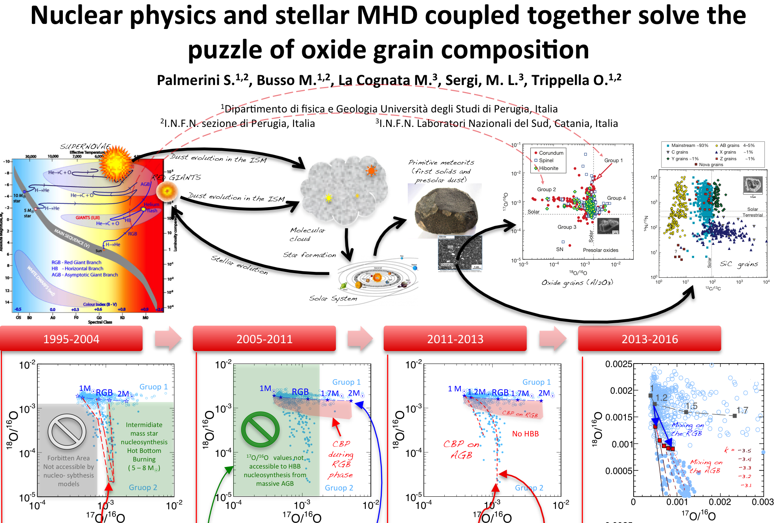

Slide 2
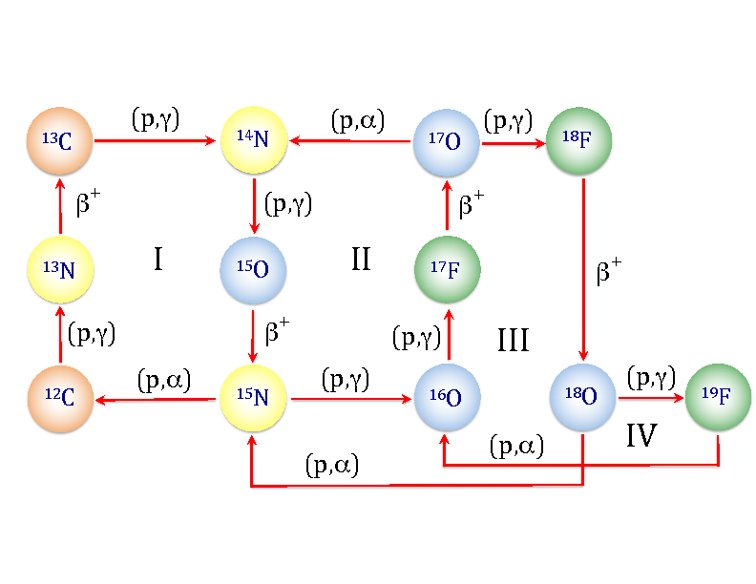
The puzzle about O isotopic mix is solved thanks to nuclear physics
The puzzle about Al isotopic mix is solved thanks to stellar MHD

