Slide 1



RUN II - ALICE results in Pb-Pb collisions at 5.02 TeV
E. Vercellin
Dipartimento di Fisica and INFN Torino

Slide 2
Outline
ALICE – RUN II
  Detector, performance, data taking Pb-Pb
Results
  Global observables and collective behaviour
    charged particle multiplicity
    Flow
  Hight p_{T}
    Charged particles
    Jets
  Open heavy flavors
  Quarkonia
    Charmonia
    Bottomonia
Perspectives

Slide 3
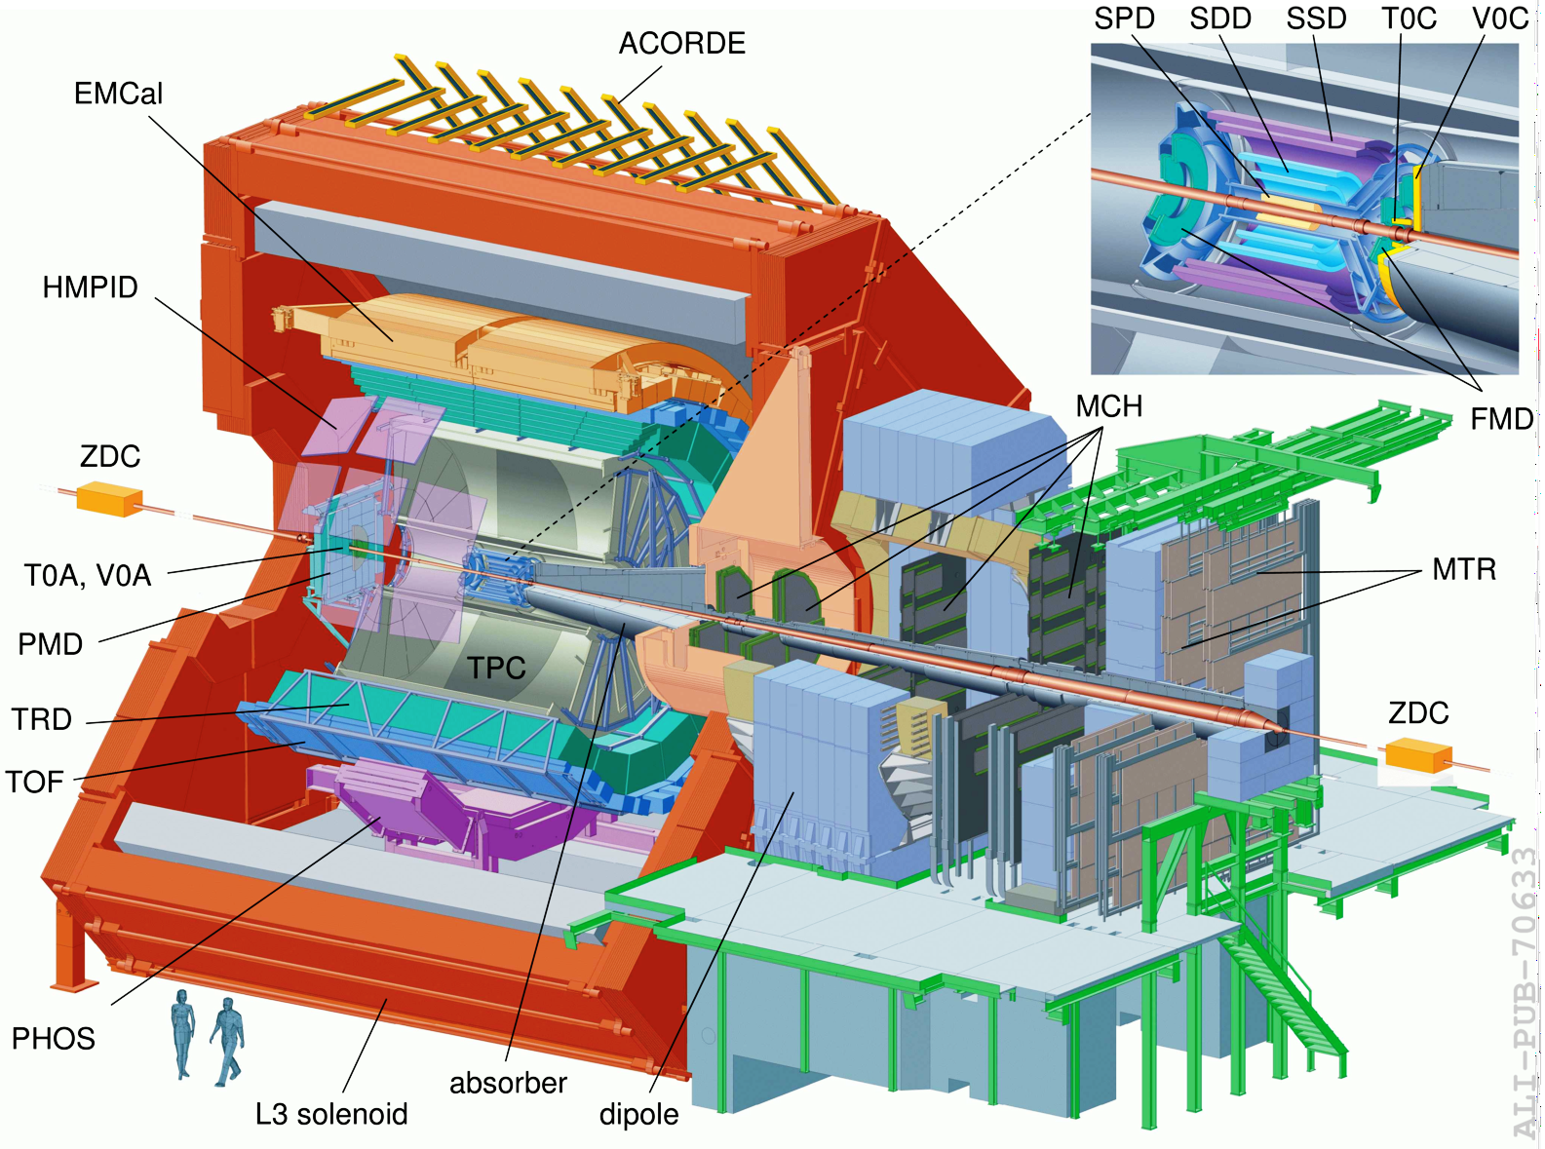
ALICE setup
Central Barrel
2 π tracking & PID
|η| < 1
Muon Spectrometer
-2.5 > η > -4

Slide 4
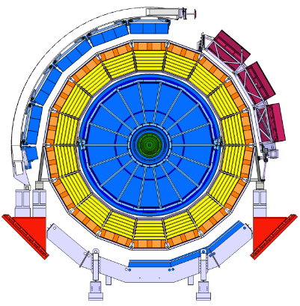
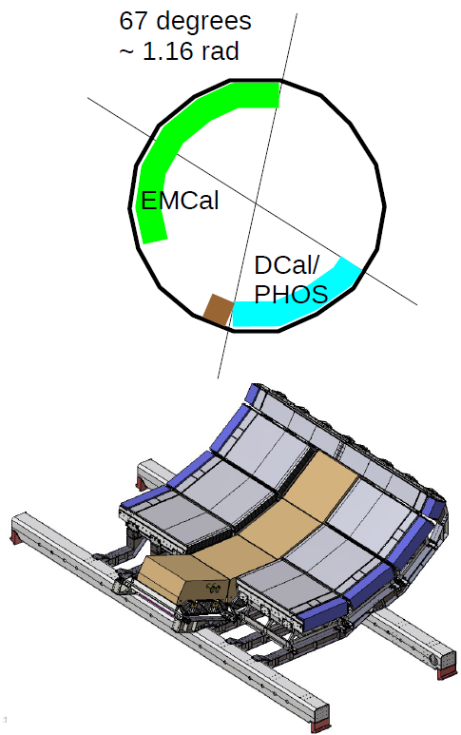
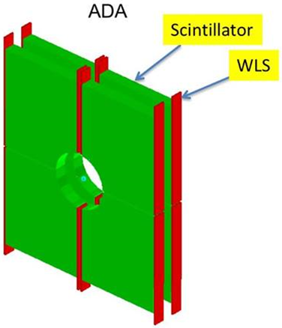
ALICE Setup for Run II
Setup improved during Long Shutdown I
  Installation of full TRD completed: full central barrel acceptance
  Improved calorimetry
    - PHOS completed (4° module + veto)
    - DCAL calorimeter installed back-to-back to existing EMCal
ALICE Diffractive (AD) detector
On each side of IP
4.9 < η < 6.3 and −7.0 < η < −4.8

Slide 5
ALICE Setup for Run II
Setup improved during Long Shutdown I
  Installation of full TRD completed: full central barrel acceptance
  Improved calorimetry
    - PHOS completed (4° module + veto)
    - DCAL calorimeter installed back-to-back to existing EMCal
ALICE Diffractive (AD) detector
On each side of IP
4.9 < η < 6.3 and −7.0 < η < −4.8

Slide 6
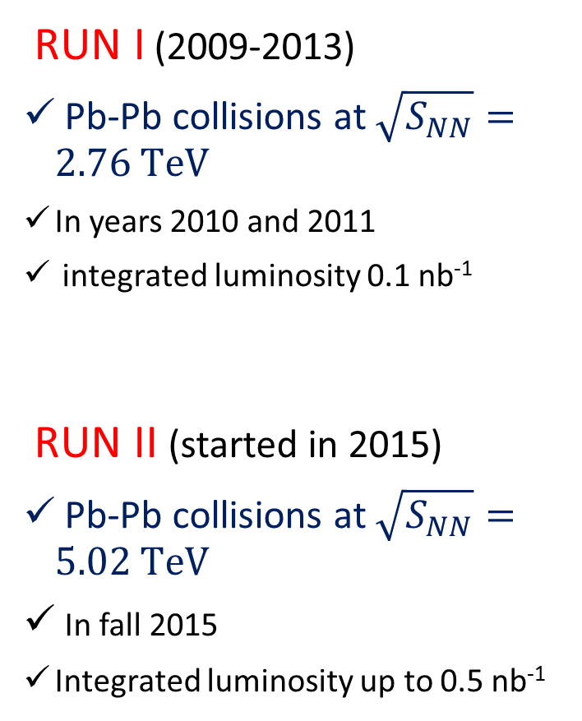
Pb-Pb Data Taking
RUN I (2009-2013)
Pb-Pb collisions at $\sqrt{S_{NN}}=2.76 TeV$
In years 2010 and 2011
integrated luminosity 0.1 nb⁻¹
RUN II (started in 2015)
Pb-Pb collisions at $\sqrt{S_{NN}}=5.02 TeV$
In fall 2015
Integrated luminosity up to 0.5 nb⁻¹

Slide 7
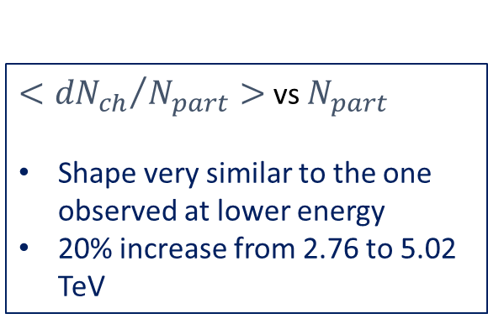
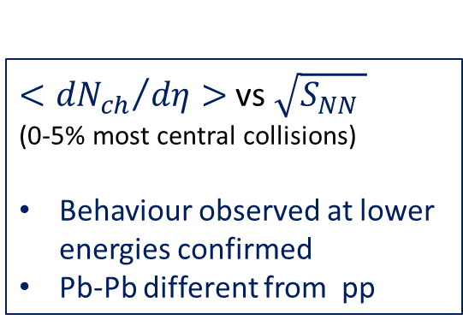
Charged particle multiplicity
$<{{dN}_{ch}}/{dη>}$ vs $\sqrt{S_{NN} }$ (0-5% most central collisions)
Behaviour observed at lower energies confirmed
Pb-Pb different from pp
$<{{dN}_{ch}}/{N_{part}>}$ vs $N_{part}$
Shape very similar to the one observed at lower energy
20% increase from 2.76 to 5.02 TeV

Slide 8
Anisotropic Flow
Azimuthal anysotropy of emitted particles pressure gradient initial space anisotropy of the overlap region
Quantified by Fourier decomposition of particle azimuthal distribution relative to the reaction plane
Sensitive to hydrodinamic properties of the expanding medium

Slide 9
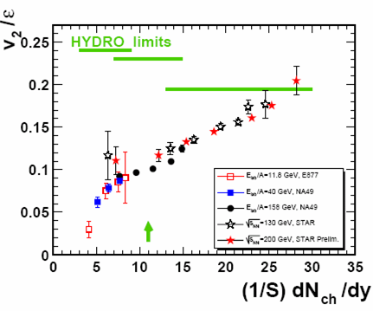
Anisotropic Flow
Spatial anisotropy of the initial system are due to:
Event by event fluctuations Geometry of the collisions
Main message from lower energies studies (RHIC, LHC RUNI)
  Values of flow coefficients are large
  Data reproduced by hydro calculation with low shear viscosity-to-entropy ratio (η/S), close to theoretical lower bound: 1/4π
Indication for a strongly interacting, low viscosity «perfect» fluid
RHIC
SPS
(scaled) Flow
AGS
Multiplicity

Slide 10
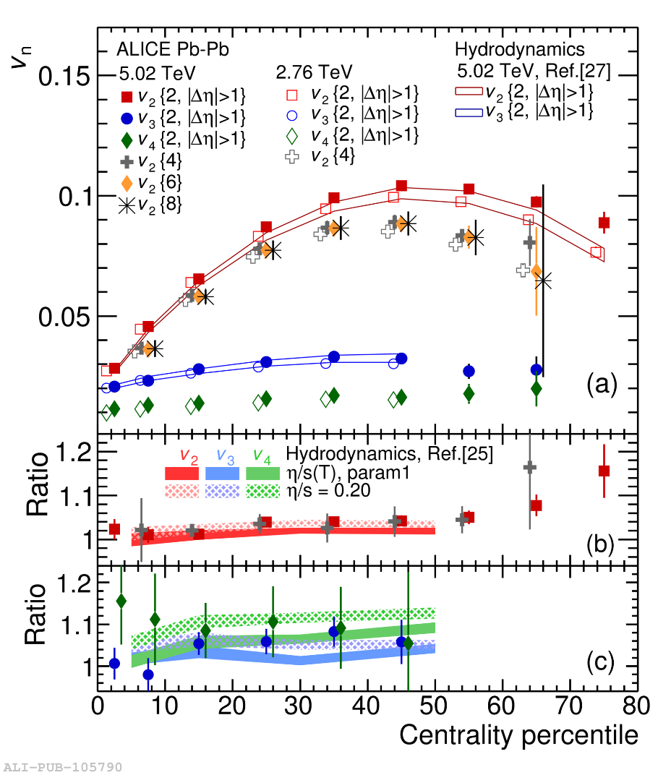
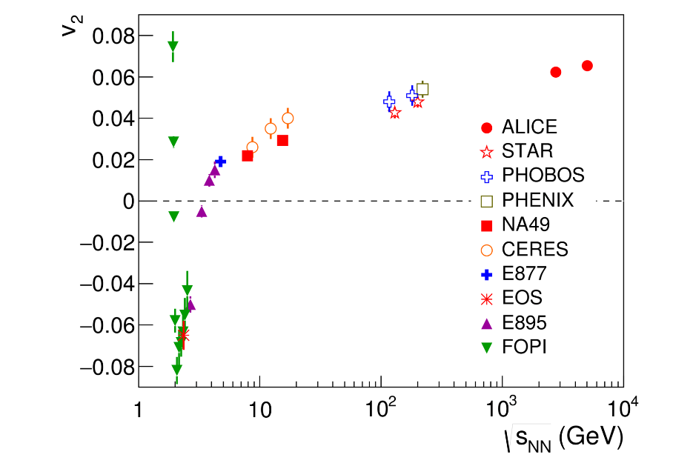
Anisotropic Flow
Results at 5.02 TeV: centrality and energy dependence of flow coefficients
Centrality dependence: results at 5.02 TeV and 2.76 TeV
  Slight increase (by few %) for v₂, v₃ and v₄ in 0-50% centrality interval
  Ratio sensitive to η/S value (constraint to teorethical calculations) → data indicate no or small changes in η/S with energy.
Energy dependence of v₂ (20%-30% cent.)
[25] H. Niemi et al. , PRC 93, 024907 (2016)

Slide 11
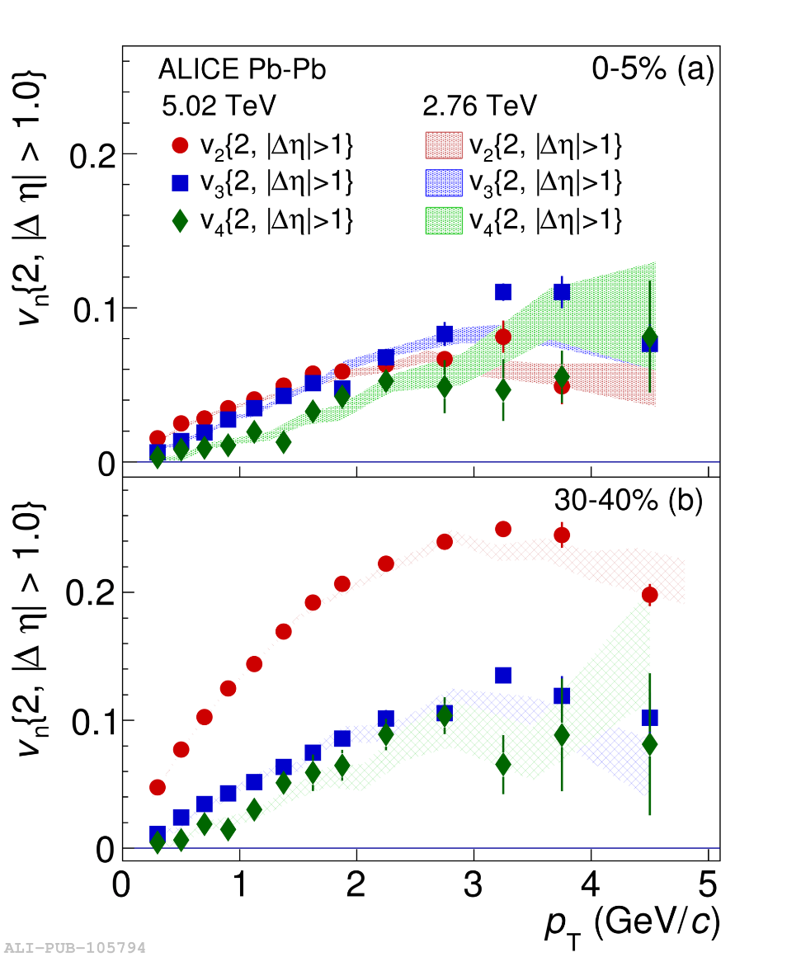
Anisotropic Flow
Results at 5.02 TeV: transverse momentum dependence of flow coefficients
5.02 TeV data consistent with those at 2.76 TeV
  v₂ is the dominant harmonic over all p_{T}, excepted in central events (0-5%) at p_{T}> 2 GeV/c
  The increase in p_{T}-integrated flow can be attributed to an increase in <p_{T}>, i.e. stronger radial flow at higher energies

Slide 12
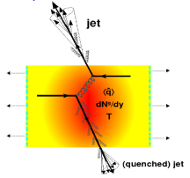

High-p_{T} hadrons and Jets
Parton energy loss:
a parton passing through the QCD medium undergoes energy loss which results in the suppression of high-p_{T} hadron yields, via
Collisional energy loss with partons in the medium
Radiation of gluons (gluonstralhung)
Experimental observable:
Nuclear Modification Factor R_{AA}
Binary scaling
Note: R_{AA} depends on energy lass but also on other parameters, such as the slope of the p_{T} distribution

Slide 13
R_{AA} of high p_{T} charged particles
Nucelar modification factor R_{AA} for non-identified charged particles measured at mid rapidity in different centrality bins at midrapidity
Strong suppression of charged particle production confirmed
Minimum at p_{T} ≈ 6-7 GeV/c
Rise in the p_{T} region between 6 and 50 GeV/c
Clear evolution with centrality
RAA at 5.02 TeV similar to 2.76 TeV

Slide 14
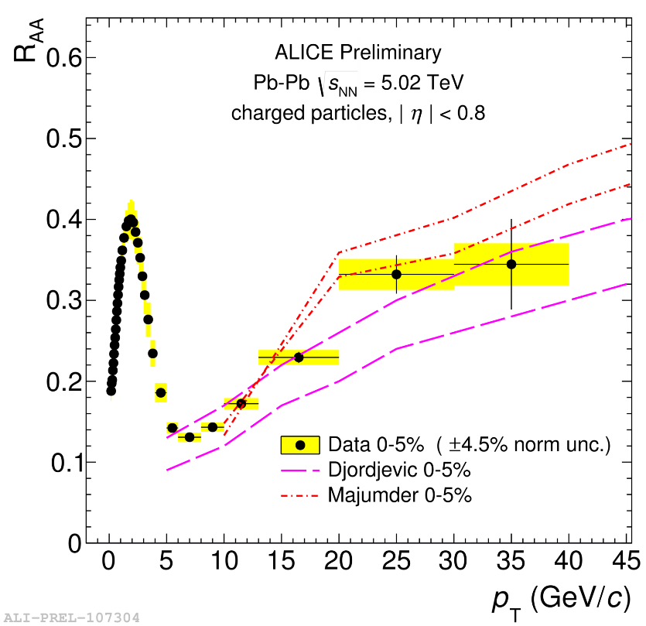
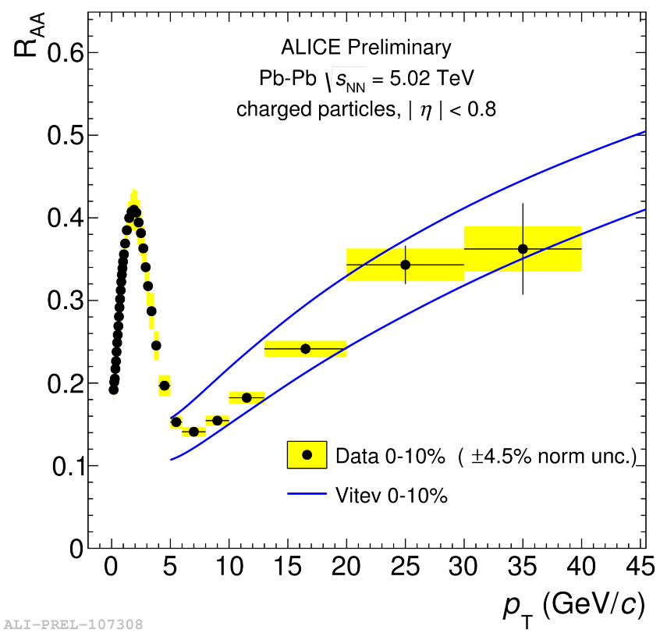
R_{AA} of high p_{T} charged particles
R_{AA}: comparison to models
Data reproduced by models including:
Radiative energy loss Radiative and collisional energy loss
Vitev et al., Phys Rev. D 93 074030 (2016) Djordjevich at al., arXiv:1601.07852
Majumder et al., Phys. Rev. Lett. 109 202301 (2016)

Slide 15
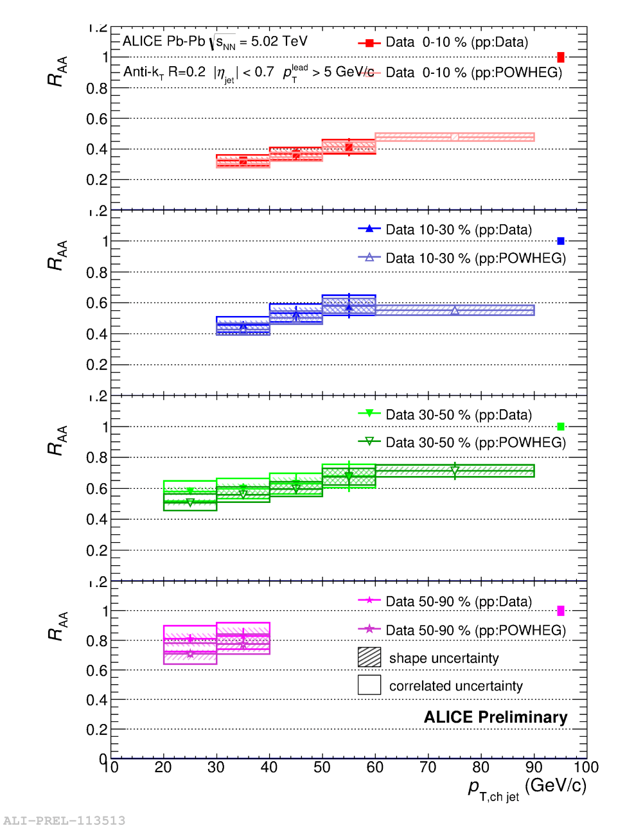
Jets
Jets: spray of particles from hard parton fragmentation → closer access to parton energy
Out of cone radiation → influence on Jet R_{AA}
In-cone radiation → may lead to Jet shape modifications, «jet broadening»
Charged-particle jet R_{AA}:
Strong suppression observed at 5.02 TeV
Clear evolution with centrality

Slide 16
Jets

Slide 17
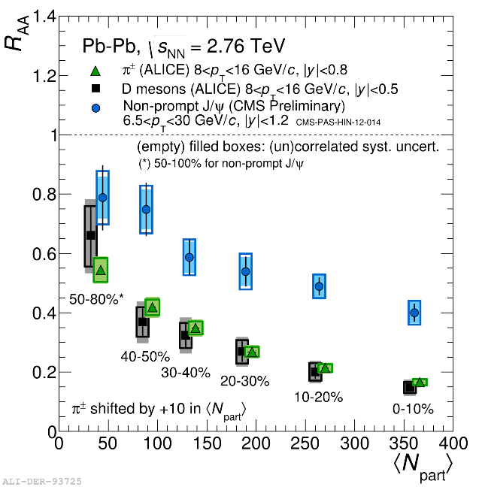
Open heavy flavors
Specific features of heavy quarks relevant to heavy-ion studies
Large mass (m_{c}≈1.5 GeV, m_{b}≈5 GeV) → produced in hard processes at the initial stage of the collision with short formation time, much smaller than QGP lifetime
Flavor conserved by strong interaction + production of HF in QGP is subdominant → interaction with QGP do not change flavor identity
HF are hardly distroyed/created by the medium and are transported through the full system evolution
Tool for understanding the general properties of parton energy loss in a deconfined medium since this is expected to depend (also) on the Casimir factor C_{R} and on the quark mass (dead cone effect)
ALICE: arXiv:1506.06604
CMS: PAS_HIN-12-14
RUN-I: first indication of mass dependence of energy loss

Slide 18
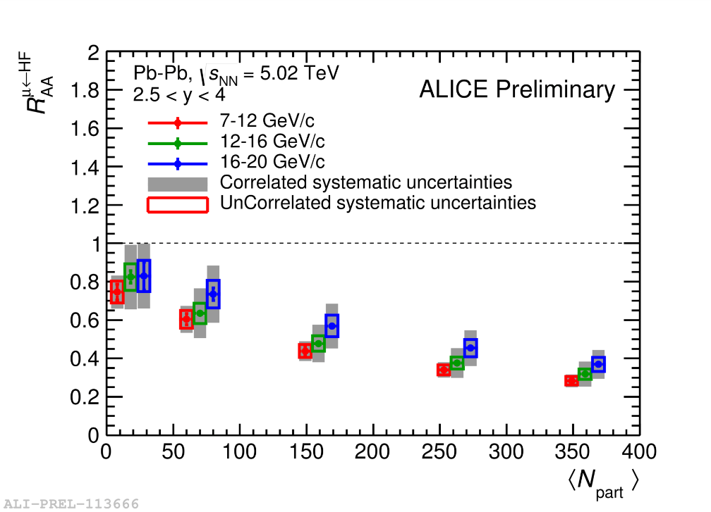
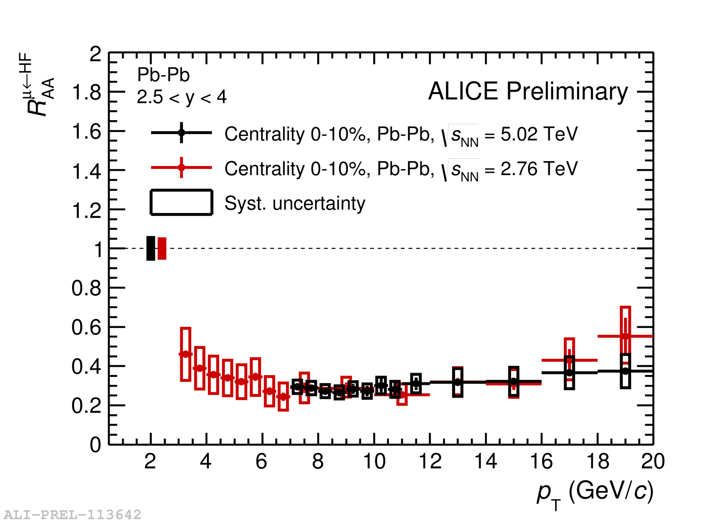
Open heavy flavors
First R_{AA} results at 5.02 TeV: muons from HF decays at forward rapidity
Strong suppression of muons from HF decay:
increasing with centrality
(slightly) decreasing with p_{T} for p_{T} above 7 GeV/c
R_{AA} at 5.02 TeV is compatible with the one at 2.76 TeV
(note: denser medium but flatter p_{T} spectrum)

Slide 19
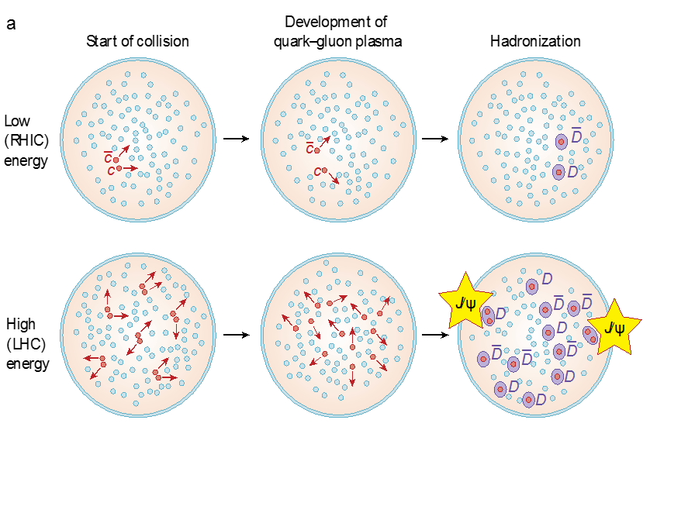
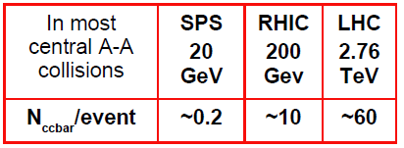
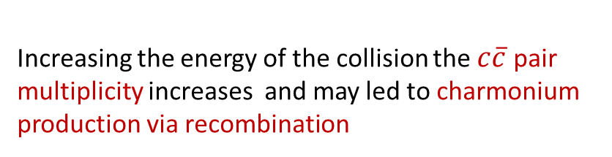
Quarkonia: suppression … and (re)-generation
Matsui & Satz: charmonia are dissociated in QGP becoause of color screening → J/ψ suppression
Difference between binding energies of quarkonia states
→ sequential melting, QGP Thermometer
(Digal,Petrecki,Satz PRD 64(2001) 0940150)
Increasing the energy of the collision the $c\overline{c}$ pair multiplicity increases and may led to charmonium production via recombination
Charmonoum production may be enhanced via (re)combination of cc pairs at hadronization (statistical approach) or during QGP stage (kinetic recombination approach)
P. Braun-Muzinger and J. Stachel, Phys. Lett. B490(2000) 196, R. Thews et al, Phys.ReV.C63:054905(2001)

Slide 20
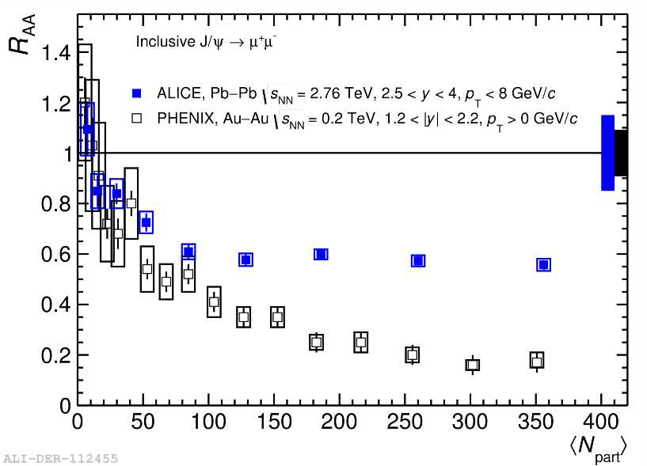
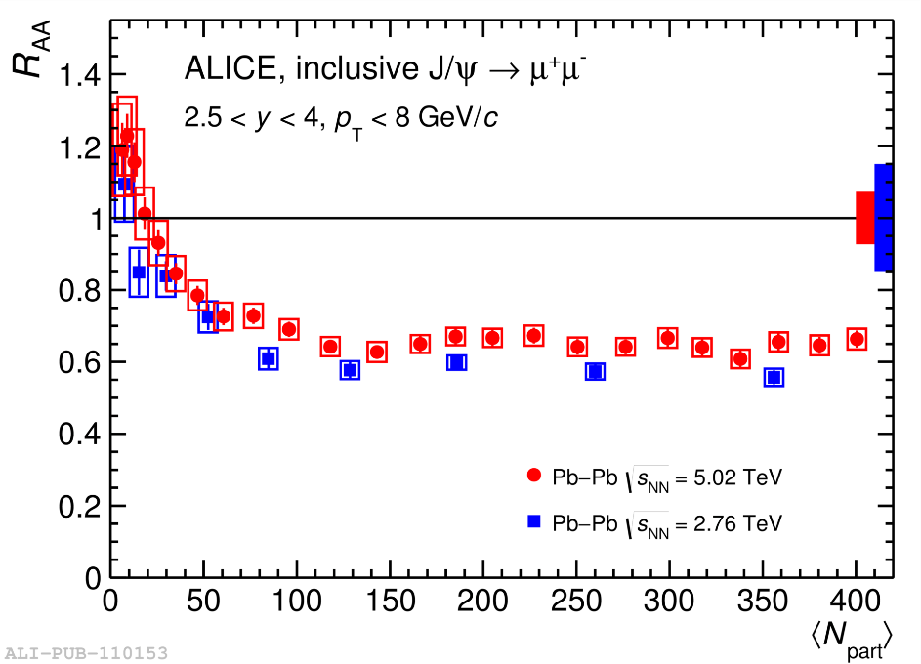
J/ψ : R_{AA} vs centrality
PLB 734 (2014) 314-327
Focus: inclusive J/ψ prod. at forward rapidity
R_{AA} in Pb-Pb collisions at 2.76 TeV:
  Larger than Au-Au collisions at 200 GeV:
  J/ψ less suppressed at LHC than at RHIC
  Consistent with regeneration scenarii
arXiv:1601.08197
R_{AA} in Pb-Pb collisions at 5.02 TeV:
  w.r.t. RUN I: better statistics and reduced systematics errors
  Trend similar to the one at 2.76 TeV
  Flat behaviour for N_{part}>100
  Hint for electromagnetic production in the most peripheral bins

Slide 21
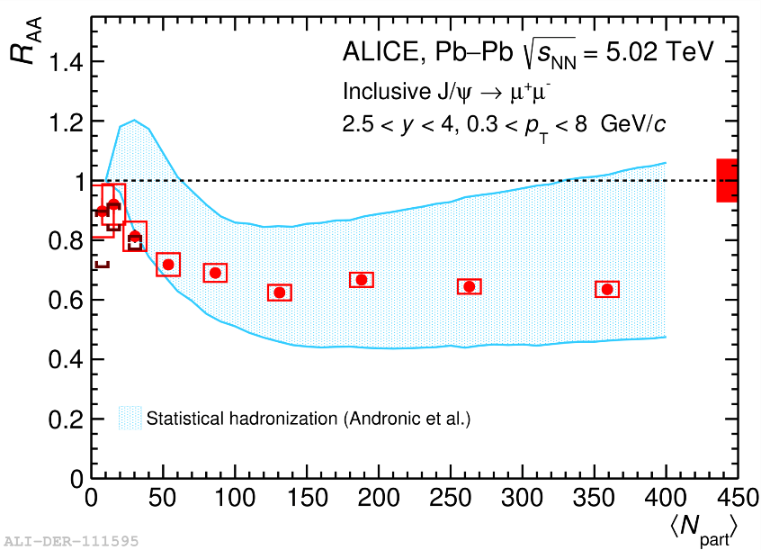
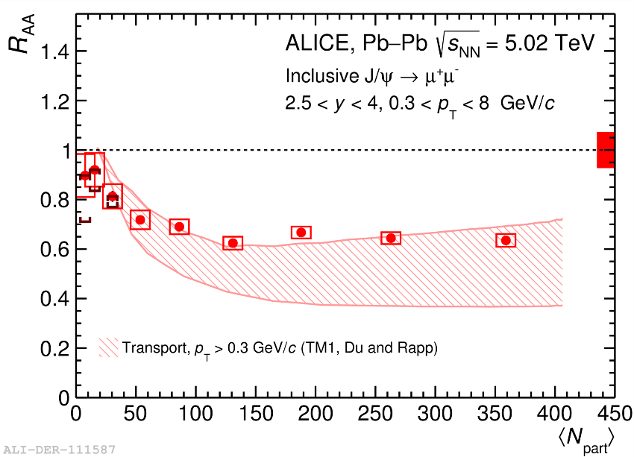
J/ψ : comparison to models
R_{AA} vs. centrality : agreement with regeneration models.
Note: plots for J/ψ transverse momentum above 0.3 GeV/c to minimise of possible influence of e.m. production mechsnism, relevant at low p_{T}.

Slide 22
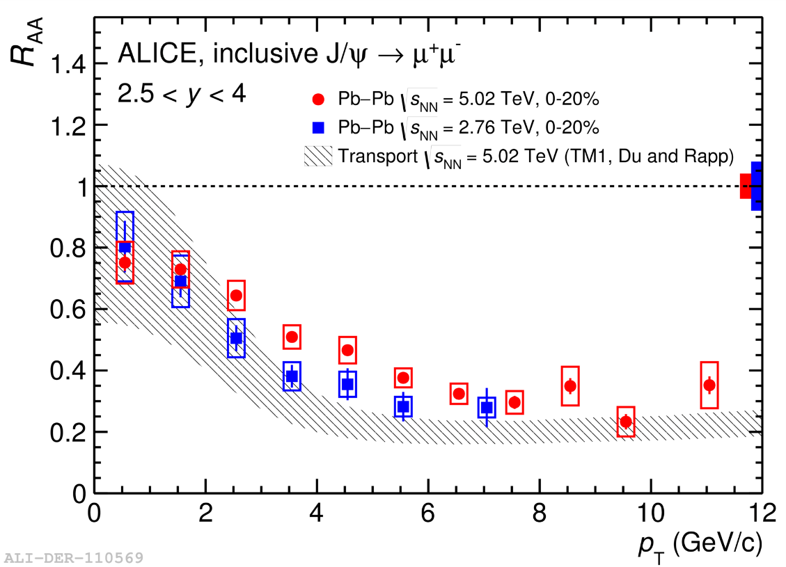
J/ψ: R_{AA}vs. p_{T}
Comparison to 2.76 TeV and to models
We observe less suppression at low p_{T}, as expected in case of a strong regeneration component.
Extended p_{T} range at 5.02 TeV, up to 12 GeV/c
In the common p_{T} interval, similar behaviour for the two energies
The observed behavior is reasonably well reproduced by transport models (Du and Rapp)

Slide 23
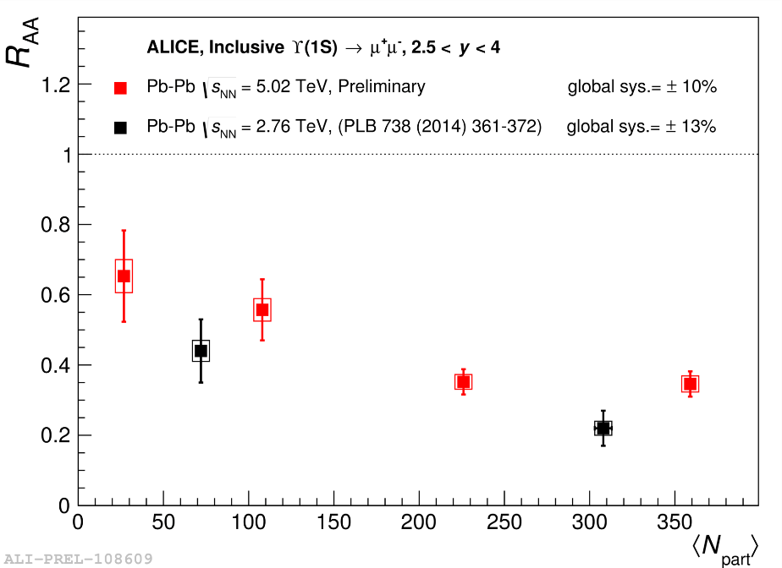
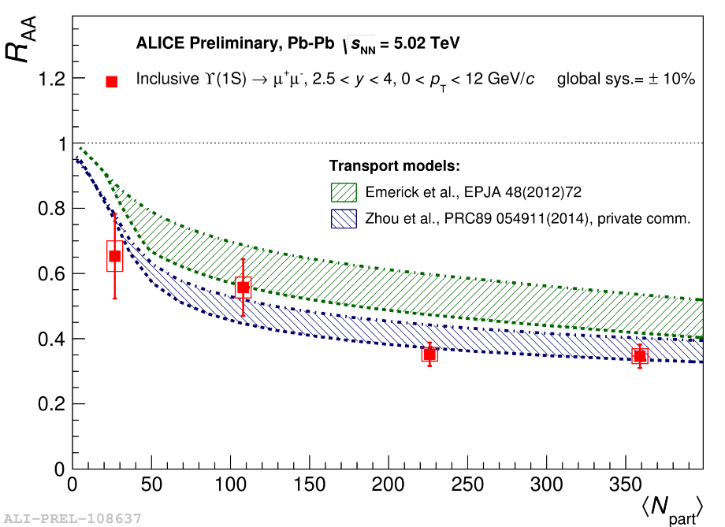
Bottomonia: ϒ(1s)
R_{AA} vs. centrality
ϒ(1s) measured at forward rapidity via dimuon decay channel
R_{AA} indicates strong suppression, increasing from peripheral to central collisions
R_{AA} similar at 5.02 and 2.76 TeV (within uncertainties)
Data at 5.02 Tev are compared to transport models, which turn out to reproduce the main features of the observed suppression pattern.
  A. Emerik, X. Zhao and R. Rapp → Regeneration included, feed down data-tuned, band width by varying shadowing
  K. Zhou, N. Xu, Z. Xu and P. Zhuang → regeneration NOT included, band width by varying feed down, shadowing EKS98

