Slide 1

Crystal structures in geant4
Enrico Bagli

Slide 2
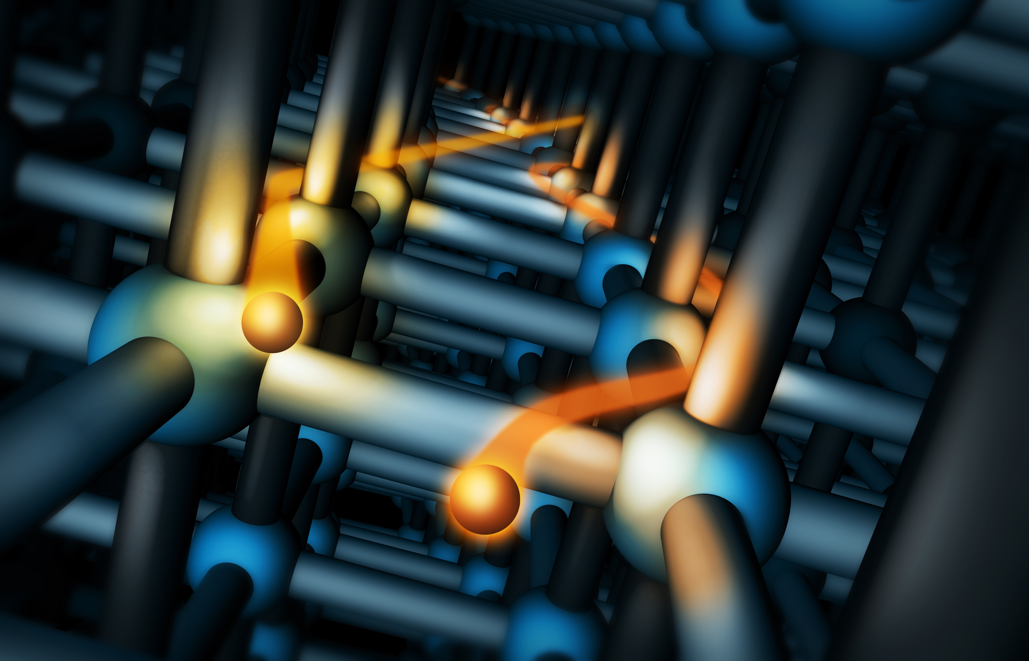
Introduction

Slide 3
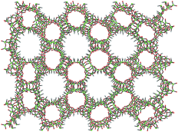
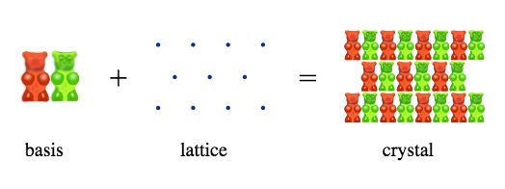
Crystals
A lattice is a discrete but infinite regular arrangement of points in a vector space
A crystal is defined as a lattice with a basis added to each lattice site.
Usually the basis consists of an atom, a group of atoms or a molecule.

Slide 4
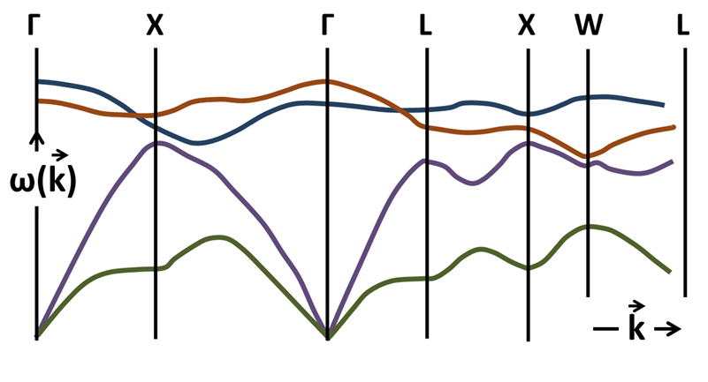
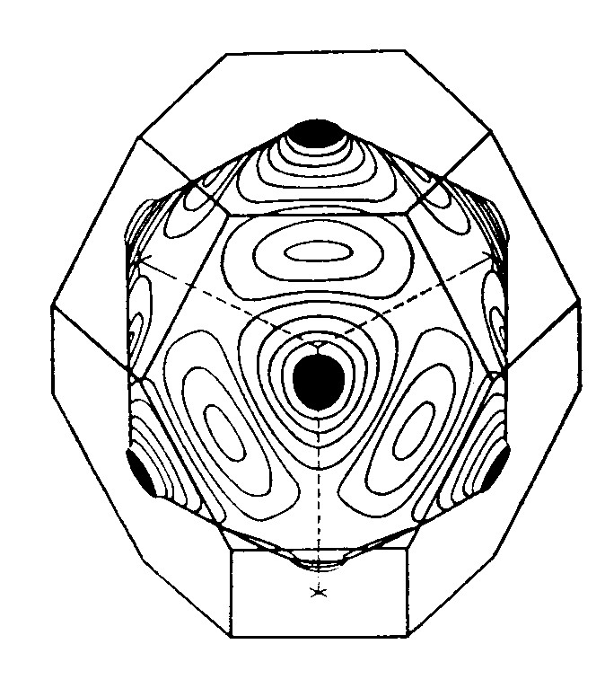
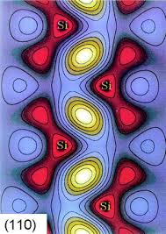
Crystals
Periodicity of the crystal structure is fundamental for many physical processes.
Important physical values can be calculated for each crystal structure.
For example the electron density in the crystal, the band structure, the dispersion relation for the phonon group velocity evolution.

Slide 5
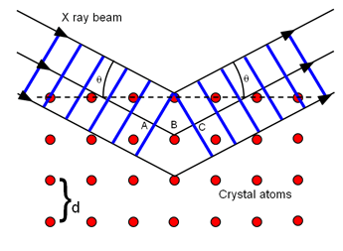
Crystals
The crystal lattice has an orientation in space.
The lattice orientation determines if some physics processes happen.
As an example X-ray diffraction strongly depends on the lattice orientation with respect to the incoming beam direction.

Slide 6
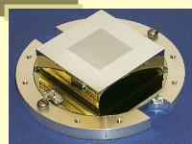
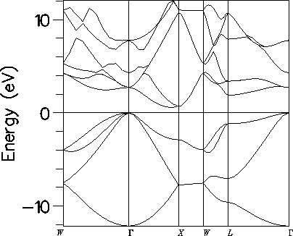
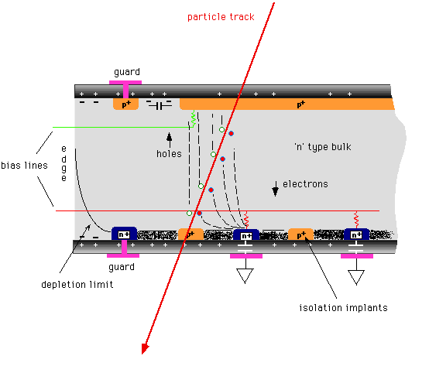
Solid-state detectors
Semiconductor based detectors are used for astrophysics and high-energy physics, for X-rays detection in medical imaging and diagnostic, for particle counters in nuclear phyisic.
Ionizing particle produces a current pulse in the semiconductor, generating pairs of electron-holes transported by an electric-field, amplified, collected and digitalized.

Slide 7
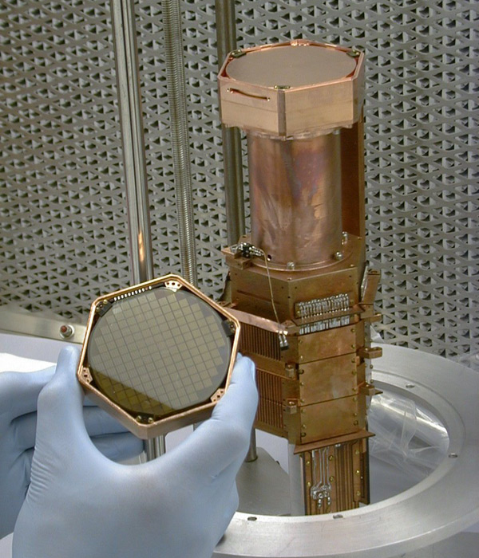
Dark matter search
  Measurement of the recoil energy imparted to a nucleus due to collisions with WIMPs is done employing detectors highly sensitive to the ionization and phonon signals that results from a WIMP-nucleus collision (Cryogenic Dark Matter Search experiment)

Slide 8
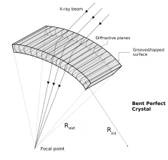

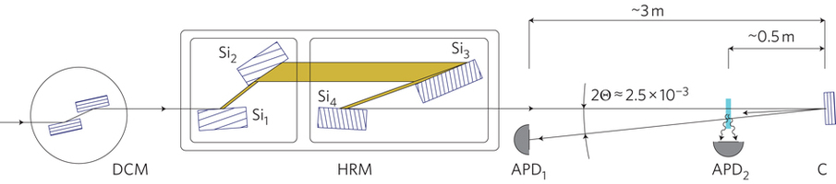
Diffraction from periodical lattice
Bragg diffraction is the consequence of the interference between waves reflecting from different crystal planes coherently .
Field of applications are accelerator (synchrotrons), nuclear reactors (neutron diffraction), crystalline material analysis (diffractometry), astrophysics (laue lens), medicine (DNA, RNA macromolecules analysis).

Slide 9
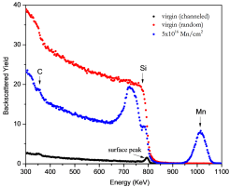
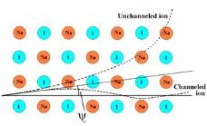
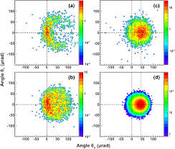
Channeling in crystals
Particle trajectories and penetration depth into crystal are altered by the presence of periodic structures.
Material analysis by ion channeling allows to examining the density of defects and the contaminants of the crystal.
At GeV energies channeling in bent crystals is used for the extraction, collimation and focusing of charged particles beams.

Slide 10
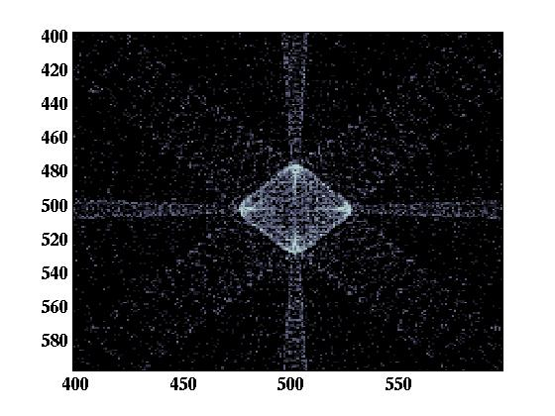
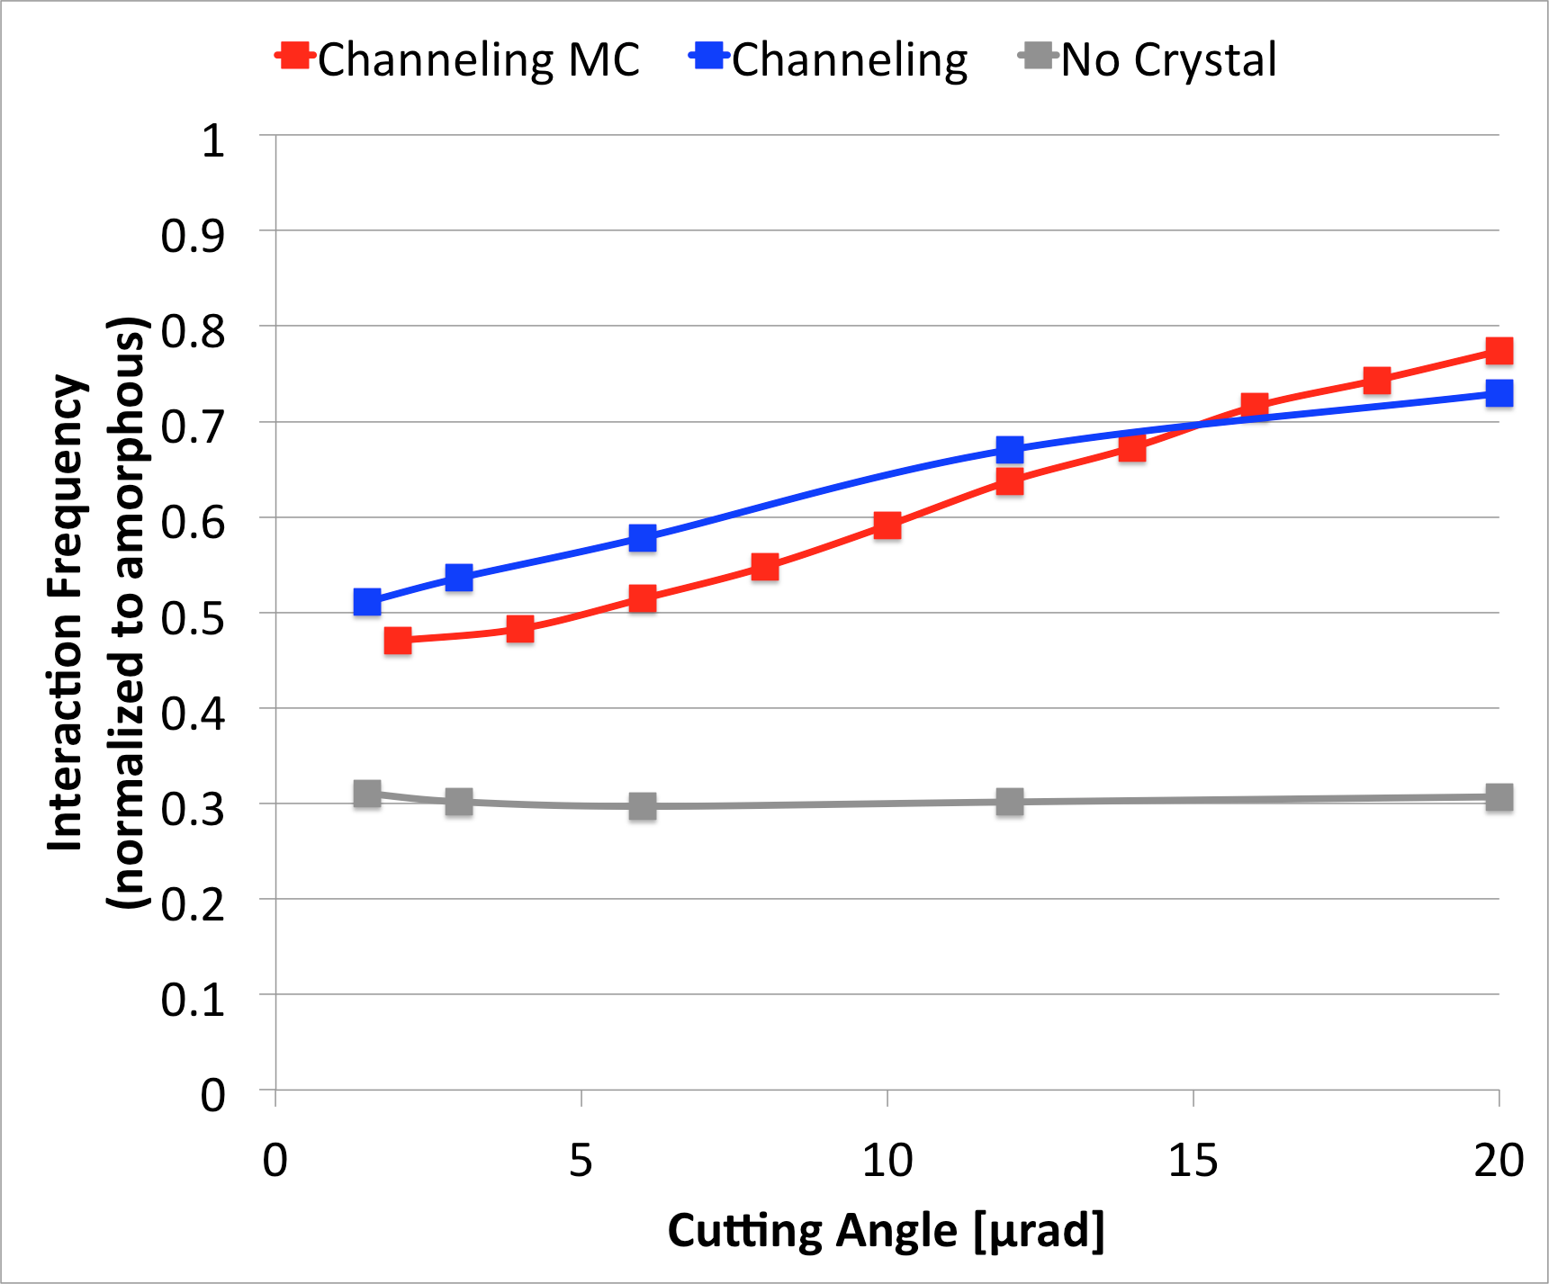
Crystals in Geant4

Slide 11
Geant4 + Crystals
Now:
Geant4 provides two examples with crystals, with two versions of support for crystal structures
  Phonon propagation in ultra-cold Ge
    examples/extended/exotic/phonon
  Channeling at high-energy in Si/Ge
    examples/extended/exotic/channeling
Near Future
General support for crystal structures in Geant4 (2016)
Physics list (from 2017):
  Channeling
  Phonon

Slide 12
Geant4 Crystal Objects
Physical Volume
Crystal Data
Crystal Material
Logical Crystal Volume
Crystal Lattice
Atoms
A crystal is an ordered structure of atoms, ions or molecules.
G4MaterialCrystal is a class derived from the G4Material class.
G4MaterialCrystal collects the description of the unit cell, the base and the lattice.

Slide 13
Geant4 Crystal Objects
Physical Volume
Crystal Data
Crystal Material
Logical Crystal Volume
Crystal Lattice
Atoms
G4LogicalCrystalVolume is a class derived from the G4LogicalVolume class.
G4LogicalCrystalVolume collects
  Crystal data (band structure, electron density, etc…);
  Lattice orientation with respect to the solid.

Slide 14
Existing solid-state codes
Crystallographic Information File
Solid State Software (GPL)
Crystallographic Information File
  the standard for crystallographic data exchange prescribed by the International Union of Crystallography since 1991.
Crystallography Open Database:
  open-access database in which users are able to contribute with published and unpublished structures of small molecules and small to medium sized unit cell crystals to the database.
Geant4 is devoted to the simulation the propagation of particles (pseudo-particles) in matter.
The physical quantities of interest in crystals, e.g., electrons distributions, potential, electronic band structure, are needed by the Geant4 crystal processes.
The compatibility of input with existing codes is fundamental in the first version of the Geant4 support to crystal structures.

Slide 15
Geant4 Crystal Objects
A Geant4 crystal object is instantiated as:
G4MaterialCrystal* SiCrystal =
new G4MaterialCrystal(Si);
SiCrystal->AddCrystalLattice(14,
new G4CrystalLatticeDiamond());
G4LogicalVolume* fXtalLogic =
new G4LogicalCrystalVolume(fXtalSolid,SiCrystal,"Target");
((G4LogicalCrystalVolume*)fXtalLogic)->AddCrystalData(
new G4CrystalProcessData());
Instantiate a crystalline material instead of a standard material
Preliminary

Slide 16
Geant4 Crystal Objects
A Geant4 crystal object is instantiated as:
G4MaterialCrystal* SiCrystal =
new G4MaterialCrystal(Si);
SiCrystal->AddCrystalLattice(14,
new G4CrystalLatticeDiamond());
G4LogicalVolume* fXtalLogic =
new G4LogicalCrystalVolume(fXtalSolid,SiCrystal,"Target");
((G4LogicalCrystalVolume*)fXtalLogic)->AddCrystalData(
new G4CrystalProcessData());
Add a lattice to the base (the Si element)
Preliminary

Slide 17
Geant4 Crystal Objects
A Geant4 crystal object is instantiated as:
G4MaterialCrystal* SiCrystal =
new G4MaterialCrystal(Si);
SiCrystal->AddCrystalLattice(14,
new G4CrystalLatticeDiamond());
G4LogicalVolume* fXtalLogic =
new G4LogicalCrystalVolume(fXtalSolid,SiCrystal,"Target");
((G4LogicalCrystalVolume*)fXtalLogic)->AddCrystalData(
new G4CrystalProcessData());
Instantiate a crystalline logical volume with the crystalline material
Preliminary

Slide 18
Geant4 Crystal Objects
A Geant4 crystal object is instantiated as:
G4MaterialCrystal* SiCrystal =
new G4MaterialCrystal(Si);
SiCrystal->AddCrystalLattice(14,
new G4CrystalLatticeDiamond());
G4LogicalVolume* fXtalLogic =
new G4LogicalCrystalVolume(fXtalSolid,SiCrystal,"Target");
((G4LogicalCrystalVolume*)fXtalLogic)->AddCrystalData(
new G4CrystalProcessData());
Add crystal data to the logical crystal volume
G4CrystalProcessData is a derived class of G4CrystalData
Preliminary

Slide 19
Geant4 Crystal Objects
Standard material
Crystal material
G4Material* Si =
G4NistManager::Instance()-> FindOrBuildMaterial("G4_Si");
G4MaterialCrystal* SiCrystal =
new G4MaterialCrystal(Si);
SiCrystal->AddCrystalLattice(14,
new G4CrystalLatticeDiamond());
G4LogicalVolume* fXtalLogic = new G4LogicalVolume(fXtalSolid,Si,
"Target");
G4LogicalVolume* fXtalLogic = new G4LogicalCrystalVolume(fXtalSolid,
SiCrystal,"Target");
((G4LogicalCrystalVolume*)
fXtalLogic)->AddCrystalData(
new G4CrystalProcessData());
Preliminary

Slide 20
Geant4 Crystal Objects
In a Geant4 process, you can ask if the logical volume is a crystal and get the crystal data:
if(G4CrystalManager::GetManager()->Has(logVolume)){
G4LogicalCrystalVolume* logCrystal =
(G4LogicalCrystalVolume*) logVolume;
if(savedIndex == -1){
savedIndex = logCrystal
->GetCrystalDataIndex("someCrystalData");
if(savedIndex > -1){
G4CrystalProcessData* crystalData = (G4CrystalProcessData*) logCrystal
->GetCrystalData(savedIndex );
G4double aValue = crystalData->GetValue();
...
}
}
Ask the crystal manager if a logical volume is a crystal
Preliminary

Slide 21
Geant4 Crystal Objects
In a Geant4 process, you can ask if the logical volume is a crystal and get the crystal data:
if(G4CrystalManager::GetManager()->Has(logVolume)){
G4LogicalCrystalVolume* logCrystal =
(G4LogicalCrystalVolume*) logVolume;
if(savedIndex == -1){
savedIndex = logCrystal
->GetCrystalDataIndex("someCrystalData");
if(savedIndex > -1){
G4CrystalProcessData* crystalData = (G4CrystalProcessData*) logCrystal
->GetCrystalData(savedIndex );
G4double aValue = crystalData->GetValue();
...
}
}
Ask the logical crystal volume the index of the data “someCrystalData”
Preliminary

Slide 22
Geant4 Crystal Objects
In a Geant4 process, you can ask if the logical volume is a crystal and get the crystal data:
if(G4CrystalManager::GetManager()->Has(logVolume)){
G4LogicalCrystalVolume* logCrystal =
(G4LogicalCrystalVolume*) logVolume;
if(savedIndex == -1){
savedIndex = logCrystal
->GetCrystalDataIndex("someCrystalData");
if(savedIndex > -1){
G4CrystalProcessData* crystalData = (G4CrystalProcessData*) logCrystal
->GetCrystalData(savedIndex );
G4double aValue = crystalData->GetValue();
...
}
}
Get the data using the stored index
Preliminary

Slide 23
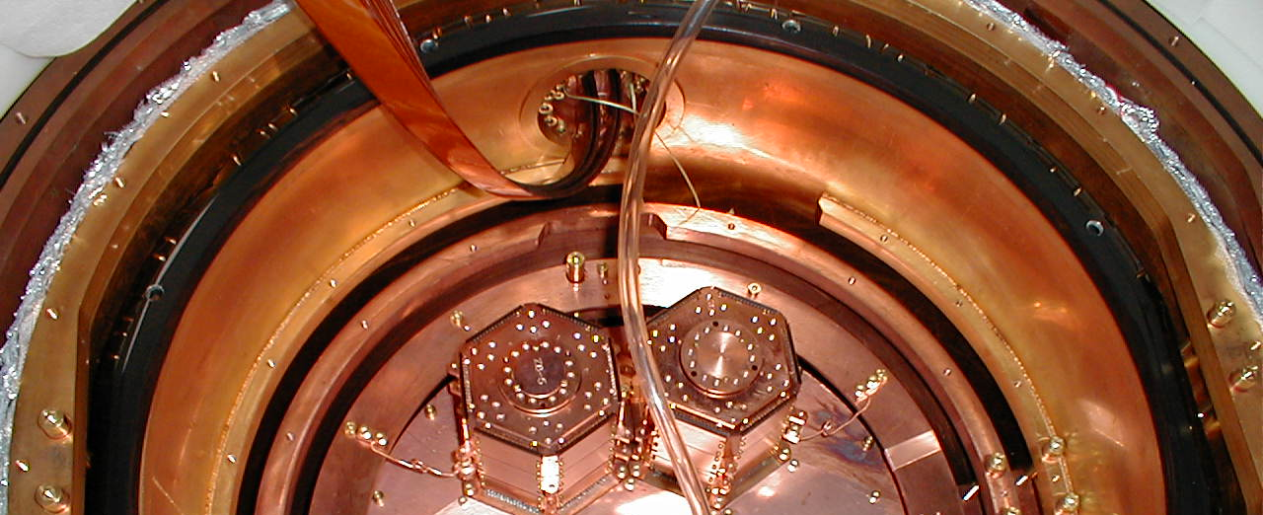
Phonon Propagation
Phonon example in extended/exotic

Slide 24
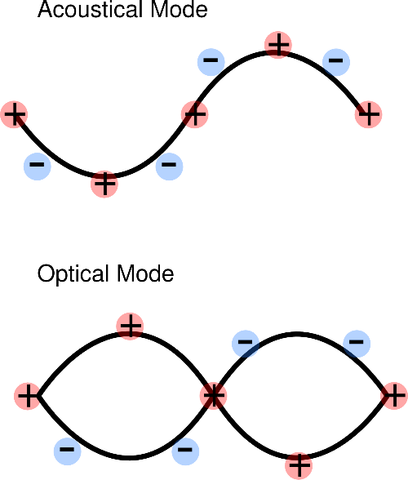
Phonons
Phonons are collective oscillations of a crystal lattice (wave-particle duality)
Two types of phonons:
  acoustic phonons:
    coherent movements of atoms of the lattice
  optical phonons
    out-of-phase movements of the atoms in the lattice

Slide 25
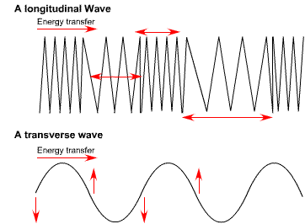
Phonons
Oscillations of acoustic and optical phonons may have three modes:
  Longitudinal waves: the displacement and the travel of the wave are in the same/opposite direction
  Transverse waves: oscillations are perpendicular to the direction of energy transfer (slow and fast)

Slide 26
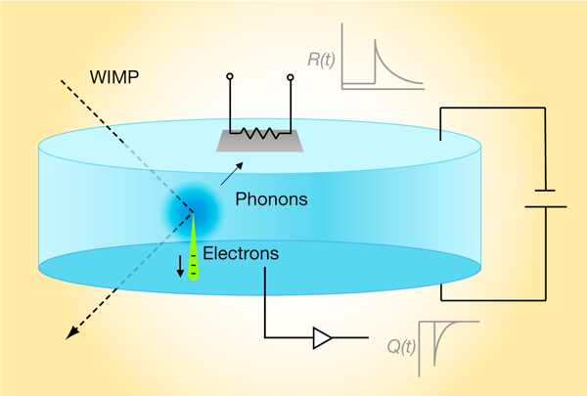
Geant4 Phonons
CDMS experiment
Nuclear Recoil
The goal of the CDMS experiment is to detect CDMS the WIMPs (Weakly Interacting Massive Particles), i.e. the Dark Matter.
The experiment aims to measure the recoil energy imparted to a nucleus due to collisions with WIMPs.
The employed detectors are highly sensitive to the ionization and phonon signals that results from a WIMP-nucleus collision.
The CDMS detectors are cylindrical Ge crystals approximately 75 mm in diameter with a height of 25 mm, cooled to approximately 60 mK

Slide 27
Geant4 Phonons
CDMS experiment
Geant4 Phonon Types
The goal of the CDMS experiment is to detect CDMS the WIMPs (Weakly Interacting Massive Particles), i.e. the Dark Matter.
The experiment aims to measure the recoil energy imparted to a nucleus due to collisions with WIMPs.
The employed detectors are highly sensitive to the ionization and phonon signals that results from a WIMP-nucleus collision.
The CDMS detectors are cylindrical Ge crystals approximately 75 mm in diameter with a height of 25 mm, cooled to approximately 60 mK
The phonon transport code described is intended for temperatures T < 1K
Scattering of thermally excited background phonons is ignored
Only acoustic phonons in cubic lattices are treated.
Three types of phonons are implemented:
  Longitudinal
  “slow” and “fast” transverse

Slide 28
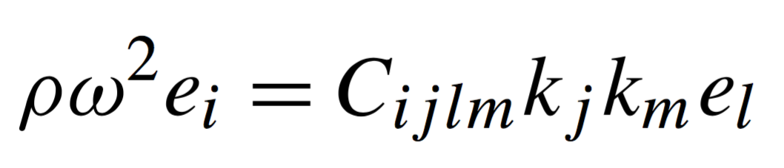
Geant4 Phonons Processes
Processes implemented
Anisotropic propagation
Anisotropic propagation
Isotope Scattering
Mode Mixing
Downconversion
Phonon propagation in the absorber crystal is governed by the three-dimensional wave equation
By solving it for a phonon of given wave vector k, three eigenvalues ω and three eigenvectors e can be found, corresponding to the three discrete polarization states Longitudinal , Fast and Slow Transverse.

Slide 29
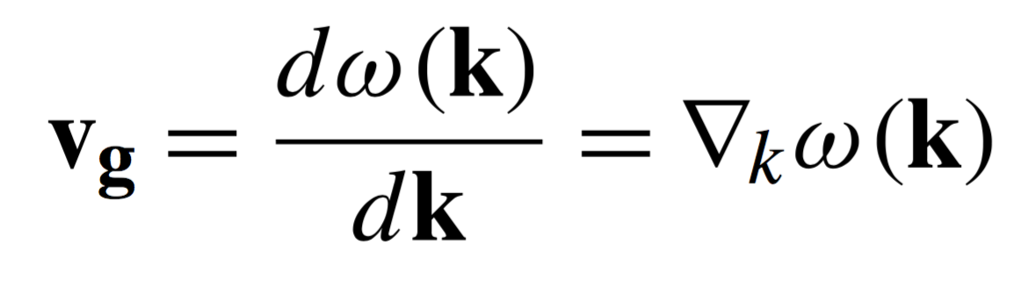
Geant4 Phonons Processes
Processes implemented
Anisotropic propagation
Anisotropic propagation
Isotope Scattering
Mode Mixing
Downconversion
Energy transport occurs along the group velocity vector, which can be found from the three-dimensional wave equation as
There are two key aspects to the solution of the wave equation:
  The momentum vector is not generally parallel to the vector of energy transport.
  Phonons at frequencies characteristic of quasi diffusion are non-dispersive.

Slide 30
Geant4 Phonons Processes
Processes implemented
Isotope Scattering & Mode Mixing
Anisotropic propagation
Isotope Scattering
Mode Mixing
Downconversion
Isotope scattering occurs when a phonon interacts with an isotopic substitution site in the lattice.
During the elastic scattering the phonon momentum vector is randomized, and the phonon polarization state can change freely between the three states (mode mixing)

Slide 31
Geant4 Phonons Processes
Processes implemented
Downconversion
Anisotropic propagation
Isotope Scattering
Mode Mixing
Downconversion
In anharmonic inelastic scattering events, energetic phonons spontaneously decay into pairs of less energetic phonons
The wave vector directions of the daughter phonons are determined by assuming that the group velocity is isotropic and requiring that energy and momentum are conserved.
k'
k
k''

Slide 32
Phonon physics list
void XPhysicsList::ConstructParticle() {
G4PhononLong::PhononDefinition();
G4PhononTransFast::PhononDefinition();
G4PhononTransSlow::PhononDefinition();
}
void XPhysicsList::ConstructProcess() {
AddTransportation();
// Only make processes once
G4VProcess* phScat = new G4PhononScattering;
G4VProcess* phRefl = new G4PhononReflection;
G4VProcess* phDown = new G4PhononDownconversion;
theParticleIterator->reset();
while( (*theParticleIterator)() ){
G4ParticleDefinition* particle = theParticleIterator->value();
G4ProcessManager* pmanager = particle->GetProcessManager();
if (phScat->IsApplicable(*particle)) pmanager->AddDiscreteProcess(phScat);
if (phDown->IsApplicable(*particle)) pmanager->AddDiscreteProcess(phDown);
if (phRefl->IsApplicable(*particle)) pmanager->AddDiscreteProcess(phRefl);
}
}

Slide 33
Phonon physics list
void XPhysicsList::ConstructParticle() {
G4PhononLong::PhononDefinition();
G4PhononTransFast::PhononDefinition();
G4PhononTransSlow::PhononDefinition();
}
void XPhysicsList::ConstructProcess() {
AddTransportation();
// Only make processes once
G4VProcess* phScat = new G4PhononScattering;
G4VProcess* phRefl = new G4PhononReflection;
G4VProcess* phDown = new G4PhononDownconversion;
theParticleIterator->reset();
while( (*theParticleIterator)() ){
G4ParticleDefinition* particle = theParticleIterator->value();
G4ProcessManager* pmanager = particle->GetProcessManager();
if (phScat->IsApplicable(*particle)) pmanager->AddDiscreteProcess(phScat);
if (phDown->IsApplicable(*particle)) pmanager->AddDiscreteProcess(phDown);
if (phRefl->IsApplicable(*particle)) pmanager->AddDiscreteProcess(phRefl);
}
}
Longitudinal, fast and slow transverse phonons are constructred

Slide 34
Phonon physics list
void XPhysicsList::ConstructParticle() {
G4PhononLong::PhononDefinition();
G4PhononTransFast::PhononDefinition();
G4PhononTransSlow::PhononDefinition();
}
void XPhysicsList::ConstructProcess() {
AddTransportation();
// Only make processes once
G4VProcess* phScat = new G4PhononScattering;
G4VProcess* phRefl = new G4PhononReflection;
G4VProcess* phDown = new G4PhononDownconversion;
theParticleIterator->reset();
while( (*theParticleIterator)() ){
G4ParticleDefinition* particle = theParticleIterator->value();
G4ProcessManager* pmanager = particle->GetProcessManager();
if (phScat->IsApplicable(*particle)) pmanager->AddDiscreteProcess(phScat);
if (phDown->IsApplicable(*particle)) pmanager->AddDiscreteProcess(phDown);
if (phRefl->IsApplicable(*particle)) pmanager->AddDiscreteProcess(phRefl);
}
}
Create one instance of each process, since they are the same for the three phonons

Slide 35
Phonon physics list
void XPhysicsList::ConstructParticle() {
G4PhononLong::PhononDefinition();
G4PhononTransFast::PhononDefinition();
G4PhononTransSlow::PhononDefinition();
}
void XPhysicsList::ConstructProcess() {
AddTransportation();
// Only make processes once
G4VProcess* phScat = new G4PhononScattering;
G4VProcess* phRefl = new G4PhononReflection;
G4VProcess* phDown = new G4PhononDownconversion;
theParticleIterator->reset();
while( (*theParticleIterator)() ){
G4ParticleDefinition* particle = theParticleIterator->value();
G4ProcessManager* pmanager = particle->GetProcessManager();
if (phScat->IsApplicable(*particle)) pmanager->AddDiscreteProcess(phScat);
if (phDown->IsApplicable(*particle)) pmanager->AddDiscreteProcess(phDown);
if (phRefl->IsApplicable(*particle)) pmanager->AddDiscreteProcess(phRefl);
}
}
Add the processes to the manager only if they are applicable to the particle

Slide 36
Scattering process
G4double G4PhononScattering::GetMeanFreePath(const G4Track& aTrack,
G4double /*previousStepSize*/,
G4ForceCondition* condition) {
//Dynamical constants retrieved from PhysicalLattice
G4double B = theLattice->GetScatteringConstant();
G4double Eoverh = aTrack.GetKineticEnergy()/h_Planck;
//Calculate mean free path
G4double mfp = aTrack.GetVelocity()/(Eoverh*Eoverh*Eoverh*Eoverh*B);
if (verboseLevel > 1)
G4cout << "G4PhononScattering::GetMeanFreePath = " << mfp << G4endl;
*condition = NotForced;
return mfp;
}

Slide 37
Scattering process
G4double G4PhononScattering::GetMeanFreePath(const G4Track& aTrack,
G4double /*previousStepSize*/,
G4ForceCondition* condition) {
//Dynamical constants retrieved from PhysicalLattice
G4double B = theLattice->GetScatteringConstant();
G4double Eoverh = aTrack.GetKineticEnergy()/h_Planck;
//Calculate mean free path
G4double mfp = aTrack.GetVelocity()/(Eoverh*Eoverh*Eoverh*Eoverh*B);
if (verboseLevel > 1)
G4cout << "G4PhononScattering::GetMeanFreePath = " << mfp << G4endl;
*condition = NotForced;
return mfp;
}
The mean free path scales as E⁻⁴

Slide 38
Scattering process
G4VParticleChange* G4PhononScattering::PostStepDoIt( const G4Track& aTrack, G4Step& aStep) {
G4StepPoint* postStepPoint = aStep.GetPostStepPoint();
if (postStepPoint->GetStepStatus()==fGeomBoundary) {
return G4VDiscreteProcess::PostStepDoIt(aTrack,aStep);
}
aParticleChange.Initialize(aTrack);
G4ThreeVector newDir = G4RandomDirection();
G4int polarization = ChoosePolarization(theLattice->GetLDOS(),
theLattice->GetSTDOS(),
theLattice->GetFTDOS());
G4Track* sec = CreateSecondary(polarization, newDir, aTrack.GetKineticEnergy());
aParticleChange.SetNumberOfSecondaries(1);
aParticleChange.AddSecondary(sec);
aParticleChange.ProposeEnergy(0.);
aParticleChange.ProposeTrackStatus(fStopAndKill);
return &aParticleChange;

Slide 39
Scattering process
G4VParticleChange* G4PhononScattering::PostStepDoIt( const G4Track& aTrack, G4Step& aStep) {
G4StepPoint* postStepPoint = aStep.GetPostStepPoint();
if (postStepPoint->GetStepStatus()==fGeomBoundary) {
return G4VDiscreteProcess::PostStepDoIt(aTrack,aStep);
}
aParticleChange.Initialize(aTrack);
G4ThreeVector newDir = G4RandomDirection();
G4int polarization = ChoosePolarization(theLattice->GetLDOS(),
theLattice->GetSTDOS(),
theLattice->GetFTDOS());
G4Track* sec = CreateSecondary(polarization, newDir, aTrack.GetKineticEnergy());
aParticleChange.SetNumberOfSecondaries(1);
aParticleChange.AddSecondary(sec);
aParticleChange.ProposeEnergy(0.);
aParticleChange.ProposeTrackStatus(fStopAndKill);
return &aParticleChange;
Only works if the particles is not at boundary

Slide 40
Scattering process
G4VParticleChange* G4PhononScattering::PostStepDoIt( const G4Track& aTrack, G4Step& aStep) {
G4StepPoint* postStepPoint = aStep.GetPostStepPoint();
if (postStepPoint->GetStepStatus()==fGeomBoundary) {
return G4VDiscreteProcess::PostStepDoIt(aTrack,aStep);
}
aParticleChange.Initialize(aTrack);
G4ThreeVector newDir = G4RandomDirection();
G4int polarization = ChoosePolarization(theLattice->GetLDOS(),
theLattice->GetSTDOS(),
theLattice->GetFTDOS());
G4Track* sec = CreateSecondary(polarization, newDir, aTrack.GetKineticEnergy());
aParticleChange.SetNumberOfSecondaries(1);
aParticleChange.AddSecondary(sec);
aParticleChange.ProposeEnergy(0.);
aParticleChange.ProposeTrackStatus(fStopAndKill);
return &aParticleChange;
Randomly choose the direction and the polarization of the new phonon

Slide 41
Scattering process
G4VParticleChange* G4PhononScattering::PostStepDoIt( const G4Track& aTrack, G4Step& aStep) {
G4StepPoint* postStepPoint = aStep.GetPostStepPoint();
if (postStepPoint->GetStepStatus()==fGeomBoundary) {
return G4VDiscreteProcess::PostStepDoIt(aTrack,aStep);
}
aParticleChange.Initialize(aTrack);
G4ThreeVector newDir = G4RandomDirection();
G4int polarization = ChoosePolarization(theLattice->GetLDOS(),
theLattice->GetSTDOS(),
theLattice->GetFTDOS());
G4Track* sec = CreateSecondary(polarization, newDir, aTrack.GetKineticEnergy());
aParticleChange.SetNumberOfSecondaries(1);
aParticleChange.AddSecondary(sec);
aParticleChange.ProposeEnergy(0.);
aParticleChange.ProposeTrackStatus(fStopAndKill);
return &aParticleChange;
Create the ”secondary” particle and add to the stack

Slide 42
Scattering process
G4VParticleChange* G4PhononScattering::PostStepDoIt( const G4Track& aTrack, G4Step& aStep) {
G4StepPoint* postStepPoint = aStep.GetPostStepPoint();
if (postStepPoint->GetStepStatus()==fGeomBoundary) {
return G4VDiscreteProcess::PostStepDoIt(aTrack,aStep);
}
aParticleChange.Initialize(aTrack);
G4ThreeVector newDir = G4RandomDirection();
G4int polarization = ChoosePolarization(theLattice->GetLDOS(),
theLattice->GetSTDOS(),
theLattice->GetFTDOS());
G4Track* sec = CreateSecondary(polarization, newDir, aTrack.GetKineticEnergy());
aParticleChange.SetNumberOfSecondaries(1);
aParticleChange.AddSecondary(sec);
aParticleChange.ProposeEnergy(0.);
aParticleChange.ProposeTrackStatus(fStopAndKill);
return &aParticleChange;
Kill the primary particle, which is “substituted” by the secondary

Slide 43
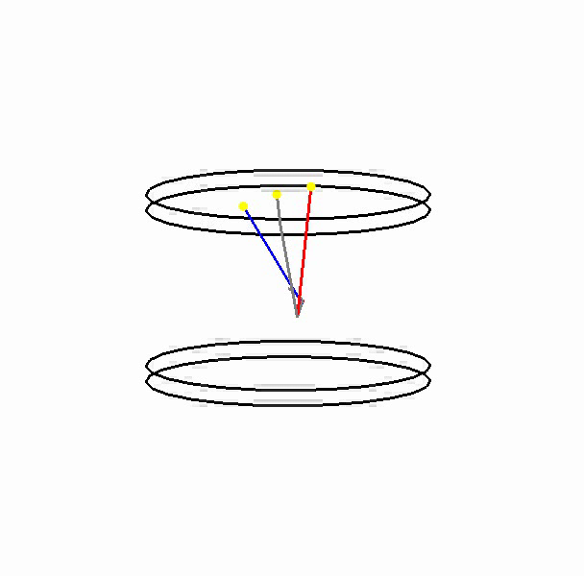
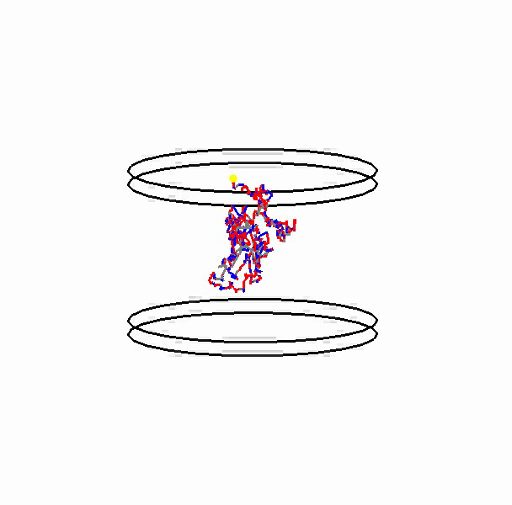
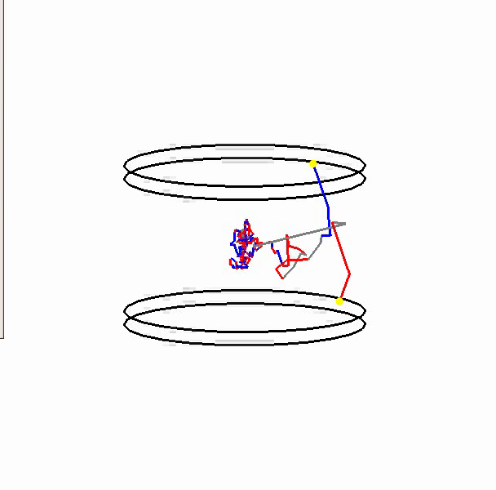
Simulated transport processes
Downconversion
Isotope Scattering +
Mode Mixing
Downconversion + Isotope Scattering +
Mode Mixing

Slide 44
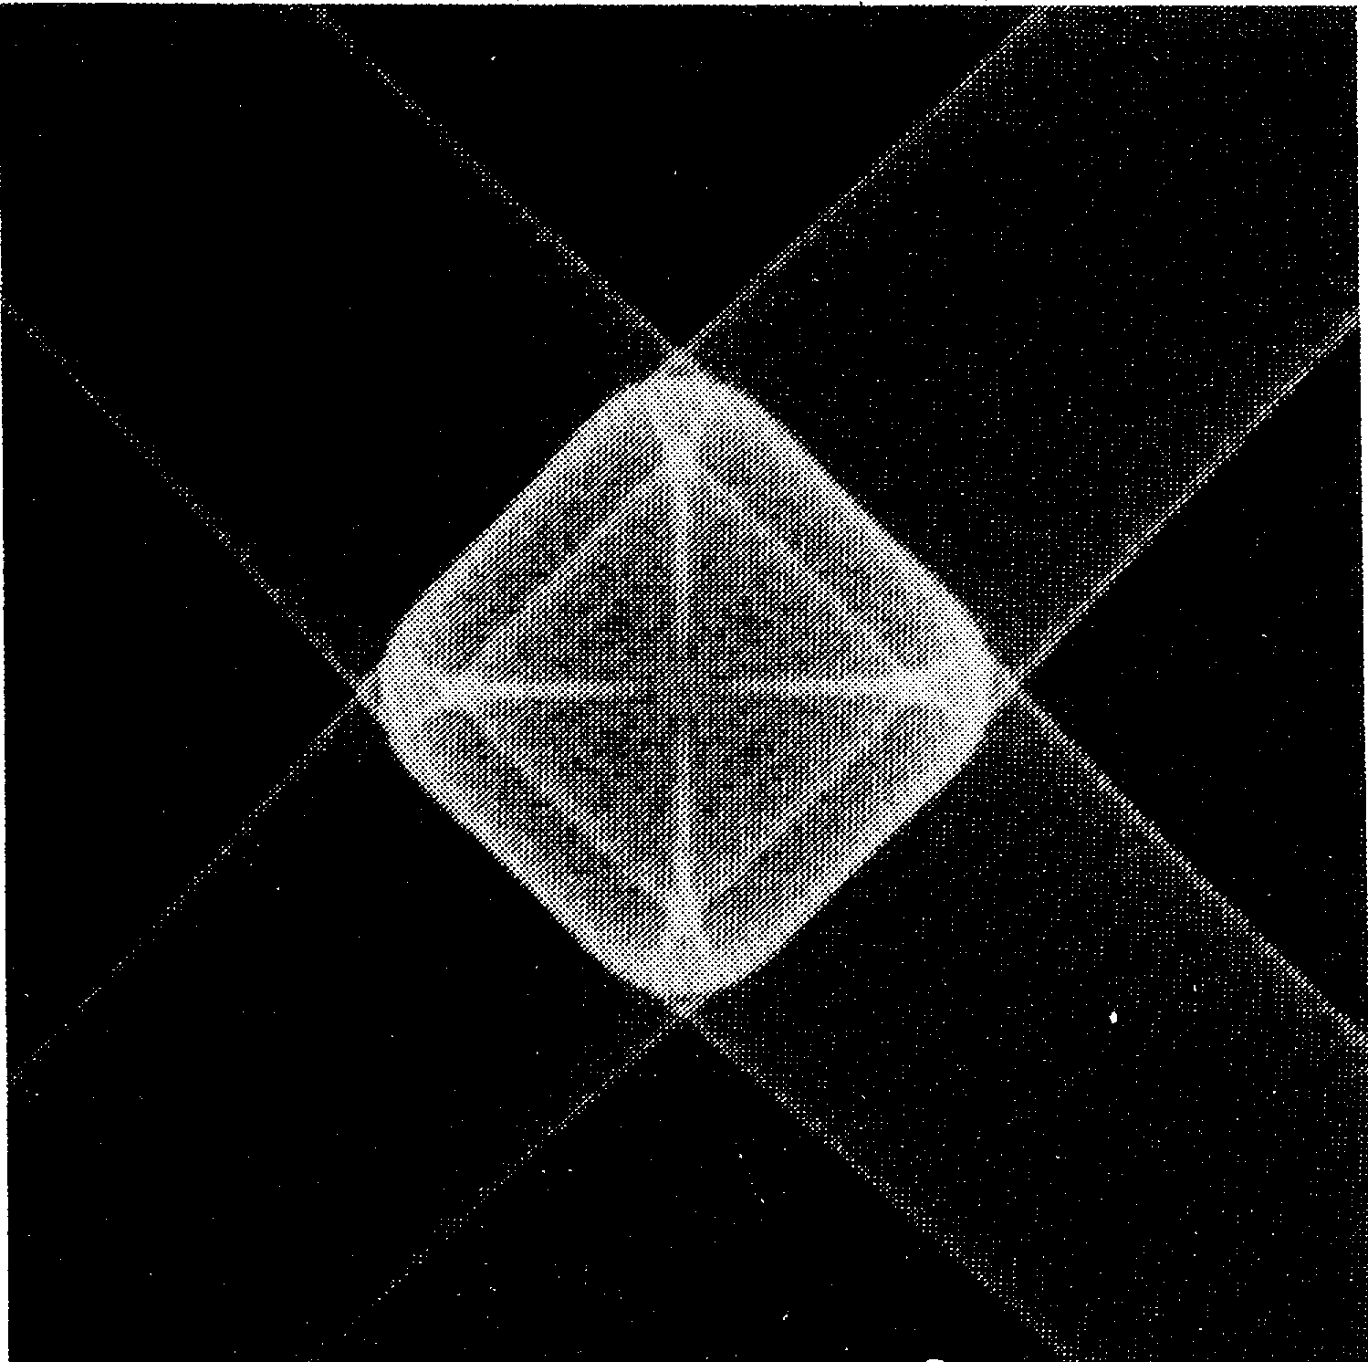
Phonon Focusing
Experimental
Geant4
Northrop and Wolfe PRL 19, 1424 (1979)
Phonon flux intensity on a Ge crystal face resulting from a point source at the crystal center.
Notes:
Anisotropies in the elasticity tensor lead to phonon focusing into complicated intensity patterns.
Three phonon processes are currently available, though may not be fully functional.
•G4PhononScattering Treats scattering of phonons off of isotopic impurities or lattice defects, changing direction and
randomizing the polarization state (mode mixing)
•G4PhononDownconversion Longitudinal phonons split in two,
either L ➔ L’T or L ➔TT
The processes developed so far support acoustic phonons, which are relevant for low-temperature (tens of mK) crystals.
Three polarization states are recognized
Longitudinal (G4PhononLong)
Transverse “slow speed” (G4PhononTransFast)
Transverse “fast speed” (G4PhononTransSlow)

Slide 45
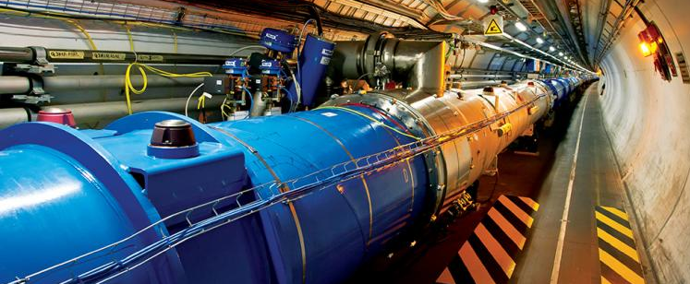
Channeling
ExExCh example in extended/exotic

Slide 46
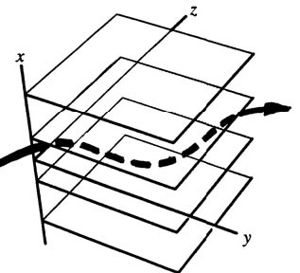
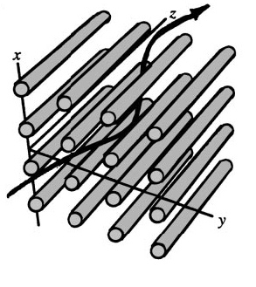
Particle interaction with aligned crystals
Condition for coherent effects: particle direction of motion nearly aligned with crystal planes or axes.

Slide 47
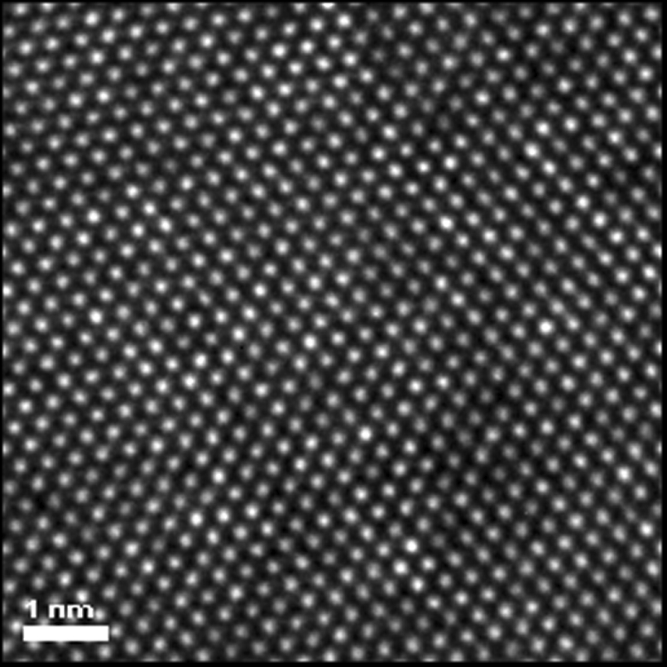
Crystal
Ordered pattern of atoms.
Ki-Bum Kim, SPIE Newsroom, DOI: 10.1117/2.1200812.1396

Slide 48
Crystal
Ordered pattern of atoms.
Aligned atoms can be seen as planes or axes.
Ki-Bum Kim, SPIE Newsroom, DOI: 10.1117/2.1200812.1396

Slide 49
Charged Particle Interaction
Crystal
Amorphous

Slide 50
Bent crystal
3.
1.
Channeled particles follows the crystal curvature and are deflected (1.).
Particle whose trajectories is tangent to crystalline planes are “reflected” by the potential barrier (3.)
2.
Penetration Depth
Impact Position

Slide 51
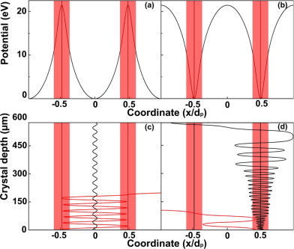
Modified density
Positive particles oscillate between atomic planes; negative particles repeatedly cross them.

Slide 52
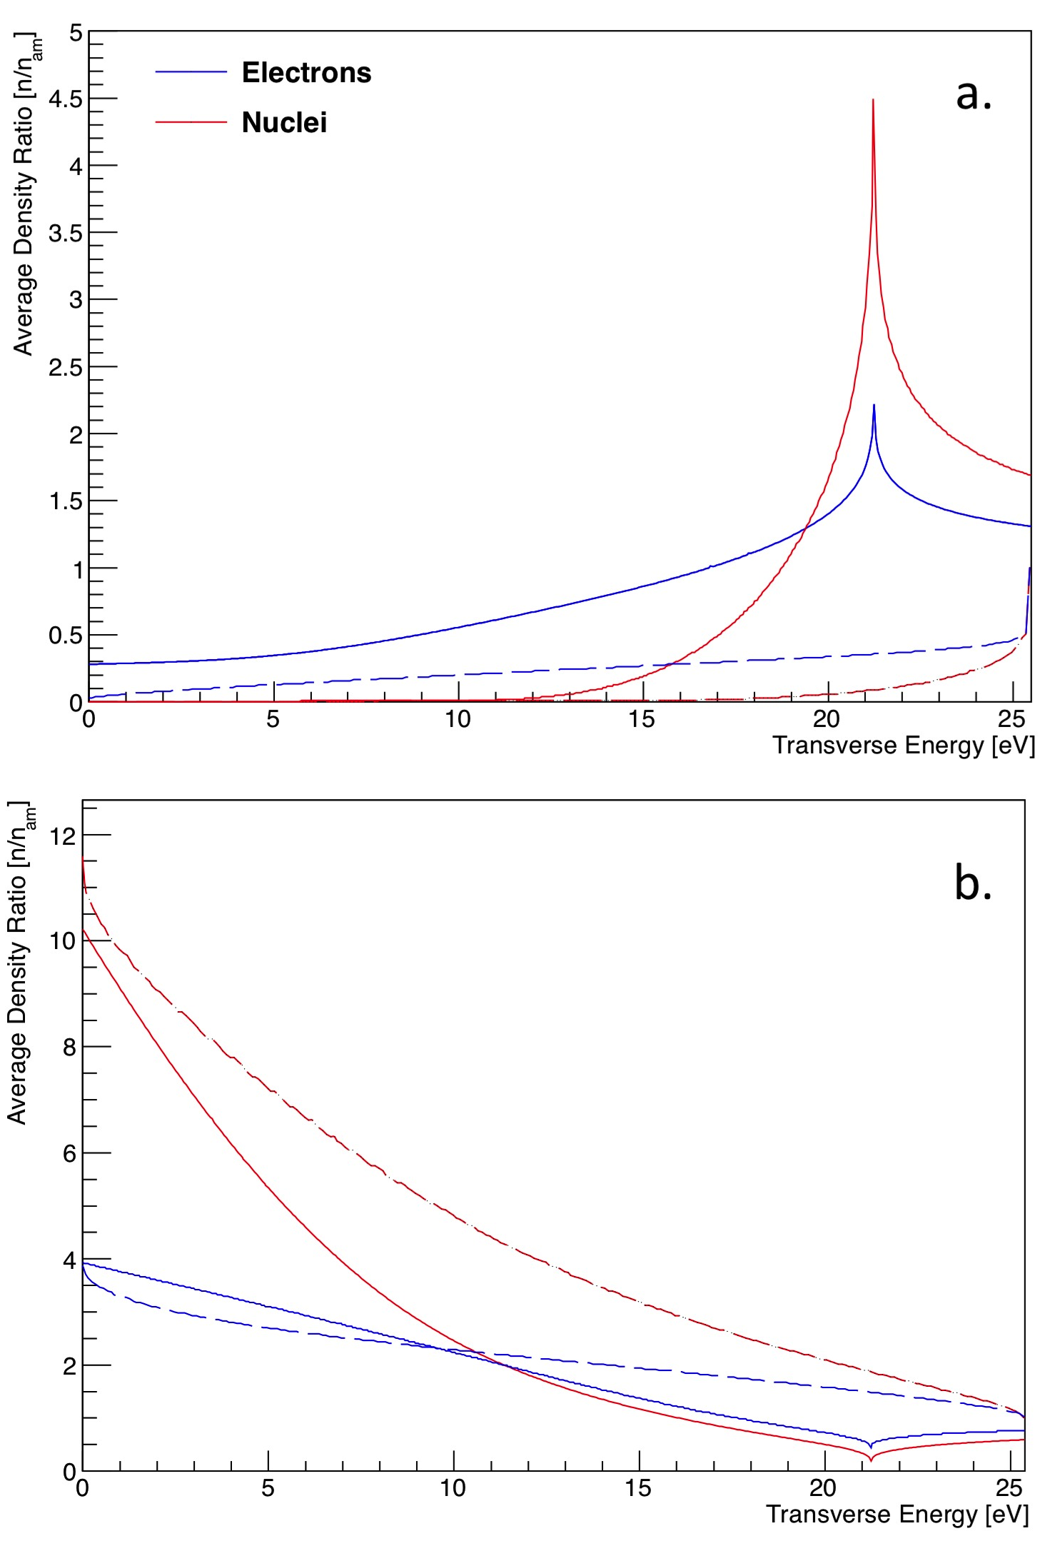
Modified density
Positive particles oscillate between atomic planes; negative particles repeatedly cross them.
Depending on the transverse energy of the particle, the density of nuclei and electron “seen” by a channeled particle is different
Positive
Negative

Slide 53
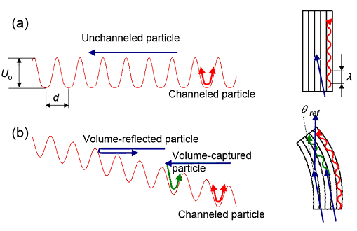
Orientational phenomena in bent crystals
Transverse Energy
Impact Position

Slide 54
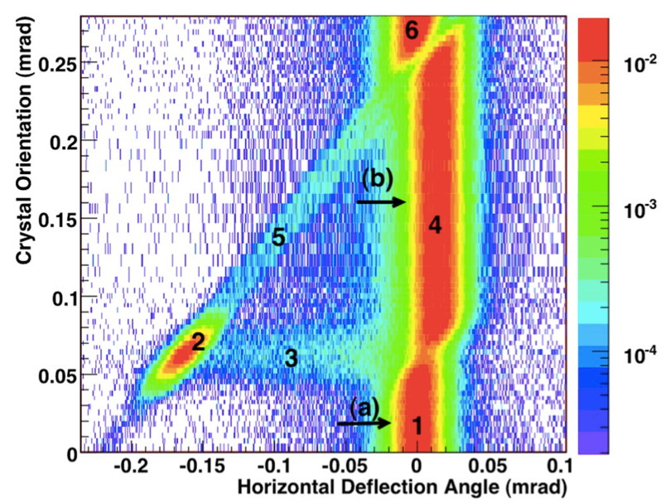
Bent crystal
Varying the crystal orientation with respect to the beam direction orientational effects are observed:
No effect
Channeling
Dechanneling
Volume reflection
Volume capture
No effect
Notes:
CERN H8 experiment:
Beam
Protons
400 GeV/c
Si crystal
Plane (110)
Length 3.0 mm
Radius 18.5 m

Slide 55
Bent crystal
Varying the crystal orientation with respect to the beam direction orientational effects are observed:
No effect
Channeling
Dechanneling
Volume reflection
Volume capture
No effect
C
B
A
W. Scandale et al., PRL 98, 154801 (2007)
A
B
C
Notes:
CERN H8 experiment:
Beam
Protons
400 GeV/c
Si crystal
Plane (110)
Length 3.0 mm
Radius 18.5 m

Slide 56
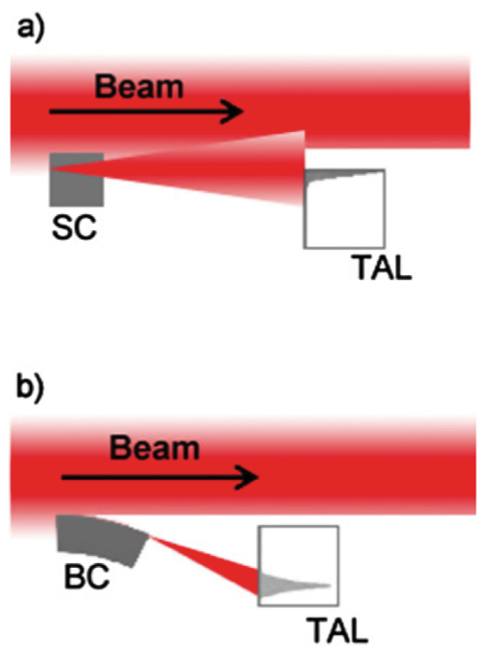
Collimation with bent crystals
UA9 experiment
Experimental Setup
Crystal can be used as a primary collimator to deflect particles of the halo toward a secondary collimator.
Main advantage is the possibility to deflect the beam out and reduce the beam losses.
standard collimation system
crystal collimation system
W. Scandale et al. PLB 692, 72 (2010)

Slide 57
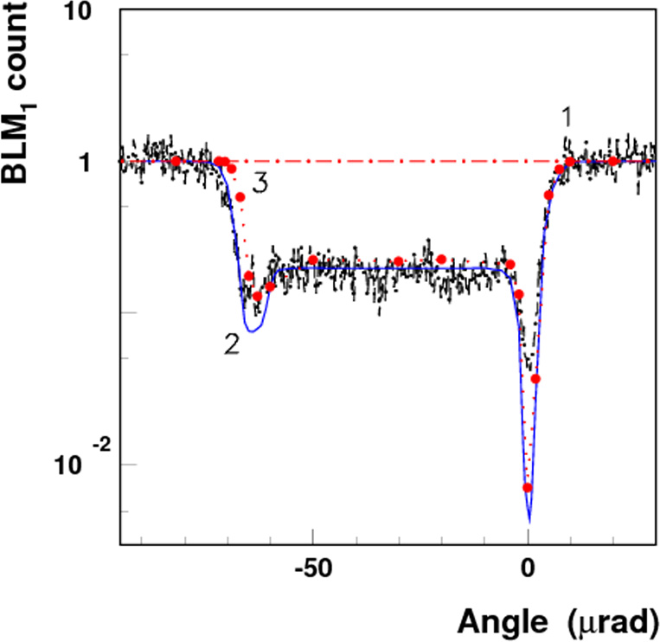
Beam loss reduction
Two bent Si crystals were mounted on the LHC on February 2014. Measurement in the CERN LHC ring with 6.5 TeV/c protons and Si (110) crystal varying the crystal orientation with respect to beam direction showed a of the ratio of the beam loss.
W. Scandale et al., Physics Letters B 758 (2016) 129–133

Slide 58
Channeling process
Features
Scheme
Working from MeV (or hundreds of KeV) to GeV particle energies.
Exact information on position and momentum within one step.
On-the-fly average nuclei density per step.
Interface to Geant4 processes managed by biasing classes.

Slide 59
Channeling process
G4double ExExChProcessChanneling::
GetMeanFreePath(const G4Track& aTrack,
G4double, // previousStepSize
G4ForceCondition* condition){
//----------------------------------------
// the condition is forced to check if
// the volume has a lattice at each step.
// if it hasn't, return DBL_MAX
//----------------------------------------
*condition = Forced;
if(HasLattice(aTrack)){
GetInfo(aTrack)->SetInTheCrystal(true);
return GetChannelingMeanFreePath(aTrack);
}
else{
GetInfo(aTrack)->SetInTheCrystal(false);
return DBL_MAX;
}
}

Slide 60
Channeling process
G4double ExExChProcessChanneling::
GetMeanFreePath(const G4Track& aTrack,
G4double, // previousStepSize
G4ForceCondition* condition){
//----------------------------------------
// the condition is forced to check if
// the volume has a lattice at each step.
// if it hasn't, return DBL_MAX
//----------------------------------------
*condition = Forced;
if(HasLattice(aTrack)){
GetInfo(aTrack)->SetInTheCrystal(true);
return GetChannelingMeanFreePath(aTrack);
}
else{
GetInfo(aTrack)->SetInTheCrystal(false);
return DBL_MAX;
}
}
Check if the volume traversed by the particle has a lattice

Slide 61
Channeling process
G4double ExExChProcessChanneling::
GetMeanFreePath(const G4Track& aTrack,
G4double, // previousStepSize
G4ForceCondition* condition){
//----------------------------------------
// the condition is forced to check if
// the volume has a lattice at each step.
// if it hasn't, return DBL_MAX
//----------------------------------------
*condition = Forced;
if(HasLattice(aTrack)){
GetInfo(aTrack)->SetInTheCrystal(true);
return GetChannelingMeanFreePath(aTrack);
}
else{
GetInfo(aTrack)->SetInTheCrystal(false);
return DBL_MAX;
}
}
If TRUE, limits the step and set TRUE the flag “InTheCrystal” for the other processes

Slide 62
Channeling process
G4double ExExChProcessChanneling::
GetMeanFreePath(const G4Track& aTrack,
G4double, // previousStepSize
G4ForceCondition* condition){
//----------------------------------------
// the condition is forced to check if
// the volume has a lattice at each step.
// if it hasn't, return DBL_MAX
//----------------------------------------
*condition = Forced;
if(HasLattice(aTrack)){
GetInfo(aTrack)->SetInTheCrystal(true);
return GetChannelingMeanFreePath(aTrack);
}
else{
GetInfo(aTrack)->SetInTheCrystal(false);
return DBL_MAX;
}
}
If FALSE, do NOT limit the step and set FALSE the flag “InTheCrystal”

Slide 63
Channeling process
G4VParticleChange* ExExChProcessChanneling::
PostStepDoIt(const G4Track& aTrack,
const G4Step&){
aParticleChange.Initialize(aTrack);
GetInfo(aTrack)->StoreDensityPreviousStep();
if((HasLattice(aTrack) == true) &&
(HasLatticeOnBoundaryPost(aTrack) == false)){
UpdateParameters(aTrack);
G4ThreeVector vMomentum =
GetInfo(aTrack)->GetMomentumChanneled().unit();
G4ThreeVector vPosition;
vPosition =
ComputePositionInTheCrystal(aTrack.GetStep()->GetPostStepPoint(),
aTrack);
GetXPL(aTrack)->ProjectMomentumVectorFromLatticeToWorld(vMomentum,
vPosition);
aParticleChange.ProposeMomentumDirection(vMomentum.unit());
}
Check if the volume traversed by the particle has a lattice

Slide 64
Channeling process
G4VParticleChange* ExExChProcessChanneling::
PostStepDoIt(const G4Track& aTrack,
const G4Step&){
aParticleChange.Initialize(aTrack);
GetInfo(aTrack)->StoreDensityPreviousStep();
if((HasLattice(aTrack) == true) &&
(HasLatticeOnBoundaryPost(aTrack) == false)){
UpdateParameters(aTrack);
G4ThreeVector vMomentum =
GetInfo(aTrack)->GetMomentumChanneled().unit();
G4ThreeVector vPosition;
vPosition =
ComputePositionInTheCrystal(aTrack.GetStep()->GetPostStepPoint(),
aTrack);
GetXPL(aTrack)->ProjectMomentumVectorFromLatticeToWorld(vMomentum,
vPosition);
aParticleChange.ProposeMomentumDirection(vMomentum.unit());
}
Update position and momentum in the channel and the density ratio

Slide 65
Channeling process
G4VParticleChange* ExExChProcessChanneling::
PostStepDoIt(const G4Track& aTrack,
const G4Step&){
aParticleChange.Initialize(aTrack);
GetInfo(aTrack)->StoreDensityPreviousStep();
if((HasLattice(aTrack) == true) &&
(HasLatticeOnBoundaryPost(aTrack) == false)){
UpdateParameters(aTrack);
G4ThreeVector vMomentum =
GetInfo(aTrack)->GetMomentumChanneled().unit();
G4ThreeVector vPosition;
vPosition =
ComputePositionInTheCrystal(aTrack.GetStep()->GetPostStepPoint(),
aTrack);
GetXPL(aTrack)->ProjectMomentumVectorFromLatticeToWorld(vMomentum,
vPosition);
aParticleChange.ProposeMomentumDirection(vMomentum.unit());
}
Propose a new direction of the particle, i.e. rotate the particle momentum

Slide 66
Channeling process
else{
// if the volume has no lattice it resets the density factors
ResetDensity(aTrack);
GetInfo(aTrack)->SetMomentumChanneled(G4ThreeVector(DBL_MAX,
DBL_MAX,
DBL_MAX));
GetInfo(aTrack)->SetPositionChanneled(G4ThreeVector(DBL_MAX,
DBL_MAX,
DBL_MAX));
}
return &aParticleChange;
}
If the volume does is not a crystal, reset the stored position in the channel, the stored transverse momentum and set to 1 de density ratio of nuclei and electrons

Slide 67
Process Wrapper
G4double XWrapperDiscreteProcess::
PostStepGetPhysicalInteractionLength (const G4Track &aTrack,
G4double previousStepSize,
G4ForceCondition *condition){
[...]
if ( (previousStepSize < 0.0) || (theNumberOfInteractionLengthLeft<=0.0))
ResetNumberOfInteractionLengthLeft();
} else if ( previousStepSize > 0.0) {
SubtractNumberOfInteractionLengthLeft(previousStepSize*vDensityPreviousStep);
} else {}
G4double regIntLength =
fRegisteredProcess->PostStepGetPhysicalInteractionLength(aTrack,
previousStepSize*vDensityPreviousStep,
[...]
currentInteractionLength = regIntLength;
[...]
if(vDensity == 0.) return DBL_MAX;
currentInteractionLength /= vDensity;
return currentInteractionLength;

Slide 68
Process Wrapper
G4double XWrapperDiscreteProcess::
PostStepGetPhysicalInteractionLength (const G4Track &aTrack,
G4double previousStepSize,
G4ForceCondition *condition){
[...]
if ( (previousStepSize < 0.0) || (theNumberOfInteractionLengthLeft<=0.0))
ResetNumberOfInteractionLengthLeft();
} else if ( previousStepSize > 0.0) {
SubtractNumberOfInteractionLengthLeft(previousStepSize*vDensityPreviousStep);
} else {}
G4double regIntLength =
fRegisteredProcess->PostStepGetPhysicalInteractionLength(aTrack,
previousStepSize*vDensityPreviousStep,
[...]
currentInteractionLength = regIntLength;
[...]
if(vDensity == 0.) return DBL_MAX;
currentInteractionLength /= vDensity;
return currentInteractionLength;
Divide the current interaction length by the density ratio. If the density is higher than 1, the step is shorter than the standard one and vice versa for density lower than 1

Slide 69
Process Wrapper
G4double XWrapperDiscreteProcess::
PostStepGetPhysicalInteractionLength (const G4Track &aTrack,
G4double previousStepSize,
G4ForceCondition *condition){
[...]
if ( (previousStepSize < 0.0) || (theNumberOfInteractionLengthLeft<=0.0))
ResetNumberOfInteractionLengthLeft();
} else if ( previousStepSize > 0.0) {
SubtractNumberOfInteractionLengthLeft(previousStepSize*vDensityPreviousStep);
} else {}
G4double regIntLength =
fRegisteredProcess->PostStepGetPhysicalInteractionLength(aTrack,
previousStepSize*vDensityPreviousStep,
[...]
currentInteractionLength = regIntLength;
[...]
if(vDensity == 0.) return DBL_MAX;
currentInteractionLength /= vDensity;
return currentInteractionLength;
Subtract to the number of interaction length left the previous real step size multiplied by the density ratio of the previous step

Slide 70
Process Wrapper
G4double XWrapperDiscreteProcess::
PostStepGetPhysicalInteractionLength (const G4Track &aTrack,
G4double previousStepSize,
G4ForceCondition *condition){
[...]
if ( (previousStepSize < 0.0) || (theNumberOfInteractionLengthLeft<=0.0))
ResetNumberOfInteractionLengthLeft();
} else if ( previousStepSize > 0.0) {
SubtractNumberOfInteractionLengthLeft(previousStepSize*vDensityPreviousStep);
} else {}
G4double regIntLength =
fRegisteredProcess->PostStepGetPhysicalInteractionLength(aTrack,
previousStepSize*vDensityPreviousStep,
[...]
currentInteractionLength = regIntLength;
[...]
if(vDensity == 0.) return DBL_MAX;
currentInteractionLength /= vDensity;
return currentInteractionLength;
Modify the physical interaction length with the density ratio of the previous step

Slide 71
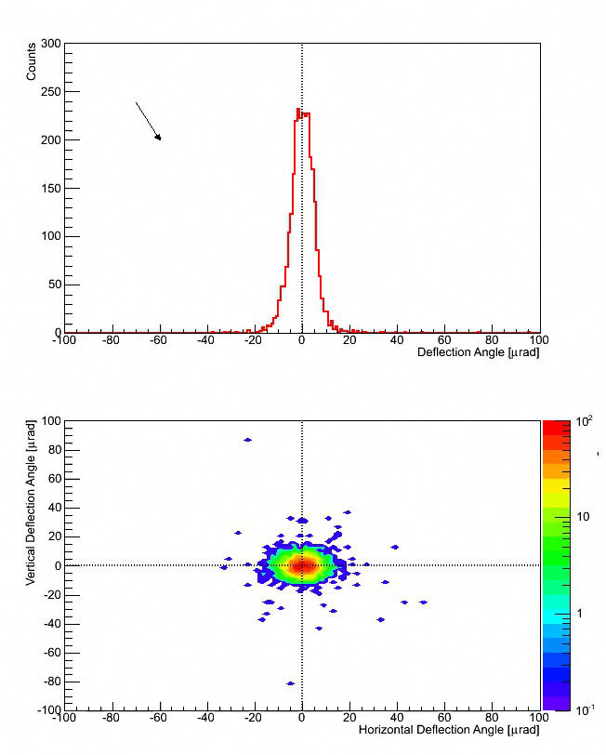
Channeling Example in Geant4
Beam Deflection
Experimental Setup
Channeling
The example simulates the channeling of 400 GeV/c protons in bent Si crystal.
The example provides the physical model for planar channeling and volume reflection in bent crystals.
Physical model published in:
  E. Bagli, M. Asai, D. Brandt, A. Dotti, V. Guidi, D. H. Wright, “A model for the interaction of high-energy particles in straight and bent crystals implemented in Geant4”, European Physics Journal C 74, 2996 (2014)
Volume Reflection
Not Aligned
Bent Crystal
Beam

Slide 72
Deflection Angle Distribution
Data
Geant4
1.
1.
2.
2.
4.
4.
3.
3.
Channeling
Dechanneling
Volume Reflection
Not aligned

Slide 73
Deflection Angle Distribution
dechanneling due to elastic collision
Geant4 model for elastic scattering
Some particles are lost due to inelastic collisions
Outgoing Particles/Incoming Particles = (98.8 +/- 0.9) %

Slide 74
Temperature Dependence (G4)
Channeling Population
Dechanneling Population

Slide 75
Conclusions
General support for crystal structure in Geant4 is under development (release for the end of 2016).
Thanks to this implementation, each user would be able to take information of crystal structures and use them for its own processes/purposes.
Geant4 already provides support for the channeling process and the phonon transportation at low temperature in the extended/exotic examples.

Slide 76
Thank you for your attention

