Slide 1
Measurementof Higgs boson
mass and couplings:
Combination of LHC results
Suzanne GASCON-SHOTKIN
IPN Lyon (IN2P3-CNRS)/Université Claude Bernard Lyon 1
On behalf of the ATLAS and CMS Collaborations
Les Rencontres de Physique de la Vallée d'Aoste
March 11, 2016 La Thuile (Aoste), Italy

Slide 2
Outline
The Higgs boson we have discovered
Measurement of its mass (PRL 114, 191803 )
Measurement of signal strengths and couplings (ATLAS-CONF-2015-044; CMS-PAS-HIG-15-002 )
Definitions and methodology
Signal strengths , significance and ratios
Couplings, BR_{BSM} and ratios
Summary and conclusions
Acknowledgements
Note: All results presented here are based on LHC Run 1 data recorded by the ATLAS and CMS detectors in 2011-2012, with integrated luminosities per experiment of ~5 fb⁻¹ at √s= 7 TeV and 20 fb⁻¹ at √s= 8 TeV

Slide 3
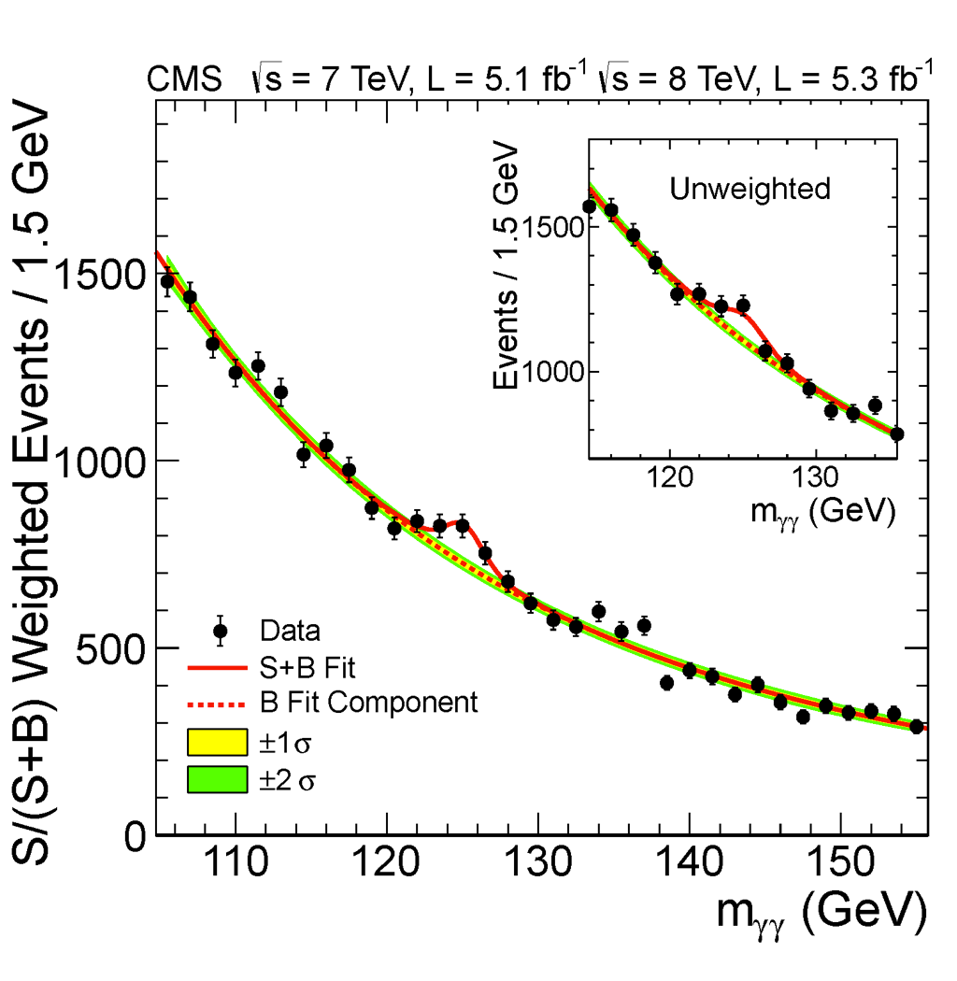
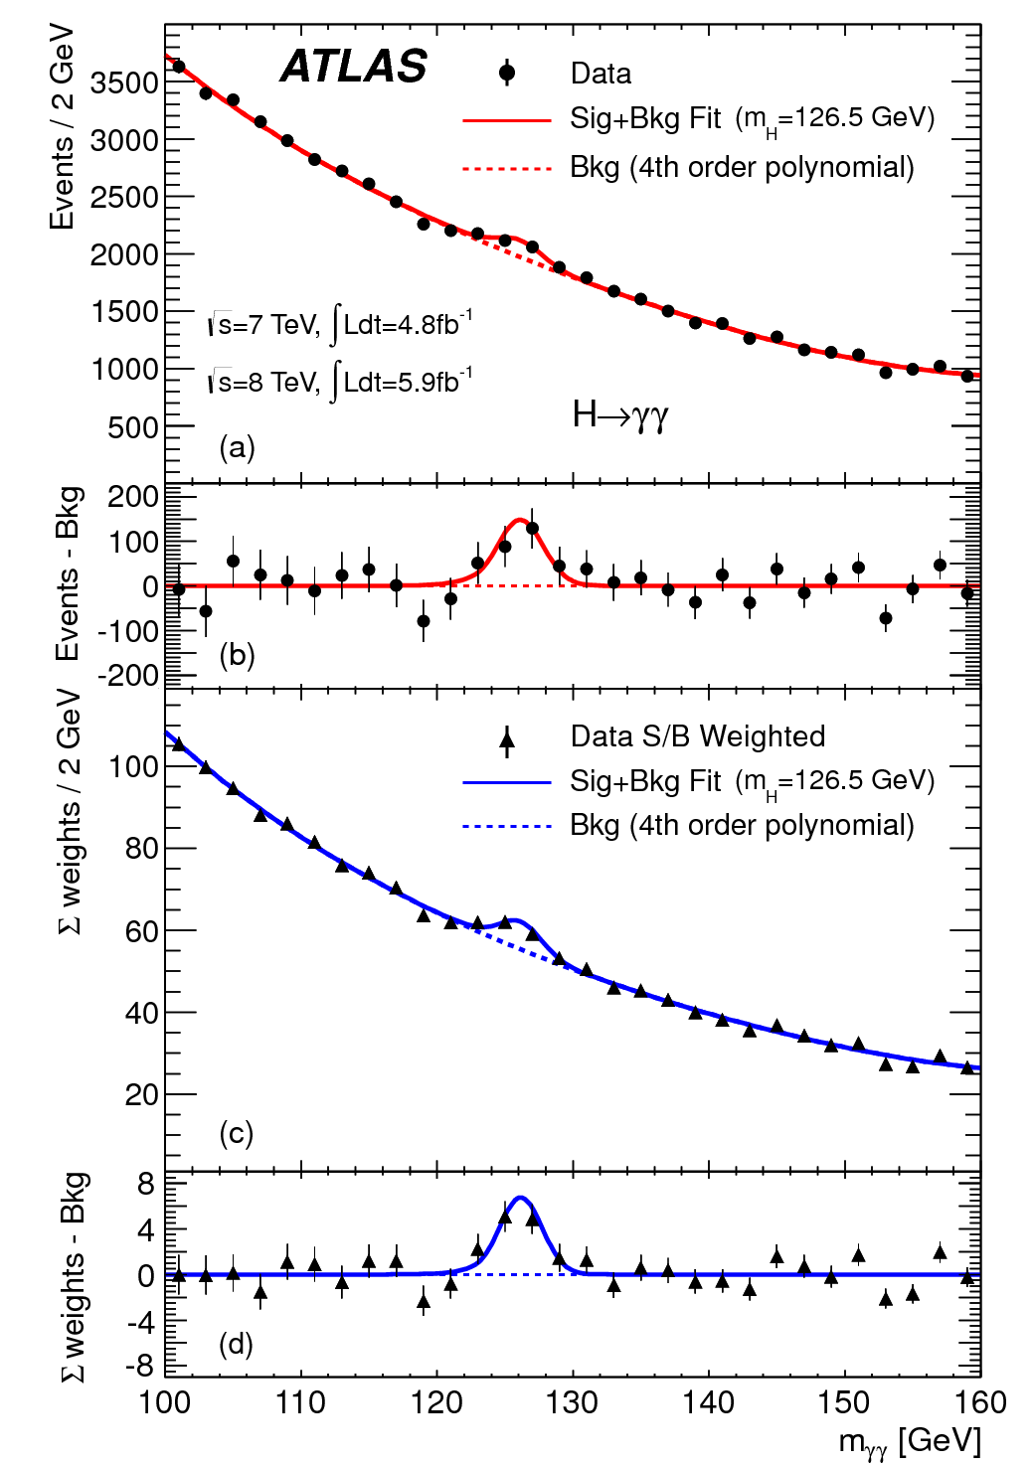
July 4 2012, 9:30 AM…..A Higgs Boson
Phys. Lett. B716 (2012)
“This result constitutes evidence for the existence of a new massive state that decays into two photons.”
“Clear evidence for the production of a neutral boson …is presented.”
Goal for Runs 1-2 of the LHC and beyond:
Measure its mass and other properties including couplings
Is it alone?
S. Gascon-Shotkin La Thuile 11 March 2016

Slide 4
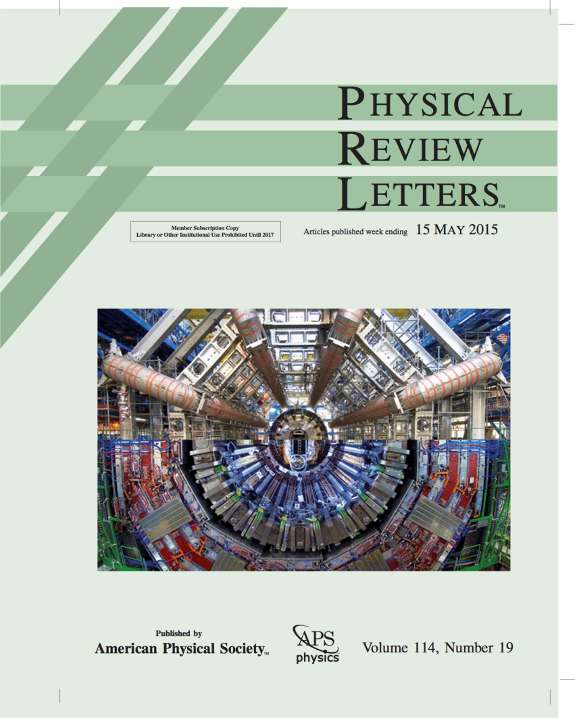
ATLAS/CMS combined Higgs boson mass measurement
Exploits H→γγ , H→ZZ→4l channels
Simultaneous fit to reconstructed invariant mass peaks in both channels for the two experiments
Maximize the profile-likelihood ratio:

Slide 5
Higgs boson mass measurement profile likelihood
To reduce dependence on SM assumptions, introduce signal strengths μ to be profiled:
2 for H→γγ (for gluon- and quark-induced production processes),
1 for H→ZZ→4l.
θ are nuisance parameters (~200), also profiled

Slide 6
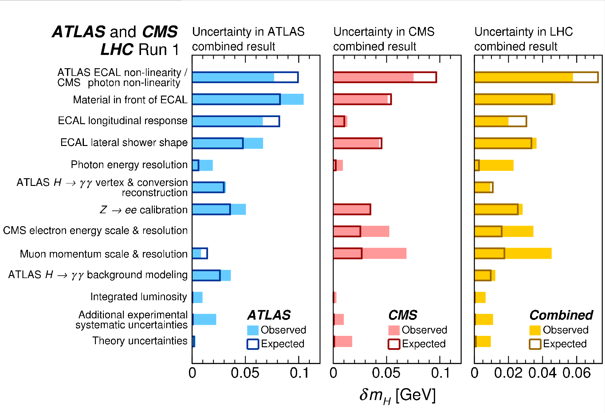
Higgs boson mass measurement uncertainties (grouped)
S. Gascon-Shotkin La Thuile 11 March 2016
Notes:
Circle or mention most important ones in total: ECAL and photon non-linearities

Slide 7
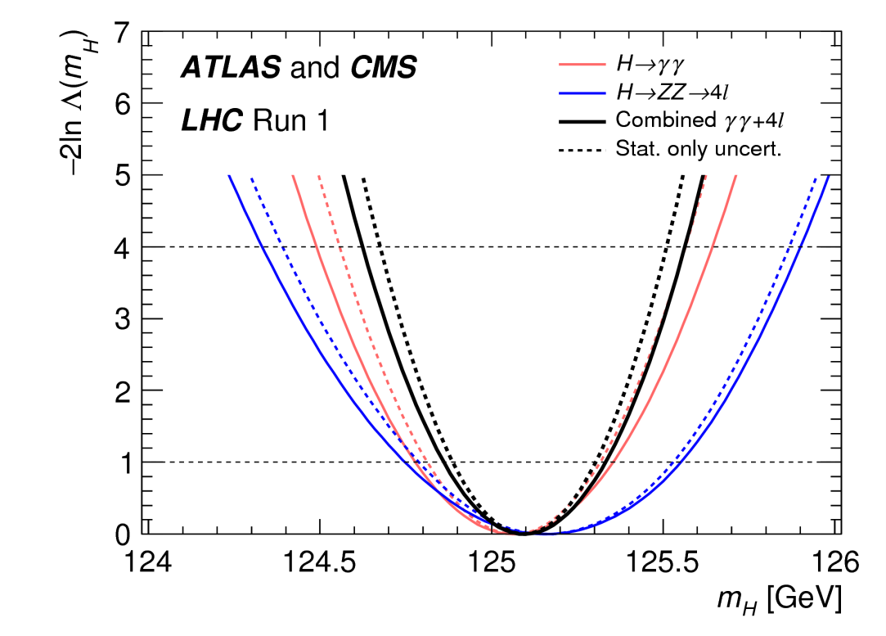
ATLAS/CMS combined Higgs boson mass measurement
mH = 125.09 ± 0.21 (stat) ± 0.11 (scale) ± 0.02 (other) ± 0.01 (theory) GeV
Notes:
Label 68% (1.0) and 95% (3.84) CL limits

Slide 8
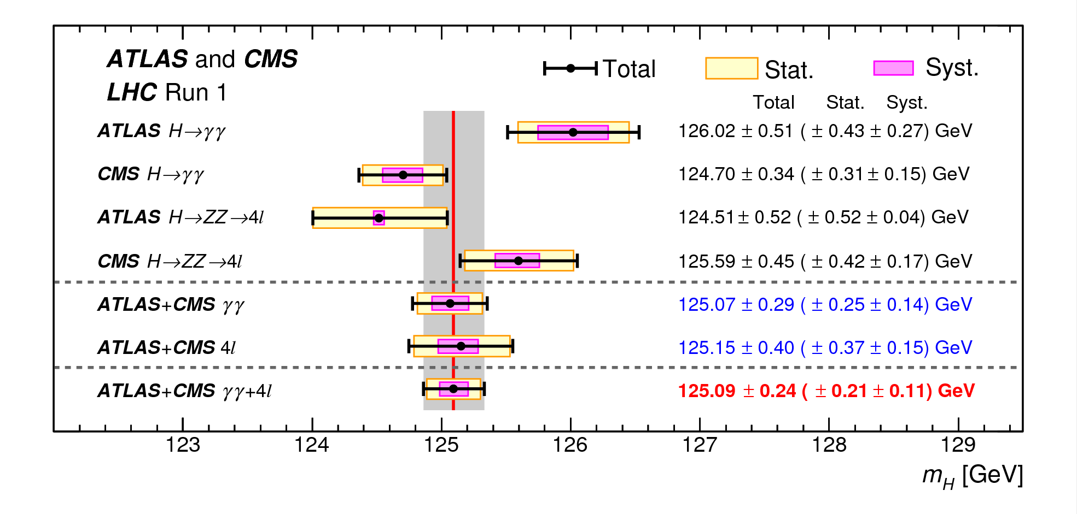
Visibility
mH = 125.09 ± 0.21 (stat) ± 0.11 (scale) ± 0.02 (other) ± 0.01 (theory) GeV

Slide 9
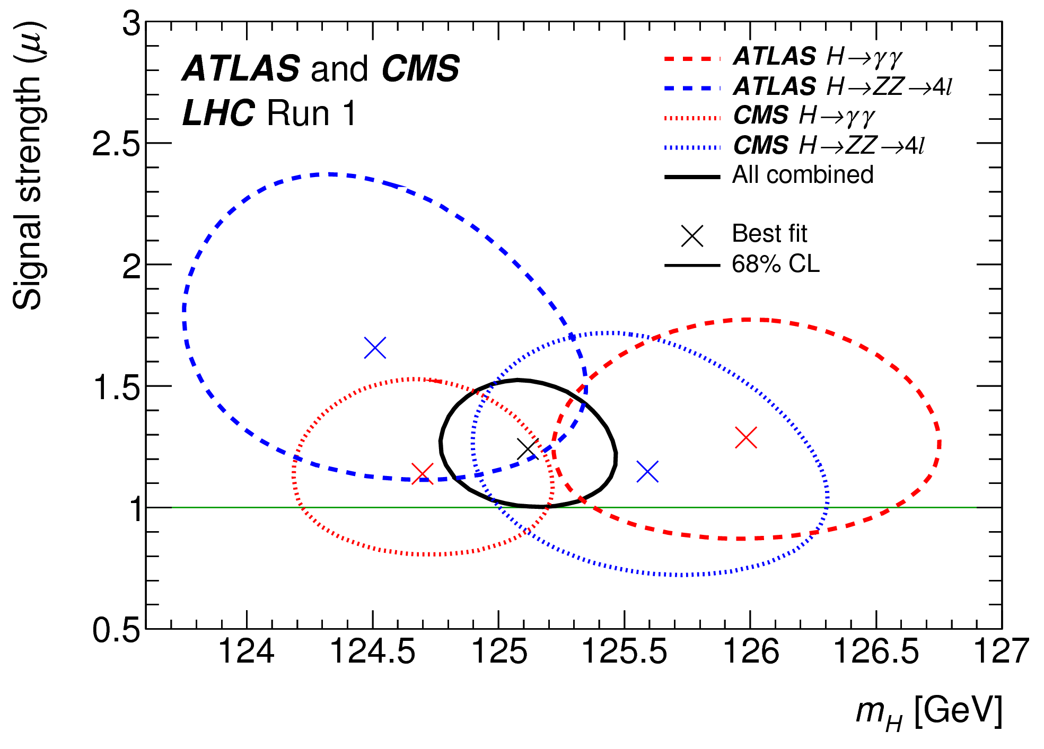
Signal Strength μ vs. m_{H}
2D likelihood scans
Three μ assumed equal in the combination
No evident correlation between μ and m_{H} (small correlation between μ_{ZZ} and m_{H} due to SM-predicted variation in the BR with m_{H})
Notes:
Add the plot with S in backup.

Slide 11
Other Measurements: Definitions and Methodology
Relationship between signal strengths μ and coupling modifiers κ :
σ_{i} = κ_{i}² ∗ σ_{i}(SM), Γ_{f} = κ_{f}² ∗Γ_{f}(SM) ➔
μ^{f}_{i} = κ_{i}² ∗ κ_{f}² / (Γ_{H}/ Γ_{H}(SM))
Effective coupling modifiers κ_{g} , κ_{γ} for loops (describing ggF production and H→γγ decay)
Coupling modifier ratios λ_{ij}=κ_{i}/κ_{j}
All measurements assume the combined mass measurement exact value: mH = 125.09 GeV
Production processes: ggF, VBF, WH, ZH, ttH
Decay channels: H→ZZ,WW,γγ,ττ,bb,μμ
Parameter estimation via profile lh ratio test statistic Λ and estimator q=-2lnΛ assumed Χ²
Notes:
In box, start with 2eme definition in each part. Effective coupling modifiers assume presence of BSM particles in loops does not significantly change kinematics.

Slide 12
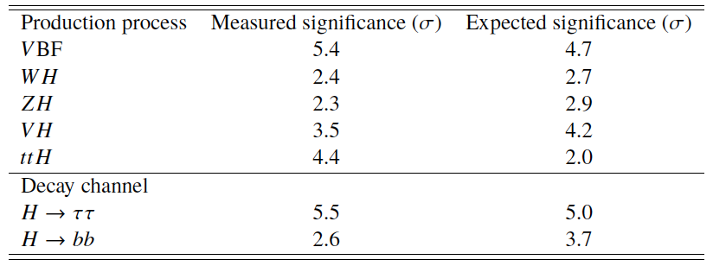
Signal Significances
Results for production modes (decays) obtained constraining decays (production modes) to SM values
VBF production, H→ττ significances now>5σ

Slide 13
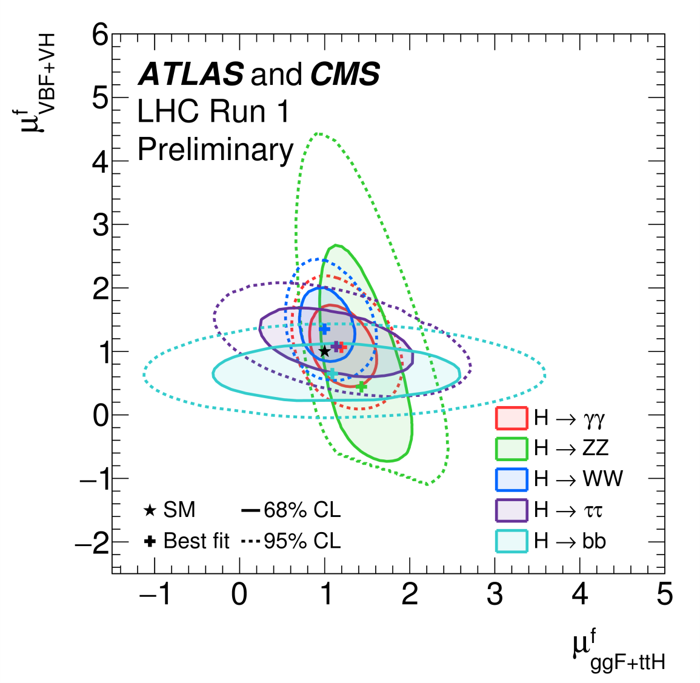
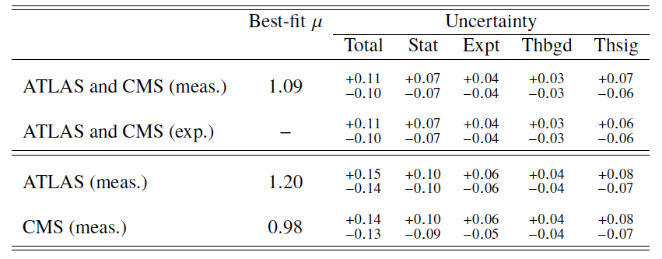
Signal Strengths μ
Global signal strength μ assuming SM Higgs boson production cross sections and branching ratios
Signal theory and statistical uncertainties now comparable
Signal strengths of quark vs gluon-induced production processes: Combination would require assumptions about branching ratios

Slide 14
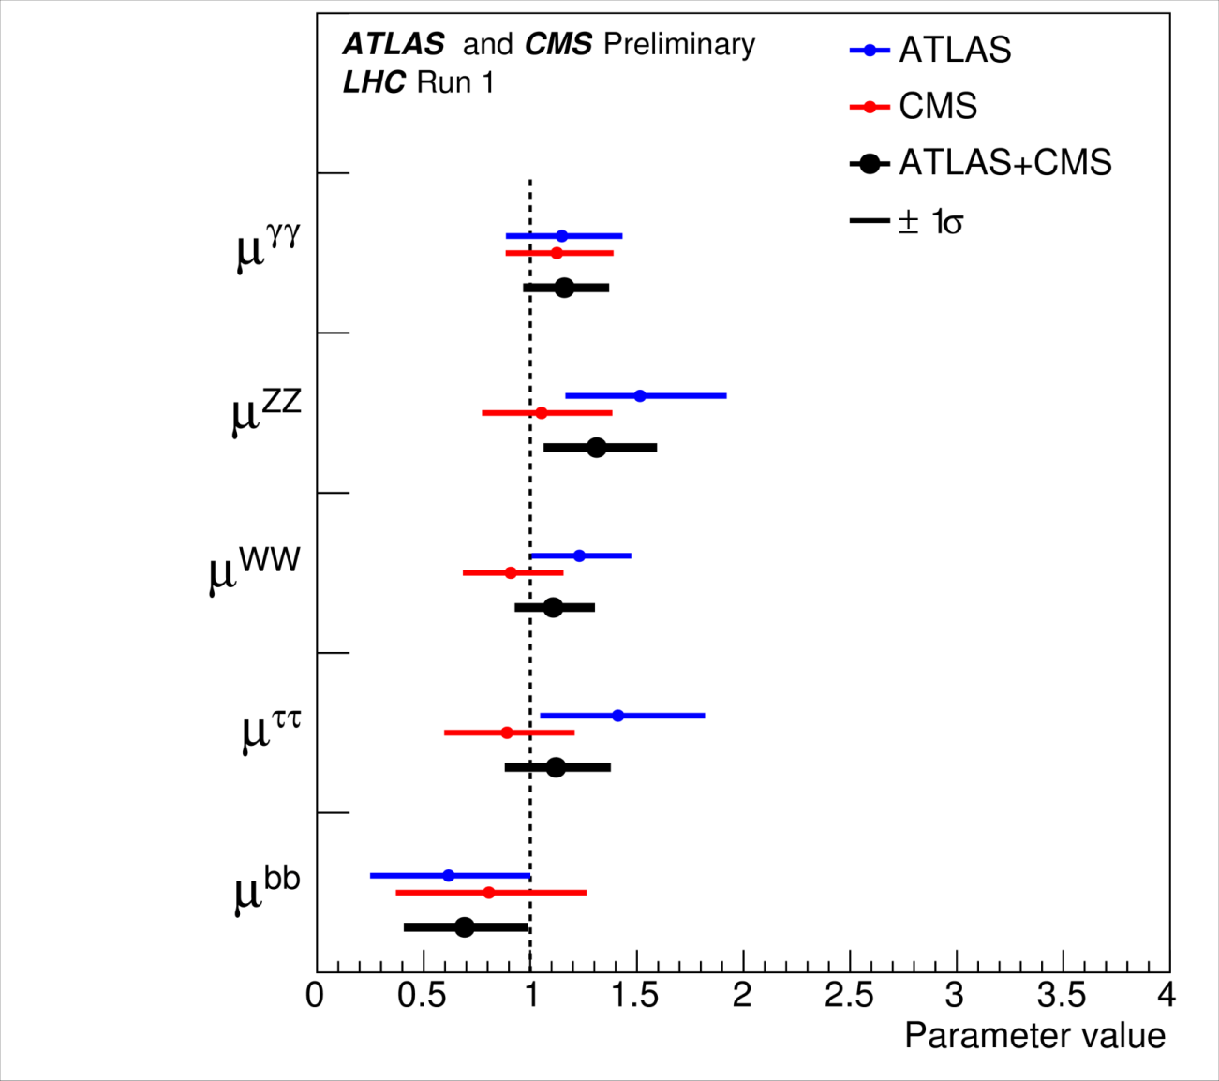
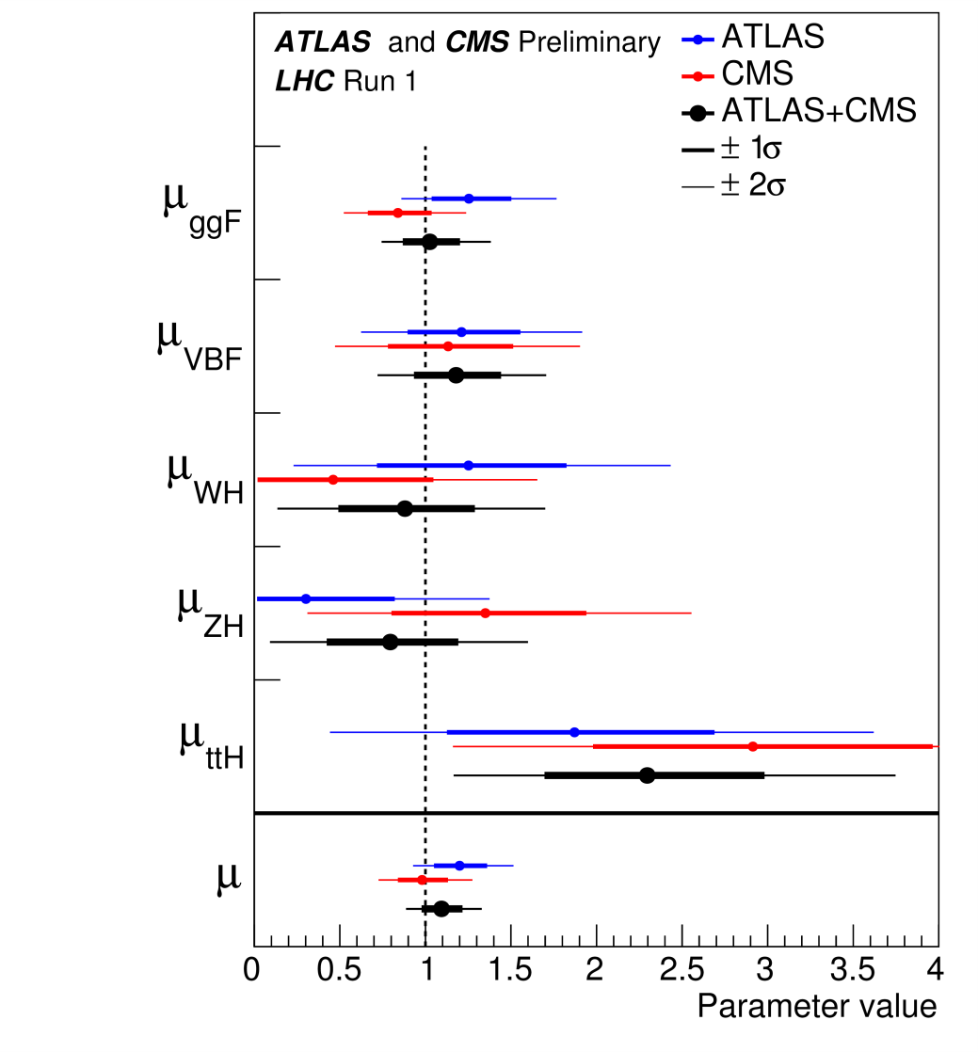
Signal Strengths μ: Production and Decay
Production modes assuming SM BR
BR assuming SM cross section

Slide 15
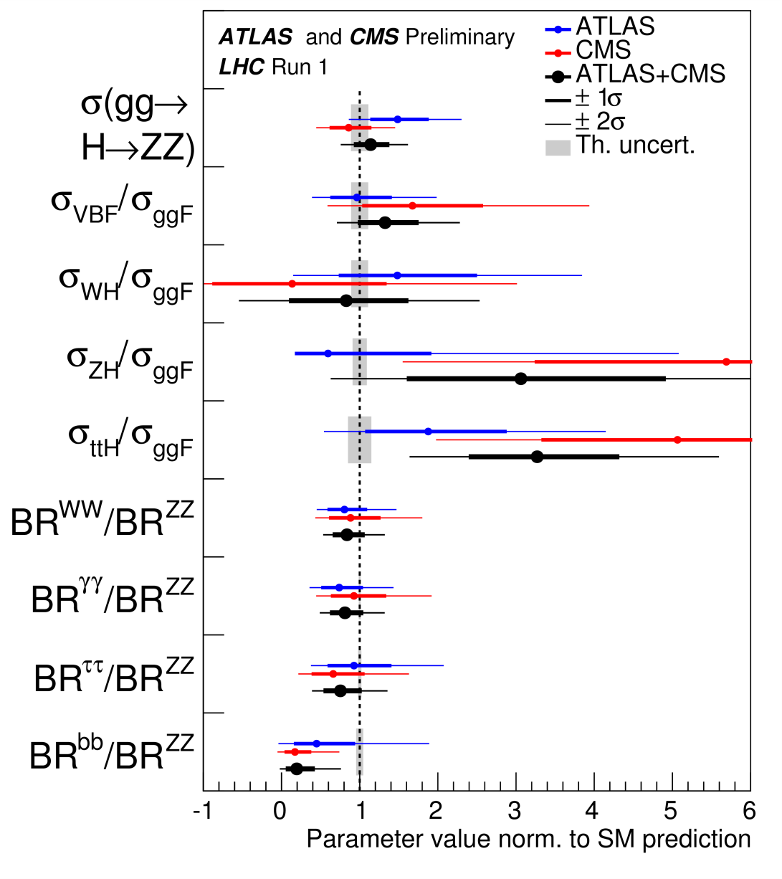
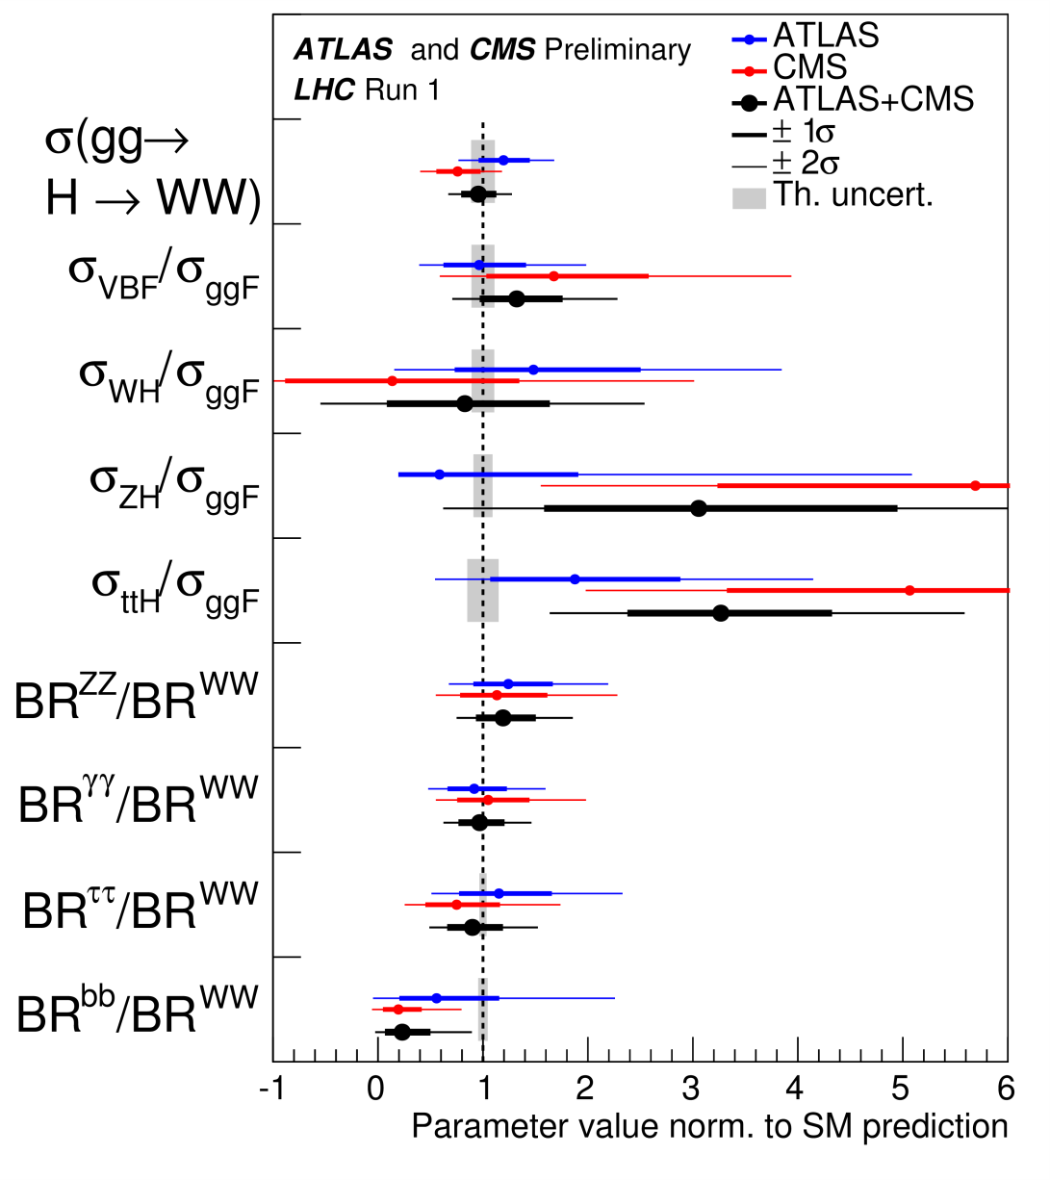
Ratios of σ & BR to reference processes (ZZ, WW)
Generic parametrization via ratios allows fewer assumptions on the SM, allows cancellation of systematics (mostly theoretical)

Slide 16
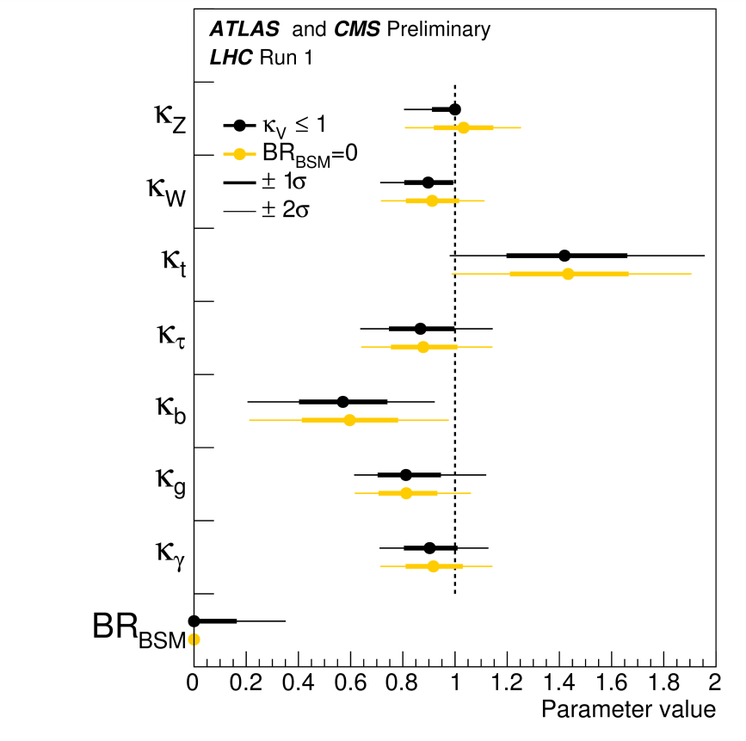
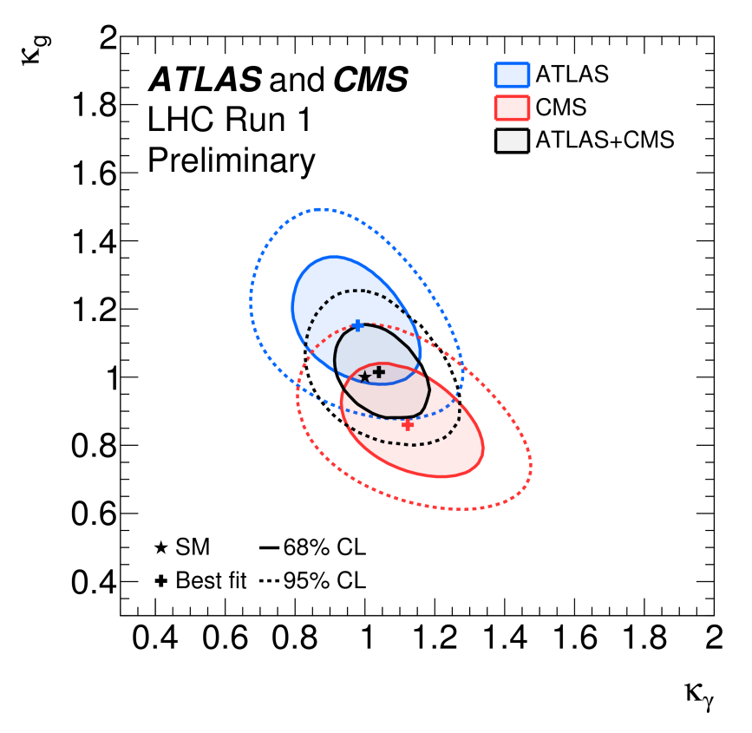
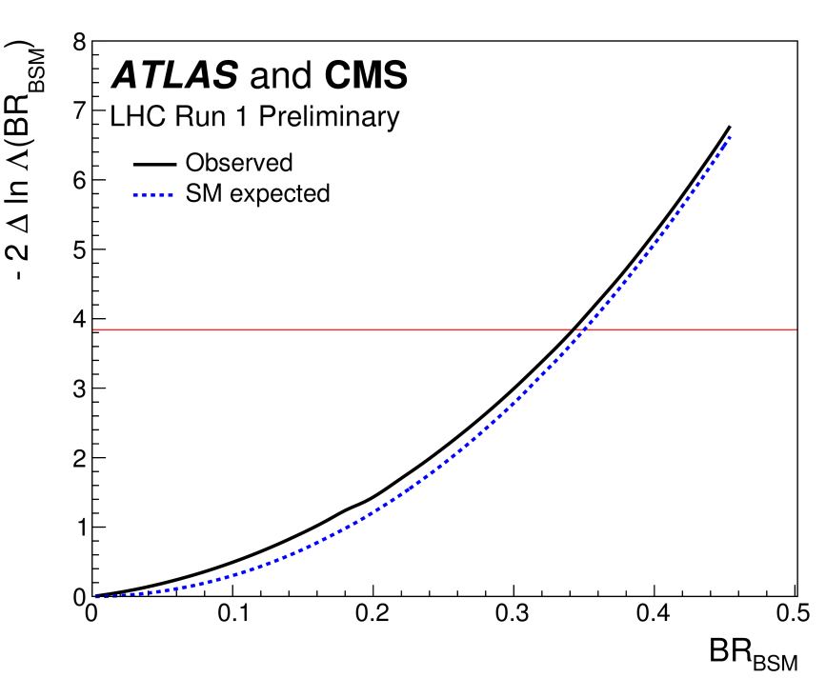
Coupling modifiers κ with BSM loop and/or decay contributions
BR_{BSM} < 0.34 (exp. 0.35) @95%CL if κ_{v} (κ_{w} or κ_{Z}) ≤ 1 (condition compatible with many BSM models)
Assume BSM contributions from loops only (BR_{BSM} =0), other κ fixed to SM values
Two scenarios: BSM contributions (κ_{v} ≤ 1) contribute to Γ_{H} or not

Slide 17
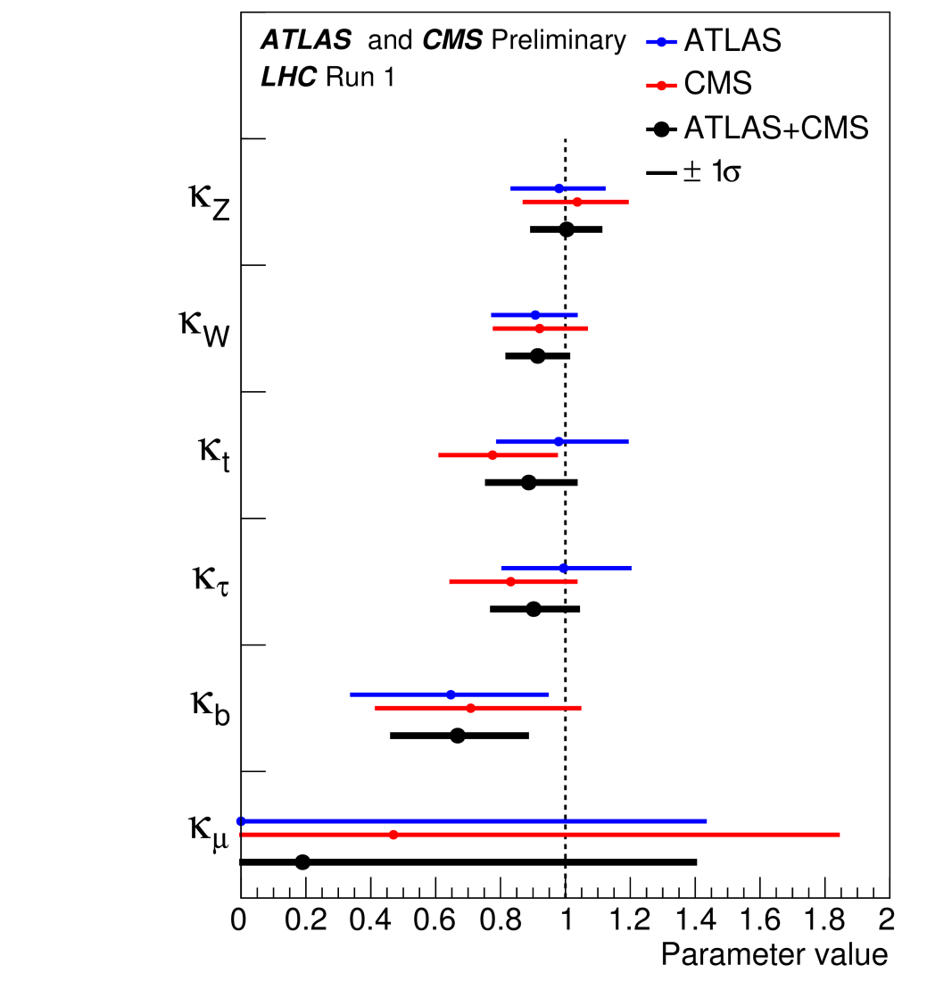
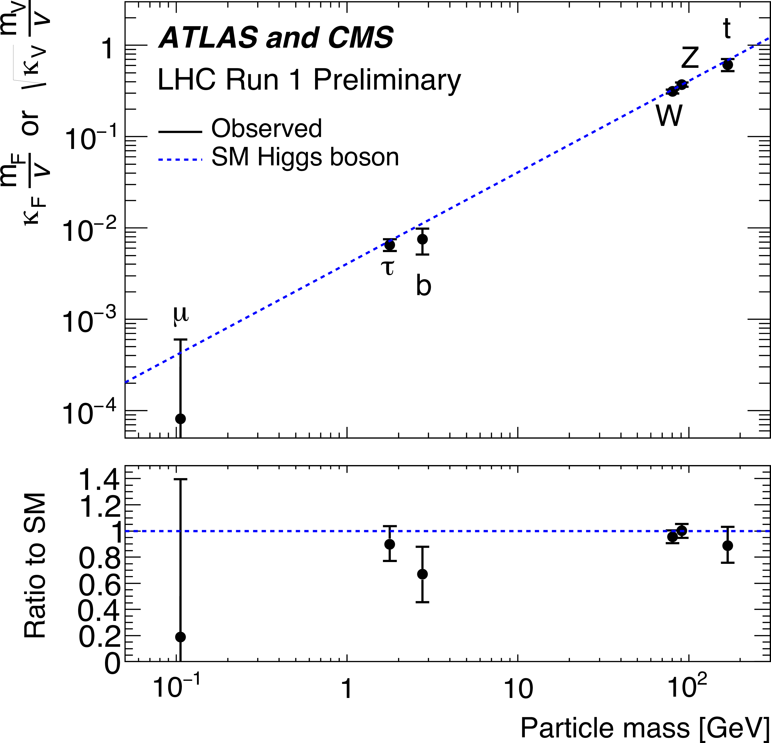
Coupling modifiers κ: Assume no BSM contributions
Mass-scaled coupling modifiers vs mass

Slide 18
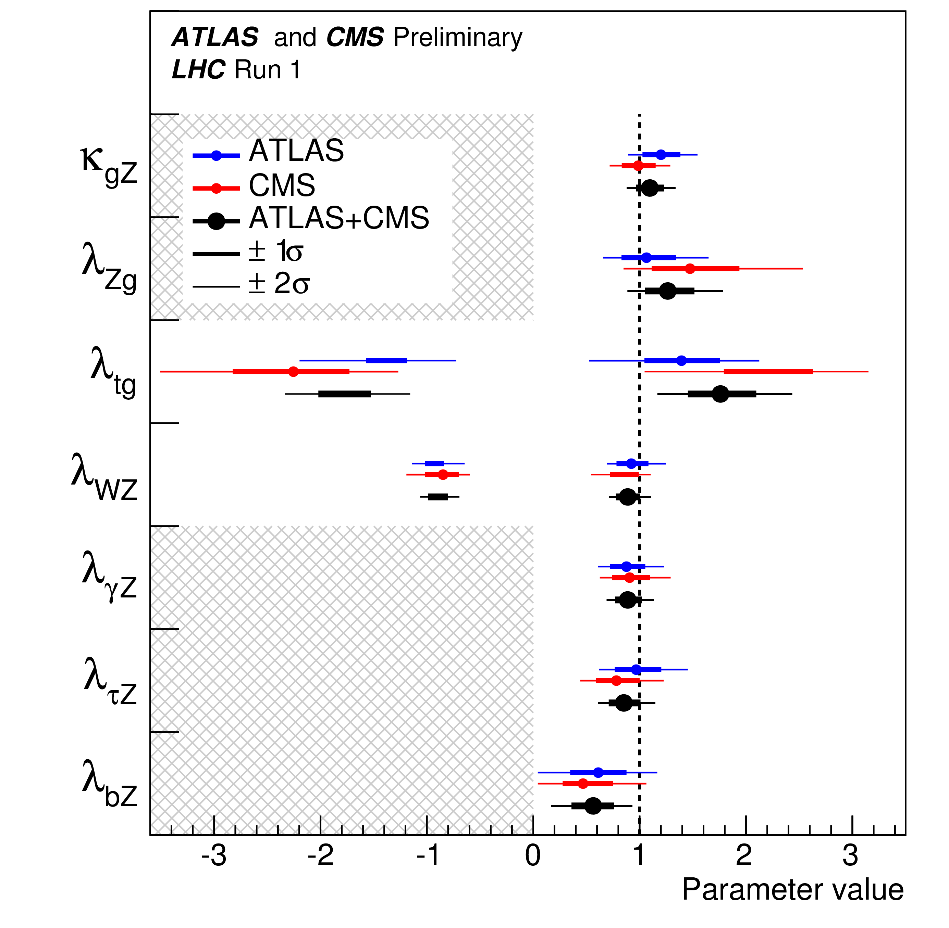
Ratios of Coupling Modifiers λ
Generic parametrization, possible to avoid assumption on total width
Connect a production and a decay channel together
σxBR of gg→H→ZZ parametrized as function of κ_{gZ} = κ_{g *} κ_{Z} /κ_{H}
Negative λ allowed for λ_{tg} and λ_{WZ} , probed respectively by ttH and ZH processes and subject to interference from tH and ggZH
Otherwise can assume positive without loss of generality
Still quite dominated by statistical error.
Notes:
Maybe move this slide? Add negative scan(s) in backup

Slide 19
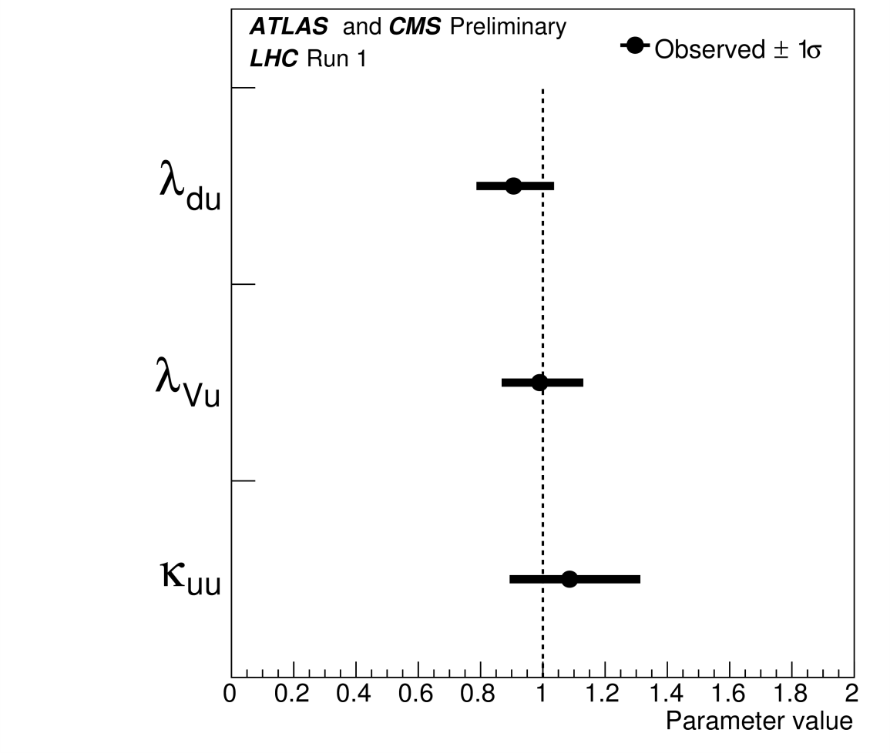
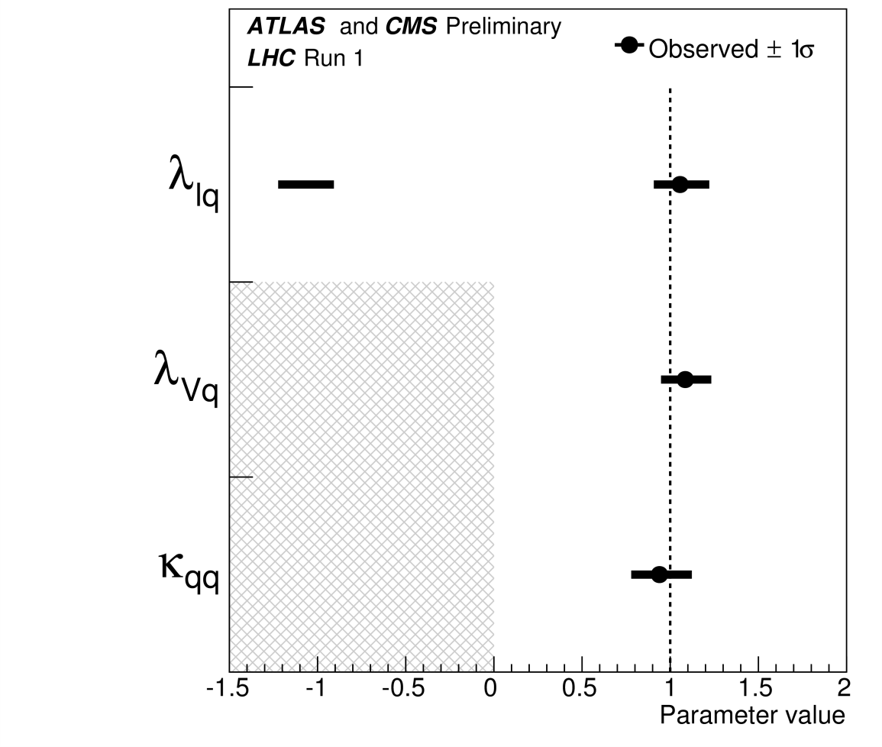
Ratios of Coupling Modifiers λ
Up-down fermion symmetry Quark-lepton symmetry

Slide 20
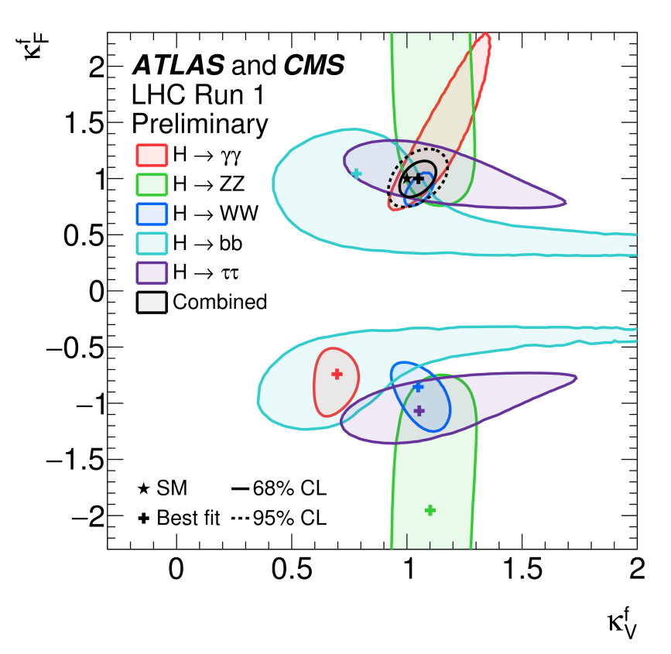
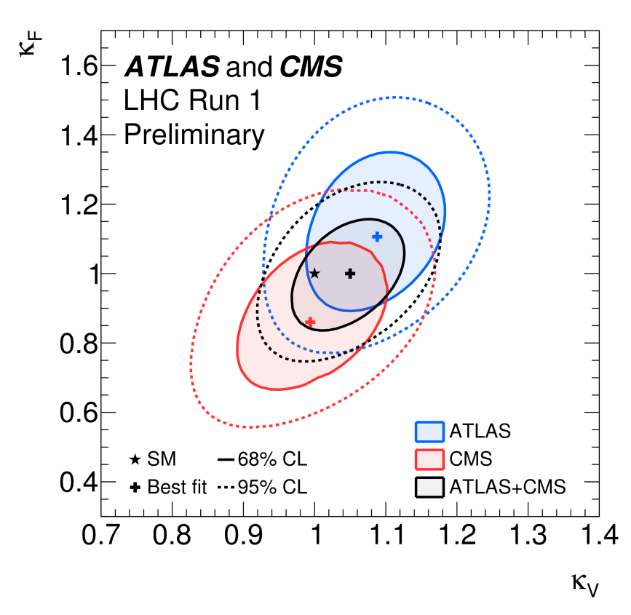
Coupling modifiers to fermions vs. to vector bosons, BR_{BSM}=0
Allow relative negative sign, combined best-fit positive
Best-fit restricted to positive quadrant
Notes:
the signs of the individual decay channel
measurements are often nearly degenerate, while the combination clearly favours
the positive sign (5 sigma). BR_BSM=0. most restrictive model.

Slide 21
Summary and Conclusions
Combined LHC Run 1 Higgs boson mass measurement: m_{H} = 125.09 ± 0.24 GeV, statistical error still dominant
Couplings: The data are consistent with the Standard Model predictions for all parametrisations considered. Compatibility p-values vary from 11-88%
‘Space’ left for BSM: BR_{BSM}<34%
Final Run 1 Legacy results coming soon
Run2 is underway, new results will be forthcoming!

Slide 22
Acknowledgements
T. Adye, A. David, M. Duehrssen-Debling, A. Gilbert, G. Gomez-Ceballos, , E. Gross, P. Padley, G. Petrucciani, M. Pieri, J. Novakova, G. Unal, N. Wardle…
The Organizers and staff of the Rencontres…….

Slide 23
Backup

Slide 24
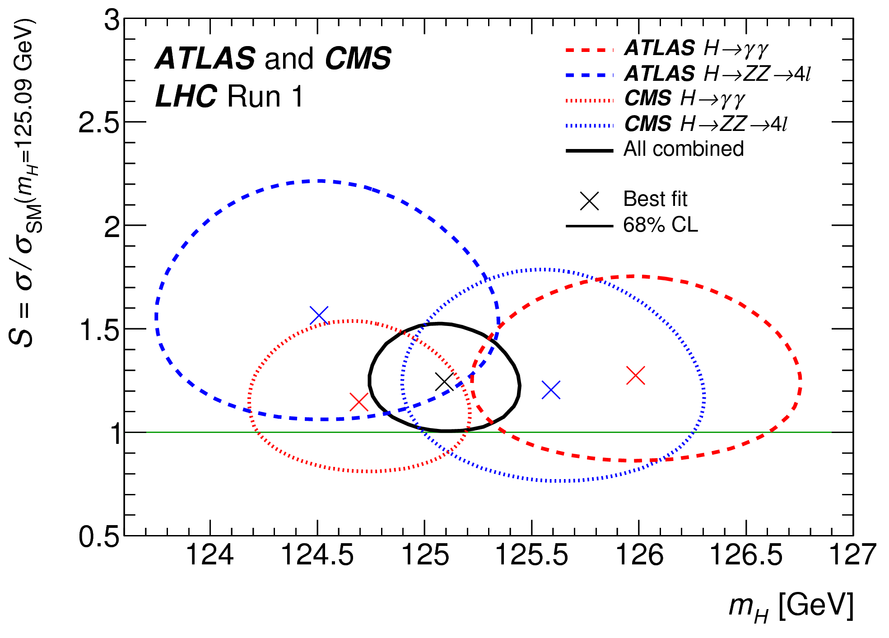
2D Likelihood scan of the normalized signal yield S ≡ σ / σ_{SM} (mH = 125.09 GeV)

Slide 25
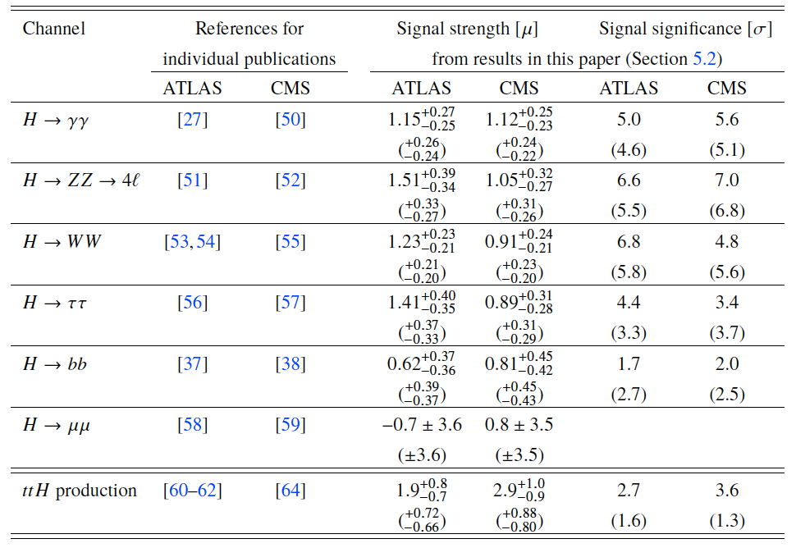
Individual ATLAS and CMS Signal Strengths and Siginificances

Slide 26
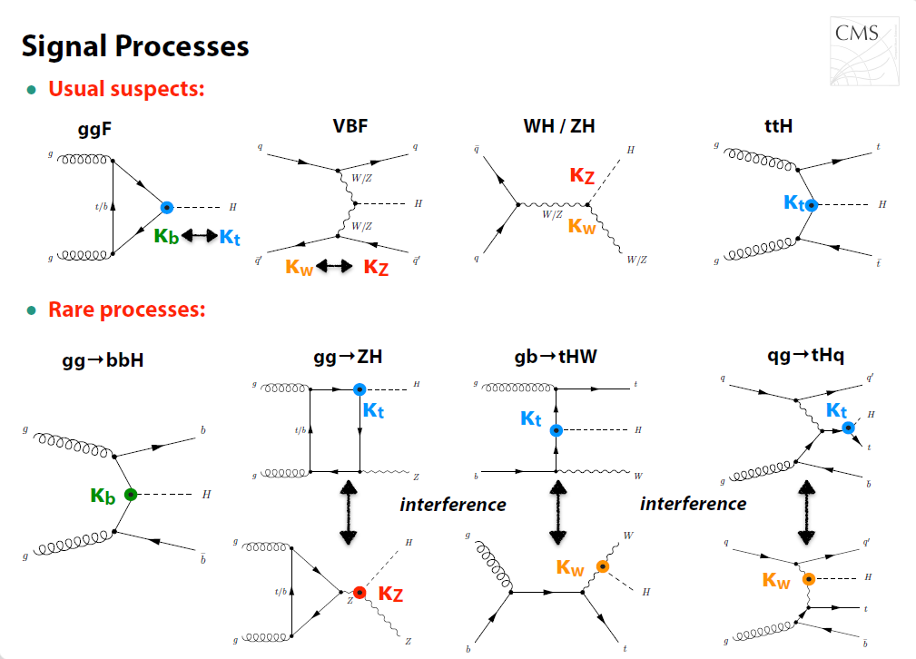

Slide 27
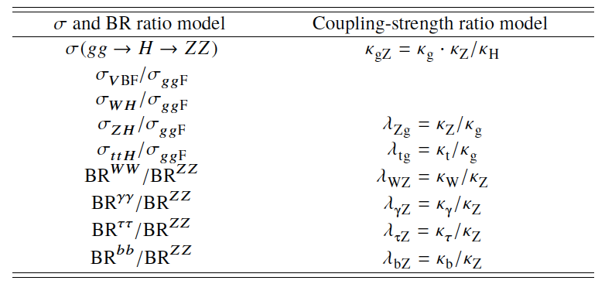
Parameters of interest in the 2 generic parametrizations

Slide 28
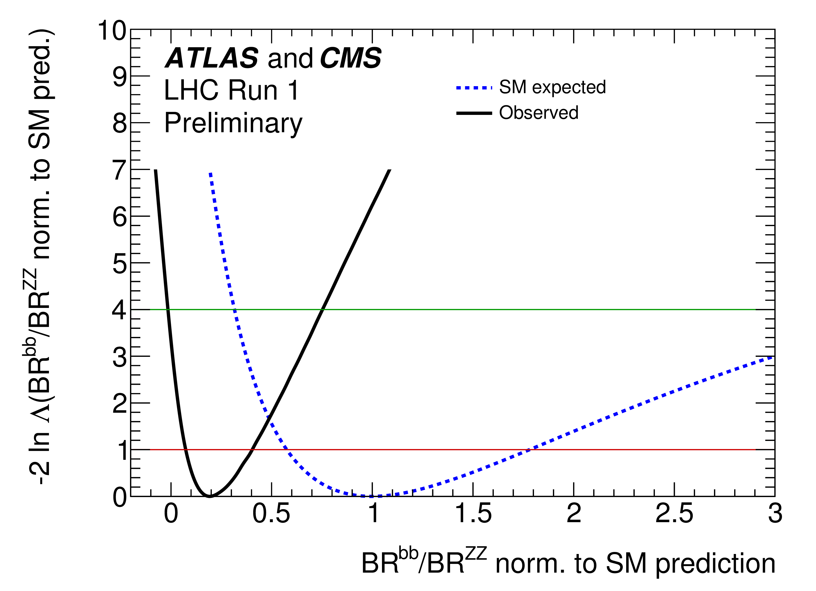
Negative log-likelihood scan of BR^{bb}/BR^{ZZ}

Slide 29
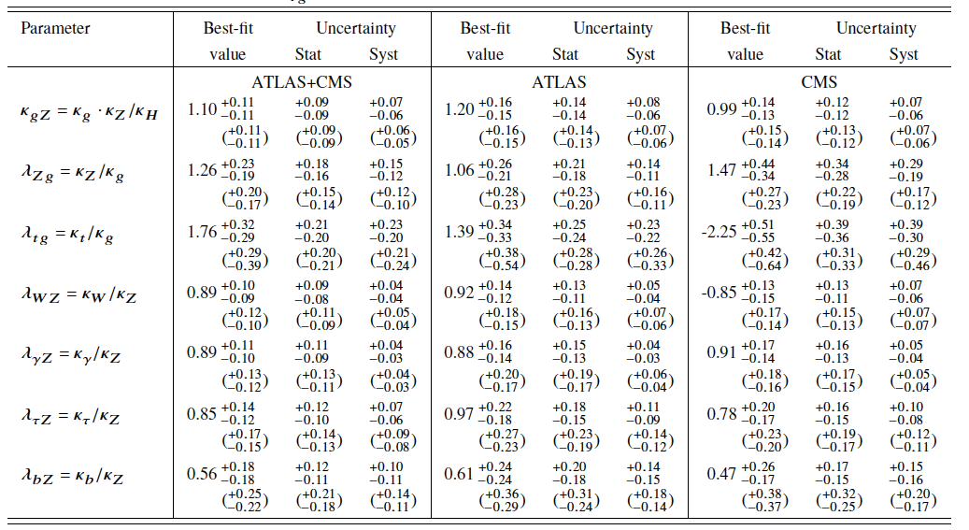
Best-fit values of κ_{gZ} and the ratios of coupling modifiers λ

Slide 30
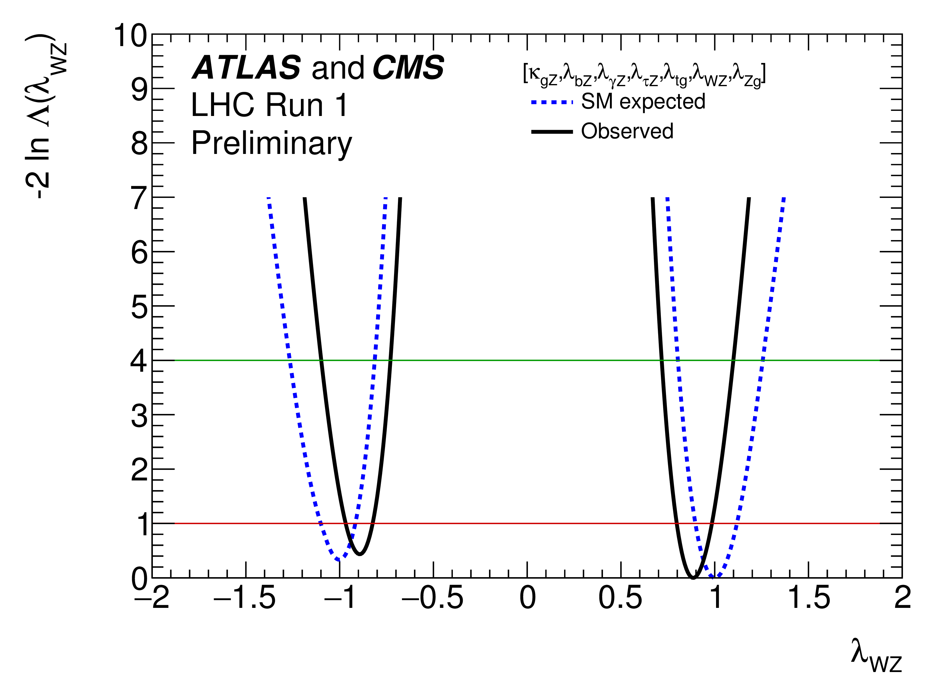
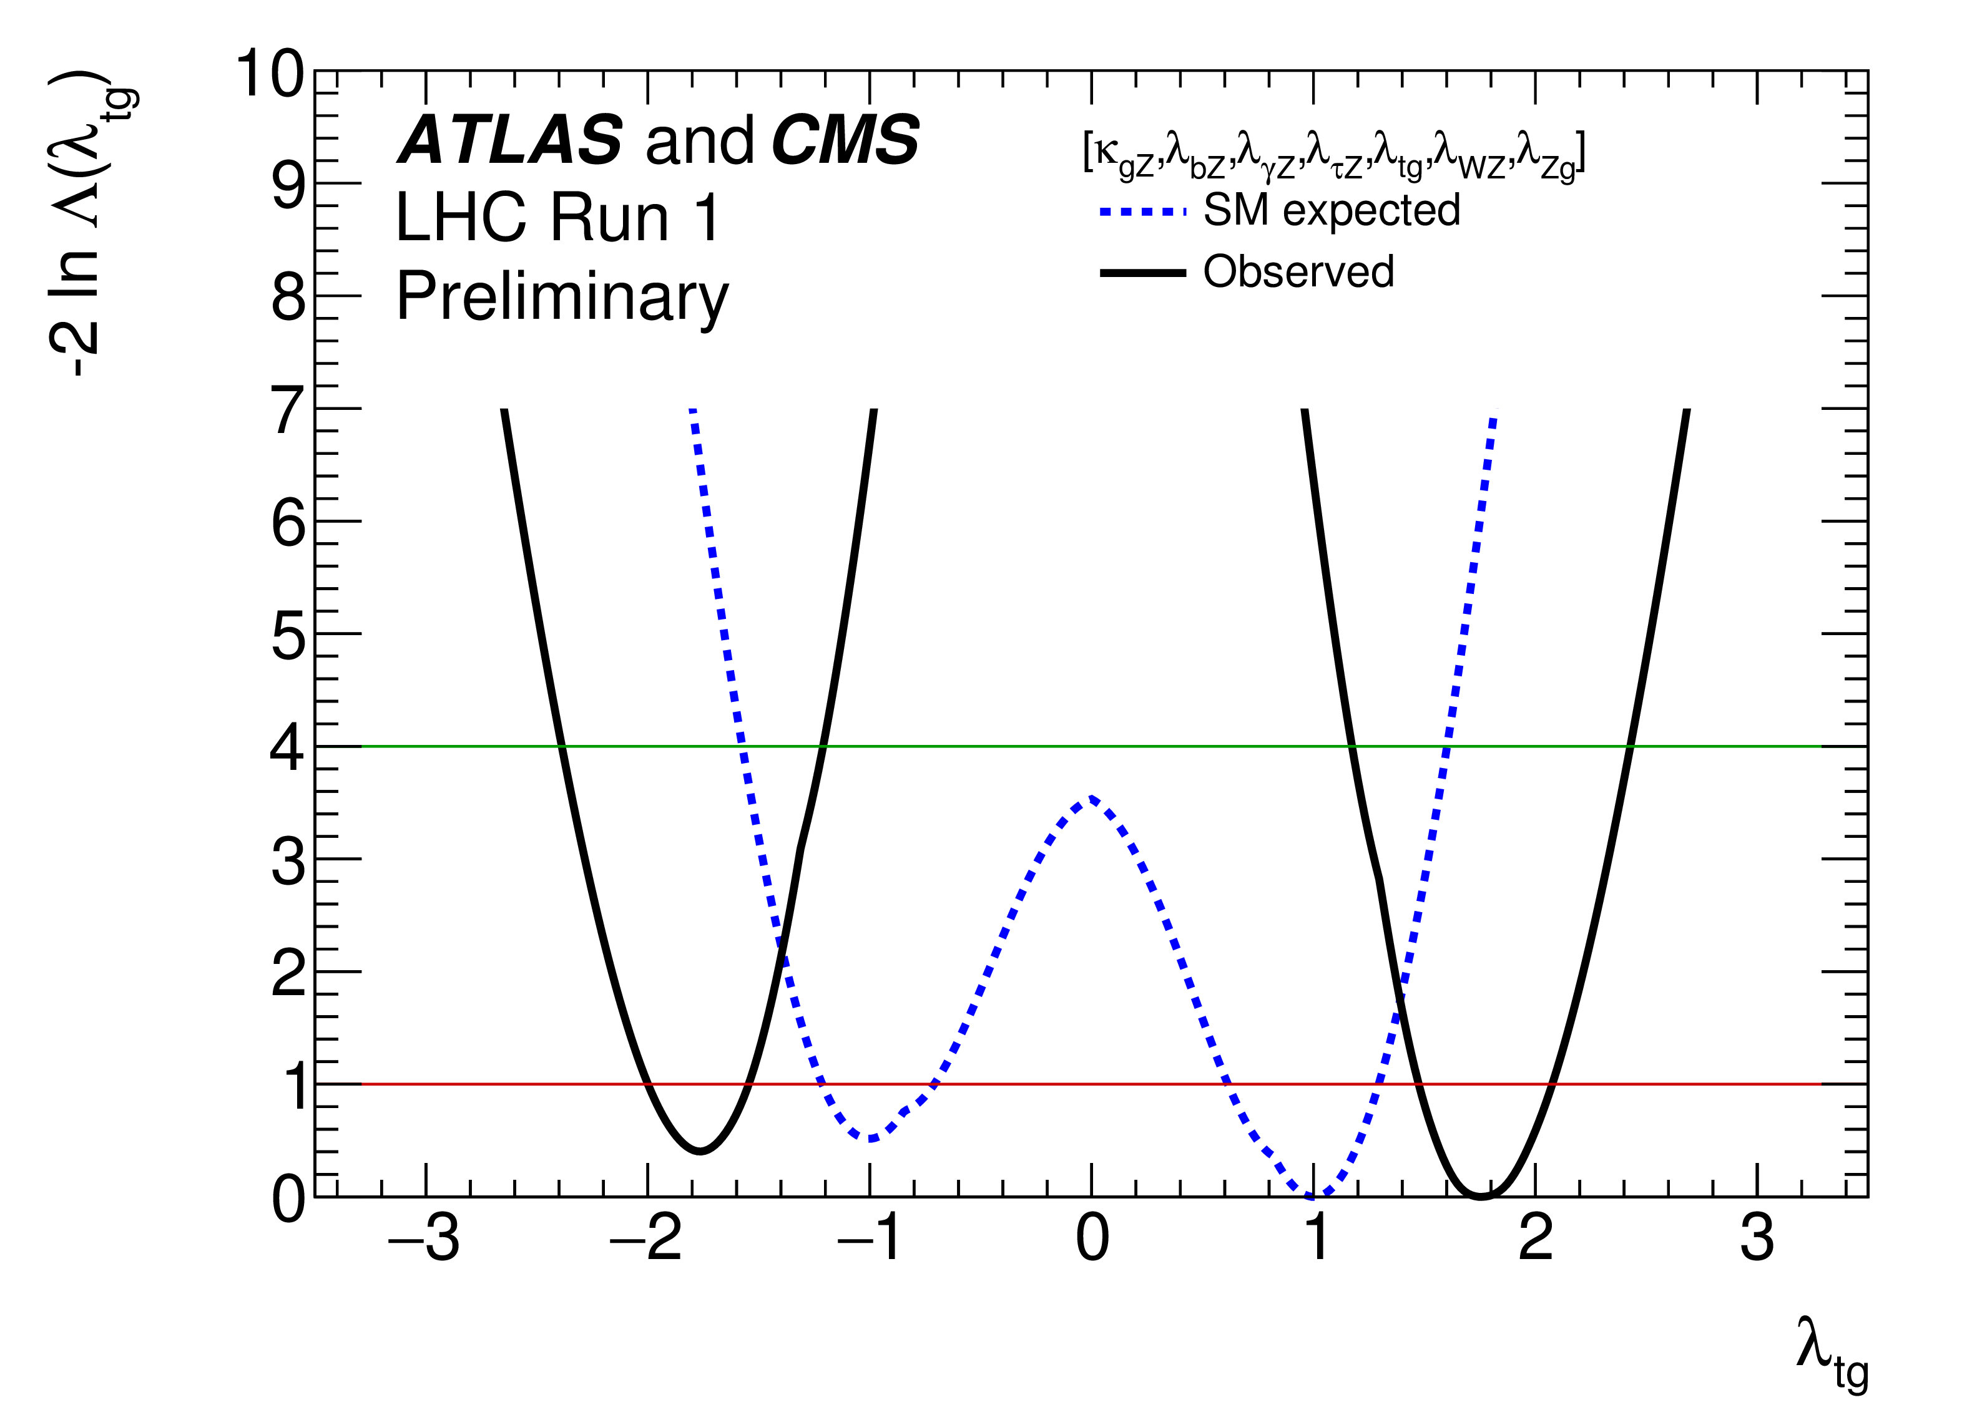
Negative log-likelihood scans of λ_{WZ} and λ_{tg}

Slide 31
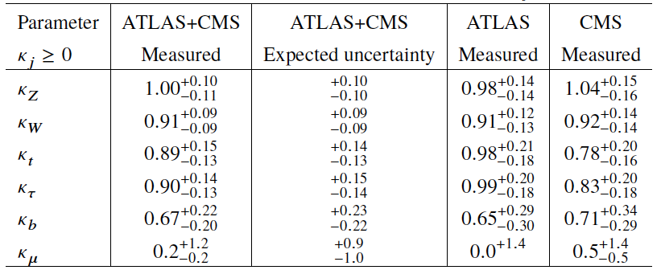
Coupling modifier fit results with no BSM contributions

Slide 32
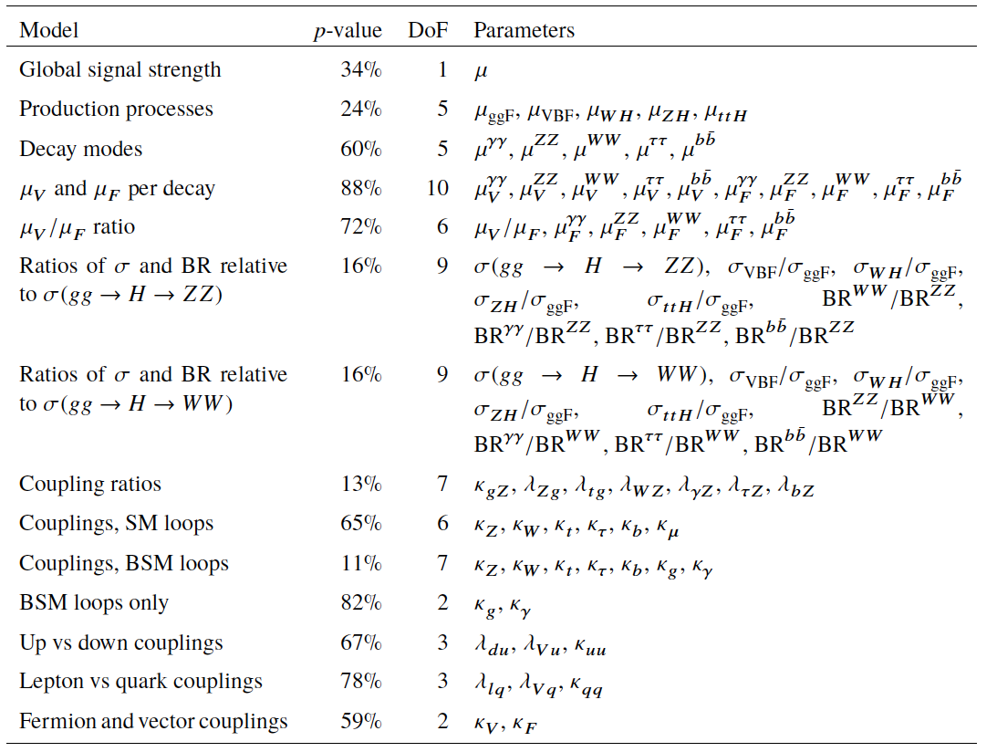
Compatibility of combined fit results with SM (p-values)

Slide 33
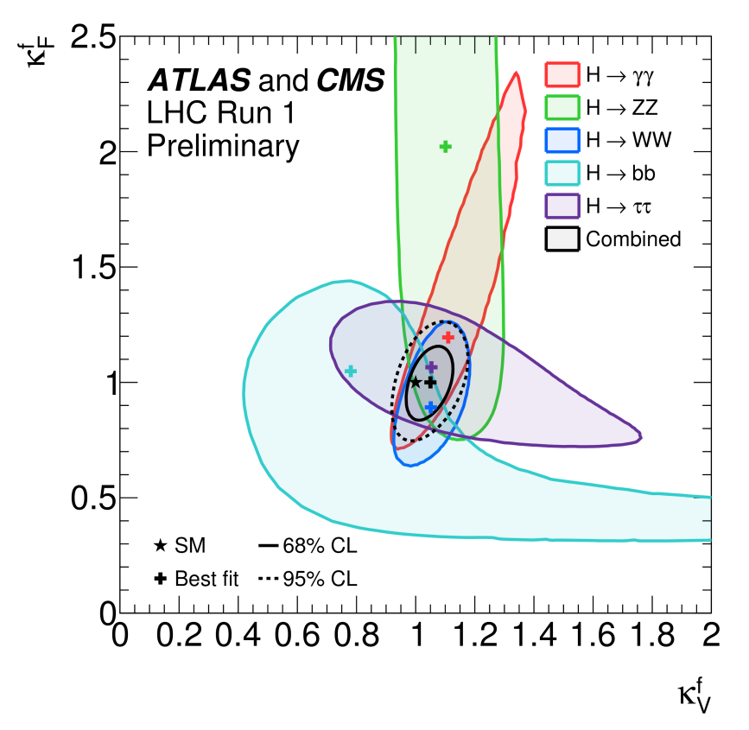
Negative log-likelihood contours of κ^{f}_{F} versus κ^{f}_{V} assuming all >0

