Slide 1
A two-stage torsion pendulum for ground testing free fall conditions on two degrees of freedom
Lorenzo Marconi, Ruggero Stanga, Noemi Finetti,
INFN and Università di Firenze
Massimo Bassan, Fabrizio De Marchi, Giuseppe Pucacco, Massimo Visco.
INFN and Università di Roma Tor Vergata
Martina De Laurentis, Rosario De Rosa, Luciano Di Fiore, Fabio Garufi,
Aniello Grado, Leopoldo Milano.
INFN and Università di Napoli "Federico II"
A. Cavalleri, R. Dolesi, M. Hueller, D. Vetrugno, S. Vitale, W.J. Weber.
Università di Trento and INFN-TIFPA
This work is supported by INFN Commission II

Slide 2
Talk overview
few words about the LISA-PF GRS
goal of the activity
Description of the apparatus (PETER)
present status and results
next steps and perspectives

Slide 3
Drag free spacecraft control : the GRS
Courtesy of S. Vitale
Notes:
3

Slide 4
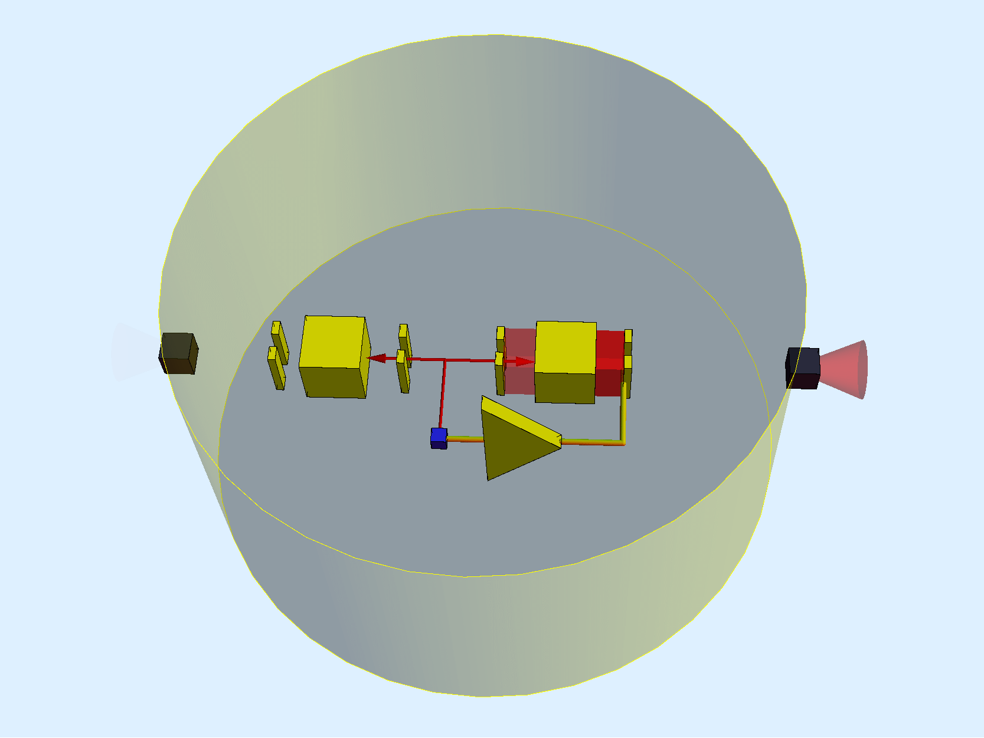
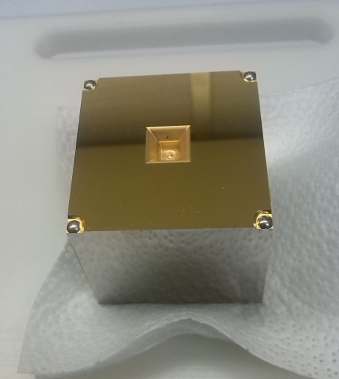
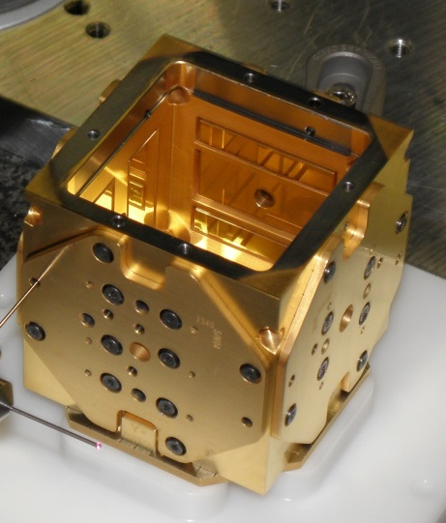
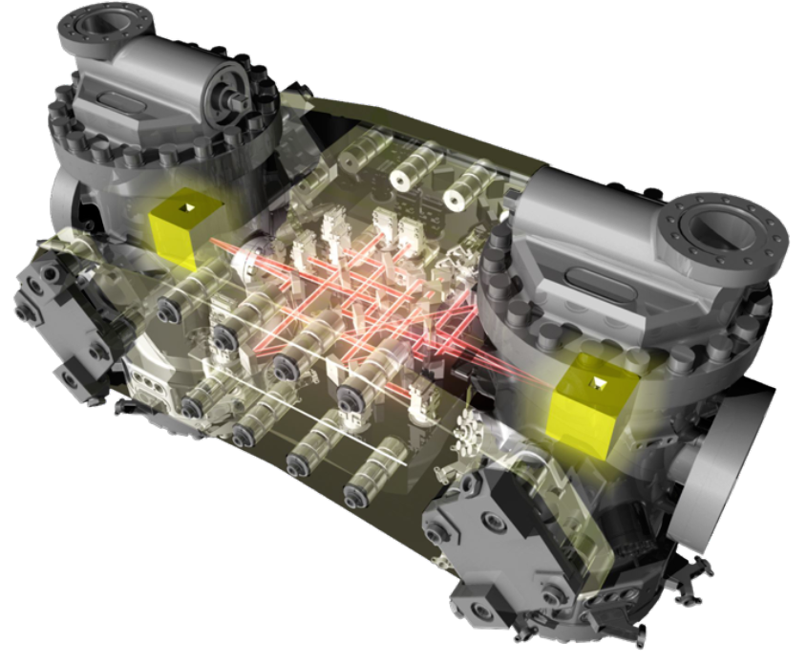
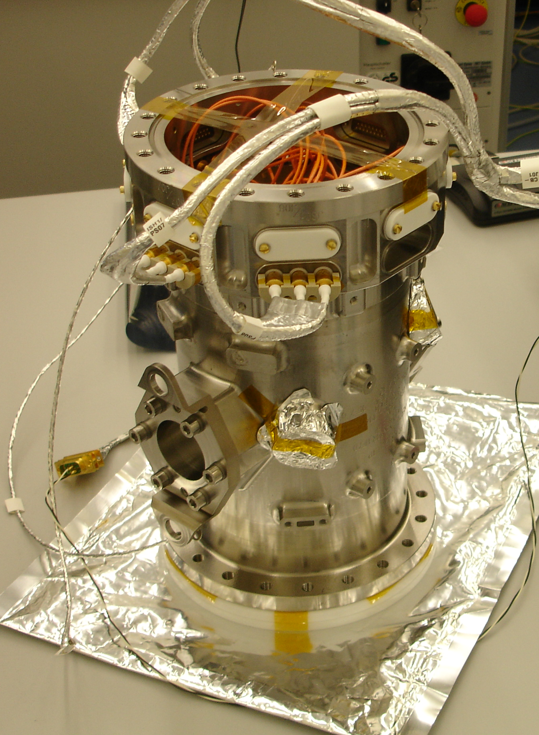
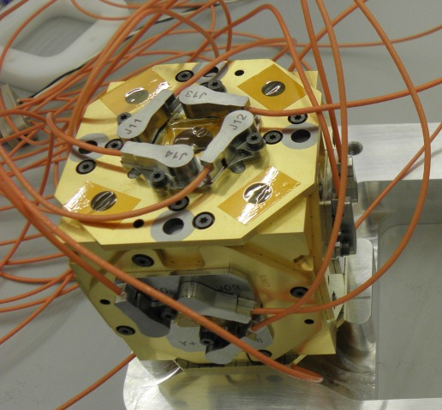
  GRS in LISA PF: a capacitive sensor surrounding the TM
.
Notes:
LISA PF will fly a capacitive sensor with gaps of mm size surrounding the test mass.
It is used to provide test mass position measurement and the actuation abilities for the drag-free control loop, without being a source of excess force noise on the TM s
Candidate
There are 2 for implemenetng the control stratgy of LPF where
Here the control strategy of LPF is illustrated.
TM1 is used as a “drag-free” reference to control the translation and attitude of the satellite
Position of spacecraft relative to TM1 is measured by a local interferometer
and the other (TM2) is electrostatically forced to maintain constant its separation from the first TM1, separtion read by the so called differential accelerometer.
cosa più vicina alla TM!

Slide 5
GRS testing with torsion pendulums
Single stage torsion pendulum facilities have been intensively used for ground testing during the development of the Gravitational Reference Sensor (GRS) of the LISA-Pathfinder mission.
This idea was proposed by the group of prof. Vitale in Trento
They carried on a pioneering work developing two facilities that are still intensively used for free-fall testing of the LISA-PF GRS; in particular
a single mass torsion pendulum
a four mass torsion pendulum
see for example:
Phys.Rev.Lett.91, 151101 (2003)
Phys.Rev. D 76, 102003 (2007)
Phys.Rev. Lett. 108, 181101 (2012)
All these testes were performed with a system with a single soft DOF

Slide 6
Goal of the activity
Our goal has been the development and operation of a torsion pendulum that is "soft" in 2 DOFs so that the TM is in free-fall in 2 DOFs.
This will permit simultaneous measurement of force and torque acting on the TM allowing:
measurement of stray forces and torques on TM
measurement of cross-talks between different DOFs both in read-out and actuation.
measurement of residual stiffness (force acting on the TM due to GRS motion) both in angle and displacement.
other measurements that are also permitted by single pendulums (charge, thermal effects, ...)
In this talk we will in particular report actuation Cross-Talk measuemtnsts

Slide 7
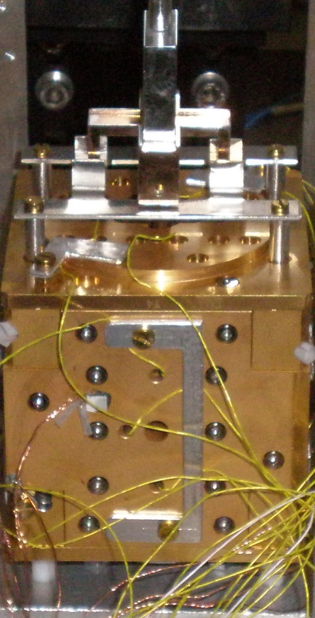
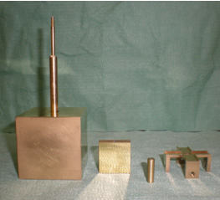
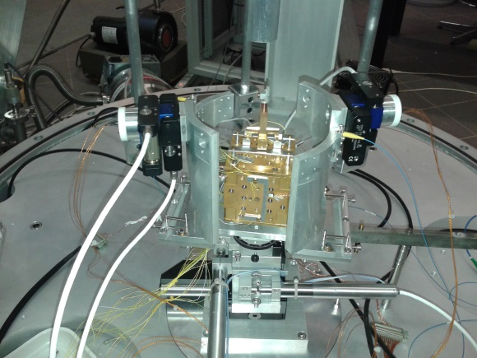
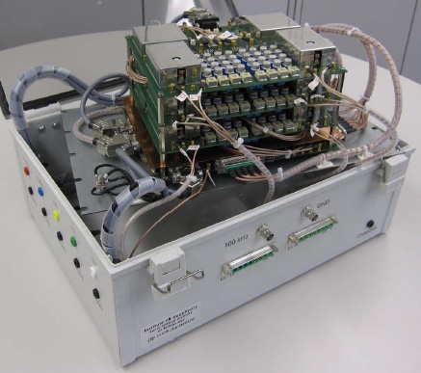
The experimental apparatus (PETER)
PETER (Pendolo Traslazionale E Rotazionale = translational and rotational pendulum) is a two stages torsion pendulum initially developed in Florence with strong support from the Trento Group.
We borrowed from Trento a copy of the LISA-PF GRS engineering model (4mm gap sensor in Mo and SHAPAL)
The GRS electronics (from ETHZ) is similar to the LISA-PF one.
The total length is about 1.7 m
The double pendulum is enclosed in a vacuum tank
(residual pressure about 10⁻⁷ mbar).

Slide 8
Single stage torsion pendulum configurations
Single mass torsion pendulum
four mass torsion pendulum
TM
TM
In this case we can only measure a torque acting on the TM
In this case we can only measure a force acting on the TM

Slide 9
Principle of operation of PETER
With a two stages torsion pendulum we can get two soft DOFs
in this case we can measure both force
TM

Slide 10
Principle of operation of PETER
With a two stages torsion pendulum we can get two soft DOFs
in this case we can measure both force
and torque
TM

Slide 11
Principle of operation of PETER
With a two stages torsion pendulum we can get two soft DOFs
in this case we can measure both force
and torque
simultaneously
TM

Slide 12
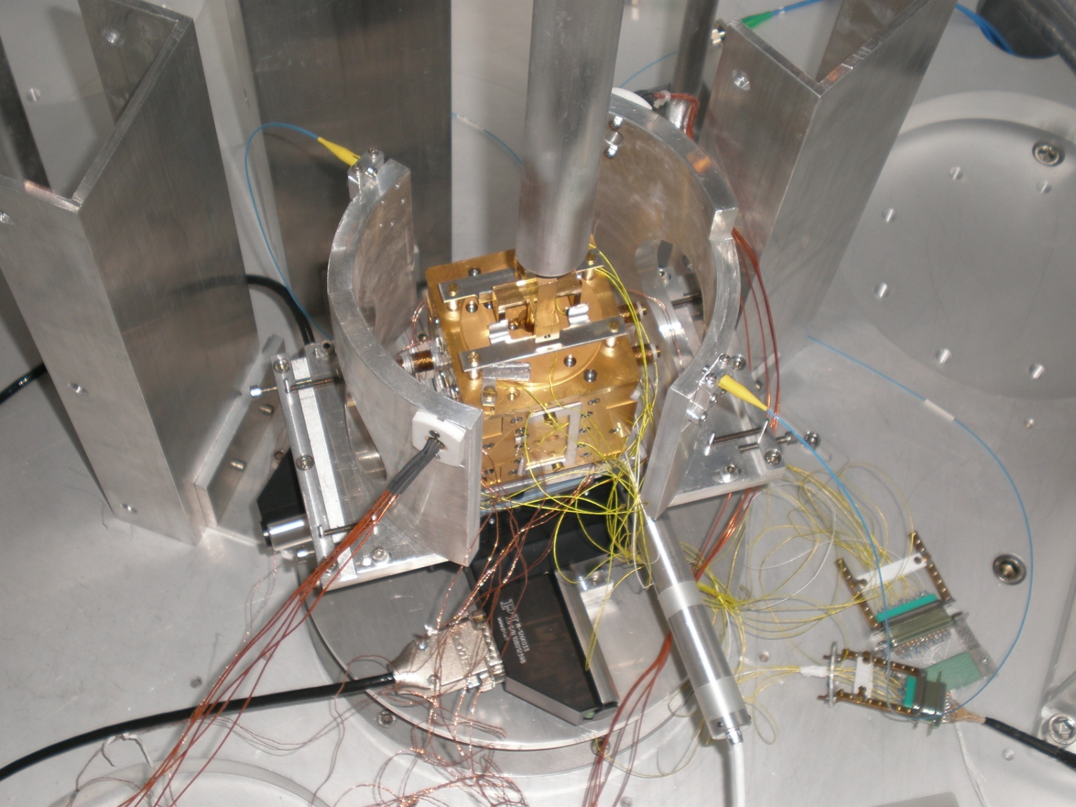
Readout scheme of PETER
The facility has a redundant readout system with combination of different sensors
Autocollimator at the crossbar level
GRS at the TM level
optical read-out (ORO) at the TM level
ORO at the crossbar level (being implemented)
ORO
AC
ORO
GRS

Slide 13
Moving PETER from Florence to Napoli
The activity was started few years ago by the Florence and Roma groups.
It was then decided to transfer the apparatus from Florence to the Napoli Gravitational Physics Laboratory.
An important motivation was the environmental condition of the lab
the facility was housed in a large open space building, with lot of human activity around, large temperature fluctuations, air currents etc.
We prepared the Napoli lab to house the facility
We built a platform with an independent foundation separated by the rest of the building and from the floor of the lab.
The pendulum was finally suspended again on November 17th 2014 and started operation in early 2015.

Slide 14
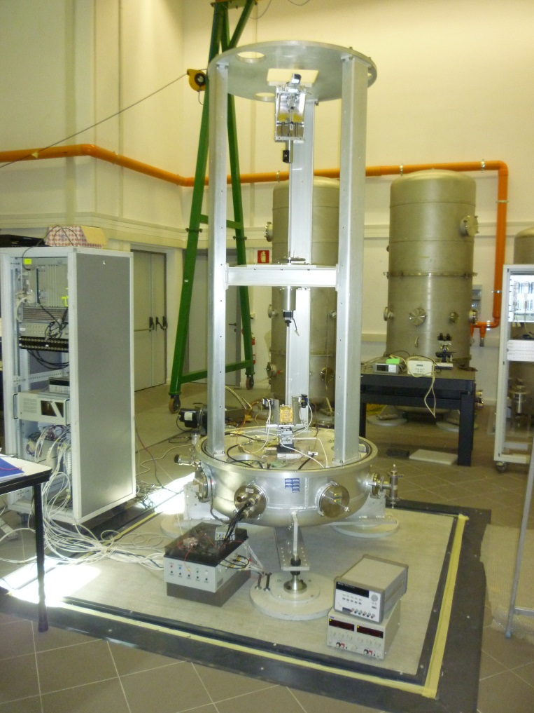
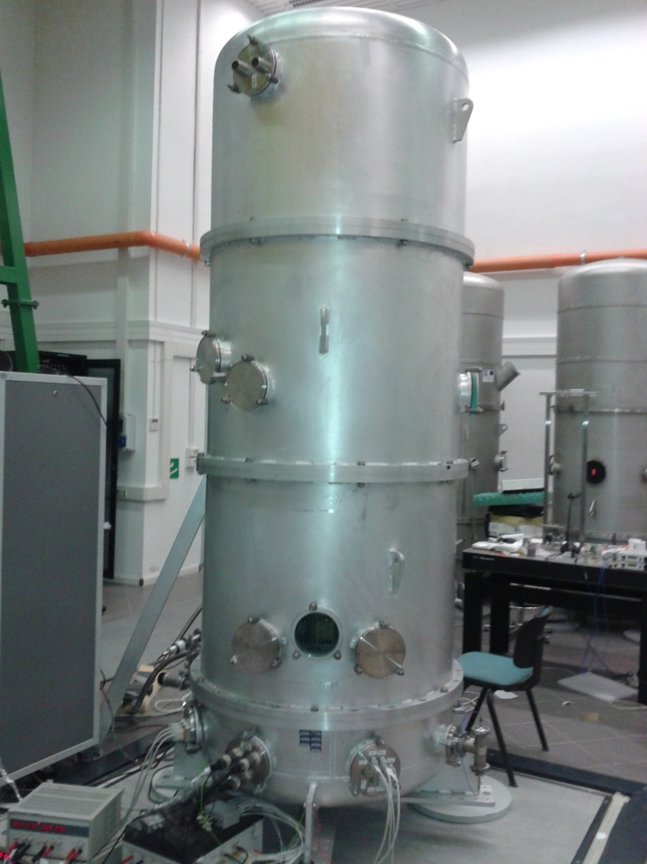
PETER in the Napoli lab during the assembling phase
reinforced concrete basement

Slide 15
Position and angle measurements
displacement (X) PSD
Angular (phi) PSD

Slide 16
Force and torque measurements
From TM angle and position we can compute force and torque acting on the TM
Force PSD
Torque PSD

Slide 17

Actuation for C.C. measurement
We actuate on pairs of virtual electrodes (X e Phi)
Force is proportional to V²
the applied voltage is proportional to the square root of the required force ➔ V=a∙sqrt(F)
we use one pairs of electrodes for the positive force and the other for the negative one
Force actuation
torque actuation

Slide 18


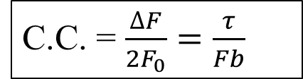
Cross-coupling (C.C.) measurement
sinusoidal actuation in force (F)
(f_{m}=14 mHz)
Measurement of force at f=f_{m}
F₁ =F₀
b
F₂ = (F₀+ΔF)
F = $F_{1}+F_{2}= \sim 2F_{0}$
$$τ=\left(F_{1}−F_{2}\right)∙b=−\text{D}F∙b$$
C.C. = $\frac{∆F}{{2F}_{0}}=\frac{τ}{Fb}$

Slide 19



Cross-coupling measurement
Sinusoidal actuation in torque (τ)
(f_{m}=18 mHz)
Measured force at f_{m}
F₁ =F₀
b
F₂ = -(F₀+ΔF)
$$τ=\left(F_{1}−F_{2}\right)∙b\sim 2F_{0}∙b$$
F = $F_{1}+F_{2}= \text{−}\text{D}\text{F}$
C.C. $≔\frac{∆F}{{2F}_{0}}=\frac{F}{τ}∙b$

Slide 20
C.C. measurement
The C.C. measurement is performed by moving with motors the electrode housing (EH) around the TM in x and y along a defined grid, while acting with a sinusoidal force on the TM
For each position the data is acquired for some time (2 - 6 hours),
From the TM position it is possible to measure, both force and torque and then obtain the C.C,
In this example we move in a spiral from the EH center by steps of .1 mm in x and y
The measurement (25 steps) lasts for 50 h (more than two days)

Slide 21
An example of Force to Torque C.C. measurement
The measurement points lay on a regular surface

Slide 22
The measured values can be well fitted with a second order polynomial in two dimensions
The residuals (measure-fit) are close to zero

Slide 23
Comparison with the model
The force exerted by each electrode can be computed as the gradient of the capacity that is in turn a function of electrode geometry and TM position (in 6 DOF).
This allows us to compute force and torque as a function of position (x, y and φ)
We stop it to the second order.
The values disagree by about 10 %
This could depend on the calibration accuracy (this was recently checked to less than 1 %)
or on a non accurate knowledge of the moments of inertia

Slide 24
Comparison of measured C.C. with the model
Note that the absolute calibration doesn't affect the result

Slide 25
Comparison of measured C.C. with the model
Two projections of the bi-dimensional plot along x and y

Slide 26
Repeatability
we performed a few measurement runs with different grid shapes and different force amplitude
The measurements are very repeatable
All the data sit on the same curve fitted to experiment

Slide 27
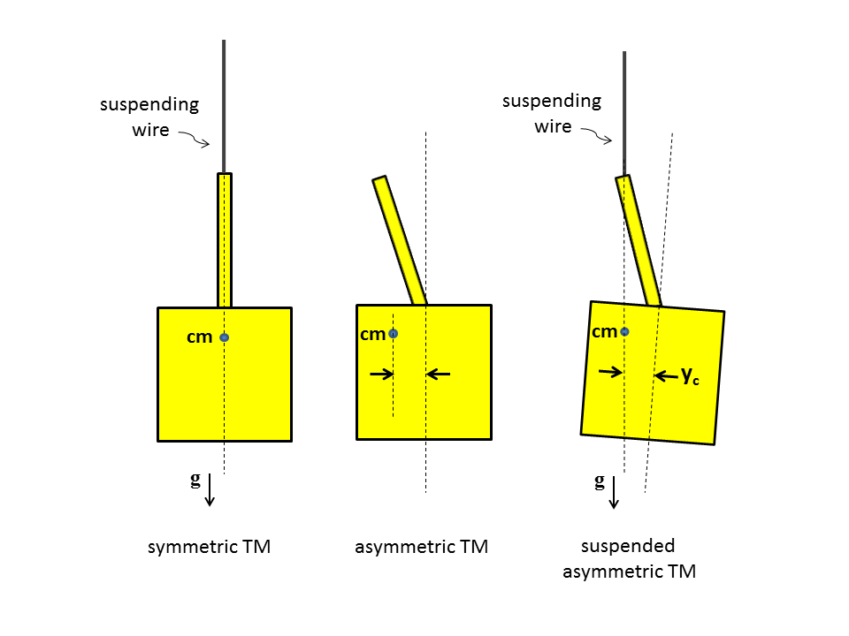
Torque to force Cross-Talk measurement
For CT__{(τ→F)} the data analysis was a little trickier than in the case of CT__{(F→τ)}: we needed to take into account a geometrical readout CT from φ to x, proportional to the y displacement, given by:
x=x_{e}-(y_{e}-y_{c})∙φ
The static effect is due to TM asymmetry
it is much exaggerated in figure

Slide 28
Torque to force Cross-Talk measurement
Also in this case, we performed several measurement runs, with good repeatability
the C.C. value was larger than expected

Slide 29
Projections of measured C.T. along x and y
The measured C.T. is larger than expecter (up to a few % at the edge of the GRS science range)
Close the center, it is still below 1 % and does not look a big problem.

Slide 30
Discussion
We have performed several repeatable measurement run of Force to Torque and Torque to Force cross-couplings of the LISA-PF GRS.
measured Force to Torque CC is very close to the expectations:
measured Torque to Force CC is larger than expected. Further investigations are going-on to check it there are other features introduced by the apparatus itself.
In any case the measured C.T. are not a problem for LISA-Pathfinder operation
We are looking for comparison with C.T test from flight as soon as available

Slide 31
A possible upgrade: 3 DOF pendulum
In this case we can measure two forces and a torque acting on the TM
Force along x
TM

Slide 32
A possible upgrade: 3 DOF pendulum
In this case we can measure two forces and a torque acting on the TM
Force along y
TM

Slide 33
A possible upgrade: 3 DOF pendulum
In this case we can measure two forces and a torque acting on the TM
Torque around vertical axis
TM

Slide 34
Next steps
we are working to improve system characterization (moments of inertia and torsional stiffness) to better understand if the observed extra C.C. is really due to GRS system asymmetries.
We are also planning several upgrades of the system, including the insertion of a third pendulum stage to perform free fall measurement in 3 DOFs
After the completion of LISA-Pathfinder operation, we think that the PETER facility could be very useful for ground testing of the GRS of the future LISA mission or for other drag free space experiment

Slide 35
Thank you for your attention

