Slide 1

Perspectives for detection of gamma-ray counterparts of gravitational wave sources
Lorenzo Natalucci*, Pietro Ubertini, Angela Bazzano, Sandro Mereghetti, Carlo Ferrigno, Erik Kuulkers, Volodymyr Savchenko
*Istituto di Astrofisica e Planetologia Spaziali, INAF, Rome, Italy
on behalf of the INTEGRAL GW Team
Ligo-Virgo MoU 5/4/2014
Cosmic Ray International Seminar 2016, Ischia 4-8 July 2016
Notes:
Rapid development of collaborations, tools and resources for hunting of EM counterparts.
Talk is mostly based on soft-gamma ray searches

Slide 2
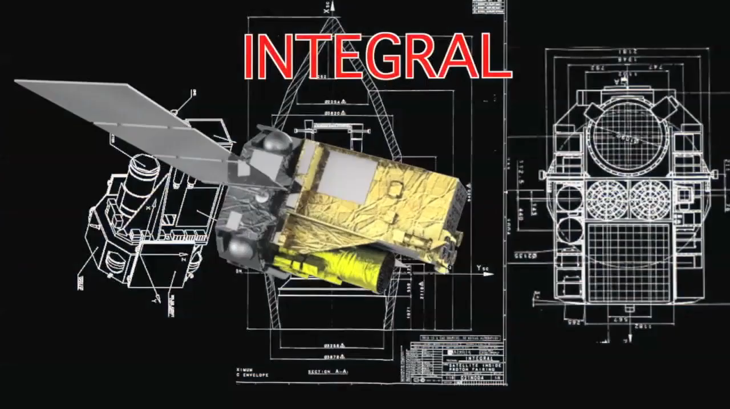
The INTEGRAL Space Observatory
Launched in 2002 by ESA, INTEGRAL is providing advanced spectral and imaging capabilities in the X-ray/soft γ-ray band
INTEGRAL has provided, so far, the tightest upper limits on the EM energy emission GW150914
Savchenko et al. 2016
L. Natalucci – Cosmic Ray International Seminar, Ischia 4-8 July 2016

Slide 3
INTEGRAL main features
3 keV-10 MeV energy range with unprecedented sensitivity
2.7 days uninterrupted observations
wide FOV: ~100-1000 deg²
120 μs time resolution
arc min angular and keV energy resolution and
unique polarimetric capability
INTEGRAL is the link between the soft X-ray and high energy γ-ray sky
So far ~1000 INTEGRAL papers published
102+7 on-going PhD thesis (15+1 Italy)
and 100+ press releases
L. Natalucci – Cosmic Ray International Seminar, Ischia 4-8 July 2016

Slide 4
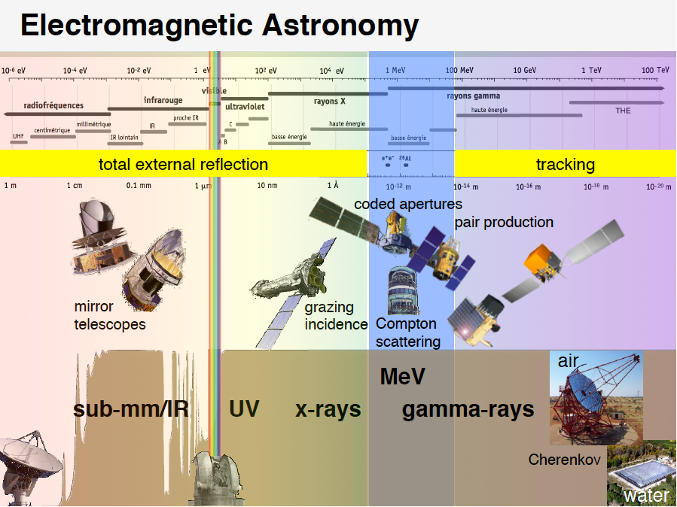
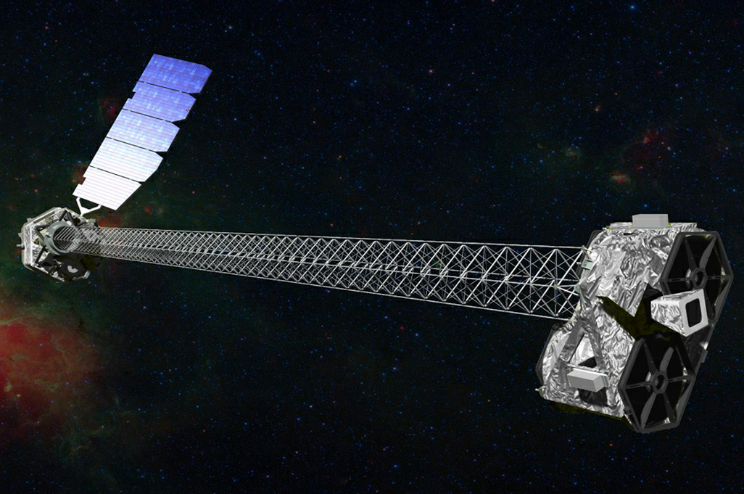

Slide 5
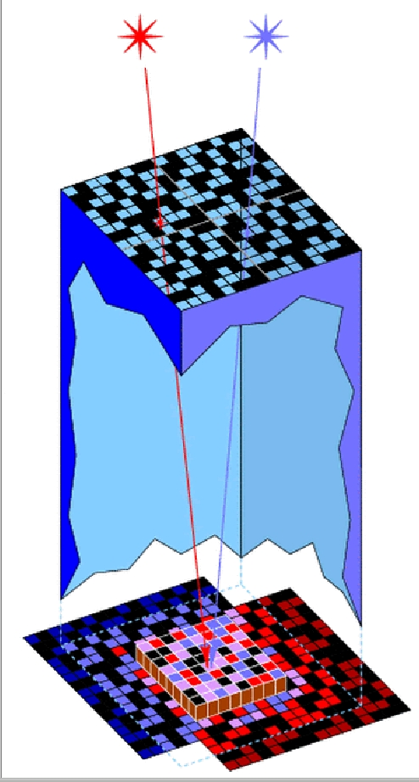
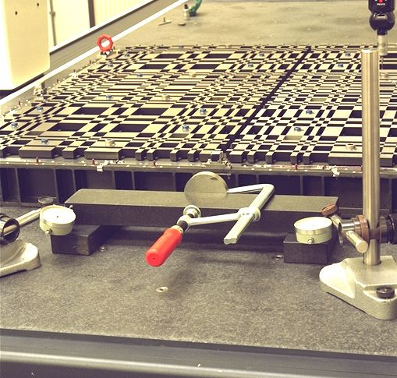
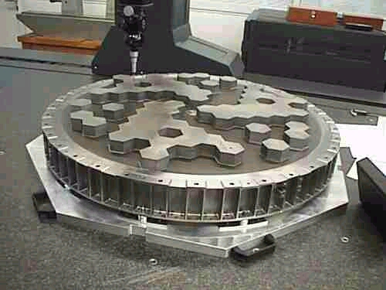
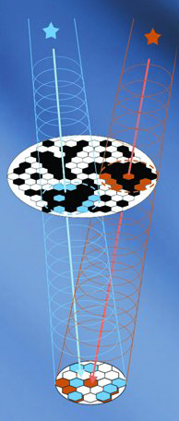
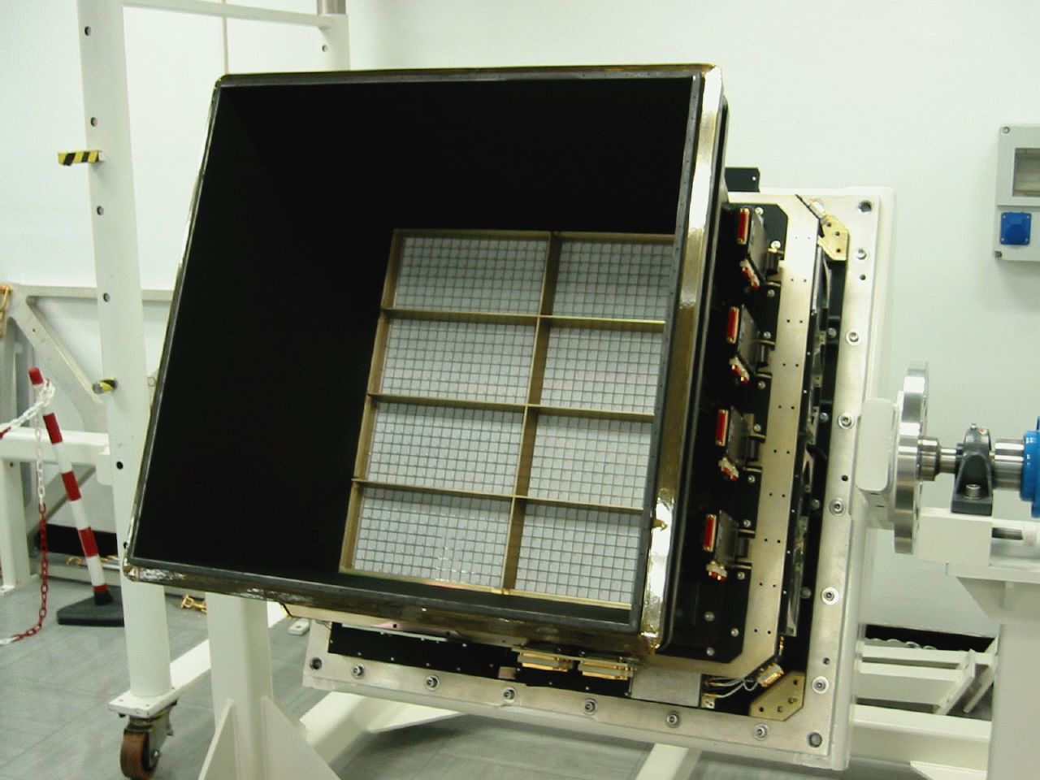
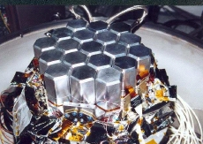
The coded aperture technique
All INTEGRAL high energy instruments use coded aperture to provide sky images
Developed after the ’60s; this technique is based on multiplexing the FOV by measuring different source positions and fluxes on the same detector elements
3.2m
IBIS
SPI
How is this obtained?
An aperture passive device called coded mask, made of an array of opaque and transparent elements is standing at some distance from a position sensitive detector
1.8m
L. Natalucci – Cosmic Ray International Seminar, Ischia 4-8 July 2016
Notes:
Let’s see briefly how INTEGRAL works

Slide 6
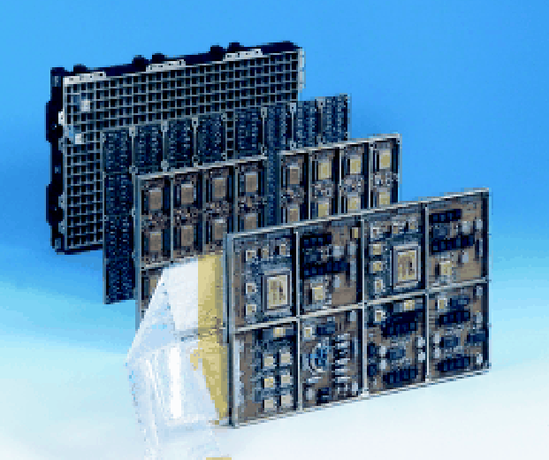
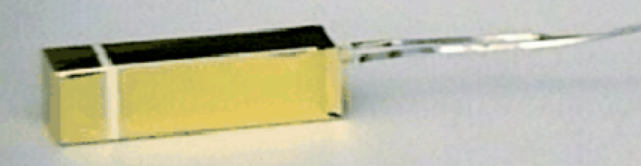
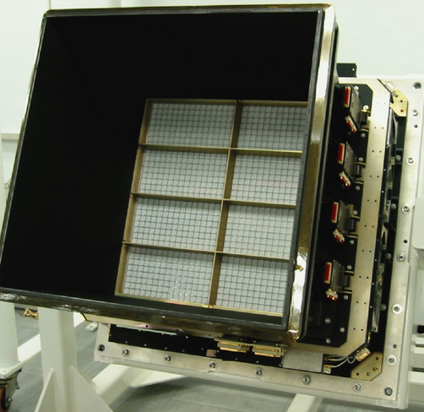
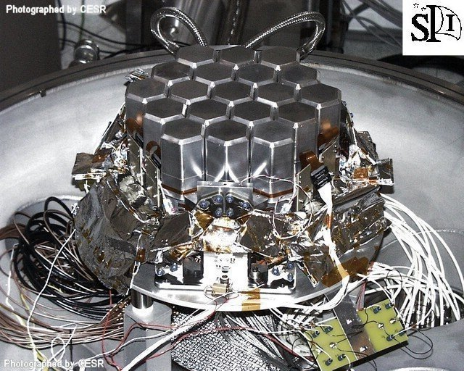
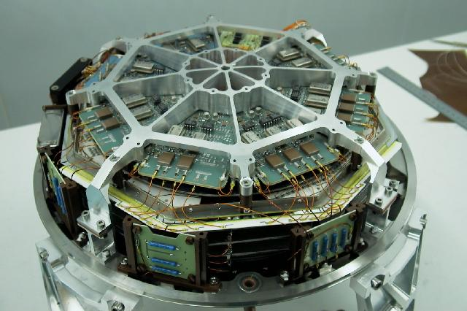
The INTEGRAL high energy detectors
IBIS carries two stacked imaging detector arrays: ISGRI (0.02-1MeV) based on room temperature CdTe semiconductor detectors. PICsiT (0.2-10 MeV) based on CsI scintillator devices
SPI (0.02-10 MeV), Ge cooled detectors provide high resolution spectra
JEM-X (3-35 keV) based on two identical high pressure microstrip gas chambers is providing low energy extension and arcmin resolution images
PICsIT array module and CsI crystal glued to its photodiode
ISGRI (CdTe) and SPI (Ge) detectors
The JEM-X detector
L. Natalucci – Cosmic Ray International Seminar, Ischia 4-8 July 2016

Slide 7
Performance parameters, IBIS vs SPI
IBIS SPI
Energy range | 0.015-10 MeV | 0.018-8 MeV
FOV (F.C.) | 9x9 deg | 16 deg hexagonal
Energy resolution | 8% @100 keV | 2.2 keV @1.2MeV
Detection area | 2100 cm2 | 500 cm2
Angular Resolution | 12’ | 2.5 deg
Location accuracy | < 1’ (> 20σ source) | ~ 1deg
Timing accuracy | < 200 μs | < 200 μs
For details see Ubertini et al. (IBIS) and Roques et al. (SPI),
2003 A&A 411(special issue on INTEGRAL)
L. Natalucci – Cosmic Ray International Seminar, Ischia 4-8 July 2016

Slide 8
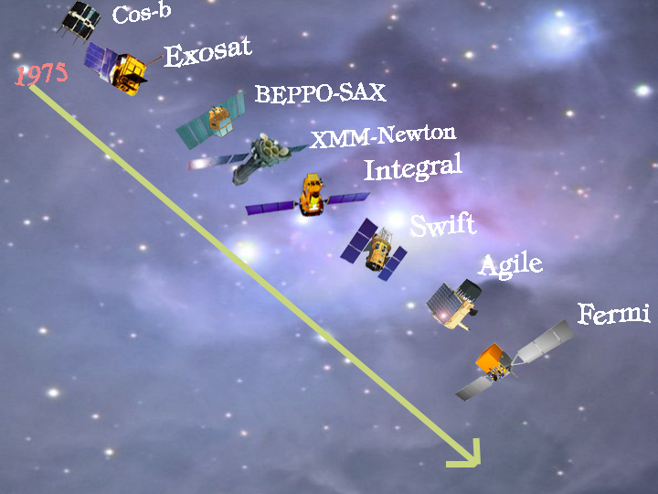
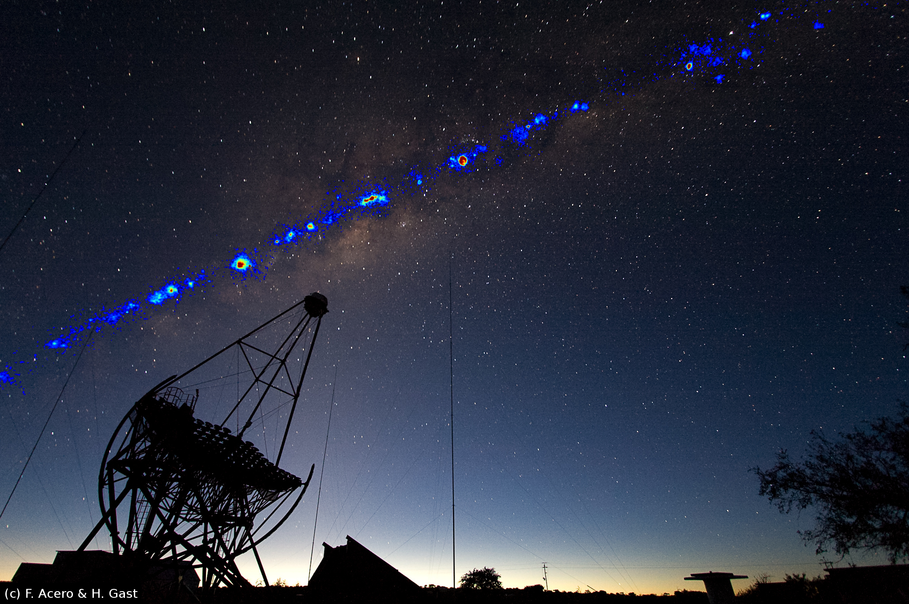
August 1975
May 1983
April 1996
December 1999
October 2002
November 2004
From BeppoSAX increasing the energy range in the last 20 years → XMM → INTEGRAL → AGILE → and CTA to exploit very high energy gamma ray science
April 2007
Now: hunting
Gravitational Wave astrophysical counterparts
June 2008
Italy, and Europe, has a worldwide 4 decades record of success in the field of high energy astrophysics

Slide 9
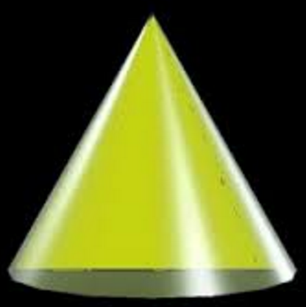
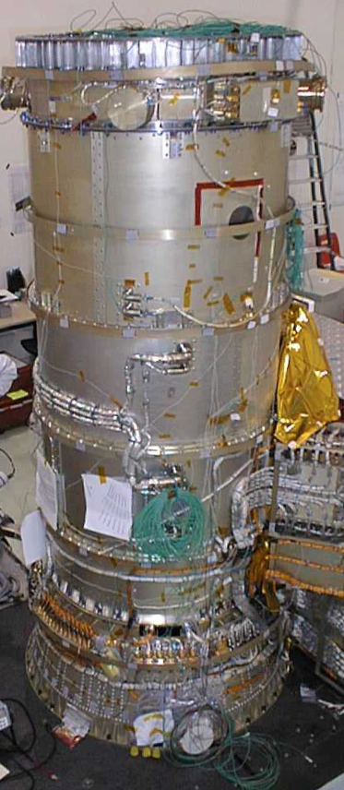
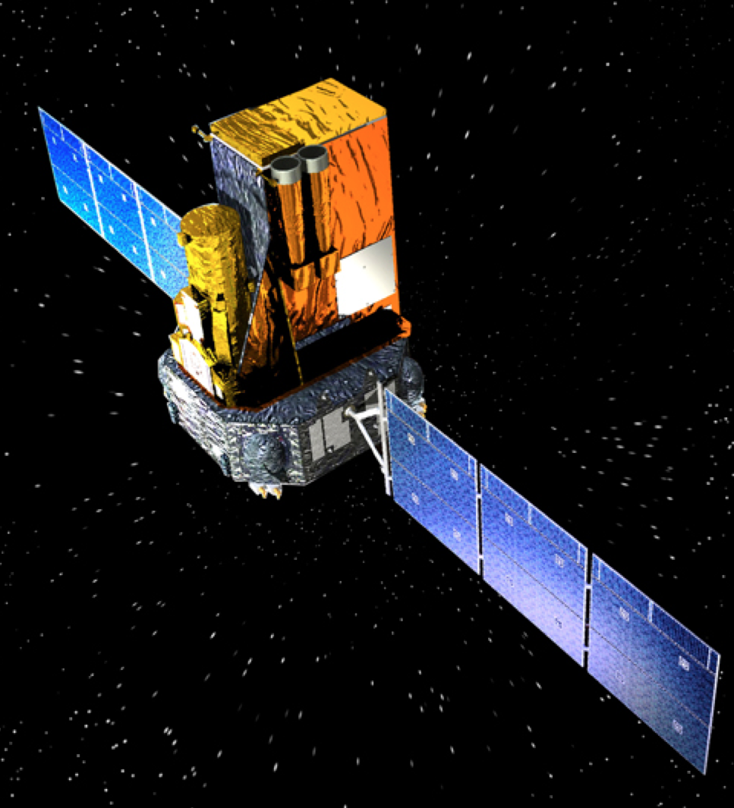
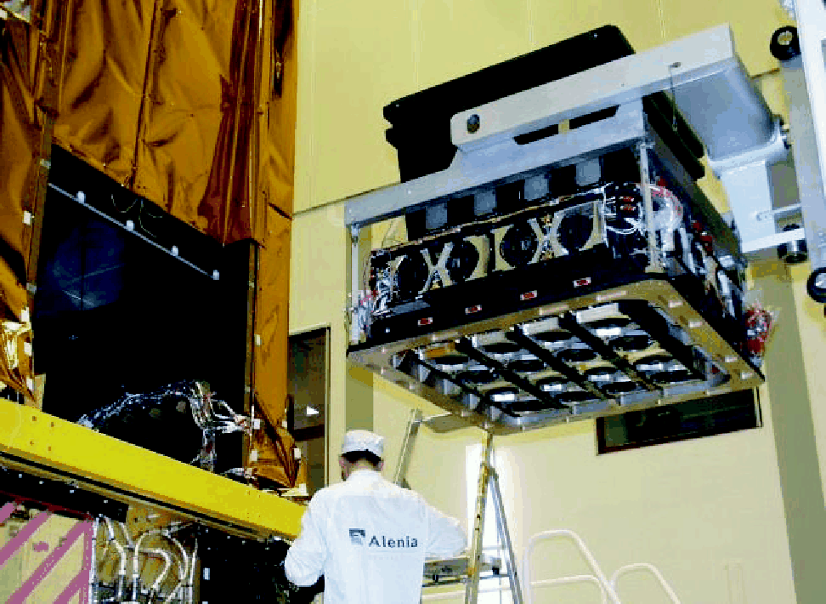
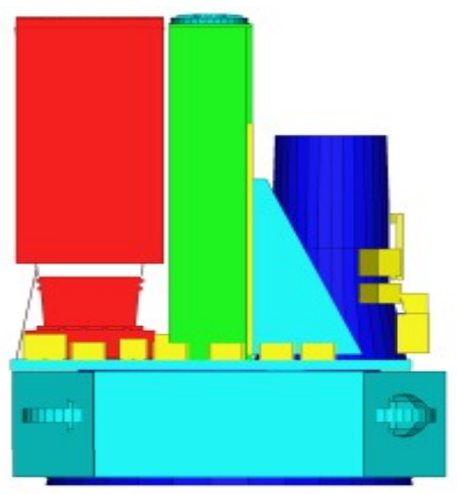
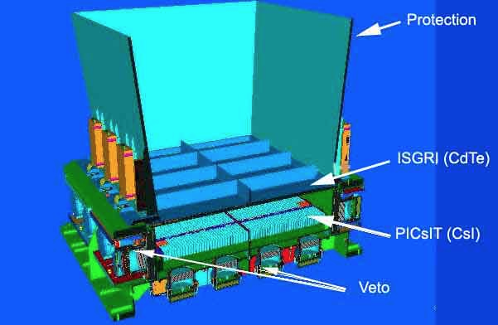
INTEGRAL to hunt γ-ray transients
The SPI/ACS detectors view ~4π solid angle of the sky.
E>75 keV, Tres=50ms
Effective area: up to 1m²
The IBIS detectors ISGRI and PICsIT have max sensitivity to directions normal to SPI/ACS factor of 5 at least
Outside the IBIS FOV (~30x30 deg²) the ISGRI and PICsIT detectors also view ~4π in the ~0.25-2.6 MeV band.
PICsIT: T_res=15.6ms
Effective area up to ~900cm²
The sensitivity to a gamma-ray transient depends on sky position and its evaluation must take into account the payload and satellite masses distribution
INTEGRAL is similar to BeppoSAX for GW counterpart search…
L. Natalucci – Cosmic Ray International Seminar, Ischia 4-8 July 2016
Notes:
INTEGRAL is also a true all-sky transient monitor in gamma-rays. The thick BGO shielding around the SPI detector is routinely used to detect gamma-ray bursts and a burst alert system –IBAS- is running all the time. In addtion the 3cm thick PICsit detector array can be used to detect transients outside the IBIS FOV.

Slide 10
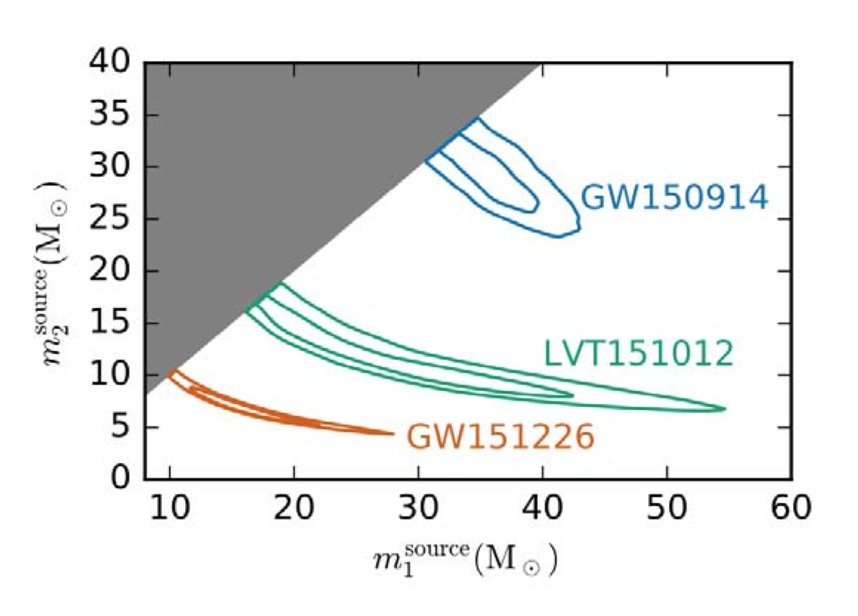
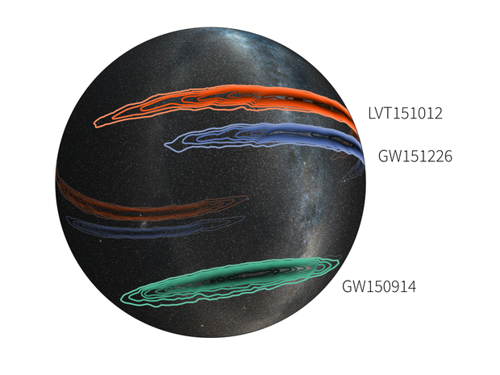
Events observed during
LIGO/Virgo O1
Three events observed: all consistent with Binary BH mergers: most followed is GW150914
One of them, LVT151012, has a statistical significance of ~98%.
GW151226 not covered by INTEGRAL (but see the very recent CALET results, Adriani+16, arXiv:1607.00233v1)
Credit: LIGO/Virgo Collaboration
L. Natalucci – Cosmic Ray International Seminar, Ischia 4-8 July 2016

Slide 11
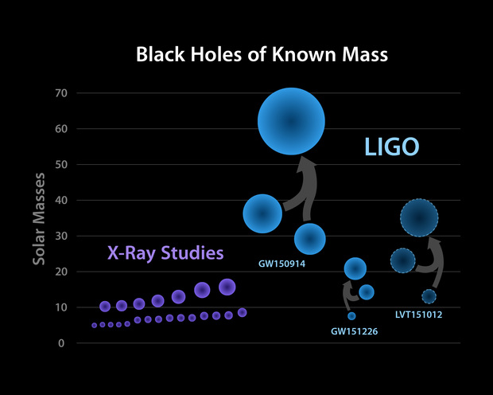
Main astrophysical sources of gravitational waves
BH-BH mergers ???
NS-BH and NS-NS mergers Short GRBs
Gravitational Collapse Long GRBs
Magnetars; Pulsar Glitches Soft γ-ray Flares
Extending substantially the range of masses of visible black holes!
L. Natalucci – Cosmic Ray International Seminar, Ischia 4-8 July 2016
Notes:
Why do we search for EM counterparts? What do we expect to observe?

Slide 12
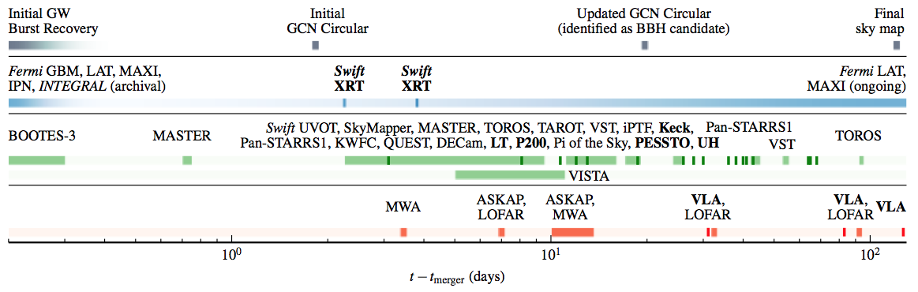
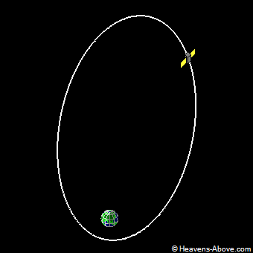
arxiv1602.08492
V. Savchenko et al., 2016 ApJL,820,L36
Abbott, B. P et al, 2016 ApJL
Notes:
25 observing teams have searched the astrophysical counterpart spanning the whole EM spectrum. Gamma

Slide 13
GW 150914
The Real-time IBAS GRB trigger system has not been triggered by the GW event. Off-line analysys has then been performed.
The whole sky was covered by INTEGRAL in the range from 50KeV to 2MeV before and after the reported GW150914 event
Using the omni-directional view of the INTEGRAL/SPI-ACS and the IBIS-PICSIT side FoV we have obtained tight upper limits on
the hard X-ray/gamma-ray prompt emission
INTEGRAL, FERMI and SWIFT data strongly constrain the fraction of energy emitted in the high energy electromagnetic component from the full high-probability sky region of LIGO/Virgo trigger
L. Natalucci – Cosmic Ray International Seminar, Ischia 4-8 July 2016

Slide 14
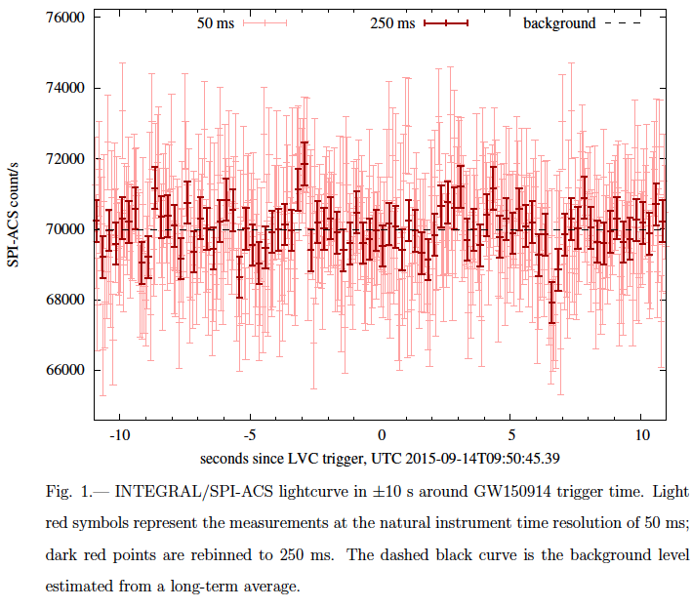
INTEGRAL UL on γ-ray emission from GW150914
ΔT= -3s
ΔT= 0.4s
http://arxiv.org/abs/1602.04180
L. Natalucci – Cosmic Ray International Seminar, Ischia 4-8 July 2016

Slide 15
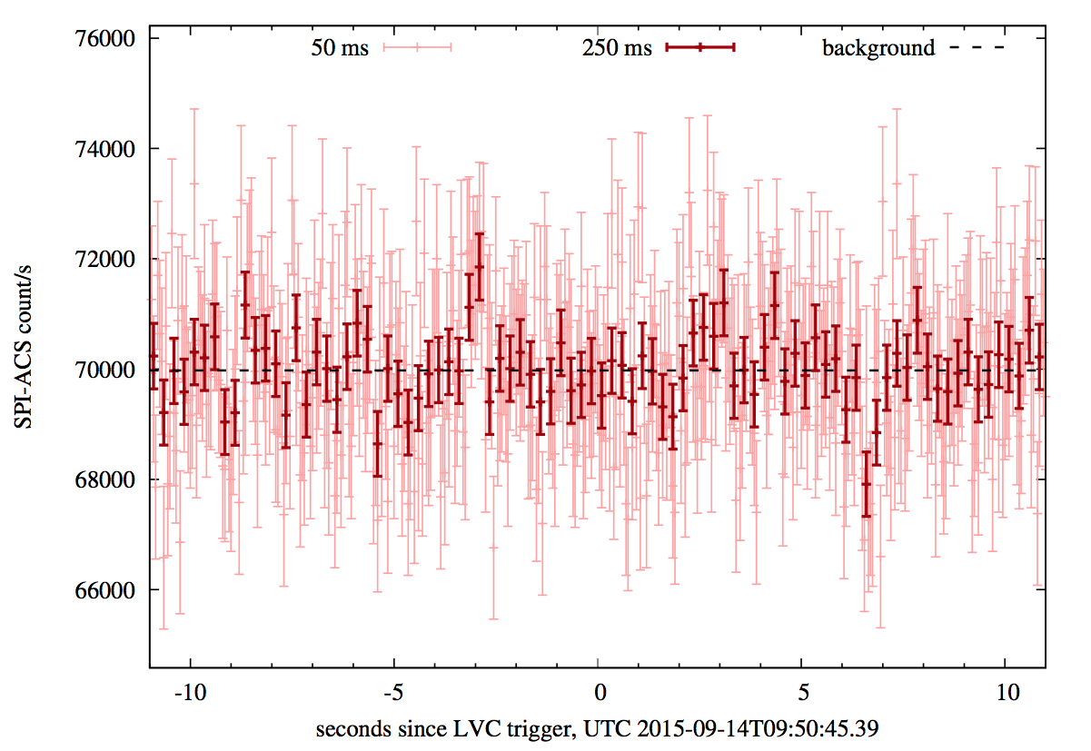
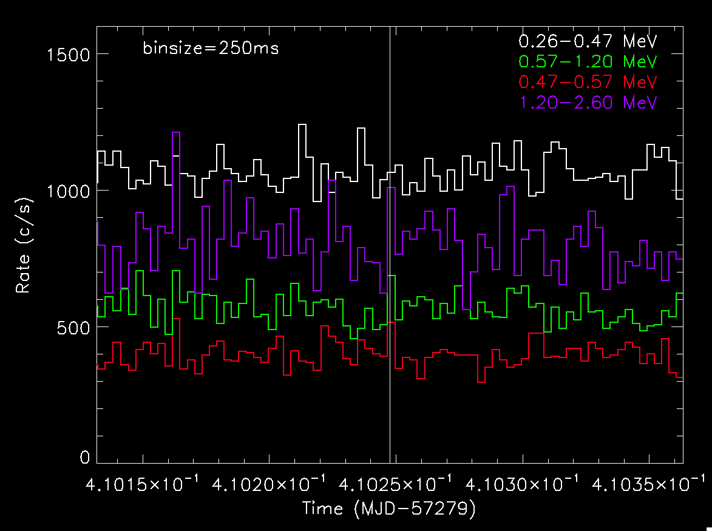
PICSIT Spectral Timing data
260 keV – 2.6 MeV
16ms time resolution

Slide 16
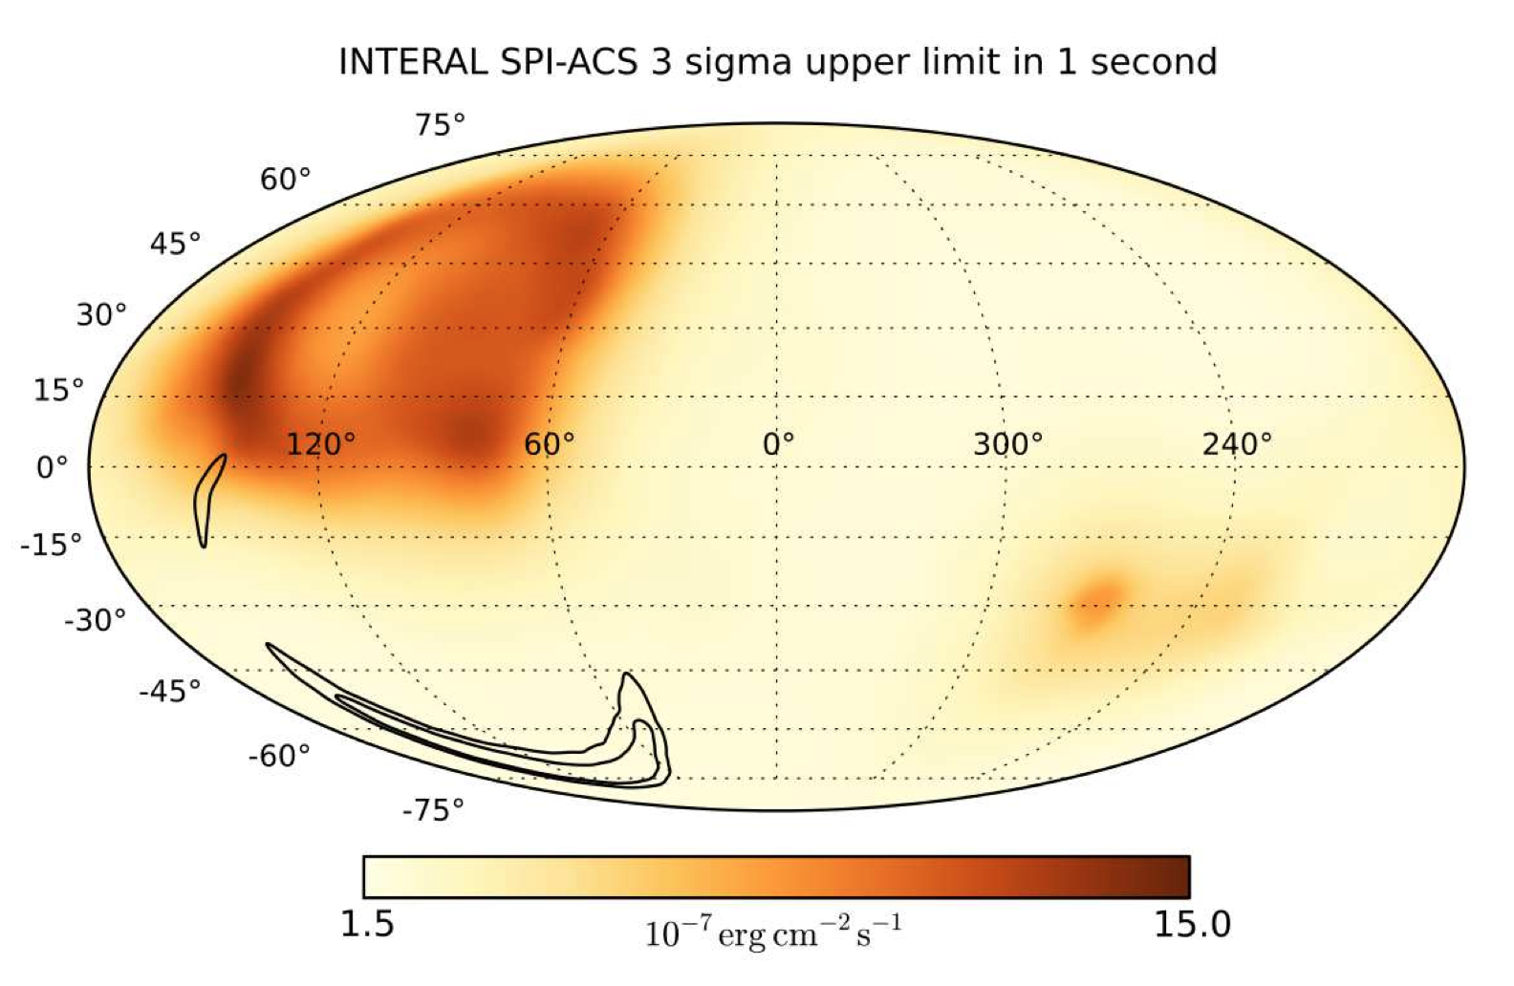
INTEGRAL Upper Limits on the γ-ray emission of GW 150914
Localization by the LIGO/Virgo collaboration yields a very large region…
The SPI/ACS sensitivity in FOV vary up by a factor 5, but its optimal value applies to 75% of the sky
GW150914: U.L. range is 0.2-4.5x10⁻⁷ erg cm⁻² for event durations of 0.05 to 10s, respectively (applies to 95% of the Adv. LIGO error region)
Savchenko et al., ApJ lett., 2016
The ratio of e.m. to gravitational energy is R_{γ/g}= 0.2-5x10⁻⁶
In case of events in the ~300 sq.deg FOV of INTEGRAL, the search flux limits would decrease by a factor ~5 at least
L. Natalucci – Cosmic Ray International Seminar, Ischia 4-8 July 2016

Slide 17
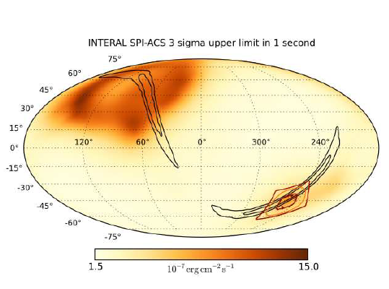

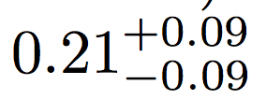
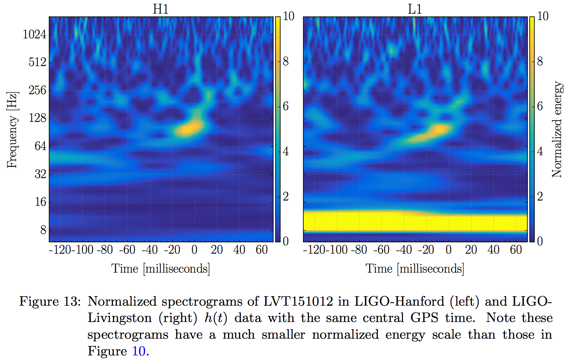
LVT 151012
Event with associated false alarm probability of 0.02
Location compatible to be within INTEGRAL FoV
Possible BBH merger, with initial masses
and redshift
Abbott+16, arXiv:1602.03844v3
L. Natalucci – Cosmic Ray International Seminar, Ischia 4-8 July 2016

Slide 18

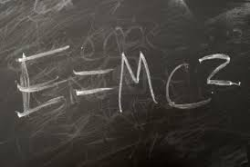
INTEGRAL Highlights Summary for O1
INTEGRAL operation was changed after GW150914 to IMMEDIATELY follow-up the NEXT GW trigger.
INTEGRAL has constrained the energy emitted in the high energy electromagnetic component from the full high-probability sky region of LIGO/Virgo trigger to:
E_{g}/E_{GW} < 10⁻⁶
L_{iso} ≤ 10⁴⁶ erg/s
INTEGRAL has observed with the allsky monitor LVT 151012 and a large part of the LIGO/VIRGO error box is within the FoV!!! →
More stringent upper limit to come….

Slide 19
Prospects for O2 and beyond
LIGO/Virgo O2 starting in the Fall of 2016; Virgo expected to begin ops near the end of the year
Starting from the next O2 campaign, aLIGO+Virgo will start to approach their design performance. The error region will decrease to <few 100s sq.degrees
3-100 BBH events expected in O2 (see arXiv:1602.03842)
Different timescales for follow-up to be considered: from real-time (prompt) to hours-days (delayed emission)
INTEGRAL, Swift, Fermi are best candidates for follow-up
In case of events in the ~300 sq. deg FOV of INTEGRAL the flux limits would decrease by a factor ~5 at least
INTEGRAL can characterize the prompt and also the delayed emission using dedicated TOO programs.
L. Natalucci – Cosmic Ray International Seminar, Ischia 4-8 July 2016
Notes:
The fluence limit is ~1.5x10-7 erg cm⁻² for 1s burst
O2: factor of a few in sensitivity better than O1;
Rates degli eventi previsti sono 5-500/campagna, dipende dai modelli

Slide 20
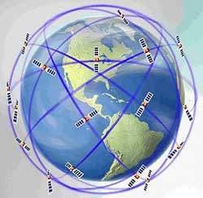
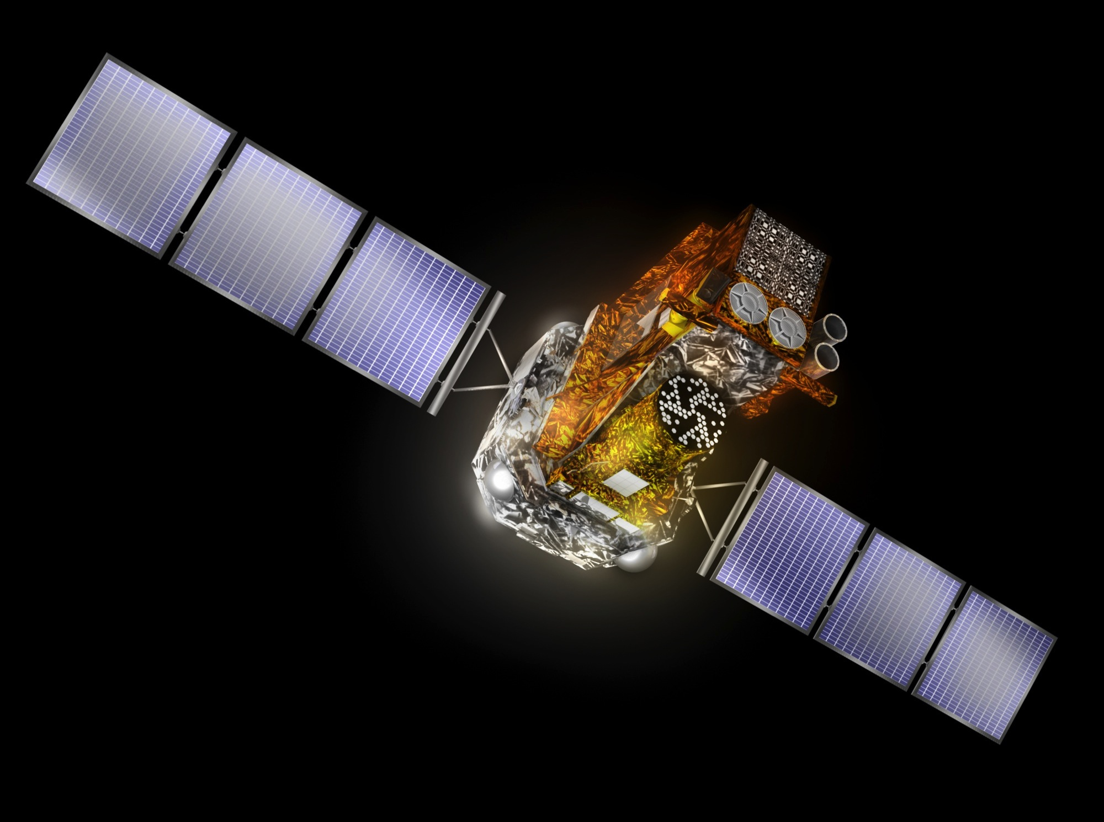
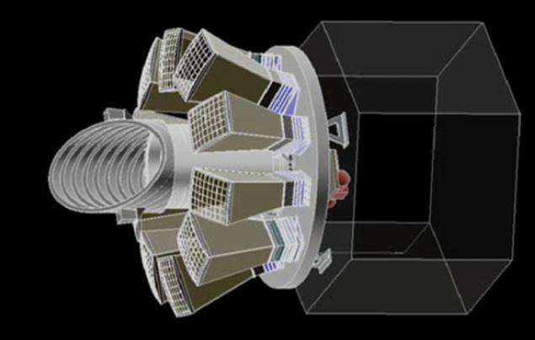
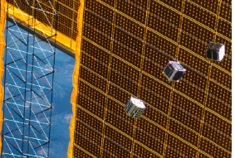
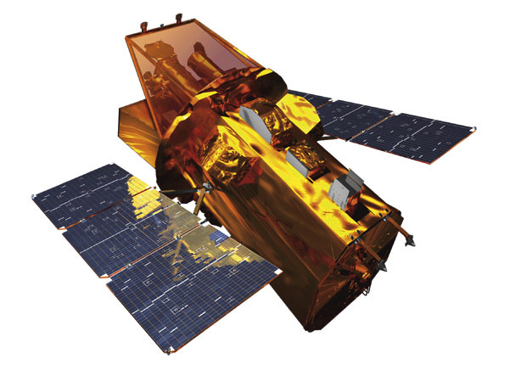
What’s next
The HERMES mission
High Energy Rapid Modular
Experiment Satellites
LOBSTER (NASA)
Theseus (ESA)
INTEGRAL-SWIFT
Large Observatories
>10 years operations
Low cost!..
Lobster eye X-Ray
+ gamma-ray trigger
10-50 High-Z GRBs
10y development Cost 100-500M€
Cubesat sworm constellation arcsec positioning
Short turnaround
Moderate cost, modularity: 100cubesat
L. Natalucci – Cosmic Ray International Seminar, Ischia 4-8 July 2016
Notes:
Cubesats con Gps fino 10ns di ris.temporale

Slide 21
Backup slides
L. Natalucci – Cosmic Ray International Seminar, Ischia 4-8 July 2016

Slide 22
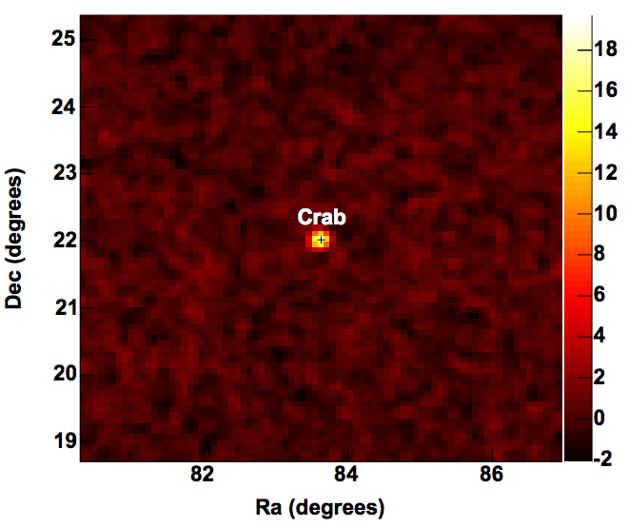
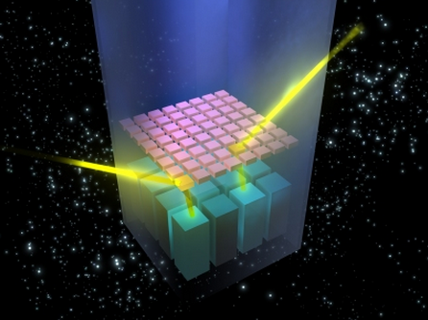



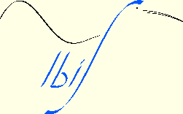
IBIS IN FRONT OF THE MeV: THE COMPTON MODE
ISGRI and PICsIT are also operated in signal coincidence, allowing to exploit the Compton kinematics for each event in the time coincidence window.
This allows to extend the energy range well into the MeV region,and to exploit polarization measurements.
Crab, Compton mode, 300ks (Forot et al. 2007)
L. Natalucci, Rome Tor Vergata, 2013

Slide 23
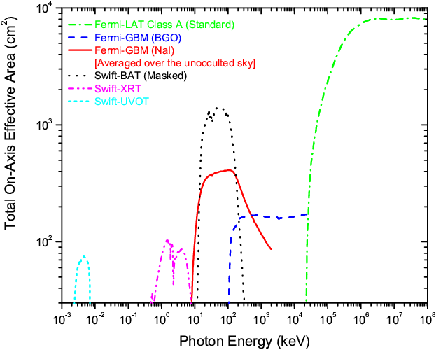
INTEGRAL vs Fermi/GBM
 | SPI/ACS | PICsIT | GBM | GBM
Detector | BGO | CsI | BGO | NaI
Energy range | >75 keV | 0.2-2.6 MeV Compton Mode 0.3-10MeV | 0.15-30 MeV | 8-1000 keV
Effective area | Up to ~1m² | Up to ~900cm² | Up to ~400cm² | Up to ~150 cm²
Time resolution | 50ms | 15.6ms | 5μs
The SPI/ACS and GBM have quite different energy coverage and effective area
Assuming the Fermi/GBM spectral model, INTEGRAL would have detected a signal of significance in the range 5-15 sigma. The higher value is for the southern (most probable) direction
IBIS/PiCsIT

