Slide 1
Stop->4 bodies signal samples with 2 leptons in final state

Slide 2
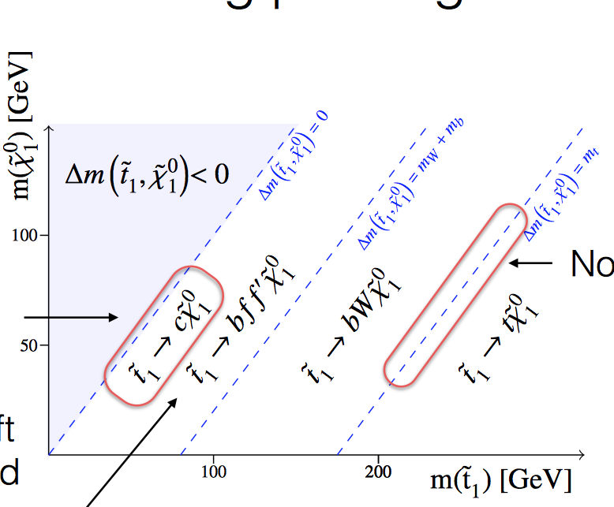
Motivation
In CMS PAS SUS-14-021 a soft single lepton and dilepton analysis is described
ATLAS monojet
CMS soft single lepton and dilepton

Slide 3
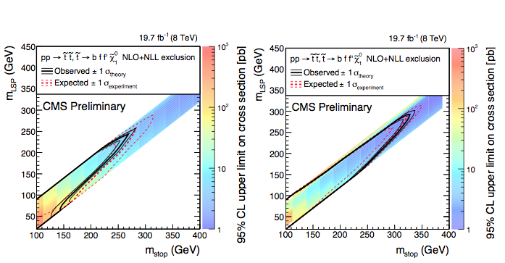
CMS soft single lepton search
CMS soft
dilepton
search
CMS reachs better exclusion wrt ATLAS combined monojet and c-tagged analysis

Slide 4
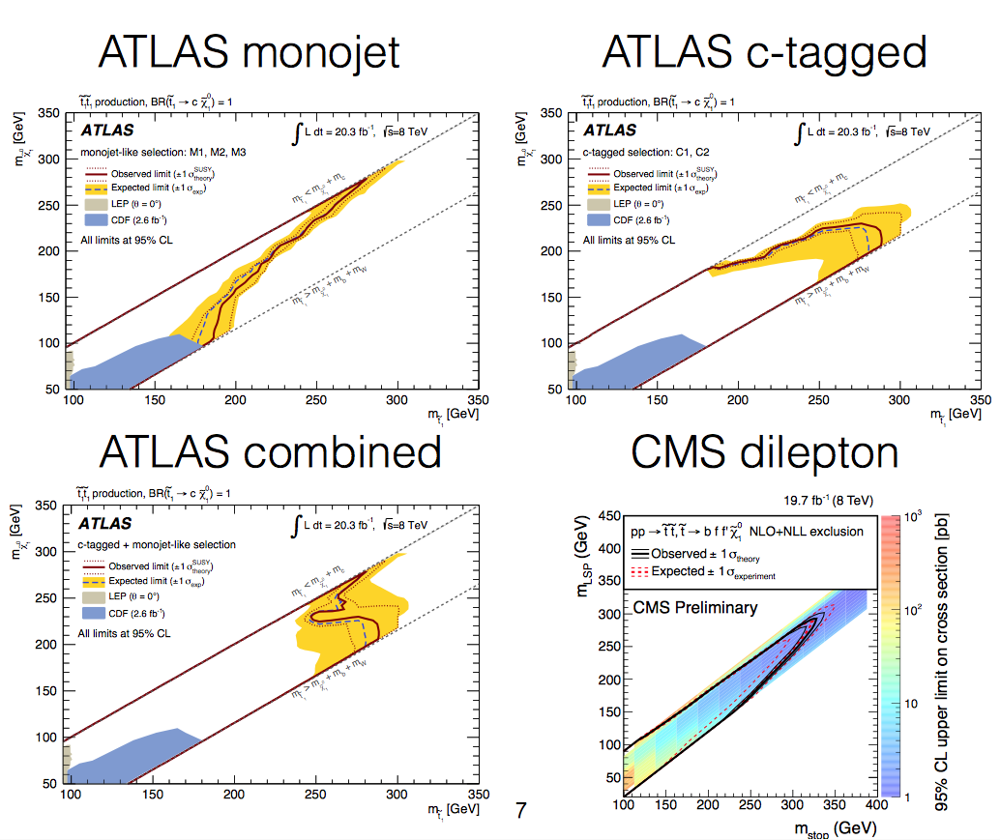

Slide 5
CMS (8 TeV) 4-body decays: m_{stop} ranging from 100-400 GeV, Δm_{stop-neutralino} ranging from 10-80 GeV.
Trigger and Preselection:
  Trigger-> Etmiss > 120 GeV or Etmiss > 95 GeV and a central jet with pT > 80 GeV
  ISR jet with p_{T} > 110 GeV and |η| < 2.4
  At most another jet with p_{T} > 60 GeV
  Etmiss > 200 GeV
  At least one identified muon with p_{T} > 5 GeV and |η| < 2.1
Selection in dilepton channel:
  ISR jet with p_{T} > 150, Etmiss > 200 GeV
  b-tagged jets are vetoed (to remove ttbar)
  Etmiss/H_{T} > 2/3 (to remove multi-jets, H_{T} is the scalar sum of pT of all jets)
  exactly two identified leptons of opposite sign, with at least one of them a muon
  pT of the leading lepton: 5–15 GeV, and 15–25 GeV. The second lepton is required to have pT < 15 GeV
  Assuming lepton parallel to tau, pT of the tau pair is equal to ISR jet, and m_{ττ} < 160 GeV is rejected
  dilepton pairs < 5 GeV are rejected
Main background in dilepton channel: ttbar (dominant), WW, WZ, ττ pairs with leptonic decays, fakes

Slide 6
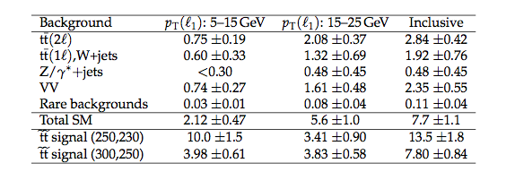
CMS expected signals and backgrounds

Slide 7

Signals
Started to look at MadGraph5+Pythia8 stop-> 4-body sample production. Core jobOptions and SLHA template is ready for the MadGraph5+Pythia8 samples
Produced a 4-body signal point (m__{stop},m__{neutralino}) = (300,220), 99000 events
Met100 filter applied: INFO Filter Efficiency = 0.318 [99000 / 311234]
[met60 filter → filter efficiency = 0.626 (measured on 10000 ev.)],
2Lep > 3 GeV filter gives instead Efficiency = 0.229 (measured on 10000 ev.)
JO: MC15JobOptions/common/MadGraph/MadGraphControl_SimplifiedModel_TT_bffN.py

Slide 8
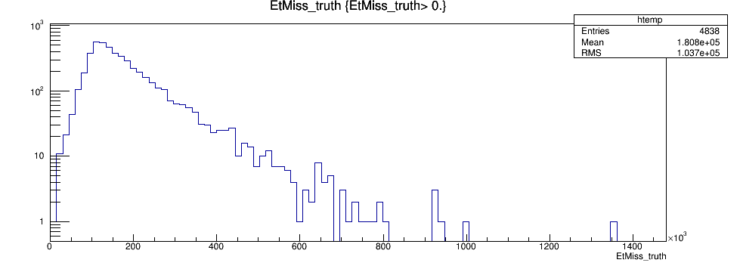
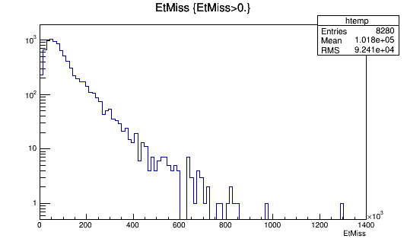
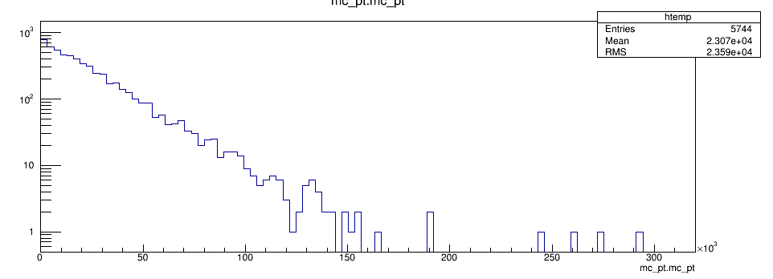
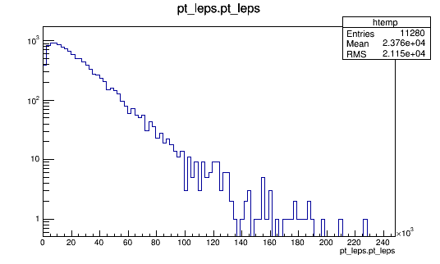
  μ or e coming directly from stop decays or from stop decays in τ. Ev. with at least 1 lepton
Met100 filter (TRUTH)
2Lep3 filter (TRUTH)
<Etmiss>= 180 GeV
<Etmiss>= 100 GeV
<Lepton pt> = 23 GeV
<Lepton pt> = 24 GeV

Slide 9
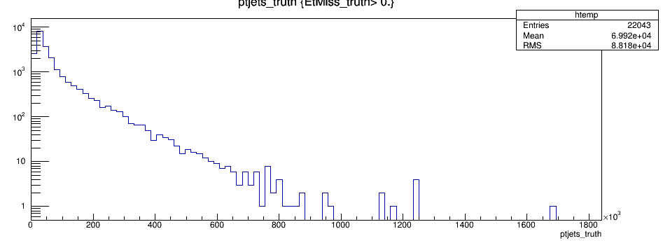
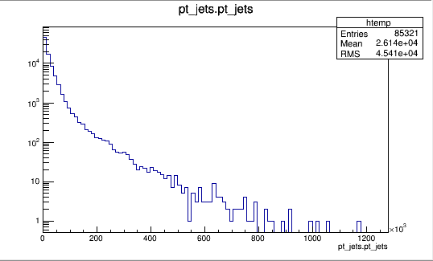
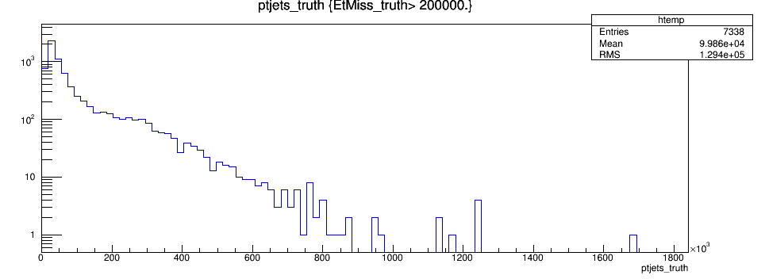
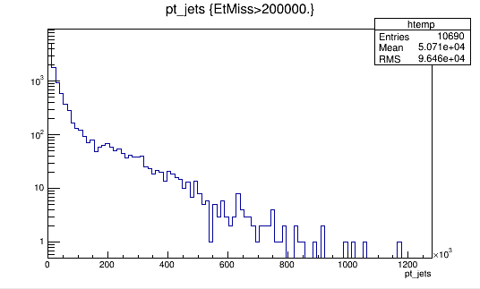
Met100 filter (TRUTH)
2Lep3 filter (TRUTH)
<Ptjets> = 70 GeV
<Ptjets> = 26 GeV
<Ptjets (Etmiss > 200)> = 100 GeV
<Ptjets (Etmiss > 200)> = 51 GeV

Slide 10
10000 ev. MET100 filter, cuts applied on TRUTH
2 OS leptons | 763 ev. | “CMS-like” cuts
Etmiss > 150 | 402 ev. | Etmiss > 200 | 222 ev.
Etmiss > 150 && pt^{J1} > 110 | 358 ev. | Etmiss > 200 && pt^{J1} > 150 | 196 ev.
Etmiss > 150 && pt^{J1} > 110 && pt^{l1,l2} > 7 | 220 ev. | Etmiss > 200 && pt^{J1} > 150 && pt^{l1,l2} > 7 | 126 ev.

Slide 11
10000 ev. 2Lep > 3 GeV filter, cuts applied on TRUTH
2 OS leptons | 2577 ev. | “CMS-like” cuts
Etmiss > 150 | 470 ev. | Etmiss > 200 | 290 ev.
Etmiss > 150 && pt^{J1} > 110 | 422 ev. | Etmiss > 200 && pt^{J1} > 150 | 259 ev.
Etmiss > 150 && pt^{J1} > 110 && pt^{l1,l2} > 7 | 286 ev. | Etmiss > 200 && pt^{J1} > 150 && pt^{l1,l2} > 7 | 173 ev.

Slide 12
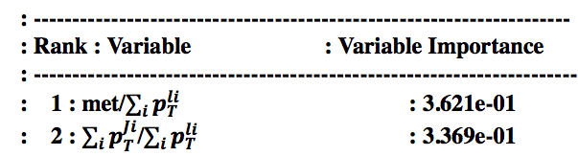
We dealt with soft leptons in http://cds.cern.ch/record/2032460
for the MVA stop->b+chargino analysis@ 8 TeV (Two “baseline” leptons, 𝑝𝑇 >7GeV for electrons and 𝑝𝑇 >6 GeV for muons )
In that case, 11 variables were used in MVA, and the best ranked are:
CMS uses Etmiss/H_{T}, i.e. met/Σ_{i}p_{T}^{Ji}

Slide 13
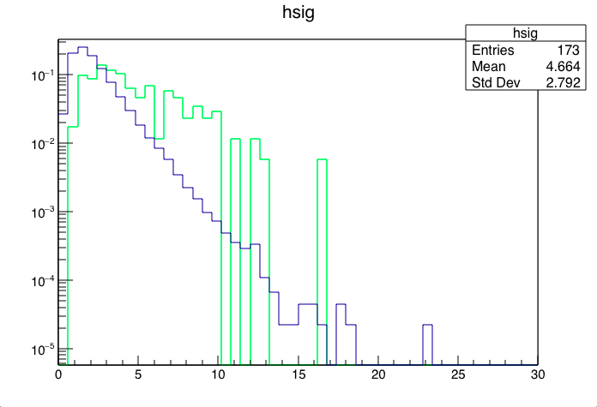
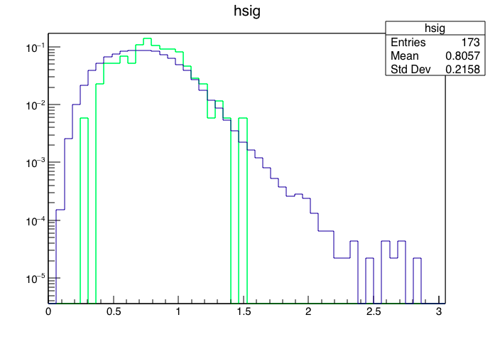
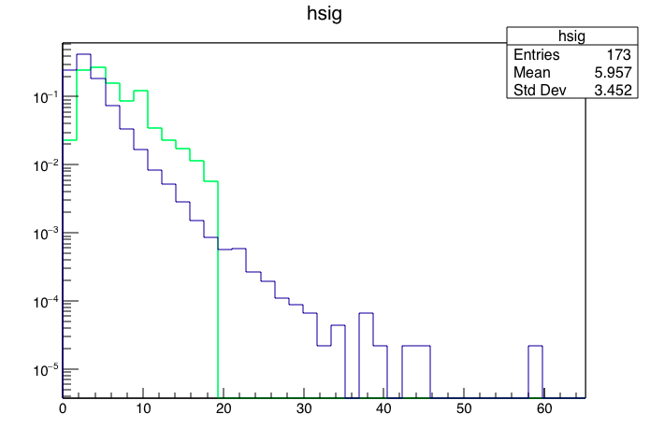
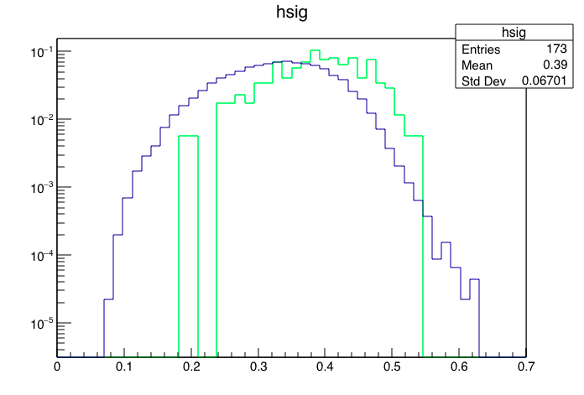
TRUTH (normalized): signal vs ttbar (Met100 filter), 2 OS Lep > 10 GeV(*)
met/Σ_{i}p_{T}^{li}
met/Σ_{i}p_{T}^{Ji}
EtMiss>150GeV && pt_jet1>110GeV
EtMiss>150GeV && pt_jet1>110GeV
Sign
ttbar
Sign
ttbar
Σ_{i}p_{T}^{Ji}/Σ_{i}p_{T}^{li}
met/meff
EtMiss>150GeV && pt_jet1>110GeV
EtMiss>150GeV && pt_jet1>110GeV
Sign
ttbar
Sign
ttbar
(*) ttbar sample was 2-lepton filtered at 10 GeV

Slide 14
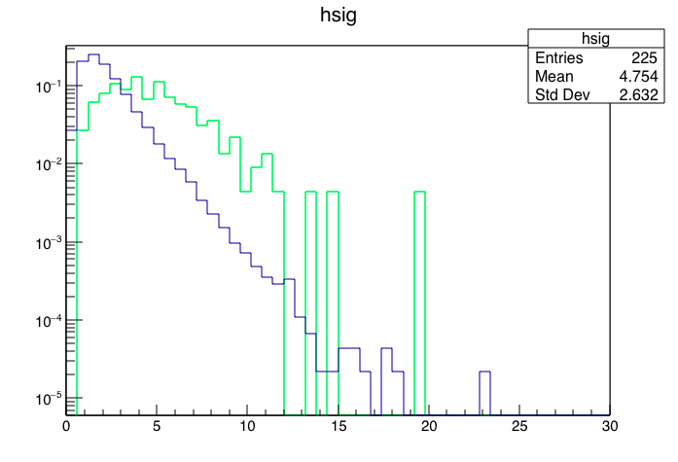
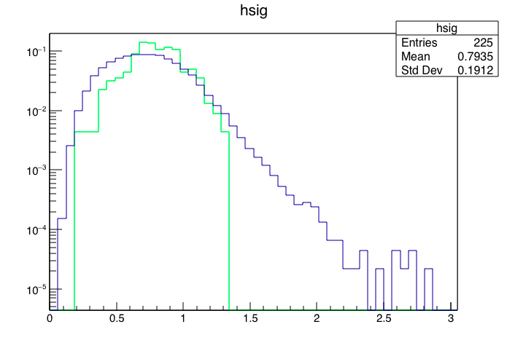
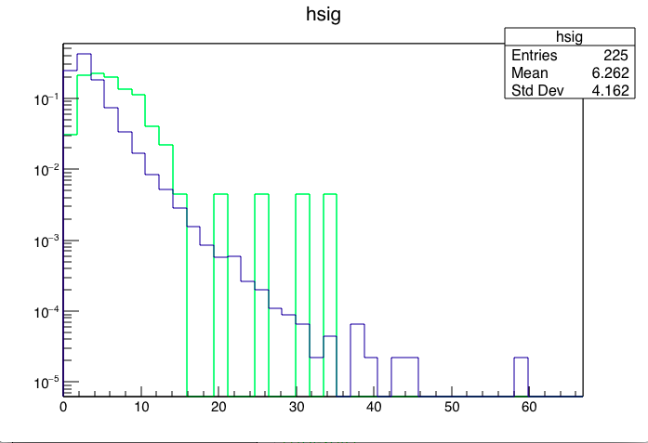
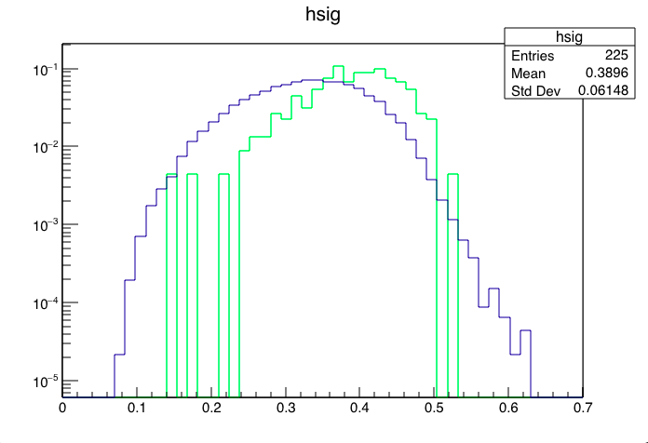
TRUTH: signal vs ttbar (2Lep3 filter), 2 OS Lep > 10 GeV (*)
met/Σ_{i}p_{T}^{li}
met/Σ_{i}p_{T}^{Ji}
EtMiss>200GeV && pt_jet1>110GeV
Sign
ttbar
EtMiss>150GeV && pt_jet1>110GeV
Sign
ttbar
Σ_{i}p_{T}^{Ji}/Σ_{i}p_{T}^{li}
met/meff
EtMiss>200GeV && pt_jet1>110GeV
EtMiss>150GeV && pt_jet1>110GeV
Sign
ttbar
Sign
ttbar
(*) ttbar sample was 2-lepton filtered at 10 GeV

Slide 15
Possible grid
Benchmark points
(400,390)
(350,340)
(400,350)
(320,310)
(400,320)
(300,290)
(350,300)
(280,250)
(320,270)
(350,270)
(300,250)
(260,230)
(320,240)
(300,220)

Slide 16
Statistics
Stop mass (GeV) | Neutralino mass (GeV) | Cross section (pb) | Filter efficiency | # of events | Int. Lumi (fb⁻¹)
260 | 230 | 17.7 | 0.3 | *excluded by CMS (???)
280 | 250 | 12.2 | 0.3 | *excluded by CMS (???)
300 | 220 | 8.5 | 0.3 | 100000 | 39.2
300 | 250 | 8.5 | 0.3 | *excluded by CMS (???)
300 | 290 | 8.5 | 0.3 | 100000 | 39.2
320 | 240 | 6.1 | 0.3 | 75000 | 41.0
320 | 270 | 6.1 | 0.3 | *excluded by CMS (???)
320 | 310 | 6.1 | 0.3 | 75000 | 41.0
350 | 270 | 3.8 | 0.3 | 50000 | 43.9
350 | 300 | 3.8 | 0.3 | 50000 | 43.9
350 | 340 | 3.8 | 0.3 | 50000 | 43.9
400 | 320 | 1.8 | 0.3 | 25000 | 45.5
400 | 350 | 1.8 | 0.3 | 25000 | 45.5
400 | 390 | 1.8 | 0.3 | 25000 | 45.5
Total events: 575K + ???

