Slide 1
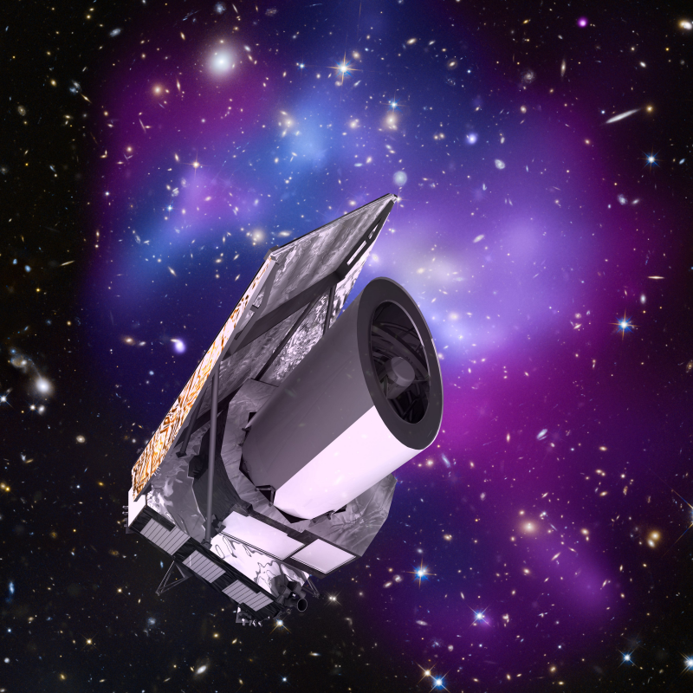

Euclid Big Data Opportunities
Tom Kitching (UCL MSSL) – Euclid Science Lead

Slide 2

What is Euclid ?
ESA Medium-Class Mission
In the Cosmic Visions Programme
M2 slot (M1 Solar Orbiter, M3 PLATO)
Due for launch 2020
Largest astronomical consortium in history: 15 countries, ~2000 scientists, ~200 institutes
Scientific Objectives
To understand the origins of the Universe’s accelerated expansion
Using at least 2 independent complementary probes (5 probes total)
Geometry of the universe:
Weak Lensing (WL) Galaxy Clustering (GC)
Cosmic history of structure formation:
WL, Redshift Space Distortion (RSD), Clusters of Galaxies (CL)
Controlling systematic residuals to an unprecedented level of accuracy, impossible from the ground

Slide 3
Euclid
Science Ground Segment
Instrument Teams
Science Working Groups
Responsible for
Data processing,
Producing catalogues
Maps and raw statistics
Responsible for
Designing
Building
Operating
Responsible for
Setting requirements
Science analysis
Operations support

Slide 4
Big Sims
Euclid will require between 10⁴ to 10⁶ n-body (or better hydrodynamical) simulations per cosmology
Two reasons:
1) What is the probability of our observations?
Only one “collision”
The error-on-the-error, “covariance”, needs to be estimated (Taylor, Joachimi, Kitching, 2014)
2) How structure changes when dark energy varies needs to be modelled _{(Kitching & Taylor, 2010)}

Slide 5
Big Sums: Pre-Launch
Space missions are not like ground-based telescopes
Cannot tweak an instrument once it is millions of Km away in space
Before launch requirements need to be specified to a very high level of precision and accuracy
We need to compute expected error bars in order to design to survey optimally
Example: we have recently created 10¹⁴ galaxies (10,000 Euclid realizations) in order to set one technical requirement on depth of the images
There are hundreds of requirements to compute

Slide 6
Big Sums: Post-Launch
After launch need to sample cosmological parameter space
Simple method
~100’s free parameters
Normal nested sampling methods appropriate
Departmental-level HPC sufficient
More complex approaches, e.g. Bayesian Hierarchical modeling
1000s, 10000s free parameters
National-level HPC required

Slide 7
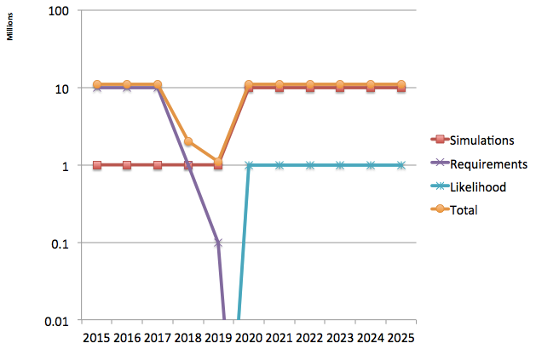
Total Science CPU Requirements
Millions of Core Hours per year

Slide 8
Two PhD themes
Both very complimentary between UCL and Saclay
Already excellent synergies within the Euclid project
ITN brings big data and machine learning expertise

Slide 9
PhD Theme Proposal
1) 3D Data compression
Large amount of data
Need efficient storage schemes, and lossless compression
Compressed sensing and sparse estimators
In spin-weight SO(3) geometries (ball geometries),

Slide 10
PhD Theme Proposal
2) Massive Dimensional Parameter Estimation
Bayesian Hierarchical modeling approaches
Covariance-free and likelihood-free parameter estimation methods
Direct data modeling
Parameter inference over Millions or Billions of dimensions

