Slide 1
News on FTK rack infrastructure
A. Lanza – INFN Pavia
FTK Italy meeting – 27.11.2015

Slide 2
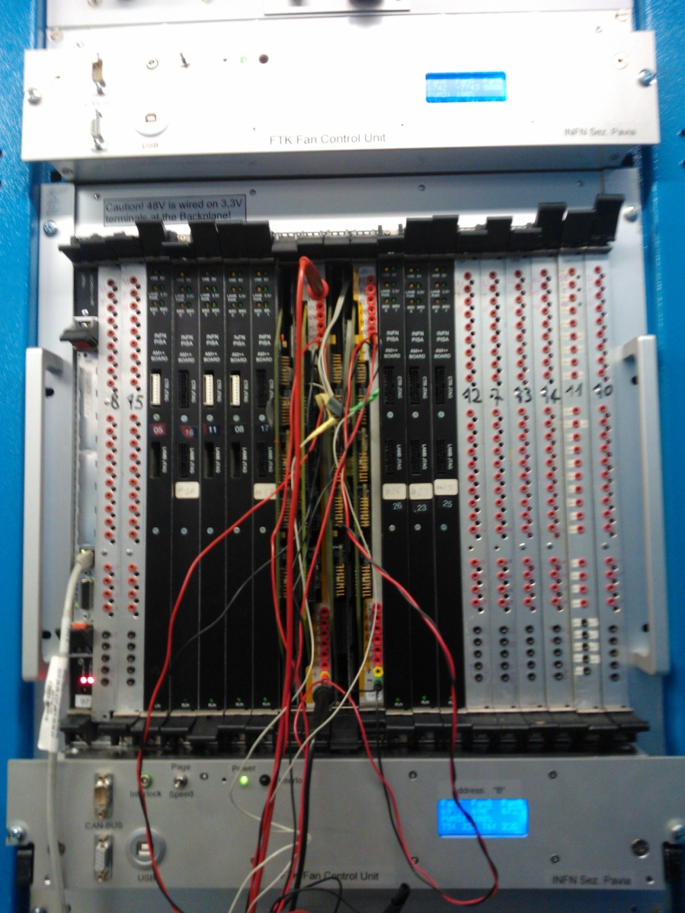
Status of the cooling test rack in USA15
Core rack 05-09.A2
The second custom fan tray was added on 11 November, after having cleared a couple of minor mechanical problems. This fan tray is placed inside the Wiener crate, but due to its rear control connector, the fan tray is sticking out from the front of crate by 20 mm. This constraint can be avoided removing the control connector (it needs to remove the crate from rack).
The first fan tray is placed on top of crate, sticking out from front of crate by 42 mm. This is to get the center of the first fan raw aligned with the center of the external final LAMBs.

Slide 3
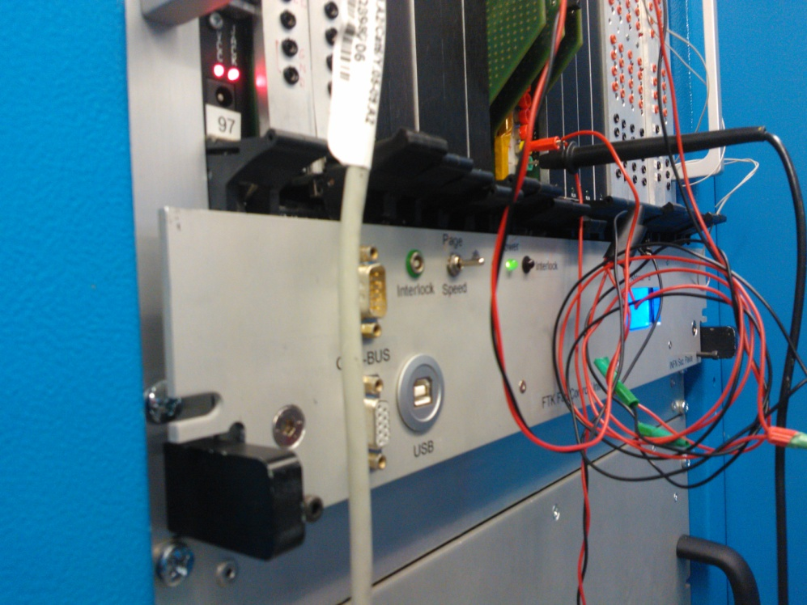
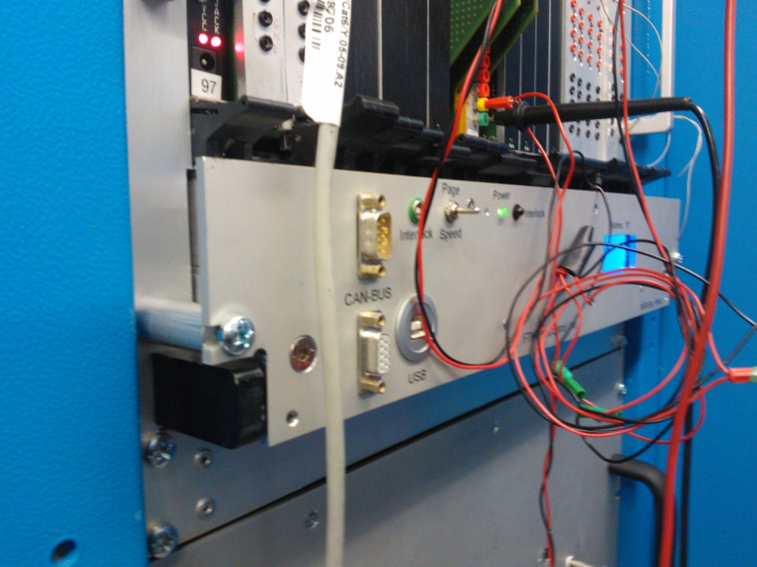
Cooling test in November 2015
There was a test performed on November 12th, with the same setup used in July. The four “old” AMBoards were available, but unfortunately one was not working properly and the current sunk from the 48V was practically 0.
The four AMBoards were placed in the same slots used in July. All the other slots were filled in with dummy boards not inserted in the backplane.
Differently from July, both fan trays were custom.
We took two measurement sets, the first with the bottom fan tray displaced from the front of crate by 20 mm, the second with this fan tray displaced by 42 mm. The top fan tray was always displaced by 42 mm.
Speed for all fans was set to the maximum, 6800 rpm (nominal speed is 6400, but they are supplied now at 27V).
Position of the bottom fan tray during the first measurement set (20 mm displacement)
Position of the bottom fan tray during the second measurement set (42 mm displacement)

Slide 4
Summary of the cooling test results
The total dissipated power was 673 W.
The two fan trays in the first set of measurements were displaced one to the other by 22 mm.
The peak temperature was 65 °C, in the top center region of the AMBoard in slot 10 (the only one measured). This is a bit higher than what measured in July (60 °C.).
In the second set the two fan trays were aligned on the same vertical axis. The peak temperature was still in the top center region, but descreased by more than 5 °C and compatible with the July measurements.
The conclusion is that the two fan trays are working better aligned then disaligned.

Slide 5
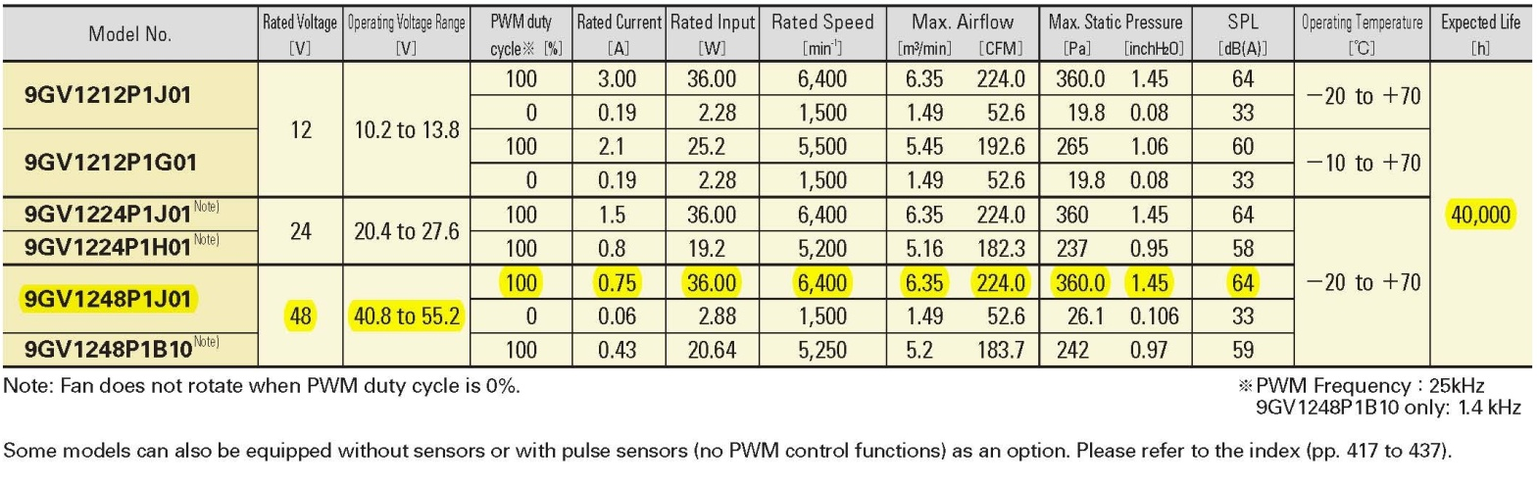
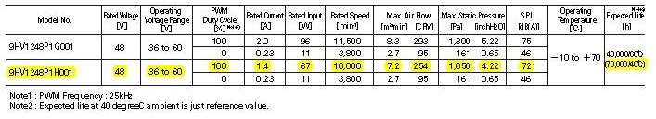
Which kind of fans for the final custom units?
They should work at 48VDC. Main reasons are:
  Currents are ½ with respect to the 24V versions
  They can offer better performance in terms of air flow in case we will need it
  Commercial PS at 48V are easily to find and their cost is mitigated by the minor current required
We have selected two fans good for our purposes, both produced by Sanyo Denki. The first, 9GV1248P1J01, has the same performance of the 24VCD fan we are using now in the two custom fan units, the second, 9HV1248P1H001, has superior performance but a quite huge current consumption and a higher cost.
Questions:
How much the cost of a 48V AC/DC scales with the current?
The foreseen lifetime is 70k hrs at 40 °C, which correspond to about 8 years of continuous work. Is this enough to prefer the less expensive model?

