Slide 1
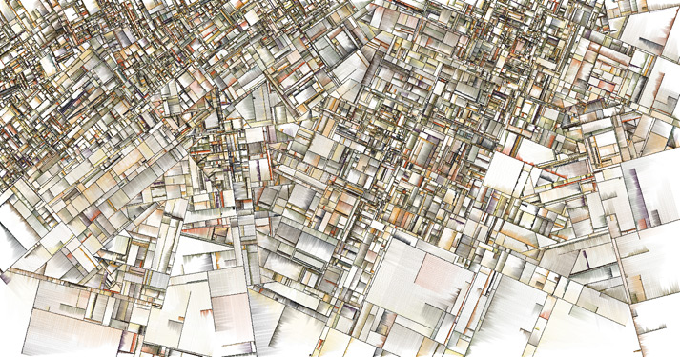
Modelling of the mode-dependent mechanical losses in disc substrates
http://www.complexification.net/
Matteo Lorenzini (INFN-Gran Sasso Science Institute)
Gianpietro Cagnoli, Massimo Granata (Laboratoire des Matériaux Avancés, Lyon - CNRS)
Elisabetta Cesarini (Università di Roma Tor Vergata)
Daniel Heinert , Ronny Nawrodt (Friedrich-Schiller-Universität, Jena)
Filippo Martelli, Francesco Piergiovanni (Università di Urbino)

Slide 2
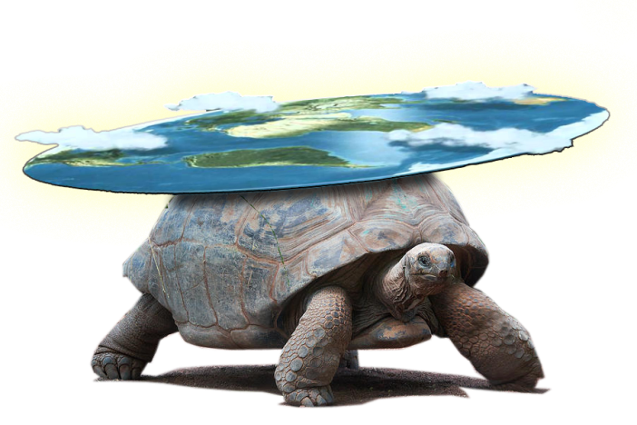
OUTLINE
MEASUREMENT OF COATING LOSS
  GeNS and disc-shaped samples
SILICON SUBSTRATES
  Thermoelastic noise: review of theory
  Thermoelastic loss in discs: approach based on Zener’s general theory
  Mode-dependent loss parameters
  Measurements on silicon discs
  Comparative measurements
  Parameters for general evaluation
SILICA SUBSTRATES
  Substrate loss measurements and mode dependent branching
  Comparison with bulk/shear energies
  Comparison with a model of barrel surface defects

Slide 3
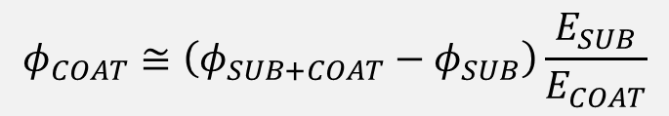
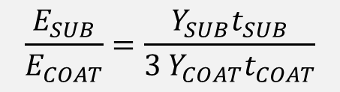
COATING LOSS MEASUREMENT
Loss evaluated as the effect of coating on the sample loss:
$$φ_{COAT}≅\left(φ_{SUB+COAT}−φ_{SUB}\right)\frac{E_{SUB}}{E_{COAT}}$$
Knowledge of the substrate loss is mandatory.
Substrate is measured before coating deposition;
Substrate losses are supposed independent by the coating deposition process (annealing, handling…)
Energy stored in the coating is evaluated by FEM or analitically under simple assumptions:
Direct measurement of mode dependent dilution factor : see M. Granata’s talk
$$\frac{E_{SUB}}{E_{COAT}}=\frac{Y_{SUB}t_{SUB}}{{3 Y}_{COAT}t_{COAT}}$$

Slide 4
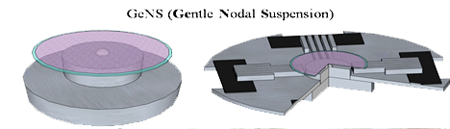
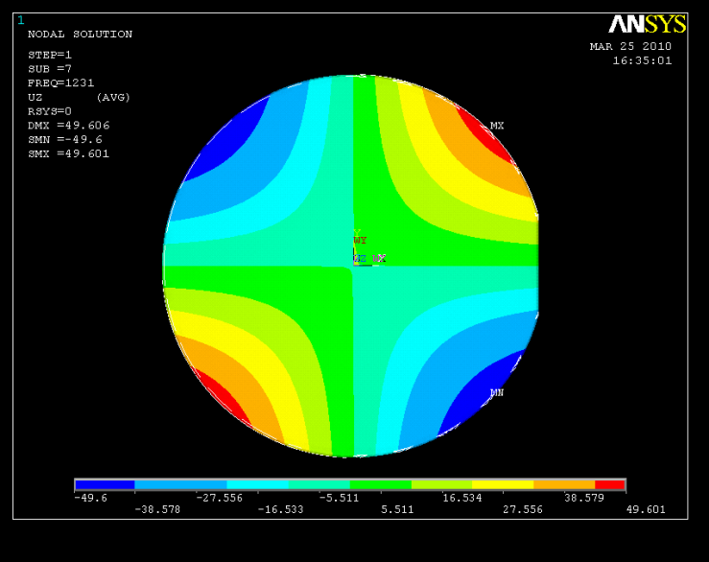
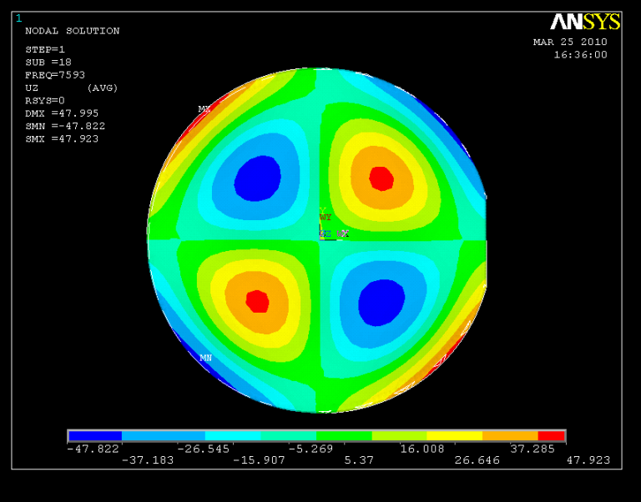
DISC SAMPLES FOR GeNS
Gentle Nodal Suspension is an ideal reference solution for coating characterization:
All suspension parameters are under control;
Very high repeatability of Qs (within ….%);
Stability vs repeated suspensions;
Coated surfaces are not damaged;
All mode families with nodal lines at the center can be measured
Samples are disc-shaped, mode families are set by the condition of free edges
E. Cesarini et al. Rev. Sci. Instr. 80, 053904 (2009)
GeNS is available at LMA (room T and cryogenic), Roma Tor Vergata, and is going to be set up in Perugia….

Slide 5
SILICON DISCS

Slide 6
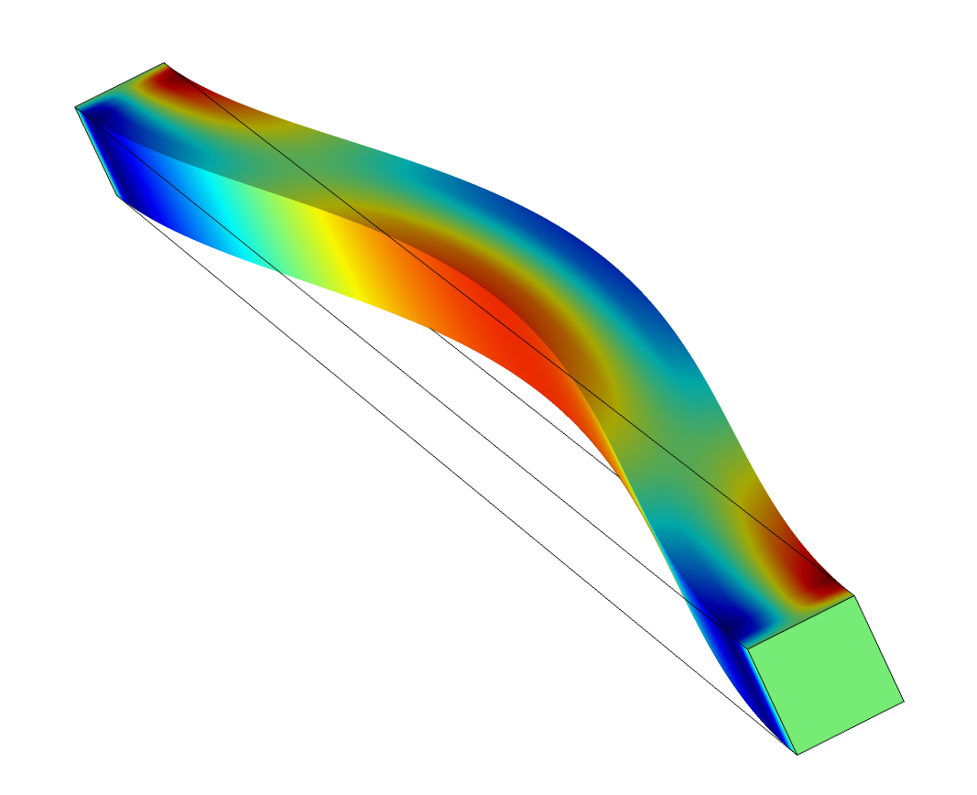
SILICON SUBSTRATES: THERMOELASTIC LOSS
The thermoelastic effect is a relaxation process caused by the heat excanged within the vibrating body, between compressed and expanded regions. It can be thought as:
due to relaxation time induced by heat flux
due to the increase of body entropy resulting from the heat exchange
In thin silicon discs, at acoustic frequencies, the main contribution to the substrate loss is expected to be due to thermoelastic loss:
Very low intrinsic losses measured at cryogenic temperatures (lamb…)
High thermal conductivity pushes the peak frequency in the acoustic band

Slide 7
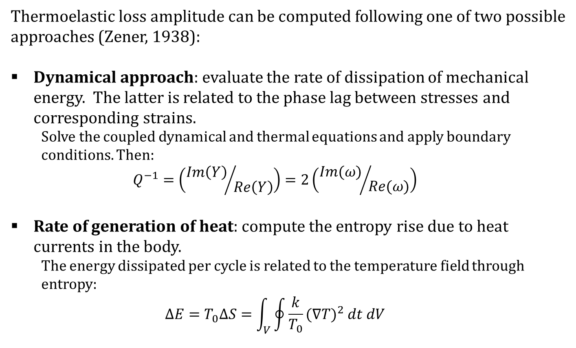
THERMOELASTIC LOSS 1
Thermoelastic loss amplitude can be computed following one of two possible approaches (Zener, 1938):
Dynamical approach: evaluate the rate of dissipation of mechanical energy. The latter is related to the phase lag between stresses and corresponding strains.
  Solve the coupled dynamical and thermal equations and apply boundary conditions. Then:
  $$Q^{−1}=\left({Im\left(Y\right)}/{Re\left(Y\right)}\right)=2\left({Im(ω)}/{Re(ω)}\right)$$
Rate of generation of heat: compute the entropy rise due to heat currents in the body.
  The energy dissipated per cycle is related to the temperature field through entropy:
  $$∆E=T_{0}∆S=\int_{V}^{ }{\oint{\frac{k}{T_{0}}{(∇T)}^{2} dt dV}}$$

Slide 8
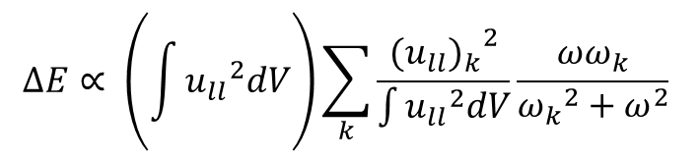
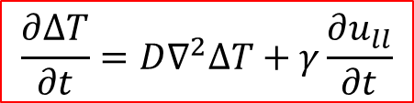
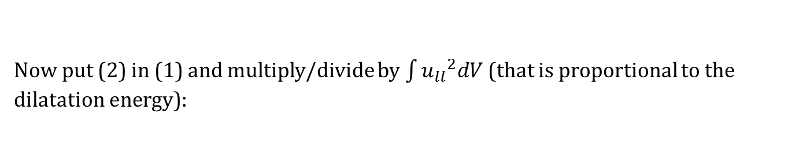
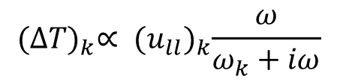

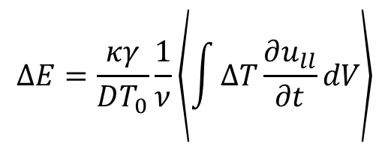
THERMOELASTIC LOSS 2
General theory (from Zener, 1938):
Based on entropy increase;
applied to a vibrating cylinder by Martelli and Piergiovanni (2009):
$$∆E=\frac{κγ}{DT_{0}}\frac{1}{ν}\left\langle \int{ΔT\frac{∂u_{ll}}{∂t}}dV\right\rangle$$
$$\frac{∂∆T}{∂t}=D∇^{2}∆T+γ\frac{∂u_{ll}}{∂t}$$
(1)
solve
$$\left(D∇^{2}+ω_{k}\right)U_{k}=0$$
$${(ΔT)}_{k}∝ {(u_{ll})}_{k}\frac{ω}{ω_{k}+iω}$$
(2)
and expand ΔT, u_{ll} on U_{k}
Now put (2) in (1) and multiply/divide by $\int{{u_{ll}}^{2}dV}$ (that is proportional to the dilatation energy):
$$ΔE∝ \left(\int{{u_{ll}}^{2}dV}\right)\sum_{k}{\frac{{{(u_{ll})}_{k}}^{2}}{\int{{u_{ll}}^{2}dV}}\frac{ωω_{k}}{{ω_{k}}^{2}+ω^{2}}}$$
Notes:
D è il coefficiente di diffusione, k/Cv, mentre gamma è la variazione di temperatura per una variazione adiabatica di volume

Slide 9
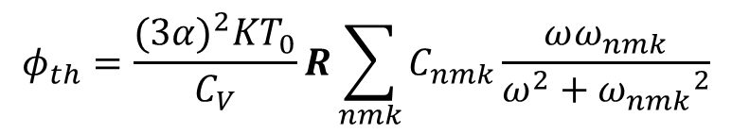
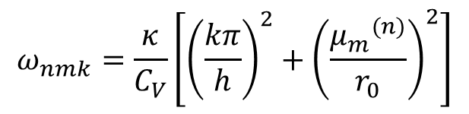
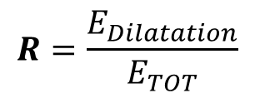
THERMOELASTIC LOSS 3
Study of the thermoelasitc effect in a cylinder
F. Martelli, F. Piergiovanni, 2009
The loss is represented by a converging series of Debye peaks;
$$φ_{th}=\frac{{(3α)}^{2}KT_{0}}{C_{V}}R\sum_{nmk}{C_{nmk}\frac{ωω_{nmk}}{ω^{2}+{ω_{nmk}}^{2}}}$$
$$R=\frac{E_{Dilatation}}{E_{TOT}}$$
The dissipation peaks are centered at angular frequencies ω_{mnk} determined as:
$$ω_{nmk}=\frac{κ}{C_{V}}\left[{\left(\frac{kπ}{h}\right)}^{2}+{\left(\frac{{μ_{m}}^{(n)}}{r_{0}}\right)}^{2}\right]$$
In a disc, the heat flux is mainly across the thickness h. It can be shown that this implies that the only relevant terms in the sum are those with k=1, and they all have an (amost) equal peak frequency.
The sum converges to a single Debye curve.

Slide 10
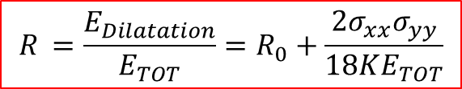
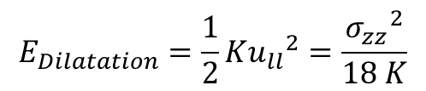
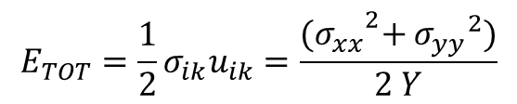
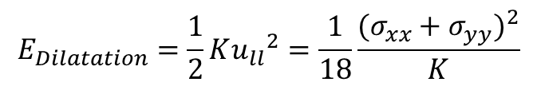
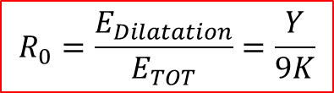
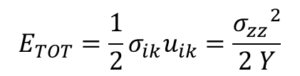
THERMOELASTIC LOSS 4
Case of a thin rod: the only relevant stress is along the z axis:
$$E_{Dilatation}=\frac{1}{2}K{u_{ll}}^{2}=\frac{{σ_{zz}}^{2}}{18 K}$$
$$E_{TOT}=\frac{1}{2}σ_{ik}u_{ik}=\frac{{σ_{zz}}^{2}}{2 Y}$$
$$R_{0}=\frac{E_{Dilatation}}{E_{TOT}}=\frac{Y}{9K}$$
Case of a disc: the stresses are (locally) along x and y:
$$E_{Dilatation}=\frac{1}{2}K{u_{ll}}^{2}=\frac{1}{18}\frac{{(σ_{xx}+σ_{yy})}^{2}}{K}$$
$$R_{ }=\frac{E_{Dilatation}}{E_{TOT}}=R_{0}+\frac{2σ_{xx}σ_{yy}}{18KE_{TOT}}$$
$$E_{TOT}=\frac{1}{2}σ_{ik}u_{ik}=\frac{{{(σ}_{xx}}^{2}+{σ_{yy}}^{2})}{2 Y}$$
The ratio R between the dilatational and total energy is influenced by the mode sape: the thermoelastic loss must show a branching behaviour, depending on mode families.
R can be computed analytically for a thin disc (Amabili, Pasqualini and Dalpiaz 1995) or by FEM
Notes:
σ_{ii}=3KU_{ii}

Slide 11
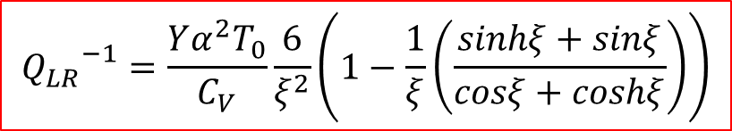
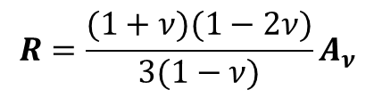
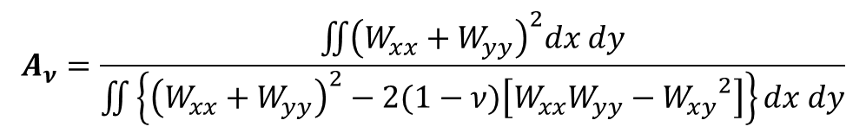
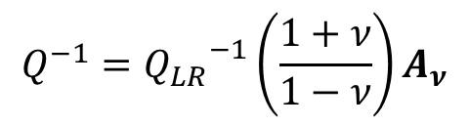
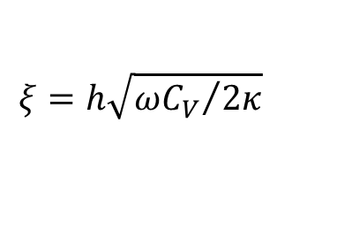
THERMOELASTIC LOSS 5
The dynamical approach was pursued by Lifshitz and Roukes (2000) for a rod. They found:
$${Q_{LR}}^{−1}=\frac{Yα^{2}T_{0}}{C_{V}}\frac{6}{ξ^{2}}\left(1−\frac{1}{ξ}\left(\frac{sinhξ+sinξ}{cosξ+coshξ}\right)\right)$$
$$ξ=h\sqrt{{ωC_{V}}/{2κ}}$$
Their formula was extended to a vibrating membrane by Li, Fang and Hu (2012), in analogy with similar results from the classical Zener approach (see for instance references in Blair and Ferreirinho, 1982) obtaining:
$$Q^{−1}={Q_{LR}}^{−1}\left(\frac{1+ν}{1−ν}\right)A_{ν}$$
where:
$$A_{ν}=\frac{\iint{{\left(W_{xx}+W_{yy}\right)}^{2}dx dy}}{\iint{\left\{{\left(W_{xx}+W_{yy}\right)}^{2}−2(1−ν)\left[W_{xx}W_{yy}−{W_{xy}}^{2}\right]\right\}dx dy}}$$
$$R=\frac{(1+ν)(1−2ν)}{3(1−ν)}A_{ν}$$
Notes:
Notice: this is in agreement with what Martelli and Piergiovanni found for a thin disc (membrane), while for «thick» discs the signle Debye peak is not suitable

Slide 12
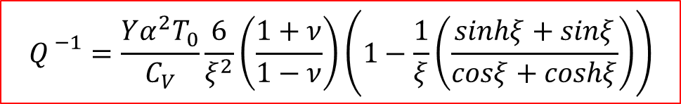

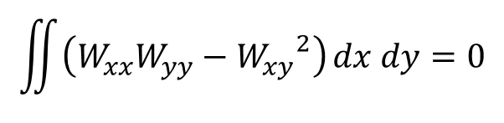
THERMOELASTIC LOSS 6
Several computations based on Lifshitz and Roukes’ formulation showed a continuous plot of the thermoelastic loss in membranes (for instance, Sun and Tohmyoh, 2009 or Sun and Saka, 2010):
$${Q_{ }}^{−1}=\frac{Yα^{2}T_{0}}{C_{V}}\frac{6}{ξ^{2}}\left(\frac{1+ν}{1−ν}\right)\left(1−\frac{1}{ξ}\left(\frac{sinhξ+sinξ}{cosξ+coshξ}\right)\right)$$
BUT: in all those works, membranes are clamped at the edges. The boundary conditions operate a selection of mode families. It can be clearly seen in terms of Gauss-Bonnet theorem, that states the Gaussian curvature is zero for membranes with clamped or supported edges:
$$\iint{\left(W_{xx}W_{yy}−{W_{xy}}^{2}\right)}dx dy=0$$
$$A_{ν}=1$$

Slide 13
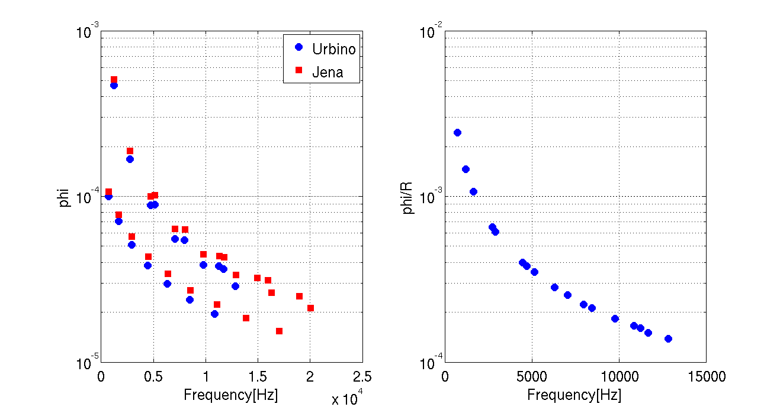
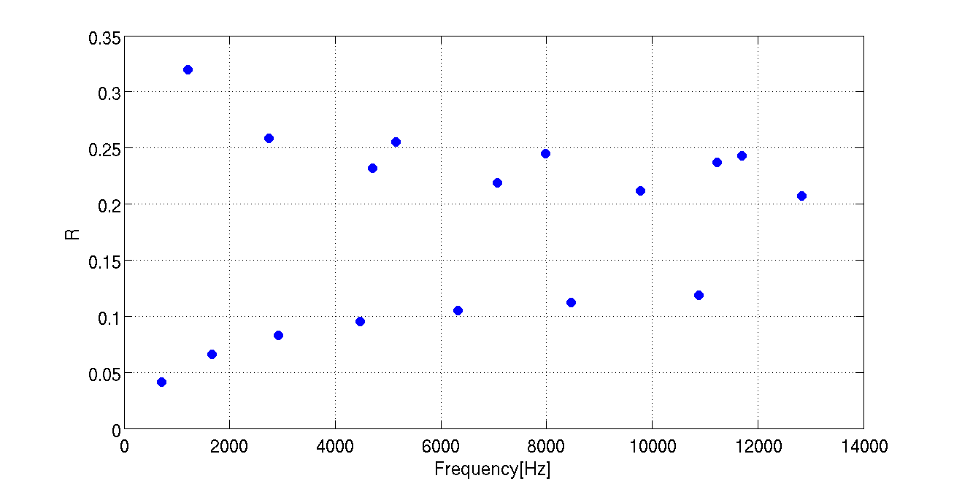
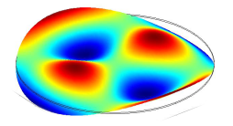
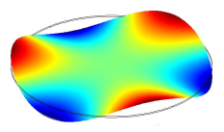
THERMOELASTIC LOSS 7
In the case of a membrane with free edges (such as discs in GeNS measurements) the loss is foreseen to be neatly mode dependent
Computed loss angle shows branches depending on mode shape families
R-normalized loss is (to a good approximation) a single Debye peak centered in f₀
Martelli Piergiovanni +ANSYS
COMSOL
NOTICE: the knowledge of f₀ and R is enough to estimate the thermoelastic loss in thin substrates.

Slide 14
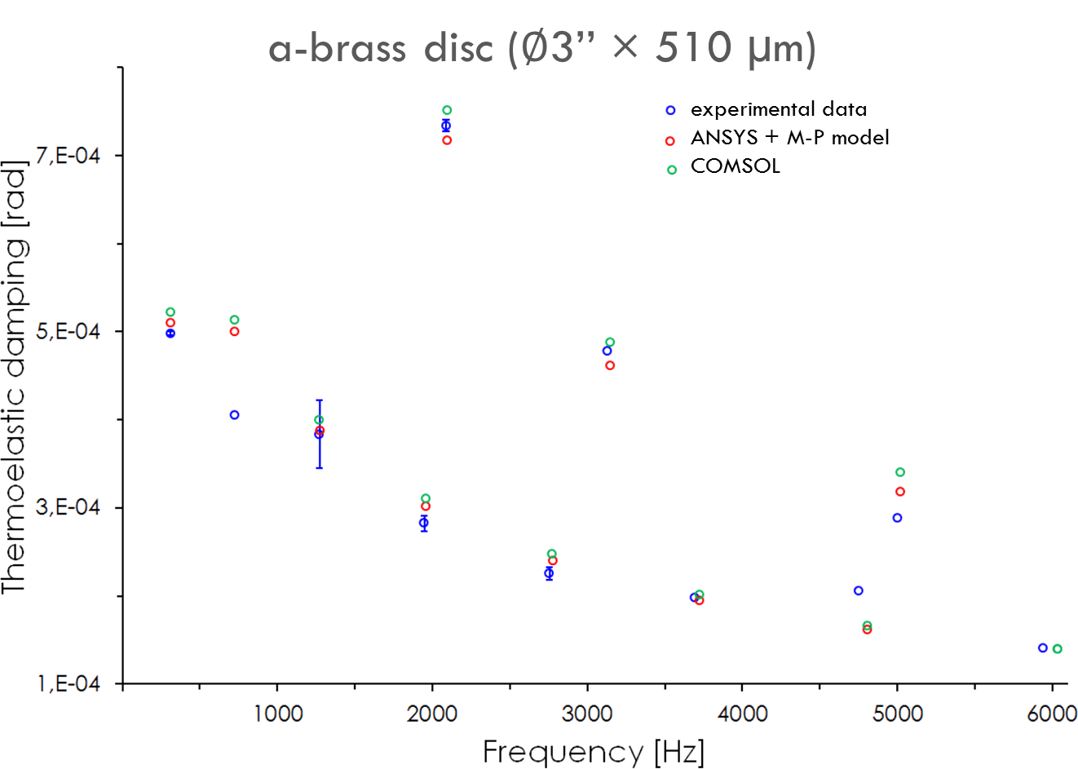
MEASUREMENTS ON α BRASS
CuZn disc, 3’’ x 510 μm
Cu 62.5 %
Y=106 GPa;
ρ=8420 kg/m³;
α=18.7e-6 K⁻¹ ;
κ= 120 W/(m K)
C_{p}=368.4 J/(kg K)
ν=0.35

Slide 15
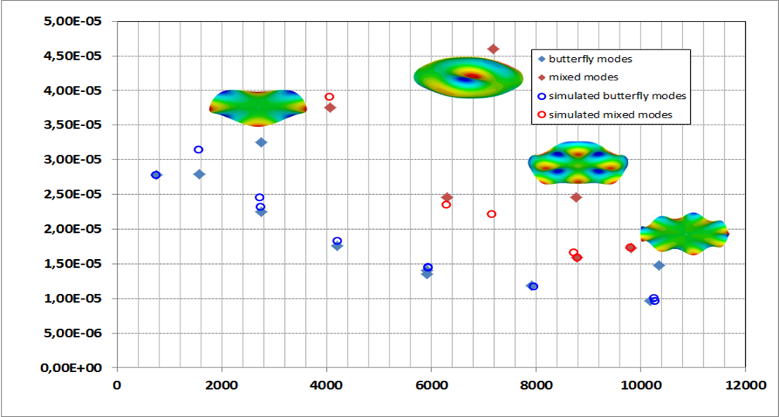
MEASUREMENTS ON p-SILICON (100)
Silicon is anisotropic: only FEM-based computation is perfectly matching
Silicon (100) wafer
d=75.94 mm
t=466.7 μm
K (bulk modulus) =97.8 GPa
κ=149 W/(m K)
ρ=2330 kg/m³
α=2.58e-6 K⁻¹
C_{P}=710 J/(kg K)
Stiffness matrix:
C₁₁=1,66 e11 Pa
C₁₂=0,64 e11 Pa
C₄₄=0,8 e11 Pa
Loss angle
Frequency [Hz]

Slide 16
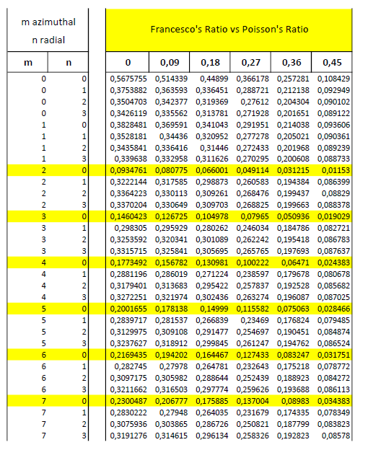
R FACTOR FOR THIN HOMOGENEOUS DISCS
R factor
Poisson’s ratio
Butterfly modes
Notes:
Here again, the table is valid only for thin discs, while for thick ones, the full formula of Martelli, Piergiovanni must be exploited.

Slide 17
SILICA DISCS

Slide 18
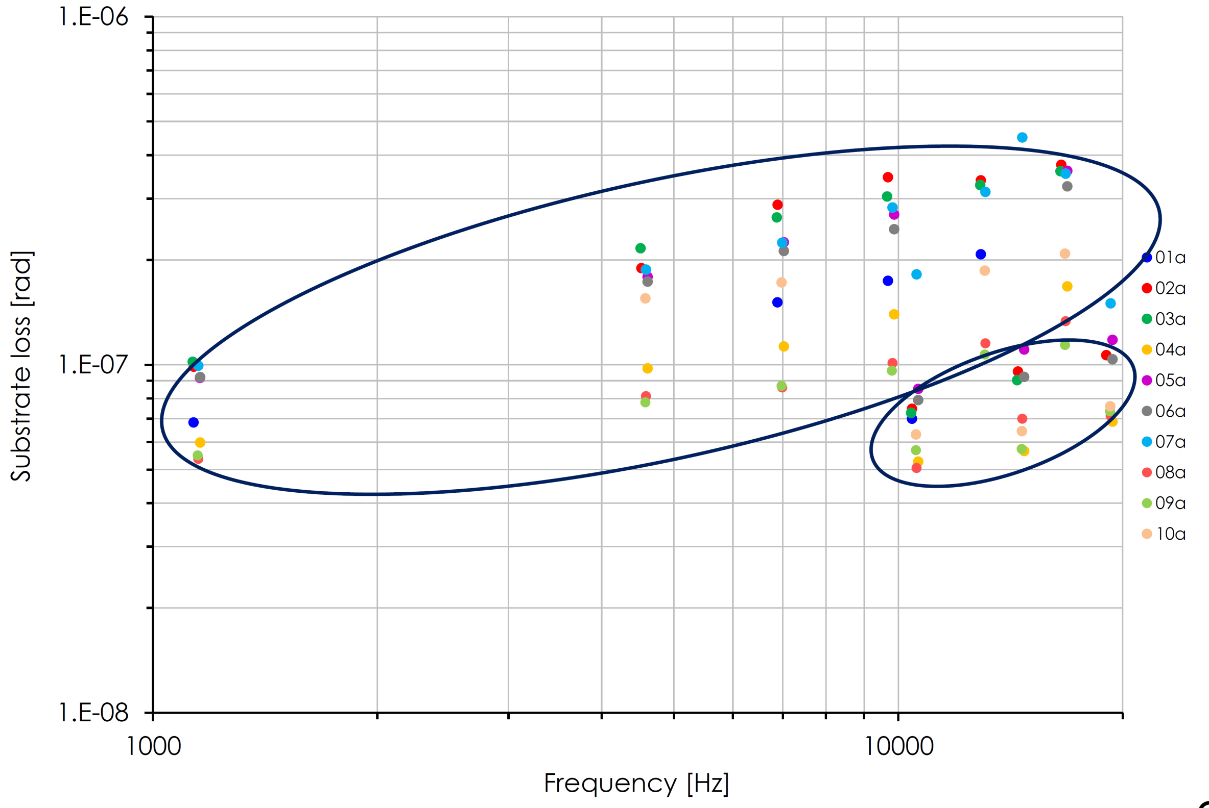
SILICA SUBSTRATES 1
Several measurements of bare silica discs showed a branching behavior of loss angle :
Corning7980 glass, 3’’ x 1 mm, measured at LMA

Slide 19
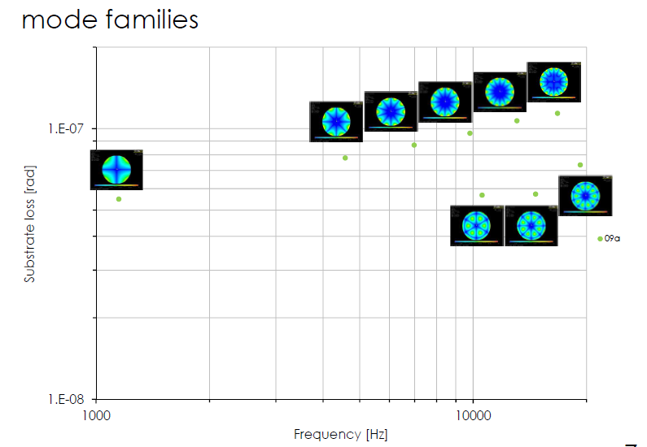
SILICA SUBSTRATES 1
Corning7980 glass, 3’’ x 1 mm, measured at LMA

Slide 20

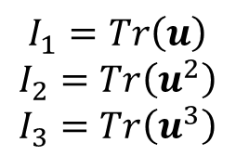
SILICA SUBSTRATES 2
Strain tensor u_{mn} (up to cubic symmetry) has 3 invariants:
$$I_{1}=Tr\left(u\right)$$
$$I_{2}=Tr\left(u^{2}\right)$$
$$I_{3}=Tr\left(u^{3}\right)$$
I₁ is basically the local volume variation, that is, proportional to dilatation energy. The total energy minus the dilatation energy (von Mises) is also invariant.
Can I₁ also explain the observed behaviour (bulk losses/shear losses)?
Mode shape | freq | E_dilatation/E_total
B2 | 1116 | 0.0641
B4 | 4463 | 0.1255
B5 | 6806 | 0.1428
B6 | 9580 | 0.1557
B7 | 12769 | 0.1656
B8 | 16395 | 0.1735
B3D1 | 10318 | 0.2694
B4D1 | 14314 | 0.2595
B5D1 | 18807 | 0.2539

Slide 21
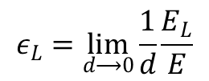
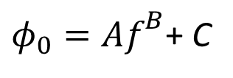

SILICA SUBSTRATES 3
Another hypotesis: is the loss behaviour due to a surface-like spurious dissipation in the barrel (not polished) surface of discs?
Define the energy stored in the barrel layer as:
$$ε_{L}=\lim_{d⟶0}{\frac{1}{d}\frac{E_{L}}{E}}$$
Suppose the loss is contributed by a bulk (power-like) dissipation plus the damping due to the barrel layer:
d
$$φ=φ_{0}+hφ_{L}ε_{L}$$
${φ_{0}=Af}^{B}$+ C
Notes:
Remember that the h phiL is small

Slide 22
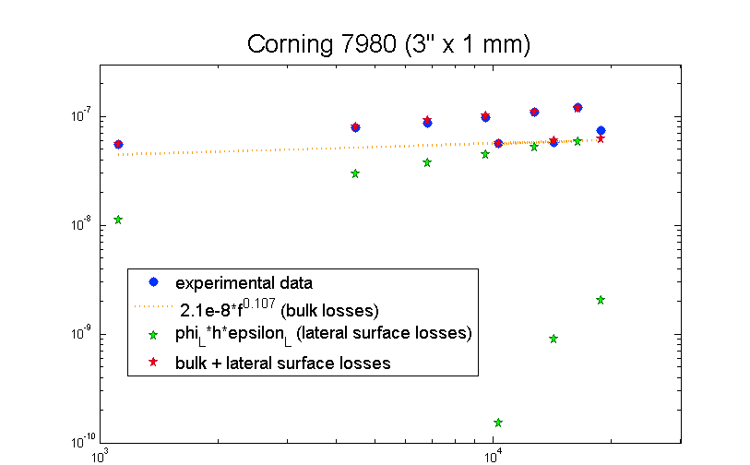
SILICA SUBSTRATES 4
Computation of ε_{L} done with a Matlab code based on the analytical description of deformed shape in thin discs (Amabili, Pasqualini and Dalpiaz 1995)
loss angle
frequency [Hz]
TBD: if the model is correct, flame polishing of the barrel would result in a reduction of the amount of spurious losses.

Slide 23
CONCLUSIONS
Thermoelastic loss is expected to show mode-dependent behavior
Measurements on silicon discs with GeNS show agreement with theoretical thermoelastic loss to high accuracy
A similar mode-dependent loss in silica could probably be explained starting from a model that takes into account spurious losses in the unpolished lateral surface.
The mechanics of the discs is being revealed. There are models that explain the measured losses to a high degree of accuracy. All this work is important for the interpretation of measurements when a coating is deposited on discs.

