Slide 1


Precision Neutrino Physics with
Neutrino Factories
Topical Seminar: Neutrino Physics
(in memoria di Guido)
Universita di Roma Tre
Paul Soler, 18 November 2015

Slide 2
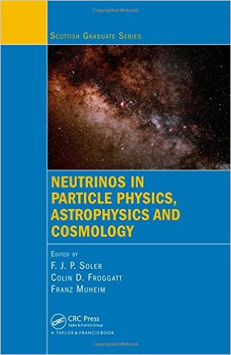

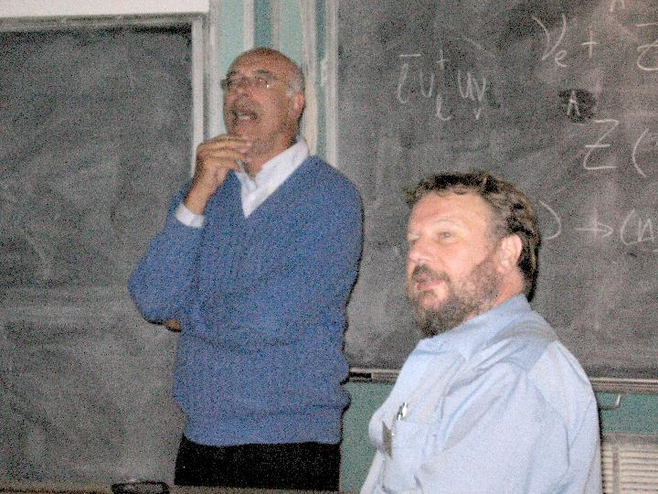
Guido Altarelli
My first encounter with Guido was at the St Andrews Summer School on “Neutrinos in Particle Physics, Astrophysics and Cosmology” in 2006
  He gave three lectures on Neutrino Masses and Mixing and enjoyed time in Scotland: http://www-archive.ph.ed.ac.uk/sussp61/
  Lectures documented in text book edited by CRC Press
Neutrinos (in memoria di Guido), Roma Tre: 9 December 2015

Slide 3
Model predictions
Guido’s approach of using discrete flavour groups to understand neutrino mixing matrices and masses leads to a number of models and predictions of patterns
  There are distinct pre(post?)dictions for the mixing angles and sum rules with the neutrino CP phase δ_{CP}
  To test predictions requires very accurate measurements of mixing angles, knowledge of neutrino masses and accuracy in CP phase Δδ_{CP} ~ 3º-4º
  Models can be tested only if neutrino physics enters into precision era: long baseline neutrino oscillation experiments, neutrino factories, double beta decay and neutrino mass measurements
Neutrinos (in memoria di Guido), Roma Tre: 9 December 2015

Slide 4
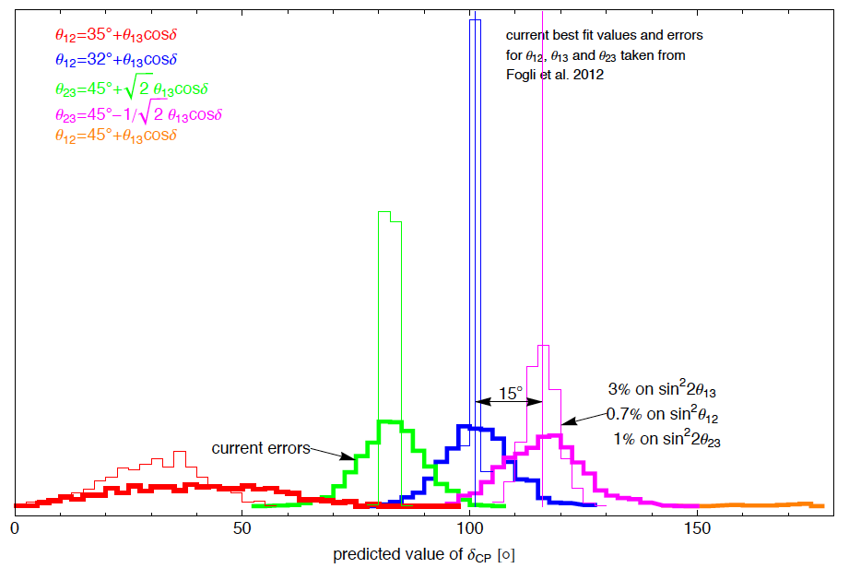
Model predictions
Sum rule predictions for δ_{CP} need to be tested to advance understanding of neutrino mixing and underlying theory
CP violation searches from DUNE or Hyper-Kamiokande will give error in the measurement of CP phase Δδ_{CP} ~ 20º
Distinguish between models requires Δδ_{CP} < 5º
Neutrino Factories
Neutrinos (in memoria di Guido), Roma Tre: 9 December 2015

Slide 5
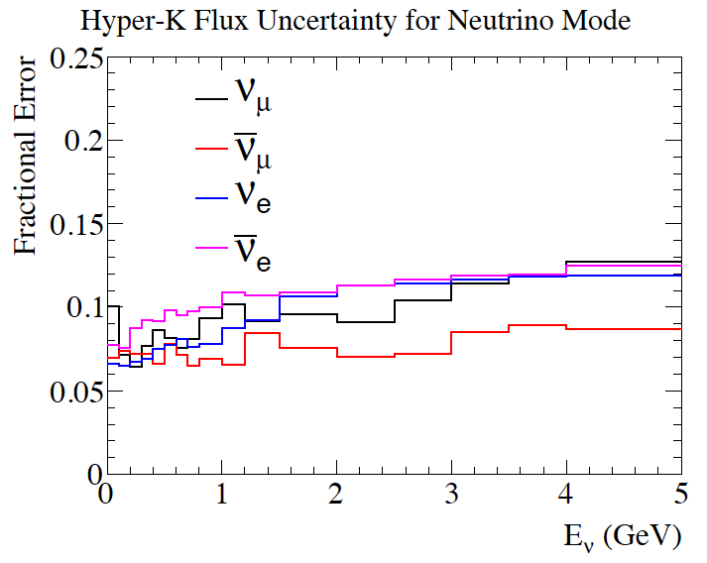
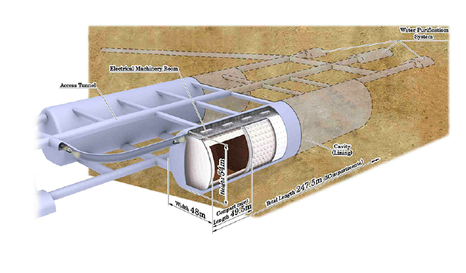
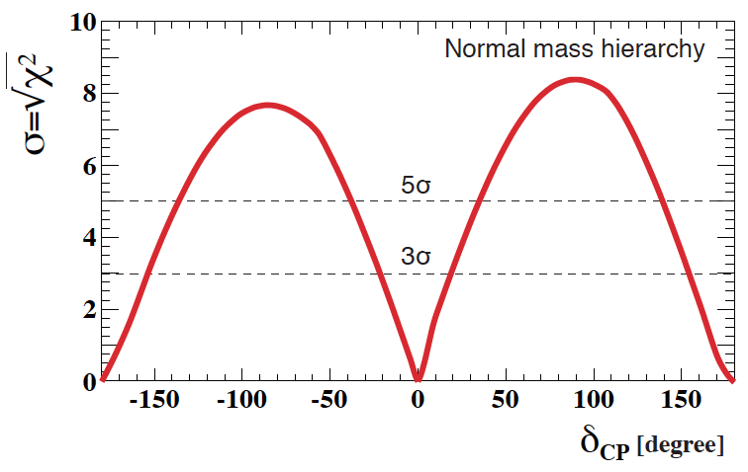
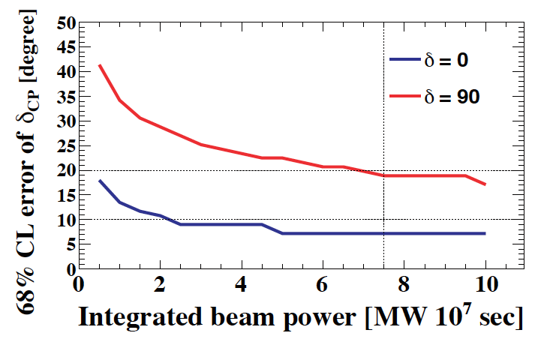
Hyper-Kamiokande
Expected flux errors ~10%, Δδ_{CP}~20º
arXiv:1502.05199
Neutrinos (in memoria di Guido), Roma Tre: 9 December 2015

Slide 6
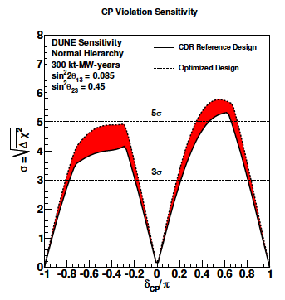

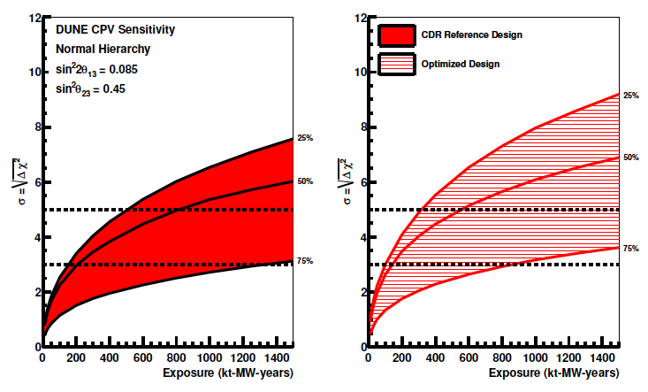
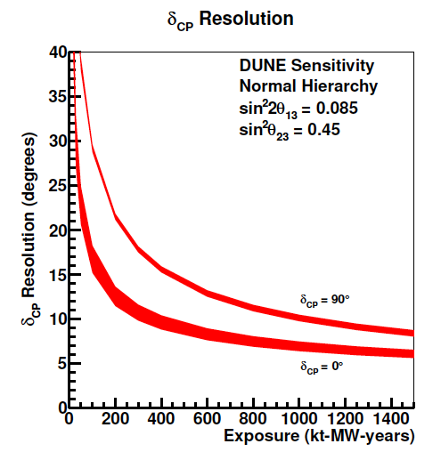
DUNE
Expected flux errors ~5%, Δδ_{CP}~10º-15º
DUNE Physics Volume CDR, 2015
Neutrinos (in memoria di Guido), Roma Tre: 9 December 2015

Slide 7
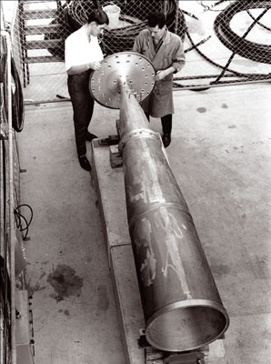
Neutrino beams
Neutrino beams have not evolved conceptually since 1963, with the invention of the van der Meer horn
  Proton beam hits target to create secondary pions, kaons
  Secondaries are focused by horns
  Secondaries decay in decay pipe
  Absorber material and “beam dump” removes charged particles
  Detectors along beam line are used to monitor flux and direction
Neutrino flux accuracy depends on secondary pion and kaon production from protons on target: ~ 10-20%
Neutrinos (in memoria di Guido), Roma Tre: 9 December 2015

Slide 8
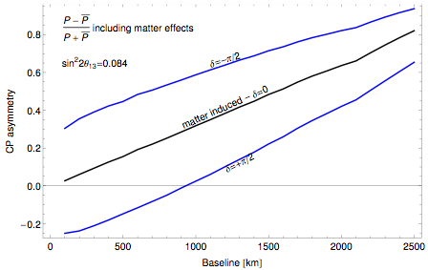
How can we improve CP precision?
Precision requirement for CP violation:
  For 75% of CP asymmetry coverage at 3σ: A_{CP} as low as 5%
  Requires 1.5% measurement of (~1% syst. error), but we measure rate:
Huber, Palmer, Bross
arXiv:1411:0629
Neutrinos (in memoria di Guido), Roma Tre: 9 December 2015

Slide 9
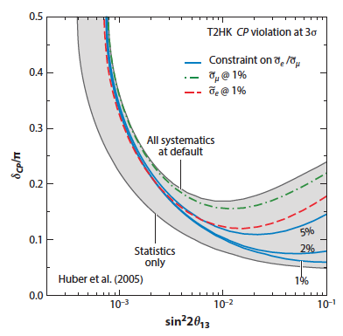
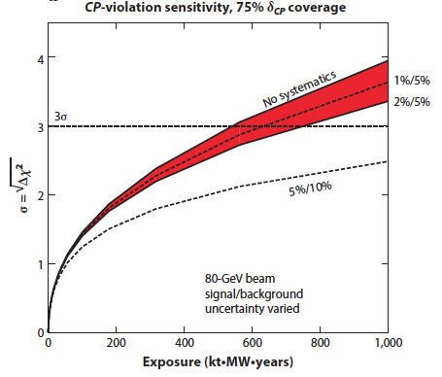
Long baseline physics
Precision requirement for CP violation:
  In disappearance experiment we can satisfy:
  In an appearance experiment , so ν_{α} beam cannot measure
Huber, Mezzetto, Schwetz
arXiv:0711.2950
CP violation sensitivity
for 75% δ_{CP} coverage
at LBNF/DUNE
  Syst. error on ratio in T2HK
  Difference in and can be large
Huber, Palmer, Bross arXiv:1411:0629
Neutrinos (in memoria di Guido), Roma Tre: 9 December 2015

Slide 10
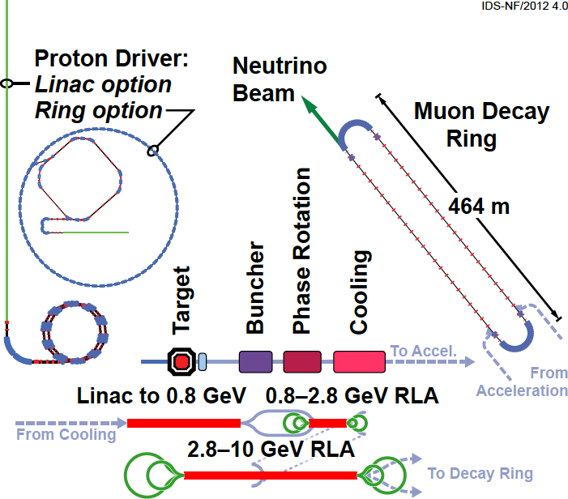
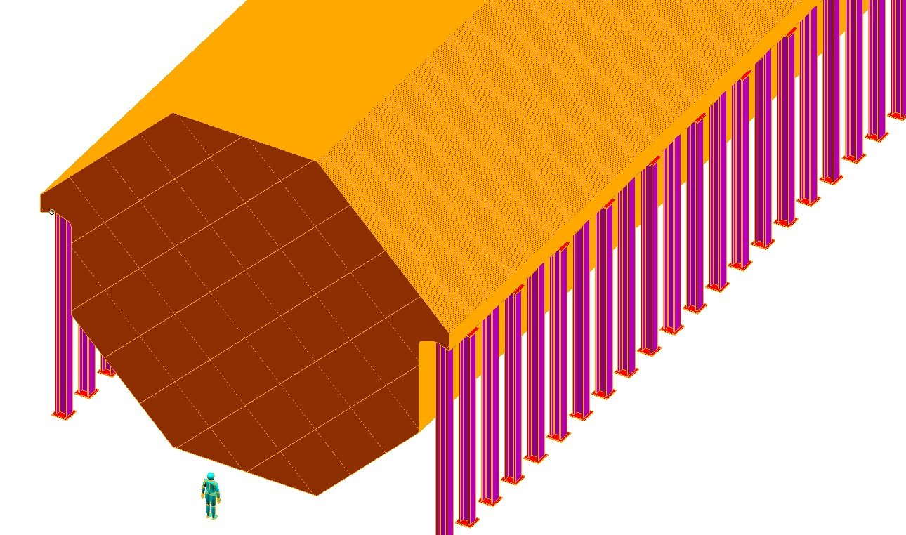
Neutrino Factory
International Design study for a Neutrino Factory (IDS-NF)
Baseline: 10 GeV muons, one
storage ring with detector at
~2000 km, due to large θ₁₃
Magnetised Iron Neutrino Detector (MIND):
  100 kton at ~2000 km
562 m
IDS-NF Interim Design Report
arXiv:1112.2853
Neutrinos (in memoria di Guido), Roma Tre: 9 December 2015

Slide 11
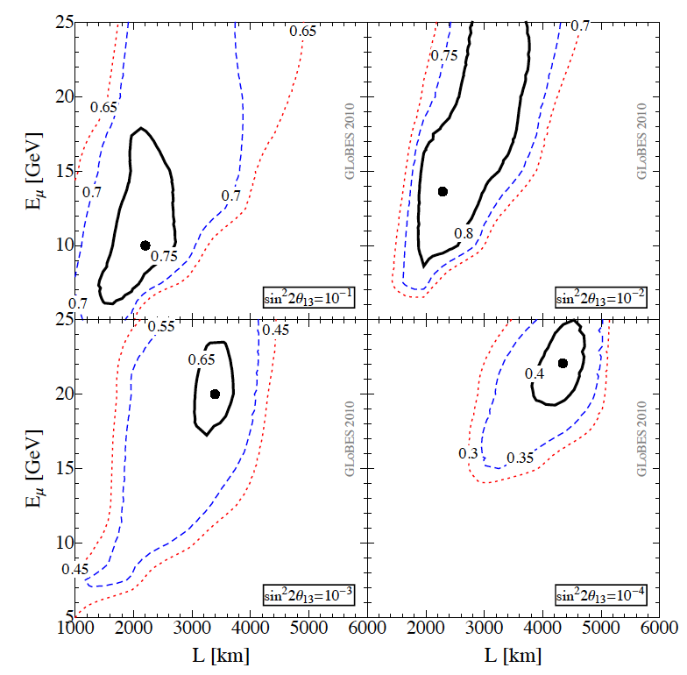
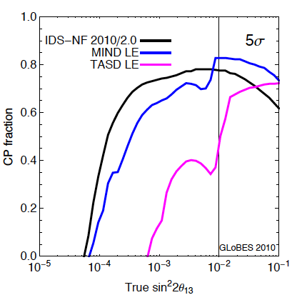
Optimisation of Neutrino Factory
Optimisation for high θ₁₃: 10 GeV muons and 2000 km
Contours of CP coverage
100 kton MIND
Neutrinos (in memoria di Guido), Roma Tre: 9 December 2015

Slide 12
Neutrino Factory Baseline
Proton driver: 4 MW
  Proton beam ~8 GeV on target
Target, capture and decay
  Create π, decay into μ (R&D: MERIT)
Bunching and phase rotation
  Reduce ΔE of bunch
Ionization Cooling
  Reduce transverse emittance (R&D: MICE)
Acceleration
  120 MeV→ 10 GeV with RLAs
Decay ring
  Store for ~100 turns
  Long straight sections
  10²¹ muons/year
562 m
IDS-NF Reference Design Report
to be published in JINST special
issue on Muon Accelerators
Neutrinos (in memoria di Guido), Roma Tre: 9 December 2015

Slide 13
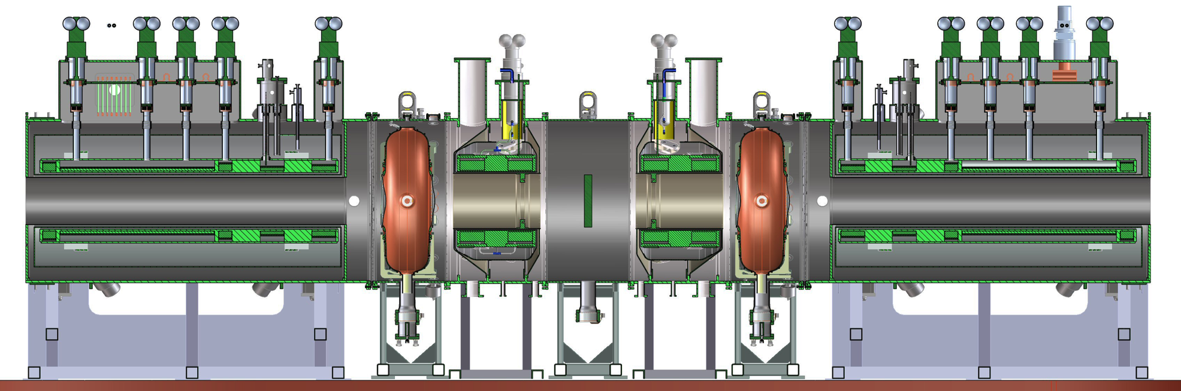
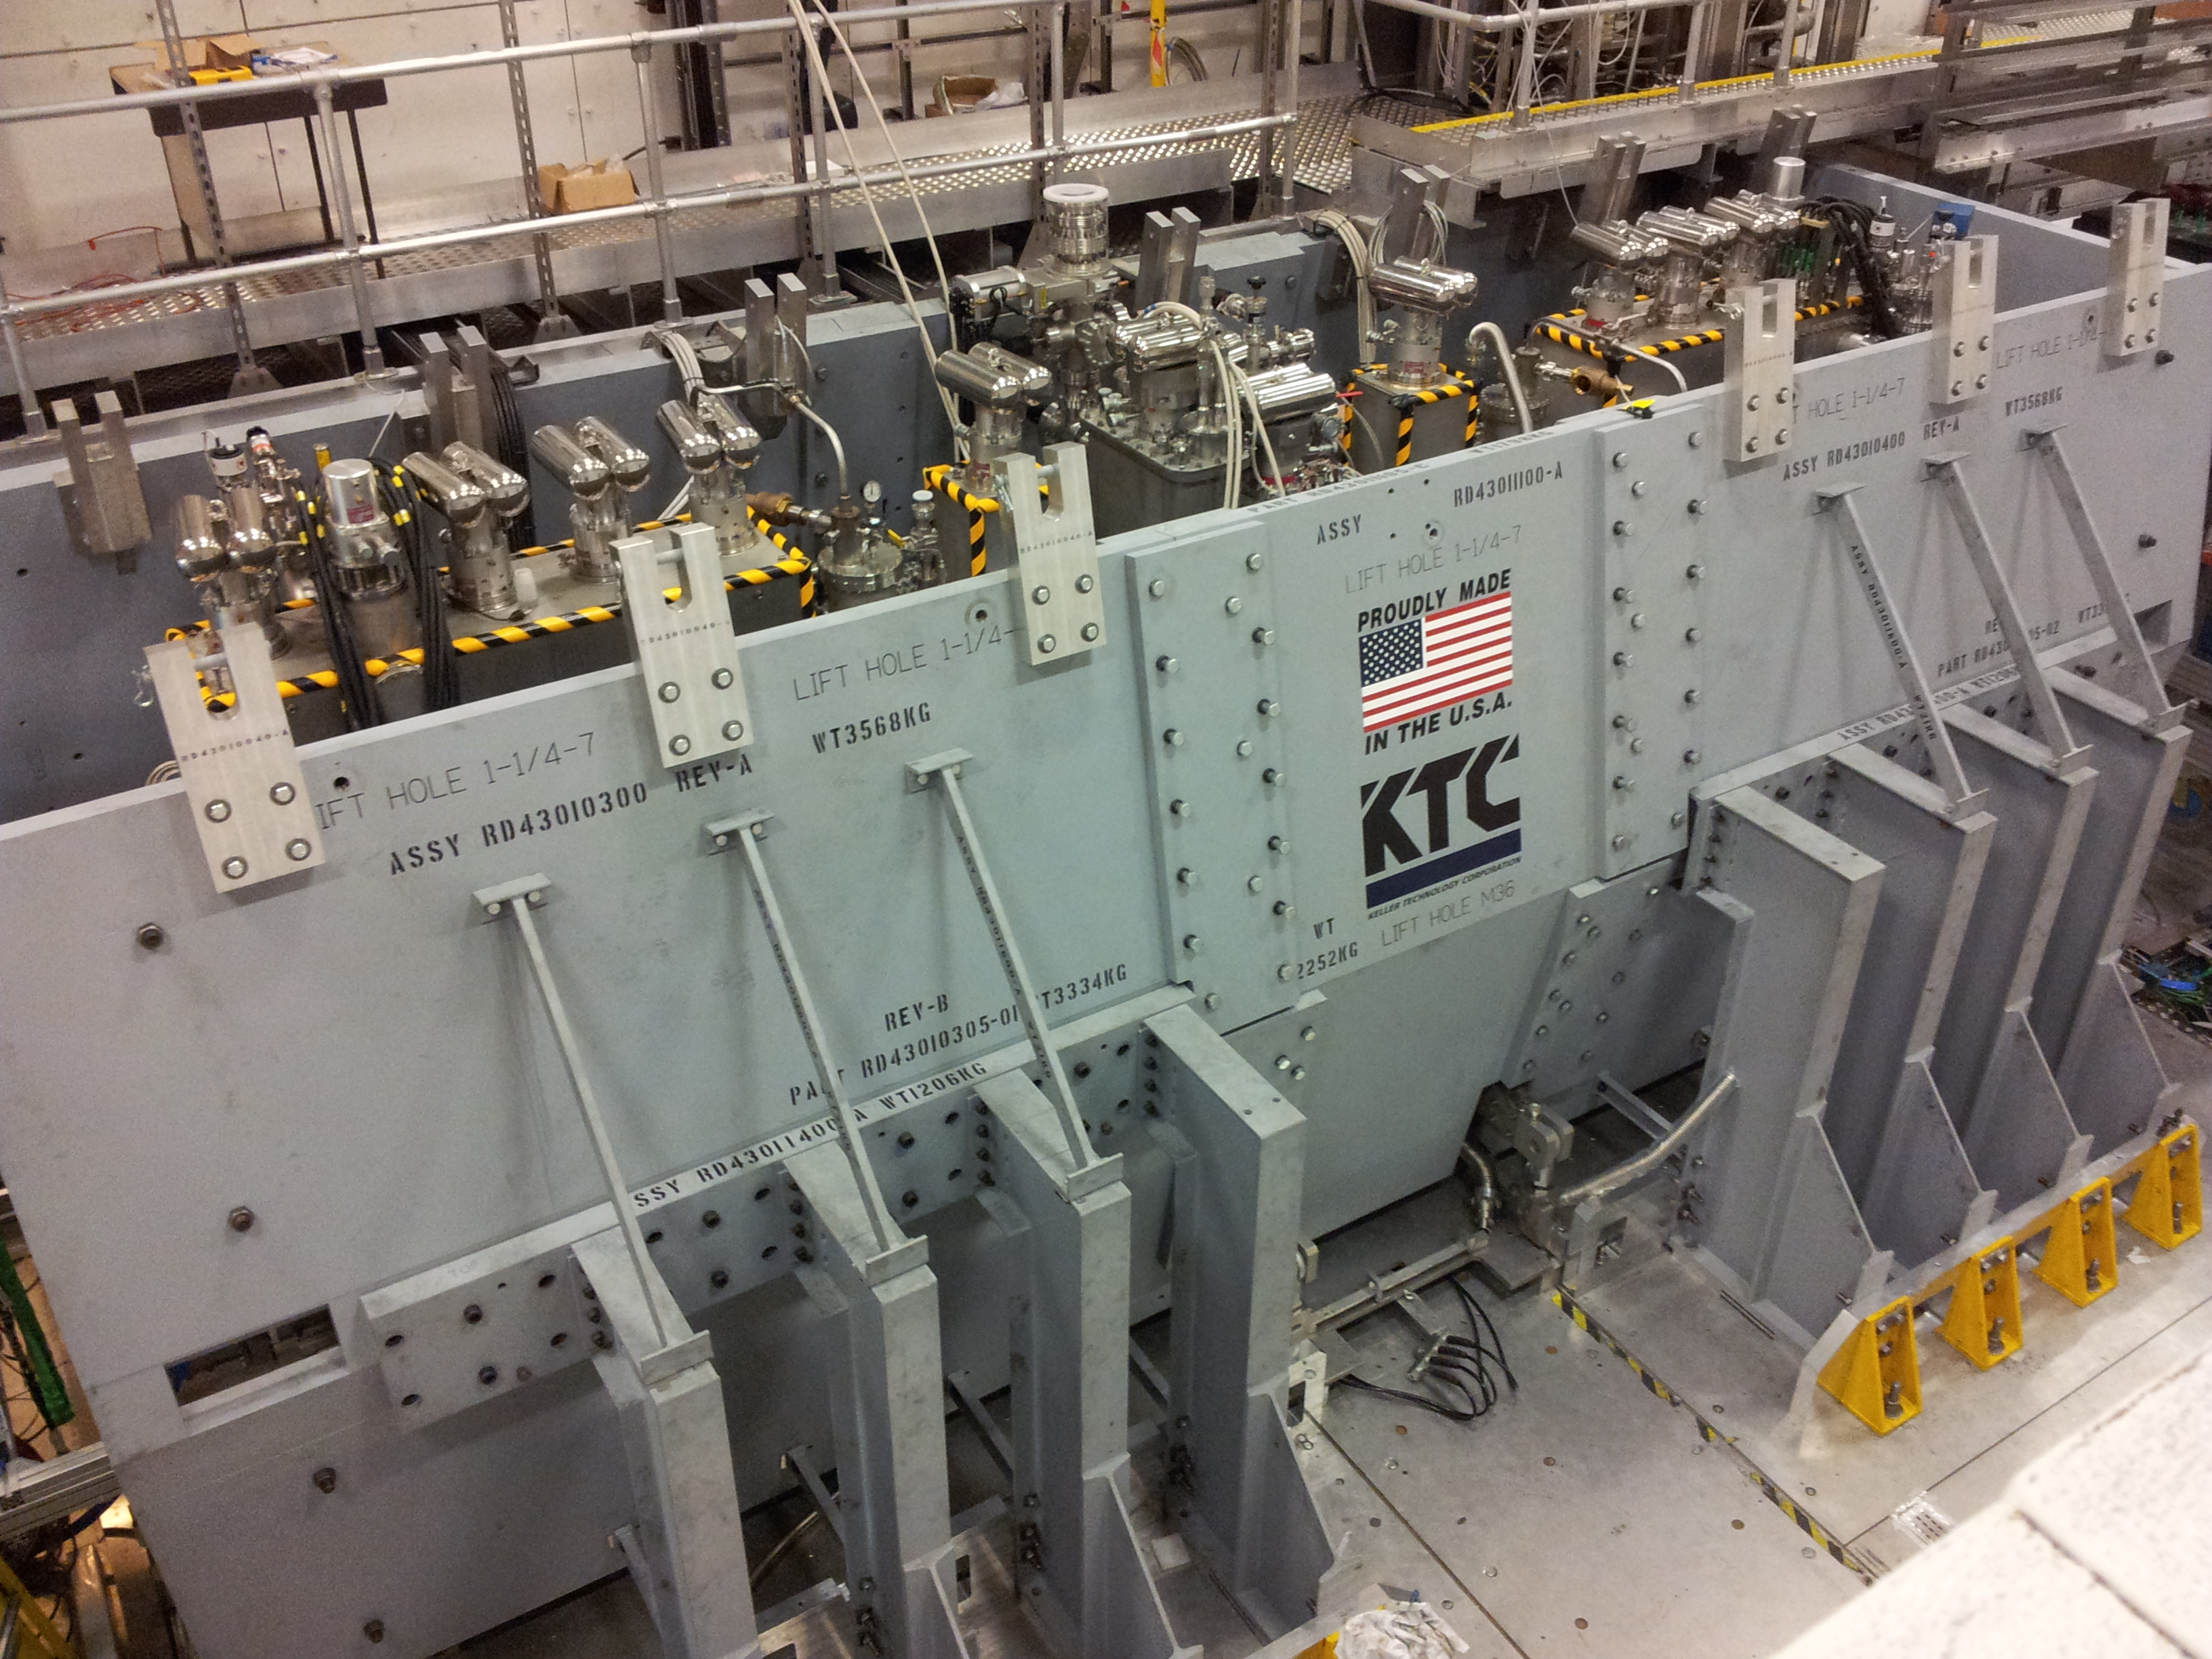
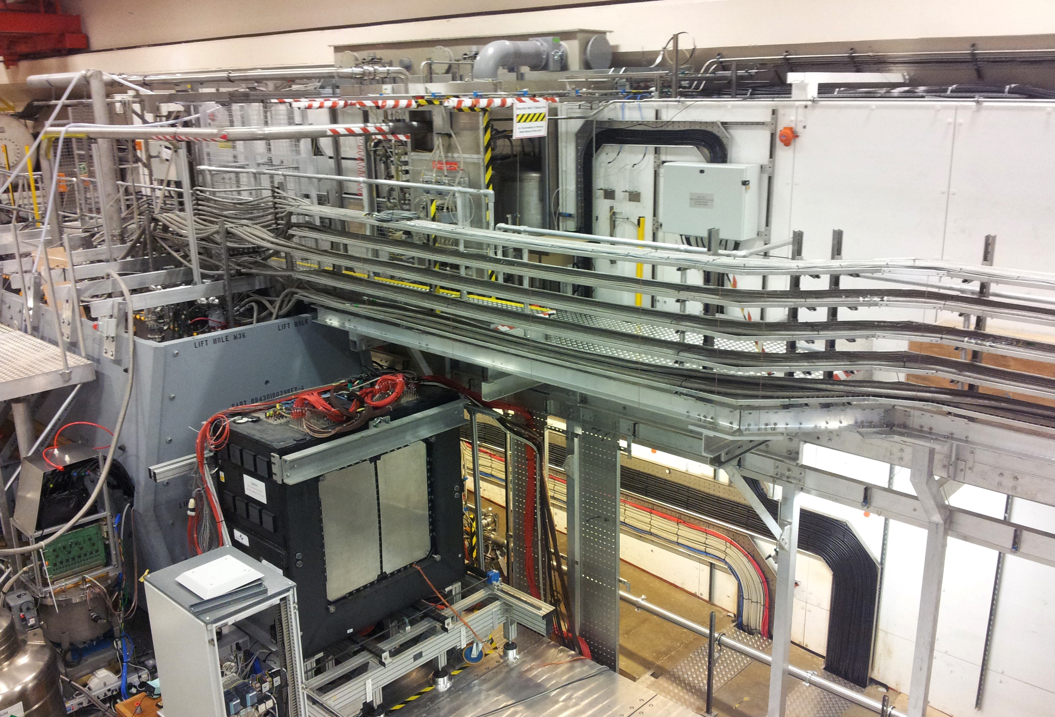
Muon Ionization Cooling Experiment (MICE)
MICE: demonstration of ionization cooling at Rutherford Appleton Laboratory by 2018:
  Two RF cavities and LiH absorbers
INFN contribution (Milano,
Napoli, Pavia, Roma Tre):
crucial contribution to
PID detectors
Neutrinos (in memoria di Guido), Roma Tre: 9 December 2015

Slide 14
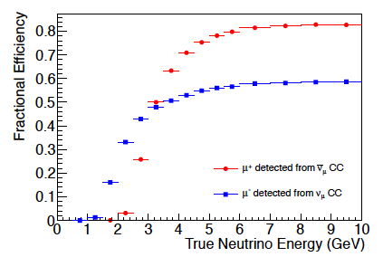
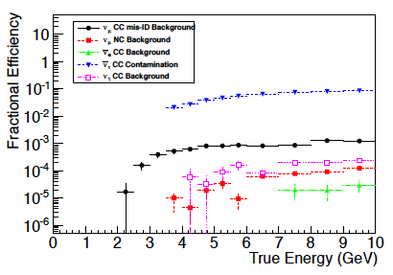
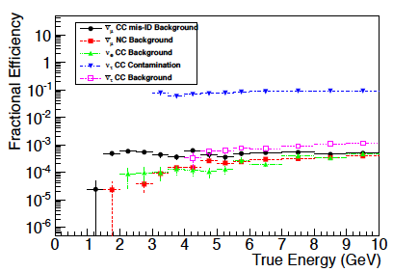
CP violation analysis at IDS-NF
BDT efficiency, focussing μ⁺
BDT background (stored μ⁻, focussing μ⁺)
Tau signal
Courtesy
R. Bayes
BDT efficiency, focussing μ⁻
BDT background (stored μ⁺, focussing μ⁺)
Tau signal
Neutrinos (in memoria di Guido), Roma Tre: 9 December 2015

Slide 15
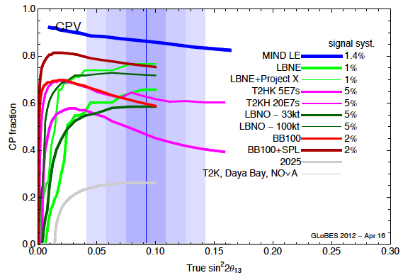
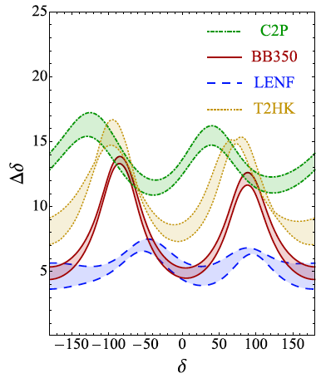
Performance 10 GeV Neutrino Factory
Analysis shows that 10 GeV Neutrino Factory, with 10²¹ μ/year, 100 kton MIND at 2000 km gives best sensitivity to CP violation
More than 85% 5σ coverage
(ie. 85% probability of CPV discovery!)
arXiv:1203.5651
Neutrinos (in memoria di Guido), Roma Tre: 9 December 2015

Slide 16
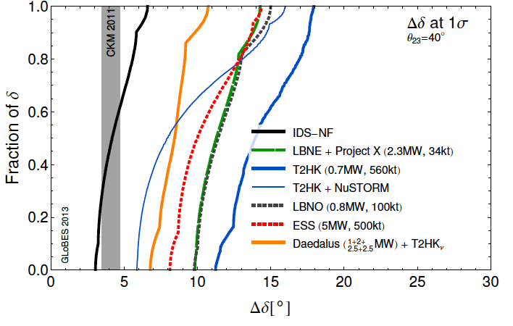
Neutrino Factory CP sensitivity
Analysis shows that 10 GeV Neutrino Factory, with 10²¹ μ/year, 100 kton MIND at 2000 km gives best sensitivity to CP violation
arXiv:1209.5973
Neutrinos (in memoria di Guido), Roma Tre: 9 December 2015

Slide 17
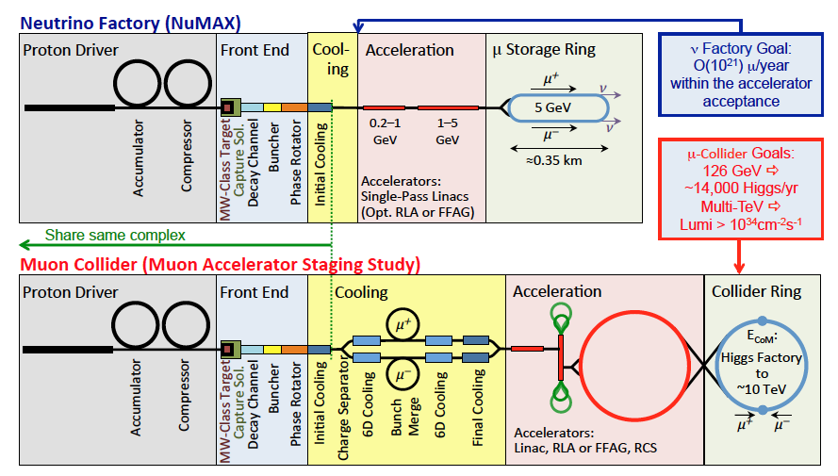
Muon Accelerator Staging Programme
NuMAX is Neutrino Factory in Fermilab context (5 GeV to Sanford Lab, at 1300 km) – similar sensitivity to IDS-NF
Synergy with Muon Collider components
Neutrinos (in memoria di Guido), Roma Tre: 9 December 2015

Slide 18
Physics performance of NuMAX
Physics performance in terms of fraction of CP phase δ with measurement accuracy at or below Δδ
P. Huber
Neutrinos (in memoria di Guido), Roma Tre: 9 December 2015

Slide 19
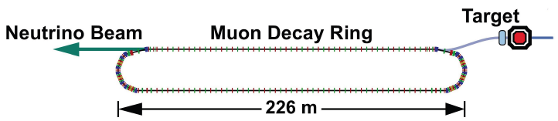
nuSTORM: Neutrinos from STORed Muons
nuSTORM: first stage neutrino factory with 3.8 GeV/c muons that does not rely on any new technology
  Pions of 5 Gev/c captured and injected into ring.
  52% of pions decay to muons before first turn:
  This creates a first flash of neutrinos from pion decays
  Ring designed to store muons with p = 3.8 GeV ± 10%
  Muons decay producing neutrinos:
  Creates hybrid beam of neutrinos from pion & muon decay
3.8 GeV/c
Neutrinos (in memoria di Guido), Roma Tre: 9 December 2015

Slide 20
Physics motivation
Physics motivation of nuSTORM:
  Creation of a neutrino beam with a flux accuracy of 10⁻³ for neutrino scattering physics: “the neutrino light source”
  Measurement of ν_{e} cross sections and nuclear effects in neutrino-nucleus collisions, essential for long baseline neutrino oscillation programme
  Definitive resolution of sterile neutrino problem and search for short-baseline neutrino oscillations
  Creation of a test bed for muon accelerator R&D for future high intensity neutrino factories and muon collider
A new way of doing neutrino physics
Adey, Bayes, Bross, Snopok, Ann. Rev. Nucl. Part. Sci. 2015 65:145-75.
Neutrinos (in memoria di Guido), Roma Tre: 9 December 2015

Slide 21
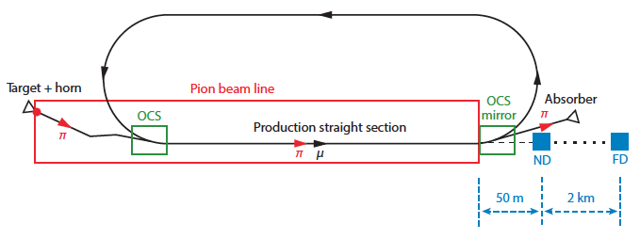
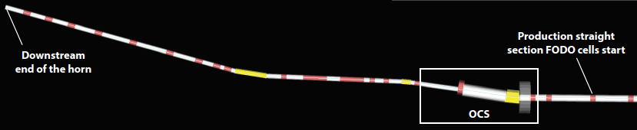
nuSTORM Facility
nuSTORM facility:
  120 GeV protons on carbon or inconel target (100 kW)
  NuMI-style horn for pion collection
  Injection pions (5 GeV/c ± 10%) into storage ring: 0.09 π/POT
  Storage ring: large aperture FODO lattice (3.8 GeV/c ± 10%) muons: 8×10⁻³ μ/PO
Neutrinos (in memoria di Guido), Roma Tre: 9 December 2015

Slide 22
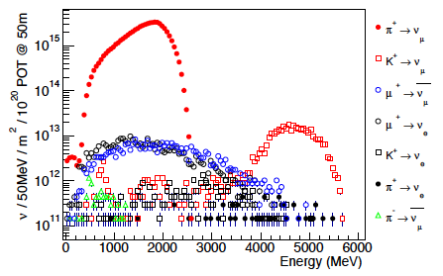
nuSTORM Flux and Spectrum
nuSTORM flux and energy spectrum
  ν_{μ} from pion decay flux: 6.3×10¹⁶ ν/m² at 50 m
  ν_{e} from muon decay flux: 3.0×10¹⁴ ν/m² at 50 m
  ν_{μ} from kaon decay flux: 3.8×10¹⁴ ν/m² at 50 m
  Used for cross-section measurements and short baseline oscillations
Use muon decay
neutrinos to
calibrate hadron
decay neutrinos
Neutrinos (in memoria di Guido), Roma Tre: 9 December 2015

Slide 23
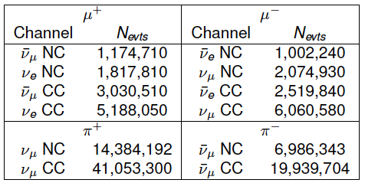
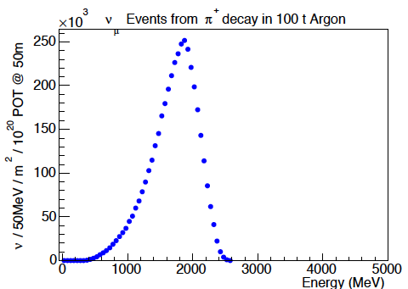
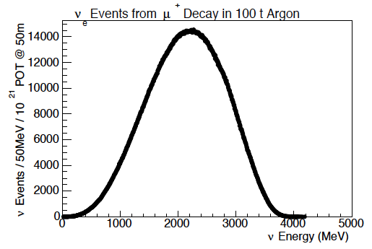
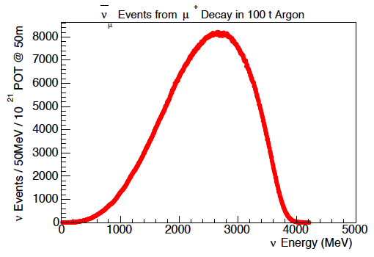
nuSTORM Event Rates
Flux uncertainties for nuSTORM from beam diagnostics: < 1%
Event rates per 10²¹ POT in 100 ton Liquid Argon at 50 m
  Limited by detector systematics:
Neutrinos (in memoria di Guido), Roma Tre: 9 December 2015

Slide 24
Neutrino interactions at nuSTORM
Very rich physics programme (just some examples):
  Electron neutrino and cross-section measurements
  π⁰ production in neutrino interactions
  Charged π and K production
  Neutrino-electron scattering
  Neutrino-nucleon scattering: charged current and neutral current (NC/CC ratio and sin²θ_{W})
  Nuclear effects in neutrino interactions
  Semi-exclusive and exclusive processes: measurement of
  production
  New physics and exclusive processes: test of universality, heavy neutrinos, eV-scale pseudo-scalar penetrating particles ….
Over 60 physics topics
already identified: PhD theses
Neutrinos (in memoria di Guido), Roma Tre: 9 December 2015

Slide 25
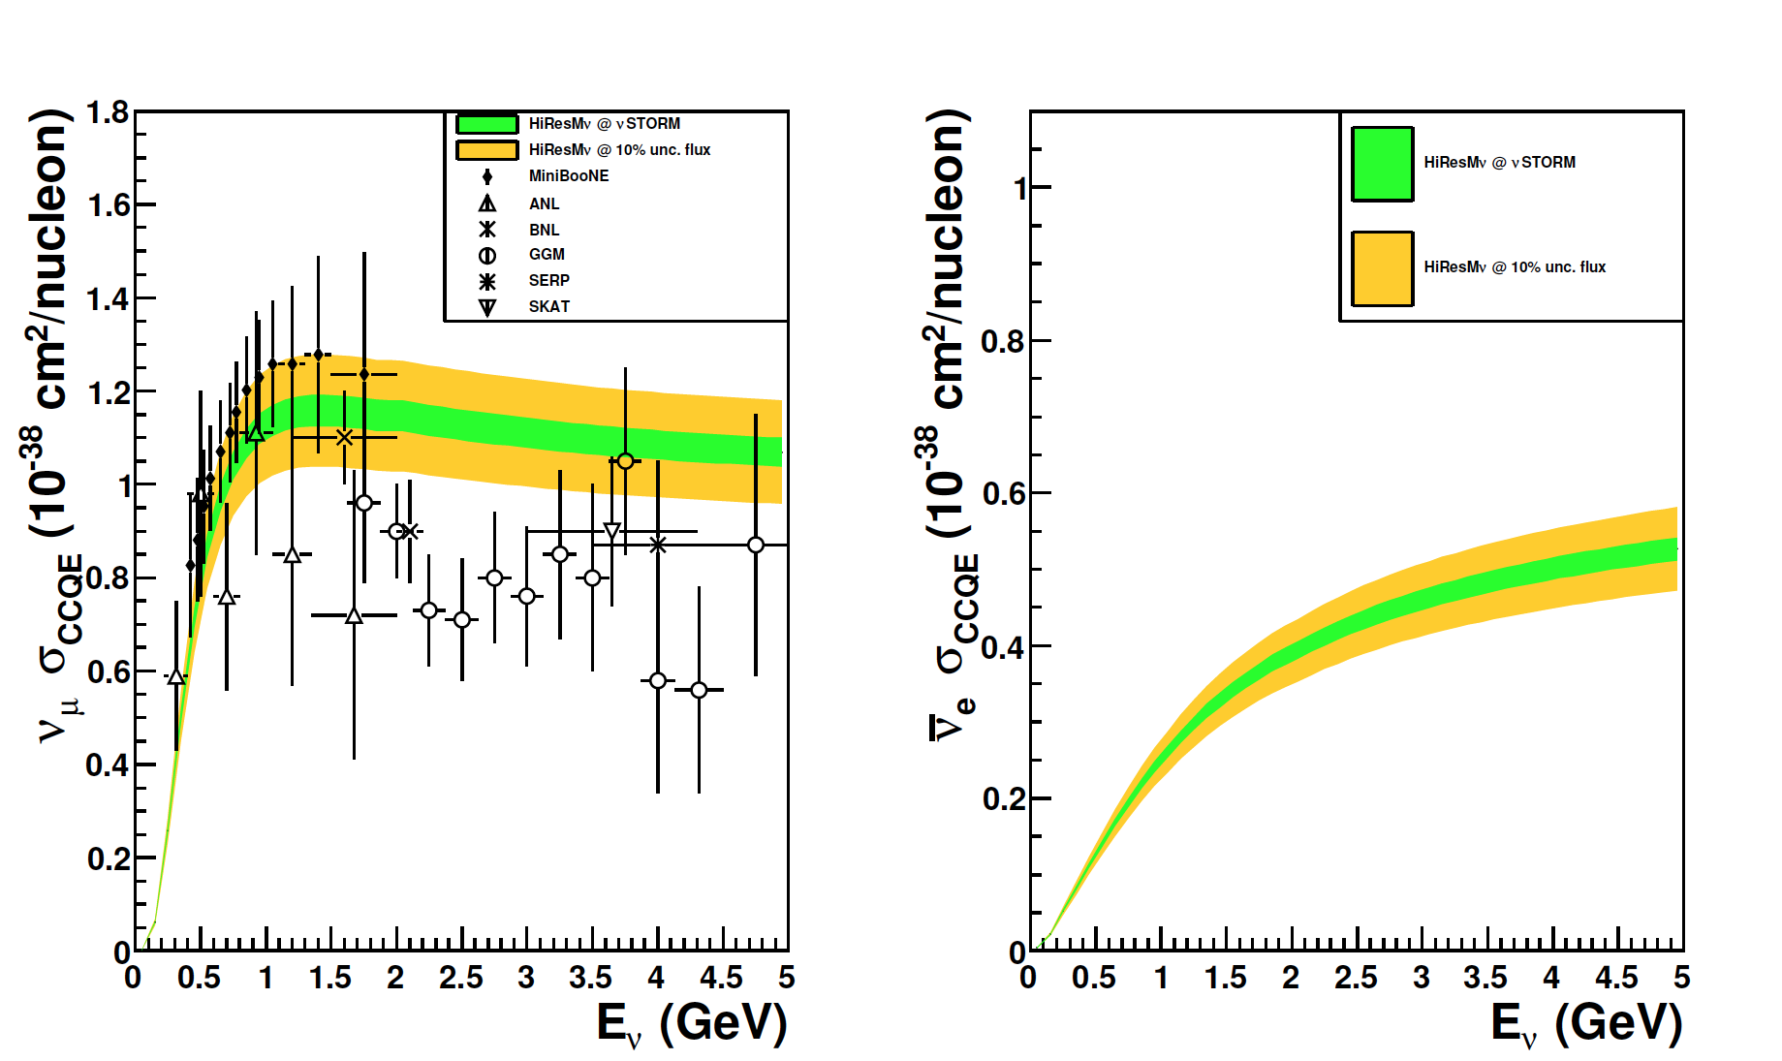
Neutrino interactions at nuSTORM
Example of CCQE measurement:
  Expected accuracy for and cross-sections
Neutrinos (in memoria di Guido), Roma Tre: 9 December 2015

Slide 26
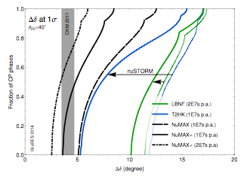
nuSTORM influence on LBL sensitivities
Influence of measurement of cross-sections with less than 1% precision as potentially provided by nuSTORM
Significantly improves δ_{CP} accuracy in DUNE and HyperK
Huber, Palmer, Bross
arXiv:1411:0629
Neutrinos (in memoria di Guido), Roma Tre: 9 December 2015

Slide 27
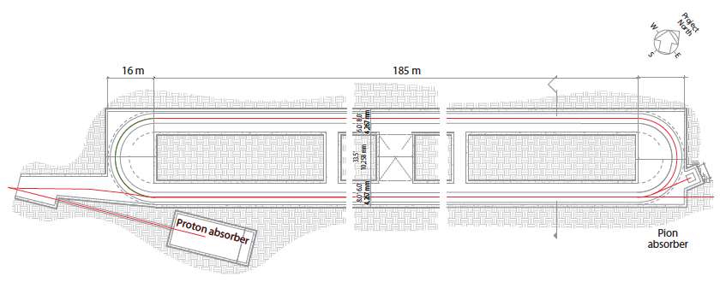
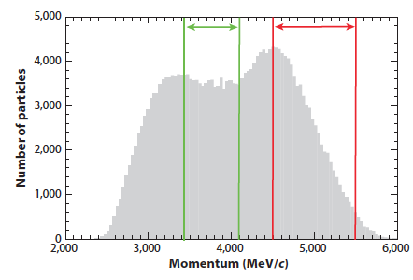
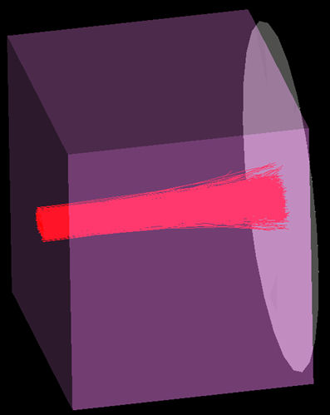
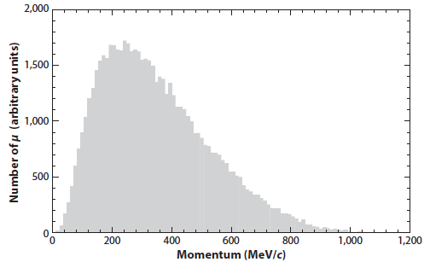
nuSTORM for accelerator R&D
nuSTORM: testbed for 6D muon cooling experiment
  At end of straight: 3.5 m iron pion absorber
  After absorber: 10¹⁰ μ/pulse between 100-300 MeV/c
3.8 GeV±10%
Muons for 6D
Neutrinos (in memoria di Guido), Roma Tre: 9 December 2015

Slide 28
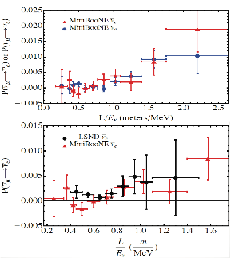
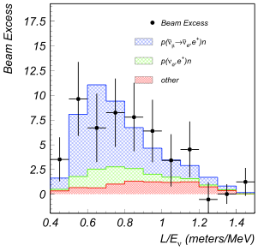
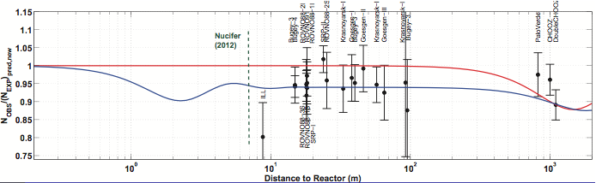
Short baseline physics
LSND and MiniBooNE hints of and appearance
and reactor anomaly (6% deficit)
LSND
Reactor anomaly
MiniBooNE

Slide 29
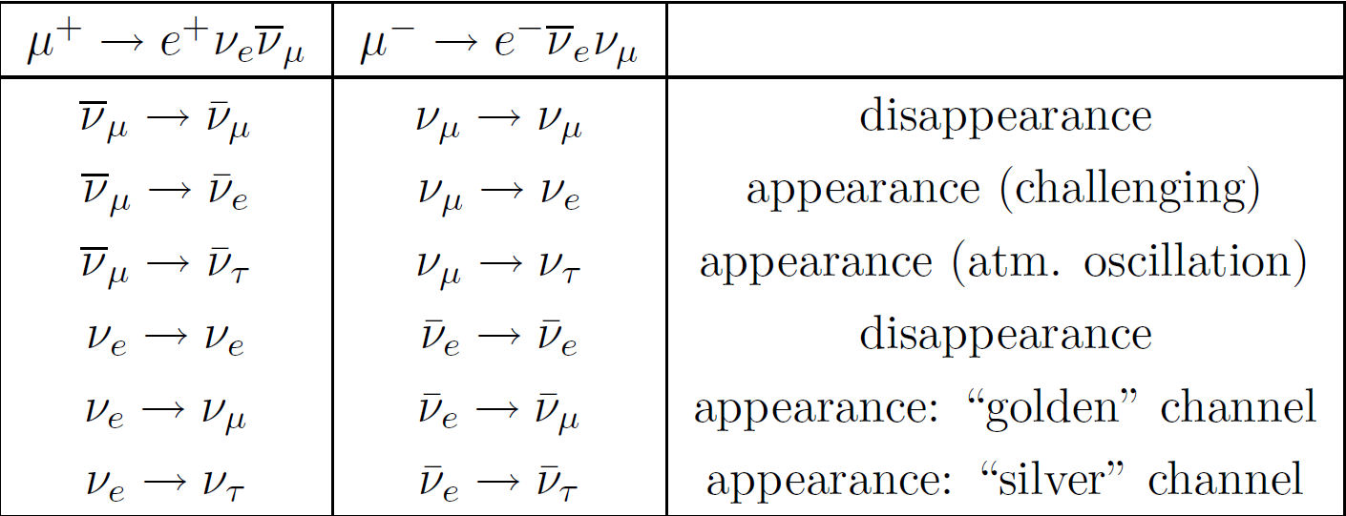
Short baseline physics
To resolve sterile neutrino hyposthesis need to verify consistency between appearance and disappearance:
  nuSTORM could probe all possible sterile neutrino appearance and disappearance channels (if E_{ν}>τ threshold) to test paradigm
Neutrinos (in memoria di Guido), Roma Tre: 9 December 2015

Slide 30
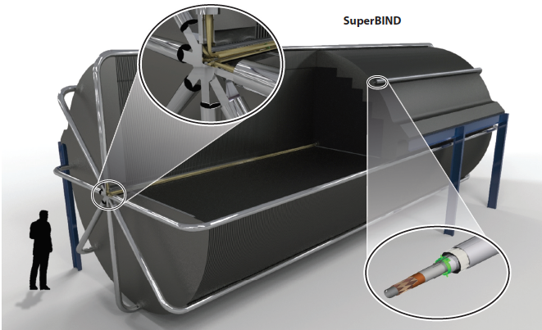
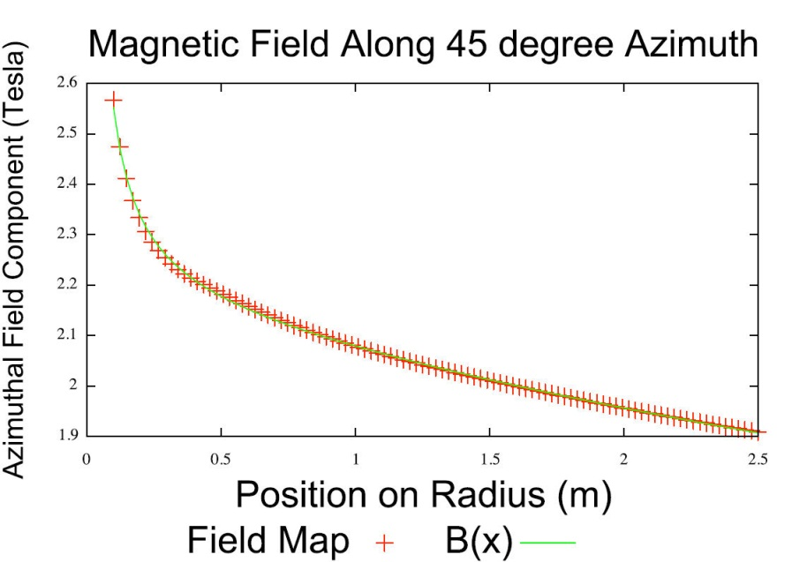
Sterile neutrino search
Assume two detectors:
Super-saturated Magnetised Iron: SuperBIND
Magnetic field: 1.5-2.6 T
240 kA from 8 Superconducting
Trasmission Lines
Neutrinos (in memoria di Guido), Roma Tre: 9 December 2015

Slide 31
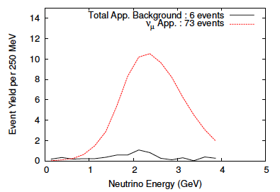
Sterile neutrino search
Appearance search:
Disappearance search:
Adey et al., PRD 89 (2014) 071301
With full reconstruction
and efficiencies, 10²¹ POT
Neutrinos (in memoria di Guido), Roma Tre: 9 December 2015

Slide 32
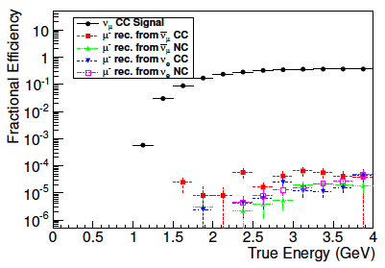

Sterile neutrino search
Short-baseline oscillation search with near detector at 50 m and far detector at 2 km, 10²¹ POT exposure
Appearance and disappearance multi-variate analyses
Adey et al., PRD 89 (2014) 071301
Appearance efficiencies
Disappearance efficiencies
Neutrinos (in memoria di Guido), Roma Tre: 9 December 2015

Slide 33


Sterile neutrino search
Short-baseline oscillation search with near detector at 50 m and far detector at 2 km, 10²¹ POT exposure
Appearance and disappearance multi-variate analyses
Adey et al., PRD 89 (2014) 071301
Appearance sensitivity
Disappearance sensitivity
Can perform combined analysis appearance/disappearance
Neutrinos (in memoria di Guido), Roma Tre: 9 December 2015

Slide 34





nuSTORM at Fermilab
Near Detector Hall
nuSTORM could be sited at Fermilab
Proposal to FNAL PAC: arXiv: 1308.6822
Far Detector Hall (D0)
Target building
Decay ring

Slide 35


nuSTORM at CERN
nuSTORM could be sited at CERN
Target station in North Area
For two detector oscillation search: near detector in North Area and far detector in Point 1.8
EoI to CERN: arXiv:1305.1419
Neutrinos (in memoria di Guido), Roma Tre: 9 December 2015

Slide 36
Conclusions
Expect discovery of CP violation in neutrinos within 15 years
Neutrino Factories from muon decay can bring neutrino physics into precision era
First stage: nuSTORM to measure neutrino cross-sections with ~1% precision, can resolve sterile neutrino issue with 10σ sensitivity and can be used to create 6D cooling R&D facility
nuSTORM would be a fantastic contribution to world-wide neutrino programme complementing long baseline experiments
Second stage: develop neutrino factory for ultimate precision of CP phase delta Δδ_{CP}~ 4º.
Neutrino factories are a stepping stone towards a muon collider – R&D is always delivering physics along the way
Neutrinos (in memoria di Guido), Roma Tre: 9 December 2015

Slide 37
Backup Slides
Neutrinos (in memoria di Guido), Roma Tre: 9 December 2015

Slide 38

Sterile neutrino search
Short-baseline oscillation search with near detector at 50 m and far detector at 2 km, 10²¹ POT exposure
Appearance and disappearance multi-variate analyses
Adey et al., PRD 89 (2014) 071301
Appearance sensitivity
Disappearance sensitivity
Can perform combined analysis appearance/disappearance
Neutrinos (in memoria di Guido), Roma Tre: 9 December 2015

Slide 39

NuMAX: Neutrino Factory FNAL/Sanford
Neutrinos from a Muon Accelerator CompleX (NuMAX)
  Neutrino Factory with 10²⁰ straight muons decays/year @ 5 GeV
  Muon ring at 5 GeV pointing neutrino beam towards Sanford
  A 10kT MIND or magnetized LAr detector upgraded from LBNE
PIPII
NuMAX
commissioning
0.8GeV
J.P. Delahaye
PIPIII
Dual use
Linac
2.2GeV
μ Preinjector
3.75GeV
650MHz
1.0 GeV
325MHz
6.75 GeV
Protons
No cooling
255MeV/c
Muons
Accumulator
Front-end
Target
Buncher
Main Injector
Neutrinos (in memoria di Guido), Roma Tre: 9 December 2015

Slide 40
NuMAX: Neutrino Factory FNAL/Sanford
Neutrinos from a Muon Accelerator CompleX (NuMAX)
  Add small amount of 6D cooling
  Neutrino Factory with 5×10²⁰ straight muon decays/year @ 5 GeV
  Muon ring at 5 GeV pointing neutrino beam towards Sanford
PIPII
NuMAX and NuMAx+
0.8GeV
J.P. Delahaye
PIPIII
Dual use
Linac
2.2GeV
μ Preinjector
3.75GeV
650MHz
1.0 GeV
325MHz
6.75 GeV
Protons
Add cooling
255MeV/c
Muons
Cooling
Accumulator
Front-end
Target
Buncher
Main Injector
Neutrinos (in memoria di Guido), Roma Tre: 9 December 2015

Slide 41
NuMAX+: upgrade NuMax
Neutrinos from a Muon Accelerator CompleX (NuMAX+)
  Neutrino Factory with 10²¹ straight muons decays/year @ 5 GeV
  Muon ring at 5 GeV pointing neutrino beam towards Sanford
  Increased proton power and/or larger detectors
PIPII
NuMAX and NuMAx+
0.8GeV
J.P. Delahaye
PIPIII
Dual use
Linac
2.2GeV
μ Preinjector
3.75GeV
650MHz
1.0 GeV
325MHz
6.75 GeV
Protons
Add cooling
255MeV/c
Muons
Cooling
Accumulator
Front-end
Target
Buncher
Main Injector
Neutrinos (in memoria di Guido), Roma Tre: 9 December 2015

Slide 42


Higgs Factory
Higgs Factory: production of Higgs at 126 GeV CM
  Collider capable of providing ~13,500 Higgs events per year with exquisite energy resolution: direct Higgs mass and width
  Possible upgrade to a Top Factory with production of up to 60000 top particles per year
PIPII
Higgs factory
0.8GeV
J.P. Delahaye
PIPIII
Dual use
Linac
2.2GeV
μ Preinjector
3.75GeV
650MHz
125GeV
300 m
Add 6D cooling
1.0 GeV
325MHz
RLA
6.75 GeV
Protons
6D cooling
Bunch
merge
6D cooling
255MeV/c
Muons
Charge separator
Compressor
Accumulator
Initial Cooling
Buncher
Front-end
Target
Main Injector
Neutrinos (in memoria di Guido), Roma Tre: 9 December 2015

Slide 43
High Energy Muon Collider
Multi-TeV muon collider:
  If warranted by LHC results a muon collider can reach up to 10 TeV
  Likely offers the best performance, least cost and power consumption of any lepton collider operating in the multi-TeV regime.
PIPII
Muon collider
J.P. Delahaye
0.8GeV
Post cooling
acceleration
PIPIII
Dual use
Linac
2.2GeV
0.25 GeV
3.75GeV
650MHz
Final cooling
1.0 GeV
325MHz
RLA
6.75 GeV
Protons
6D cooling
Bunch
merge
6D cooling
255MeV/c
Muons
RCS
Charge separator
Compressor
Accumulator
1.5 to 6 (10) TeV
2.5 to 6km
Initial Cooling
Buncher
Front-end
Target
Muon
Collider
Neutrinos (in memoria di Guido), Roma Tre: 9 December 2015

Slide 44

nuSTORM at CERN
nuSTORM serving the Neutrino Platform at CERN
Neutrinos (in memoria di Guido), Roma Tre: 9 December 2015

Slide 45

nuSTORM at CERN
nuSTORM serving the Neutrino Platform at CERN
Neutrinos (in memoria di Guido), Roma Tre: 9 December 2015

Slide 46

nuSTORM at CERN
nuSTORM serving the Neutrino Platform at CERN
Neutrinos (in memoria di Guido), Roma Tre: 9 December 2015

