Slide 1
Solar, atmospheric and reactor neutrinos… what we can learn without a beam
Stefano Dusini
INFN Padova

Slide 2


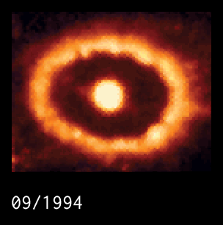
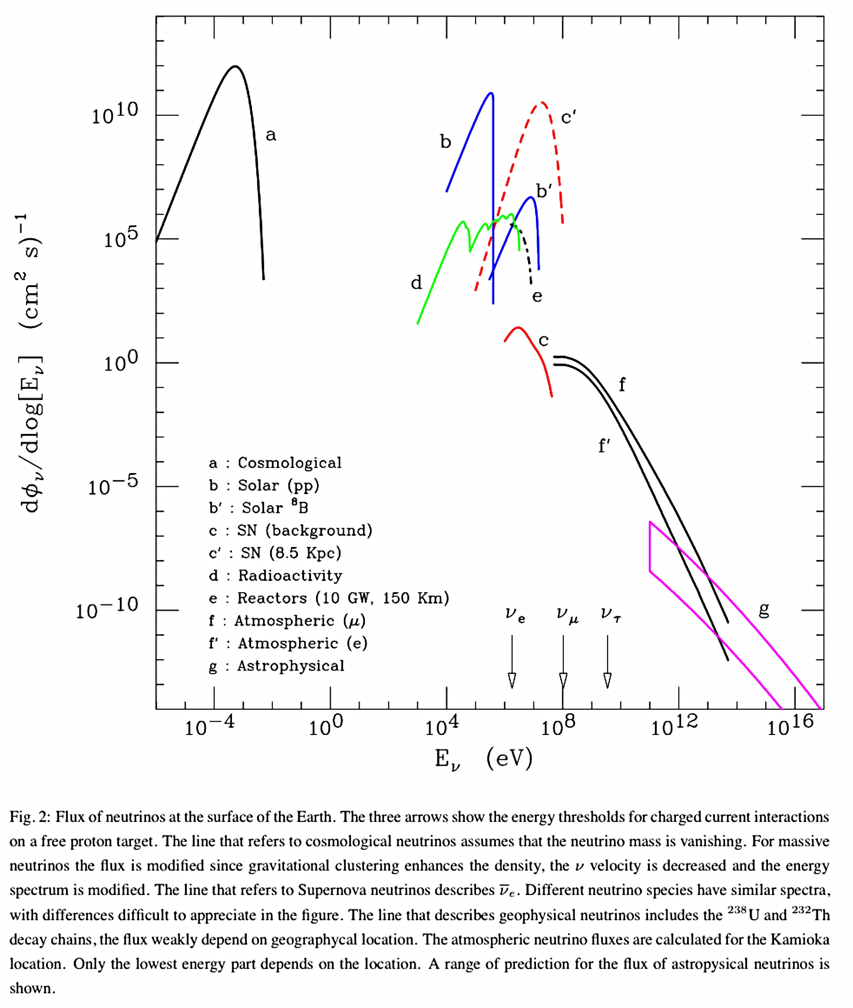
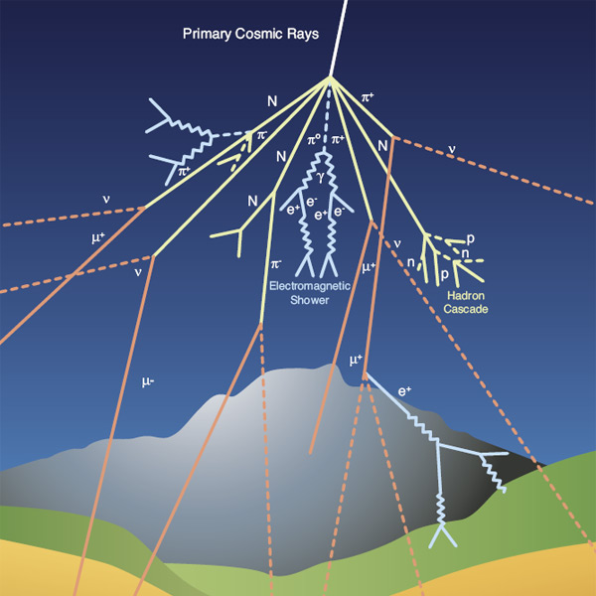
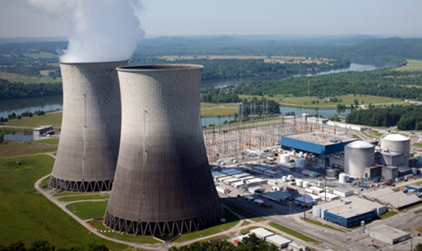
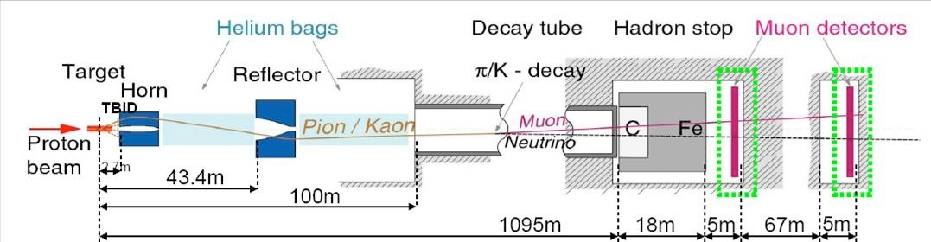
Sun: ν_{e}
ϕ_{earth} ~ 6 x 10¹⁰ ν/cm² s
E_{ν} ~ 0.1 – 20 MeV
Big Bang
ρ ~ 330/cm³
E_{ν} ~ 4 10⁻⁴ eV
Supernova
E_{ν} ~ MeV
Neutrino
sources
Nuclear Reactor
E_{ν} ~ MeV
Atmospheric neutrinos
ϕ_{ν} ~ 1 ν/cm² s
Accelerators: E_{ν} ~ 0.3 – 30 GeV
Earth-radioactivity: ϕ_{ν} ~ 6 x 10⁶ ν/cm² s

Slide 3

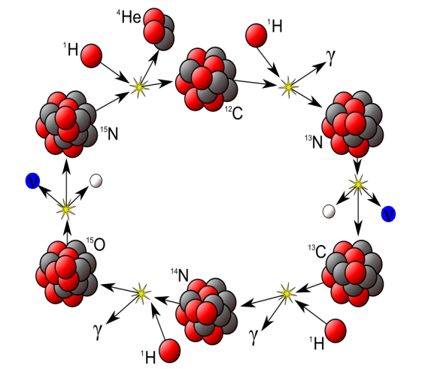
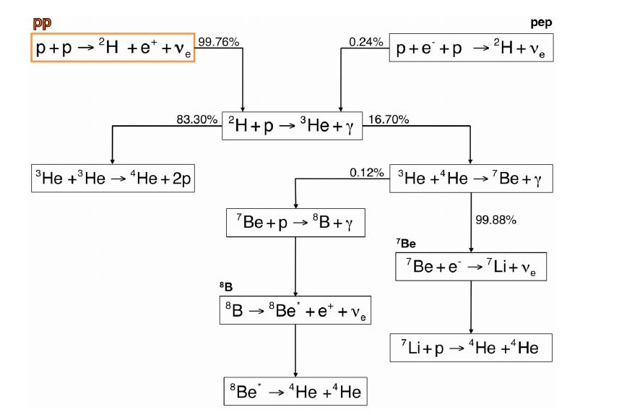
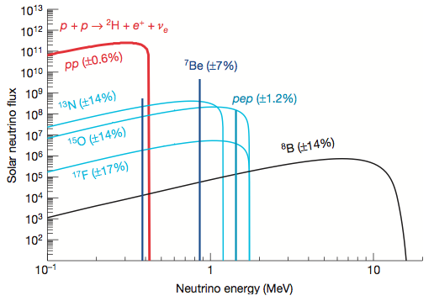
Solar neutrinos
CNO CYCLE:
~ 1.5% of the
sun energy
pp CYCLE:
~ 98.5% of the
sun energy

Slide 4
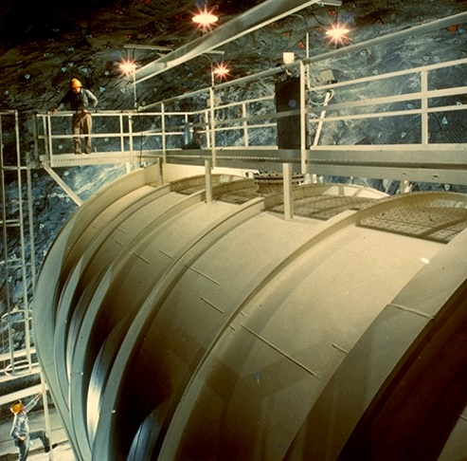
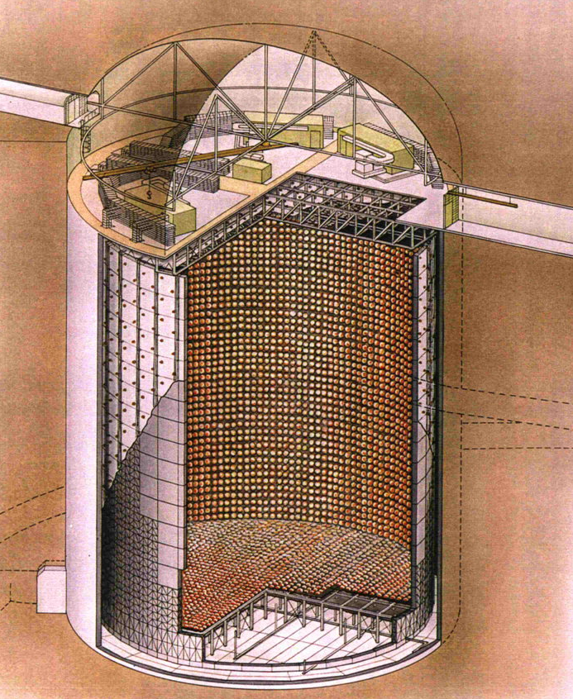
Solar neutrinos: first hint toward neutrino oscillation
GALLEX/GNO @ LNGS
Homestake
(R. Davis & coll.)
Obs/exp ~ 33%
Obs/exp ~ 54%
Cerenkov
Clorine
Obs/exp ~ 45%
Gallium
Super-Kamiokande

Slide 5
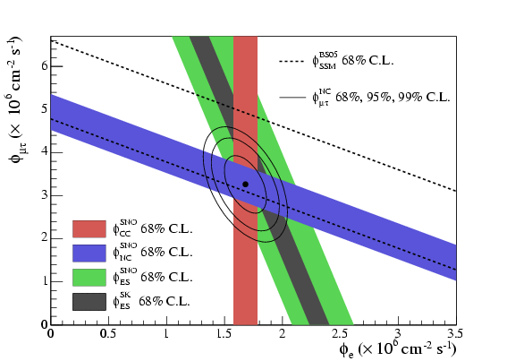
SNO: Heavy water Cerenkov detector
CC: ν_{e} + d → e⁻ + p + p (ν_{e} + n → e⁻ + p )
NC: ν_{eμτ} + d → ν_{eμτ}+ n + p (n capture on H, NaCl )
ES: ν_{eμτ} + e⁻ → ν_{eμτ} + e⁻
survival probability
ν_{e} → ν_{μ} , ν_{τ} transformation

Slide 6
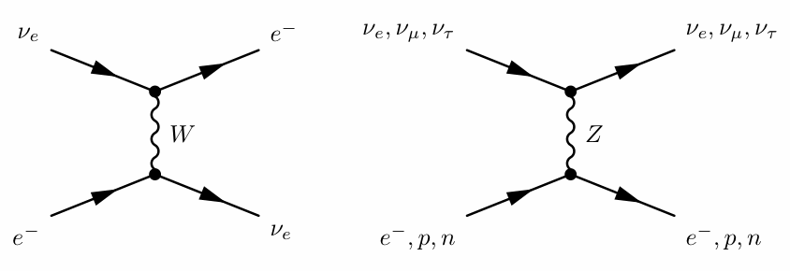
Neutrino propagation in matter
Coherent forward scattering of neutrinos
electron density of the medium
Transition amplitude
Effective mixing matrix in matter
Effective squared-mass difference
Effective mixing
angle

Slide 7
PhD Padova
S.Dusini - INFN Padova
Surface of the sun
Centre of the sun

Slide 8
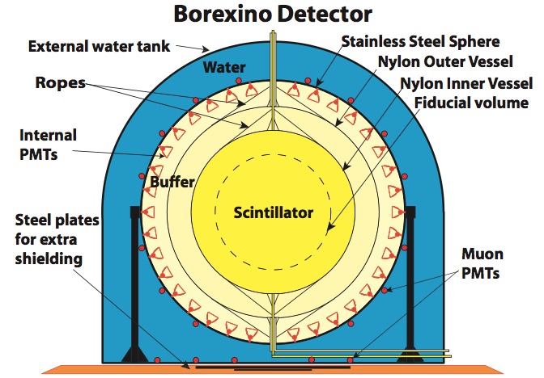
Adiabatic conversion
Observation of pp neutrinos by Borexino (@LNGS)
Confirmed the adiabatic flavour neutrino conversion in the Sun
Oscillation in vacuum
Conversion in matter
non-oscillatory
transition (E_{ν}→inf)
~ 0.31
Residual oscillation:
~ 0.015
Earth regeneration:
~ 0.015

Slide 9
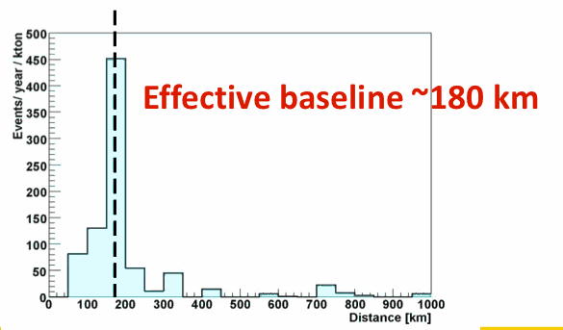
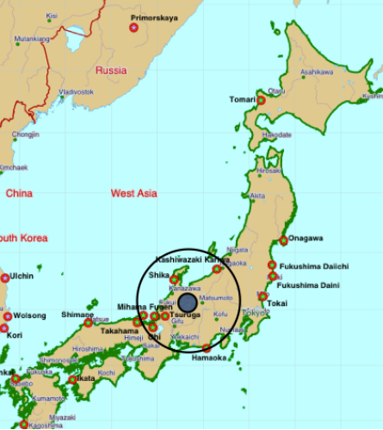
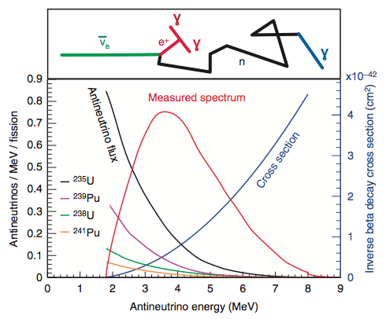
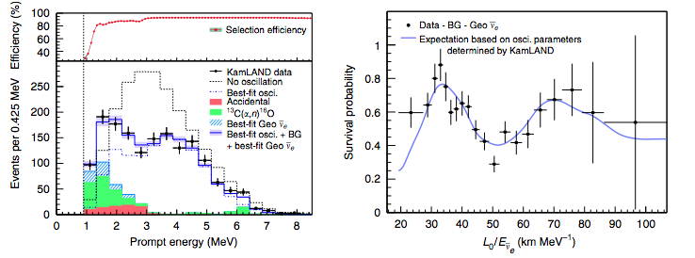
Reactor neutrinos: KamLAND
Anti-neutrino IBD
(inverse beta decay)

Slide 10
Solar neutrinos + KamLAND
Disappearance probability is invariant under CP
Vacuum oscillation
of anti-neutrinos consistent with
parameters of LMA MSW solution
2.3% precision
6.6% precision

Slide 11
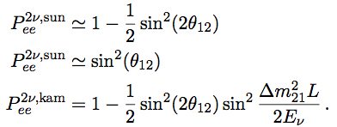

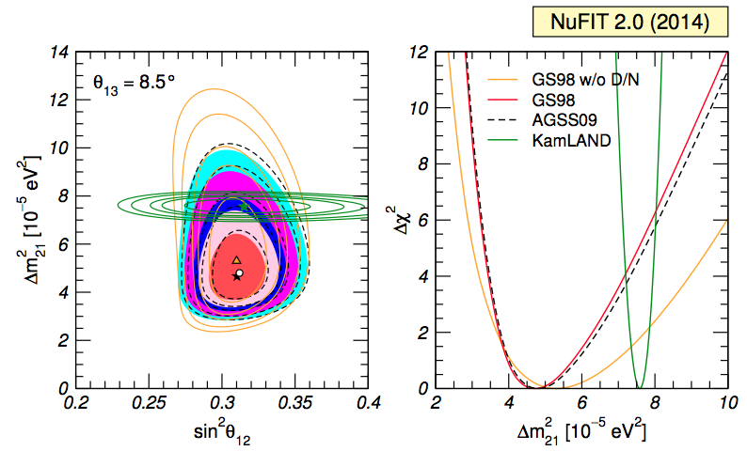
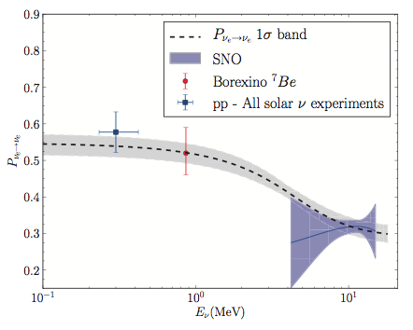
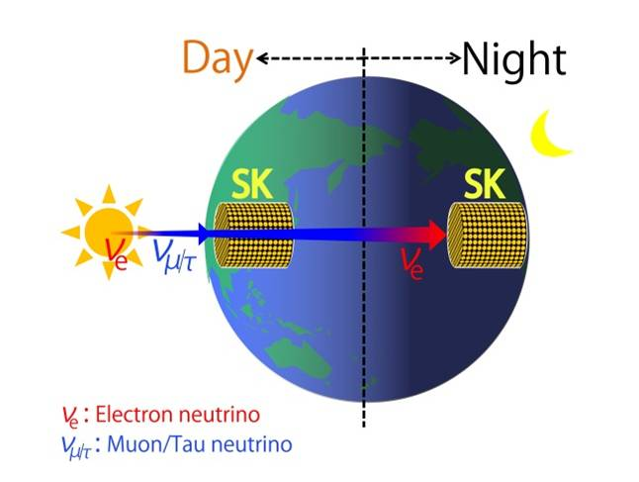
Global fit to Solar neutrino data + KamLAND
Test of three flavour structure (θ₁₃ ≠ 0)
low E
high E
Small tension (~2σ) in Δm² between
solar and KamLAND
data.
Indication for Day/Night asymmetry in SK
no up- turn seen in ⁸B spectrum so far in solar data

Slide 12
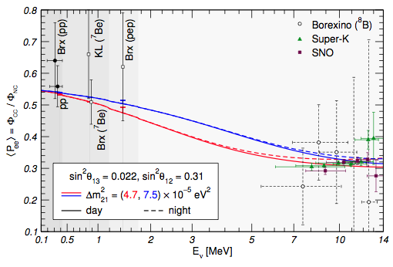
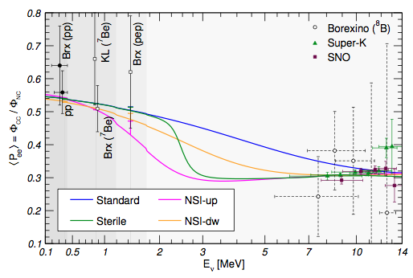
Transition region
Important to test of
flavour conversion in the sun
up-turn
Day/Night asymmetry @ up-turn
Maltoni et al. hep-ph:1507.05287v2
new physics effects
Extra sterile neutrino with
Dm²₀₁ = 1.2 x 10⁻⁵ eV², and
sin² 2a = 0.005
Non-standard interactions with
e^{u}_{D} = - 0.22, e^{u}_{N} = - 0.30
e^{d}_{D} = - 0.12, e^{d}_{N} = - 0.16

Slide 13
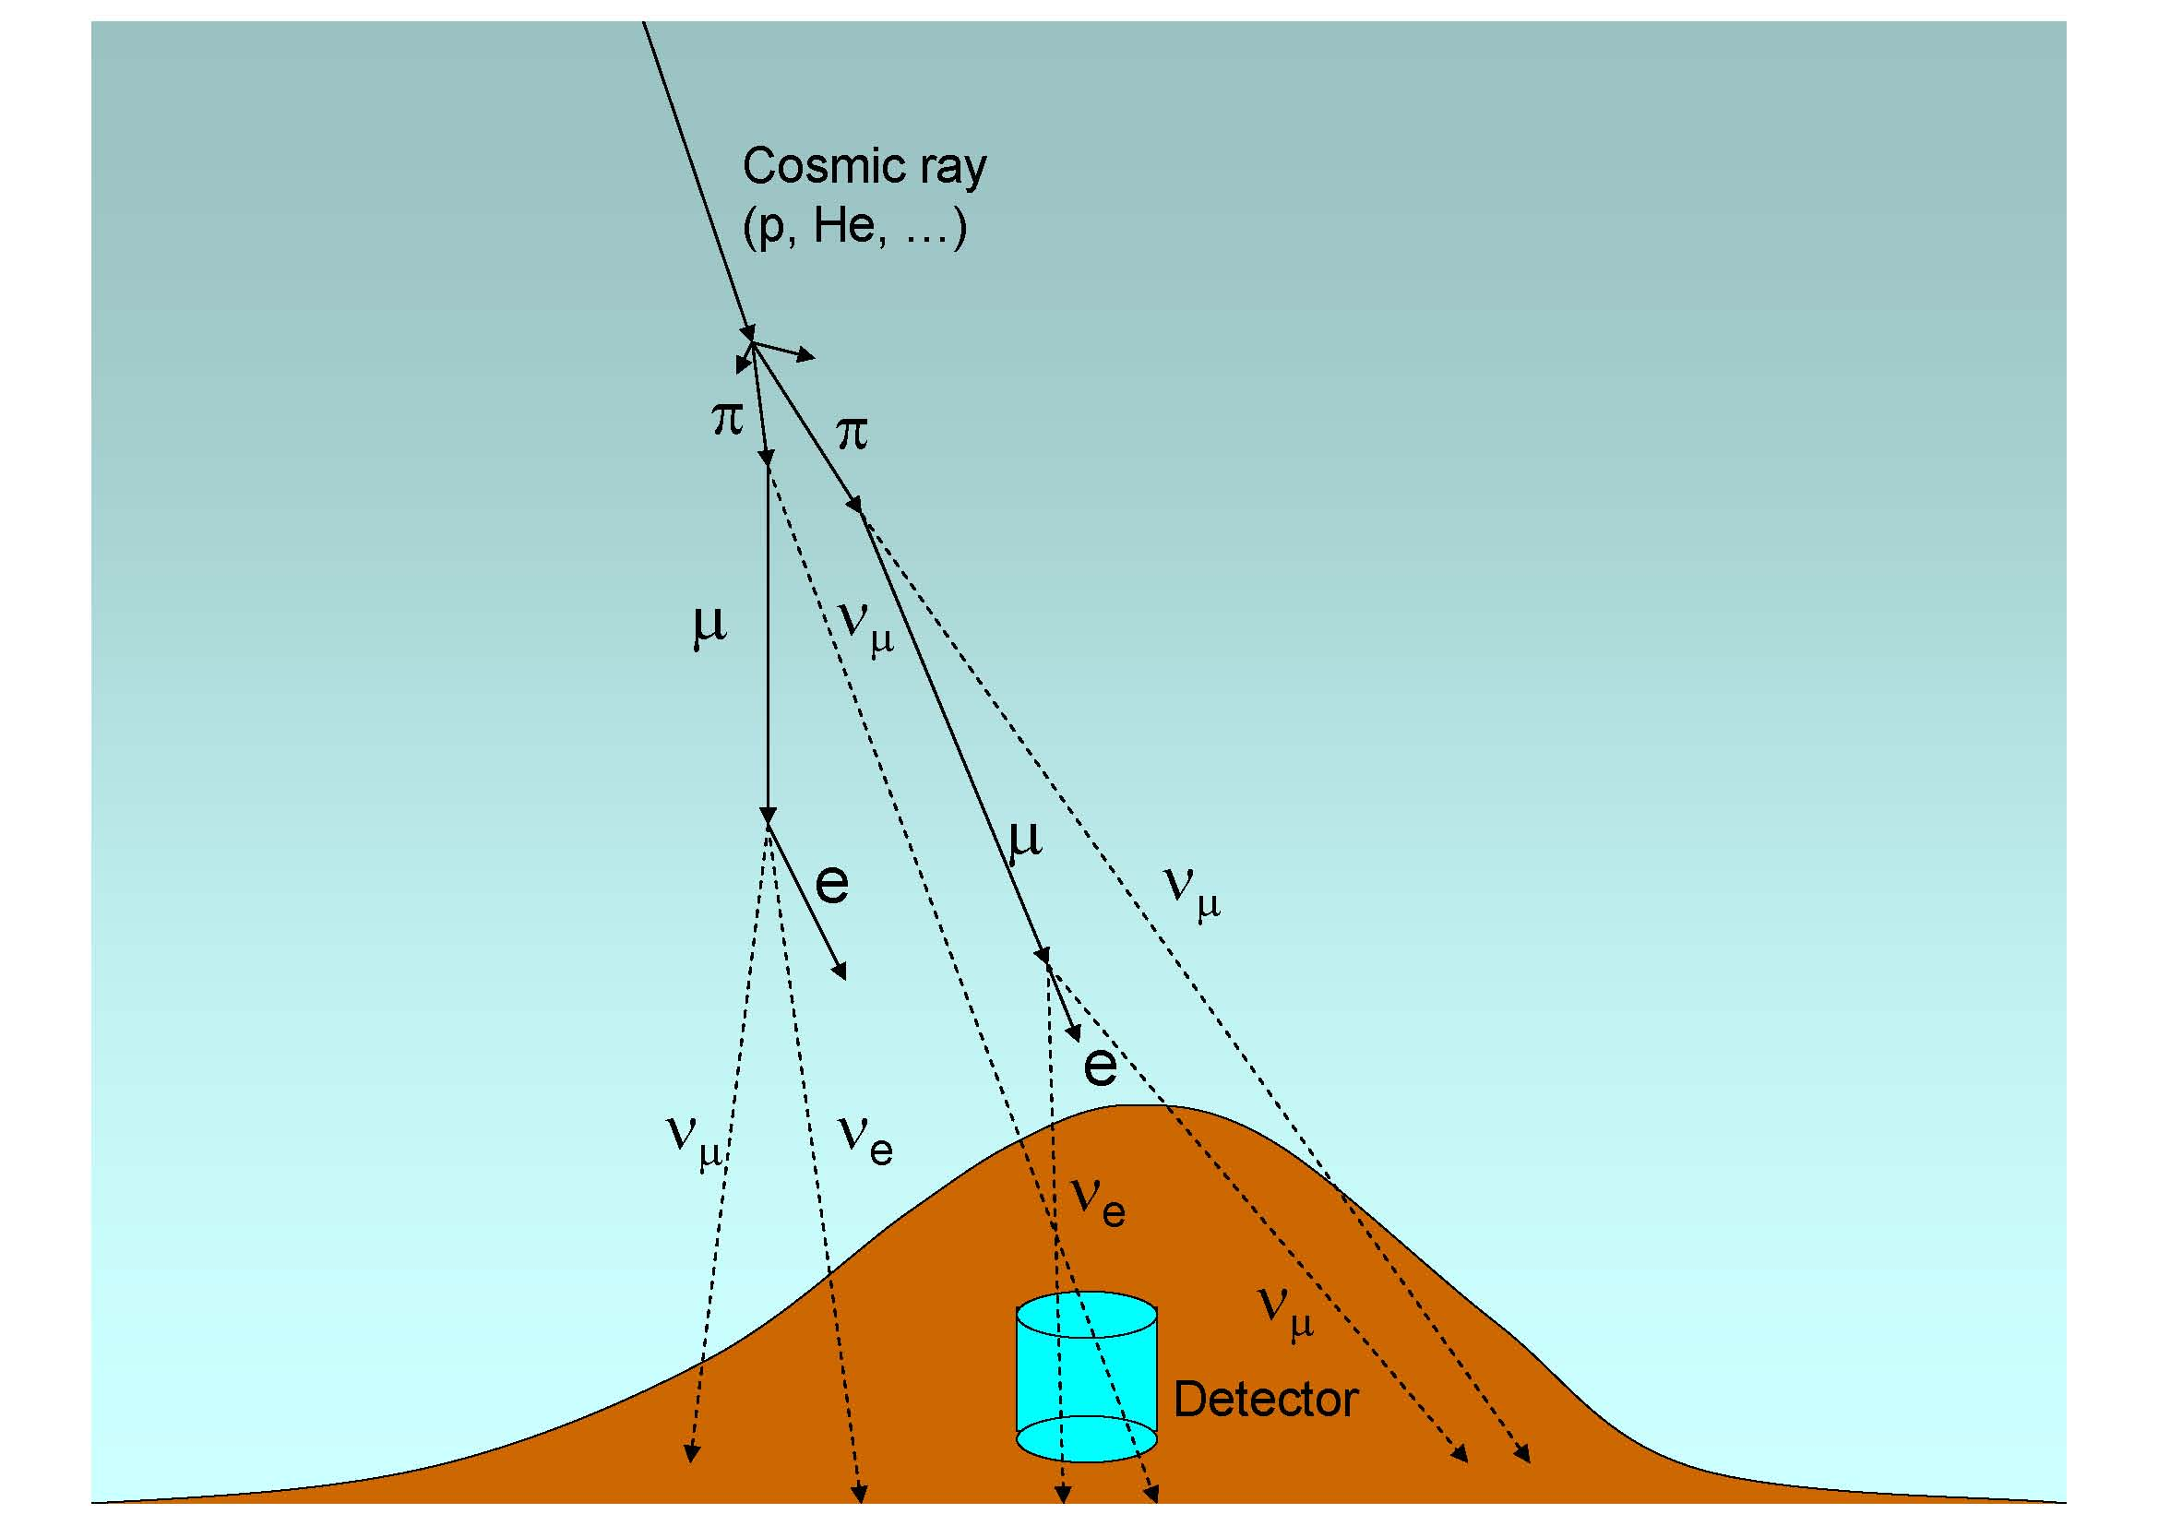

Atmospheric neutrinos
Down going neutrino θ= 0º
ν
ν
ν
Horizontal
neutrino θ= 90º
ν
L = D_{earth} cos θ
ν
ν
Up going neutrino θ= 180º
E ~ few GeV
L = 10 – 12000 km

Slide 14
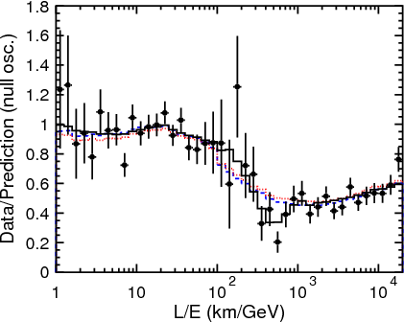
SuperKamiokande
disappearance
Deficit of the μ – like events
Determines
mixing angle θ₂₃
dotted: decoherence,
dashed: neutrino decay
No oscillation effect
Averaged oscillations
The first oscillation
minimum -
determines Δm₃₂²
Δm₃₂² = 2.5x10⁻³ eV²
sin²θ₂₃ = 0.45 – 0.55

Slide 15
Atmospheric neutrinos and mass hierarchy
Like solar neutrinos are affected by the interaction with matter, atmospheric neutrinos crossing the earth can undergo adiabatic flavour conversion induced by (1,3) mixing.
Like for solar neutrinos “matter effects” are sensitive to the sign of Δm²₃₁
Either neutrinos or anti-neutrinos cross the resonance depending of the sign of Δm²₃₁
Resonance for E_{ν}= [5, 8] GeV

Slide 16
Atmospheric neutrinos and mass hierarchy
Measurement possible if:
the detector is capable to select neutrinos from anti-neutrinos (magnetize iron calorimeter)
good knowledge of neutrino and anti-neutrino fluxes exploiting σ(ν) ≠ σ(anti-ν)
Large mass

Slide 17
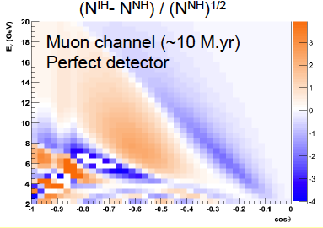
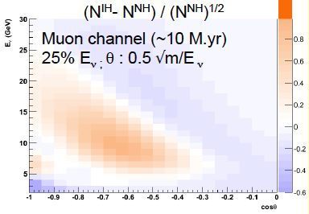
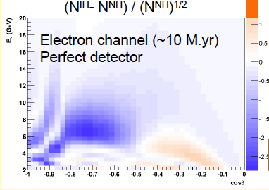
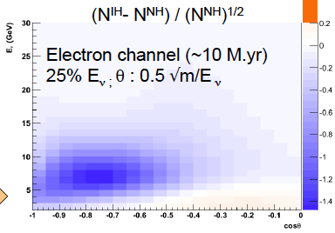
Smeared distributions
Muon- and electron-channels contribute to net hierarchy asymmetry.
Electron channel more robust against detector resolution effects:
E, θ smearing
(kinematics
+ detector
resolution)

Slide 18

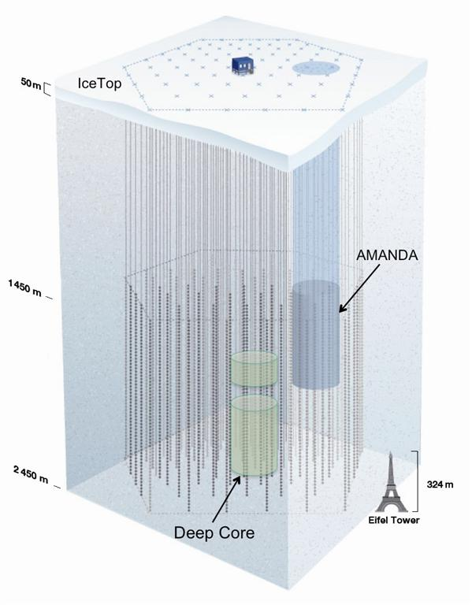
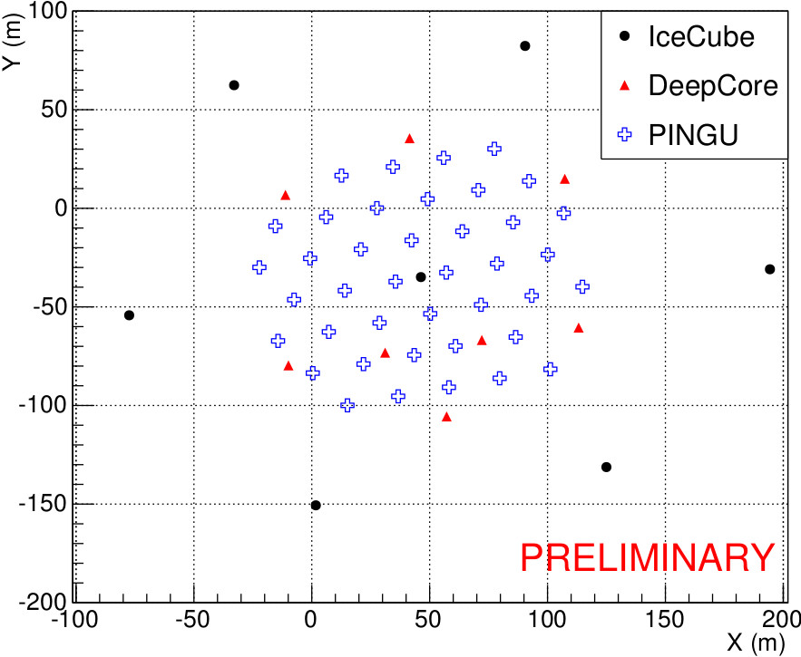
PINGU
Precision IceCube
Next Generation
Upgrade
40 strings
96 DOM’s per string
PINGU
Letter of Intent PINGU- arXiV:1401.2046

Slide 19

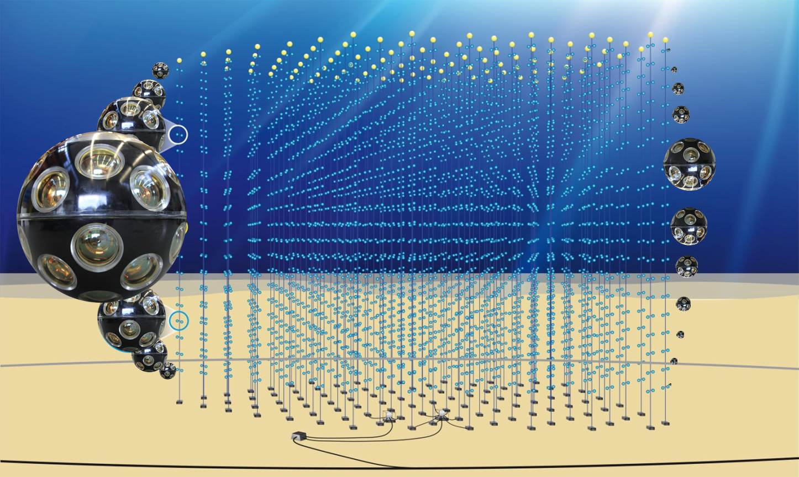
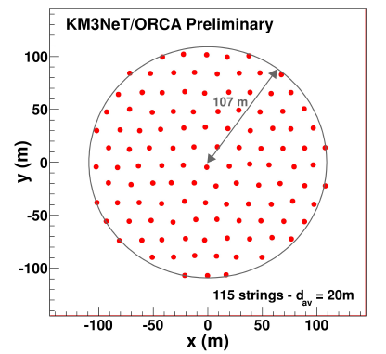
Km³-ORCA
Oscillation Research with
Cosmics in the Abyss
115 lines, 20m spaced,
18 DOMs/line, 6m spaced
Instrumented volume ~3.8 Mt,
2070 optical module.
31 3” PMTs
Digital photon counting
Directional information
Wide angle view

Slide 20
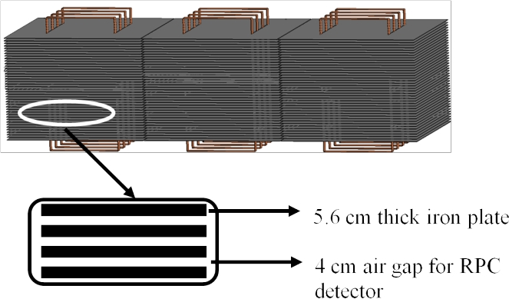
INO-ICAL
ICAL Collaboration (Ahmed Shakeel et al.) arXiv:1505.07380 [physics.ins-det]
The 50 kt magnetized iron calorimeter (ICAL) detector at the India-based Neutrino Observatory (INO)
Resistive plate
chambers
Energy and direction of the muons; energy of multi-GeV hadrons;
charge of muon
The energy and zenith angle dependence of the atmospheric neutrinos
in the multi-GeV range.

Slide 21
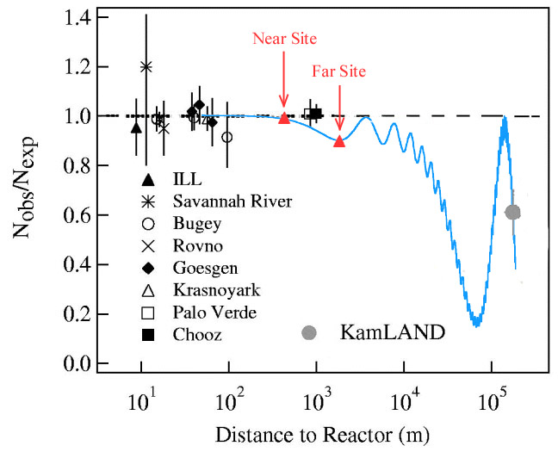
Reactor neutrinos
Fast oscillation
Daya Bay
~60 km
JUNO
~180 km
KamLAND
Slow oscillation
anti-ν_{e} disappearance
E_{ν} ~ 4 MeV

Slide 22
Reactor neutrinos
anti-ν_{e} disappearance
E_{ν} ~ 4 MeV
Daya Bay
~60 km
JUNO
~180 km
KamLAND
L ~ 180 km
Sensitive to
Δm²₂₁ and θ₁₂

Slide 23
Reactor neutrinos
anti-ν_{e} disappearance
E_{ν} ~ 4 MeV
Daya Bay
~60 km
JUNO
~180 km
KamLAND
L ~ 1.6 km
Sensitive to
Δm²₂₁ and θ₁₂

Slide 24
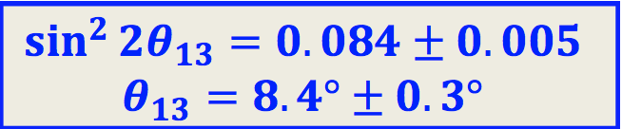
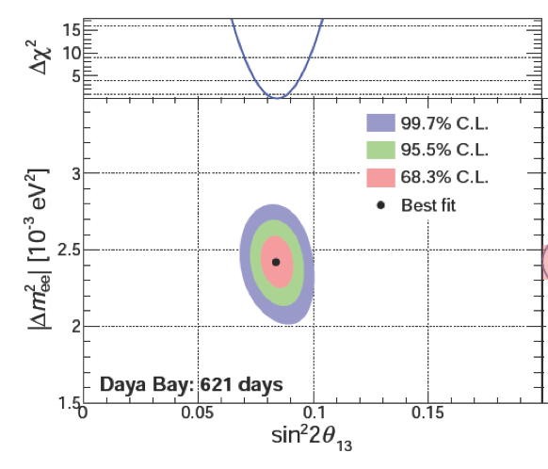
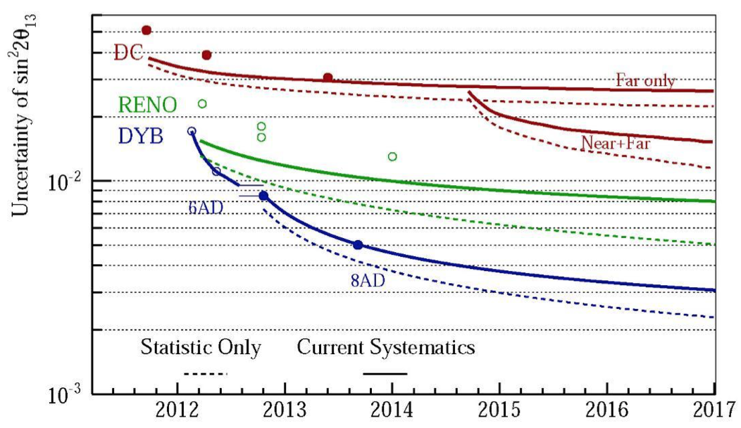
θ₁₃ mesurment
< 6%
Important for CP and unitarily checks

Slide 25
Reactor neutrinos
anti-ν_{e} disappearance
E_{ν} ~ 4 MeV
Daya Bay
~60 km
JUNO
~180 km
KamLAND
L ~ 53 km
Sensitive to
mass hierarchy

Slide 26
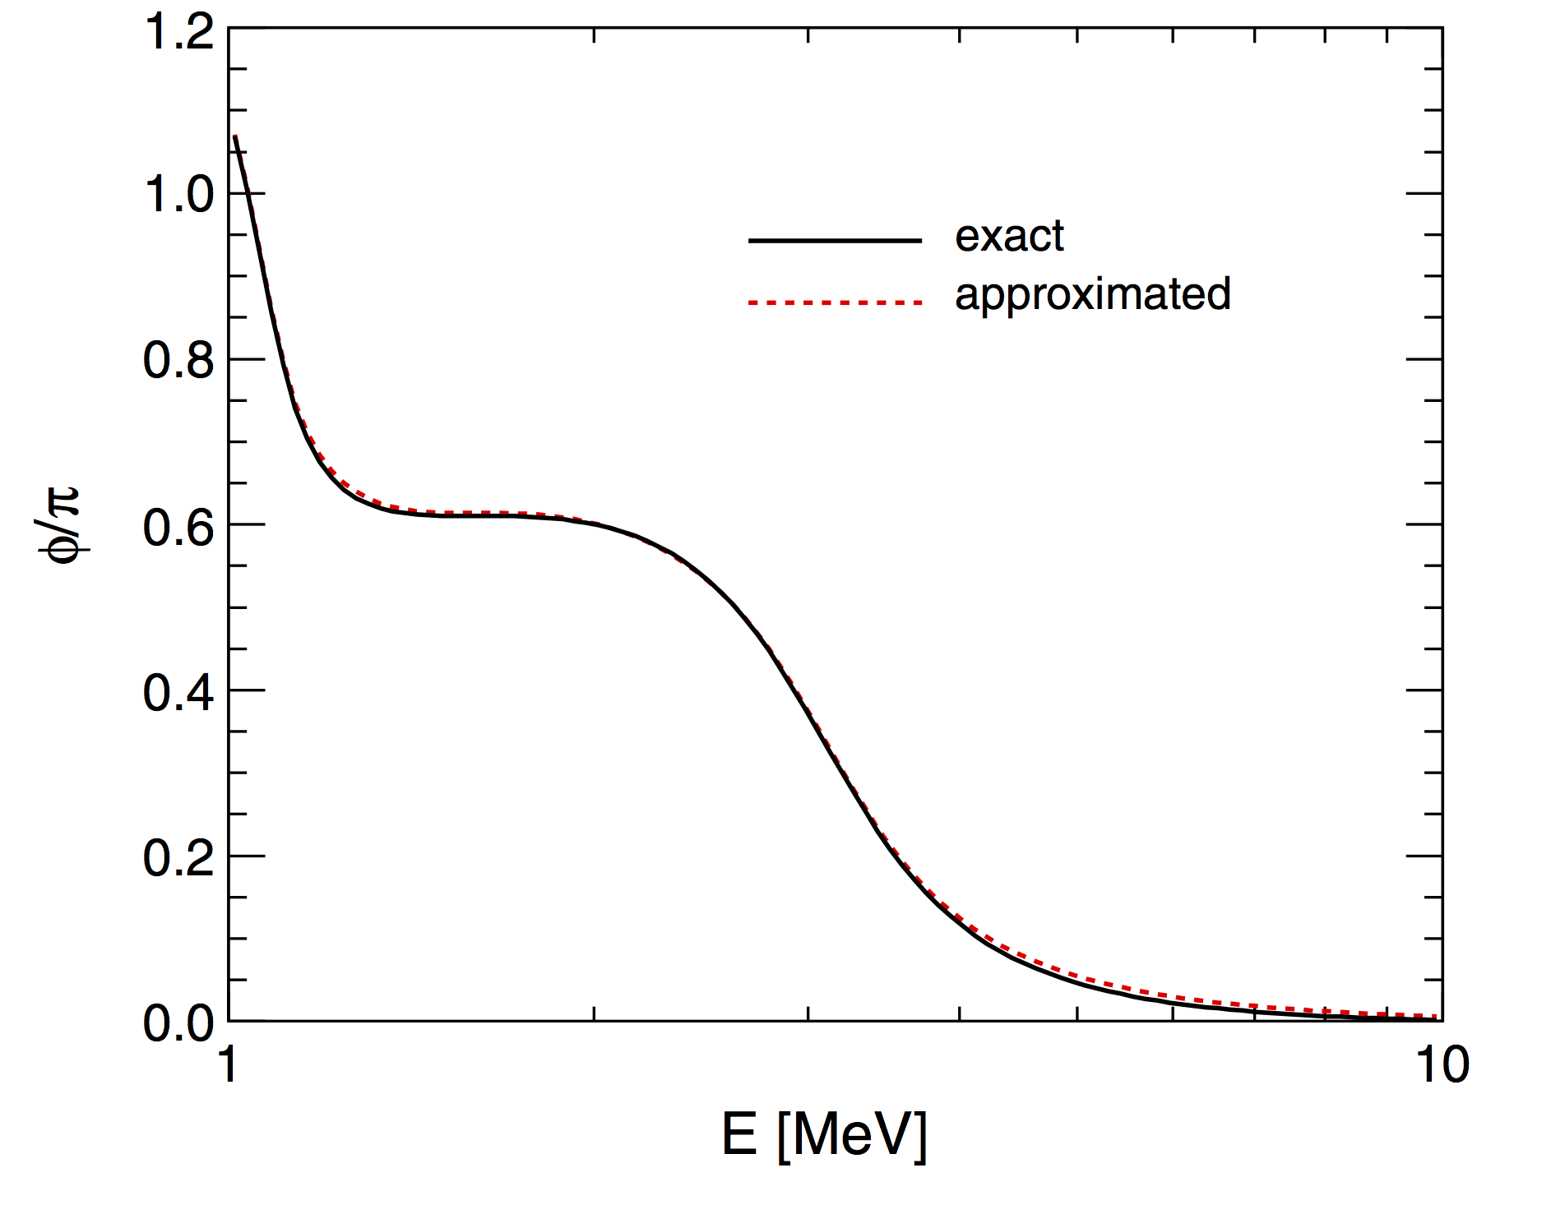
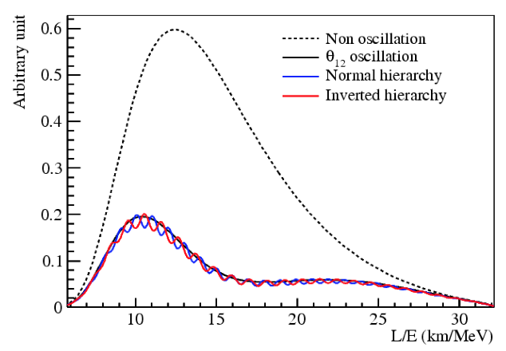
Measure hierarchy in vacuum: JUNO
(+) Normal, (-) inverted hierarchy
Not 1/E behaviour
Non L/E phases which determine an anticipation or retardation of oscillation phases depending on the mass hierarchy
Maximal sensitivity @ minimum of Δm²₂₁ oscillation

Slide 27
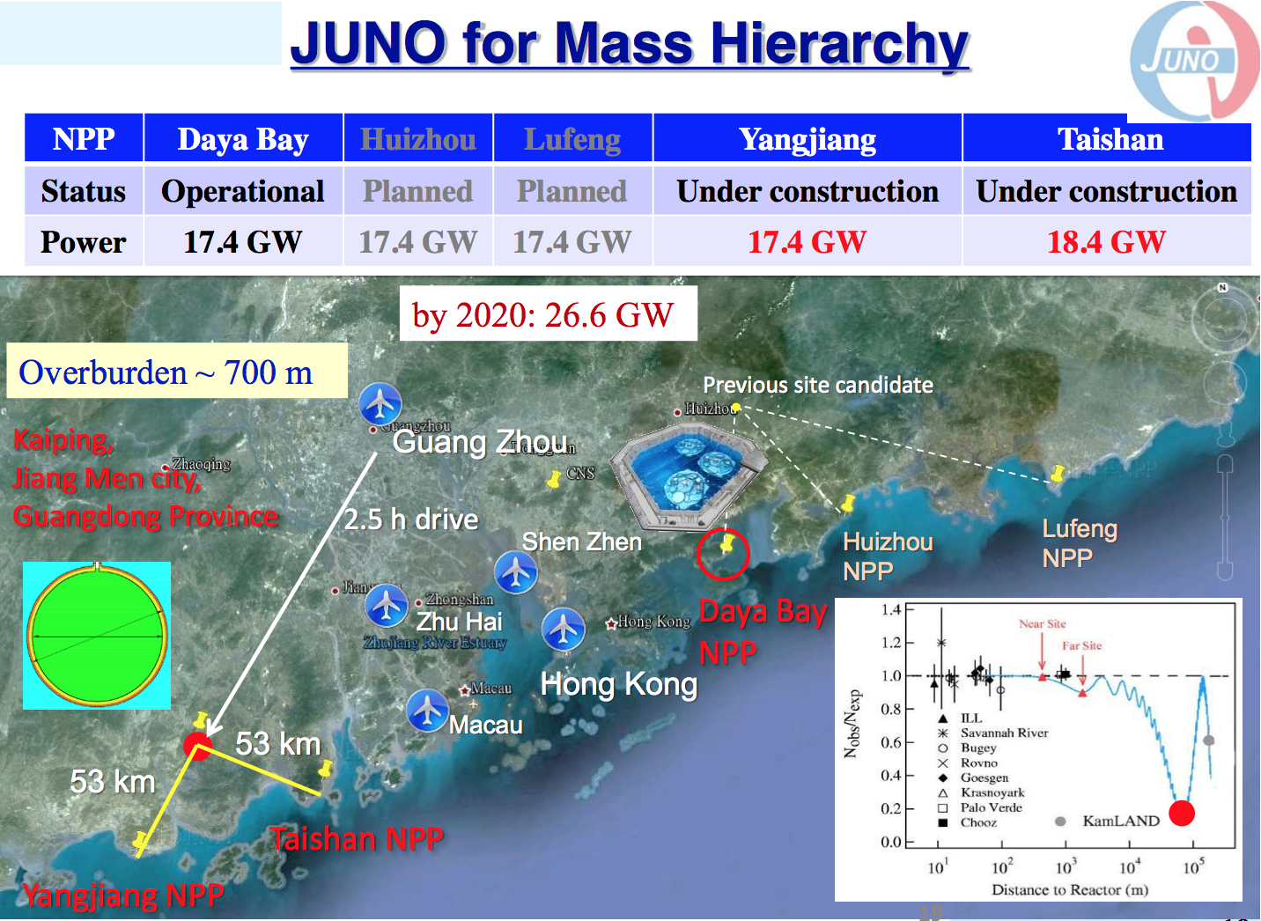

Slide 28
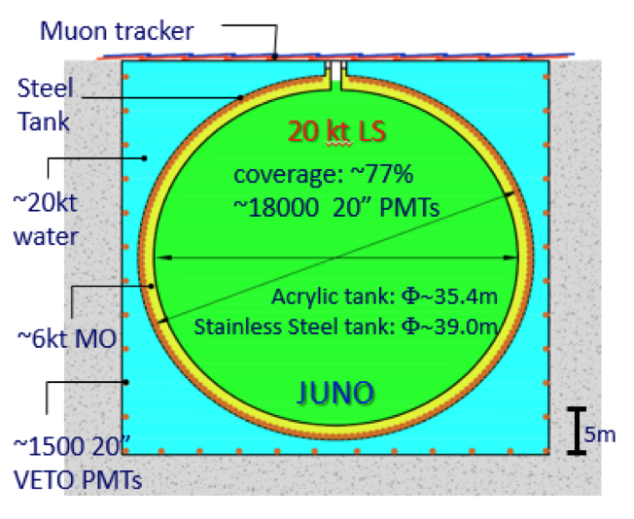
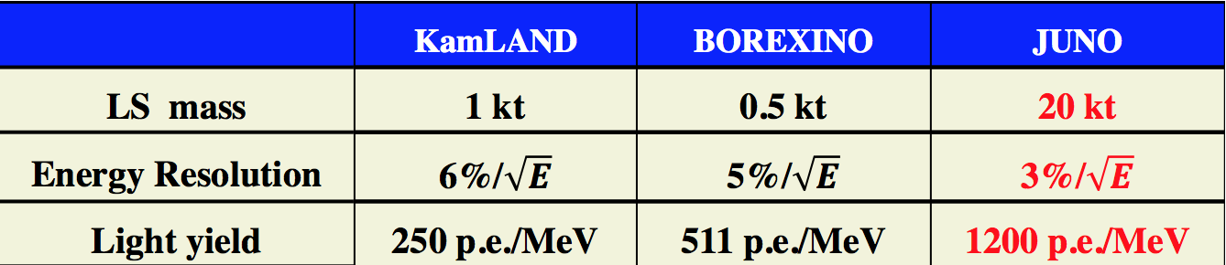
JUNO detector
Large mass liquid scintillator
→ statistics
Extreme high energy resolution 3% @ 1MeV
→ reconstruct the “wiggles”
Energy non-linearity < 1%
→ not to fake MH effect
77% Photocathode coverage
LS attenuation length ~ 20 m
PMT QE ~ 35%

Slide 29
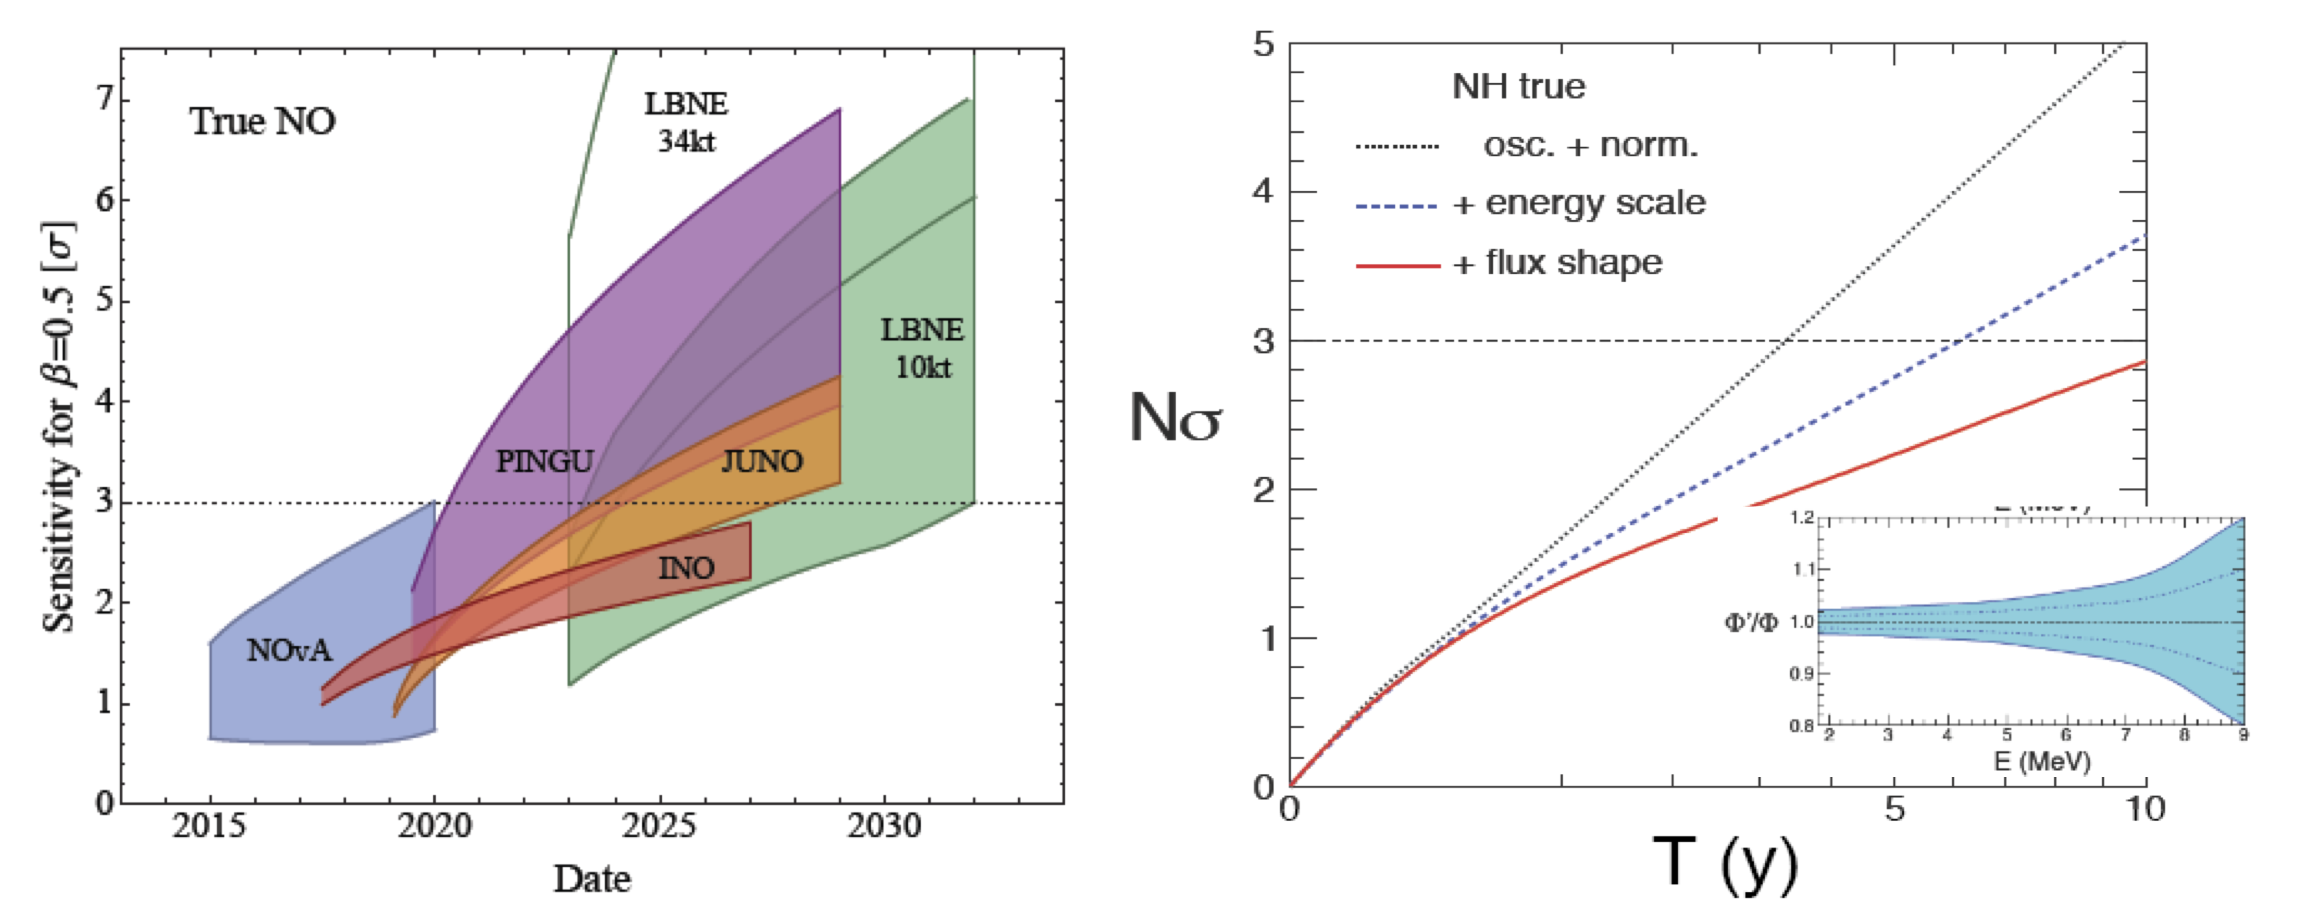
Mass hierarchy sensitivity curves
Mass hierarchy is a difficult measurement which require a proper treatment of the systematics
M. Blennow et al., JHEP 1403 (2014) 028
A.Marrone @ TAUP 2015
Size of the bands:
NOvA, LBNE: CP δ
INO PINGU: θ₂₃
JUNO: σ_{E} = 3 – 3.5% /√E

Slide 30
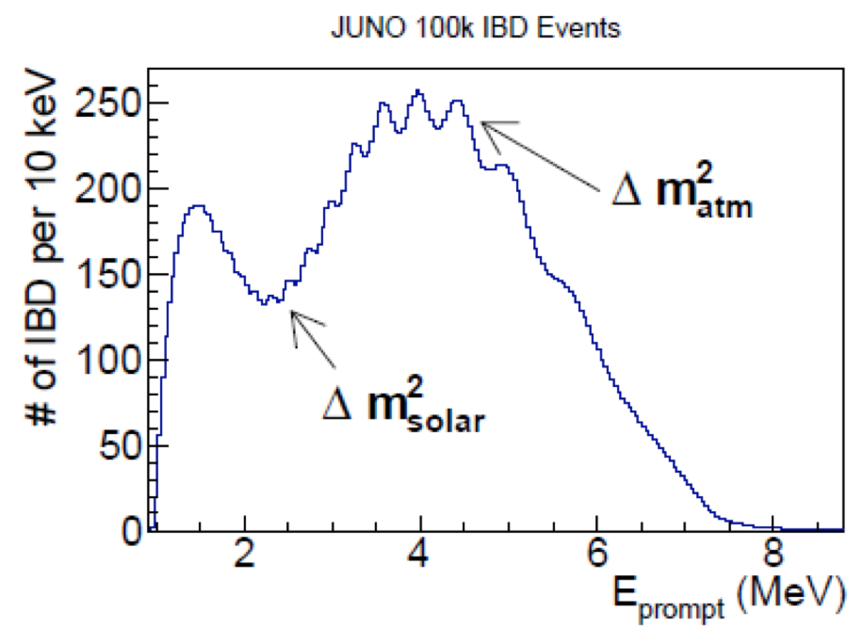
Precision measurements
Large anti-ν_{e} statistics
~ 15 k events/year
Unprecedented precision in measurement of “solar” oscillation parameters.
Important for CP @ LBL experiments
 | Stat. only | Stat. + sys.
sin²θ₁₂ | 0.54 % | 0.67 %
Δm²₂₁ | 0.24 % | 0.59 %
Δm²_{ee} | 0.27 % | 0.44 %
Probing the unitarily of U_{PMNS} to 1% level

Slide 31
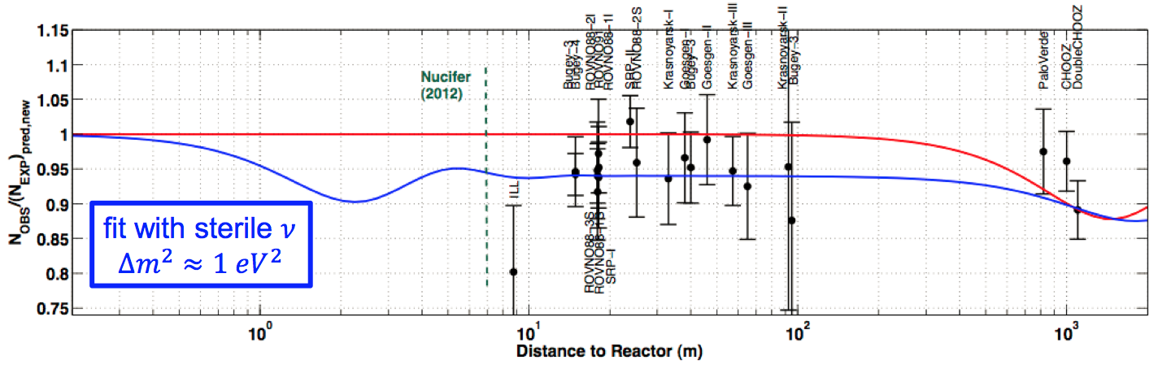
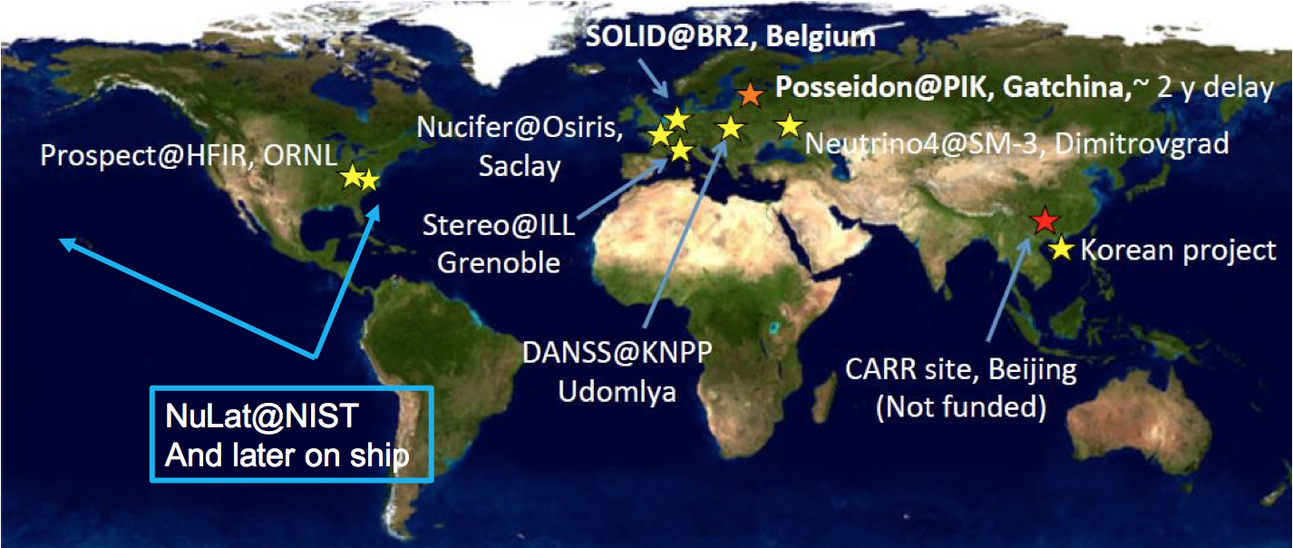
Reactor neutrinos: Sterile neutrinos
Recent calculation of anti-ν_{e} flux from reactor are few % higher the observed
eV sterile neutrino?
Tensions with beam and atmospheric data
Trigger large activity on very-SBL reactor experiments

Slide 32
Conclusions
Neutrino natural beam are a great opportunity to study neutrino properties ….great probe for astrophysical, cosmological and geological studies
With the measurement of θ₁₃ neutrino physics is entering in the precision era.
Solar Neutrinos: - Tension on Δm²₂₁
- Up-turn in the matter-vacuum transition region
- Day-Night asymmetry
- New physics? sterile neutrinos?, non standard interactions?
Mass Hierarchy: - θ₁₃ large has open the opportunity for MH and CP measurement
- Vacuum Oscillation vs. Matter Effects: two complementary approaches → redundancy and consistency checks

Slide 33
Backup slides

Slide 34
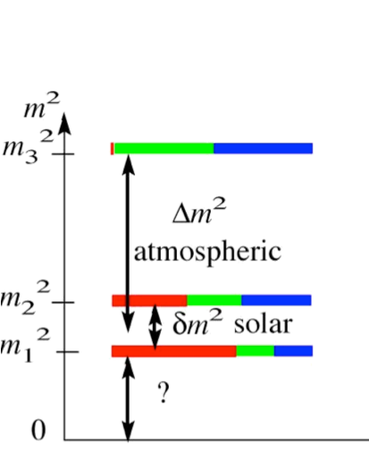
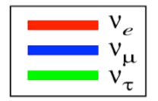
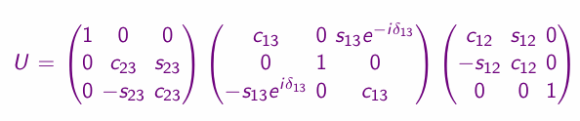
Lepton mixing
“Atmospheric”
term
“Reactor”
term
“Solar”
term

Slide 35


Slide 36
Neutrino mass ordering
ν_{e}
ν_{μ}
ν_{τ}
Δm²₂₁ fixed by solar neutrinos
ν₃
ν₂
Δm²₂₁
ν₁
MASS²
MASS²
Δm²₃₂
Δm²₂₃
ν₂
ν₁
Δm²₂₁
ν₃
Normal mass hierarchy
Inverted mass hierarchy
Σ m > m_{h}
Σ m > 2 m_{h}
|Δm²₃₁| = |Δm²₃₂| + |Δm²₂₁|
|Δm²₃₁| = |Δm²₃₂| - |Δm²₂₁|

Slide 37

The almost isotopic flux of primary cosmic ray imply that the neutrino flux at any location for Eν > 2GeV is up-down symmetric
Detector
ν
Since the production of neutrino in the atmosphere is uniform
which imply
Geomagnetic equator
Geomagnetic pole
Up/down asymmetry @sub-GeV (due to geomagnetic field effect)

Slide 38
Lepton mixing
ν_{e}
ν_{μ}
ν_{τ}
|U_{μ3}|²
|U_{τ3}|²
Mixing parameters
ν₃
~ 1/2
tan²θ₁₂ = |U_{e2}|² / |U_{e1}|²
|U_{e3}|²
sin²θ₁₃ = |U_{e3}|²
= 0.022
MASS²
Δm²₃₁
tan²θ₂₃ = |U_{μ3}|² / |U_{τ3}|²
~ 1.0
|U_{e2}|²
CP
ν₂
Mixing matrix:
Δm²₂₁
ν₁
|U_{e1}|²
ν_{f} = U_{PMNS} ν_{mass}
FLAVOR
ν_{e}
ν_{μ}
ν_{τ}
ν₁
ν₂
ν₃
= U_{PMNS}
Normal mass hierarchy
Δm²_{ij} = m²_{i} - m²_{j}
Standard parametrization
Δm²₃₂ = 2.5 x 10⁻³ eV²
U_{PMNS} = U₂₃I_{δ} U₁₃I_{−δ} U₁₂
Δm²₂₁ = 7.5 x 10⁻⁵ eV²
I_{δ} = diag (1, 1, e^{iδ} )
CP-phase

Slide 39
Lepton mixing
ν_{e}
ν_{μ}
ν_{τ}
|U_{μ3}|²
|U_{τ3}|²
Mixing parameters
ν₃
~ 1/2
tan²θ₁₂ = |U_{e2}|² / |U_{e1}|²
|U_{e3}|²
sin²θ₁₃ = |U_{e3}|²
= 0.022
MASS²
Δm²₃₁
tan²θ₂₃ = |U_{μ3}|² / |U_{τ3}|²
~ 1.0
|U_{e2}|²
CP
ν₂
Δm²₂₁
ν₁
|U_{e1}|²
FLAVOR
“Atmospheric”
term
“Reactor”
term
“Solar”
term
Normal mass hierarchy
Δm²_{ij} = m²_{i} - m²_{j}
Δm²₃₂ = 2.5 x 10⁻³ eV²
Δm²₂₁ = 7.5 x 10⁻⁵ eV²

