Slide 1


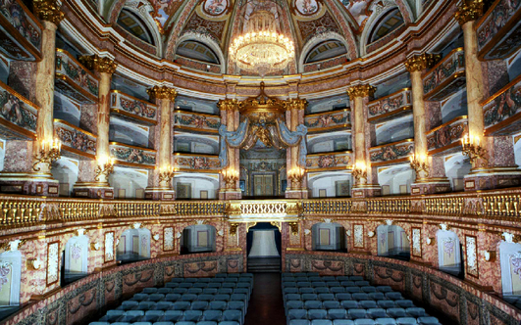
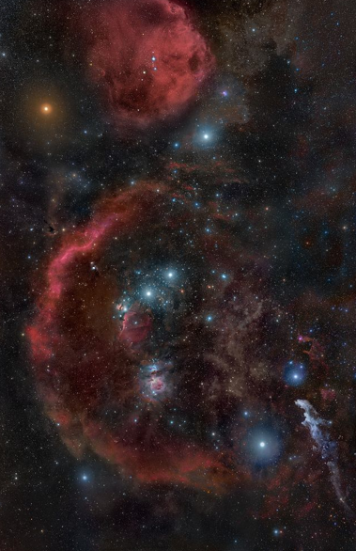
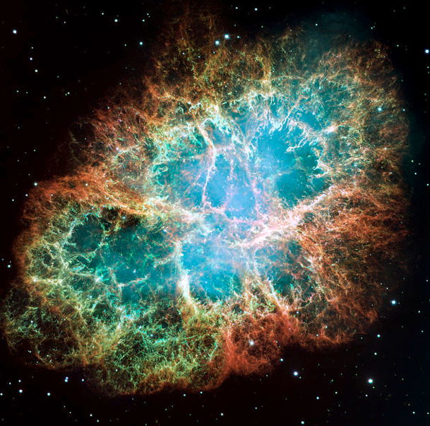
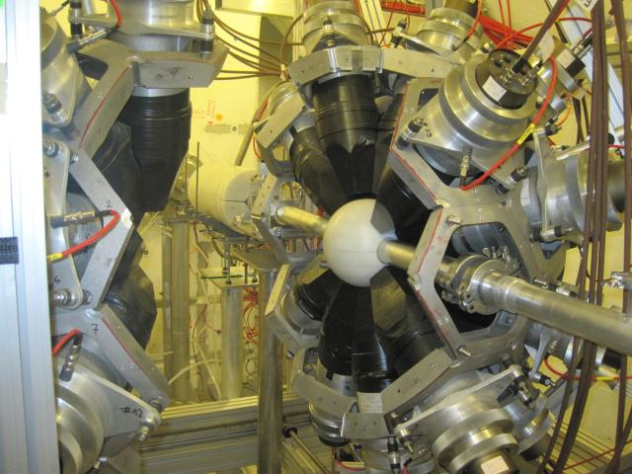
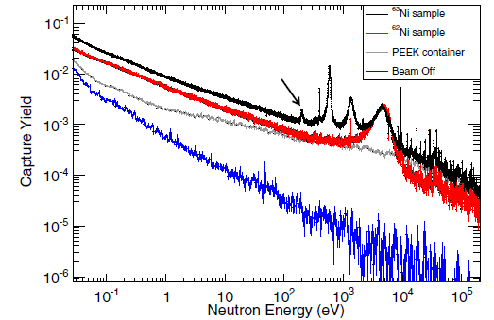
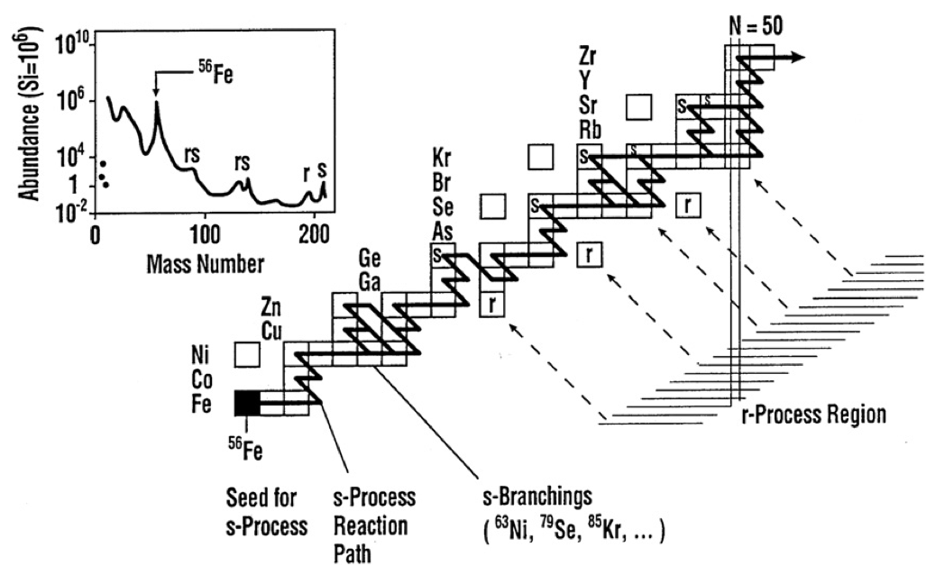

Caserta, 12-13 November 2015
Nuclear Astrophysics at CERN - n_TOF
Cristian Massimi
for the n_TOF Collaboration
Notes:
This is an overview on nuclear astrophysics at cern n_TOF

Slide 2
Outline
The n_TOF project
  Collaboration, objectives, basic parameters, instrumentation
Some examples of measurements and their impact on Nuclear Astrophysics
  Branching isotopes
  Neutron source of the s process
  BBN
recent
Notes:
Before presenting some recent results of measurements and their impact on NA, I will introduce the n_tof project

Slide 3

















The n_TOF project
Atominstitut, Technische Universität Wien, Austria
University of Vienna, Faculty of Physics, Austria
European Commission JRC, Institute for Reference Materials and Measurements (IRMM)
Department of Physics, Faculty of Science, University of Zagreb, Croatia
Charles University, Prague, Czech Republic
Centre National de la Recherche Scientifique/IN2P3 - IPN, Orsay, France
Commissariat à l’Énergie Atomique (CEA) Saclay - Irfu, Gif-sur-Yvette, France
Johann-Wolfgang-Goethe Universität, Frankfurt, Germany
Karlsruhe Institute of Technology, Campus Nord, Institut für Kernphysik, Karlsruhe, Germany
National Technical University of Athens (NTUA), Greece
Aristotle University of Thessaloniki, Thessaloniki, Greece
Bhabha Atomic Research Centre (BARC), Mumbai, India
ENEA Bologna e
Dipartimento di Fisica, e Astronomia, Università di Bologna
Sezione INFN di Bologna, INFN Bari, Bologna, LNL, Trieste, LNS
Uniwersytet Łódzki, Lodz, Poland
Instituto Tecnológico e Nuclear, Instituto Superior Técnico, Universidade Técnica de Lisboa, Portugal
Horia Hulubei National Institute of Physics and Nuclear Engineering – Bucharest, Romania
Centro de Investigaciones Energeticas Medioambientales y Tecnológicas (CIEMAT), Madrid, Spain
Instituto de Fìsica Corpuscular, CSIC-Universidad de Valencia, Spain
Universitat Politecnica de Catalunya, Barcelona, Spain
Universidad de Sevilla, Spain
Universidade de Santiago de Compostela, Spain
Department of Physics and Astronomy - University of Basel, Basel, Switzerland
European Organization for Nuclear Research (CERN), Geneva, Switzerland
Paul Scherrer Institut, Villigen PSI, Switzerland
University of Manchester, Oxford Road, Manchester, UK
University of York, Heslington, York, UK
~ 130 researchers
Notes:
In the n Collaboration there are about 130 researchers from 30 institutes mainly from europe

Slide 4
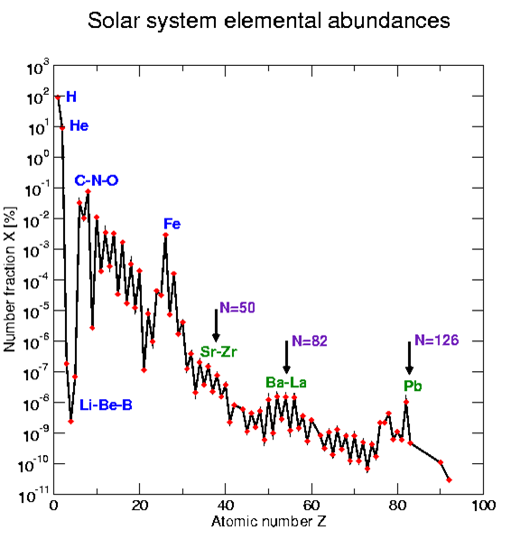
The n_TOF project
Objective: to provide Nuclear Data for Science (and Technology)
How the elements are synthesized in the Universe?
Notes:
The aim of the collaboration is to provide … Here I will present the studies about NA and in particular the formation of elements.
Looking at the elemental abundances os the SUN, 3 processes can be identified:

Slide 5
The n_TOF project
Objective: to provide Nuclear Data for Science (and Technology)
How the elements are synthesized in the Universe?
BBN
Notes:
BBN is responsible for the formation of light elements

Slide 6
The n_TOF project
Objective: to provide Nuclear Data for Science (and Technology)
How the elements are synthesized in the Universe?
Fusion
BBN
Notes:
From C to Fe, elemnts are produced by nuclear fusion reactions in the stars

Slide 7
The n_TOF project
Objective: to provide Nuclear Data for Science (and Technology)
How the elements are synthesized in the Universe?
Fusion
Elements heavier than Fe are the result of neutron capture processes
Neutron Capture
BBN
Notes:
The synthesis of heavier elements is due to neutron capture
Historically at n_TOF we have focused our attention on this last process but recently …

Slide 8
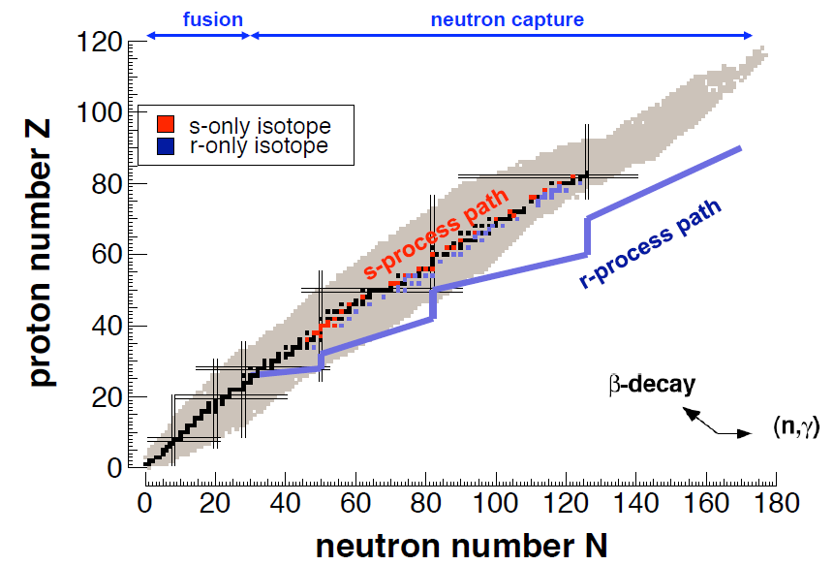
The n_TOF project
Element production beyond Fe
r-process (Supernovae)
Notes:
Heavy elements are produced by neutron capture

Slide 9
The n_TOF project
Element production beyond Fe
Neutron beams
s-process (Red Giants)
r-process (Supernovae)
s-process (slow process):
  Capture times long relative to decay time
  Involves mostly stable isotopes
  N_{n} = 10⁸ n/cm³ , E_{n} = 0.3 – 300 keV
Notes:
½ of the elemental abundances is produced by the slow neutron capture process, which takes place in RG stars, where the neutron density is low enough and the nucleosynthesis proceed along the b-stability valley. This condition can be reproduced in lab. With neutron available beams

Slide 10
The n_TOF project
Element production beyond Fe
Neutron beams
s-process (Red Giants)
Radioactive beam facilities
r-process (Supernovae)
s-process (slow process):
  Capture times long relative to decay time
  Involves mostly stable isotopes
  N_{n} = 10⁸ n/cm³ , E_{n} = 0.3 – 300 keV
r-process (rapid process):
  Capture times short relative to decay times
  Produces unstable isotopes (neutron-rich)
  N_{n} = 10²⁰⁻³⁰ n/cm³
Notes:
The other half of elemental abundances is produced by rapid neutron capture process. Typically this take place in explosve scenario like for example supernovae, ans are associated with extremely high neutron densities which drive the reaction flow towards the neutron rich side. In practice the neutron capture is faster than beta decay

Slide 11
The n_TOF project
s-process nucleosynthesis proceeds through neutron captures and successive β-decay.
  The abundance of elements in the Universe depends on:
  thermodinamic conditions (temperture and neutron density);
  neutron capture cross-sections.
Need of new and accurate neutron capture cross-sections:
  refine models of stellar nucleosynthesis in the Universe;
  obtain information on the stellar environment and evolution
Along the β-stability valley
⁶²Cu
9.74 m
⁶³Cu
69.2%
⁶⁴Cu
12.7 h
⁶⁰Ni
26.2%
⁶¹Ni
1.14%
⁶²Ni
3.63%
⁶³Ni
100 y
⁶⁴Ni
0.93%
σ(n, γ) is a key quantity
⁵⁸Co
70.86 d
⁵⁹Co
100%
⁶⁰Co
5.272 y
⁶¹Co
1.65 h
⁵⁶Fe
91.7%
⁵⁷Fe
2.2%
⁵⁸Fe
0.28%
⁵⁹Fe
44.5 d
⁶⁰Fe
1.5·10⁶ y
⁶¹Fe
6 m
s process
Notes:
Going back to s-process, the reaction flow follow the stability valley because the b-decay are faster than subsequent neutron capture.
And there are case where the abundances depend on the thermodinamic condition of the star. The main nuclear physics input is the sigma, which determines the efficiency for the production of heavy elements

Slide 12
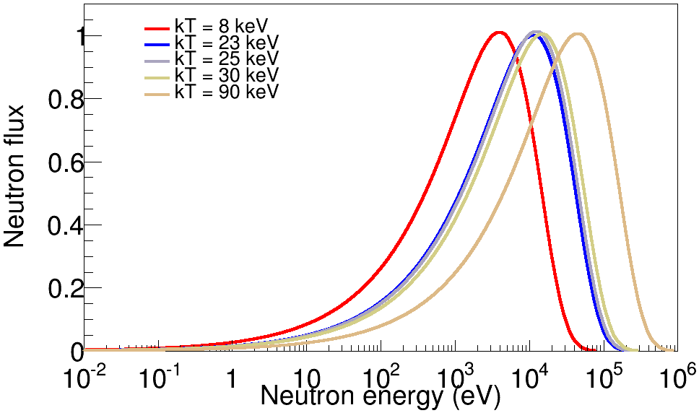
The n_TOF project
Stellar spectra: AGB (8, 23 keV) and Massive stars (25, 90 keV)
Notes:
These are MB distribution of neutron flux inside the star during s-process
The s process takes place during different burning stages of the star and temperatures range from 0.1 to 1 GK, corresponding to 8-90 keV thermal energy.

Slide 13
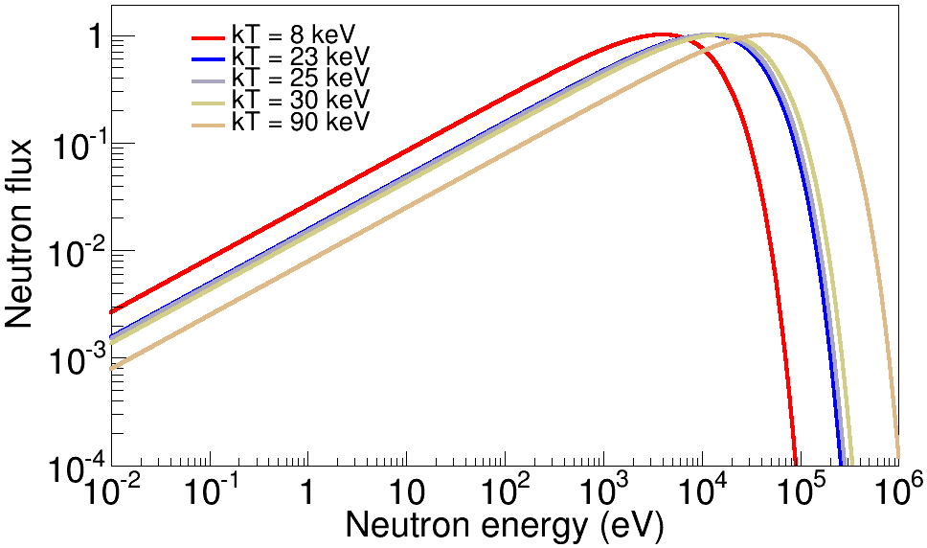
The n_TOF project
Stellar spectra: AGB (8, 23 keV) and Massive stars (25, 90 keV)
Notes:
Here the log scale help us in understanding which is the energy region of interest

Slide 14
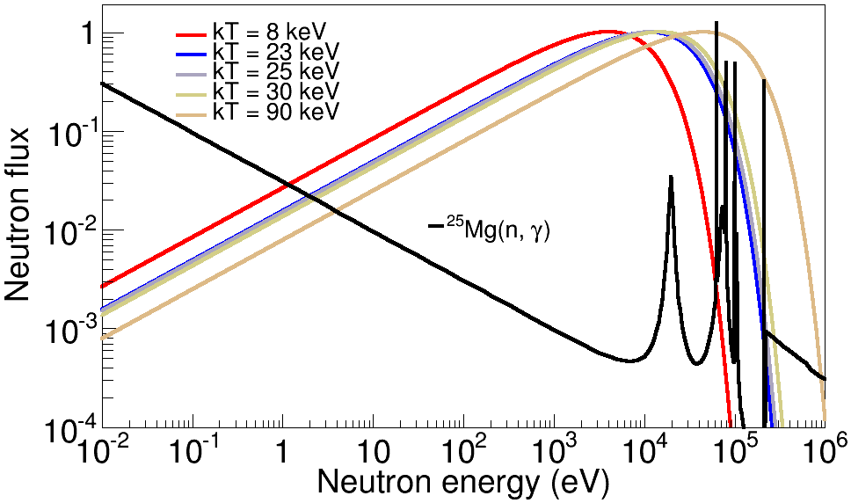
The n_TOF project
Stellar spectra: AGB (8, 23 keV) and Massive stars (25, 90 keV)
Notes:
Capture measurements must cover the region between thermal to about 1 MeV, neutron energy

Slide 15
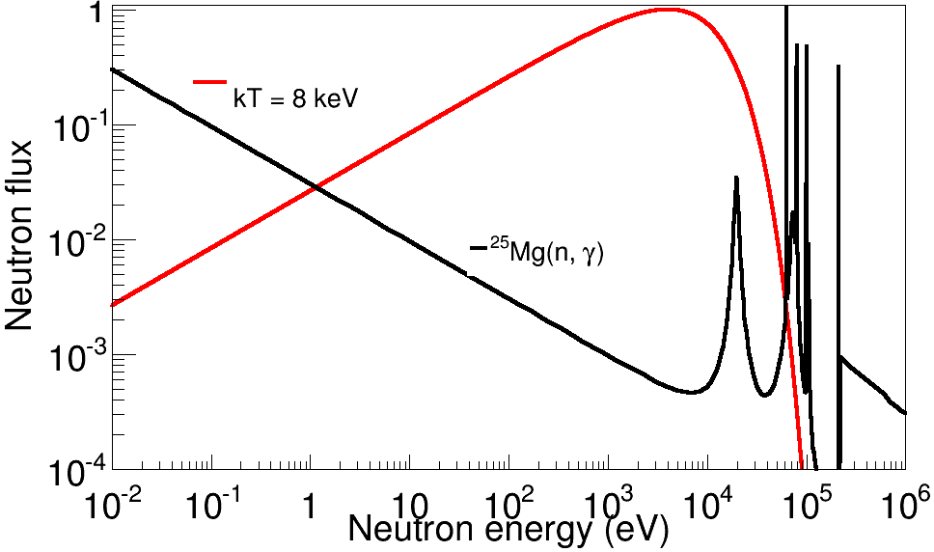


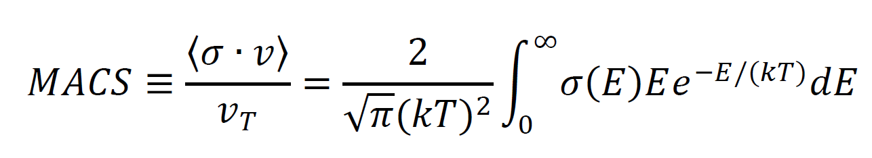
The n_TOF project
For Astrophysical applications it is important to determine Maxwellian Averaged Cross-Sections (MACS), for various temperatures (kT depends on stellar site).
Reaction rate (cm⁻³s⁻¹):
Notes:
the required quantity for the calculation of s process abundances is the reaction rate, which is linked to the cross section.
What is important here is the average of ccs over the stellar neutron flux: the so called MACS or stellar cross section

Slide 16
The n_TOF project
For Astrophysical applications it is important to determine Maxwellian Averaged Cross-Sections (MACS), for various temperatures (kT depends on stellar site).
Reaction rate (cm⁻³s⁻¹):
Two methods are used to determine MACS:
  measurement of energy dependent neutron capture cross-sections;
  integral measurement (energy integrated) using neutron beams with suitable energy spectrum.
Notes:
Thw methods for obtaining this quantity

Slide 17
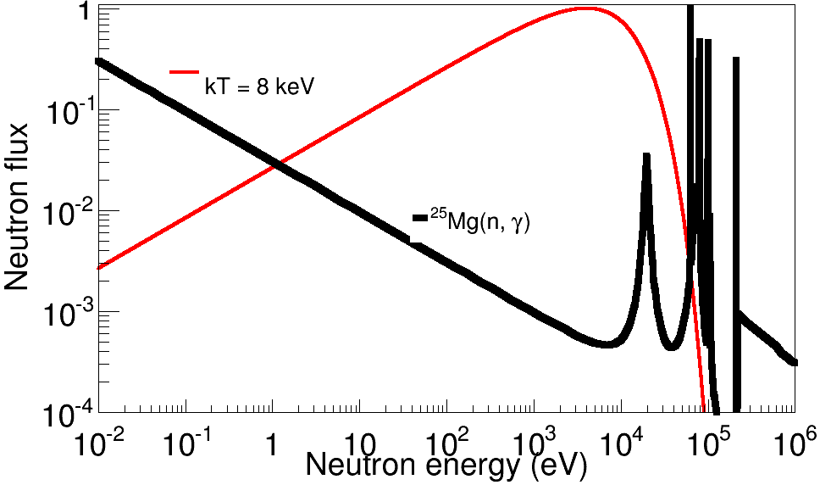
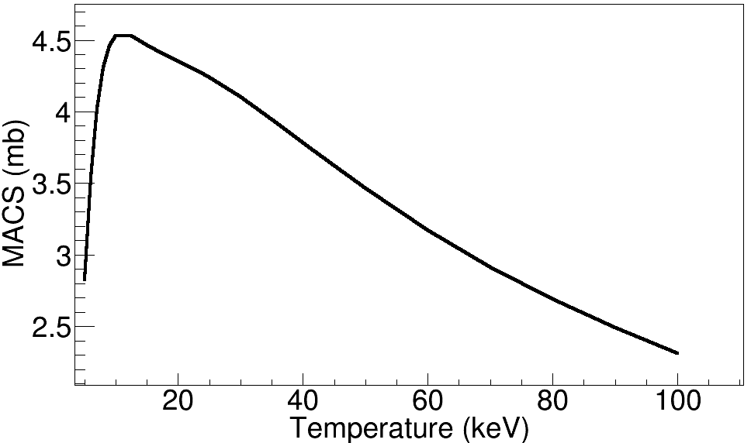
The n_TOF project
For Astrophysical applications it is important to determine Maxwellian Averaged Cross-Sections (MACS), for various temperatures (kT depends on stellar site).
Reaction rate (cm⁻³s⁻¹):
Two methods are used to determine MACS:
  measurement of energy dependent neutron capture cross-sections;
  integral measurement (energy integrated) using neutron beams with suitable energy spectrum.
Notes:
Measure CS with TOF and perform the average → MACS as a function on temperature

Slide 18
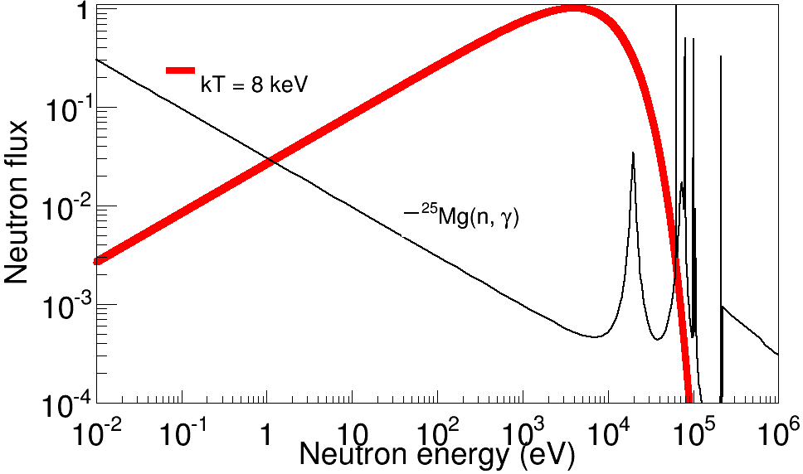
The n_TOF project
For Astrophysical applications it is important to determine Maxwellian Averaged Cross-Sections (MACS), for various temperatures (kT depends on stellar site).
Reaction rate (cm⁻³s⁻¹):
Two methods are used to determine MACS:
  measurement of energy dependent neutron capture cross-sections;
  integral measurement (energy integrated) using neutron beams with suitable energy spectrum.
Notes:
Activation, where neutron flux with MB distribution are used and the MACS is directly determined

Slide 19
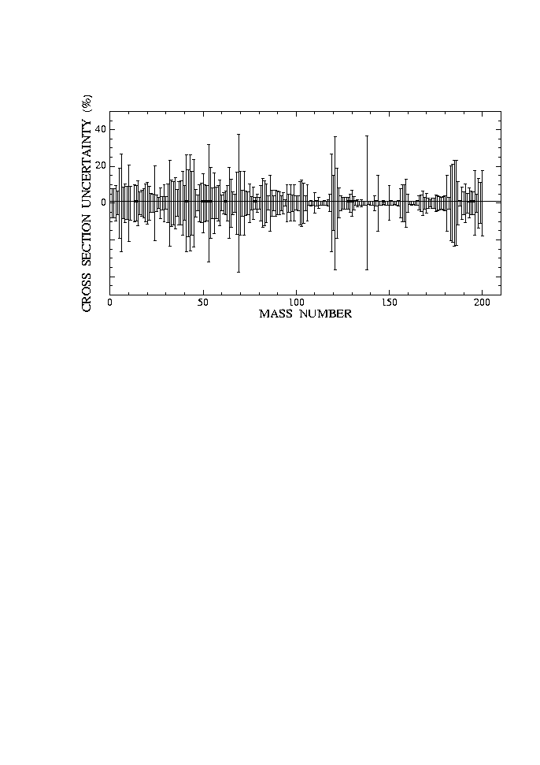
The n_TOF project
Bao et al. ADNDT 76 (2000)
Huge amount of data collected on many isotopes, mostly stable. Main features of s-process now well understood.
However, cross-section uncertainties in some cases remain high, in particular if compared with progresses in:
observations of abundances;
models of stellar evolution.
For three classes of nuclei data are lacking or need substantial improvements:
  1. Nuclei with low cross-section, in particular neutron magic nuclei (s-process bottleneck):
  N=50 ⁸⁶Kr, ⁸⁷Rb, ⁸⁸Sr, ⁹⁰Zr
  N=82 ¹³⁸Ba, ¹³⁹La, ¹⁴⁰Ce
2. Isotopes unavailable in large amount, such as rare or expensive isotopes:
  ^{25,26}Mg, ^{186,187}Os, ¹⁸⁰W, etc…
3. Radioactive branching isotopes (“stellar thermometers”):
  ⁷⁹Se, ⁸⁵Kr, ¹⁵¹Sm, ¹⁶³Ho, ²⁰⁴Tl, ²⁰⁵Pb
Notes:
Large amount of data avilable but still uncertainties, especially on 1, 2, 3

Slide 20

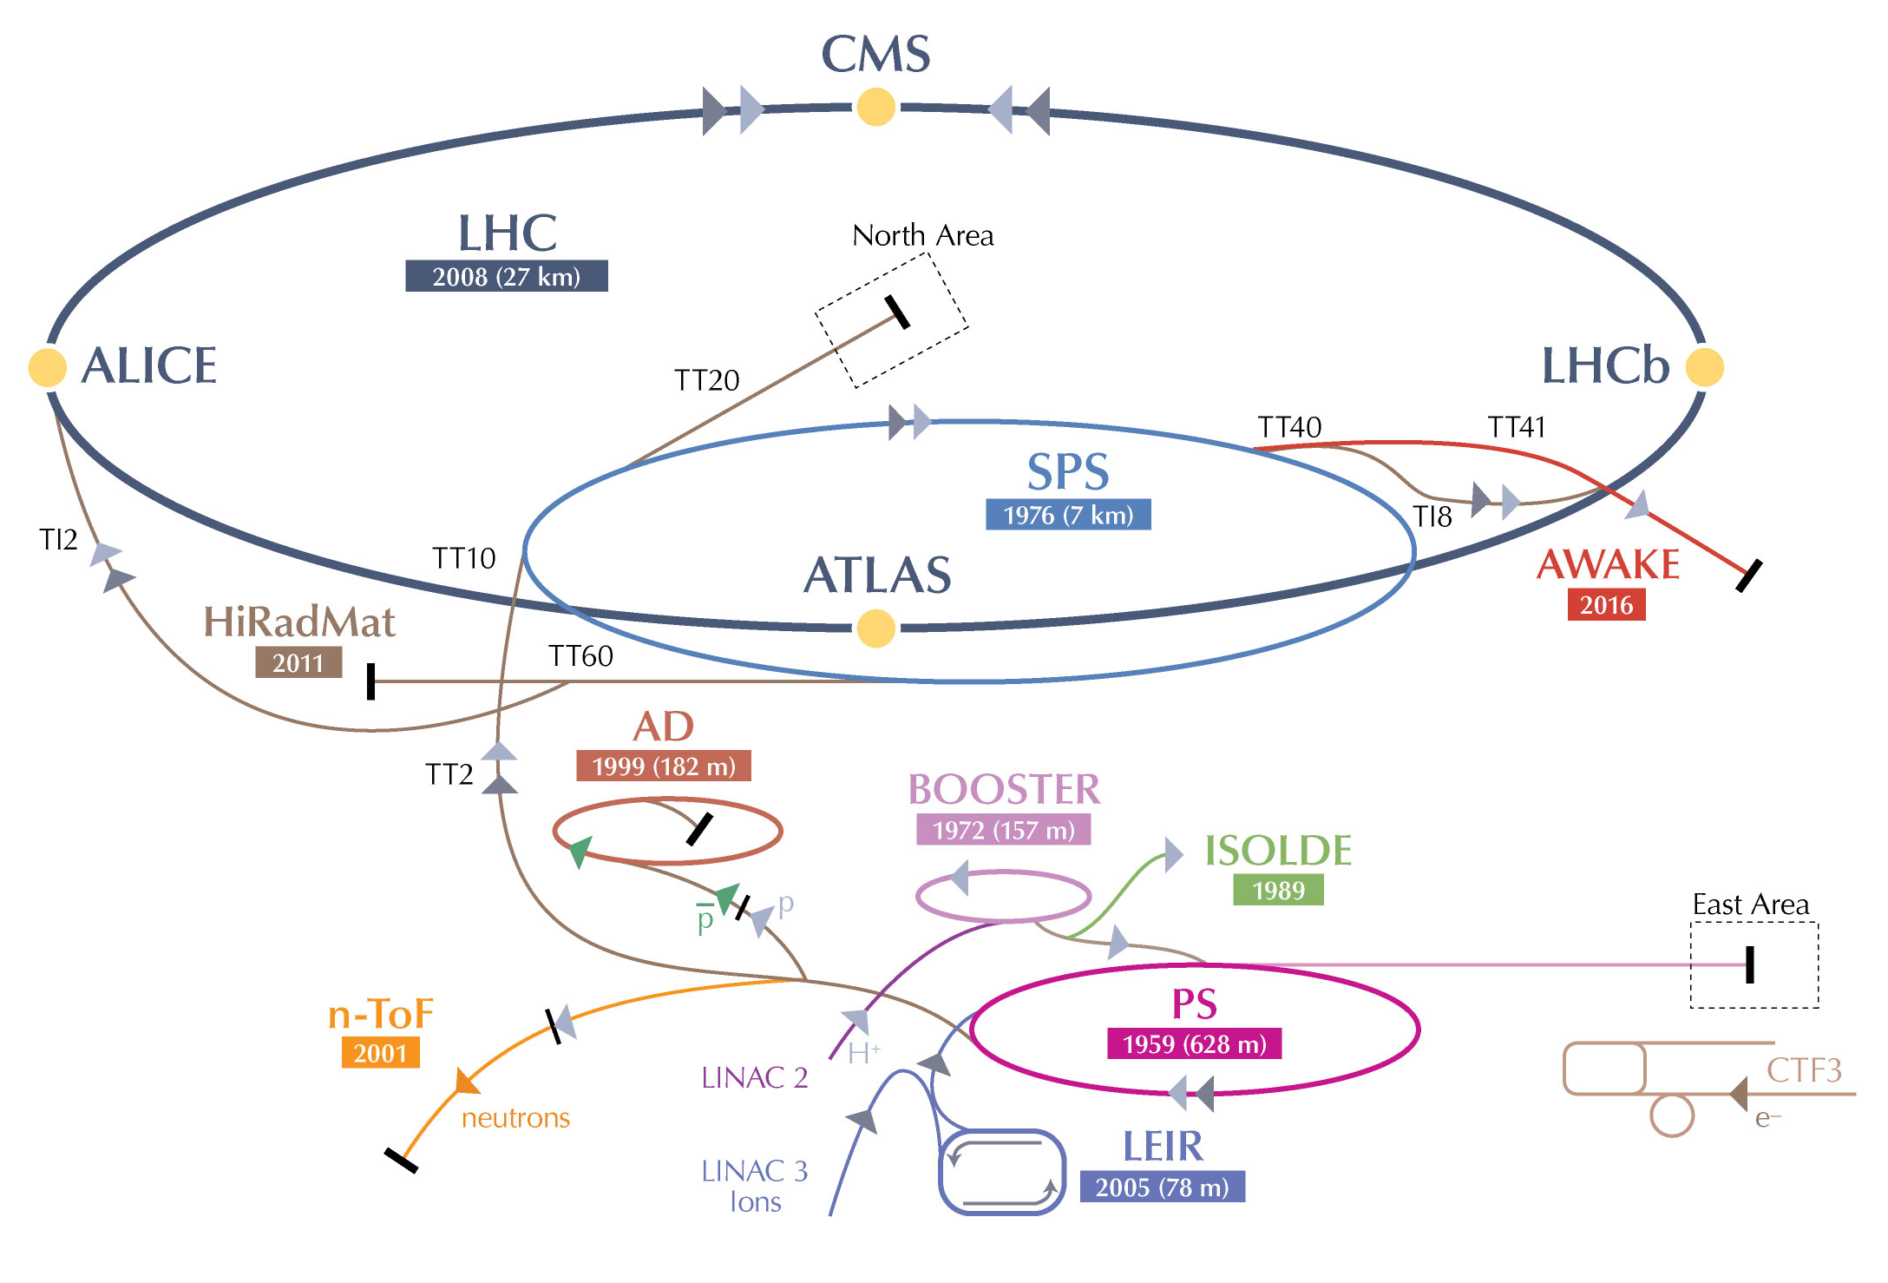
The n_TOF project
Neutron Time-Of- Flight facility: n_TOF

Slide 21
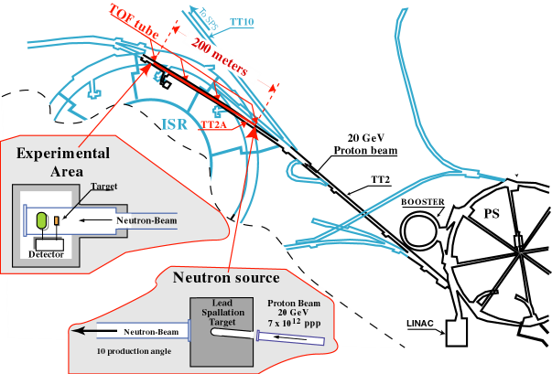
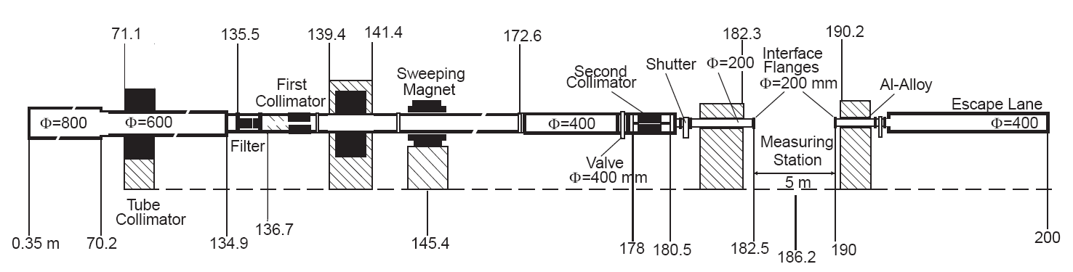
The n_TOF project
n_TOF is a spallation neutron source based on 20 GeV/c protons from the CERN PS hitting a Pb block (~300 neutrons per proton and ~ 7x10¹² ppp).
Experimental area at 185 m and 18.5 m.

Slide 22


The n_TOF project
The advange of n_TOF are a direct consequence of the characteristics of the PS proton beam: high energy, high peak current, low duty cycle.
EAR2
18.5 m
EAR1
20 GeV/c
protons
Spallation
Target
185 m

Slide 23
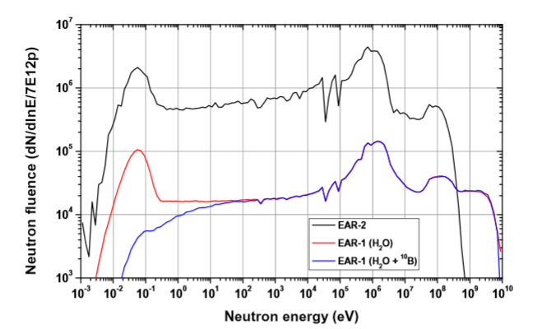
The n_TOF project
The advange of n_TOF are a direct consequence of the characteristics of the PS proton beam: high energy, high peak current, low duty cycle.
EAR2
18.5 m
EAR1
20 GeV/c
protons
Spallation
Target
185 m

Slide 24
The n_TOF project
The advange of n_TOF are a direct consequence of the characteristics of the PS proton beam: high energy, high peak current, low duty cycle.
EAR2
Wide energy range:
25 meV < E_{n} < 1 GeV
18.5 m
EAR1
20 GeV/c
protons
Spallation
Target
185 m

Slide 25
The n_TOF project
The advange of n_TOF are a direct consequence of the characteristics of the PS proton beam: high energy, high peak current, low duty cycle.
EAR2
Wide energy range:
25 meV < E_{n} < 1 GeV
  High neutron flux
  EAR2 10⁶ n/cm²/pulse
  EAR1 10⁵ n/cm²/pulse
18.5 m
EAR1
20 GeV/c
protons
Spallation
Target
185 m

Slide 26
The n_TOF project
The advange of n_TOF are a direct consequence of the characteristics of the PS proton beam: high energy, high peak current, low duty cycle.
EAR2
Wide energy range:
25 meV < E_{n} < 1 GeV
  High neutron flux
  EAR2 10⁶ n/cm²/pulse
  EAR1 10⁵ n/cm²/pulse
18.5 m
Good
energy resolution
ΔE/E ~10⁻⁴ @ EAR1
EAR1
20 GeV/c
protons
Spallation
Target
185 m

Slide 27
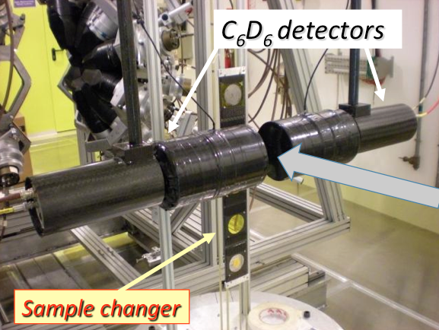
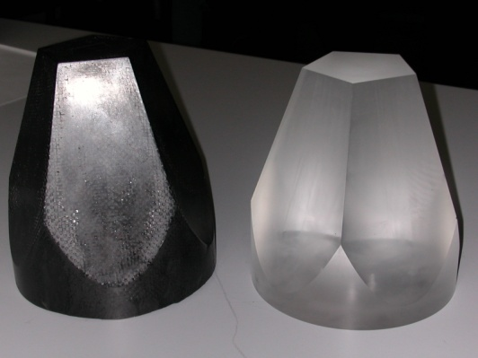
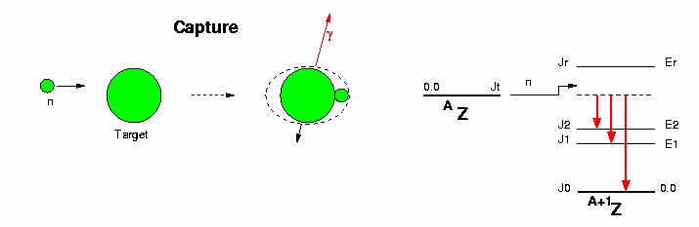
The n_TOF project
Detectors for (n, γ) reaction
Capture reactions are measured by detecting γ-rays emitted in the de-excitation process. Two different systems, to minimize different types of background
BaF₂ scintillator
4π geometry
Low neutron sensitivity
¹⁰B loaded
Carbon Fibre Capsules

Slide 28
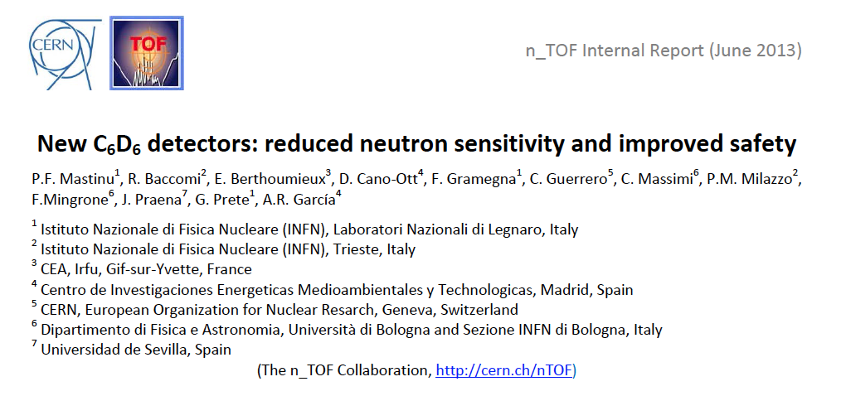
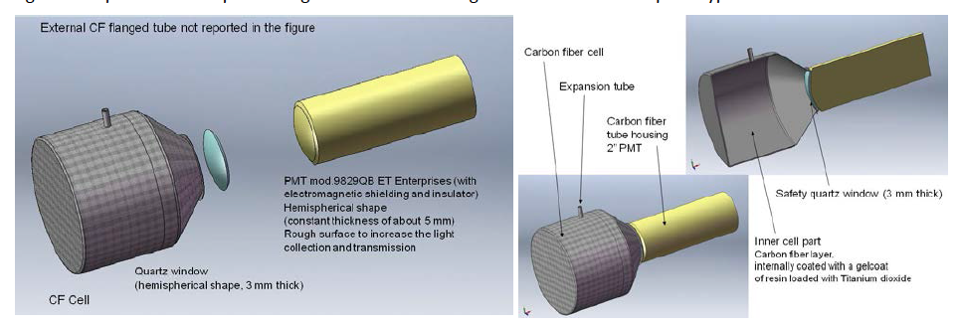
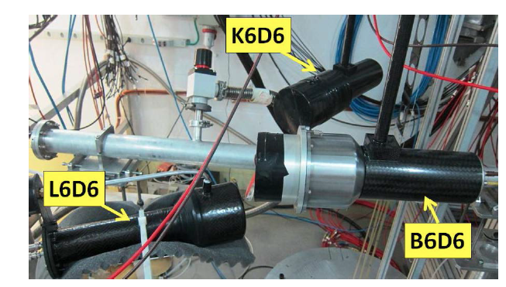
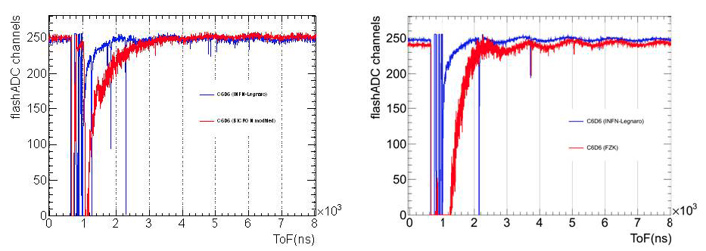
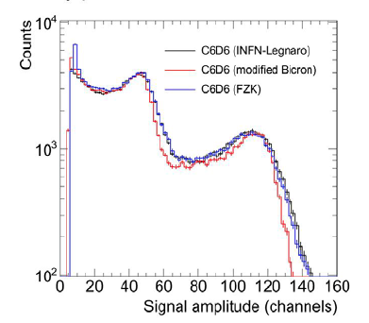
LNL @ n_TOF
Detector for (n, γ) reaction
INFN
Bicron
INFN
Bicron

Slide 29
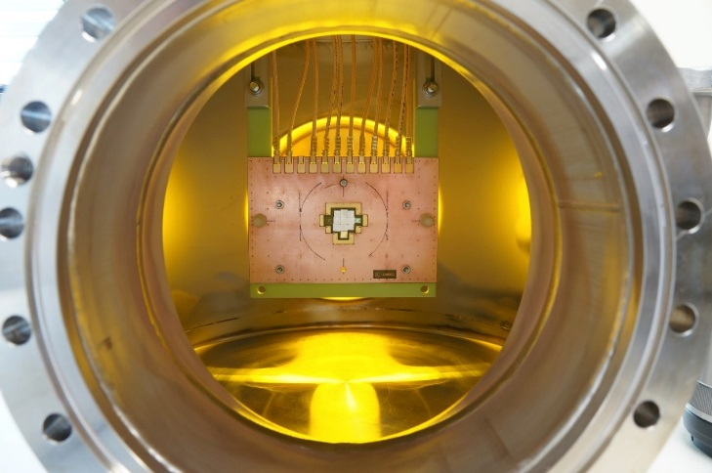
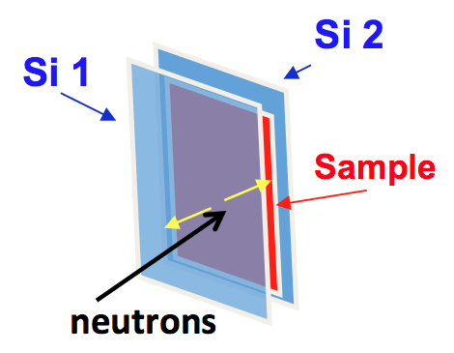
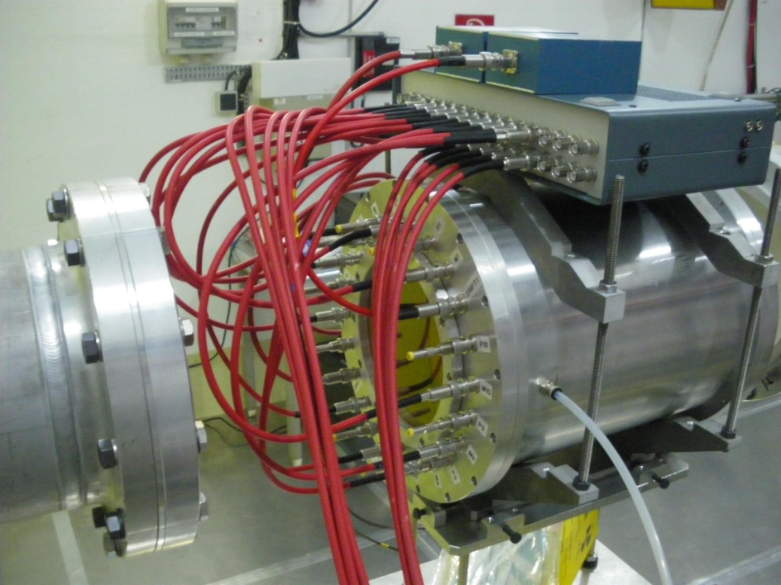
The n_TOF project
Detectors: (n, p) and (n, α) reactions
Gas and solid state detectors are used for detecting charged particles, depending on the energy region of interest and the Q-value of the reaction
Silicon detectors Silicon sandwich
Diamond detector
ΔE-E Telescopes
Micromegas chamber
low-noice, high-gain, radiation-hard detector

Slide 30
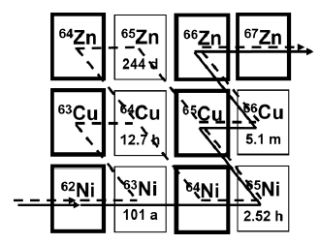
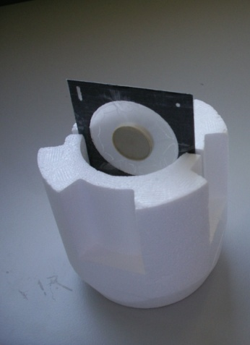
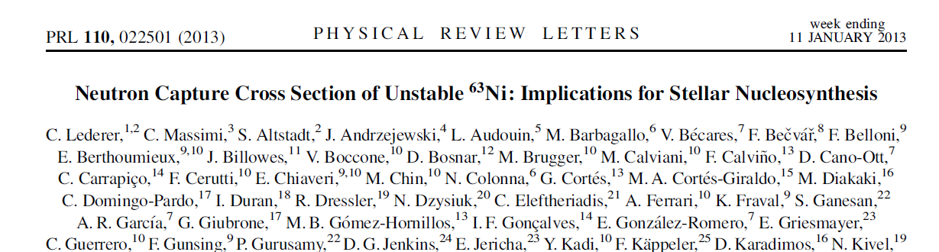
The case of ⁶³Ni
⁶³Ni (t_{1/2}=100 y) represents the first branching point in the s-process, and determines the abundance of ^{63,65}Cu
⁶²Ni sample (1g) irradiated in thermal reactor (1984 and 1992), leading to enrichment in ⁶³Ni of ~13 % (131 mg)
In 2011 ~ 15.4 mg ⁶³Cu in the sample (from ⁶³Ni decay).
After chemical separation at PSI, ⁶³Cu contamination <0.01 mg
First high-resolution measurement of ⁶³Ni(n, γ) in the astrophysical energy range.

Slide 31
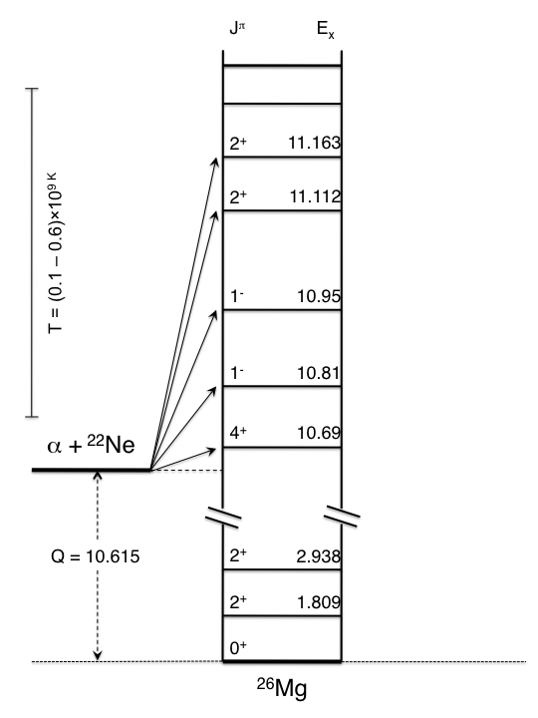
The case of ²⁵Mg
Constraints for the
²²Ne(α, n)²⁵Mg reaction
Element | Spin/parity
²²Ne | 0⁺
⁴He | 0⁺
Only natural-parity states in ²⁶Mg can participate in the ²²Ne(α ,n)²⁵Mg reaction
MeV
J^{π} = 0⁺, 1⁻, 2⁺, 3⁻, 4⁺ …
Notes:
The reaction rate of this neutron source is determined by the level density of the compound nucleus formed in the reaction 26Mg, above the alfa threshold
Here ony states with natural spin parity can be formed

Slide 32
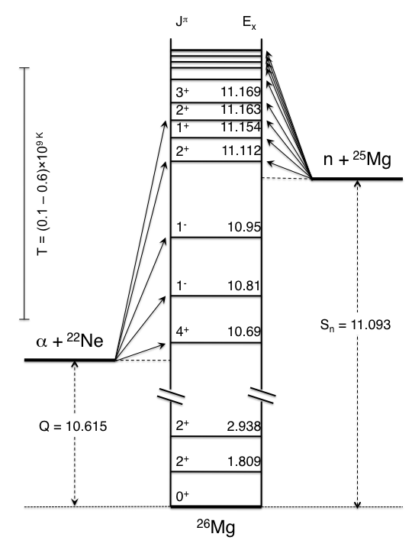
The case of ²⁵Mg
Constraints for the
²²Ne(α, n)²⁵Mg reaction
Element | Spin/parity
²⁵Mg | 5/2⁺
neutron | 1/2⁺
MeV
MeV
s-wave →J^{π}= 2⁺, 3⁺
p-wave →J^{π}= 1⁻, 2⁻, 3⁻, 4⁻
d-wave →J^{π} = 0⁺, 1⁺, 2⁺, 3⁺, 4⁺, 5⁺
States in ²⁶Mg populated by ²⁵Mg+n reaction
Notes:
We have studied the level density of 26Mg by populating its unbound states via 25Mg+n reactions
A complication arise frm the fact that here there are more combination of spin and parity

Slide 33
The case of ²⁵Mg
Constraints for the
²²Ne(α, n)²⁵Mg reaction
Experimental evidence of natural spin parity states in the energy region of interest
Element | Spin/parity
²⁵Mg | 5/2⁺
neutron | 1/2⁺
MeV
MeV
s-wave →J^{π}= 2⁺, 3⁺
p-wave →J^{π}= 1⁻, 2⁻, 3⁻, 4⁻
d-wave →J^{π} = 0⁺, 1⁺, 2⁺, 3⁺, 4⁺, 5⁺
States in ²⁶Mg populated by ²⁵Mg+n reaction
Notes:
We have observed experimental evidence of natural spin parity states in the energy region of interest

Slide 34
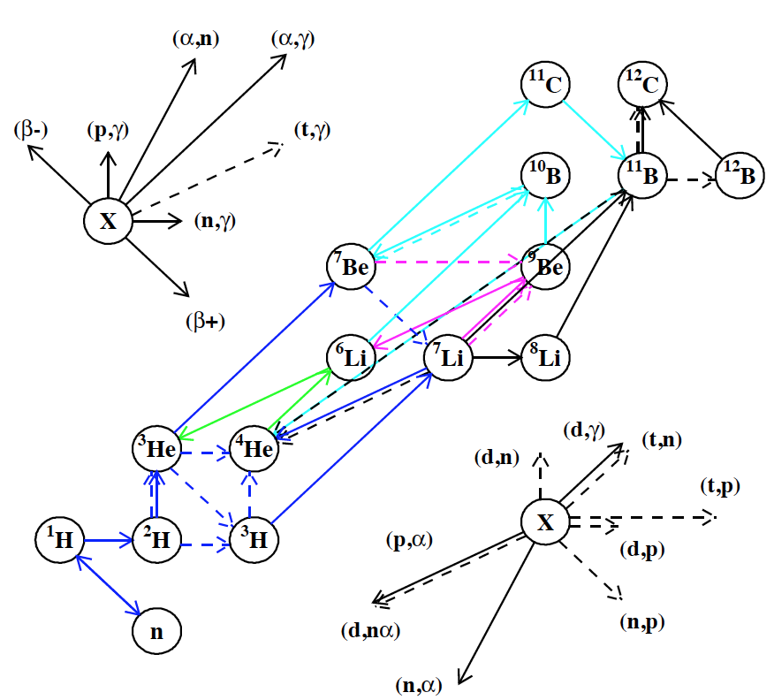
The case of ⁷Li
BBN successfully predicts the abundances of primordial elements such as ⁴He, D and ³He. Large discrepancy for ⁷Li, which is produced from electron capture decay of ⁷Be
Notes:
The BBN is very interesting because represents the earliest event in the history of the universe for which the prediction can be verified by observation

Slide 35
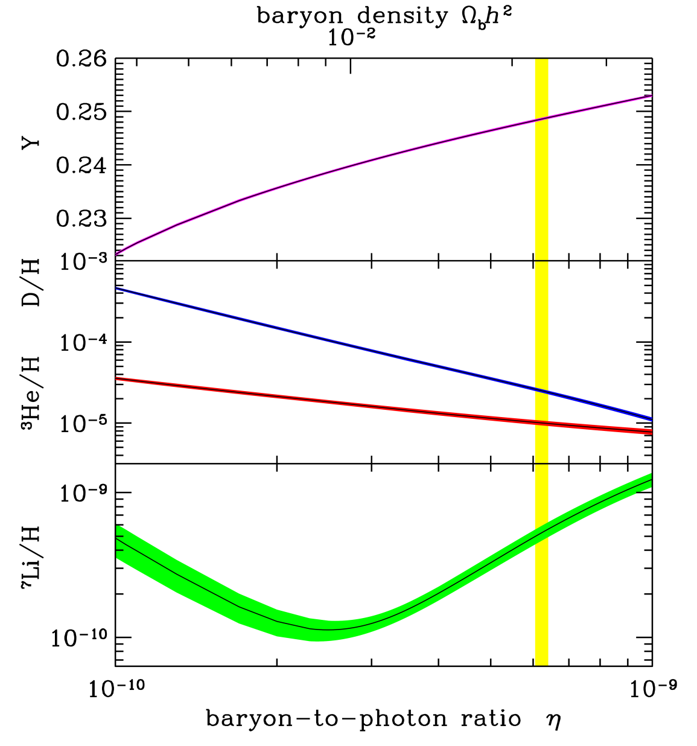
The case of ⁷Li
BBN successfully predicts the abundances of primordial elements such as ⁴He, D and ³He. Large discrepancy for ⁷Li, which is produced from electron capture decay of ⁷Be
Notes:
The theory predict the abundance of H2,He3, He4 and Li7 produced I the fist minutes of the evolution of the universe

Slide 36
The case of ⁷Li
BBN successfully predicts the abundances of primordial elements such as ⁴He, D and ³He. Large discrepancy for ⁷Li, which is produced from electron capture decay of ⁷Be
Notes:
These abundances only depend on the baryion density which is now well known and ….

Slide 37
The case of ⁷Li
~ 95% of ⁷Li is produced by the decay of ⁷Be (T_{1/2}=53.2 d)
⁷Be is the key

Slide 38
The case of ⁷Li
~ 95% of ⁷Li is produced by the decay of ⁷Be (T_{1/2}=53.2 d)
⁷Be is the key
⁷Be is destroyed by:
(n, p) ≈ 97%
(n, α) ≈ 2.5%
With a 10 times higher destruction rate of ⁷Be the cosmological lithium problem could be solved (nuclear solution)

Slide 39
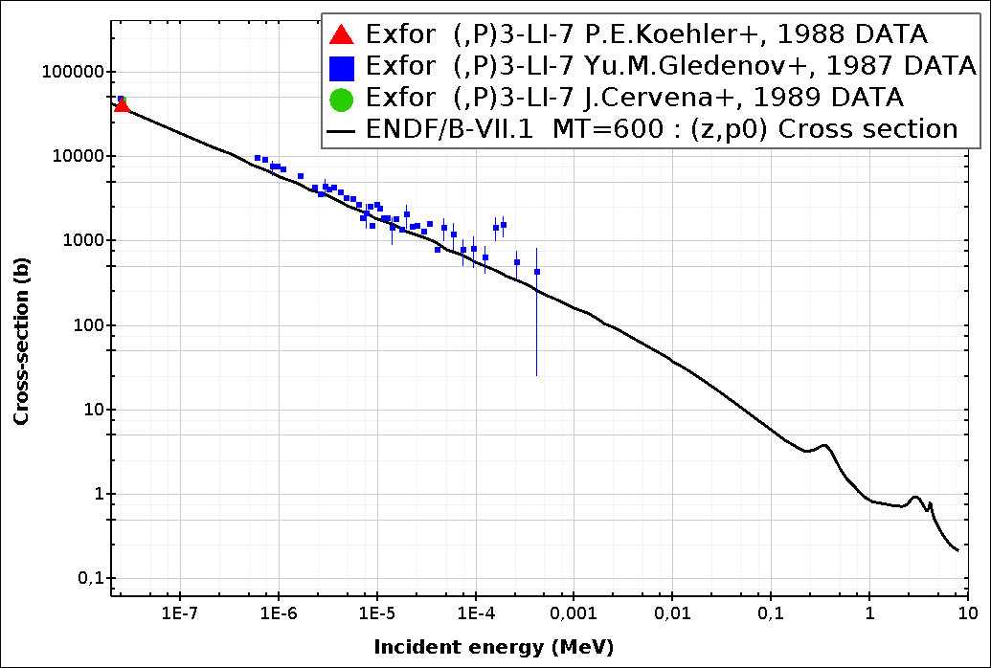
The case of ⁷Li
~ 95% of ⁷Li is produced by the decay of ⁷Be (T_{1/2}=53.2 d)
⁷Be is the key
⁷Be is destroyed by:
(n, p) ≈ 97%
(n, α) ≈ 2.5%
With a 10 times higher destruction rate of ⁷Be the cosmological lithium problem could be solved (nuclear solution)
⁷Be(n, p)

Slide 40
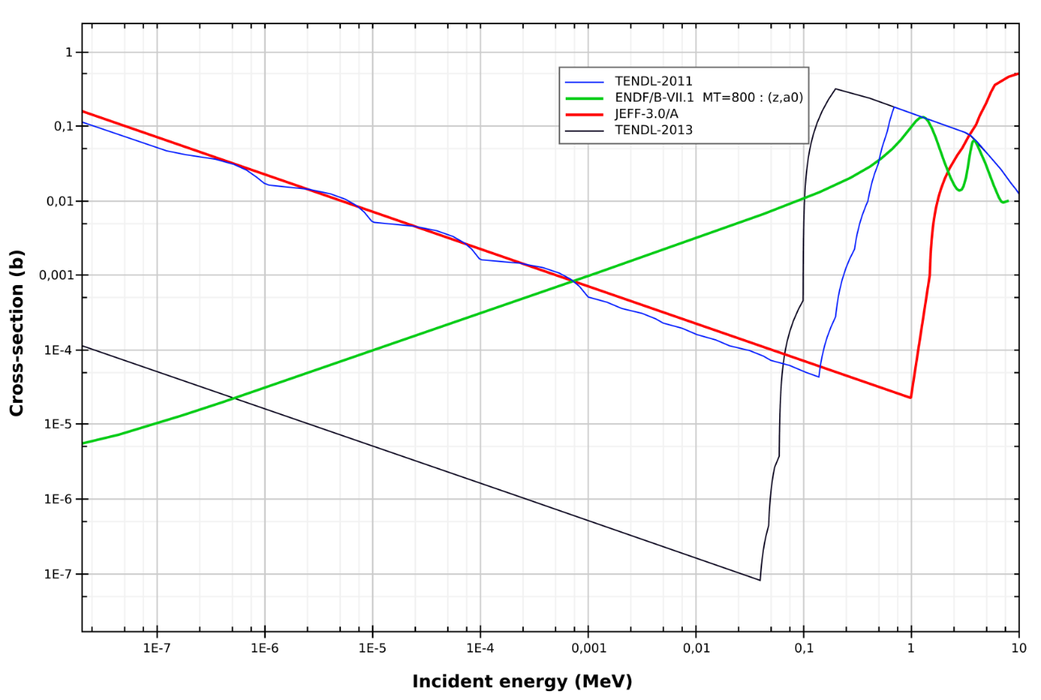
The case of ⁷Li
~ 95% of ⁷Li is produced by the decay of ⁷Be (T_{1/2}=53.2 d)
⁷Be is the key
⁷Be is destroyed by:
(n, p) ≈ 97%
(n, α) ≈ 2.5%
With a 10 times higher destruction rate of ⁷Be the cosmological lithium problem could be solved (nuclear solution)
⁷Be(n,α)
P. Bassi 1963
⁷Be(n, p)

Slide 41
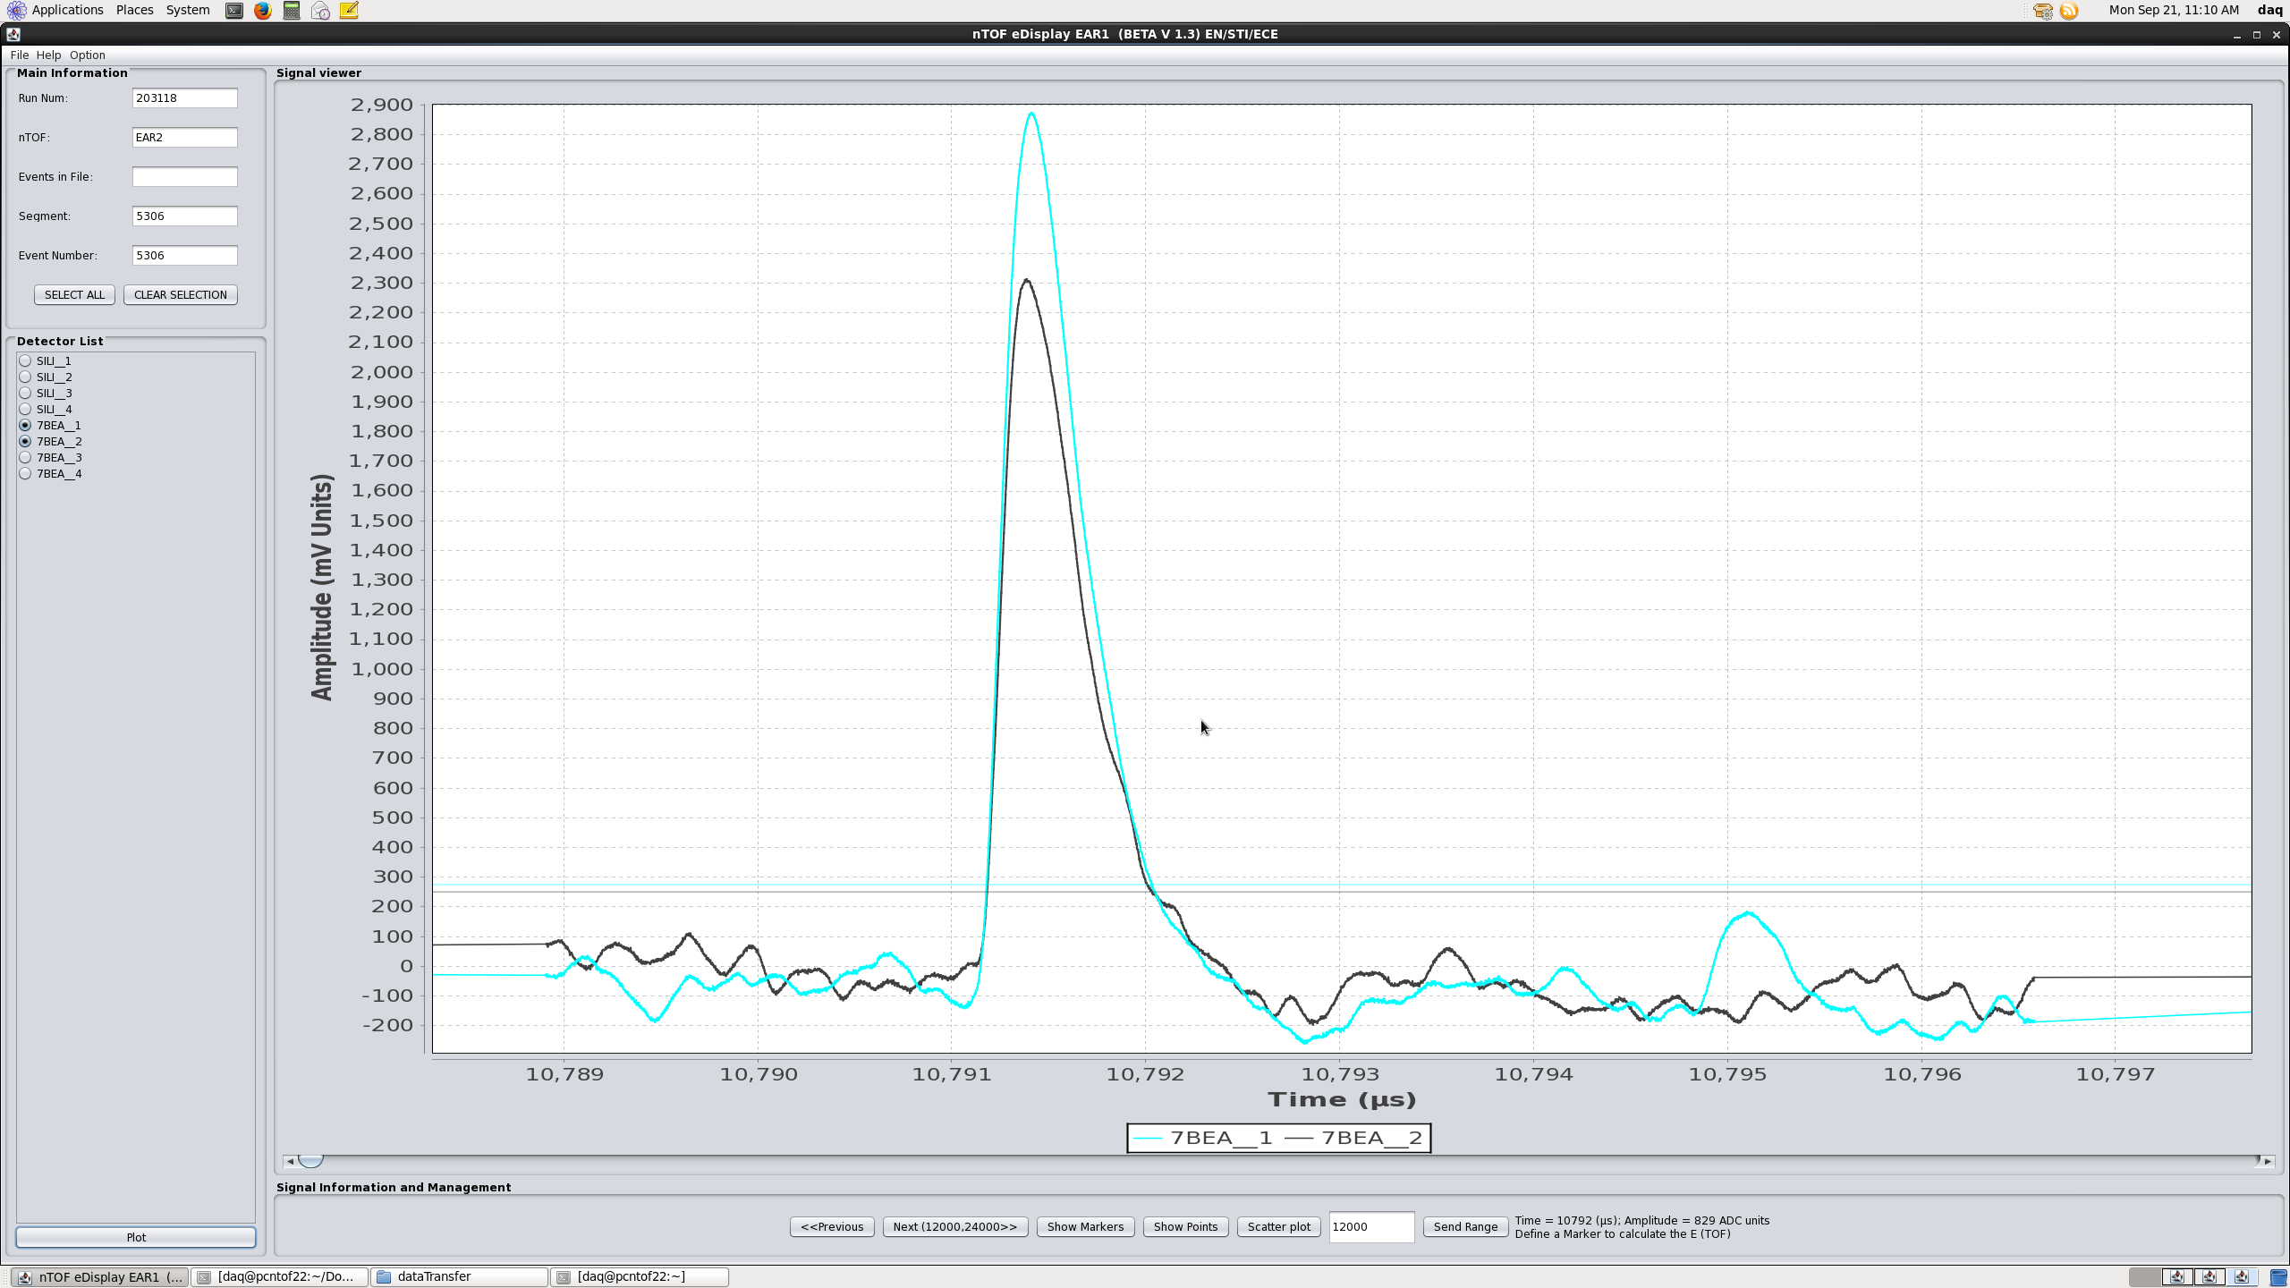
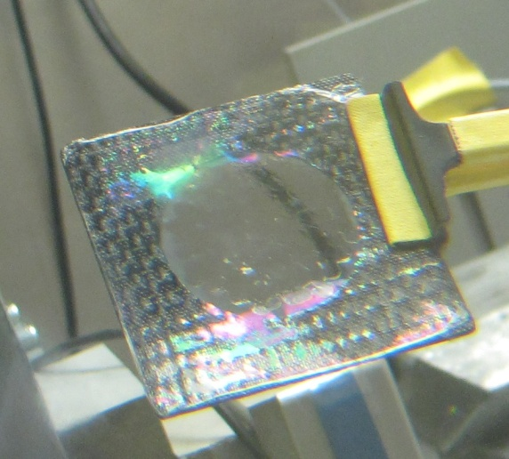
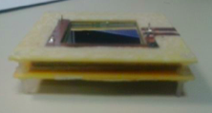
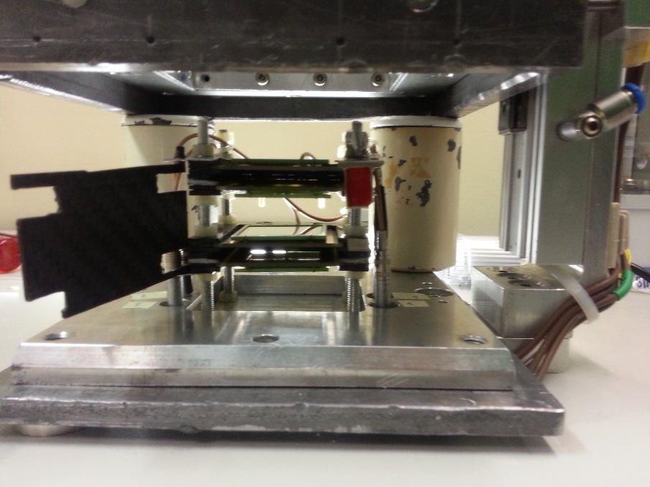
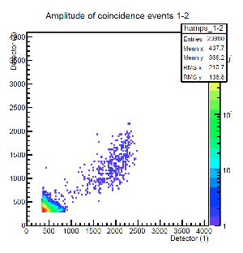
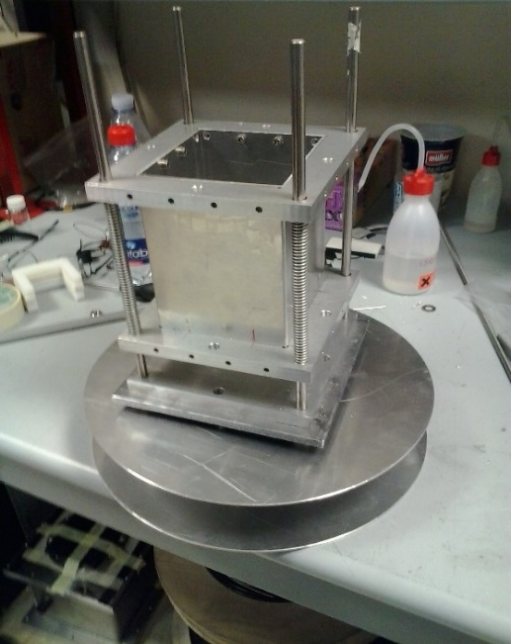
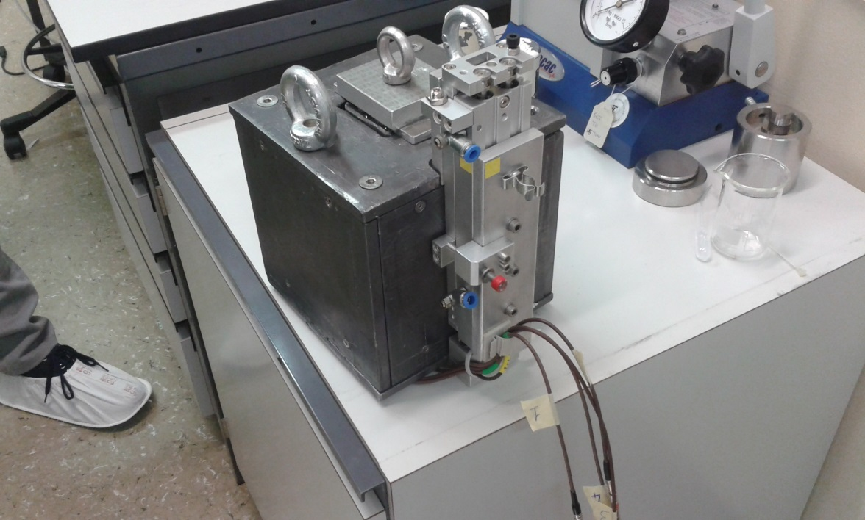
LNS @ n_TOF
The (n, α) reaction produces two α-particles emitted back-to-back with several MeV energy (Q-value=19 MeV)
2 Sandwiches of silicon detector (140 mm,3x3cm²) with ⁷Be sample in between directly inserted in the neutron beam
Coincidence technique: strong background rejection

Slide 42
LNS @ n_TOF
The (n, α) reaction produces two α-particles emitted back-to-back with several MeV energy (Q-value=19 MeV)
2 Sandwiches of silicon detector (140 mm,3x3cm²) with ⁷Be sample in between directly inserted in the neutron beam
Coincidence technique: strong background rejection
Just measured !

Slide 43
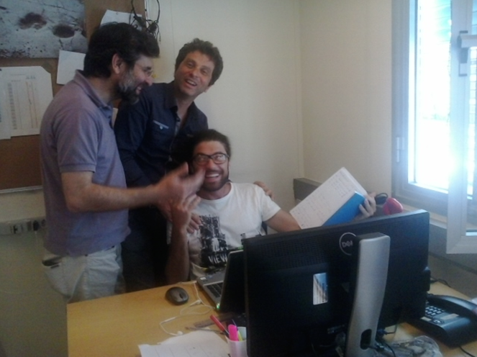
LNS @ n_TOF
… soon the first
⁷Be(n, α) cross section

Slide 44
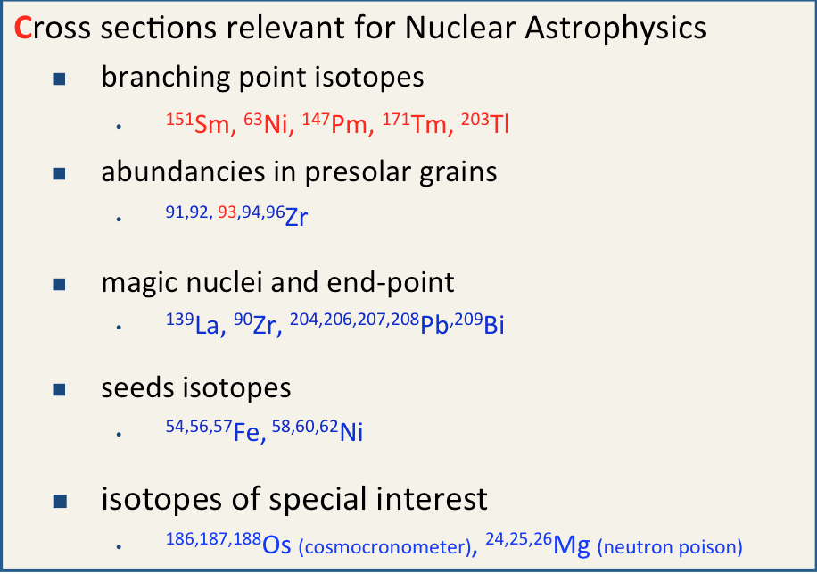
Conclusions
… a lot has been done, since 2001

Slide 45
Conclusions
… a lot has been done, since 2001
Always looking for good ideas

Slide 46

Cristian Massimi
Dipartimento di Fisica e Astronomia
massimi@bo.infn.it
www.unibo.it

Slide 48

INFN – Bo @ n_TOF
Reference Cross Section for Astrophysics
Massimi et al., ¹⁹⁷Au(n, γ) cross section in the resonance region, Physical Review C 81 (2010) 044616
Lederer, Massimi et al., Au197(n, γ) cross section in the unresolved resonance region, Phys. Rev. C 83 (2011) 034608
Massimi et al., Neutron capture cross section measurements for ¹⁹⁷Au from 3.5 to 84 keV at GELINA, The European Physical Journal A 50 (2014) 124

Slide 49





INFN @ n_TOF
SiMon – EAR1
Detector for the neutron flux
SiMon – EAR2
⁶Li
Resistive layer
n
α,t
Energy deposition MeV
Monitor + profile
Neutron energy eV

Slide 50




INFN @ n_TOF
Detector for the neutron flux
The spatial distribution of neutrons as a function of energy has been measured by means of a double side silicon strip detector (DSSSD).
16 x 16 Si sensor strips
3 mm wide strips, 500 μm thick
50 x 50 mm² X-Y grid
LiF converter

Slide 51



INFN @ n_TOF
Study of the neutron flux
Detectors equipped with different neutron converters placed in front of the sensible layer or volume

Slide 52



Flux
The flux was measured for each target, with four different systems based on ⁶Li, ¹⁰B and ²³⁵U.
Measurements were repeated for the ¹⁰B-water moderator (the thermal peak in the flux is suppressed).
The use of borated water suppresses the 2.2 MeV γ-rays from ¹H(n,γ)²H. Background reduced by a factor of 10 in some energy regions!

Slide 53

INFN – Bo @ n_TOF
1. CONSTRAINTS for ²²Ne(α, n)²⁵Mg: it is one of the most important neutron source in Red Giant stars. Its reaction rate is very uncertain because of the poorly known property of the states in ²⁶Mg. From neutron measurements the J^{π} of ²⁶Mg states can be deduced.
2. NEUTRON POISON: ^{25,26}Mg are the most important neutron poisons due to neutron capture on Mg stable isotopes in competition with neutron capture on ⁵⁶Fe (the basic s-process seed for the production of heavy isotopes).

Slide 54

INFN – Bo @ n_TOF
Isotope | ORELA | GELINA
²⁵Mg | 10.13 % | 97.86 %
²⁴Mg | 78.80 % | 1.83 %
²⁶Mg | 11.17 % | 0.31 %

Slide 55

INFN – Bo @ n_TOF
Previous evaluation
E_{R}=72 keV, J^{π}=2⁺
E_{R}=79 keV, J^{π}=3⁺
χ²=1.85

Slide 56

INFN – Bo @ n_TOF
Experimental evidence of natural spin parity
This work
E_{R}=72 keV, J^{π}=2⁺
E_{R}=79 keV, J^{π}=3⁻
χ²=1.18

Slide 57

Data Analysis
Simultaneous Resonance Shape Analysis
²⁵Mg(n, γ)
@ n_TOF
²⁵Mg(n, tot)
@ GELINA

Slide 58

Data Analysis
Simultaneous Resonance Shape Analysis
²⁵Mg(n, γ)
@ n_TOF
²⁵Mg(n, tot)
@ GELINA

Slide 59

Data Analysis
Simultaneous Resonance Shape Analysis
²⁵Mg(n, γ)
@ n_TOF
²⁵Mg(n, tot)
@ GELINA

Slide 60

Data Analysis
Simultaneous Resonance Shape Analysis
²⁵Mg(n, γ)
@ n_TOF
²⁵Mg(n, tot)
@ GELINA

Slide 61



Results
²⁵Mg(n, γ)²⁶Mg resonances
R-matrix parameterization of the cross section
Convoluted with neutron stellar flux
MACS and reaction rate
Notes:
By convoluting the capture cross section with the neutron flux in stars the so called MACS or stellar cross section is extracted and the reaction rate is determined

Slide 62

Results
²⁵Mg(n, γ)
@ n_TOF
Stellar site | Temperature keV | MACS (Massimi 2003) | MACS (KADoNiS) | MACS Massimi 2012
He - AGB | 8 | 4.9±0.6 mb | 4.9 mb | 4.3 mb
He - AGB | 23 | 3.2±0.2 mb | 6.1 mb | 4.3 mb
30 | 30 | 4.1±0.6 mb | 6.4±0.4 mb | 4.1 mb
He – Massive | 25 | 3.4±0.2 mb | 6.2 mb | 4.2 mb
C - Massive | 90 | 2.6±0.3 mb | 4.0 mb | 2.5 mb
Old Sample, oxide powder
Capture
New Sample, metal disc
Capture + transmission
Notes:
The results for the capture measurement are summarized here

