Slide 1

Measurements of NN correlations in nuclei
Damir Bosnar
Department of Physics
Faculty of Science
University of Zagreb, Croatia
What are and why NN-correlations ?
Overview of NN measurements
NN correlations and neutron stars
Measurements of pp correlations at MAMI
and future plans
ISU2015
Quest for visible and invisible strange stuff in the Universe, Frascati, 27 November 2015

Slide 2
What are NN-correlations in nuclei?
Experimentalist:
Existence of a high momentum nucleon in nuclei whose momentum is balanced by other nucleon :
-large relative momentum
-small total momentum
2N-SRC
~1 fm
≤1.f
1.7f
1.7 fm
ρ_{o} = 0.16 GeV/fm³
Nucleons
k_{F} ~ 250 MeV/c
High momentum tail:
300-1000 MeV/c
1.5 K_{F} - 5 K_{F}

Slide 3
Why NN correlations ?
Since early fifties nuclei have been successfully described by the nuclear shell model.
However, descriptions of some of nuclear properties (e.g. binding energies) require inclusion of interactions beyond mean-field approximation.
In eighties and nineties electron scattering experiments showed that approx. 2/3 protons participate in the independent particle motion → correlated pairs – evidences of existence of NN correlations
Consequences of NN correlations on neutron stars

Slide 4
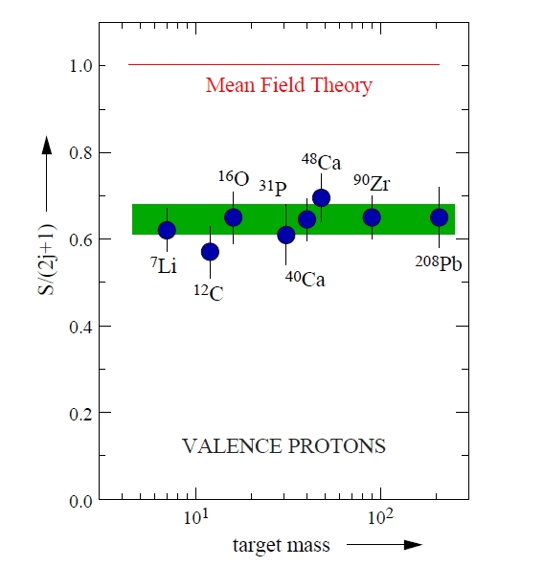
Evidence for NN correlations in A(e,e’p)B reactions
Spectroscopic factors from (e,e’p) reaction for different nuclei obtained at NIKHEF
W.H. Dickhoff, C. Barbieri Prog. Part. Nucl. Phys. 52 (2004) 377
L. Lapikas, Nucl. Phys. A553 (1993)297c
The spectral function is the joint probability of finding a proton with
momentum p and binding energy E inside the nucleus.

Slide 5
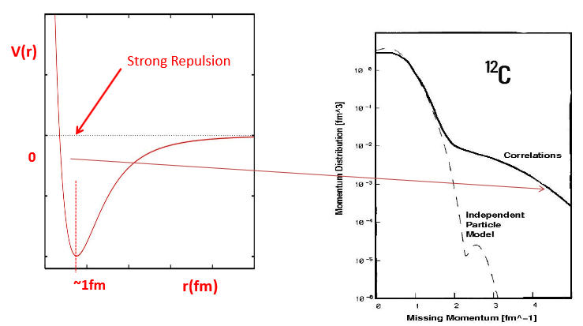
NN correlations are responsible for high momentum part of nuclear w.f.

Slide 6
Investigations of NN correlations in A(e,e’pN)B reactions
Powerful tool for investigations of NN correlations: one can investigate isospin structure and content of NN correlations.
Different kinds of correlations: SRC (potential at short distances is dominated by strong repulsion) and tensor correlations (depends on spin and spatial orientation of nucleons), LRC
A(e,e’pp)B or A(e,e’pn) in different kinematics-
suppression of other possible processes: IC, MEC, FSI (one has to study other reactions: (γ,pp), (γ,pn), (p,ppN)..)

Slide 7
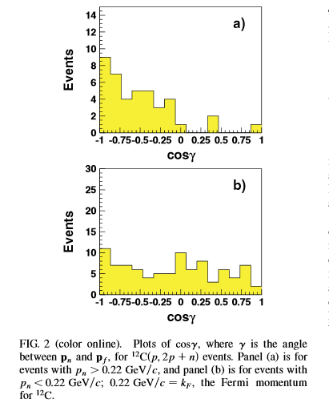
¹²C(p,ppn) EVA/BNL
A. Tang et al. Phys. Rev Lett. 90 (2003) 042301
p
p
γ
p
¹²C
n

Slide 8
Investigations of NN correlations at JLAB (electron beam 6, 12 GeV)
A(e,e’), ¹²C(e,e’p), ¹²C(e,e’pp), ¹²C(e,epn)³He(e,e’p)pn, ³He(e,e’pp)n, A(e,e’pN)B
Reactions at high energy and momentum transfer,
selecting different four-momentum and energy transfer different aspects of nucleus can be focused: nucleon charge distribution, nuclear quark distribution, SRC in nucleus.
→ confirmed evidences for NN correlations.
→ Isospin content of NN correlations
Overview, e.g.:
D.W. Higinbotham, E. Piasetzky, S.A. Wood
J. Phys. Conf. Ser. 299 (2011) 012010
Notes:
Subedi: We therefore speculate that the small concentration of protons inside neutron stars might have a
disproportionately large effect that needs to be addressed in realistic descriptions of neutron.
If neutron stars consisted only of neutrons, the relatively weak n-n short-range interaction
would mean that they could be reasonably well approximated as an ideal Fermi gas, with only
perturbative corrections. However, theoretical analysis of neutrino cooling data indicates that
neutron stars contain about 5 to 10% protons and electrons in the first central layers (20–22).
The strong p-n short-range interaction reported here suggests that momentum distribution for
the protons and neutrons in neutron stars will be substantially different from that characteristic
of an ideal Fermi gas.
stars.

Slide 9
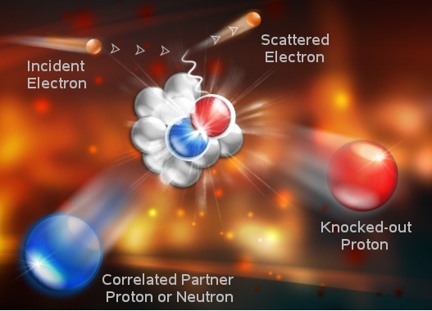
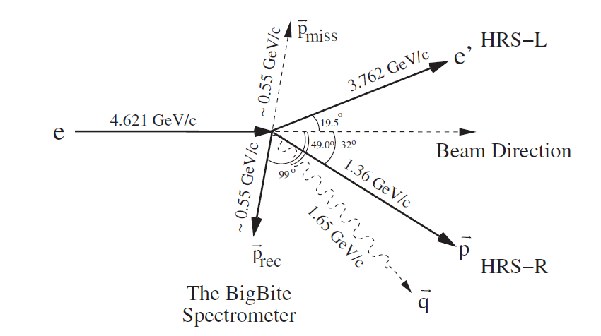
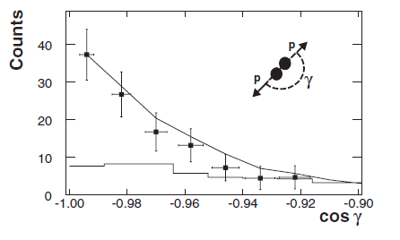
Investigations of ¹²C(e,e’pN) reaction at JLAB
R. Shneor et al. Phys. Rev. Lett. (2007) 99 072501
R. Subedi et al. Science 320 (2008) 1476
Q²=2GeV/c
Pmiss =300-600MeV/C
and neutron wall n or p

Slide 10
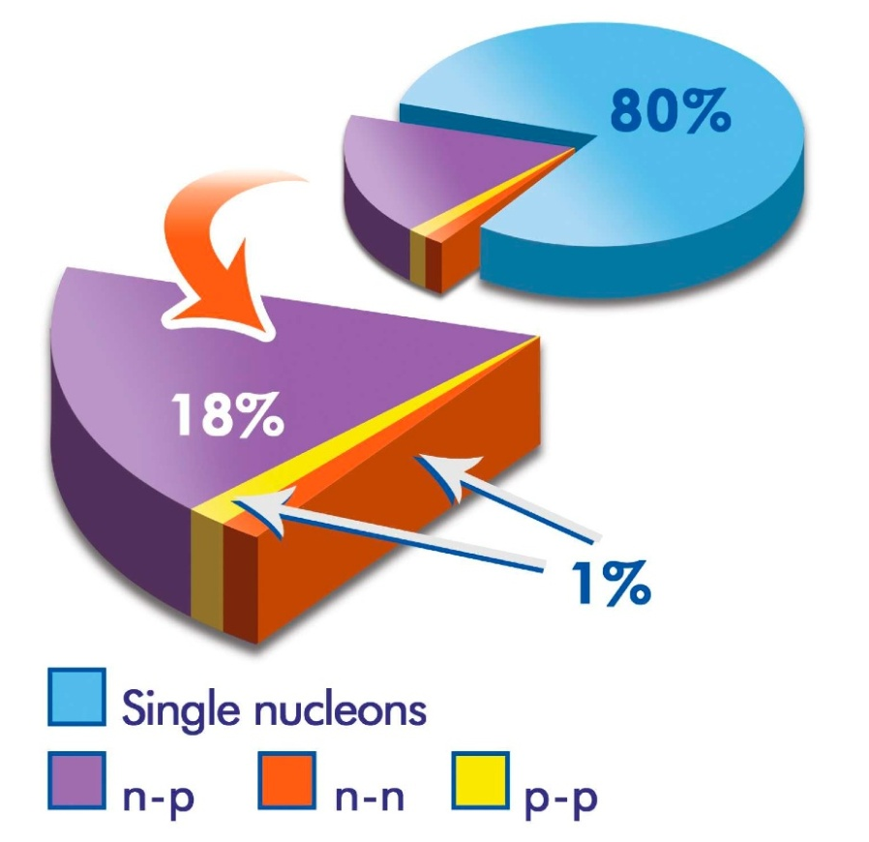
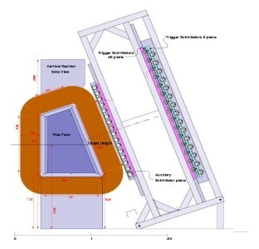
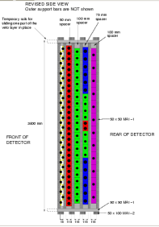
Comparison of pp and np correlations at JLAB ,¹²C(e,e’pN)
R. Subedi et al. Science 320 (2008) 1476
Approx. 20 times more np than pp correlations

Slide 11
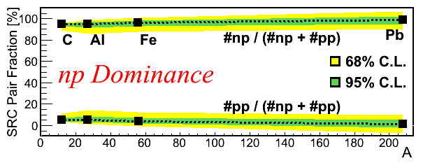
np vs. pp correlations
O. Hen et al. Science 346 614 (2014)

Slide 12


Correlations and Neutron Stars
‘Classical’ neutron star: fermi gases of e, p and n
Low temperature ⇒ almost filled fermi spheres
⇒ limited ability of p⇔n decays (Urca process)
Correlations ⇒ high momentum tail and holes in the fermi spheres
Presence of NN
correlations, I=0
Why does this matter?
Cooling should be dominated by the Urca process:
Correlations-caused holes in the proton fermi sphere should enhance this process by large factors and speed neutron star cooling.
More protons in core than crust of neutron star – influence on magnetic fields
L. Frankfurt, PANIC 2008
M.M. Sargasian, J. Phys. Conf..Ser. 496 (2014) 012007

Slide 13
Consequences for neutron stars
A. Subedi et al.Science 320 (2008) 1476
If neutron stars consisted only of neutrons, the relatively weak n-n short-range interaction would mean that they could be reasonably well approximated as an ideal Fermi gas, with only perturbative corrections.
However, theoretical analysis of neutrino cooling data indicates that neutron stars contain about 5 to 10% protons and electrons in the first central layers [J.M.Lattimer M. Parkas, Science 304 536 (2004), G.Baym, Nucl. Phys. A 702 3 (2002)]
The strong p-n short-range interactions suggests that momentum distribution for the protons and neutrons in neutron stars will be substantially different from that characteristic of an ideal Fermi gas.
A theoretical calculation that takes into account the p-n correlation effect at relevant neutron star densities and realistic proton concentration shows the correlation effect on the momentum distribution of the protons and the neutrons [T. Frick et al. PRC71 014313 (2005)]
The small concentration of protons inside neutron stars might have a disproportionately large effect that needs to be addressed in realistic descriptions of neutron stars

Slide 14
Investigations of NN correlations in A(e,e’pN)B reactions on lower Q² at MAMI
Lower energies, but more precise measurement of different variables
Differential cross section measurements, defined final states – nature of NN correlations
A(e,e’pp)B or A(e,e’pn) in different kinematics-
suppression of other possible processes: IC, MEC, FSI.

Slide 15
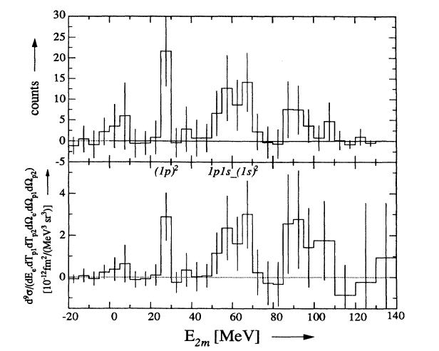
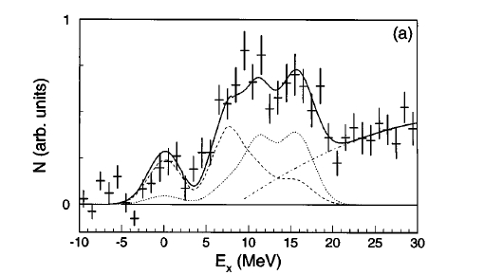
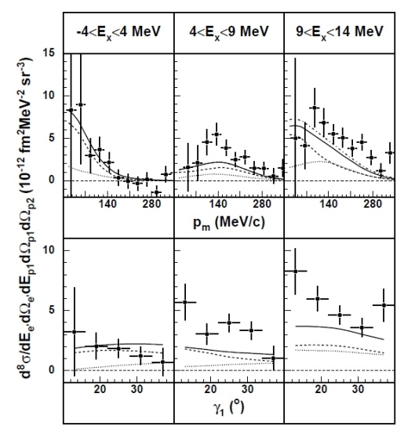
At NIKHEF in nineties:
Reported evidences for pp SRC correlations.
Limited statistics, low resolution.
12C(e,e’pp) at NIKHEF
A. Zondervan et al. Nucl. Phys. A587 (1995) 697
in Δ-resonance region, limited statistics
L. Kester et al. Phys. Rev. Lett. 74 (1995) 1712
in “dip” region ω=212 MeV, 270 MeV/c
evidence for SRC; low resolution, limited statistics
¹⁶O(e,e’pp)¹⁴C at NIKHEF
C.J.G. Onderwater et al. Phys. Rev. Lett. 78 (1997) 4893
identified dominance of ¹S₀ proton pairs, in agreement with theoretical predictions for pp SRC, identified GS
C.J.G. Onderwater et al. Phys. Rev. Lett. 81 (1998) 2213
cross section determined, comparison with theoretical
calculations show signatures for pp SRC.
R. Starnik et al. Phys. Lett B 474 (2000) 33
3He(e,e’pp)n at NIKHEF
D.L.Groep et al. Phys. Rev. Lett. 83 (1999) 5443
D.L. Groep et al. Phys. Rev. C63 (2000) 014005

Slide 16
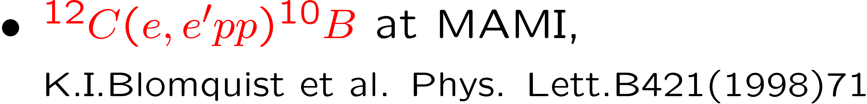
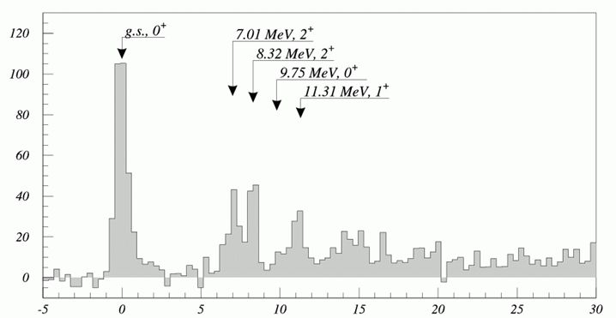
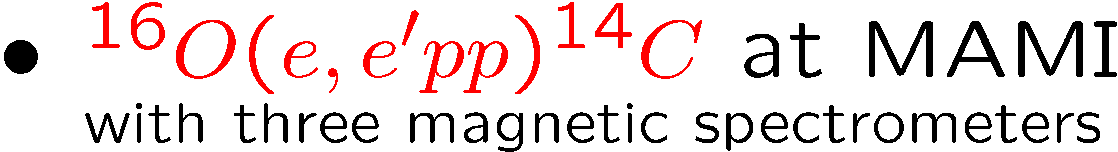
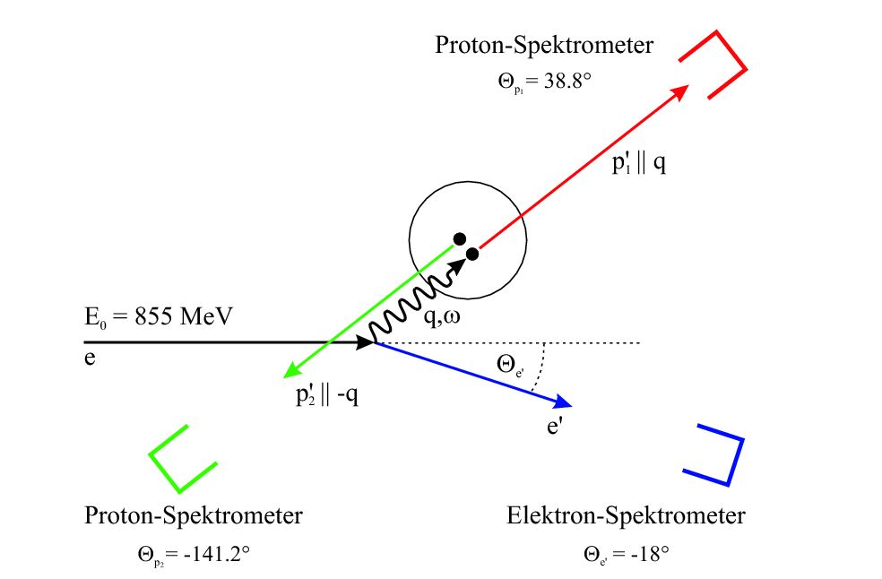
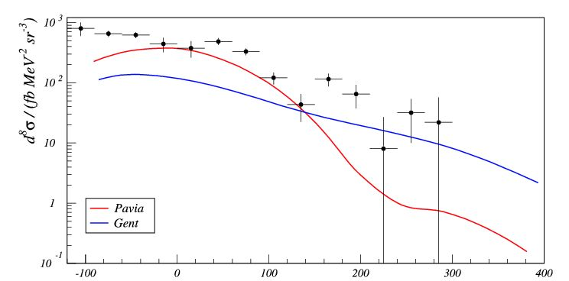
Measurements of A(e,e’pp)B at MAMI
¹⁶O(e,e’pp)¹⁴C
R. Edelhoff, PhD, Uni Main 2000 :
4π BGO – ball, dip region, ¹²C(e,e’), ¹²C(e,e’p),
¹²C(e,e’pp)
M. Kahrau, PhD, Uni. Mainz 1999
Eb = 855 MeV q = 316 MeV/c, ω = 215 MeV
Super-parallel
kinematics:
E_{x} (MeV)
Later calcuations have shown that FSI (NN) has bigger
cotribution at medium and large p_{m}:
M. Schwab et al. Eur. Phys. JA17 (2003) 7
P_{m}(MeV/c)
G. Rosner, Prog. Part. Nucl. Phys 44 99 (2000)

Slide 17
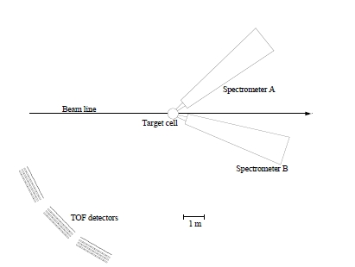
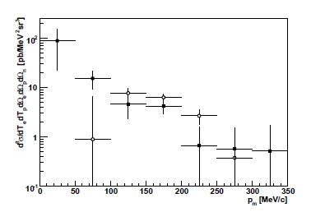
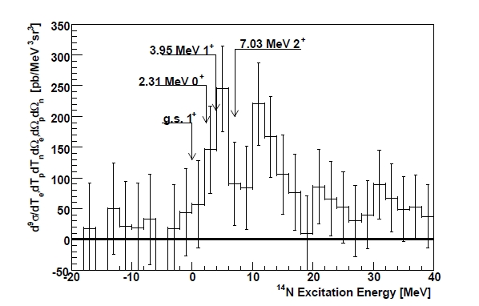
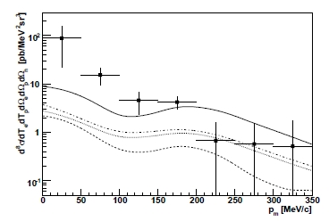
Measurements of A(e,e’pn)B at MAMI
Complementary information
about NN,tensor correlation
term
¹⁶O(e,e’pn)¹⁴N : G.D. Middleton et al. Eur. Phy. J. A29 (2006) 261
³He(e,e’pn)p : G.D. Middleton et al. Phys. Rev. Lett. 103 (2009) 152501
¹⁶O(e,e’pn)¹⁴N :
full squares
2≤E_{x}≤9 MeV
empty cycles
9≤E_{x}≤15 MeV
Experimental Set-Up
Super-parallel kinematics, ω = 215 MeV
Resolution:
E_{x} ~ 3 MeV FWHM
2≤E_{x}≤9 MeV
³He(e,pn)p :
-final state is determined, resolution of detector system not so critical
-calculations using Argonee V18 or Bonn B pot. over-predict measured
xs by factor 5 (p_{m} < 200 MeV/c); p_{m} > 200 MeV/c rough agreement (exp. error)
Notes:
16O(e,e’pn):
It is not possible to identify individual states.
Comparison with theoretical calculations of Pavia group, theoret. xs one order of magnitude smaller.
Prediction is that transition to 3.95 will be the biggest, comfirmed with the experiment.
This experiment Middleton EPJA2007 has measured exclusive (e,e′pn) cross sections
for the first time.
3He(e,e’pn)p
-final state is determined – single nucleon, resolution of the detector system is not critical.
-exist theoretical calculations.
measured in dip region. Calculations using the Argonne V18 or Bonn B potentials over-predict the measured cross sections by factor 5 at low
p_missing, but are in rough agreement (within the large statistical experimental errors at p_missing > 200 MeV/c.

Slide 18

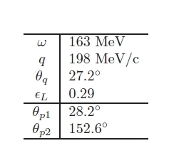
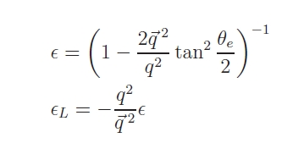
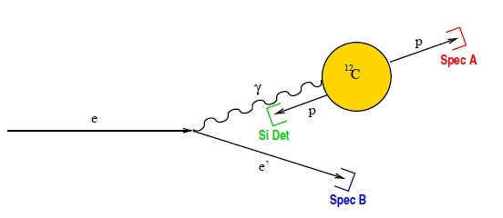
Measurements of differential cross section of¹²C(e, e’pp)¹⁰Be(GS) at MAMI
Eb=480 MeV

Slide 19
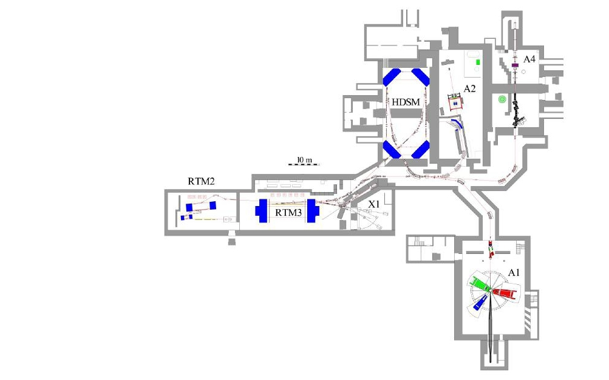
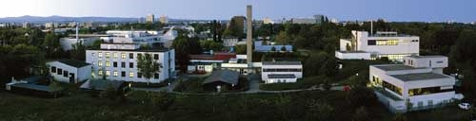
MAMI – Mainz Microtron
Beam characteristics:
-CW beam
-Max. Energy = 1.508 GeV
-polarized beam, ~80%
K.H. Kaiser et al. Nucl. Inst. and Meth.
A 593 (2008) 159
Institute for Nuclear Physics, Johannes Gutenberg University, Mainz

Slide 20
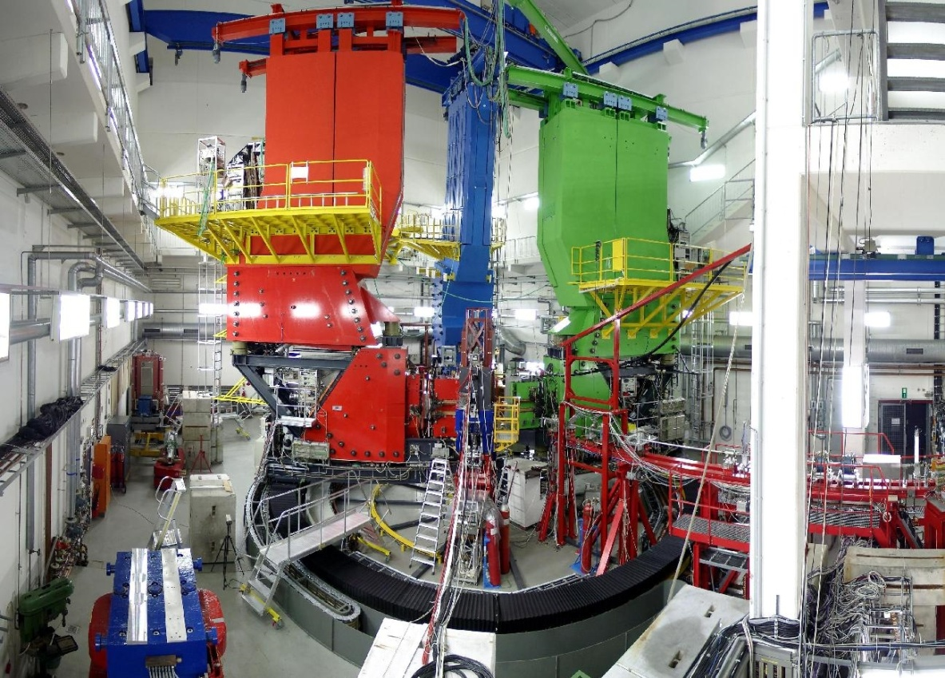
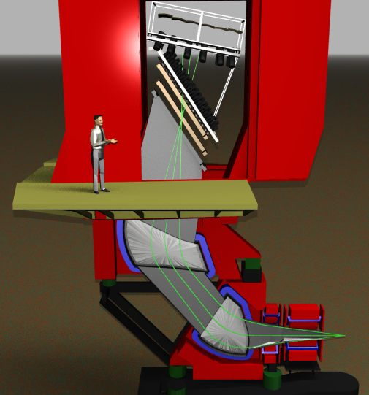
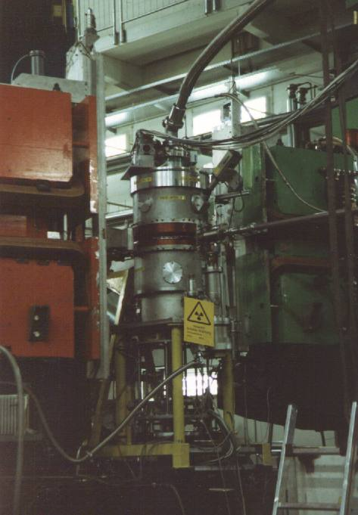
Magnetic spectormeters of A1-collaboration
Characteristics:
Spectrometer A:
P_{max} = 735 MeV/c
Δp/p = 10⁻⁴
Θ = 18º – 160º
Angular res. =?
Ω = 28 msr
Spectrometer B:
P_{max} = 870 MeV/c
Δp/p = 10⁻⁴
Θ = 7º – 62º
Angular res. =
Ω = 5.6 msr
Target cell:
Spectrometer C:
P_{max} = 551 MeV/c
Δp/p = 10⁻⁴
Θ = 18º – 160º
Angular res. =?
Ω = 28 msr
Cherenkov
(or PP)
Scintillator
VDC
Magnets
K.I. Blomqvist et al.
Nucl Instr. Meth. A403 (1998) 263

Slide 21
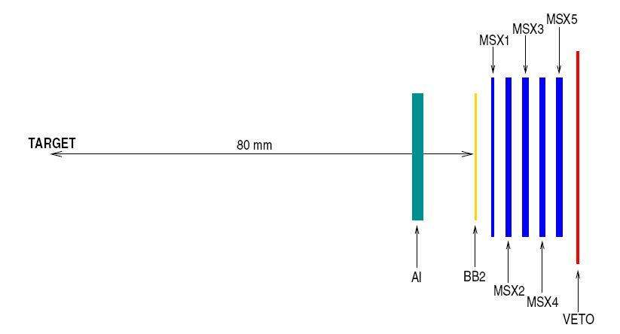
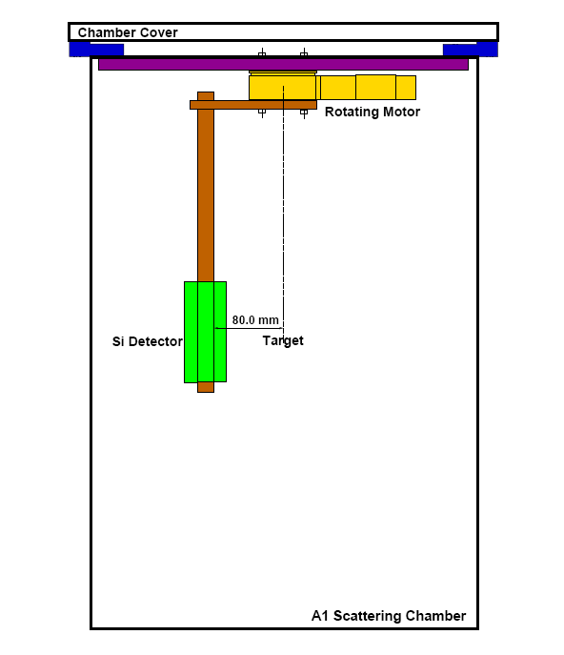
Si-detector system
Al – aluminum absorber, 2mm
BB2 – double sided silicon strip detector,
24x24 mm², 300 μm thick, 1mm pitch
(Micron Semiconductor)
MSX1-MSX5 – silicon detector
30x30 mm², 1 mm thick
(Micron Semiconductor)
Veto –silicon detector, 300 μm thick.
Angular acceptance: ~88 msr, at 8 cm from the target
Energy acceptance for protons 25 MeV - 41 MeV
Estimated energy resloution 700-800 keV

Slide 22
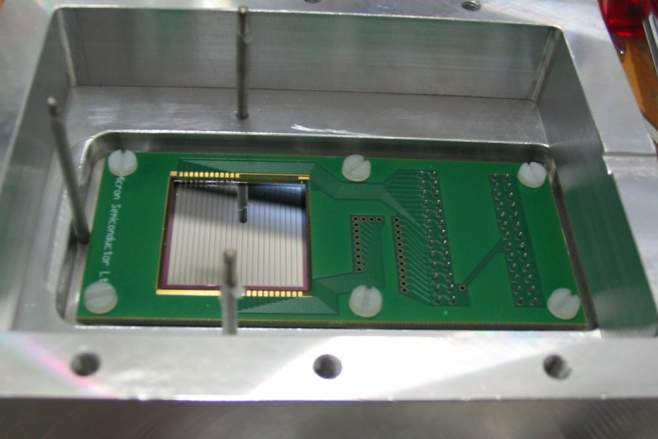
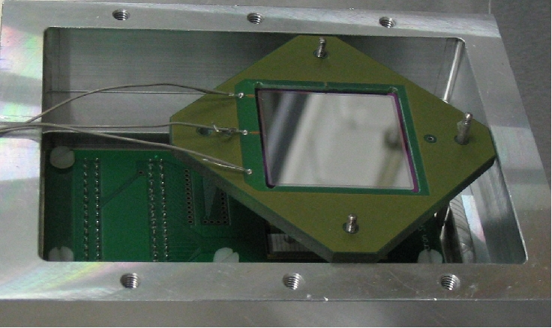
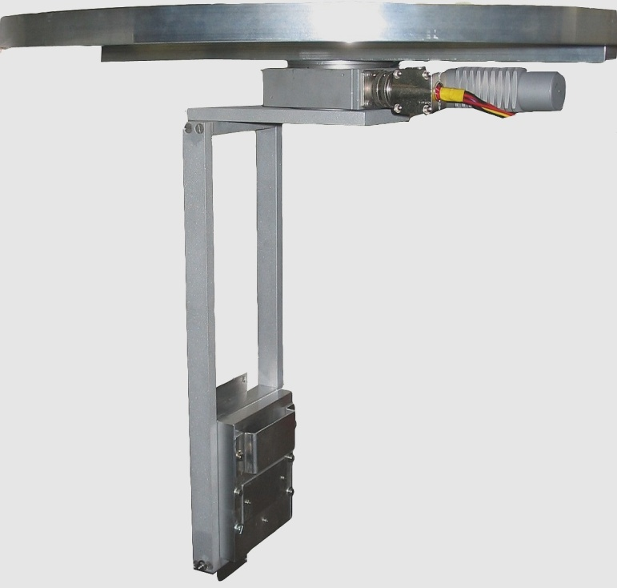
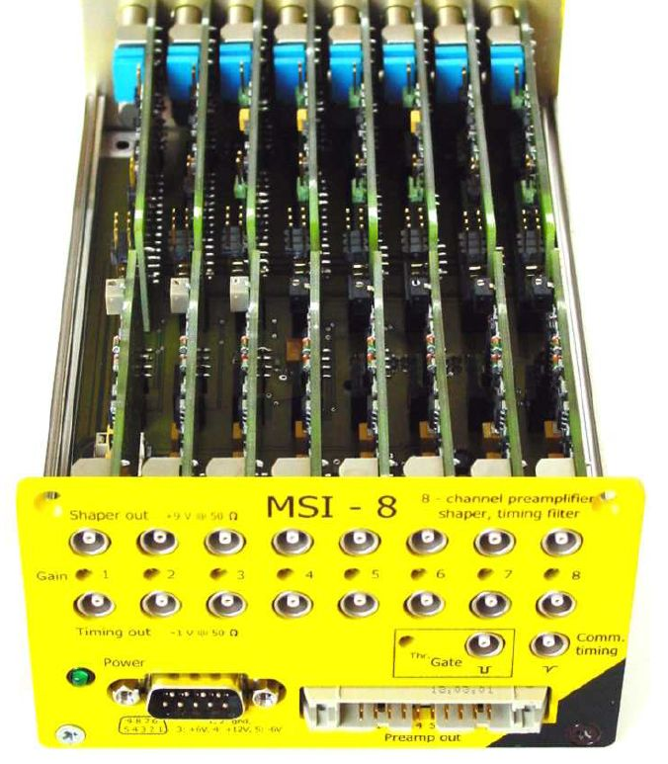
Si-detectors
→ preamplifier +
shaper
MSI-8 Mesytec
8 channel preamplifier + shaper
+ timing amplifier.
Fixed shaping time: 1μs
ballistic effect problem

Slide 23
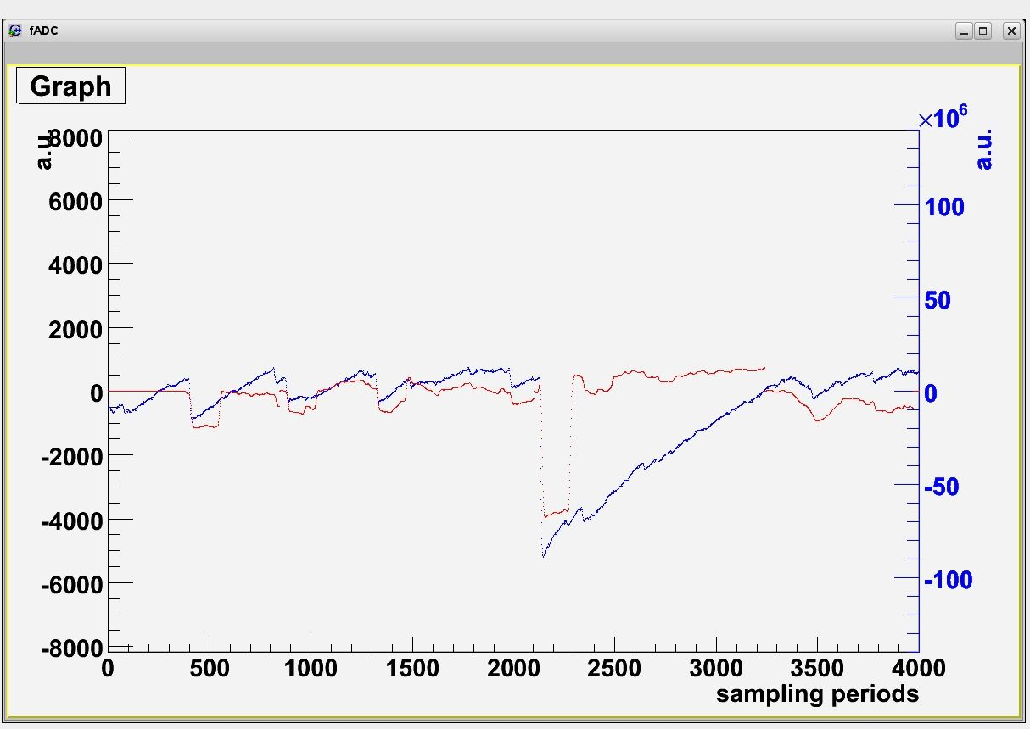
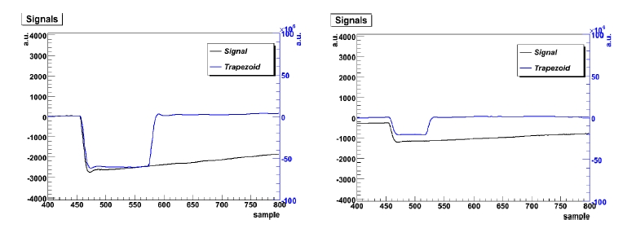
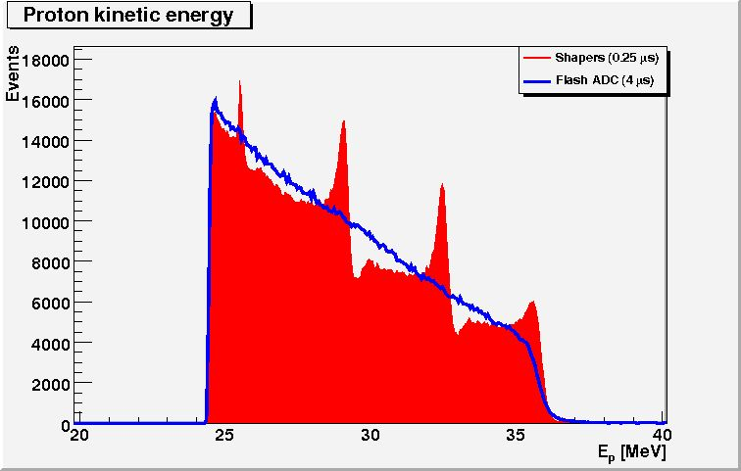
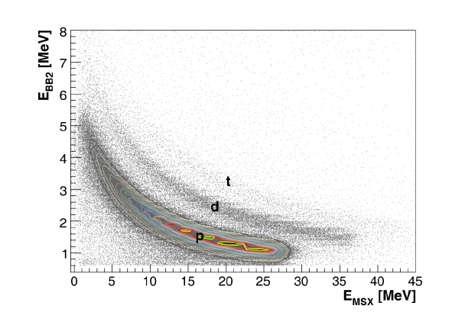
Solution:
CAEN NIM-N1728A
4 Ch. 14 bit 100MHz Flash ADC
Oscilograms; energy reconstruction using
variable “shaping” times.
100 MHz sampling rate
M. Makek et al., Nucl. Instr. Meth. A 673 (2012) 82

Slide 24

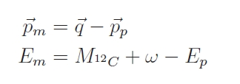

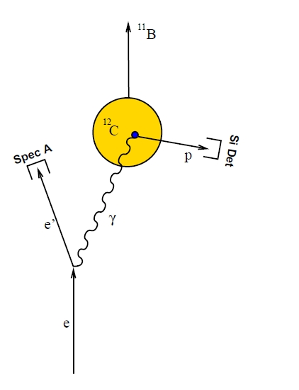
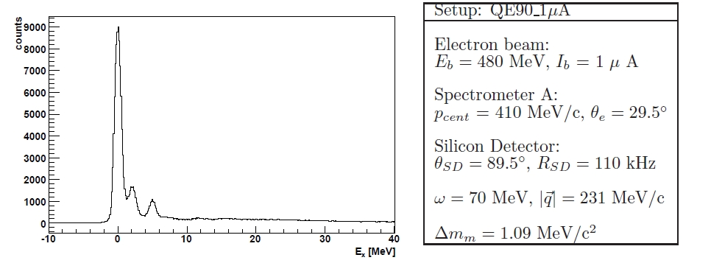
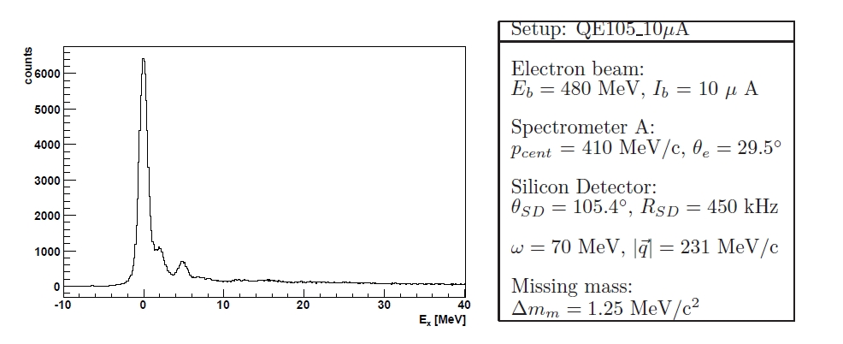

¹²C(e,e’p)¹¹B measurements
Missing momentum and energy:
Missing mass:
Excitation energy of ¹¹B:

Slide 25
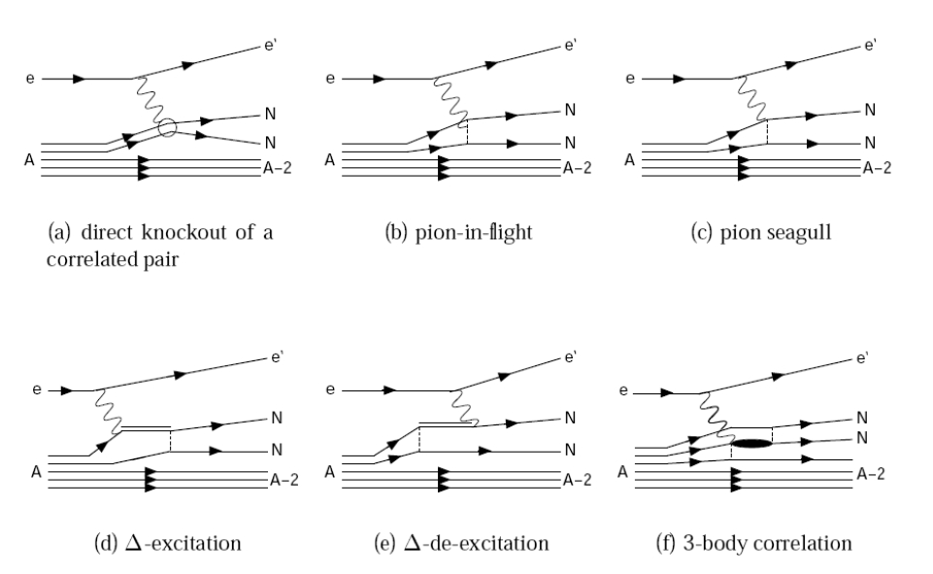
NN – knockout
+ FSI contribution
Very improtant: choice of reaction kinematics !

Slide 26
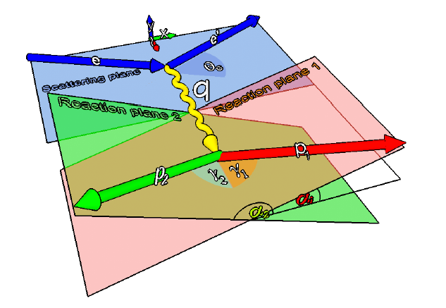



Choice of ¹²C(e,e’pp)¹⁰Be kinematics
Super-parallel kinematics
Eb=480MeV
Properties of chosen reaction kinematics:
only scalar SRC contribute between pp
MEC suppressed due to isospin
selection rules
Δ-contribution suppressed because of
selected energy transfer ω:
minimal FSI contribution (calcuations
by C. Giusti et al.)

Slide 27
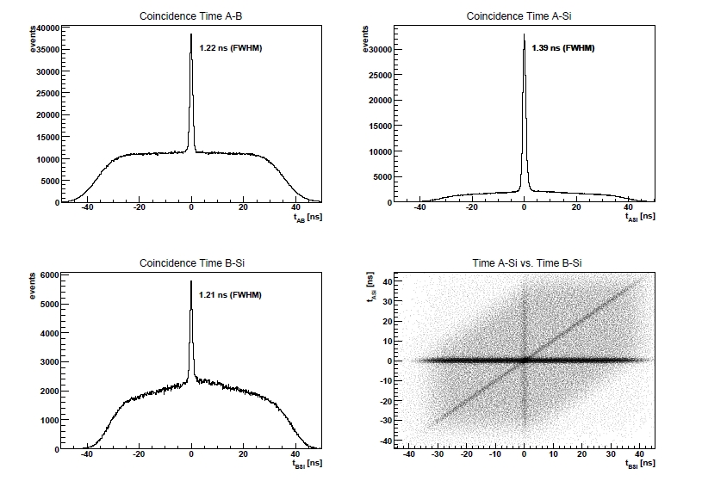

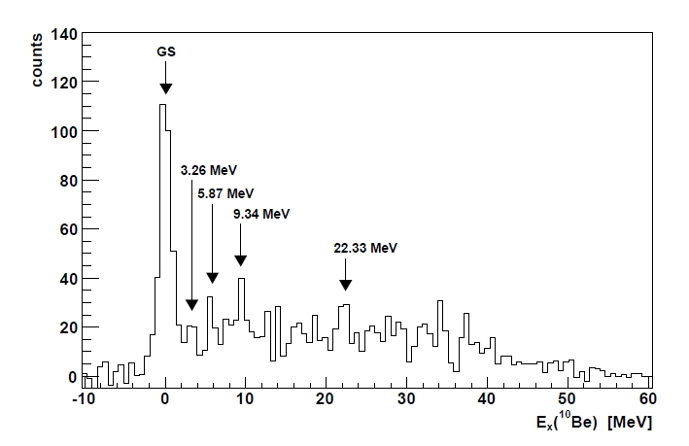




¹²C(e,e’pp)¹⁰Be reaction:¹⁰Be excitation spectrum
PID cuts in each detector +
coincidence time cuts →
¹⁰Be excitation spectrum
¹²C(e,e’pp)¹⁰Be

Slide 28





Differential cross-section extraction
Differential cross section:
A(e,e’pp)B reaction:
Cross section for transition in definite state of final nucleus:
, ε – detector efficiency

Slide 29
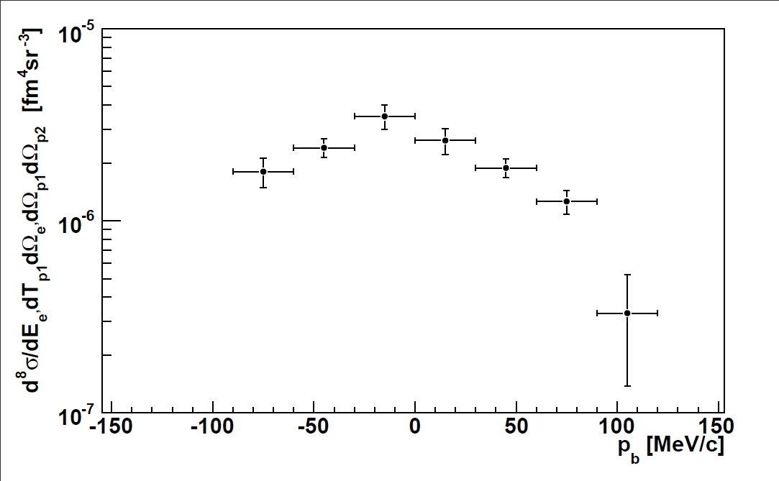
Extracted cross section
¹²C(e,e’pp)¹⁰Be(GS)

Slide 30
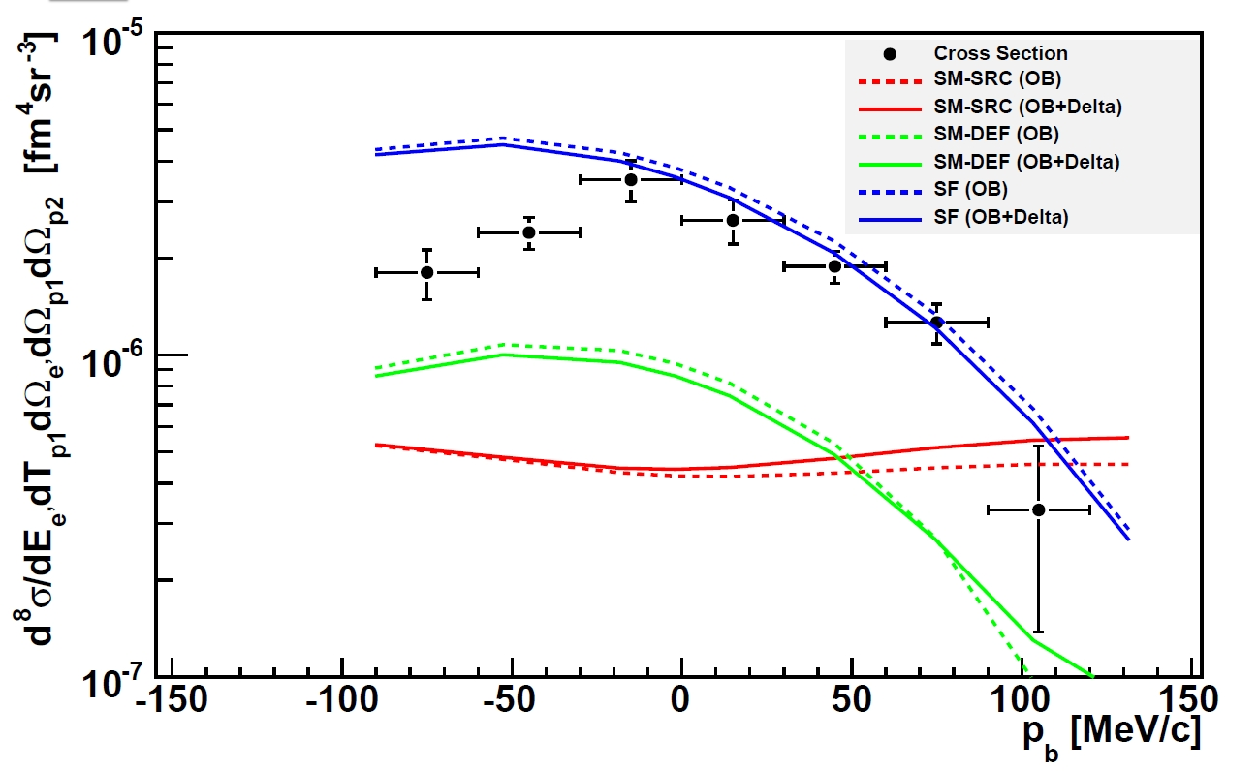
Comparison of ¹²C(e,e’pp)¹⁰Be(GS) cross sections with theoretical calculations

Slide 31
Summary and outlook
We have measured ¹²C(e,e’pp)¹⁰Be differential cross section in selected kinematics (SRC) and for definite final state → check for theoretical models.
We have developed flexible Si-detector system with larger solid angle and acceptable resolution.
Three high-resolution magnetic spectrometers and Si-detector system can be used in future A(e,e’pN)B measurements
(simultaneous measurements of e,e’pp e,e’pn).

Slide 32
Thank you!

Slide 33
Backup slides

Slide 34

FSI
Black lines ¹⁶O(e,e’pp)¹⁴C(GS)
-dotted: calculations using SM-SRC calculations
-dash dotted: SM-SRC parametrization with NN-FSI included
-dashed: SF-B parametrization
-full: SF-B parametrization with NN-FSI
overlap
overlap
C. Giusti, F. Pacati, and M. Schwamb, arXiv:0801.2304v1 (2008).
Red lines ¹²C(e,e’pp)¹⁰Be(GS):
-dotted: calculations using SM-SRC parametrization
-dash-dotted : SM-SRC parametrization with NN-FSI
C. Giusti privet communication

Slide 35
Comparison of ¹²C(e,e’pp)¹⁰Be(GS) cross sections with theoretical calculations

Slide 36

FSI (NN) contribution
MAMI ¹⁶(e,e’pp)¹⁴C
M. Schwab et al. Eur. Phys. JA17 (2003) 7

Slide 37
High momentum protons have partners
pn
R. Subedi et al., Science, 2008
Yield Ratio [%]
96 ± 23 %
BNL Experiment measurement was
+8
92 %
-18
9.5 ± 2 %
R. Shneor et al.,
PRL 99, 072501 (2007)
Yield Ratio [%]
pp/pN = 5%
Since the electron
can hit either
proton
pp
Missing momentum [MeV/c]
(proton initial momentum)

Slide 38

pp to pn comparison
BNL
Hall A
np/2N
pp/2N
Subedi et al, Science (2008)
HALL A
Hall A
¹²C
 | <Q²> (GeV²) | pn to pp ratio
Hall A / BNL | 2 / ?? | 18
CLAS | 1-2 | 4
Relative
Contradiction???

Slide 39
A1-kolaboracija wwwa1.kph.uni-mainz.de
Zagrebačka grupa član od 1998. godine
Neutronski form-faktori; Produkcija piona na pragu, Produkcija
η-mezona na pragu; NN korelacije; Struktura 3He; Potraga za tamnom materijom,
Razvoj sustava silicijevih detektora za detekciju protona:
Mihael Makek ^{c}, Patrick Achenbach ª, Carlos Ayerbe Gayoso ª, Dagmar Baumann ª, Jan C. Bernauer ª, Ralph Bohm ª, Damir Bosnar ^{c} ,Achim Denig ª, Mathias Ding ª, Michael O. Distler ª, Luca Doria ª, Jorg Friedrich ª, Ivica Friscic ^{c}, Mar Gomez ª, Harald Merkel ª, Ulrich Muller ª, Lars Nungesser ª, Josef Pochodzalla ª, Milan Potokar ^{b}, Michael Seimetz ª, Salvador Sanchez Majos ª, Bjorn Soren Schlimme ª, Simon Sirca ^{b}, Thomas Walcher ª, Markus Weinriefer ª
ª Institut fur Kernphysik, Johannes Gutenberg-Universitat Mainz, Germany
^{b} University of Ljubljana and Institut ”Jozef Stefan” Ljubljana, Slovenia
^{c} Physics Department, Faculty of Science, University of Zagreb, Zagreb, Croatia

