Slide 1
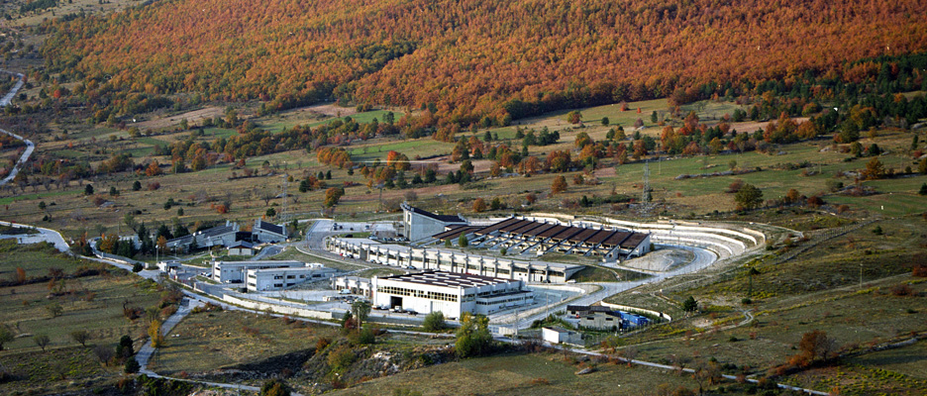
Director’s Report
LNGS – XLIV SC
12 November 2015

Slide 2
LNGS Organization
Technical Manager:
Stefano Gazzana since Nov. 2nd 2015
A vacant position for several years
Coordination of technical services and tech. services with experiments
Head of Research Division
Alba Formicola
Aldo Ianni went on leave (Director of LSC)

Slide 3
EAC
External Advisory Committee (Roberto Saban, Ingo Ruehl, Roberto Bozzi, Jean-François Bouteille, Paul Berkevens, Domenico Barone) visited LNGS on June 22-23.
Meetings with Director, Technical Division, Savety & Protection Services
First set of recommendations
Rules for use and operation of hoists
Stricter access procedures

Slide 4
SC Chair
Ken’s 2nd mandate ends on 27 September 2016
Tatsuya Nakada will chair LNGS-SC from 28 September 2016
Ken is not able to chair the XLIV meeting
David is going to chair the meeting

Slide 5
XENON1T
Magnificent inauguration yesterday
Many thanks to XENON Collaboration
Many thanks to all experiments for reducing their activity on Nov. 11

