Slide 1
The Thales group
Corporate presentation

Slide 2
Profile
Collective intelligence for a safer world
Employees
Global presence
Self-funded R&D
61,000
56
675
Whenever critical decisions need to be made, Thales has a role to play. In all its markets (aerospace, space, ground transportation, defence and security ) Thales solutions help customers to make the right decisions at the right time and act accordingly.
World-class technology, the combined expertise of 61,000 employees and operations in 56 countries have made Thales a key player in keeping the public safe and secure, guarding vital infrastructure and protecting the national security interests of countries around the globe.
(workforce under management at 31 Dec. 2014)
countries
million euros
A balanced revenue structure
Shareholders (at 31 December 2014)
Defence
50%
Civil
50%
26,4%
French State
Revenues in 2014
Float
48,3%
25,3%
13
Dassault Aviation
billion euros
of which employee-owned 2%

Slide 3



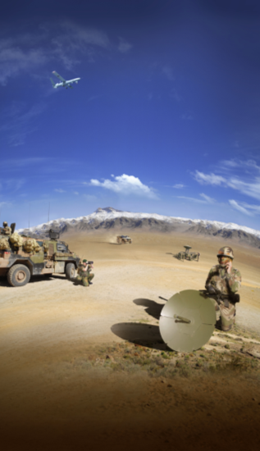
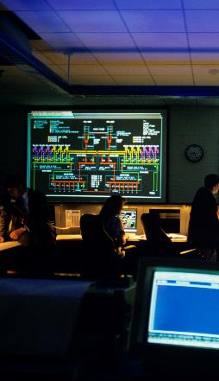
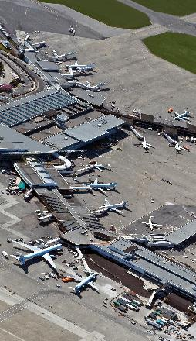
Businesses
AEROSPACE
SPACE
GROUND TRANSPORTATION
DEFENCE
SECURITY
Thales operates as a single organisation, drawing on the talent and technologies of the entire Group to act as prime contractor, systems integrator, equipment supplier and value-added service provider on both civil and military programmes.
EACH OF THE MARKETS THAT THALES SERVES PLAYS A VITAL ROLE IN SOCIETY.

Slide 4
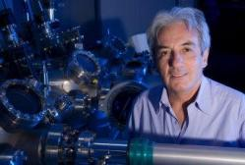
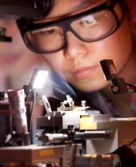
A strategy driven by innovation
Long-term vision
Self-funded R&D: 675 million euros
Focus on key technical domains
Complex systems
Hardware (sensor technologies)
Software
Algorithms and decision support
Open research policy
International network of research centres
Cooperation with academic and government research institutes worldwide
Focused product policy
Shorter development cycles
Risk reduction
ALBERT FERT scientific director of the CNRS/Thales joint physics unit and winner of the 2007 Nobel Prize in Physics.
Some 25,000 Thales employees, over 70% of them engineers, are involved in the Group’s technical operations from research to engineering.
Inventing tomorrow’s products today

Slide 5
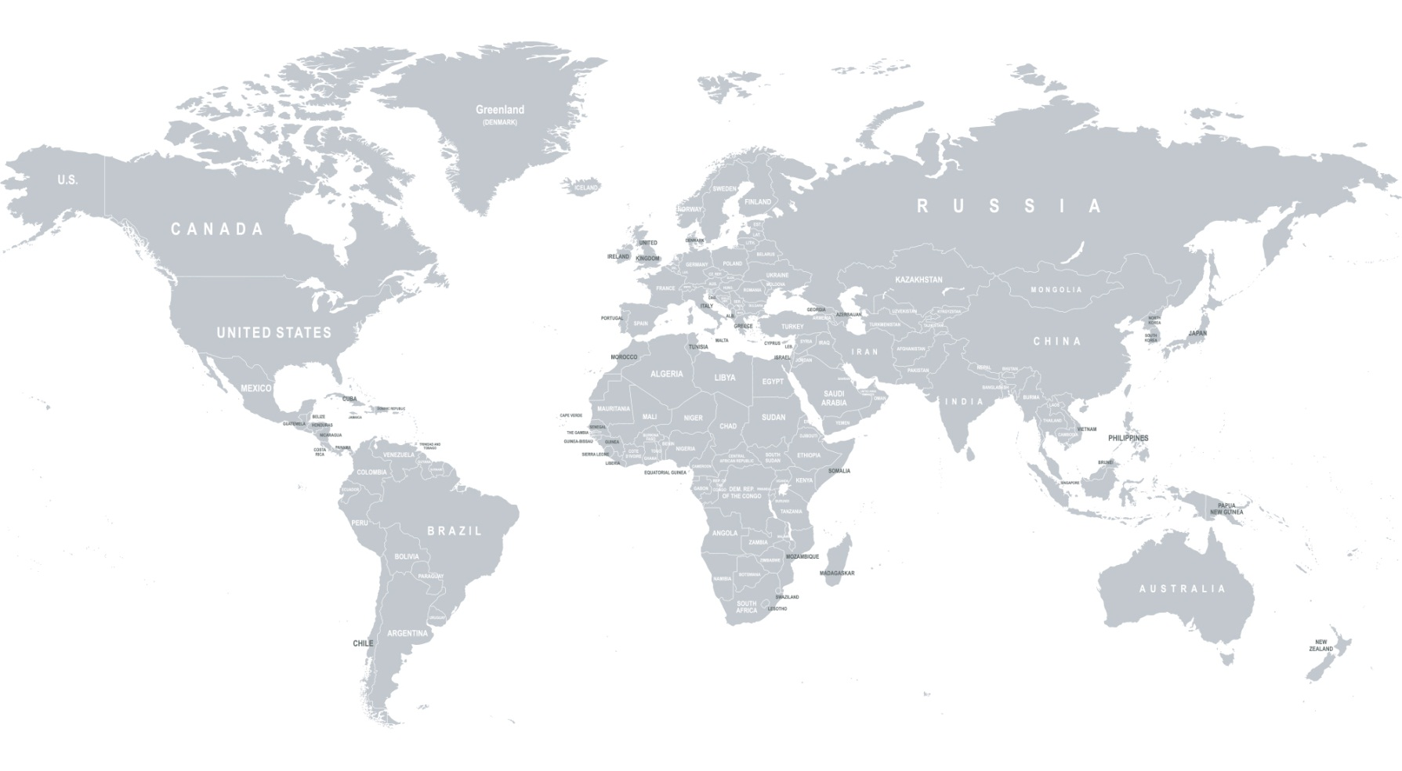
Thales Global Presence (per country)

Slide 6


Together, Safer, Everywhere
Our global approach ensures that customers all over the world have access to the best expertise.
We operate on all five continents, wherever our customers' operations are located. We are stepping up our development in fast-growing economies where our experience and unique value proposition can help customers to meet the new challenges of globalisation, urbanisation and cybersecurity.
Interoperability is part of our genetic code. It is one of our key differentiators and the key to the efficient use of resources in an interconnected, increasingly complex world.
Our solutions – from the smallest component to the most complex systems – are deployed in all environments (air, land, maritime, space, cyberspace) to meet the needs of both civil and military users.
The solutions we propose draw on the knowledge and experience of the Group's best experts, wherever they are located, and benefit from Thales's proven capacity for multinational teamwork. Our global investment strategy is shaped by this relentless quest for technical excellence
TOGETHER, SAFER, EVERYWHERE

