Slide 1
Enel Research and Innovation 09th November 2015

Slide 2































Enel Group overview ¹
Italy
Romania
Slovakia
1° in generation (27%)
1° in distribution (85%)
Capacity: 36,8 GW (of witch 3,1 GW)
30,7 mln power&gas clients
upstream gas activities
2° in distribution (36%)
Capacity: 0,5 GW
2,7 mln customers
1° in generation (82%)
Capacity: 4,9 GW
USA e Canada
Capacity: 2,1 GW
USA
Russia
Capacity : 0,8 GW
Iberia
Generation (5%)
Capacity: 9,1 GW
market
1° in generation (24%)
1° in distribution (42%)
Capacity: 23,5 GW (of witch 1,8 GW)
12,5 mln power&gas clients
Colombia
1° in generation² (21%)
1° in distribution² (22%)
Capacity : 3,0 GW
2,8 mln customers
Eastern
Indonesia
Europe
Trading
Peru
generation
0,7 GW (of witch 0,3 GW)
market
1° in generation (22%)
2° in distribution (31%)
Capacity: 1,9 GW
1,3 mln customers
Brazil
generation(1%) and distribution (7%)
Capacity: 1,3 GW (of witch 0,4 GW)
6,4 mln customers
South Africa
Chile
Generation ~ 0,1 GW (of witch 10 MW)
upstream gas activities
1° in generation (27%)
1° in distribution (33%)
Capacity : 6,8 GW (di cui 0,5 GW)
1,7 mln customers
Argentina
Enel
1° in generation² (11%)
2° in distribution (17%)
Capacity: 4,4 GW
2,5 mln customers
Enel Green Power
# ° Market Positioning
% Market share
GW Enel Green Power Capacity
Uruguay
Capacity under construction
Global Player in 31 Countries
Data as 31th, December 2014
Respect to private players

Slide 3
Enel Group structure
CEO
Administration, Finance and Control
Human Resources and Organization
Communications
Legal and Corporate Affairs
Innovation and Sustainability
European Affairs
Audit
Holding Functions
Global Procurement
Global ICT
Global Infrastructure and Networks
Global Generation
Renewable Energies
Global
Trading
Upstream
Gas
Global Business Line
Italy
Customers
Local Stakeholder
Regulatory
Revenue
Cash flow
EBITDA
Best practices sharing
CAPEX & OPEX efficiency
Capital Allocation
EBITDA
Iberia
Geography
Latin America
Eastern
Europe
Easy and focused organization

Slide 4


Enel Group Dashboard¹
15,82 bln€² EBITDA
34 bln€ Investment
68.961 Employees
Main Indicators
Enel vs European competitors
Infrastructure and Networks
61 mln of end users
37 mln of smart meters
Customers
[mln]
Market
56 mln of power end users
5 mln of gas end users
Installed Capacity
[GW]
Renewables
9,6 GW of installed
capacity
EBITDA
[Bln€]
Generation
86 GW of installed
capacity
Leadership in the different segments of the value chain
Data as 31th, December 2014
Including capital gains, losses and one-off items

Slide 5
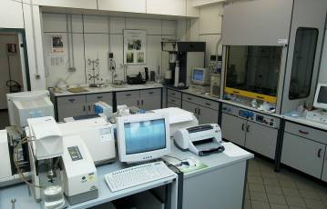
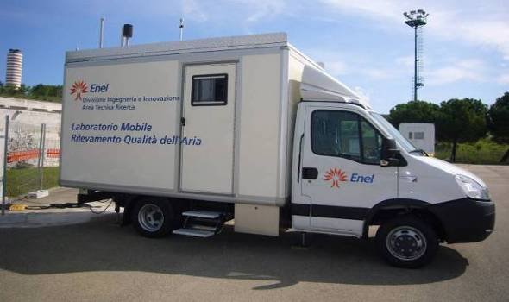
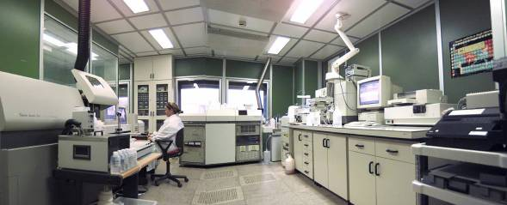
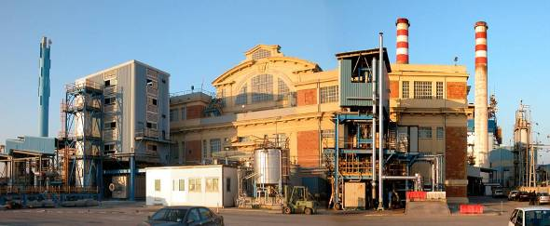
ENEL Research & Innovation
Brindisi:
Chemical Lab
Chemical-environmental analysis
Technological analysis
Micro-morphology and crystal analysis
Eco-toxicology and biological analysis
Pisa:
Chemical Lab
Combustion
Emissions
Micro-pollutants
Computing Centre
Livorno:
Experimental Area
Electric storage facility
Combustion pilot plants
Flue gas treatment facility
Low-enthalpy geothermal demo-plant
Biomass pilot plant (EFGT)
2 Research Centers in Italy
1 Experimental Area
2 Chemical Labs
115 Reseachers

Slide 6
ENEL Research & Innovation Portfolio by Areas
Efficiency and flexibility for Hydro PPs
Technology for efficiency, flexibility and reliability of Hydro PP
Monitoring and Diagnostic Systems for Hydro PP O&M
Emissions & Environmental Impact
Efficiency and flexibility for Thermal PPs
Environmental Impact Management
Advanced solutions to emission control
Water management
Residue Management and Valorization
Advanced solutions for power plant material management
Monitoring and diagnostic systems for Thermal PP O&M
Fuel Flexibility
Technologies for efficiency and flexibility improvement of OIL&GAS PP
Technologies for efficiency and flexibility improvement of Coal PP
Storage & Distributed Generation
Cross Area
Energy storage system
Distributed Generation
Zero Accident Projects
Robotics for O&M

Slide 7
ENEL Research & Innovation Big Data Activities
Completed
Home of the Future (Intrepid project) - Big data analysis for energy optimization of residential buildings
Smart City Malaga - Consumption Profiling (Clustering on consumption patterns)
Mobility Data Analysis - electric vehicle compatibility with current mobility style in Tuscany
Machine learning for non technical losses detection
Ongoing
Energy Management – Trading forecast optimization: Energy market and weather forecast data crawling + machine learning -> Optimized offer on the day-ahead-market
Hydro Diagnostic – Data gathering and Predictive Maintenance

