Slide 1
A successful public-private partnership
Alberto Di Meglio
CERN openlab Head

Slide 2
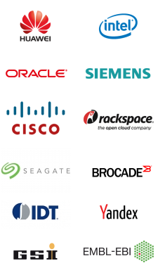



CERN openlab in a nutshell
A science – industry partnership to drive R&D and innovation with over a decade of success
Evaluate state-of-the-art technologies in a challenging environment and improve them
Test in a research environment today what will be used in many business sectors tomorrow
Train next generation of engineers/employees
Disseminate results and outreach to new audiences

Slide 3
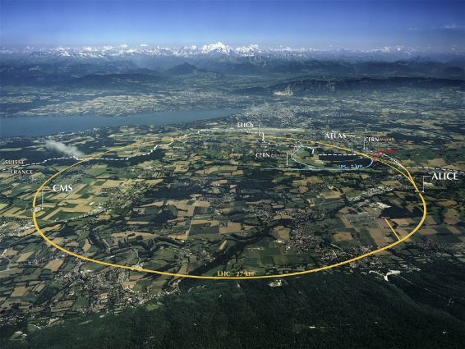
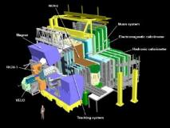
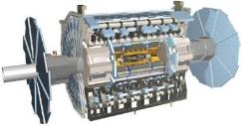
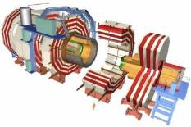
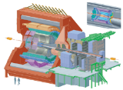
The Large Hadron Collider (LHC)

Slide 4
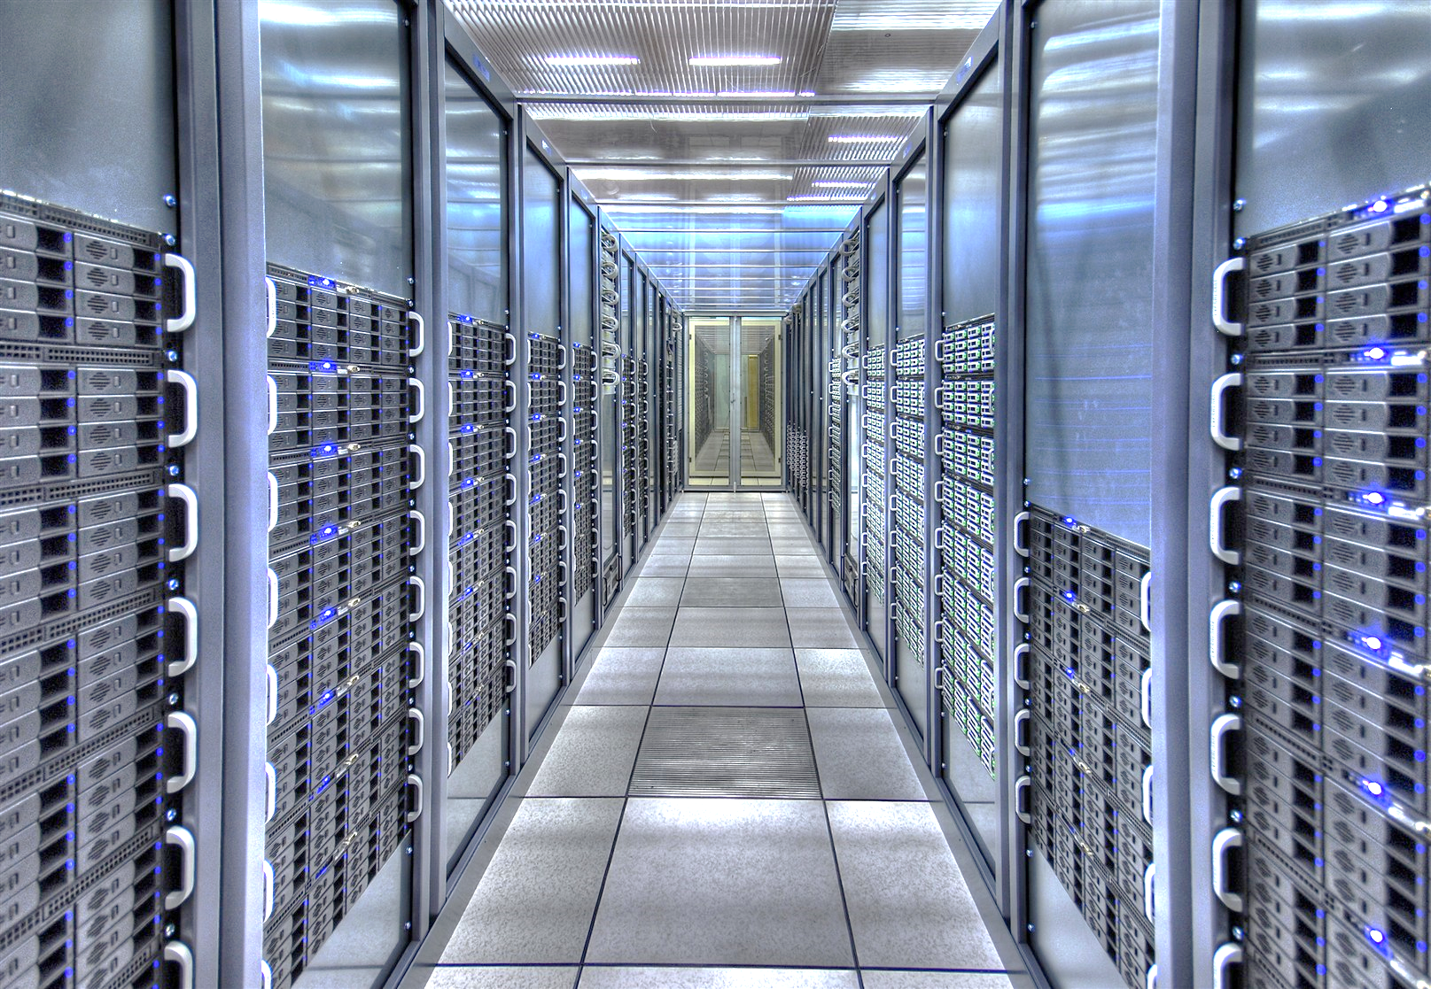
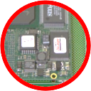
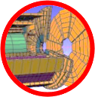

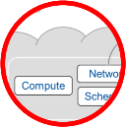


Information Technology Research Areas
Data acquisition and filtering
Computing platforms, data analysis, simulation
Data storage and long-term data preservation
Compute provisioning (cloud)
Networks
Medical applications
Data analytics

Slide 5
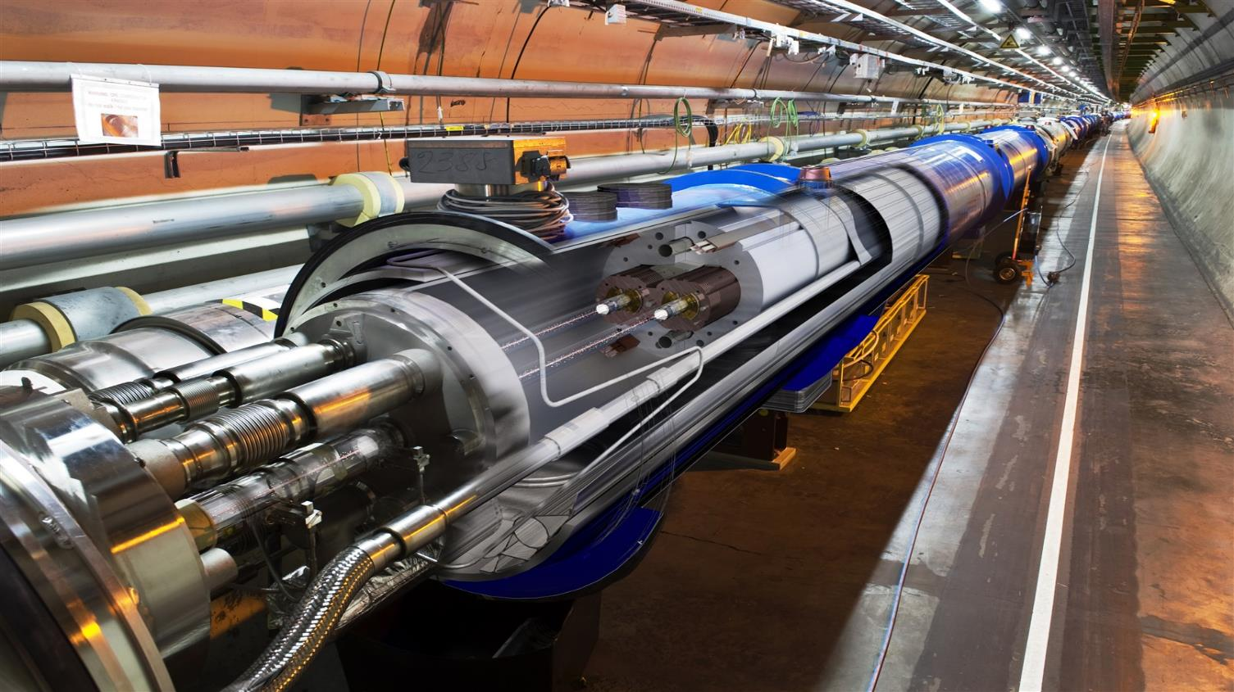
New educational requirements
Multicore CPU programming, graphical processors (GPU),
multithreaded
software
Data Analysis
Machine Learning technologies,
tools,
data visualization,
monitoring, security, etc.
Applications of physics to medical research (hadron therapy, etc.),
simulation
software
Software & Computing Engineers
Data Scientists
Multidisciplinary applications

Slide 6
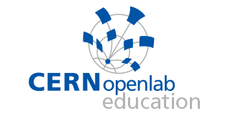
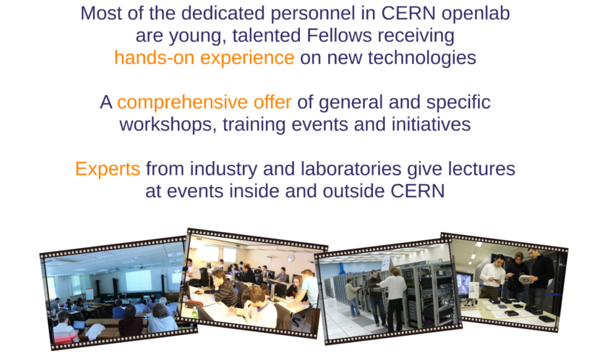
The Educational Programme

Slide 7
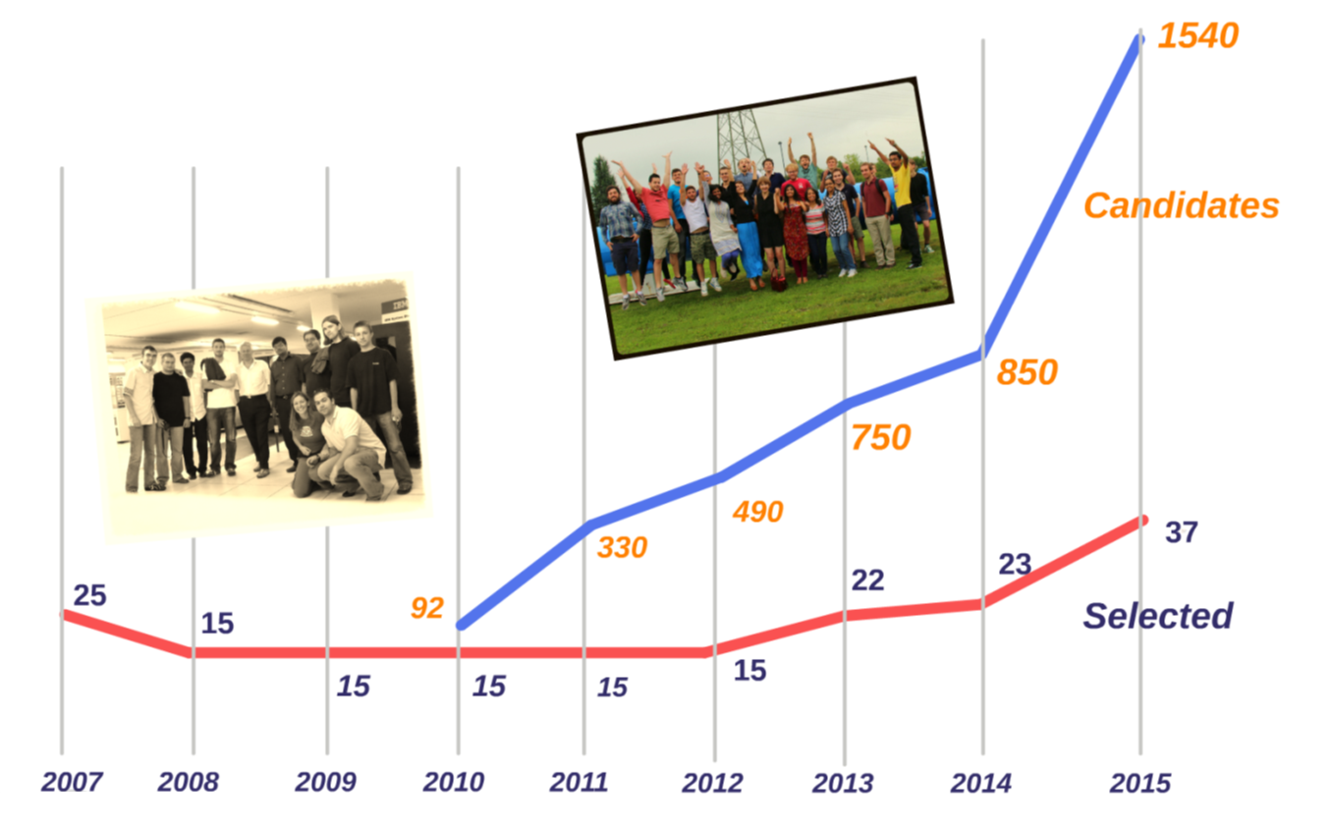
Summer Student Program
In 2015
1540+ applicants
40 selected students
14 lectures
Visits to external labs and companies
Lightning talks session
Technical reports
40

Slide 8
Executive contact
Alberto Di Meglio, CERN openlab Head
alberto.di.meglio@cern.ch
Technical contact
Fons Rademakers, CERN openlab CTO
fons.rademakers@cern.ch
Communication contact
Mélissa Gaillard, CERN openlab Communication Officer
melissa.gaillard@cern.ch
Admin contact
Kristina Gunne, CERN openlab Administration Officer
kristina.gunne@cern.ch

