Slide 1

Structured parallel programming on multi-core wireless sensor networks
Nicoletta Triolo, Francesco Baldini,
Susanna Pelagatti, Stefano Chessa
University of Pisa, Italy

Slide 2
Background: wireless sensor networks
User
Sink
Internet,
Satellite Networks,
etc..

Slide 3
Wireless sensor networks (WSN)
Main tasks of a sensor:
  Sense
  (pre)-process
  Communicate
Models of computation
  Centralized (at the sink, a sensor can make some pre-processing)
  Distributed

Slide 4
Wireless sensor network platforms
platforms for conventional (single-core) sensors:
  8 bits/8MHz microcontrollers (MicaZ, T-Mote)
  128 KB flash memory
  8 KB RAM
  IEEE 802.15.4
  TinyOS + NesC

Slide 5
Trends in WSN
Architectural level:
Application level:
Example of Application Domains: Multimedia WSN and VSN
Single-core WSN
Multi-core WSN
Simple data acquisition + forwarding
in-network processing model compute-intensive applications +computation -communication

Slide 6
Trends in WSN
Parallel architectures of the single sensor node
Distributed computations throughout the WSN
Need for high-level abstractions
to support
Parallel Distributed programming

Slide 7
Example of multi-core WSN node
Raspberry PI 2 Model B
ARM Cortex-A7 CPU
900 MHz quad-core
1GB RAM
Linux-Like + C/C++/Java + Wi-Fi IEEE 802.11

Slide 8
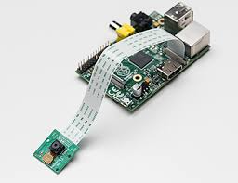
Wireless/Visual Sensor Networks (W/VSN)
Number of networked devices
Each device:
  Microsystem with processor/memory
  Camera
  Wireless/wired network interface
Constrained resources
  Processing, communications
  Energy
Often used for tracking applications
    Mix of video processing, distributed communications

Slide 9
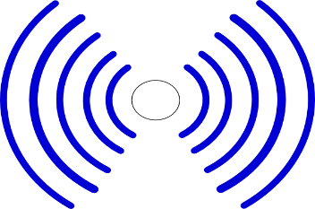
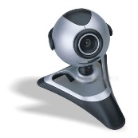
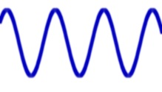
Tracking with W/VSN
A number of cameras cooperatively track a mobile target
Detection when a target is in the Field of View (FoV) of a camera
Each camera computes location information of the target
All location information from different cameras are fused together
  Improve localization accuracy
  Alert other cameras in advance

Slide 10
Example of a tracking application (I)
A generic node c_{i} runs an infinite loop.
In a generic iteration k:
1. Acquisition phase:
Acquires an image from own camera: s^{k}

Slide 11
Example of a tracking application (II)
2. Exchange phase:
c_{i} receives the output m_{i}^{k} from its logical neighbors in n(c_{i} )
where each N_{j} in n(c_{i}) shares (part) of the FOV with c_{i}

Slide 12
Example of an application: tracking (III)
3. Computation phase:
x^{k+1} = f (x^{k} , m₁^{k}, m₂^{k} , … , m_{i}^{k}, s^{k})
f is the aggregation function
x^{k+1} is the output of tracking (estimated position of the target) at step k+1
m_{i}^{k} is the output of neighbor N_{i} at step k
s^{k} is the local image acquired at step k

Slide 13
Example of an application: tracking (IV)
4. Transmission phase:
Broadcasts x^{k+1} to its logical neighbors

Slide 14
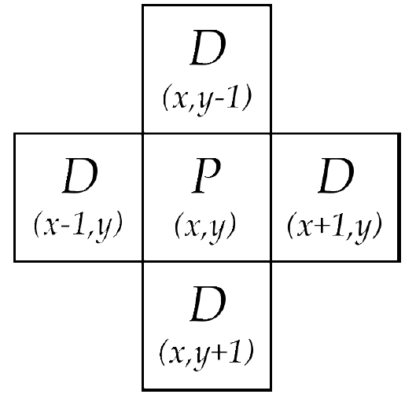
Iterative Neighbor Stencil (INS) skeleton
Stencil-like computation
computation on matrix data structure
Fits common patterns of tracking apps in W/VSN
  Local image acquisition
  Local processing
  Exchange processed data with physical/logical neighbors (cameras with intersection FOVs)

Slide 15
Skeletons: programming abstractions
efficient, portable, reusable and parametric

Slide 16
Modeling tracking applications with INS
Real time execution
τ : max. latency of each round
  At next round data of this round are outdated
ρ : max. fraction of packets lost in each round per node
  Packet loss affects the quality of tracking
Non-functional requirement
Maximize network lifetime by reducing cameras duty cycle.

Slide 17
Modeling tracking applications with INS
Implications on the underlying MAC layer
Determine a communication pattern
Affects packet loss and latency
Affects energy consumption
Two MAC protocols: MACAW and T-MAC
Two extremes:
  MACAW keeps radio always on
  T-MAC schedules off-periods for the radio
Tuning of MACAW and T-MAC for INS

Slide 18
T-MAC and MACAW parameters
T-MAC
Preamble sampling based
Fs: frame size
Ta: length of active time
Vl: contention interval
MACAW
CSMA/CA, exponential backoff, radio always on
Initial backoff length

Slide 19
Simulations
Castalia simulator
CC2420 wireless radio (IEEE 802.15.4)
4,7,10 nodes in a single hop network
100 iterations of the INS skeleton
Round of 0.5 sec.
Camera processing time of 30 msec.
τ=470 msec. (max communication Latency)
ρ=0.1 (max packet loss)
Notes:
Un nuovo frame ogni 0,5 sec.
Una camera elabora il dato in 30 msec.

Slide 20
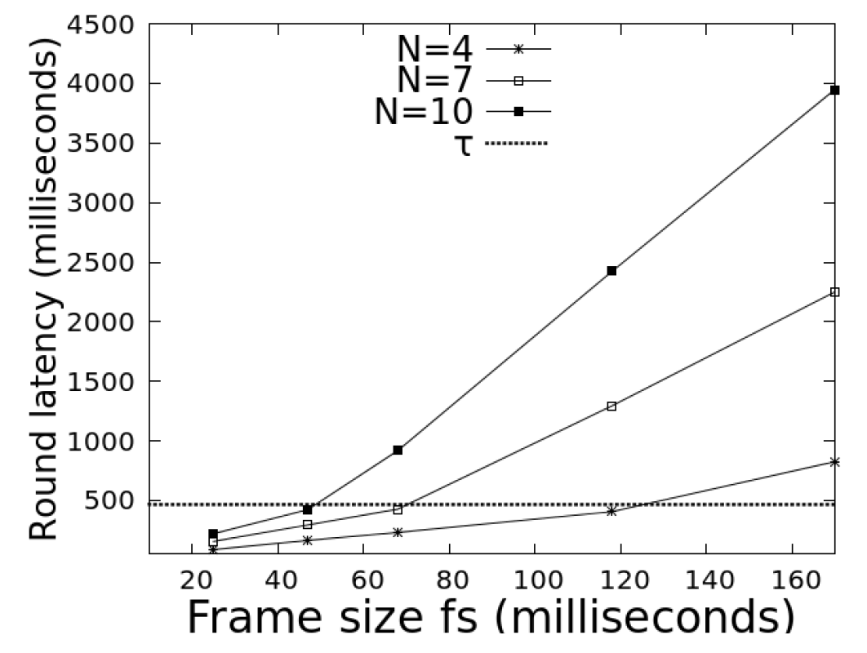
Results
T-MAC
Frame size (Fs)
vs
round latency (τ)
Notes:
Frame size Fs è la lunghezza totale di un frame T-MAC che include un periodo attivo di durata Ta e un periodo inattivo di durata Fs-Ta
All’aumentare della lunghezza del frame aumenta il periodo ne quale la radio è spenta e dopo un po’ si supera il limite
Nel grafico si fissa Ta e Vl a 10 millisecondi

Slide 21
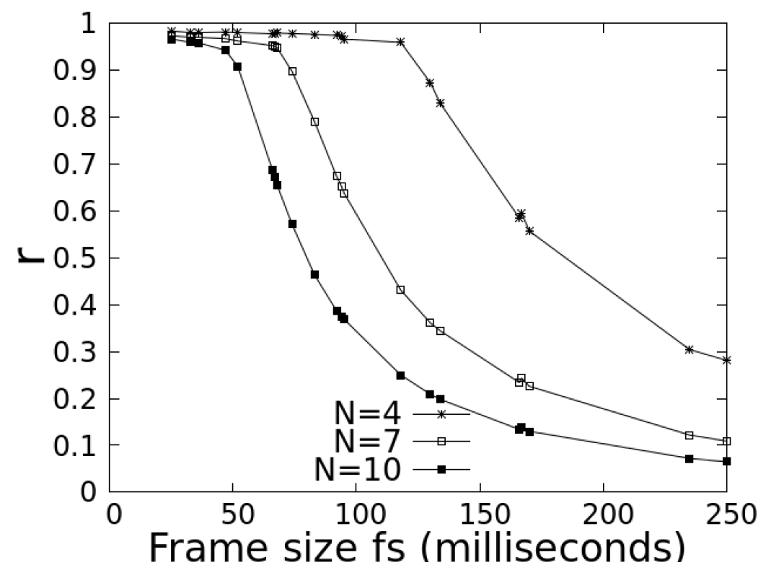
Results
T-MAC
Frame size (Fs)
vs
packet received in time (r)
Notes:
Nota che conferma i risultati precedenti, per N=10 il max frame size è 50 ms

Slide 22
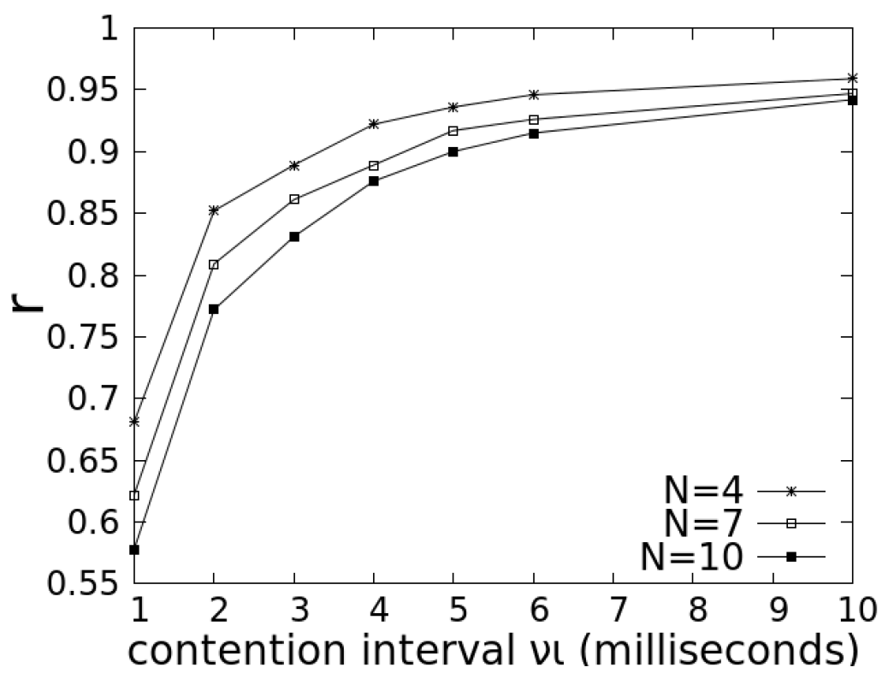
Results
T-MAC
packet received in time (r)
vs
Contention Interval (Vl)

Slide 23
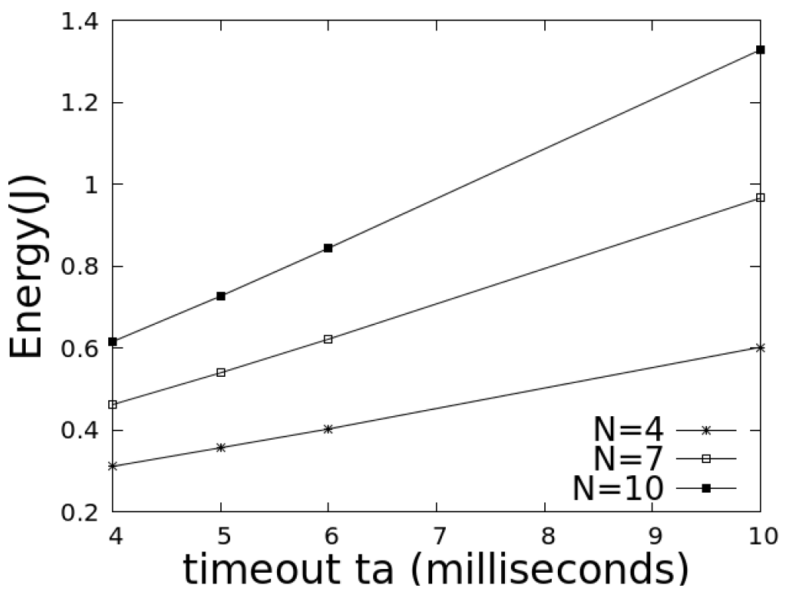
Results
T-MAC
Energy consumption for communications *
vs
Timeout (Ta)
*of the camera that spends more
Notes:
Energy consumption of the camera that spends more!!!

Slide 24
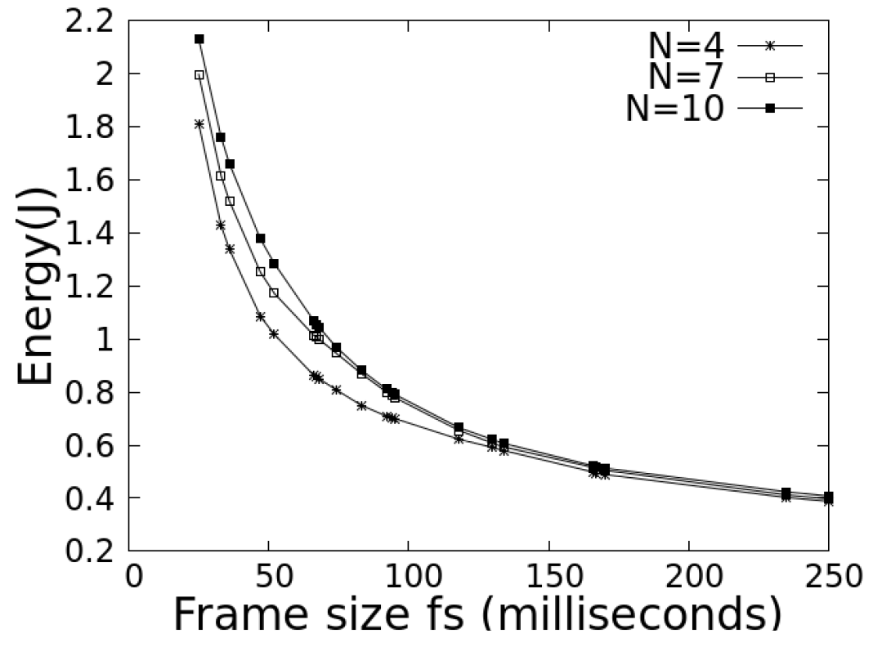
Results
T-MAC
Energy consumption for communications
vs
Frame size (Fs)
Active time Ta=10ms
Notes:
Solo fino a Fs=100 si può usare con N=4, dopo (per N>100) inizia a perdere molti pacchetti ed è per questo che il consumo è simile per tutti gli N
All of this suggests how to configure the T-MAC parameters in order to optimize energy consumption vs latency and packet loss
Fs = t/N
Ta= vl

Slide 25
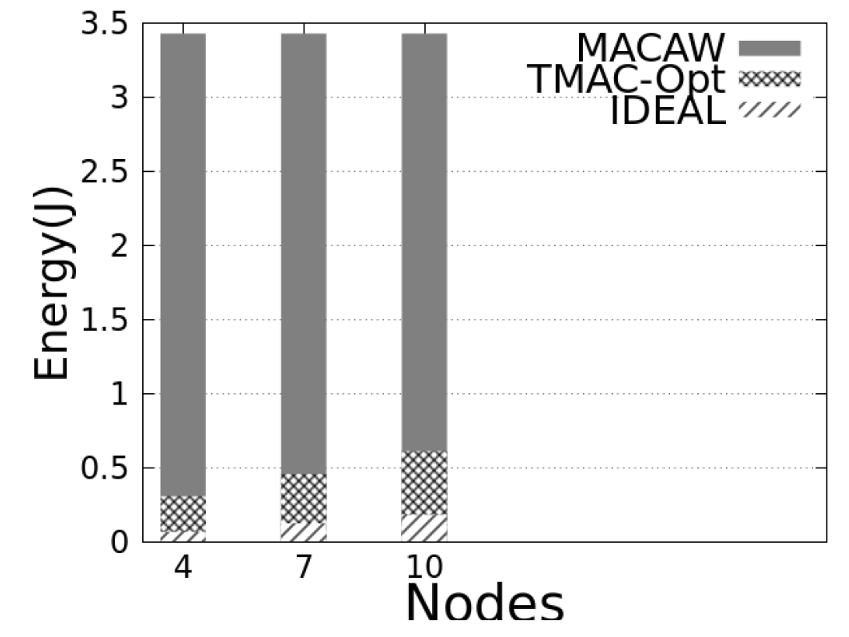
Results
Energy consumption with T-MAC and MACAW
T-MAC configured according to the previous experiments

Slide 26
Conclusions
INS Skeleton fits well processing & communication patterns of tracking applications of W/VSN
Knowledge of communication pattern allows for fine configuration of MAC paramseters
  to achieve energy efficiency
  to meet requirements on latency and packet loss

Slide 27
Future works
Analyse the tracking accuracy w.r.t. energy behaviour of INS
Analyse the behaviour of INS in multihop W/VSN
  cameras with intersecting FOV may be far in the communication topology
Extend this study to other patterns (skeletons) for WSN

