Slide 1
Heterogeneous ARM64 and NVIDIA GPU
Filippo SPIGA^{1,2} <fs395@cam.ac.uk>
¹ High Performance Computing Service, University of Cambridge
² Quantum ESPRESSO Foundation

Slide 2
Why ARM and NVIDIA GPU?
HPC people wants performance, performance in a pure ARM is “not quite there yet”
GPU delivers FLOPS, many GPU-accelerated applications exist
CUDA is not open-source… but programming in CUDA is not difficult
For applications designed for exploiting GPU, the CPU just “drives” the computation... why bother about it?
No one big HPC system but few specialized ones (including a GPU-accelerated)
If nobody starts, we are not going everywhere

Slide 3
Applied Micro X-Gene
ARMv8
8 Cores @ 2.4GHz in-order
PCIE Gen3 (x8 lanes)
40nm TSMC
Processor Module
  2 cores + shared L2 cache
  4 wide out-of-order superscalar microarchitecture
  >100 instructions in flight
  Separate L1I and L1D caches
  Shared L2 cache among 2 CPUs
  globally shared 8MB L3 Cache
1 core → ~5 Watt @ 100%
Source: APM, HotChips 2014

Slide 4
Applied Micro X-Gene
Source: APM, HotChips 2014

Slide 5
ARM+GPU
Today 2 “reference” node architectures on the market...
GPU
GPU
GPU
GPU
GPU
PLX
CPU
CPU
IB
IB
Major limiting factor: lack of PCIe I/O ports

Slide 6
(Missing) Enabling technologies
GPU Direct peer-to-peer
  What is it? Ability to transfer data across multiple GPUs without involve CPU at all.
  Why? Troubles handling PCIe with ARM, NVIDIA driver not yet fully Q/A
GPU Direct over RDMA
  What is it? Ability to transfer data via IB using DMA without involve CPU at all.
  Why? MLN_OFED “should” work, NVIDIA driver not yet fully Q/A, GDRcopy for ARM
Support for NVIDIA K80
  What is it? Two K40 merged together in the same envelope, includes PCIe switch
  Why? Something is wrong in the what the on-board PCIe switch is detected

Slide 7
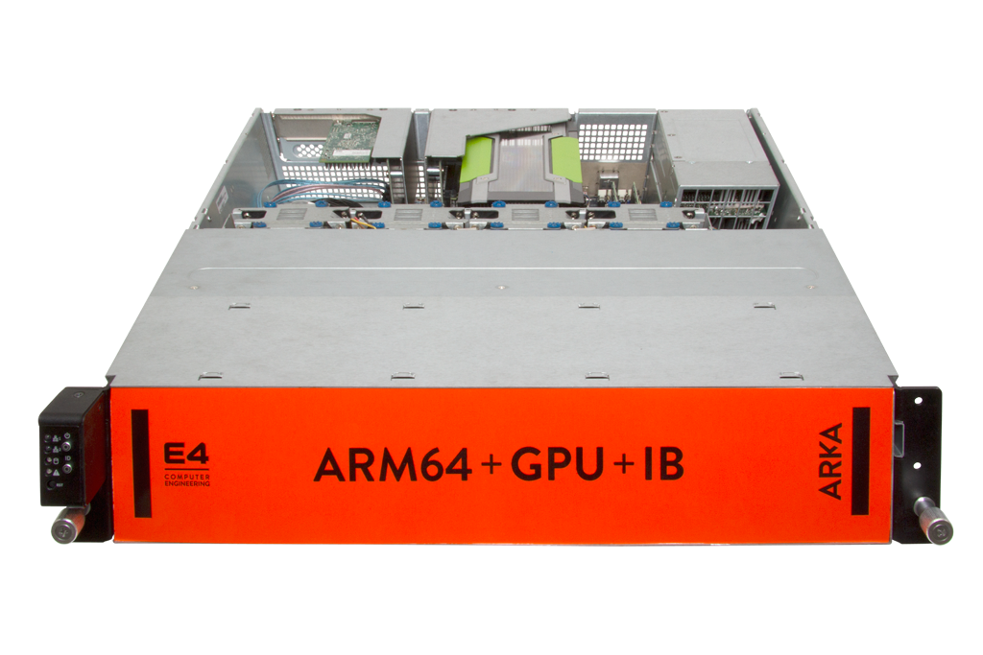
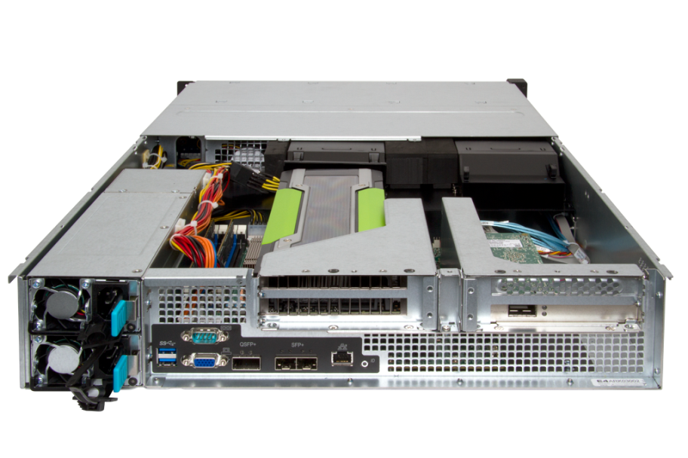

Testing platform: ARKA (E4) - HW
4 nodes
PCIe 8x
Gen 3
Mellanox ConnectX-3
APM
X-Gene
PCIe 8x
Gen 3
Nvidia K40m
2x ETH
(10Gb)
4 x SATA
SATA 2.5’’ SSD

Slide 8
Testing platform: ARKA (E4) - SW
Ubuntu 15.04 (vivid)
CUDA SDK 6.5
GCC 5.2.0
Libraries:
  OpenBLAS 0.2.15-arm_v8
  Open MPI 1.8.5
  ARM Performance Libraries 1.1.0

Slide 9
Energy-to-solution
Energy-to-Solution (ETS) is the total amount of electrical energy (Joule) consumed to reach the a solution
Practically speaking, if we have a "tool" that sample instantaneous power regularly, we can compute the total energy
Goal:
maximize performance (= minimize TTS) while minimize energy-to-solution

Slide 10
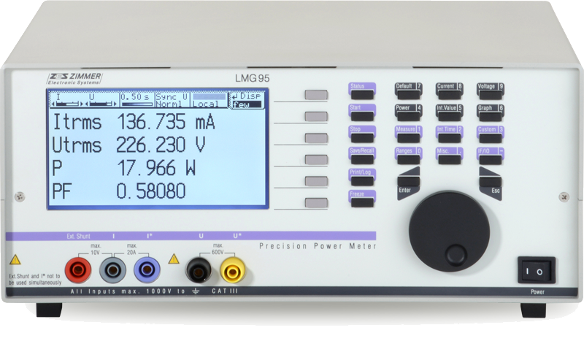
Power instrumentation
No access to Performance Counters (e.g. RALP) on current silicon
No proper IPMI support via Linux
NVIDIA Management Library (NVML) fully supported – GPU covered
Precision Power Meter LMG95
Very good accuracy 0.03%
0.05Hz...500kHz
Data can be read via serial port and dumped into CSV file
We sample idle power before and after, average and then subtract

Slide 11

Applications
HOOMD-BLUE
Python + specialized C / CUDA kernels
No OpenMP but special optimization for AVX
Quantum ESPRESSO
FORTRAN 90/95
GPU covers most of BLAS, LAPACK, FFTs
NO EXPLICIT OPTIMIZATIONS MADE TO COPE WITH NEW NODE ARCHITECTURE

Slide 12
HOOMD-BLUE (triblock copolymer)
10K steps, ~95% (CPU) workload moved on GPU, 1 OMP
~50x
~11x
-78%
TIME-TO-SOLUTION [s]
PEAK POWER [W]
ENERGY-TO-SOLUTION [Joule]

Slide 13
HOOMD-BLUE (triblock copolymer)
375MiB / 11519MiB = 3%
10K steps, … , 6 MPI
~6.3x
~4x
-40%
TIME-TO-SOLUTION [s]
PEAK POWER [W]
ENERGY-TO-SOLUTION [Joule]

Slide 14
QE-GPU (AUSURK112, gamma-point)
10 iterations, ~60% (CPU) workload moved on GPU, 6 OMP
~4.9x
~7x
-6%
TIME-TO-SOLUTION [s]
PEAK POWER [W]
ENERGY-TO-SOLUTION [Joule]

Slide 15
QE-GPU (AUSURK112, k-point)
3 iterations, ~70% (CPU) workload moved on GPU, 6 OMP
~6x
~6.9x
-16%
TIME-TO-SOLUTION [s]
PEAK POWER [W]
ENERGY-TO-SOLUTION [Joule]

Slide 16
General considerations
ARM64 + GPU is worth considering for those applications where majority workload can be move on a GPU
Python ecosystem is mature
User experience not yet completely smooth…
  Compiling everything take longer than normal systems...
  Need hacking around makefiles and autoconf...
We need more open-source!
  ARM Performance Libraries / NAG (commercial), PathScale (commercial), PGI (commercial), ...
Some current silicon chips lack of proper robust “turn on/off cores” feature

Slide 17
Energy-awareness → Energy-efficiency
Where I can save energy?
When MPI communication occurs
During GPU-only algorithms
When OpenMP scaling is not that efficient
Energy API (collaboration with Andrea Bartolini)
Self-contained C library & FORTRAN bindings
Switch on/off cores on-demand
Re-scale frequency on-demand

Slide 18
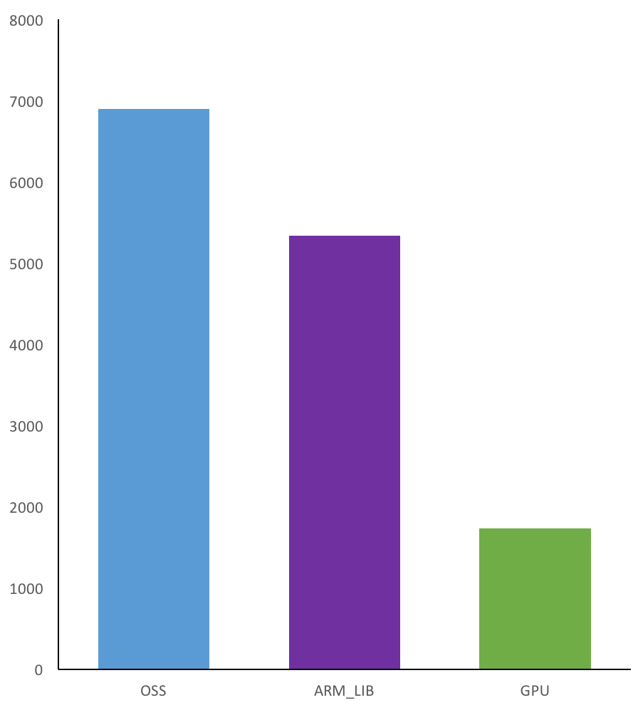
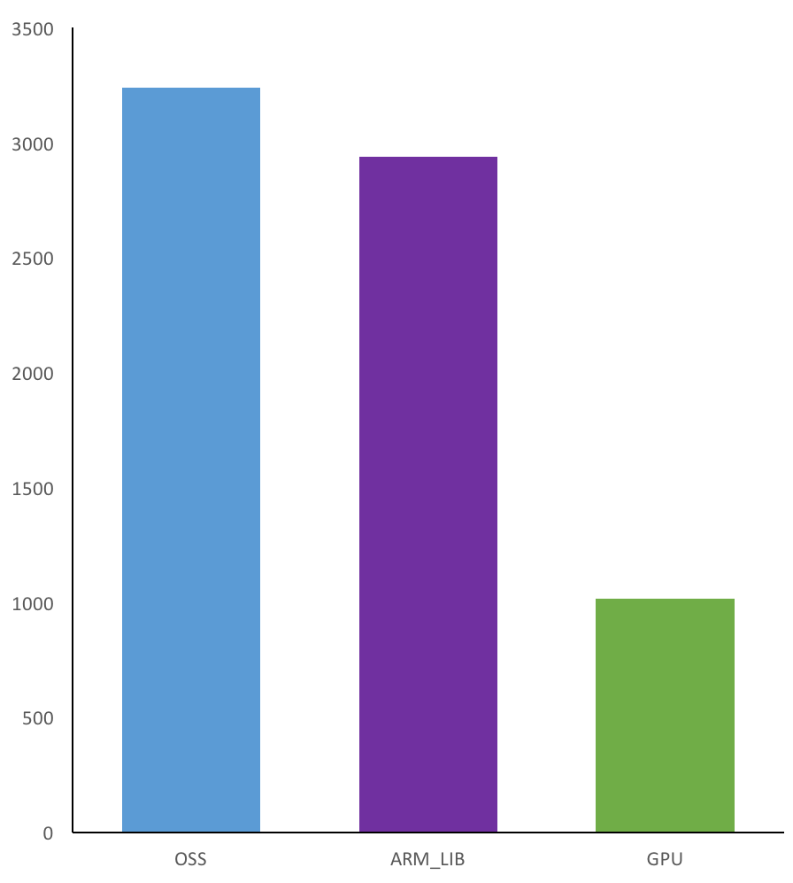
Bonus: evaluating ARM Performance Libraries
SiO2
(serial, 8 OMP)
GeSnTe134
(parallel, 4 MPI + 8 OMP)
23%, 3.9x
~10%, 3.1x

Slide 19
Next Steps
Validate, validate, validate !!!
Mixing GPU and ARM_LIB
Improve data movement (PCIe ←→ GPU), memory management (on the GPU), process binding and thread affinity
Experiment with Energy API
Find the “sweet spots”, find the use-cases
Engage with the boader community to build a better software ecosystem

Slide 20
THANK YOU FOR YOU ATTENTION

