Slide 1
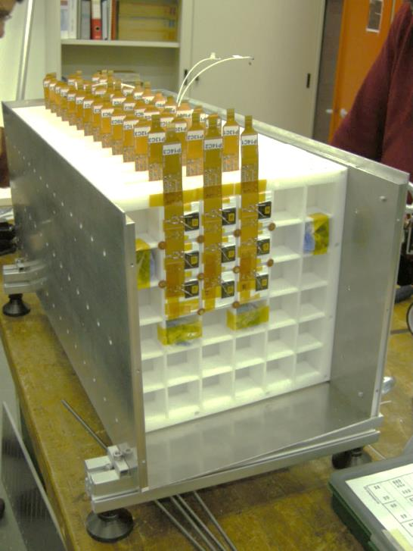
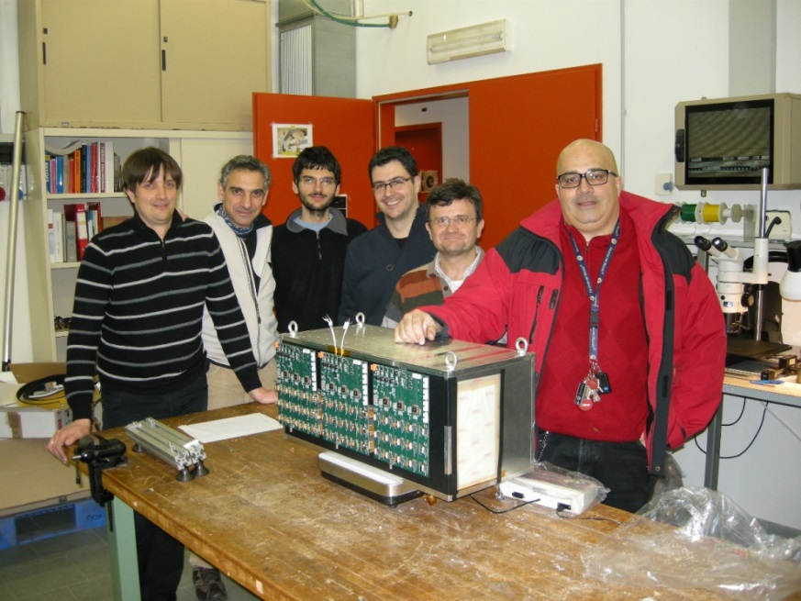
Stato dell’analisi dei test su fascio
Vannuccini Elena
On behalf of the Florence group

Slide 2
Sommario test su fascio
Feb 2013 → Test su fascio all’SPS del CERN
(Pb+Be) → Ioni A/Z=2 @13-30 GeV/u
Prima versione del prototipo 14 piani
Lug 2014 → Test su fascio di elettroni alla BTF di Frascati
Elettroni multipli 1×500 ÷ 400×300 MeV
Studio del regime di transizione di CASIS tra alto e basso guadagno e della dipendenza della risposta dalla tempistica del segnale
Feb 2015 → Test su fascio all’SPS del CERN
(Ar+Polyethylene) → Ioni A/Z=2 @19-30 GeV/u
Upgrade: cristalli schermati per eliminare cross-talk ottico + 15° piano equipaggiato con «cristalleria»
Aug/Sep 2015 → Test su fascio all’SPS del CERN
Elettroni, muoni e adroni fino a 350 GeV
Upgrade: rivestimento cristalli ottimizzato (vikuiti) e implementazione PD di piccola superficie (basso guadagno)

Slide 3
Feb2013 → Single crystal signal
Signal of the first crystal along the beam direction
All events
Not-interacting 4He
hig gain ←|→ low gain
Test 2013
Pb+Be
30 GeV/u
Hit ≡ 5×RN cut
4He
2H
log(ADC counts)

Slide 4
Feb2013 → Ionization signal –vs– Z²
Non-linear behaviour for higher Z → not instrumental but physical effect
Ionization signal
Cross-talk signal
Equilized ADC counts
Equilized ADC counts
|
Cl
Na
|
F
|
Ne
|
Ne
|
O
|
|
Na
F
|
O
|
Non-linearity in scintillator response to high-Z ions
Linear fit from He to O
Linear fit from Na to Cl
Courtesy of Pisa/Siena group

Slide 5
Feb2013 → Ionization signal –vs– Z²
Discrepancy between beam-test and MC data
Not-interacting ions
30.0GeV/u
(2013 test)
$$S∝Z^{2}$$
Prototype calibrated with He
MC tuning:
14% optical cross talk → to match cube/layer signal ratio for C
4.5% additional gaussian spread to single-crystal signal → to match ionization-signal spread
17%
discrepancy
 Central crystal (gaussian fit)
 Total over layer
MC normalized to MIP

Slide 6
Feb2013 → Showers: beam-test –vs– MC data
+1%
-5%
Beam test
MC
+5%
-3%

Slide 7
Feb2013 → Showers: energy resolution –vs– A
$${\left(\frac{σ_{E}}{E}\right)}_{A}=\frac{1}{\sqrt{A}}{\left(\frac{σ_{E}}{E}\right)}_{p}$$
● Beam test 2013
○ MC
$$\left(\frac{σ_{E}}{E}\right)\sim \frac{RMS}{MEAN}$$
30 GeV/n
12.8 GeV/n
Showers starting on layer 3

Slide 8
Feb2013 → Beam-test –vs– MC data
+4%
-10%
● Beam-test
○ MC
30.0 GeV/n
12.8 GeV/n
Beam test
MC
+6%
-14%

Slide 9
Feb2013 → Energy resolution –vs– A
$${\left(\frac{σ_{E}}{E}\right)}_{A}=\frac{1}{\sqrt{A}}{\left(\frac{σ_{E}}{E}\right)}_{p}$$
● Beam test 2013
○ MC
$$\left(\frac{σ_{E}}{E}\right)\sim \frac{RMS}{MEAN}$$
30 GeV/n
12.8 GeV/n
Showers starting on layer 1

Slide 10
Feb2013 → conclusions
First prototype exposed to ions of total energy ranging between ∼ 20÷2000 GeV (D÷Fe)
Study of detector response to ionization energy deposits
Non-linear Z² dependency found
Study of shower classification and energy resolution
MC tuned on 2013 data → agreement MC/data within 15%
Difficulty in MC tuning due to optical cross-talk

Slide 11
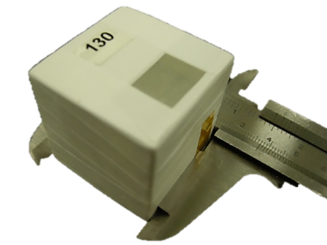
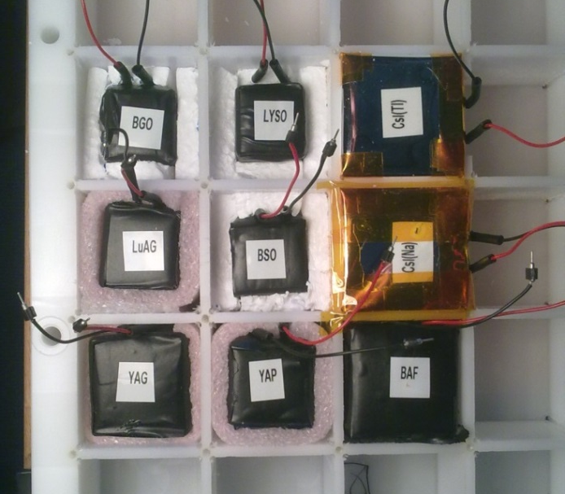
The Feb-2015 setup
Assembly
CsI(Tl) cubes 3.6 cm side
diffusive (Teflon tape) wrapping
+ absorber layer (Tedlar film) to shield optical cross-talk
3×3×14 elements (0.4 cm gap)
∼1.5 R_{M} containment
active depth 27 X₀→1.3 λ_{I}
Spare 3×3 layer with test crystals
Sensors
VTH2090H PDs
Active area 84.6 mm2 × 0.3 A/W @550 nm
FE electronics
CASIS
Teflon wrapping
+
black Tedlar film

Slide 12
The Feb-2015 setup
BEAM TRACKER (BT)
4 Si-pixel matrixes + 8 Si-strip layers
CALORIMETER
3×3×14 CsI:Tl crystals
SPARE PLATE
3×3 test crystals
FRONT exposure
ION
BEAM
BACK exposure
ION
BEAM

Slide 13
Feb2015 → Single crystal signal
Signal of the first crystal along the beam direction
All events
Not-interacting 4He
hig gain ←|→ low gain
Test 2015
Ar+Polyethylene
30GeV/u
4He
Hit ≡ 5×RN cut
2H
log(ADC counts)

Slide 14
Feb2015 → Calibration
Scan of 3×3 column with ion beam
FRONT + BACK exposure
Iterative selection of not-interacting He (standalone calorimeter)
Events with interacting ions accepted up to 1-layer before interaction point
First iteration → topological selection (cube-to-layer fraction > 90%)
Second iteration → + charge selection (signal ∈ MP±1.5⋅SIG)

Slide 15
Front exposure
0
1
2
3
4
5
6
7
8
9
10
11
12
13
14
Candidate He event
Accepted up to layer 11

Slide 16
Front exposure
0
1
2
3
4
5
6
7
8
9
10
11
12
13
14
Candidate He event
Accepted up to layer 5

Slide 17
Front exposure
0
1
2
3
4
5
6
7
8
9
10
11
12
13
14
Candidate D
Accepted up to layer 3

Slide 18
Back exposure
0
1
2
3
4
5
6
7
8
9
10
11
12
13
14
Candidate He event
Accepted up to layer 8

Slide 19
Front exposure
0
1
2
3
4
5
6
7
8
9
10
11
12
13
14
Heavy ion (Ar? Si?)
Accepted up to layer 5

Slide 20
Back exposure
0
1
2
3
4
5
6
7
8
9
10
11
12
13
14
Heavy ion (Ar? Si?)
Accepted up to layer 11

Slide 21
Feb2015 → Calibration parameters
19 GeV/u front ~ 1050
30 GeV/u front ~ 974
30 GeV/u back ~ 1069

Slide 22
Calibration parameters (2013)
Gain dispersion ~14%
Gain +50%

Slide 23
Maximum gain
19 GeV/u (front)

Slide 24
Minimum gain
19 GeV/u (front)

Slide 25
Maximum statistics (@first layer)
19 GeV/u (front)

Slide 26
Minimu statistics (n.entries>1000)
19 GeV/u (front)

Slide 27
Feb2015 → Parameter comparison
Weighted ratios:
1.019
1.004
1.028
19 GeV/u
front
30 GeV/u
front
30 GeV/u
back

Slide 28
Feb2015 → Statistical errors
19 GeV/u front
30 GeV/u front
30 GeV/u back

Slide 30
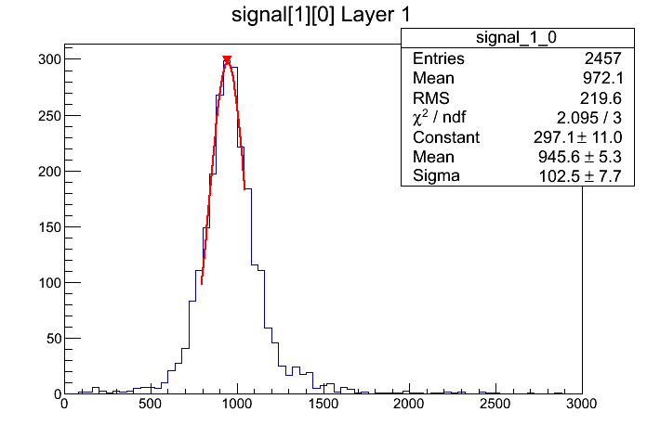
19 GeV/u front –vs– 30 GeV/u front

Slide 31
Gain dispersion
RMS ∼ 21%
Merging of front&back data-set @30 GeV/u
Crystal responses equalized by normalizing to 4MIP the ionization energy deposit of 4He (@peak)
2015 → ${\left\langle S/N\right\rangle }_{1MIP} \sim 8$
Lower signal and larger dispersion due to absorber wrapping
(preliminary)
(Spare plane with test crystals)
CsI(Tl) with diffusive+reflective wrapping (Teflon+Vikuiti)
ADC counts
Feb2013
∼1510
Feb 2015
∼1050

Slide 32
2013 –vs– 2015 prototype
beam-test 2013
beam-test 2015
33.8%
33.5%
Showers starting on layer 2
He @ 30.0 GeV/n
preliminary
(Z-tagging from first calorimeter layer )

Slide 33
Test of scintillating materials
Test of 9 scintillating materials
CsI:Na, CsI:Tl, YAG:Ce, BaF2, YAP:Ce, LuAG:Ce, BSO, BGO, LYSO:Ce
Teflon+Vikuiti+Tedlar wrapping
Z-tagging from BT+CAL
Study of the ionization signal –vs– Z²
ION
BEAM
BEAM TRACKER (BT)
4 Si-pixel matrixes + 8 Si-strip layers
SPARE PLANE
3×3 test crystals
CALORIMETER
3×3×14 CsI:Tl crystals

Slide 34
«Cristalleria»
 | Density (g/cm3) | l (cm) | X₀ (cm) | l/X₀ | R_{M} (cm) | Cube side (cm) @ 2t | Total n.int.lengths @ 2t | Total n.rad.lengths @ 2t | W.L. max. emission (nm) | D.time (ns) | L.Y. (%) @300K |  | Cherenkov | L.Y.*VTH2090 Sp.Res. / W.L.max | ... * ρR_{M}/16.1
CaF2:Eu | 3,18 | 34 | 3,1 | 11 | 3,7 | 86 | 2,5 | 28 | 435 | 940 | 50 | Scionix |  | 25,3 | 18,4
CsI | 4,5 | 40 | 1,9 | 21 | 3,6 | 76 | 1,9 | 41 | 310 | 10 | 5 | DETEC | ? | 1,6 | 1,6
CsI:Na | 4,5 | 40 | 1,9 | 21 | 3,6 | 76 | 1,9 | 41 | 420 | 630 | 88 | DETEC | ? | 43,0 | 43,0
CsI:Tl | 4,5 | 40 | 1,9 | 21 | 3,6 | 76 | 1,9 | 41 | 550 | 1250 | 165 | DETEC |  | 100 | 99,8
YAG:Ce | 4,57 | 25 | 3,5 | 7 | 2,8 | 76 | 3,0 | 22 | 550 | 70 | 40 | Crytur | ? | 24,2 | 19,5
BaF2 | 4,89 | 31 | 2,0 | 15 | 3,1 | 74 | 2,4 | 37 | 300 | 630 | 36 | Scionix |  | 10,5 | 9,9
YAP:Ce | 5,5 | 22 | 2,7 | 8 | 2,4 | 71 | 3,3 | 26 | 370 | 27 | 47 | Scionix |  | 19,9 | 16,3
LuAG:Ce | 6,73 | 21 | 1,5 | 14 | 2,2 | 67 | 3,3 | 46 | 535 | 70 | 20 | Crytur |  | 11,9 | 11,0
BSO | 6,8 | 22 | 1,1 | 20 | 2,2 | 67 | 3,0 | 60 | 480 | 100 | 6 | MolTech |  | 3,3 | 3,0
BGO | 7,13 | 23 | 1,1 | 20 | 2,2 | 65 | 2,9 | 58 | 480 | 300 | 21 | CERN |  | 11,6 | 11,4
LYSO:Ce | 7,4 | 21 | 1,1 | 19 | 2,1 | 65 | 3,1 | 59 | 402 | 40 | 85 | Cinesi |  | 39,7 | 37,8
PWO | 8,3 | 21 | 0,9 | 23 | 2,0 | 62 | 3,0 | 70 | 425 | 5 | 0,3 | MolTech |  | 0,1 | 0,1

Slide 35
Segnali attesi
Z → | 1 | 2 | 3 | 4 | 5 | 6 | 7 | 8
CaF2:Eu | 18 | 74 | 166 | 295 | 461 | 664 | 904 | 1181
CsI | 2 | 6 | 14 | 25 | 39 | 56 | 77 | 100
CsI:Na | 43 | 172 | 387 | 687 | 1074 | 1546 | 2105 | 2749
CsI:Tl | 100 | 399 | 898 | 1596 | 2494 | 3592 | 4889 | 6386
YAG:Ce | 19 | 78 | 175 | 312 | 487 | 701 | 954 | 1246
BaF2 | 10 | 40 | 89 | 159 | 248 | 357 | 486 | 634
YAP:Ce | 16 | 65 | 146 | 260 | 407 | 586 | 798 | 1042
LuAG:Ce | 11 | 44 | 99 | 175 | 274 | 394 | 537 | 701
BSO | 3 | 12 | 27 | 49 | 76 | 110 | 149 | 195
BGO | 11 | 46 | 103 | 183 | 286 | 411 | 560 | 731
LYSO:Ce | 38 | 151 | 340 | 604 | 944 | 1360 | 1851 | 2417
PWO | 0 | 0 | 1 | 1 | 2 | 3 | 4 | 5
X
X
X
X
X
X
X
X
X
Segnale di ionizzazione atteso (% del CsI:Tl), tenendo conto della risposta spettrale del PD, della LY, delle dimensioni e della densità del cristallo, in funzione dello ione.
CsI(Tl) ⇒ S/N>10 @mip (CERN 2013)
Evidenziati gli ioni dai quali ci si aspetta un segnale rivelabile (S/N>5)

Slide 36
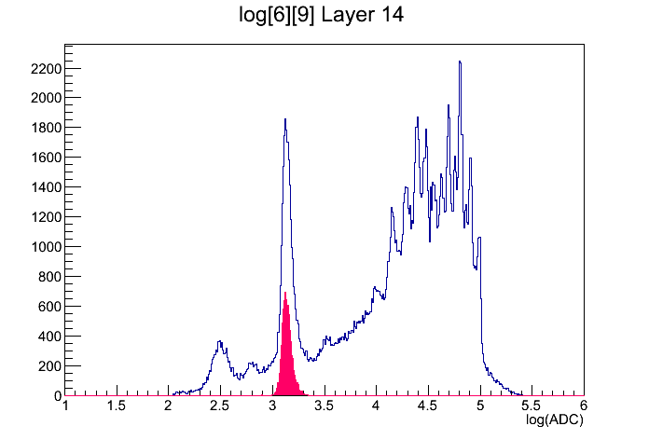
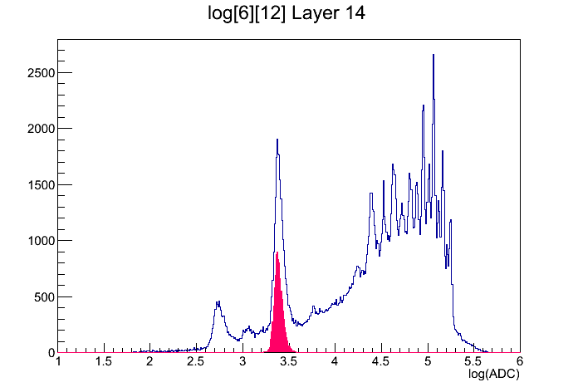
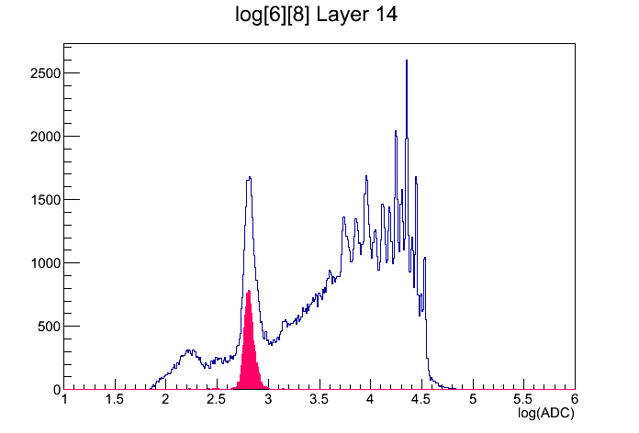
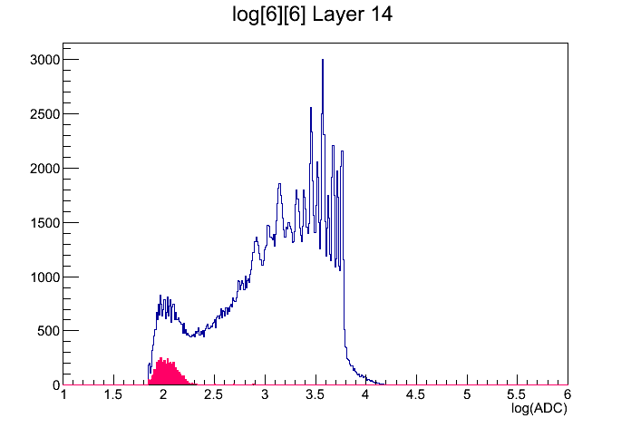
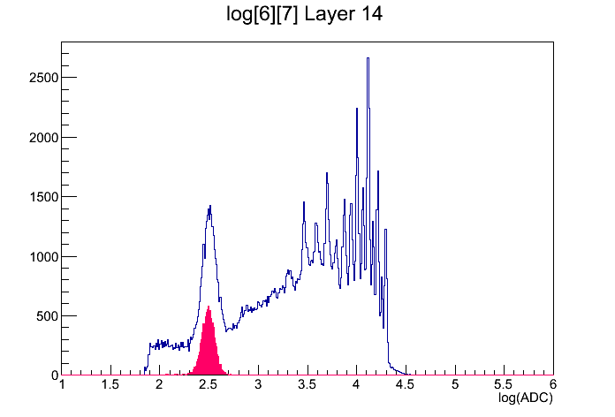
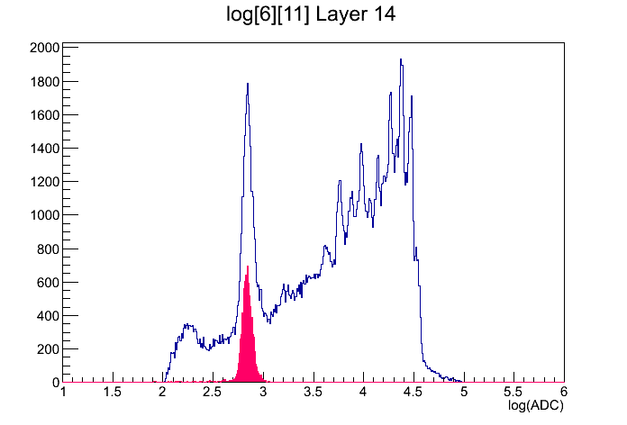
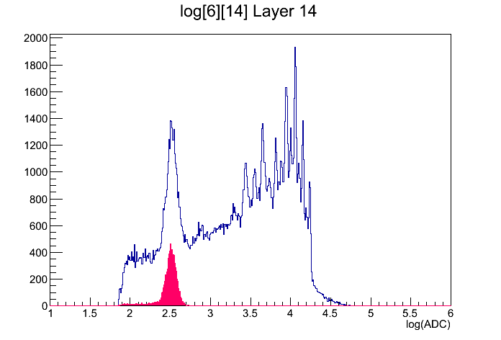
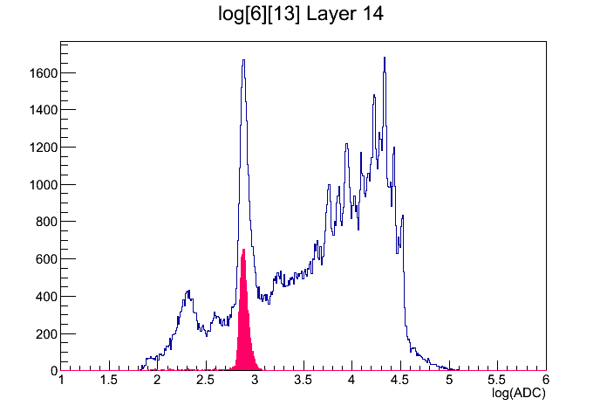
Signals
CsI:Na
CsI:Tl
YAG:Ce
BaF2
YAP:Ce
LuAG:Ce
BGO
LYSO
All events
Non-interacting He

Slide 37
Crystals
YAP
 | Expected |  | Measured
 | Z=1 (a.u.) | Z=2 (a.u.) | Z=2 (ADC counts) | Relative width | Norm. @CsI:Tl (a.u.) | Measured/Expected
CsI:Na | 43 | 172 | 1336 | 8,3% | 229 | 1,3
CsI:Tl | 100 | 399 | 2330 | 7,6% | 399 | 1,0
YAG:Ce | 19 | 78 | 642 | 9,4% | 110 | 1,4
BaF2 | 10 | 40 | 95 | 14,6% | 16 | 0,4
YAP:Ce | 16 | 65 | 316 | 13,7% | 54 | 0,8
LuAG:Ce | 11 | 44 | 674 | 9,1% | 115 | 2,6
BSO | 3 | 12 | - | - | - | -
BGO | 11 | 46 | 312 | 13,4% | 53 | 1,2
LYSO:Ce | 38 | 151 | 759 | 7,6% | 130 | 0,9
LuAG
(preliminary)

Slide 38
Next steps
Implementation of BT information, under progress
Shower analysis:
Comparison of energy resolution for individual ions with Feb2013 results
Tuning of MC model (no OCT) and comparison with beam-test data
Test crystals:
Study of ionization signal with Z-tag given by BT

