Slide 1
Simulazione:applicazione della tecnica del dual readout
M. Bongi, S. Bottai , 12/11/2015

Slide 2
THE SIMULATION & RECONSTRUCTION TOOL
Fluka-based MC simulation
  3,6cm CsI Scintillating crystals Scintillation Light collection efficiency and PD quantum efficiency (BGO , PWO ………..)
  Photodiode Energy deposits in the photodiodes due to ionization are taken into account
  Carbon fiber support structure (filling the gaps between crystals)
  Number of crystals passed via parameter
  New dedicated versions for Cherenkov and Neutrons detection added recently (to be finalized and eventually ‘unificated’ with standard version)
C++ reconstruction tools
  Noise
  Shower axis reconstructed by fit
  Lateral and longitudinal profiles respect to axis
  Point of first interaction along axis
  Length from first interaction to end of calorimeter
  ............................................................................
No MC truth is needed
in the analysys

Slide 3
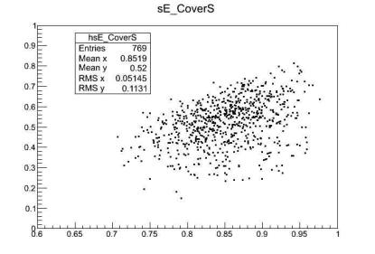
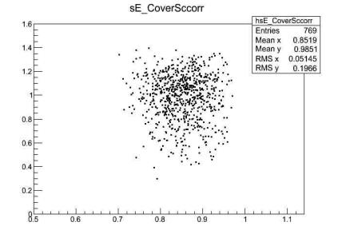
Apply the C/S correction to CALOCUBE
DUAL READOUT IN CALOCUBE
Vertical protons E=100 GeV, interacting in the first layer
S/E
S_{corrected}/E
RMS=22%
RMS=20%
C/S
C/S
C=cherenkov and S=scintillation signals properly normalized
RESOLUTION IMPROVEMENT ~ 10%

Slide 4
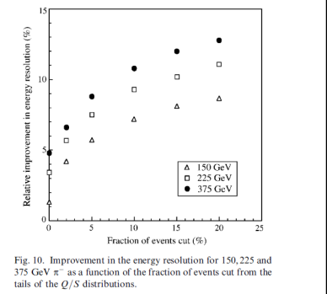
ACCESS CALORIMETER : THIN SAMPLING CALO
Vladimir Nagaslaev, Alan Sill, Richard Wigmans
TEST BEAM ANALYSIS
~ 10%
IMPROVEMENT DUE TO DUAL REDOUT ~ 10%

Slide 5
E=Ee +E_{h}
E_{e} =E*fem E_{h} =E*(1-fem)
S_{em} =Ee * k_{e}
Energy lost in ionization by electromagnetic fraction
S_{had} =E_{h} * k_{h}
Energy lost in ionization by hadronic fraction
E
calorimeter
EE
Eh
S_{em} =Ee * k_{e}
Typical values
in our calo
S_{had} =E_{h} * k_{h}
k_{e} ~ 0,95
Nucl excit., neutrons, p leak. !
k_{h} ~ 0,1-0,2
π+/-

Slide 6
With Scintillation only we see total contribution to energy loss
Erec=α S_{tot}=α(S_{em}+S_{had})=α (Ee * k_{e} + E_{h} * k_{h} )=α (fem * E * k_{e} + (1-fem)*E * k_{h} )
If k_{e} ≠ k_{h} the fluctuation of fem induce a fluctuation on Erec
If k_{e} = k_{h} Erec= α (fem * E * k_{e} + (1-fem)*E * k_{h} )= α k_{e} Ε
the fluctuation of fem DOES NOT induce a fluctuation on Erec
BUT ALSO FLUCTUATIONS ON k_{h} PLAY THE GAME

Slide 7
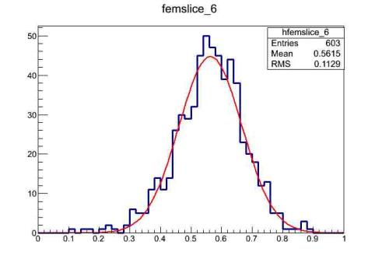
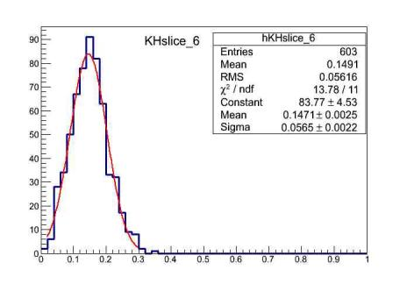
2,8 λ _{I} CSI calo – 10 TeV
σ=20 %
Electromagnetic fraction (fem)
2,8 λ _{I} CSI calo – 10 TeV
σ=38%
Kh=Had Energy dep/Had Energy

Slide 8
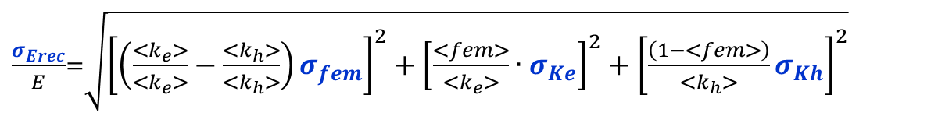
With Scintillation only we see total contribution to energy loss
Erec=α S=α(S_{em}+S_{had})=α (Ee * k_{e} + E_{h} * k_{h} )=α (fem * E * k_{e} + (1-fem)*E * k_{h} )
Scintillation + Cherenkov (or neutrons) give information separately on S_{em} and S_{had} (not on Eh)
THE 'IDEAL' DUAL READOUT ALLOWS TO PERFECTLY MEASURE S_{em} and S_{had}
$$Erec= \left(\frac{\text{S}\text{em}}{<k_{e}>}+\frac{\text{S}\text{had}}{<k_{h}>}\right)= \left(\frac{fem∙E∙k_{e}}{<k_{e}>}+\frac{\left(1−fem\right)∙E∙k_{h}}{<k_{h}>}\right)$$
propagating errors with approx of gaussian independent distributions
Typical values
in our calo
k_{e} ~ 0,95
k_{h} ~ 0,1-0,2
Once we know S_{had} , to reconstruct E_{h}, E, fem we need to use the constant 1/<k_{h}> which can be large and hence increase the fluctuations of k_{h} term

Slide 9
STUDY OF CHERENKOV CORRECTIONS METHODS VERSUS CALO DEPTH
NEW SIMULATION
x 3
WE SELECT 8 DIFFERENT SET OF VERTICAL SHOWERS FAR FROM BORDERS.
IN EACH SET THE SHOWERS HAS FIRST INTERACTION IN THE SAME CSI LAYERS
IN EACH SET THE SHOWERS SEE THE SAME CALO LENGTH FROM FIRST INT. TO END
THE 8 SETS CORRESPONDS TO 8 DIFFERENT CALO DEPTH FROM 5,6 λ_{I} TO 1.6 λ_{I}

Slide 10

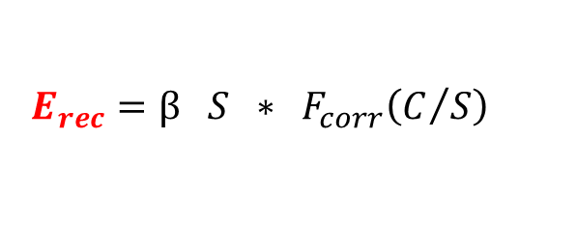
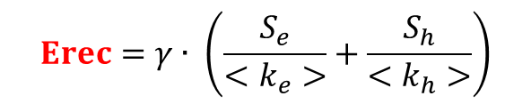
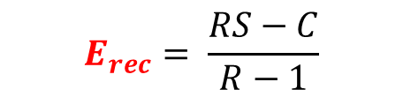
methods of energy reconstructions compared
E_{rec} = α ∗ S
SCINTILLATION ALONE
(all showers see the same calo length, no length correction needed)
Use Cherenkov/S to correct S
(S/E)
$$E_{rec}=\text{β} S ∗ F_{corr}\left(C/S\right)$$
(A. Para)
C/S
Cherenkov correction ‘DREAM’ like
S=E [ fem+(1-fem) (<k_{h}>/<k_{e}>) ]
C=E [ fem+(1-fem) (<k_{h}>/<k_{e}>)_{c} ]
$$E_{rec}= \frac{RS−C}{R−1}$$
R=[1 - (<k_{h}>/<k_{e}>)_{c} ] / [1 - (<k_{h}>/<k_{e}>) ]
Ideal ‘dual’ detector , S_{e} and S_{h} taken separetely event by event from simulation truth
$$Erec=γ∙ \left(\frac{S_{e}}{<k_{e}>}+\frac{S_{h}}{<k_{h}>}\right)$$

Slide 11
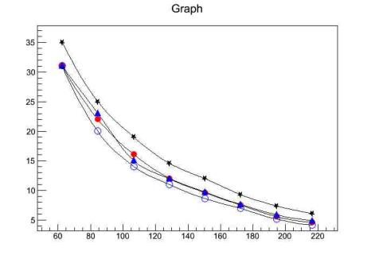
RESULTS
10 TeV protons
1,9 λ_{Ι}
Scintillation alone
σ(Erec-E)/E (%)
Cherenkov corr. C/S
3 λ_{Ι}
Chrenkov corr. Dream
Ideal ‘dual’ detector
standard
Calocube
20x20
1,9 λ_{Ι}
5,7 λ_{Ι}
CSI Calo length from 1⁰ interaction to end (cm)
The resolution gain is roughly equivalent to add ~3 CSI plane

Slide 12
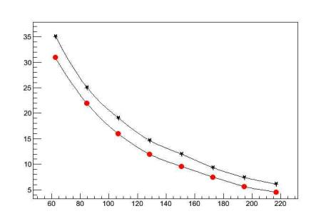
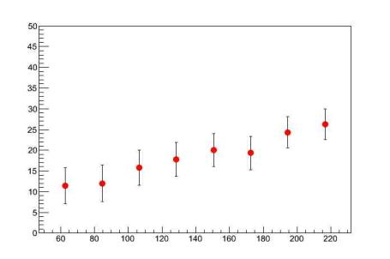
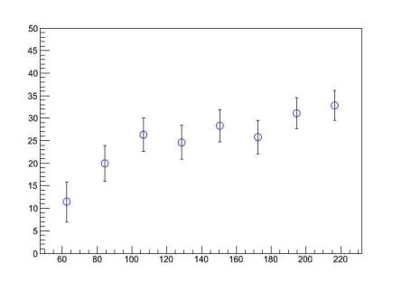
Resolution with Cherenkov corrections (gaussian fit to peaks)
Relative Resolution Gain
1,9 λ_{Ι}
10 TeV protons
1,9 λ_{Ι}
Scintillation alone
3 λ_{Ι}
σ(Erec-E)/E (%)
Cherenkov corr. C/S
5,7 λ_{Ι}
3 λ_{Ι}
Relative Resolution Gain
standard
Calocube
20x20
1,9 λ_{Ι}
5,7 λ_{Ι}
Cherenkov corr. C/S
10 TeV protons
CSI Calo length from 1⁰ interaction to end (cm)
CSI Calo length from 1⁰ interaction to end (cm)
10 TeV protons
Relative Resolution Gain
1,9 λ_{Ι}
Scintillation alone
5,7 λ_{Ι}
1,9 λ_{Ι}
3 λ_{Ι}
σ(Erec-E)/E (%)
Cherenkov corr. C/S
3 λ_{Ι}
Chrenkov corr. Dream
Ideal ‘dual’ detector
Relative Resolution Gain
standard
Calocube
20x20
1,9 λ_{Ι}
5,7 λ_{Ι}
Ideal ‘dual’ detector
CSI Calo length from 1⁰ interaction to end (cm)
CSI Calo length from 1⁰ interaction to end (cm)

