Slide 1
Silicon Carbide sensors for Calocube project

Slide 2
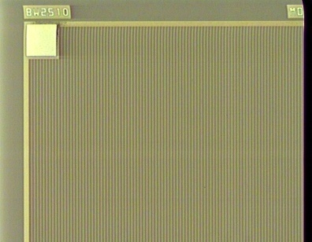
Starting point:
visible blind – 4H-SiC Interdigit Schottky UV photodiodes
Initially designed and fabricated by CNR-IMM CT
and successively fabricated and industrialised by STMicroelectronics
Direct exposure of Optically Active Area
and vertical electrical operation

Slide 3
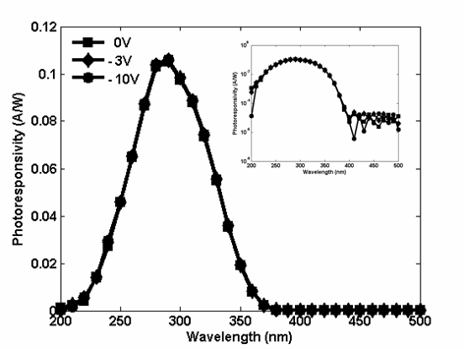
4H-SiC Interdigit Schottky Photodiodes
I-V Characteristics
C-V Characteristics
Responsivity @ 25°C
Responsivity (A/W)
Wavelength (nm)
Electro-optical characteristics measured @ 0V and 25°C
Parameter | Value
Total Area (mm²) | 1.2 x 1.2
Fill Factor (%) | 78.5
Operative Reverse Bias (V) | 0÷-10
Dark Current Density (pA/mm²) | 1
Capacitance (pF) | 20
Range of Spectral Sensitivity (nm) | 210-370
Peak Detection Wavelength (nm) | 290
Responsivity at 290 nm (A/W) | 0.106 (QE_{ext}≈45.3%)
QE_{int} at 290 nm (%) | 75
Visible Rejection Ratio (QE_{400nm}/QE_{290nm}) | ~2x10⁻⁴
Simple fabrication flow
Low dark current
High QE also < 250 nm
Maximum signal-to-noise ratio at low reverse voltage (0V)
Good visible blindness
M.Mazzillo et al., IEEE Photonics Technology Letters, 21 (23), 1782, (2009).

Slide 4
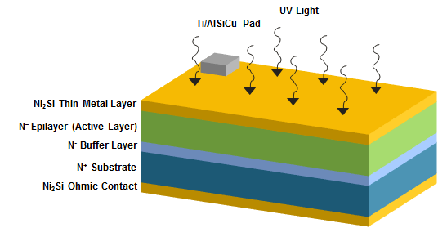
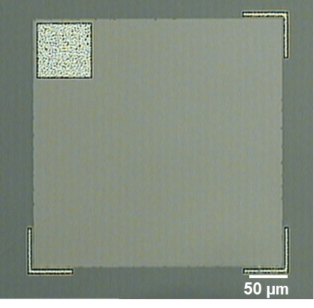
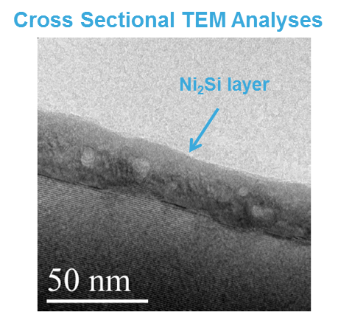
4H-SiC Thin Metal Film Schottky Photodiodes
Layout
Device Side View
Layout
Fabricated on 4” diameter 4H-SiC wafers (LPE-ETC supplier);
0.5x0.5 mm² total area;
Low doped surface epilayer (Th = 6.0 µm/N_{d} = 8x10¹³ cm⁻³) for full depletion (i.e. maximum optical response) at very low reverse bias;
~20 nm Ni₂Si metal surface layer for semitransparent Schottky contact.
~ 20 nm
A.Sciuto et al., IEEE Photonics Technology Letters, Vol.26, No.17, 2014.

Slide 5
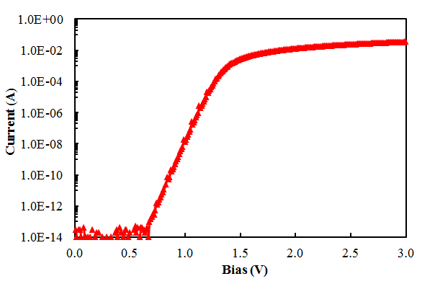
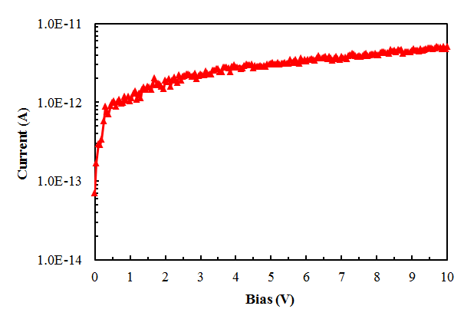
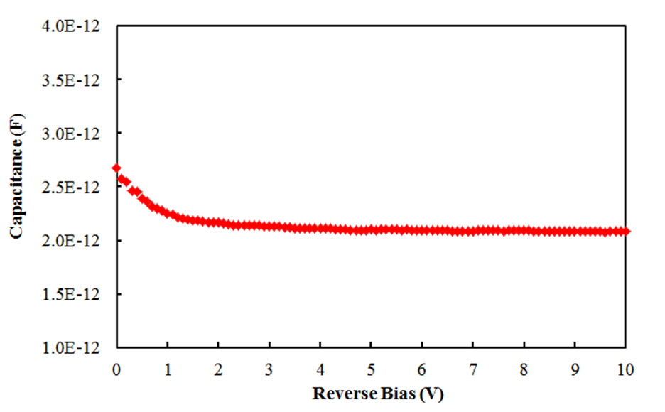
Electrical Characteristics
I-V Forward Characteristics @ 25°C
I-V Reverse Characteristics @ 25°C
C-V Characteristics @ 25°C
Ideal diode characteristics;
Ni₂Si/4H-SiC barrier height 1.68 eV;
Very low leakage current even at high temperature (not reported here);
Very weak dependence on the reverse bias;
The low doping of the surface epitaxial layer allows its full depletion already at very low reverse voltage close to 0V;
1 MHz Readout Frequency

Slide 6
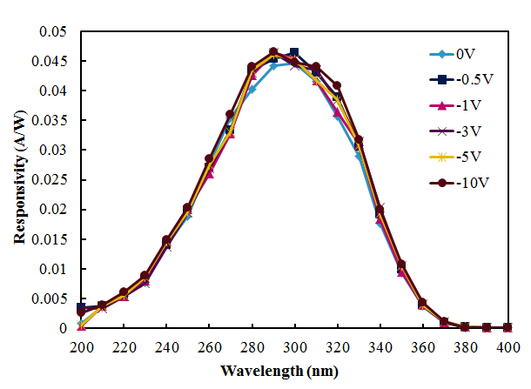
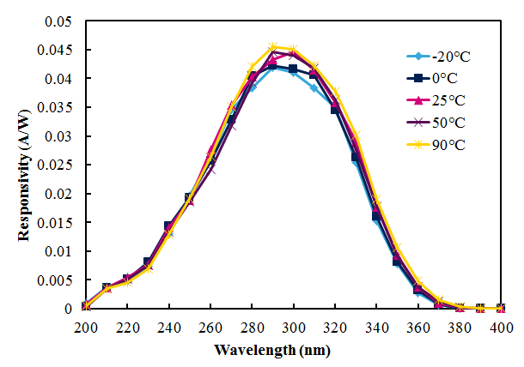
Optical Characteristics
Responsivity vs Bias @ 25°C
Responsivity vs Temperature @ 0V
Maximum responsivity already at 0V (photovoltaic regime);
A maximum responsivity value of about 0.045 A/W (QE=19.2%) is measured at 290 nm and 0V;
Positive responsivity coefficient with the temperature (~10⁻⁵ A/W○C above 290 nm);
Visible blindness (responsivity ratio between the values measured at 400 nm and 290 nm) around 10⁻⁴ and independent on the reverse bias and temperature values.

Slide 7
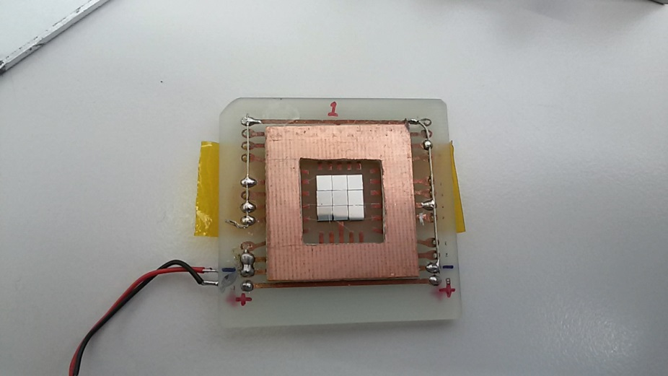
To obtain large sensitive area and high photocurrent levels
We designed large devices for the Calocube project
To test our idea we assembled two matrix of interdigit devices in parallel electrical configuration obtaining an active area of about 63 mm2.

Slide 8
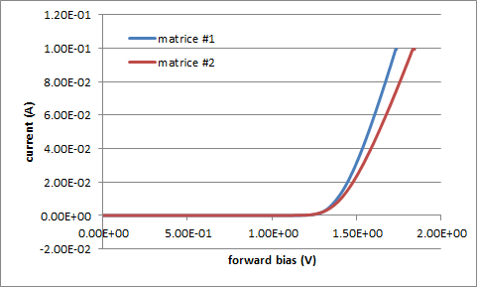
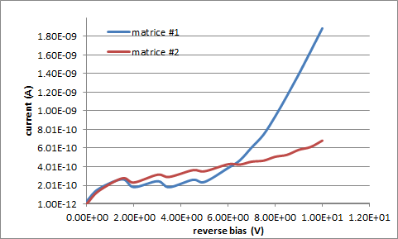
Caratteristiche elettriche delle due matrici misurate a Temperatura ambiente

Slide 9
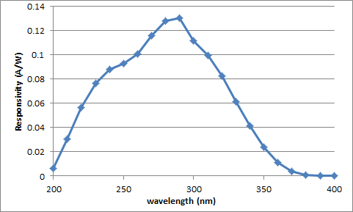
Spettro di risposta ottica delle matrici misurato a 0 V
linearità della risposta al crescere della potenza ottica @ 326 nm

Slide 10
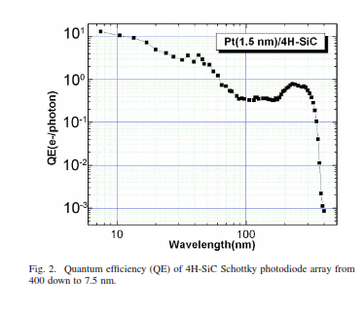
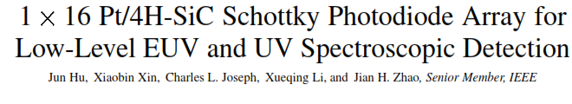
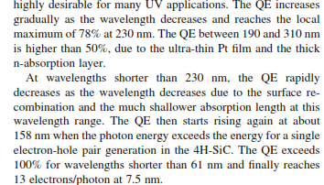

Slide 11
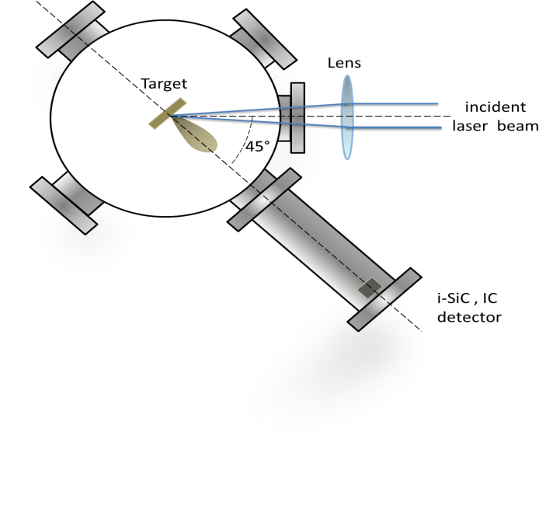
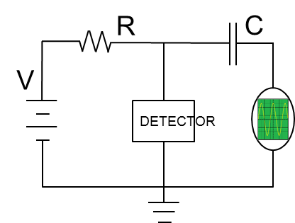
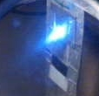
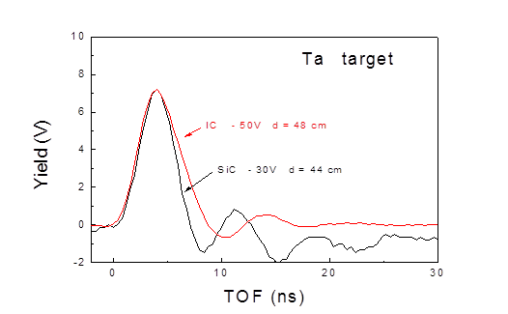
Use in Plasma Monitoring
Laser Generated Plasma Monitoring
Experimental Setup
Equivalent circuit used for signal acquisition
Q-switched Nd:Yag pulsed laser @ 1064 nm
3 ns pulse width
1–200 mJ pulse energy
10⁻⁶ mbar in vacuum/plasma chamber
incidence angle 45°
spot size 0.5 mm²
maximum laser intensity 10¹⁰ W/cm²
targets: polymers, semiconductors and metals
2.8x2.8 mm² 4H-SiC Detector Area
Comparison of the photo-peak signal obtained with a SiC detector and a 200 cm³ Integration Chamber
20 eV (62 nm ) energy extimated for the soft x-ray detected
High compactness, ruggedness and operation at high temperatures!
L.Torrisi et al., JINST, Vol.10, P07009, (2015).

Slide 12
High quality Substrate :
Supplier SiCrystal : Ultra low MPD
4H-SiC, N-type, Production Grade, 100mm dia. (+/- 0.25mm), 4 deg off-axis, resistivity 0.015-0.028 ohm-cm,
350um (+/-25um) thickness,
ultra-low MPD (<=1micropipes/cm2),
double-side polish, Si-face CMP, epi ready
EPITAXIAL LAYER(S) grown by ETC srl
Epi 1 : Type N
Layer 1 : Thickness 0.5 µm
Layer 1 : Doping Concentration 1 E 18 cm3
Epi 2 : type N
Layer 2 : Thickness 10,0 -12,0 µm
Layer 2 : Doping Concentration 5E13 - 1E14cm3

Slide 13
Work in progress and future steps
Sono già in lavorazione* nuovi diodi/sensori :
-di tipo Schottky di area maggiore rispetto a quelli ad oggi
realizzati;
-a giunzione pn senza guadagno interno
-di tipo APD di varie dimensioni : diodi grandi ( > 1mm2) potrebbero presentare correnti di buio elevate;
Caratterizzazione completa (strutturale, elettrica ed elettro-ottica) dei nuovi diodi e/o matrici di diodi di tipo Schottky e di tipo APD
*La lavorazione viene effettuata presso le facilities del CNR-IMM CT e di STMicroelectronics CT grazie ad una collaborazione preesistente tra CNR ed ST che ci permette di accedere a processi di deposizioni di metalli e di dielettrici, ai processi di impiantazione ionica e termici ad alta temperatura

Slide 14
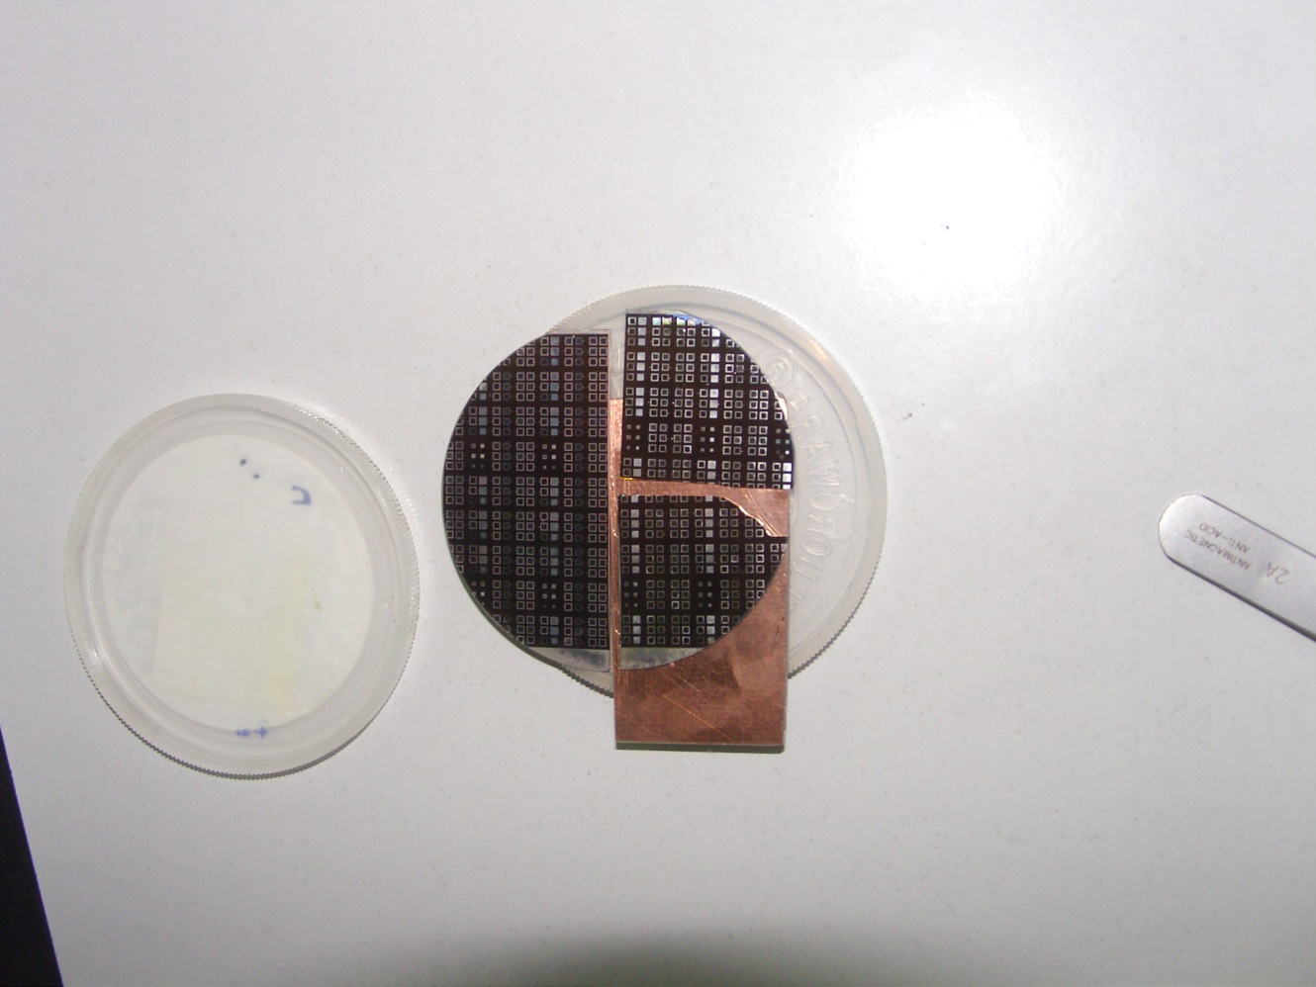
Activity on Avalanche Photodiode:
evaluation of p+n junction photodiodes
Picture of devices on 2 inch wafer 4H-SiC Fabricated at CNR-IMM-Catania

Slide 15
Not in scale cross section schemes of some fabricated devices
Ox
metal
metal
Ox
metal
metal
Al p⁺
Al p⁺
n⁻
n⁻
B
B
D
E
n ⁺
n ⁺
Ox
metal
metal
Ox
metal
metal
P
n⁻
n⁻
B
P
P
B
B
P
B
Q
I
n ⁺
n ⁺
metal
metal
Ox
n⁻
B
P
P
B
G
n ⁺

Slide 16
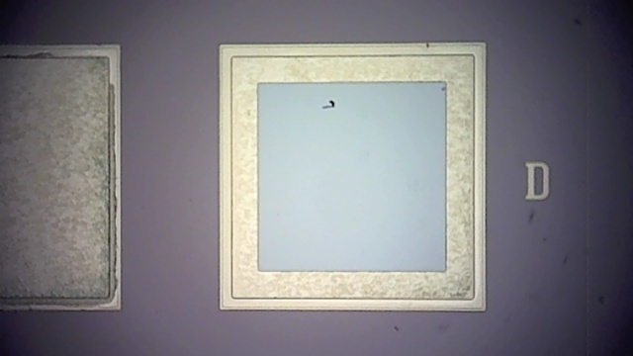
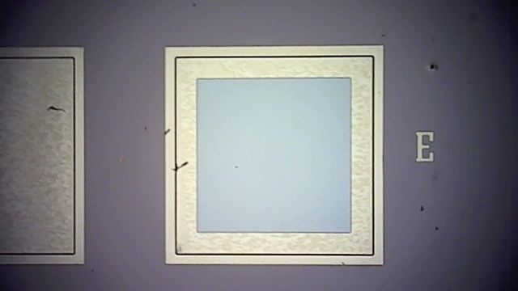
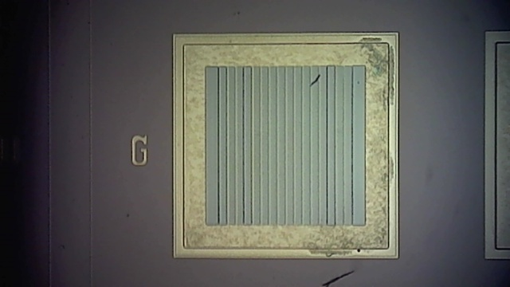
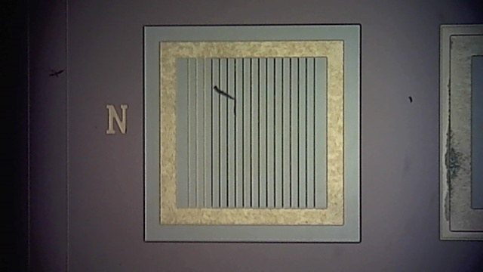
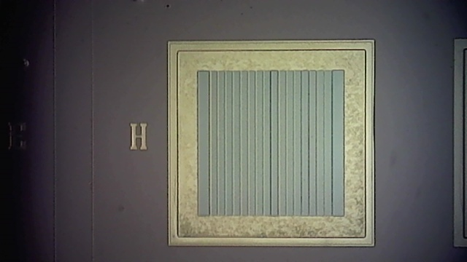
Pictures of devices

Slide 17
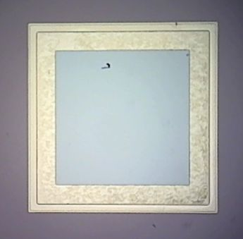
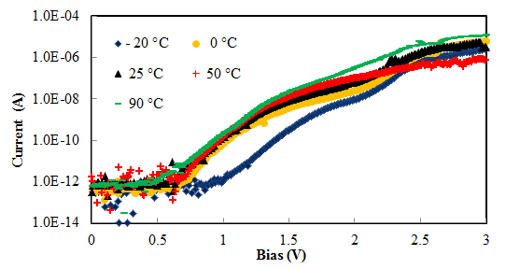
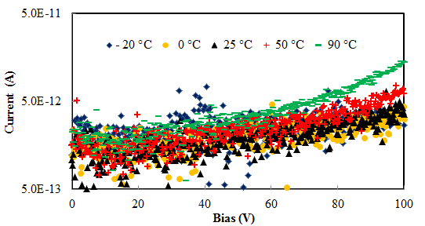
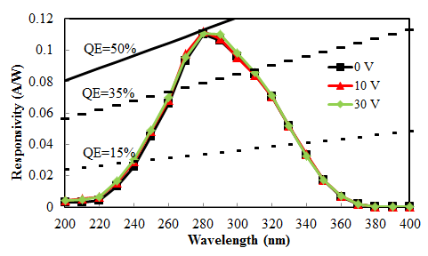
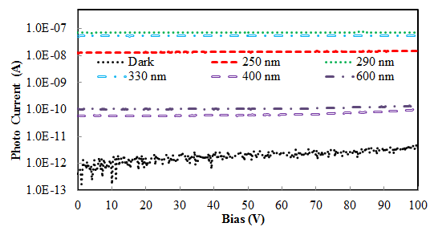
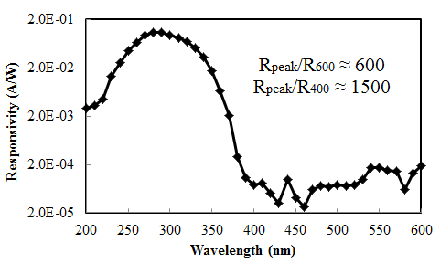
electro-optical performances of the D type devices

Slide 18
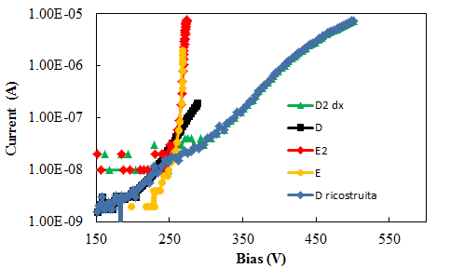
Effect of boron implanted lateral ring on Break Down Voltage
Ox
metal
metal
Ox
metal
metal
Al p⁺
Al p⁺
n⁻
n⁻
B
B
D
E
n ⁺
n ⁺

Slide 19
4H-SiC Avalanche Photodiode
La rivelazione di segnali UV di bassa intensità mediante l’uso di dispositivi con alta sensibilità e elevato rapporto segnale rumore, trova applicazione in svariati campi quali ad esempio la rivelazione di fiamma, l’astronomia UV, la spettroscopia in campo biologico e chimico e il monitoraggio di fumi.
Tubi fotomoltiplicatori (PMTs) vengono usualmente adoperati ma il loto ingombro, la loro fragilità ed I loro elevati costi rispetto ai dispositivi a stato solido , sono certamente lati negativi .
Fotodiodi a valanga in Silicio disponibili sul mercato, presentano moderate efficienza nell’UV e richiedono filtri esterni per ottenere una elevata reizione della componente visibile della radiazione incidente (indispensabile per il monitoraggio della sola debole componente UV)
In letteratura sono riportati dati su rivelatori APD in GaN con alta sensibilità nell’UV e insensibiltà nel visibile e con elevato guadagno interno ma la maturità del materiale e della tecnologia dei dispositivi in GaN è ancora insufficiente a garantire bassa difettosità e quindi bassi livelli di rumore
Il SiC presenta invece una maturità tecnologica, una intrinseca trasparenza al visibile e una molto bassa geneazione termica e quindi basso noise, che lo rendono un ottimo candidato per la realizzazione di rivelatori a valanga, anche se non è ancora disponibile sul mercato tale tipologia di dispositivo.

Slide 20
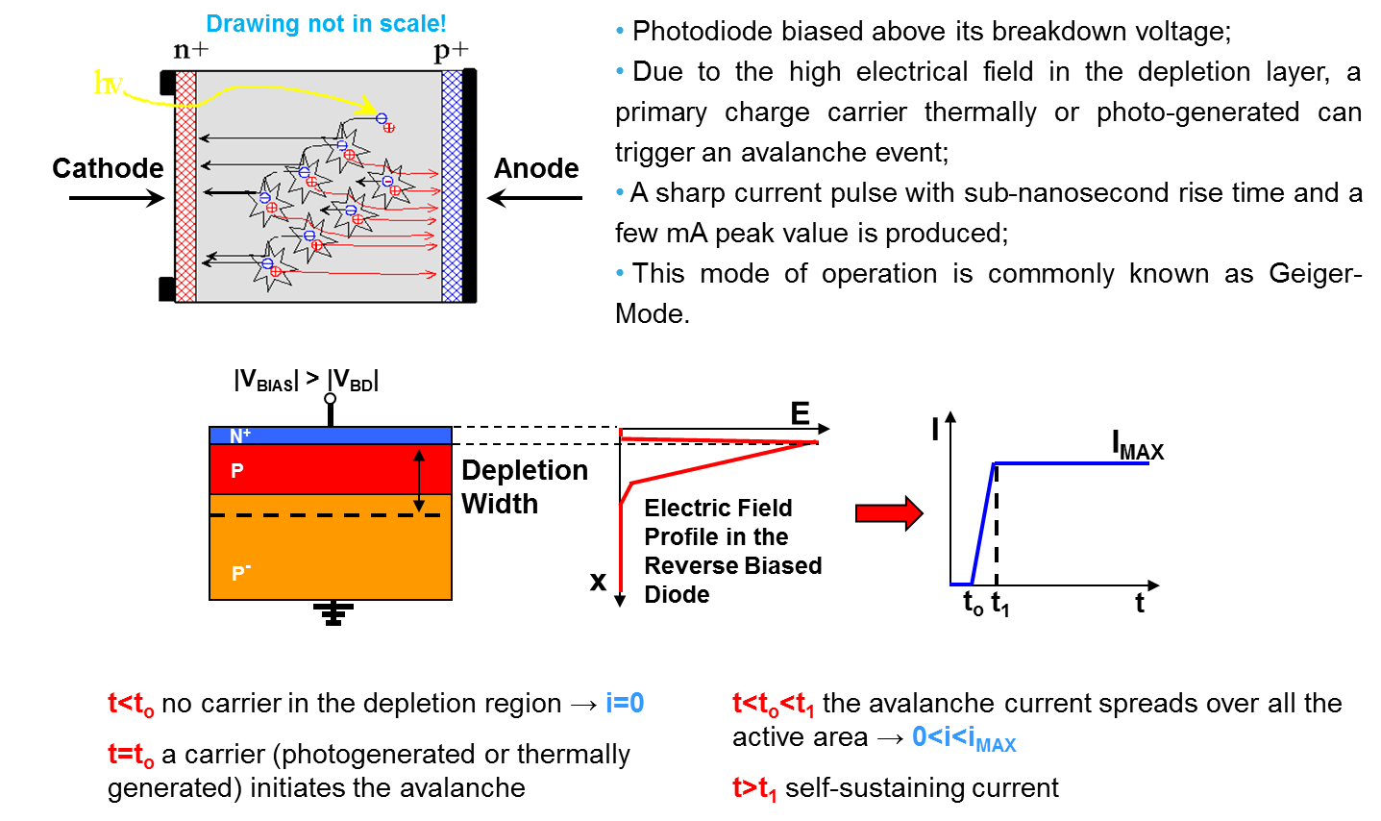
SPAD Working Principle
Main Characteristics
Operation in avalanche mode with high intrinsic gain (10⁵÷10⁶)
Sensitivity to very low photon fluxes
Very fast timing response (hundreds of ps)
APDs operate with the same working principle but slightly below the BV and limited gain (10²÷10³)

Slide 21
4H-SiC APD/SPAD possible geometry
Ti/AlSiCu
Ni₂Si
ox
N⁺
N⁻
N⁺⁺ Substrate
Ni₂Si
Ti/Ni/Au
Main Features
P+/N/N- structure
P+/N shallow junction defined by P+ implantation
P- implanted edge ring
4H-SiC P-on-N shallow junctions operating in Geiger mode are widely preferable due to the higher holes impact ionization rate about one order of magnitude higher than the electron ionization coefficient which means that the avalanche multiplication is dominated by hole injections;

Slide 22
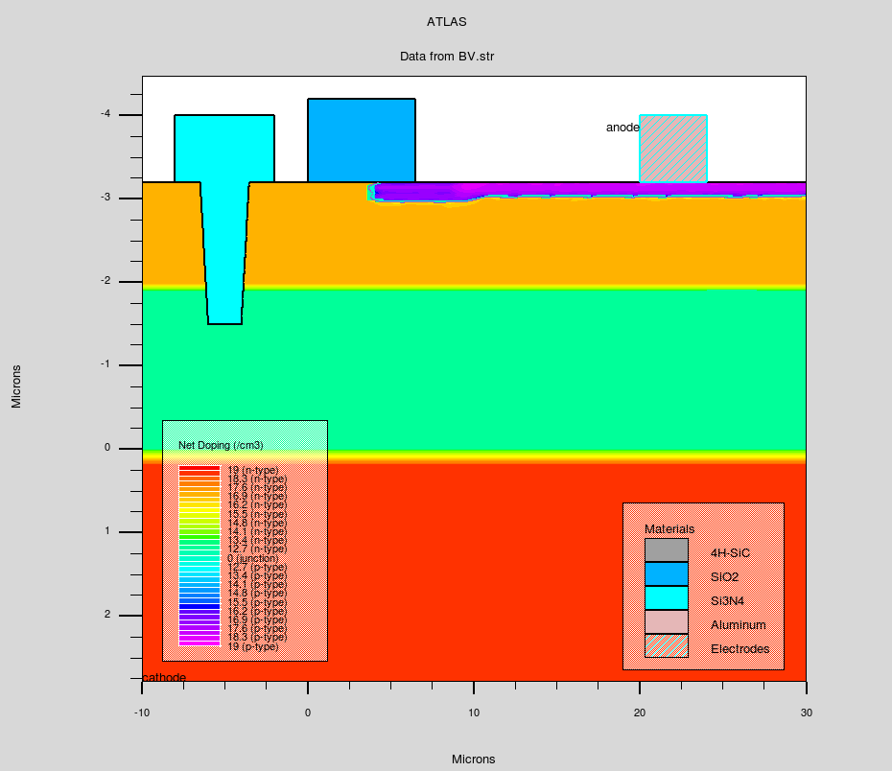
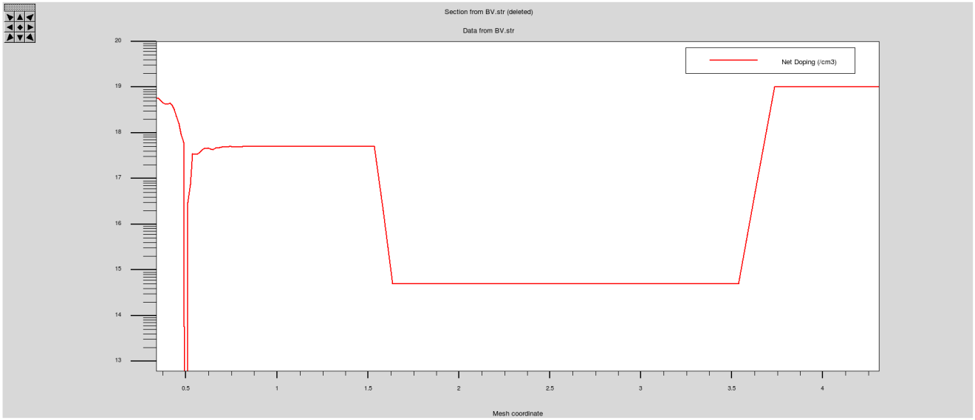
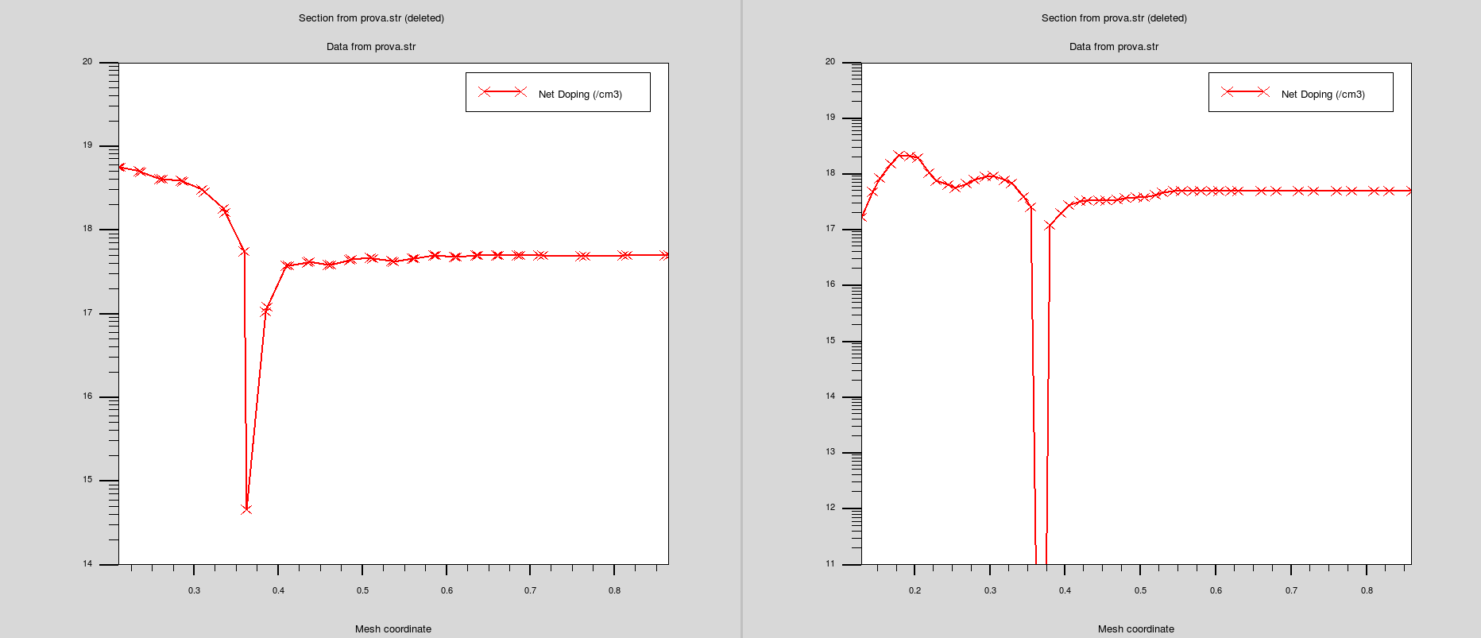
Simulazioni elettriche effettuate con Silvaco
presso STMicrolectronics-CT
Trench
Doping Profile
Ox
P+
P-
P+
N
N+
N
N-
N-
N+
P+ doping profile
P- doping profile
P+
P-
N
N
0.15 µm
0.35 µm

Slide 23
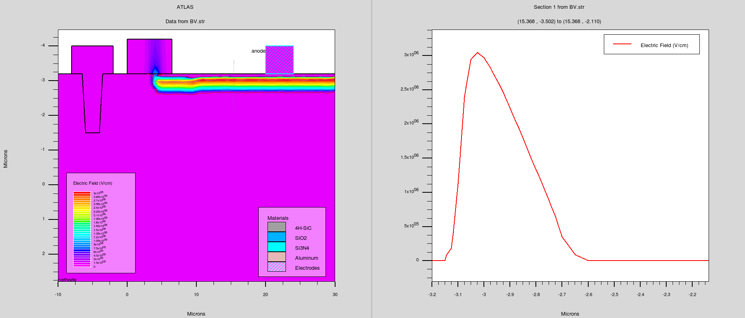
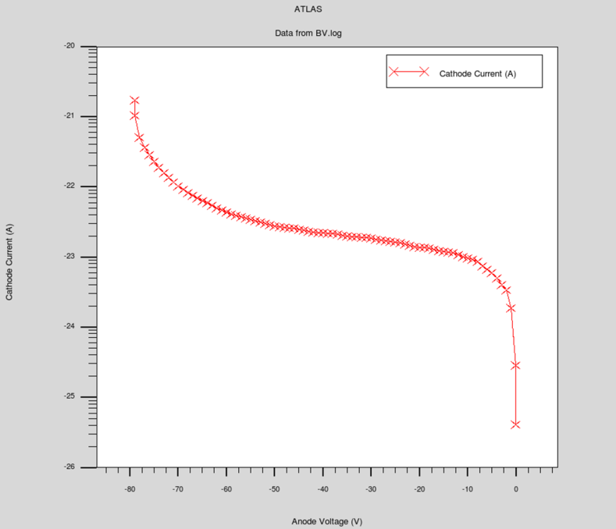
Simulazioni elettriche effettuate con Silvaco
presso STMicrolectronics-CT
Electric Field Distribution at BV
Electric Field along Y direction in p+ well
Depletion Region
Simulation results in line with the expectations

Slide 24

CNR- IMM
Institute for Microelectronics and Microsystems
research fields:
innovative solutions for micro and nanoelectronics, advanced materials and processes for smart components, optoelectronics and photonics, sensors and multifunctional micro/nanosystems
Antonella Sciuto is with CNR-IMM CT from 1999
From 2005 we work on SiC UV sensors for health care applications
In 2008 the technology developed in the CNR-IMM was transferred in ST Microelectronics
In 2012 started a new collaboration IMM - STMicroelectronics focused to the industrialisation of the UV SiC sensor technology (UV index measurements) & in 2014 STMicroelectronics started the production of UV SiC sensors

Slide 25
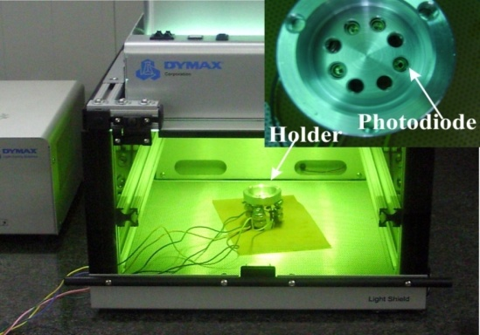
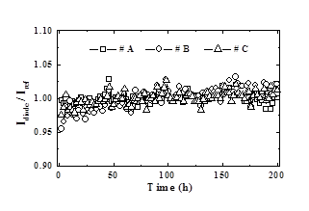
No aging effects under very intense and prolonged UV light fluxes!
200 hours of exposure at 254 nm (sterilization wavelength) at a flux of 10 mW/cm²
Irradiation Setup
Light Curing Mercury Lamp
Photocurrents ratio of the aged devices and a reference diode

